Slide 1
Module 7: Standards and Frameworks
The OECD principles, the NIST AI RMF and Playbook, and the core ISO standards
Domain II · Competency D · Indicators II.D.1 to II.D.3
AIGP Exam Prep Masterclass
Module 7 · Part 1
Notes:
Welcome to Module seven: Standards and Frameworks. This is competency D of domain two. After the laws, you now meet the tools that organizations use to organize their work. They are the O E C D principles, the N I S T A I Risk Management Framework and its Playbook, and the three core I S O standards.

Slide 2
What You Will Learn
Part 1
Explain the OECD principles, the policy recommendations and the recommended practices
Explain the NIST AI RMF: functions, categories, subcategories, and the Playbook
Explain the three core ISO standards: 22989, 42001 and 42005
Tell law, standard and framework apart, and say how they fit together
AIGP Exam Prep Masterclass | Certified AI Governance Professional
Module 7: Standards and Frameworks: OECD, NIST and ISO
2 / 26
Notes:
By the end of this module you will be able to do four things. Explain the O E C D principles, the policy recommendations and the recommended practices. Explain the N I S T A I R M F: its functions, categories and subcategories, and the Playbook. Explain the three core I S O standards: twenty-two nine eight nine, forty-two thousand and one, and forty-two thousand and five. And tell law, standard and framework apart, and say how they fit together.

Slide 3
Case Check-In: One Stack for Helios
Part 1
CASE CHECK-IN · Helios
Samira Haddad's committee must choose how to organize the program
It picks ISO/IEC 42001 to structure the program, the NIST AI RMF to run risk on each system, and the EU AI Act as the legal floor
It bases its policy on the OECD principles
You must explain what each instrument is for, and why they do not compete
AIGP Exam Prep Masterclass | Certified AI Governance Professional
Module 7: Standards and Frameworks: OECD, NIST and ISO
3 / 26
Notes:
At Helios, Samira Haddad's committee must choose how to organize the program. It picks I S O forty-two thousand and one to structure the program, the N I S T A I R M F to run risk on each system, and the E U A I Act as the legal floor. It bases its policy on the O E C D principles. You must explain what each instrument is for, and why they do not compete.

Slide 4
The OECD AI Principles: Origin and Role
DATES
Part 1
The OECD is an intergovernmental organization; its Recommendation on AI is a non-binding standard that many governments follow
It was first adopted in 2019 and updated in May 2024
It sets five values-based principles for AI actors and five recommendations for policy-makers
Its definition of an AI system (module 1) was reused in other laws and frameworks
It is soft law: it shapes policy and legislation but is not itself enforced
EXAM TIP The OECD principles are values for governments and organizations; they are not a certification or a statute.
AIGP Exam Prep Masterclass | Certified AI Governance Professional
Module 7: Standards and Frameworks: OECD, NIST and ISO
4 / 26
Notes:
This slide is tagged dates. The O E C D is an intergovernmental organization. Its Recommendation on A I is a non-binding standard that many governments follow. It was first adopted in twenty nineteen and updated in May, twenty twenty-four. It sets five values-based principles for A I actors, and five recommendations for policy-makers. Its definition of an A I system, which we met in module one, was reused in other laws and frameworks. It is soft law. Exam tip: the principles are values, not a certification or a statute.

Slide 5
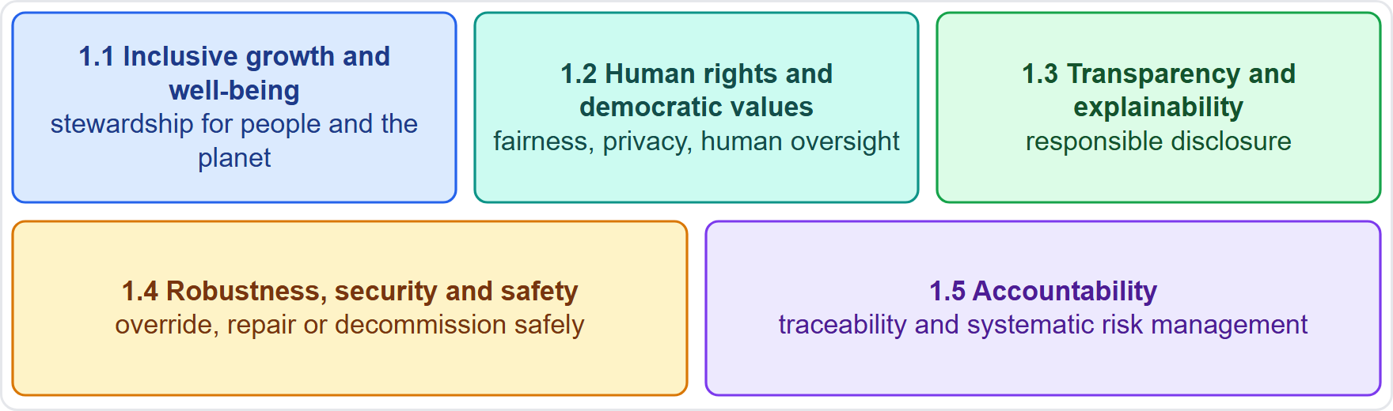
The Five Values-Based Principles
Part 1
1.1 Inclusive growth, sustainable development and well-being: responsible stewardship of trustworthy AI for people and the planet
1.2 Human rights and democratic values, including fairness and privacy: respect the rule of law, with safeguards such as human oversight
1.3 Transparency and explainability: responsible disclosure and meaningful information about systems
1.4 Robustness, security and safety: across the whole lifecycle, with the ability to override, repair or decommission safely
1.5 Accountability: for proper functioning, with traceability and a systematic risk management approach to each lifecycle phase
EXAM TIP Safe decommissioning and systematic risk management are the OECD's practical hooks for organizations.
AIGP Exam Prep Masterclass | Certified AI Governance Professional
Module 7: Standards and Frameworks: OECD, NIST and ISO
5 / 26
Notes:
The O E C D has five values-based principles. One point one: inclusive growth, sustainable development and well-being, with responsible stewardship of trustworthy A I. One point two: human rights and democratic values, including fairness and privacy, with safeguards such as human oversight. One point three: transparency and explainability, with responsible disclosure. One point four: robustness, security and safety across the whole lifecycle, with the ability to override, repair or decommission safely. One point five: accountability, with traceability and a systematic risk management approach to each phase. Exam tip: safe decommissioning is a practical hook.

Slide 6
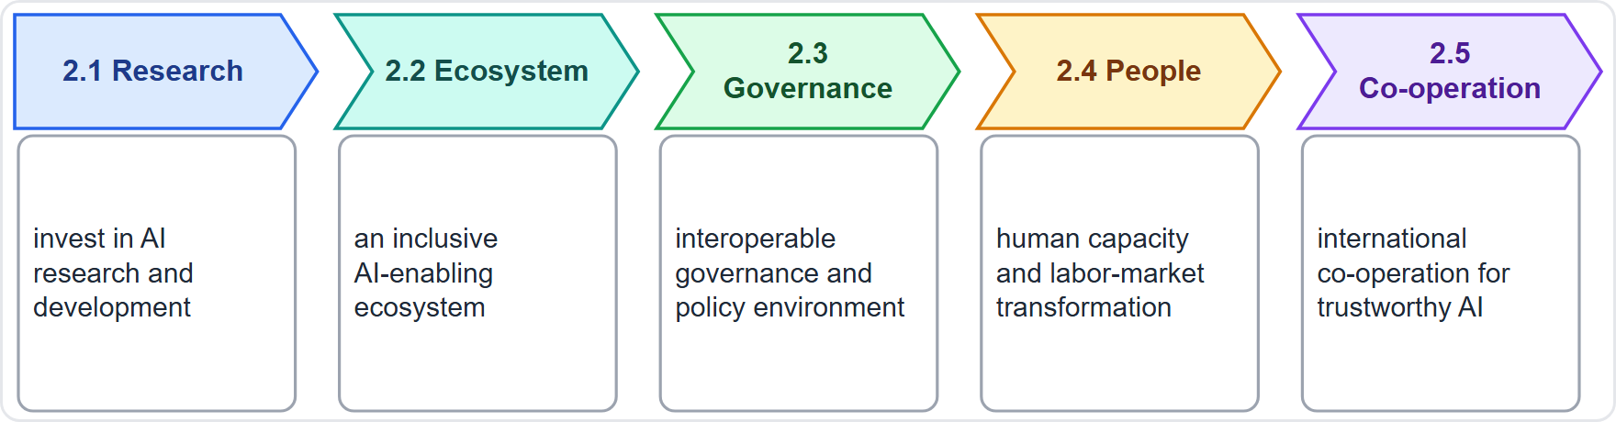
Recommendations for Policy-Makers
Part 1
2.1 investing in AI research and development
2.2 fostering an inclusive AI-enabling ecosystem
2.3 shaping an enabling, interoperable governance and policy environment
2.4 building human capacity and preparing for labor-market transformation
2.5 international co-operation for trustworthy AI
These are aimed at governments; organizations meet them through policy engagement and skills programs
EXAM TIP Principles are for AI actors; recommendations are for governments.
AIGP Exam Prep Masterclass | Certified AI Governance Professional
Module 7: Standards and Frameworks: OECD, NIST and ISO
6 / 26
Notes:
The O E C D also makes five recommendations to governments. Two point one: invest in A I research and development. Two point two: foster an inclusive A I-enabling ecosystem. Two point three: shape an enabling, interoperable governance and policy environment. Two point four: build human capacity and prepare for labor-market transformation. Two point five: international co-operation for trustworthy A I. Organizations meet these through policy engagement and skills programs. Exam tip: principles are for A I actors. Recommendations are for governments.

Slide 7
The OECD Framework and Recommended Practices
Part 1
Classification framework: the OECD classifies AI systems along five dimensions: people and planet, economic context, data and input, AI model, and task and output (NIST adapted it for its own lifecycle figure)
Lifecycle thinking: apply risk management to each phase, from design to retirement
Recommended practices for actors: traceability of data, processes and decisions; responsible business conduct with suppliers; cooperation across the AI value chain
Safety valve: systems that cause undue harm can be overridden, repaired or decommissioned
Tools: the OECD.AI observatory collects policies and tools for trustworthy AI
EXAM TIP The OECD framework helps you describe a system (its context, data, model, task); it is not a compliance checklist.
AIGP Exam Prep Masterclass | Certified AI Governance Professional
Module 7: Standards and Frameworks: OECD, NIST and ISO
7 / 26
Notes:
The O E C D also offers a framework and practices. Its classification framework describes an A I system along five dimensions: people and planet, economic context, data and input, A I model, and task and output. N I S T adapted it for its own lifecycle figure. For organizations, recommended practices include risk management in each lifecycle phase, traceability of data, processes and decisions, and responsible business conduct with suppliers. Systems that cause undue harm can be overridden, repaired or decommissioned. Exam tip: the framework describes a system. It is not a checklist.

Slide 8
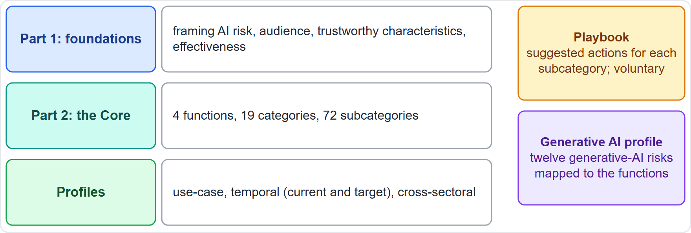
The NIST AI RMF at a Glance
DATES · VERIFY LIVE
Part 1
NIST AI RMF 1.0 was released in January 2023; it is voluntary, sector-agnostic and meant to be a living document
A formal review is expected no later than 2028
Part 1: foundations: framing AI risk, the audience, trustworthy characteristics, effectiveness
Part 2: the Core: 4 functions, 19 categories, 72 subcategories; then profiles
The Playbook (online) suggests actions; the generative AI profile applies it to generative AI
As of 27 October 2026: NIST's Playbook page says the framework is being updated; check the current version
EXAM TIP The AI RMF is guidance, not law and not a certification: organizations choose how much of it to use.
AIGP Exam Prep Masterclass | Certified AI Governance Professional
Module 7: Standards and Frameworks: OECD, NIST and ISO
8 / 26
Notes:
This slide is tagged dates and verify live. N I S T released A I R M F one point zero in January, twenty twenty-three. It is voluntary, sector-agnostic, and meant to be a living document, with a formal review expected no later than twenty twenty-eight. Part one gives foundations: framing A I risk, the audience, trustworthy characteristics and effectiveness. Part two is the Core: four functions, nineteen categories and seventy-two subcategories, followed by profiles. The online Playbook suggests actions, and the generative A I profile applies it to generative A I. As of the twenty-seventh of October, twenty twenty-six, N I S T says the framework is being updated.

Slide 9
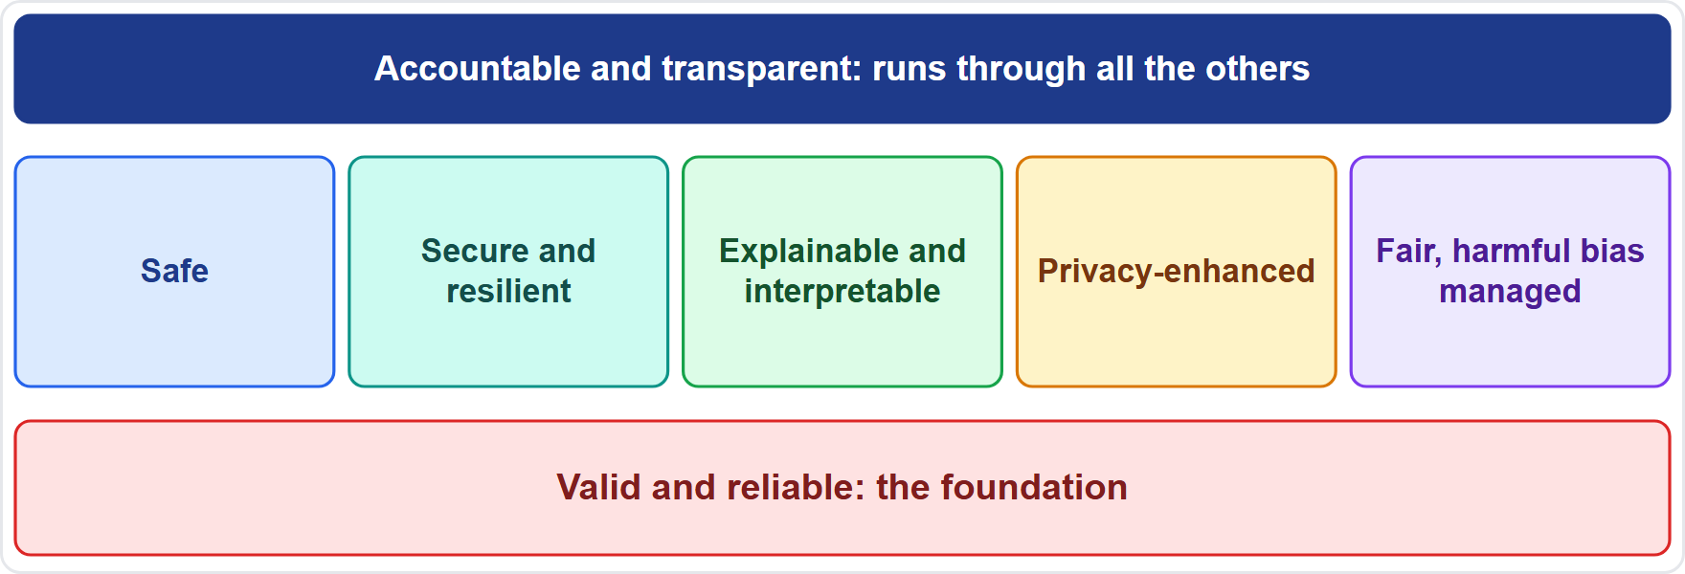
The Seven Trustworthy Characteristics
Part 1
Valid and reliable (the foundation), safe, secure and resilient
Accountable and transparent (runs through all)
Explainable and interpretable
Privacy-enhanced
Fair, with harmful bias managed
Tradeoffs are usual: balance them by context, and justify the choice openly (module 1)
Trustworthiness is only as strong as its weakest characteristic
EXAM TIP Seven characteristics, one foundation: if the system is not valid and reliable, nothing above it helps.
AIGP Exam Prep Masterclass | Certified AI Governance Professional
Module 7: Standards and Frameworks: OECD, NIST and ISO
9 / 26
Notes:
The N I S T framework names seven characteristics of trustworthy A I. Valid and reliable is the foundation. Then safe, and secure and resilient. Accountable and transparent runs through all of them. Then explainable and interpretable, privacy-enhanced, and fair with harmful bias managed. Tradeoffs among them are usual, so balance them by context and justify the choice openly. Trustworthiness is only as strong as its weakest characteristic. Exam tip: if the system is not valid and reliable, nothing above it helps.

Slide 10
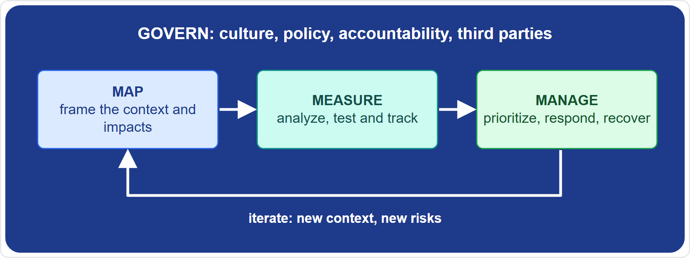
The Core: Four Functions
Part 1
GOVERN: a cross-cutting culture, policies, accountability and structures
MAP: frame the context and risks of a specific system
MEASURE: analyze, assess and track risks with metrics and tests
MANAGE: prioritize and treat risks, with response and recovery
The actions are not a checklist and need no fixed order; after GOVERN is in place, most users start with MAP, then MEASURE and MANAGE, and iterate
EXAM TIP GOVERN applies to everything; the other three apply system by system.
AIGP Exam Prep Masterclass | Certified AI Governance Professional
Module 7: Standards and Frameworks: OECD, NIST and ISO
10 / 26
Notes:
The Core has four functions. GOVERN is cross-cutting: culture, policies, accountability and structures. MAP frames the context and risks of a specific system. MEASURE analyzes, assesses and tracks risks with metrics and tests. MANAGE prioritizes and treats risks, with response and recovery. The actions are not a checklist and need no fixed order. After GOVERN is in place, most users start with MAP, then MEASURE and MANAGE, and iterate. Exam tip: GOVERN applies to everything. The other three apply system by system.

Slide 11
GOVERN: Culture, Accountability and Policy
Part 1
Category | What it covers
GOVERN 1 | policies, processes and practices; legal requirements; risk tolerance; inventory; decommissioning
GOVERN 2 | accountability structures; roles; training; executive responsibility
GOVERN 3 | diversity, equity, inclusion and accessibility in risk work
GOVERN 4 | a culture that considers and communicates AI risk
GOVERN 5 | engagement with relevant AI actors
GOVERN 6 | third-party software, data and supply-chain risks
6 categories, 19 subcategories; modules 2 and 3 used several (for example GOVERN 2.1 on roles and GOVERN 6.1 on third parties)
EXAM TIP GOVERN is about the organization's rules and culture; it is not tied to one system.
AIGP Exam Prep Masterclass | Certified AI Governance Professional
Module 7: Standards and Frameworks: OECD, NIST and ISO
11 / 26
Notes:
GOVERN has six categories and nineteen subcategories. Govern one covers policies, processes and practices, including legal requirements, risk tolerance, inventory and decommissioning. Govern two covers accountability structures, roles, training and executive responsibility. Govern three covers diversity, equity, inclusion and accessibility. Govern four covers a culture that considers and communicates A I risk. Govern five covers engagement with relevant A I actors. Govern six covers third-party software, data and supply chain. Modules two and three used several, such as Govern two point one and Govern six point one. Exam tip: GOVERN is not tied to one system.

Slide 12
MAP: Context and Impacts
Part 1
Category | What it covers
MAP 1 | context is established and understood (intended purposes, laws, settings)
MAP 2 | the AI system is categorized (its tasks and methods)
MAP 3 | capabilities, usage, goals, benefits and costs against benchmarks
MAP 4 | risks and benefits of all components, including third-party
MAP 5 | impacts on individuals, groups, communities, organizations and society
5 categories, 18 subcategories
MAP ends with enough context to inform an initial go or no-go decision
MAP 1.1: intended purposes, beneficial uses, laws and norms, and settings are understood and documented
EXAM TIP If a question is about who is affected and what the system is for, the function is MAP.
AIGP Exam Prep Masterclass | Certified AI Governance Professional
Module 7: Standards and Frameworks: OECD, NIST and ISO
12 / 26
Notes:
MAP has five categories and eighteen subcategories. Map one: context is established and understood, including intended purposes, laws and settings. Map two: the A I system is categorized by its tasks and methods. Map three: capabilities, usage, goals, benefits and costs are understood against benchmarks. Map four: risks and benefits of all components, including third-party. Map five: impacts on individuals, groups, communities, organizations and society. MAP ends with enough context to inform an initial go or no-go decision. Exam tip: who is affected and what is it for? That is MAP.

Slide 13
MEASURE: Metrics, Testing and Tracking
Part 2
Category | What it covers
MEASURE 1 | appropriate methods and metrics are identified and applied
MEASURE 2 | the system is evaluated for trustworthy characteristics
MEASURE 3 | mechanisms track identified risks over time
MEASURE 4 | feedback about the efficacy of measurement is gathered
4 categories, 22 subcategories
Uses quantitative, qualitative or mixed methods; systems are tested before deployment and regularly in operation (TEVV: test, evaluation, verification and validation)
MEASURE 2.11: fairness and bias are evaluated and documented
Independent review can improve the testing and reduce internal bias
EXAM TIP Measuring is how you know whether a risk is real; MANAGE is what you do about it.
AIGP Exam Prep Masterclass | Certified AI Governance Professional
Module 7: Standards and Frameworks: OECD, NIST and ISO
13 / 26
Notes:
MEASURE has four categories and twenty-two subcategories. Measure one: appropriate methods and metrics are identified and applied. Measure two: the system is evaluated for trustworthy characteristics. Measure three: mechanisms track identified risks over time. Measure four: feedback about the efficacy of measurement is gathered. It uses quantitative, qualitative or mixed methods, and systems are tested before deployment and regularly in operation. Measure two point eleven covers fairness and bias. Independent review improves testing. Exam tip: measuring shows whether a risk is real. MANAGE decides what to do.

Slide 14
MANAGE: Prioritize, Respond and Recover
Part 2
Category | What it covers
MANAGE 1 | risks are prioritized, responded to and managed
MANAGE 2 | strategies to maximize benefits and minimize impacts
MANAGE 3 | third-party risks and benefits are managed
MANAGE 4 | risk treatments, response, recovery and communication plans
4 categories, 13 subcategories
MANAGE 1.2: treatment is prioritized by impact, likelihood and available resources
MANAGE 2.4: mechanisms to supersede, disengage or deactivate systems that behave outside intended use
MANAGE 4.1: post-deployment monitoring plans, with appeal and override, decommissioning, incident response and change management
EXAM TIP Deactivation, incident response and monitoring plans are MANAGE items.
AIGP Exam Prep Masterclass | Certified AI Governance Professional
Module 7: Standards and Frameworks: OECD, NIST and ISO
14 / 26
Notes:
MANAGE has four categories and thirteen subcategories. Manage one: risks are prioritized, responded to and managed. Manage two: strategies to maximize benefits and minimize impacts. Manage three: third-party risks and benefits. Manage four: risk treatments, response, recovery and communication plans. Manage one point two prioritizes treatment by impact, likelihood and resources. Manage two point four sets mechanisms to supersede, disengage or deactivate systems. Manage four point one covers post-deployment monitoring plans, with appeal and override, decommissioning and incident response. Exam tip: deactivation and incident response are MANAGE.

Slide 15
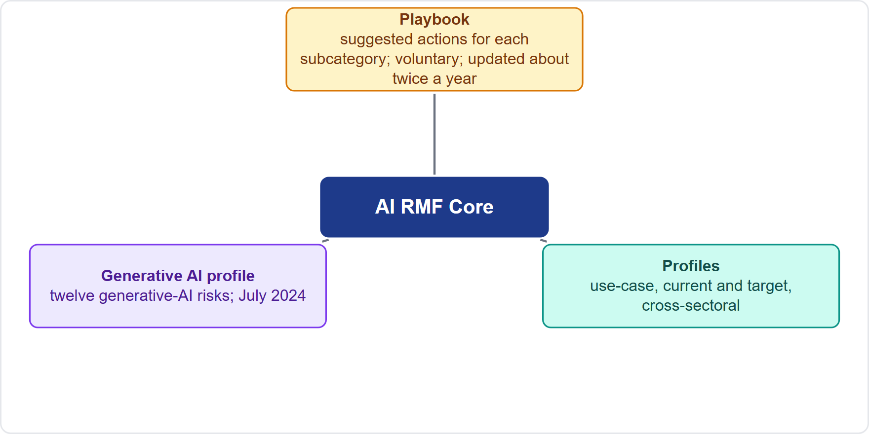
The Playbook, Profiles and the Generative AI Profile
BEYOND THE BOK · DATES · VERIFY LIVE
Part 2
Playbook: suggested actions for each subcategory; voluntary, not a checklist; a living resource updated about twice a year, in several formats
Use-case profiles: the Core applied to a setting, such as a hiring profile
Temporal profiles: a current and a target profile; the gap between them becomes the action plan
Cross-sectoral profiles: topics such as large language models, cloud services or acquisition
Generative AI profile (July 2024): defines twelve generative-AI risks and maps actions to the four functions
As of 27 October 2026: the Playbook will follow the framework's update
EXAM TIP Current profile, target profile, gap, action plan: that is how profiles drive improvement.
AIGP Exam Prep Masterclass | Certified AI Governance Professional
Module 7: Standards and Frameworks: OECD, NIST and ISO
15 / 26
Notes:
This is a beyond-the-Body-of-Knowledge slide, tagged dates and verify live. The Playbook offers suggested actions for each subcategory. It is voluntary, not a checklist, and a living resource updated about twice a year. Profiles tailor the Core. A use-case profile applies it to a setting, such as hiring. Temporal profiles describe a current and a target state, and the gap becomes the action plan. Cross-sectoral profiles cover topics such as large language models. The generative A I profile, from July twenty twenty-four, defines twelve generative A I risks. As of the twenty-seventh of October, twenty twenty-six, the Playbook will follow the framework's update.

Slide 16
ISO/IEC 22989: A Shared Language
Part 2
ISO/IEC 22989 sets out AI concepts and terminology: what words such as AI system, machine learning, bias and robustness mean
It describes stakeholder roles across the AI value chain and lifecycle concepts
Its AI system definition (an engineered system generating outputs for human-defined objectives, module 1) feeds NIST and other documents
It is a vocabulary standard: it gives no requirements and cannot be certified against
Depth marker: taught from the BoK and public summaries; the standard is paid and was not read
EXAM TIP 22989 is the dictionary; 42001 is the certifiable management system.
AIGP Exam Prep Masterclass | Certified AI Governance Professional
Module 7: Standards and Frameworks: OECD, NIST and ISO
16 / 26
Notes:
I S O twenty-two nine eight nine sets out A I concepts and terminology: what terms such as A I system, machine learning, bias and robustness mean. It describes stakeholder roles across the A I value chain and lifecycle concepts. Its A I system definition, an engineered system generating outputs for human-defined objectives, feeds N I S T and other documents. It is a vocabulary standard: no requirements, and no certification. This course teaches it from the Body of Knowledge and public summaries, because the standard is paid. Exam tip: twenty-two nine eight nine is the dictionary.

Slide 17
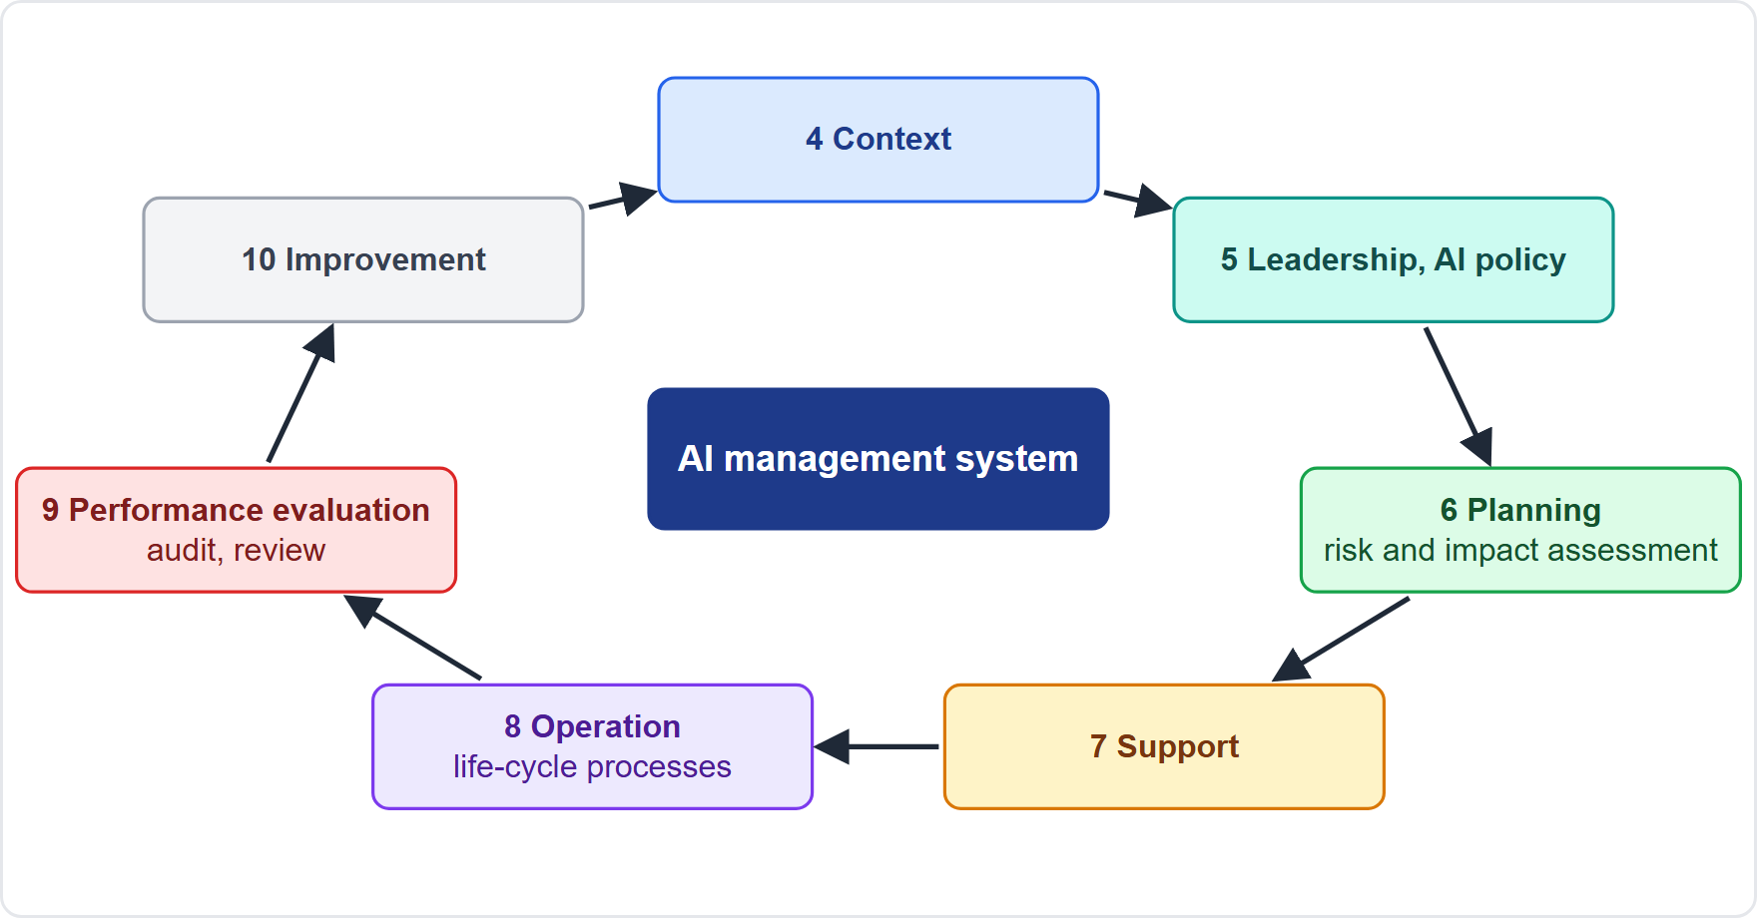
ISO/IEC 42001: The AI Management System
DATES
Part 2
ISO/IEC 42001 (published December 2023) sets requirements for an AI management system (AIMS): an organization-wide system to govern AI responsibly
Same harmonized structure as ISO 27001 and ISO 9001: clauses 4 to 10 in a plan-do-check-act cycle
4 context, 5 leadership and AI policy, 6 planning (risk and impact assessment), 7 support, 8 operation (lifecycle processes), 9 performance evaluation (audit, review), 10 improvement
It is certifiable by accredited bodies
Depth marker: taught from public summaries; the standard is paid and was not read
EXAM TIP A management system is a continuing process of policy, risk, operation, audit and improvement, not a one-time project.
AIGP Exam Prep Masterclass | Certified AI Governance Professional
Module 7: Standards and Frameworks: OECD, NIST and ISO
17 / 26
Notes:
This slide is tagged dates. I S O forty-two thousand and one, published in December twenty twenty-three, sets requirements for an A I management system: an organization-wide system to govern A I responsibly. It follows the same harmonized structure as I S O twenty-seven thousand and one and nine thousand and one: clauses four to ten, in a plan-do-check-act cycle. Four is context, five leadership and A I policy, six planning, including risk and impact assessment, seven support, eight operation, nine performance evaluation, and ten improvement. It is certifiable by accredited bodies. The depth here comes from public summaries. Exam tip: a management system is a continuing process.

Slide 18
ISO/IEC 42001: Controls and Certification
Part 2
Annex A: a reference set of 38 controls in nine control objectives (for example AI policy, internal organization, resources, impact assessment, life cycle, data, information for parties, use, third-party relationships)
Selection is risk-based: the organization chooses controls and records its choices in a statement of applicability
Annex B: implementation guidance; Annex C: AI-related risk sources; Annex D: use across sectors
Certification: an accredited body audits the AIMS; a certificate shows the system meets the standard, not that a product is safe or legal
Helios: uses 42001 to give the program a structure that auditors recognize
EXAM TIP A 42001 certificate covers the organization's management system; it is not proof that a given AI system complies with a law.
AIGP Exam Prep Masterclass | Certified AI Governance Professional
Module 7: Standards and Frameworks: OECD, NIST and ISO
18 / 26
Notes:
Annex A is a reference set of thirty-eight controls in nine control objectives, covering topics such as A I policy, internal organization, resources, impact assessment, life cycle, data, information for parties, use, and third-party relationships. Selection is risk-based: the organization chooses controls and records its choices in a statement of applicability. Annex B gives implementation guidance, Annex C lists A I-related risk sources, and Annex D covers sectors. An accredited body audits the system and certifies it. The certificate shows the management system meets the standard, not that a product is safe or legal. Exam tip: it is not proof of legal compliance.

Slide 19
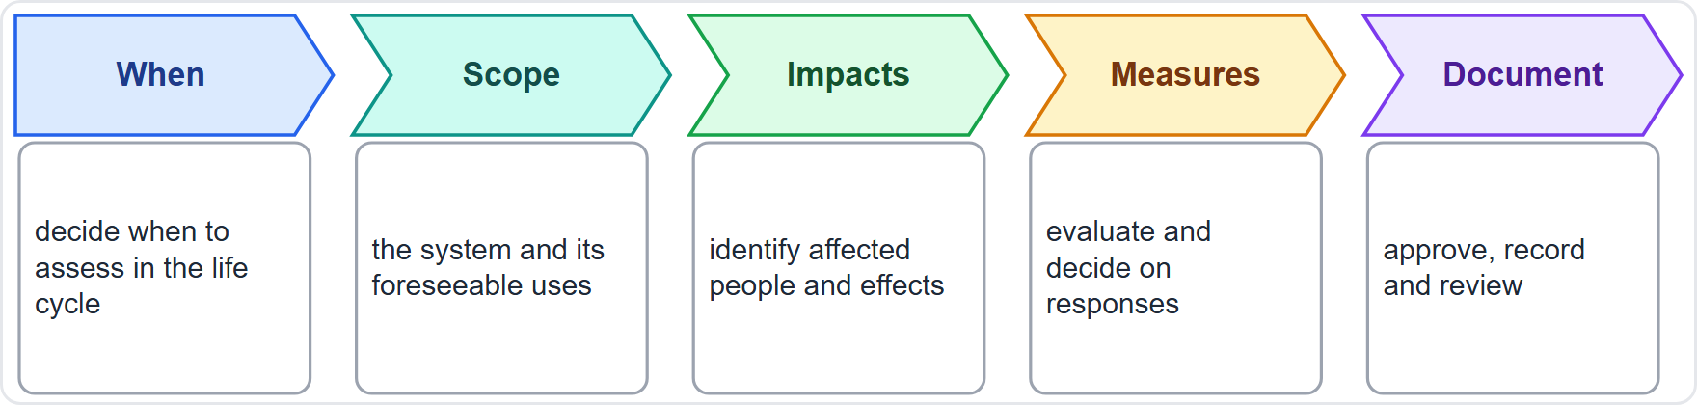
ISO/IEC 42005: AI System Impact Assessment
DATES
Part 2
ISO/IEC 42005 (published 27 May 2025) gives guidance, not requirements, for AI system impact assessment
It covers how and when to assess how a system and its foreseeable uses may affect individuals and society, and at which life-cycle stages
It covers documentation, including approval and review
It is for organizations of any size, and the assessment can be integrated with AI risk management and the management system
Link: 42001 asks for AI system impact assessment; 42005 explains how to do it
Depth marker: taught from public summaries
EXAM TIP 42001 requires impact assessment inside the management system; 42005 is the guidance on how to perform it.
AIGP Exam Prep Masterclass | Certified AI Governance Professional
Module 7: Standards and Frameworks: OECD, NIST and ISO
19 / 26
Notes:
This slide is tagged dates. I S O forty-two thousand and five, published on the twenty-seventh of May, twenty twenty-five, gives guidance, not requirements, for A I system impact assessment. It covers how and when to assess how a system and its foreseeable uses may affect individuals and society, at which life-cycle stages, and how to document, approve and review the result. It suits organizations of any size, and the assessment can be integrated with A I risk management and the management system. Forty-two thousand and one asks for impact assessment. Forty-two thousand and five explains how to do it. Exam tip: one requires, the other guides.

Slide 20
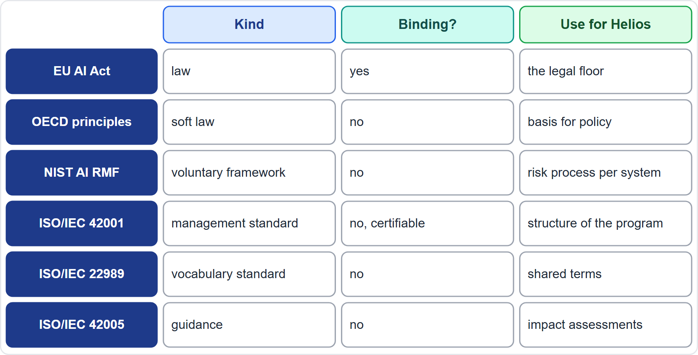
Law, Standard, Framework: How They Fit
Part 2
EU AI Act: binding law; sets duties and penalties; Helios's legal floor
OECD principles: soft law; values that shape policy; Helios's policy basis
NIST AI RMF: voluntary framework; a risk process run system by system
ISO/IEC 42001: certifiable standard; the management structure of the program
ISO/IEC 22989 and 42005: vocabulary and impact-assessment guidance
ISO/IEC 23894 (one row only): guidance on AI risk management
They work together; only law is mandatory, and standards can help show compliance
EXAM TIP Question stems often ask what an instrument is: binding law, soft law, voluntary framework or certifiable standard.
AIGP Exam Prep Masterclass | Certified AI Governance Professional
Module 7: Standards and Frameworks: OECD, NIST and ISO
20 / 26
Notes:
How do they fit together? The E U A I Act is binding law, with duties and penalties, and Helios's legal floor. The O E C D principles are soft law, shaping policy, and Helios's policy basis. The N I S T A I R M F is a voluntary framework, a risk process run system by system. I S O forty-two thousand and one is a certifiable standard, the management structure of the program. Twenty-two nine eight nine is vocabulary, and forty-two thousand and five is impact-assessment guidance. I S O twenty-three thousand eight hundred ninety-four gives guidance on A I risk management. Only law is mandatory. Exam tip: know what kind of instrument it is.

Slide 21
Module Recap
Part 2
1
OECD
2
NIST AI RMF
five principles (inclusive growth; human rights, fairness and privacy; transparency and explainability; robustness, security and safety; accountability) and five policy recommendations
voluntary; four functions, 19 categories, 72 subcategories; GOVERN cross-cuts, MAP then MEASURE then MANAGE; Playbook and profiles
3
ISO
4
Fit
22989 vocabulary; 42001 certifiable management system; 42005 impact-assessment guidance
law is binding; the others are soft law, framework, standard and guidance
AIGP Exam Prep Masterclass | Certified AI Governance Professional
Module 7: Standards and Frameworks: OECD, NIST and ISO
21 / 26
Notes:
Let us recap. The O E C D has five principles: inclusive growth; human rights, fairness and privacy; transparency and explainability; robustness, security and safety; and accountability. It also has five policy recommendations. The N I S T A I R M F is voluntary, with four functions, nineteen categories and seventy-two subcategories. GOVERN cuts across, and MAP leads to MEASURE and MANAGE. The Playbook and profiles tailor it. I S O has a vocabulary, a certifiable management system, and impact-assessment guidance. And only law is binding.

Slide 22
Practice Question 1
Part 2
Q1
Which list correctly names the OECD's five values-based principles for trustworthy AI?
A
Inclusive growth, profitability and competitiveness, transparency, robustness, accountability for outcomes
B
Human oversight, fairness, privacy, transparency, and innovation and market access for firms
C
Inclusive growth, human rights and fairness, innovation incentives, security, accountability of regulators
D
Inclusive growth, human rights and fairness, transparency, robustness and safety, accountability
AIGP Exam Prep Masterclass | Certified AI Governance Professional
Module 7: Standards and Frameworks: OECD, NIST and ISO
22 / 26
Notes:
Question one. Which list correctly names the O E C D's five values-based principles for trustworthy A I? The four options are on the screen. [PAUSE 12] The answer is D. They are inclusive growth, sustainable development and well-being; human rights and democratic values, including fairness and privacy; transparency and explainability; robustness, security and safety; and accountability. The other lists swap in items that are not O E C D principles.

Slide 23
Practice Question 2
Part 2
Q2
Helios's committee wants to document the intended purpose, the legal context, the affected groups and the expected benefits of the new assistant before it is tested. Which NIST AI RMF function does this work belong to?
A
MANAGE, because the work prioritizes and treats risks identified for the assistant
B
GOVERN, because policies and accountability must be set before a system is described
C
MAP, because it establishes the context and impacts of a specific system
D
MEASURE, because it evaluates the assistant against metrics and test results
AIGP Exam Prep Masterclass | Certified AI Governance Professional
Module 7: Standards and Frameworks: OECD, NIST and ISO
23 / 26
Notes:
Question two. Helios's committee wants to document the intended purpose, the legal context, the affected groups and the expected benefits of the new assistant before it is tested. Which N I S T A I R M F function does this belong to? The four options are on the screen. [PAUSE 12] The answer is C. MAP establishes context: purposes, legal context, settings, benefits and impacts on people. MEASURE comes after, and MANAGE treats the risks.

Slide 24
Practice Question 3
Part 2
Q3
Which TWO statements about the NIST AI RMF Playbook are correct? (Select TWO.)
A
Using the Playbook is mandatory for organizations that sell AI products in the United States
B
Its suggestions are voluntary, and it is not a checklist to be followed in its entirety
C
Completing the Playbook earns an organization a certificate recognized by accreditation bodies
D
It replaces the Core and the need to choose among the categories and subcategories
E
It suggests actions that organizations can adapt for each subcategory of the Core
AIGP Exam Prep Masterclass | Certified AI Governance Professional
Module 7: Standards and Frameworks: OECD, NIST and ISO
24 / 26
Notes:
Question three. Which two statements about the N I S T A I R M F Playbook are correct? Select two. The five options are on the screen. [PAUSE 15] The answers are B and E. The Playbook offers voluntary suggested actions aligned to the Core's subcategories, and organizations tailor them. It is not mandatory, not a certification scheme, and not a replacement for the Core.

Slide 25
Practice Question 4
Part 2
Q4
How does ISO/IEC 42001 differ from the NIST AI RMF?
A
ISO/IEC 42001 is a binding law that regulators enforce, while the NIST AI RMF is only a glossary
B
The NIST AI RMF is a certifiable standard, while ISO/IEC 42001 is a voluntary risk-assessment checklist
C
Both documents are voluntary guidance with no requirements, so an organization is not audited against either
D
ISO/IEC 42001 sets requirements for an AI management system that an organization can be certified against
AIGP Exam Prep Masterclass | Certified AI Governance Professional
Module 7: Standards and Frameworks: OECD, NIST and ISO
25 / 26
Notes:
Question four. How does I S O forty-two thousand and one differ from the N I S T A I R M F? The four options are on the screen. [PAUSE 12] The answer is D. I S O forty-two thousand and one specifies requirements for an A I management system, and it is certifiable by accredited bodies. The N I S T framework is voluntary guidance with no certification. Neither is a binding law.

Slide 26
Answers at a Glance
Part 2
Question | Answer | Why
Q1 | D | The five OECD values-based principles
Q2 | C | MAP: context, purpose, impacts
Q3 | B, E | The Playbook is voluntary and suggests actions per subcategory
Q4 | D | 42001 is a certifiable management-system standard
AIGP Exam Prep Masterclass | Certified AI Governance Professional
Module 7: Standards and Frameworks: OECD, NIST and ISO
26 / 26
Notes:
Here are all four answers. Question one: D. Question two: C. Question three: B and E. Question four: D. That completes Module seven, and with it domain two. Next, domain three begins with Module eight: governing the design and build of an A I system.

