Slide 1
Module 8: Governing the Design and Build
From the business case to the documented design
Domain III · Competency A · Indicators III.A.1 to III.A.5
AIGP Exam Prep Masterclass
Module 8 · Part 1
Notes:
Welcome to Module eight: Governing the Design and Build. This opens domain three, which follows an A I system through development. Competency A covers the first stage: from the business case to the documented design. It is where most risks can still be designed out.

Slide 2
What You Will Learn
Part 1
Set out the business context and use case for an AI system
Carry out or review an impact assessment
Apply policies, best practices and ethics to design and build
Identify and manage risks with matrices, hierarchies, benchmarks and pilots
Document the design and build to show compliance and manage risk
AIGP Exam Prep Masterclass | Certified AI Governance Professional
Module 8: Governing the Design and Build
2 / 31
Notes:
By the end of this module you will be able to do five things. Set out the business context and use case for an A I system. Carry out or review an impact assessment. Apply policies, best practices and ethics to design and build. Identify and manage risks with matrices, hierarchies, benchmarks and pilots. And document the design and build to show compliance and manage risk.

Slide 3
Case Check-In: A Ratio of 0.68 Before Launch
Part 1
CASE CHECK-IN · Helios
Lucia Moreno wants the hiring tool live for the next campaign
Daniel Osei, Head of Data Science, runs the impact assessment: the tool selects women at 68% of the rate of men, an impact ratio of 0.68
That is below the usual 0.8 rule-of-thumb threshold
Samira Haddad asks: approve with conditions, fix first, or stop?
AIGP Exam Prep Masterclass | Certified AI Governance Professional
Module 8: Governing the Design and Build
3 / 31
Notes:
At Helios, Lucia Moreno wants the hiring tool live for the next campaign. Daniel Osei, Head of Data Science, runs the impact assessment, and the result is clear: the tool selects women at sixty-eight percent of the rate of men, an impact ratio of zero point six eight. That is below the usual zero point eight rule-of-thumb threshold. Samira Haddad asks: approve with conditions, fix first, or stop?

Slide 4
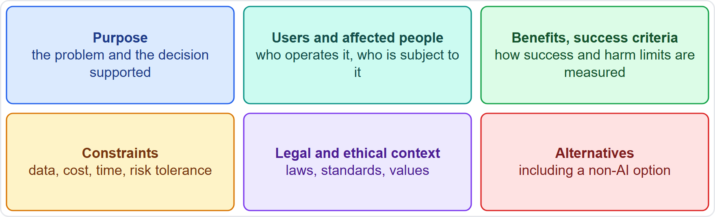
The Business Context and the Use Case
Part 1
Purpose and objectives: the problem and the decision the system will support
Users and affected people: who operates it, and who is subject to its outputs
Benefits and success criteria: how success is measured, including harm limits
Constraints and risk tolerance: data, cost, time, and the risk the organization accepts
Legal and ethical context: laws, standards and values that apply
Alternatives: including a non-AI option
EXAM TIP Governance starts before design: no clear purpose, no meaningful risk assessment.
AIGP Exam Prep Masterclass | Certified AI Governance Professional
Module 8: Governing the Design and Build
4 / 31
Notes:
Start with the use case. Define the purpose and objectives: the problem, and the decision the system will support. Define the users and the affected people: who operates it, and who is subject to its outputs. Define benefits and success criteria, including harm limits. Define constraints and risk tolerance. Define the legal and ethical context. And define alternatives, including a non-A I option. Exam tip: governance starts before design. With no clear purpose, there is no meaningful risk assessment.

Slide 5
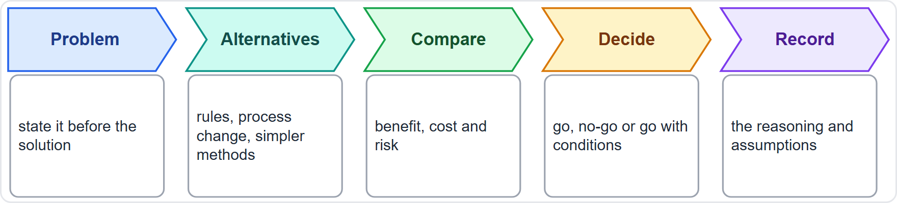
Is AI the Right Tool?
Part 1
State the problem before the solution
List alternatives, including rules, process change or a simpler method
Compare benefit, cost and risk; NIST asks users to weigh viable non-AI alternatives (MANAGE 2.1)
Decide: go, no-go or go with conditions; the mapping work should give enough context for an initial go or no-go decision
Record the reasoning
EXAM TIP If a simpler non-AI method meets the need with less risk, the governance answer may be not to use AI.
AIGP Exam Prep Masterclass | Certified AI Governance Professional
Module 8: Governing the Design and Build
5 / 31
Notes:
Is A I the right tool? State the problem before the solution. List alternatives, including rules, process change or a simpler method. Compare benefit, cost and risk. N I S T, in Manage two point one, asks users to weigh viable non-A I alternatives. Then decide: go, no-go, or go with conditions. The mapping work should give enough context for an initial go or no-go decision. Record the reasoning. Exam tip: if a simpler method meets the need with less risk, the governance answer may be not to use A I.

Slide 6
Approving the Use Case: Gate, Owner and Conditions
Part 1
A use case passes the intake gate (module 3) with a named business owner, a risk tier, and the required sign-offs
Helios: Lucia Moreno owns the hiring tool; the committee tiers it high-risk and asks for an impact assessment first
Approval can carry conditions: tests that must pass, controls that must exist, a review date
The approval is recorded, with the context assumptions it rests on
If the context changes (a new region, a new use), the use case is re-approved
EXAM TIP Approval with conditions is normal; the conditions must be specific, owned and checked.
AIGP Exam Prep Masterclass | Certified AI Governance Professional
Module 8: Governing the Design and Build
6 / 31
Notes:
A use case passes the intake gate from module three, with a named business owner, a risk tier and the required sign-offs. At Helios, Lucia Moreno owns the hiring tool, and the committee tiers it high-risk and asks for an impact assessment first. Approval can carry conditions: tests that must pass, controls that must exist, a review date. The approval is recorded with the assumptions it rests on. If the context changes, the use case is re-approved. Exam tip: conditions must be specific, owned and checked.

Slide 7
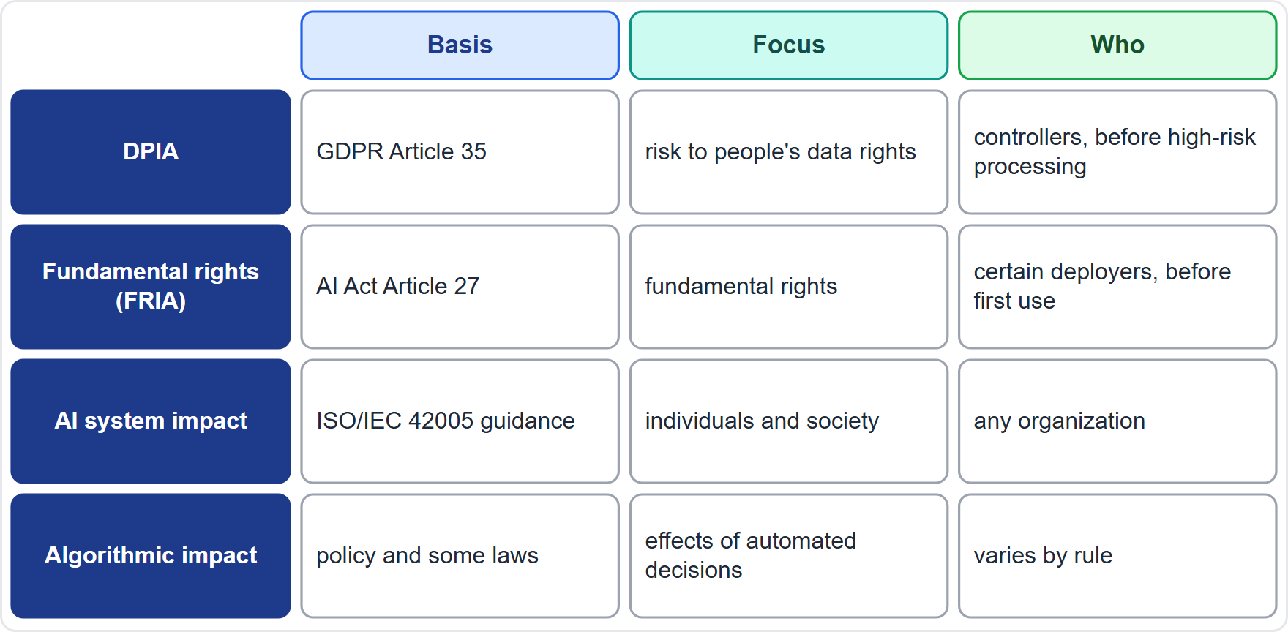
Impact Assessments Compared
BEYOND THE BOK
Part 1
DPIA: GDPR Article 35; risk to people's rights from processing personal data; needed before processing likely to be high risk
Fundamental rights impact assessment: AI Act Article 27; certain deployers of high-risk systems; before first use; may cross-refer to a DPIA
AI system impact assessment: ISO/IEC 42005 guidance; effects on individuals and society across the life cycle; any organization
Algorithmic impact assessment: the effects of automated decisions, in policy and some laws
They overlap: do the work once, and cross-reference it
EXAM TIP The assessments overlap, so the usual answer is to build one on another rather than repeat the work.
AIGP Exam Prep Masterclass | Certified AI Governance Professional
Module 8: Governing the Design and Build
7 / 31
Notes:
This is a beyond-the-Body-of-Knowledge slide. Four assessments overlap. A data protection impact assessment, under G D P R Article thirty-five, looks at risk to people's rights from processing personal data, before processing likely to be high risk. A fundamental rights impact assessment, under A I Act Article twenty-seven, is for certain deployers of high-risk systems, before first use, and can cross-refer to a D P I A. An A I system impact assessment, as I S O forty-two thousand and five describes, looks at effects on individuals and society across the life cycle. An algorithmic impact assessment looks at the effects of automated decisions. Do the work once, and cross-reference it.

Slide 8
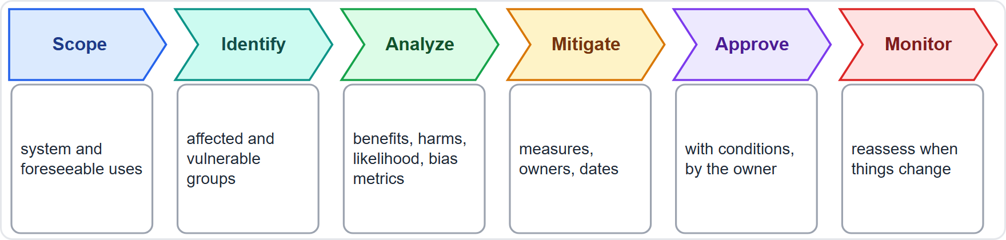
Performing an AI Impact Assessment
Part 1
Scope the system, its intended and foreseeable uses
Identify the people and groups affected, including vulnerable groups
Analyze benefits and harms: likelihood, severity and bias metrics
Set mitigations with owners and dates
Approve with conditions, signed by the accountable owner
Monitor and reassess when anything material changes
EXAM TIP The assessment's point is to inform a decision, so its output is a recommendation with conditions.
AIGP Exam Prep Masterclass | Certified AI Governance Professional
Module 8: Governing the Design and Build
8 / 31
Notes:
How do you perform an impact assessment? Scope the system, with its intended and foreseeable uses. Identify the people and groups affected, including vulnerable groups. Analyze benefits and harms: likelihood, severity and bias metrics. Set mitigations with owners and dates. Approve with conditions, signed by the accountable owner. And monitor and reassess when anything material changes. Exam tip: the point of the assessment is to inform a decision, so its output is a recommendation with conditions.

Slide 9
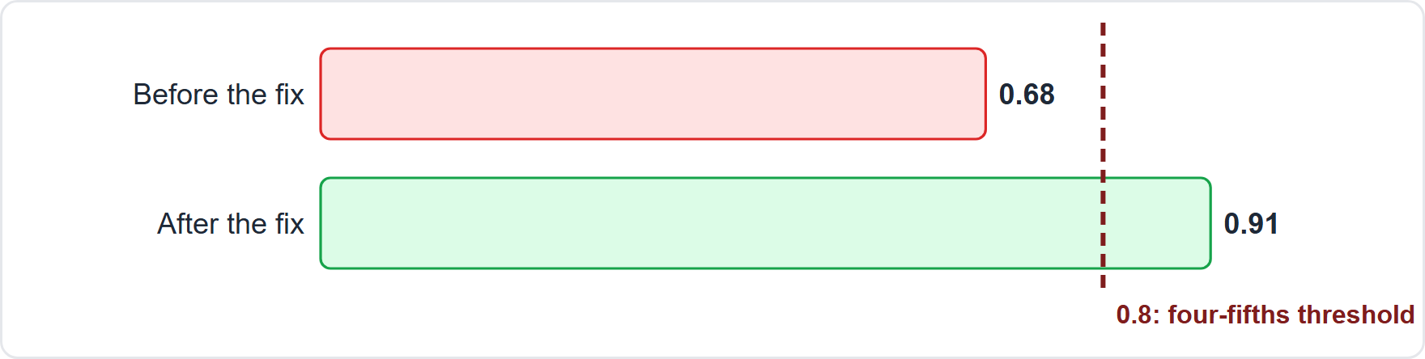
Measuring Impact: The Impact Ratio at Helios
Part 1
Impact ratio = the selection rate of one group divided by the rate of the highest group
Before the fix: women were selected at 68% of the rate of men, a ratio of 0.68, below 0.8
After the fix: the ratio is 0.91, above the threshold
A ratio above 0.8 does not prove the tool is lawful (module 5); it removes the red flag, and testing continues
Use several metrics, because no single number captures fairness
EXAM TIP The ratio is the lower group's rate over the higher group's rate; under 0.8 means investigate.
AIGP Exam Prep Masterclass | Certified AI Governance Professional
Module 8: Governing the Design and Build
9 / 31
Notes:
The impact ratio is the selection rate of one group divided by the rate of the highest group. Before the fix, women were selected at sixty-eight percent of the rate of men, a ratio of zero point six eight, below zero point eight. After the fix, the ratio is zero point nine one, above the threshold. A ratio above zero point eight does not prove the tool is lawful, as we saw in module five. It removes the red flag, and testing continues. Use several metrics, because no single number captures fairness. Exam tip: under zero point eight means investigate.

Slide 10
Acting on the Findings
Part 1
Find the cause: biased training data, a proxy feature, an unsuitable threshold, or a flawed label
Mitigate: remove or rebalance features, re-weight data, adjust thresholds, add human review, or change the design
Retest on fresh data and record the result
Decide with the accountable owner: approve with conditions, send back, or stop
Helios: the team removes proxy features and recalibrates; the ratio becomes 0.91; launch is approved with monitoring and a re-test after each hiring campaign
Keep the assessment on file as evidence
EXAM TIP An assessment that finds a problem is a success; the failure is launching without acting on it.
AIGP Exam Prep Masterclass | Certified AI Governance Professional
Module 8: Governing the Design and Build
10 / 31
Notes:
What do you do with the finding? Find the cause: biased training data, a proxy feature, an unsuitable threshold, or a flawed label. Mitigate: remove or rebalance features, re-weight data, adjust thresholds, add human review, or change the design. Retest on fresh data and record the result. Decide with the accountable owner: approve with conditions, send back, or stop. At Helios, the team removes proxy features and recalibrates, the ratio becomes zero point nine one, and launch is approved with monitoring. Exam tip: an assessment that finds a problem is a success.

Slide 11
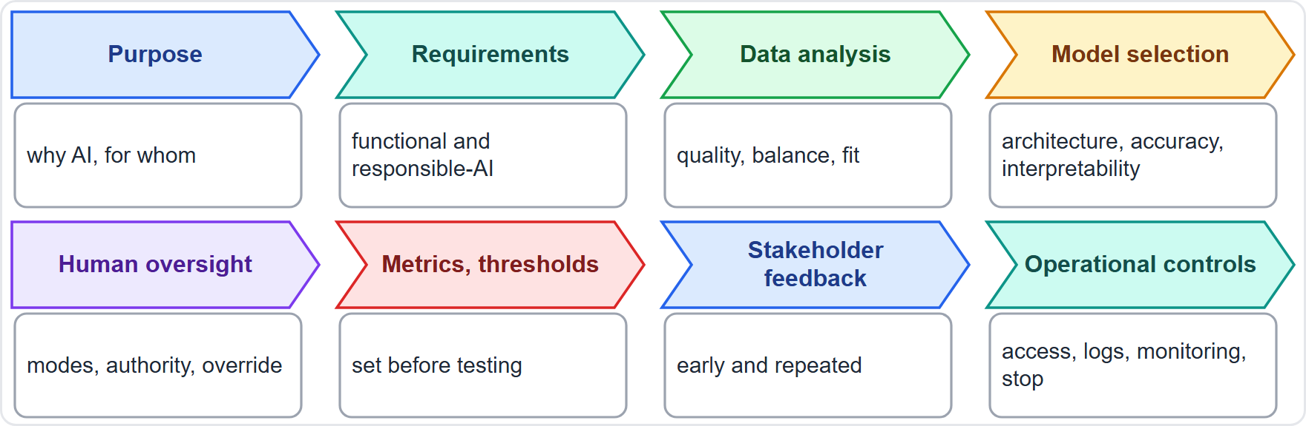
Governance by Design: The Design Stages
Part 1
Apply policy, best practice and ethics at each design step
Purpose and requirements, data analysis, architecture and model selection
Human oversight, metrics and thresholds, stakeholder feedback, operational controls
Each step has a decision and a record
Late fixes cost more: design in fairness, explainability, privacy and safety
EXAM TIP Questions about design ask which control belongs at which step.
AIGP Exam Prep Masterclass | Certified AI Governance Professional
Module 8: Governing the Design and Build
11 / 31
Notes:
Apply policy, best practice and ethics at each design step. Purpose and requirements. Data analysis. Architecture and model selection. Human oversight. Metrics and thresholds. Stakeholder engagement and feedback. And operational controls. Each step has a decision and a record. Late fixes cost more, so design in fairness, explainability, privacy and safety from the start. Exam tip: questions about design ask which control belongs at which step.

Slide 12
Requirements Gathering and Model Selection
Part 1
Functional requirements: what the system must do
Responsible-AI requirements: fairness targets, explainability level, privacy and security needs, safety and reliability limits, oversight points
Requirements are testable and traceable to the use case and the risks
Data analysis: check the data's quality, balance and fit for the purpose before choosing a model
Model selection weighs accuracy, interpretability, data needs, cost, security and the build, buy or fine-tune choice
Record the options considered and why one was chosen
EXAM TIP A more accurate but opaque model is not automatically the right choice; the use case sets the balance.
AIGP Exam Prep Masterclass | Certified AI Governance Professional
Module 8: Governing the Design and Build
12 / 31
Notes:
Requirements include functional ones, what the system must do, and responsible-A I ones: fairness targets, explainability level, privacy and security needs, safety and reliability limits, and oversight points. Requirements are testable and traceable to the use case and the risks. Data analysis checks quality, balance and fit before choosing a model. Model selection weighs accuracy, interpretability, data needs, cost, security, and the choice to build, buy or fine-tune. Record the options considered, and why one was chosen. Exam tip: the most accurate model is not automatically the right one.

Slide 13
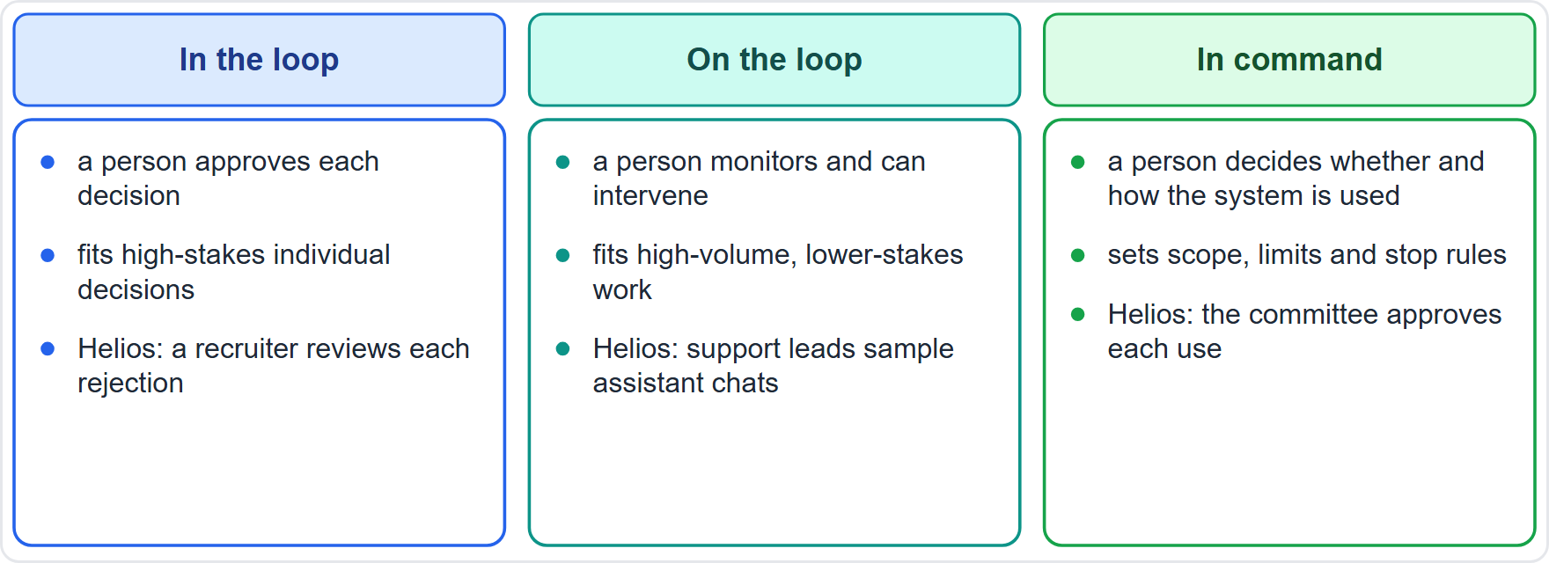
Designing Human Oversight
Part 1
In the loop: a person approves each decision; fits high-stakes individual decisions
On the loop: a person monitors and can intervene; fits high-volume, lower-stakes work
In command: a person decides whether and how the system is used
Whatever the mode, design time, information, training and authority to override (module 6, Article 14)
Guard against automation bias: show reasons and uncertainty, and log overrides
Helios: a recruiter reviews every rejection the tool recommends
EXAM TIP Oversight that cannot change the outcome is for show; design the override.
AIGP Exam Prep Masterclass | Certified AI Governance Professional
Module 8: Governing the Design and Build
13 / 31
Notes:
Three modes of human oversight. In the loop: a person approves each decision, which fits high-stakes individual decisions. On the loop: a person monitors and can intervene, which fits high-volume, lower-stakes work. In command: a person decides whether and how the system is used. Whatever the mode, design time, information, training and authority to override, as module six described under Article fourteen. Guard against automation bias by showing reasons and uncertainty, and log overrides. At Helios, a recruiter reviews every rejection the tool recommends. Exam tip: design the override.

Slide 14
Metrics and Thresholds
Part 1
Kind | Examples | Why it matters
Performance | accuracy, precision, recall, error rates | does it work for the purpose
Fairness | selection rates and impact ratio, error rates by group | does it treat groups equitably
Robustness and safety | performance on unusual or adversarial inputs | does it hold up
Explainability | whether reasons can be given to users | can it be overseen and contested
Set the thresholds before testing: the acceptance criteria for launch and for later monitoring
The AI Act asks for testing before market placement against predefined metrics and probabilistic thresholds (Article 9)
Trade-offs between metrics are decided by the owner, openly
EXAM TIP Thresholds set after seeing the results are not governance; set them first.
AIGP Exam Prep Masterclass | Certified AI Governance Professional
Module 8: Governing the Design and Build
14 / 31
Notes:
Choose metrics of several kinds. Performance: accuracy, precision, recall and error rates. Fairness: selection rates, the impact ratio, and error rates by group. Robustness and safety: performance on unusual or adversarial inputs. Explainability: whether reasons can be given to users. Set the thresholds before testing: the acceptance criteria for launch and for later monitoring. The A I Act asks for testing before market placement against predefined metrics and probabilistic thresholds, in Article nine. Trade-offs between metrics are decided by the owner, openly. Exam tip: set thresholds first.

Slide 15
Stakeholder Engagement, Feedback and Operational Controls
Part 1
Engage stakeholders: users, affected groups, legal, privacy, security and the business, early and repeatedly
Collect feedback in design reviews and pilots, and record what changed because of it
Operational controls designed in: access control, logging, monitoring hooks, change management, a way to pause or stop
Security by design: threat modeling and protection of data and model
Hand-off: the design carries operating instructions for the deployer
EXAM TIP A system that cannot be logged, monitored or stopped was not designed for governance.
AIGP Exam Prep Masterclass | Certified AI Governance Professional
Module 8: Governing the Design and Build
15 / 31
Notes:
Engage stakeholders early and repeatedly: users, affected groups, legal, privacy, security and the business. Collect feedback in design reviews and pilots, and record what changed because of it. Design in operational controls: access control, logging, monitoring hooks, change management, and a way to pause or stop. Use security by design, with threat modeling and protection of the data and the model. And hand off operating instructions to the deployer. Exam tip: a system that cannot be logged, monitored or stopped was not designed for governance.

Slide 16
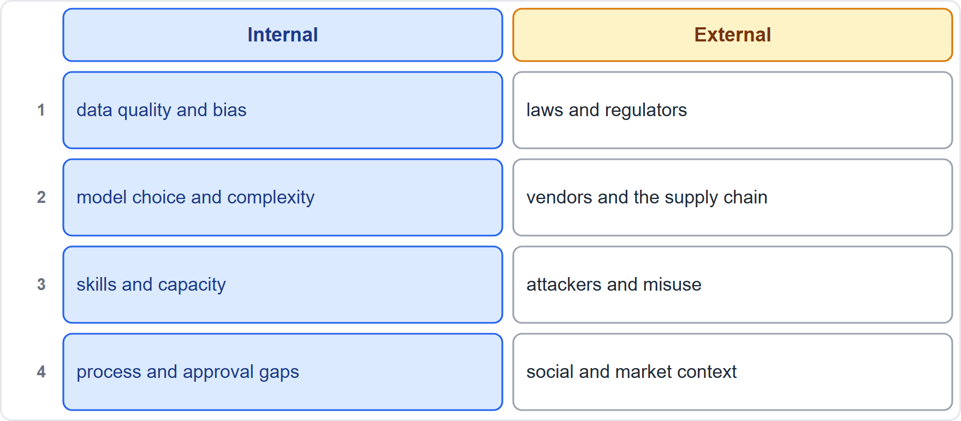
Internal and External Risk Factors
Part 2
Internal factors: data quality and bias, model choice and complexity, skills and capacity, process and approval gaps
External factors: laws and regulators, vendors and the supply chain, attackers and misuse, social and market context
Risks interact: a weak vendor and poor data can combine
Identify risks to people as well as to the organization
EXAM TIP A complete risk review looks both inward and outward.
AIGP Exam Prep Masterclass | Certified AI Governance Professional
Module 8: Governing the Design and Build
16 / 31
Notes:
Now risk. Internal factors include data quality and bias, model choice and complexity, skills and capacity, and process and approval gaps. External factors include laws and regulators, vendors and the supply chain, attackers and misuse, and social and market context. Risks interact: a weak vendor and poor data can combine. And identify risks to people as well as to the organization. Exam tip: a complete risk review looks both inward and outward.

Slide 17
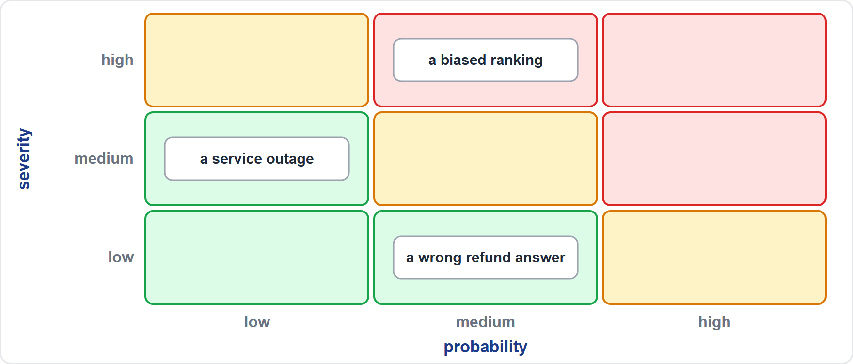
The Probability and Severity Harms Matrix
Part 2
Rate each risk by probability and severity
High-high risks come first; low-low risks are accepted or monitored
Consider severity to people (rights, safety, livelihood), not only cost
Low-probability, high-severity harms still need controls
Helios: a biased ranking is medium probability and high severity, so it gets the strongest controls
EXAM TIP A harms matrix ranks; it does not decide acceptance by itself, since the owner sets the risk tolerance.
AIGP Exam Prep Masterclass | Certified AI Governance Professional
Module 8: Governing the Design and Build
17 / 31
Notes:
The probability and severity harms matrix rates each risk on two axes. High probability and high severity come first. Low and low can be accepted or monitored. Consider severity to people, such as rights, safety and livelihood, not only cost. Low-probability, high-severity harms still need controls. At Helios, a biased ranking is medium probability and high severity, so it gets the strongest controls. Exam tip: a matrix ranks risks. The owner sets the risk tolerance.

Slide 18
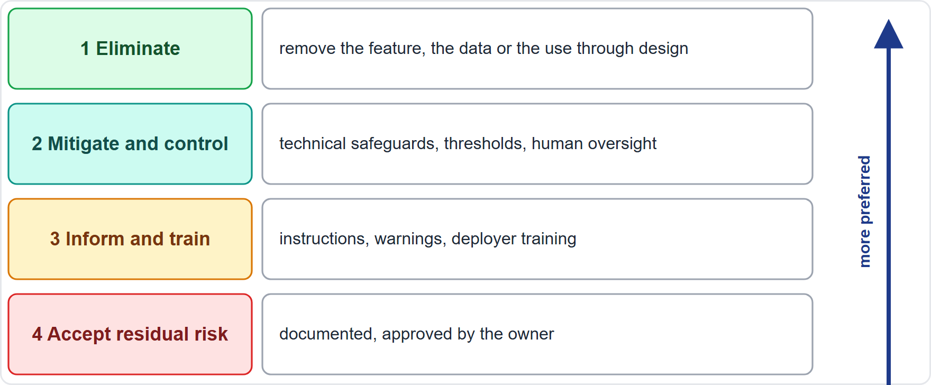
The Risk Mitigation Hierarchy
Part 2
First: eliminate the risk through design (remove the feature, the data or the use)
Second: mitigate and control (technical safeguards, thresholds, human oversight)
Third: inform and train (instructions, warnings, deployer training)
Then: judge the residual risk acceptable, documented and approved
The AI Act's risk management duty states this same order (Article 9)
EXAM TIP A warning or training is the weakest answer when the risk can be designed out.
AIGP Exam Prep Masterclass | Certified AI Governance Professional
Module 8: Governing the Design and Build
18 / 31
Notes:
The risk mitigation hierarchy has an order of preference. First, eliminate the risk through design: remove the feature, the data or the use. Second, mitigate and control: technical safeguards, thresholds, human oversight. Third, inform and train: instructions, warnings and deployer training. Then judge the residual risk acceptable, documented and approved. The A I Act's risk management duty states the same order, in Article nine. Exam tip: a warning or training is the weakest answer when the risk can be designed out.

Slide 19
Stakeholder Mapping, Use-Case Evaluation and Benchmarking
Part 2
Stakeholder mapping: list everyone affected or interested, their influence and stake, and how each will be consulted
Use-case evaluation: test the use case against ethics, law and risk tolerance, and re-evaluate when it changes
Benchmarking: compare performance and risk with standard test sets, similar systems and human baselines
Internal and external review: a second pair of eyes from legal, security and independent experts
Record findings in the risk register with owners
EXAM TIP Mapping the people affected is how a design team finds harms it would otherwise miss.
AIGP Exam Prep Masterclass | Certified AI Governance Professional
Module 8: Governing the Design and Build
19 / 31
Notes:
Three more tools. Stakeholder mapping lists everyone affected or interested, their influence and stake, and how each will be consulted. Use-case evaluation tests the use case against ethics, law and risk tolerance, and re-evaluates it when it changes. Benchmarking compares performance and risk with standard test sets, similar systems and human baselines. Add internal and external review, with a second pair of eyes from legal, security and independent experts, and record findings in the risk register with owners. Exam tip: mapping the people affected finds harms a team would otherwise miss.

Slide 20
Pre-Deployment Pilots and Testing
Part 2
Pilots run the system on a limited scale to learn before full launch
Shadow mode: the system runs without acting, so its outputs are compared with human decisions
Phased rollout: a small group first, then wider, with stop criteria
Testing: performance, fairness, robustness, security and red-team exercises
Go or no-go criteria are set in advance, and the decision is recorded
The AI Act allows testing in real-world conditions under defined safeguards (Articles 9 and 60)
EXAM TIP A pilot is a controlled test with exit criteria, not a soft launch with no way back.
AIGP Exam Prep Masterclass | Certified AI Governance Professional
Module 8: Governing the Design and Build
20 / 31
Notes:
Before deployment, run pilots and tests. A pilot runs the system on a limited scale to learn before full launch. Shadow mode runs the system without acting, and compares its outputs with human decisions. A phased rollout starts with a small group, then widens, with stop criteria. Testing covers performance, fairness, robustness, security and red-team exercises. Go or no-go criteria are set in advance, and the decision is recorded. The A I Act allows testing in real-world conditions under defined safeguards, in Articles nine and sixty. Exam tip: a pilot has exit criteria.

Slide 21
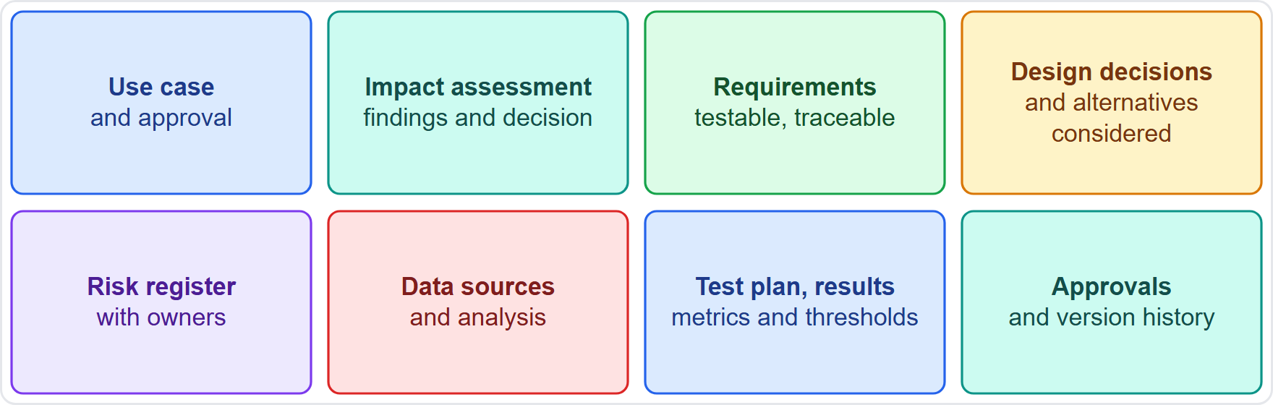
Documenting the Design and Build
Part 2
Why document: to show compliance and manage risk: auditors, regulators and later teams rely on it
What: the use case and approval, impact assessment, requirements, design decisions and alternatives, risk register, data sources, test plan and results, approvals and versions
Keep it version-controlled, dated and owned
Write it as you go; reconstructing it later is unreliable
Helios: the design record is the file Samira Haddad's committee reviews at the launch gate
EXAM TIP If it is not documented, an auditor cannot tell whether it was done.
AIGP Exam Prep Masterclass | Certified AI Governance Professional
Module 8: Governing the Design and Build
21 / 31
Notes:
Document the design and build to show compliance and manage risk. Auditors, regulators and later teams rely on it. Keep the use case and approval, the impact assessment, the requirements, the design decisions and alternatives, the risk register, the data sources, the test plan and results, and the approvals and versions. Keep it version-controlled, dated and owned. Write it as you go, because reconstructing it later is unreliable. At Helios, it is the file the committee reviews at the launch gate. Exam tip: if it is not documented, an auditor cannot tell whether it was done.

Slide 22
Documentation for Compliance: Annex IV and Model Records
BEYOND THE BOK
Part 2
The AI Act's technical documentation (Article 11, Annex IV) is the model for a high-risk design record
Annex IV, first part: a general description; the development process (methods, design specifications and trade-offs, architecture, data requirements, human oversight assessment, pre-determined changes, validation and testing with metrics, cybersecurity)
Annex IV, second part: monitoring and control; justification of metrics; the risk management system; lifecycle changes; standards applied; the declaration of conformity (Article 47); the post-market monitoring plan (Article 72)
Testing logs and reports are dated and signed
Model cards and datasheets summarize a model and its data (module 9)
EXAM TIP Documentation is a continuing record: it must be updated when the design changes.
AIGP Exam Prep Masterclass | Certified AI Governance Professional
Module 8: Governing the Design and Build
22 / 31
Notes:
This is a beyond-the-Body-of-Knowledge slide. The A I Act's technical documentation, in Article eleven and Annex four, is a good model for a high-risk design record. Annex four covers a general description, and the development process: methods, design specifications and trade-offs, architecture, data requirements, the human oversight assessment, pre-determined changes, validation and testing with metrics, and cybersecurity. It also covers monitoring and control, justification of metrics, the risk management system, lifecycle changes, standards applied, the declaration of conformity, and the post-market monitoring plan. Testing logs are dated and signed. Exam tip: documentation is continuing.

Slide 23
Module Recap
Part 2
1
Use case
2
Impact assessment
3
Design
define purpose, users, benefits, constraints, alternatives; approve with conditions
DPIA, FRIA, AI impact assessment overlap; scope, affected people, benefits and harms, mitigation, approval, monitoring; ratio under 0.8 means investigate
requirements, model selection, oversight design, metrics and thresholds set first, stakeholder feedback, operational controls
4
Risk
5
Records
internal and external factors, harms matrix, mitigation hierarchy, mapping, benchmarking, pilots
a version-controlled design record, modeled on Annex IV
AIGP Exam Prep Masterclass | Certified AI Governance Professional
Module 8: Governing the Design and Build
23 / 31
Notes:
Let us recap. Use case: define purpose, users, benefits, constraints and alternatives, and approve with conditions. Impact assessment: the D P I A, the rights assessment and the A I impact assessment overlap; scope, affected people, benefits and harms, mitigation, approval and monitoring; a ratio under zero point eight means investigate. Design: requirements, model selection, oversight, thresholds set first, feedback and operational controls. Risk: factors, matrix, hierarchy, mapping, benchmarking and pilots. Records: a version-controlled design record, modeled on Annex four.

Slide 24
Practice Question 1
Part 2
Q1
Lucia Moreno asks what must be settled about the business context before the hiring tool is designed. Which set is the best answer?
A
The model architecture, the hyperparameters and the cloud vendor to be used for training
B
The final test results, the launch date and the exact wording of the candidate notice text
C
The advertising message, the price of the service and the expected number of paying customers
D
Purpose, users and people affected, success criteria, constraints and any non-AI alternative
AIGP Exam Prep Masterclass | Certified AI Governance Professional
Module 8: Governing the Design and Build
24 / 31
Notes:
Question one. Lucia Moreno asks what must be settled about the business context before the hiring tool is designed. Which set is the best answer? The four options are on the screen. [PAUSE 12] The answer is D. A use case defines the purpose, the users and affected people, the benefits and success criteria, the constraints, and the alternatives, including a non-A I option.

Slide 25
Practice Question 2
Part 2
Q2
Before launch, Helios's hiring tool selects women at 68% of the rate of men. What should Helios conclude and do?
A
Launch as planned, because recruiters make the final decision about each applicant
B
Treat the ratio of 0.68 as acceptable, because it is above the four-fifths threshold of 0.8 in use
C
Treat 0.68 as a red flag below 0.8, find the cause, mitigate, retest and decide before launch
D
Delete the assessment from the file, because a poor result should not be kept as evidence
AIGP Exam Prep Masterclass | Certified AI Governance Professional
Module 8: Governing the Design and Build
25 / 31
Notes:
Question two. Before launch, Helios's hiring tool selects women at sixty-eight percent of the rate of men. What should Helios conclude and do? The four options are on the screen. [PAUSE 12] The answer is C. A ratio of zero point six eight is below zero point eight, so it is a red flag. Find the cause, mitigate, retest and decide before launch, and keep the assessment on file.

Slide 26
Practice Question 3
Part 2
Q3
Which TWO statements about impact assessments are correct? (Select TWO.)
A
An AI impact assessment replaces the need for a data protection impact assessment
B
A fundamental rights impact assessment is required for AI systems used in commercial sectors
C
A DPIA is required under GDPR Article 35 for processing likely to be high risk to people
D
ISO/IEC 42005 is a binding regulation that fixes the exact format of assessment reports
E
A fundamental rights assessment can cross-refer to an existing DPIA to avoid duplication
AIGP Exam Prep Masterclass | Certified AI Governance Professional
Module 8: Governing the Design and Build
26 / 31
Notes:
Question three. Which two statements about impact assessments are correct? Select two. The five options are on the screen. [PAUSE 15] The answers are C and E. Article thirty-five requires a D P I A for processing likely to be high risk, and the A I Act lets a deployer's fundamental rights impact assessment cross-refer to a D P I A. An A I impact assessment does not replace a D P I A, and I S O forty-two thousand and five is guidance.

Slide 27
Practice Question 4
Part 2
Q4
A team is designing a hiring tool. Which TWO practices best apply governance to the design stage? (Select TWO.)
A
Choosing the largest available model, whatever the effect on the ability to explain results
B
Designing human oversight with the time, information and authority to override the tool
C
Collecting the widest range of data fields about applicants in case it improves the model
D
Setting fairness and performance thresholds before testing begins and recording them
E
Skipping stakeholder feedback during design to shorten the schedule before the pilot
AIGP Exam Prep Masterclass | Certified AI Governance Professional
Module 8: Governing the Design and Build
27 / 31
Notes:
Question four. A team is designing a hiring tool. Which two practices best apply governance to the design stage? Select two. The five options are on the screen. [PAUSE 15] The answers are B and D. Oversight must be designed with real authority to override, and thresholds are set before testing so results cannot move the goalposts. Choosing size over explainability, collecting everything, and skipping feedback work against governance.

Slide 28
Practice Question 5
Part 2
Q5
On a probability and severity harms matrix, which risk should the team treat first?
A
A harm with a high probability and a high severity for the people affected by the system
B
A harm with a low probability and a low severity that would cost very little to fix later
C
A harm that has a high probability but a negligible effect on the people affected
D
A harm that is expensive for the company but unlikely to affect the people involved
AIGP Exam Prep Masterclass | Certified AI Governance Professional
Module 8: Governing the Design and Build
28 / 31
Notes:
Question five. On a probability and severity harms matrix, which risk should the team treat first? The four options are on the screen. [PAUSE 12] The answer is A. The matrix ranks risks by probability and severity, so a high-probability, high-severity risk to people takes priority. Low and low can be accepted or monitored.

Slide 29
Practice Question 6
Part 2
Q6
During design review, a team finds a feature that can produce harmful outputs. Under the risk mitigation hierarchy, which response is the most preferred?
A
Add a warning about the feature to the user guide and the release notes for deployers
B
Train the deployers to recognize when the feature produces harmful outputs and to escalate
C
Add a monitoring alert that notifies the operations team when harmful outputs are detected
D
Redesign the system to remove the cause, so the harmful outputs cannot occur at all
AIGP Exam Prep Masterclass | Certified AI Governance Professional
Module 8: Governing the Design and Build
29 / 31
Notes:
Question six. During design review, a team finds a feature that can produce harmful outputs. Under the risk mitigation hierarchy, which response is the most preferred? The four options are on the screen. [PAUSE 12] The answer is D. The hierarchy prefers eliminating the risk through design, then mitigation and control, then information and training. Removing the cause beats a warning, training or an alert.

Slide 30
Practice Question 7
Part 2
Q7
Which design-stage record best helps show compliance and manage risk for a high-risk system?
A
A slide deck shown at the kickoff meeting, saved on one team member's own laptop for later
B
A version-controlled design record of use case, assessment, requirements, risks, tests and approvals
C
An email thread among the developers that mentions the main decisions and some of the known risks
D
A summary written from memory after launch, to be filed when an auditor eventually asks
AIGP Exam Prep Masterclass | Certified AI Governance Professional
Module 8: Governing the Design and Build
30 / 31
Notes:
Question seven. Which design-stage record best helps show compliance and manage risk for a high-risk system? The four options are on the screen. [PAUSE 12] The answer is B. A dated, owned and version-controlled record of the use case, assessment, requirements, alternatives, risks, tests and approvals shows what was done and why. Informal or after-the-fact records cannot do that reliably.

Slide 31
Answers at a Glance
Part 2
Question | Answer | Why
Q1 | D | Purpose, users, success criteria, constraints, alternatives
Q2 | C | A ratio of 0.68 is a red flag: investigate, mitigate, retest
Q3 | C, E | DPIA under Article 35; a rights assessment can cross-refer to it
Q4 | B, D | Designed oversight with authority; thresholds set before testing
Q5 | A | High probability and high severity comes first
Q6 | D | Eliminate by design before warnings or training
Q7 | B | A version-controlled design record
AIGP Exam Prep Masterclass | Certified AI Governance Professional
Module 8: Governing the Design and Build
31 / 31
Notes:
Here are all seven answers. Question one: D. Question two: C. Question three: C and E. Question four: B and D. Question five: A. Question six: D. Question seven: B. That completes Module eight. Next, Module nine covers governing data, training and testing.

