Slide 1
Module 9: Governing Data, Training and Testing
Where the data come from, how the model is trained, and how it is tested
Domain III · Competency B · Indicators III.B.1 to III.B.5
AIGP Exam Prep Masterclass
Module 9 · Part 1
Notes:
Welcome to Module nine: Governing Data, Training and Testing. This is competency B of domain three. A model is only as good, and only as lawful, as the data it learns from and the tests it passes. You will learn how to govern the data, how to plan and run training and testing, and how to keep the records.

Slide 2
What You Will Learn
Part 1
Set and follow data governance requirements: lawful rights, quality and fitness
Record lineage and provenance
Plan and run training and testing, including bias, security and interpretability tests
Find and manage issues that appear in training and testing
Document the work to validate results and show compliance
AIGP Exam Prep Masterclass | Certified AI Governance Professional
Module 9: Governing Data, Training and Testing
2 / 31
Notes:
By the end of this module you will be able to do five things. Set and follow data governance requirements: lawful rights, quality and fitness. Record lineage and provenance. Plan and run training and testing, including bias, security and interpretability tests. Find and manage issues that appear along the way. And document the work to validate results and show compliance.

Slide 3
Case Check-In: Whose Data Is This?
Part 1
CASE CHECK-IN · Helios
Daniel Osei asks Veridex where its hiring tool's training data came from; the answer is vague
For the customer assistant, Helios will ground answers in its own support documents, which need lineage and quality checks
Mei Tanaka worries about tampering with the document store
You must set the data rules, the test plan and the records
AIGP Exam Prep Masterclass | Certified AI Governance Professional
Module 9: Governing Data, Training and Testing
3 / 31
Notes:
At Helios, Daniel Osei asks Veridex where its hiring tool's training data came from, and the answer is vague. For the customer assistant, Helios will ground answers in its own support documents, which need lineage and quality checks. Mei Tanaka worries about tampering with the document store. Your job is to set the data rules, the test plan and the records.

Slide 4
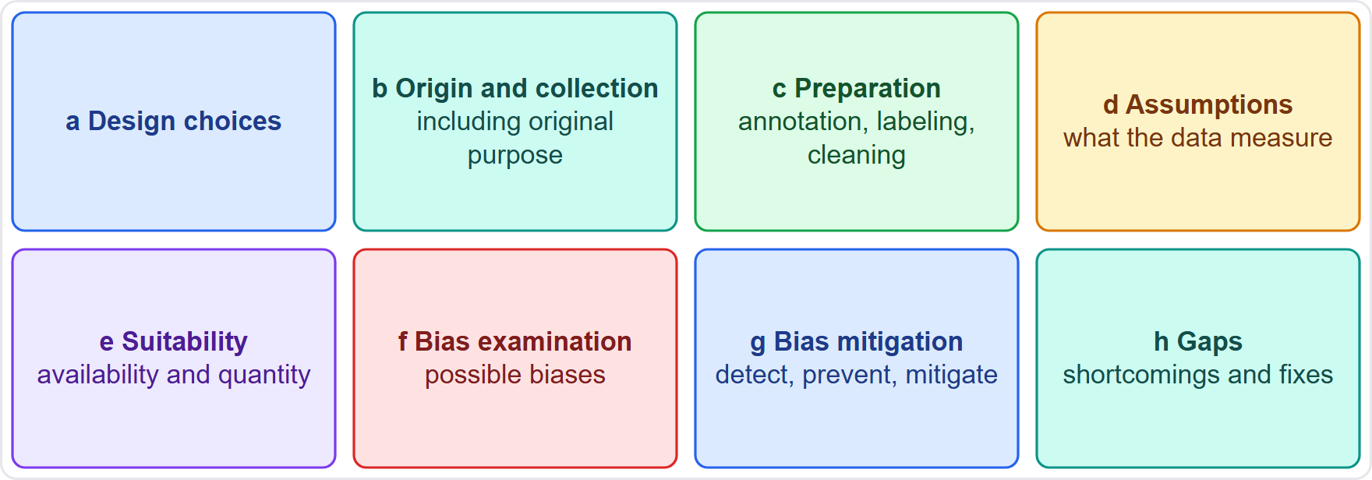
Data Governance for AI: The Requirements
Part 1
Data governance gives every dataset an owner, rules for use, quality checks, access control, retention and records
AI Act Article 10 names eight practices for high-risk training, validation and testing data: design choices, origin and collection, preparation, assumptions, availability and suitability, bias examination, bias mitigation and gaps
Even outside the AI Act, these are the governance questions an auditor asks
Data governance applies to training, validation and testing data alike
EXAM TIP Data governance for AI is the same discipline as for any data, plus bias, representativeness and provenance.
AIGP Exam Prep Masterclass | Certified AI Governance Professional
Module 9: Governing Data, Training and Testing
4 / 31
Notes:
Data governance gives every dataset an owner, rules for use, quality checks, access control, retention and records. A I Act Article ten names eight practices for high-risk training, validation and testing data: design choices, origin and collection, preparation, assumptions, availability and suitability, bias examination, bias mitigation, and gaps. Even outside the A I Act, these are the questions an auditor asks. And governance applies to training, validation and testing data alike. Exam tip: it is the same discipline as for any data, plus bias, representativeness and provenance.

Slide 5
Lawful Rights to Collect and Use Data
Part 1
Source and purpose: where did the data come from, and what was the original purpose? (Article 10(2)(b))
Privacy: a lawful basis, notice, minimization, sensitive-data rules and transfer mechanisms (module 4)
IP and contract: licenses, website terms, scraping rules and rights reservations (module 5)
Third-party data: warranties that the provider had the right to supply it, and audit rights
Confidentiality: customer and employee data have contractual limits
Document the assessment before the data are used, not after
EXAM TIP If lawful rights are unclear, quality and accuracy do not matter: do not use the data until the rights are settled.
AIGP Exam Prep Masterclass | Certified AI Governance Professional
Module 9: Governing Data, Training and Testing
5 / 31
Notes:
First, lawful rights. Where did the data come from, and what was the original purpose? On privacy, check the lawful basis, notice, minimization, sensitive-data rules and transfers, from module four. On I P and contract, check licenses, website terms, scraping rules and rights reservations, from module five. For third-party data, get warranties and audit rights. Customer and employee data have contractual limits. And document the assessment before the data are used. Exam tip: if lawful rights are unclear, quality does not matter. Do not use the data.

Slide 6
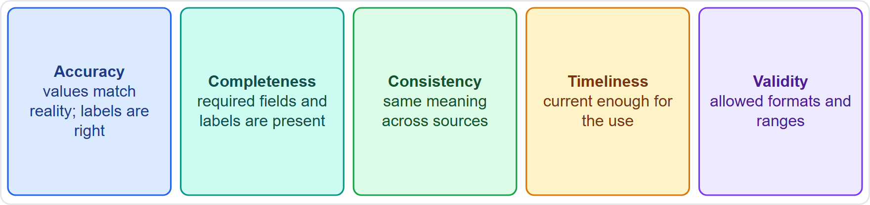
Data Quality: The Five Checks
Part 1
Accuracy: values match reality; labels are right
Completeness: required fields and labels are present
Consistency: the same thing means the same thing across sources
Timeliness: data are current enough for the use; stale data mislead
Validity: values are in allowed formats and ranges
AI Act Article 10 asks for data that are relevant, sufficiently representative, free of errors as far as possible and complete
EXAM TIP Quality is judged against the purpose: data that are fine for reporting can be poor for training.
AIGP Exam Prep Masterclass | Certified AI Governance Professional
Module 9: Governing Data, Training and Testing
6 / 31
Notes:
Five quality checks. Accuracy: values match reality, and labels are right. Completeness: required fields and labels are present. Consistency: the same thing means the same thing across sources. Timeliness: data are current enough for the use, and stale data mislead. Validity: values are in allowed formats and ranges. A I Act Article ten asks for data that are relevant, sufficiently representative, free of errors as far as possible, and complete. Exam tip: quality is judged against the purpose. Data fine for reporting can be poor for training.

Slide 7
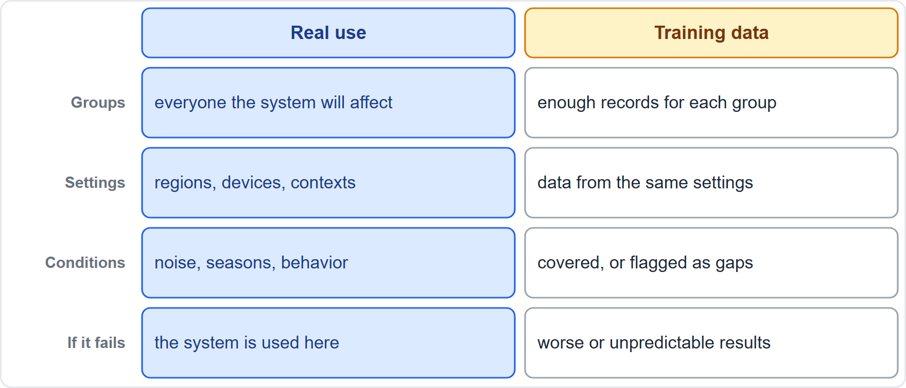
Quantity, Representativeness and Fit for Purpose
Part 1
Enough data is judged per group and per condition, not just in total
Representative: the data reflect the people and settings of real use, including geographic, contextual, behavioral or functional conditions (Article 10(4))
Gaps mean the model may perform worse or unpredictably where data are thin
Stale or detached data that no longer match the deployment setting lower trustworthiness (NIST)
Fit for purpose: the data answer the question the model is meant to answer
EXAM TIP A big dataset is not a representative dataset.
AIGP Exam Prep Masterclass | Certified AI Governance Professional
Module 9: Governing Data, Training and Testing
7 / 31
Notes:
How much data is enough? Judge it per group and per condition, not just in total. Representative data reflect the people and settings of real use, including geographic, contextual, behavioral or functional conditions, as Article ten, paragraph four, says. Gaps mean the model may perform worse or unpredictably where data are thin. N I S T also warns that stale or detached data lower trustworthiness. And fit for purpose means the data answer the question the model is meant to answer. Exam tip: a big dataset is not a representative dataset.

Slide 8
Data Integrity and Protection
Part 1
Integrity: the data have not been altered by accident or attack since they were approved
Controls: access control, version control, checksums or hashes, secure pipelines and audit trails
Data poisoning: an attack that manipulates training data to change model behavior; the AI Act names it among threats to guard against (Article 15)
Quarantine new data until checked; sample and inspect labels
Helios: the support-document store gets change control and owner approval
EXAM TIP Whoever can change the training data can change the model's behavior.
AIGP Exam Prep Masterclass | Certified AI Governance Professional
Module 9: Governing Data, Training and Testing
8 / 31
Notes:
Integrity means the data have not been altered, by accident or attack, since they were approved. Controls include access control, version control, checksums or hashes, secure pipelines and audit trails. Data poisoning is an attack that manipulates training data to change model behavior, and the A I Act names it among the threats to guard against, in Article fifteen. Quarantine new data until checked, and sample and inspect labels. At Helios, the support-document store gets change control and owner approval. Exam tip: whoever can change the data can change the model.

Slide 9
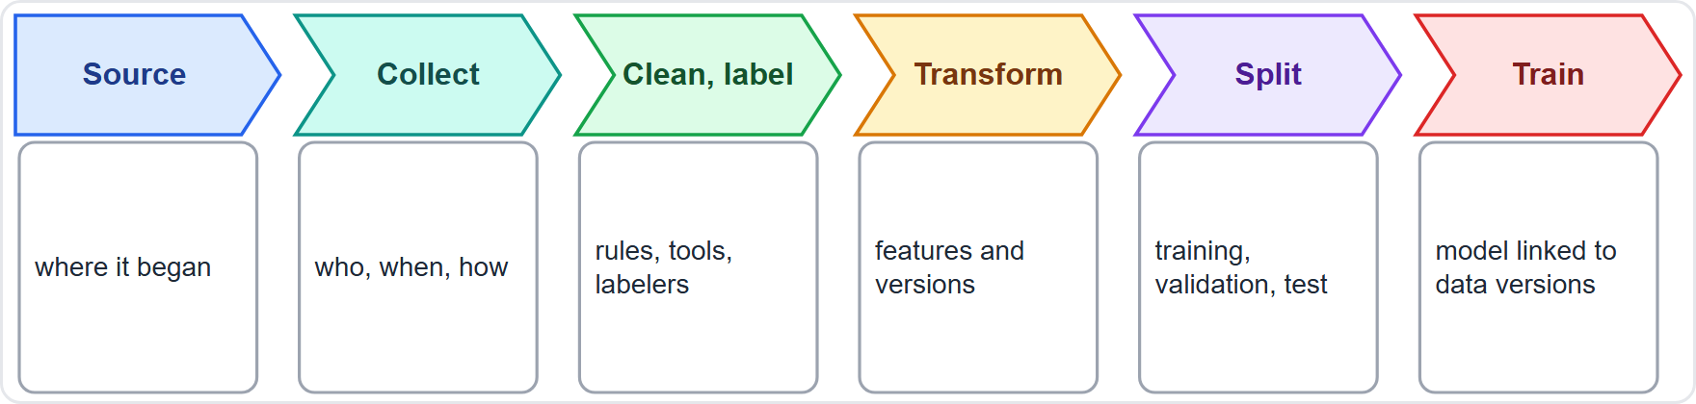
Lineage: Where Data Came From and What Happened to It
Part 1
Lineage is the traceable path of data from source to model: every step, change, owner and version
Why: to reproduce results, find the cause of a problem, remove data on request, and prove compliance
Record at each step: who did it, when, what changed, and the version produced
Link each trained model to the exact dataset versions used
Lineage makes deletion and correction requests possible (module 4)
EXAM TIP If you cannot trace which data trained the model, you cannot fix, delete or defend it.
AIGP Exam Prep Masterclass | Certified AI Governance Professional
Module 9: Governing Data, Training and Testing
9 / 31
Notes:
Lineage is the traceable path of data from source to model: every step, change, owner and version. Why? To reproduce results, find the cause of a problem, remove data on request, and prove compliance. Record at each step who did it, when, what changed, and the version produced. Link each trained model to the exact dataset versions used. Lineage makes deletion and correction requests possible, as module four showed. Exam tip: if you cannot trace which data trained the model, you cannot fix, delete or defend it.

Slide 10
Provenance: Origin, Rights and Trust
Part 1
Provenance is the origin and history of data: who created it, how, when, and on what terms
Provenance record: source, collection method, date, license or consent basis, labeling process and any transformation
External data: ask the provider for documentation, warranties and audit rights; vague answers are a risk finding
Synthetic data: record the generator and the real data it was based on
Helios: Veridex must document its training-data provenance before the hiring tool is relied on
EXAM TIP Provenance answers where the data came from and whether you may use it; lineage answers what happened to it afterward.
AIGP Exam Prep Masterclass | Certified AI Governance Professional
Module 9: Governing Data, Training and Testing
10 / 31
Notes:
Provenance is the origin and history of data: who created it, how, when, and on what terms. A provenance record holds the source, the collection method, the date, the license or consent basis, the labeling process and any transformation. For external data, ask the provider for documentation, warranties and audit rights; vague answers are a risk finding. For synthetic data, record the generator and the real data it was based on. At Helios, Veridex must document its provenance before the hiring tool is relied on. Exam tip: provenance is origin and rights. Lineage is what happened afterward.

Slide 11
Tools and Documents for Lineage and Provenance
BEYOND THE BOK
Part 1
Data catalogs and metadata
Data versioning
Hashes and registries
each dataset version is fixed and identifiable; models reference versions
detect unexpected changes
describe each dataset, its owner and its tags
Experiment tracking
Datasheets for datasets
Audit trails
links data, code, settings and results
who accessed or changed what
a short document stating a dataset's motivation, composition, collection process and recommended uses
EXAM TIP A datasheet is to a dataset what a model card is to a model.
AIGP Exam Prep Masterclass | Certified AI Governance Professional
Module 9: Governing Data, Training and Testing
11 / 31
Notes:
This is a beyond-the-Body-of-Knowledge slide. Several tools help. Data catalogs and metadata describe each dataset, its owner and its tags. Data versioning makes each dataset version fixed and identifiable, so models reference versions. Hashes and registries detect unexpected changes. Experiment tracking links data, code, settings and results. Datasheets for datasets are short documents stating a dataset's motivation, composition, collection process and recommended uses. And audit trails show who accessed or changed what. Exam tip: a datasheet is to a dataset what a model card is to a model.

Slide 12
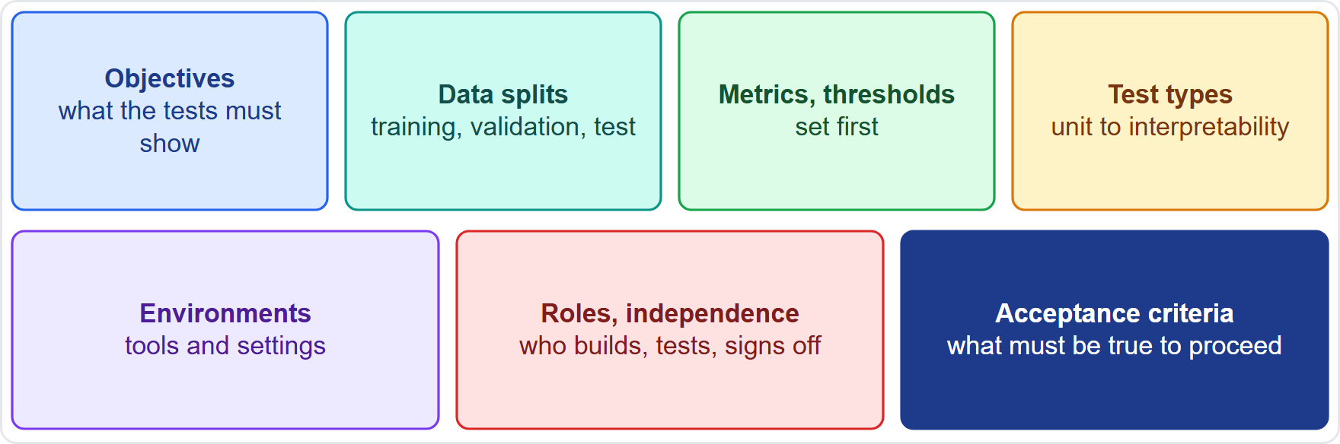
Planning Training and Testing
Part 1
Plan before you train: objectives, data splits, metrics and thresholds, test types, tools and environments
Roles and independence: who builds, who tests, and who signs off; independent review reduces internal bias (NIST MEASURE)
Acceptance criteria: what must be true to move to the next stage
Thresholds are set first (module 8) so results cannot move the goalposts
Record the plan and any changes to it
EXAM TIP A test plan written after the results is a report, not a plan.
AIGP Exam Prep Masterclass | Certified AI Governance Professional
Module 9: Governing Data, Training and Testing
12 / 31
Notes:
Plan before you train. Set the objectives, the data splits, the metrics and thresholds, the test types, and the tools and environments. Define roles and independence: who builds, who tests, and who signs off. N I S T notes that independent review reduces internal bias. Set acceptance criteria: what must be true to move to the next stage. Set thresholds first, as module eight said, so results cannot move the goalposts. And record the plan and any change to it. Exam tip: a test plan written after the results is a report.

Slide 13
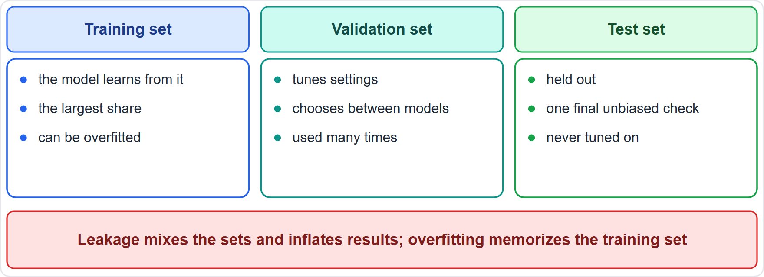
Data Splits, Overfitting and Leakage
Part 1
Training data teach the model; validation data tune settings and choose between models; test data are held out for a final, unbiased check
Overfitting: the model memorizes training data and fails on new data
Leakage: information from the test data (or from the answer) gets into training, so results look better than they are
Split before preprocessing, and use time-based splits when data change over time
Never tune on the test set
EXAM TIP A model that scores perfectly on its own training data tells you nothing about how it will perform.
AIGP Exam Prep Masterclass | Certified AI Governance Professional
Module 9: Governing Data, Training and Testing
13 / 31
Notes:
Training data teach the model. Validation data tune settings and choose between models. Test data are held out for a final, unbiased check. Overfitting is when the model memorizes training data and fails on new data. Leakage is when information from the test data, or from the answer, gets into training, so results look better than they are. Split before preprocessing, and use time-based splits when data change over time. Never tune on the test set. Exam tip: a model that scores perfectly on its own training data tells you nothing.

Slide 14
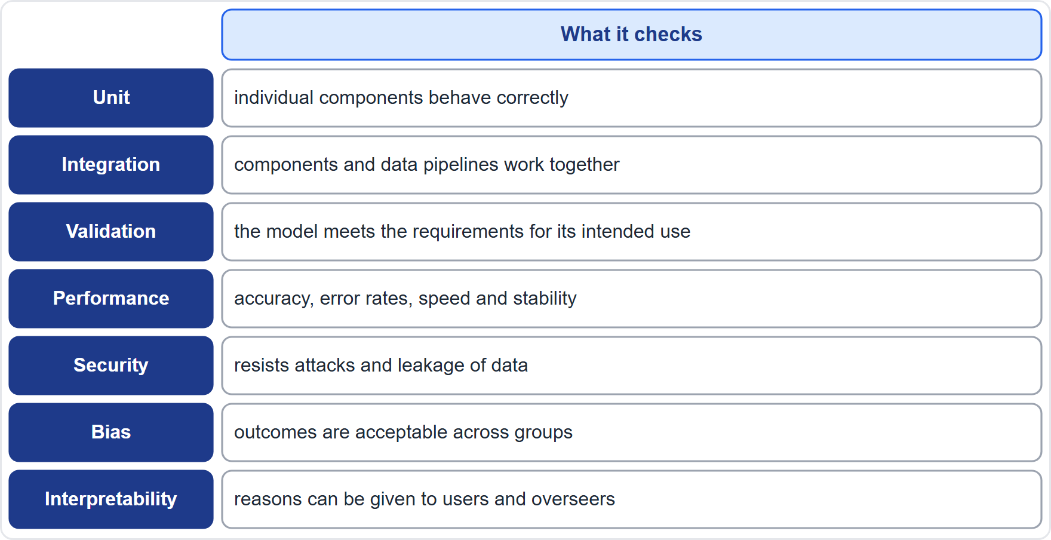
The Test Types, From Units to Interpretability
Part 1
Unit: individual components behave correctly
Integration: components, data pipelines and interfaces work together
Validation: the model meets the requirements for its intended use
Performance: accuracy, error rates, speed and stability
Security: resistance to attacks and leakage of data
Bias: outcomes are acceptable across groups
Interpretability: reasons can be given to users and overseers
EXAM TIP Match the test to the risk: leakage is a security test, group differences are a bias test.
AIGP Exam Prep Masterclass | Certified AI Governance Professional
Module 9: Governing Data, Training and Testing
14 / 31
Notes:
Seven kinds of test. Unit tests check that individual components behave correctly. Integration tests check that components, data pipelines and interfaces work together. Validation tests check that the model meets the requirements for its intended use. Performance tests check accuracy, error rates, speed and stability. Security tests check resistance to attacks and leakage of data. Bias tests check that outcomes are acceptable across groups. And interpretability tests check that reasons can be given to users and overseers. Exam tip: match the test to the risk.

Slide 15
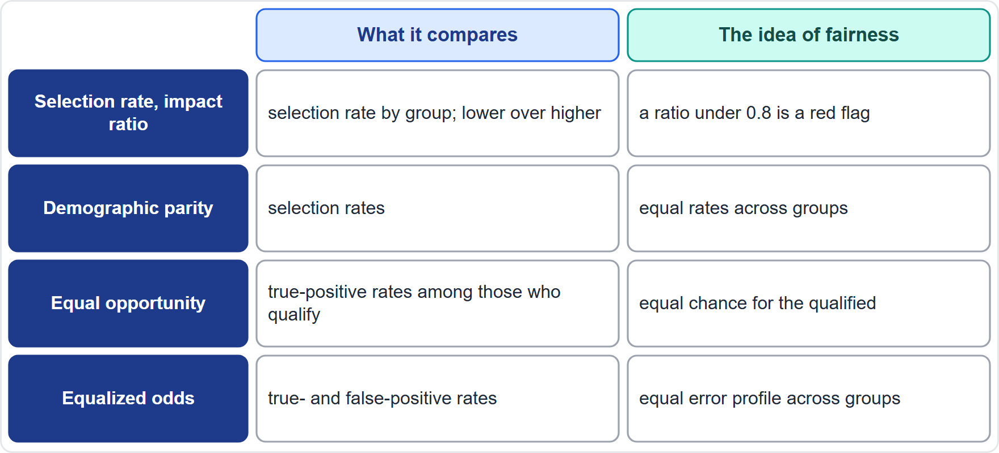
Bias Testing and Fairness Metrics
BEYOND THE BOK
Part 2
Test by group, including intersections (for example sex and age together)
Selection rate and impact ratio: the rate of selection by group, lower over higher (module 5)
Demographic parity: equal selection rates across groups
Equal opportunity: equal true-positive rates among people who qualify
Equalized odds: equal true- and false-positive rates
These cannot all be satisfied at once in most real settings, so choose by context and record why
NIST asks that fairness and bias be evaluated and results documented (MEASURE 2.11)
EXAM TIP Removing the protected attribute does not make a model fair, because proxies remain.
AIGP Exam Prep Masterclass | Certified AI Governance Professional
Module 9: Governing Data, Training and Testing
15 / 31
Notes:
This is a beyond-the-Body-of-Knowledge slide. Test by group, including intersections, such as sex and age together. Selection rate and impact ratio compare the rate of selection by group, lower over higher, as in module five. Demographic parity asks for equal selection rates. Equal opportunity asks for equal true-positive rates among people who qualify. Equalized odds asks for equal true-positive and false-positive rates. These cannot all be satisfied at once in most real settings, so choose by context and record why. N I S T Measure two point eleven asks that fairness and bias be evaluated and documented. Exam tip: removing the protected attribute does not make a model fair.

Slide 16
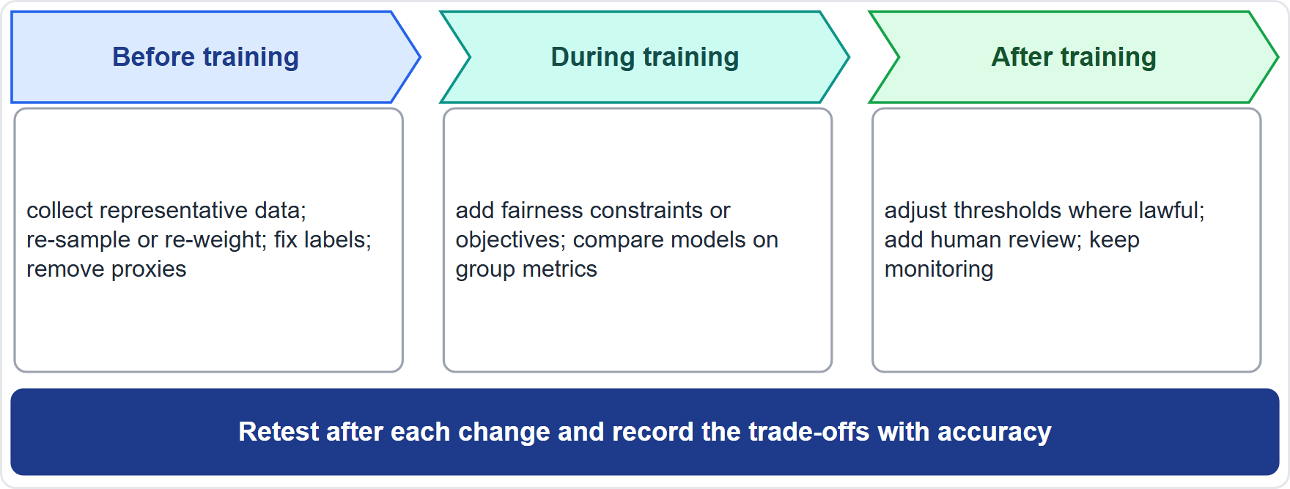
Mitigating Bias: Before, During and After Training
BEYOND THE BOK
Part 2
Before training: collect more representative data, re-sample or re-weight, fix labels, remove proxies
During training: add fairness constraints or objectives
After training: adjust thresholds (where lawful), add human review, keep monitoring
Retest after each change and record the trade-offs with accuracy
Some adjustments by group can raise legal questions; involve legal before using them
Helios: the proxy features were removed and the model recalibrated; the ratio rose to 0.91
EXAM TIP Fixing the data usually beats patching the outputs; the order of preference mirrors the risk hierarchy.
AIGP Exam Prep Masterclass | Certified AI Governance Professional
Module 9: Governing Data, Training and Testing
16 / 31
Notes:
This is a beyond-the-Body-of-Knowledge slide. Bias can be reduced at three points. Before training: collect more representative data, re-sample or re-weight, fix labels and remove proxies. During training: add fairness constraints or objectives. After training: adjust thresholds, where lawful, add human review, and keep monitoring. Retest after each change and record the trade-offs with accuracy. Some adjustments by group can raise legal questions, so involve legal first. At Helios, the proxy features were removed and the model recalibrated, and the ratio rose to zero point nine one. Exam tip: fixing the data usually beats patching the outputs.

Slide 17
Security and Interpretability Testing
Part 2
Adversarial testing: inputs built to cause mistakes, and prompts built to break rules (for language models)
Data poisoning checks: look for manipulated or suspicious training records
Privacy leakage tests: can the model reveal or reproduce training data or personal information?
Robustness tests: performance under noise, drift and unusual inputs
Interpretability tests: can overseers and users get reasons for outputs? Feature-importance and example-based methods help
The AI Act's accuracy, robustness and cybersecurity requirement names poisoning, adversarial examples and confidentiality attacks (Article 15)
EXAM TIP Security testing asks whether the model can be attacked or made to leak; it is separate from accuracy testing.
AIGP Exam Prep Masterclass | Certified AI Governance Professional
Module 9: Governing Data, Training and Testing
17 / 31
Notes:
Security and interpretability tests need their own attention. Adversarial testing uses inputs built to cause mistakes, and prompts built to break rules for language models. Data poisoning checks look for manipulated or suspicious training records. Privacy leakage tests ask whether the model can reveal or reproduce training data or personal information. Robustness tests check noise, drift and unusual inputs. Interpretability tests ask whether overseers and users can get reasons. The A I Act names poisoning, adversarial examples and confidentiality attacks in Article fifteen. Exam tip: security testing is separate from accuracy testing.

Slide 18
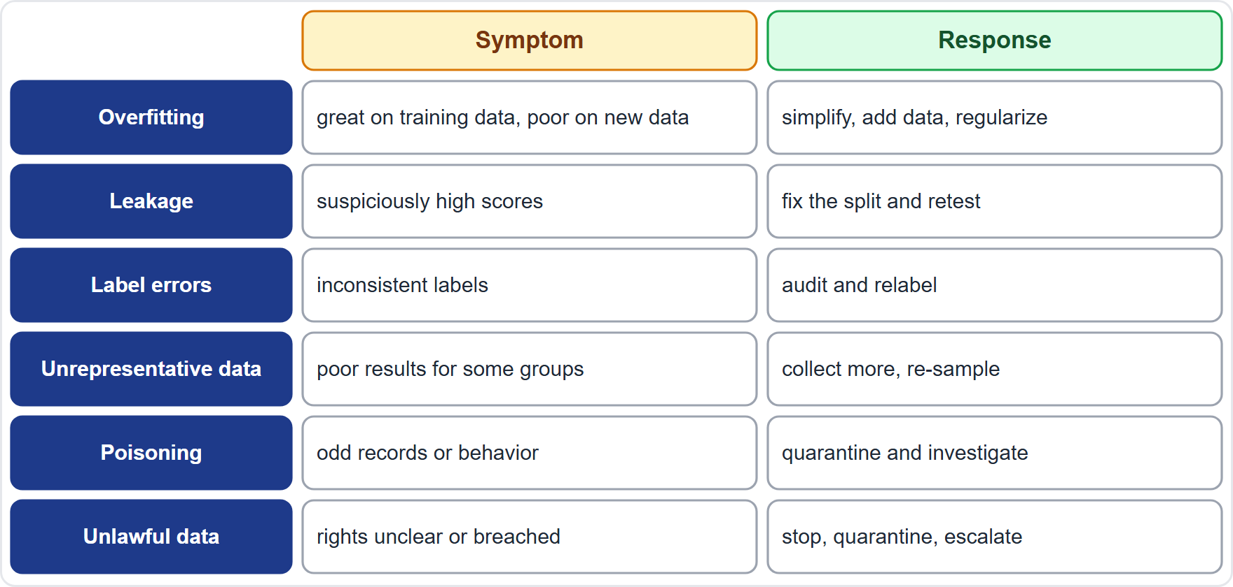
Common Issues in Training and Testing
Part 2
Overfitting: great on training data, poor on new data: simplify, add data, regularize
Leakage: suspiciously high scores: fix the split and retest
Label errors: inconsistent labels: audit and relabel
Unrepresentative data: poor results for some groups: collect more, re-sample
Poisoning: odd records or behavior: quarantine and investigate
Unlawful or unclear rights: stop, quarantine and escalate
EXAM TIP Read the symptom in the question, and pick the response that fits it.
AIGP Exam Prep Masterclass | Certified AI Governance Professional
Module 9: Governing Data, Training and Testing
18 / 31
Notes:
Six common issues. Overfitting: great on training data, poor on new data, so simplify, add data, or regularize. Leakage: suspiciously high scores, so fix the split and retest. Label errors: inconsistent labels, so audit and relabel. Unrepresentative data: poor results for some groups, so collect more or re-sample. Poisoning: odd records or behavior, so quarantine and investigate. And unlawful or unclear rights: stop, quarantine and escalate. Exam tip: read the symptom in the question, and pick the response that fits it.

Slide 19
Managing Issues: Log, Triage, Fix, Retest
Part 2
Log every issue with its severity and owner
Triage: does it affect people, legality or safety? Those go up first
Find the root cause and fix: change data, features, model or process
Retest and record that the issue is closed; escalate what cannot be fixed
Stop criteria: unresolved high-severity issues block the next stage
If unlawfully obtained data are found, quarantine them, ask legal and privacy for a decision, and record whether the model must be retrained; the EDPB treats the consequences as case-specific (module 4)
EXAM TIP Unresolved lawfulness questions are stop-the-line issues, not items for the backlog.
AIGP Exam Prep Masterclass | Certified AI Governance Professional
Module 9: Governing Data, Training and Testing
19 / 31
Notes:
Manage issues in four moves. Log every issue with its severity and owner. Triage: does it affect people, legality or safety? Those go up first. Find the root cause and fix it by changing data, features, the model or the process. Retest and record that the issue is closed, and escalate what cannot be fixed. Unresolved high-severity issues block the next stage. If unlawfully obtained data are found, quarantine them and ask legal and privacy for a decision. Exam tip: unresolved lawfulness questions stop the line.

Slide 20
Risks of Pretrained, Generative and Third-Party Models
Part 2
Inherited issues: a pretrained or foundation model brings its own bias, data rights and memorization risks
Fine-tuning can add new data issues and can weaken safety behaviors
Benchmark contamination: test items may have been in the model's training data, so scores look inflated
Retrieval data (as at Helios) need quality, rights and freshness controls
Vendor evidence: ask for test reports, data documentation and known limitations, and verify key claims with your own tests
EXAM TIP Buying a model does not remove your duty to test it for your use case.
AIGP Exam Prep Masterclass | Certified AI Governance Professional
Module 9: Governing Data, Training and Testing
20 / 31
Notes:
Pretrained and third-party models carry their own risks. A foundation model brings its own bias, data rights and memorization risks. Fine-tuning can add new data issues and can weaken safety behaviors. Benchmark contamination means test items may have been in the model's training data, so scores look inflated. Retrieval data, as at Helios, need quality, rights and freshness controls. And ask vendors for test reports, data documentation and known limitations, then verify key claims with your own tests. Exam tip: buying a model does not remove your duty to test it.

Slide 21
Documenting Training and Testing
Part 2
Why: to validate results, show compliance and manage risk; to let others reproduce the work
Data: sources, versions, splits, lineage and provenance
Training: methods, settings, experiments and tools
Testing: test plan, metrics and thresholds, results by group, issues found and fixed, and sign-offs
Decisions: why this model, this threshold and this trade-off were chosen
NIST asks that test sets, metrics and tool details used in TEVV be documented (MEASURE 2.1)
EXAM TIP A result without its data version, settings and test set cannot be reproduced or defended.
AIGP Exam Prep Masterclass | Certified AI Governance Professional
Module 9: Governing Data, Training and Testing
21 / 31
Notes:
Document training and testing to validate results, show compliance, manage risk, and let others reproduce the work. For data: sources, versions, splits, lineage and provenance. For training: methods, settings, experiments and tools. For testing: the test plan, metrics and thresholds, results by group, issues found and fixed, and sign-offs. And the decisions: why this model, this threshold and this trade-off. N I S T Measure two point one asks that test sets, metrics and tool details be documented. Exam tip: a result without its data version cannot be defended.

Slide 22
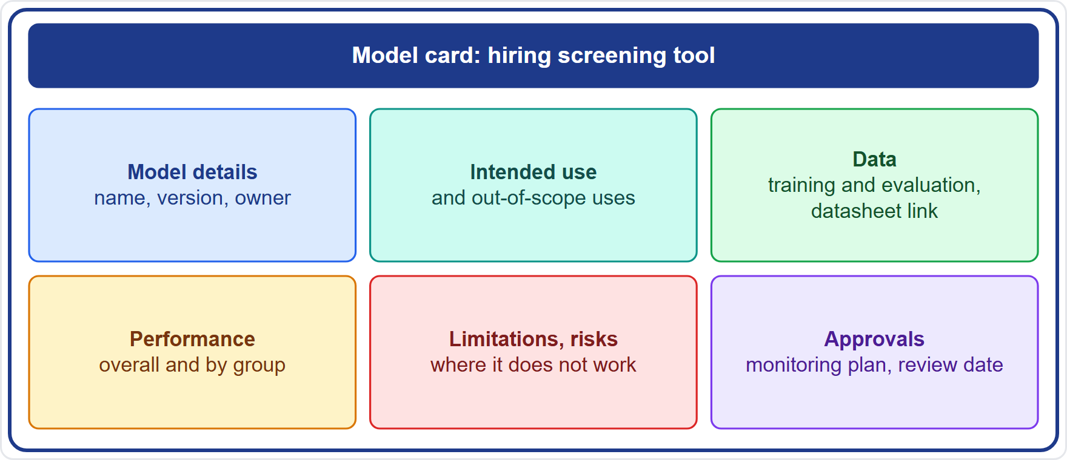
Model Cards and Test Reports
BEYOND THE BOK
Part 2
A model card is a short document that accompanies a model: intended use, performance across groups, the conditions of evaluation, and limitations
It links to the datasheet for the training data
It supports deployers who need to know what the model can and cannot do
The AI Act's Annex IV asks for similar detail: data requirements, validation and testing with metrics, and discriminatory impacts
Helios: asks Veridex for a model card and checks it against its own test results
EXAM TIP A model card tells users where the model works and where it does not, so state both.
AIGP Exam Prep Masterclass | Certified AI Governance Professional
Module 9: Governing Data, Training and Testing
22 / 31
Notes:
This is a beyond-the-Body-of-Knowledge slide. A model card is a short document that accompanies a model: its intended use, performance across groups, the conditions of evaluation, and its limitations. It links to the datasheet for the training data. It helps deployers know what the model can and cannot do. The A I Act's Annex four asks for similar detail: data requirements, validation and testing with metrics, and discriminatory impacts. At Helios, the team asks Veridex for a model card and checks it against its own results. Exam tip: state where the model works and where it does not.

Slide 23
Module Recap
Part 2
1
Data rules
2
Lineage and provenance
3
Training and testing
lawful rights first; then quality, representativeness and integrity; protect against tampering
trace data from source to model; record origin, rights and changes
plan first; split data properly; unit to interpretability tests; test bias by group; mitigate before, during and after
4
Issues
5
Records
log, triage, fix, retest; stop on unresolved high severity or unclear rights
data, methods, metrics, results by group, decisions; datasheets and model cards
AIGP Exam Prep Masterclass | Certified AI Governance Professional
Module 9: Governing Data, Training and Testing
23 / 31
Notes:
Let us recap. Data rules: lawful rights first, then quality, representativeness and integrity, with protection against tampering. Lineage and provenance: trace data from source to model, and record origin, rights and changes. Training and testing: plan first, split data properly, run the tests from unit to interpretability, test bias by group, and mitigate before, during and after training. Issues: log, triage, fix, retest, and stop on unresolved high severity or unclear rights. Records: data, methods, metrics, results by group, decisions, datasheets and model cards.

Slide 24
Practice Question 1
Part 2
Q1
Daniel Osei wants to use Helios's past support tickets to ground the customer assistant. Which check must come first?
A
Tuning the retrieval settings so that the assistant finds the best answers in the tickets quickly and reliably
B
Checking the spelling and formatting of the tickets so that the text is clean and ready for the assistant
C
Confirming Helios may use the tickets for this purpose, including personal data and confidentiality terms
D
Comparing the assistant's answers with those of a competitor's assistant to set a clear performance goal
AIGP Exam Prep Masterclass | Certified AI Governance Professional
Module 9: Governing Data, Training and Testing
24 / 31
Notes:
Question one. Daniel Osei wants to use Helios's past support tickets to ground the customer assistant. Which check must come first? The four options are on the screen. [PAUSE 12] The answer is C. Lawful rights come first: if Helios may not use the tickets for this purpose, quality and tuning do not matter. The tickets contain personal data and may carry confidentiality terms.

Slide 25
Practice Question 2
Part 2
Q2
Which TWO checks assess the quality and fitness for purpose of data for a hiring screening model? (Select TWO.)
A
Counting the graphics processors that are available for the training run
B
Checking that the applicant data cover the groups and settings in which the model will be used
C
Reviewing which vendor offers the lowest price for storing the training data over several years
D
Measuring the rate of missing values and label errors in the training data
E
Measuring how quickly the data can be copied between two cloud regions
AIGP Exam Prep Masterclass | Certified AI Governance Professional
Module 9: Governing Data, Training and Testing
25 / 31
Notes:
Question two. Which two checks assess the quality and fitness for purpose of data for a hiring screening model? Select two. The five options are on the screen. [PAUSE 15] The answers are B and D. Fitness depends on how representative the data are for the real population and setting, and on error and completeness rates in values and labels. Compute, storage price and transfer speed are operational matters.

Slide 26
Practice Question 3
Part 2
Q3
A vendor cannot say where the data used to train its tool came from. What is the best governance response?
A
Accept the tool, because vendors are not required to document anything about their training data sources
B
Rely on the vendor's reputation and its other customers as evidence that the data were obtained lawfully
C
Test the accuracy of the tool, since the origin of the data does not affect what the tool can do for users
D
Treat it as an open provenance risk: ask for documentation and warranties, and avoid high-risk reliance
AIGP Exam Prep Masterclass | Certified AI Governance Professional
Module 9: Governing Data, Training and Testing
26 / 31
Notes:
Question three. A vendor cannot say where the data used to train its tool came from. What is the best governance response? The four options are on the screen. [PAUSE 12] The answer is D. Provenance determines whether the data may be used and what risks they carry, so missing documentation is a finding. Ask for documentation, warranties and audit rights, and avoid high-risk reliance until it is resolved.

Slide 27
Practice Question 4
Part 2
Q4
Which practice best prevents data leakage when evaluating a model?
A
Splitting the data before preprocessing and keeping the test set untouched until the final check
B
Using the test set repeatedly while tuning, so that the final model is optimized for it
C
Training on the available data first and then selecting a test sample from that same data pool
D
Reusing the validation data as the test data, so that fewer records are needed for evaluation
AIGP Exam Prep Masterclass | Certified AI Governance Professional
Module 9: Governing Data, Training and Testing
27 / 31
Notes:
Question four. Which practice best prevents data leakage when evaluating a model? The four options are on the screen. [PAUSE 12] The answer is A. Leakage happens when information from the test data reaches training or tuning. Splitting first and leaving the test set untouched until the final check keeps the result unbiased. The other practices mix the sets and inflate results.

Slide 28
Practice Question 5
Part 2
Q5
Helios will test the hiring tool for bias. Which TWO actions fit? (Select TWO.)
A
Evaluating the overall accuracy, because it summarizes the performance of the tool
B
Removing the protected attribute and treating the tool as fair without further testing
C
Comparing selection rates and the impact ratio across groups, including intersections
D
Testing on the training set, because the model has already learned from that data
E
Comparing error rates, such as true-positive rates, across groups among qualified applicants
AIGP Exam Prep Masterclass | Certified AI Governance Professional
Module 9: Governing Data, Training and Testing
28 / 31
Notes:
Question five. Helios will test the hiring tool for bias. Which two actions fit? Select two. The five options are on the screen. [PAUSE 15] The answers are C and E. Bias testing compares outcomes and errors across groups, including intersections. Overall accuracy can hide group gaps, removing an attribute leaves proxies, and testing on training data says nothing about new applicants.

Slide 29
Practice Question 6
Part 2
Q6
During training, a team learns that part of its dataset was scraped in breach of the source's terms. What is the best response?
A
Continue training, because the data are already in the pipeline and the work is almost finished now
B
Quarantine the data, escalate to legal and privacy, and decide with them on removal and retraining
C
Delete the log entries about the source, so that the issue does not appear in the audit trail
D
Keep the data but exclude the source's name from the dataset documentation to avoid questions
AIGP Exam Prep Masterclass | Certified AI Governance Professional
Module 9: Governing Data, Training and Testing
29 / 31
Notes:
Question six. During training, a team learns that part of its dataset was scraped in breach of the source's terms. What is the best response? The four options are on the screen. [PAUSE 12] The answer is B. Data with unclear or breached rights are a stop-the-line issue. Quarantine them, escalate, and decide with legal and privacy on removal and retraining. Continuing, deleting records or hiding the source makes it worse.

Slide 30
Practice Question 7
Part 2
Q7
Which content best belongs in a model card?
A
The marketing slogan, the price list and the sales contacts for the customers who buy the model
B
The full source code and the private keys that the model needs to run in the production system
C
The names of the individuals whose data were used to train the model, with their home addresses
D
The intended and out-of-scope uses, the evaluation data, performance by group, and known limits
AIGP Exam Prep Masterclass | Certified AI Governance Professional
Module 9: Governing Data, Training and Testing
30 / 31
Notes:
Question seven. Which content best belongs in a model card? The four options are on the screen. [PAUSE 12] The answer is D. A model card states what the model is for, how it was evaluated, how it performs across groups, and where it falls short. Marketing material, secrets and personal data do not belong in it.

Slide 31
Answers at a Glance
Part 2
Question | Answer | Why
Q1 | C | Lawful rights come first
Q2 | B, D | Representativeness and error rates
Q3 | D | Open provenance risk: document, warrant, do not rely
Q4 | A | Split first, keep the test set untouched
Q5 | C, E | Selection rates and error rates across groups
Q6 | B | Quarantine, escalate, decide on removal and retraining
Q7 | D | Intended use, evaluation, group performance, limits
AIGP Exam Prep Masterclass | Certified AI Governance Professional
Module 9: Governing Data, Training and Testing
31 / 31
Notes:
Here are all seven answers. Question one: C. Question two: B and D. Question three: D. Question four: A. Question five: C and E. Question six: B. Question seven: D. That completes Module nine. Next, Module ten covers governing release, monitoring and maintenance.

