Slide 1
Module 10: Governing Release, Monitoring and Maintenance
Going live, staying safe, and being open about it
Domain III · Competency C · Indicators III.C.1 to III.C.6
AIGP Exam Prep Masterclass
Module 10 · Part 1
Notes:
Welcome to Module ten: Governing Release, Monitoring and Maintenance. This is the biggest competency of domain three. It follows the A I system from the moment it goes live: how to release it responsibly, how to keep watching it, how to test it harder from time to time, how to handle incidents, and what to disclose.

Slide 2
What You Will Learn
Part 1
Assess readiness and prepare the release, including the model card and conformity
Monitor continuously and keep a schedule for maintenance, updates and retraining
Run periodic assessments: security tests, audits, red teaming and threat modeling
Handle and record incidents, issues and risks
Work with stakeholders to find why incidents happen
Make the disclosures that transparency duties require
AIGP Exam Prep Masterclass | Certified AI Governance Professional
Module 10: Governing Release, Monitoring and Maintenance
2 / 38
Notes:
By the end of this module you will be able to do six things. Assess readiness and prepare the release, including the model card and conformity. Monitor continuously and keep a schedule for maintenance, updates and retraining. Run periodic assessments: security tests, audits, red teaming and threat modeling. Handle and record incidents, issues and risks. Work with stakeholders to find why incidents happen. And make the disclosures that transparency duties require.

Slide 3
Case Check-In: Release, a Wrong Refund and a Shift in Applicants
Part 1
CASE CHECK-IN · Helios
The hiring tool is ready for a gate review; Daniel Osei brings the model card and the conformity evidence
Weeks after launch, the assistant tells a customer about a refund window that does not exist; the cause is out-of-date support documents
After a hiring campaign in a new region, monitoring flags a shift in the input data
Mei Tanaka's team plans a red-team test; Lucia Moreno asks what Helios must disclose to candidates
AIGP Exam Prep Masterclass | Certified AI Governance Professional
Module 10: Governing Release, Monitoring and Maintenance
3 / 38
Notes:
At Helios, the hiring tool is ready for a gate review, and Daniel Osei brings the model card and the conformity evidence. Weeks after launch, the assistant tells a customer about a refund window that does not exist; the cause is out-of-date support documents. After a hiring campaign in a new region, monitoring flags a shift in the input data. Mei Tanaka's team plans a red-team test, and Lucia Moreno asks what Helios must disclose to candidates.

Slide 4
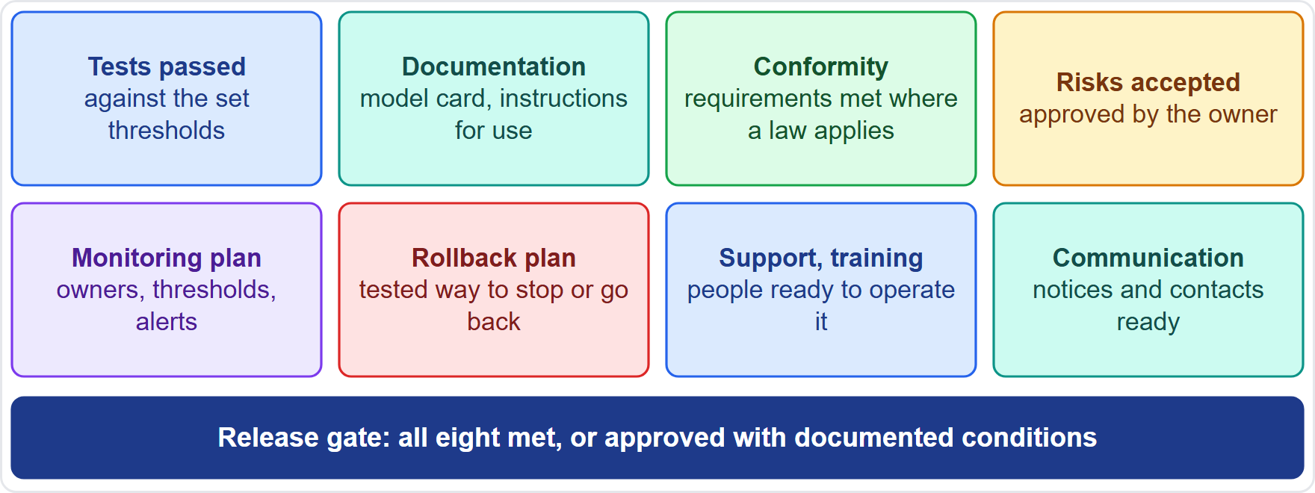
Release Readiness: The Gate and the Checklist
Part 1
A release gate decides whether the system is ready for production
Tests passed against the thresholds set earlier; residual risks accepted by the owner
Documentation complete: model card, instructions for use, technical documentation
Conformity requirements satisfied where a law requires them
Operations ready: a monitoring plan, a rollback or shutdown plan, support and training, and a communication plan
No gate, no go-live: missing items are conditions, not afterthoughts
EXAM TIP Readiness is wider than test results: it includes documents, approvals and the ability to monitor and roll back.
AIGP Exam Prep Masterclass | Certified AI Governance Professional
Module 10: Governing Release, Monitoring and Maintenance
4 / 38
Notes:
A release gate decides whether the system is ready for production. Tests are passed against the thresholds set earlier, and residual risks are accepted by the owner. Documentation is complete: the model card, the instructions for use and the technical documentation. Conformity requirements are satisfied where a law requires them. Operations are ready: a monitoring plan, a rollback or shutdown plan, support and training, and a communication plan. Missing items are conditions, not afterthoughts. Exam tip: readiness is wider than test results.

Slide 5
The Release Package: Model Card, Instructions and Records
Part 1
Model card (module 9): intended use, performance by group, evaluation conditions, limitations
Instructions for use for deployers: provider identity, capabilities and limits, oversight measures, resources and lifetime, log collection (Article 13)
Technical documentation (Article 11, Annex IV) and the risk assessment record
Test and validation reports, approvals and version identifiers
Monitoring plan and incident contacts
Helios: Daniel Osei assembles the package for the committee's launch gate
EXAM TIP The deployer can only oversee what the provider tells it, so the instructions for use are part of the release, not an extra.
AIGP Exam Prep Masterclass | Certified AI Governance Professional
Module 10: Governing Release, Monitoring and Maintenance
5 / 38
Notes:
The release package has several parts. The model card, from module nine: intended use, performance by group, evaluation conditions and limitations. The instructions for use for deployers: provider identity, capabilities and limits, oversight measures, resources and lifetime, and log collection, under Article thirteen. Technical documentation under Article eleven and Annex four, and the risk assessment record. Test reports, approvals and version identifiers. And the monitoring plan and incident contacts. Exam tip: the deployer can only oversee what the provider tells it.

Slide 6
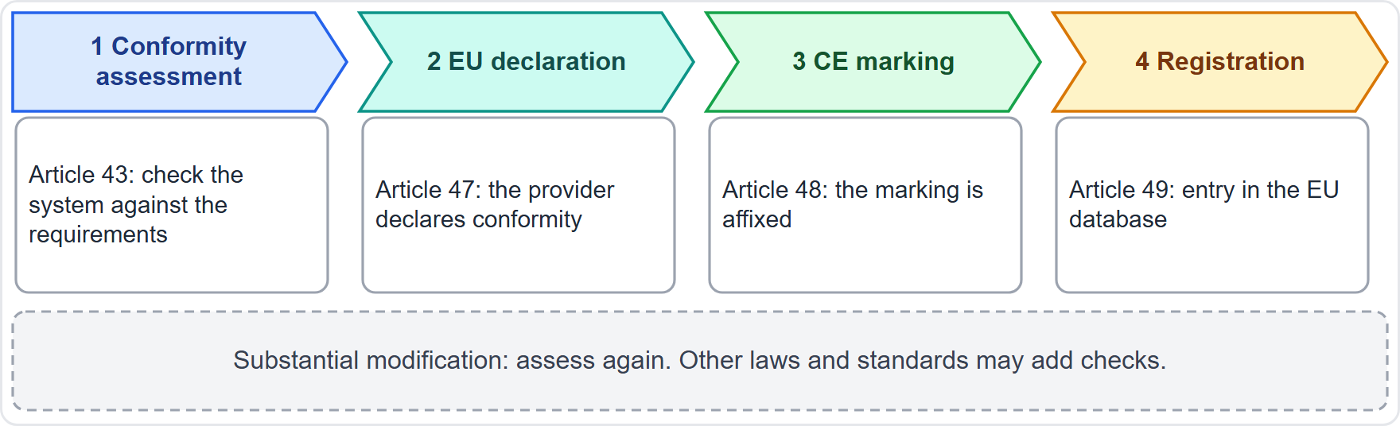
Satisfying Conformity Requirements
Part 1
EU high-risk systems: conformity assessment (Article 43), EU declaration (Article 47), CE marking (Article 48) and registration (Article 49) before placing on the market
A substantial modification after release needs a new assessment; changes pre-determined for a learning system are not substantial
Elsewhere: sector rules, state laws and contract commitments may add checks (for example audits of hiring tools)
Standards such as ISO/IEC 42001 can help organize the evidence
The release gate tracks each requirement with an owner
EXAM TIP Conformity comes before market placement, not after the first problem.
AIGP Exam Prep Masterclass | Certified AI Governance Professional
Module 10: Governing Release, Monitoring and Maintenance
6 / 38
Notes:
For E U high-risk systems, complete the conformity assessment under Article forty-three, declare conformity under Article forty-seven, affix the C E marking under Article forty-eight, and register under Article forty-nine, all before placing the system on the market. A substantial modification after release needs a new assessment, though changes pre-determined for a learning system are not substantial. Elsewhere, sector rules, state laws and contract commitments may add checks. Standards such as I S O forty-two thousand and one can help organize the evidence. Exam tip: conformity comes before market placement.

Slide 7
Staged Release and Rollback
Part 1
Staged release: start with a small share of users, then widen as monitoring stays healthy
Feature flags and canaries: turn parts on or off, and compare against the old version
Rollback criteria: the thresholds that trigger a return to the previous version or a pause
Kill switch: a tested way to stop the system (NIST: mechanisms to supersede, disengage or deactivate)
Support readiness: staff know how to escalate, and users know how to reach a person
Helios: the hiring tool starts with one region and an agreed rollback trigger
EXAM TIP A rollback that has never been tested is not a rollback plan.
AIGP Exam Prep Masterclass | Certified AI Governance Professional
Module 10: Governing Release, Monitoring and Maintenance
7 / 38
Notes:
Release in stages. Start with a small share of users, then widen as monitoring stays healthy. Use feature flags and canaries to turn parts on and off and to compare against the old version. Agree rollback criteria: the thresholds that trigger a return to the previous version or a pause. Have a kill switch, a tested way to stop the system; N I S T asks for mechanisms to supersede, disengage or deactivate. And make support ready. At Helios, the hiring tool starts in one region. Exam tip: an untested rollback is not a rollback plan.

Slide 8
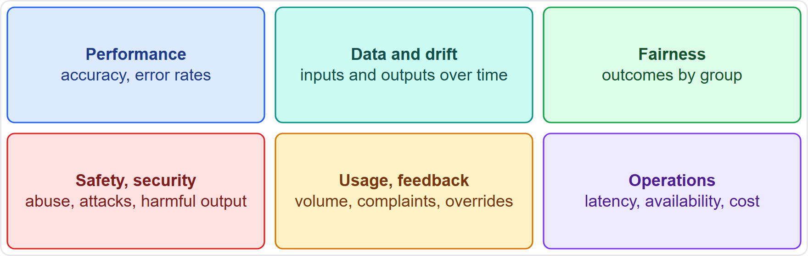
What to Monitor
Part 1
Performance: accuracy and error rates against the thresholds
Data and drift: changes in inputs and outputs over time
Fairness: outcomes by group, compared with launch
Safety and security: abuse, attacks and harmful outputs
Usage and feedback: volume, complaints, appeals and human overrides
Operations: latency, availability and cost
NIST asks for approaches to track existing, unanticipated and emergent risks (MEASURE 3.1)
EXAM TIP Monitor what can go wrong for people, not only what can go wrong for the server.
AIGP Exam Prep Masterclass | Certified AI Governance Professional
Module 10: Governing Release, Monitoring and Maintenance
8 / 38
Notes:
Monitor six families. Performance: accuracy and error rates against the thresholds. Data and drift: changes in inputs and outputs over time. Fairness: outcomes by group, compared with launch. Safety and security: abuse, attacks and harmful outputs. Usage and feedback: volume, complaints, appeals and human overrides. And operations: latency, availability and cost. N I S T Measure three point one asks for approaches to track existing, unanticipated and emergent risks. Exam tip: monitor what can go wrong for people, not only for the server.

Slide 9
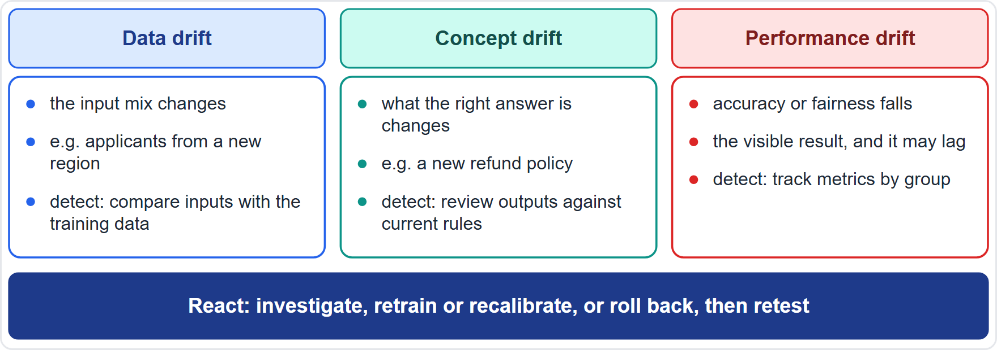
Drift: Data, Concept and Model
Part 1
Data drift: the mix of inputs changes (Helios: applicants from a new region)
Concept drift: the relationship between inputs and the right answer changes (a new refund policy)
Performance drift: accuracy or fairness falls; it may lag the other two
Detect: compare input distributions and outputs with the training baseline; track metrics by group
React: investigate, retrain or recalibrate, or roll back, then retest
NIST notes that systems may need more frequent maintenance because of data, model or concept drift
EXAM TIP Data drift can appear before accuracy drops; that early warning is why you monitor inputs.
AIGP Exam Prep Masterclass | Certified AI Governance Professional
Module 10: Governing Release, Monitoring and Maintenance
9 / 38
Notes:
Drift comes in three forms. Data drift: the mix of inputs changes, as when Helios gets applicants from a new region. Concept drift: the relationship between inputs and the right answer changes, as with a new refund policy. Performance drift: accuracy or fairness falls, and it may lag the other two. Detect drift by comparing input distributions and outputs with the training baseline, and tracking metrics by group. React by investigating, retraining or recalibrating, or rolling back, then retesting. Exam tip: data drift can appear before accuracy drops.

Slide 10
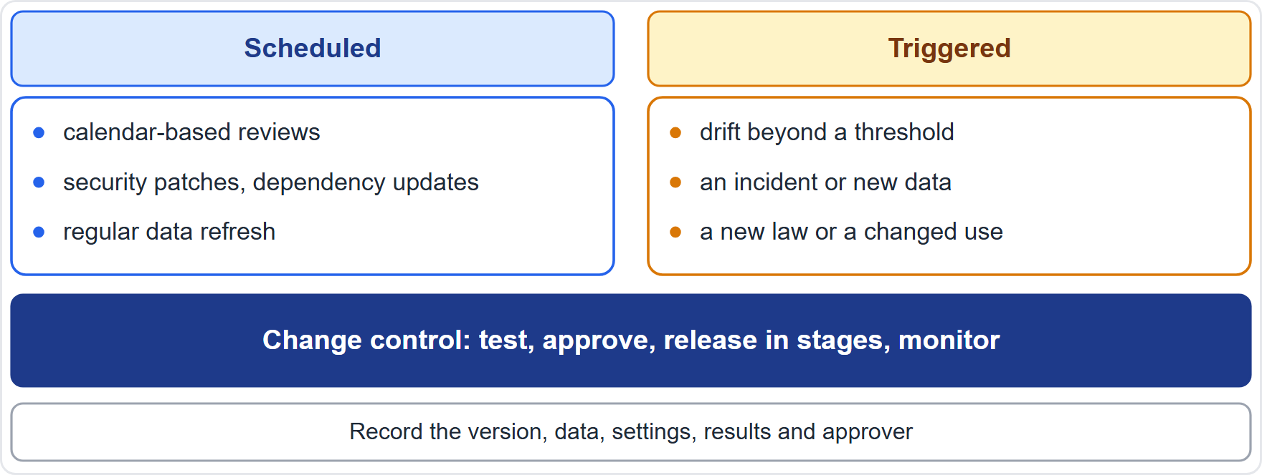
Maintenance, Updates and Retraining
Part 1
A maintenance schedule sets regular reviews, security patches, dependency updates and data refreshes
Scheduled retraining keeps the model current; triggered retraining responds to drift, incidents, new data or a new law
Every change goes through change control: test, approve, release in stages, monitor
A substantial modification may need new conformity assessment (module 6)
Document each version: data, settings, results, approver
Retire the model when it cannot be kept safe or useful
EXAM TIP Retraining is a change like any other: it needs testing and approval before it goes live.
AIGP Exam Prep Masterclass | Certified AI Governance Professional
Module 10: Governing Release, Monitoring and Maintenance
10 / 38
Notes:
A maintenance schedule sets regular reviews, security patches, dependency updates and data refreshes. Scheduled retraining keeps the model current, while triggered retraining responds to drift, incidents, new data or a new law. Every change goes through change control: test, approve, release in stages and monitor. A substantial modification may need a new conformity assessment, as module six said. Document each version: data, settings, results and approver. And retire the model when it cannot be kept safe or useful. Exam tip: retraining is a change like any other.

Slide 11
Monitoring in Practice: Owners, Thresholds, Alerts, Logs
Part 1
Owners: each metric has a named owner and a review rhythm
Thresholds and alerts: warning and action levels, with who is paged
Logs: the system records events for traceability (AI Act Article 12), and logs are kept for the period the rules require
Human review of samples: people read a sample of real outputs, because metrics miss some failures
Escalation: alerts above the action level go to the incident process
Post-market monitoring plan: the provider's documented system for collecting performance data over the system's life (Article 72)
EXAM TIP Monitoring without owners, thresholds and an escalation path is just data collection.
AIGP Exam Prep Masterclass | Certified AI Governance Professional
Module 10: Governing Release, Monitoring and Maintenance
11 / 38
Notes:
Monitoring in practice needs five things. Owners: each metric has a named owner and a review rhythm. Thresholds and alerts: warning and action levels, with who is paged. Logs: the system records events for traceability, under Article twelve, and logs are kept for the period the rules require. Human review of samples: people read a sample of real outputs, because metrics miss some failures. Escalation: alerts above the action level go to the incident process. And the provider's post-market monitoring plan, under Article seventy-two. Exam tip: monitoring without owners and escalation is just data collection.

Slide 12
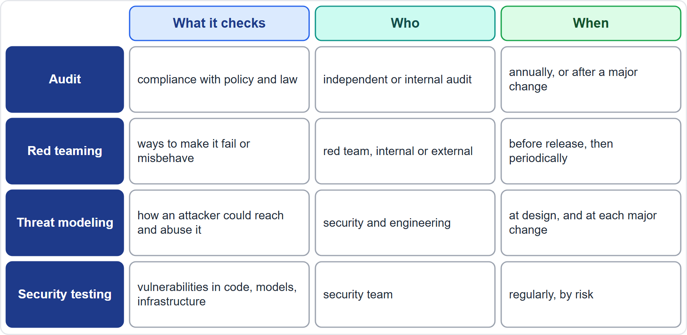
Periodic Assessment: What, How Often, Who
Part 1
Continuous monitoring watches the live system; periodic assessments step back and test it harder
Audits: compliance with policy and law
Red teaming: trying to make the system fail or misbehave
Threat modeling: how an attacker could reach and abuse it
Security testing: vulnerabilities in code, models and infrastructure
Set frequency by risk, and also run them after major changes
EXAM TIP Match the assessment to the question: policy compliance is an audit, breaking the system is red teaming, mapping attack paths is threat modeling.
AIGP Exam Prep Masterclass | Certified AI Governance Professional
Module 10: Governing Release, Monitoring and Maintenance
12 / 38
Notes:
Continuous monitoring watches the live system. Periodic assessments step back and test it harder. Audits check compliance with policy and law. Red teaming tries to make the system fail or misbehave. Threat modeling maps how an attacker could reach and abuse the system. Security testing looks for vulnerabilities in code, models and infrastructure. Set frequency by risk, and also run them after major changes. Exam tip: policy compliance is an audit, breaking the system is red teaming, and mapping attack paths is threat modeling.

Slide 13
Audits of AI Systems
Part 1
Internal audit: the third line checks governance and risk management (module 2)
External or independent audit: an outside party examines compliance and controls; ISO/IEC 42001 certification relies on audits of the management system
Scope: policy compliance, data and model records, testing evidence, monitoring, incident handling
Evidence: documents, logs, test results and interviews
Outputs: findings, owners and due dates; follow-up audits confirm fixes
Bias audits: some laws, such as New York City's rule for hiring tools, require independent bias audits (module 6)
EXAM TIP An audit looks backward at evidence; it does not replace testing the system's behavior.
AIGP Exam Prep Masterclass | Certified AI Governance Professional
Module 10: Governing Release, Monitoring and Maintenance
13 / 38
Notes:
Audits take several forms. Internal audit is the third line, checking governance and risk management, as in module two. An external or independent audit examines compliance and controls, and I S O forty-two thousand and one certification relies on audits of the management system. The scope covers policy compliance, data and model records, testing evidence, monitoring and incident handling. Evidence is documents, logs, test results and interviews. Outputs are findings with owners and due dates. Some laws, such as New York City's rule for hiring tools, require independent bias audits. Exam tip: an audit looks backward at evidence.

Slide 14
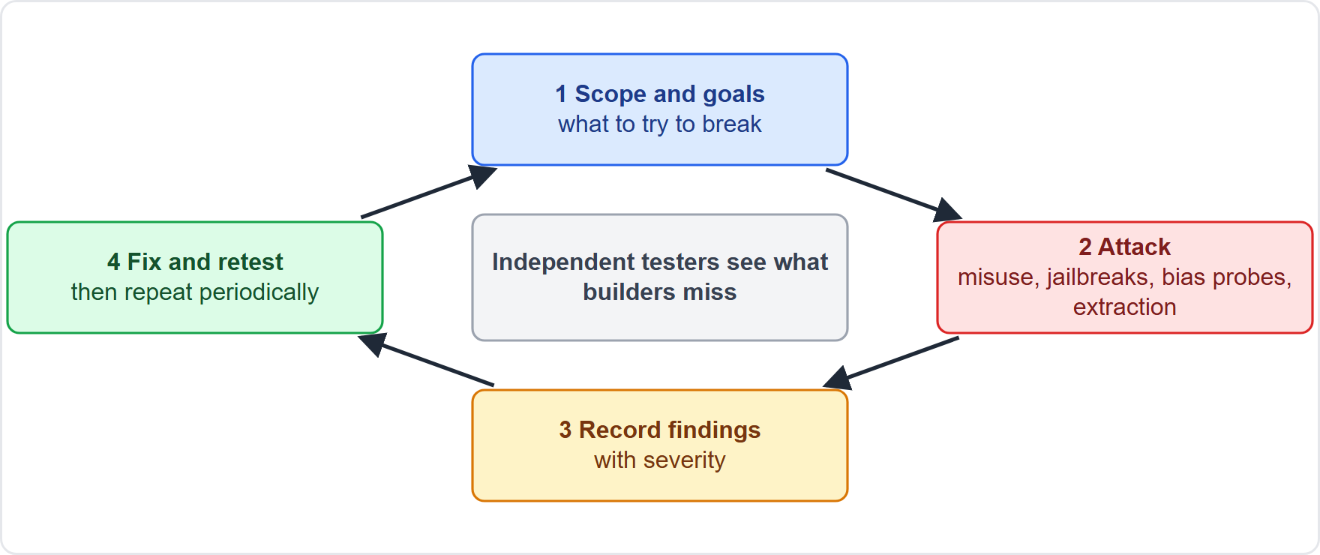
Red Teaming
Part 1
Red teaming is a structured attempt to make the system fail or misbehave, as a determined misuser would
Methods: misuse and jailbreak attempts, bias probes, data-extraction attempts, harmful-output tests
Independent testers see what builders miss; mix internal and external skills
Findings are rated, fixed and retested
The AI Act requires adversarial testing for general-purpose models with systemic risk (Article 55)
Helios: Mei Tanaka's team tests the assistant for abuse and data leakage
EXAM TIP Red teaming tests what an adversary could make the system do; it is broader than normal acceptance testing.
AIGP Exam Prep Masterclass | Certified AI Governance Professional
Module 10: Governing Release, Monitoring and Maintenance
14 / 38
Notes:
Red teaming is a structured attempt to make the system fail or misbehave, as a determined misuser would. Methods include misuse and jailbreak attempts, bias probes, data-extraction attempts and harmful-output tests. Independent testers see what builders miss, so mix internal and external skills. Findings are rated, fixed and retested. The A I Act requires adversarial testing for general-purpose models with systemic risk, in Article fifty-five. At Helios, Mei Tanaka's team tests the assistant for abuse and data leakage. Exam tip: red teaming is broader than normal acceptance testing.

Slide 15
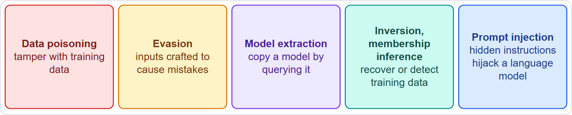
Threat Modeling and AI-Specific Attacks
BEYOND THE BOK
Part 1
Threat modeling: list assets, attackers, entry points and abuse cases, then plan controls
Data poisoning: tampering with training data
Evasion: inputs crafted to cause mistakes
Model extraction: copying a model by querying it
Inversion and membership inference: recovering or detecting training data
Prompt injection: hidden instructions in input that hijack a language model
Reference lists exist: MITRE ATLAS (Adversarial Threat Landscape for AI Systems: adversary tactics against AI) and the OWASP (Open Worldwide Application Security Project) Top 10 for LLM Applications
EXAM TIP You need to recognize each attack by its description, not to know how to carry it out.
AIGP Exam Prep Masterclass | Certified AI Governance Professional
Module 10: Governing Release, Monitoring and Maintenance
15 / 38
Notes:
This is a beyond-the-Body-of-Knowledge slide. Threat modeling lists assets, attackers, entry points and abuse cases, then plans controls. Know five A I-specific attacks by description. Data poisoning: tampering with training data. Evasion: inputs crafted to cause mistakes. Model extraction: copying a model by querying it. Inversion and membership inference: recovering or detecting training data. Prompt injection: hidden instructions in input that hijack a language model. Reference lists exist: MITRE ATLAS, the Adversarial Threat Landscape for A I Systems, and the O W A S P, the Open Worldwide Application Security Project, Top Ten for L L M Applications. Exam tip: recognize each attack by its description.

Slide 16
Security Testing, Reliability and Safety Checks
Part 1
Security testing: penetration tests of the application and APIs, vulnerability scans, tests for leakage and access control
Model-level tests: adversarial inputs, poisoning checks, extraction and inversion attempts, prompt-injection tests
Reliability checks: performance under stress, noise and drift, failover and recovery
Safety checks: do outputs or actions harm people in foreseeable use or misuse?
Supply chain: check third-party models, data and components (module 3)
Record results, fix findings, and feed them back into the risk register
EXAM TIP Security, reliability and safety are three different questions; one passing test does not answer the others.
AIGP Exam Prep Masterclass | Certified AI Governance Professional
Module 10: Governing Release, Monitoring and Maintenance
16 / 38
Notes:
Security testing includes penetration tests of the application and its interfaces, vulnerability scans, and tests for leakage and access control. Model-level tests add adversarial inputs, poisoning checks, extraction and inversion attempts, and prompt-injection tests. Reliability checks look at performance under stress, noise and drift, failover and recovery. Safety checks ask whether outputs or actions harm people in foreseeable use or misuse. Check third-party models, data and components too. Record results, fix findings, and feed them into the risk register. Exam tip: security, reliability and safety are three different questions.

Slide 17
What Counts as an AI Incident
Part 1
An incident is an event in which an AI system causes or could cause harm, or fails or behaves unexpectedly
Examples: a wrong or harmful output, a biased outcome pattern, a data leak, a security breach, a safety event, an outage that affects people
Near misses matter: log them and learn
An issue is a smaller problem to fix; a risk is something that may happen; keep separate registers, linked
Severity depends on harm to people, legal duties and scale
Helios: the assistant's wrong refund answer is an incident, and a pattern of them would be a bigger one
EXAM TIP A near miss is cheap information: record it.
AIGP Exam Prep Masterclass | Certified AI Governance Professional
Module 10: Governing Release, Monitoring and Maintenance
17 / 38
Notes:
An incident is an event in which an A I system causes or could cause harm, or fails or behaves unexpectedly. Examples: a wrong or harmful output, a biased outcome pattern, a data leak, a security breach, a safety event, or an outage that affects people. Near misses matter: log them and learn. An issue is a smaller problem to fix, and a risk is something that may happen, so keep separate registers, linked. Severity depends on harm to people, legal duties and scale. Exam tip: a near miss is cheap information.

Slide 18
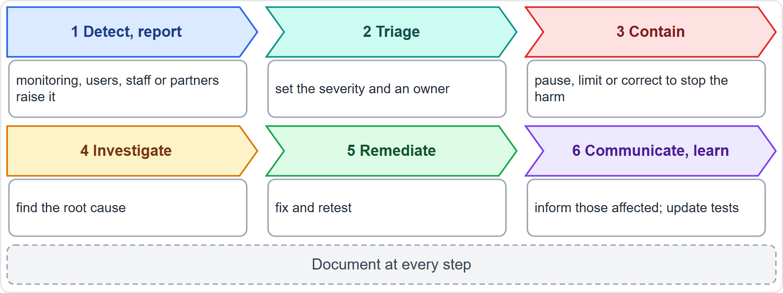
The Incident Response Cycle
Part 1
Detect and report: monitoring, users, staff or a partner raises it
Triage: set severity and the owner
Contain: pause, limit or correct the system to stop further harm
Investigate: find the root cause
Remediate and retest, then communicate to those affected and to authorities where required
Learn: update tests, thresholds and documents; document at every step
EXAM TIP Contain before you investigate: stop the harm first, then find the cause.
AIGP Exam Prep Masterclass | Certified AI Governance Professional
Module 10: Governing Release, Monitoring and Maintenance
18 / 38
Notes:
Incident response has six steps. Detect and report: monitoring, users, staff or a partner raises it. Triage: set severity and an owner. Contain: pause, limit or correct the system to stop further harm. Investigate: find the root cause. Remediate and retest, then communicate to those affected and to authorities where required. And learn: update tests, thresholds and documents. Document at every step. Exam tip: contain before you investigate. Stop the harm first, then find the cause.

Slide 19
Reporting Clocks and Records
Part 1
Source | Clock
EU AI Act, serious incident (provider, Article 73) | not later than 15 days after awareness; 2 days for a widespread infringement; 10 days after a death
GDPR personal data breach (controller, Article 33) | not later than 72 hours after awareness, where feasible
Contracts | customer and vendor agreements may set shorter notice
Internal policy | escalation to the committee, as set by the AI policy
Communicate incidents to affected people and relevant parties, with plain information (NIST MANAGE 4.3)
Keep the incident record: facts, effects, actions and the lessons learned
EXAM TIP One incident can start several clocks at once; the shortest applicable limit governs.
AIGP Exam Prep Masterclass | Certified AI Governance Professional
Module 10: Governing Release, Monitoring and Maintenance
19 / 38
Notes:
Several clocks can start at once. Under the E U A I Act, Article seventy-three, a provider reports a serious incident not later than fifteen days after awareness, two days for a widespread infringement, and ten days after a death. Under the G D P R, Article thirty-three, a controller notifies a personal data breach not later than seventy-two hours after awareness, where feasible. Contracts may set shorter notice, and internal policy sets escalation. Communicate to affected people with plain information, as N I S T Manage four point three says. Exam tip: the shortest applicable limit governs.

Slide 20
Issue and Risk Registers, and Learning
Part 1
Risk register: risks, likelihood and severity, controls, owners, status; updated after each incident
Issue log: problems found in operation, with severity, owner, due date and closure evidence
Incident register: every incident and near miss, with root cause and corrective actions
Trends: repeated issues point to a systemic cause; report them to the committee
Lessons learned: change tests, thresholds, training and documents, and record what changed
Post-deployment plans should include appeal and override, decommissioning, incident response, recovery and change management (NIST MANAGE 4.1)
EXAM TIP An incident that does not change a control, a test or a document has not been learned from.
AIGP Exam Prep Masterclass | Certified AI Governance Professional
Module 10: Governing Release, Monitoring and Maintenance
20 / 38
Notes:
Keep three linked registers. The risk register lists risks, likelihood and severity, controls, owners and status, and is updated after each incident. The issue log records problems found in operation, with severity, owner, due date and closure evidence. The incident register records every incident and near miss, with root cause and corrective actions. Repeated issues point to a systemic cause, so report trends to the committee. Record lessons learned. N I S T Manage four point one asks for appeal and override, decommissioning and recovery plans. Exam tip: an incident that changes nothing was not learned from.

Slide 21
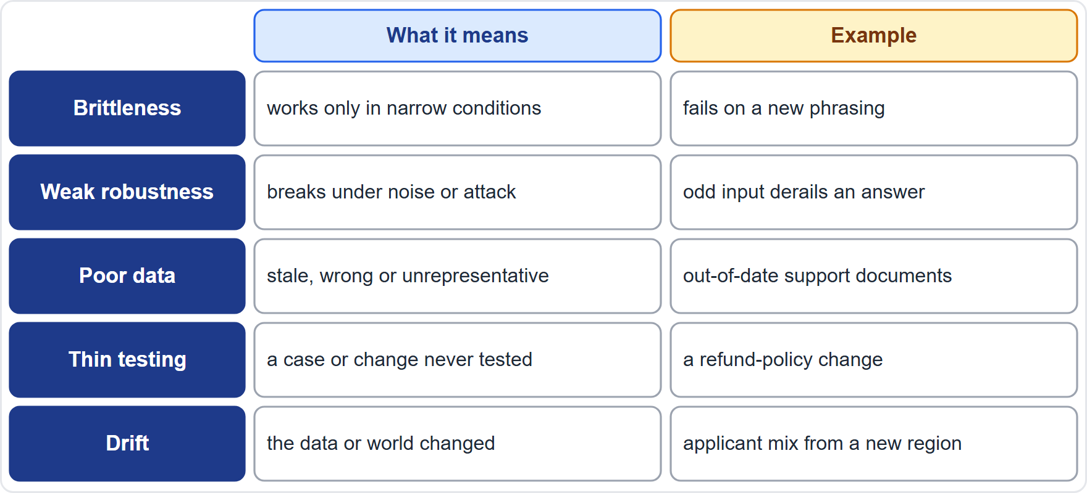
Why AI Incidents Arise: Five Causes
Part 2
Brittleness: the system works only in narrow conditions and breaks outside them
Weak robustness: it fails under noise, odd inputs or attack
Poor data: stale, wrong or unrepresentative data (the Helios refund error)
Insufficient testing: a case or change that was never tested
Drift: the data or the world changed since training
Often several causes combine
EXAM TIP Name the cause from the symptom: stale answers point to data, sudden failure on new inputs to brittleness, slow decay to drift.
AIGP Exam Prep Masterclass | Certified AI Governance Professional
Module 10: Governing Release, Monitoring and Maintenance
21 / 38
Notes:
Five causes explain many A I incidents. Brittleness: the system works only in narrow conditions and breaks outside them. Weak robustness: it fails under noise, odd inputs or attack. Poor data: stale, wrong or unrepresentative data, like the Helios refund error. Insufficient testing: a case or change that was never tested. And drift: the data or the world changed since training. Often several causes combine. Exam tip: name the cause from the symptom. Stale answers point to data, sudden failure on new inputs to brittleness, and slow decay to drift.

Slide 22
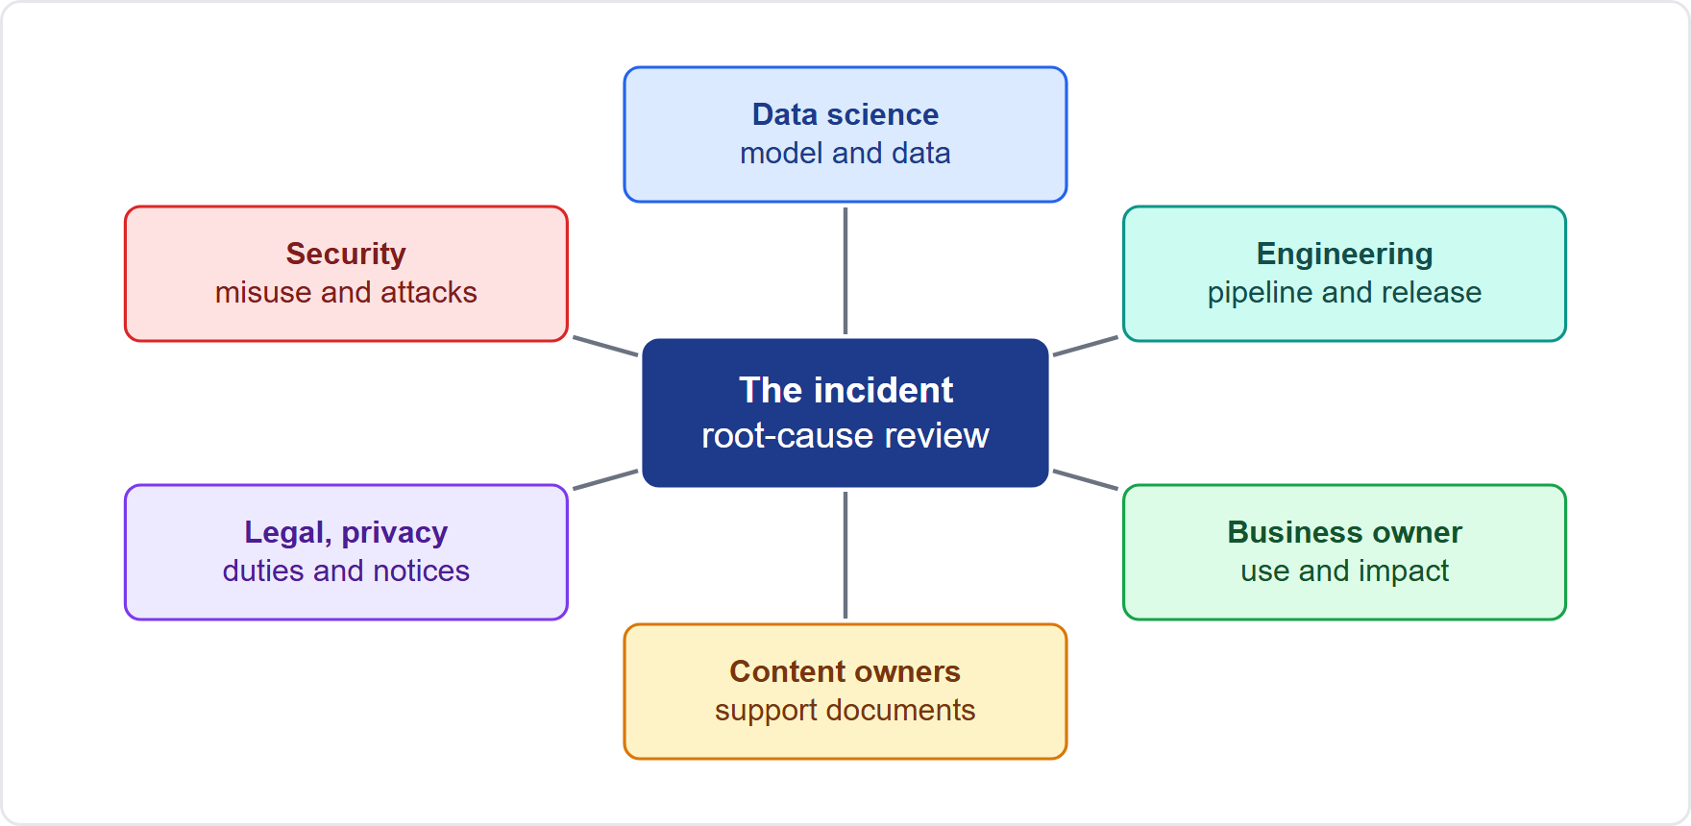
Root-Cause Analysis With Cross-Functional Teams
Part 2
Why cross-functional: causes cross boundaries: data, model, process, content and use
Who: data science, engineering, the business owner, content owners, legal and privacy, security, and support
Methods: a timeline of events, five whys, a cause-and-effect diagram
Blameless review: find system causes, not culprits
Output: causes, corrective actions, owners and dates
Helios: support content owners join data science to trace the refund error
EXAM TIP A purely technical review misses process and content causes; bring the people who own each link in the chain.
AIGP Exam Prep Masterclass | Certified AI Governance Professional
Module 10: Governing Release, Monitoring and Maintenance
22 / 38
Notes:
Why cross-functional? Because causes cross boundaries: data, model, process, content and use. Bring data science, engineering, the business owner, content owners, legal and privacy, security and support. Use methods such as a timeline of events, five whys, and a cause-and-effect diagram. Keep the review blameless: find system causes, not culprits. The output is causes, corrective actions, owners and dates. At Helios, support content owners join data science to trace the refund error. Exam tip: a purely technical review misses process and content causes.

Slide 23
Helios: Two Incidents, Two Root Causes
Part 2
Incident | Likely cause | Corrective action
Wrong refund window from the assistant | out-of-date support documents in the retrieval source (poor data, weak change control) | refresh and version the documents, add an owner and review date, test answers against policy changes
Shift in input data after a new-region campaign | data drift: the applicant mix changed | re-test fairness and performance on the new mix, retrain or recalibrate, add drift alerts
Common thread: the data changed and nobody owned the change
Both feed the risk register and the test plan
EXAM TIP Fix the process that let the cause through, not only the single wrong answer.
AIGP Exam Prep Masterclass | Certified AI Governance Professional
Module 10: Governing Release, Monitoring and Maintenance
23 / 38
Notes:
Helios had two incidents. The wrong refund window came from out-of-date support documents in the retrieval source: poor data and weak change control. The corrective actions are to refresh and version the documents, add an owner and a review date, and test answers against policy changes. The shift in input data after the new-region campaign is data drift: the applicant mix changed. The actions are to retest fairness and performance on the new mix, retrain or recalibrate, and add drift alerts. The common thread: the data changed and nobody owned the change. Exam tip: fix the process, not only the single wrong answer.

Slide 24
From Cause to Prevention
Part 2
Poor data: data owners, freshness rules, quality checks at the source, change control
Insufficient testing: regression tests for every incident, test sets that include edge cases and policy changes
Brittleness and weak robustness: stress and adversarial testing, input validation, fallbacks to a person
Drift: monitoring with alerts, scheduled and triggered retraining
Governance: update the risk register, thresholds and instructions after each incident
Share lessons with the deployers and, where required, authorities
EXAM TIP Every cause needs a matching control, and every incident should add a test.
AIGP Exam Prep Masterclass | Certified AI Governance Professional
Module 10: Governing Release, Monitoring and Maintenance
24 / 38
Notes:
Match every cause to a control. Poor data: data owners, freshness rules, quality checks at the source and change control. Insufficient testing: regression tests for every incident, and test sets that include edge cases and policy changes. Brittleness and weak robustness: stress and adversarial testing, input validation, and fallbacks to a person. Drift: monitoring with alerts, and scheduled and triggered retraining. Governance: update the risk register, thresholds and instructions after each incident, and share lessons with deployers and authorities. Exam tip: every incident should add a test.

Slide 25
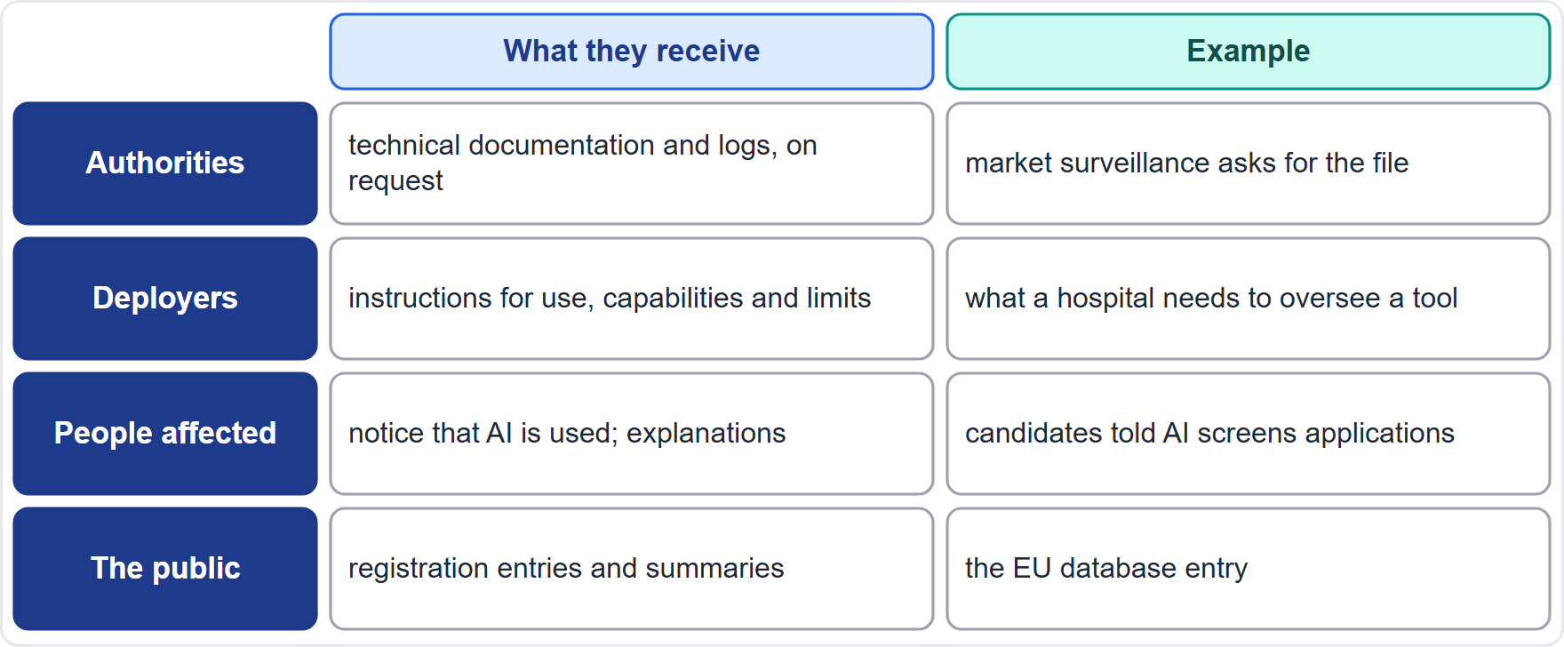
Public Disclosures: What, to Whom
Part 2
Authorities and assessors: technical documentation and logs on request
Deployers: instructions for use, capabilities and limits, oversight measures (Article 13)
People affected and users: notices that AI is used, and where required, explanations (Article 50 and modules 4 and 6)
The public: registration entries and summaries where the law requires them
Helios: tells candidates that AI screens applications and how to ask for a person
EXAM TIP Disclosure follows the audience: authorities get documentation, deployers get instructions, people get notices.
AIGP Exam Prep Masterclass | Certified AI Governance Professional
Module 10: Governing Release, Monitoring and Maintenance
25 / 38
Notes:
Disclosures follow the audience. Authorities and assessors receive technical documentation and logs on request. Deployers receive instructions for use, capabilities and limits, and oversight measures, under Article thirteen. People affected and users receive notices that A I is used and, where required, explanations, as in Article fifty and modules four and six. The public receives registration entries and summaries where the law requires them. At Helios, candidates are told that A I screens applications, and how to ask for a person. Exam tip: documentation to authorities, instructions to deployers, notices to people.

Slide 26
Instructions for Use and Technical Documentation
Part 2
Instructions for use must be clear and accessible to deployers: provider identity, capabilities and limitations, pre-determined changes, human oversight measures, resources and lifetime, log collection (Article 13)
Technical documentation (Article 11, Annex IV) is kept current and supplied to authorities on request
Accuracy levels and metrics are declared in the instructions (Article 15)
Update both when the system changes
Deployers use the instructions to meet their own duties, so gaps pass downstream
EXAM TIP If the instructions for use are vague, the deployer cannot oversee the system properly.
AIGP Exam Prep Masterclass | Certified AI Governance Professional
Module 10: Governing Release, Monitoring and Maintenance
26 / 38
Notes:
Instructions for use must be clear and accessible to deployers. They state the provider's identity, the capabilities and limitations, pre-determined changes, human oversight measures, resources and lifetime, and log collection, under Article thirteen. Technical documentation, under Article eleven and Annex four, is kept current and supplied to authorities on request. Accuracy levels and metrics are declared in the instructions, under Article fifteen. Update both when the system changes. Deployers use the instructions to meet their own duties, so gaps pass downstream. Exam tip: vague instructions mean the deployer cannot oversee properly.

Slide 27
Post-Market Plans, Registration and Public Summaries
VERIFY LIVE
Part 2
Post-market monitoring plan: part of the technical documentation (Article 72); it shows how the provider will watch the system after release
EU database: information registered for high-risk systems under Article 49 is publicly accessible in a user-friendly form, except one protected section (Article 71)
General-purpose models: publish the training-content summary (module 6)
Hiring tools in New York City: a public summary of the independent bias audit
As of 27 October 2026: disclosure rules differ by jurisdiction and are still developing; confirm each duty at release
EXAM TIP Public disclosure is limited and specific: registration entries, notices and summaries, not the whole technical file.
AIGP Exam Prep Masterclass | Certified AI Governance Professional
Module 10: Governing Release, Monitoring and Maintenance
27 / 38
Notes:
This slide is tagged verify live. The post-market monitoring plan is part of the technical documentation, under Article seventy-two, and shows how the provider will watch the system after release. Information registered for high-risk systems under Article forty-nine is publicly accessible in a user-friendly form, except one protected section, according to Article seventy-one. General-purpose model providers publish a training-content summary, as module six said. Hiring tools in New York City need a public summary of the independent bias audit. As of the twenty-seventh of October, twenty twenty-six, disclosure rules are still developing. Exam tip: public disclosure is limited and specific.

Slide 28
Module Recap
Part 2
1
Release
2
Monitoring and maintenance
3
Periodic assessment
a gate on tests, documents, conformity, approvals, monitoring and rollback; staged rollout
performance, data drift, fairness, safety, usage, operations; owners and thresholds; scheduled and triggered retraining under change control
audits, red teaming, threat modeling, security testing; five AI attack types
4
Incidents
5
Causes
6
Disclosures
contain, investigate, remediate, communicate, learn; clocks of 15, 10 and 2 days and 72 hours
brittleness, weak robustness, poor data, thin testing, drift; cross-functional review
documentation to authorities, instructions to deployers, notices to people, registrations to the public
AIGP Exam Prep Masterclass | Certified AI Governance Professional
Module 10: Governing Release, Monitoring and Maintenance
28 / 38
Notes:
Let us recap. Release: a gate on tests, documents, conformity, approvals, monitoring and rollback, with a staged rollout. Monitoring and maintenance: performance, data drift, fairness, safety, usage and operations, with owners and thresholds, and scheduled and triggered retraining under change control. Periodic assessment: security testing, audits, red teaming and threat modeling, and five A I attack types. Incidents: contain, investigate, remediate, communicate and learn, with clocks of fifteen, ten and two days and seventy-two hours. Causes: brittleness, weak robustness, poor data, thin testing and drift. And disclosures by audience.

Slide 29
Practice Question 1
Part 2
Q1
Helios's hiring tool passes all its tests, but its model card is incomplete and no monitoring plan exists. What should the release gate decide?
A
Release now and finish the model card and monitoring plan within the first month of use
B
Hold the release until the model card and monitoring plan are done, since readiness covers both
C
Release to the regions together, because passing the tests shows that the system is safe
D
Skip the monitoring plan, because monitoring is the deployer's task and is not part of release readiness
AIGP Exam Prep Masterclass | Certified AI Governance Professional
Module 10: Governing Release, Monitoring and Maintenance
29 / 38
Notes:
Question one. Helios's hiring tool passes all its tests, but its model card is incomplete and no monitoring plan exists. What should the release gate decide? The four options are on the screen. [PAUSE 12] The answer is B. Readiness covers tests, documentation, approvals, monitoring and rollback together. A system that cannot be monitored or explained is not ready.

Slide 30
Practice Question 2
Part 2
Q2
Which TWO items belong in the release readiness review of a high-risk EU system? (Select TWO.)
A
The date and guest list for the public launch event and the press release for the product
B
The size of the sales commission that will be paid on the first customer contracts
C
Evidence that the conformity assessment, declaration, marking and registration are complete
D
The color scheme and logo that will appear on the system's user interface screens
E
A tested rollback or shutdown plan and a monitoring plan with named owners and thresholds
AIGP Exam Prep Masterclass | Certified AI Governance Professional
Module 10: Governing Release, Monitoring and Maintenance
30 / 38
Notes:
Question two. Which two items belong in the release readiness review of a high-risk E U system? Select two. The five options are on the screen. [PAUSE 15] The answers are C and E. A release review checks conformity evidence and operational readiness, including a tested rollback and a monitoring plan with owners and thresholds. Event planning, commissions and visual design are not readiness criteria.

Slide 31
Practice Question 3
Part 2
Q3
A deployed model's input data start to differ from its training data, but accuracy has not yet fallen. What is happening, and what should the team do?
A
Nothing is wrong, because accuracy is the only measure that matters for a deployed model
B
This is a security attack, so the team should shut the system down and delete the logs
C
This is a hardware fault, so the team should replace the servers and leave the model unchanged
D
This is data drift, so the team should investigate and decide on retraining or recalibration
AIGP Exam Prep Masterclass | Certified AI Governance Professional
Module 10: Governing Release, Monitoring and Maintenance
31 / 38
Notes:
Question three. A deployed model's input data start to differ from its training data, but accuracy has not yet fallen. What is happening, and what should the team do? The four options are on the screen. [PAUSE 12] The answer is D. A change in the input mix is data drift, an early warning that can come before a fall in accuracy. Investigate, retrain or recalibrate if needed, and retest.

Slide 32
Practice Question 4
Part 2
Q4
Which approach best fits a model whose data change quickly?
A
Scheduled reviews and threshold-triggered retraining, with testing and approval before redeployment
B
Retraining once at launch and not again, because the model has already been tested in production
C
Retraining nightly and deploying the new version straight away, with no testing or approval step
D
Waiting for customers to complain before the model is reviewed, retrained or rolled back to its earlier state
AIGP Exam Prep Masterclass | Certified AI Governance Professional
Module 10: Governing Release, Monitoring and Maintenance
32 / 38
Notes:
Question four. Which approach best fits a model whose data change quickly? The four options are on the screen. [PAUSE 12] The answer is A. A schedule keeps the model current, triggers respond to drift and incidents, and change control tests and approves each new version. Never retraining, untested automatic deployment and waiting for complaints are all weak.

Slide 33
Practice Question 5
Part 2
Q5
Which TWO activities are periodic assessments of an AI system's performance, reliability and safety? (Select TWO.)
A
Writing the advertising copy that describes the system to prospective customers and the press
B
A structured red-team exercise that tries to make the system fail or misbehave
C
Choosing the font used in the system's documentation and the layout of the help pages
D
An independent audit of the system's controls, testing evidence and monitoring records
E
Counting how many staff attended the company's annual holiday celebration this year
AIGP Exam Prep Masterclass | Certified AI Governance Professional
Module 10: Governing Release, Monitoring and Maintenance
33 / 38
Notes:
Question five. Which two activities are periodic assessments of an A I system's performance, reliability and safety? Select two. The five options are on the screen. [PAUSE 15] The answers are B and D. Red teaming and independent audits are periodic assessments, alongside threat modeling and security testing. The other activities have nothing to do with assessing the system.

Slide 34
Practice Question 6
Part 2
Q6
The Helios assistant tells a customer about a refund window that does not exist. What is the best response sequence?
A
Wait for further complaints, and then decide whether the matter is serious enough to be examined
B
Change the model's name and release it again, so that earlier complaints no longer refer to the same system
C
Contain the harm, log the incident, find the root cause, fix and retest, and communicate as required
D
Delete the conversation logs, so that the wrong answer is hard to trace back to the company or its staff
AIGP Exam Prep Masterclass | Certified AI Governance Professional
Module 10: Governing Release, Monitoring and Maintenance
34 / 38
Notes:
Question six. The Helios assistant tells a customer about a refund window that does not exist. What is the best response sequence? The four options are on the screen. [PAUSE 12] The answer is C. Contain the harm, log the incident, find the root cause, fix and retest, and communicate as required. Waiting, renaming or deleting evidence makes the problem worse.

Slide 35
Practice Question 7
Part 2
Q7
After a hiring campaign in a new region, the applicant mix changes and a model's results shift. Which cause of AI incidents does this best illustrate?
A
Insufficient testing of the user interface, because the buttons were placed in the wrong order
B
Data drift, because the inputs the model now sees differ from those it was trained on
C
A weak password policy, because employees reused credentials across several internal systems
D
Brittleness caused by a hardware failure in the data center that hosts the model
AIGP Exam Prep Masterclass | Certified AI Governance Professional
Module 10: Governing Release, Monitoring and Maintenance
35 / 38
Notes:
Question seven. After a hiring campaign in a new region, the applicant mix changes and a model's results shift. Which cause of A I incidents does this best illustrate? The four options are on the screen. [PAUSE 12] The answer is B. A changed input mix is data drift: the model now sees data unlike its training data. Interface layout, passwords and hardware are not the cause.

Slide 36
Practice Question 8
Part 2
Q8
Who should take part in the root-cause review of the wrong refund answer?
A
Only the data scientists, since the model produced the answer and nobody else touches the system
B
The lawyers, because refunds are a legal matter and technical staff would slow the review down
C
The customer who received the answer, because that person is the one who was affected by it
D
A cross-functional group: data science, engineering, content owners, legal, privacy and security
AIGP Exam Prep Masterclass | Certified AI Governance Professional
Module 10: Governing Release, Monitoring and Maintenance
36 / 38
Notes:
Question eight. Who should take part in the root-cause review of the wrong refund answer? The four options are on the screen. [PAUSE 12] The answer is D. The causes cross data, model, content, process and legal duties, so the review needs the people who own each link in the chain, not a single function.

Slide 37
Practice Question 9
Part 2
Q9
Which of these is made publicly available for a high-risk system under the EU AI Act?
A
Registration information entered in the EU database, apart from one protected section
B
The provider's complete technical documentation, including its source code and training data
C
The system's internal risk register and the logs of its individual decisions
D
The unpublished test reports that the provider keeps for its own internal quality control
AIGP Exam Prep Masterclass | Certified AI Governance Professional
Module 10: Governing Release, Monitoring and Maintenance
37 / 38
Notes:
Question nine. Which of these is made publicly available for a high-risk system under the E U A I Act? The four options are on the screen. [PAUSE 12] The answer is A. Information registered in the E U database is publicly accessible in a user-friendly form, with one protected section. Technical documentation and logs go to authorities on request, and internal registers and test reports are not published.

Slide 38
Answers at a Glance
Part 2
Question | Answer | Why
Q1 | B | Readiness includes documents and monitoring
Q2 | C, E | Conformity evidence; rollback and monitoring plans
Q3 | D | Data drift: investigate and retrain or recalibrate
Q4 | A | Scheduled and triggered retraining under change control
Q5 | B, D | Red teaming and independent audit
Q6 | C | Contain, record, find cause, fix, communicate
Q7 | B | Data drift
Q8 | D | A cross-functional root-cause review
Q9 | A | EU database registration is public
AIGP Exam Prep Masterclass | Certified AI Governance Professional
Module 10: Governing Release, Monitoring and Maintenance
38 / 38
Notes:
Here are all nine answers. Question one: B. Question two: C and E. Question three: D. Question four: A. Question five: B and D. Question six: C. Question seven: B. Question eight: D. Question nine: A. That completes Module ten, and with it domain three. Next, domain four begins with Module eleven: the decision to deploy.

