Slide 1
Module 11: The Decision to Deploy: Context, Models and Options
Choosing what to use, and where and how to run it
Domain IV · Competency A · Indicators IV.A.1 to IV.A.3
AIGP Exam Prep Masterclass
Module 11 · Part 1
Notes:
Welcome to Module eleven: The Decision to Deploy. Domain four moves to the deployer's side. Before an organization puts an A I system to work, it should understand the setting, choose a type of model, and choose where and how to run it. This module covers all three, and the risks each choice brings.

Slide 2
What You Will Learn
Part 1
Check the setting of an AI use case: goals, performance needs, data, ethics and people
Tell apart model types: predictive or generative, closed or open, small or large, text-only or multimodal
Tell apart deployment options: cloud, on-premises or edge, and as is, fine-tuned, retrieval-augmented or agentic
Spot the risks each choice brings, and who carries them
Reach a decision: go, go with conditions, or no-go
AIGP Exam Prep Masterclass | Certified AI Governance Professional
Module 11
2 / 32
Notes:
By the end of this module you will be able to do five things. Check the setting of a use case: goals, performance needs, data, ethics and people. Tell apart model types: predictive or generative, closed or open, small or large, text-only or multimodal. Tell apart deployment options: cloud, on-premises or edge, and as is, fine-tuned, retrieval-augmented or agentic. Spot the risks each choice brings. And reach a decision: go, go with conditions, or no-go.

Slide 3
Case Check-In: Choosing the Assistant's Model and Setup
Part 1
CASE CHECK-IN · Helios
Anika Berg, the Customer Support director, wants the customer assistant to answer service questions faster
Context: the goal is clear, but some support documents are out of date and the support staff need training
Model: Helios weighs a large closed model from Corvid Labs against a small open model it could host itself
Setup: answer from retrieved support documents or fine-tune the model; an agentic "book a meeting for me" function is held back
Samira Haddad asks the question this module answers: go, go with conditions, or no-go?
AIGP Exam Prep Masterclass | Certified AI Governance Professional
Module 11
3 / 32
Notes:
At Helios, Anika Berg, the Customer Support director, wants the customer assistant to answer service questions faster. The goal is clear, but some support documents are out of date, and the support staff need training. The team weighs a large closed model from Corvid Labs against a small open model it could host itself. It also weighs retrieved documents against fine-tuning, and holds back an agentic meeting-booking function. Samira Haddad asks: go, go with conditions, or no-go?

Slide 4
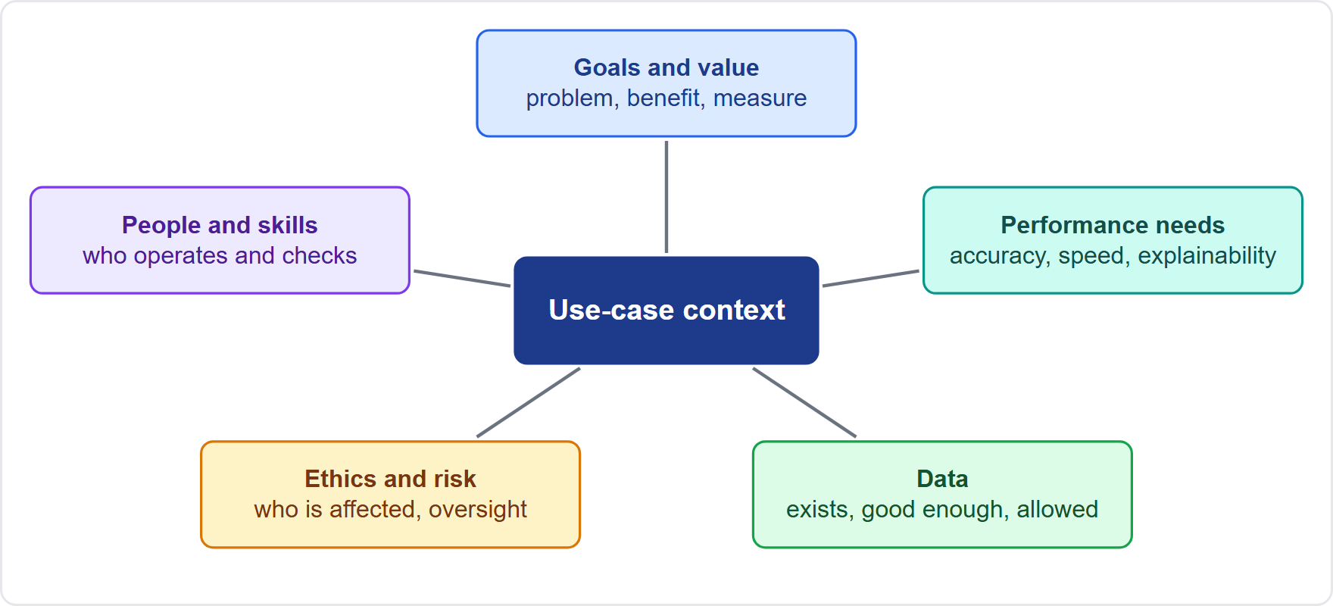
Start With the Use Case: Five Context Factors
Part 1
Before any model is chosen, define the setting in which the AI will work
Goals: the problem, the benefit expected and how success will be measured
Performance needs: how accurate, fast, available and explainable it must be
Data: what exists, how good it is and whether it may be used
Ethics and risk: who could be affected and how much oversight is needed
People and skills: who will operate, check and rely on it
EXAM TIP The context comes first and the model second: a model chosen before the use case is understood is a guess.
AIGP Exam Prep Masterclass | Certified AI Governance Professional
Module 11
4 / 32
Notes:
Before any model is chosen, define the setting. There are five factors. Goals: the problem, the benefit expected and how success will be measured. Performance needs: how accurate, fast, available and explainable the system must be. Data: what exists, how good it is and whether it may be used. Ethics and risk: who could be affected and how much oversight is needed. And people and skills: who will operate, check and rely on it. Exam tip: the context comes first and the model second. A model chosen before the use case is understood is a guess.

Slide 5
Goals and Performance Needs: What Good Enough Means
Part 1
A clear goal names the problem, the user and the measure of success
Performance requirements turn the goal into numbers: accuracy, error tolerance, speed, availability, explainability and cost
Tolerance for error follows harm: a wrong film suggestion is cheap; a wrong hiring ranking is not
Set thresholds before testing (module 9) and review them if the use changes
A need that cannot be measured cannot be shown to be met
Helios: the assistant must answer in seconds, in plain language, and say when it does not know
EXAM TIP The cost of a wrong output sets the performance bar: higher harm, tighter requirement.
AIGP Exam Prep Masterclass | Certified AI Governance Professional
Module 11
5 / 32
Notes:
A clear goal names the problem, the user and the measure of success. Performance requirements turn the goal into numbers: accuracy, error tolerance, speed, availability, explainability and cost. Tolerance for error follows harm. A wrong film suggestion is cheap; a wrong hiring ranking is not. Set thresholds before testing, as module nine said, and review them if the use changes. A need that cannot be measured cannot be shown to be met. At Helios, the assistant must answer in seconds, in plain language, and say when it does not know. Exam tip: the cost of a wrong output sets the bar.

Slide 6
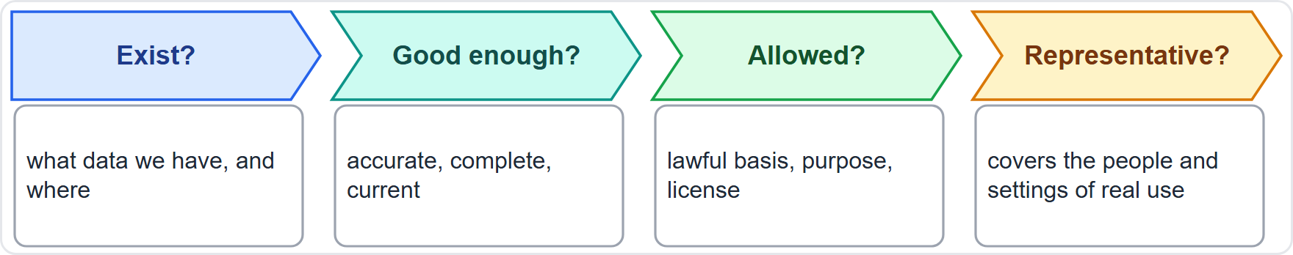
Data Availability: Can the Use Case Be Fed?
Part 1
Every use case runs on data: the system's own and any organization data it draws on
Ask four questions: do they exist, are they good enough, may we use them, do they represent real use?
Missing or poor data may rule a use case out, or change the approach: collect first, narrow the scope, or use a pre-trained model
Rights and privacy: lawful basis, purpose limits and licensing (modules 4 and 5)
Helios: the support documents exist, but some are old; fixing them comes before go-live
EXAM TIP No suitable data, no suitable use case: say so before money is spent on a model.
AIGP Exam Prep Masterclass | Certified AI Governance Professional
Module 11
6 / 32
Notes:
Every use case runs on data. Ask four questions. Do the data exist? Are they good enough: accurate, complete and current? May we use them: is there a lawful basis, a clear purpose and a license? And do they represent real use? Missing or poor data may rule a use case out, or change the approach: collect first, narrow the scope, or use a pre-trained model. At Helios, the support documents exist, but some are old, so fixing them comes before go-live. Exam tip: no suitable data, no suitable use case. Say so before money is spent on a model.

Slide 7
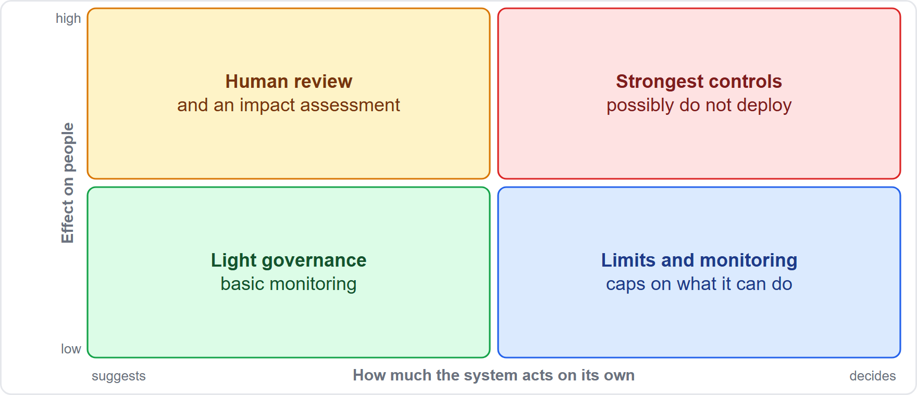
Ethics and Risk Appetite: Who Is Affected?
Part 1
Ask who is affected, how seriously, and whether the effect can be undone
Rights and fairness: work, credit, health and education set high bars in law and ethics (modules 1, 5 and 6)
Human oversight: does a person review the output, or does the system act alone?
Risk appetite: the level of risk the organization accepts, set by leaders and the committee
More effect and more autonomy mean more governance, and sometimes do not deploy
EXAM TIP Weigh effect on people and autonomy together: high on both calls for the strongest controls.
AIGP Exam Prep Masterclass | Certified AI Governance Professional
Module 11
7 / 32
Notes:
Ask who is affected, how seriously, and whether the effect can be undone. Work, credit, health and education set high bars in law and ethics, as modules one, five and six showed. Ask about human oversight: does a person review the output, or does the system act alone? Risk appetite is the level of risk the organization accepts, set by leaders and the committee. The matrix shows the pattern. The more a system affects people, and the more it acts on its own, the stronger the controls, up to a decision not to deploy. Exam tip: weigh effect and autonomy together.

Slide 8
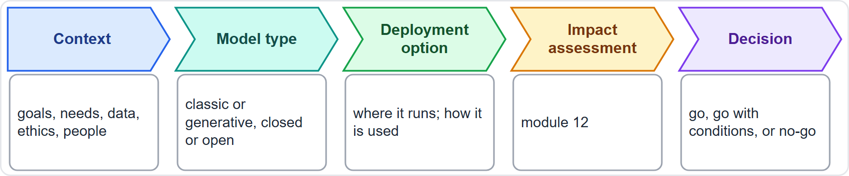
Workforce Readiness and the Go or No-Go Decision
Part 1
People and skills: can staff use the tool, check its output and escalate problems? (module 2 training)
Change management: roles shift, so plan communication, support and a feedback route
Capacity: who will monitor, maintain and answer questions after launch?
The decision: go, go with conditions (for example training first), or no-go
Findings feed the model and option choices, then the impact assessment (module 12)
Helios: support agents learn when to correct the assistant before launch
EXAM TIP A technically sound system still fails if the people around it are not ready.
AIGP Exam Prep Masterclass | Certified AI Governance Professional
Module 11
8 / 32
Notes:
People and skills: can staff use the tool, check its output and escalate problems? Module two covered training. Change management: roles shift, so plan communication, support and a feedback route. Capacity: who will monitor and maintain the system after launch? The decision has three outcomes: go, go with conditions, such as training first, or no-go. The context findings feed the model and option choices, and then the impact assessment in module twelve. At Helios, support agents learn when to correct the assistant before launch. Exam tip: a sound system still fails if the people around it are not ready.

Slide 9
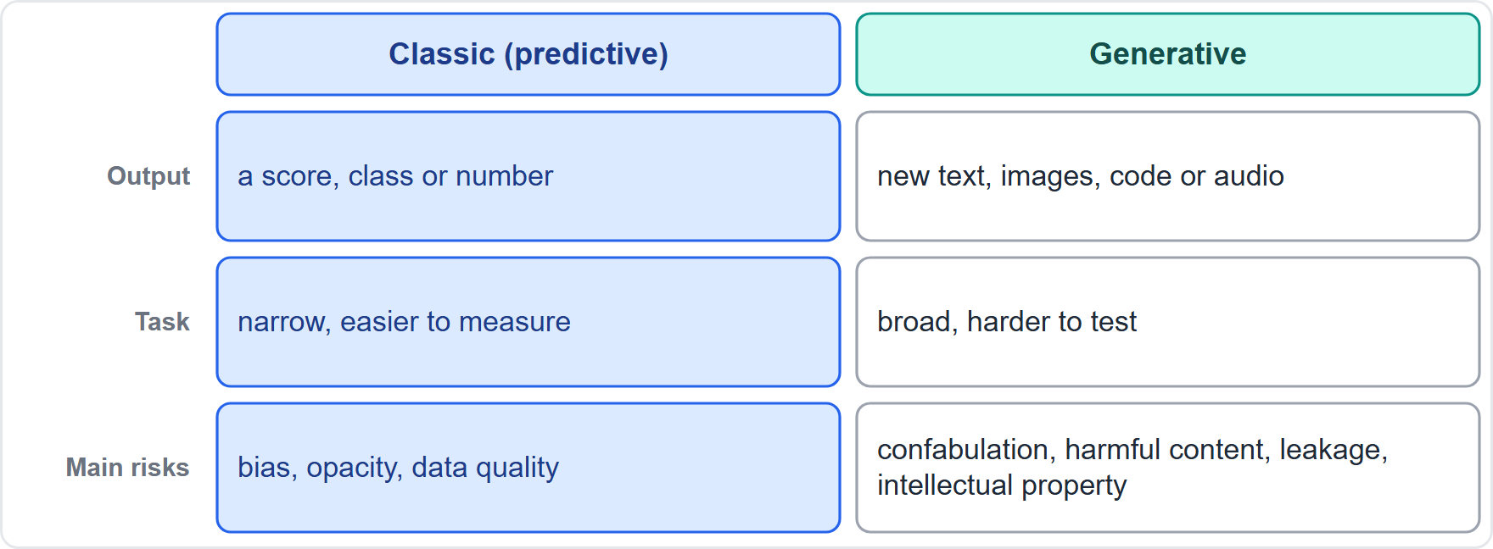
Classic and Generative Models
Part 1
Classic (predictive) models score, classify or predict, often from structured data: a ranking, a yes or no, a number
Generative models create new content: text, images, code or audio
Classic: a narrow task and outputs that are easier to measure; generative: broad tasks and open-ended outputs that are harder to test
Classic risks: biased scores, opacity, poor data
Generative adds: confabulation, harmful content, leakage and intellectual property questions
Helios: the hiring tool is predictive; the assistant is generative (module 1)
EXAM TIP Open-ended output means open-ended failure modes, so testing and monitoring must be broader.
AIGP Exam Prep Masterclass | Certified AI Governance Professional
Module 11
9 / 32
Notes:
Classic, or predictive, models score, classify or predict, often from structured data: a ranking, a yes or no, a number. Generative models create new content: text, images, code or audio. Classic models have a narrow task and outputs that are easier to measure. Generative models take on broad tasks, with open-ended outputs that are harder to test. Classic risks include biased scores, opacity and poor data. Generative models add confabulation, harmful content, leakage and intellectual property questions. At Helios, the hiring tool is predictive and the assistant is generative. Exam tip: open-ended output means open-ended failure modes.

Slide 10
What Generative AI Adds to the Risk List
Part 1
The NIST generative AI profile names twelve risks unique to or worsened by generative AI (module 1)
Content: confabulation, dangerous, violent or hateful content, obscene or abusive content, information integrity
Data and rights: data privacy, intellectual property
Security: information security, chemical, biological, radiological and nuclear (CBRN) information or capabilities
People and systems: human-AI configuration, harmful bias or homogenization
Supply chain and planet: value chain and component integration, environmental impacts
Choosing a generative model means deciding which apply and how each will be controlled
EXAM TIP In a generative AI case, expect confabulation, privacy leaks and intellectual property to be in play.
AIGP Exam Prep Masterclass | Certified AI Governance Professional
Module 11
10 / 32
Notes:
The N I S T generative A I profile names twelve risks that are unique to, or made worse by, generative A I, as module one said. Content: confabulation, dangerous, violent or hateful content, obscene or abusive content, and information integrity. Data and rights: data privacy and intellectual property. Security: information security, and chemical, biological, radiological and nuclear information or capabilities. People and systems: human-A I configuration, and harmful bias or homogenization. Supply chain and planet: value chain and component integration, and environmental impacts. Choosing a generative model means deciding which apply. Exam tip: expect confabulation, privacy leaks and intellectual property.

Slide 11
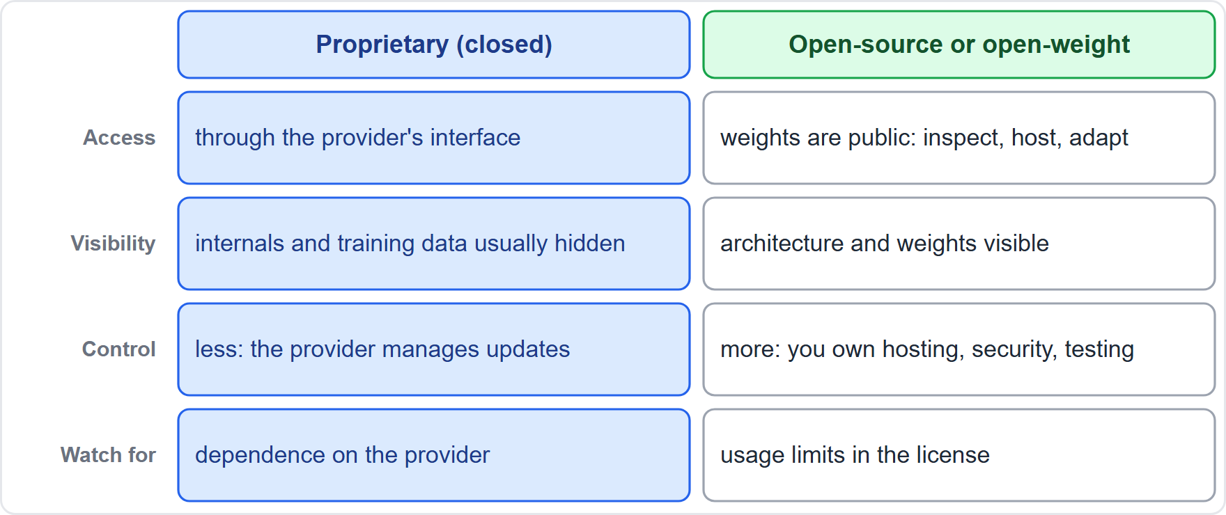
Proprietary and Open-Source Models
Part 1
Proprietary (closed) models: owned by a provider and reached through an interface; internals and training data are usually not visible
Open-source or open-weight models: the weights are public, so you can inspect, host and adapt them
Closed: provider-managed updates and support, less control; open: control and transparency, but more work for you in hosting, security, testing and updates
Licenses differ: open models can carry usage limits; read them
Either way, the deployer must evaluate the model for its own use
Helios: the Corvid Labs model is closed; an open alternative was weighed
EXAM TIP Open does not mean risk-free or rule-free: the deployer carries more of the safety work.
AIGP Exam Prep Masterclass | Certified AI Governance Professional
Module 11
11 / 32
Notes:
Proprietary, or closed, models are owned by a provider and reached through an interface. Their internals and training data are usually not visible. Open-source or open-weight models make the weights public, so you can inspect, host and adapt them. Closed models bring provider-managed updates and support, with less control. Open models bring control and transparency, but more work for you in hosting, security, testing and updates. Licenses differ, and open models can carry usage limits, so read them. Either way, the deployer must evaluate the model for its own use. At Helios, the Corvid Labs model is closed. Exam tip: open does not mean risk-free.

Slide 12
Open Source and the Law
Part 1
AI Act, Article 2(12): systems released under free and open-source licenses are largely outside the Act, unless they are high-risk, prohibited (Article 5) or subject to transparency duties (Article 50)
General-purpose models, Article 53(2): open-source providers are exempt from the technical documentation and downstream information duties
They still owe the copyright policy and the training-content summary, and the exemption is lost for systemic-risk models (module 6)
Article 25(4) supplier agreements do not cover free and open-source components, except general-purpose models
GDPR, product liability and other laws apply whatever the license
EXAM TIP The open-source exemption is partial: copyright policy and training summary remain, and systemic-risk models never qualify.
AIGP Exam Prep Masterclass | Certified AI Governance Professional
Module 11
12 / 32
Notes:
The A I Act gives open source a partial exemption. Under Article two, point twelve, systems released under free and open-source licenses are largely outside the Act, unless they are high-risk, prohibited under Article five, or subject to transparency duties under Article fifty. For general-purpose models, Article fifty-three, point two, exempts open-source providers from the technical documentation and downstream information duties. They still owe the copyright policy and the training-content summary, and the exemption is lost for systemic-risk models. G D P R, product liability and other laws apply whatever the license. Exam tip: the exemption is partial.

Slide 13
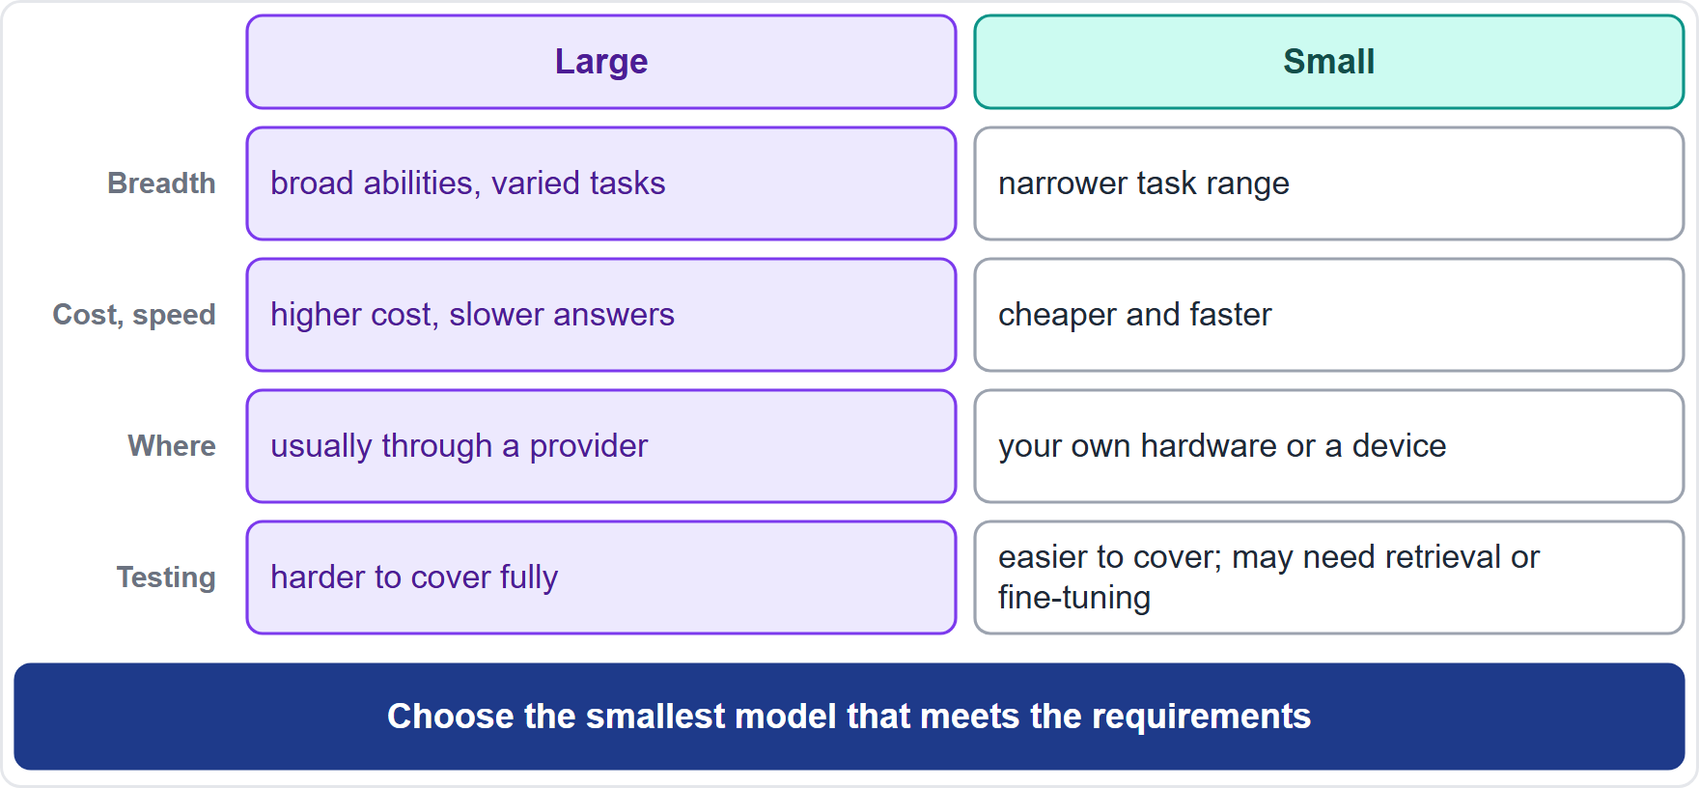
Small and Large Models
BEYOND THE BOK
Part 1
Large models: broad abilities and varied tasks, but higher cost per use, slower responses and harder to test fully
Small models: narrower, cheaper and faster, able to run on your own hardware or a device; they may need retrieval or fine-tuning to reach quality
Fit over size: choose the smallest model that meets the requirements
Governance: small models can keep data in-house; the providers of the largest models may face systemic-risk duties (module 6)
Test both on your own tasks: public benchmarks may not reflect your use
Helios: a small open model could handle routine questions
EXAM TIP Bigger is not automatically better or safer: match the size to the task and the risk.
AIGP Exam Prep Masterclass | Certified AI Governance Professional
Module 11
13 / 32
Notes:
This is a beyond-the-Body-of-Knowledge slide. Large models offer broad abilities and varied tasks, but at higher cost per use, with slower responses, and they are harder to test fully. Small models are narrower, cheaper and faster, and can run on your own hardware or a device. They may need retrieval or fine-tuning to reach the quality you need. The rule is fit over size: choose the smallest model that meets the requirements. Small models can keep data in-house. Test both on your own tasks, because public benchmarks may not reflect your use. Exam tip: bigger is not automatically better or safer.

Slide 14
Language and Multimodal Models
BEYOND THE BOK
Part 1
Language models work with text, including code
Multimodal models take in or produce images, audio and video as well as text
New uses: reading scans and charts, describing images, voice assistants, video analysis
New risks: deepfakes and synthetic media (Article 50 transparency, module 6), biometric and sensitive data in faces and voices (module 4), hidden instructions in images, and more ways to attack the system
Test each input type and check the data rights for each
Helios: the hiring tool's video interview handles voice and video, so sensitive-data and emotion-analysis limits apply (modules 4 and 6)
EXAM TIP Every added modality adds questions about data, security and transparency.
AIGP Exam Prep Masterclass | Certified AI Governance Professional
Module 11
14 / 32
Notes:
This is a beyond-the-Body-of-Knowledge slide. Language models work with text, including code. Multimodal models take in or produce images, audio and video as well as text. They open new uses: reading scans and charts, describing images, voice assistants and video analysis. They also bring new risks: deepfakes and synthetic media, covered by the Article fifty transparency duties; biometric and sensitive data in faces and voices; hidden instructions in images; and more ways to attack the system. Test each input type, and check the data rights for each. At Helios, the hiring tool's video interview raises these questions. Exam tip: every added modality adds questions.

Slide 15
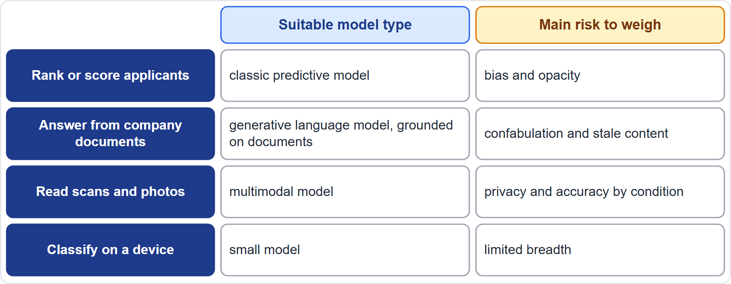
Matching the Model Type to the Task
Part 1
Start from the task, not from the technology
Rank, classify, predict: classic models
Draft, summarize, answer: generative language models
Images, audio, video: multimodal models
Closed or open, small or large: decide on control needs, cost, data sensitivity and testing
Record the reasons in the decision record
EXAM TIP Match the model type to the task and the risk, and write down why.
AIGP Exam Prep Masterclass | Certified AI Governance Professional
Module 11
15 / 32
Notes:
Start from the task, not from the technology. To rank, classify or predict, use classic models. To draft, summarize or answer, use generative language models. For images, audio and video, use multimodal models. Then decide between closed or open, and small or large, based on control needs, cost, data sensitivity and testing. The table pairs four tasks with a model type and the main risk to weigh. Record the reasons in the decision record, so that the choice can be reviewed later. Exam tip: match the model type to the task and the risk, and write down why.

Slide 16
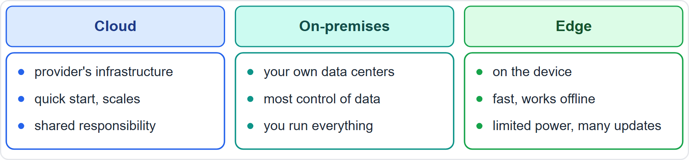
Where It Runs: Cloud, On-Premises or Edge
Part 2
Cloud: run on a provider's infrastructure: quick to start, scalable, less to maintain
On-premises: run in your own data centers: the most control over data and security, but you buy and run everything
Edge: run on the device, such as a phone, camera or vehicle: fast, works offline, data stay local, but limited power and harder updates
Hybrid setups mix these
Drivers: data sensitivity, speed, cost, skills and laws on data location
EXAM TIP Where the system runs decides who controls the data, the security and the updates.
AIGP Exam Prep Masterclass | Certified AI Governance Professional
Module 11
16 / 32
Notes:
Three places to run a model. Cloud means a provider's infrastructure: quick to start, scalable and lighter to maintain. On-premises means your own data centers: the most control over data and security, but you buy and run everything. Edge means on the device, such as a phone, a camera or a vehicle: fast, works offline and keeps data local, but with limited power and harder updates. Hybrid setups mix these. The drivers are data sensitivity, speed, cost, skills and laws on data location. Exam tip: where the system runs decides who controls the data, the security and the updates.

Slide 17
Cloud Deployment: Shared Responsibility and Data Location
Part 2
Shared responsibility: the provider secures the infrastructure; the customer secures its data, access settings and use
Data location and transfers: moving personal data across borders must meet the GDPR transfer rules (Articles 44 to 49), so check where the provider processes and stores data (module 4)
Contract terms: use of your data for the provider's own training, logging and retention, sub-processors, audit rights, incident notice (module 12)
Lock-in and continuity: what happens if the provider changes the model, the price or its service?
Concentration risk: too many services on one provider
Helios: the assistant reaches its model through a cloud interface, so these terms matter
EXAM TIP The cloud moves work to the provider; it does not move the legal responsibility for the data.
AIGP Exam Prep Masterclass | Certified AI Governance Professional
Module 11
17 / 32
Notes:
In the cloud, responsibility is shared. The provider secures the infrastructure; the customer secures its data, its access settings and its use. Data location matters: moving personal data across borders must meet the G D P R transfer rules in Articles forty-four to forty-nine, so check where the provider processes and stores data. Contract terms matter too: use of your data for the provider's own training, logging and retention, sub-processors, audit rights and incident notice. Watch for lock-in and concentration risk. At Helios, the assistant reaches its model through a cloud interface. Exam tip: the cloud does not move legal responsibility for the data.

Slide 18
On-Premises and Edge: Control, Cost and Maintenance
Part 2
On-premises: data stay inside your boundary, you set security and access, and strict data rules are easier to meet
Cost and effort: hardware, specialists, patching, capacity planning and your own monitoring
Edge: local processing reduces transfers and delay, useful where the network is poor or the data are sensitive
Edge limits: small models, limited power, many devices to update and secure, and physical access risks
Updates: a flaw in a model on thousands of devices needs a patch and withdrawal plan
Helios: hosting an open model itself would add security and maintenance duties the team does not have today
EXAM TIP More control means more work: choose it only when the need justifies the effort.
AIGP Exam Prep Masterclass | Certified AI Governance Professional
Module 11
18 / 32
Notes:
On-premises deployment keeps data inside your boundary. You set security and access, and strict data rules are easier to meet. The price is cost and effort: hardware, specialists, patching, capacity planning and your own monitoring. Edge deployment reduces transfers and delay, which helps where the network is poor or the data are sensitive. But edge brings small models, limited power, many devices to update and secure, and physical access risks. A flaw in a model on thousands of devices needs a patch and withdrawal plan. At Helios, hosting an open model would add duties the team lacks today. Exam tip: more control means more work.

Slide 19
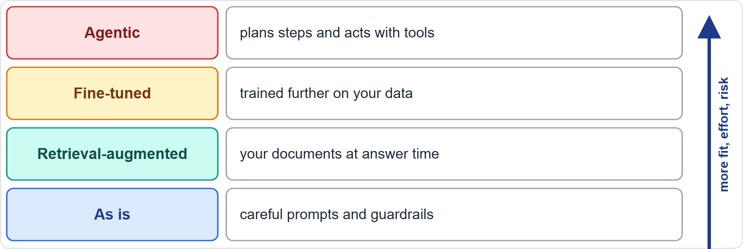
How the Model Is Used: A Ladder of Adaptation
Part 2
As is: the model with careful prompts and guardrails: least effort, least fit
Retrieval-augmented: the model answers using documents fetched at the moment of the question
Fine-tuned: the model is trained further on your data to change its behavior
Agentic: the model plans steps and uses tools to act
Combinations are common; start with the least adaptation that meets the need
Each step up adds effort, cost and risk to govern
EXAM TIP Try the simplest approach first, and add adaptation only when testing shows a gap.
AIGP Exam Prep Masterclass | Certified AI Governance Professional
Module 11
19 / 32
Notes:
Now, how the model is used. Look at the ladder. As is: the model with careful prompts and guardrails, which takes the least effort and gives the least fit. Retrieval-augmented: the model answers using documents fetched at the moment of the question. Fine-tuned: the model is trained further on your data to change its behavior. Agentic: the model plans steps and uses tools to act. Combinations are common. Start with the least adaptation that meets the need, because each step up adds effort, cost and risk to govern. Exam tip: try the simplest approach first.

Slide 20
Using the Model As Is: Prompts, Guardrails and Other Techniques
Part 2
Prompt design: instructions, examples and a system prompt shape behavior without changing the model
Guardrails: input and output filters, topic limits, blocked actions and fallbacks to a person
Other techniques: parameter settings, caching, combining models, and distillation (a small model trained to imitate a larger one)
Limits: the model's knowledge and flaws stay the same, and guardrails can be bypassed by clever inputs
Governance: record the prompt and settings as part of the system version, and test them
Helios: Anika Berg's team writes the assistant's system prompt: tone, scope and say you do not know
EXAM TIP Prompts and settings are part of the system: version, test and review them like code.
AIGP Exam Prep Masterclass | Certified AI Governance Professional
Module 11
20 / 32
Notes:
Using a model as is does not mean using it carelessly. Prompt design, with instructions, examples and a system prompt, shapes behavior without changing the model. Guardrails add input and output filters, topic limits, blocked actions and fallbacks to a person. Other techniques include parameter settings, caching, combining models, and distillation, where a small model is trained to imitate a larger one. The limits: the model's knowledge and flaws stay the same, and clever inputs can bypass guardrails. Record the prompt and settings as part of the system version, and test them. Exam tip: prompts and settings are part of the system.

Slide 21
Fine-Tuning: Benefits, Risks and Role Changes
Part 2
Fine-tuning: further training on your own examples to change style, format or domain behavior
Benefits: better fit, shorter prompts, sometimes a smaller model
Risks: leakage of training data in outputs, bias in the new data, drift from the original safety behavior, extra cost, and the need to retest everything
Data governance: the fine-tuning data need the same lineage, quality and rights checks as any training data (module 9)
Role change: a substantial modification of a high-risk system can make the deployer its provider (Article 25); module 12 returns to this
Facts that change often belong in retrieval, not in the weights
EXAM TIP Fine-tune for behavior and style; use retrieval for facts that change.
AIGP Exam Prep Masterclass | Certified AI Governance Professional
Module 11
21 / 32
Notes:
Fine-tuning means further training on your own examples to change style, format or domain behavior. The benefits are better fit, shorter prompts and sometimes a smaller model. The risks are leakage of training data in outputs, bias in the new data, drift from the original safety behavior, extra cost, and the need to retest everything. The fine-tuning data need the same lineage, quality and rights checks as any training data, as module nine said. And roles can change: a substantial modification of a high-risk system can make the deployer its provider, under Article twenty-five. Exam tip: fine-tune for behavior and style; use retrieval for facts that change.

Slide 22
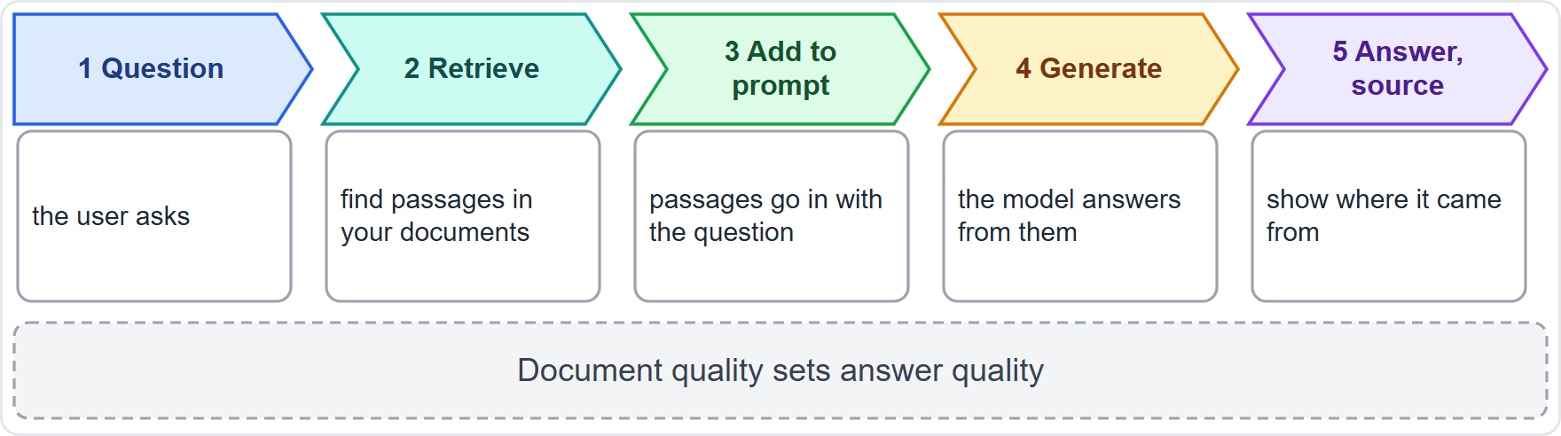
Retrieval-Augmented Generation: Grounding on Your Documents
Part 2
The system retrieves relevant passages from your documents and gives them to the model with the question
Benefits: answers use current company content; update the documents without retraining; sources can be shown
It reduces, not removes, confabulation: the model can still misread or ignore a passage
Risks: stale or wrong documents (the Helios refund error), access control (users seeing documents they should not), injection through documents, and poor retrieval
Governance: owners, review dates and versions for the knowledge source; test retrieval and answers; log the sources used
EXAM TIP With retrieval, the document source is part of the system: its quality is the system's quality.
AIGP Exam Prep Masterclass | Certified AI Governance Professional
Module 11
22 / 32
Notes:
With retrieval, the system searches your documents for relevant passages, adds them to the prompt, and the model answers from them, ideally with a source. The benefits: answers use current company content, you can update documents without retraining, and sources can be shown. But retrieval reduces confabulation; it does not remove it. The risks are stale or wrong documents, as in the Helios refund error, weak access control, injection through documents, and poor retrieval. Give the knowledge source owners, review dates and versions, and test both retrieval and answers. Exam tip: the document source is part of the system.

Slide 23
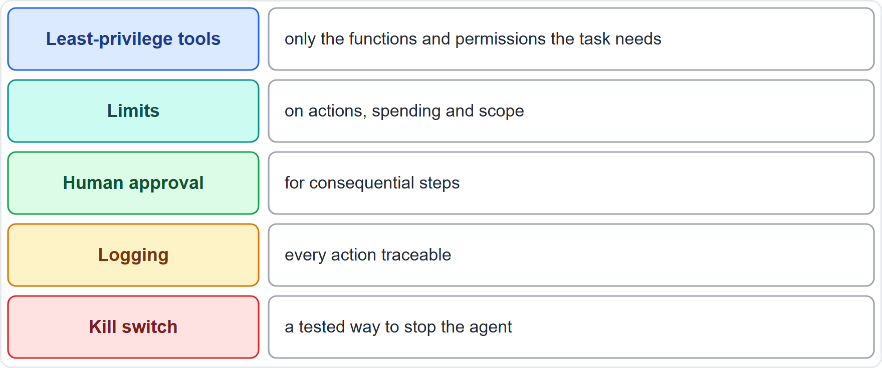
Agentic Architectures: Autonomy and Excessive Agency
Part 2
Agentic systems plan multi-step tasks and use tools, such as calendars, email, payments or code, to act on their own
New risk: a mistake or a manipulated instruction becomes a real action, quickly and at scale
Excessive agency (OWASP list): more functions, permissions or autonomy than the task needs
Controls: least-privilege tools, limits on actions and spending, human approval for consequential steps, logging and a kill switch (module 10)
Test for misuse, injection and chains of errors, not only single answers
Helios: the "book a meeting for me" function is held back until permissions, approvals and logging are designed and tested
EXAM TIP Autonomy multiplies the impact of every other risk: limit it, and keep a person in the loop for consequential actions.
AIGP Exam Prep Masterclass | Certified AI Governance Professional
Module 11
23 / 32
Notes:
Agentic systems plan multi-step tasks and use tools, such as calendars, email, payments or code, to act on their own. The new risk is that a mistake or a manipulated instruction becomes a real action, quickly and at scale. The O W A S P list calls the problem excessive agency: more functions, permissions or autonomy than the task needs. The controls are least-privilege tools, limits on actions and spending, human approval for consequential steps, logging and a kill switch, as module ten said. At Helios, the meeting-booking function is held back until these are designed and tested. Exam tip: autonomy multiplies every other risk.

Slide 24
Module Recap
Part 2
1
Context
2
Model types
3
Where it runs
goals, performance needs, data, ethics and risk, people and skills; the outcome is go, go with conditions or no-go
classic or generative; closed or open (the open-source exemptions are partial); small or large (choose the smallest that fits); language or multimodal
cloud, on-premises or edge, with who controls data and updates
4
How it is used
5
Watch-outs
as is, retrieval-augmented, fine-tuned or agentic: the least adaptation that works
retrieval depends on the documents, fine-tuning can leak and shift roles, agentic needs limits and approval
AIGP Exam Prep Masterclass | Certified AI Governance Professional
Module 11
24 / 32
Notes:
Let us recap. Context: goals, performance needs, data, ethics and risk, and people and skills, ending in go, go with conditions or no-go. Model types: classic or generative, closed or open, where the open-source exemptions are partial, small or large, where you choose the smallest that fits, and language or multimodal. Where it runs: cloud, on-premises or edge, and who controls data and updates. How it is used: as is, retrieval-augmented, fine-tuned or agentic, with the least adaptation that works. And the watch-outs for each.

Slide 25
Practice Question 1
Part 2
Q1
Anika Berg wants the Helios assistant to answer service questions. The goal is clear and the support staff are trained, but the support documents are scattered, out of date and contradict one another. Which factor of the use-case context is the main concern?
A
Workforce readiness, because the support staff have not yet been trained to use the new tool in daily work
B
Ethical considerations, because some customers might prefer to speak with a person
C
Data availability and quality, because the information the assistant needs is unreliable
D
Performance requirements, because the assistant must answer within a few seconds
AIGP Exam Prep Masterclass | Certified AI Governance Professional
Module 11
25 / 32
Notes:
Question one. Anika Berg wants the Helios assistant to answer service questions. The goal is clear and the support staff are trained, but the support documents are scattered, out of date and contradict one another. Which factor of the use-case context is the main concern? The four options are on the screen. [PAUSE 12] The answer is C. The goal is clear and staff are trained, so the weak point is the data. Fix the documents before go-live.

Slide 26
Practice Question 2
Part 2
Q2
A claims team plans to use AI to triage insurance claims. Which TWO questions belong in the context review before a model is chosen? (Select TWO.)
A
Which vendor has the most attractive website and the longest list of public awards and industry prizes
B
Which model on the market has the largest number of parameters
C
How many wrong triage decisions the business can tolerate, and what harm each would cause
D
Which colors and fonts will appear on the screens that the claims handlers use
E
Whether the claims handlers have the skills and time to review the output and correct it
AIGP Exam Prep Masterclass | Certified AI Governance Professional
Module 11
26 / 32
Notes:
Question two. A claims team plans to use A I to triage insurance claims. Which two questions belong in the context review before a model is chosen? Select two. The five options are on the screen. [PAUSE 15] The answers are C and E. The context review covers performance needs, including how much error is tolerable, and workforce readiness. Vendor branding, parameter counts and screen design are not context factors.

Slide 27
Practice Question 3
Part 2
Q3
Which statement best describes a difference between proprietary and open-source models?
A
Open models give the deployer more control and visibility, and more responsibility for security and testing
B
Proprietary models are always safer, because only the provider can see how they were built and trained in-house
C
Open-source models are exempt from the law, because their license allows anyone to use them for free or modify them
D
Proprietary models can be adapted by anyone who downloads their weights and runs them locally
AIGP Exam Prep Masterclass | Certified AI Governance Professional
Module 11
27 / 32
Notes:
Question three. Which statement best describes a difference between proprietary and open-source models? The four options are on the screen. [PAUSE 12] The answer is A. Open weights let the deployer inspect, host and adapt the model, and the deployer then owns more of the safety work. Closed models are not automatically safer, open models are not exempt from law, and only open weights can be downloaded and adapted.

Slide 28
Practice Question 4
Part 2
Q4
The Helios assistant mostly answers short, routine questions about services. A colleague proposes always using the largest available model. What is the best governance response?
A
Agree, because a larger model produces safer, more accurate and fairer answers for most tasks and users
B
Agree, because model size has no effect on cost, speed or how fully the model can be tested
C
Reject large models, because large models are not able to be combined with a company's own documents or data
D
Test whether a smaller model meets the requirements, choose the smallest one that does and record why
AIGP Exam Prep Masterclass | Certified AI Governance Professional
Module 11
28 / 32
Notes:
Question four. The Helios assistant mostly answers short, routine questions about services. A colleague proposes always using the largest available model. What is the best governance response? The four options are on the screen. [PAUSE 12] The answer is D. Fit matters more than size. A smaller model may meet the need at lower cost, with faster answers and easier testing, so test it, choose the smallest that works, and record the reasons.

Slide 29
Practice Question 5
Part 2
Q5
A hospital needs an AI tool for dictated patient notes. Its policy says patient data must not leave the hospital network, and the tool must keep working during network outages. Which deployment option fits best?
A
A public cloud service reached over the internet, because it is the quickest to start
B
On-premises or edge deployment, because data stay inside the hospital and no connection is needed
C
A cloud service in another country, because it lowers cost and the hospital's policy can be changed later on
D
A hybrid design in which the patient data are first sent to a provider for processing
AIGP Exam Prep Masterclass | Certified AI Governance Professional
Module 11
29 / 32
Notes:
Question five. A hospital needs an A I tool for dictated patient notes. Its policy says patient data must not leave the hospital network, and the tool must keep working during network outages. Which deployment option fits best? The four options are on the screen. [PAUSE 12] The answer is B. Keeping data inside the network and working offline point to on-premises or edge deployment. Cloud options send data out and depend on a connection.

Slide 30
Practice Question 6
Part 2
Q6
Which TWO statements about retrieval-augmented generation are correct? (Select TWO.)
A
It grounds answers on retrieved documents, so document quality and freshness affect answer quality
B
It changes the model's weights by training it further on the organization's own documents
C
It removes the risk of wrong answers, because each answer is checked against the documents before it is shown
D
It requires the whole model to be trained again from scratch on the organization's own data each time
E
It lets an organization update what the system knows by changing the document source, with no retraining
AIGP Exam Prep Masterclass | Certified AI Governance Professional
Module 11
30 / 32
Notes:
Question six. Which two statements about retrieval-augmented generation are correct? Select two. The five options are on the screen. [PAUSE 15] The answers are A and E. Retrieval grounds answers on documents, and lets the organization update knowledge by updating them. It does not change the weights, which is fine-tuning, it does not remove errors, and it needs no training from scratch.

Slide 31
Practice Question 7
Part 2
Q7
Helios proposes an assistant function that books meetings for customers: it reads emails, checks calendars and sends invitations on its own. Which feature of this design calls for the most careful governance before deployment?
A
It produces much more text than a chat assistant would, so storage cost is the main concern
B
It runs in the cloud, and cloud deployments are outside the reach of company policy or contract
C
It uses a fine-tuned model, and fine-tuned models are not allowed under the EU AI Act
D
It acts with tools and permissions, so mistakes or manipulated instructions have real effects
AIGP Exam Prep Masterclass | Certified AI Governance Professional
Module 11
31 / 32
Notes:
Question seven. Helios proposes an assistant function that books meetings for customers: it reads emails, checks calendars and sends invitations on its own. Which feature of this design calls for the most careful governance before deployment? The four options are on the screen. [PAUSE 12] The answer is D. An agentic function turns errors and manipulated instructions into actions, so it needs least-privilege permissions, limits, human approval, logging and a kill switch.

Slide 32
Answers at a Glance
Part 2
Question | Answer | Why
Q1 | C | Poor and conflicting documents: a data problem
Q2 | C, E | Error tolerance and workforce readiness
Q3 | A | Open models give control and more responsibility
Q4 | D | Fit over size: test, choose the smallest that works
Q5 | B | Data inside the network and offline use
Q6 | A, E | Grounding on documents; update without retraining
Q7 | D | Agentic actions need limits and approval
AIGP Exam Prep Masterclass | Certified AI Governance Professional
Module 11
32 / 32
Notes:
Here are all seven answers. Question one: C. Question two: C and E. Question three: A. Question four: D. Question five: B. Question six: A and E. Question seven: D. That completes Module eleven. Next, Module twelve: assessing the system, with impact assessments, vendor agreements and the risks of your own proprietary model.

