Slide 1
Module 12: Assessing the System: Impact, Vendors and Proprietary Models
Check the system you chose, read the contract, and know what building your own means
Domain IV · Competency B · Indicators IV.B.1 to IV.B.3
AIGP Exam Prep Masterclass
Module 12 · Part 1
Notes:
Welcome to Module twelve: Assessing the System. A system has been chosen. Before it goes live, the deployer assesses it: the impact on people, the terms of the vendor agreement, and, when the company builds its own model, the extra duties and liability that follow. This is the second competency of domain four.

Slide 2
What You Will Learn
Part 1
Carry out or check an impact assessment of the chosen system
Identify and weigh the key terms and risks of a vendor or license agreement
See what running your own proprietary model gains and costs
Know when a deployer becomes a provider, and what follows
AIGP Exam Prep Masterclass | Certified AI Governance Professional
Module 12
2 / 29
Notes:
By the end of this module you will be able to do four things. Carry out or check an impact assessment of the chosen system. Identify and weigh the key terms and risks of a vendor or license agreement. See what running your own proprietary model gains and costs. And know when a deployer becomes a provider, and what follows.

Slide 3
Case Check-In: The Chosen Assistant, the Contract and an In-House Idea
Part 1
CASE CHECK-IN · Helios
Samira Haddad asks for an impact assessment on the chosen assistant, not the design-stage one
Ravi Menon and Jonas Weber review the Corvid Labs agreement: data use, indemnity and notice of model changes
A proposal appears to build an in-house model; Samira Haddad asks what that would change
Your task: assess the system, weigh the contract, and compare building with buying
AIGP Exam Prep Masterclass | Certified AI Governance Professional
Module 12
3 / 29
Notes:
At Helios, Samira Haddad asks for an impact assessment on the chosen assistant, not the design-stage one. Ravi Menon and Jonas Weber review the Corvid Labs agreement: data use, indemnity and notice of model changes. Then a proposal appears: build an in-house model. Samira Haddad asks what that would change. Your task is to assess the system, weigh the contract, and compare building with buying.

Slide 4
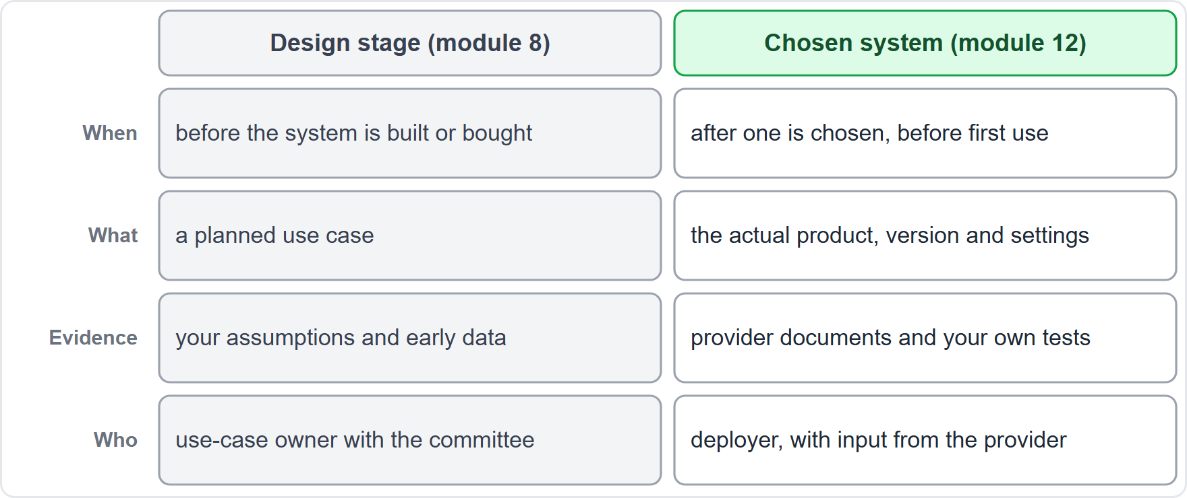
Assessing the System You Chose: What Is Different Now
Part 1
In module 8 you assessed a planned use case; now you assess the system that was actually selected
It is your use, your people and your data, which the provider's assessment cannot cover
Evidence comes from the provider's documents and your own tests and pilots
The result feeds a go, go with conditions or no-go decision, with owners and monitoring triggers
It is reviewed again when the system, the use or the law changes
EXAM TIP The provider assesses the product; the deployer assesses the use.
AIGP Exam Prep Masterclass | Certified AI Governance Professional
Module 12
4 / 29
Notes:
In module eight you assessed a planned use case. Now you assess the system that was actually selected. The table shows the difference: when, what is assessed, the evidence, and who does it. The assessment now covers your use, your people and your data, which the provider's assessment cannot cover. Evidence comes from the provider's documents and your own tests and pilots. The result feeds a go, go with conditions or no-go decision. Exam tip: the provider assesses the product; the deployer assesses the use.

Slide 5
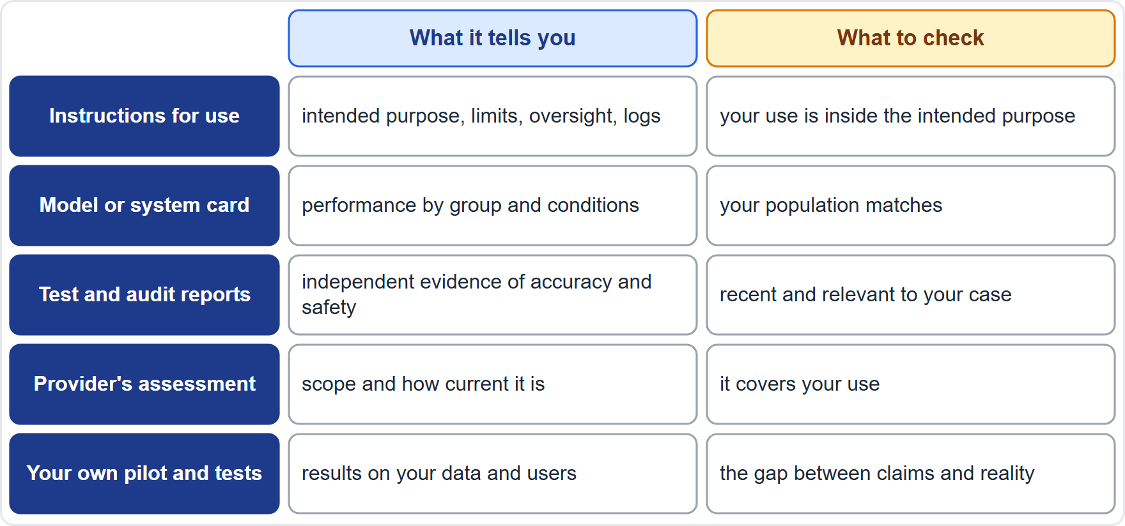
Gathering the Evidence: Provider Documents and Your Own Tests
Part 1
Instructions for use (Article 13): intended purpose, limits, oversight measures, logs
Model or system card: performance by group and evaluation conditions
Test, audit and certification reports, and any provider risk assessment
Your own pilot and test results on your data and your users
Gaps are findings: missing documents, vague claims and untested conditions go on the risk list
Ask the provider in writing: no answer is an answer
EXAM TIP Treat provider documents as claims to check against your own tests, not as proof.
AIGP Exam Prep Masterclass | Certified AI Governance Professional
Module 12
5 / 29
Notes:
Gather evidence from five sources. Instructions for use under Article thirteen: intended purpose, limits, oversight measures and logs. The model or system card: performance by group and evaluation conditions. Test, audit and certification reports, and any provider risk assessment. And your own pilot and test results on your data and users. Gaps are findings: missing documents, vague claims and untested conditions go on the risk list. Ask the provider in writing. Exam tip: treat provider documents as claims to check against your own tests, not as proof.

Slide 6
Deployer Duties That Feed the Assessment
Part 1
Article 26: use the system as the instructions say, give human oversight to people with competence, training and authority, and check that input data are relevant and representative
Monitor the system, inform the provider, suspend use if there is a risk, and report any serious incident
Keep logs for at least six months, and tell workers and affected people about the use
Article 27: public bodies, providers of public services and deployers of certain credit and insurance systems assess fundamental rights impact before first use, and may cross-refer to a DPIA (Article 35)
The assessment sets up these duties: oversight roles, data checks, monitoring and notices
Helios: its policy requires an assessment of every system, whatever the law requires
EXAM TIP Article 26 applies to every deployer of a high-risk system; Article 27 reaches only certain deployers.
AIGP Exam Prep Masterclass | Certified AI Governance Professional
Module 12
6 / 29
Notes:
For high-risk systems, Article twenty-six sets deployer duties. Use the system as the instructions say, assign human oversight to people with competence, training and authority, and check that input data are relevant and representative. Monitor, inform the provider, suspend use if there is a risk, and report any serious incident. Keep logs for at least six months, and tell workers and affected people. Article twenty-seven adds a fundamental rights impact assessment for certain deployers, and it may cross-refer to a data protection impact assessment. Exam tip: Article twenty-six applies to every deployer of a high-risk system; Article twenty-seven reaches only certain deployers.

Slide 7
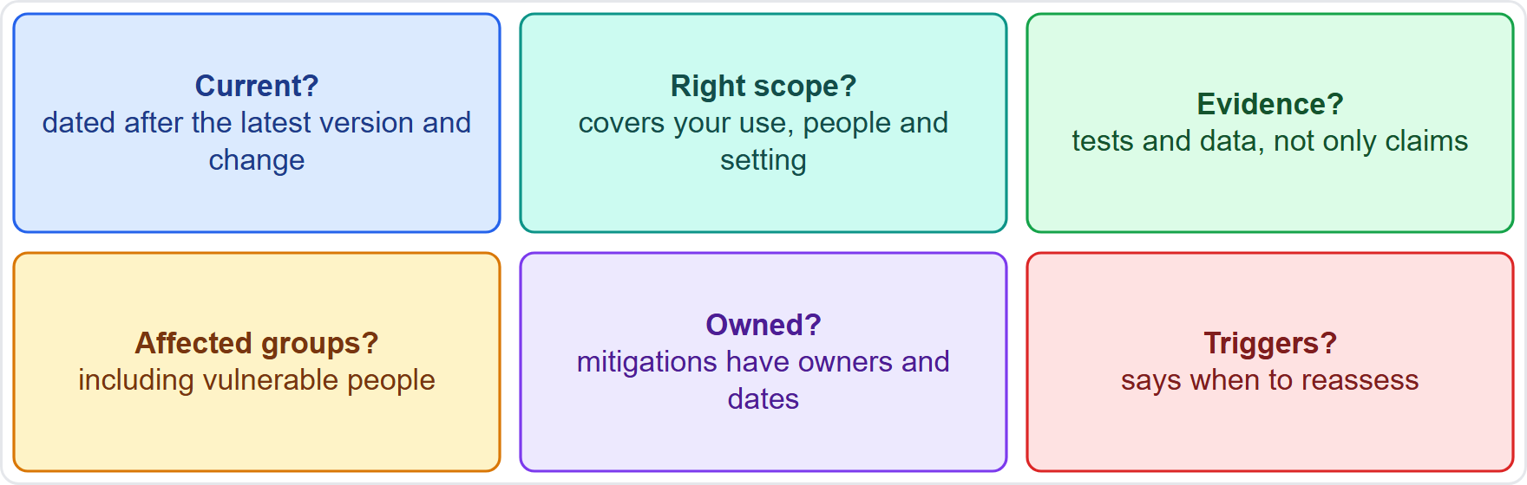
Reviewing an Existing Assessment
Part 1
A review asks whether an existing assessment (the provider's, a predecessor's or an earlier version) still fits
Is it current and in scope for your use, people and setting?
Is it backed by evidence, and does it cover affected groups, including vulnerable people?
Do mitigations have owners and dates, and are reassessment triggers named?
Reuse what holds, fill the gaps, and record what changed
Triggers: new version, new use, new data, an incident or a new law
EXAM TIP A reused assessment is acceptable only if it matches your use; otherwise update it.
AIGP Exam Prep Masterclass | Certified AI Governance Professional
Module 12
7 / 29
Notes:
Sometimes the task is to review an assessment that already exists: the provider's, a predecessor's, or an earlier version. Ask six questions. Is it current? Is the scope right for your use, people and setting? Is there evidence, not only claims? Does it cover affected groups, including vulnerable people? Do mitigations have owners and dates? And does it name triggers for reassessment? Reuse what holds, fill the gaps, and record what changed. Exam tip: a reused assessment is acceptable only if it matches your use; otherwise update it.

Slide 8
Helios: The Impact Assessment on the Chosen Assistant
Part 1
Scope: the Corvid Labs model, used through an interface, grounded on Helios's support documents and answering customers in public chat
Findings: wrong or outdated answers can harm customers and trust; chats may hold personal data; some customers may be vulnerable or rely on an answer
Evidence: the provider's documents, a pilot on real questions and Helios's own test results
Conditions for go: owners and review dates for the support documents; the assistant says when it does not know and offers a person; a monitoring and incident plan; trained support staff
Decision: go with conditions, reviewed when the model version, the documents or the use change
EXAM TIP The output of an impact assessment is a decision with conditions, not a score.
AIGP Exam Prep Masterclass | Certified AI Governance Professional
Module 12
8 / 29
Notes:
Here is the assessment at Helios. Scope: the Corvid Labs model, used through an interface, grounded on Helios's support documents, answering customers in public chat. Findings: wrong or outdated answers can harm customers and trust; chats may hold personal data; some customers may be vulnerable or rely on an answer. Conditions for go: owners and review dates for the support documents; the assistant says when it does not know and offers a person; a monitoring and incident plan; and trained support staff. The decision is go with conditions. Exam tip: the output is a decision with conditions, not a score.

Slide 9
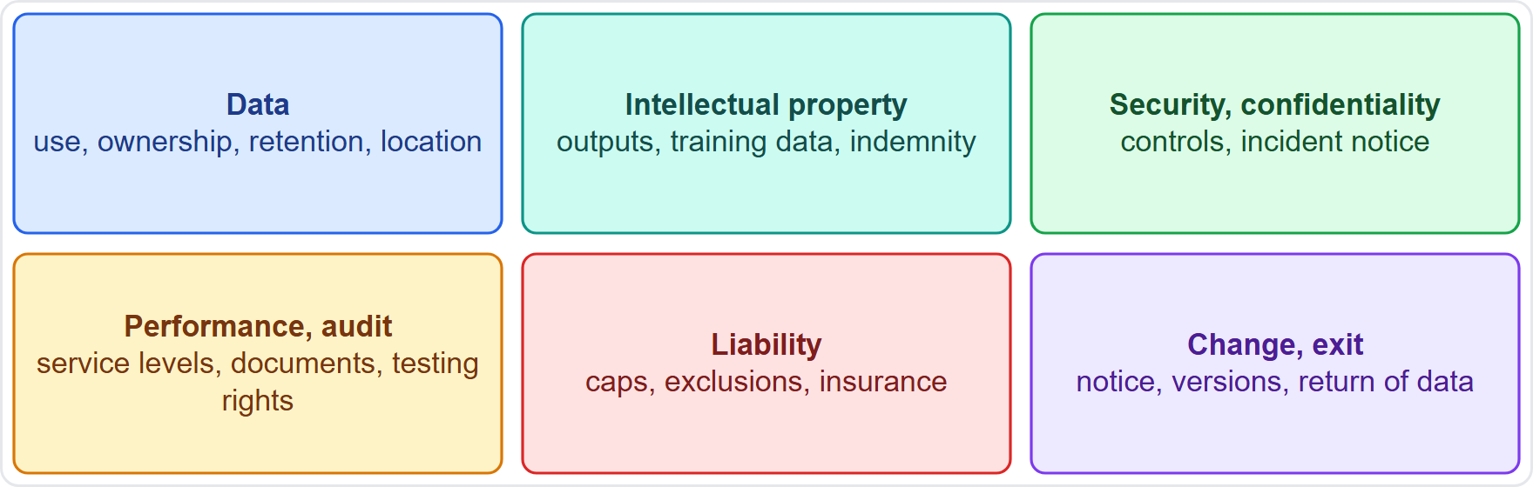
Why the Contract Is a Governance Control
Part 1
A vendor or license agreement is where the provider's promises and limits are written down
It allocates risk between provider and customer, and is evidence for audits and regulators
It is also the customer's best leverage: terms are hardest to change after signing
Six families of terms: data, intellectual property, security, performance and audit, liability, change and exit
Review with procurement, legal and privacy, security and the business owner
Helios: Ravi Menon and Jonas Weber lead the Corvid Labs review
EXAM TIP Governance tools are not only policies: the contract is one.
AIGP Exam Prep Masterclass | Certified AI Governance Professional
Module 12
9 / 29
Notes:
A vendor or license agreement is where the provider's promises and limits are written down. It allocates risk between provider and customer, and it is evidence for audits and regulators. It is also the customer's best leverage, because terms are hardest to change after signing. Six families of terms matter: data, intellectual property, security and confidentiality, performance and audit, liability, and change and exit. Review with procurement, legal and privacy, security and the business owner. At Helios, Ravi Menon and Jonas Weber lead. Exam tip: the contract is a governance tool.

Slide 10
Data Terms: Use, Ownership, Retention and Location
Part 1
Use of your data: may the provider use your prompts and files to train or improve its models? Prefer no, unless you agree
Ownership: who owns inputs and outputs, and any fine-tuned version?
Processor terms: for personal data, GDPR Article 28(3) requires a binding contract: documented instructions, confidentiality, security, sub-processor conditions, help with data subject requests, deletion or return, and audit information
Sub-processors: Article 28(4): bound by the same obligations, and the first processor stays fully liable
Retention and location: how long data are kept, how they are deleted, and where they are processed (Articles 44 to 49)
EXAM TIP The first data question for any generative AI vendor is whether your inputs train its model.
AIGP Exam Prep Masterclass | Certified AI Governance Professional
Module 12
10 / 29
Notes:
Data terms come first. May the provider use your prompts and files to train or improve its models? Prefer no, unless you agree. Who owns inputs and outputs, and any fine-tuned version? For personal data, G D P R Article twenty-eight, point three, requires a binding processor contract: documented instructions, confidentiality, security, sub-processor conditions, help with data subject requests, deletion or return, and audit information. Under point four, sub-processors are bound by the same obligations, and the first processor stays fully liable. Check retention, deletion and location, and the transfer rules in Articles forty-four to forty-nine. Exam tip: ask whether your inputs train the model.

Slide 11
Intellectual Property: Ownership, Training Data and Indemnity
Part 1
Outputs: who owns or may use what the system produces, and are there restrictions on use?
Training data: does the provider warrant its rights to the training data? (module 5)
Indemnity: will the provider defend and compensate the customer if the model or its output is said to infringe someone's rights, and what exclusions apply, such as misuse or edited output?
General-purpose model providers need a copyright policy and must publish a training-content summary (Article 53(1)): ask for both
Your inputs: your own IP and confidential content must not be reused without permission
EXAM TIP Indemnity clauses come with conditions and exclusions: read what they leave out.
AIGP Exam Prep Masterclass | Certified AI Governance Professional
Module 12
11 / 29
Notes:
For intellectual property, ask four things. Outputs: who owns or may use what the system produces, and are there restrictions? Training data: does the provider warrant its rights to the training data, as module five discussed? Indemnity: will the provider defend and compensate the customer if the model or its output is said to infringe someone's rights, and which exclusions apply, such as misuse or edited output? And your inputs: your own content must not be reused without permission. General-purpose model providers need a copyright policy and a training-content summary under Article fifty-three, point one. Exam tip: read what the indemnity leaves out.

Slide 12
Security and Confidentiality Terms
BEYOND THE BOK
Part 1
Security commitments: access controls, encryption, testing, recognized certifications and a right to see the evidence
Confidentiality: your prompts, files and outputs stay confidential, with limits on staff and sub-processor access
Incident notice: a fixed, short time to tell you; a processor must notify the controller without undue delay (GDPR Article 33(2)), and your own reporting clocks (module 10) can be short
AI-specific security: protection against prompt injection, data leakage and model theft, and a way to handle vulnerabilities
Sub-processors and location: named, notified and bound by the same terms (module 4)
EXAM TIP Your own reporting clocks can be short, so the contract must say how fast the vendor must tell you.
AIGP Exam Prep Masterclass | Certified AI Governance Professional
Module 12
12 / 29
Notes:
This is a beyond-the-Body-of-Knowledge slide. Security terms start with commitments: access controls, encryption, testing, recognized certifications and a right to see the evidence. Confidentiality means your prompts, files and outputs stay confidential, with limits on staff and sub-processor access. Incident notice needs a fixed, short time. A processor must notify the controller without undue delay, under G D P R Article thirty-three, point two, and your own reporting clocks from module ten can be short. Add protection against prompt injection, data leakage and model theft. Exam tip: the contract must say how fast the vendor must tell you.

Slide 13
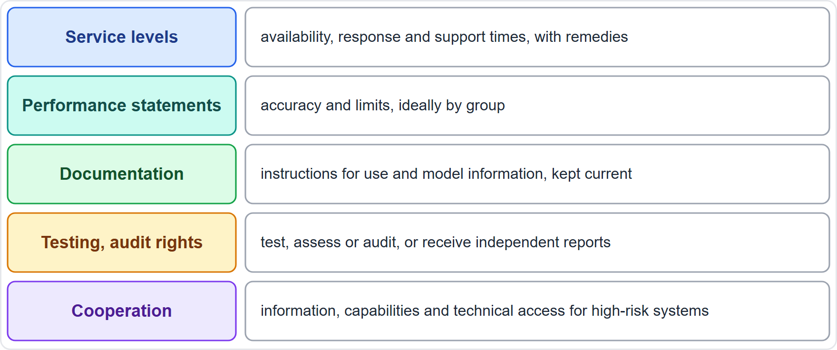
Performance, Documentation and Audit Rights
Part 1
Service levels: availability, response and support times, with remedies if missed
Performance statements: accuracy and limits, ideally by group, and what follows if they are not met
Documentation: instructions for use and model information (Article 13), kept current
Testing and audit rights: to test, assess or audit the system, or receive independent reports; a processor must support audits (Article 28(3))
Cooperation: where a high-risk system is built on a supplier's parts, a written agreement on information, capabilities and technical access (Article 25(4))
EXAM TIP Without documentation and audit rights, a customer cannot do its own oversight and assessment.
AIGP Exam Prep Masterclass | Certified AI Governance Professional
Module 12
13 / 29
Notes:
The table lists five things to secure. Service levels: availability, response and support times, with remedies if missed. Performance statements: accuracy and limits, ideally by group. Documentation: instructions for use and model information, under Article thirteen, kept current. Testing and audit rights: to test, assess or audit the system, or receive independent reports; a processor must support audits under Article twenty-eight, point three. And cooperation: where a high-risk system is built on a supplier's parts, Article twenty-five, point four, calls for a written agreement on information, capabilities and technical access. Exam tip: without these rights, a customer cannot do its own oversight.

Slide 14
Liability, Indemnities and Insurance
BEYOND THE BOK
Part 1
Liability caps: often limited to the fees paid; check whether data breach, IP and confidentiality are carved out or have a higher cap
Exclusions: vendors may exclude losses from errors in AI output; know what stays with you
Indemnities: defense and payment for named claims, such as IP or data breach caused by the vendor
Contracts allocate loss between the parties; they do not remove duties to regulators or to affected people
Insurance: ask about the vendor's cover, and check your own policy for AI-related losses
Helios: Jonas Weber asks for a higher cap for data and IP claims
EXAM TIP A liability cap limits what the vendor pays you, not what you owe to others.
AIGP Exam Prep Masterclass | Certified AI Governance Professional
Module 12
14 / 29
Notes:
This is a beyond-the-Body-of-Knowledge slide. Liability terms decide who pays. Liability caps are often limited to the fees paid, so check whether data breach, I P and confidentiality are carved out or have a higher cap. Vendors may exclude losses from errors in A I output, so know what stays with you. Indemnities give defense and payment for named claims, such as I P or data breach caused by the vendor. Contracts allocate loss between the parties; they do not remove duties to regulators or to affected people. Ask about insurance. Exam tip: a cap limits what the vendor pays you, not what you owe to others.

Slide 15
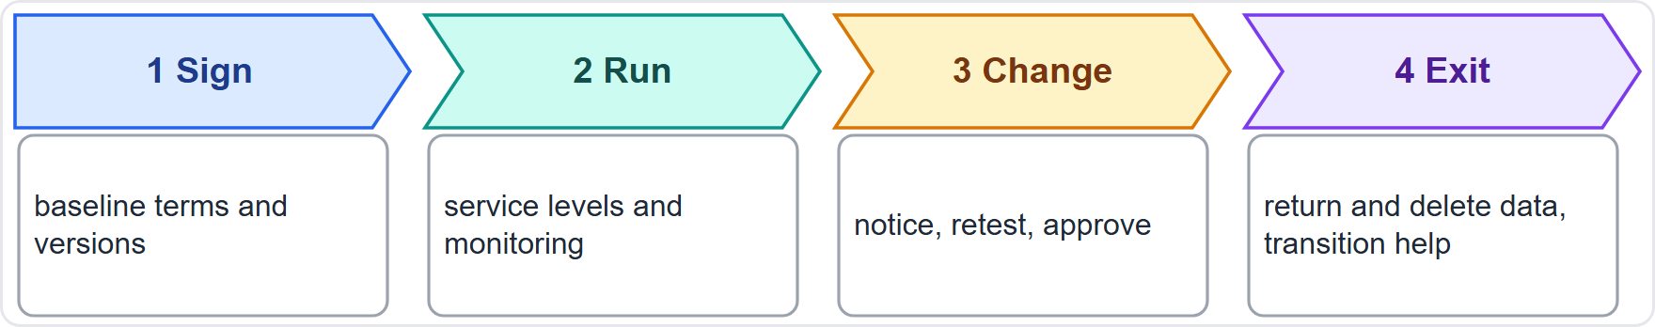
Change, Notice and Exit
BEYOND THE BOK
Part 1
Model changes: the provider may update or replace the model, so require advance notice of material changes, release notes and time to retest; consider version pinning
Deprecation: how long an old version stays available
Subcontractors and changed terms: notice and a right to object or leave
Exit: termination rights, return and deletion of data, transition help and continued access to logs
Lock-in: formats, portability and alternatives
Helios: an unannounced model change could invalidate the tests and the impact assessment (module 10)
EXAM TIP Unannounced model changes break test results, so write notice and retest time into the contract.
AIGP Exam Prep Masterclass | Certified AI Governance Professional
Module 12
15 / 29
Notes:
This is a beyond-the-Body-of-Knowledge slide. The agreement has a life: sign, run, change and exit. Model changes are the big issue. The provider may update or replace the model, so require advance notice of material changes, release notes and time to retest, and consider version pinning. Ask how long an old version stays available. For subcontractors and changed terms, require notice and a right to object or leave. For exit, require termination rights, return and deletion of data, transition help and access to logs. At Helios, an unannounced change could invalidate the tests and the impact assessment. Exam tip: write notice and retest time into the contract.

Slide 16
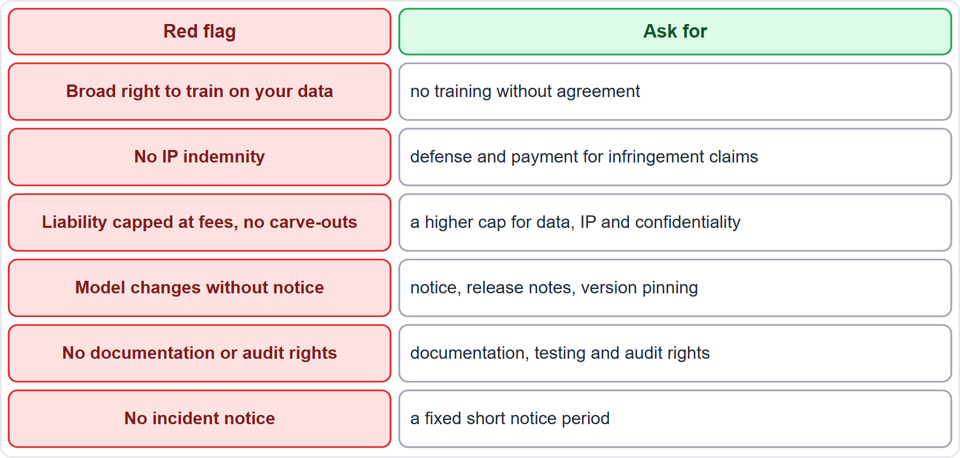
Weighing the Terms: Red Flags and a Review Checklist
BEYOND THE BOK
Part 1
Read the agreement for what each term allocates and what is missing
Red flags: training on your data, no indemnity, caps with no carve-outs, silent model changes, no audit rights, no incident notice
Weigh the terms against the risk of the use: a hiring tool needs more than a spelling helper
Negotiate what matters, and record accepted gaps with compensating controls
Escalate unresolved high risks to the committee (module 2)
EXAM TIP Match the strictness of the terms to the risk of the use, and record any gap you accept.
AIGP Exam Prep Masterclass | Certified AI Governance Professional
Module 12
16 / 29
Notes:
This is a beyond-the-Body-of-Knowledge slide. When you weigh the terms, look at what each term allocates and what is missing. The table lists six red flags and what to ask for instead. A broad right to train on your data: ask for no training without agreement. No I P indemnity: ask for defense and payment. A cap with no carve-outs: ask for a higher cap. Changes without notice: ask for notice and version pinning. No audit rights: ask for documentation and testing rights. No incident notice: ask for a fixed period. Record accepted gaps, and escalate unresolved high risks. Exam tip: match strictness to the risk of the use.

Slide 17
Deploying Your Own Model: What Changes
Part 2
A proprietary model of your own is one the company develops, or has developed, and runs under its own name
A provider develops an AI system or model and places it on the market or puts it into service under its own name (Article 3(3))
Helios today: a deployer of the hiring tool, and of the model behind the assistant (module 6)
In-house build: Helios would also become the provider, with the developer's duties from modules 8 to 10
No vendor stands between you and the user: documentation, testing and monitoring become yours
Putting your name on a high-risk system, or substantially modifying one, also makes you the provider (Article 25(1))
EXAM TIP Building your own model moves you from the deployer's side to the provider's.
AIGP Exam Prep Masterclass | Certified AI Governance Professional
Module 12
17 / 29
Notes:
A proprietary model of your own is one the company develops, or has developed, and runs under its own name. A provider develops an A I system or model and places it on the market or puts it into service under its own name, under Article three, point three. Helios today is a deployer. An in-house build would make Helios the provider too, with the developer's duties from modules eight to ten. No vendor stands between you and the user. Putting your name on a high-risk system, or substantially modifying one, also makes you the provider, under Article twenty-five, point one. Exam tip: building moves you to the provider's side.

Slide 18
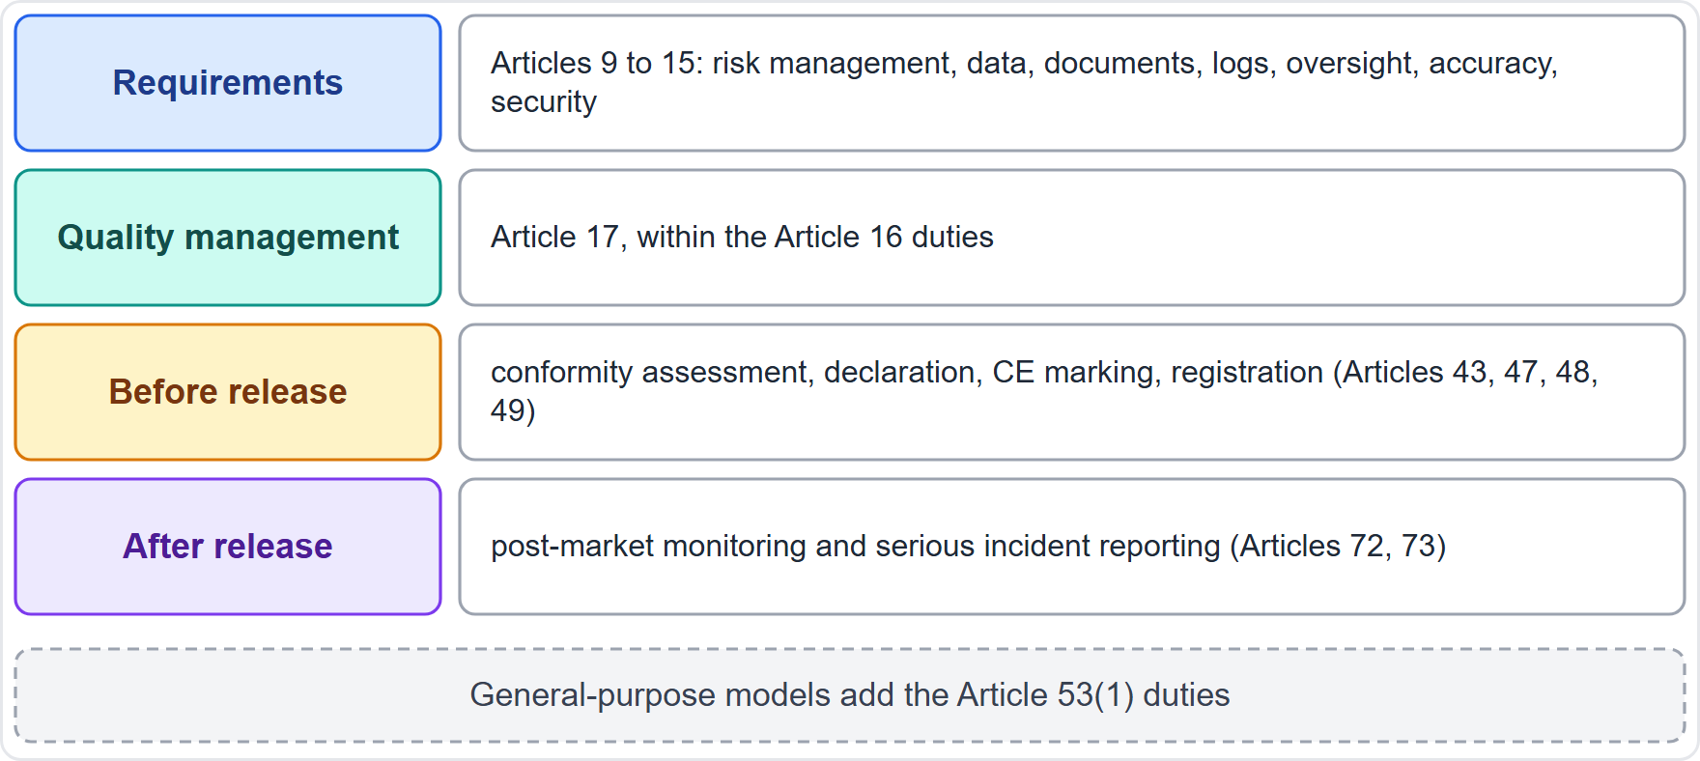
More Obligations: The Provider's Duties
Part 2
If the system is high-risk, the provider meets the requirements in Articles 9 to 15: risk management, data governance, documentation, logs, instructions, oversight, accuracy and security
Article 16: a quality management system (Article 17), documentation and logs
Before release: conformity assessment (Article 43), declaration (Article 47), CE marking (Article 48), registration (Article 49)
After release: post-market monitoring (Article 72) and serious incident reporting (Article 73)
General-purpose model: the Article 53(1) duties (module 6)
As the user of its own system, the company keeps the deployer duties too
EXAM TIP Own model, own duties: everything the provider owes in modules 8 to 10 now falls on you.
AIGP Exam Prep Masterclass | Certified AI Governance Professional
Module 12
18 / 29
Notes:
If the system is high-risk, the provider meets the requirements in Articles nine to fifteen: risk management, data governance, documentation, logs, instructions, oversight, accuracy and security. Article sixteen adds a quality management system, under Article seventeen, with documentation and logs. Before release come the conformity assessment, the declaration, the C E marking and registration, in Articles forty-three, forty-seven, forty-eight and forty-nine. After release come post-market monitoring and serious incident reporting, in Articles seventy-two and seventy-three. A general-purpose model adds Article fifty-three, point one. The company also keeps its deployer duties. Exam tip: own model, own duties.

Slide 19
Higher Potential Liability
DATES
Part 2
No vendor to share the blame: claims about defects, bias or harm come to you as the maker
Product liability: the new EU Product Liability Directive covers software and AI systems and applies to products placed on the market from 9 December 2026
Makers can be liable for defects that appear through updates or machine learning (module 5)
Regulatory exposure: the provider-level duties and fines of the AI Act (module 6)
Contract exposure: your customers' contracts may promise more than you can deliver
Reduce it: strong documentation, testing evidence, monitoring, incident handling, insurance and clear terms of use
As of 27 October 2026: check how the Directive applies to your product before release
EXAM TIP Building your own system makes you the party that injured people and authorities turn to.
AIGP Exam Prep Masterclass | Certified AI Governance Professional
Module 12
19 / 29
Notes:
With your own model, there is no vendor to share the blame. Claims about defects, bias or harm come to you as the maker. The new E U Product Liability Directive covers software and A I systems and applies to products placed on the market from the ninth of December, twenty twenty-six. Makers can be liable for defects that appear through updates or machine learning. You also face the regulatory exposure of the A I Act, and contract exposure if your promises exceed what you can deliver. Reduce it with documentation, testing evidence, monitoring, incident handling, insurance and clear terms of use. As of the twenty-seventh of October, twenty twenty-six, check how the Directive applies before release.

Slide 20
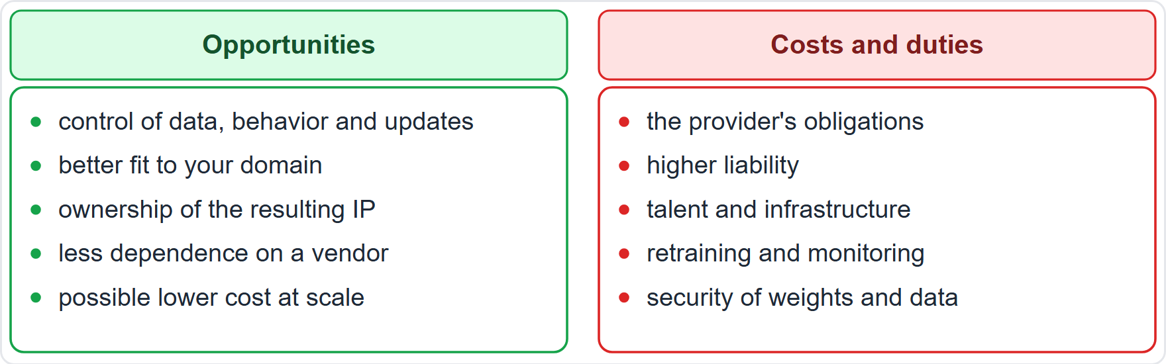
Opportunities: Control, Fit and Advantage
Part 2
Opportunities: control over data, behavior and update timing; better fit to your domain; ownership of the resulting IP; less dependence on a vendor; possible lower cost at scale; differentiation
Costs and duties: the provider's obligations, higher liability, specialist talent and infrastructure, ongoing retraining and monitoring, and security of weights and data
Honest accounting: weigh the opportunities against the obligations, not the first alone
Helios: an in-house assistant could keep data inside the company, but Helios would need new skills and a quality management system
EXAM TIP Control comes with accountability: the opportunities and the obligations arrive together.
AIGP Exam Prep Masterclass | Certified AI Governance Professional
Module 12
20 / 29
Notes:
Running your own model has real opportunities: control over data, behavior and update timing; a better fit to your domain; ownership of the resulting I P; less dependence on a vendor; possible lower cost at scale; and differentiation. But the costs and duties arrive together: the provider's obligations, higher liability, specialist talent and infrastructure, ongoing retraining and monitoring, and security of weights and data. Weigh both. At Helios, an in-house assistant could keep data inside the company, but Helios would need new skills and a quality management system. Exam tip: control comes with accountability.

Slide 21
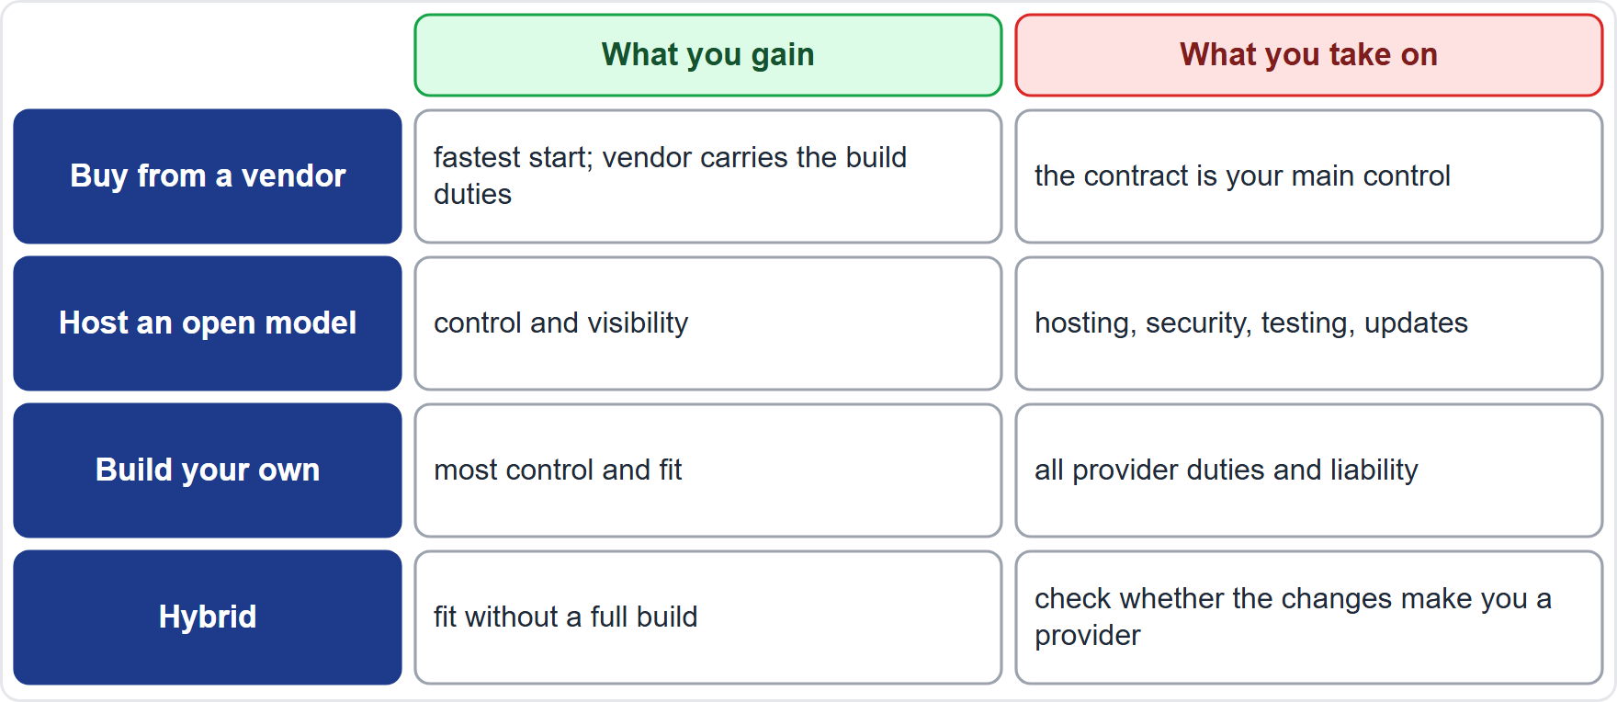
Build, Buy or Both: Deciding With Eyes Open
Part 2
Buy: the fastest start; the provider carries the build duties; the contract is your main control
Open model you host: more control; you take on hosting, security, testing and updates (module 11)
Build: most control and fit; you take on all provider duties and liability
Hybrid: a base model plus your data or retrieval; check whether the changes make you a provider (Article 25)
Decide with requirements, risk, skills, cost, time and the committee's risk appetite; record the decision
Helios: go with conditions: no in-house build until staffing, a quality management system and budget are in place
EXAM TIP Choose to build only when the benefits justify the full set of duties that come with it.
AIGP Exam Prep Masterclass | Certified AI Governance Professional
Module 12
21 / 29
Notes:
The table compares four routes. Buy: the fastest start, the provider carries the build duties, and the contract is your main control. Host an open model: more control, but you take on hosting, security, testing and updates. Build: the most control and fit, but all provider duties and liability. Hybrid: a base model plus your data or retrieval, where you must check whether the changes make you a provider. Decide with requirements, risk, skills, cost, time and the committee's risk appetite, and record the decision. At Helios: go with conditions, with no in-house build until staffing, a quality management system and budget are in place.

Slide 22
Module Recap
Part 2
1
Assess the chosen system
2
Vendor terms
your use, people and data; provider documents plus your own tests; Article 26 and 27 duties; review existing assessments for currency and fit
data use, IP and indemnity, security and incident notice, performance and audit rights, liability, change and exit; know the red flags
3
Own model
4
Decide
you become the provider, with more obligations and higher liability, and also more control and fit
build, buy or both, with eyes open and the decision recorded
AIGP Exam Prep Masterclass | Certified AI Governance Professional
Module 12
22 / 29
Notes:
Let us recap. Assess the chosen system: your use, people and data, using provider documents plus your own tests, the Article twenty-six and twenty-seven duties, and a review of existing assessments for currency and fit. Vendor terms: data use, I P and indemnity, security and incident notice, performance and audit rights, liability, and change and exit, and know the red flags. Your own model: you become the provider, with more obligations, higher liability, and more control. And decide: build, buy or both, with the decision recorded.

Slide 23
Practice Question 1
Part 2
Q1
Helios has selected the Corvid Labs model for its customer assistant. The design-stage impact assessment assumed an internal-only tool, but the assistant will now answer customers in public chat. What should the governance lead do?
A
Keep the design-stage assessment unchanged, because the model and the company are the same as they were at the design stage
B
Wait for the provider to publish its own assessment, and rely on that alone for Helios's use
C
Skip the assessment, because the provider is responsible for the safety of its own model
D
Update the assessment for the selected system and its public use, with the provider's documents and tests
AIGP Exam Prep Masterclass | Certified AI Governance Professional
Module 12
23 / 29
Notes:
Question one. Helios has selected the Corvid Labs model for its customer assistant. The design-stage impact assessment assumed an internal-only tool, but the assistant will now answer customers in public chat. What should the governance lead do? The four options are on the screen. [PAUSE 12] The answer is D. The deployer assesses its own use of the chosen system. Public use is a material change, so update the assessment before launch.

Slide 24
Practice Question 2
Part 2
Q2
A company reviews an impact assessment written by the provider of a hiring tool before relying on it. Which TWO checks are most useful? (Select TWO.)
A
Whether the document carries the provider's logo and a polished professional layout throughout the pages
B
Whether the document is long enough to mention the full range of AI topics and regulations
C
Whether it is current for the latest version and covers the company's own use and applicants
D
Whether it was written by an author who has not seen the tool used in practice
E
Whether the mitigations have named owners and dates, and the triggers for reassessment are stated
AIGP Exam Prep Masterclass | Certified AI Governance Professional
Module 12
24 / 29
Notes:
Question two. A company reviews an impact assessment written by the provider of a hiring tool before relying on it. Which two checks are most useful? Select two. The five options are on the screen. [PAUSE 15] The answers are C and E. A reused assessment must be current and match the deployer's use, and its mitigations need owners, dates and reassessment triggers. Layout and length say nothing about quality.

Slide 25
Practice Question 3
Part 2
Q3
A company reviews a vendor's generative AI service agreement. Which term most directly addresses the risk that employees' confidential prompts could be used to train the vendor's model?
A
A clause limiting the vendor's use of customer data to providing the service, with no training without agreement
B
A clause that sets the monthly uptime target and the service credits owed to the customer if it is missed
C
A clause that names the country whose courts will hear disputes between the parties to the agreement
D
A clause that sets the date on which the first invoice will be issued to the customer by the vendor
AIGP Exam Prep Masterclass | Certified AI Governance Professional
Module 12
25 / 29
Notes:
Question three. A company reviews a vendor's generative A I service agreement. Which term most directly addresses the risk that employees' confidential prompts could be used to train the vendor's model? The four options are on the screen. [PAUSE 12] The answer is A. Data terms control whether prompts and files may be reused. Uptime, courts and invoice dates matter to the contract, but none stops training on the customer's inputs.

Slide 26
Practice Question 4
Part 2
Q4
Ravi Menon and Jonas Weber review the Corvid Labs agreement. It lets the vendor replace the model at any time without notice. What is the main risk, and the best fix?
A
Replacement models are better than the old one, so no change to the terms is needed
B
The model's behavior can change after Helios has tested it, so require notice, retest time and version pinning
C
The vendor may raise its prices, so the fix is a longer period for paying the vendor's invoices each month
D
Customers may notice the change, so the vendor should hide the name of the model it uses from them
AIGP Exam Prep Masterclass | Certified AI Governance Professional
Module 12
26 / 29
Notes:
Question four. Ravi Menon and Jonas Weber review the Corvid Labs agreement. It lets the vendor replace the model at any time without notice. What is the main risk, and the best fix? The four options are on the screen. [PAUSE 12] The answer is B. A silent model change can invalidate the tests and the impact assessment. The contract should require notice, time to retest, and the option to stay on a tested version.

Slide 27
Practice Question 5
Part 2
Q5
Which TWO terms in an AI vendor agreement best help the customer meet its own oversight and assessment duties? (Select TWO.)
A
A clause giving the vendor ownership of everything the customer types into the system and receives from it
B
Access to current documentation, such as instructions for use and information about the model
C
A right for the vendor to show the customer's logo in its own marketing materials and on its website
D
Rights to test or audit the system, and a fixed short notice period for incidents
E
A statement of the location of the vendor's head office and the size of its global workforce
AIGP Exam Prep Masterclass | Certified AI Governance Professional
Module 12
27 / 29
Notes:
Question five. Which two terms in an A I vendor agreement best help the customer meet its own oversight and assessment duties? Select two. The five options are on the screen. [PAUSE 15] The answers are B and D. Oversight and assessment need documentation, the right to test or audit, and fast notice of incidents. Ownership of the customer's inputs, logo rights and the vendor's head office do not help.

Slide 28
Practice Question 6
Part 2
Q6
A company that uses a vendor's AI system decides to build its own proprietary model for the same purpose. Which statement about its position is correct?
A
Its obligations stay the same, because the use case is unchanged and the supplier of the model is the one change
B
It escapes regulation, because a model used only inside the company is never covered by any law or rule
C
It takes on a developer's obligations and higher liability, because no vendor stands between it and the harm
D
Its liability falls, because it now controls the model and there is no other party to blame for the harm it causes
AIGP Exam Prep Masterclass | Certified AI Governance Professional
Module 12
28 / 29
Notes:
Question six. A company that uses a vendor's A I system decides to build its own proprietary model for the same purpose. Which statement about its position is correct? The four options are on the screen. [PAUSE 12] The answer is C. The company becomes the provider, with the developer's obligations and a greater share of the liability. Building a model does not lower the duties or take the system outside the law.

Slide 29
Answers at a Glance
Part 2
Question | Answer | Why
Q1 | D | Update the assessment for the selected system and its use
Q2 | C, E | Current and in scope; owned mitigations and triggers
Q3 | A | A data-use limit stops training on your inputs
Q4 | B | Notice, retest time and version pinning
Q5 | B, D | Documentation; test and audit rights and incident notice
Q6 | C | Provider duties and higher liability
AIGP Exam Prep Masterclass | Certified AI Governance Professional
Module 12
29 / 29
Notes:
Here are all six answers. Question one: D. Question two: C and E. Question three: A. Question four: B. Question five: B and D. Question six: C. That completes Module twelve. Next, Module thirteen: governing deployment and use, with oversight, monitoring, unintended uses, communication, and the policy to deactivate or localize a system.

