Slide 1
Module 13: Governing Deployment and Use
Keeping a live system accountable, from the first user to the final shutdown
Domain IV · Competency C · Indicators IV.C.1 to IV.C.7
AIGP Exam Prep Masterclass
Module 13 · Part 1
Notes:
Welcome to Module thirteen: Governing Deployment and Use. This is the largest competency of domain four. It follows the deployer from the first user to the final shutdown: policies and training, monitoring, periodic checks, records, unintended uses, communication, and the policy to switch a system off or limit it.

Slide 2
What You Will Learn
Part 1
Apply policies, practices and ethics to a system in use: user training, issue management, data governance and risk management
Run monitoring, and a schedule of maintenance, updates and retraining, from the deployer's side
Carry out periodic checks of performance, reliability and safety
Keep records of incidents, issues and risks, and of monitoring plans
Forecast and reduce secondary and unintended uses and the harm they do downstream
Set up external communication plans
Put in place the policy and controls to switch a system off or limit it by region
AIGP Exam Prep Masterclass | Certified AI Governance Professional
Module 13: Governing Deployment and Use
2 / 43
Notes:
By the end of this module you will be able to do seven things. Apply policies, practices and ethics to a system in use. Run monitoring, and a schedule of maintenance, updates and retraining, from the deployer's side. Carry out periodic checks. Keep records of incidents, issues, risks and monitoring plans. Forecast and reduce secondary and unintended uses and their downstream harm. Set up external communication plans. And put in place the policy and controls to switch a system off or limit it by region.

Slide 3
Case Check-In: Oversight, a Misused Assistant and a Switched-Off Feature
Part 1
CASE CHECK-IN · Helios
Lucia Moreno's recruiters review the hiring tool's ranking before any decision; the oversight must be real, not a rubber stamp
A recruiter uses the customer assistant to rank résumés, a use it was never approved for
Samira Haddad asks for an external communication plan for the assistant and the hiring tool
The emotion-analysis feature is switched off in the EU and limited by region elsewhere
Your task: govern the two systems while they are in use
AIGP Exam Prep Masterclass | Certified AI Governance Professional
Module 13: Governing Deployment and Use
3 / 43
Notes:
At Helios, Lucia Moreno's recruiters review the hiring tool's ranking before any decision, and the oversight must be real, not a rubber stamp. A recruiter uses the customer assistant to rank résumés, a use it was never approved for. Samira Haddad asks for an external communication plan for the assistant and the hiring tool. And the emotion-analysis feature is switched off in the E U and limited by region elsewhere. Your task: govern the two systems while they are in use.

Slide 4
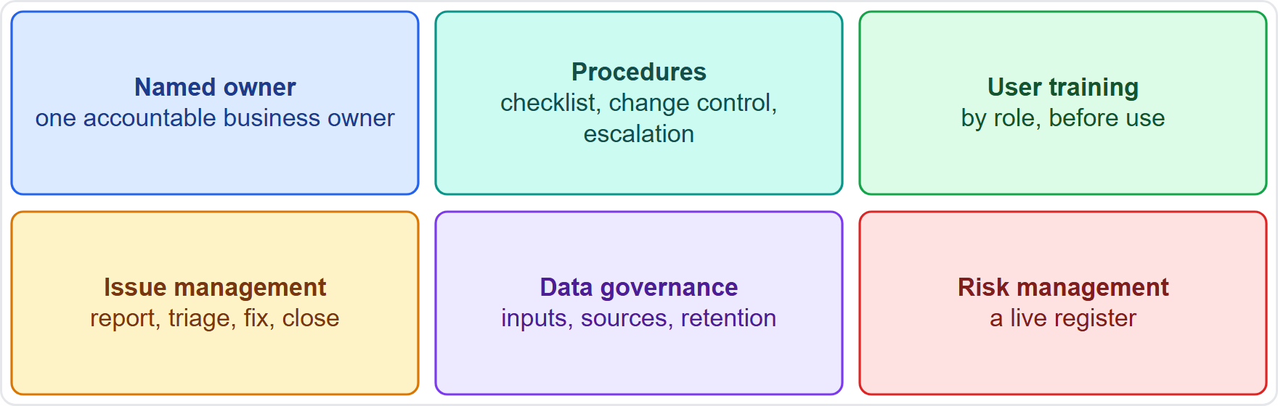
Deployment Governance: Policies, Procedures and Roles
Part 1
Putting a system into use means applying the organization's policies (module 3), not writing new ones
Owner: one named business owner is accountable for the system in use
Procedures: a deployment checklist, change control and an escalation path
Four practices run through use: user training, issue management, data governance and risk management
Ethics: the values and red lines in the policy decide what the system may be used for
Helios: Lucia Moreno owns the hiring tool; Anika Berg owns the assistant
EXAM TIP Policies exist before deployment; deployment governance applies them to the system in use.
AIGP Exam Prep Masterclass | Certified AI Governance Professional
Module 13: Governing Deployment and Use
4 / 43
Notes:
Putting a system into use means applying the organization's policies, from module three, not writing new ones. The figure shows six elements. A named owner: one accountable business owner. Procedures: a deployment checklist, change control and escalation. Then four practices that run through use: user training, issue management, data governance and risk management. Ethics matter too: the values and red lines in the policy decide what the system may be used for. At Helios, Lucia Moreno owns the hiring tool and Anika Berg owns the assistant. Exam tip: policies exist before deployment; deployment governance applies them.

Slide 5
Data Governance and Risk Management in Use
Part 1
Input data: the deployer controls what goes in; for a high-risk system it must ensure input data are relevant and sufficiently representative (Article 26)
Rules for users: what may be entered (no confidential or special-category data unless approved) and where outputs may go
Knowledge sources: owners, review dates and versions for the documents the system draws on (module 11)
Privacy: retention limits, access control and a lawful basis (module 4)
Risk management: the risk register is updated from monitoring, feedback and incidents, not left at its launch version
Helios: the support documents get owners and review dates after the wrong refund answer
EXAM TIP In use, data governance covers the inputs and sources the deployer controls, and the risk register stays alive.
AIGP Exam Prep Masterclass | Certified AI Governance Professional
Module 13: Governing Deployment and Use
5 / 43
Notes:
In use, the deployer controls what goes in. For a high-risk system it must ensure input data are relevant and sufficiently representative, under Article twenty-six. Set rules for users: what may be entered, and where outputs may go. Give knowledge sources owners, review dates and versions. Respect privacy: retention limits, access control and a lawful basis. And keep risk management alive: the risk register is updated from monitoring, feedback and incidents, not left at its launch version. At Helios, the support documents get owners and review dates after the wrong refund answer. Exam tip: the risk register stays alive.

Slide 6
Issue Management: From Report to Fix
Part 1
An issue is a problem found in use: a wrong output, a complaint, a workaround or a gap in a document
Channel: an easy way for users and affected people to report, with an owner who reads it
Flow: log, triage by severity, assign, fix, verify and close
Link to incidents: an issue that causes or could cause harm moves to the incident process (module 10)
Patterns: repeated issues point to a systemic cause and go to the committee
NIST GOVERN 5.1: policies collect and integrate feedback from people outside the team
EXAM TIP An issue log without owners and dates is only a list.
AIGP Exam Prep Masterclass | Certified AI Governance Professional
Module 13: Governing Deployment and Use
6 / 43
Notes:
An issue is a problem found in use: a wrong output, a complaint, a workaround or a gap in a document. Give users and affected people an easy way to report, with an owner who reads it. The flow is: log, triage by severity, assign, fix, verify and close. An issue that causes or could cause harm moves to the incident process from module ten. Repeated issues point to a systemic cause and go to the committee. N I S T Govern five point one asks policies to collect and integrate feedback from people outside the team. Exam tip: a log without owners and dates is only a list.

Slide 7
User Training and Acceptable Use
Part 1
Training by role: operators, reviewers, support staff and managers each need a different depth (module 2)
AI literacy: Article 4 asks deployers to take measures to support the development of AI literacy of staff and others who use the system
Oversight competence: people given oversight of a high-risk system need competence, training and authority (Article 26)
Acceptable-use rules: what the tool is for, what it is not for, what data may go in, and how to report problems
Refresh the training after major changes, incidents and new rules
Helios: recruiters learn to read the ranking, when to disagree and why not to paste résumés into the assistant
EXAM TIP Training is a control: people given oversight must be able to understand, question and override.
AIGP Exam Prep Masterclass | Certified AI Governance Professional
Module 13: Governing Deployment and Use
7 / 43
Notes:
Training is by role: operators, reviewers, support staff and managers each need a different depth, as module two said. Article four asks deployers to take measures to support the development of A I literacy of the people who use the system. People given oversight of a high-risk system need competence, training and authority, under Article twenty-six. Write acceptable-use rules: what the tool is for, what it is not for, what data may go in, and how to report problems. Refresh the training after major changes and incidents. At Helios, recruiters learn why not to paste résumés into the assistant. Exam tip: training is a control.

Slide 8
Meaningful Human Oversight and Transparency to Users
BEYOND THE BOK
Part 1
Meaningful oversight means the person can understand the system, interpret its output, and decide not to use, override or reverse it (Article 14)
Automation bias: the habit of trusting the output too much; training, time and incentives must make disagreement normal
Stop control: a way to intervene or stop the system
Transparency to users: tell people they are interacting with AI, tell those exposed to emotion recognition (Article 50), and tell affected people that a high-risk system supports decisions about them (Article 26)
Not a rubber stamp: measure override rates and review samples
Helios: the recruiters see the reasons for a ranking and may overrule it
EXAM TIP Oversight is meaningful only if the person can understand, disagree and act on the disagreement.
AIGP Exam Prep Masterclass | Certified AI Governance Professional
Module 13: Governing Deployment and Use
8 / 43
Notes:
This is a beyond-the-Body-of-Knowledge slide. Meaningful oversight means the person can understand the system, interpret its output, and decide not to use, override or reverse it, under Article fourteen. Watch for automation bias: the habit of trusting the output too much. Provide a way to intervene or stop. For transparency, tell people they are interacting with A I, tell those exposed to emotion recognition under Article fifty, and tell affected people that a high-risk system supports decisions about them, under Article twenty-six. Measure override rates and review samples. Exam tip: oversight is meaningful only if people can disagree and act on it.

Slide 9
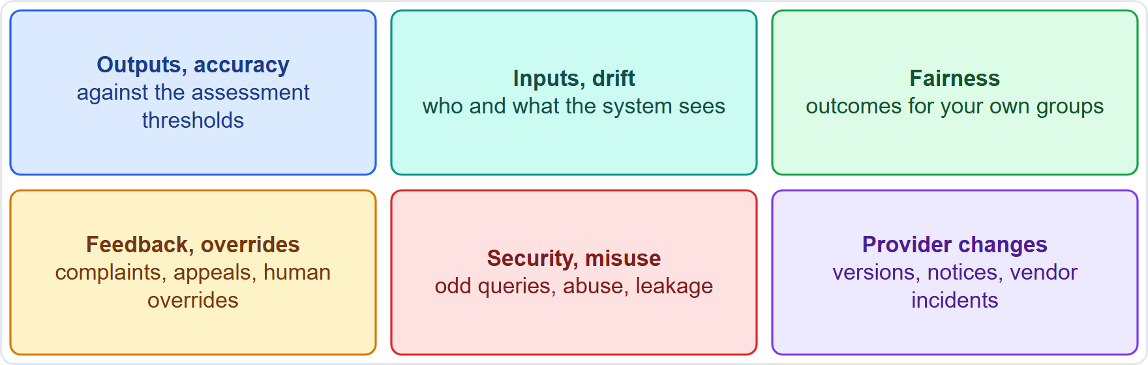
What the Deployer Monitors
Part 1
The deployer watches the system in its own setting, with its own users and data
Outputs and accuracy against the thresholds from the impact assessment
Inputs and drift: shifts in who and what the system sees (module 10)
Fairness of outcomes for your own groups, and feedback and overrides
Security and misuse: unusual queries, abuse and data leakage
Provider changes: new versions, notices and incidents at the vendor
EXAM TIP The deployer monitors the system in its own setting; the provider's monitoring cannot see that.
AIGP Exam Prep Masterclass | Certified AI Governance Professional
Module 13: Governing Deployment and Use
9 / 43
Notes:
The deployer watches the system in its own setting, with its own users and data. Six things to monitor. Outputs and accuracy against the thresholds from the impact assessment. Inputs and drift: shifts in who and what the system sees. Fairness of outcomes for your own groups. Feedback and overrides. Security and misuse: unusual queries, abuse and leakage. And provider changes: new versions, notices and incidents at the vendor. Exam tip: the deployer monitors the system in its own setting; the provider's monitoring cannot see that.

Slide 10
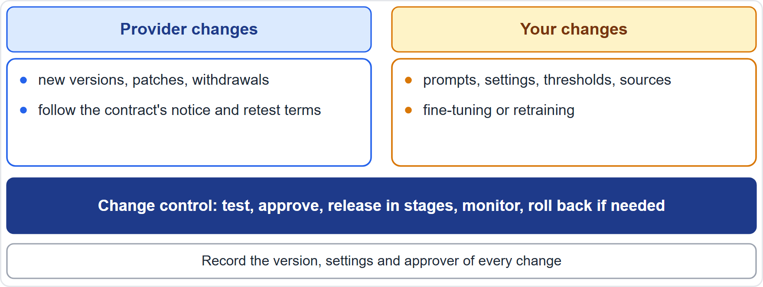
Maintenance, Updates and Retraining in Use
Part 1
Two sources of change: the provider's and your own
Provider changes: new versions, patches and withdrawals; use the contract's notice and retest terms (module 12)
Your changes: prompts, settings, thresholds, knowledge sources and any retraining or fine-tuning
Schedule: regular reviews, patch windows and document refreshes, plus triggered changes after drift or incidents
Change control: test, approve, release in stages, monitor and roll back if needed (module 10)
Record the version, settings and approver of every change
EXAM TIP Every change, whoever makes it, goes through the same test, approve, release and monitor routine.
AIGP Exam Prep Masterclass | Certified AI Governance Professional
Module 13: Governing Deployment and Use
10 / 43
Notes:
Changes come from two sources: the provider's and your own. Provider changes are new versions, patches and withdrawals; use the contract's notice and retest terms from module twelve. Your changes are prompts, settings, thresholds, knowledge sources, and any retraining or fine-tuning. Keep a schedule of regular reviews, patch windows and document refreshes, plus triggered changes after drift or incidents. Both sources pass through the same change control: test, approve, release in stages, monitor and roll back if needed. Record the version, settings and approver. Exam tip: every change, whoever makes it, gets the same routine.

Slide 11
Feedback and Escalation to the Provider
Part 1
Tell the provider: a deployer of a high-risk system must monitor operation and inform the provider, suspend use where there is a risk, and report any serious incident (Article 26)
Use the contract: incident notice, support channels and service reviews (module 12)
Share evidence: logs, examples and test results, with privacy protected
Escalate inside: unresolved issues go to the business owner, then the committee
Track the answers: the provider's fixes and dates go in the issue log
NIST: communicate incidents and errors to relevant AI actors, including affected communities (MANAGE 4.3)
EXAM TIP A deployer who sees a problem and keeps quiet loses both the fix and the chance to show diligence.
AIGP Exam Prep Masterclass | Certified AI Governance Professional
Module 13: Governing Deployment and Use
11 / 43
Notes:
A deployer of a high-risk system must monitor operation and inform the provider, suspend use where there is a risk, and report any serious incident, under Article twenty-six. Use the contract: incident notice, support channels and service reviews. Share evidence, with privacy protected. Escalate inside: unresolved issues go to the business owner, then the committee. Track the provider's answers in the issue log. N I S T Manage four point three asks that incidents and errors are communicated to relevant A I actors, including affected communities. Exam tip: a quiet deployer loses both the fix and the chance to show diligence.

Slide 12
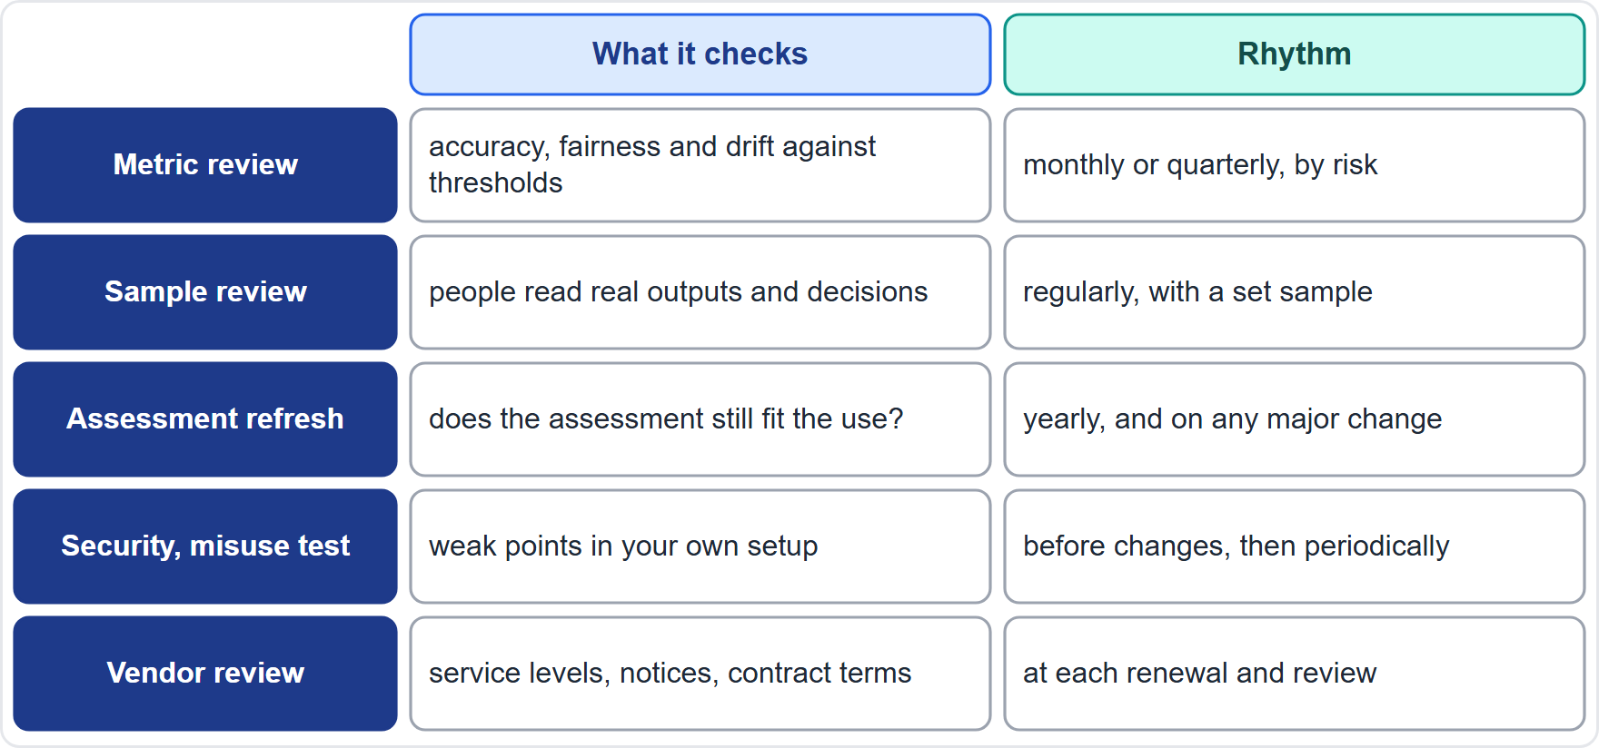
Periodic Checks: Schedule and Scope
Part 1
Periodic checks step back from continuous monitoring to ask whether the system is still performing, reliable and safe in use
Set the schedule by risk, and also run checks after major changes
The table shows five checks: metrics, samples, assessment refresh, security tests and vendor review
Owners run each check and report to the committee
Evidence: keep the results, even when nothing is found
Helios: hiring-tool metrics each quarter; assistant samples each month
EXAM TIP Continuous monitoring watches; periodic checks test.
AIGP Exam Prep Masterclass | Certified AI Governance Professional
Module 13: Governing Deployment and Use
12 / 43
Notes:
Periodic checks step back from continuous monitoring and ask whether the system is still performing, reliable and safe in use. Set the schedule by risk, and also run checks after major changes. The table shows five: a metric review, a sample review, an impact assessment refresh, a security and misuse test, and a vendor review, each with its own rhythm. Owners run each check and report to the committee, and the results are kept even when nothing is found. At Helios, hiring-tool metrics are reviewed each quarter and assistant samples each month. Exam tip: monitoring watches; periodic checks test.

Slide 13
Audits and Reviews in Use
Part 1
Internal audit (the third line, module 2) checks that the system in use follows policy and that controls work
Vendor audit rights (module 12): use them, or ask for independent reports
Independent bias audits: some laws require them, such as New York City's rule for hiring tools, with a public summary
Scope: policy compliance, training records, logs, issue and incident handling, and monitoring evidence
Findings get owners and due dates, and follow-up checks closure
Helios: internal audit reviews hiring-tool oversight; an independent bias audit is arranged for New York City
EXAM TIP An audit looks backward at evidence; it does not replace monitoring.
AIGP Exam Prep Masterclass | Certified AI Governance Professional
Module 13: Governing Deployment and Use
13 / 43
Notes:
Audits and reviews give a backward look at evidence. Internal audit, the third line from module two, checks that the system in use follows policy and that controls work. Use the vendor's audit rights from module twelve, or ask for independent reports. Some laws require independent bias audits, such as New York City's rule for hiring tools, with a public summary. The scope covers policy compliance, training records, logs, issue and incident handling, and monitoring evidence. Findings get owners and due dates. At Helios, internal audit reviews hiring-tool oversight. Exam tip: an audit does not replace monitoring.

Slide 14
Red Teaming and Security Testing of Your Own Setup
Part 1
The deployer's setup has its own weak points: system prompts, knowledge sources, connections and user habits
Red team your configuration: try misuse, injection through documents, data extraction and out-of-scope requests (module 10)
Threat model new connections and features before they ship
Security tests: access control, logging, data leakage and third-party components
Reliability checks: failure handling, fallbacks to a person and recovery
Retest after every significant change
EXAM TIP A provider's testing does not cover your configuration, so test it yourself.
AIGP Exam Prep Masterclass | Certified AI Governance Professional
Module 13: Governing Deployment and Use
14 / 43
Notes:
The deployer's setup has its own weak points: system prompts, knowledge sources, connections and user habits. Red team your configuration: try misuse, injection through documents, data extraction and out-of-scope requests. Threat model new connections and features before they ship. Run security tests on access control, logging, data leakage and third-party components. Check reliability: failure handling, fallbacks to a person and recovery. And retest after every significant change. Exam tip: the provider's testing does not cover your configuration, so test it yourself.

Slide 15
Acting on Findings: Continue, Limit or Suspend
Part 1
Every check ends in a decision: continue, continue with fixes, limit or suspend
Severity decides: harm to people, legal duty and scale
Findings become actions with owners, dates and retests
Report results and trends to the business owner and the committee
Update the risk register, the impact assessment and the training
Suspending use (where there is a risk) and informing the provider (for a risk or a serious incident) are required (Article 26)
EXAM TIP A check that never changes anything is not working.
AIGP Exam Prep Masterclass | Certified AI Governance Professional
Module 13: Governing Deployment and Use
15 / 43
Notes:
Every check ends in a decision: continue, continue with fixes, limit, or suspend. Severity decides: harm to people, legal duty and scale. Findings become actions with owners, dates and retests. Report results and trends to the business owner and the committee. Update the risk register, the impact assessment and the training. And remember that suspending use, where there is a risk, and informing the provider are required, under Article twenty-six. Exam tip: a check that never changes anything is not working.

Slide 16
Three Registers: Incidents, Issues and Risks in Use
Part 2
Incident register: every incident and near miss, with severity, cause, actions and closure
Issue log: problems found in use, with owner, due date and evidence of closure
Risk register: risks, likelihood, severity, controls, owners and status
Link them: an incident updates the risks, and repeated issues point to a risk
Deployer view: include provider incidents that affect you, and complaints from affected people
Review the registers at each committee meeting: trends matter
EXAM TIP Records are evidence: what is not written down cannot be shown.
AIGP Exam Prep Masterclass | Certified AI Governance Professional
Module 13: Governing Deployment and Use
16 / 43
Notes:
Part two begins with records. Keep three registers. The incident register: every incident and near miss, with severity, cause, actions and closure. The issue log: problems found in use, with owner, due date and evidence of closure. The risk register: risks, likelihood, severity, controls, owners and status. Link them: an incident updates the risks, and repeated issues point to a risk. For the deployer's view, include provider incidents that affect you, and complaints from affected people. Review the registers at each committee meeting. Exam tip: what is not written down cannot be shown.

Slide 17
Logs and Retention
Part 2
Automatic logs let you trace what the system did; providers design logging in (Article 12), and deployers keep the logs under their control for at least six months (Article 26)
What to log: inputs, outputs, versions, user actions, overrides and alerts
Protect them: access controls and limits, since logs may hold personal data (module 4)
Retention balance: long enough for investigations and duties, and no longer than privacy rules allow for personal data
Use them for incident investigation, audits and monitoring
NIST: track, respond to and document incidents and errors (MANAGE 4.3)
EXAM TIP Logs serve oversight, but they can also be personal data: keep what you need and protect it.
AIGP Exam Prep Masterclass | Certified AI Governance Professional
Module 13: Governing Deployment and Use
17 / 43
Notes:
Automatic logs let you trace what the system did. Providers design logging in, under Article twelve, and deployers keep the logs under their control for at least six months, under Article twenty-six. Log inputs, outputs, versions, user actions, overrides and alerts. Protect the logs with access controls, because they may hold personal data. Balance retention: long enough for investigations and duties, and no longer than privacy rules allow. Use the logs for incident investigation, audits and monitoring. N I S T Manage four point three asks that incidents and errors are tracked and documented. Exam tip: logs serve oversight, but they can also be personal data.

Slide 18
Monitoring Plans: The Provider's Plan and the Deployer's Part
Part 2
The provider runs a post-market monitoring system and plan for the product (Article 72), collecting and analyzing performance data over its lifetime
The deployer has its own part: it monitors operation and feeds information back to the provider (Article 26)
Document your own monitoring plan: what is watched, by whom, thresholds, alerts, reviews and escalation (module 10)
Align the two plans: who sends what to whom, how often and in which format
Update the plan when the system, the use or the risks change
Helios: Lucia Moreno's team keeps the hiring-tool plan and sends feedback to Veridex
EXAM TIP The provider's plan covers the product; the deployer's plan covers the use.
AIGP Exam Prep Masterclass | Certified AI Governance Professional
Module 13: Governing Deployment and Use
18 / 43
Notes:
The provider runs a post-market monitoring system and plan for the product, under Article seventy-two, collecting and analyzing performance data over its lifetime. The deployer has its own part: it monitors operation and feeds information back to the provider, under Article twenty-six. Document your own monitoring plan: what is watched, by whom, thresholds, alerts, reviews and escalation. Align the two plans: who sends what to whom, how often and in which format. Update the plan when the system, the use or the risks change. Exam tip: the provider's plan covers the product; the deployer's plan covers the use.

Slide 19
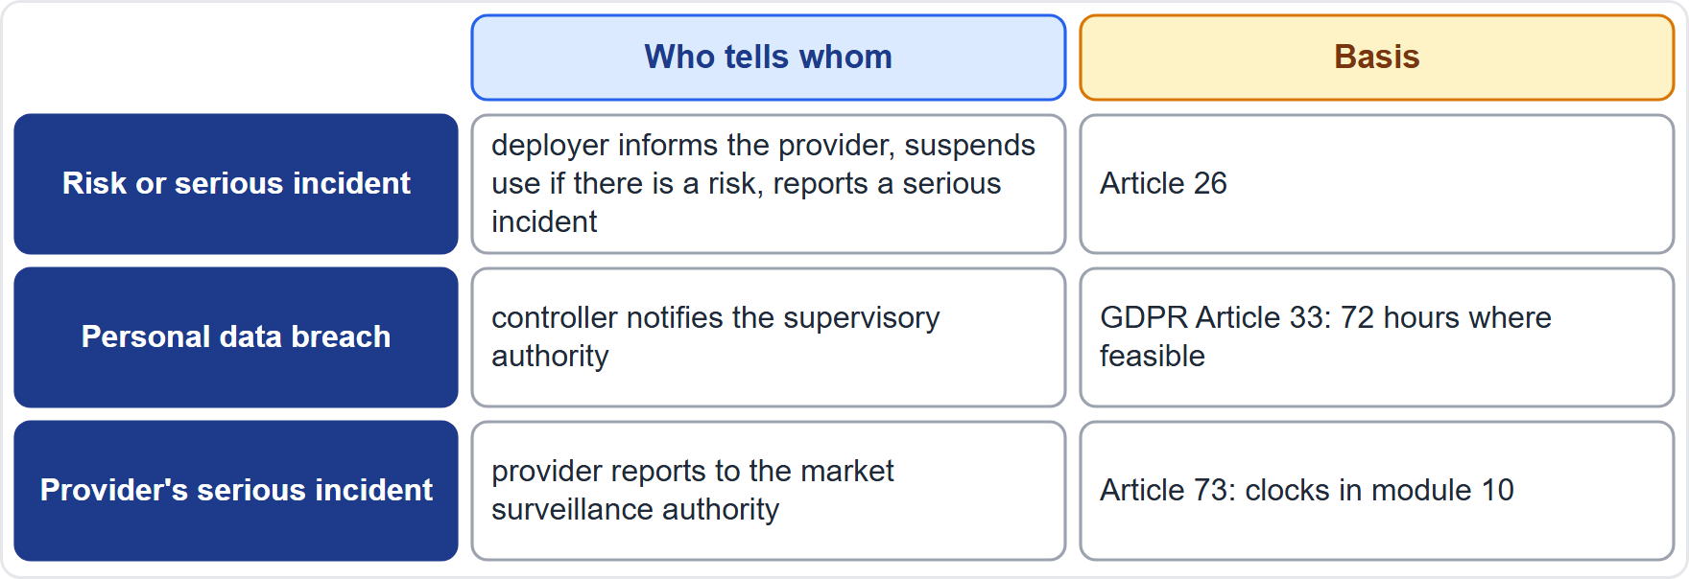
Who Reports What to Whom
Part 2
Deployer to provider: inform the provider, suspend use where there is a risk, and report any serious incident (Article 26)
Provider to authority: the provider reports serious incidents (Article 73), with the clocks from module 10
Personal data breach: the controller notifies the supervisory authority without undue delay and, where feasible, within 72 hours (GDPR Article 33)
Contracts and sector rules may add shorter notices
Affected people are informed as the rules and the communication plan require
Record who was told, when and what
EXAM TIP One event can start several clocks: the shortest applicable one governs.
AIGP Exam Prep Masterclass | Certified AI Governance Professional
Module 13: Governing Deployment and Use
19 / 43
Notes:
The table shows three reporting routes. When a high-risk system presents a risk or a serious incident, the deployer informs the provider, suspends use if there is a risk, and reports a serious incident, under Article twenty-six. When a provider has a serious incident, it reports to the market surveillance authority, under Article seventy-three, with the clocks from module ten. For a personal data breach, the controller notifies the supervisory authority without undue delay and, where feasible, within seventy-two hours, under G D P R Article thirty-three. Contracts and sector rules may add shorter notices. Record who was told, when and what. Exam tip: the shortest applicable clock governs.

Slide 20
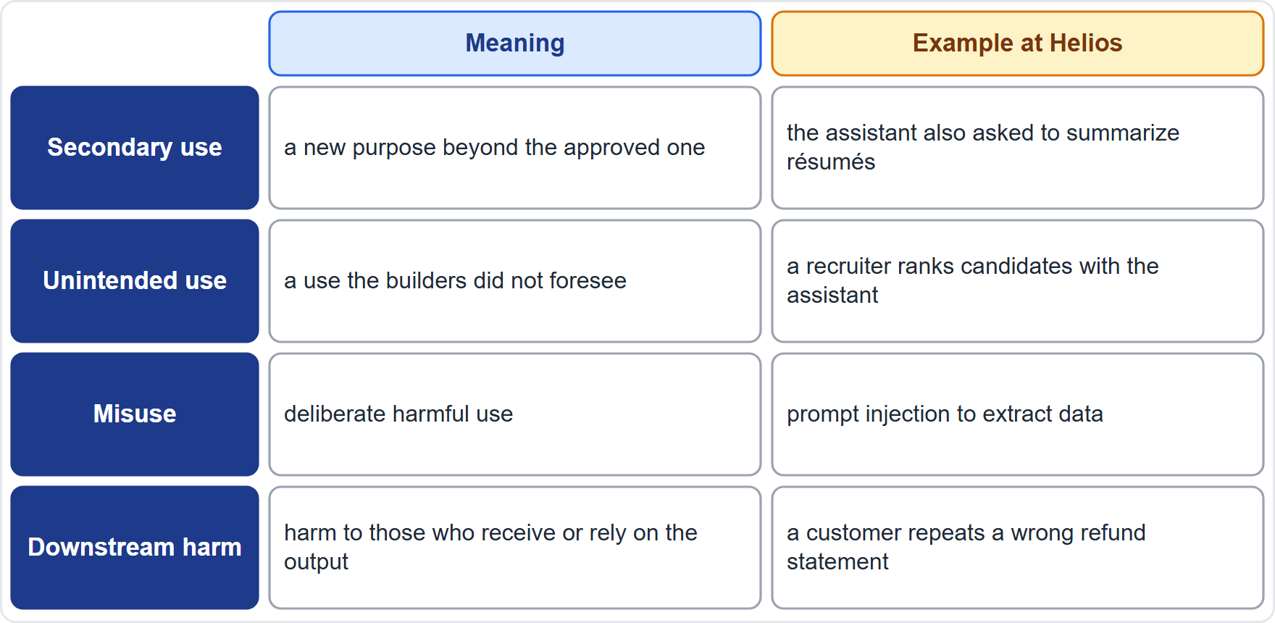
Secondary and Unintended Uses
Part 2
A system approved for one purpose gets used for others
Secondary use: a new purpose beyond the approved one
Unintended use: a use the builders did not foresee, often by well-meaning staff
Misuse: deliberate harmful use
Downstream harm: harm to people or systems that receive or rely on the output
NIST warns about off-label use of AI built for other purposes
EXAM TIP Most unintended use is not malicious: it is convenient.
AIGP Exam Prep Masterclass | Certified AI Governance Professional
Module 13: Governing Deployment and Use
20 / 43
Notes:
A system approved for one purpose gets used for others. Learn four terms. Secondary use: a new purpose beyond the approved one. Unintended use: a use the builders did not foresee, often by well-meaning staff. Misuse: deliberate harmful use. And downstream harm: harm to people or systems that receive or rely on the output. At Helios, a recruiter ranking candidates with the customer assistant is an unintended use. N I S T also warns about off-label use of A I built for other purposes. Exam tip: most unintended use is not malicious; it is convenient.

Slide 21
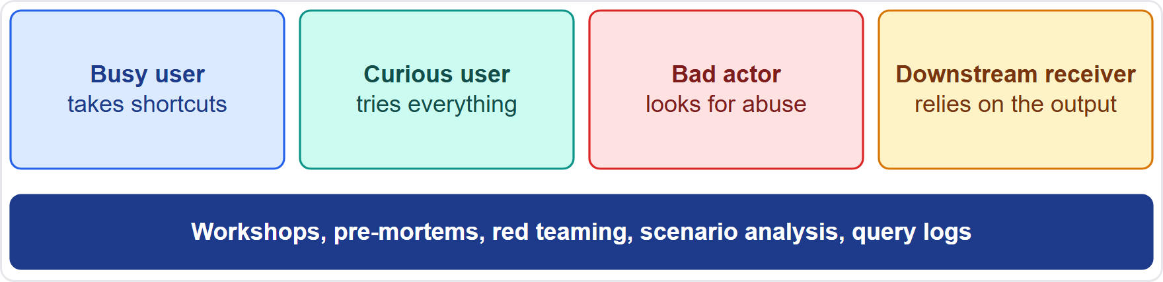
Forecasting Misuse and Downstream Harm
Part 2
Ask early: who else could use this system, for what, and what happens next?
Four lenses: the busy user who takes shortcuts, the curious user who tries everything, the bad actor, and the downstream receiver who relies on the output
Methods: use-case workshops, pre-mortems, red teaming and scenario analysis
Evidence: query logs, feedback and shadow-use surveys show how the system is really used
Link to the impact assessment: add the forecast uses and their harms
Rate each by likelihood and severity, and plan controls (module 8)
EXAM TIP Forecast by asking who else, for what, and what happens next.
AIGP Exam Prep Masterclass | Certified AI Governance Professional
Module 13: Governing Deployment and Use
21 / 43
Notes:
To forecast, ask early: who else could use this system, for what, and what happens next? Use four lenses. The busy user who takes shortcuts. The curious user who tries everything. The bad actor who looks for abuse. And the downstream receiver who relies on the output. Methods include use-case workshops, pre-mortems, red teaming and scenario analysis. Evidence comes from query logs, feedback and shadow-use surveys. Add the forecast uses to the impact assessment, rate them by likelihood and severity, and plan controls. Exam tip: ask who else, for what, and what happens next.

Slide 22
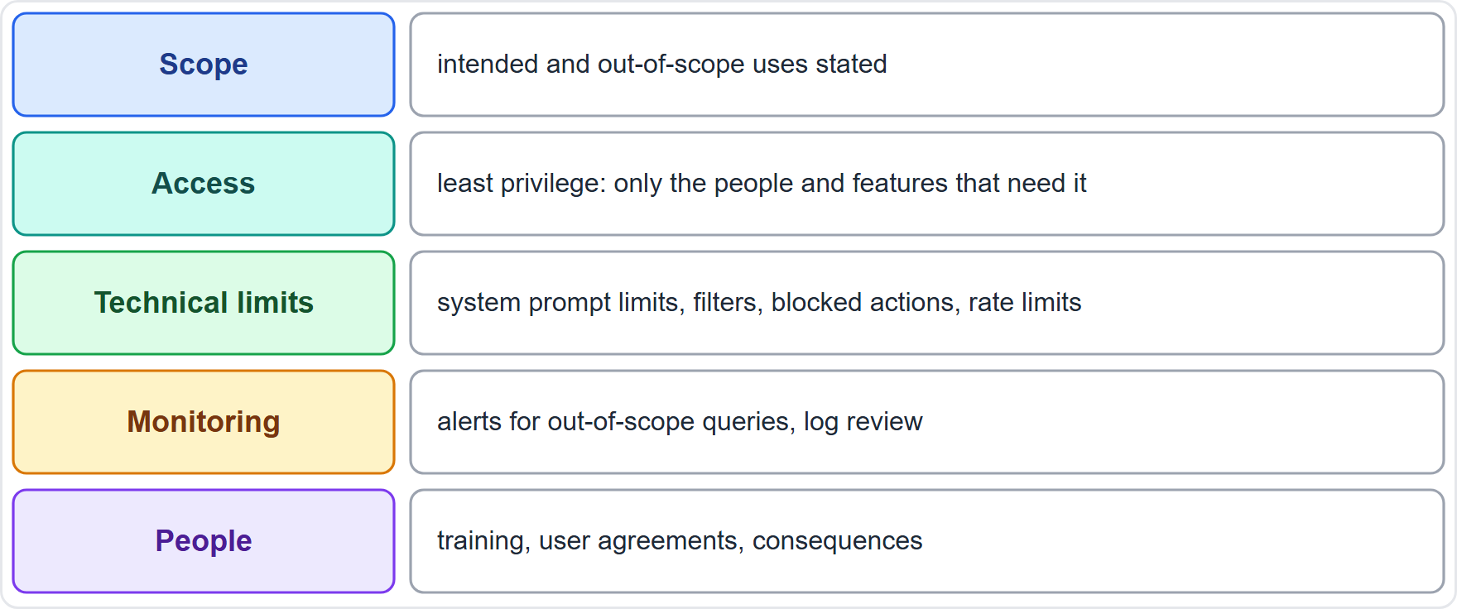
Reducing the Risk: Scope, Access, Monitoring and Training
Part 2
State the scope: intended and out-of-scope uses, in the system and in the instructions to users
Control access: least privilege; only the people and features that need it
Technical limits: system prompt limits, filters, blocked actions and rate limits
Monitor: alerts for out-of-scope queries, and review of logs and shadow use
People: training, user agreements and clear consequences
A change of purpose needs a new assessment; a deployer that changes the intended purpose so that a system becomes high-risk is treated as its provider (Article 25(1))
EXAM TIP Say what the system is for and not for, then back it with access limits and monitoring.
AIGP Exam Prep Masterclass | Certified AI Governance Professional
Module 13: Governing Deployment and Use
22 / 43
Notes:
Reduce unintended use in five layers. Scope: state intended and out-of-scope uses, in the system and in the instructions. Access: least privilege, only the people and features that need it. Technical limits: system prompt limits, filters, blocked actions and rate limits. Monitoring: alerts for out-of-scope queries, and review of logs and shadow use. And people: training, user agreements and clear consequences. A change of purpose needs a new assessment, and a deployer that changes the intended purpose so that a system becomes high-risk is treated as its provider, under Article twenty-five, point one. Exam tip: say what the system is for and not for.

Slide 23
When Harm Travels Downstream
Part 2
Downstream harm happens after the output leaves your system: a customer repeats a wrong answer, a partner reuses data, a decision rests on a draft
Mark outputs: say they are AI-generated, with limits and the need to check
Contract terms: license limits for partners and resellers, and no use for prohibited purposes
Track onward use where you can: APIs, exports and shared datasets
Value-chain risk: NIST lists value chain and component integration among the twelve generative AI risks
Fix and notify when downstream harm is found: corrections, notices and withdrawal of outputs
EXAM TIP Responsibility does not stop at the output: plan for what others do with it.
AIGP Exam Prep Masterclass | Certified AI Governance Professional
Module 13: Governing Deployment and Use
23 / 43
Notes:
Downstream harm happens after the output leaves your system: a customer repeats a wrong answer, a partner reuses data, a decision rests on a draft. Mark outputs as A I-generated, with limits and the need to check. Add contract terms: license limits for partners and resellers, and no use for prohibited purposes. Track onward use where you can: A P I s, exports and shared datasets. N I S T lists value chain and component integration among the twelve generative A I risks. And fix and notify when downstream harm is found. Exam tip: responsibility does not stop at the output.

Slide 24
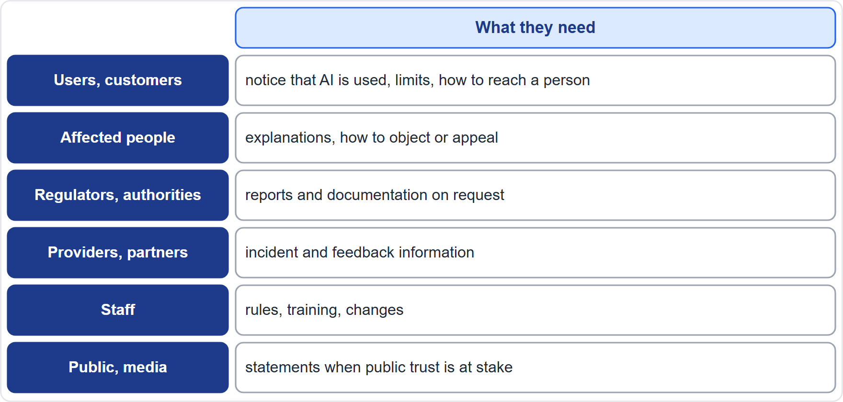
Who Needs to Hear What
Part 2
An external communication plan says who is told what, when, by whom and through which channel
Audiences: users and customers, affected people, regulators, providers and partners, staff, and the public and media
Each audience needs different content, in plain language
Cover routine communication (notices) and event-driven communication (incidents, changes, shutdowns)
Align it with legal duties and with the contract
Approve content with legal, privacy, communications and the business owner
EXAM TIP Plan the audiences first, then the messages.
AIGP Exam Prep Masterclass | Certified AI Governance Professional
Module 13: Governing Deployment and Use
24 / 43
Notes:
An external communication plan says who is told what, when, by whom and through which channel. The table lists six audiences: users and customers, affected people, regulators and authorities, providers and partners, staff, and the public and media. Each needs different content, in plain language. Cover routine communication, such as notices, and event-driven communication, such as incidents, changes and shutdowns. Align the plan with legal duties and with the contract, and approve content with legal, privacy, communications and the business owner. Exam tip: plan the audiences first, then the messages.

Slide 25
Notices, Explanations and Incident Statements
Part 2
Notices: people interacting with an AI system are told so, unless it is obvious; deployers of emotion recognition inform the people exposed to it (Article 50)
Explanations: what the system does, its limits, the role of human review and how to ask for a person
Appeal and complaint route: easy to find, with an owner and a response time
Incident statements: facts, impact, actions and the next update, prepared as templates with a holding statement
Accuracy: nothing is promised that the system cannot deliver
Helios: candidates are told that AI screens applications and how to reach a person (module 10)
EXAM TIP Prepare the words before the incident: templates save hours and mistakes.
AIGP Exam Prep Masterclass | Certified AI Governance Professional
Module 13: Governing Deployment and Use
25 / 43
Notes:
Four parts of the content. Notices: people interacting with an A I system are told so, unless it is obvious, and deployers of emotion recognition inform the people exposed to it, under Article fifty. Explanations: what the system does, its limits, the role of human review, and how to ask for a person. An appeal and complaint route, with an owner and a response time. And incident statements: facts, impact, actions and the next update, prepared as templates with a holding statement. Promise nothing the system cannot deliver. Exam tip: prepare the words before the incident.

Slide 26
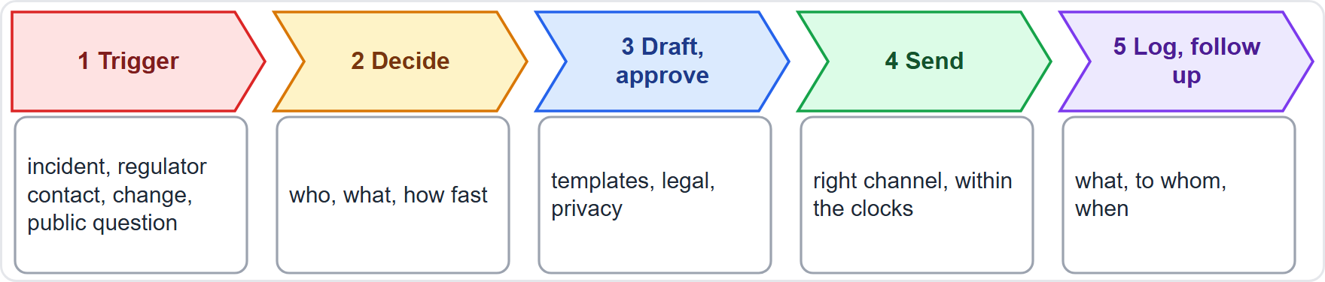
Running the Plan: Owners, Triggers, Channels and Rehearsal
Part 2
Owner: one named lead, with legal, privacy and communications
Triggers: incidents above a set severity, regulator contact, major changes and public questions
Channels and timing: the right channel for each audience, within the required clocks
Rehearse: table-top exercises for an incident, a shutdown and a media question
Log what was said, to whom and when, and review after each event
Helios: Samira Haddad, Jonas Weber and Anika Berg form the communication group
EXAM TIP A plan that is never rehearsed will fail the first time it is needed.
AIGP Exam Prep Masterclass | Certified AI Governance Professional
Module 13: Governing Deployment and Use
26 / 43
Notes:
The routine has five steps: trigger, decide, draft and approve, send, then log and follow up. Name one lead, with legal, privacy and communications. Set triggers: incidents above a set severity, regulator contact, major changes and public questions. Choose the right channel for each audience, within the required clocks. Rehearse with table-top exercises for an incident, a shutdown and a media question. Log what was said, to whom and when. At Helios, Samira Haddad, Jonas Weber and Anika Berg form the group. Exam tip: a plan that is never rehearsed will fail the first time.

Slide 27
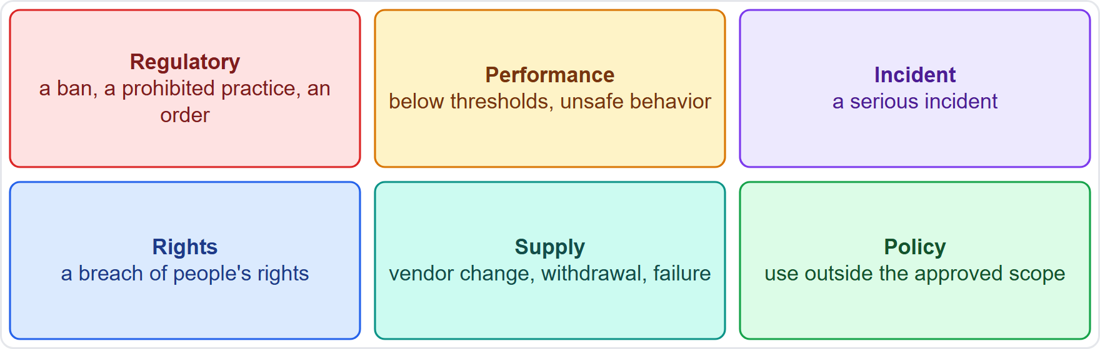
Why Switch Off or Limit a System: The Triggers
Part 2
Deactivate means switch the system or one feature off; localize means limit it by region, group or feature
Regulatory triggers: a prohibited practice in a region, a ban or an authority's order
Performance triggers: accuracy or fairness below thresholds, or unsafe behavior
Incident and rights triggers: a serious incident or a breach of people's rights
Supply and policy triggers: a vendor change or failure, or use outside the approved scope
NIST: mechanisms to supersede, disengage or deactivate systems that perform inconsistently with their intended use (MANAGE 2.4)
EXAM TIP Decide the triggers before launch, not during the crisis.
AIGP Exam Prep Masterclass | Certified AI Governance Professional
Module 13: Governing Deployment and Use
27 / 43
Notes:
To deactivate means to switch the system or one feature off. To localize means to limit it by region, group or feature. Six kinds of trigger. Regulatory: a prohibited practice in a region, a ban or an authority's order. Performance: accuracy or fairness below thresholds, or unsafe behavior. Incident and rights: a serious incident or a breach of people's rights. Supply: a vendor change or failure. And policy: use outside the approved scope. N I S T Manage two point four asks for mechanisms to supersede, disengage or deactivate. Exam tip: decide the triggers before launch, not during the crisis.

Slide 28
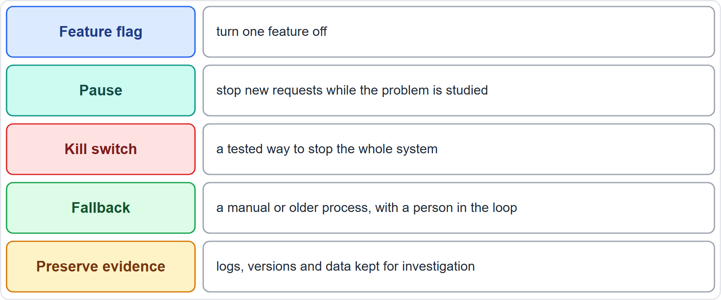
Deactivation Controls: Kill Switch, Pause and Fallback
Part 2
Feature flags: turn one feature off without stopping everything
Pause: stop new requests while the problem is studied
Kill switch: a tested way to stop the whole system at once
Fallback: a manual or older process so the business keeps running, with a person in the loop
Preserve evidence: logs, versions and data kept for investigation
Article 14 expects a way to intervene or stop a high-risk system
EXAM TIP A kill switch that has never been tested cannot be trusted.
AIGP Exam Prep Masterclass | Certified AI Governance Professional
Module 13: Governing Deployment and Use
28 / 43
Notes:
Give yourself graded control. Feature flags turn one feature off without stopping everything. A pause stops new requests while the problem is studied. A kill switch is a tested way to stop the whole system at once. A fallback is a manual or older process so the business keeps running, with a person in the loop. And preserve evidence: logs, versions and data kept for investigation. Article fourteen expects a way to intervene or stop a high-risk system. Exam tip: a kill switch that has never been tested cannot be trusted.

Slide 29
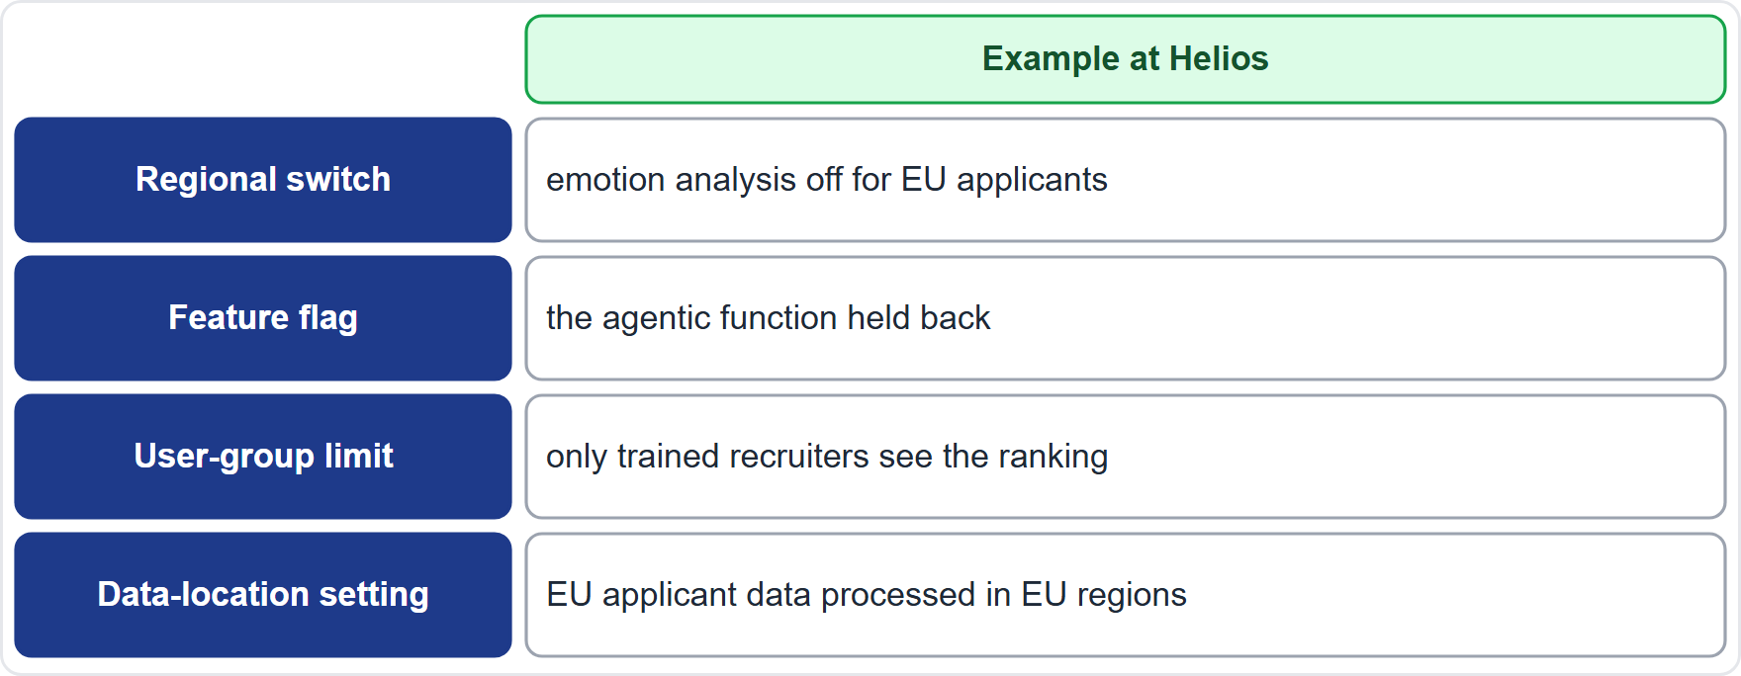
Localizing a System by Region, Group or Feature
Part 2
Why localize: laws and risks differ by region, user group and feature, so one setting rarely fits all
Methods: regional switches (geofencing), feature flags, user-group limits and data-location settings
Governance: a map of each feature by region, with the legal reason and an owner
Helios: the hiring tool's emotion analysis is off in the EU, because the law bans inferring emotions at work (Article 5), and limited by region elsewhere until legal review
Test that the switch holds, so that EU applicants never reach the feature
Review the map when the law or the system changes
EXAM TIP Localization means different settings in different places, with a record of why.
AIGP Exam Prep Masterclass | Certified AI Governance Professional
Module 13: Governing Deployment and Use
29 / 43
Notes:
Laws and risks differ by region, user group and feature, so one setting rarely fits all. Four methods: regional switches, feature flags, user-group limits and data-location settings. Keep a map of each feature by region, with the legal reason and an owner. At Helios, the hiring tool's emotion analysis is off in the E U, because the law bans inferring emotions at work, under Article five, and it is limited by region elsewhere until legal review. Test that the switch holds, so that E U applicants never reach the feature. Exam tip: different settings in different places, with a record of why.

Slide 30
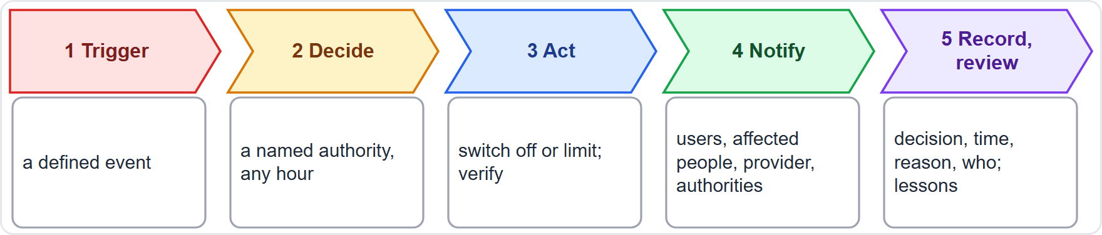
The Deactivation Policy: Authority, Steps and Records
Part 2
Authority: who may order a shutdown, including out of hours, and who must be told
Criteria: clear triggers and a fast route for urgent cases
Steps: decide, act, verify that it worked, notify and investigate
Notify: users, affected people, the provider and authorities as required
Records: the decision, the time, the reason and who acted
Test it: exercises that include switching off and recovering
EXAM TIP Give a named person the authority to switch off, so that nobody needs a meeting to stop a harm.
AIGP Exam Prep Masterclass | Certified AI Governance Professional
Module 13: Governing Deployment and Use
30 / 43
Notes:
The policy needs a named authority: who may order a shutdown, including out of hours, and who must be told. It sets clear criteria and a fast route for urgent cases. The steps are: decide, act, verify that it worked, notify, and investigate. Notify users, affected people, the provider and authorities as required. Keep records of the decision, the time, the reason and who acted. And test the policy with exercises that include switching off and recovering. Exam tip: nobody should need a meeting to stop a harm.

Slide 31
After Deactivation: Retire, Retain and Restart
Part 2
Decide the outcome: restart after fixes, run in a limited form, or retire the system
Restart conditions: root cause fixed, retests passed, approvals given and communication done
Retire: stop access, archive the model and documents, and delete or transfer data under privacy rules and contracts (NIST names decommissioning in MANAGE 4.1)
Retain: logs and records for the periods that law and policy require
Tell people: users and partners know what ends and what replaces it
Learn: update the policy, the tests and the training
EXAM TIP Switching off starts a process: decide whether to restart, limit or retire.
AIGP Exam Prep Masterclass | Certified AI Governance Professional
Module 13: Governing Deployment and Use
31 / 43
Notes:
Switching off starts a process. Decide the outcome: restart after fixes, run in a limited form, or retire the system. Restart only when the root cause is fixed, retests have passed, approvals are given and communication is done. To retire, stop access, archive the model and documents, and delete or transfer data under privacy rules and contracts; N I S T names decommissioning in Manage four point one. Retain logs and records for the periods that law and policy require. Tell users and partners what ends and what replaces it. And learn: update the policy, the tests and the training. Exam tip: decide whether to restart, limit or retire.

Slide 32
Module Recap
Part 2
1
Policies in use
2
Monitoring and checks
3
Records and reporting
a named owner, training, issue management, data governance and a live risk register; oversight that is meaningful, not a rubber stamp
the deployer's own monitoring, change control for provider and own changes, and periodic checks that end in a decision
three registers, logs for at least six months, monitoring plans, and the reporting routes and clocks
4
Unintended use
5
Communication
6
Switching off
forecast with four lenses, reduce with scope, access, technical limits, monitoring and people controls
audiences, notices, templates and rehearsal
triggers, kill switch and fallback, localizing by region, a policy with named authority, and restart or retire
AIGP Exam Prep Masterclass | Certified AI Governance Professional
Module 13: Governing Deployment and Use
32 / 43
Notes:
Let us recap. Policies in use: a named owner, training, issue management, data governance and a live risk register, with oversight that is meaningful. Monitoring and checks: the deployer's own monitoring, change control for provider and own changes, and periodic checks that end in a decision. Records and reporting: three registers, logs for at least six months, monitoring plans and reporting routes. Unintended use: four lenses to forecast, five layers to reduce. Communication: audiences, notices, templates and rehearsal. And switching off: triggers, kill switch, fallback, localizing, a policy with named authority, and restart or retire.

Slide 33
Practice Question 1
Part 3
Q1
Lucia Moreno's recruiters approve almost every candidate ranking that the Helios hiring tool produces, usually within seconds, and have never overridden one. What is the best governance response?
A
Congratulate the team, because the high approval rate shows that the tool is accurate and that the recruiters trust it
B
Remove the human review, because it adds no value if the reviewers agree with the tool's ranking and do not override it, and it saves time
C
Check whether oversight is meaningful: review samples and override rates, train recruiters, and give them time to challenge
D
Replace the recruiters with a different group who have not yet used the tool, and then repeat the same review process
AIGP Exam Prep Masterclass | Certified AI Governance Professional
Module 13: Governing Deployment and Use
33 / 43
Notes:
Question one. Lucia Moreno's recruiters approve almost every candidate ranking that the Helios hiring tool produces, usually within seconds, and have never overridden one. What is the best governance response? The four options are on the screen. [PAUSE 12] The answer is C. Near-total agreement and no overrides can signal automation bias. Measure the oversight, train the recruiters and give them time to challenge.

Slide 34
Practice Question 2
Part 3
Q2
A company puts a customer-facing generative AI assistant into use. Which TWO actions apply its policies to the system in use? (Select TWO.)
A
Name one business owner and set up a route for users to report problems to an owner who triages them
B
Publish a press release and a launch blog post about the new assistant, and treat the policy work as finished
C
Wait for the first complaint from a customer before deciding who is responsible for the assistant and its answers
D
Set rules for what users may enter, and give the documents the assistant uses owners and review dates
E
Leave the training to the vendor, because users will learn the tool by themselves through daily use over time
AIGP Exam Prep Masterclass | Certified AI Governance Professional
Module 13: Governing Deployment and Use
34 / 43
Notes:
Question two. A company puts a customer-facing generative A I assistant into use. Which two actions apply its policies to the system in use? Select two. The five options are on the screen. [PAUSE 15] The answers are A and D. Applying policy in use means accountable ownership, an issue route, rules for inputs and managed knowledge sources. A press release, waiting for complaints and no training apply no policy.

Slide 35
Practice Question 3
Part 3
Q3
A company uses a vendor's language model through an interface. The vendor announces a new model version for next month. What should the company do?
A
Accept the new version as it arrives, because vendor updates are improvements for the customers who use them
B
Refuse updates from the vendor, so that the system stays the same after it has been launched to its users
C
Wait until users report problems, and then decide whether to test the new version or just ignore it
D
Test the new version first using the notice terms, approve it under change control, and keep a rollback
AIGP Exam Prep Masterclass | Certified AI Governance Professional
Module 13: Governing Deployment and Use
35 / 43
Notes:
Question three. A company uses a vendor's language model through an interface. The vendor announces a new model version for next month. What should the company do? The four options are on the screen. [PAUSE 12] The answer is D. Provider changes are changes to your system. Test the new version before it reaches users, approve it under change control and keep a rollback ready.

Slide 36
Practice Question 4
Part 3
Q4
Which is the best example of a periodic check by the deployer, as distinct from continuous monitoring?
A
An alert that fires in the middle of the night when the error rate crosses a set threshold and pages the on-call engineer
B
A scheduled quarterly review in which reviewers read sampled outputs, retest fairness and refresh the impact assessment
C
A dashboard that shows live traffic to the system for the operations team throughout the working day
D
A log entry that is written automatically each time a user submits a request to the live system
AIGP Exam Prep Masterclass | Certified AI Governance Professional
Module 13: Governing Deployment and Use
36 / 43
Notes:
Question four. Which is the best example of a periodic check by the deployer, as distinct from continuous monitoring? The four options are on the screen. [PAUSE 12] The answer is B. Periodic checks step back and test the system on a schedule: sample review, fairness retest and assessment refresh. Alerts, dashboards and automatic logs are continuous monitoring.

Slide 37
Practice Question 5
Part 3
Q5
A deployer of a high-risk AI system keeps the automatically generated logs that are under its control. What is the best statement about how long to keep them?
A
At least six months, and no longer than privacy rules allow for any personal data in them
B
Twenty-four hours, because logs are useful for fixing technical faults on the same day they are produced
C
Indefinitely, because the logs do not contain personal data and so no time limit applies to them
D
Until the vendor asks for them, because the deployer has no duties about its own logs or their storage
AIGP Exam Prep Masterclass | Certified AI Governance Professional
Module 13: Governing Deployment and Use
37 / 43
Notes:
Question five. A deployer of a high-risk A I system keeps the automatically generated logs that are under its control. What is the best statement about how long to keep them? The four options are on the screen. [PAUSE 12] The answer is A. Deployers keep the logs they control for at least six months, and because logs can contain personal data, privacy limits apply as well.

Slide 38
Practice Question 6
Part 3
Q6
A Helios recruiter pastes candidates' résumés into the customer assistant and asks it to rank them. The assistant was approved only for answering customers' questions about services. What describes this situation and the best response?
A
A normal use, because the assistant can read the text that a user gives it, so no approval is needed
B
Downstream harm, so Helios should wait to see whether a candidate complains about the ranking before acting
C
An unintended use outside the approved scope: stop it, restate the scope, add controls and assess the risk
D
A security attack from outside the company, so the security team is the one team that needs to be told about it
AIGP Exam Prep Masterclass | Certified AI Governance Professional
Module 13: Governing Deployment and Use
38 / 43
Notes:
Question six. A Helios recruiter pastes candidates' résumés into the customer assistant and asks it to rank them. The assistant was approved only for answering customers' questions about services. What describes this situation and the best response? The four options are on the screen. [PAUSE 12] The answer is C. It is an unintended use outside the approved scope. Stop it, restate the scope, add controls, and assess the hiring risk.

Slide 39
Practice Question 7
Part 3
Q7
Which TWO methods help forecast secondary or unintended uses of an AI system? (Select TWO.)
A
Assuming that users will follow the statement of intended use, however busy they are
B
Running a pre-mortem that asks who else could use the system, for what, and what happens next
C
Waiting for regulators to announce which uses of the system they consider harmful or prohibited
D
Counting the number of pages in the user manual that explain the approved uses and the limits
E
Reviewing query logs and feedback for requests that fall outside the approved scope
AIGP Exam Prep Masterclass | Certified AI Governance Professional
Module 13: Governing Deployment and Use
39 / 43
Notes:
Question seven. Which two methods help forecast secondary or unintended uses of an A I system? Select two. The five options are on the screen. [PAUSE 15] The answers are B and E. Forecasting asks who else might use the system, and checks how it is really used, through workshops, pre-mortems, red teaming and log review. Assuming compliance, waiting for regulators and counting pages forecast nothing.

Slide 40
Practice Question 8
Part 3
Q8
Samira Haddad asks for an external communication plan for the Helios assistant. Which element is most important to prepare before any incident occurs?
A
A commitment to customers that the assistant will give correct answers under normal conditions
B
A single technical message that is sent unchanged to customers, regulators and staff alike
C
A rule to stay silent in public unless a journalist asks a direct question about the assistant
D
Named owners, triggers, channels and templates for each audience, with a rehearsal
AIGP Exam Prep Masterclass | Certified AI Governance Professional
Module 13: Governing Deployment and Use
40 / 43
Notes:
Question eight. Samira Haddad asks for an external communication plan for the Helios assistant. Which element is most important to prepare before any incident occurs? The four options are on the screen. [PAUSE 12] The answer is D. A plan works when it has owners, triggers, channels and prepared templates for each audience, and has been rehearsed. Promising no errors, one message for everyone and silence are not plans.

Slide 41
Practice Question 9
Part 3
Q9
The Helios hiring tool includes an emotion-analysis feature that is unlawful for EU applicants but may be usable elsewhere after legal review. Which control best localizes the system?
A
A regional switch that turns the feature off for EU applicants, with a test that it holds and the reason recorded
B
Deleting the whole hiring tool in each region where it runs, so that no feature remains in use in the company
C
Leaving the feature on everywhere and relying on a notice that tells applicants the feature is in use, in each region
D
Asking recruiters to ignore the emotion scores in EU cases while the feature keeps running in the background
AIGP Exam Prep Masterclass | Certified AI Governance Professional
Module 13: Governing Deployment and Use
41 / 43
Notes:
Question nine. The Helios hiring tool includes an emotion-analysis feature that is unlawful for E U applicants but may be usable elsewhere after legal review. Which control best localizes the system? The four options are on the screen. [PAUSE 12] The answer is A. Localizing means different settings in different places: switch the feature off in the E U, test the switch and record why. A notice does not make a prohibited use lawful.

Slide 42
Practice Question 10
Part 3
Q10
A company drafts a policy to deactivate a high-risk AI system when needed. Which TWO elements belong in it? (Select TWO.)
A
A rule that a shutdown needs a full committee meeting, even for an urgent safety event
B
A requirement that the kill switch be tested after the first real emergency has occurred
C
A named authority who can order a shutdown at any hour, with clear triggers
D
A promise that the system will never be switched off once it has been launched
E
Steps to notify affected parties, preserve evidence and record the decision and reason
AIGP Exam Prep Masterclass | Certified AI Governance Professional
Module 13: Governing Deployment and Use
42 / 43
Notes:
Question ten. A company drafts a policy to deactivate a high-risk A I system when needed. Which two elements belong in it? Select two. The five options are on the screen. [PAUSE 15] The answers are C and E. A deactivation policy needs a named authority with clear triggers, and steps to notify, preserve evidence and record. Committee meetings for urgent events, an untested kill switch and a promise never to switch off defeat the purpose.

Slide 43
Answers at a Glance
Part 3
Question | Answer | Why
Q1 | C | Meaningful oversight: samples, override rates, training
Q2 | A, D | Owner and issue route; input rules and managed sources
Q3 | D | Test, approve and keep a rollback
Q4 | B | A scheduled review that tests, not an alert
Q5 | A | At least six months, within privacy limits
Q6 | C | Unintended use: stop, restate scope, add controls
Q7 | B, E | Workshops and pre-mortems; log review
Q8 | D | Owners, triggers, channels, templates and rehearsal
Q9 | A | A tested regional switch with the reason recorded
Q10 | C, E | Named authority; notify, preserve evidence, record
AIGP Exam Prep Masterclass | Certified AI Governance Professional
Module 13: Governing Deployment and Use
43 / 43
Notes:
Here are all ten answers. Question one: C. Question two: A and D. Question three: D. Question four: B. Question five: A. Question six: C. Question seven: B and E. Question eight: D. Question nine: A. Question ten: C and E. That completes Module thirteen, and with it domain four. Next, Module fourteen is a quick-reference recap of everything so far, and Module fifteen covers exam technique.

