Slide 1
Module 14: Quick-Reference Recap
One page per comparison, a glossary and a decision aid
Built from modules 1 to 13, for the last days before the exam
AIGP Exam Prep Masterclass
Module 14
Notes:
Welcome to Module fourteen, the quick-reference recap. This module has no new content and no practice questions. It gathers the comparisons, the glossary and a decision aid from modules one to thirteen onto single pages, so you can scan them in the last days before the exam.

Slide 2
How to Use This Recap
Module 14
Nothing new: every page repeats what modules 1 to 13 taught, in a form you can scan
Cover and recall: hide the right-hand side of a table, answer from memory, then check
Follow the module tags: each page names where the detail lives, so you can go back
Mind the tags: pages marked Dates or Verify live hold facts that change, so confirm them before the exam
Numbers and dates are as of the dated line on each tagged page
Use it to find gaps, not to replace the modules
AIGP Exam Prep Masterclass | Certified AI Governance Professional
Module 14: Quick-Reference Recap
2 / 16
Notes:
Nothing here is new. Every page repeats what the earlier modules taught, in a form you can scan. Cover and recall: hide the right-hand side of a table, answer from memory, then check. Follow the module tags to go back to the detail. Mind the tags: pages marked Dates or Verify live hold facts that change, so confirm them before the exam. Numbers and dates are as of the dated line on each tagged page. Use the recap to find gaps, not to replace the modules.

Slide 3
The Exam Map: Four Domains, Thirteen Competencies
Module 14
Domain I (16 to 20 questions): foundations, harms and principles, roles and training, policies
Domain II (19 to 23): privacy laws, other existing laws, AI-specific laws, standards and frameworks
Domain III (21 to 25): the use case, design, data, testing and release, monitoring and incidents
Domain IV (21 to 25): context, models and options, assessing the system, governing use
The ranges show weight, not a promise
EXAM TIP Every question counts the same, so spread your last revision across all four domains.
AIGP Exam Prep Masterclass | Certified AI Governance Professional
Module 14: Quick-Reference Recap
3 / 16
Notes:
The exam map. Domain one, foundations, carries sixteen to twenty questions: harms and principles, roles and training, and policies. Domain two, laws, standards and frameworks, carries nineteen to twenty-three: privacy laws, other existing laws, A I-specific laws, and standards and frameworks. Domain three, governing development, carries twenty-one to twenty-five: the use case, design, data, testing, release and monitoring. Domain four, governing deployment and use, also carries twenty-one to twenty-five. The ranges show weight, not a promise. Exam tip: every question counts the same, so spread your revision across all four domains.

Slide 4
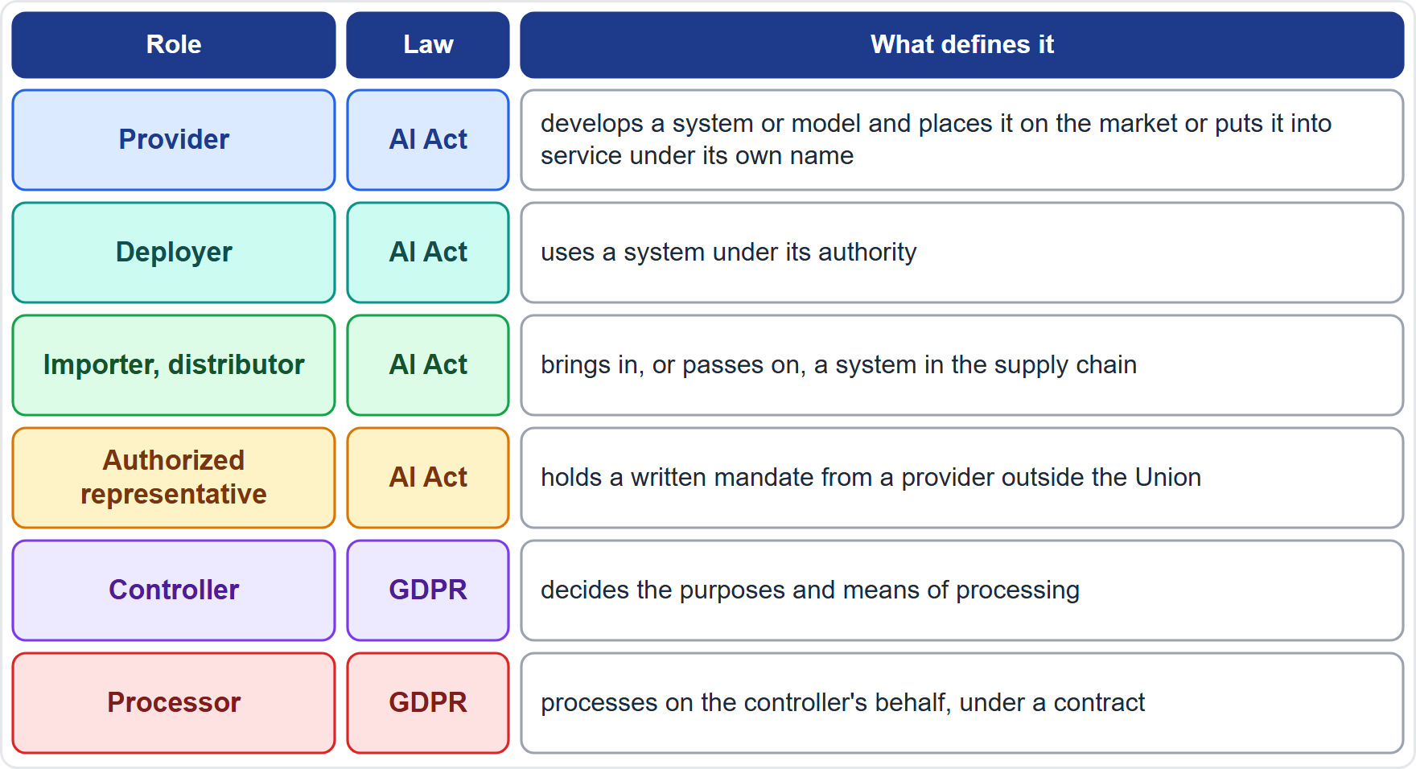
Roles by Law
Module 14
AI Act roles follow the system: provider, deployer, importer, distributor, authorized representative
GDPR roles follow the personal data: controller, processor, and joint controllers (GDPR Article 26)
One organization can hold several roles: Helios is a deployer of the hiring tool and a provider of the assistant built on a model it uses
Roles can change: putting your name on a high-risk system, or modifying it substantially, makes a deployer a provider (Article 25)
Processors work under a contract with set terms (GDPR Article 28)
EXAM TIP Identify the role first: the duties follow the role, not the size of the company.
AIGP Exam Prep Masterclass | Certified AI Governance Professional
Module 14: Quick-Reference Recap
4 / 16
Notes:
Roles by law. A I Act roles follow the system: provider, deployer, importer, distributor and authorized representative. G D P R roles follow the personal data: controller, processor, and joint controllers under G D P R Article twenty-six. One organization can hold several roles. Helios is a deployer of the hiring tool and a provider of the assistant built on a model it uses. Roles can change: putting your name on a high-risk system, or modifying it substantially, makes a deployer a provider, under Article twenty-five. Processors work under a contract with set terms, under Article twenty-eight. Exam tip: identify the role first.

Slide 5
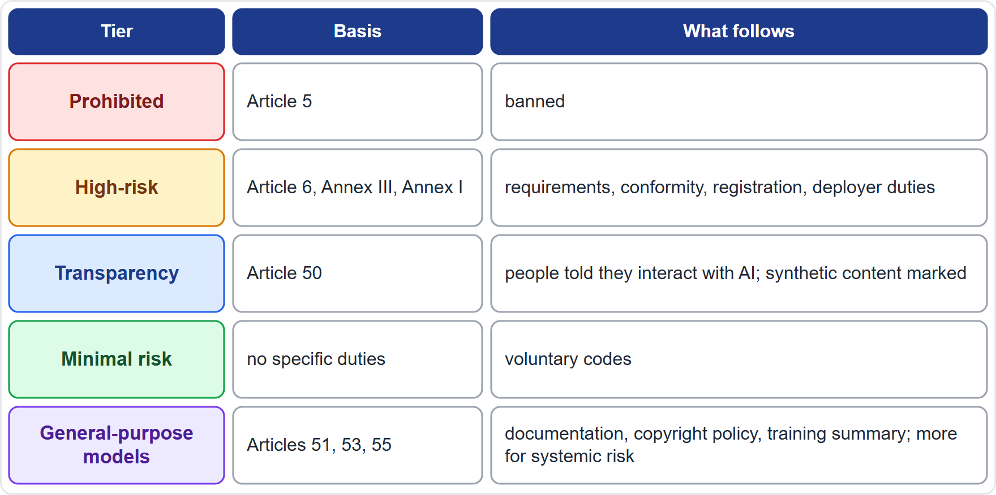
EU AI Act Risk Tiers and What Each Brings
Module 14
Prohibited (Article 5): manipulation, exploiting vulnerabilities, social scoring, crime prediction by profiling, face-scraping, workplace and school emotion inference, and more
High-risk (Article 6): Annex III areas, such as employment, and safety components under Annex I
Transparency (Article 50): people told they are interacting with AI; synthetic content marked
Minimal risk: no specific duties; voluntary codes
General-purpose models (Articles 51, 53, 55): documentation, copyright policy and training summary; extra duties for systemic risk
EXAM TIP Classify the system by its use, then read off the duties for that tier and for your role.
AIGP Exam Prep Masterclass | Certified AI Governance Professional
Module 14: Quick-Reference Recap
5 / 16
Notes:
The A I Act sorts systems into tiers. Prohibited, under Article five: manipulation, exploiting vulnerabilities, social scoring, crime prediction by profiling, face-scraping, workplace and school emotion inference, and more. High-risk, under Article six: the Annex three areas, such as employment, and safety components under Annex one. Transparency, under Article fifty: people told they interact with A I, and synthetic content marked. Minimal risk: no specific duties. And general-purpose models, under Articles fifty-one, fifty-three and fifty-five, with extra duties for systemic risk. Exam tip: classify by use, then read off the duties for that tier and your role.

Slide 6
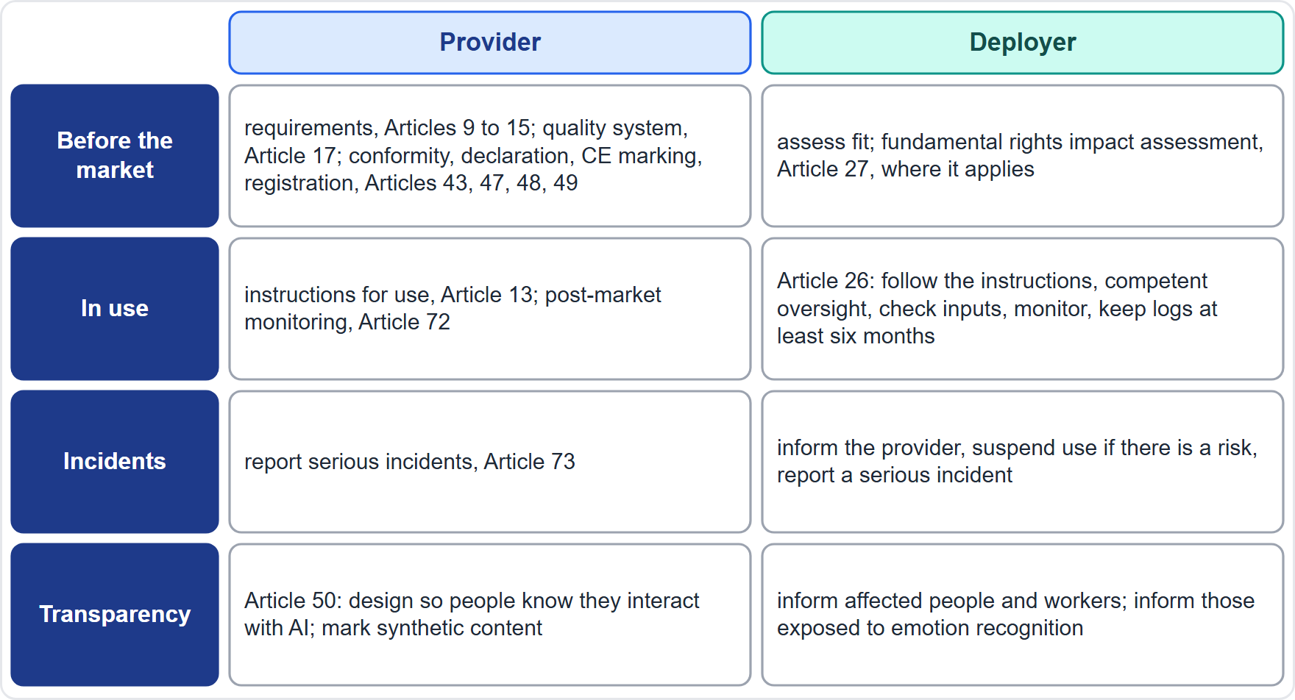
Provider and Deployer Duties Side by Side
Module 14
Provider: requirements (Articles 9 to 15), quality management (Article 17), conformity steps (Articles 43, 47, 48, 49)
Provider in use: instructions for use (Article 13), post-market monitoring (Article 72), serious incident reporting (Article 73)
Deployer (Article 26): follow the instructions, assign competent oversight, check input data, monitor, keep logs for at least six months
Deployer, where it applies: fundamental rights impact assessment (Article 27)
Both: transparency duties (Article 50)
EXAM TIP The provider proves the product; the deployer governs the use.
AIGP Exam Prep Masterclass | Certified AI Governance Professional
Module 14: Quick-Reference Recap
6 / 16
Notes:
For a high-risk system, the provider builds and proves conformity. It meets the requirements in Articles nine to fifteen, runs a quality management system under Article seventeen, and completes the conformity steps in Articles forty-three, forty-seven, forty-eight and forty-nine. In use, it supplies instructions under Article thirteen, monitors after release under Article seventy-two, and reports serious incidents under Article seventy-three. The deployer, under Article twenty-six, follows the instructions, assigns competent oversight, checks input data, monitors, and keeps logs for at least six months. Where it applies, it adds the fundamental rights impact assessment of Article twenty-seven. Exam tip: the provider proves the product; the deployer governs the use.

Slide 7
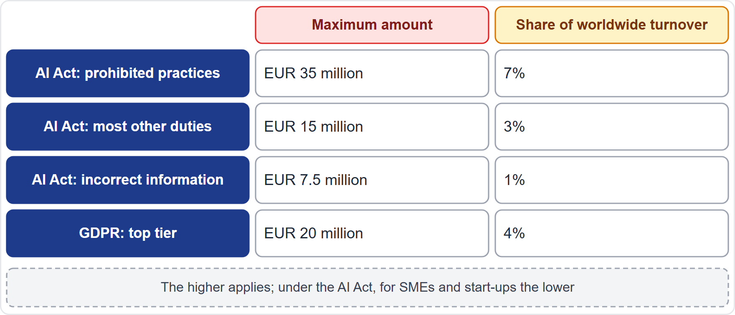
Penalties Compared
Module 14
AI Act, Article 99: prohibited practices up to EUR 35 million or 7%; most other obligations up to EUR 15 million or 3%; incorrect or misleading information up to EUR 7.5 million or 1%
Whichever is higher applies, but for small and medium-sized enterprises and start-ups the lower applies
General-purpose model providers: the Commission may fine up to 3% or EUR 15 million (Article 101)
GDPR, Article 83(5): up to EUR 20 million or 4% for breaches of the basic principles, data subject rights and transfer rules
Both regimes can apply to the same facts
EXAM TIP The AI Act's top tier is higher than the GDPR's, and it is reserved for prohibited practices.
AIGP Exam Prep Masterclass | Certified AI Governance Professional
Module 14: Quick-Reference Recap
7 / 16
Notes:
Penalties compared. Under A I Act Article ninety-nine, prohibited practices carry fines up to thirty-five million euros or seven percent of worldwide turnover. Most other obligations: fifteen million or three percent. Incorrect or misleading information: seven and a half million or one percent. The higher amount applies, but for small and medium-sized enterprises and start-ups, the lower applies. Under Article one hundred and one, the Commission may fine general-purpose model providers up to three percent or fifteen million. The G D P R, Article eighty-three, point five, reaches twenty million or four percent. Exam tip: the A I Act's top tier is reserved for prohibited practices.

Slide 8
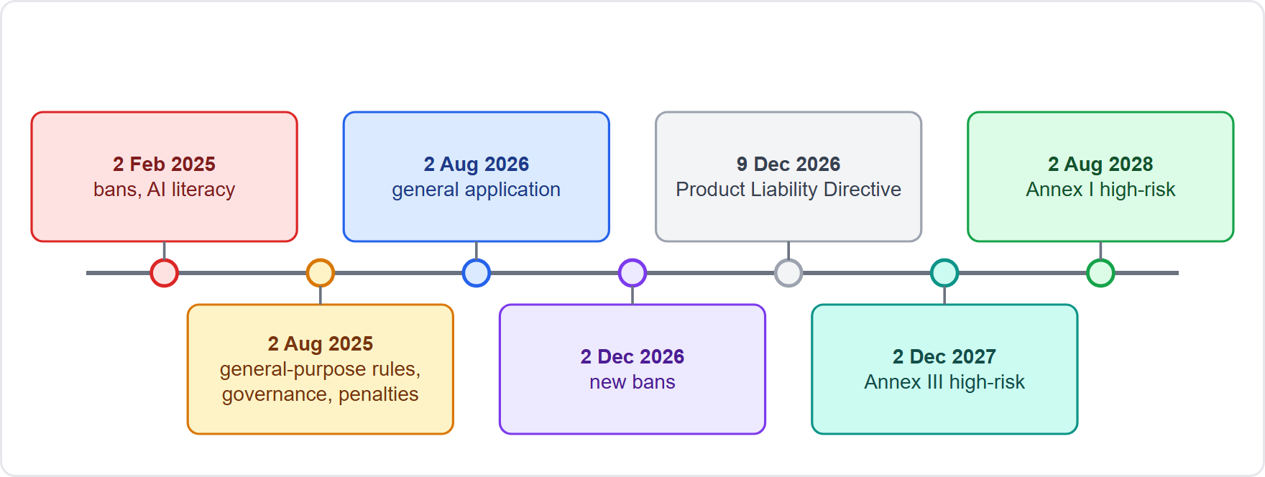
Timelines at a Glance
DATES · VERIFY LIVE
Module 14
2 February 2025: the first prohibitions and the AI literacy duty
2 August 2025: general-purpose model rules, governance and penalties
2 August 2026: the Act applies generally; 2 December 2026: new prohibitions
2 December 2027: Annex III high-risk systems; 2 August 2028: Annex I high-risk systems
9 December 2026: the Product Liability Directive applies to products placed on the market from then
As of 27 October 2026: dates were moved by the Digital Omnibus on AI; confirm them before the exam
EXAM TIP Know the order of the milestones and what each starts, not just the dates.
AIGP Exam Prep Masterclass | Certified AI Governance Professional
Module 14: Quick-Reference Recap
8 / 16
Notes:
The timeline. Second of February, twenty twenty-five: the first prohibitions and the A I literacy duty. Second of August, twenty twenty-five: general-purpose model rules, governance and penalties. Second of August, twenty twenty-six: the Act applies generally. Second of December, twenty twenty-six: new prohibitions. Second of December, twenty twenty-seven: Annex three high-risk systems. Second of August, twenty twenty-eight: Annex one high-risk systems. And the ninth of December, twenty twenty-six: the Product Liability Directive applies to products placed on the market from then. As of the twenty-seventh of October, twenty twenty-six, the Digital Omnibus on A I moved some dates, so confirm them.

Slide 9
Privacy Law and AI Law Compared
Module 14
GDPR: protects people's personal data and rights; applies to any processing of personal data, with or without AI
AI Act: regulates AI systems by risk; applies to systems placed on the Union market or whose output is used there
Tools differ: GDPR uses lawful basis, principles, rights and the DPIA (Article 35); the AI Act uses tiers, requirements and conformity
They overlap: an AI system that processes personal data is under both; the fundamental rights impact assessment (Article 27) may cross-refer to a DPIA
Other laws add more: consumer protection, nondiscrimination, product liability and sector rules (module 5)
EXAM TIP When a case involves personal data and AI, check both laws before choosing an answer.
AIGP Exam Prep Masterclass | Certified AI Governance Professional
Module 14: Quick-Reference Recap
9 / 16
Notes:
Compare the two laws on four questions. What it protects: the G D P R protects people's personal data and rights; the A I Act regulates A I systems by risk. When it applies: the G D P R applies to any processing of personal data, with or without A I; the A I Act applies to systems placed on the Union market or whose output is used there. The tools differ: lawful basis, principles, rights and the D P I A under Article thirty-five, against tiers, requirements and conformity. And they overlap: a system that processes personal data is under both, and the fundamental rights impact assessment may cross-refer to a D P I A. Exam tip: check both laws.

Slide 10
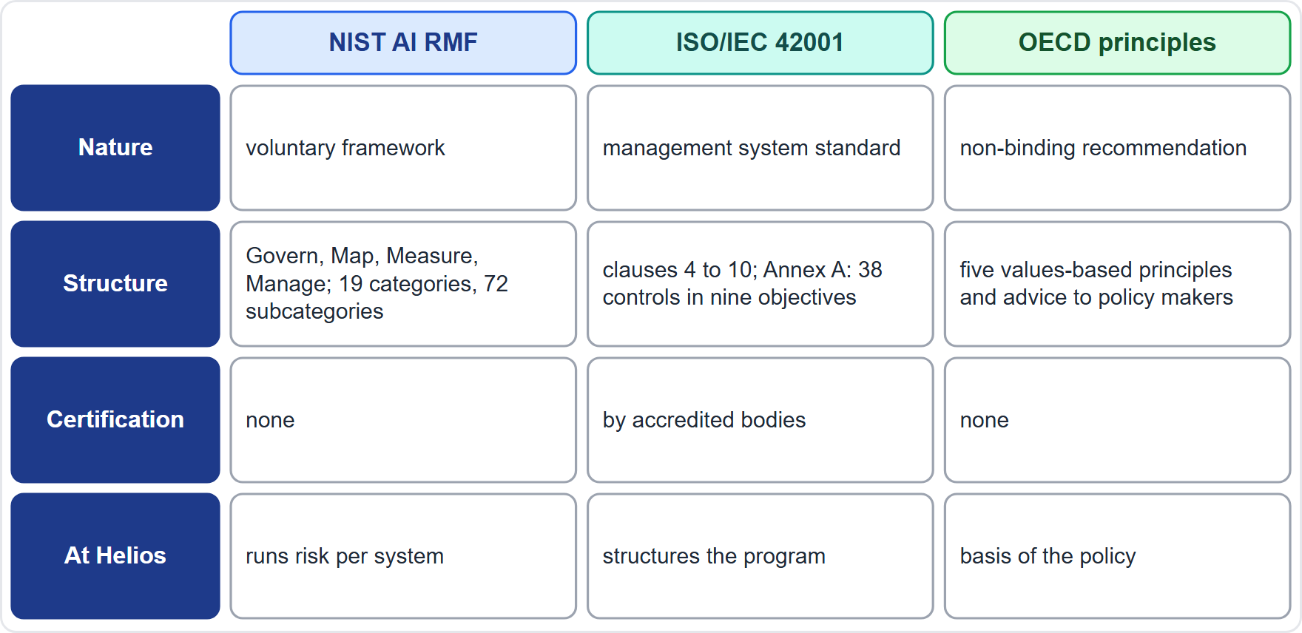
NIST, ISO and OECD Compared
Module 14
NIST AI RMF 1.0: voluntary; four functions, Govern, Map, Measure, Manage; 19 categories and 72 subcategories; profiles and a Playbook
ISO/IEC 42001: a management system standard; clauses 4 to 10; Annex A with 38 controls in nine objectives; certifiable
OECD AI Principles: non-binding; five values-based principles and recommendations for policy makers
Together at Helios: ISO to structure the program, NIST to run risk per system, the EU AI Act as the legal floor, the OECD principles as the basis of policy
ISO/IEC 42005 gives guidance on impact assessment (module 7, depth marked)
EXAM TIP Voluntary framework, certifiable standard, non-binding principles: match each to its nature.
AIGP Exam Prep Masterclass | Certified AI Governance Professional
Module 14: Quick-Reference Recap
10 / 16
Notes:
Three instruments, three natures. The N I S T A I R M F one point zero is voluntary: four functions, Govern, Map, Measure and Manage, in nineteen categories and seventy-two subcategories, with profiles and a Playbook. I S O forty-two thousand and one is a management system standard: clauses four to ten, Annex A with thirty-eight controls in nine objectives, and it is certifiable. The O E C D A I Principles are non-binding: five values-based principles and recommendations for policy makers. At Helios they work together. I S O structures the program, N I S T runs risk per system, the E U A I Act is the legal floor, and the O E C D principles are the basis of policy. Exam tip: match each to its nature.

Slide 11
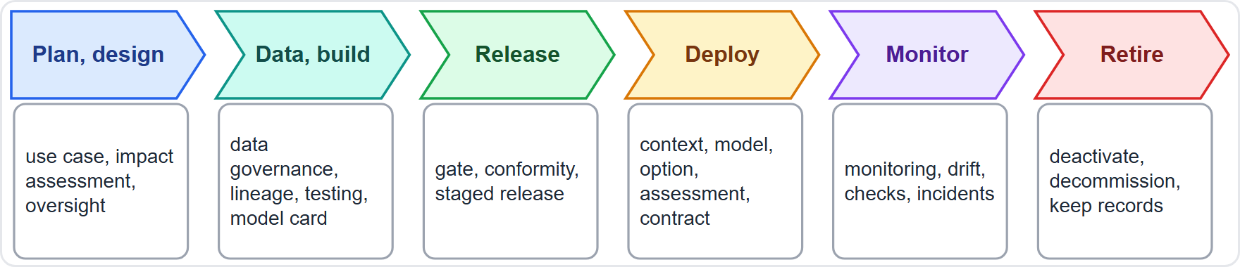
The Life Cycle and Where Each Control Sits
Module 14
Plan and design (module 8): use-case approval, impact assessment, human oversight design, metrics
Data and build (module 9): data governance, lineage, testing, fairness metrics, model card
Release (module 10): readiness gate, conformity, staged release, rollback
Deploy (modules 11 to 13): context, model and option, assessment of the chosen system, contract, training, oversight
Monitor, maintain, retire (modules 10 and 13): monitoring, drift, periodic checks, incidents, deactivation
EXAM TIP For any scenario, find the life-cycle stage first, then pick the control that belongs to it.
AIGP Exam Prep Masterclass | Certified AI Governance Professional
Module 14: Quick-Reference Recap
11 / 16
Notes:
Controls follow the life cycle. Plan and design, from module eight: use-case approval, impact assessment, oversight design and metrics. Data and build, module nine: data governance, lineage, testing, fairness metrics and the model card. Release, module ten: the readiness gate, conformity, staged release and rollback. Deploy, modules eleven to thirteen: context, model and option, assessment of the chosen system, contract, training and oversight. And monitor, maintain and retire, modules ten and thirteen: monitoring, drift, periodic checks, incidents and deactivation. Exam tip: find the life-cycle stage first, then pick the control that belongs to it.

Slide 12
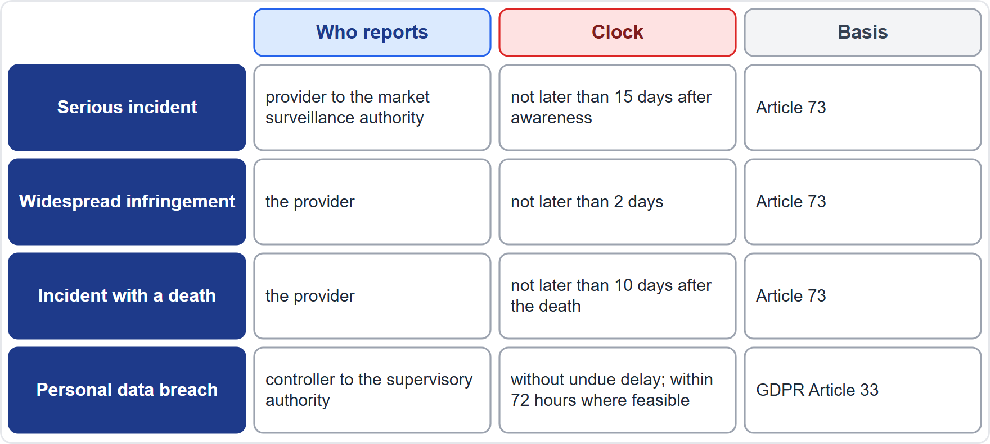
Reporting Clocks at a Glance
Module 14
AI Act, Article 73: serious incidents are reported not later than 15 days after awareness, 2 days for a widespread infringement and 10 days after a death
GDPR, Article 33: a personal data breach is notified without undue delay, where feasible within 72 hours
A processor tells the controller without undue delay (Article 33)
A deployer informs the provider and suspends use where there is a risk (Article 26)
Contracts may set shorter notices, and one event can start several clocks
EXAM TIP One event can start several clocks, and the shortest applicable one governs.
AIGP Exam Prep Masterclass | Certified AI Governance Professional
Module 14: Quick-Reference Recap
12 / 16
Notes:
Reporting clocks. Under A I Act Article seventy-three, a provider reports a serious incident not later than fifteen days after awareness, two days for a widespread infringement, and ten days after a death. Under G D P R Article thirty-three, a personal data breach is notified without undue delay and, where feasible, within seventy-two hours. A processor tells the controller without undue delay. A deployer informs the provider and suspends use where there is a risk, under Article twenty-six. Contracts may set shorter notices. Exam tip: one event can start several clocks, and the shortest applicable one governs.

Slide 13
Glossary 1: Concepts and Risks
Module 14
Term | Meaning | Term | Meaning
AI system | Machine-based system that infers how to generate outputs | Generative AI | Creates new text, images, code or audio
Predictive model | Scores, classifies or predicts | General-purpose AI model | Broad model used in many downstream systems
Confabulation | Confident but false output | Bias | Systematic skew in data, model or use
Fairness | Comparable outcomes for comparable people | Impact ratio | Selection rate of one group over another
Explainability | Giving reasons for an output | Transparency | Openness about what a system is and does
Robustness | Holding up under noise or attack | Drift | A shift in data or behavior over time
Overfitting | Memorizing training data | Data leakage | Test data leaking into training
Automation bias | Over-trusting the output | Human oversight | A person who can understand, override and stop
Red teaming | Trying to make a system fail | Prompt injection | Hidden instructions that hijack a model
Model card | Plain record of a model's use and limits | Data lineage | Traceable path of data from source to model
AIGP Exam Prep Masterclass | Certified AI Governance Professional
Module 14: Quick-Reference Recap
13 / 16
Notes:
Glossary one: concepts and risks. A I system: a machine-based system that infers how to generate outputs. Generative A I: creates new content. Predictive model: scores, classifies or predicts. General-purpose A I model: a broad model used in many downstream systems. Confabulation: confident but false output. Bias: a systematic skew. Fairness: comparable outcomes for comparable people. Impact ratio: one group's selection rate over another's. Explainability: giving reasons. Transparency: openness about what a system does. Robustness: holding up under noise or attack. Drift: a shift over time. Overfitting: memorizing training data. Data leakage: test data leaking into training. Automation bias: over-trusting the output. Human oversight: a person who can understand, override and stop. Red teaming: trying to make a system fail. Prompt injection: hidden instructions that hijack a model. Model card: a plain record of use and limits. Data lineage: the traceable path of data.

Slide 14
Glossary 2: Roles, Law and Assessment
Module 14
Term | Meaning | Term | Meaning
Provider | Develops and places a system on the market | Deployer | Uses a system under its authority
Importer | Brings a non-Union system to the market | Distributor | Passes a system along the supply chain
Controller | Decides purposes and means of processing | Processor | Processes on the controller's behalf
DPIA | Data protection impact assessment | FRIA | Fundamental rights impact assessment
High-risk system | Annex I or Annex III system with full duties | Prohibited practice | A banned use under Article 5
Conformity assessment | Check before market placement | CE marking | Sign that conformity was shown
Systemic risk | Risk from the largest general-purpose models | Serious incident | Death, serious harm or major disruption
Instructions for use | Provider's guide for deployers | Technical documentation | Provider's record of design and testing
Substantial modification | Change needing a new assessment | Post-market monitoring | Provider's watch on a system in use
AIGP Exam Prep Masterclass | Certified AI Governance Professional
Module 14: Quick-Reference Recap
14 / 16
Notes:
Glossary two: roles, law and assessment. Provider: develops and places a system on the market. Deployer: uses a system under its authority. Importer: brings a non-Union system to the market. Distributor: passes a system along the supply chain. Controller: decides purposes and means. Processor: processes on the controller's behalf. D P I A: data protection impact assessment. F R I A: fundamental rights impact assessment. High-risk system: an Annex one or Annex three system with full duties. Prohibited practice: a banned use under Article five. Conformity assessment: the check before market placement. C E marking: the sign that conformity was shown. Systemic risk: risk from the largest general-purpose models. Serious incident: death, serious harm or major disruption. Instructions for use: the provider's guide for deployers. Technical documentation: the record of design and testing. Substantial modification: a change needing a new assessment. Post-market monitoring: the provider's watch on a system in use.

Slide 15
Glossary 3: Frameworks and Practice
Module 14
Term | Meaning | Term | Meaning
Govern, Map, Measure, Manage | The four NIST functions | Profile | A NIST view of a use case, time or sector
Playbook | NIST's suggested actions | Statement of applicability | ISO list of chosen controls
OECD principles | Non-binding values for trustworthy AI | Three lines | Management, risk oversight, internal audit
Risk appetite | Level of risk the organization accepts | Risk register | List of risks with owners and controls
Incident register | Record of incidents and near misses | Change control | Test, approve, release, monitor
Kill switch | Tested way to stop a system | Fallback | A manual or older process
Localize | Limit a system by region or feature | Indemnity | Vendor's promise to defend and pay
Shadow AI | AI used without registration | Pre-mortem | Imagine the failure, then work out why
Staged release | Small share first, then wider | Rollback | Return to the previous version
AIGP Exam Prep Masterclass | Certified AI Governance Professional
Module 14: Quick-Reference Recap
15 / 16
Notes:
Glossary three: frameworks and practice. Govern, Map, Measure, Manage: the four N I S T functions. Profile: a N I S T view of a use case, a time or a sector. Playbook: N I S T's suggested actions. Statement of applicability: the I S O list of chosen controls. O E C D principles: non-binding values for trustworthy A I. Three lines: management, risk oversight and internal audit. Risk appetite: the level of risk the organization accepts. Risk register: risks with owners and controls. Incident register: incidents and near misses. Change control: test, approve, release, monitor. Kill switch: a tested way to stop a system. Fallback: a manual or older process. Localize: limit a system by region or feature. Indemnity: the vendor's promise to defend and pay. Shadow A I: A I used without registration. Pre-mortem: imagine the failure, then work out why. Staged release: a small share first, then wider. Rollback: return to the previous version.

Slide 16
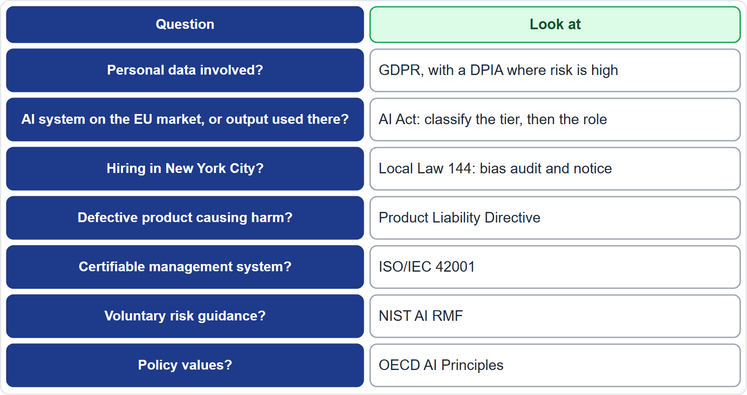
Which Instrument Applies? A Decision Aid
Module 14
Personal data? GDPR, with a DPIA where the risk is high
AI system on the EU market, or output used in the EU? the AI Act: classify the tier, then the role
Hiring in New York City? Local Law 144: bias audit and notice
Defective product causing harm? the Product Liability Directive
Management system, risk guidance or policy values? ISO/IEC 42001, the NIST AI RMF, the OECD principles
EXAM TIP Name the situation, the role and the life-cycle stage first; the instrument usually follows.
AIGP Exam Prep Masterclass | Certified AI Governance Professional
Module 14: Quick-Reference Recap
16 / 16
Notes:
A decision aid. Personal data involved? Look at the G D P R, with a D P I A where the risk is high. An A I system on the E U market, or output used in the E U? The A I Act: classify the tier, then the role. Hiring in New York City? Local Law one hundred forty-four: a bias audit and notice. A defective product causing harm? The Product Liability Directive. A certifiable management system? I S O forty-two thousand and one. Voluntary risk guidance? The N I S T A I R M F. Policy values? The O E C D principles. Exam tip: name the situation, the role and the life-cycle stage first; the instrument usually follows.

