Slide 1
Module 15: Exam Technique and Final Review
Turning what you know into points on the day
Only what IAPP publishes; no predictions about the questions
AIGP Exam Prep Masterclass
Module 15 · Part 1
Notes:
Welcome to Module fifteen, the last module. You know the material. This module is about turning it into points on the day: time, reading questions, scenarios, multi-select, traps, the final week, exam day and what follows. It uses only what I A P P publishes, and makes no predictions about the questions.

Slide 2
What You Will Learn
Part 1
Plan your time across the two halves
Read a stem and a scenario in a fixed order: the ask, the role, the instrument and the stage
Answer multi-select questions with exactly the right number of options
Match your answer to the depth that the verb asks for
Eliminate options that fall into the common traps
Prepare the final week and exam day, and know what happens afterwards
AIGP Exam Prep Masterclass | Certified AI Governance Professional
Module 15: Exam Technique and Final Review
2 / 23
Notes:
By the end of this module you will be able to do six things. Plan your time across the two halves. Read a stem and a scenario in a fixed order: the ask, the role, the instrument and the stage. Answer multi-select questions with exactly the right number of options. Match your answer to the depth the verb asks for. Eliminate options that fall into the common traps. And prepare the final week and exam day.

Slide 3
The Exam in One Page
VERIFY LIVE
Part 1
100 items, all multiple choice, including case studies and scenarios; no essays; one point for each correct answer
2.75 hours of testing time, with a 15-minute break halfway
Two halves: each holds half the questions and half the time, and the first half cannot be reopened after you submit it
Passing score: 300 on a scale of 100 to 500; passing takes a set number of correct answers, and section percentages cannot be averaged to find it
Scope: topics in the Body of Knowledge, but you may be asked to apply them to situations the materials do not show
As of 27 October 2026: confirm the format on IAPP's pages
EXAM TIP Know the structure before test day, so that the only surprises are the questions.
AIGP Exam Prep Masterclass | Certified AI Governance Professional
Module 15: Exam Technique and Final Review
3 / 23
Notes:
The exam in one page. One hundred items, all multiple choice, including case studies and scenarios; no essays; one point for each correct answer. Two and three-quarter hours of testing time, with a fifteen-minute break halfway. The break divides the exam into two halves, each with half the questions and half the time, and the first half cannot be reopened after you submit it. The passing score is three hundred on a scale of one hundred to five hundred, and section percentages cannot be averaged to find it. Questions come from the Body of Knowledge, but you may need to apply it to new situations. As of the twenty-seventh of October, twenty twenty-six, confirm the format on I A P P's pages.

Slide 4
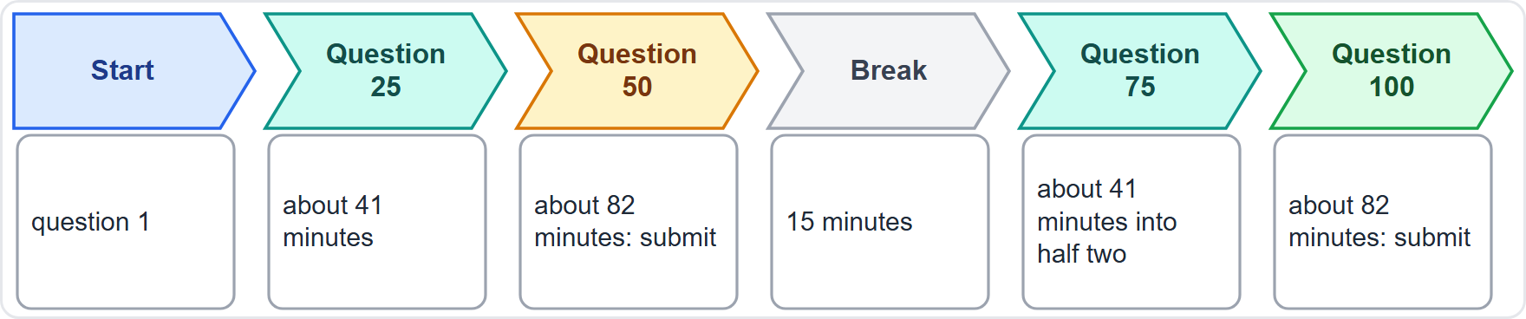
Pacing: About Ninety-Nine Seconds a Question
Part 1
Arithmetic: 165 minutes for 100 items is about 99 seconds an item
Each half: 50 questions in 82.5 minutes
Checkpoints: question 25 by about 41 minutes and question 50 by about 82 minutes; the same again in the second half
Bank time: short definition questions take less, scenarios take more
Cap a hard question: choose your best answer, flag it and move on
Use the break to reset, not to study
EXAM TIP A hard question is worth the same single point as an easy one, so do not let it eat the clock.
AIGP Exam Prep Masterclass | Certified AI Governance Professional
Module 15: Exam Technique and Final Review
4 / 23
Notes:
Start with arithmetic. One hundred sixty-five minutes for one hundred items is about ninety-nine seconds an item. Each half has fifty questions in eighty-two and a half minutes. Use checkpoints: question twenty-five by about forty-one minutes, question fifty by about eighty-two minutes, and then the same again in the second half. Bank time: short definition questions take less, scenarios take more. Cap a hard question: choose your best answer, flag it and move on. And use the break to reset, not to study. Exam tip: a hard question is worth the same single point as an easy one.

Slide 5
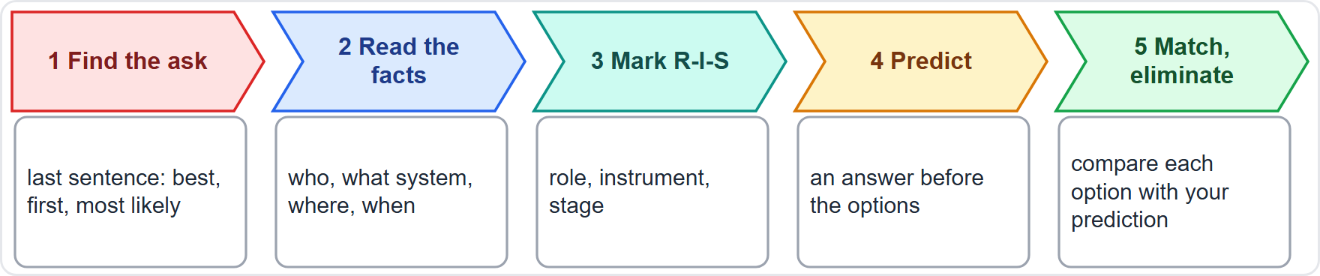
Reading a Stem: Five Steps
Part 1
Find the ask: the last sentence; words such as best, first, most likely change the answer
Read the facts: who is involved, which system, where and when
Mark the role, the instrument and the stage (next slide)
Predict an answer before you read the options
Match and eliminate: options are written to tempt, so compare each with your prediction
Skip nothing: a number, a region or a date in the stem is there for a reason
EXAM TIP Predict the answer before you read the options, because the options are built to tempt.
AIGP Exam Prep Masterclass | Certified AI Governance Professional
Module 15: Exam Technique and Final Review
5 / 23
Notes:
Read every stem in five steps. One: find the ask, in the last sentence. Words such as best, first and most likely change the answer. Two: read the facts: who is involved, which system, where and when. Three: mark the role, the instrument and the stage. Four: predict an answer before you read the options. Five: match and eliminate; the options are written to tempt, so compare each with your prediction. And skip nothing: a number, a region or a date in the stem is there for a reason. Exam tip: predict first.

Slide 6
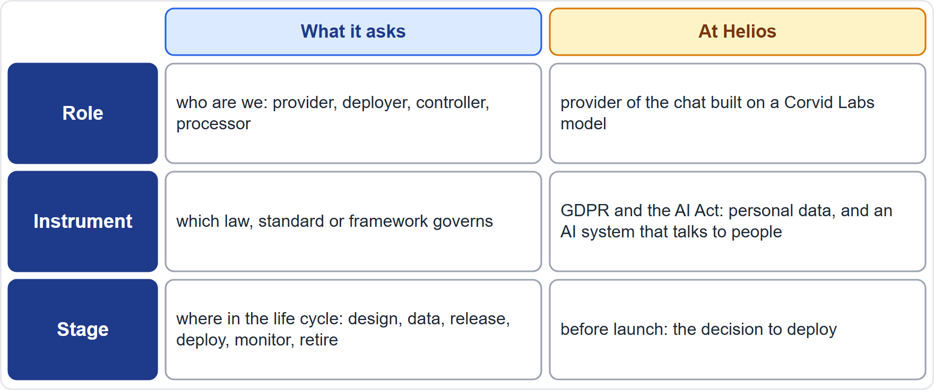
Scenario Questions: Role, Instrument and Stage
Part 1
A scenario is a bundle of facts: sort them before you read the options
Role decides whose duties apply (modules 2 and 6)
Instrument decides which rule applies (modules 4 to 7)
Stage decides which control fits (modules 8 to 13)
Distractors often give a right answer for the wrong role, instrument or stage
Do the sort every time, even when the answer looks obvious
EXAM TIP Name the role, the instrument and the stage first: most wrong options fail one of the three.
AIGP Exam Prep Masterclass | Certified AI Governance Professional
Module 15: Exam Technique and Final Review
6 / 23
Notes:
A scenario is a bundle of facts. Sort them into three lenses before you read the options. Role: who are we? Provider, deployer, controller, processor. The role decides whose duties apply. Instrument: which law, standard or framework governs? That decides which rule applies. Stage: where are we in the life cycle? That decides which control fits. The table shows the Helios example: Helios builds a chat on a Corvid Labs model and offers it under its own name, so it is the provider of the chat. Distractors often give a right answer for the wrong role, instrument or stage. Exam tip: do the sort every time.

Slide 7
Multi-Select: Exactly N, No Partial Credit
Part 1
The stem says how many to select; select exactly that number
No partial credit: one wrong choice, or one missing, scores nothing
Judge each option on its own as true or false for this stem, then count the trues
More trues than the number asked for? Re-read the stem for the qualifier: first, best, most
Fewer? Re-check the options you marked false: one may be right in this context
Watch for options that are true in general but do not answer this stem
EXAM TIP Treat each option as its own true-or-false question, then count.
AIGP Exam Prep Masterclass | Certified AI Governance Professional
Module 15: Exam Technique and Final Review
7 / 23
Notes:
For multi-select, the stem says how many to select. Select exactly that number. There is no partial credit: one wrong choice, or one missing, scores nothing. Judge each option on its own as true or false for this stem, then count the trues. If you have more trues than the number asked for, re-read the stem for the qualifier: first, best, most. If you have fewer, re-check the options you marked false; one may be right in this context. And watch for options that are true in general but do not answer this stem. Exam tip: each option is its own true-or-false question.

Slide 8
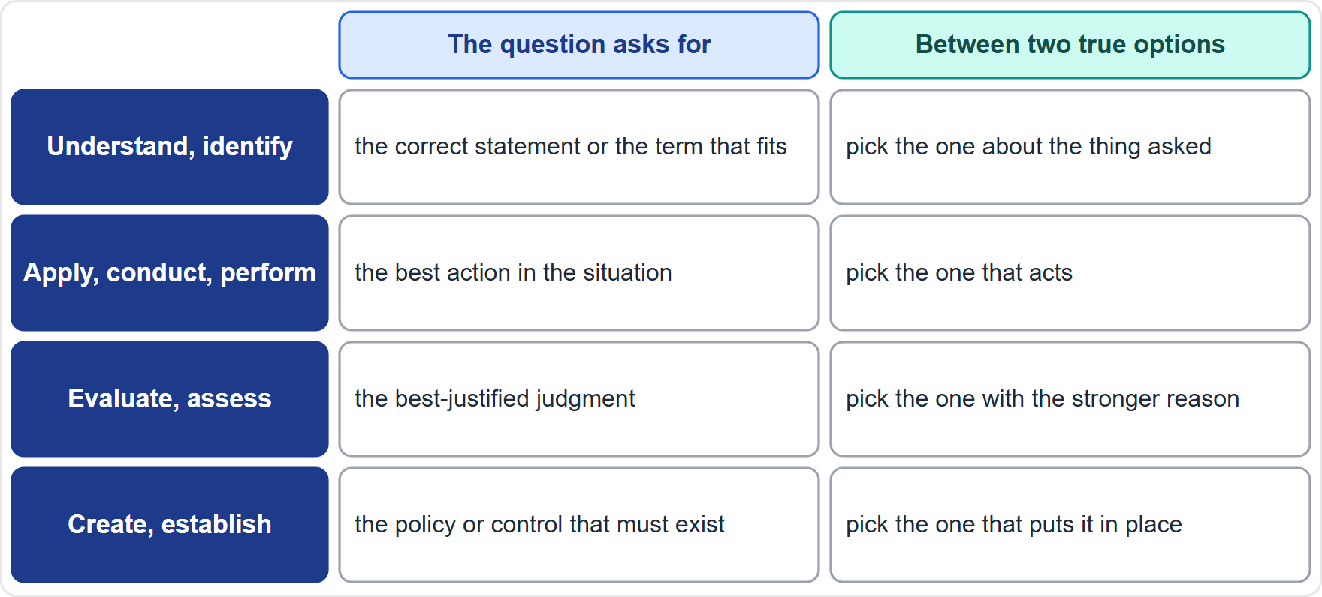
The Verbs Set the Depth: How to Answer
Part 1
Module 0: the verb that starts an indicator sets the depth of the question
Understand, identify: the correct statement, or the term that fits
Apply, conduct, perform: the best action in the situation
Evaluate, assess: the best-justified judgment
Create, establish: the policy or control that must exist
Two options both true? Pick the one that fits the depth of the verb
EXAM TIP Ask what the question wants you to do with the knowledge: recall it, choose with it, judge with it or build with it.
AIGP Exam Prep Masterclass | Certified AI Governance Professional
Module 15: Exam Technique and Final Review
8 / 23
Notes:
Module zero said that the verb that starts an indicator sets the depth of the question. Here is how to use that. Understand and identify: the correct statement, or the term that fits. Apply, conduct and perform: the best action in the situation. Evaluate and assess: the best-justified judgment. Create and establish: the policy or control that must exist. If two options are both true, pick the one that fits the depth of the verb. The table adds how to choose between two true options. Exam tip: ask what the question wants you to do with the knowledge: recall it, choose with it, judge with it or build with it.

Slide 9
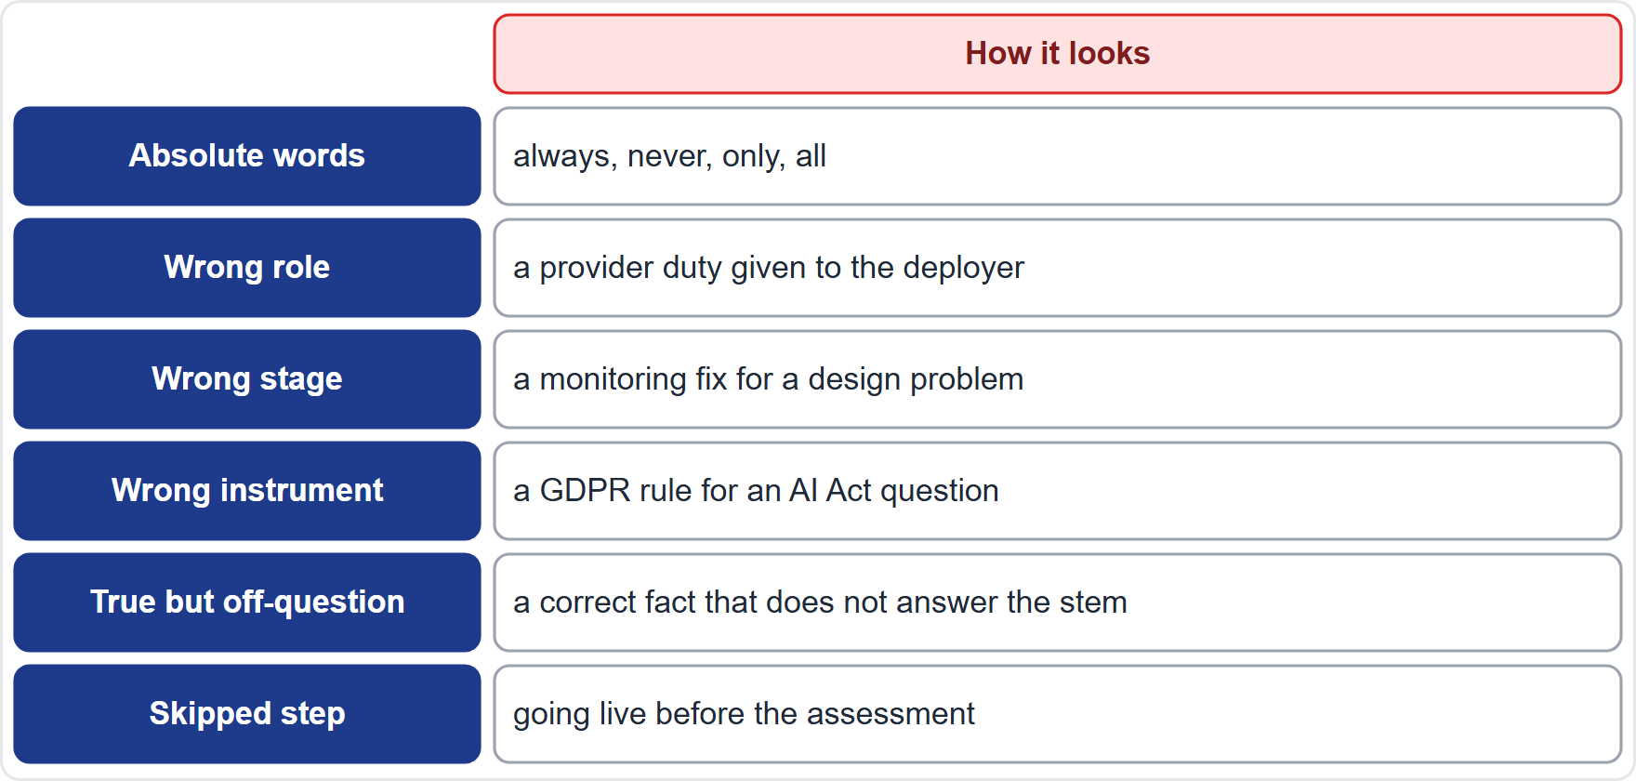
Eliminating Options: Traps That Look Right
Part 1
Absolute words: always, never, only and all are rarely true in governance
Wrong role: a provider duty handed to the deployer, or the reverse
Wrong stage: a monitoring fix for a design problem
Wrong instrument: a GDPR rule for an AI Act question
True but off-question: a correct fact that does not answer this stem
Skipped step: going live before the assessment, or acting before containing the harm
EXAM TIP Strike the options that fail on role, instrument or stage; what is left is usually the answer.
AIGP Exam Prep Masterclass | Certified AI Governance Professional
Module 15: Exam Technique and Final Review
9 / 23
Notes:
Six traps make a wrong option look right. Absolute words: always, never, only and all are rarely true in governance. The wrong role: a provider duty handed to the deployer, or the reverse. The wrong stage: a monitoring fix for a design problem. The wrong instrument: a G D P R rule for an A I Act question. True but off-question: a correct fact that does not answer this stem. And the skipped step: going live before the assessment, or acting before containing the harm. Exam tip: strike the options that fail on role, instrument or stage; what is left is usually the answer.

Slide 10
Flagging, Changing Answers and the First-Half Rule
Part 1
Use flags for questions you want to revisit within a half; the forward and backward arrows move between questions
The first half is final: after you submit it you cannot return, so clear your flags before you submit
Answer every question: each correct answer earns a point, and a blank cannot
Change an answer only for a reason: a fact you recalled or a qualifier you missed, not a feeling
Keep a few minutes at the end of each half for flagged items
Do not carry doubt into the second half
EXAM TIP Because the first half cannot be reopened, finish and review it before you submit.
AIGP Exam Prep Masterclass | Certified AI Governance Professional
Module 15: Exam Technique and Final Review
10 / 23
Notes:
Use flags for questions you want to revisit within a half; the forward and backward arrows move between questions. The first half is final: after you submit it you cannot return, so clear your flags first. Answer every question, because each correct answer earns a point and a blank cannot. Change an answer only for a reason: a fact you recalled or a qualifier you missed, not a feeling. Keep a few minutes at the end of each half for flagged items. And do not carry doubt into the second half. Exam tip: finish and review the first half before you submit it.

Slide 11
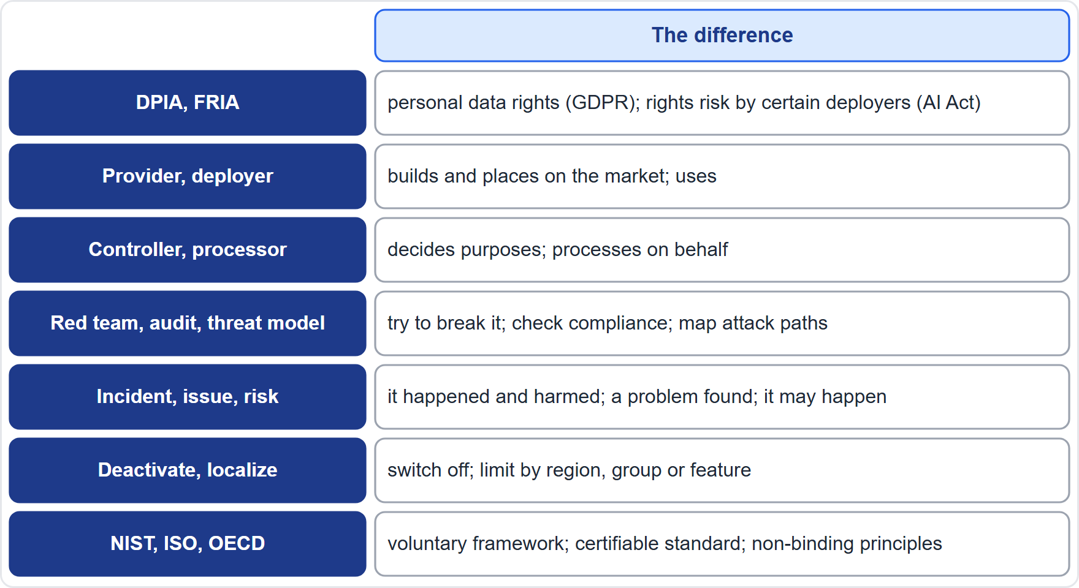
Look-Alike Pairs the Course Teaches Apart
Part 1
DPIA and FRIA: personal data rights under the GDPR; fundamental rights by certain deployers under the AI Act
Provider and deployer; controller and processor: who builds or decides, and who uses or acts on behalf
Red teaming, audit, threat modeling: try to break it, check compliance, map attack paths
Incident, issue, risk: it happened and harmed, a problem was found, it may happen
Deactivate and localize; NIST, ISO and OECD: off or limited; framework, certifiable standard, principles
EXAM TIP When two options differ by one of these pairs, check the stem for which side applies.
AIGP Exam Prep Masterclass | Certified AI Governance Professional
Module 15: Exam Technique and Final Review
11 / 23
Notes:
Some concepts look alike and are taught apart. D P I A and F R I A: personal data rights under the G D P R, against fundamental rights, for certain deployers, under the A I Act. Provider and deployer: who builds, and who uses. Controller and processor: who decides, and who acts on behalf. Red teaming, audit and threat modeling: try to break it, check compliance, and map attack paths. Incident, issue and risk: it happened and harmed, a problem was found, it may happen. Deactivate and localize: off, or limited. And N I S T, I S O and O E C D: framework, certifiable standard and principles. Exam tip: check the stem for which side applies.

Slide 12
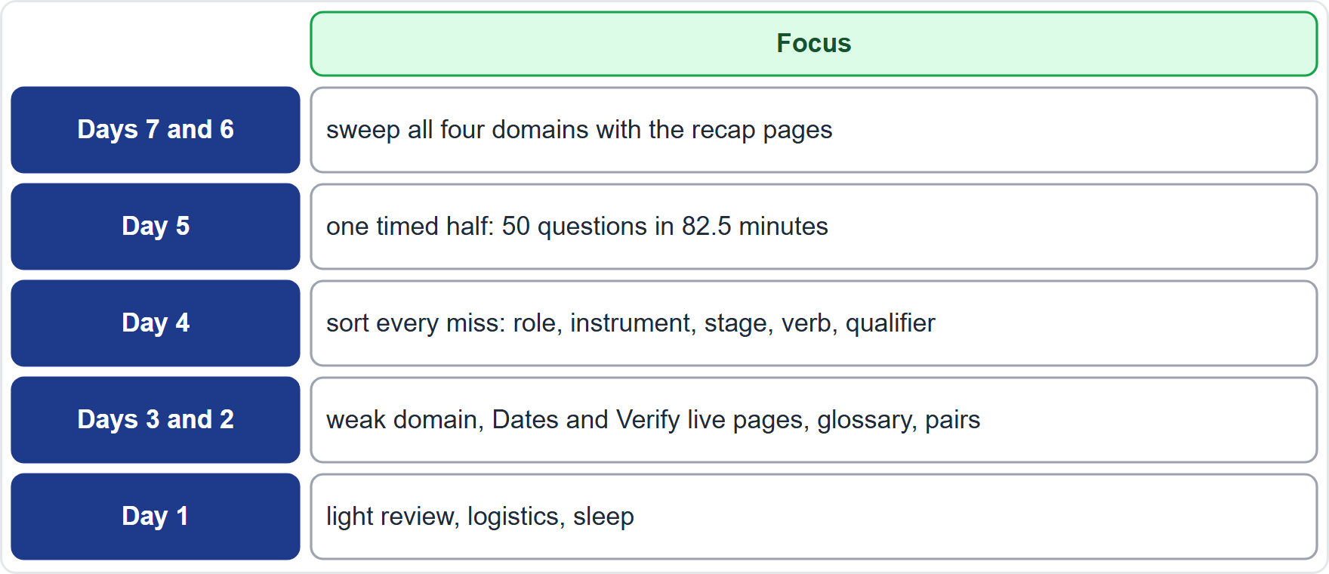
Your Final Week: A Plan
Part 2
IAPP recommends at least 30 hours of study in total; the final week consolidates
Study materials are tools, not a one-to-one guide to exam content
Practice in halves: 50 questions in 82.5 minutes
Sort your misses by cause: role, instrument, stage, verb or a missed qualifier
Recheck the pages tagged Dates and Verify live
Light last day: logistics and sleep, not new topics
EXAM TIP Fix the cause of each miss, not only the answer.
AIGP Exam Prep Masterclass | Certified AI Governance Professional
Module 15: Exam Technique and Final Review
12 / 23
Notes:
A plan for the final week. I A P P recommends at least thirty hours of study in total, so the final week consolidates. Remember that study materials are tools, not a one-to-one guide to the exam. Days seven and six: sweep all four domains with the recap pages. Day five: practice one timed half, fifty questions in eighty-two and a half minutes. Day four: sort every miss by cause: role, instrument, stage, verb or a missed qualifier. Days three and two: weak domains, then the Dates and Verify live pages, the glossary and the pairs. Day one: light review, logistics and sleep. Exam tip: fix the cause of each miss.

Slide 13
Exam Day at a Test Center
VERIFY LIVE
Part 2
Arrive 15 minutes early; a late arrival may be treated as a no-show, and all fees are forfeited
Bring two qualifying forms of ID that meet the test center's requirements
No electronic devices and no reading material in the exam room
The timer does not stop if you leave the room for a break
Reschedule or cancel up to 48 hours before the appointment, and wait for the confirmation email
Special accommodations: ask as early as you can
As of 27 October 2026: the rules are in the handbook version in force, so check it before you book
EXAM TIP Do the logistics a week early: ID, route and timing should be boring on the day.
AIGP Exam Prep Masterclass | Certified AI Governance Professional
Module 15: Exam Technique and Final Review
13 / 23
Notes:
At a test center, arrive fifteen minutes early; a late arrival may be treated as a no-show, and all fees are forfeited. Bring two qualifying forms of I D that meet the test center's requirements. No electronic devices and no reading material are allowed in the exam room. The timer does not stop if you leave the room for a break. You may reschedule or cancel up to forty-eight hours before the appointment, and you should wait for the confirmation email. Request special accommodations as early as you can. As of the twenty-seventh of October, twenty twenty-six, check the handbook before you book. Exam tip: make the logistics boring.

Slide 14
Exam Day Online With OnVUE
VERIFY LIVE
Part 2
Use a personal computer, not a work-issued one, with no virtual private network (VPN); run the system check on the microphone, webcam and internet speed
Check-in opens 30 minutes before; you photograph yourself, a government-issued ID and four views of your surroundings
Rules: keep your face in view, stay at your workspace, nobody else in the room, no headphones, one beverage only, no speaking aloud
Proctoring: a human proctor watches by webcam and microphone; AI assists, and a person makes the decisions
Change or cancel the appointment until 15 minutes after the scheduled start
As of 27 October 2026: confirm the rules on the handbook and Pearson VUE pages
EXAM TIP Test your setup well before exam day, and clear the room of anything that looks like study material.
AIGP Exam Prep Masterclass | Certified AI Governance Professional
Module 15: Exam Technique and Final Review
14 / 23
Notes:
For online testing with OnVUE, use a personal computer, not a work-issued one, with no virtual private network, and run the system check on the microphone, webcam and internet speed. Check-in opens thirty minutes before. You photograph yourself, a government-issued I D and four views of your surroundings. The rules: keep your face in view, stay at your workspace, nobody else in the room, no headphones, one beverage only, and no speaking aloud. A human proctor watches by webcam and microphone; A I assists, and a person makes the decisions. You may change or cancel the appointment until fifteen minutes after the scheduled start. As of the twenty-seventh of October, twenty twenty-six, confirm the rules.

Slide 15
After the Exam: Results, Breakdown and Next Steps
VERIFY LIVE
Part 2
Results are immediate: pass or fail, and the score
A later email gives a breakdown by section; IAPP does not give the number of correct answers
If you do not pass: a retake no sooner than 7 days after the attempt, at a discounted price; use the section breakdown to aim your study
If you pass: certification maintenance is USD 250 for a two-year term, or IAPP membership at USD 295 a year, plus 20 credits a year
Exams are updated each year, about 10% to 15% of content, announced at least 90 days ahead
As of 27 October 2026: confirm fees and rules on IAPP's site
EXAM TIP A section breakdown is a map of where to study, not a verdict on you.
AIGP Exam Prep Masterclass | Certified AI Governance Professional
Module 15: Exam Technique and Final Review
15 / 23
Notes:
Results are immediate: pass or fail, and the score. A later email gives a breakdown by section; I A P P does not give the number of correct answers. If you do not pass, you may retake no sooner than seven days after the attempt, at a discounted price, and the section breakdown shows where to aim your study. If you pass, certification maintenance is two hundred fifty dollars for a two-year term, or I A P P membership at two hundred ninety-five dollars a year, plus twenty credits a year. Exams are updated each year, about ten to fifteen percent of content, announced at least ninety days ahead. As of the twenty-seventh of October, twenty twenty-six, confirm fees and rules.

Slide 16
Final Checklist
Part 2
1
Technique
2
Traps
3
First half
99 seconds a question; checkpoints at 25 and 50; find the ask; role, instrument, stage; predict, then match; exactly N for multi-select
absolutes, wrong role, wrong stage, wrong instrument, true but off-question, skipped step
flag, review and clear it before you submit
4
Review
5
Logistics
6
Mindset
recap pages, glossary, look-alike pairs, and the Dates and Verify live pages
ID, route or room, system check, confirmation email, sleep
every question is one point; take the next one
AIGP Exam Prep Masterclass | Certified AI Governance Professional
Module 15: Exam Technique and Final Review
16 / 23
Notes:
A final checklist. Technique: ninety-nine seconds a question, checkpoints at twenty-five and fifty, find the ask, role, instrument and stage, predict then match, and exactly the right number for multi-select. Traps: absolutes, the wrong role, stage or instrument, true but off-question, and the skipped step. First half: flag, review and clear it before you submit. Review: the recap pages, glossary, look-alike pairs, and the Dates and Verify live pages. Logistics: I D, route or room, system check, confirmation email and sleep. And mindset: every question is one point; take the next one.

Slide 17
Case Set: The Helios Candidate Chat
Part 2
CASE CHECK-IN · Helios
Helios plans a candidate chat: job applicants in the EU and in New York City ask about roles and the hiring process, and can ask it to summarize their own résumé
It runs on the general-purpose model from Corvid Labs, used through an interface and grounded on Helios's careers pages
Anika Berg's team wants to launch in six weeks
Jonas Weber notes that the chat will process applicants' personal data
Mei Tanaka notes that it will accept free-text input from anyone
Samira Haddad asks the governance lead for a recommendation before the launch decision
Five questions follow: answer each one from the case, using role, instrument and stage
AIGP Exam Prep Masterclass | Certified AI Governance Professional
Module 15: Exam Technique and Final Review
17 / 23
Notes:
Now a case set: one scenario, five questions. Helios plans a candidate chat. Job applicants in the E U and in New York City ask about roles and the hiring process, and can ask it to summarize their own résumé. It runs on the general-purpose model from Corvid Labs, used through an interface and grounded on Helios's careers pages. Anika Berg's team wants to launch in six weeks. Jonas Weber notes that the chat will process applicants' personal data. Mei Tanaka notes that it will accept free-text input from anyone. Samira Haddad asks the governance lead for a recommendation before the launch decision. Answer each question from the case, using role, instrument and stage.

Slide 18
Practice Question 1
Part 2
Q1
In the Helios candidate chat case, which describes Helios's role for the chat?
A
The provider of the chat offered under its own name, and a deployer of the Corvid Labs model
B
Only a deployer, because the model comes from Corvid Labs and Helios builds nothing of its own to offer applicants
C
A distributor, because the chat passes the model's answers on to applicants without changing them
D
A controller, so that no AI Act role applies to the chat, whatever it does
AIGP Exam Prep Masterclass | Certified AI Governance Professional
Module 15: Exam Technique and Final Review
18 / 23
Notes:
Question one. In the Helios candidate chat case, which describes Helios's role for the chat? The four options are on the screen. [PAUSE 12] The answer is A. Helios builds the chat on the model and offers it under its own name, so it is the provider of the chat, and it also deploys the Corvid Labs model. A feature built on a model does not make Helios a mere distributor.

Slide 19
Practice Question 2
Part 2
Q2
In the Helios candidate chat case, which TWO checks should the governance lead make first? (Select TWO.)
A
Whether the GDPR applies, because the chat will process applicants' personal data
B
Whether the chat is a medical device, because an applicant might ask about health-related adjustments
C
Whether the chat must follow vehicle type-approval rules, because some of the roles involve driving
D
Whether the chat falls under the rules for nuclear installations, because one office is near such a site
E
Whether the AI Act's transparency duties apply, because people will be interacting with an AI system
AIGP Exam Prep Masterclass | Certified AI Governance Professional
Module 15: Exam Technique and Final Review
19 / 23
Notes:
Question two. In the Helios candidate chat case, which two checks should the governance lead make first? Select two. The five options are on the screen. [PAUSE 15] The answers are A and E. Personal data brings the G D P R, and a system that interacts with people brings the A I Act's transparency duties under Article fifty. Medical device, vehicle and nuclear rules have nothing to do with a careers chat.

Slide 20
Practice Question 3
Part 2
Q3
The Helios team wants to launch the candidate chat in six weeks. Which activity belongs at the decision-to-deploy stage and should be finished before launch?
A
Reading the first month's usage logs to see what applicants asked the chat once it was live
B
Publishing a public statement about a data leak that was found some time after the launch
C
An impact assessment of the selected chat, with the provider's documents and Helios's tests
D
Retiring the chat and deleting its records once the hiring season has ended
AIGP Exam Prep Masterclass | Certified AI Governance Professional
Module 15: Exam Technique and Final Review
20 / 23
Notes:
Question three. The Helios team wants to launch the candidate chat in six weeks. Which activity belongs at the decision-to-deploy stage and should be finished before launch? The four options are on the screen. [PAUSE 12] The answer is C. Before go-live the deployer assesses the system it chose, with the provider's documents and its own tests. Reading logs and answering a leak come after launch, and retirement comes at the end.

Slide 21
Practice Question 4
Part 2
Q4
During testing of the candidate chat, a tester types hidden instructions into the free-text box and the chat reveals part of its configuration. Which risk is this, and what is the best next step?
A
Prompt injection: add input and output controls and limits on what the chat can reveal or do, then retest
B
Data drift: retrain the model on a new set of applicants' questions and release it straight away, without testing
C
Model theft: switch the chat off in each region and abandon the project
D
Bias in selection rates: calculate the impact ratio for each group of applicants who used the chat
AIGP Exam Prep Masterclass | Certified AI Governance Professional
Module 15: Exam Technique and Final Review
21 / 23
Notes:
Question four. During testing of the candidate chat, a tester types hidden instructions into the free-text box and the chat reveals part of its configuration. Which risk is this, and what is the best next step? The four options are on the screen. [PAUSE 12] The answer is A. Hidden instructions in input that change the system's behavior are prompt injection. Add controls on inputs, outputs and permissions, and retest with red teaming.

Slide 22
Practice Question 5
Part 2
Q5
Weeks after launch, the candidate chat gives applicants visa-sponsorship details taken from an outdated careers page. What is the best response?
A
Wait to see whether applicants complain before taking action on the matter
B
Retrain the underlying model from scratch on the corrected page and release it straight away, without testing it
C
Delete the logs of the affected conversations, so that the error is harder to trace
D
Contain the harm, log the incident, fix the source and retest, and tell those affected as required
AIGP Exam Prep Masterclass | Certified AI Governance Professional
Module 15: Exam Technique and Final Review
22 / 23
Notes:
Question five. Weeks after launch, the candidate chat gives applicants visa-sponsorship details taken from an outdated careers page. What is the best response? The four options are on the screen. [PAUSE 12] The answer is D. The cause is a stale document in the retrieval source, so contain the harm, record the incident, fix the document, retest and communicate. Waiting, retraining the whole model and deleting evidence make things worse.

Slide 23
Answers at a Glance
Part 2
Question | Answer | Why
Q1 | A | Provider of the chat, deployer of the model
Q2 | A, E | GDPR for personal data; transparency for an AI system
Q3 | C | Assess the chosen system before go-live
Q4 | A | Prompt injection: controls and red-team retest
Q5 | D | Contain, record, fix the source, retest, communicate
AIGP Exam Prep Masterclass | Certified AI Governance Professional
Module 15: Exam Technique and Final Review
23 / 23
Notes:
Here are the five answers. Question one: A. Question two: A and E. Question three: C. Question four: A. Question five: D. That completes the course. You have covered all four domains, thirteen competencies and fifty-eight indicators, with a recap, a glossary and a method for the day. Use the recap pages, practice in timed halves, and fix the cause of every miss. Good luck with the exam.

