Slide 1
CDMP FUNDAMENTALS
CDMP Fundamentals
Complete Exam Preparation Course
14 Knowledge Areas · Slide by Slide · With Practice Questions
Module 0 of 15 — Course Orientation
100
90
Open
≥60%
MCQ
minutes
book
to pass
CDMP Fundamentals | DAMA-DMBOK 2nd Edition
dama.org / cdmp.info
Notes:
: Title Slide
Welcome, and congratulations on taking the first step toward becoming a Certified Data Management Professional. This course is your complete, structured path to passing the CDMP Fundamentals exam, which is based entirely on the DAMA-DMBOK Second Edition. Over the next fourteen modules, we'll work through every knowledge area the exam tests — clearly, efficiently, and with a constant eye on what actually shows up on test day. Let's get started.
---

Slide 2
Welcome — Let's Get You Certified
Module 0 — Orientation
Built from real exam experience:
"I'll show you not just the content — but exactly what the exam tests and how it phrases it."
Passed the CDMP Fundamentals exam at 80%+ (Master-tier threshold)
Every module maps directly to a DMBOK2 chapter and the exam blueprint
Designed to take you from zero to exam-ready, efficiently
CDMP Fundamentals | DAMA-DMBOK 2nd Edition
dama.org / cdmp.info
Notes:
: Welcome & About Your Instructor
Before we dive in, a quick word about why this course exists. I sat the CDMP Fundamentals exam and passed it with a score above eighty percent — the threshold that qualifies for the Master tier. So everything you're about to learn is shaped by real exam experience, not just theory. Here's my promise to you: I won't just walk you through the DMBOK content. I'll show you exactly what the exam tests, how it phrases its questions, and where candidates trip up. That insider perspective is the difference between knowing the material and passing the exam. Let's make sure you do both.
---

Slide 3
Is This Course for You?
Module 0 — Orientation
Ideal for:
You'll succeed if you:
Data analysts, engineers, architects, DBAs
Data governance / DQ / MDM practitioners
BI and analytics professionals
Business analysts and project managers
Students entering the data field
Can commit focused study hours each week
Want a structured path through DMBOK2
Prefer "exam-relevant" over "everything"
No prior certification required
CDMP Fundamentals | DAMA-DMBOK 2nd Edition
dama.org / cdmp.info
Notes:
: Who This Course Is For
So, is this course right for you? If you work with data in almost any capacity — as an analyst, an engineer, an architect, a database administrator, a governance or quality specialist, or a BI professional — this is built for you. It's equally valuable if you're a business analyst, a project manager, or a student looking to break into the data field and prove your knowledge with a respected, vendor-neutral credential. You don't need any prior certification; the Fundamentals exam has no prerequisites. What you do need is a few focused hours each week and a willingness to learn the DMBOK's specific vocabulary. If that's you, you're in exactly the right place.
---

Slide 4
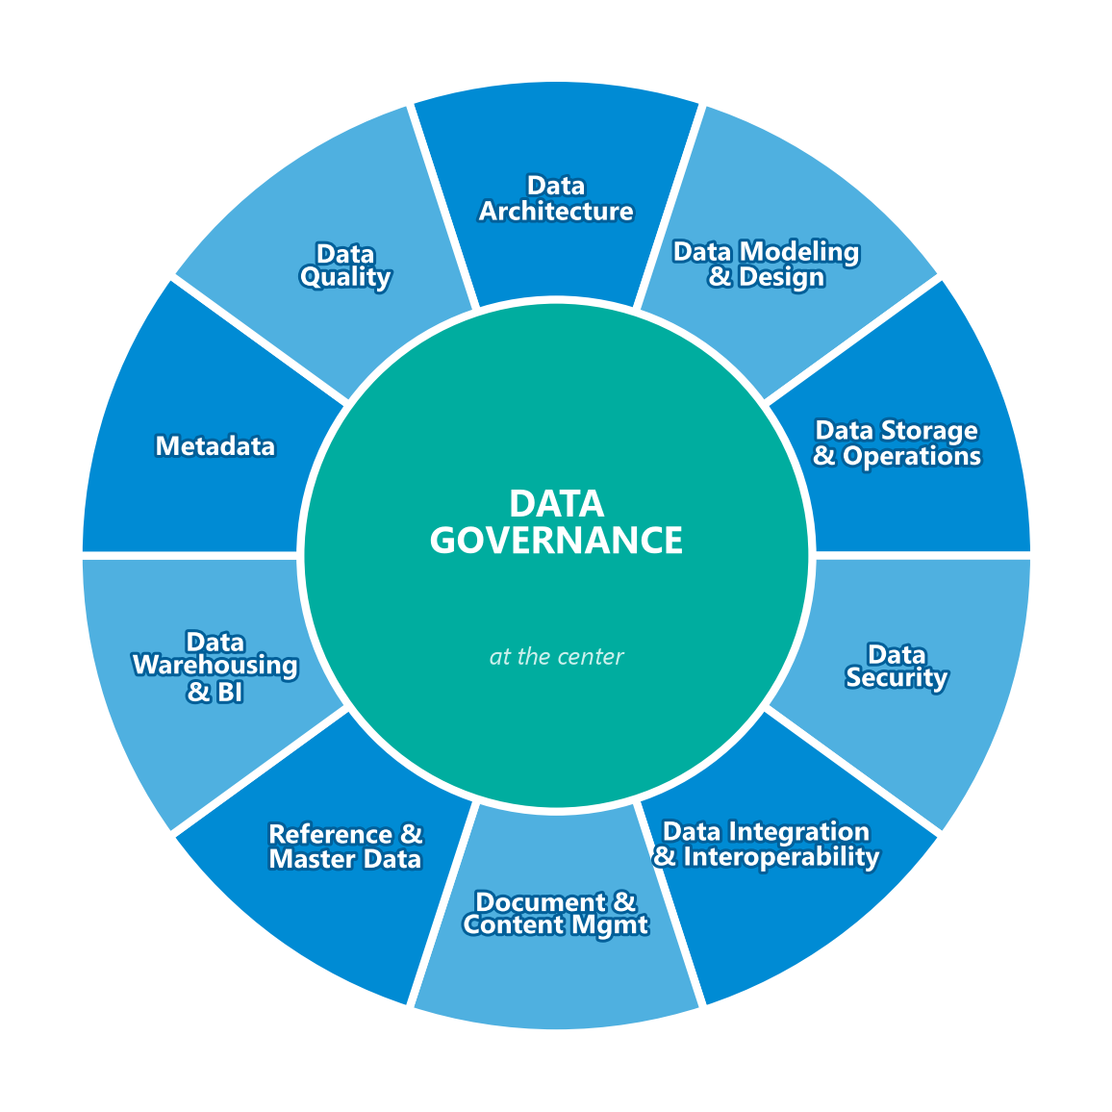
14 DMBOK2 Knowledge Areas You Must Master
Module 0 — Orientation
1. Data Management
2. Data Handling Ethics
3. Data Governance
4. Data Architecture
5. Data Modeling & Design
6. Data Storage & Operations
7. Data Security
8. Data Integration & Interoperability
9. Document & Content Management
10. Reference & Master Data
11. Data Warehousing & BI
12. Metadata Management
13. Data Quality
14. Big Data & Data Science
The DAMA Wheel shows the 11 knowledge areas (Data Governance at the centre). The course adds Ethics, the Data Management overview, and Big Data — 14 chapters in total.
CDMP Fundamentals | DAMA-DMBOK 2nd Edition
dama.org / cdmp.info
Notes:
: What You Will Learn — Course Scope
Here's the full scope of what we'll cover: the fourteen knowledge areas of the DMBOK Second Edition. We start with Data Management itself, then move through Data Ethics, Governance, Architecture, Modeling and Design, Storage and Operations, Security, Integration and Interoperability, Document and Content Management, Reference and Master Data, Data Warehousing and Business Intelligence, Metadata, Data Quality, and finally Big Data and Data Science. Each one becomes a dedicated module. Now, the wheel on your screen is the famous DAMA Wheel — it places Data Governance right at the hub, with ten knowledge areas arranged around it. Our course wraps three more chapters around those eleven — the Data Management overview, Data Ethics, and Big Data — to reach fourteen in total. Together they map one-to-one onto the exam blueprint — so when you finish this course, you'll have covered everything the exam can ask.
---

Slide 5
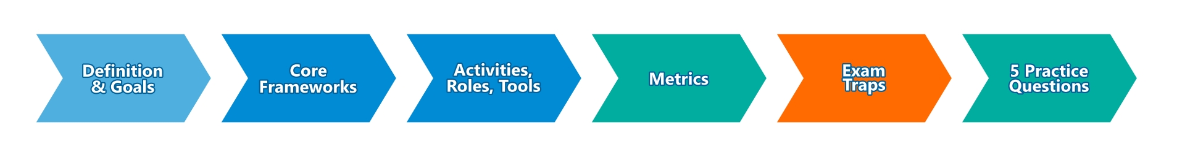
Every Module Follows the Same Proven Pattern
Module 0 — Orientation
One module per DMBOK2 chapter (15 modules total)
Each module = slide deck + matching speaker script for every slide
Each module ends with 5 exam-style practice questions
"Exam Tip" callouts flag the highest-probability test points
Module depth is proportional to exam weight — more slides for higher-weight chapters
CDMP Fundamentals | DAMA-DMBOK 2nd Edition
dama.org / cdmp.info
Notes:
: How This Course Is Structured
Every module in this course follows the same proven rhythm, so you always know what to expect. Follow the flow on screen: we begin with the formal definition and goals, move into the core frameworks and models, then cover the activities, roles, tools, and metrics, and we finish by calling out the common exam traps. Then — and this is important — every single module ends with five exam-style practice questions drawn from real practice pools, so you can test yourself immediately. Throughout, you'll see "Exam Tip" callouts; those flag the highest-probability test points, the things I'd bet money you'll see on the exam. And one more thing: the depth of each module is deliberately proportional to its exam weight. We'll spend far more time on the eleven-percent chapters than on the two-percent ones — which brings us to the certification itself.
---

Slide 6
What Is the CDMP?
Module 0 — Orientation
Leading professional certification for data management
Administered by DAMA International (Data Management Association)
Based entirely on the DAMA-DMBOK 2nd Edition (2017)
Vendor-neutral and globally recognized
Validates knowledge across all 14 DMBOK2 chapters
The DMBOK2 itself names the CDMP as the exam it underpins
CDMP Fundamentals | DAMA-DMBOK 2nd Edition
dama.org / cdmp.info
Notes:
: What Is the CDMP?
Let's define what you're actually earning. The CDMP — Certified Data Management Professional — is the leading professional certification in the data management field, administered by DAMA International, the Data Management Association. What makes it credible is that it's built entirely on the DAMA-DMBOK Second Edition, published in 2017. That's the "Data Management Body of Knowledge" — the closest thing our profession has to a universal reference text. The certification is vendor-neutral, globally recognized, and it validates your knowledge across all fourteen DMBOK chapters. In fact, the DMBOK itself explicitly names the CDMP as the exam it supports. So when you study the book, you're studying the exam.
---

Slide 7
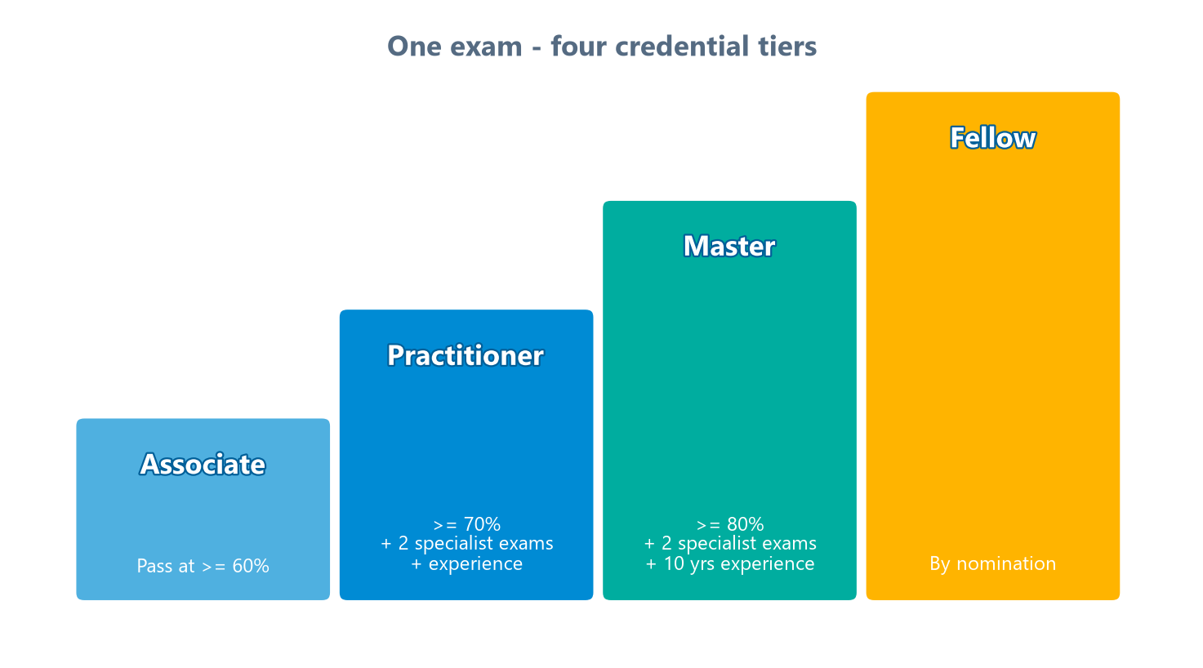
One Exam, Four Credential Tiers
Module 0 — Orientation
Level | Requirement
Associate | Fundamentals ≥ 60%
Practitioner | Fundamentals ≥ 70% + 2 Specialist exams + 2–10 yrs exp
Master | Fundamentals ≥ 80% + 2 Specialist exams + 10+ yrs exp
Fellow | By nomination — sustained distinguished contribution
⭐ EXAM TIP: Your score on the single Fundamentals exam determines which tier you qualify for. Aim for 80% — it keeps every door open.
CDMP Fundamentals | DAMA-DMBOK 2nd Edition
dama.org / cdmp.info
Notes:
: The CDMP Certification Levels
Now here's something that surprises a lot of candidates: there's essentially one exam, but four credential tiers — and you can see them climbing on screen. Pass the Fundamentals exam at sixty percent or above, and you earn the Associate credential. Score seventy percent or higher, and — combined with two specialist exams and some years of experience — you become eligible for the Practitioner tier. Hit eighty percent, plus the specialist exams and more experience, and you're on track for Master. The top tier, Fellow, isn't earned by exam at all — it's awarded by nomination for distinguished, long-term contributions to the profession. Here's the key takeaway, and write this down: your score on this single Fundamentals exam determines which tiers you qualify for. That's why I always say — aim high. A strong score keeps every door open for the rest of your career.
---

Slide 8
The Fundamentals Exam at a Glance
Module 0 — Orientation
100 multiple-choice questions (single best answer, A–D)
90 minutes (~54 seconds per question)
ESL accommodation: +20 minutes + printed language dictionary
Open book — DMBOK2 (print or e-book) allowed
Delivered online with a remote proctor
Score shown immediately on completion
⭐ EXAM TIP: ~54 seconds per question at 90 minutes. Pace matters — more on strategy later.
CDMP Fundamentals | DAMA-DMBOK 2nd Edition
dama.org / cdmp.info
Notes:
: The Fundamentals Exam at a Glance
Let's demystify the exam format, because knowing it removes a lot of anxiety. You'll face one hundred multiple-choice questions, each with a single best answer chosen from four options. You get ninety minutes. If English isn't your first language, you can request an accommodation — typically an extra twenty minutes and the use of a printed language dictionary. Now, here's the part people love: it's an open-book exam. You're allowed to reference the DMBOK Second Edition, in print or e-book form, while you test. The exam is delivered online with a remote proctor, and you'll see your result when you finish. One quick bit of math: ninety minutes across one hundred questions is about fifty-four seconds per question. That pace matters, and we'll talk strategy for it shortly.
---

Slide 9
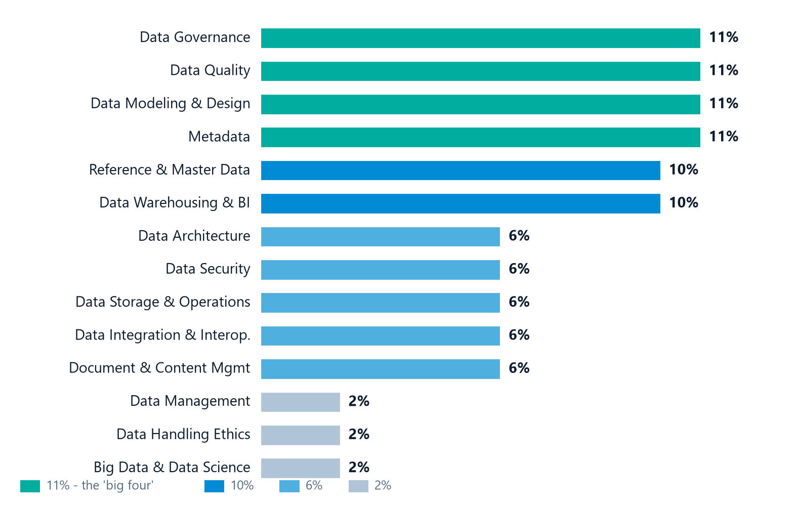
Exam Content Blueprint — Where the 100 Questions Come From
Module 0 — Orientation
Ch | Topic | %
3 | Data Governance | 11%
13 | Data Quality | 11%
5 | Data Modeling & Design | 11%
12 | Metadata Management | 11%
10 | Reference & Master Data | 10%
11 | Data Warehousing & BI | 10%
4 | Data Architecture | 6%
7 | Data Security | 6%
6 | Data Storage & Operations | 6%
8 | Data Integration & Interop. | 6%
9 | Document & Content Mgmt | 6%
1 | Data Management | 2%
2 | Data Handling Ethics | 2%
14 | Big Data & Data Science | 2%
⭐ EXAM TIP: The "Big 4" (Ch 3, 5, 12, 13) = 44% combined. Add Ch 10 + 11 = ~64% of the exam. Prioritize your study time accordingly.
CDMP Fundamentals | DAMA-DMBOK 2nd Edition
dama.org / cdmp.info
Notes:
: Exam Content Blueprint (Weighting)
This slide is one you'll want to come back to, because it tells you where to invest your study time. Look at the bar chart: the hundred questions aren't spread evenly across the chapters — the bars make the imbalance obvious at a glance. Six knowledge areas dominate. Data Governance, Data Quality, Data Modeling and Design, and Metadata each carry about eleven percent — that's your "big four," and together they're forty-four percent of the entire exam. Add Reference and Master Data and Data Warehousing and BI, each around ten percent, and you're looking at roughly sixty-four percent of the exam coming from just six chapters. The middle tier — Architecture, Security, Storage, Integration, and Document and Content Management — sits at about six percent each. And three foundational chapters — Data Management, Data Ethics, and Big Data — are two percent apiece. The lesson is simple: don't give every chapter equal time. Weight your effort toward the heavy hitters.
---

Slide 10
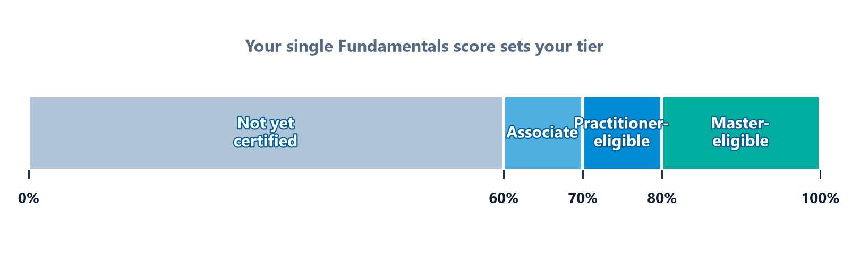
What 'Passing' Really Means — Score Thresholds
Module 0 — Orientation
You sit the same Fundamentals exam regardless of target tier
Score determines which credential tier(s) you qualify for
Higher score future-proofs your certification for Practitioner / Master
⭐ EXAM TIP: Target 70%+ even for Associate — it builds a safety margin and keeps higher tiers open.
CDMP Fundamentals | DAMA-DMBOK 2nd Edition
dama.org / cdmp.info
Notes:
: Scoring & Pass Thresholds
Let's be crystal clear about what passing means — and the coloured scale on screen lays it out band by band. Below sixty percent, you're not yet certified — but you can retake. Land between sixty and sixty-nine percent, and you've earned the CDMP Associate. Reach seventy to seventy-nine, and you're Associate-certified and Practitioner-eligible. Eighty percent or above, and you've opened the door to the Master tier. Here's my advice, even if you only need the Associate credential: target seventy percent or higher. Why? Because it gives you a comfortable safety margin on exam day, and it future-proofs your certification in case you decide to pursue the higher tiers later. Aim for the score you'll wish you had, not the minimum you can scrape by with.
---

Slide 11
Registration & Logistics
Module 0 — Orientation
Register at DAMA International — cdmp.info
Online exam, remotely proctored — need webcam, stable internet, quiet room
Have your DMBOK2 ready (print or e-book) — it's open book
Retakes available — waiting period and fees apply
⚠️ Always verify current fee, scheduling, ID requirements, and retake policy at the official site before booking.
CDMP Fundamentals | DAMA-DMBOK 2nd Edition
dama.org / cdmp.info
Notes:
: Registration & Logistics
A few practical notes on actually booking the exam. You register through DAMA International's official CDMP portal. The exam is taken online with a remote proctor watching through your webcam, so you'll need stable internet and a quiet, private room. Have your DMBOK Second Edition on hand, since it's open book. And if things don't go your way the first time, you can retake it — there's a waiting period and an additional fee. One important caveat, shown right here on the slide: exam fees, scheduling, identification requirements, and retake policies do change over time. So before you book, always confirm the current details on the official DAMA website. Don't take any dollar figure or policy as permanent — verify it.
---

Slide 12
Open Book ≠ No Preparation
Module 0 — Orientation
DO:
DON'T:
Know DMBOK2 structure — find facts in seconds
Tab key tables: definitions, principles, the DAMA Wheel
Use the book to confirm answers, not to learn them
Rely on looking everything up — only ~54 sec/question
Search mid-exam for concepts you never studied
Treat 'open book' as a substitute for preparation
⭐ EXAM TIP: The DMBOK is a safety net for 5–10 tough questions, not a replacement for study.
CDMP Fundamentals | DAMA-DMBOK 2nd Edition
dama.org / cdmp.info
Notes:
: The Open-Book Advantage — Use It Wisely
The open-book format is a genuine advantage — but only if you use it correctly, and many candidates misuse it. Here's the trap: people assume "open book" means they don't have to study. That's a fast way to fail. Remember, you have about fifty-four seconds per question. You simply don't have time to look up more than a handful of answers. So here's how to use the book well. First, know its structure cold, so you can flip to the right section in seconds. Second, tab and bookmark the key tables — the definitions, the principles, the DAMA Wheel. And third, use the book to confirm an answer you're unsure about, not to learn the material for the first time. Think of the DMBOK as a safety net for five or ten genuinely tough questions — not as a replacement for preparation. Study first; the book is your backup.
---

Slide 13
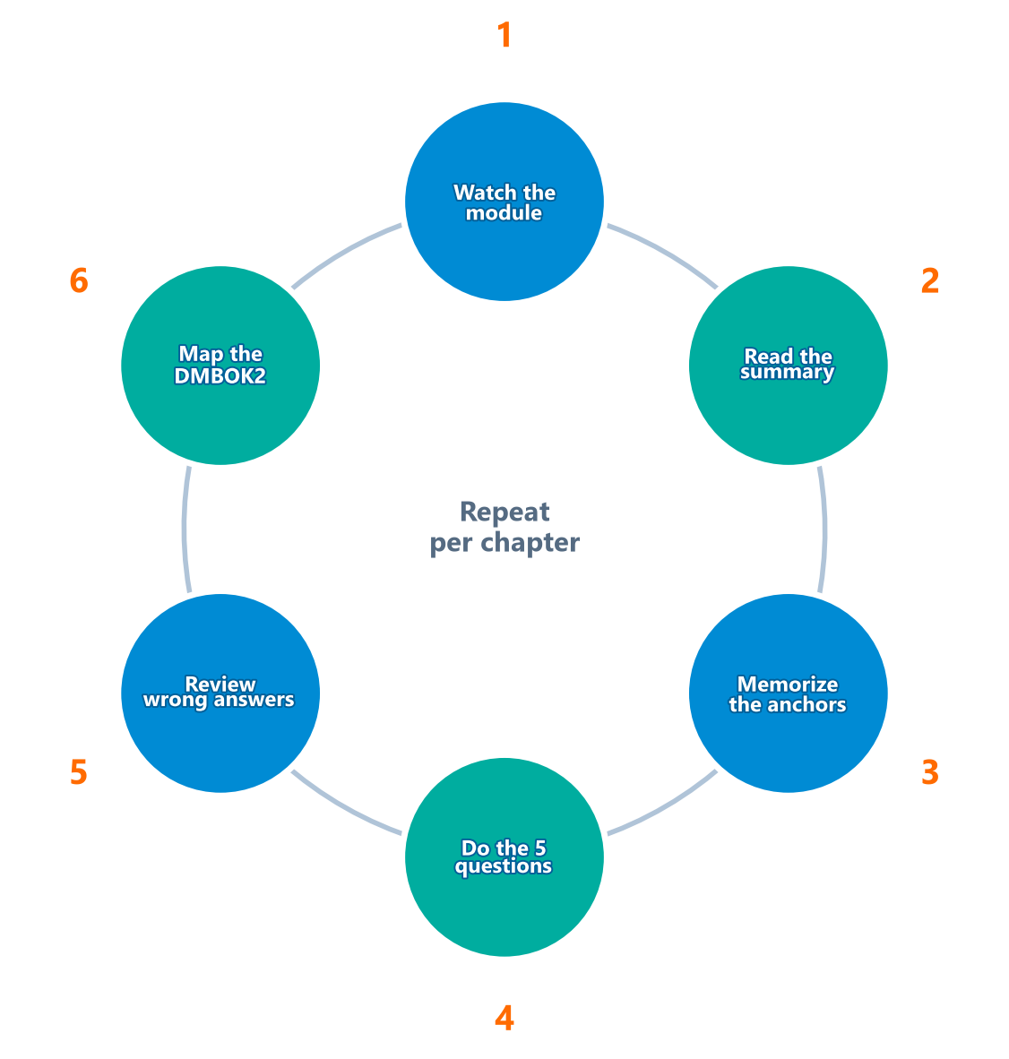
Your 6-Step Study Strategy
Module 0 — Orientation
1. Watch the module (this course)
2. Read the chapter summary to reinforce key points
3. Memorize anchors — definitions, numbered lists, acronyms
4. Do the 5 module questions, then full practice exams
5. Review wrong answers — understand WHY, not just the letter
6. Map the DMBOK2 — practice finding facts fast for open-book
⭐ EXAM TIP: Prioritize study time by blueprint weight — spend most on the 10–11% chapters.
CDMP Fundamentals | DAMA-DMBOK 2nd Edition
dama.org / cdmp.info
Notes:
: Your 6-Step Study Strategy
Let me give you a concrete, repeatable study loop you can run for every chapter — it's the circle you see on screen, and you run it once per chapter. Step one: watch the module here in this course. Step two: read the corresponding chapter summary to reinforce the key points while they're fresh. Step three: memorize the anchors — the definitions, the numbered lists, the acronyms — because the exam tests these precisely. Step four: do the five practice questions at the end of each module, then progress to full-length practice exams. Step five — and this is the one people skip — review your wrong answers and understand why you got them wrong; don't just memorize the right letter. And step six: spend a little time mapping the DMBOK so you can find facts fast during the open-book exam. Run that loop, weighted toward the heavy chapters, and you'll be ready.
---

Slide 14
High-Yield Memory Anchors & Acronyms
Module 0 — Orientation
Acronym | Stands For
SMART | Specific, Measurable, Actionable, Realistic, Time-bound
DIKW | Data → Information → Knowledge → Wisdom (pyramid)
ROT | Redundant, Obsolete, Trivial (data to minimize)
P/D/C/O | Plan, Develop, Control, Operate (activity categories)
ADKAR | Awareness, Desire, Knowledge, Ability, Reinforcement
GAIP | Generally Accepted Information Principles
SIPOC | Suppliers, Inputs, Process, Outputs, Consumers
⭐ EXAM TIP: If a list has a named count ("the 6 goals"), the exam may ask which item is NOT one of them — memorize the full set.
CDMP Fundamentals | DAMA-DMBOK 2nd Edition
dama.org / cdmp.info
Notes:
: Memory Anchors & Acronyms
The CDMP exam has a real fondness for precise lists and acronyms, so let's arm you with the highest-yield ones up front. SMART — Specific, Measurable, Actionable, Realistic, Time-bound — describes good objectives. DIKW is the Data, Information, Knowledge, Wisdom pyramid. ROT stands for Redundant, Obsolete, and Trivial data, the kind you want to minimize. P-D-C-O — Plan, Develop, Control, Operate — are the four activity categories used across every knowledge area. ADKAR — Awareness, Desire, Knowledge, Ability, Reinforcement — comes from change management. GAIP is the Generally Accepted Information Principles. And SIPOC — Suppliers, Inputs, Process, Outputs, Consumers — is the basis for the DMBOK context diagrams. Here's a crucial exam tip: when a list has a named count, like "the six goals" or "the eleven principles," the exam loves to ask which item is NOT one of them. So don't half-learn these lists — memorize the complete set.
---

Slide 15
Exam-Day Technique — Score Every Point You Can
Module 0 — Orientation
Budget ~54 sec/question — never let one item eat 5 minutes
Two-pass approach: easy questions first, flag hard ones, return later
Eliminate obviously wrong choices — improves odds on guesses
Answer every question — no penalty for guessing (blank = wasted chance)
Read the full stem — watch for BEST, MOST, NOT, EXCEPT
Two answers look right? Pick the one that uses DMBOK2's exact language.
CDMP Fundamentals | DAMA-DMBOK 2nd Edition
dama.org / cdmp.info
Notes:
: Exam-Day Technique
Let's talk tactics for the exam itself, because good technique can be worth several points. First, budget your time — about fifty-four seconds per question — and never let a single tough question swallow five minutes. Use a two-pass approach: answer all the easy questions first, flag the hard ones, and circle back with whatever time remains. When you're unsure, eliminate the obviously wrong choices to improve your odds. And always, always answer every question — there's no penalty for guessing, so a blank is just a wasted chance. Finally, read the entire question stem and watch for qualifier words like BEST, MOST, NOT, and EXCEPT, which completely change what's being asked. And when two answers both look correct, choose the one that uses the DMBOK's exact wording. That tiebreaker wins more often than you'd think.
---

Slide 16
Common Traps & Red-Flag Words
Module 0 — Orientation
Data Governance (oversight) ≠ Data Management (execution) — most-tested distinction
The 3 operating models: Centralized / Replicated / Federated — know the difference
Steward types have different levels of authority — don't mix them up
Data lifecycle ≠ SDLC — it's modelled on the product lifecycle
Absolute words are often wrong: "always," "never," "only," "all," "none"
DMBOK2 favors balanced, qualified statements — absolutes are frequently distractors.
CDMP Fundamentals | DAMA-DMBOK 2nd Edition
dama.org / cdmp.info
Notes:
: Common Traps & Red-Flag Words
Now let me show you where candidates routinely lose easy marks, so you don't. The single most common trap is confusing Data Governance with Data Management. Governance is oversight — it ensures data is managed properly. Management is execution — it actually does the work. The exam tests that distinction constantly. Another trap: mixing up the three operating models — Centralized, Replicated, and Federated. A third: confusing the different steward types and how much authority each one has. And a classic one — treating the data lifecycle as if it's the systems development lifecycle. It isn't; it's based on the product lifecycle. Finally, watch for red-flag absolute words: "always," "never," "only," "all," "none," "exclusively." The DMBOK favors balanced, qualified statements, so an answer with an absolute is frequently — though not always — a distractor. Read those carefully.
---

Slide 17
How to Use This Course
Module 0 — Orientation
Follow modules in order the first time — later chapters build on earlier ones
Pause and say definitions out loud — scripts are written to be spoken
Attempt the 5 practice questions cold before reviewing answers
Revisit big-weight chapters (3, 5, 12, 13) at least twice
Keep a personal cheat sheet of numbers and lists as you go
Each module's scripts.md gives you the full spoken narration for every slide
CDMP Fundamentals | DAMA-DMBOK 2nd Edition
dama.org / cdmp.info
Notes:
: How to Use This Course
A few tips to get maximum value from these modules. The first time through, follow them in order — later chapters genuinely build on concepts from earlier ones. As you watch, pause and say the definitions out loud; the scripts are written to be spoken, and speaking them helps them stick. After each module, attempt the five practice questions cold, before you review the answers — that tells you what you truly know versus what just felt familiar. Revisit the big-weight chapters — Governance, Modeling, Metadata, and Data Quality — at least twice. And keep a personal cheat sheet of the numbers and lists as you go; building it yourself is one of the best ways to lock them into memory. Every module's script file gives you the exact narration for every slide, so you can study by listening too.
---

Slide 18
What's Next — Module 1: Data Management
Module 0 — Orientation
The formal DMBOK2 definition of Data Management
The 11 data management principles
The DAMA Wheel and the DMBOK2 framework structure
The data lifecycle and why data is a unique asset
Master Chapter 1 and the whole DMBOK2 framework clicks into place.
CDMP Fundamentals | DAMA-DMBOK 2nd Edition
dama.org / cdmp.info
Notes:
: What's Next — Module 1
Alright — orientation done. You now know the exam, the blueprint, the scoring, and the strategy. It's time to start learning the material itself. In Module 1, we tackle Data Management: the formal definition you'll see quoted on the exam, the eleven data management principles, the DAMA Wheel that organizes the entire body of knowledge, and the data lifecycle that explains why data is such a unique asset. Master this foundational chapter, and the whole DMBOK framework clicks into place. I'll see you in Module 1.
---
*End of Module 0 scripts.*

