Slide 1
CDMP FUNDAMENTALS
Module 1: Data Management
DAMA-DMBOK 2nd Edition, Chapter 1
Exam weight: ~2% — foundational framework every other chapter builds on
Module 1 — Data Management
100
90
Open
≥60%
MCQ
minutes
book
to pass
CDMP Fundamentals | DAMA-DMBOK 2nd Edition
dama.org / cdmp.info
Notes:
: Module Title Slide
Welcome to Module 1: Data Management. This is Chapter 1 of the DMBOK, and although it only accounts for about two percent of the exam, I want you to give it your full attention — because this chapter defines the language, the principles, and the framework that every other chapter depends on. Get this foundation right, and the remaining thirteen modules will feel far more connected. Let's begin.
---

Slide 2
Module Overview & Learning Objectives
Module 1 — Data Management
By the end, you'll be able to:
Recite the formal DMBOK2 definition of Data Management
List the 6 goals and 11 principles of data management
Explain why data is a unique asset
Describe the data lifecycle and why it's based on the product lifecycle
Navigate the DAMA-DMBOK framework: the Wheel, the Hexagon, the Context Diagram
Name the 11 Knowledge Areas and what each covers
CDMP Fundamentals | DAMA-DMBOK 2nd Edition
dama.org / cdmp.info
Notes:
: Module Overview & Learning Objectives
Here's what you'll walk away with after this module. You'll be able to recite the formal definition of Data Management — the exact one the exam quotes. You'll know the six goals and the eleven principles of data management. You'll understand why data is considered a unique kind of asset. You'll be able to describe the data lifecycle and explain why it's modeled on the product lifecycle rather than the systems development lifecycle. And critically, you'll be able to navigate the DAMA-DMBOK framework — the Wheel, the Hexagon, and the Context Diagram — and name all eleven Knowledge Areas. That's a lot of foundational value packed into one chapter, so let's get into it.
---

Slide 3
The Definition of Data Management
Module 1 — Data Management
DMBOK2 Definition (memorize):
"Data Management is the development, execution, and supervision of plans, policies, programs, and practices that deliver, control, protect, and enhance the value of data and information assets throughout their lifecycles."
Data Management Professional: any person working in any facet of data management
Ranges from highly technical (DBA, programmer) to strategic (Data Steward, CDO)
⭐ EXAM TIP: Know this definition word-for-word — especially "throughout their lifecycles."
CDMP Fundamentals | DAMA-DMBOK 2nd Edition
dama.org / cdmp.info
Notes:
: The Definition of Data Management
Let's start with the single most important sentence in this entire chapter. Data Management is the development, execution, and supervision of plans, policies, programs, and practices that deliver, control, protect, and enhance the value of data and information assets throughout their lifecycles. Read that again, and notice the structure: three verbs about activity — develop, execute, supervise; four verbs about purpose — deliver, control, protect, enhance; and then the object — the value of data and information assets, throughout their lifecycles. That final phrase, "throughout their lifecycles," is the part the exam loves to test, so don't drop it. Also note who a Data Management Professional is: anyone working in any facet of data management, from a highly technical database administrator all the way up to a strategic Chief Data Officer. It's a deliberately broad definition. Memorize this slide.
---

Slide 4
Business Drivers & The 6 Goals of Data Management
Module 1 — Data Management
1. Understanding and supporting the information needs of the enterprise and its stakeholders
2. Capturing, storing, protecting, and ensuring the integrity of data assets
3. Ensuring the quality of data and information
4. Ensuring privacy and confidentiality of stakeholder data
5. Preventing unauthorized or inappropriate access, manipulation, or use
6. Ensuring data can be used effectively to add value to the enterprise
⭐ EXAM TIP: Primary driver: enable organizations to get value from data assets — just as managing financial assets yields value.
CDMP Fundamentals | DAMA-DMBOK 2nd Edition
dama.org / cdmp.info
Notes:
: Business Drivers & The 6 Goals
Why do organizations manage data at all? The primary business driver is simple but powerful: to get value from their data assets — exactly the way good management of financial and physical assets lets a company get value from those. Failure to manage data is like failure to manage capital: it leads to waste and lost opportunity. Flowing from that driver are the six goals of data management. One: understand and support the information needs of the enterprise and its stakeholders. Two: capture, store, protect, and ensure the integrity of data assets. Three: ensure quality. Four: ensure privacy and confidentiality. Five: prevent unauthorized or inappropriate access and use. And six: ensure data can be used effectively to add value. Notice how those six goals balance value creation with protection and control. If the exam asks "which is NOT a goal," you'll want all six locked in.
---

Slide 5
What Is Data?
Module 1 — Data Management
Data represents facts about the world, stored in digital (or paper) form
Data is BOTH an interpretation of the objects it represents, AND an object that must be interpreted
Context = data's representational system (vocabulary + relationships between components)
The conventions of that system are documented as Metadata
⭐ EXAM TIP: Data requires context to be meaningful, and that context is captured as Metadata — a recurring DMBOK theme.
CDMP Fundamentals | DAMA-DMBOK 2nd Edition
dama.org / cdmp.info
Notes:
: What Is Data?
Let's get philosophical for a moment, because the DMBOK does. What is data? At its core, data represents facts about the world, stored in digital — or even paper — form. But here's the subtle point the exam likes: data is both an interpretation of the objects it represents, and an object that must itself be interpreted. In plain terms, data needs context to mean anything. Think of the number "twelve" — twelve what? Twelve dollars, twelve months, twelve degrees? Without context, it's meaningless. That context — the common vocabulary and the relationships between pieces of data — is what the DMBOK calls data's representational system. And the conventions of that system get documented as Metadata. So remember this chain: data needs context, context is the representational system, and that system is captured as Metadata. It's a theme you'll see again and again.
---

Slide 6
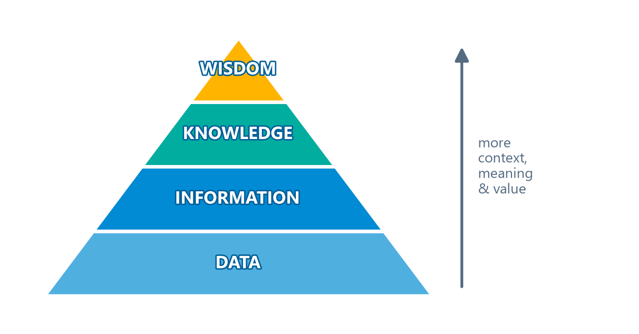
Data vs. Information & the DIKW Pyramid
Module 1 — Data Management
Data = raw material of information; Information = data in context
DIKW: Data → Information → Knowledge → Wisdom
DMBOK2's 3 criticisms: (1) data must be created, (2) knowledge is needed to create data, (3) data and information are intertwined
In the DMBOK, "data" and "information" are used interchangeably
⭐ EXAM TIP: Each DIKW layer adds context, meaning, and value — but the model is an imperfect simplification.
CDMP Fundamentals | DAMA-DMBOK 2nd Edition
dama.org / cdmp.info
Notes:
: Data vs. Information & the DIKW Pyramid
You've probably seen the DIKW pyramid — it's on your screen now: Data at the bottom, then Information, then Knowledge, and Wisdom at the peak. Data has been called the raw material of information, and information has been called data in context. The pyramid is a useful teaching image, but the DMBOK pointedly criticizes it on three grounds, and these three criticisms are very testable. First, the pyramid assumes data simply exists — but in reality, data has to be created; it doesn't just appear. Second, by showing a neat linear climb from data to wisdom, it ignores that you actually need knowledge to create data in the first place. And third, it implies data and information are separate things, when in fact they're intertwined and dependent on each other. That's why, throughout the DMBOK, the terms "data" and "information" are used interchangeably. If a question asks for a limitation of the DIKW pyramid, those three points are your answer.
---

Slide 7
Data Is an Asset — With Unique Properties
Module 1 — Data Management
Asset = an economic resource that can be owned/controlled and holds or produces value
Not consumed when used — can even be stolen without being gone
Used by multiple people simultaneously
Durable (doesn't wear out), but not easy to reproduce if lost
Easy to copy and transport
Most uses of data beget more data — volumes keep growing
⭐ EXAM TIP: "Data is not consumed when it is used" is the single most-tested differentiator.
CDMP Fundamentals | DAMA-DMBOK 2nd Edition
dama.org / cdmp.info
Notes:
: Data Is an Asset — With Unique Properties
We keep calling data an asset, so let's define the word. An asset is an economic resource that can be owned or controlled and that holds or produces value. Data qualifies — but it behaves very differently from physical or financial assets, and these differences are heavily tested. The most important one: data is not consumed when it's used. If I spend a dollar, it's gone; if I use a piece of data, it's still there — I can use it again, and so can other people, at the same time. Data can even be stolen without being gone, because the thief copies it while you still have it. Data is durable — it doesn't wear out — yet it's not easy to reproduce if it's truly lost. It's easy to copy and transport. And here's a kicker: most uses of data create even more data, so volumes keep growing. If you remember one differentiator for the exam, make it this: data is not consumed when it is used.
---

Slide 8
The 11 Data Management Principles (Part 1)
Module 1 — Data Management
1. Data is an asset with unique properties
2. The value of data can and should be expressed in economic terms
3. Managing data means managing the quality of data
4. It takes Metadata to manage data
5. It takes planning to manage data
6. Data management requirements must drive IT decisions
7. Data management is cross-functional
⭐ EXAM TIP: Grouped: data is valuable (1-2), data management is a business requirement (3-6), diverse skills (7).
CDMP Fundamentals | DAMA-DMBOK 2nd Edition
dama.org / cdmp.info
Notes:
: The 11 Data Management Principles (Part 1)
The DMBOK lays out eleven data management principles, and it groups them, which makes them much easier to remember. We'll take them in two slides. The first group is "data is valuable," and it has two principles: data is an asset with unique properties, and the value of data can and should be expressed in economic terms. The second group is "data management requirements are business requirements," and it has four: managing data means managing the quality of data; it takes Metadata to manage data; it takes planning to manage data; and — very important — data management requirements must drive information technology decisions. The third group is "data management depends on diverse skills," and it starts with the principle that data management is cross-functional. We'll finish the list on the next slide. Notice the recurring message: data management is a business discipline that happens to involve technology, not the other way around.
---

Slide 9
The 11 Data Management Principles (Part 2)
Module 1 — Data Management
1. Data management requires an enterprise perspective
2. Data management must account for a range of perspectives
3. Different types of data have different lifecycle characteristics
4. Managing data includes managing the risks associated with data
5. FOUNDATIONAL: Effective data management requires leadership commitment
⭐ EXAM TIP: Technology should SERVE, not DRIVE, data needs (Principle 6). Watch for this exact framing.
CDMP Fundamentals | DAMA-DMBOK 2nd Edition
dama.org / cdmp.info
Notes:
: The 11 Data Management Principles (Part 2)
Continuing the diverse-skills group: principle eight, data management requires an enterprise perspective — it can't just be local; and principle nine, data management must account for a range of perspectives, because data is fluid and constantly evolving. Then comes the group "data management is lifecycle management," with two principles: different types of data have different lifecycle characteristics, and managing data includes managing the risks associated with data. And underpinning all of them is the foundational principle: effective data management requires leadership commitment. Here's an exam tip worth repeating: principle six says technology must serve, not drive, an organization's data needs. The exam phrases this several ways, so whenever you see "technology drives the data strategy," your radar should go up — that's usually the wrong answer.
---

Slide 10
Data Management Challenges
Module 1 — Data Management
Data differs from other assets → hard to value, hard to inventory, hard to assign ownership
Data valuation → neither costs nor benefits are standardized; value is contextual and temporal
Data quality → historically treated as an IT afterthought ('garbage in, garbage out')
Planning, Metadata, cross-functional coordination, enterprise perspective
⭐ EXAM TIP: Value of data is both contextual (varies by org) and temporal (changes over time).
CDMP Fundamentals | DAMA-DMBOK 2nd Edition
dama.org / cdmp.info
Notes:
: Data Management Challenges
Because data has these unusual properties, actually following the principles creates real challenges — and the DMBOK devotes a whole section to them. Let me highlight the ones most likely to surface on the exam. First, data differs from other assets, which makes it genuinely hard to put a monetary value on, hard to inventory, and hard to assign clean ownership for. Second, data valuation: neither the costs nor the benefits of data are standardized, so value ends up being contextual — what's valuable to one organization may be worthless to another — and temporal, meaning what was valuable yesterday may not be today. Third, data quality, which historically got treated as an IT afterthought — the old "garbage in, garbage out" shrug. There are more challenges — planning, Metadata, cross-functional coordination, the enterprise perspective — but if you remember that data's value is both contextual and temporal, you'll have a frequently tested fact in your pocket.
---

Slide 11
The Cost of Poor Data Quality
Module 1 — Data Management
Experts estimate organizations spend 10–30% of revenue handling data quality issues
IBM estimated the cost of poor quality data in the US (2016) at $3.1 Trillion
Costs: scrap & rework, work-arounds, inefficiency, conflict, low morale, customer dissatisfaction, compliance fines, reputational damage
Benefits: better customer experience, higher productivity, reduced risk, increased revenue, competitive advantage
⭐ EXAM TIP: Memorize the two numbers — 10–30% of revenue and $3.1 Trillion (IBM, 2016).
CDMP Fundamentals | DAMA-DMBOK 2nd Edition
dama.org / cdmp.info
Notes:
: The Cost of Poor Data Quality
Let's talk money, because the DMBOK gives us two numbers that show up on the exam. Experts estimate that organizations spend between ten and thirty percent of revenue just handling data quality issues. And IBM estimated the cost of poor quality data in the United States, in 2016, at three-point-one trillion dollars. Those are staggering figures, and they're memorizable, so memorize them. The costs of poor quality come from scrap and rework, hidden work-arounds, inefficiency, organizational conflict, low morale, customer dissatisfaction, lost opportunities, compliance fines, and reputational damage. Flip all of that around and you get the benefits of high quality data: better customer experience, higher productivity, reduced risk, the ability to act on opportunities, increased revenue, and competitive advantage. Two numbers to lock in: ten to thirty percent of revenue, and three-point-one trillion dollars.
---

Slide 12
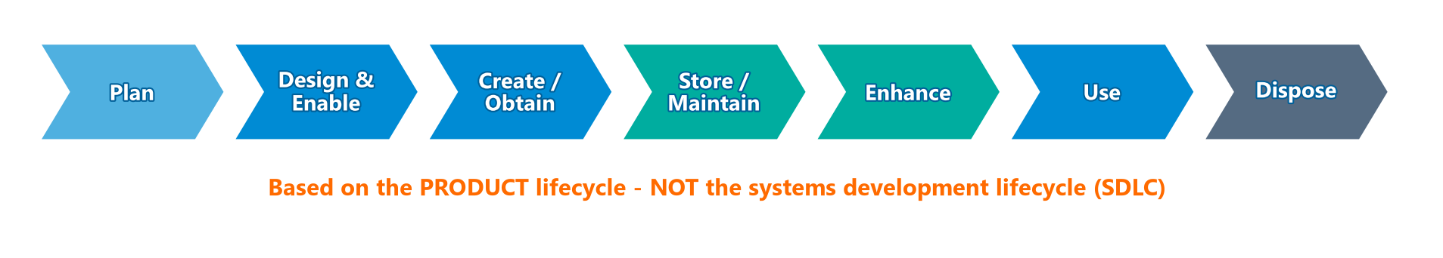
The Data Lifecycle
Module 1 — Data Management
Based on the product lifecycle — NOT the SDLC
Phases: Plan → Design & Enable → Create/Obtain → Store/Maintain → Enhance → Use → Dispose
Data also has lineage — the pathway from origin to usage (the data chain)
⭐ EXAM TIP: If an answer says the data lifecycle is based on the SDLC — it's WRONG. It's the product lifecycle.
CDMP Fundamentals | DAMA-DMBOK 2nd Edition
dama.org / cdmp.info
Notes:
: The Data Lifecycle
Here's a concept the exam tests almost every time, and it's easy points if you know it. Data has a lifecycle, and that lifecycle is based on the product lifecycle. It is not — I repeat, not — the systems development lifecycle, or SDLC. Don't confuse the two. Follow the chevrons on screen: the data lifecycle runs plan, then design and enable, then create or obtain, then store and maintain, then enhance, then use, and finally dispose of. On top of the lifecycle, data also has lineage — the pathway it travels from its point of origin to its point of usage, sometimes called the data chain. So lifecycle is about the stages data passes through; lineage is about the path it travels. If any answer choice tells you the data lifecycle is based on the SDLC, eliminate it immediately.
---

Slide 13
Implications of the Lifecycle (and ROT)
Module 1 — Data Management
Creation and usage are the most critical points in the lifecycle
Data Quality must be managed throughout the lifecycle
Metadata quality must be managed throughout
Data Security must be managed throughout — from creation to disposal
Focus on the most critical data; minimize ROT
ROT = Redundant, Obsolete, Trivial data
⭐ EXAM TIP: "From creation to disposal" is the security/lifecycle phrase to remember.
CDMP Fundamentals | DAMA-DMBOK 2nd Edition
dama.org / cdmp.info
Notes:
: Implications of the Lifecycle (and ROT)
Focusing on the lifecycle leads to several important implications, and the DMBOK spells them out. Creation and usage are the two most critical points in the lifecycle — that's where data gets its cost and its value. Data quality has to be managed throughout the entire lifecycle, not bolted on at the end. The same is true for Metadata quality. And data security must be managed throughout the lifecycle as well — the DMBOK's phrase is "from creation to disposal," which is worth memorizing. Finally, because organizations produce far more data than they ever use, lifecycle management means focusing on your most critical data and minimizing ROT. ROT stands for Redundant, Obsolete, and Trivial data — the clutter you want to eliminate. So: protect data from creation to disposal, and cut the ROT.
---

Slide 14
Data and Risk
Module 1 — Data Management
Data represents value AND risk — can be lost, stolen, misunderstood, or misused
Information gaps = the difference between what we know and what we need to know — enterprise liabilities
Organizations get most value from data that is: available, relevant, complete, accurate, consistent, timely, usable, meaningful
SOX — accuracy/validity of financial transaction data
Solvency II — data lineage and quality behind insurance risk models
⭐ EXAM TIP: Information gaps = enterprise liabilities.
CDMP Fundamentals | DAMA-DMBOK 2nd Edition
dama.org / cdmp.info
Notes:
: Data and Risk
Data isn't only valuable — it's also risky. It can be lost, stolen, misunderstood, or misused. The DMBOK introduces a sharp little concept here called the information gap: the difference between what we know and what we need to know to make an effective decision. And it labels those information gaps as enterprise liabilities — that exact phrase is testable. Organizations get the most value from data that is available, relevant, complete, accurate, consistent, timely, usable, meaningful, and understood. The chapter also name-checks two regulations in the risk context: Sarbanes-Oxley, which focuses on the accuracy and validity of financial transaction data, and Solvency II, which focuses on data lineage and quality behind insurance risk models. If you remember just one phrase from this slide, make it "information gaps are enterprise liabilities."
---

Slide 15
Data Management & Technology
Module 1 — Data Management
Managing technology is NOT the same as managing data
The rule: data requirements aligned with business strategy should drive technology decisions — not the reverse
The CDO role exists because successful data management must be business-driven, not IT-driven
The CDO leads both data initiatives AND cultural change
⭐ EXAM TIP: Technology should SERVE data strategy. "Technology drives data decisions" is a classic wrong answer.
CDMP Fundamentals | DAMA-DMBOK 2nd Edition
dama.org / cdmp.info
Notes:
: Data Management & Technology
Because nearly all data today is stored electronically, data management and technology are deeply intertwined — but the DMBOK is emphatic that managing technology is not the same as managing data. There's a natural tension in most organizations between the urge to build shiny new technology and the need for reliable, well-managed data. The principle that resolves it: data requirements aligned with business strategy should drive technology decisions — never the reverse. This is exactly why the Chief Data Officer role emerged. The CDO exists on the recognition that successful data management must be business-driven, not IT-driven. And the CDO doesn't just run initiatives; they lead cultural change, helping the whole organization think more strategically about its data. Watch for exam answers claiming that technology should drive data decisions — that framing is almost always wrong.
---

Slide 16
Data Management Strategy — Components
Module 1 — Data Management
Strategy = a set of choices charting a high-level course to achieve high-level goals
Data strategy must flow from data needs inherent in the business strategy
Typically owned by the CDO, enacted via a data governance team, supported by a Data Governance Council
Components: vision, business case, guiding principles, mission & goals, SMART objectives, roles & decision rights, roadmap
SMART = Specific, Measurable, Actionable, Realistic, Time-bound
⭐ EXAM TIP: SMART objectives cover a 12–24 month horizon; the Scope Statement covers 3 years.
CDMP Fundamentals | DAMA-DMBOK 2nd Edition
dama.org / cdmp.info
Notes:
: Data Management Strategy — Components
Let's talk strategy. A strategy is a set of choices and decisions that chart a high-level course of action toward high-level goals. A data strategy has to come from understanding the data needs that are inherent in the business strategy — what data the organization needs, how it'll get it, manage it, and use it. In most organizations, this strategy is owned by the CDO, enacted through a data governance team, and supported by a Data Governance Council. The components of the strategy include a compelling vision, a business case, guiding principles, the mission and long-term goals, measures of success, short-term SMART objectives on a twelve-to-twenty-four-month horizon, descriptions of roles and decision rights, program components, a prioritized program of work, and a draft roadmap. And remember the acronym SMART: Specific, Measurable, Actionable, Realistic, and Time-bound.
---

Slide 17
The 3 Strategy Deliverables
Module 1 — Data Management
Deliverable | What it contains
Data Management Charter | Vision, business case, goals, guiding principles, measures of success, risks, operating model
Data Management Scope Statement | Goals & objectives for a planning horizon (usually 3 years); accountable roles and leaders
Data Management Implementation Roadmap | Specific programs, projects, task assignments, delivery milestones
⭐ EXAM TIP: Charter → Scope Statement (3-year horizon) → Roadmap. Know all three names.
CDMP Fundamentals | DAMA-DMBOK 2nd Edition
dama.org / cdmp.info
Notes:
: The 3 Strategy Deliverables
Strategic planning for data management produces three named deliverables, and the exam expects you to know all three. First, the Data Management Charter — that's the big-picture document: vision, business case, goals, guiding principles, measures of success, recognized risks, and the operating model. Second, the Data Management Scope Statement, which lays out goals and objectives for a planning horizon — usually three years — along with the roles and leaders accountable for achieving them. Remember that three-year horizon; it's a testable detail. And third, the Data Management Implementation Roadmap, which gets specific: programs, projects, task assignments, and delivery milestones. So the progression is Charter, then Scope Statement, then Roadmap — from vision, to scope, to concrete plan.
---

Slide 18
Data Management Frameworks — Overview
Module 1 — Data Management
Chapter 1 presents five frameworks:
Strategic Alignment Model (SAM) — high-level drivers
Amsterdam Information Model (AIM) — the '9-cell'
The DAMA-DMBOK Framework — the Wheel, the Hexagon, the Context Diagram
Aiken's DMBOK Pyramid — maturity progression
DAMA Framework Evolved (Geuens) — dependencies between functions
The DAMA-DMBOK Framework is the one the exam focuses on most
CDMP Fundamentals | DAMA-DMBOK 2nd Edition
dama.org / cdmp.info
Notes:
: Data Management Frameworks — Overview
The DMBOK offers several frameworks as different lenses for understanding data management, and Chapter 1 presents five of them. Two are high-level alignment models: the Strategic Alignment Model and the Amsterdam Information Model. Then there's the main event — the DAMA-DMBOK Framework itself, expressed through three visuals: the Wheel, the Hexagon, and the Context Diagram. And finally, two reformulations: Aiken's DMBOK Pyramid, which describes a maturity progression, and the DAMA Framework Evolved by Sue Geuens, which maps the dependencies between functions. The exam concentrates most on the DAMA-DMBOK Framework, so that's where we'll spend our time over the next few slides. Let's look at the two alignment models first.
---

Slide 19
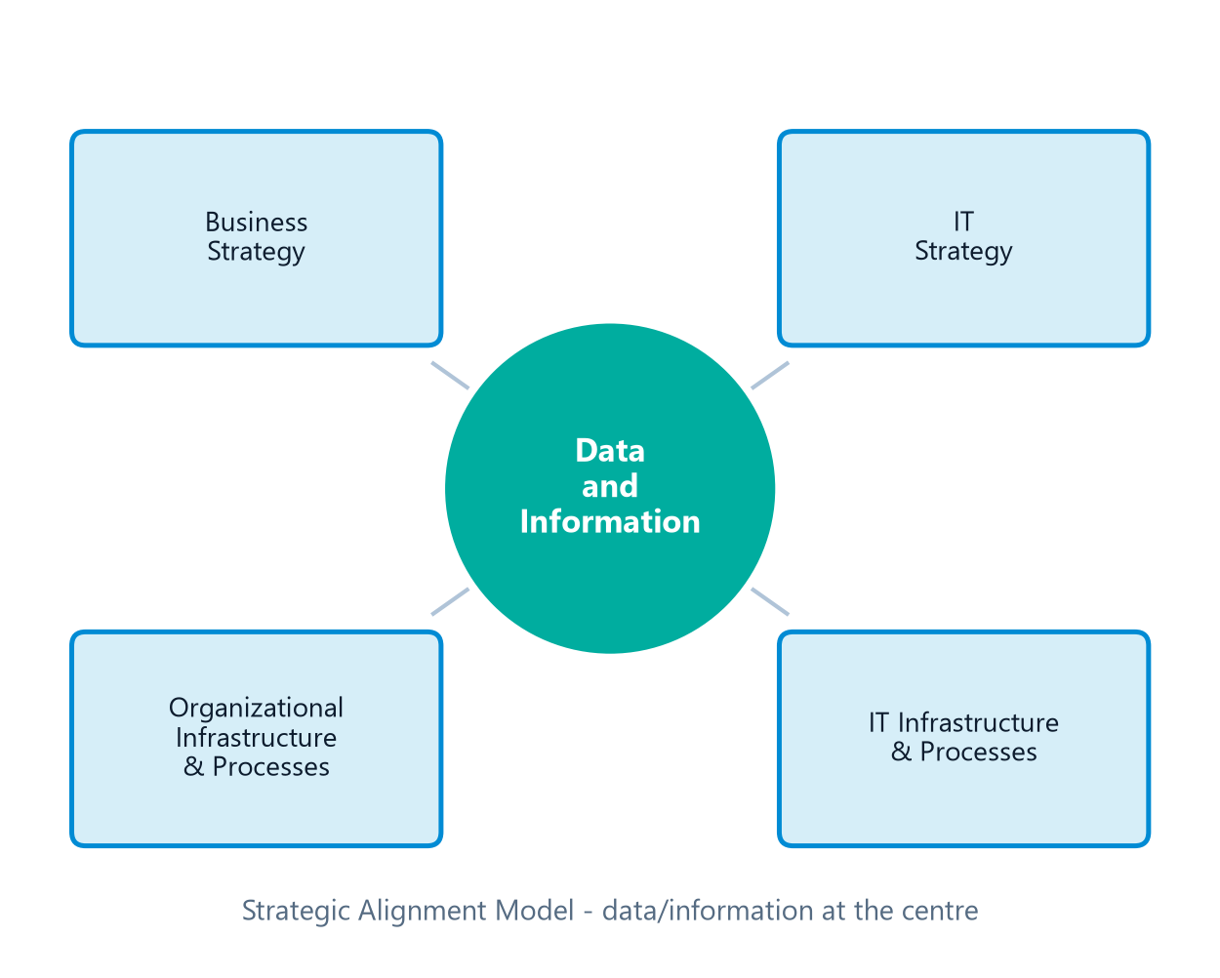
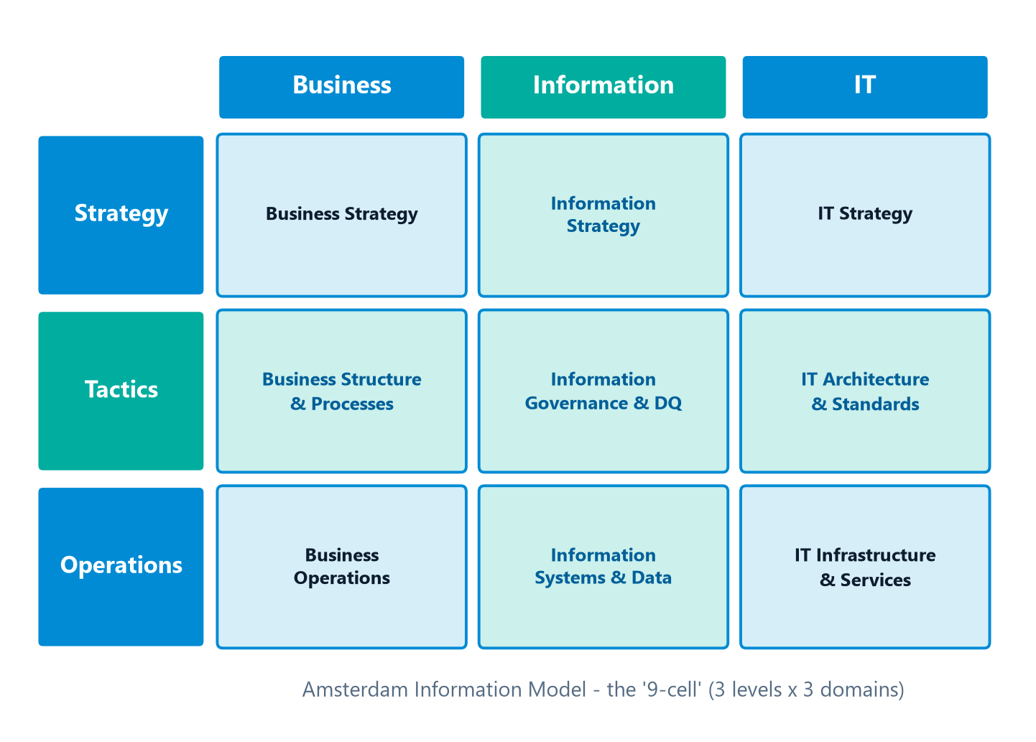
Strategic Alignment Model & Amsterdam Information Model
Module 1 — Data Management
⭐ EXAM TIP: AIM = 9-cell (Strategy/Tactics/Operations × Business/Information/IT). SAM = data/information at the center, four strategic domains.
CDMP Fundamentals | DAMA-DMBOK 2nd Edition
dama.org / cdmp.info
Notes:
: Strategic Alignment Model & Amsterdam Information Model
Two alignment models, quickly. The Strategic Alignment Model, from Henderson and Venkatraman in 1999, puts the relationship between data and information right at its center. Information ties to business strategy and the operational use of data; data ties to information technology. Surrounding that center are four domains of strategic choice: business strategy, IT strategy, organizational infrastructure and processes, and IT infrastructure and processes. The Amsterdam Information Model, from Abcouwer, Maes, and Truijens in 1997, is famously known as the nine-cell. As the grid on screen shows, it's a three-by-three grid: three levels — strategy, tactics, operations — crossed with three columns — business, information, and IT. Its key contribution is recognizing that middle tactical layer for structure and planning, plus an information governance and data quality pillar. For the exam, anchor these two facts: the Amsterdam model is the nine-cell, and the Strategic Alignment Model has data and information at its center with four strategic domains around it.
---

Slide 20
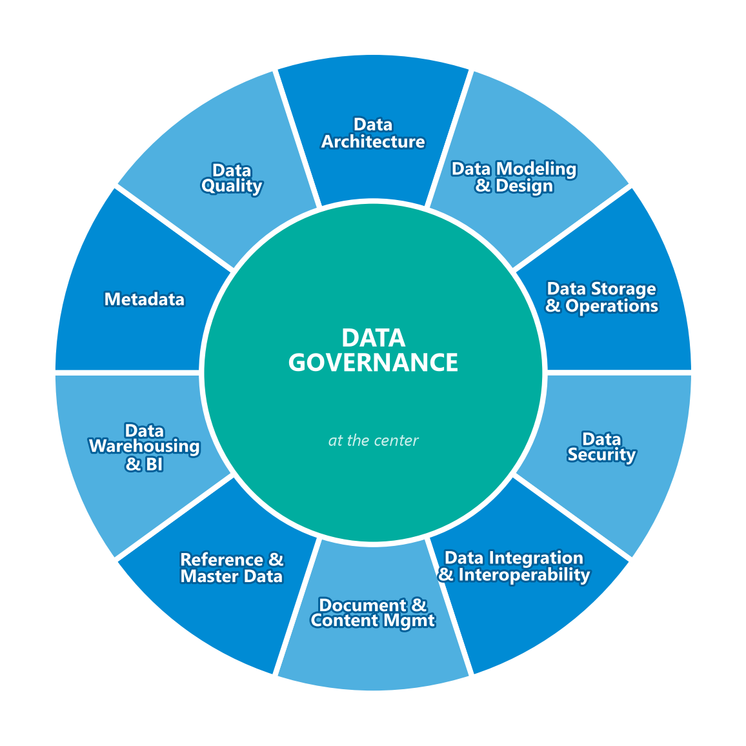
The DAMA Wheel
Module 1 — Data Management
Data Governance sits at the center — provides consistency within and balance between all other functions
Other 10 KAs: Architecture, Modeling & Design, Storage & Operations, Security, Integration & Interoperability, Document & Content, Reference & Master Data, DW & BI, Metadata, Data Quality
⭐ EXAM TIP: What is at the center of the DAMA Wheel? → Data Governance. Know WHY (consistency + balance).
CDMP Fundamentals | DAMA-DMBOK 2nd Edition
dama.org / cdmp.info
Notes:
: The DAMA Wheel
Now the centerpiece, right here on screen: the DAMA Wheel. This is the image that defines the eleven Knowledge Areas of data management, and it's probably the single most exam-relevant diagram in the whole book. Here's the one fact you absolutely must know: Data Governance sits at the center of the Wheel. Why? Because governance provides consistency within and balance between all the other functions. Arranged around that governance hub are the other ten Knowledge Areas — Data Architecture, Data Modeling and Design, Data Storage and Operations, Data Security, Data Integration and Interoperability, Document and Content Management, Reference and Master Data, Data Warehousing and Business Intelligence, Metadata, and Data Quality. If the exam asks what's at the center of the DAMA Wheel, your instant answer is Data Governance — and you should be ready to say why: consistency and balance across the functions.
---

Slide 21
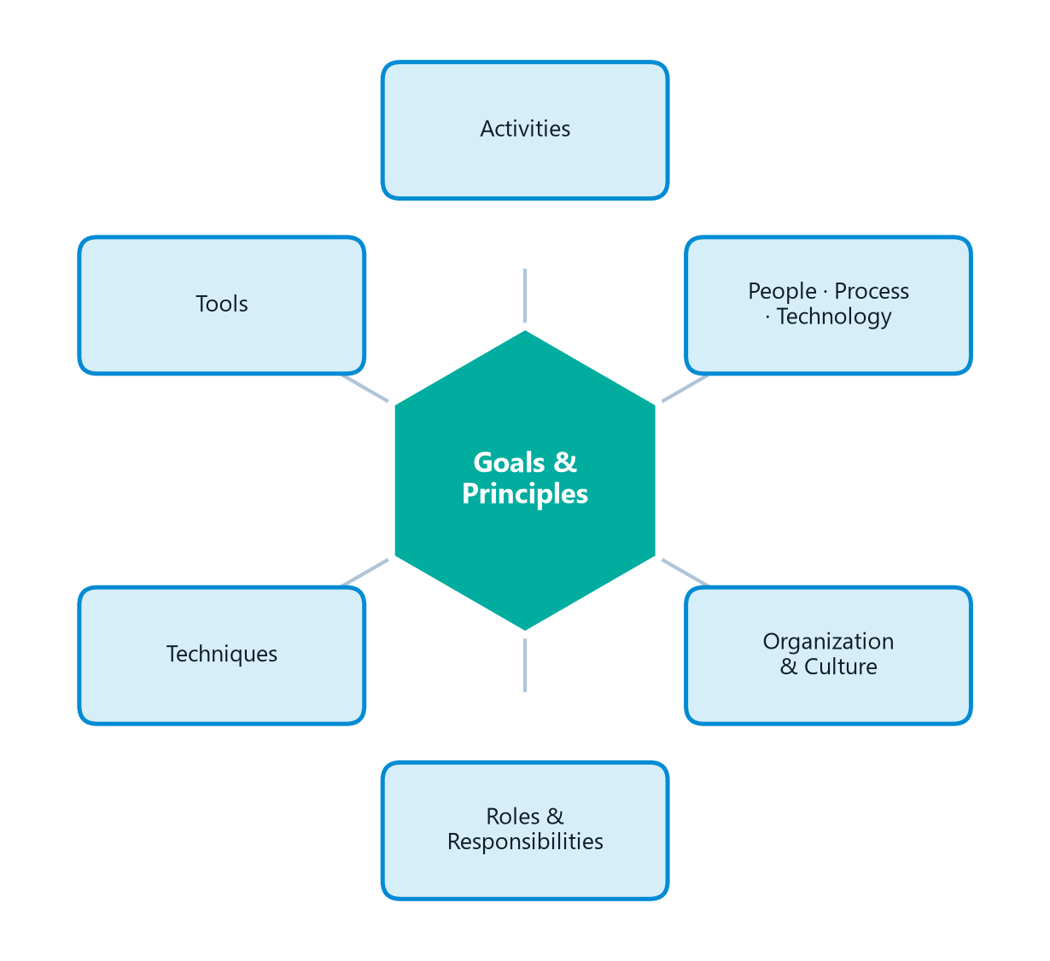
The Environmental Factors Hexagon
Module 1 — Data Management
Hexagon shows the relationship between people, process, and technology
Goals & Principles at the center — they guide how people execute activities and use tools
Surrounding factors: Activities, Tools, Techniques, Roles & Responsibilities, Organization & Culture
⭐ EXAM TIP: Wheel center = Data Governance. Hexagon center = Goals & Principles. A classic exam swap.
CDMP Fundamentals | DAMA-DMBOK 2nd Edition
dama.org / cdmp.info
Notes:
: The Environmental Factors Hexagon
The second visual in the framework is the Environmental Factors Hexagon, and there's a classic exam trap hiding here, so pay attention. The Hexagon on screen shows the relationship between people, process, and technology. And at its center, it places Goals and Principles — because goals and principles guide how people perform activities and use their tools. Around the center you'll find activities, tools, techniques, roles and responsibilities, and organization and culture. Now here's the trap: students constantly mix up the centers. The Wheel's center is Data Governance. The Hexagon's center is Goals and Principles. The exam will absolutely try to swap those two on you. So burn it in: Wheel equals Governance, Hexagon equals Goals and Principles.
---

Slide 22
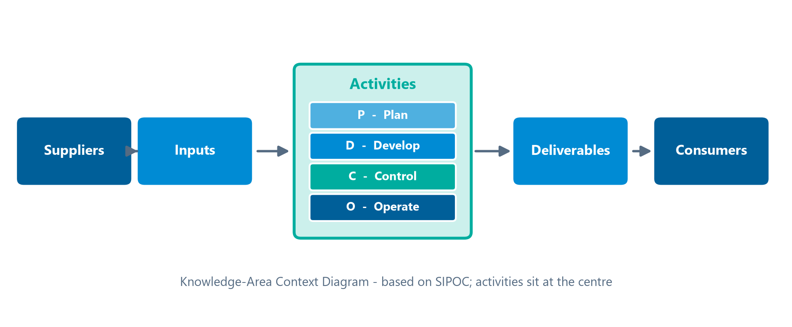
The Knowledge Area Context Diagram
Module 1 — Data Management
Code | Phase | Description
(P) | Planning | Set strategic/tactical course; recurring
(D) | Development | Organized around the SDLC
(C) | Control | Ensure ongoing quality, integrity, reliability, security
(O) | Operational | Support use, maintenance, enhancement
⭐ EXAM TIP: Suppliers enable inputs · Consumers benefit from deliverables · Participants perform/manage/approve activities.
CDMP Fundamentals | DAMA-DMBOK 2nd Edition
dama.org / cdmp.info
Notes:
: The Knowledge Area Context Diagram
The third visual is the Knowledge Area Context Diagram, and it's the detailed template the DMBOK uses for every Knowledge Area. It's based on a SIPOC diagram — Suppliers, Inputs, Process, Outputs, Consumers — and, as the layout on screen shows, it puts activities at the center, because activities produce the deliverables that meet stakeholder requirements. Those activities are sorted into four phases — P, D, C, and O. Planning activities set the strategic and tactical course and recur over time. Development activities are organized around the systems development lifecycle. Control activities ensure ongoing quality, integrity, reliability, and security. And Operational activities support use, maintenance, and enhancement. The full diagram has twelve components, including definition, goals, activities, inputs, deliverables, roles, suppliers, consumers, participants, tools, techniques, and metrics. One precise distinction the exam loves: suppliers enable access to inputs, consumers benefit from the deliverables, and participants are the ones who actually perform, manage, or approve the activities. Know those three apart.
---

Slide 23
The 11 Knowledge Areas
Module 1 — Data Management
Ch | Knowledge Area | One-line definition
3 | Data Governance | Direction & oversight; a system of decision rights
4 | Data Architecture | Blueprint aligning data assets with strategy
5 | Data Modeling & Design | Discover, analyze, represent data requirements
6 | Data Storage & Operations | Design/support of stored data across the lifecycle
7 | Data Security | Ensure privacy, confidentiality, appropriate access
8 | Data Integration & Interoperability | Movement & consolidation of data
9 | Document & Content Management | Manage unstructured media lifecycle
10 | Reference & Master Data | Reconcile core shared data to a version of truth
11 | Data Warehousing & BI | Manage decision-support data; analysis & reporting
12 | Metadata | Access to high-quality, integrated Metadata
13 | Data Quality | Measure, assess, improve fitness of data for use
⭐ EXAM TIP: Ch 2 (Ethics) and Ch 14 (Big Data) are DMBOK chapters but NOT Knowledge Areas on the Wheel.
CDMP Fundamentals | DAMA-DMBOK 2nd Edition
dama.org / cdmp.info
Notes:
: The 11 Knowledge Areas
Let's put names to all eleven Knowledge Areas, because the rest of this course is essentially a deep dive into each one. Chapter 3 is Data Governance — direction and oversight through a system of decision rights. Chapter 4, Data Architecture — the blueprint aligning data assets with strategy. Chapter 5, Data Modeling and Design. Chapter 6, Data Storage and Operations. Chapter 7, Data Security. Chapter 8, Data Integration and Interoperability. Chapter 9, Document and Content Management — managing unstructured media. Chapter 10, Reference and Master Data. Chapter 11, Data Warehousing and Business Intelligence. Chapter 12, Metadata. And Chapter 13, Data Quality. That's the eleven. One important note: Chapter 2, Data Handling Ethics, and Chapter 14, Big Data and Data Science, are full chapters in the DMBOK and they're on the exam — but they are not Knowledge Areas on the Wheel. The exam sometimes tests that distinction, so keep it straight.
---

Slide 24
Key Numbers & Quick Facts (Cheat Sheet)
Module 1 — Data Management
Fact | Value
DAMA Wheel Knowledge Areas | 11
Cost of poor data quality | 10–30% of revenue
IBM cost of poor DQ in US (2016) | $3.1 Trillion
SMART objectives timeframe | 12–24 months
Scope Statement planning horizon | 3 years
Context Diagram activity categories | 4 (P, D, C, O)
Context Diagram components | 12
Amsterdam Information Model | 9-cell
DMBOK first edition published | 2009
Leader's Data Manifesto | 2017
CDMP Fundamentals | DAMA-DMBOK 2nd Edition
dama.org / cdmp.info
Notes:
: Key Numbers & Quick Facts (Cheat Sheet)
Let's consolidate the testable numbers from this chapter into one cheat sheet you can photograph in your memory. There are eleven Knowledge Areas on the Wheel. Poor data quality costs ten to thirty percent of revenue. IBM pegged the US cost of poor data quality in 2016 at three-point-one trillion dollars. SMART objectives operate on a twelve-to-twenty-four-month timeframe. The Scope Statement uses a three-year planning horizon. The Context Diagram has four activity categories — P, D, C, O — and twelve components total. The Amsterdam Information Model is the nine-cell. The first edition of the DMBOK was published in 2009, and the Leader's Data Manifesto dates to 2017. If a question hinges on a number, odds are it's on this slide — so review it until it's automatic.
---

Slide 25
Common Exam Traps
Module 1 — Data Management
Data lifecycle = SDLC → WRONG: it's the product lifecycle
Center of the Wheel = Goals/Principles → WRONG: that's the Hexagon; the Wheel's center is Data Governance
Technology drives data decisions → WRONG: business strategy / data requirements drive technology
Data is consumed when used → WRONG: data is not consumed; it can be reused simultaneously
Confusing Suppliers / Consumers / Participants in the context diagram
⭐ EXAM TIP: The Wheel-vs-Hexagon 'center' swap is a favorite distractor. Lock it in.
CDMP Fundamentals | DAMA-DMBOK 2nd Edition
dama.org / cdmp.info
Notes:
: Common Exam Traps
Before we wrap, let me arm you against the specific traps this chapter sets. Trap one: the data lifecycle is based on the product lifecycle, not the SDLC — don't let a question talk you out of that. Trap two, the big one: the center of the Wheel is Data Governance, while the center of the Hexagon is Goals and Principles. The exam will swap them; don't fall for it. Trap three: business strategy and data requirements drive technology — not the reverse, no matter how the question is dressed up. Trap four: data is not consumed when it's used, so any answer implying data gets "used up" is wrong. And trap five: keep suppliers, consumers, and participants straight in the context diagram. Know these five, and you'll dodge the most common ways candidates lose points on Chapter 1 material.
---

Slide 26
Module Summary
Module 1 — Data Management
Data Management = development, execution, supervision of plans/policies that deliver, control, protect, and enhance data value throughout the lifecycle
Data is an asset with unique properties — chiefly, it is NOT consumed when used
6 goals and 11 principles; leadership commitment is foundational
The data lifecycle is based on the product lifecycle; minimize ROT
DAMA Wheel (Governance at center), Hexagon (Goals & Principles at center), Context Diagram (Activities at center, P/D/C/O)
CDMP Fundamentals | DAMA-DMBOK 2nd Edition
dama.org / cdmp.info
Notes:
: Module Summary
Let's bring it all together. Data Management is the development, execution, and supervision of plans, policies, and practices that deliver, control, protect, and enhance data's value throughout the lifecycle. Data is an asset with unique properties — above all, it's not consumed when used. There are six goals and eleven principles, and leadership commitment underpins them all. The data lifecycle follows the product lifecycle, and good lifecycle management means minimizing ROT. And the DMBOK framework rests on three visuals: the Wheel, with Data Governance at the center; the Hexagon, with Goals and Principles at the center; and the Context Diagram, with Activities at the center, organized by Plan, Develop, Control, and Operate. Nail those, and you've nailed Chapter 1.
---

Slide 27
Let's Test Your Knowledge
Module 1 — Data Management
5 practice questions — Data Management
Try each one before revealing the answer. Watch for the qualifier words.
CDMP Fundamentals | DAMA-DMBOK 2nd Edition
dama.org / cdmp.info
Notes:
: Let's Test Your Knowledge
Time to put it to the test. Here are five practice questions drawn from the Data Management material. My advice: pause on each one and commit to an answer before you reveal the solution. And read carefully for those qualifier words — "primary," "best," "not" — because they decide the question. Ready? Let's go.
---

Slide 28
Practice Question 1
Module 1 — Data Management
Q1
Which of the following is a primary goal of an organizational data management program?
A) To transfer data ownership exclusively to the IT department
B) To enable the organization to get value from its data assets while managing associated costs and risks
C) To maximize the number of data systems an organization operates
D) To ensure that all data is stored in a single centralized repository
Answer: The DMBOK states the primary driver for data management is to enable organizations to get value from their data assets — just as managing financial and physical assets yields value. A and D describe narrow technical outcomes, and C is counter to good management; none capture the value-and-risk purpose.
CDMP Fundamentals | DAMA-DMBOK 2nd Edition
dama.org / cdmp.info
Notes:
: Practice Questions (Q1–Q5)
Question one asks for a primary goal of a data management program. The answer is B — to enable the organization to get value from its data assets while managing costs and risks. That's the DMBOK's core purpose statement; the other options are narrow or even counterproductive.
Question two: the four activity types within each knowledge area. The answer is C — Planning, Control, Development, and Operational. Remember P, D, C, O. The other choices are tempting pipeline stages, but they aren't the DMBOK's categories.
Question three asks for a core component of a data management strategy. The answer is A — a statement of vision, goals, guiding principles, and a prioritized roadmap. The other options are inventories and artifacts, not the strategy itself.
Question four contrasts the CDO and the CIO. The answer is B — the CDO leverages data as a strategic business asset and drives data culture, while the CIO manages IT infrastructure and delivery. Option C reverses them, which is the trap.
And question five: what kind of organization is DAMA International? The answer is B — a non-profit professional association advancing data management practices. Not a government, not a regulator, not a vendor consortium.
How did you do? If any of those tripped you up, revisit the relevant slide before moving on. When you're ready, I'll see you in Module 2: Data Handling Ethics.
---
*End of Module 1 scripts.*

Slide 29
Practice Question 2
Module 1 — Data Management
Q2
Within each DMBOK2 knowledge area, activities are organized into which four broad types?
A) Strategy, Architecture, Implementation, and Maintenance
B) Ingestion, Storage, Processing, and Reporting
C) Planning, Control, Development, and Operational
D) Acquisition, Transformation, Integration, and Consumption
Answer: Every Knowledge Area Context Diagram classifies activities into Plan (P), Develop (D), Control (C), and Operate (O). The other options are plausible-sounding data lifecycles or pipeline stages, but they are not the DMBOK's activity categories.
CDMP Fundamentals | DAMA-DMBOK 2nd Edition
dama.org / cdmp.info
Notes:
: Practice Questions (Q1–Q5)
Question one asks for a primary goal of a data management program. The answer is B — to enable the organization to get value from its data assets while managing costs and risks. That's the DMBOK's core purpose statement; the other options are narrow or even counterproductive.
Question two: the four activity types within each knowledge area. The answer is C — Planning, Control, Development, and Operational. Remember P, D, C, O. The other choices are tempting pipeline stages, but they aren't the DMBOK's categories.
Question three asks for a core component of a data management strategy. The answer is A — a statement of vision, goals, guiding principles, and a prioritized roadmap. The other options are inventories and artifacts, not the strategy itself.
Question four contrasts the CDO and the CIO. The answer is B — the CDO leverages data as a strategic business asset and drives data culture, while the CIO manages IT infrastructure and delivery. Option C reverses them, which is the trap.
And question five: what kind of organization is DAMA International? The answer is B — a non-profit professional association advancing data management practices. Not a government, not a regulator, not a vendor consortium.
How did you do? If any of those tripped you up, revisit the relevant slide before moving on. When you're ready, I'll see you in Module 2: Data Handling Ethics.
---
*End of Module 1 scripts.*

Slide 30
Practice Question 3
Module 1 — Data Management
Q3
Which of the following is a core component typically included in a data management strategy?
A) A statement of data management vision, goals, guiding principles, and a prioritized roadmap of initiatives
B) The organization's complete physical data model for all systems
C) A directory of all employee names who have access to data systems
D) A list of all approved software vendors for the next five years
Answer: A data management strategy includes a compelling vision, goals, guiding principles, SMART objectives, and a prioritized roadmap. The other options are operational artifacts or inventories — useful, but not components of the strategy itself.
CDMP Fundamentals | DAMA-DMBOK 2nd Edition
dama.org / cdmp.info
Notes:
: Practice Questions (Q1–Q5)
Question one asks for a primary goal of a data management program. The answer is B — to enable the organization to get value from its data assets while managing costs and risks. That's the DMBOK's core purpose statement; the other options are narrow or even counterproductive.
Question two: the four activity types within each knowledge area. The answer is C — Planning, Control, Development, and Operational. Remember P, D, C, O. The other choices are tempting pipeline stages, but they aren't the DMBOK's categories.
Question three asks for a core component of a data management strategy. The answer is A — a statement of vision, goals, guiding principles, and a prioritized roadmap. The other options are inventories and artifacts, not the strategy itself.
Question four contrasts the CDO and the CIO. The answer is B — the CDO leverages data as a strategic business asset and drives data culture, while the CIO manages IT infrastructure and delivery. Option C reverses them, which is the trap.
And question five: what kind of organization is DAMA International? The answer is B — a non-profit professional association advancing data management practices. Not a government, not a regulator, not a vendor consortium.
How did you do? If any of those tripped you up, revisit the relevant slide before moving on. When you're ready, I'll see you in Module 2: Data Handling Ethics.
---
*End of Module 1 scripts.*

Slide 31
Practice Question 4
Module 1 — Data Management
Q4
How does the Chief Data Officer (CDO) role differ from the Chief Information Officer (CIO) role?
A) The CDO and CIO roles are interchangeable titles for the same function
B) The CDO focuses on leveraging data as a strategic business asset and driving data culture, while the CIO focuses on managing IT infrastructure and technology delivery
C) The CDO focuses on technology infrastructure, while the CIO focuses on data as a business asset
D) The CDO role is subordinate to the CIO and handles only data quality remediation
Answer: The CDO exists because data management must be business-driven, not IT-driven; the CDO leverages data as a strategic asset and leads cultural change. The CIO manages technology delivery. Option C reverses the two roles, and A and D mischaracterize the CDO.
CDMP Fundamentals | DAMA-DMBOK 2nd Edition
dama.org / cdmp.info
Notes:
: Practice Questions (Q1–Q5)
Question one asks for a primary goal of a data management program. The answer is B — to enable the organization to get value from its data assets while managing costs and risks. That's the DMBOK's core purpose statement; the other options are narrow or even counterproductive.
Question two: the four activity types within each knowledge area. The answer is C — Planning, Control, Development, and Operational. Remember P, D, C, O. The other choices are tempting pipeline stages, but they aren't the DMBOK's categories.
Question three asks for a core component of a data management strategy. The answer is A — a statement of vision, goals, guiding principles, and a prioritized roadmap. The other options are inventories and artifacts, not the strategy itself.
Question four contrasts the CDO and the CIO. The answer is B — the CDO leverages data as a strategic business asset and drives data culture, while the CIO manages IT infrastructure and delivery. Option C reverses them, which is the trap.
And question five: what kind of organization is DAMA International? The answer is B — a non-profit professional association advancing data management practices. Not a government, not a regulator, not a vendor consortium.
How did you do? If any of those tripped you up, revisit the relevant slide before moving on. When you're ready, I'll see you in Module 2: Data Handling Ethics.
---
*End of Module 1 scripts.*

Slide 32
Practice Question 5
Module 1 — Data Management
Q5
DAMA International is best described as which type of organization?
A) A government agency that oversees data governance compliance globally
B) A non-profit professional association dedicated to advancing data management concepts and practices
C) A vendor consortium that sets proprietary data architecture standards
D) A regulatory body that certifies data management software products
Answer: DAMA International (the Data Management Association) is a vendor-neutral, non-profit professional association that produces the DMBOK and administers the CDMP. It is not a government, regulatory, or vendor body — a distinction the exam likes to test. End of Module 1 — Data Management.
CDMP Fundamentals | DAMA-DMBOK 2nd Edition
dama.org / cdmp.info
Notes:
: Practice Questions (Q1–Q5)
Question one asks for a primary goal of a data management program. The answer is B — to enable the organization to get value from its data assets while managing costs and risks. That's the DMBOK's core purpose statement; the other options are narrow or even counterproductive.
Question two: the four activity types within each knowledge area. The answer is C — Planning, Control, Development, and Operational. Remember P, D, C, O. The other choices are tempting pipeline stages, but they aren't the DMBOK's categories.
Question three asks for a core component of a data management strategy. The answer is A — a statement of vision, goals, guiding principles, and a prioritized roadmap. The other options are inventories and artifacts, not the strategy itself.
Question four contrasts the CDO and the CIO. The answer is B — the CDO leverages data as a strategic business asset and drives data culture, while the CIO manages IT infrastructure and delivery. Option C reverses them, which is the trap.
And question five: what kind of organization is DAMA International? The answer is B — a non-profit professional association advancing data management practices. Not a government, not a regulator, not a vendor consortium.
How did you do? If any of those tripped you up, revisit the relevant slide before moving on. When you're ready, I'll see you in Module 2: Data Handling Ethics.
---
*End of Module 1 scripts.*

