Slide 1
CDMP FUNDAMENTALS
Module 3: Data Governance
DAMA-DMBOK 2nd Edition, Chapter 3
Exam weight: ~11% (≈11 questions) — the single most-tested chapter
Module 3 — Data Governance
100
90
Open
≥60%
MCQ
minutes
book
to pass
CDMP Fundamentals | DAMA-DMBOK 2nd Edition
dama.org / cdmp.info
Notes:
: Module Title Slide
Welcome to Module 3: Data Governance — and pay close attention, because this is the single most important module in the entire course. Data Governance carries about eleven percent of the exam, roughly twelve questions, and it sits at the very center of the DAMA Wheel for a reason: it guides every other data management function. If you master this chapter, you'll pick up more exam points here than anywhere else. So let's give it the focus it deserves.
---

Slide 2
Module Overview & Learning Objectives
Module 3 — Data Governance
Heading: What you'll master in this module
By the end, you'll be able to:
  State the definition of Data Governance and the oversight-vs-execution distinction
  Contrast DG vs Data Management and DG vs IT Governance
  List the 3 goals, 3 requirements, and 6 principles
  Describe the 5 DG bodies and the 3 operating models
  Identify the 7 types of data stewards
  Explain issue escalation, the business glossary, GAIP, and key regulations
CDMP Fundamentals | DAMA-DMBOK 2nd Edition
dama.org / cdmp.info
Notes:
: Module Overview & Learning Objectives
Here's what you'll walk away with. You'll be able to state the definition of Data Governance and explain the crucial difference between oversight and execution. You'll contrast Data Governance with both Data Management and IT Governance — two distinctions the exam tests relentlessly. You'll know the three goals, the three requirements, and the six principles. You'll be able to describe the five governance bodies and the three operating models, identify the seven types of data stewards, and explain issue escalation, the business glossary, the GAIP principles, and the key regulations. That's a lot — but it's all high-value. Let's dive in.
---

Slide 3
The Definition of Data Governance
Module 3 — Data Governance
DMBOK2 Definition (memorize):
DG guides all other data management functions — it sits at the center of the DAMA Wheel.
Key idea: DG ensures data is managed properly — it does not directly execute data management.
⭐ EXAM TIP: Note the phrase "shared decision-making" and the trio planning, monitoring, enforcement.
CDMP Fundamentals | DAMA-DMBOK 2nd Edition
dama.org / cdmp.info
Notes:
: The Definition of Data Governance
Let's start with the definition, which you should commit to memory. Data Governance is the exercise of authority, control, and shared decision-making — specifically planning, monitoring, and enforcement — over the management of data assets. Notice three things. First, "authority, control, and shared decision-making" — governance isn't dictatorial; it's shared. Second, the trio of planning, monitoring, and enforcement. And third, it operates over the management of data assets — meaning it guides all the other functions on the DAMA Wheel. Here's the conceptual heart of it: Data Governance ensures that data is managed properly; it does not directly do the managing. Hold onto that idea, because the next two slides build on it.
---

Slide 4
Governance = Oversight, Management = Execution
Module 3 — Data Governance
 | Data Governance | Data Management
Role | Oversight — ensures data is managed | Execution — actually manages data
Question | How are decisions about data made? | Doing the work across the lifecycle
⭐ EXAM TIP: "DG ensures data is managed; it does not manage data directly." This distinction is tested constantly.
CDMP Fundamentals | DAMA-DMBOK 2nd Edition
dama.org / cdmp.info
Notes:
: Governance = Oversight, Management = Execution
This is the distinction the exam tests more than any other in this chapter, so let's nail it. Data Governance represents an inherent separation of duty between oversight and execution. The classic analogy is auditing and accounting. An auditor or financial controller sets the rules for how financial assets must be managed — but the auditor doesn't actually do the bookkeeping. In the same way, Data Governance professionals set the rules for managing data assets, and other functions carry those rules out. So on one side you have Data Governance: oversight, ensuring data is managed, focused on how decisions about data get made. On the other side, Data Management: execution, actually doing the work across the lifecycle. If an exam answer says governance "manages" or "executes" data directly, that's your signal it's wrong. Governance oversees; management executes.
---

Slide 5
Data Governance vs. IT Governance
Module 3 — Data Governance
 | Data Governance | IT Governance (COBIT)
Focus | Management of data as an asset | IT investments, app & project portfolio
Scope | Data assets exclusively | Hardware, software, technical architecture
Aligns | Business data strategy | IT strategy with enterprise goals
⭐ EXAM TIP: DG is separate from IT governance and focuses exclusively on data.
CDMP Fundamentals | DAMA-DMBOK 2nd Edition
dama.org / cdmp.info
Notes:
: Data Governance vs. IT Governance
The second distinction you must master is Data Governance versus IT Governance — because they sound similar but are genuinely separate. Data Governance focuses on the management of data as an asset; its scope is data assets exclusively; and it aligns the business data strategy. IT Governance, by contrast, makes decisions about IT investments, the application portfolio, and the project portfolio — hardware, software, technical architecture. Its standard framework is COBIT, Control Objectives for Information and Related Technology, and importantly, only a small portion of COBIT actually addresses managing data. One nuance worth knowing: some topics, like Sarbanes-Oxley compliance, span corporate governance, IT governance, and data governance all at once. But the exam wants you to know that Data Governance is separate from IT governance and focuses exclusively on data.
---

Slide 6
The 3 Goals of Data Governance
Module 3 — Data Governance
Data Governance exists to:
Enable an organization to manage its data as an asset
Define, approve, communicate, and implement principles, policies, procedures, metrics, tools, and responsibilities for data management
Monitor and guide policy compliance, data usage, and management activities
⭐ EXAM TIP: Goal 1 = enable asset management · Goal 2 = define & implement the rules · Goal 3 = monitor & guide.
CDMP Fundamentals | DAMA-DMBOK 2nd Edition
dama.org / cdmp.info
Notes:
: The 3 Goals of Data Governance
Data Governance has three goals, and they form a logical progression. The first goal is to enable the organization to manage its data as an asset — that's the overarching purpose. The second is to define, approve, communicate, and implement the principles, policies, procedures, metrics, tools, and responsibilities for data management — in other words, to create and put in place the rules. And the third goal is to monitor and guide policy compliance, data usage, and management activities — to keep watch and steer. So: enable asset management, define and implement the rules, then monitor and guide. Three goals — know them as a set.
---

Slide 7
Business Drivers
Module 3 — Data Governance
Reducing Risk | Improving Processes
General risk management (E-Discovery, legal) | Regulatory compliance
Data security (availability, integrity, auditability) | Data quality improvement
Privacy (PII control & monitoring) | Metadata / Business Glossary · SDLC efficiency · Vendor management
⭐ EXAM TIP: A typical path: need better customer data → build MDM → realize MDM needs governance.
CDMP Fundamentals | DAMA-DMBOK 2nd Edition
dama.org / cdmp.info
Notes:
: Business Drivers
What pushes organizations to start governing data? The most common driver, by far, is regulatory compliance — especially in heavily regulated industries like financial services and healthcare. But organizations also arrive at governance through other doors: a Master Data Management program, a major data quality crisis, or the rise of advanced analytics and Data Science. The DMBOK groups governance drivers into two themes: reducing risk and improving processes. On the risk side: general risk management, data security, and privacy. On the process side: regulatory compliance, data quality improvement, metadata and the business glossary, development efficiency, and vendor management. There's a very common real-world path the exam likes: a company needs better customer data, so it builds Customer MDM, and then discovers that successful MDM requires data governance. Governance often comes in through the side door.
---

Slide 8
The 3 Requirements of a DG Program
Module 3 — Data Governance
Requirement | Meaning
Sustainable | "Sticky" — not a project with an end; requires ongoing commitment & change management
Embedded | Not an add-on — built into software development, analytics, MDM, and risk management
Measured | DG done well has positive financial impact — demonstrate it with baselines & metrics
⭐ EXAM TIP: Sustainable · Embedded · Measured. "DG is a program, not a project" — a recurring theme.
CDMP Fundamentals | DAMA-DMBOK 2nd Edition
dama.org / cdmp.info
Notes:
: The 3 Requirements of a DG Program
For a governance program to succeed, the DMBOK says it must be three things: sustainable, embedded, and measured. Sustainable means it's "sticky" — Data Governance is not a project with a defined end date; it's an ongoing process that requires continued organizational commitment, leadership, and ownership. Embedded means it's not an add-on or a bolt-on; governance activities have to be woven into how the organization develops software, uses analytics, manages master data, and handles risk. And measured means that governance done well has a positive financial impact — but to prove that, you need a baseline and metrics. Sustainable, embedded, measured. And remember the mantra: Data Governance is a program, not a project. The exam returns to that idea again and again.
---

Slide 9
The 6 Data Governance Principles
Module 3 — Data Governance
Leadership and Strategy — visionary, committed leadership; data strategy driven by business strategy
Business-driven — DG is a business program that governs IT decisions about data
Shared Responsibility — shared between business data stewards and technical data management professionals
Multi-layered — occurs at enterprise and local levels (and in between)
Framework-based — an operating framework defines accountabilities and interactions
Principle-based — guiding principles are the foundation of DG policy
⭐ EXAM TIP: DG is business-driven, not IT-driven, and shared between business and technical roles.
CDMP Fundamentals | DAMA-DMBOK 2nd Edition
dama.org / cdmp.info
Notes:
: The 6 Data Governance Principles
Data Governance rests on six guiding principles. One: Leadership and Strategy — it starts with visionary, committed leadership, and the data strategy is itself driven by the business strategy. Two: Business-driven — Data Governance is a business program, and it governs IT's decisions about data as much as it governs the business's interaction with data. Three: Shared Responsibility — across all the knowledge areas, governance is shared between business data stewards and technical data management professionals. Four: Multi-layered — it happens at both the enterprise and local levels, and often in between. Five: Framework-based — because governance spans functions, it needs an operating framework that defines accountabilities and interactions. And six: Principle-based — guiding principles are the foundation of governance policy. The two ideas the exam emphasizes most: governance is business-driven, not IT-driven, and it's a shared responsibility.
---

Slide 10
The Data Governance Organization
Module 3 — Data Governance
Function | DG equivalent
Legislative-like | Defining policies, standards, Enterprise Data Architecture
Judicial-like | Issue management and escalation
Executive | Protecting and serving; administrative responsibilities
⭐ EXAM TIP: Legislative = make rules · Judicial = resolve issues · Executive = administer.
CDMP Fundamentals | DAMA-DMBOK 2nd Edition
dama.org / cdmp.info
Notes:
: The Data Governance Organization
The core word in governance is govern, so it helps to think about Data Governance the way we think about political governance. It has three kinds of functions. Legislative-like functions: defining the policies, standards, and the enterprise data architecture — making the rules. Judicial-like functions: issue management and escalation — resolving disputes. And executive functions: protecting and serving, plus the administrative responsibilities — running things day to day. Most organizations adopt a representative form of governance so that all stakeholders have a voice, and they often build multiple layers — local, divisional, and enterprise-wide. So when you think about how a governance organization is structured, map it to those three branches: legislative makes the rules, judicial resolves the issues, executive administers.
---

Slide 11
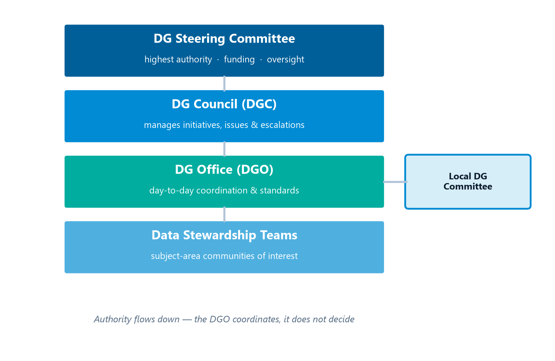
The 5 Data Governance Bodies
Module 3 — Data Governance
The five governance bodies, with authority flowing down from the Steering Committee.
⭐ EXAM TIP: Steering Committee = highest authority & funding. DGO = day-to-day coordination (not decision authority).
CDMP Fundamentals | DAMA-DMBOK 2nd Edition
dama.org / cdmp.info
Notes:
: The 5 Data Governance Bodies
Let's meet the five governance bodies — stacked on screen by level of authority — because the exam loves to test which body does what. First, the Data Governance Steering Committee — this is the highest authority. It's a cross-functional group of senior executives responsible for oversight, support, and — critically — funding. Second, the Data Governance Council, the DGC, which manages governance initiatives, issues, and escalations. Third, the Data Governance Office, the DGO, which handles the day-to-day coordination, support, and administration, and maintains enterprise-level definitions and standards. Fourth, the Data Stewardship Teams — communities of interest focused on specific subject areas or projects. And fifth, Local Data Governance Committees, which only large organizations need. The two facts most likely to be tested: the Steering Committee is the highest authority and controls funding, and the DGO is about day-to-day coordination — it is not the top decision-maker.
---

Slide 12
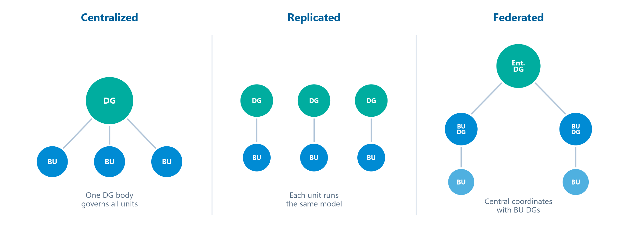
The 3 Operating Model Types
Module 3 — Data Governance
Centralized, Replicated, and Federated topologies side by side.
Choose Federated when: business units have significant autonomy, distinct regulatory environments, or low data interdependency.
⭐ EXAM TIP: Centralized = one for all · Replicated = each unit copies the model · Federated = central coordinates with many.
CDMP Fundamentals | DAMA-DMBOK 2nd Edition
dama.org / cdmp.info
Notes:
: The 3 Operating Model Types
There are three governance operating models, shown side by side on screen, and you must be able to tell them apart instantly. In a centralized model, one single Data Governance organization oversees all activities across all subject areas — one body for everything. In a replicated model, the same governance operating model and standards are adopted independently by each business unit — every unit runs its own copy of the same approach. And in a federated model, one Data Governance organization coordinates with multiple business units to maintain consistent definitions and standards — central coordination, distributed execution. When would you choose federated? When business units have significant autonomy, face distinct regulatory environments, or manage data domains that don't overlap much. Quick mnemonic: centralized is one for all, replicated is each unit copies the model, and federated is a center coordinating with many.
---

Slide 13
Data Stewardship
Module 3 — Data Governance
Data Stewardship = the most common label for accountability and responsibility for data and the processes that ensure effective control and use of data assets.
Core stewardship activities:
  Creating & managing core Metadata (business glossary terms)
  Documenting rules and standards (business & data quality rules)
  Managing data quality issues
  Executing operational DG day-to-day
"The best data stewards are often found, not made." (but they can be trained)
⭐ EXAM TIP: Stewardship = accountability & responsibility for data, not ownership of the systems.
CDMP Fundamentals | DAMA-DMBOK 2nd Edition
dama.org / cdmp.info
Notes:
: Data Stewardship
Let's talk about stewardship, because it's the operational backbone of governance. Data Stewardship is the most common label for the accountability and responsibility for data, and for the processes that ensure the effective control and use of data assets. What do stewards actually do? They create and manage core metadata — like business glossary terms. They document rules and standards, both business rules and data quality rules. They manage data quality issues, identifying and helping resolve them. And they execute the operational, day-to-day governance work, project by project. There's a memorable line in the DMBOK: the best data stewards are often found, not made — meaning good stewards frequently emerge from people who already care about the data, though they can certainly be trained too. Remember: stewardship is about accountability and responsibility for the data itself.
---

Slide 14
The 7 Types of Data Stewards
Module 3 — Data Governance
Type | Role
Chief Data Steward | Chairs DG bodies in lieu of CDO; may act as CDO in virtual DG
Executive Data Steward | Senior manager on the Data Governance Council
Enterprise Data Steward | Oversight of a data domain across business functions
Business Data Steward | Business SME accountable for a subset of data
Data Owner | A Business Data Steward with approval authority for decisions
Technical Data Steward | IT professional in a KA (DBA, DQ analyst, Metadata admin)
Coordinating Data Steward | Leads teams of business + technical stewards (large orgs)
⭐ EXAM TIP: A Data Owner = a Business Data Steward with approval authority.
CDMP Fundamentals | DAMA-DMBOK 2nd Edition
dama.org / cdmp.info
Notes:
: The 7 Types of Data Stewards
The DMBOK describes seven types of data stewards, and the exam may ask you to identify any one of them. The Chief Data Steward chairs governance bodies in place of a CDO, and in a virtual or distributed governance setup may effectively act as the CDO. The Executive Data Steward is a senior manager who sits on the Data Governance Council. The Enterprise Data Steward has oversight of a data domain that spans business functions. The Business Data Steward is a business subject-matter expert accountable for a subset of data. The Data Owner is a Business Data Steward who additionally holds approval authority for decisions about their data. The Technical Data Steward is an IT professional within a knowledge area — a DBA, a data quality analyst, a metadata administrator. And the Coordinating Data Steward leads teams of business and technical stewards, which matters most in large organizations. The single most tested point: a Data Owner is a Business Data Steward with approval authority.
---

Slide 15
Data Policies
Module 3 — Data Governance
Data Policies = directives that codify principles and management intent into fundamental rules governing the creation, acquisition, integrity, security, quality, and use of data.
Policies describe the 'WHAT' (what to do / not do).
Standards and procedures describe the 'HOW'.
Policies should be few, brief, directly stated, and global in nature.
⭐ EXAM TIP: Policy = WHAT; Standards/Procedures = HOW. A classic distinction question.
CDMP Fundamentals | DAMA-DMBOK 2nd Edition
dama.org / cdmp.info
Notes:
: Data Policies
Data Policies are directives that codify principles and management intent into the fundamental rules governing how data is created, acquired, kept accurate, secured, made high quality, and used. Here's the distinction the exam tests: policies describe the "what" — what to do and what not to do. Standards and procedures describe the "how" — how to actually carry governance out. Good data policies share a few traits: they should be few in number, brief, directly stated, and global in nature — they apply across the whole organization. So if you see a question contrasting policies with standards, anchor on this: policy equals what, standards and procedures equal how. It's one of the easiest points in the chapter if you remember that single mapping.
---

Slide 16
Data Asset Valuation
Module 3 — Data Governance
Method | Basis
Replacement cost | Cost to recover lost data after disaster/breach
Market value | Value as a business asset at merger/acquisition
Identified opportunities | Income from BI insights, transactions
Selling data | Packaging data/insights as a product
Risk cost | Penalties/remediation from absent or wrong data
⭐ EXAM TIP: Data only delivers value when it is used — not by merely being stored.
CDMP Fundamentals | DAMA-DMBOK 2nd Edition
dama.org / cdmp.info
Notes:
: Data Asset Valuation
How do you put a value on data? The DMBOK is clear that data brings value when it's used — value equals the economic benefit of using the data, minus the cost of acquiring and storing it, minus the cost of managing its risk. There are several ways to measure that value. Replacement cost: what it would cost to recover the data after a disaster or breach. Market value: what the data is worth as a business asset during a merger or acquisition. Identified opportunities: the income you could earn from BI insights or transactions. Selling data: packaging the data or its insights as a product. And risk cost: the penalties and remediation costs that come from missing or wrong data. The key exam idea: data delivers value only when it's used — simply storing it creates cost, not value.
---

Slide 17
Generally Accepted Information Principles (GAIP)
Module 3 — Data Governance
Principle | Core idea | Principle | Core idea
Accountability | Identify who is accountable | Level of Valuation | Value at the most sensible level
Asset | Manage data like financial assets | Liability | Liability from misuse/mismanagement
Audit | Periodic independent audit | Quality | DQ affects financial status
Due Diligence | Report known/possible risk | Risk | Recognize data risk as a liability
Going Concern | Data is critical, not a by-product | Value | Value from usage & marketability
⭐ EXAM TIP: GAIP derives from accounting principles. Know Audit = by an independent body and Going Concern.
CDMP Fundamentals | DAMA-DMBOK 2nd Edition
dama.org / cdmp.info
Notes:
: Generally Accepted Information Principles (GAIP)
GAIP — the Generally Accepted Information Principles — is deliberately modeled on Generally Accepted Accounting Principles, the idea being that we should treat information with the same rigor accountants treat money. There are ten principles. Accountability: identify who's ultimately accountable. Asset: manage data like a financial asset. Audit: accuracy should be subject to periodic audit by an independent body. Due Diligence: report known and possible risk. Going Concern: data is critical to ongoing operations, not a disposable by-product. Level of Valuation: value data at the level that makes the most sense. Liability: recognize the financial liability from misuse. Quality: data quality can affect the organization's financial status. Risk: formally recognize data risk as a liability. And Value: value comes from usage and marketability. Two that get tested: Audit must be by an independent body, and Going Concern means data is critical, not a by-product.
---

Slide 18
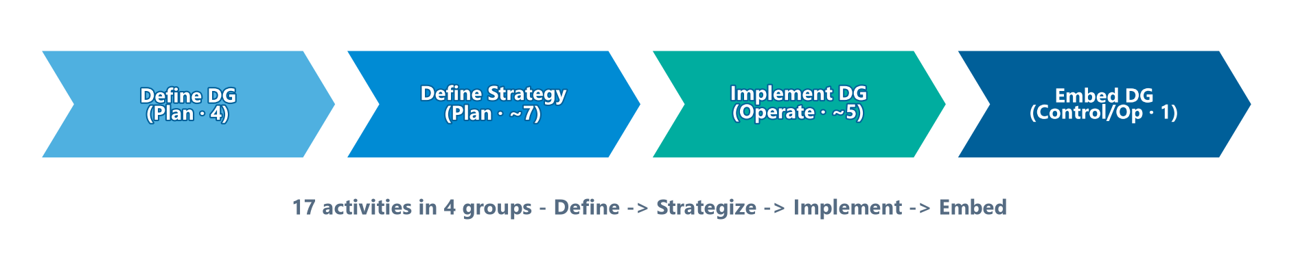
The 17 Activities in 4 Groups
Module 3 — Data Governance
DG activities fall into 4 groups (mapped to P/C/O):
The arc of DG activities across the four groups.
⭐ EXAM TIP: The arc is Define → Strategize → Implement → Embed.
CDMP Fundamentals | DAMA-DMBOK 2nd Edition
dama.org / cdmp.info
Notes:
: The 17 Activities in 4 Groups
The DMBOK organizes Data Governance into seventeen activities across four groups, and rather than memorizing all seventeen, I want you to remember the arc of the four groups shown on screen. Group one is "Define Data Governance for the Organization" — a planning group covering defining DG, doing a readiness assessment, performing discovery and business alignment, and developing organizational touchpoints. Group two, "Define the Data Governance Strategy," also planning, covers the operating framework, goals principles and policies, underwriting projects, change management, issue management, and compliance. Group three, "Implement Data Governance," is operational — sponsoring standards, building the business glossary, coordinating with architecture, and sponsoring asset valuation. And group four is simply "Embed Data Governance." So the storyline is Define, then Strategize, then Implement, then Embed. Remember the arc, and the details fall into place.
---

Slide 19
Readiness Assessment — 4 Types
Module 3 — Data Governance
Before launching DG, assess organizational readiness across four areas:
Data management maturity — current DM capabilities and capacity
Capacity to change — ability to change behaviors; identifies resistance points
Collaborative readiness — ability to collaborate (stewardship is inherently collaborative)
Business alignment — how well data uses align with business strategy
⭐ EXAM TIP: Maturity · Capacity to Change · Collaborative Readiness · Business Alignment.
CDMP Fundamentals | DAMA-DMBOK 2nd Edition
dama.org / cdmp.info
Notes:
: Readiness Assessment — 4 Types
Before you launch a governance program, you assess whether the organization is actually ready — and the DMBOK names four readiness assessments. First, data management maturity: what are the organization's current data management capabilities and capacity? Second, capacity to change: how able is the organization to change its behaviors, and where will resistance show up? Third, collaborative readiness: how well can people collaborate — which matters because stewardship is inherently collaborative? And fourth, business alignment: how well do current data uses align with the business strategy? Four assessments: maturity, capacity to change, collaborative readiness, and business alignment. Together they tell you where you're starting from and what you'll need to overcome.
---

Slide 20
DG Strategy Deliverables
Module 3 — Data Governance
The DG strategy produces 4 deliverables:
Charter — business drivers, vision, mission, principles, readiness assessment, success criteria
Operating framework & accountabilities — structure and responsibility for DG
Implementation roadmap — timeframes for policies, glossary, architecture, valuation, standards
Plan for operational success — target state of sustainable DG
⭐ EXAM TIP: Don't confuse the DG Charter (this chapter) with the Data Management Charter (Chapter 1).
CDMP Fundamentals | DAMA-DMBOK 2nd Edition
dama.org / cdmp.info
Notes:
: DG Strategy Deliverables
The governance strategy produces four concrete deliverables. First, the Charter — which captures the business drivers, vision, mission, principles, the readiness assessment results, and the success criteria. Second, the operating framework and accountabilities — the structure and the responsibilities for governance activities. Third, the implementation roadmap — the timeframes for rolling out policies, the glossary, architecture work, asset valuation, and standards. And fourth, a plan for operational success — describing the target state of sustainable governance. One quick caution: don't confuse the Data Governance Charter from this chapter with the Data Management Charter from Chapter 1. They're related ideas but distinct deliverables, and the exam may try to blur them.
---

Slide 21
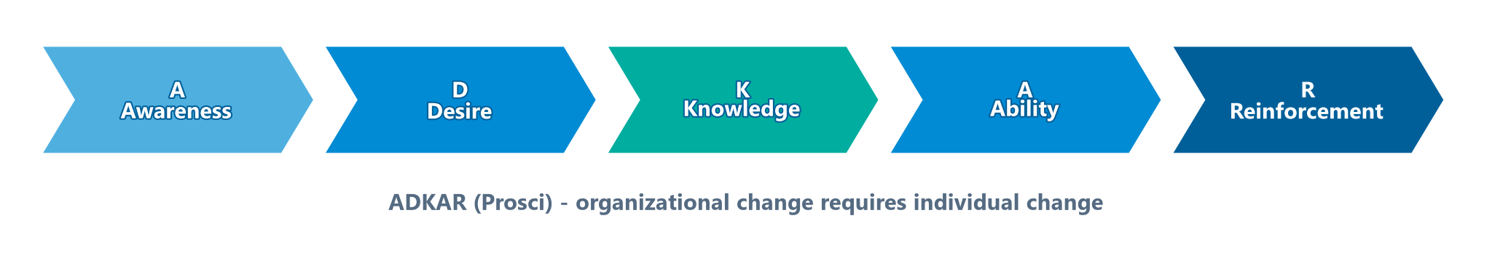
Change Management — ADKAR
Module 3 — Data Governance
DG demands behavioral change, so it requires formal Organizational Change Management (OCM).
The ADKAR model (Prosci) measures change across 5 areas:
  Awareness of the need to change
  Desire to participate and support
  Knowledge of how to change
⭐ EXAM TIP: Organizational change requires individual change. Memorize ADKAR.
CDMP Fundamentals | DAMA-DMBOK 2nd Edition
dama.org / cdmp.info
Notes:
: Change Management — ADKAR
Because governance demands real behavioral change, it requires a formal Organizational Change Management process — and one of the foundational tenets is that organizational change requires individual change. The model the DMBOK references is ADKAR, from Prosci, which measures change across the five stages shown on screen. A: Awareness of the need to change. D: Desire to participate and support the change. K: Knowledge about how to change. A: Ability to implement the new skills and behaviors. And R: Reinforcement to keep the change in place over time. Awareness, Desire, Knowledge, Ability, Reinforcement. If you can spell ADKAR, you've got it — and the exam does occasionally ask what the letters stand for.
---

Slide 22
Issue Management — 8 Issue Types
Module 3 — Data Governance
DG identifies, defines, escalates, and resolves issues. The 8 types:
Authority (decision rights)
Change management escalations
Compliance
Conflicts (policies, rules, definitions, ownership)
Conformance
Contracts (data sharing, cloud, buy/sell data)
Data security & identity (privacy, breach)
Data quality
⭐ EXAM TIP: Issue management is a core, ongoing DG activity — not a one-off.
CDMP Fundamentals | DAMA-DMBOK 2nd Edition
dama.org / cdmp.info
Notes:
: Issue Management — 8 Issue Types
A core, ongoing governance activity is issue management — identifying, defining, escalating, and resolving issues. The DMBOK lists eight types of issues governance has to handle. Authority issues, about decision rights. Change management escalations. Compliance issues. Conflicts — over policies, rules, definitions, or ownership. Conformance issues. Contract issues — around data sharing, cloud, or buying and selling data. Data security and identity issues, including privacy and breaches. And data quality issues. You don't need to memorize all eight word-for-word, but recognize that issue management is a continuous governance function spanning authority, compliance, conflicts, contracts, security, and quality — not a one-time cleanup.
---

Slide 23
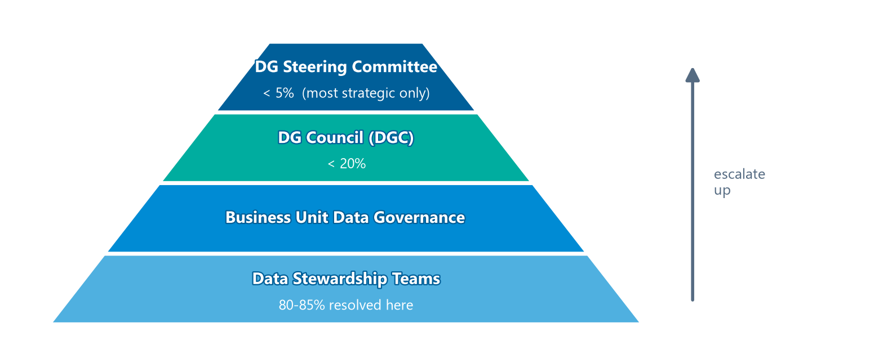
The Issue Escalation Path
Module 3 — Data Governance
Issues resolve at the lowest possible level, escalating only as needed:
Most issues resolve at the base; very few escalate to the top.
⭐ EXAM TIP: 80–85% of issues are resolved at the Stewardship Team level, <20% reach the DGC, <5% reach the Steering Committee. These percentages are testable.
CDMP Fundamentals | DAMA-DMBOK 2nd Edition
dama.org / cdmp.info
Notes:
: The Issue Escalation Path
This slide contains some of the most testable numbers in the chapter, so let's be precise. Governance issues should be resolved at the lowest possible level, escalating only when necessary. At the base, the Data Stewardship Teams resolve roughly eighty to eighty-five percent of all conflicts. Less than twenty percent of issues escalate up to the Data Governance Council. And less than five percent — only the most strategic — reach the Data Governance Steering Committee at the top. Picture it as the pyramid on screen: most issues handled at the bottom by stewards, a smaller slice rising to the council, and just a sliver reaching the steering committee. Those percentages — eighty to eighty-five percent at the stewardship level, under twenty to the council, under five to the steering committee — are exactly the kind of detail the exam likes to quiz.
---

Slide 24
The Business Glossary — 4 Objectives
Module 3 — Data Governance
A business glossary is a core DG deliverable. Its four objectives:
Enable common understanding of core business concepts & terminology
Reduce risk of data misuse from inconsistent understanding
Improve alignment between technology assets and the business
Maximize search capability and access to institutional knowledge
A glossary is NOT just a list of terms — each term includes synonyms, metrics, lineage, business rules, and a responsible steward.
⭐ EXAM TIP: A business glossary builds shared meaning, reducing misuse risk.
CDMP Fundamentals | DAMA-DMBOK 2nd Edition
dama.org / cdmp.info
Notes:
: The Business Glossary — 4 Objectives
The business glossary is one of governance's signature deliverables, and it has four objectives. First, to enable a common understanding of core business concepts and terminology — getting everyone speaking the same language. Second, to reduce the risk of data misuse that comes from people interpreting terms inconsistently. Third, to improve alignment between the organization's technology assets and the business. And fourth, to maximize search capability and provide access to documented institutional knowledge. Here's a point the exam likes: a business glossary is not merely a list of terms. Each entry is rich — it includes synonyms, related metrics, data lineage, business rules, and the name of the responsible steward. So think of the glossary as a tool for building shared meaning, which in turn reduces the risk of misuse.
---

Slide 25
Regulatory Compliance — Key Regulations
Module 3 — Data Governance
Regulation | Scope
BCBS 239 / Basel | EU/global banking — risk data aggregation & reporting (since 2006); accuracy, lineage, timeliness
CPG 235 (APRA) | Australian banking/insurance — managing data risk across the lifecycle
PCI-DSS | Payment Card Industry Data Security Standards
Solvency II | EU insurance (like Basel for banks) — data lineage & quality for risk models
SOX / HIPAA | US financial accuracy / US health PHI privacy & security
⭐ EXAM TIP: BCBS 239 = bank risk data aggregation. CPG 235 = APRA data risk. Don't mix them up.
CDMP Fundamentals | DAMA-DMBOK 2nd Edition
dama.org / cdmp.info
Notes:
: Regulatory Compliance — Key Regulations
Since compliance is the most common driver of governance, you should recognize the key regulations the DMBOK names. BCBS 239, tied to Basel, governs risk data aggregation and reporting in banking — it's been in force since 2006 and demands accuracy, lineage, and timeliness of risk data. CPG 235, from the Australian Prudential Regulation Authority, APRA, is about managing data risk across the lifecycle for banks and insurers. PCI-DSS is the Payment Card Industry Data Security Standard. Solvency II is the EU insurance equivalent of Basel — data lineage and quality behind risk models. And you should know SOX for US financial accuracy and HIPAA for US health information privacy and security. The most commonly confused pair is BCBS 239 versus CPG 235 — remember, BCBS 239 is bank risk data aggregation, and CPG 235 is APRA's data risk standard.
---

Slide 26
CDO Organizational Touchpoints
Module 3 — Data Governance
The Chief Data Officer influences four key organizational touchpoints:
Procurement & Contracts — standard language for DaaS, cloud, outsourcing, licensing
Budget & Funding — prevent duplicate efforts; optimize data assets
Regulatory Compliance — monitor & track new/potential regulatory impacts
SDLC / Development Framework — embed control points for enterprise policies/standards
⭐ EXAM TIP: The CDO typically owns the data strategy and leads both initiatives and cultural change.
CDMP Fundamentals | DAMA-DMBOK 2nd Edition
dama.org / cdmp.info
Notes:
: CDO Organizational Touchpoints
The Chief Data Officer extends governance's influence through four key organizational touchpoints. First, procurement and contracts — establishing standard contract language for data-as-a-service, cloud, outsourcing, and content licensing. Second, budget and funding — preventing duplicate efforts and optimizing the data assets the organization has already acquired. Third, regulatory compliance — monitoring and tracking new and potential regulatory impacts. And fourth, the SDLC or development framework — embedding control points so that enterprise data policies and standards are enforced as systems get built. And remember from earlier chapters: the CDO typically owns the data strategy and leads not just the initiatives but the cultural change behind them.
---

Slide 27
Tools & Techniques
Module 3 — Data Governance
Tool | Purpose
Online presence / website | Hub for strategy, policies, roles, training, issue procedures
Business Glossary | Agreed definitions linked to data
Workflow tools | Manage processes (e.g., policy implementation)
Document management | Manage policies & procedures
DG Scorecards | Automated metrics collection for the DGC & committees
CDMP Fundamentals | DAMA-DMBOK 2nd Edition
dama.org / cdmp.info
Notes:
: Tools & Techniques
Let's quickly cover the tools that support governance. A governance website or online presence acts as the central hub for the strategy, policies, stewardship roles, training, and issue procedures. Business glossary tools hold the agreed-upon definitions and link them to actual data. Workflow tools manage processes like rolling out a new policy. Document management tools handle the policies and procedures themselves. And governance scorecards automatically collect metrics to report up to the council and steering committees. On the techniques side, the DMBOK mentions simple but effective things — concise messaging, a contact list, and even a recognizable logo to give the governance program an identity. Tools and techniques together make governance visible and usable.
---

Slide 28
Metrics — 3 Categories
Module 3 — Data Governance
Category | Examples
Value | Contributions to objectives, risk reduction, operational efficiency
Effectiveness | Goal achievement, tool usage by stewards, communication, training, speed of adoption
Sustainability | Performance of policies/processes; conformance to standards
⭐ EXAM TIP: Value · Effectiveness · Sustainability — three metric categories for DG.
CDMP Fundamentals | DAMA-DMBOK 2nd Edition
dama.org / cdmp.info
Notes:
: Metrics — 3 Categories
How do you measure a governance program? The DMBOK gives three categories of metrics. Value metrics capture contributions to business objectives, reduction of risk, and improved operational efficiency — essentially, what the program is delivering. Effectiveness metrics track whether goals are being achieved, how much stewards are actually using the governance tools, how well communication and training are working, and the speed of change adoption. And sustainability metrics look at whether the policies and processes are performing and whether staff are conforming to the standards. On top of those three, there's also compliance to regulatory and internal data policies. So: Value, Effectiveness, and Sustainability — three categories that the exam expects you to know.
---

Slide 29
Context Diagram Snapshot
Module 3 — Data Governance
Element | Highlights
Inputs | Business/IT/Data strategies, org policies, culture & maturity assessments, regulations
Deliverables | DG strategy, roadmap, principles, policies, operating framework, business glossary, scorecard
Participants | Steering committees, CIO, CDO/Chief Data Stewards, Executive/Coordinating/Business Data Stewards
Tools | Websites, glossary tools, workflow, document mgmt, scorecards
Metrics | Compliance, Value, Effectiveness, Sustainability
⭐ EXAM TIP: Note that Participants include both governance bodies and the steward hierarchy.
CDMP Fundamentals | DAMA-DMBOK 2nd Edition
dama.org / cdmp.info
Notes:
: Context Diagram Snapshot
Let's pull the context diagram together at a glance. The inputs to governance include the business, IT, and data strategies, organizational policies, the culture and maturity assessments, and regulatory requirements. The deliverables include the governance strategy, the roadmap, data principles and policies, the operating framework, the business glossary, and the scorecard. The participants are the steering committees, the CIO, the CDO and chief data stewards, and the executive, coordinating, and business data stewards — essentially the whole governance hierarchy. The tools are the websites, glossary tools, workflow, document management, and scorecards. And the metrics, as we just covered, are compliance, value, effectiveness, and sustainability. Notice how the participants span both the governance bodies and the full steward hierarchy.
---

Slide 30
Key Numbers & Quick Facts (Cheat Sheet)
Module 3 — Data Governance
Fact | Value
Goals of DG | 3
Requirements (Sustainable/Embedded/Measured) | 3
DG Principles | 6
DG Bodies/Committees | 5
Operating models | 3 (Centralized, Replicated, Federated)
Types of data stewards | 7
GAIP principles | 10
Activities / groups | 17 in 4 groups
Readiness assessment types | 4
Issue types | 8
Issues resolved at stewardship level | 80–85%
Metric categories | 3 (Value, Effectiveness, Sustainability)
CDMP Fundamentals | DAMA-DMBOK 2nd Edition
dama.org / cdmp.info
Notes:
: Key Numbers & Quick Facts (Cheat Sheet)
Let's consolidate the numbers, because this chapter is dense with them. Three goals. Three requirements — sustainable, embedded, measured. Six principles. Five governance bodies. Three operating models — centralized, replicated, federated. Seven types of data stewards. Ten GAIP principles. Seventeen activities organized into four groups. Four readiness assessment types. Eight issue types. Eighty to eighty-five percent of issues resolved at the stewardship level. And three metric categories — value, effectiveness, sustainability. If a Data Governance question turns on a number, it's almost certainly on this slide, so review it until every figure is instant recall. This single slide could be worth several exam points.
---

Slide 31
Common Exam Traps (Part 1)
Module 3 — Data Governance
❌ DG executes data management → ✅ DG is oversight; management is execution
❌ DG = IT Governance → ✅ DG focuses exclusively on data; IT Gov (COBIT) on IT investments
❌ DGO is the highest authority → ✅ the Steering Committee is highest; the DGO does day-to-day coordination
❌ Policy describes 'how' → ✅ Policy = WHAT; standards/procedures = HOW
CDMP Fundamentals | DAMA-DMBOK 2nd Edition
dama.org / cdmp.info
Notes:
: Common Exam Traps (Part 1)
Let me walk you through the traps, starting with four big ones. First: an answer claiming Data Governance executes data management is wrong — governance is oversight, management is execution. Second: don't equate Data Governance with IT Governance — governance focuses exclusively on data, while IT Governance, through COBIT, focuses on IT investments. Third: the Data Governance Office is not the highest authority — the Steering Committee is; the DGO handles day-to-day coordination. And fourth: watch the policy-versus-standards wording — policy describes the "what," while standards and procedures describe the "how." Get these four straight and you've protected yourself against the most common mistakes.
---

Slide 32
Common Exam Traps (Part 2)
Module 3 — Data Governance
❌ Centralized vs Federated confusion → ✅ Centralized = one for all; Federated = central coordinates with many BUs
❌ Data Owner = any steward → ✅ Data Owner = Business Data Steward with approval authority
❌ DG is a project → ✅ DG is a sustainable, ongoing program
❌ Most issues escalate to the top → ✅ 80–85% resolve at the stewardship level
⭐ EXAM TIP: When in doubt, pick the answer that frames DG as business-driven oversight.
CDMP Fundamentals | DAMA-DMBOK 2nd Edition
dama.org / cdmp.info
Notes:
: Common Exam Traps (Part 2)
Four more traps. First: don't confuse centralized with federated — centralized is one body for everything, while federated is a central body coordinating with many autonomous business units. Second: a Data Owner isn't just any steward — it's specifically a Business Data Steward with approval authority. Third: never treat governance as a project — it's a sustainable, ongoing program. And fourth: don't assume most issues escalate to the top — remember, eighty to eighty-five percent are resolved right at the stewardship level. And here's a general heuristic for this chapter: when two answers seem plausible, favor the one that frames governance as business-driven oversight. That framing is almost always the DMBOK's intent.
---

Slide 33
Module Summary (Part 1)
Module 3 — Data Governance
Data Governance = exercise of authority, control, and shared decision-making over data assets — oversight, not execution.
DG is separate from IT governance and sits at the center of the DAMA Wheel.
3 goals · 3 requirements (Sustainable, Embedded, Measured) · 6 principles.
5 bodies: Steering Committee (highest), DGC, DGO (day-to-day), Stewardship Teams, Local DG.
CDMP Fundamentals | DAMA-DMBOK 2nd Edition
dama.org / cdmp.info
Notes:
: Module Summary (Part 1)
Let's bring it together in two summary slides. Data Governance is the exercise of authority, control, and shared decision-making over data assets — and above all, it's oversight, not execution. It's separate from IT governance, and it sits at the center of the DAMA Wheel because it guides every other function. Remember the core counts: three goals, three requirements — sustainable, embedded, and measured — and six principles. And remember the five bodies: the Steering Committee as the highest authority, the Data Governance Council, the Data Governance Office handling day-to-day work, the Stewardship Teams, and Local Data Governance committees.
---

Slide 34
Module Summary (Part 2)
Module 3 — Data Governance
3 operating models: Centralized, Replicated, Federated.
7 steward types, with the Data Owner holding approval authority.
Policy = WHAT; Standards = HOW. Build a business glossary for shared meaning.
80–85% of issues resolve at the stewardship level; GAIP = 10 principles.
Key regs: BCBS 239, CPG 235, PCI-DSS, Solvency II; metrics: Value, Effectiveness, Sustainability.
CDMP Fundamentals | DAMA-DMBOK 2nd Edition
dama.org / cdmp.info
Notes:
: Module Summary (Part 2)
Continuing the summary. There are three operating models — centralized, replicated, and federated. There are seven steward types, and the Data Owner is the one with approval authority. Policy describes the what; standards describe the how. Build a business glossary to create shared meaning across the organization. Eighty to eighty-five percent of issues resolve at the stewardship level. GAIP gives you ten principles modeled on accounting. The key regulations are BCBS 239, CPG 235, PCI-DSS, and Solvency II. And the three metric categories are value, effectiveness, and sustainability. Master those points and you've mastered the highest-weighted chapter on the exam.
---

Slide 35
Let's Test Your Knowledge
Module 3 — Data Governance
Heading: 5 practice questions — Data Governance
Subtitle: This is the heaviest chapter — make these count. Answer before revealing.
CDMP Fundamentals | DAMA-DMBOK 2nd Edition
dama.org / cdmp.info
Notes:
: Let's Test Your Knowledge
Now let's put it to the test with five practice questions. Because this is the heaviest chapter on the exam, these points really matter — so treat each question seriously. Read the full stem, watch for the qualifier words like "best" and "primary," commit to an answer, and only then reveal the solution. Ready? Let's go.
---

Slide 36
Practice Question 1
Module 3 — Data Governance
Q1
Which of the following BEST describes the primary responsibility of a Data Governance Council (DGC)?
A) Executing day-to-day data management tasks and resolving data quality issues at the operational level
B) Maintaining the corporate data catalog and ensuring metadata completeness across all domains
C) Providing technical architecture guidance for data warehouse and data lake implementations
D) Approving data governance policies, arbitrating cross-functional data disputes, and setting enterprise data priorities
Answer: The DGC manages DG initiatives, issues, and escalations — approving policies, arbitrating disputes, and setting priorities. Day-to-day execution (A) belongs to stewards/operations, the catalog (B) to the DGO/metadata function, and architecture (C) to architecture groups.
CDMP Fundamentals | DAMA-DMBOK 2nd Edition
dama.org / cdmp.info
Notes:
: Practice Questions (Q1–Q3)
Question one asks for the primary responsibility of a Data Governance Council. The answer is D — approving governance policies, arbitrating cross-functional disputes, and setting enterprise data priorities. The council manages initiatives, issues, and escalations. Day-to-day execution belongs to stewards, the catalog to the metadata function, and architecture to the architecture groups.
Question two asks which factor favors a federated model over a centralized one. The answer is A — business units with significant autonomy, distinct regulatory environments, or limited data interdependency. Federated means central coordination across semi-autonomous units. Organization size, cloud hosting, and personal preference aren't the deciding factors.
Question three asks for the key distinction between a data governance project and a data governance program. The answer is C — a project has a defined start and end with specific deliverables, while a program is an ongoing organizational capability with continuous, evolving activities. That reflects the requirement that governance be sustainable, not a one-time project. The terms are not interchangeable.
How are you doing so far? Two more on the next slide.
---

Slide 37
Practice Question 2
Module 3 — Data Governance
Q2
When selecting a data governance operating model, which factor most strongly favors a federated rather than a centralized approach?
A) The business units operate with significant autonomy, have distinct regulatory environments, or manage data domains with limited interdependency
B) The organization has fewer than 500 employees
C) The organization's IT systems are hosted across multiple cloud providers
D) The CDO personally prefers a federated model
Answer: A federated model has one DG organization coordinating with multiple business units, which fits when units are autonomous, face distinct regulations, or have low data interdependency. Size, cloud hosting, and personal preference are not the determining factors.
CDMP Fundamentals | DAMA-DMBOK 2nd Edition
dama.org / cdmp.info
Notes:
: Practice Questions (Q1–Q3)
Question one asks for the primary responsibility of a Data Governance Council. The answer is D — approving governance policies, arbitrating cross-functional disputes, and setting enterprise data priorities. The council manages initiatives, issues, and escalations. Day-to-day execution belongs to stewards, the catalog to the metadata function, and architecture to the architecture groups.
Question two asks which factor favors a federated model over a centralized one. The answer is A — business units with significant autonomy, distinct regulatory environments, or limited data interdependency. Federated means central coordination across semi-autonomous units. Organization size, cloud hosting, and personal preference aren't the deciding factors.
Question three asks for the key distinction between a data governance project and a data governance program. The answer is C — a project has a defined start and end with specific deliverables, while a program is an ongoing organizational capability with continuous, evolving activities. That reflects the requirement that governance be sustainable, not a one-time project. The terms are not interchangeable.
How are you doing so far? Two more on the next slide.
---

Slide 38
Practice Question 3
Module 3 — Data Governance
Q3
What is the key distinction between a data governance project and a data governance program?
A) A program focuses only on compliance while a project addresses data quality
B) A project is managed by IT while a program is managed by the business
C) A project has a defined start and end date with specific deliverables, while a program is an ongoing organizational capability with continuous activities and evolving objectives
D) There is no meaningful distinction; the terms are used interchangeably in DMBOK2
Answer: A data governance project has a defined start and end with specific deliverables, whereas a program is an ongoing organizational capability with continuous, evolving activities. This reflects the DMBOK requirement that governance be sustainable — not a one-time project. The terms are not interchangeable.
CDMP Fundamentals | DAMA-DMBOK 2nd Edition
dama.org / cdmp.info
Notes:
: Practice Questions (Q1–Q3)
Question one asks for the primary responsibility of a Data Governance Council. The answer is D — approving governance policies, arbitrating cross-functional disputes, and setting enterprise data priorities. The council manages initiatives, issues, and escalations. Day-to-day execution belongs to stewards, the catalog to the metadata function, and architecture to the architecture groups.
Question two asks which factor favors a federated model over a centralized one. The answer is A — business units with significant autonomy, distinct regulatory environments, or limited data interdependency. Federated means central coordination across semi-autonomous units. Organization size, cloud hosting, and personal preference aren't the deciding factors.
Question three asks for the key distinction between a data governance project and a data governance program. The answer is C — a project has a defined start and end with specific deliverables, while a program is an ongoing organizational capability with continuous, evolving activities. That reflects the requirement that governance be sustainable, not a one-time project. The terms are not interchangeable.
How are you doing so far? Two more on the next slide.
---

Slide 39
Practice Question 4
Module 3 — Data Governance
Q4
Which statement correctly distinguishes a data trustee, a data steward, and a data custodian?
A) All three roles are interchangeable synonyms
B) A custodian defines data; a trustee handles quality; a steward manages security
C) A data trustee holds delegated authority for a data domain on behalf of senior leadership; a data steward performs day-to-day governance activities; a data custodian is responsible for the technical storage and protection of data
D) A trustee performs operational cleansing; a steward manages infrastructure; a custodian sets strategic policy
Answer: Authority flows down: a trustee holds delegated authority for a domain, a steward performs day-to-day governance, and a custodian handles the technical storage and protection of data. The other options scramble these accountabilities.
CDMP Fundamentals | DAMA-DMBOK 2nd Edition
dama.org / cdmp.info
Notes:
: Practice Questions (Q4–Q5)
Question four asks you to distinguish a data trustee, a data steward, and a data custodian. The answer is C. Think of authority flowing downward: the trustee holds delegated authority for a data domain on behalf of senior leadership, the steward performs the day-to-day governance activities, and the custodian is responsible for the technical storage and protection of the data. The other options scramble those accountabilities.
And question five asks for the most consistently cited critical success factor for governance programs. The answer is D — securing visible, sustained executive sponsorship, establishing clear accountability through defined roles, and demonstrating early business value. Notice that the wrong answers all describe classic failure patterns: leading with tooling before policy, attempting an exhaustive data inventory before doing anything, or demanding perfect data quality before launch. Governance succeeds when it's sponsored, accountable, and value-driven.
That completes Module 3 — the most important chapter on the exam. Take a moment to review the cheat sheet before you move on. Next up is Module 4, Data Architecture. I'll see you there.
---
*End of Module 3 scripts.*

Slide 40
Practice Question 5
Module 3 — Data Governance
Q5
According to DMBOK2, which factor is most consistently cited as a critical success factor for data governance programs?
A) Deploying an enterprise DG software platform before defining policies or roles
B) Completing an exhaustive inventory of every data asset before any governance begins
C) Achieving 100% data quality across all critical datasets before launch
D) Securing visible, sustained executive sponsorship, establishing clear accountability through defined roles, and demonstrating early business value
Answer: DG succeeds on executive sponsorship, clear role accountability, and early demonstrated value — it is business- and people-driven. Leading with tooling (A), boiling the ocean with a full inventory (B), or demanding perfect quality first (C) are common failure patterns, not success factors. End of Module 3 — Data Governance.
CDMP Fundamentals | DAMA-DMBOK 2nd Edition
dama.org / cdmp.info
Notes:
: Practice Questions (Q4–Q5)
Question four asks you to distinguish a data trustee, a data steward, and a data custodian. The answer is C. Think of authority flowing downward: the trustee holds delegated authority for a data domain on behalf of senior leadership, the steward performs the day-to-day governance activities, and the custodian is responsible for the technical storage and protection of the data. The other options scramble those accountabilities.
And question five asks for the most consistently cited critical success factor for governance programs. The answer is D — securing visible, sustained executive sponsorship, establishing clear accountability through defined roles, and demonstrating early business value. Notice that the wrong answers all describe classic failure patterns: leading with tooling before policy, attempting an exhaustive data inventory before doing anything, or demanding perfect data quality before launch. Governance succeeds when it's sponsored, accountable, and value-driven.
That completes Module 3 — the most important chapter on the exam. Take a moment to review the cheat sheet before you move on. Next up is Module 4, Data Architecture. I'll see you there.
---
*End of Module 3 scripts.*

