Slide 1
CDMP FUNDAMENTALS
Module 4: Data Architecture
DAMA-DMBOK 2nd Edition, Chapter 4
Exam weight: ~6% (≈6 questions) — blueprints, frameworks, EA domains
Module 4 — Data Architecture
100
90
Open
≥60%
MCQ
minutes
book
to pass
CDMP Fundamentals | DAMA-DMBOK 2nd Edition
dama.org / cdmp.info
Notes:
: Module Title Slide
Welcome to Module 4: Data Architecture. This is Chapter 4 of the DMBOK, worth about six percent of the exam — roughly six questions. Data Architecture is where business strategy meets technical design. In this module you'll learn how organizations create the master blueprints that align their data with their business goals, and you'll meet the famous Zachman Framework, which the exam genuinely loves to test. Let's get into it.
---

Slide 2
Module Overview & Learning Objectives
Module 4 — Data Architecture
Heading: What you'll master in this module
By the end, you'll be able to:
  Define Data Architecture and its 3 goals
  Name the 4 Enterprise Architecture domains
  Explain the Zachman Framework (6×6 matrix, columns & rows)
  Describe the Enterprise Data Model and its 4 levels of abstraction
  Explain data flow design and the 3–5 year roadmap
  Recognize the implementation risks, cultural factors, and metrics
CDMP Fundamentals | DAMA-DMBOK 2nd Edition
dama.org / cdmp.info
Notes:
: Module Overview & Learning Objectives
Here's our plan. You'll learn the definition of Data Architecture and its three goals. You'll name the four Enterprise Architecture domains and see how they depend on each other. You'll work through the Zachman Framework — its six-by-six matrix, the columns, and the rows. You'll understand the Enterprise Data Model and its four levels of abstraction, plus the idea of data flow design. You'll learn the three-to-five-year roadmap. And you'll be ready for questions on implementation risks, cultural factors, and metrics. Let's begin with the definition.
---

Slide 3
What Is Data Architecture?
Module 4 — Data Architecture
DMBOK2 Definition:
ISO/IEC 42010 architecture: the fundamental organization of a system — its components, their relationships, and the principles governing its design and evolution.
"Architecture" can mean the current state, future state, the discipline, the artifacts, or the team.
⭐ EXAM TIP: Key word — master blueprints. Data Architecture is the bridge between business strategy and technology execution.
CDMP Fundamentals | DAMA-DMBOK 2nd Edition
dama.org / cdmp.info
Notes:
: What Is Data Architecture?
The DMBOK defines Data Architecture as identifying the data needs of the enterprise — regardless of structure — and designing and maintaining the master blueprints to meet those needs. Those master blueprints then guide data integration, control the data assets, and align data investments with business strategy. There's also a formal ISO definition worth knowing: architecture is the fundamental organization of a system — its components, their relationships, and the principles governing its design and evolution. And note that the word "architecture" is overloaded: it can refer to the current state, the future state, the discipline itself, the artifacts, or even the team. But the phrase to anchor on is master blueprints. Data Architecture is the bridge between business strategy and technology execution — keep that image in mind throughout this module.
---

Slide 4
The 3 Goals of Data Architecture
Module 4 — Data Architecture
Identify data storage and processing requirements
Design structures and plans to meet the current and long-term data requirements of the enterprise
Strategically prepare organizations to quickly evolve their products, services, and data to seize opportunities in emerging technologies
⭐ EXAM TIP: Goal 3 is about agility — preparing the organization to evolve quickly.
CDMP Fundamentals | DAMA-DMBOK 2nd Edition
dama.org / cdmp.info
Notes:
: The 3 Goals of Data Architecture
Data Architecture has three goals. First, identify the data storage and processing requirements — what data needs to be kept and worked on. Second, design the structures and plans to meet both the current and the long-term data requirements of the enterprise. And third — this one is about agility — strategically prepare the organization to quickly evolve its products, services, and data so it can seize opportunities in emerging technologies. That third goal is the forward-looking one: architecture isn't just about today's needs, it's about positioning the organization to move fast tomorrow.
---

Slide 5
Business Drivers — The 5 Roles of a Data Architect
Module 4 — Data Architecture
Data Architecture bridges business strategy and technology execution. Architects:
Strategically prepare the organization for emerging technologies
Translate business needs into data and system requirements
Manage complex data and information delivery across the enterprise
Facilitate alignment between Business and IT
Act as agents for change, transformation, and agility
⭐ EXAM TIP: The architect is a change agent and a Business–IT translator, not just a diagram-drawer.
CDMP Fundamentals | DAMA-DMBOK 2nd Edition
dama.org / cdmp.info
Notes:
: Business Drivers — The 5 Roles of a Data Architect
So what does a data architect actually do? The DMBOK describes five roles, and together they show that the architect is far more than someone who draws diagrams. First, they strategically prepare the organization for emerging technologies. Second, they translate business needs into data and system requirements, so business processes consistently get the data they need. Third, they manage complex data and information delivery across the whole enterprise. Fourth, they facilitate alignment between the business and IT. And fifth, they act as agents for change, transformation, and agility. Notice that recurring theme — the architect is a translator between business and IT, and a change agent. That framing often shows up in exam answers.
---

Slide 6
The 4 Enterprise Architecture Domains
Module 4 — Data Architecture
Domain | Purpose | Key elements
Business Architecture | How the enterprise creates value | Models, processes, capabilities, vocabulary
Data Architecture | How data is organized & managed | Data models, definitions, mappings, flows
Applications Architecture | Structure & function of applications | Business systems, software, databases
Technology Architecture | Physical tech enabling systems | Platforms, networks, security, integration
⭐ EXAM TIP: Data Architecture is one of four EA domains — it does not stand alone.
CDMP Fundamentals | DAMA-DMBOK 2nd Edition
dama.org / cdmp.info
Notes:
: The 4 Enterprise Architecture Domains
Data Architecture doesn't exist in isolation. It's one of four Enterprise Architecture domains, and you should know all four. Business Architecture covers how the enterprise creates value — its models, processes, capabilities, and vocabulary. Data Architecture covers how data is organized and managed — data models, definitions, mappings, and flows. Applications Architecture covers the structure and function of applications — the business systems, software, and databases. And Technology Architecture covers the physical technology that enables everything to run — platforms, networks, security, and integration tools. The key exam point is simply that Data Architecture is one of four EA domains; it works alongside the other three, not on its own.
---

Slide 7
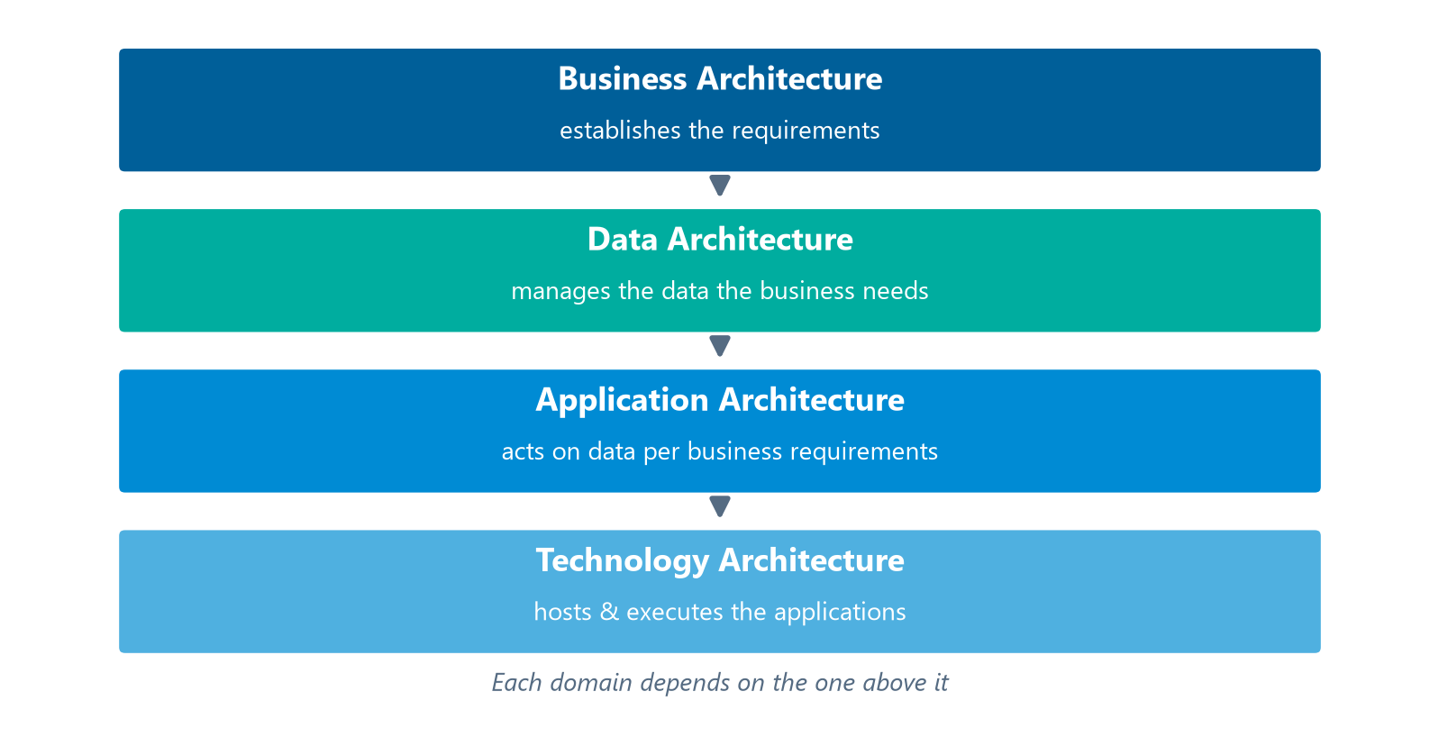
The EA Dependency Chain
Module 4 — Data Architecture
The four domains depend on one another in sequence:
The four EA domains, each depending on the one above it.
⭐ EXAM TIP: Business sets requirements → Data → Applications → Technology hosts it all.
CDMP Fundamentals | DAMA-DMBOK 2nd Edition
dama.org / cdmp.info
Notes:
: The EA Dependency Chain
These four domains aren't just a list — they depend on each other in a logical chain, the stack you see on screen, and understanding that chain helps you reason about exam questions. Business Architecture comes first; it establishes the requirements. Data Architecture then manages the data that the business creates and requires. Application Architecture acts on that data according to the business requirements. And finally, Technology Architecture hosts and executes the applications. So the flow runs: business sets the requirements, data supports them, applications act on the data, and technology hosts the whole stack. Business, then Data, then Applications, then Technology.
---

Slide 8
Enterprise Architecture Frameworks
Module 4 — Data Architecture
An architecture framework = a foundational structure used to develop a broad range of related architectures — an "architecture for architecture."
Standard: ISO/IEC/IEEE 42010:2011 — Architecture Description.
Major frameworks: Zachman, TOGAF (ADM), FEAF (US federal, with the Data Reference Model), DoDAF.
⭐ EXAM TIP: TOGAF's ADM Phase C (Information Systems Architecture) covers data and application architecture.
CDMP Fundamentals | DAMA-DMBOK 2nd Edition
dama.org / cdmp.info
Notes:
: Enterprise Architecture Frameworks
To organize all of this, we use enterprise architecture frameworks. A framework is a foundational structure for developing a broad range of related architectures — you can think of it as an architecture for architecture. The relevant standard is ISO/IEC/IEEE 42010, the architecture description standard. The major frameworks you might encounter are Zachman, which we'll dig into next; TOGAF, with its Architecture Development Method; FEAF, the US federal framework, which includes a Data Reference Model; and DoDAF, from the Department of Defense. One exam-relevant detail: in TOGAF's ADM, Phase C — Information Systems Architecture — is the phase that covers data and application architecture. But the framework the CDMP exam focuses on most is Zachman.
---

Slide 9
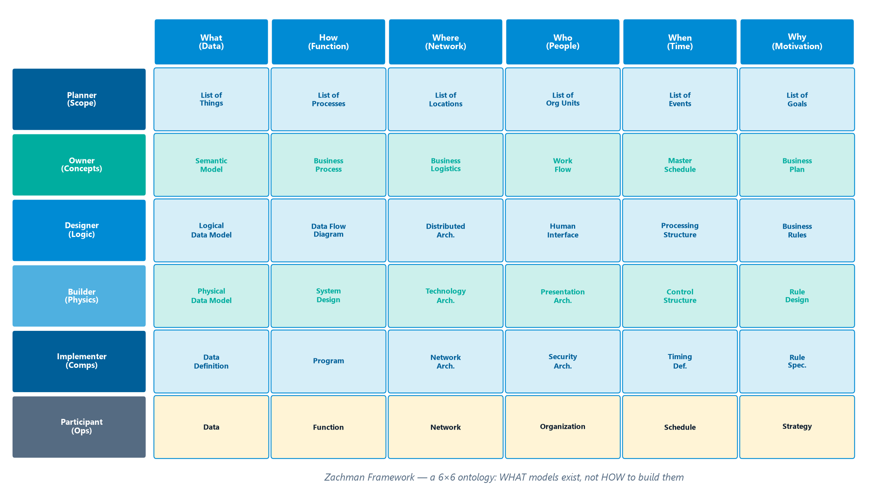
The Zachman Framework — Overview
Module 4 — Data Architecture
Developed by John A. Zachman in the 1980s — the most well-known EA framework.
It is an ontology — a 6×6 matrix representing the complete set of models needed to describe an enterprise.
It defines WHAT models should exist — NOT HOW to create them.
Each cell = a unique type of design artifact (a row–column intersection).
The 6×6 ontology: six interrogative columns × six perspective rows (the User/Participant row has no models).
⭐ EXAM TIP: Zachman shows what, not how. It's a classification ontology, not a methodology.
CDMP Fundamentals | DAMA-DMBOK 2nd Edition
dama.org / cdmp.info
Notes:
: The Zachman Framework — Overview
The Zachman Framework was developed by John Zachman in the 1980s, and it's the most well-known enterprise architecture framework in existence. Here's what you must understand about it. First, it's an ontology — the six-by-six matrix on screen — that represents the complete set of models needed to describe an enterprise and the relationships between them. Second, and this is the single most tested point: Zachman defines what models should exist — it does not tell you how to create them. It's a classification scheme, not a methodology. Third, each cell of the matrix represents a unique type of design artifact, formed by the intersection of a row and a column. So whenever you see a Zachman question, anchor on this: it shows what, not how. If an answer claims Zachman prescribes a method or a how-to, it's wrong.
---

Slide 10
Zachman — The 6 Columns (Interrogatives)
Module 4 — Data Architecture
Column | Question | Represents
What | Inventory | Entities / things
How | Process | Activities performed
Where | Distribution | Business & technology locations
Who | Responsibility | Roles & organizations
When | Timing | Events, cycles, schedules
Why | Motivation | Goals, strategies, means
⭐ EXAM TIP: The columns are the six communication interrogatives — What, How, Where, Who, When, Why.
CDMP Fundamentals | DAMA-DMBOK 2nd Edition
dama.org / cdmp.info
Notes:
: Zachman — The 6 Columns (Interrogatives)
Let's look at the columns. The six columns of the Zachman matrix are the communication interrogatives — the basic questions you can ask about anything. What, which is the inventory column — the entities or things. How, the process column — the activities performed. Where, the distribution column — business and technology locations. Who, the responsibility column — roles and organizations. When, the timing column — events, cycles, and schedules. And Why, the motivation column — goals, strategies, and means. An easy way to remember them: they're just the classic questions — what, how, where, who, when, and why. Six interrogatives, six columns.
---

Slide 11
Zachman — The 6 Rows (Perspectives)
Module 4 — Data Architecture
Row | Perspective | Role
1 | Executive | Planner (scope/context)
2 | Business Management | Owner (concepts)
3 | Architect | Designer (logic)
4 | Engineer | Builder (physics)
5 | Technician | Implementer (components)
6 | User | Participant (operational — no models)
⭐ EXAM TIP: The User/Participant row has no models — it's the running instance.
CDMP Fundamentals | DAMA-DMBOK 2nd Edition
dama.org / cdmp.info
Notes:
: Zachman — The 6 Rows (Perspectives)
Now the rows, which represent different stakeholder perspectives, moving from the most abstract at the top to the most concrete at the bottom. Row one is the Executive, acting as Planner — defining scope and context. Row two is Business Management, the Owner — business concepts. Row three is the Architect, the Designer — the system logic. Row four is the Engineer, the Builder — the technology physics. Row five is the Technician, the Implementer — component assemblies. And row six is the User, the Participant — the operational, running instances. Here's the detail the exam likes: row six, the User or Participant level, has no models — it's the actual functioning enterprise, not a representation of it. The rows are called reification transformations, which just means translating an abstract idea, step by step, into a concrete instance.
---

Slide 12
Enterprise Data Architecture = EDM + Data Flows
Module 4 — Data Architecture
Enterprise Data Architecture (EDA) defines standard terms and designs for the elements important to the organization — describing the collection, storage, integration, movement, and distribution of data.
EDA must include two outputs:
Enterprise Data Model (EDM) — the holistic data structure
Data Flow Design — how data moves across stores, apps, platforms, networks
⭐ EXAM TIP: EDA = Enterprise Data Model + Data Flow Design. Know both halves.
CDMP Fundamentals | DAMA-DMBOK 2nd Edition
dama.org / cdmp.info
Notes:
: Enterprise Data Architecture = EDM + Data Flows
Let's narrow from enterprise architecture down to Enterprise Data Architecture specifically. Enterprise Data Architecture defines the standard terms and designs for the elements that matter to the organization, describing how data is collected, stored, integrated, moved, and distributed. And here's a key exam fact: Enterprise Data Architecture must include two distinct outputs. The first is the Enterprise Data Model — the holistic structure of the data. The second is the Data Flow Design — how that data actually moves across data stores, applications, platforms, and networks. So whenever you think Enterprise Data Architecture, think two halves: the Enterprise Data Model plus the Data Flow Design. We'll examine each in turn.
---

Slide 13
The Enterprise Data Model (EDM)
Module 4 — Data Architecture
A holistic, enterprise-level, implementation-independent conceptual or logical data model.
Provides a common, consistent view of data across the enterprise.
Includes key enterprise entities, relationships, critical business rules, and some critical attributes.
It is the foundation for all data-related projects — project models must derive from it.
Built incrementally and iteratively, in layers, with stakeholder consensus.
⭐ EXAM TIP: Implementation-independent = technology-agnostic. The EDM is not tied to any platform.
CDMP Fundamentals | DAMA-DMBOK 2nd Edition
dama.org / cdmp.info
Notes:
: The Enterprise Data Model (EDM)
The Enterprise Data Model, or EDM, is a holistic, enterprise-level, implementation-independent conceptual or logical data model. Let's unpack that. Holistic and enterprise-level means it spans the whole organization, giving a common, consistent view of data. Implementation-independent means it's not tied to any particular database or technology — and that phrase is testable, so remember it. The EDM captures the key enterprise entities, their relationships, the critical business rules, and some critical attributes. Crucially, it's the foundation for all data-related projects — any project-level model must be based on it. And it's built incrementally and iteratively, in layers, with stakeholders reviewing it to reach consensus. The phrase to lock in: implementation-independent, which is the same idea as technology-agnostic.
---

Slide 14
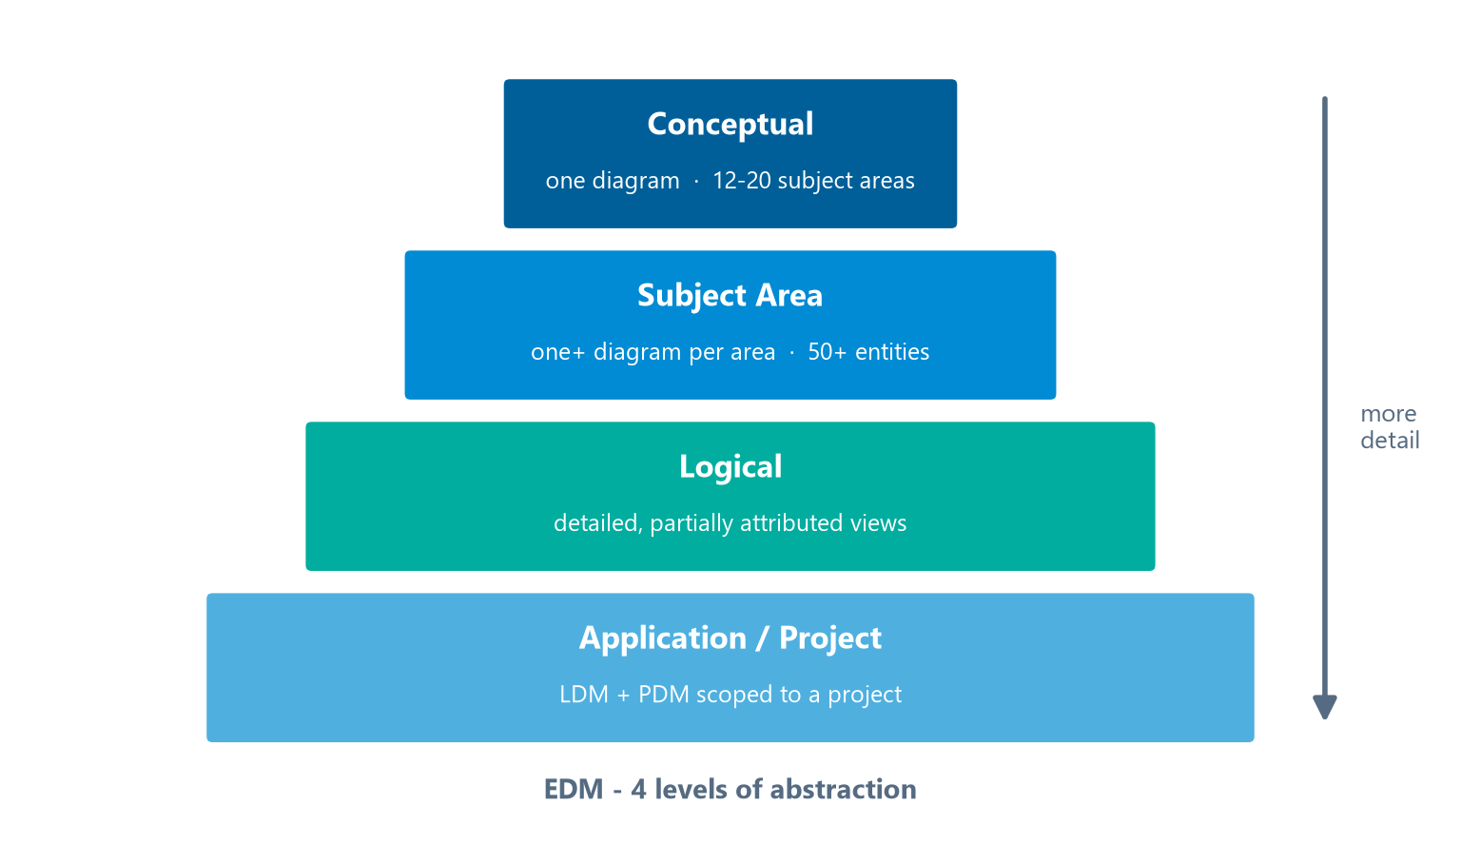
EDM — The 4 Levels of Abstraction
Module 4 — Data Architecture
The four levels, widening in detail from Conceptual down to Application/Project.
⭐ EXAM TIP: Remember the scales — 12–20 subject areas at the conceptual level; 50+ entities within a subject area.
CDMP Fundamentals | DAMA-DMBOK 2nd Edition
dama.org / cdmp.info
Notes:
: EDM — The 4 Levels of Abstraction
The Enterprise Data Model is structured across four levels of abstraction, from broadest to most detailed — the widening tiers on screen — and the exam sometimes tests the scales involved. At the top, the Conceptual model is a single diagram of the enterprise's subject areas — typically twelve to twenty significant subject areas with their relationships. Next, each Subject Area model drills into one area, often containing fifty or more significant entities. Then the Logical model adds detail — attributes and the less-significant entities — giving partially attributed views. And finally, the Application or Project models are the logical and physical models scoped to a specific application or project. Two numbers worth remembering: twelve to twenty subject areas at the conceptual level, and fifty-plus entities within a single subject area.
---

Slide 15
EDM Linkages & Building Approaches
Module 4 — Data Architecture
Linkages:
  Vertical — models at each level map to other levels (creates model lineage)
  Horizontal — entities appearing in multiple models at the same level (links between subject areas)
Building approaches:
  Top-down — define subject areas first, then populate
  Bottom-up — derive subject areas from existing models
  Combined (recommended) — start bottom-up, then complete by delegating subject-area modeling to projects
⭐ EXAM TIP: The combined approach is recommended.
CDMP Fundamentals | DAMA-DMBOK 2nd Edition
dama.org / cdmp.info
Notes:
: EDM Linkages & Building Approaches
Two more concepts about the Enterprise Data Model. First, linkages. Vertical linkages map models between the levels — a physical table maps up to a logical entity, up to a subject-area entity, and so on — which creates model lineage. Horizontal linkages show entities that appear in multiple models at the same level, connecting different subject areas. Second, building approaches. Top-down means you define the subject areas first, then populate them. Bottom-up means you derive the subject-area structure from existing data models. And the combined approach — which the DMBOK recommends — starts bottom-up with your existing models, then completes the picture by delegating subject-area modeling to individual projects. So if asked the recommended approach, the answer is combined.
---

Slide 16
Subject Area Discriminators
Module 4 — Data Architecture
How do you decide what belongs in each subject area? Candidate "discriminator" principles:
  Normalization rules ← most effective for Data Architecture
  Division from systems portfolios (funding)
  Data governance structure & ownership
  Top-level business processes (value chains)
  Business capabilities (EA-based)
⭐ EXAM TIP: Normalization rules are the most effective subject-area discriminator — they establish the major entities that constitute each area.
CDMP Fundamentals | DAMA-DMBOK 2nd Edition
dama.org / cdmp.info
Notes:
: Subject Area Discriminators
How do you decide what goes into each subject area? The DMBOK offers several discriminator principles. You could divide by systems portfolios and funding, by data governance ownership, by top-level business processes or value chains, or by business capabilities. But there's one the DMBOK singles out as the most effective for Data Architecture work: normalization rules. The normalization process establishes the major entities that carry and constitute each subject area, making it the strongest basis for drawing those boundaries. So if a question asks for the most effective subject-area discriminator, the answer is normalization rules.
---

Slide 17
Data Flow Design
Module 4 — Data Architecture
A type of data lineage documentation showing how data moves through processes and systems — where it originates, is stored/used, and how it's transformed.
Maps data to: applications, data stores, network segments (security), business roles (CRUD), and locations.
Documented at subject-area, entity, or attribute level.
Represented as 2D matrices or data flow diagrams.
History: the matrix practice came from IBM (Business Systems Planning, BSP); James Martin popularized it via Information Systems Planning (ISP) in the 1980s.
⭐ EXAM TIP: Data flows = lineage. Origin = IBM BSP, popularized by James Martin.
CDMP Fundamentals | DAMA-DMBOK 2nd Edition
dama.org / cdmp.info
Notes:
: Data Flow Design
Now the second half of Enterprise Data Architecture: data flow design. A data flow is a type of data lineage documentation — it shows how data moves through business processes and systems: where it originates, where it's stored and used, and how it's transformed along the way. Data flows map data to applications, to data stores, to network segments — which is useful for security mapping — to business roles using the CRUD model of create, read, update, delete, and to physical locations. You can document them at the subject-area, entity, or attribute level, and you can represent them as two-dimensional matrices or as data flow diagrams. A nice historical detail the exam sometimes uses: the matrix practice originated with IBM's Business Systems Planning method and was later popularized by James Martin through Information Systems Planning in the 1980s.
---

Slide 18
Activities — Establishing the DA Practice (5 Work Streams)
Module 4 — Data Architecture
Establishing an Enterprise Data Architecture practice involves 5 work streams:
Strategy — select frameworks, state approaches, develop the roadmap
Acceptance & culture — inform and motivate behavioral change
Organization — assign accountabilities and responsibilities
Working methods — define best practices within projects (with EA)
Results — produce DA artifacts within the roadmap
⭐ EXAM TIP: Strategy · Acceptance & Culture · Organization · Working Methods · Results.
CDMP Fundamentals | DAMA-DMBOK 2nd Edition
dama.org / cdmp.info
Notes:
: Activities — Establishing the DA Practice (5 Work Streams)
Let's talk about how you actually stand up a Data Architecture practice. The DMBOK describes five work streams. Strategy: selecting your frameworks, stating your approaches, and developing the roadmap. Acceptance and culture: informing and motivating the behavioral changes that architecture requires. Organization: assigning the accountabilities and responsibilities. Working methods: defining the best practices to use within development projects, in coordination with enterprise architecture. And results: actually producing the Data Architecture artifacts within the overall roadmap. Five work streams — Strategy, Acceptance and Culture, Organization, Working Methods, and Results. Notice that two of the five — acceptance and culture, and organization — are about people and change, not just technical output.
---

Slide 19
The Data Architecture Roadmap
Module 4 — Data Architecture
Describes the architecture's 3–5 year development path — how the target architecture becomes reality.
Guided by a data management maturity assessment (Chapter 15) and integrated into the overall EA roadmap.
A business-data-driven roadmap starts with the most independent capabilities (least dependency) → ends with the most dependent.
The most independent capabilities are typically Master Data (Product Management, Customer Management).
⭐ EXAM TIP: Roadmap horizon = 3–5 years; start with Master Data (most independent).
CDMP Fundamentals | DAMA-DMBOK 2nd Edition
dama.org / cdmp.info
Notes:
: The Data Architecture Roadmap
The roadmap is a key deliverable, and it has a few testable specifics. It describes the architecture's three-to-five-year development path — how the target architecture will actually become reality. It's guided by a data management maturity assessment, which we'll cover in a later chapter, and it must be integrated into the overall enterprise architecture roadmap. Now, here's an interesting sequencing rule: a business-data-driven roadmap starts with the most independent business capabilities — the ones with the least dependency on others — and works toward the most dependent. And the most independent capabilities are typically the Master Data areas, like Product Management and Customer Management. So two facts to remember: the roadmap horizon is three to five years, and you start with Master Data because it's the most independent.
---

Slide 20
Managing Enterprise Requirements within Projects
Module 4 — Data Architecture
Method | Approach
Waterfall | Sequential phases with tollgates; include the enterprise perspective
Incremental | Mini-waterfalls; comprehensive data design in early iterations
Agile / Iterative | Sprints (Scrum, etc.); deliver data model specs for capture, storage, distribution
⭐ EXAM TIP: Whatever the methodology, the enterprise data perspective must be preserved.
CDMP Fundamentals | DAMA-DMBOK 2nd Edition
dama.org / cdmp.info
Notes:
: Managing Enterprise Requirements within Projects
Architecture has to coexist with real delivery projects, whatever methodology those projects use. At the end of a project, architects determine whether the enterprise-wide entities conform to the agreed standards, what should be folded into the overall Enterprise Data Architecture, and whether definitions need generalizing for future trends. And the implementation approach adapts to the method. In Waterfall, you work through sequential phases with tollgates, making sure the enterprise perspective is included. In Incremental delivery, you use mini-waterfalls with comprehensive data design in the early iterations. And in Agile or iterative delivery, you work in sprints, delivering data model specifications for how data is captured, stored, and distributed. The constant across all three: the enterprise data perspective must be preserved no matter the methodology.
---

Slide 21
Tools & Techniques
Module 4 — Data Architecture
Tools:
  Data modeling tools — manage the EDM and track lineage between models
  Asset management software — inventory systems, collect Metadata
  Graphical design applications — diagrams, data flows, value chains
Techniques:
  Lifecycle projections — classify products by status (see next)
  Diagramming clarity — 6 characteristics (legend, object/legend match, line direction, line crossings, object attributes, linear symmetry)
CDMP Fundamentals | DAMA-DMBOK 2nd Edition
dama.org / cdmp.info
Notes:
: Tools & Techniques
Quickly, the tools and techniques. On tools: data modeling tools manage the Enterprise Data Model and track lineage between models; asset management software inventories your systems and collects metadata about them; and graphical design applications help you create the diagrams, data flows, and value chains. On techniques, there are two worth knowing. Lifecycle projections classify technology products by their status — we'll see the eight statuses on the next slide. And diagramming clarity is a set of six characteristics that keep architectural diagrams readable: a clear consistent legend, a match between diagram objects and the legend, consistent line direction, consistent handling of line crossings, meaningful object attributes, and linear symmetry. Clear diagrams communicate; messy ones mislead.
---

Slide 22
Technique — Lifecycle Projections (8 Statuses)
Module 4 — Data Architecture
Status | Meaning
Current | Supported and in use now
Deployment | Deployed in the next 1–2 years
Strategic | Expected to be available in 2+ years
Retirement | Retired / to be retired within a year
Preferred | Preferred for use by most applications
Containment | Limited to certain applications
Emerging | Being researched / piloted
Reviewed | Evaluated; not in any other status
⭐ EXAM TIP: Note the timeframes: Deployment = 1–2 yrs, Strategic = 2+ yrs.
CDMP Fundamentals | DAMA-DMBOK 2nd Edition
dama.org / cdmp.info
Notes:
: Technique — Lifecycle Projections (8 Statuses)
The lifecycle projection technique assigns one of eight statuses to each technology product, which helps you plan what to adopt and what to retire. Current means supported and in use now. Deployment means it'll be deployed within the next one to two years. Strategic means it's expected to be available in two or more years. Retirement means it's being retired within a year. Preferred means it's the go-to choice for most applications. Containment means its use is limited to certain applications. Emerging means it's being researched or piloted. And Reviewed means it's been evaluated but doesn't currently fall into any other status. The two timeframes worth memorizing are Deployment at one-to-two years and Strategic at two-plus years.
---

Slide 23
Implementation Guidelines & 7 Risks
Module 4 — Data Architecture
4 implementation components: organize teams/forums · produce initial artifacts · embed a DA way-of-working in projects · build organizational awareness.
Traditional starting point: Master Data areas → expand to transactional data.
7 implementation risks:
Lack of management support
No proven track record
Apprehensive sponsor
Counter-productive executive decisions
Culture shock
Inexperienced project leader
Dominance of a one-dimensional view (e.g., ERP dictating the enterprise)
⭐ EXAM TIP: The biggest risk = lack of management support.
CDMP Fundamentals | DAMA-DMBOK 2nd Edition
dama.org / cdmp.info
Notes:
: Implementation Guidelines & 7 Risks
When implementing Data Architecture, there are four components: organizing the teams and forums, producing the initial artifacts like the enterprise data model and roadmaps, embedding an architectural way of working into projects, and building awareness of the value of architecture across the organization. The traditional starting point is the Master Data areas, where the need for improvement is greatest, then expanding to transactional data. Now, the DMBOK lists seven implementation risks, and you should at least recognize them: lack of management support, no proven track record, an apprehensive sponsor, counter-productive executive decisions, culture shock, an inexperienced project leader, and the dominance of a one-dimensional view — like the owners of a single ERP system trying to dictate the entire enterprise architecture. The single most significant risk is the first one: lack of management support.
---

Slide 24
Cultural Factors & DA Governance
Module 4 — Data Architecture
6 cultural factors for adopting DA: architecture-friendly culture · data as a business asset · enterprise (not local) perspective · integrate artifacts into project methods · acceptance of governance · holistic view.
Data Architecture Governance — 4 activities:
Overseeing projects (compliance with DA)
Managing designs, lifecycle, and tools (EDA as a "zoning plan")
Defining standards
Creating data-related artifacts
Ideal: assign a Data Architect AND a Data Steward to each subject area.
CDMP Fundamentals | DAMA-DMBOK 2nd Edition
dama.org / cdmp.info
Notes:
: Cultural Factors & DA Governance
Adopting Data Architecture is as much cultural as technical. The DMBOK names six cultural factors, and the themes are: having an architecture-friendly culture, recognizing data as a business asset rather than just an IT concern, being able to let go of a local perspective in favor of an enterprise one, integrating architectural deliverables into project methods, accepting formal data governance, and being able to look at the enterprise holistically. On the governance side, there are four Data Architecture governance activities: overseeing projects for compliance, managing the designs lifecycle and tools — where the Enterprise Data Architecture acts like a zoning plan for long-term integration — defining standards, and creating data-related artifacts. And the ideal arrangement is to assign both a Data Architect and a Data Steward to each subject area, pairing design expertise with stewardship accountability.
---

Slide 25
Metrics — 3 Categories
Module 4 — Data Architecture
Category | What it measures
Architecture standard compliance rate | How closely projects comply with DA standards
Implementation trends | Use/reuse/replace/retire rates; project execution efficiency
Business value measurements | Agility, quality, operational quality, environment improvements
⭐ EXAM TIP: Compliance · Implementation trends · Business value — three DA metric categories.
CDMP Fundamentals | DAMA-DMBOK 2nd Edition
dama.org / cdmp.info
Notes:
: Metrics — 3 Categories
Data Architecture is measured across three categories. The architecture standard compliance rate measures how closely projects comply with the established architectures, tracking exceptions as obstacles to adoption. Implementation trends look at use, reuse, replace, and retire measurements — the proportion of new versus reused artifacts — plus project execution efficiency, like lead times and resource costs. And business value measurements capture things like business agility improvements, whether business cases are fulfilled, operational quality gains, and broader environmental improvements such as better client retention or fewer regulatory remarks. Three categories: compliance rate, implementation trends, and business value.
---

Slide 26
Key Numbers & Quick Facts (Cheat Sheet)
Module 4 — Data Architecture
Fact | Value
Goals of Data Architecture | 3
EA domains | 4 (Business, Data, Applications, Technology)
Zachman matrix | 6×6 (developed 1980s, Zachman)
Zachman columns | What, How, Where, Who, When, Why
Zachman rows | Planner, Owner, Designer, Builder, Implementer, Participant (no models)
EDA outputs | 2 (Enterprise Data Model + Data Flow Design)
EDM levels | 4 (Conceptual, Subject Area, Logical, Application)
Conceptual subject areas | 12–20
Best SA discriminator | Normalization rules
DA roadmap horizon | 3–5 years
Work streams / risks | 5 / 7
Lifecycle statuses | 8
CDMP Fundamentals | DAMA-DMBOK 2nd Edition
dama.org / cdmp.info
Notes:
: Key Numbers & Quick Facts (Cheat Sheet)
Let's consolidate the numbers for this chapter. Data Architecture has three goals. There are four EA domains — Business, Data, Applications, Technology. The Zachman Framework is a six-by-six matrix developed by Zachman in the 1980s, with columns what, how, where, who, when, why, and rows planner, owner, designer, builder, implementer, and participant — and remember the participant row has no models. Enterprise Data Architecture has two outputs: the Enterprise Data Model and the Data Flow Design. The EDM has four levels, with twelve to twenty subject areas at the conceptual level. The best subject-area discriminator is normalization rules. The roadmap horizon is three to five years. There are five work streams, seven risks, and eight lifecycle statuses. Drill these until they're automatic.
---

Slide 27
Common Exam Traps
Module 4 — Data Architecture
❌ Zachman tells you how to build models → ✅ it shows what models should exist, not how
❌ Data Architecture is standalone → ✅ it's one of four EA domains
❌ The EDM is tied to a platform → ✅ it's implementation-independent / technology-agnostic
❌ Roadmap starts with the most complex/dependent capability → ✅ start with the most independent (Master Data)
❌ The Zachman User row has detailed models → ✅ the Participant row has no models
⭐ EXAM TIP: "Master blueprints" and "implementation-independent" are signature DA phrases.
CDMP Fundamentals | DAMA-DMBOK 2nd Edition
dama.org / cdmp.info
Notes:
: Common Exam Traps
Here are the traps for this chapter. First, the big one: Zachman does not tell you how to build models — it shows what models should exist. Any answer saying Zachman is a methodology is wrong. Second, Data Architecture is not standalone — it's one of four EA domains. Third, the Enterprise Data Model is implementation-independent, or technology-agnostic; don't pick answers that tie it to a specific database or platform. Fourth, the roadmap starts with the most independent capabilities, typically Master Data — not the most complex or dependent ones. And fifth, remember the Zachman User, or Participant, row has no models; it's the live, running enterprise. Watch for the signature phrases "master blueprints" and "implementation-independent" — they point you to the right answers.
---

Slide 28
Module Summary
Module 4 — Data Architecture
Data Architecture designs and maintains the master blueprints that align data with business strategy — the bridge between business and technology.
It's one of 4 EA domains; the Zachman Framework is a 6×6 ontology (what, not how).
EDA = Enterprise Data Model (4 levels) + Data Flow Design; the EDM is implementation-independent.
The roadmap spans 3–5 years, starting with Master Data.
Watch the 7 risks (esp. lack of management support) and the 3 metric categories.
CDMP Fundamentals | DAMA-DMBOK 2nd Edition
dama.org / cdmp.info
Notes:
: Module Summary
Let's wrap up. Data Architecture designs and maintains the master blueprints that align data with business strategy — it's the bridge between business and technology. It's one of four enterprise architecture domains, and the Zachman Framework is a six-by-six ontology that tells you what, not how. Enterprise Data Architecture has two parts: the Enterprise Data Model, with its four levels, and the Data Flow Design — and the EDM is implementation-independent. The roadmap spans three to five years and starts with Master Data. And keep in mind the seven implementation risks — especially lack of management support — and the three metric categories. That's Chapter 4.
---

Slide 29
Practice Question 1
Module 4 — Data Architecture
Q1
In the Zachman Framework, which artifact addresses the "What" question from the perspective of the system designer (Row 3)?
A) The technology-specific physical database schema
B) The data flow diagram showing information movement
C) The list of things important to the business
D) The entity-relationship diagram defining logical data models
Answer: Row 3 is the Architect/Designer perspective; the "What" column at that row is the logical data model, expressed as an entity-relationship diagram. The physical schema is Row 4 (Builder), the business list is Rows 1–2, and a data flow diagram answers "How," not "What."
CDMP Fundamentals | DAMA-DMBOK 2nd Edition
dama.org / cdmp.info
Notes:
: Practice Questions (Q1–Q5)
Let's test what you've learned with five questions.
Question one: in the Zachman Framework, which artifact addresses "What" from the system designer's perspective, Row 3? The answer is D — the entity-relationship diagram defining the logical data model. Row 3 is the Architect or Designer, and the "What" column there is the logical data model. The physical schema would be Row 4, and a data flow diagram answers "How," not "What."
Question two: which notations document data architecture at the conceptual and logical levels? The answer is C — entity-relationship diagrams and data flow diagrams. The other options describe network, deployment, or business-process notations.
Question three: which statement exemplifies a technology-agnostic principle? The answer is D — managing data to support business needs independent of any specific platform. The Enterprise Data Model is implementation-independent. Tying it to a relational database, an ERP, or a cloud vendor is the opposite.
Question four: how does an ontology differ from a taxonomy? The answer is D — a taxonomy is a strict hierarchy, while an ontology captures richer, multi-relational concepts and the logical rules among them. Recall that Zachman itself is described as an ontology.
And question five: the primary output of a current-versus-target architecture assessment? The answer is B — a gap analysis with prioritized initiatives, which drives the transformation roadmap. A full physical model, a task-level plan, or a vendor scorecard are not the guiding output.
That completes Module 4. Next up is one of the big ones — Module 5, Data Modeling and Design, an eleven-percent chapter. I'll see you there.
---
*End of Module 4 scripts.*

Slide 30
Practice Question 2
Module 4 — Data Architecture
Q2
Which modeling notations are most commonly used to document data architecture at the conceptual and logical levels in DMBOK2-aligned practice?
A) Network topology diagrams (ANSI/TIA-606)
B) UML deployment diagrams
C) Entity-Relationship (ER) diagrams and data flow diagrams
D) BPMN swimlane diagrams
Answer: DMBOK-aligned data architecture relies on Entity-Relationship diagrams (for data structure) and data flow diagrams (for movement/lineage). The other notations target networks, deployment, or business processes — not conceptual/logical data structure.
CDMP Fundamentals | DAMA-DMBOK 2nd Edition
dama.org / cdmp.info
Notes:
: Practice Questions (Q1–Q5)
Let's test what you've learned with five questions.
Question one: in the Zachman Framework, which artifact addresses "What" from the system designer's perspective, Row 3? The answer is D — the entity-relationship diagram defining the logical data model. Row 3 is the Architect or Designer, and the "What" column there is the logical data model. The physical schema would be Row 4, and a data flow diagram answers "How," not "What."
Question two: which notations document data architecture at the conceptual and logical levels? The answer is C — entity-relationship diagrams and data flow diagrams. The other options describe network, deployment, or business-process notations.
Question three: which statement exemplifies a technology-agnostic principle? The answer is D — managing data to support business needs independent of any specific platform. The Enterprise Data Model is implementation-independent. Tying it to a relational database, an ERP, or a cloud vendor is the opposite.
Question four: how does an ontology differ from a taxonomy? The answer is D — a taxonomy is a strict hierarchy, while an ontology captures richer, multi-relational concepts and the logical rules among them. Recall that Zachman itself is described as an ontology.
And question five: the primary output of a current-versus-target architecture assessment? The answer is B — a gap analysis with prioritized initiatives, which drives the transformation roadmap. A full physical model, a task-level plan, or a vendor scorecard are not the guiding output.
That completes Module 4. Next up is one of the big ones — Module 5, Data Modeling and Design, an eleven-percent chapter. I'll see you there.
---
*End of Module 4 scripts.*

Slide 31
Practice Question 3
Module 4 — Data Architecture
Q3
Which statement best exemplifies a technology-agnostic data architecture principle as described in DMBOK2?
A) All enterprise data should be stored in a relational database for consistency
B) The enterprise data architecture must be designed around the existing ERP system
C) Architecture decisions should be driven by cloud-native services to maximize vendor support
D) Data should be managed to support current and future business needs independent of any specific technology platform
Answer: The Enterprise Data Model is implementation-independent — designed around business needs, not a platform. Tying architecture to a specific database, ERP, or cloud vendor is the opposite of the technology-agnostic principle.
CDMP Fundamentals | DAMA-DMBOK 2nd Edition
dama.org / cdmp.info
Notes:
: Practice Questions (Q1–Q5)
Let's test what you've learned with five questions.
Question one: in the Zachman Framework, which artifact addresses "What" from the system designer's perspective, Row 3? The answer is D — the entity-relationship diagram defining the logical data model. Row 3 is the Architect or Designer, and the "What" column there is the logical data model. The physical schema would be Row 4, and a data flow diagram answers "How," not "What."
Question two: which notations document data architecture at the conceptual and logical levels? The answer is C — entity-relationship diagrams and data flow diagrams. The other options describe network, deployment, or business-process notations.
Question three: which statement exemplifies a technology-agnostic principle? The answer is D — managing data to support business needs independent of any specific platform. The Enterprise Data Model is implementation-independent. Tying it to a relational database, an ERP, or a cloud vendor is the opposite.
Question four: how does an ontology differ from a taxonomy? The answer is D — a taxonomy is a strict hierarchy, while an ontology captures richer, multi-relational concepts and the logical rules among them. Recall that Zachman itself is described as an ontology.
And question five: the primary output of a current-versus-target architecture assessment? The answer is B — a gap analysis with prioritized initiatives, which drives the transformation roadmap. A full physical model, a task-level plan, or a vendor scorecard are not the guiding output.
That completes Module 4. Next up is one of the big ones — Module 5, Data Modeling and Design, an eleven-percent chapter. I'll see you there.
---
*End of Module 4 scripts.*

Slide 32
Practice Question 4
Module 4 — Data Architecture
Q4
In data architecture, how does an ontology differ from a taxonomy?
A) A taxonomy supports automated reasoning; an ontology supports only browsing
B) An ontology is used only for web data; a taxonomy only for enterprise data
C) An ontology is a flat list of terms; a taxonomy adds definitions
D) A taxonomy organizes concepts in a strict hierarchy, while an ontology defines richer, multi-relational concepts and the logical rules governing their relationships
Answer: A taxonomy is a hierarchical classification; an ontology is richer — it captures multiple relationship types and logical rules that support reasoning. (Note: the Zachman Framework itself is described as an ontology.)
CDMP Fundamentals | DAMA-DMBOK 2nd Edition
dama.org / cdmp.info
Notes:
: Practice Questions (Q1–Q5)
Let's test what you've learned with five questions.
Question one: in the Zachman Framework, which artifact addresses "What" from the system designer's perspective, Row 3? The answer is D — the entity-relationship diagram defining the logical data model. Row 3 is the Architect or Designer, and the "What" column there is the logical data model. The physical schema would be Row 4, and a data flow diagram answers "How," not "What."
Question two: which notations document data architecture at the conceptual and logical levels? The answer is C — entity-relationship diagrams and data flow diagrams. The other options describe network, deployment, or business-process notations.
Question three: which statement exemplifies a technology-agnostic principle? The answer is D — managing data to support business needs independent of any specific platform. The Enterprise Data Model is implementation-independent. Tying it to a relational database, an ERP, or a cloud vendor is the opposite.
Question four: how does an ontology differ from a taxonomy? The answer is D — a taxonomy is a strict hierarchy, while an ontology captures richer, multi-relational concepts and the logical rules among them. Recall that Zachman itself is described as an ontology.
And question five: the primary output of a current-versus-target architecture assessment? The answer is B — a gap analysis with prioritized initiatives, which drives the transformation roadmap. A full physical model, a task-level plan, or a vendor scorecard are not the guiding output.
That completes Module 4. Next up is one of the big ones — Module 5, Data Modeling and Design, an eleven-percent chapter. I'll see you there.
---
*End of Module 4 scripts.*

Slide 33
Practice Question 5
Module 4 — Data Architecture
Q5
When performing a data architecture assessment of current state versus target state, what is the primary output that guides the transformation roadmap?
A) A complete physical data model of all existing systems
B) A gap analysis identifying differences between current and target architecture, with prioritized initiatives to close those gaps
C) A detailed project plan with tasks and timelines for all development teams
D) A vendor evaluation scorecard ranking technology options
Answer: Comparing current to target state produces a gap analysis with prioritized initiatives — the input that drives the roadmap. A full physical model, a task-level project plan, or a vendor scorecard are downstream or out-of-scope artifacts. End of Module 4 — Data Architecture.
CDMP Fundamentals | DAMA-DMBOK 2nd Edition
dama.org / cdmp.info
Notes:
: Practice Questions (Q1–Q5)
Let's test what you've learned with five questions.
Question one: in the Zachman Framework, which artifact addresses "What" from the system designer's perspective, Row 3? The answer is D — the entity-relationship diagram defining the logical data model. Row 3 is the Architect or Designer, and the "What" column there is the logical data model. The physical schema would be Row 4, and a data flow diagram answers "How," not "What."
Question two: which notations document data architecture at the conceptual and logical levels? The answer is C — entity-relationship diagrams and data flow diagrams. The other options describe network, deployment, or business-process notations.
Question three: which statement exemplifies a technology-agnostic principle? The answer is D — managing data to support business needs independent of any specific platform. The Enterprise Data Model is implementation-independent. Tying it to a relational database, an ERP, or a cloud vendor is the opposite.
Question four: how does an ontology differ from a taxonomy? The answer is D — a taxonomy is a strict hierarchy, while an ontology captures richer, multi-relational concepts and the logical rules among them. Recall that Zachman itself is described as an ontology.
And question five: the primary output of a current-versus-target architecture assessment? The answer is B — a gap analysis with prioritized initiatives, which drives the transformation roadmap. A full physical model, a task-level plan, or a vendor scorecard are not the guiding output.
That completes Module 4. Next up is one of the big ones — Module 5, Data Modeling and Design, an eleven-percent chapter. I'll see you there.
---
*End of Module 4 scripts.*

