Slide 1
CDMP FUNDAMENTALS
Module 6: Data Storage & Operations
DAMA-DMBOK 2nd Edition, Chapter 6
Exam weight: ~6% (≈6 questions) — ACID, BASE, CAP, recovery, NoSQL
Module 6 — Data Storage & Operations
100
90
Open
≥60%
MCQ
minutes
book
to pass
CDMP Fundamentals | DAMA-DMBOK 2nd Edition
dama.org / cdmp.info
Notes:
: Module Title Slide
Welcome to Module 6: Data Storage and Operations. This is Chapter 6 of the DMBOK, worth about six percent of the exam. This chapter is the most "infrastructure-flavored" of the knowledge areas — it's where the database administrators live. We'll cover the famous trio of ACID, BASE, and CAP, the different database architectures, and the operational realities of backup, recovery, and availability. Let's dive in.
---

Slide 2
Module Overview & Learning Objectives
Module 6 — Data Storage & Operations
By the end, you'll be able to:
  Define Data Storage & Operations and its 2 sub-activities, 3 goals
  Identify the DBA types and database architectures
  Compare ACID, BASE, and the CAP theorem
  Describe database organization (hierarchical, relational, NoSQL)
  Explain replication, recovery, RPO/RTO, and availability (MRRS)
  Recognize the environments, migration phases, and metrics
CDMP Fundamentals | DAMA-DMBOK 2nd Edition
dama.org / cdmp.info
Notes:
: Module Overview & Learning Objectives
Here's our plan for this module. You'll define Data Storage and Operations, including its two sub-activities and three goals. You'll identify the different DBA types and database architectures. You'll compare ACID, BASE, and the CAP theorem — which together are the most testable part of this chapter. You'll describe how databases are organized — hierarchical, relational, and NoSQL. You'll explain replication, recovery, and the key metrics RPO and RTO, as well as the availability factors. And you'll recognize the database environments, the data migration phases, and the governance metrics. Let's start with the basics.
---

Slide 3
Definition, Goals & Driver
Module 6 — Data Storage & Operations
DMBOK2 Definition: the design, implementation, and support of stored data to maximize its value throughout its lifecycle.
2 sub-activities: Database Support (lifecycle: implementation, backup, purge, performance) + Database Technology Support (architecture, installing/administering technology).
3 goals: (1) manage availability across the lifecycle; (2) ensure integrity of data assets; (3) manage performance of transactions.
Primary driver: business continuity — if a system is unavailable, operations may stop.
⭐ EXAM TIP: The driver is business continuity.
CDMP Fundamentals | DAMA-DMBOK 2nd Edition
dama.org / cdmp.info
Notes:
: Definition, Goals & Driver
The DMBOK defines Data Storage and Operations as the design, implementation, and support of stored data to maximize its value throughout its lifecycle. It splits into two sub-activities. Database Support covers the data lifecycle work — implementation, backup, purging, performance. Database Technology Support covers the technical side — architecture, and installing and administering the technology itself. There are three goals: manage the availability of data across the lifecycle, ensure the integrity of data assets, and manage the performance of data transactions. And the primary business driver is business continuity — because if a system becomes unavailable, business operations can grind to a halt. So if you're asked the driver for this knowledge area, the answer is business continuity.
---

Slide 4
The 5 DBA Guiding Principles
Module 6 — Data Storage & Operations
Identify and act on automation opportunities — shorten development cycles
Build with reuse in mind — abstracted/reusable objects prevent tight coupling
Understand and appropriately apply best practices — flexible, not dogmatic
Connect database standards to support requirements — SLA reflects DBA methods
Set expectations for the DBA role in project work — onboard the DBA in the definition phase
⭐ EXAM TIP: Bring the DBA in early — at project definition, not at the end.
CDMP Fundamentals | DAMA-DMBOK 2nd Edition
dama.org / cdmp.info
Notes:
: The 5 DBA Guiding Principles
Database administrators follow five guiding principles. One, identify and act on automation opportunities, to shorten development cycles. Two, build with reuse in mind, using abstracted, reusable data objects to avoid tight coupling. Three, understand and appropriately apply best practices — being flexible rather than dogmatic about them. Four, connect database standards to support requirements, so the service-level agreement reflects the methods the DBA recommends. And five, set expectations for the DBA role in project work — and importantly, that means onboarding the DBA during the project's definition phase, not at the end. The recurring theme: bring the DBA in early.
---

Slide 5
DBA Types
Module 6 — Data Storage & Operations
DBA type | Focus
Production DBA | Operations: performance, backup/recovery, failover, archiving
Application DBA | One+ databases across all environments
Procedural DBA | Stored procedures, triggers, UDFs
Development DBA | Data design, sandbox/exploration
NSA (Network Storage Admin) | Hardware/software for storage arrays
CDMP Fundamentals | DAMA-DMBOK 2nd Edition
dama.org / cdmp.info
Notes:
: DBA Types
The database administrator is described by the DMBOK as the most established and most widely adopted data professional role. There are several specializations. The Production DBA handles operations — performance, backup and recovery, clustering and failover, archiving. The Application DBA owns one or more databases across all environments, from development through production. The Procedural DBA focuses on stored procedures, triggers, and user-defined functions. The Development DBA handles data design and the sandbox exploration environments. And the Network Storage Administrator, the NSA, manages the hardware and software supporting the storage arrays. Note that the Procedural and Development DBA functions are often combined into a single position, and the DBA generally serves as level-two technical support.
---

Slide 6
Database Architecture — Centralized, Distributed, Federated
Module 6 — Data Storage & Operations
Coupling | Description
Loosely coupled | Each component DB builds its own federated schema
Tightly coupled | Independent processes build one published integrated schema
⭐ EXAM TIP: Federated = a virtual view over autonomous sources; best for heterogeneous integration & MDM.
CDMP Fundamentals | DAMA-DMBOK 2nd Edition
dama.org / cdmp.info
Notes:
: Database Architecture — Centralized, Distributed, Federated
There are three architecture types to know. Centralized means all the data lives in one system — simple, but it creates a single point of failure. Distributed means multiple databases across multiple systems, typically on commodity hardware, designed to scale out, with software replicating data for high availability — and some distributed databases use MapReduce, which splits a data request into many small fragments co-located on the compute nodes. The third type, federated, is the subtle one. A federated database provisions data without any additional persistence or duplication of the source — it maps multiple autonomous databases into a single federated view. Crucially, there's no actual data integration; data interoperability just manages the view. Federation comes in two flavors: loosely coupled, where each component database builds its own federated schema, and tightly coupled, where independent processes build one published, integrated schema. Federation is best for heterogeneous, distributed integration and Master Data Management.
---

Slide 7
Blockchain & Cloud Databases
Module 6 — Data Storage & Operations
Blockchain = a type of federated database for secure transactions (finance, contracts, health).
  Two structures: individual records and blocks; each block carries info from the previous block.
  Hash algorithms create block info; once written, an old block's hash never changes (immutable); tampering shows as mismatched hashes.
Cloud / virtualization — 3 methods: Virtual Machine Image · Database-as-a-Service (DaaS) · Managed Database Hosting.
⭐ EXAM TIP: Blockchain is immutable — a federated database with hash-chained blocks.
CDMP Fundamentals | DAMA-DMBOK 2nd Edition
dama.org / cdmp.info
Notes:
: Blockchain & Cloud Databases
Here's a fact the exam likes: a blockchain is a type of federated database, used to securely manage transactions — financial transactions, contracts, health information. It has two structures, individual records and blocks, and each block contains information from the previous block, forming the chain. Hash algorithms generate the block information, and once a new block is created, the old block's hash never changes — that's what makes a blockchain immutable. If someone tampers with the data, the hash values no longer match, and the tampering becomes obvious. On the cloud side, there are three ways to deploy databases: a virtual machine image, where you run the database on a VM; Database-as-a-Service, where the provider installs and maintains it and you pay per usage; and managed database hosting, where the cloud hosts and manages it on your behalf. Remember: blockchain is a federated, immutable database.
---

Slide 8
ACID
Module 6 — Data Storage & Operations
Letter | Meaning
A — Atomicity | All operations perform, or none do
C — Consistency | The transaction meets all rules; no half-completed transactions
I — Isolation | Each transaction is independent
D — Durability | Once committed, it cannot be undone
⭐ EXAM TIP: Atomicity = all-or-nothing. Durability = survives a crash.
CDMP Fundamentals | DAMA-DMBOK 2nd Edition
dama.org / cdmp.info
Notes:
: ACID
Now the first of our three big acronyms: ACID. The term was coined by Haerder and Reuter in 1983, building on a concept established by Jim Gray, and it's been the indispensable reliability constraint for database transactions ever since. ACID dominates relational storage. The A is Atomicity — all of a transaction's operations perform, or none of them do; it's all-or-nothing. The C is Consistency — the transaction must meet all the rules, with no half-completed transactions. The I is Isolation — each transaction runs independently of the others. And the D is Durability — once a transaction is committed, it cannot be undone, even by a crash. Two to remember most: Atomicity is all-or-nothing, and Durability means it survives a system failure.
---

Slide 9
BASE
Module 6 — Data Storage & Operations
Letter | Meaning
B — Basically Available | Some availability even with node failures; data may be stale
S — Soft State | Data is in constant flux; not guaranteed current (may change without new input)
E — Eventual Consistency | Data becomes consistent eventually, not at every moment
⭐ EXAM TIP: Soft State means the state can change over time as data propagates — even without new input.
CDMP Fundamentals | DAMA-DMBOK 2nd Edition
dama.org / cdmp.info
Notes:
: BASE
The counterpart to ACID is BASE, which arose from the explosion in data volumes and variability — the need to handle unstructured data, read-optimized workloads, and flexible scaling. BASE is common in Big Data environments and at large online and social-media organizations. The B is Basically Available — the system guarantees some availability even when nodes fail, though the data you get back may be stale. The S is Soft State — the data is in constant flux and isn't guaranteed to be current; in fact, the state can change over time even without new input, as data propagates. And the E is Eventual Consistency — the data will eventually become consistent across all nodes, just not at every single moment. The trickiest of these is Soft State, so remember: the state can drift over time as replicas sync.
---

Slide 10
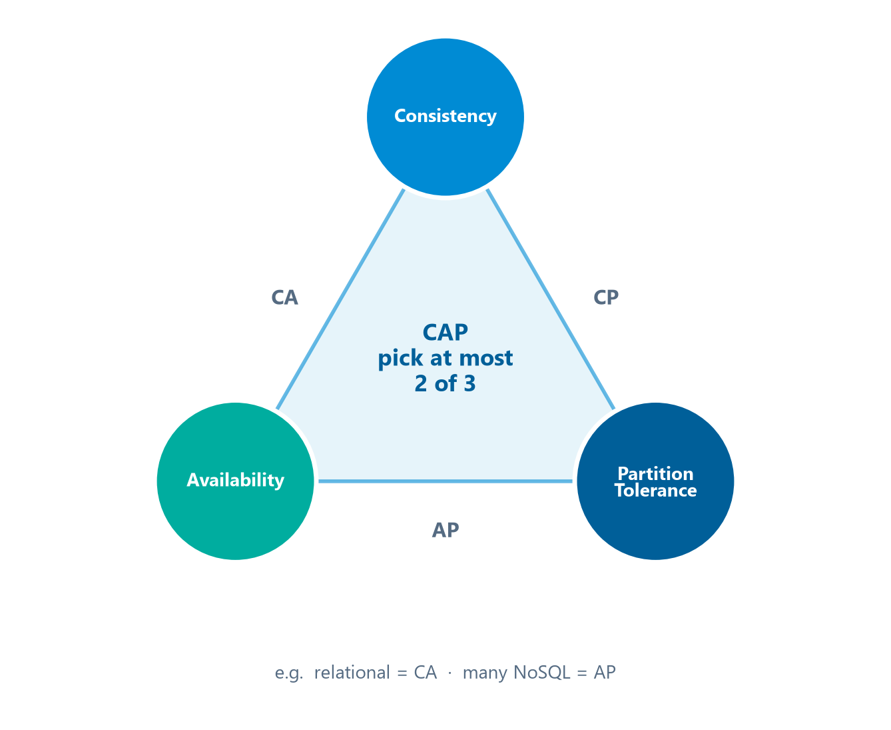
ACID vs. BASE & the CAP Theorem
Module 6 — Data Storage & Operations
CAP Theorem (Brewer, 2000) — a distributed system cannot satisfy all of ACID at all times; you may have at most 2 of 3:
  C — Consistency · A — Availability · P — Partition Tolerance
A distributed system can satisfy at most two of the three corners.
⭐ EXAM TIP: CAP = "pick two." If a partition occurs and you stay available, you sacrifice consistency.
CDMP Fundamentals | DAMA-DMBOK 2nd Edition
dama.org / cdmp.info
Notes:
: ACID vs. BASE & the CAP Theorem
Let's contrast ACID and BASE, then introduce CAP. ACID uses schema on write — the structure must exist before you write — with strong consistency, rooted in 1970s relational systems. BASE uses a dynamic, schema-on-read approach, with consistency that may be strong, eventual, or none, and it emerged in the 2000s for unstructured data. Now the CAP theorem, also called Brewer's theorem, from Brewer in the year 2000. It was developed for distributed systems, and it states that such a system cannot comply with all parts of ACID at all times. The practical formulation is "pick two," shown as the triangle on screen: at most two of three properties — Consistency, Availability, and Partition tolerance — can hold in any shared-data system at once. The key scenario: if a network partition happens and you choose to stay available, you must sacrifice consistency. CAP equals pick two.
---

Slide 11
Database Organization
Module 6 — Data Storage & Operations
Organization | Key facts
Hierarchical | Oldest model; tree-like; mandatory parent/child (1-to-many); e.g., XML, directories
Relational | Named for relational algebra (set theory), not table relations; schema on write; row-oriented; SQL
Non-Relational (NoSQL) | "Not Only SQL"; schema on read; built for performance/latency
⭐ EXAM TIP: OLTP = row-oriented; OLAP = column-oriented.
CDMP Fundamentals | DAMA-DMBOK 2nd Edition
dama.org / cdmp.info
Notes:
: Database Organization
Beyond architecture, there are three ways to organize a database, and they're not mutually exclusive. Hierarchical is the oldest model, used in early mainframe systems — it's a rigid, tree-like structure with mandatory parent-child, one-to-many relationships; think directory trees and XML. Relational is named, interestingly, for relational algebra, which is set theory — not for the "relations between tables," which is a common misconception the exam exploits. Relational uses SQL, schema on write, and is row-oriented. And non-relational, or NoSQL — which stands for "Not Only SQL" — uses schema on read and aims for improved performance, especially latency and throughput. Two relational variants to know: the multidimensional variant used in data warehousing, queried with MDX; and the temporal variant, where Valid Time plus Transaction Time gives you bi-temporal support. And a key pairing: OLTP is row-oriented, OLAP is column-oriented.
---

Slide 12
NoSQL / Non-Relational Types
Module 6 — Data Storage & Operations
Type | Key fact
Column-oriented | Compresses redundancy; suited to OLAP / BI
Spatial | Geometric/geographic; uses a spatial index
Object / Multimedia | Hierarchical Storage Management
Flat file | No relationships between records; Hadoop uses flat files
Key-Value | Document DBs (XML/JSON) + graph DBs
Triplestore | Subject-predicate-object (RDF); best for taxonomy, linked data
⭐ EXAM TIP: Triplestore = RDF subject-predicate-object; Flat file = Hadoop.
CDMP Fundamentals | DAMA-DMBOK 2nd Edition
dama.org / cdmp.info
Notes:
: NoSQL / Non-Relational Types
Let's enumerate the non-relational types. Column-oriented stores compress redundant data and are well suited to OLAP and BI workloads. Spatial databases are optimized for geometric and geographic data using a spatial index. Object or multimedia databases use a hierarchical storage management system. Flat-file databases store rows and columns in a single file with no relationships between records — and notably, Hadoop uses flat files. Key-value databases include document databases, which use XML or JSON, and graph databases. And triplestores store data as subject-predicate-object triples — that's the RDF format — making them ideal for taxonomies, thesauruses, and linked data. Two to anchor for the exam: triplestore equals RDF subject-predicate-object, and flat file is associated with Hadoop.
---

Slide 13
Common Database Processes
Module 6 — Data Storage & Operations
Process | Key fact
Archiving | Move data to lower-performance media; test restoration regularly
CDC (Change Data Capture) | Detect changes; "log-based replication"; non-invasive
Purging | Permanently remove data — cannot be recovered; reduces cost & liability
Replication | Same data on multiple devices (active vs passive)
Retention | How long data is kept; part of physical design; regulatory
Sharding | Small chunks updated independently
⭐ EXAM TIP: Purge = unrecoverable. Archive = moved but retrievable.
CDMP Fundamentals | DAMA-DMBOK 2nd Edition
dama.org / cdmp.info
Notes:
: Common Database Processes
There are several routine database processes worth knowing. Archiving moves data to lower-performance media, and you must align it with your partitioning strategy and regularly test that you can restore it. Change Data Capture, or CDC, detects that data has changed and is sometimes called log-based replication; it's non-invasive and works either by data versioning or by reading the logs. Purging completely removes data — and here's the key point — purged data cannot be recovered; it reduces cost and liability. Replication keeps the same data on multiple devices. Retention defines how long data is kept and is driven by regulatory compliance. And sharding isolates small chunks of a database so they can be updated independently. The exam contrast to remember: purging is permanent and unrecoverable, while archiving moves data but keeps it retrievable.
---

Slide 14
Replication & Scaling
Module 6 — Data Storage & Operations
Replication patterns:
  Mirroring — updates replicated immediately (two-phase commit); more expensive; good for one secondary
  Log shipping — secondary receives transaction logs at intervals; for additional secondaries
Active vs Passive: Active recreates data at every replica; Passive recreates on a primary, then pushes to secondaries.
Scaling: Horizontal = more replicas; Vertical = replicas geographically further apart.
⭐ EXAM TIP: Mirroring = immediate/two-phase; Log shipping = interval-based.
CDMP Fundamentals | DAMA-DMBOK 2nd Edition
dama.org / cdmp.info
Notes:
: Replication & Scaling
Let's go deeper on replication. There are two main patterns. Mirroring replicates updates immediately using a two-phase commit; it's more expensive and works well when you have a single secondary. Log shipping sends the secondary the transaction logs at regular intervals; it's cheaper and is used when you have additional secondary servers. Replication can also be active or passive: active replication recreates the same data at every replica from every other replica, while passive recreates it on a single primary and then pushes that state out to the secondaries. And you can scale replication two ways — horizontally, meaning more replicas, or vertically, meaning replicas that are geographically further apart. The key contrast: mirroring is immediate and two-phase; log shipping is interval-based.
---

Slide 15
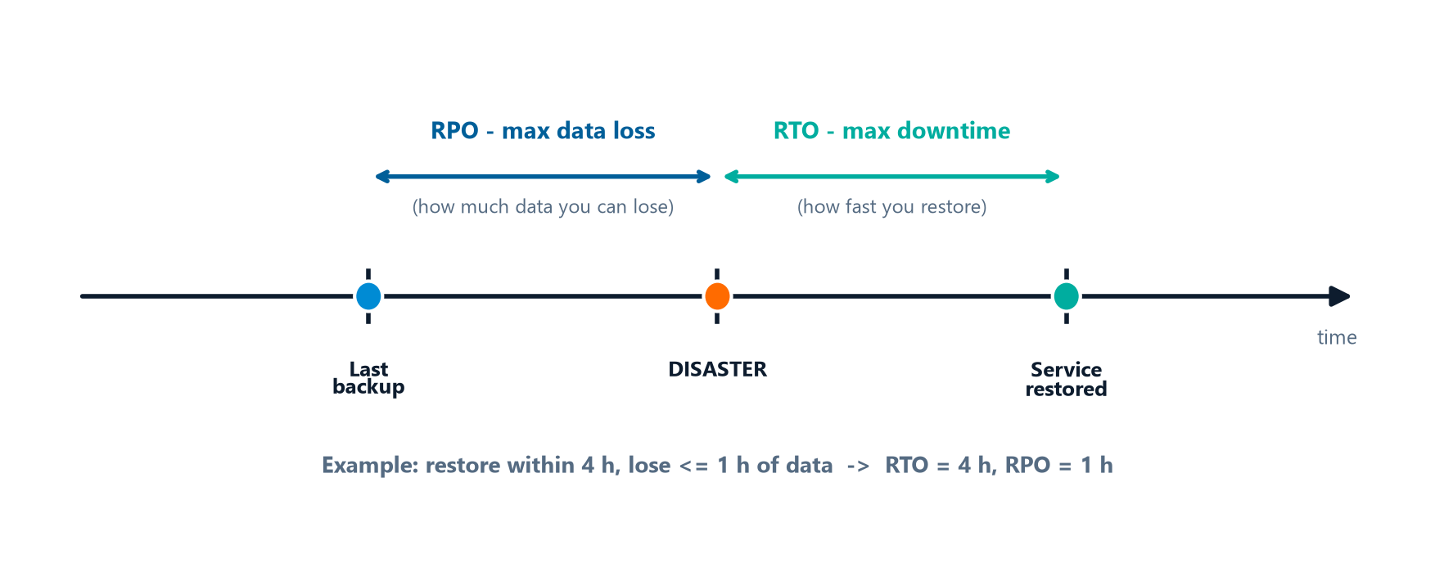
Recovery, RPO & RTO
Module 6 — Data Storage & Operations
3 recovery types: Immediate (auto-failover by design) · Critical (restore ASAP) · Non-critical (can wait).
Two key disaster-recovery metrics:
  RTO (Recovery Time Objective) — how fast you must restore service (max downtime)
  RPO (Recovery Point Objective) — how much data loss is tolerable (max time of lost transactions)
RPO looks back to the last backup (data loss); RTO looks forward to service restored (downtime).
⭐ EXAM TIP: RTO = time to restore; RPO = acceptable data loss. "Restore within 4 hrs, lose ≤1 hr of data" → RTO = 4h, RPO = 1h.
CDMP Fundamentals | DAMA-DMBOK 2nd Edition
dama.org / cdmp.info
Notes:
: Recovery, RPO & RTO
The DMBOK names three recovery types. Immediate recovery is handled through design, like automatic failover. Critical recovery means you restore as quickly as possible to minimize downtime. And non-critical recovery can be delayed until the more critical systems are back. Now two metrics that the exam loves, and that people constantly mix up — picture them on the timeline on screen. RTO, the Recovery Time Objective, is about time — how fast you must restore service, the maximum acceptable downtime. RPO, the Recovery Point Objective, is about data — how much data loss you can tolerate, the maximum age of transactions you might lose. So if an SLA says "restore within four hours and lose no more than one hour of data," that's an RTO of four hours and an RPO of one hour. Lock that distinction in: RTO is time to restore, RPO is acceptable data loss.
---

Slide 16
Database Environments
Module 6 — Data Storage & Operations
Environment | Key facts
Production | Mission-critical; the "real" environment
Development | Slimmer; first place to apply patches
Test | QA, integration, UAT, performance; never writes to production
Sandbox | Read-only from prod; CRUD in own space; for POC; never writes back
Alternate Production | Offline backups, failover; identical to production
⭐ EXAM TIP: Sandbox and Test never write to production.
CDMP Fundamentals | DAMA-DMBOK 2nd Edition
dama.org / cdmp.info
Notes:
: Database Environments
Organizations maintain several database environments, and you should know their roles. Production is the mission-critical, real environment where business processes actually run. Development is a slimmer version with less disk, CPU, and RAM, isolated from production, and it's the first place you apply patches. Test covers QA, integration testing, user acceptance testing, and performance testing — ideally on the same hardware and software as production — and critically, it never writes to production. Sandbox provides read-only connections to production, gives users CRUD rights in their own separate space for proofs of concept and hypotheses, and likewise should never write back to production. And alternate production holds offline backups and provides failover and resiliency, identical to production. The exam point to remember: sandbox and test environments never write to production.
---

Slide 17
Database Availability (MRRS) & Backups
Module 6 — Data Storage & Operations
Availability = % of time a system can be used for productive work.
4 factors — MRRS:
Manageability — create & maintain the environment
Recoverability — reestablish service after interruption
Reliability — deliver service at specified levels
Serviceability — identify, diagnose, repair problems
Backups: Hot (while running) vs Cold (offline); store on a separate filesystem/medium and keep copies off-site.
⭐ EXAM TIP: MRRS = Manageability, Recoverability, Reliability, Serviceability.
CDMP Fundamentals | DAMA-DMBOK 2nd Edition
dama.org / cdmp.info
Notes:
: Database Availability (MRRS) & Backups
Availability is the percentage of time a system or database can be used for productive work. Four factors affect it, and a handy mnemonic is MRRS. Manageability — the ability to create and maintain the environment. Recoverability — the ability to reestablish service after an interruption. Reliability — the ability to deliver service at specified levels for a stated period. And Serviceability — the ability to identify, diagnose, and repair problems. On backups: a hot backup is taken while applications are running, with updates rolling forward or back on reload, while a cold backup is taken when the database is offline — which isn't viable if you need continuous availability. Best practice is to store backup files on a separate filesystem, back them up to a separate storage medium, and keep copies in a secure off-site facility. Remember MRRS for the availability factors.
---

Slide 18
Activities & ITIL
Module 6 — Data Storage & Operations
2 activity groups:
  Manage Database Technology — understand (P) → evaluate via POC (D) → manage & monitor (O)
  Manage Databases — understand requirements, plan continuity, develop instances, manage performance, manage test data, manage migration
Reference model: ITIL (Information Technology Infrastructure Library) — developed in the United Kingdom.
DBMS selection weighs architecture, scalability, resiliency, plus non-technical factors (risk appetite, staff, cost of ownership, vendor support).
⭐ EXAM TIP: Technology management reference model = ITIL (UK).
CDMP Fundamentals | DAMA-DMBOK 2nd Edition
dama.org / cdmp.info
Notes:
: Activities & ITIL
The work of this knowledge area splits into two activity groups. Managing database technology runs through understand, evaluate, and manage-and-monitor — and the evaluation step should start with a proof of concept. Managing the databases themselves covers understanding requirements, planning for business continuity, developing database instances, managing performance, managing test datasets, and managing data migration. The reference model for technology management is ITIL — the Information Technology Infrastructure Library — which was developed in the United Kingdom. And when selecting a DBMS, you weigh technical factors like architecture, scalability, and resiliency, but also non-technical ones: the organization's risk appetite, the supply of trained staff, the total cost of ownership, and the vendor's reputation and support. If asked for the technology management reference model, the answer is ITIL.
---

Slide 19
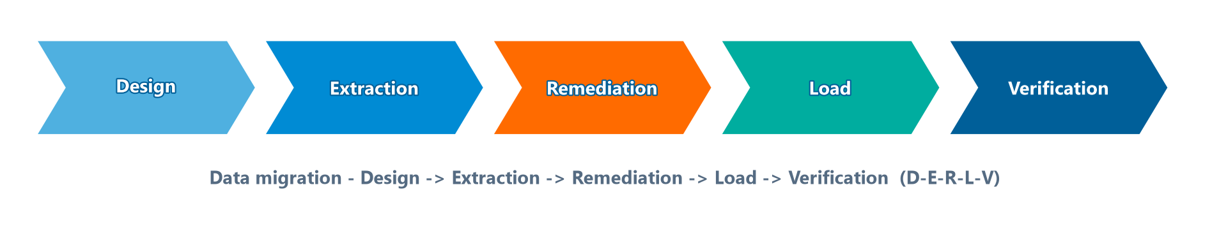
Config Management (SCM) & Data Migration
Module 6 — Data Storage & Operations
Software Configuration Management — 4 procedures: Identification, Change Control, Status Accounting, Audits (physical = installed per design; functional = performance achieved).
Data Migration — 5 phases: Design → Extraction → Remediation → Load → Verification (often repeated for complex moves).
The five migration phases in order (D-E-R-L-V).
⭐ EXAM TIP: Migration phases — D-E-R-L-V. Two audit types: physical vs functional.
CDMP Fundamentals | DAMA-DMBOK 2nd Edition
dama.org / cdmp.info
Notes:
: Config Management (SCM) & Data Migration
Two more operational topics. Software Configuration Management has four procedures: configuration identification, where you identify, document, and baseline all the configuration attributes; configuration change control, the processes and approval stages for changing and re-baselining; configuration status accounting, recording and reporting on the baseline at any point in time; and configuration audits, which come in two types — physical, ensuring the system is installed per the detailed design documentation, and functional, ensuring the performance attributes are actually achieved. Data migration, meanwhile, follows the five phases on screen: Design, Extraction, Remediation, Load, and Verification — and these are commonly repeated several times for moderate-to-high complexity migrations. Remember the migration sequence, D-E-R-L-V, and the two audit types, physical and functional.
---

Slide 20
Performance — Common Causes & Tools
Module 6 — Data Storage & Operations
Common performance problem causes: memory contention, locking & blocking (deadlock), stale statistics, poorly coded SQL (most common), inefficient joins, insufficient indexing, overloaded servers, runaway queries (use query governors).
Tools: data modeling tools · database monitoring tools · database management tools · developer support tools.
⭐ EXAM TIP: The most common performance cause is poorly coded SQL.
CDMP Fundamentals | DAMA-DMBOK 2nd Edition
dama.org / cdmp.info
Notes:
: Performance — Common Causes & Tools
When database performance degrades, the DMBOK lists common causes: memory allocation or contention, locking and blocking — which at its worst is deadlock, inaccurate database statistics, poorly coded SQL, inefficient complex table joins, insufficient indexing, competing application activity, overloaded servers, database volatility, and runaway queries, which you control with query governors. Of all these, the most common cause is poorly coded SQL — that's a likely exam point. On tools, you have data modeling tools, database monitoring tools that watch capacity and availability and alert the DBAs, database management tools for configuration and backup and cloning, and developer support tools that give a visual interface to the database. So: the single most common performance culprit is poorly coded SQL.
---

Slide 21
Techniques & Governance
Module 6 — Data Storage & Operations
Techniques: test in lower environments first · physical naming standards (ISO/IEC 11179 Part 5) · use scripts for all changes.
Governance metrics — 4 categories: Storage, Performance, Operations, Service.
Data Audit vs Data Validation:
  Data Audit — evaluate a dataset against defined criteria (compliance)
  Data Validation — evaluate stored data against acceptance criteria (quality/usability)
⭐ EXAM TIP: Track software licenses — out-of-compliance = serious financial/legal risk.
CDMP Fundamentals | DAMA-DMBOK 2nd Edition
dama.org / cdmp.info
Notes:
: Techniques & Governance
A few techniques and governance points to close out the activities. The techniques: always test in lower environments first, starting at development and promoting upward; follow physical naming standards, specifically ISO/IEC 11179 Part 5, the naming and identification principles; and place all changes in update scripts, tested in non-production first. For governance, the metrics fall into four categories: storage, performance, operations, and service. And know the distinction between two evaluation concepts: a data audit evaluates a dataset against defined criteria to check compliance, while data validation evaluates stored data against established acceptance criteria to determine quality and usability. One more governance reality — track your software license agreements carefully, because being out of compliance carries serious financial and legal risk.
---

Slide 22
Key Numbers & Quick Facts (Cheat Sheet)
Module 6 — Data Storage & Operations
Fact | Value
ACID coined | Haerder & Reuter, 1983 (Jim Gray)
CAP theorem | Brewer, 2000 — pick 2 of 3
BASE | Basically Available, Soft State, Eventual Consistency
Tech mgmt reference model | ITIL (UK)
Schema on write / read | Relational / NoSQL
OLTP / OLAP | Row-oriented / Column-oriented
Blockchain | A federated database; immutable
Availability factors | MRRS
Migration phases | Design, Extraction, Remediation, Load, Verification
SCM procedures | 4
Physical naming standard | ISO/IEC 11179 Part 5
Metric categories | Storage, Performance, Operations, Service
CDMP Fundamentals | DAMA-DMBOK 2nd Edition
dama.org / cdmp.info
Notes:
: Key Numbers & Quick Facts (Cheat Sheet)
Let's consolidate. ACID was coined by Haerder and Reuter in 1983, with the concept established by Jim Gray. The CAP theorem is Brewer's, from 2000 — pick two of three. BASE is Basically Available, Soft State, Eventual Consistency. The technology management reference model is ITIL, developed in the UK. Schema on write is relational; schema on read is NoSQL. OLTP is row-oriented; OLAP is column-oriented. Blockchain is a federated, immutable database. Availability factors are MRRS. Data migration has five phases. There are four SCM procedures. The physical naming standard is ISO/IEC 11179 Part 5. And the governance metric categories are storage, performance, operations, and service. Review these until they're automatic.
---

Slide 23
Common Exam Traps
Module 6 — Data Storage & Operations
❌ Relational = "relations between tables" → ✅ named for relational algebra (set theory)
❌ CAP lets you have all three → ✅ pick two; partition + availability sacrifices consistency
❌ Purge = recoverable → ✅ purge is permanent; archive is retrievable
❌ RPO = restore time → ✅ RPO = data loss tolerance; RTO = restore time
❌ Sandbox writes to production → ✅ sandbox/test never write to production
⭐ EXAM TIP: Blockchain is a federated database — not its own category.
CDMP Fundamentals | DAMA-DMBOK 2nd Edition
dama.org / cdmp.info
Notes:
: Common Exam Traps
Let me point out the traps. First, the relational model is named for relational algebra — set theory — not for "relations between tables"; the exam plays on that misconception. Second, CAP does not let you have all three properties; you pick two, and choosing availability during a partition costs you consistency. Third, purging is permanent and unrecoverable, while archiving keeps data retrievable — don't confuse them. Fourth, RPO is your data-loss tolerance and RTO is your restore-time target; people reverse these constantly. And fifth, sandbox and test environments never write to production. One bonus: a blockchain is a federated database, not a standalone category. Know these and you'll dodge the chapter's favorite tricks.
---

Slide 24
Module Summary
Module 6 — Data Storage & Operations
Data Storage & Operations designs, implements, and supports stored data; driver = business continuity; goals = availability, integrity, performance.
DBA types (Production, Application, Procedural, Development, NSA); architectures: centralized, distributed, federated (incl. blockchain).
ACID (relational) vs BASE (NoSQL); CAP = pick two.
OLTP = row / OLAP = column; purge is permanent; RTO = time, RPO = data loss.
Availability = MRRS; migration = D-E-R-L-V; reference model = ITIL.
CDMP Fundamentals | DAMA-DMBOK 2nd Edition
dama.org / cdmp.info
Notes:
: Module Summary
Let's wrap up. Data Storage and Operations designs, implements, and supports stored data; its driver is business continuity, and its goals are availability, integrity, and performance. You've got the DBA types — Production, Application, Procedural, Development, and the NSA — and the architectures: centralized, distributed, and federated, with blockchain as a federated example. ACID governs relational systems, BASE governs NoSQL, and CAP says pick two. OLTP is row-oriented, OLAP is column-oriented; purging is permanent; RTO is restore time and RPO is data loss. Availability is MRRS, migration is D-E-R-L-V, and the reference model is ITIL. That's Chapter 6.
---

Slide 25
Let's Test Your Knowledge
Module 6 — Data Storage & Operations
Heading: 5 practice questions — Data Storage & Operations
Subtitle: Watch the ACID/BASE/CAP and RPO/RTO wording carefully.
CDMP Fundamentals | DAMA-DMBOK 2nd Edition
dama.org / cdmp.info
Notes:
: Let's Test Your Knowledge
Let's test your knowledge with five questions on data storage and operations. Several of these turn on the precise meaning of an ACID, BASE, or CAP property, or on the RPO-versus-RTO distinction — so read carefully, decide on your answer, and then reveal the solution. Here we go.
---

Slide 26
Practice Question 1
Module 6 — Data Storage & Operations
Q1
A funds transfer must either fully commit or fully roll back — money must never be debited from one account without being credited to another. Which ACID property does this most directly reflect?
A) Consistency — referential integrity constraints
B) Atomicity — the transaction is a single indivisible unit of work
C) Durability — committed data survives failures
D) Isolation — concurrent transactions can't see intermediate states
Answer: "All-or-nothing" is Atomicity — the transaction is treated as one indivisible unit; either every operation completes or none do. Consistency is about rules/integrity, Durability about surviving crashes, and Isolation about concurrency.
CDMP Fundamentals | DAMA-DMBOK 2nd Edition
dama.org / cdmp.info
Notes:
: Practice Questions (Q1–Q3)
Question one: a funds transfer must fully commit or fully roll back. Which ACID property? The answer is B, Atomicity — the all-or-nothing, indivisible-unit property. Consistency is about rules and integrity, Durability about surviving failures, and Isolation about concurrency.
Question two: under CAP, when a partition occurs and the system stays available, what's sacrificed? The answer is D, Consistency — different nodes may temporarily return different values. You can't opt out of partition tolerance in a distributed system, and Durability isn't even part of CAP.
Question three: how does BASE's Soft State differ from ACID Consistency? The answer is D — the system state may change over time even without new input, as data propagates across replicas. That's the essence of soft, in-flux state, the opposite of strong, immediate consistency.
Two more coming up on the next slide.
---

Slide 27
Practice Question 2
Module 6 — Data Storage & Operations
Q2
Under the CAP theorem, when a network partition occurs and a distributed system chooses to remain available, which property must be partially sacrificed?
A) Durability — writes may be lost
B) Availability — the system stops accepting requests
C) Partition tolerance — the system opts out of partitions
D) Consistency — different nodes may temporarily return different values
Answer: CAP lets you keep at most two of three. During a partition (P), if you insist on availability (A), you must relax consistency (C) — nodes may temporarily disagree. You cannot "opt out" of partition tolerance in a distributed system, and Durability is an ACID property, not part of CAP.
CDMP Fundamentals | DAMA-DMBOK 2nd Edition
dama.org / cdmp.info
Notes:
: Practice Questions (Q1–Q3)
Question one: a funds transfer must fully commit or fully roll back. Which ACID property? The answer is B, Atomicity — the all-or-nothing, indivisible-unit property. Consistency is about rules and integrity, Durability about surviving failures, and Isolation about concurrency.
Question two: under CAP, when a partition occurs and the system stays available, what's sacrificed? The answer is D, Consistency — different nodes may temporarily return different values. You can't opt out of partition tolerance in a distributed system, and Durability isn't even part of CAP.
Question three: how does BASE's Soft State differ from ACID Consistency? The answer is D — the system state may change over time even without new input, as data propagates across replicas. That's the essence of soft, in-flux state, the opposite of strong, immediate consistency.
Two more coming up on the next slide.
---

Slide 28
Practice Question 3
Module 6 — Data Storage & Operations
Q3
In BASE, how does "Soft State" differ from the ACID concept of Consistency?
A) It enforces schema constraints loosely but still validates data types
B) It guarantees strong consistency at all times, like ACID
C) It is equivalent to ACID Isolation for distributed transactions
D) It means the system state may change over time even without new input, as data propagates across replicas
Answer: Soft State means the data is in flux — the state can change over time as updates propagate across replicas, even with no new input. That's the opposite of ACID's strong, immediate Consistency.
CDMP Fundamentals | DAMA-DMBOK 2nd Edition
dama.org / cdmp.info
Notes:
: Practice Questions (Q1–Q3)
Question one: a funds transfer must fully commit or fully roll back. Which ACID property? The answer is B, Atomicity — the all-or-nothing, indivisible-unit property. Consistency is about rules and integrity, Durability about surviving failures, and Isolation about concurrency.
Question two: under CAP, when a partition occurs and the system stays available, what's sacrificed? The answer is D, Consistency — different nodes may temporarily return different values. You can't opt out of partition tolerance in a distributed system, and Durability isn't even part of CAP.
Question three: how does BASE's Soft State differ from ACID Consistency? The answer is D — the system state may change over time even without new input, as data propagates across replicas. That's the essence of soft, in-flux state, the opposite of strong, immediate consistency.
Two more coming up on the next slide.
---

Slide 29
Practice Question 4
Module 6 — Data Storage & Operations
Q4
An SLA requires the payment system to be restored within 4 hours of a disaster, with no more than 1 hour of transactions lost. Which metrics capture these requirements, respectively?
A) RPO = 4 hours; RTO = 1 hour
B) RTO = 1 hour; RPO = 4 hours
C) MTTR = 4 hours; MTBF = 1 hour
D) RTO = 4 hours; RPO = 1 hour
Answer: RTO (Recovery Time Objective) is the maximum time to restore service — here 4 hours. RPO (Recovery Point Objective) is the maximum tolerable data loss — here 1 hour. So RTO = 4h, RPO = 1h.
CDMP Fundamentals | DAMA-DMBOK 2nd Edition
dama.org / cdmp.info
Notes:
: Practice Questions (Q4–Q5)
Question four: an SLA requires restoration within four hours and no more than one hour of lost transactions. Which metrics? The answer is D — RTO equals four hours, RPO equals one hour. RTO is the time to restore service; RPO is the tolerable data loss. Remember, the wrong options swap them or use unrelated metrics like MTTR and MTBF.
Question five: a seven-year retention policy that then requires secure deletion — how does it drive operations? The answer is B — it drives automated archiving jobs for aging records and purge jobs that permanently delete records past the seven-year limit, operationalizing compliance without manual effort. It doesn't mandate in-memory storage, indiscriminate annual purges, or the removal of backups.
That completes Module 6. Next we move into Module 7, Data Security — another important and very practical chapter. I'll see you there.
---
*End of Module 6 scripts.*

Slide 30
Practice Question 5
Module 6 — Data Storage & Operations
Q5
A retention policy says customer transaction records must be kept 7 years for compliance, then securely deleted. How does this directly drive database operations?
A) It requires all transaction data to be stored in-memory for fast deletion
B) It drives automated archiving jobs for records older than 7 years and purge jobs that delete records past the limit, ensuring compliance without manual intervention
C) It requires purging all transaction data annually regardless of timelines
D) It eliminates the need for backups because records are retained by default
Answer: A retention policy directly shapes archiving and purging operations — automatically moving aged data to archive storage and permanently purging records once the retention period expires. This operationalizes compliance. It does not mandate in-memory storage, indiscriminate annual purges, or removal of backups. End of Module 6 — Data Storage & Operations.
CDMP Fundamentals | DAMA-DMBOK 2nd Edition
dama.org / cdmp.info
Notes:
: Practice Questions (Q4–Q5)
Question four: an SLA requires restoration within four hours and no more than one hour of lost transactions. Which metrics? The answer is D — RTO equals four hours, RPO equals one hour. RTO is the time to restore service; RPO is the tolerable data loss. Remember, the wrong options swap them or use unrelated metrics like MTTR and MTBF.
Question five: a seven-year retention policy that then requires secure deletion — how does it drive operations? The answer is B — it drives automated archiving jobs for aging records and purge jobs that permanently delete records past the seven-year limit, operationalizing compliance without manual effort. It doesn't mandate in-memory storage, indiscriminate annual purges, or the removal of backups.
That completes Module 6. Next we move into Module 7, Data Security — another important and very practical chapter. I'll see you there.
---
*End of Module 6 scripts.*

