Slide 1
CDMP FUNDAMENTALS
Module 7: Data Security
DAMA-DMBOK 2nd Edition, Chapter 7
Exam weight: ~6% (≈6 questions) — Four A's, confidentiality, encryption, RBAC
Module 7 — Data Security
100
90
Open
≥60%
MCQ
minutes
book
to pass
CDMP Fundamentals | DAMA-DMBOK 2nd Edition
dama.org / cdmp.info
Notes:
: Module Title Slide
Welcome to Module 7: Data Security. This is Chapter 7 of the DMBOK, worth about six percent of the exam. Data Security is one of the more intuitive chapters because so much of it maps to ideas you already know — passwords, encryption, firewalls. But the exam tests precise distinctions, like authentication versus authorization, or persistent versus dynamic masking. So let's make sure those distinctions are crisp. Here we go.
---

Slide 2
Module Overview & Learning Objectives
Module 7 — Data Security
By the end, you'll be able to:
  Define Data Security and its 3 goals
  Explain the Four A's (+ Entitlement) and the Goldilocks Principle
  Distinguish risk classifications and confidentiality levels
  Map regulations (SOX, HIPAA, FERPA, PCI-DSS) to data categories
  Compare encryption methods and data masking types
  Recognize threats, malware, and the 5 security activities
CDMP Fundamentals | DAMA-DMBOK 2nd Edition
dama.org / cdmp.info
Notes:
: Module Overview & Learning Objectives
Here's our roadmap. You'll define Data Security and its three goals. You'll learn the Four A's — plus a fifth concept, Entitlement — and the memorable Goldilocks Principle. You'll distinguish the risk classifications and the five confidentiality levels. You'll map the key regulations — SOX, HIPAA, FERPA, PCI-DSS — to their data categories. You'll compare the encryption methods and the types of data masking. And you'll recognize the threats, the malware types, and the five security activities. Let's start with the definition.
---

Slide 3
Definition & Goals
Module 7 — Data Security
DMBOK2 Definition: the planning, development, and execution of security policies and procedures to provide proper authentication, authorization, access, and auditing of data and information assets.
3 goals:
Enable appropriate access and prevent inappropriate access
Understand and comply with regulations (privacy, protection, confidentiality)
Ensure the privacy & confidentiality needs of stakeholders are enforced and audited
⭐ EXAM TIP: Security is about the Four A's — authentication, authorization, access, audit.
CDMP Fundamentals | DAMA-DMBOK 2nd Edition
dama.org / cdmp.info
Notes:
: Definition & Goals
The DMBOK defines Data Security as the planning, development, and execution of security policies and procedures to provide proper authentication, authorization, access, and auditing of data and information assets. Notice those four words — authentication, authorization, access, and auditing — because they're the Four A's we'll return to shortly. There are three goals. First, enable appropriate access while preventing inappropriate access to enterprise data. Second, understand and comply with all relevant regulations and policies for privacy, protection, and confidentiality. And third, ensure the privacy and confidentiality needs of all stakeholders are enforced and audited. So the whole chapter really orbits those Four A's.
---

Slide 4
Business Drivers & the Goldilocks Principle
Module 7 — Data Security
Two primary drivers: Risk Reduction (compliance, fiduciary duty, reputation) and Business Growth (trusted e-commerce builds confidence and profit).
Goldilocks Principle: security must be appropriate — not too lax, and not so onerous it blocks legitimate work.
4-step information security process: (1) identify & classify sensitive data; (2) locate it across the enterprise; (3) determine how to protect each asset; (4) identify how it interacts with business processes.
⭐ EXAM TIP: "Not too much, not too little" = the Goldilocks Principle.
CDMP Fundamentals | DAMA-DMBOK 2nd Edition
dama.org / cdmp.info
Notes:
: Business Drivers & the Goldilocks Principle
There are two primary business drivers for data security. The first is risk reduction — meeting regulatory compliance, fulfilling fiduciary responsibility, and protecting reputation. The second is business growth — because trusted, secure e-commerce drives profit, and robust security builds customer confidence. Now, one memorable concept the exam likes: the Goldilocks Principle. It says data security must be appropriate — not too lax, but also not so onerous that it prevents users from doing their legitimate work. Just right. The DMBOK also gives a four-step information security process: identify and classify sensitive data, locate it across the enterprise, determine how each asset needs protecting, and identify how the information interacts with business processes. Remember the Goldilocks Principle: not too much, not too little.
---

Slide 5
The 6 Guiding Principles
Module 7 — Data Security
Collaboration — IT security, stewards, governance, audit, legal together
Enterprise approach — standards applied consistently across the organization
Proactive management — dynamic; overcome cultural bottlenecks
Clear accountability — defined roles incl. chain of custody
Metadata-driven — security classification is part of data definitions
Reduce risk by reducing exposure — minimize proliferation, especially to non-production
⭐ EXAM TIP: Security is metadata-driven — classification travels with the data.
CDMP Fundamentals | DAMA-DMBOK 2nd Edition
dama.org / cdmp.info
Notes:
: The 6 Guiding Principles
Data Security follows six guiding principles. One, collaboration — it involves IT security, data stewards, governance, audit, and legal all working together. Two, an enterprise approach — standards applied consistently across the whole organization, not piecemeal. Three, proactive management — staying dynamic, engaging stakeholders, and overcoming cultural bottlenecks. Four, clear accountability — well-defined roles, including a chain of custody for data. Five, metadata-driven — security classification is an essential part of data definitions, so the classification travels with the data. And six, reduce risk by reducing exposure — minimize the proliferation of sensitive data, especially into non-production environments. The principle the exam most likes to highlight is that security is metadata-driven.
---

Slide 6
Essential Concepts — Vulnerability, Threat, Risk
Module 7 — Data Security
Vulnerability — a weakness that allows a successful attack (unpatched systems, weak passwords, backdoors).
Threat — a potential offensive action; internal/external, malicious/unintentional (the attack surface).
Risk — both the possibility of loss and the condition that poses potential loss.
Risk is prioritized by probability, damage, revenue effect, fix cost, and attacker intent.
⭐ EXAM TIP: Vulnerability = weakness · Threat = potential action · Risk = possibility + condition of loss.
CDMP Fundamentals | DAMA-DMBOK 2nd Edition
dama.org / cdmp.info
Notes:
: Essential Concepts — Vulnerability, Threat, Risk
Three foundational terms, and the exam expects you to tell them apart. A vulnerability is a weakness that allows a successful attack — think unpatched systems, weak passwords, untrained users, or backdoors. A threat is a potential offensive action against the organization; it can be internal or external, malicious or unintentional, and the collection of possible threats is sometimes called the attack surface. And risk is both the possibility of loss and the condition that poses that potential loss. Organizations prioritize risks by factors like probability, the type and amount of damage, the effect on revenue, the cost to fix, the cost to prevent, and the attacker's intent. So in one line: vulnerability is the weakness, threat is the potential action, and risk is the possibility and condition of loss.
---

Slide 7
Risk Classifications & the Aggregation Rule
Module 7 — Data Security
Classification | Description
Critical Risk Data (CRD) | Aggressively sought personal info; high financial value; harms individuals & company
High Risk Data (HRD) | Actively sought; provides competitive edge; exposure causes financial/legal harm
Moderate Risk Data (MRD) | Little value to outsiders, but unauthorized use still harms the company
⭐ EXAM TIP: CRD > HRD > MRD. One sensitive field raises the whole dataset's classification.
CDMP Fundamentals | DAMA-DMBOK 2nd Edition
dama.org / cdmp.info
Notes:
: Risk Classifications & the Aggregation Rule
The DMBOK gives three risk classifications for data. Critical Risk Data, or CRD, is personal information that's aggressively sought, has high direct financial value, and can harm both individuals and the company. High Risk Data, HRD, is actively sought and provides a competitive edge; its exposure causes financial harm and legal exposure. And Moderate Risk Data, MRD, has little tangible value to outsiders, but its unauthorized use still negatively affects the company. So the severity order is CRD, then HRD, then MRD. And here's a crucial rule the exam loves: the aggregation rule. The highest security classification of any single piece of data in a data set determines the classification of the entire set. One critical field drags the whole dataset up to its level.
---

Slide 8
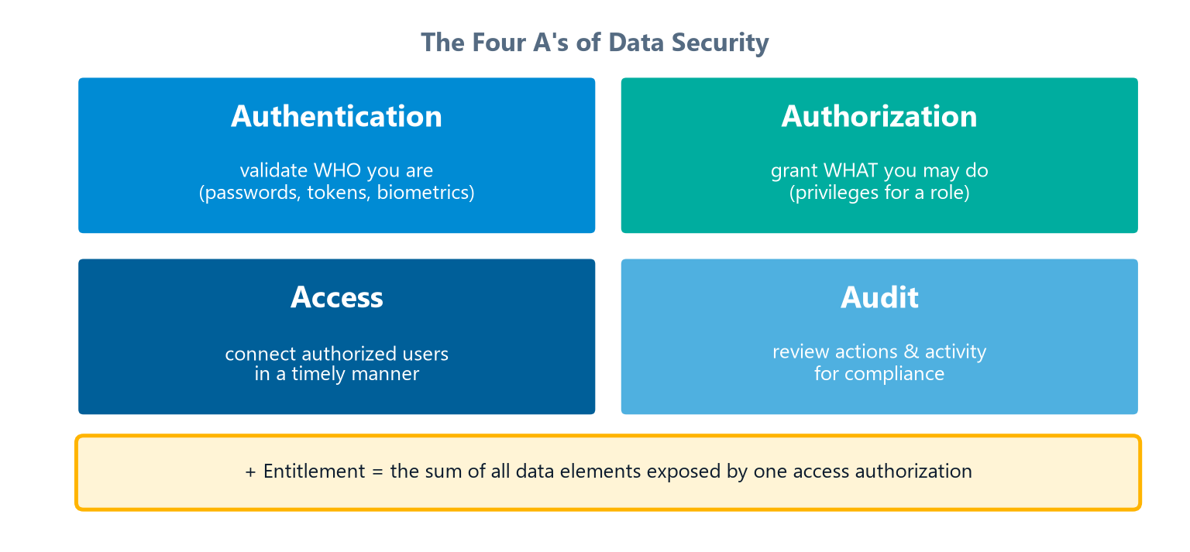
The Four A's (+ Entitlement)
Module 7 — Data Security
Authentication, Authorization, Access, Audit — plus Entitlement.
⭐ EXAM TIP: Authentication = who you are; Authorization = what you may do. Don't swap them.
CDMP Fundamentals | DAMA-DMBOK 2nd Edition
dama.org / cdmp.info
Notes:
: The Four A's (+ Entitlement)
Now the centerpiece, laid out in the four quadrants on screen: the Four A's of security. Access means enabling authorized individuals to connect to information systems in a timely manner. Audit means reviewing security actions and user activity to ensure compliance with regulations and policy. Authentication means validating users' identities — through passwords, tokens, or biometrics — with transmissions encrypted. And Authorization means granting individuals the privileges to access specific data appropriate to their role. There's also a fifth, more recently added concept: Entitlement, which is the sum total of all the data elements exposed to a user by a single access authorization decision. The distinction the exam tests most is authentication versus authorization. Authentication is about who you are — proving your identity. Authorization is about what you're allowed to do. Don't ever swap those two.
---

Slide 9
Monitoring — Active vs. Passive
Module 7 — Data Security
Active monitoring — real-time; detects unexpected events; alerts or interrupts suspicious activity → a detection mechanism.
Passive monitoring — tracks changes via snapshots; compares trends against benchmarks → an assessment mechanism.
⭐ EXAM TIP: Active = real-time detection; Passive = snapshot assessment.
CDMP Fundamentals | DAMA-DMBOK 2nd Edition
dama.org / cdmp.info
Notes:
: Monitoring — Active vs. Passive
There are two kinds of security monitoring, and they serve different purposes. Active monitoring happens in real time — it detects unexpected events as they occur and alerts on or interrupts suspicious activity. Think of it as a detection mechanism. Passive monitoring tracks changes by taking snapshots over time and comparing trends against benchmarks. Think of it as an assessment mechanism. So the quick contrast: active monitoring is real-time detection, while passive monitoring is snapshot-based assessment. The exam may give you a scenario and ask which type is being described — listen for "real-time" versus "periodic snapshots."
---

Slide 10
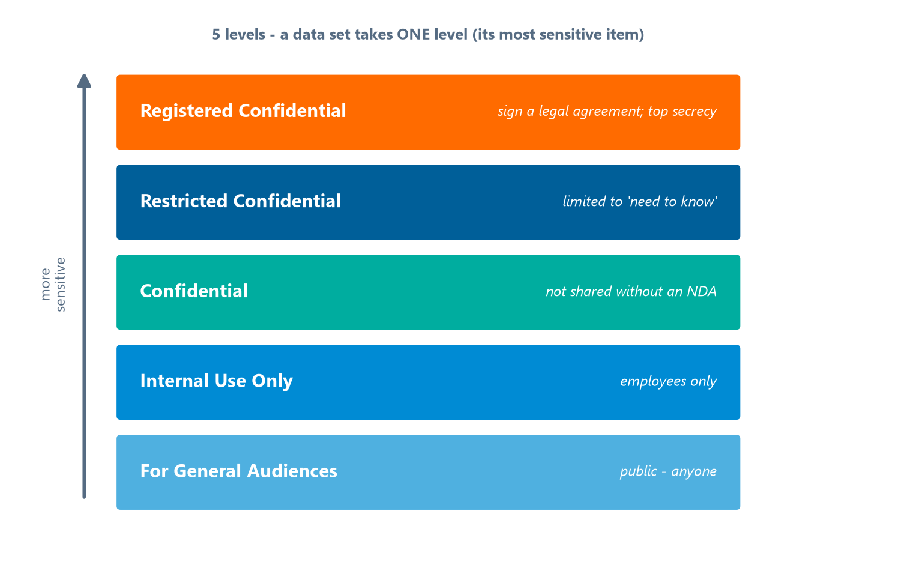
The 5 Data Confidentiality Levels
Module 7 — Data Security
A data set has only ONE confidentiality level — based on its most sensitive item.
The five levels rising in sensitivity, from public to registered confidential.
⭐ EXAM TIP: Confidentiality classification is internal and singular per data set.
CDMP Fundamentals | DAMA-DMBOK 2nd Edition
dama.org / cdmp.info
Notes:
: The 5 Data Confidentiality Levels
The DMBOK defines five confidentiality levels, climbing from least to most restrictive as the ladder on screen shows. For General Audiences means it's public — available to anyone. Internal Use Only means it's limited to employees, with minimal risk if shared, but not for copying outside the organization. Confidential means it isn't shared outside the organization without a non-disclosure agreement. Restricted Confidential means access is limited to roles with a genuine need to know, and may require security clearance. And Registered Confidential is the highest level — anyone accessing it must sign a legal agreement. The key rule: any given data set can have only one confidentiality level, and that level is set by the most sensitive item within it. Notice how that mirrors the aggregation rule from a moment ago.
---

Slide 11
Confidentiality vs. Regulatory Classification
Module 7 — Data Security
Confidentiality — restriction originates internally; one level per data set.
Regulatory — externally defined and additive: a single data set may carry multiple regulatory categories at once.
⭐ EXAM TIP: Confidentiality = internal & singular; Regulatory = external & additive. This contrast is frequently tested.
CDMP Fundamentals | DAMA-DMBOK 2nd Edition
dama.org / cdmp.info
Notes:
: Confidentiality vs. Regulatory Classification
This slide draws a distinction the exam genuinely loves, so lock it in. Confidentiality classification originates internally — your organization decides it — and a data set has exactly one confidentiality level. Regulatory classification, on the other hand, is externally defined by laws and regulators, and crucially, it's additive. That means a single data set can carry multiple regulatory categories at the same time — it might be subject to PII rules and financial regulations and health-privacy rules all at once. So the contrast is: confidentiality is internal and singular, while regulatory is external and additive. If a question asks which type of classification can stack multiple categories on one dataset, the answer is regulatory.
---

Slide 12
Regulatory Families
Module 7 — Data Security
Category | Key regulation(s)
PII (Personally Identifiable Information) | EU directives, PIPEDA, PIP Act (Japan), GLB
Financially Sensitive | SOX, Insider Trading Laws, GLBA
PHI (Personal Health Information) | HIPAA (US)
Educational Records | FERPA (US)
Payment Cards | PCI-DSS
⭐ EXAM TIP: HIPAA = health (PHI); FERPA = education; PCI-DSS = card data.
CDMP Fundamentals | DAMA-DMBOK 2nd Edition
dama.org / cdmp.info
Notes:
: Regulatory Families
Let's map the major regulations to their data categories. Personally Identifiable Information, or PII, is covered by things like the EU privacy directives, Canada's PIPEDA, Japan's PIP Act, and Gramm-Leach-Bliley. Financially sensitive data is governed by Sarbanes-Oxley, insider trading laws, and GLBA. Personal Health Information, PHI, is protected in the US by HIPAA. Educational records are protected by FERPA — the Family Educational Rights and Privacy Act. And payment card data falls under PCI-DSS, the Payment Card Industry Data Security Standard. The three you most need to keep straight: HIPAA is health, FERPA is education, and PCI-DSS is payment cards. Those exact mappings show up regularly on the exam.
---

Slide 13
SOX vs. Insider Trading Laws
Module 7 — Data Security
Sarbanes-Oxley (SOX) — restricts who can CHANGE financial data (data integrity).
Insider Trading Laws — restrict who can SEE financial data (data confidentiality).
⭐ EXAM TIP: SOX = who can change; Insider Trading = who can see. A classic distinction question.
CDMP Fundamentals | DAMA-DMBOK 2nd Edition
dama.org / cdmp.info
Notes:
: SOX vs. Insider Trading Laws
Here's a small but frequently tested distinction within financial data. Sarbanes-Oxley, SOX, restricts who can change financial data — it's about protecting the integrity and validity of those numbers. Insider trading laws, by contrast, restrict who can see financial data — it's about confidentiality, preventing people from acting on information they shouldn't have. So the one-line memory hook: SOX governs who can change the data, while insider trading laws govern who can see it. Change versus see. The exam will absolutely put both in the answer choices and see if you can tell them apart.
---

Slide 14
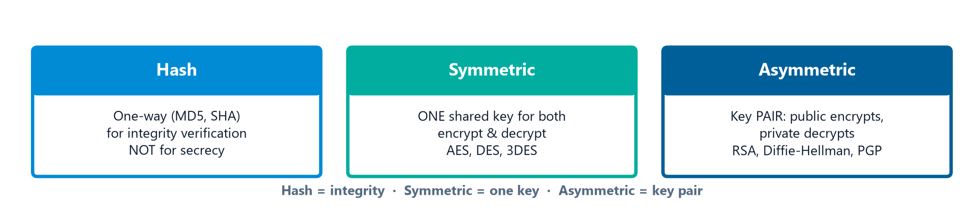
Encryption — 3 Methods
Module 7 — Data Security
Encryption = translating plain text into coded form to hide information, verify transmission, or verify the sender.
Hash (one-way), Symmetric (one key), Asymmetric (key pair).
⭐ EXAM TIP: Symmetric = one shared key (AES); Asymmetric = key pair (RSA). Hash = integrity, not secrecy.
CDMP Fundamentals | DAMA-DMBOK 2nd Edition
dama.org / cdmp.info
Notes:
: Encryption — 3 Methods
Encryption translates plain text into complex codes to hide privileged information, verify a transmission, or verify the sender's identity. There are three main methods, shown side by side on screen. Hashing uses algorithms like MD5 and SHA to convert data into a mathematical representation; it's one-way and used mainly for verifying transmission integrity. Private-key, or symmetric, encryption uses a single key for both encrypting and decrypting — common algorithms include AES, DES, and 3DES. Public-key, or asymmetric, encryption uses a key pair: the sender encrypts with the recipient's public key, and the recipient decrypts with their private key — methods include RSA and Diffie-Hellman, and PGP is a well-known free implementation. The key contrast: symmetric uses one shared key, asymmetric uses a key pair, and hashing is for integrity, not secrecy.
---

Slide 15
Data Masking — Persistent vs. Dynamic
Module 7 — Data Security
Type | Key facts
Persistent (Static) | Permanently & irreversibly alters data; used for non-production (test) copies
Dynamic | Changes appearance to the user without altering stored data (e.g., SSN as *--6789)
⭐ EXAM TIP: Persistent = for test/non-prod copies; Dynamic = display-only in production.
CDMP Fundamentals | DAMA-DMBOK 2nd Edition
dama.org / cdmp.info
Notes:
: Data Masking — Persistent vs. Dynamic
Data masking makes data less available by removing, shuffling, or changing its appearance — but without losing its meaning or relational integrity. There are two main types. Persistent masking, also called static, permanently and irreversibly alters the data; it's used when creating copies for non-production environments, like test or development. Dynamic masking changes only what the end user sees, without altering the underlying stored data — for example, showing a Social Security number as asterisks followed by the last four digits. Persistent masking has two sub-types: in-flight, where data is masked while moving from source to destination — more secure and re-runnable — and in-place, where the source and destination are the same and the unmasked data gets overwritten, which is risky if the process fails partway. Remember: persistent for test copies, dynamic for production display.
---

Slide 16
Masking Methods & Tokenization
Module 7 — Data Security
8 masking methods: Substitution · Shuffling · Temporal variance · Value variance · Nulling/Deleting · Randomization · Encryption · Expression masking. (Key masking ensures unique, repeatable results for key fields.)
Tokenization — replaces sensitive data with a non-sensitive surrogate (token) that has no mathematical relationship to the original (unlike encryption, which is reversible with a key). Common for payment cards to reduce PCI-DSS scope.
⭐ EXAM TIP: Tokenization ≠ encryption — a token is a meaningless surrogate, not a reversible cipher.
CDMP Fundamentals | DAMA-DMBOK 2nd Edition
dama.org / cdmp.info
Notes:
: Masking Methods & Tokenization
The DMBOK lists eight masking methods: substitution, which replaces values from a lookup or pattern; shuffling, which swaps values between rows; temporal variance, which shifts dates by a small number of days; value variance, which applies a random percentage factor; nulling or deleting; randomization; encryption; and expression masking, which sets values to the result of an expression. There's also a ninth, key masking, which ensures the result is unique and repeatable — important for database key fields. Now, related but distinct from masking is tokenization. Tokenization replaces sensitive data with a non-sensitive surrogate, a token, that has no mathematical relationship to the original value — unlike encryption, which is reversible with a key. Tokenization is most commonly used for payment card numbers, because it reduces an organization's PCI-DSS compliance scope. Keep tokenization and encryption separate in your mind.
---

Slide 17
Access Control Models
Module 7 — Data Security
Model | Basis for access
RBAC (Role-Based) | The user's role (DMBOK's primary approach; use a Role Assignment Grid)
ABAC (Attribute-Based) | Policies evaluating attributes of subject, resource, action, environment
DAC (Discretionary) | The data owner grants permissions
MAC (Mandatory) | System-enforced security labels
⭐ EXAM TIP: When access depends on multiple contextual attributes (department + time + sensitivity), the model is ABAC.
CDMP Fundamentals | DAMA-DMBOK 2nd Edition
dama.org / cdmp.info
Notes:
: Access Control Models
Let's look at access control models. Role-Based Access Control, RBAC, grants access based on the user's role, and it's the DMBOK's primary approach — typically implemented with a role assignment grid or hierarchy. Attribute-Based Access Control, ABAC, grants access based on policies that evaluate attributes of the subject, the resource, the action, and the environment. Discretionary Access Control, DAC, lets the data owner grant permissions at their own discretion. And Mandatory Access Control, MAC, enforces security labels set centrally by the system. The exam scenario to watch for: when access depends on multiple contextual attributes at once — say, a user's department and the time of day and the data's sensitivity label — the right model is ABAC, because only ABAC evaluates all those attributes together.
---

Slide 18
Network Security Terms
Module 7 — Data Security
Term | Meaning
Firewall | Filters network traffic; most primitive form of IPS
DMZ | Edge zone with a firewall on both sides (internet ↔ org)
VPN | Encrypted secure tunnel over the internet into the organization
Backdoor | Hidden entry bypassing passwords — always a risk
Penetration testing | Ethical hacker finds vulnerabilities before release
Key logger | Records keystrokes and sends them to an attacker
⭐ EXAM TIP: A DMZ sits between the internet and the internal network, firewalled on both sides.
CDMP Fundamentals | DAMA-DMBOK 2nd Edition
dama.org / cdmp.info
Notes:
: Network Security Terms
A quick tour of network security terms. A firewall filters network traffic and is the most primitive form of an intrusion prevention system. A DMZ, or de-militarized zone, is an edge area with a firewall on both sides — between the internet and the organization's internal network — used to pass or temporarily hold data moving between organizations. A VPN uses the internet to create an encrypted, secure tunnel into the organization. A backdoor is a hidden entry point that bypasses password requirements, and any backdoor is a security risk. Penetration testing is when an ethical hacker attempts to break in, identifying vulnerabilities before they can be exploited maliciously. And a key logger is attack software that records every keystroke and sends it to a hacker. The one most likely to be tested is the DMZ — firewalled on both sides, sitting between internet and internal network.
---

Slide 19
System Security Risks
Module 7 — Data Security
Abuse of excessive privilege — more access than needed → query-level control
Abuse of legitimate privilege — misusing valid access → endpoint control
Unauthorized privilege elevation — exploiting flaws → IPS + query control
SQL injection — inject unauthorized SQL → sanitize inputs
Default passwords — eliminate ALL after every implementation
Backup data abuse — encrypt all database backups
⭐ EXAM TIP: The fix for SQL injection is input sanitization.
CDMP Fundamentals | DAMA-DMBOK 2nd Edition
dama.org / cdmp.info
Notes:
: System Security Risks
The DMBOK catalogs several system security risks along with their mitigations. Abuse of excessive privilege is when users have more access than they need; you mitigate it with query-level access control. Abuse of legitimate privilege is when users misuse access they're entitled to, intentionally or accidentally; you mitigate it with endpoint access control. Unauthorized privilege elevation is exploiting vulnerabilities to gain admin rights; you mitigate it with intrusion prevention plus query access control. SQL injection is injecting unauthorized SQL into data channels, and you mitigate it by sanitizing inputs. Default passwords are known to hackers, so eliminate all of them after every implementation. And backup data is itself a risk, so encrypt all database backups. The mitigation most likely to be tested: sanitize inputs to stop SQL injection.
---

Slide 20
Malware & Social Threats
Module 7 — Data Security
Malware: Adware (tracks browsing) · Spyware (covert tracking) · Trojan horse (disguised in legit software) · Virus (needs a host program) · Worm (self-replicates across a network).
Social threats: Phishing (lures victims to reveal info) · Spear-phishing (targets specific executives by name) · Social engineering (tricks people into granting access).
⭐ EXAM TIP: A virus needs a host; a worm self-replicates without one.
CDMP Fundamentals | DAMA-DMBOK 2nd Edition
dama.org / cdmp.info
Notes:
: Malware & Social Threats
Let's cover malware and social threats. Adware monitors your browsing habits — it's not illegal but is easily leveraged for identity theft. Spyware tracks online activity without consent, often piggybacking on other software. A Trojan horse is a malicious program disguised within legitimate software. A virus attaches to an executable file and needs a host program to run, executing when the infected file is opened. And a worm self-reproduces and spreads across a network on its own, consuming bandwidth and potentially shutting the network down. On the social side: phishing lures victims into revealing private information; spear-phishing is targeted at specific senior executives by name; and social engineering tricks people into granting access. The key malware distinction for the exam: a virus needs a host program, while a worm self-replicates without one.
---

Slide 21
The 5 Security Activities
Module 7 — Data Security
Identify data security requirements — business rules + data-to-role/CRUD matrices; inventory regulations
Define data security policy — governed by the Data Governance Council; keep separate from IT security policy
Define data security standards — passwords change every 45–180 days; two-factor for highly sensitive data; assign confidentiality levels
Implement controls & procedures — role-based access, CRUD matrix, active + passive monitoring
Audit data security — independent auditors; not fault-finding; objective assessment
⭐ EXAM TIP: Auditors must be independent of the process they audit.
CDMP Fundamentals | DAMA-DMBOK 2nd Edition
dama.org / cdmp.info
Notes:
: The 5 Security Activities
Data Security has five activities. First, identify data security requirements — analyzing business rules and processes, using data-to-role and CRUD matrices, and building a central inventory of all relevant regulations. Second, define the data security policy — which is governed by the Data Governance Council, and which should be kept separate from, and more granular than, the IT security policy. Third, define data security standards — for example, requiring passwords to change every forty-five to one hundred eighty days, using two-factor authentication for highly sensitive information, and assigning confidentiality levels to all data elements. Fourth, implement controls and procedures — role-based access control, the CRUD matrix mapping create, read, update, and delete, and both active and passive monitoring. And fifth, audit data security — using auditors who are independent of the process being audited, with the goal of objective assessment, not fault-finding. Remember that independence requirement for auditors.
---

Slide 22
Outsourcing, Cloud & Metrics
Module 7 — Data Security
Outsourcing principle: "Anything can be outsourced except liability." Keep ownership of the security architecture in-house; use RACI matrices in contracts.
Cloud: as-a-Service models need adapted policies; chain of custody and shared responsibility are critical.
Metric categories: Security Implementation · Security Awareness · Data Protection · Security Incident · Confidential Data Proliferation (reduce copies).
⭐ EXAM TIP: You can outsource the work, but never the liability.
CDMP Fundamentals | DAMA-DMBOK 2nd Edition
dama.org / cdmp.info
Notes:
: Outsourcing, Cloud & Metrics
A few closing topics. On outsourcing, the guiding principle is memorable: anything can be outsourced except liability. So while an outsourced partner may implement security, your organization must retain ownership of the security architecture, and you define responsibilities using RACI matrices in the contract. In the cloud, the as-a-service models — data, software, and platform as a service — require adapted security policies, and chain of custody and shared responsibility become critical, because your data may sit in a provider's cloud. Finally, the metric categories: security implementation, security awareness, data protection, security incidents, and confidential data proliferation — that last one being about reducing the number of copies of confidential data. The line to remember: you can outsource the work, but never the liability.
---

Slide 23
Key Numbers & Quick Facts (Cheat Sheet)
Module 7 — Data Security
Fact | Value
Goals of Data Security | 3
Business drivers | Risk Reduction · Business Growth
Four A's | Access, Audit, Authentication, Authorization (+ Entitlement)
Risk classifications | CRD, HRD, MRD
Confidentiality levels | 5 (one per data set)
Confidentiality vs Regulatory | internal/singular vs external/additive
SOX / Insider Trading | change / see financial data
HIPAA / FERPA / PCI-DSS | health / education / cards
Encryption | Hash · Symmetric (AES) · Asymmetric (RSA)
Masking | Persistent (non-prod) · Dynamic (prod)
Password change interval | 45–180 days
CDMP Fundamentals | DAMA-DMBOK 2nd Edition
dama.org / cdmp.info
Notes:
: Key Numbers & Quick Facts (Cheat Sheet)
Let's consolidate. Data Security has three goals and two business drivers — risk reduction and business growth. The Four A's are access, audit, authentication, and authorization, plus entitlement. The three risk classifications are CRD, HRD, and MRD. There are five confidentiality levels, one per data set. Confidentiality is internal and singular; regulatory is external and additive. SOX governs who can change financial data; insider trading laws govern who can see it. HIPAA is health, FERPA is education, PCI-DSS is cards. Encryption is hash, symmetric with AES, or asymmetric with RSA. Masking is persistent for non-production or dynamic for production. And passwords change every forty-five to one hundred eighty days. Drill these.
---

Slide 24
Common Exam Traps
Module 7 — Data Security
❌ Authentication = authorization → ✅ Authentication = identity; authorization = privileges
❌ Confidentiality is additive → ✅ regulatory is additive; confidentiality is one level
❌ SOX controls who can see data → ✅ SOX controls who can change it (Insider Trading = see)
❌ Tokenization = encryption → ✅ a token has no math relationship to the original
❌ A virus self-replicates → ✅ a worm self-replicates; a virus needs a host
⭐ EXAM TIP: Persistent masking is for non-production; dynamic masking is display-only.
CDMP Fundamentals | DAMA-DMBOK 2nd Edition
dama.org / cdmp.info
Notes:
: Common Exam Traps
Here are the traps for this chapter. First, never confuse authentication with authorization — authentication proves identity, authorization grants privileges. Second, it's regulatory classification that's additive, not confidentiality; confidentiality is a single level per data set. Third, SOX controls who can change financial data, while insider trading laws control who can see it. Fourth, tokenization is not encryption — a token has no mathematical relationship to the original value, whereas encryption is a reversible cipher. And fifth, it's a worm that self-replicates, while a virus needs a host program. One more to carry: persistent masking is for non-production copies, and dynamic masking only changes the display. Nail these and you'll dodge the chapter's favorite tricks.
---

Slide 25
Module Summary
Module 7 — Data Security
Data Security delivers the Four A's — authentication, authorization, access, audit — at the Goldilocks level.
It's metadata-driven; classification (CRD/HRD/MRD) follows the aggregation rule.
5 confidentiality levels (internal, singular) vs additive regulatory categories; SOX = change, Insider Trading = see.
Encryption (hash/symmetric/asymmetric) and masking (persistent vs dynamic) protect data; tokenization ≠ encryption.
5 activities: requirements, policy (DGC-governed), standards, controls (RBAC/CRUD), independent audit.
CDMP Fundamentals | DAMA-DMBOK 2nd Edition
dama.org / cdmp.info
Notes:
: Module Summary
Let's wrap up. Data Security delivers the Four A's — authentication, authorization, access, and audit — at the Goldilocks level: appropriate, neither too lax nor too restrictive. It's metadata-driven, and classification using CRD, HRD, and MRD follows the aggregation rule, where the most sensitive item sets the level. There are five confidentiality levels, which are internal and singular, contrasted with additive regulatory categories — and remember SOX is change, insider trading is see. Encryption and masking protect data, and tokenization is distinct from encryption. Finally, the five activities run from identifying requirements through policy, standards, controls, and an independent audit. That's Chapter 7.
---

Slide 26
Let's Test Your Knowledge
Module 7 — Data Security
Heading: 5 practice questions — Data Security
Subtitle: Watch the masking, classification, and access-control distinctions.
CDMP Fundamentals | DAMA-DMBOK 2nd Edition
dama.org / cdmp.info
Notes:
: Let's Test Your Knowledge
Let's test your knowledge with five questions on data security. These focus on the distinctions we emphasized — who classifies data, the masking types, tokenization versus encryption, and access-control models. Read each one carefully, choose your answer, and then reveal the solution. Here we go.
---

Slide 27
Practice Question 1
Module 7 — Data Security
Q1
According to DMBOK2, who bears primary responsibility for classifying an organization's data assets?
A) The Chief Information Security Officer (CISO)
B) The Data Steward or Data Owner of the business domain, because they understand the business value and sensitivity of the data
C) The Data Governance Council
D) The IT department, because they manage the systems where data is stored
Answer: Classification depends on understanding the business value and sensitivity of the data content, which the Data Steward / Data Owner of the domain knows best. Security and IT implement controls and the DGC sets policy, but the business owner drives the actual classification.
CDMP Fundamentals | DAMA-DMBOK 2nd Edition
dama.org / cdmp.info
Notes:
: Practice Questions (Q1–Q3)
Question one: who bears primary responsibility for classifying data assets? The answer is B — the Data Steward or Data Owner of the business domain, because they understand the business value and sensitivity of the data. Security and IT implement the controls, and the governance council sets policy, but the business owner drives the actual classification.
Question two: what distinguishes static, or persistent, masking from dynamic masking? The answer is D — static masking permanently transforms data in a copy of the dataset, while dynamic masking transforms the display at query time without altering the stored data. Watch out for option A, which reverses the environments.
Question three: a development team needs a sanitized copy of production for testing. Which approach? The answer is B — static data masking, creating a persistent masked copy for the test environment. Dynamic masking is for live production display, and re-identifiable tokens or mere encryption-at-rest would still expose real values to the test team.
Two more on the next slide.
---

Slide 28
Practice Question 2
Module 7 — Data Security
Q2
What BEST distinguishes static (persistent) data masking from dynamic data masking?
A) Static masking is for production; dynamic masking is for development
B) Static masking requires encryption keys; dynamic masking does not
C) Static masking replaces data with random characters; dynamic uses format-preserving substitution
D) Static masking permanently transforms data in a copy of the dataset, while dynamic masking applies transformations at query time without altering stored data
Answer: Static/persistent masking permanently alters a copy of the data (typically for non-production/test use), whereas dynamic masking transforms the display at query time while the stored data stays intact. The environments in option A are reversed.
CDMP Fundamentals | DAMA-DMBOK 2nd Edition
dama.org / cdmp.info
Notes:
: Practice Questions (Q1–Q3)
Question one: who bears primary responsibility for classifying data assets? The answer is B — the Data Steward or Data Owner of the business domain, because they understand the business value and sensitivity of the data. Security and IT implement the controls, and the governance council sets policy, but the business owner drives the actual classification.
Question two: what distinguishes static, or persistent, masking from dynamic masking? The answer is D — static masking permanently transforms data in a copy of the dataset, while dynamic masking transforms the display at query time without altering the stored data. Watch out for option A, which reverses the environments.
Question three: a development team needs a sanitized copy of production for testing. Which approach? The answer is B — static data masking, creating a persistent masked copy for the test environment. Dynamic masking is for live production display, and re-identifiable tokens or mere encryption-at-rest would still expose real values to the test team.
Two more on the next slide.
---

Slide 29
Practice Question 3
Module 7 — Data Security
Q3
A development team needs a sanitized copy of the production database for testing. Which masking approach is most appropriate?
A) Tokenization, with tokens developers can re-identify as needed
B) Static data masking, applied to create a persistent masked copy for the test environment
C) Dynamic data masking at the query layer so developers see masked values in real time
D) Encryption at rest, leaving the test database otherwise identical to production
Answer: A persistent (static) masked copy is the right fit for a non-production test database — the sensitive values are permanently removed in the copy. Dynamic masking suits live production display; re-identifiable tokens and mere encryption-at-rest still expose real values to the test team.
CDMP Fundamentals | DAMA-DMBOK 2nd Edition
dama.org / cdmp.info
Notes:
: Practice Questions (Q1–Q3)
Question one: who bears primary responsibility for classifying data assets? The answer is B — the Data Steward or Data Owner of the business domain, because they understand the business value and sensitivity of the data. Security and IT implement the controls, and the governance council sets policy, but the business owner drives the actual classification.
Question two: what distinguishes static, or persistent, masking from dynamic masking? The answer is D — static masking permanently transforms data in a copy of the dataset, while dynamic masking transforms the display at query time without altering the stored data. Watch out for option A, which reverses the environments.
Question three: a development team needs a sanitized copy of production for testing. Which approach? The answer is B — static data masking, creating a persistent masked copy for the test environment. Dynamic masking is for live production display, and re-identifiable tokens or mere encryption-at-rest would still expose real values to the test team.
Two more on the next slide.
---

Slide 30
Practice Question 4
Module 7 — Data Security
Q4
How does tokenization differ from encryption as a data-protection technique?
A) Tokenization replaces sensitive data with a non-sensitive surrogate (token) that has no mathematical relationship to the original, while encryption transforms data with a reversible algorithm and a key
B) Tokenization requires a public-key infrastructure; encryption does not
C) Tokenization works only on text; encryption works on any data type
D) Tokenization uses a mathematical algorithm; encryption uses a lookup table
Answer: A token is a meaningless surrogate stored in a lookup vault — it has no mathematical relationship to the original value, so compromising it reveals nothing. Encryption is a reversible mathematical transformation recoverable with a key. (Option D reverses the two.)
CDMP Fundamentals | DAMA-DMBOK 2nd Edition
dama.org / cdmp.info
Notes:
: Practice Questions (Q4–Q5)
Question four: how does tokenization differ from encryption? The answer is A — tokenization replaces sensitive data with a non-sensitive surrogate token that has no mathematical relationship to the original, while encryption is a reversible algorithm recoverable with a key. A token is a meaningless stand-in; that's why compromising it reveals nothing. Note that option D reverses the two techniques.
Question five: a healthcare organization grants access based on department, job title, time of day, and data sensitivity. Which access-control model? The answer is B — Attribute-Based Access Control, ABAC, because it evaluates multiple contextual attributes of the subject, resource, action, and environment. RBAC keys only on role, DAC on owner discretion, and MAC on fixed system labels — none of those handle the full mix of attributes the scenario describes.
That completes Module 7. Next up is Module 8, Data Integration and Interoperability, where we'll cover ETL, ELT, and the movement of data across systems. I'll see you there.
---
*End of Module 7 scripts.*

Slide 31
Practice Question 5
Module 7 — Data Security
Q5
A healthcare organization must grant access based on a combination of the user's department, job title, time of day, and the data's sensitivity label. Which access-control model is best suited?
A) Role-Based Access Control (RBAC)
B) Attribute-Based Access Control (ABAC), because it evaluates multiple contextual attributes to make access decisions
C) Discretionary Access Control (DAC)
D) Mandatory Access Control (MAC)
Answer: When access depends on multiple contextual attributes — subject (department, title), environment (time of day), and resource (sensitivity) — the right model is ABAC, which evaluates policies over those attributes. RBAC keys only on role, DAC on owner discretion, and MAC on fixed system labels. End of Module 7 — Data Security.
CDMP Fundamentals | DAMA-DMBOK 2nd Edition
dama.org / cdmp.info
Notes:
: Practice Questions (Q4–Q5)
Question four: how does tokenization differ from encryption? The answer is A — tokenization replaces sensitive data with a non-sensitive surrogate token that has no mathematical relationship to the original, while encryption is a reversible algorithm recoverable with a key. A token is a meaningless stand-in; that's why compromising it reveals nothing. Note that option D reverses the two techniques.
Question five: a healthcare organization grants access based on department, job title, time of day, and data sensitivity. Which access-control model? The answer is B — Attribute-Based Access Control, ABAC, because it evaluates multiple contextual attributes of the subject, resource, action, and environment. RBAC keys only on role, DAC on owner discretion, and MAC on fixed system labels — none of those handle the full mix of attributes the scenario describes.
That completes Module 7. Next up is Module 8, Data Integration and Interoperability, where we'll cover ETL, ELT, and the movement of data across systems. I'll see you there.
---
*End of Module 7 scripts.*

