Slide 1
CDMP FUNDAMENTALS
Module 8: Data Integration & Interoperability
DAMA-DMBOK 2nd Edition, Chapter 8
Exam weight: ~6% (≈6 questions) — ETL/ELT, CDC, latency, integration patterns
Module 8 — Data Integration & Interoperability
100
90
Open
≥60%
MCQ
minutes
book
to pass
CDMP Fundamentals | DAMA-DMBOK 2nd Edition
dama.org / cdmp.info
Notes:
: Module Title Slide
Welcome to Module 8: Data Integration and Interoperability — often abbreviated DII. This is Chapter 8 of the DMBOK, worth about six percent of the exam. This chapter is all about how data moves and gets consolidated across systems — the world of ETL, message queues, and service buses. There are several precise distinctions the exam tests, like ETL versus ELT and the different latency types, so let's get them straight. Here we go.
---

Slide 2
Module Overview & Learning Objectives
Module 8 — Data Integration & Interoperability
By the end, you'll be able to:
  Define DII and distinguish integration vs interoperability
  List the 6 latency types and the 3 interaction models
  Compare ETL vs ELT and the transformation types
  Explain CDC, ESB, SOA, CEP, and the canonical model
  Apply the point-to-point interface formula n(n-1)/2
  Recognize the 5 activities, governance, and metrics
CDMP Fundamentals | DAMA-DMBOK 2nd Edition
dama.org / cdmp.info
Notes:
: Module Overview & Learning Objectives
Here's our plan. You'll define Data Integration and Interoperability and learn to distinguish integration from interoperability — they're related but not identical. You'll list the six latency types and the three interaction models. You'll compare ETL with ELT and learn the transformation types. You'll understand Change Data Capture, the Enterprise Service Bus, Service-Oriented Architecture, Complex Event Processing, and the canonical model. You'll be able to apply the point-to-point interface formula. And you'll recognize the five activities, plus governance and metrics. Let's start with the definition.
---

Slide 3
Definition & Goals
Module 8 — Data Integration & Interoperability
DMBOK2 Definition: processes related to the movement and consolidation of data within and between data stores, applications, and organizations.
Interoperability = the ability of multiple systems to communicate. Integration = consolidating data, resolving inconsistencies, converting to common formats.
3 goals: (1) make data available in the format & timeframe needed; (2) lower cost & complexity via shared models/interfaces; (3) ensure critical data is available, secure, and reliable.
⭐ EXAM TIP: Integration = consolidate; Interoperability = communicate.
CDMP Fundamentals | DAMA-DMBOK 2nd Edition
dama.org / cdmp.info
Notes:
: Definition & Goals
The DMBOK defines Data Integration and Interoperability as the processes related to the movement and consolidation of data within and between data stores, applications, and organizations. Now, two related terms that the exam likes to separate. Interoperability is the ability of multiple systems to communicate with each other. Integration is about consolidating data in one place, resolving inconsistencies, and converting data to common formats. There are three goals: make data available in the format and timeframe that consumers need; lower the cost and complexity of solutions by developing shared models and interfaces; and ensure critical data is available where and when needed, securely and reliably. The one-line distinction: integration consolidates, interoperability communicates.
---

Slide 4
Business Drivers
Module 8 — Data Integration & Interoperability
Accessing data from multiple systems and sources
Reducing the cost of data movement and conversion
Meeting regulatory requirements
Providing accurate, timely information for decisions
Supporting legacy migration
Enabling Master Data Management
⭐ EXAM TIP: DII is foundational to MDM, data warehousing, and migration projects.
CDMP Fundamentals | DAMA-DMBOK 2nd Edition
dama.org / cdmp.info
Notes:
: Business Drivers
What drives the need for DII? Several things. Accessing data scattered across multiple systems and sources. Reducing the cost of moving and converting data. Adhering to regulatory requirements. Aligning data with business needs and providing accurate, timely information for decisions. Supporting migration away from legacy systems. And enabling Master Data Management. The big-picture point is that DII is the foundational plumbing beneath many other initiatives — you can't do Master Data Management, build a data warehouse, or migrate off a legacy system without solid data integration underneath it all.
---

Slide 5
The 3 Guiding Principles
Module 8 — Data Integration & Interoperability
Design for re-use — build solutions for maximum reuse; transformation code stays stable as systems change
Abstraction — separate the interface from the implementation, so many sources/targets use one interface
Shared responsibility — business stewards validate transformation rules; technical teams implement them
⭐ EXAM TIP: Re-use · Abstraction · Shared responsibility.
CDMP Fundamentals | DAMA-DMBOK 2nd Edition
dama.org / cdmp.info
Notes:
: The 3 Guiding Principles
DII rests on three guiding principles. First, design for re-use — build your approaches and solutions for maximum reuse, so that transformation code and mappings remain stable even as source and target systems change around them. Second, abstraction — separate the interface from the implementation, which lets multiple sources and targets interact through a single interface rather than custom-wiring each one. And third, shared responsibility — DII requires cooperation between technical and business teams, where the business data stewards validate the transformation rules and the technical teams implement them. Re-use, abstraction, shared responsibility — three principles that all push toward maintainable, collaborative integration.
---

Slide 6
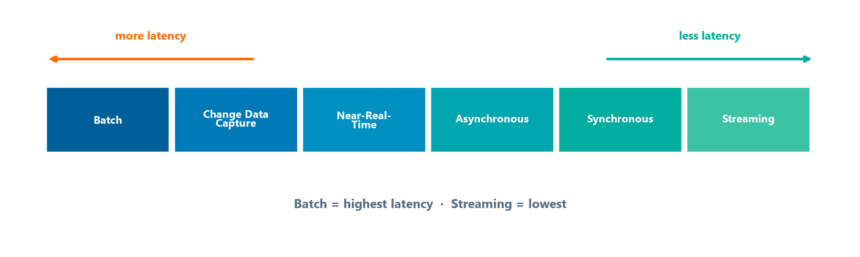
Latency — The 6 Types
Module 8 — Data Integration & Interoperability
Latency = the time delay between when data is produced and when it is available for consumption.
The six latency types from highest (batch) to lowest (streaming).
⭐ EXAM TIP: Batch = highest latency; Streaming = lowest.
CDMP Fundamentals | DAMA-DMBOK 2nd Edition
dama.org / cdmp.info
Notes:
: Latency — The 6 Types
Latency is the time delay between when data is produced and when it becomes available for consumption — and the DMBOK names six types, which you should be able to order along the spectrum on screen. With the most latency is batch, where data moves in bulk at scheduled intervals, anywhere from hours to days. Next is Change Data Capture, which moves only the changed data, so there's less overhead than a full batch. Then near-real-time, where data is available within seconds to minutes. Then asynchronous, where data moves without waiting for a response. Then synchronous, which is immediate — the calling system waits for a response before proceeding. And with the lowest latency, streaming — a continuous flow. The exam fact to anchor: batch has the highest latency, streaming has the lowest.
---

Slide 7
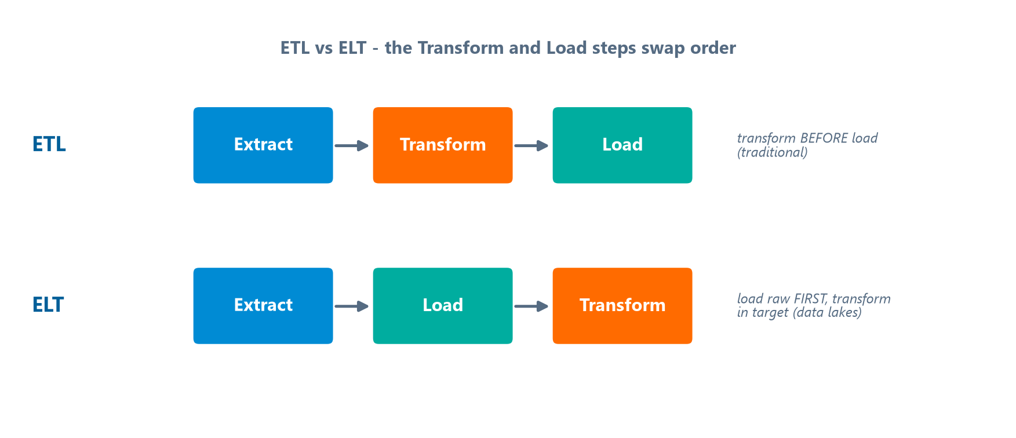
Transformation & ETL vs. ELT
Module 8 — Data Integration & Interoperability
Transformation types: Structural (format, e.g., XML→relational) · Semantic (reconcile meaning) · Calculated/Derived (apply business rules).
ETL (Extract, Transform, Load) — transform before loading; the traditional approach.
ELT (Extract, Load, Transform) — load raw data first, then transform in the target; common for Big Data / data lakes.
The Transform and Load steps swap order between the two approaches.
⭐ EXAM TIP: ELT loads first (used in data lakes); ETL transforms first. The target must have processing power for ELT.
CDMP Fundamentals | DAMA-DMBOK 2nd Edition
dama.org / cdmp.info
Notes:
: Transformation & ETL vs. ELT
When you integrate data, you usually transform it to reconcile differences. There are three transformation types. Structural transformation converts formats — say, XML to relational. Semantic transformation reconciles different meanings of the same concept across systems. And calculated or derived transformation applies business rules to compute new values. Now the big distinction, laid out side by side on screen: ETL versus ELT. ETL stands for Extract, Transform, Load — you transform the data before loading it into the target, which is the traditional approach. ELT stands for Extract, Load, Transform — you load the raw data first and then transform it inside the target system. ELT is common in Big Data and data lake environments, but it requires the target system to have substantial processing capacity. So remember: ETL transforms first, ELT loads first.
---

Slide 8
Change Data Capture (CDC)
Module 8 — Data Integration & Interoperability
CDC detects and moves only the data that has changed — far less overhead than full batch.
CDC methods:
  Log-based — read the database transaction log; near-real-time, minimal source impact (best)
  Trigger-based — DB triggers write changes to a shadow/audit table; adds overhead to every write
  Timestamp-based — query a last-modified column
⭐ EXAM TIP: Log-based CDC is least invasive; trigger-based burdens the source on every write.
CDMP Fundamentals | DAMA-DMBOK 2nd Edition
dama.org / cdmp.info
Notes:
: Change Data Capture (CDC)
Change Data Capture, CDC, is an efficient technique that detects and moves only the data that has changed, rather than re-processing everything — which dramatically reduces overhead. There are three main CDC methods. Log-based CDC reads the database's transaction log; it works in near real-time and has minimal impact on the source system, which makes it the best option in most cases. Trigger-based CDC uses database triggers to write changes to a shadow or audit table — but because a trigger fires on every write, it adds overhead to every transaction on the source. And timestamp-based CDC simply queries a last-modified column, which is simple but can miss deletes. The exam point: log-based CDC is the least invasive, while trigger-based CDC burdens the source on every write.
---

Slide 9
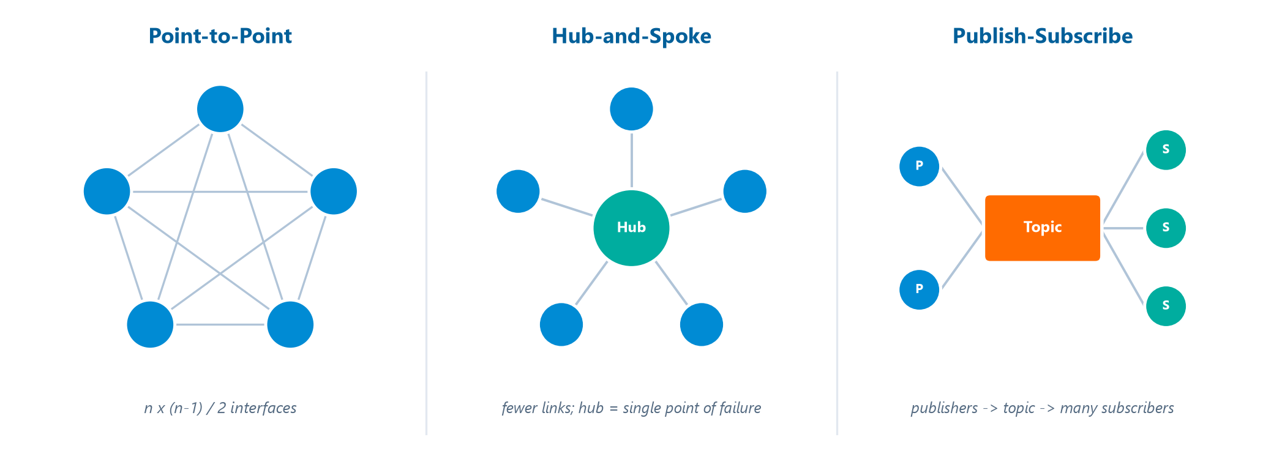
The 3 Interaction Models
Module 8 — Data Integration & Interoperability
Interface formula (point-to-point): for n systems → n × (n−1) / 2 interfaces.
Point-to-point mesh vs central hub vs publish-subscribe topic.
⭐ EXAM TIP: In pub-sub, multiple independent subscribers can each receive a copy of the event.
CDMP Fundamentals | DAMA-DMBOK 2nd Edition
dama.org / cdmp.info
Notes:
: The 3 Interaction Models
There are three interaction models for connecting systems, drawn side by side on screen. Point-to-point uses direct connections between systems — it's simple when you have just a few systems, but it becomes unmanageable as you scale. In fact, there's a formula you should memorize: for n systems, point-to-point requires n times n-minus-one, divided by two, unique interfaces. Hub-and-spoke uses a central hub that receives and routes all data, which dramatically reduces the number of connections — but the hub becomes a single point of failure. And publish-subscribe has publishers post data to topics, with subscribers receiving only the data they care about, providing loose coupling between systems. One key exam fact about pub-sub: multiple independent subscribers can each receive their own copy of an event — that's what distinguishes it from a simple queue.
---

Slide 10
Architecture Patterns
Module 8 — Data Integration & Interoperability
Enterprise Service Bus (ESB) — middleware coordinating messaging between services (routing, transformation, protocol translation); a component of SOA.
Service-Oriented Architecture (SOA) — loosely coupled, interoperable, reusable services exposed via standard interfaces.
Complex Event Processing (CEP) — processes many events in real time to find patterns and trigger responses (e.g., fraud detection).
Data-as-a-Service (DaaS) — data delivered via web service on demand.
⭐ EXAM TIP: ESB is the messaging backbone of SOA; CEP = real-time event pattern detection.
CDMP Fundamentals | DAMA-DMBOK 2nd Edition
dama.org / cdmp.info
Notes:
: Architecture Patterns
Let's cover four architecture patterns. The Enterprise Service Bus, or ESB, is a middleware layer that coordinates messaging between services — it handles routing, transformation, and protocol translation, and it's a core component of Service-Oriented Architecture. Service-Oriented Architecture, SOA, is an architecture where services are loosely coupled, interoperable, and reusable, exposed through standard interfaces like web services, which lets you share business functions across systems. Complex Event Processing, CEP, processes many events in real time to identify patterns and trigger responses — a classic use case is fraud detection. And Data-as-a-Service, DaaS, delivers data via a web service on demand, isolating data management from the consumers. The relationship to remember: the ESB is the messaging backbone of SOA, and CEP is your real-time event pattern engine.
---

Slide 11
Exchange Standards & the Canonical Model
Module 8 — Data Integration & Interoperability
Canonical model — a common, enterprise-wide data model used as the standard for exchange. Systems map to/from the canonical model instead of building N×(N−1) point-to-point mappings → drastically less complexity.
NIEM (National Information Exchange Model) — US Federal framework & methodology for data exchange — a standard, not a technology.
XML (structured/semi-structured) and JSON (lightweight; web services & NoSQL) are common exchange formats.
⭐ EXAM TIP: A canonical model collapses many point-to-point mappings into one shared model.
CDMP Fundamentals | DAMA-DMBOK 2nd Edition
dama.org / cdmp.info
Notes:
: Exchange Standards & the Canonical Model
When systems exchange data, standards reduce chaos. The canonical model is the big idea here — it's a common, enterprise-wide data model used as the standard for data exchange. Instead of building N-times-N-minus-one point-to-point mappings between every pair of systems, each system simply maps to and from the single canonical model, which collapses an enormous amount of complexity. NIEM, the National Information Exchange Model, is the US Federal framework and methodology for developing data exchanges between organizations — and an important exam nuance is that NIEM is a standard and methodology, not a technology. And for formats, XML is widely used for structured and semi-structured data, while JSON is lightweight and preferred for web services and NoSQL. The headline concept: a canonical model replaces many point-to-point mappings with one shared model.
---

Slide 12
Data Hubs & Interaction Points
Module 8 — Data Integration & Interoperability
Shared-storage hubs:
  Operational Data Store (ODS) — integration point for operational systems; current, near-real-time data
  Data Warehouse — integrated, historical, subject-oriented data for analysis
  Data Lake — raw data in native format; schema applied at read time
Interaction points: APIs · Web services (SOAP or REST over HTTP) · Message queues (async; persistent storage = guaranteed delivery).
⭐ EXAM TIP: ODS = current/operational; Data Warehouse = historical/analytical; Data Lake = raw/schema-on-read.
CDMP Fundamentals | DAMA-DMBOK 2nd Edition
dama.org / cdmp.info
Notes:
: Data Hubs & Interaction Points
Let's distinguish three shared-storage hubs, because the exam likes to contrast them. An Operational Data Store, or ODS, is an integration point for operational systems holding current, near-real-time data. A Data Warehouse holds integrated, historical, subject-oriented data for analysis. And a Data Lake stores raw data in its native format, applying schema only at read time — schema-on-read. On the interaction-point side, you have APIs, which define how systems interact; web services, which expose functionality over HTTP using SOAP or REST; and message queues, which hold messages between systems to enable asynchronous communication — and because they use persistent storage, they can guarantee delivery. So: ODS is current and operational, the warehouse is historical and analytical, and the lake is raw and schema-on-read.
---

Slide 13
The 5 Activities
Module 8 — Data Integration & Interoperability
Define the DII architecture — assess current state, choose interaction models, define exchange standards/canonical models
Design data integration solutions — capture source-to-target mappings, define transformation rules, error handling
Develop solutions — implement ETL/ELT, build & test data services, document lineage
Implement data flows — deploy, schedule, monitor, handle exceptions
Maintain & monitor — watch latency, throughput, error rates; manage schema changes
⭐ EXAM TIP: Source-to-target mapping and data lineage are core DII deliverables.
CDMP Fundamentals | DAMA-DMBOK 2nd Edition
dama.org / cdmp.info
Notes:
: The 5 Activities
DII has five activities. First, define the DII architecture — assess the current state, define the target, select the appropriate interaction models, and define your exchange standards and canonical models. Second, design the data integration solutions — capture the source-to-target mapping requirements, define the transformation rules, and establish error handling and logging. Third, develop the solutions — implement the ETL or ELT processes, build and test the data services, and document the data lineage. Fourth, implement the data flows — deploy and schedule the processes, monitor them, and handle exceptions. And fifth, maintain and monitor — track latency, throughput, and error rates, and manage changes to source and target schemas. Two deliverables to remember: source-to-target mappings and data lineage.
---

Slide 14
Governance & Metrics
Module 8 — Data Integration & Interoperability
Governance concerns: data lineage (source→target), transformation-rule management, error-handling standards, Metadata (mappings & technical lineage).
Metrics: latency (actual vs target), data quality (error rates), availability, volume (records/time), rejects (failed validations).
⭐ EXAM TIP: DII depends heavily on Metadata — especially source-to-target mappings and lineage.
CDMP Fundamentals | DAMA-DMBOK 2nd Edition
dama.org / cdmp.info
Notes:
: Governance & Metrics
Governance for DII centers on a few concerns: data lineage, tracking data from source to target; transformation-rule management, making sure business rules are documented and approved; error-handling standards, so failed integrations are handled consistently; and metadata management, especially the source-to-target mappings and technical lineage. For metrics, you watch latency — actual versus target delivery time; data quality, measured by error rates in the integration processes; availability of the integration services; volume, the records processed per unit time; and rejects, the number of records that fail validation. The takeaway: DII leans heavily on metadata, particularly mappings and lineage, to stay governable.
---

Slide 15
Key Numbers & Quick Facts (Cheat Sheet)
Module 8 — Data Integration & Interoperability
Fact | Value
Goals of DII | 3
Guiding principles | Re-use · Abstraction · Shared responsibility
Latency types | 6 (Batch → … → Streaming)
Highest / lowest latency | Batch / Streaming
Interaction models | 3 (P2P, Hub-Spoke, Pub-Sub)
Point-to-point formula | n(n−1)/2
ETL / ELT | Transform-then-load / Load-then-transform
Best CDC method | Log-based
ESB | Messaging backbone of SOA
Canonical model | One shared model replaces N×(N−1) mappings
NIEM | US Federal exchange standard/methodology
CDMP Fundamentals | DAMA-DMBOK 2nd Edition
dama.org / cdmp.info
Notes:
: Key Numbers & Quick Facts (Cheat Sheet)
Let's consolidate. DII has three goals and three guiding principles — re-use, abstraction, and shared responsibility. There are six latency types, with batch the highest and streaming the lowest. There are three interaction models, and point-to-point follows the formula n times n-minus-one over two. ETL transforms then loads; ELT loads then transforms, used in data lakes. The best CDC method is log-based. The ESB is the messaging backbone of SOA. A canonical model replaces N-times-N-minus-one mappings with one shared model. And NIEM is the US Federal exchange standard and methodology. Review these until they're instant.
---

Slide 16
Common Exam Traps
Module 8 — Data Integration & Interoperability
❌ Integration = interoperability → ✅ Integration consolidates; interoperability communicates
❌ Streaming has the most latency → ✅ Batch has the most; streaming the least
❌ ETL = ELT → ✅ ELT loads first (data lakes); ETL transforms first
❌ Trigger-based CDC is least invasive → ✅ log-based is least invasive
❌ Hub-and-spoke has no weakness → ✅ the hub is a single point of failure
⭐ EXAM TIP: Memorize n(n−1)/2 for point-to-point interfaces.
CDMP Fundamentals | DAMA-DMBOK 2nd Edition
dama.org / cdmp.info
Notes:
: Common Exam Traps
Here are the traps. First, don't equate integration with interoperability — integration consolidates data, while interoperability is about systems communicating. Second, streaming does not have the most latency; batch does, and streaming has the least. Third, ETL and ELT are not the same — ELT loads the raw data first and is used in data lakes, while ETL transforms first. Fourth, trigger-based CDC is not the least invasive; log-based CDC is, because it reads the transaction log instead of firing on every write. And fifth, hub-and-spoke does have a weakness — the hub is a single point of failure. And don't forget to memorize the point-to-point formula, n times n-minus-one over two.
---

Slide 17
Module Summary
Module 8 — Data Integration & Interoperability
DII moves and consolidates data within and between systems — integration consolidates, interoperability communicates.
6 latency types (Batch = most, Streaming = least); 3 interaction models (P2P with n(n−1)/2, hub-and-spoke, pub-sub).
ETL transforms first; ELT loads first (data lakes); log-based CDC is least invasive.
ESB powers SOA; CEP does real-time patterns; a canonical model slashes mapping complexity.
Governed through lineage, source-to-target mappings, and Metadata.
CDMP Fundamentals | DAMA-DMBOK 2nd Edition
dama.org / cdmp.info
Notes:
: Module Summary
Let's wrap up. Data Integration and Interoperability moves and consolidates data within and between systems — integration consolidates, interoperability communicates. There are six latency types, with batch the most and streaming the least, and three interaction models: point-to-point, governed by the n-times-n-minus-one-over-two formula; hub-and-spoke, where the hub is a single point of failure; and publish-subscribe, with loose coupling. ETL transforms first while ELT loads first for data lakes, and log-based CDC is the least invasive change-capture method. The ESB powers SOA, CEP handles real-time patterns, and a canonical model slashes mapping complexity. And the whole discipline is governed through lineage, source-to-target mappings, and metadata. That's Chapter 8.
---

Slide 18
Let's Test Your Knowledge
Module 8 — Data Integration & Interoperability
Heading: 5 practice questions — Data Integration & Interoperability
Subtitle: Watch the CDC methods and the pub-sub vs queue distinction.
CDMP Fundamentals | DAMA-DMBOK 2nd Edition
dama.org / cdmp.info
Notes:
: Let's Test Your Knowledge
Time for five practice questions on data integration and interoperability. These focus on the change-data-capture methods, ETL transformations, and the difference between publish-subscribe and a point-to-point queue. Read each carefully, pick your answer, and then reveal the solution. Here we go.
---

Slide 19
Practice Question 1
Module 8 — Data Integration & Interoperability
Q1
An organization wants to capture every INSERT, UPDATE, and DELETE on a source table in near real-time with minimal performance impact on the source. Which CDC method is best?
A) Log-based CDC reading the database transaction log
B) Diff-based CDC comparing full snapshots of the source table
C) Timestamp-based CDC querying a last-modified column
D) Trigger-based CDC using database triggers to write to a shadow table
Answer: Log-based CDC reads the transaction log, capturing all change types in near real-time with minimal load on the source. Snapshot diffs are heavy, timestamp queries miss deletes, and triggers add overhead to every write.
CDMP Fundamentals | DAMA-DMBOK 2nd Edition
dama.org / cdmp.info
Notes:
: Practice Questions (Q1–Q3)
Question one: you need to capture every insert, update, and delete in near real-time with minimal impact on the source. Which CDC method? The answer is A — log-based CDC, which reads the transaction log to capture all change types with minimal source load. Snapshot diffs are heavy, timestamp queries miss deletes, and triggers add overhead.
Question two: what's the primary drawback of trigger-based CDC versus log-based? The answer is B — it adds overhead to every write transaction on the source, because the trigger fires on each modification. Log-based CDC avoids that by reading the already-written log.
Question three: an ETL process corrects misspelled cities, trims spaces, and standardizes phone formats. Which transform type? The answer is C — cleansing and standardization. Partitioning splits data, aggregation summarizes it, and enrichment adds external data — none of which is happening here.
Two more on the next slide.
---

Slide 20
Practice Question 2
Module 8 — Data Integration & Interoperability
Q2
A trigger-based CDC implementation writes changed records to an audit table whenever a row is modified. What is its primary drawback versus log-based CDC?
A) It cannot capture DELETE operations
B) It adds overhead to every write transaction on the source system
C) It requires schema changes to the target database
D) It only supports batch-mode processing
Answer: Because a trigger fires on every write, trigger-based CDC adds processing overhead to each source transaction, degrading source performance. Log-based CDC avoids this by reading the already-written transaction log.
CDMP Fundamentals | DAMA-DMBOK 2nd Edition
dama.org / cdmp.info
Notes:
: Practice Questions (Q1–Q3)
Question one: you need to capture every insert, update, and delete in near real-time with minimal impact on the source. Which CDC method? The answer is A — log-based CDC, which reads the transaction log to capture all change types with minimal source load. Snapshot diffs are heavy, timestamp queries miss deletes, and triggers add overhead.
Question two: what's the primary drawback of trigger-based CDC versus log-based? The answer is B — it adds overhead to every write transaction on the source, because the trigger fires on each modification. Log-based CDC avoids that by reading the already-written log.
Question three: an ETL process corrects misspelled cities, trims spaces, and standardizes phone formats. Which transform type? The answer is C — cleansing and standardization. Partitioning splits data, aggregation summarizes it, and enrichment adds external data — none of which is happening here.
Two more on the next slide.
---

Slide 21
Practice Question 3
Module 8 — Data Integration & Interoperability
Q3
During an ETL transform phase, a process corrects misspelled city names, trims leading/trailing spaces, and converts phone numbers to a standard format. Which transform type best describes these operations?
A) Data partitioning
B) Data aggregation
C) Data cleansing and standardization
D) Data enrichment
Answer: Correcting values and enforcing standard formats is cleansing and standardization. Partitioning splits data, aggregation summarizes it, and enrichment adds new data from external sources — none of which is happening here.
CDMP Fundamentals | DAMA-DMBOK 2nd Edition
dama.org / cdmp.info
Notes:
: Practice Questions (Q1–Q3)
Question one: you need to capture every insert, update, and delete in near real-time with minimal impact on the source. Which CDC method? The answer is A — log-based CDC, which reads the transaction log to capture all change types with minimal source load. Snapshot diffs are heavy, timestamp queries miss deletes, and triggers add overhead.
Question two: what's the primary drawback of trigger-based CDC versus log-based? The answer is B — it adds overhead to every write transaction on the source, because the trigger fires on each modification. Log-based CDC avoids that by reading the already-written log.
Question three: an ETL process corrects misspelled cities, trims spaces, and standardizes phone formats. Which transform type? The answer is C — cleansing and standardization. Partitioning splits data, aggregation summarizes it, and enrichment adds external data — none of which is happening here.
Two more on the next slide.
---

Slide 22
Practice Question 4
Module 8 — Data Integration & Interoperability
Q4
In a publish/subscribe pattern, a producer publishes an event to a topic. How does this differ from a point-to-point message queue?
A) In pub/sub, messages are delivered synchronously and block the producer
B) In pub/sub, the producer addresses the message to a specific single consumer
C) In pub/sub, multiple independent subscribers can each receive a copy of the event
D) In pub/sub, only one message can exist in the topic at a time
Answer: Publish/subscribe broadcasts each event to a topic, and every subscriber gets its own copy — enabling loose coupling and many consumers. A point-to-point queue, by contrast, delivers each message to a single consumer.
CDMP Fundamentals | DAMA-DMBOK 2nd Edition
dama.org / cdmp.info
Notes:
: Practice Questions (Q4–Q5)
Question four: in publish/subscribe, how does publishing an event to a topic differ from a point-to-point message queue? The answer is C — in pub/sub, multiple independent subscribers can each receive a copy of the event. A point-to-point queue delivers each message to just a single consumer. That fan-out, with loose coupling, is the defining feature of pub/sub.
Question five: a downstream service is temporarily down, and the platform holds messages until it recovers. Which property makes that possible? The answer is B — guaranteed delivery with persistent message storage. Because the queue stores messages durably, it retains them until the consumer is available again. Synchronous semantics, by contrast, would fail or block when the consumer is down.
That completes Module 8. Next up is Module 9, Document and Content Management, where we move from structured data into the world of unstructured content and records. I'll see you there.
---
*End of Module 8 scripts.*

Slide 23
Practice Question 5
Module 8 — Data Integration & Interoperability
Q5
In a message-queue integration, a downstream service is temporarily down, so the platform holds messages until the consumer recovers and processes them. Which property makes this possible?
A) Synchronous request-reply semantics
B) Guaranteed delivery with persistent message storage
C) Schema enforcement at the producer side
D) Broadcast delivery to all registered consumers
Answer: Guaranteed delivery via persistent message storage lets the queue retain messages durably until the consumer is available — the foundation of reliable asynchronous integration. Synchronous semantics would instead fail or block when the consumer is down. End of Module 8 — Data Integration & Interoperability.
CDMP Fundamentals | DAMA-DMBOK 2nd Edition
dama.org / cdmp.info
Notes:
: Practice Questions (Q4–Q5)
Question four: in publish/subscribe, how does publishing an event to a topic differ from a point-to-point message queue? The answer is C — in pub/sub, multiple independent subscribers can each receive a copy of the event. A point-to-point queue delivers each message to just a single consumer. That fan-out, with loose coupling, is the defining feature of pub/sub.
Question five: a downstream service is temporarily down, and the platform holds messages until it recovers. Which property makes that possible? The answer is B — guaranteed delivery with persistent message storage. Because the queue stores messages durably, it retains them until the consumer is available again. Synchronous semantics, by contrast, would fail or block when the consumer is down.
That completes Module 8. Next up is Module 9, Document and Content Management, where we move from structured data into the world of unstructured content and records. I'll see you there.
---
*End of Module 8 scripts.*

