Slide 1
CDMP FUNDAMENTALS
Module 9: Document & Content Management
DAMA-DMBOK 2nd Edition, Chapter 9
Exam weight: ~6% (≈6 questions) — GARP, EDRM, controlled vocabularies, records
Module 9 — Document & Content Management
100
90
Open
≥60%
MCQ
minutes
book
to pass
CDMP Fundamentals | DAMA-DMBOK 2nd Edition
dama.org / cdmp.info
Notes:
: Module Title Slide
Welcome to Module 9: Document and Content Management. This is Chapter 9 of the DMBOK, worth about six percent of the exam. Here we leave the structured, tidy world of relational databases and enter the messier world of unstructured content — documents, emails, web pages, images — and the records management and e-discovery disciplines that govern them. There are several named standards and models to learn, so let's work through them carefully.
---

Slide 2
Module Overview & Learning Objectives
Module 9 — Document & Content Management
By the end, you'll be able to:
  Define Document & Content Management and its 3 goals
  State the 8 GARP principles (ARMA) and the maturity levels
  Distinguish documents vs records and the ISO 15489 record qualities
  Compare controlled vocabularies and taxonomy structures
  Walk through the EDRM 8-phase e-discovery model
  Explain open- vs closed-world assumptions and key tools
CDMP Fundamentals | DAMA-DMBOK 2nd Edition
dama.org / cdmp.info
Notes:
: Module Overview & Learning Objectives
Here's our plan. You'll define Document and Content Management and its three goals. You'll learn the eight GARP principles from ARMA and the maturity levels. You'll distinguish documents from records and learn the ISO 15489 record qualities. You'll compare the controlled vocabularies and taxonomy structures. You'll walk through the eight-phase EDRM e-discovery model. And you'll understand the open-world versus closed-world assumption, plus the key tools. Let's begin.
---

Slide 3
Definition & Goals
Module 9 — Document & Content Management
DMBOK2 Definition: planning, implementation, and control activities for the lifecycle management of data and information found in any form or medium.
Focus: data stored outside relational databases — unstructured/semi-structured content.
Statistics: ~80% of stored data is unstructured; >90% of documents created today are electronic.
3 goals: (1) comply with legal obligations for records; (2) effective storage, retrieval, use; (3) integrate structured & unstructured content.
⭐ EXAM TIP: Remember the 80% unstructured-data statistic.
CDMP Fundamentals | DAMA-DMBOK 2nd Edition
dama.org / cdmp.info
Notes:
: Definition & Goals
The DMBOK defines Document and Content Management as the planning, implementation, and control activities for the lifecycle management of data and information found in any form or medium. The crucial focus is data stored outside relational databases — the unstructured and semi-structured information. And here's a statistic the exam loves: an estimated eighty percent of all stored data is maintained outside relational databases, meaning it's unstructured. On top of that, more than ninety percent of documents created today are electronic. The three goals are: comply with legal obligations and customer expectations around records management; ensure effective, efficient storage, retrieval, and use of documents; and ensure integration between structured and unstructured content. Remember that eighty percent figure — it explains why this discipline matters so much.
---

Slide 4
Business Drivers & E-Discovery Law
Module 9 — Document & Content Management
Drivers: regulatory compliance · e-discovery (litigation response) · business continuity (vital records) · efficiency (workflow, faster retrieval).
E-discovery law: the US Federal Rules of Civil Procedure (FRCP) has governed discovery since 1938; the 2006 amendments added Electronically Stored Information (ESI).
⭐ EXAM TIP: FRCP since 1938; ESI amendments in 2006.
CDMP Fundamentals | DAMA-DMBOK 2nd Edition
dama.org / cdmp.info
Notes:
: Business Drivers & E-Discovery Law
Several business drivers push organizations toward formal content management. Regulatory compliance — many activities legally must be recorded. E-discovery — the ability to find electronic records to respond to litigation. Business continuity — managing vital records for disaster recovery. And efficiency — managing workflow, enabling collaboration, finding documents faster, and preventing document loss. On the legal front, there's an exam-worthy timeline: in the United States, the Federal Rules of Civil Procedure have governed discovery since 1938, and the 2006 amendments specifically accommodated Electronically Stored Information, or ESI. So if you see a date question here, it's FRCP since 1938, ESI amendments in 2006.
---

Slide 5
ARMA GARP — The 8 Principles
Module 9 — Document & Content Management
Principle | Principle
Accountability | Availability
Integrity | Retention
Protection | Disposition
Compliance | Transparency
⭐ EXAM TIP: 8 GARP principles. ARMA is the records & information management professional association.
CDMP Fundamentals | DAMA-DMBOK 2nd Edition
dama.org / cdmp.info
Notes:
: ARMA GARP — The 8 Principles
GARP stands for the Generally Accepted Recordkeeping Principles, published by ARMA International in 2009. ARMA is the not-for-profit professional association for records and information management. There are eight GARP principles: Accountability, Integrity, Protection, Compliance, Availability, Retention, Disposition, and Transparency. You don't necessarily need to recite all eight verbatim, but you should recognize them as a set and know there are eight. A few of them — retention, disposition, and protection — map directly to the core records-management activities we'll discuss. So: eight GARP principles, from ARMA, 2009.
---

Slide 6
ARMA Maturity Model (5 Levels)
Module 9 — Document & Content Management
Sub-Standard — concerns not (or minimally) addressed
In Development — developing recognition of impact
Essential — minimum legal/regulatory requirements met
Proactive — established program with continuous improvement
Transformational — integrated into corporate infrastructure & processes
⭐ EXAM TIP: 5 levels, Sub-Standard → Transformational.
CDMP Fundamentals | DAMA-DMBOK 2nd Edition
dama.org / cdmp.info
Notes:
: ARMA Maturity Model (5 Levels)
ARMA also provides a maturity model with five levels, and like most maturity models it runs from immature to fully integrated. Level one is Sub-Standard, where recordkeeping concerns aren't addressed, or only minimally. Level two is In Development, where the organization is starting to recognize the impact. Level three is Essential, where the minimum legal and regulatory requirements are met. Level four is Proactive, where a program is established with a focus on continuous improvement. And level five is Transformational, where recordkeeping is fully integrated into the corporate infrastructure and business processes. Five levels, from Sub-Standard up to Transformational.
---

Slide 7
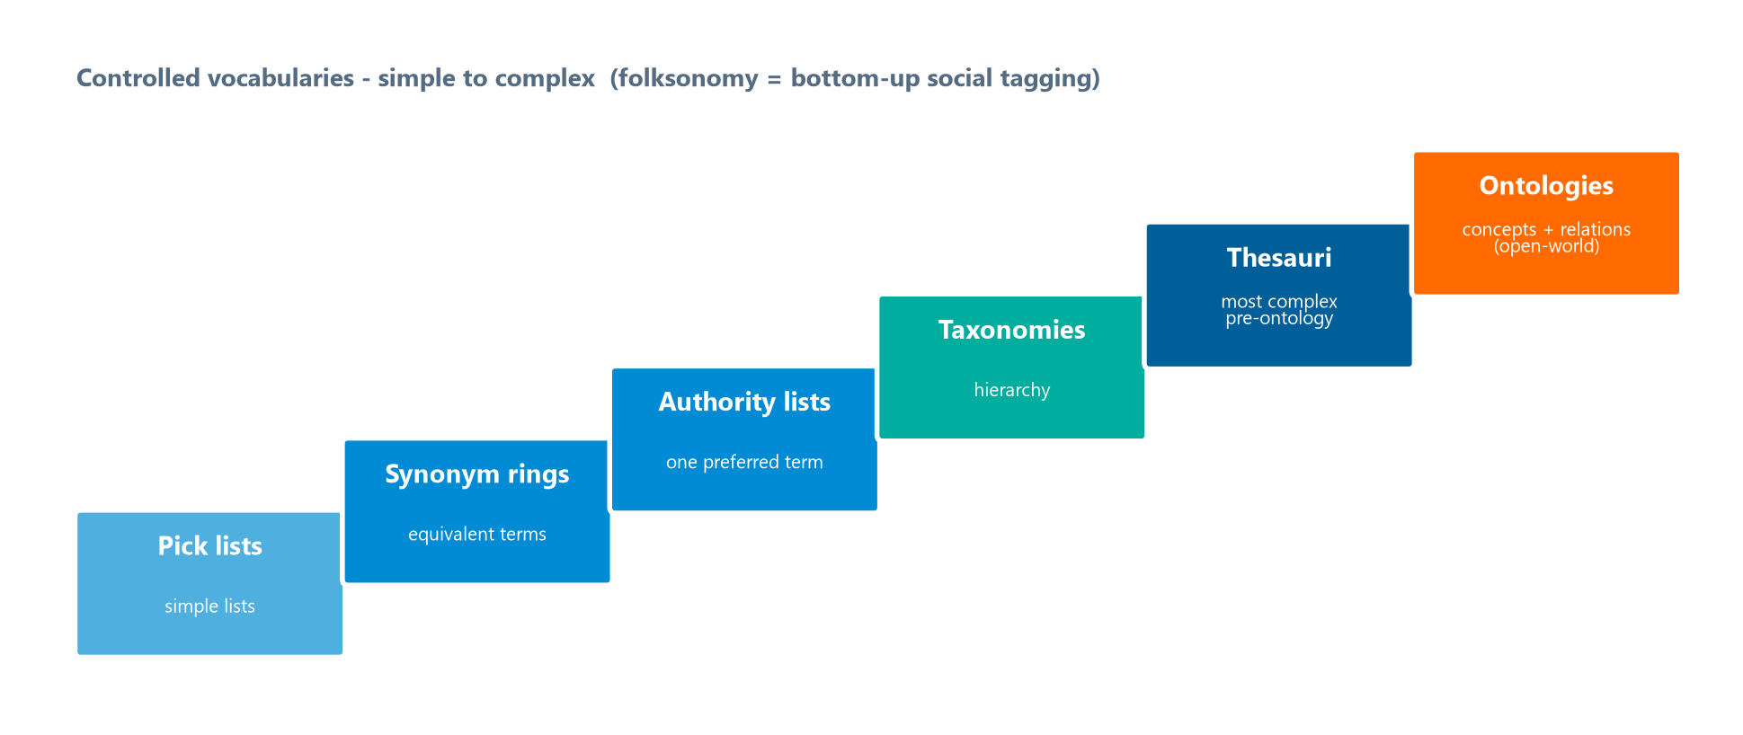
Content, Modeling & Delivery
Module 9 — Document & Content Management
Content vs document: a document is to content what a bucket is to water — the document is the container; content is the data inside.
Content Metadata is essential — without it you cannot inventory/organize unstructured content.
3 content delivery types:
  Push — on a schedule (syndication, RSS)
  Pull — users fetch it (online retail)
⭐ EXAM TIP: Push = RSS/syndication; Pull = user-initiated; Interactive = real-time.
CDMP Fundamentals | DAMA-DMBOK 2nd Edition
dama.org / cdmp.info
Notes:
: Content, Modeling & Delivery
Let's clarify content versus document with a memorable analogy from the DMBOK: a document is to content what a bucket is to water. The document is just the container; the content is the actual data and information inside it. Content metadata is essential, because without it you simply cannot inventory and organize unstructured content. And there are three content delivery system types. Push delivery sends content on a predetermined schedule — think syndication and RSS feeds. Pull delivery has users fetch content themselves — like browsing an online retail store. And interactive delivery is a real-time exchange of data, using technologies like enterprise application integration and change data capture. Push is RSS, pull is user-initiated, interactive is real-time.
---

Slide 8
Controlled Vocabularies
Module 9 — Document & Content Management
Type | Key fact
Term / Pick lists | Lists; no relationships
Synonym rings | Equivalent terms (search one, find all)
Authority lists | One preferred term; others are variants
Taxonomies | Hierarchical naming structure for navigation
Thesauri | Most complex: synonyms + taxonomy + associations
Ontologies | Concepts & relationships; open-world
⭐ EXAM TIP: Thesaurus is the most complex pre-ontology vocabulary.
CDMP Fundamentals | DAMA-DMBOK 2nd Edition
dama.org / cdmp.info
Notes:
: Controlled Vocabularies
A controlled vocabulary is a defined list of explicitly allowed terms used to index, categorize, tag, and retrieve content — and the governing standard is ANSI/NISO Z39.19, from 2005. The DMBOK lists the types from simplest to most complex, climbing the staircase on screen. Term lists, or pick lists, are just lists with no relationships. Synonym rings group terms with equivalent meaning, so searching one finds all related content. Authority lists designate one preferred term, with others treated as variants, using cross-references to guide you from a non-preferred term to the preferred one. Taxonomies add a hierarchical naming structure that enables navigation. Thesauri are the most complex of the traditional vocabularies, combining synonym lists and taxonomies with hierarchical, associative, and equivalent relationships. And ontologies represent concepts and their relationships and use the open-world assumption. One more term: a folksonomy is bottom-up classification from social tagging by users — useful, but not authoritative.
---

Slide 9
Taxonomy Structures & Term Relationships
Module 9 — Document & Content Management
5 taxonomy structures: Flat (no relationships) · Hierarchical (tree) · Polyhierarchy (multiple parents) · Facet (star; attributes of a center object) · Network (hierarchical + facet).
3 term relationships (ANSI/NISO Z39.19):
  Equivalent — same meaning, one preferred (most common in IT for data mapping)
  Hierarchical — broader↔narrower (parent/child)
  Related — associative, not hierarchical
⭐ EXAM TIP: Facet = star structure; Polyhierarchy = a child with multiple parents.
CDMP Fundamentals | DAMA-DMBOK 2nd Edition
dama.org / cdmp.info
Notes:
: Taxonomy Structures & Term Relationships
Taxonomies come in five structural types. Flat has no relationships — all categories are equal, like a list of countries. Hierarchical is a tree with at least two levels, where moving up generalizes and moving down refines. Polyhierarchy allows a child node to have multiple parents, which introduces a risk of invalid traversals. Facet is a star structure where each node is an attribute of a central object. And network combines hierarchical and facet structures, letting any two nodes link — used in things like recommender engines and thesauri. There are also three term-relationship types defined by the ANSI/NISO standard: equivalent, where two terms mean the same thing and one is preferred — the most common in IT systems for data mapping; hierarchical, the broader-to-narrower parent-child link; and related, which is associative but not hierarchical. Watch for facet as the star structure and polyhierarchy as the multiple-parent case.
---

Slide 10
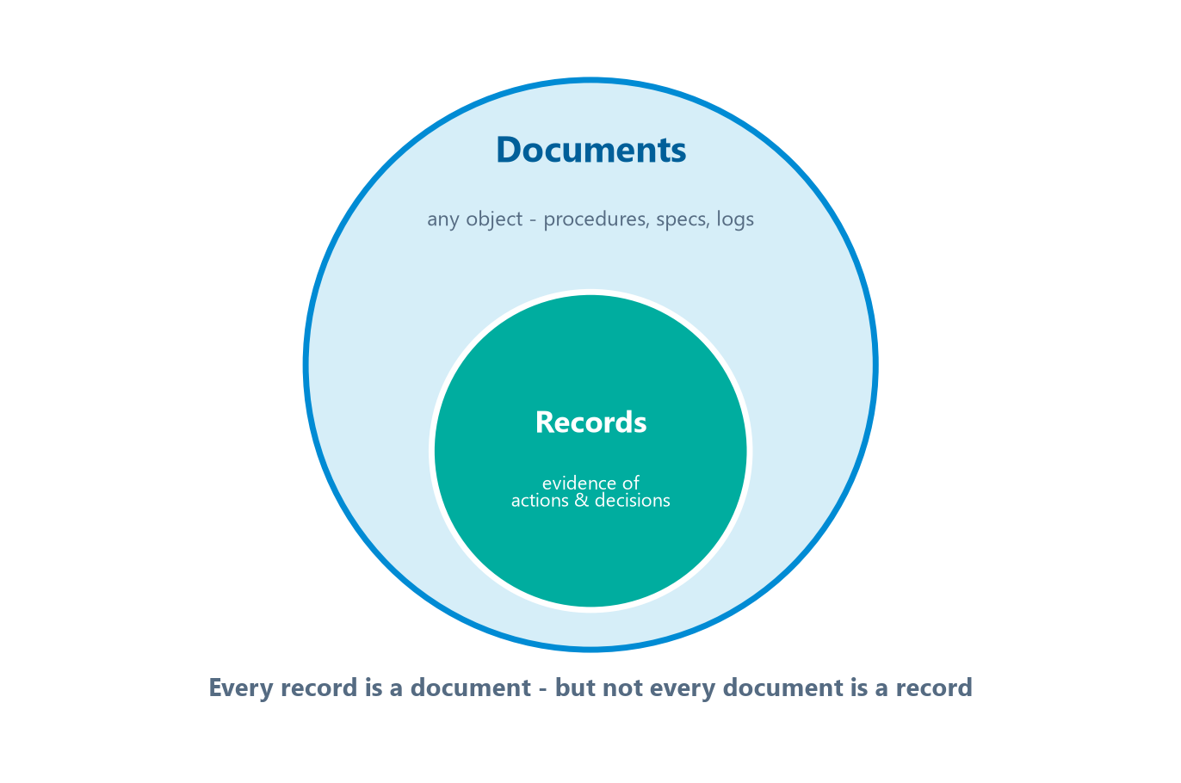
Documents vs. Records (ISO 15489)
Module 9 — Document & Content Management
A document is any electronic/paper object (procedures, specs, logs).
A record is only a subset of documents — designated to provide evidence of actions and decisions.
ISO 15489 defines records management: the systematic control of the creation, receipt, maintenance, use, and disposition of records.
5 record types: Physical · Electronic · Website · Media/Hardware · Database.
A vital record is required to resume operations after a disaster.
⭐ EXAM TIP: Every record is a document, but not every document is a record.
CDMP Fundamentals | DAMA-DMBOK 2nd Edition
dama.org / cdmp.info
Notes:
: Documents vs. Records (ISO 15489)
This is a distinction the exam tests directly. A document is any electronic or paper object — procedures, protocols, specifications, logs. A record, however, is only a subset of documents — the smaller circle nested inside the larger one on screen — specifically those designated to provide evidence of actions taken and decisions made. So every record is a document, but not every document is a record. The international standard ISO 15489 defines records management as the field responsible for the efficient and systematic control of the creation, receipt, maintenance, use, and disposition of records. There are five record types: physical, electronic, website, media or hardware, and database. And a special category, the vital record, is a record required to resume the organization's operations in the event of a disaster. Remember: a record is the evidentiary subset of documents.
---

Slide 11
Record Qualities & Characteristics
Module 9 — Document & Content Management
ISO 15489 record qualities:
  Authenticity — it is what it claims to be, by the stated agent at the stated time
  Reliability — content accurately and completely represents the activity
  Integrity — complete and unaltered
  Usability — can be located, retrieved, presented, and interpreted
5 characteristics of well-prepared records: Content (accurate) · Context (metadata) · Timeliness · Permanency (cannot be changed once a record) · Structure.
⭐ EXAM TIP: Reliability = accurate/complete content; Usability = findable & interpretable.
CDMP Fundamentals | DAMA-DMBOK 2nd Edition
dama.org / cdmp.info
Notes:
: Record Qualities & Characteristics
ISO 15489 also defines four qualities that a trustworthy record must have, and the exam likes to test these. Authenticity means the record is what it claims to be, created by the stated agent at the stated time. Reliability means its content accurately and completely represents the activity it documents. Integrity means it's complete and unaltered. And usability means it can be located, retrieved, presented, and interpreted. Separately, the DMBOK lists five characteristics of well-prepared records: content that's accurate, context captured as descriptive metadata, timeliness, permanency — meaning once something is designated a record it cannot be changed — and structure. The two qualities most often confused are reliability, which is about accurate and complete content, and usability, which is about being findable and interpretable.
---

Slide 12
The 3 Control Levels (ANSI Standard 859)
Module 9 — Document & Content Management
Level | Description | When
Formal Control | Formal change initiation, evaluation, full status accounting | High criticality
Revision Control | Less formal; notify stakeholders; increment versions | Moderate criticality
Custody Control | Least formal; safe storage & retrieval only | Low criticality
⭐ EXAM TIP: Formal > Revision > Custody. Custody control is storage/retrieval only.
CDMP Fundamentals | DAMA-DMBOK 2nd Edition
dama.org / cdmp.info
Notes:
: The 3 Control Levels (ANSI Standard 859)
ANSI Standard 859 defines three levels of control for managing changes to documents, matched to how critical the document is. Formal control is the most stringent — it requires formal change initiation, thorough evaluation, and full status accounting, used for high-criticality items with significant project or enterprise impact. Revision control is moderate — less formal, but it notifies stakeholders and increments version numbers, used when change history is needed. And custody control is the least formal — it provides only safe storage and retrieval, used for low-criticality documents with minimal impact. So the order, from most to least stringent, is formal, revision, custody — and custody is storage and retrieval only.
---

Slide 13
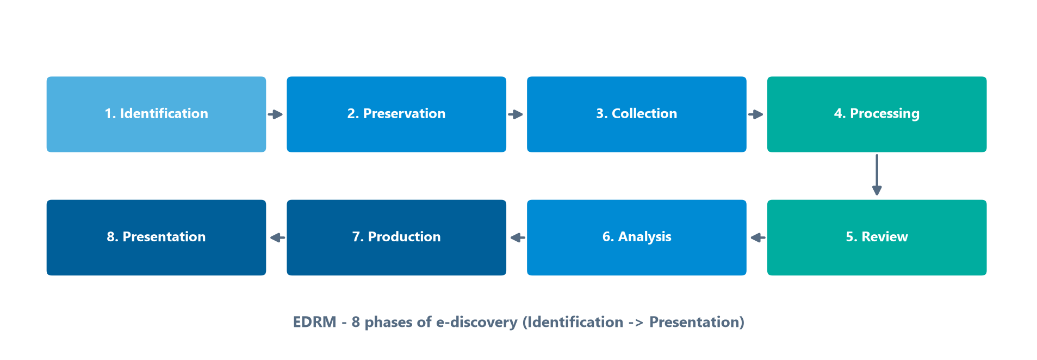
E-Discovery & the Data Map
Module 9 — Document & Content Management
E-discovery = finding electronic records that may serve as evidence in legal action.
ESI (Electronically Stored Information) = all electronic data subject to discovery.
Data Map = an inventory of all ESI sources, applications, owners, custodians, locations, and data types.
Legal Hold Notification (LHN) = identifying, locking, and notifying parties of data under legal hold (so it can't be destroyed).
⭐ EXAM TIP: A legal hold suspends destruction — it overrides the normal retention schedule.
CDMP Fundamentals | DAMA-DMBOK 2nd Edition
dama.org / cdmp.info
Notes:
: E-Discovery & the Data Map
E-discovery is the process of finding electronic records that might serve as evidence in a legal action. The data involved is called Electronically Stored Information, or ESI — all the electronic data subject to discovery. To support e-discovery, organizations build a data map, which is an inventory of all their ESI sources, applications, and IT environments, including the owners, custodians, geographic locations, and data types. And a critical mechanism is the Legal Hold Notification, the LHN — the process of identifying data relevant to a legal proceeding, locking it so it can't be edited or deleted, and notifying all the parties. The key exam point: a legal hold suspends destruction, overriding the normal retention schedule. You cannot destroy data that's under legal hold, even if its retention period has expired.
---

Slide 14
The EDRM — 8 Phases of E-Discovery
Module 9 — Document & Content Management
Identification — early case & data assessment
Preservation — place data in legal hold
Collection — transfer data to counsel defensibly
Processing — de-duplicate, search, analyze
Review — select responsive docs; withhold privileged
Analysis — understand facts & evidence
Production — hand over to opposing counsel
Presentation — display at depositions/trials
The eight e-discovery phases, from Identification to Presentation.
⭐ EXAM TIP: EDRM = Electronic Discovery Reference Model, 8 phases, starting with Identification, ending with Presentation.
CDMP Fundamentals | DAMA-DMBOK 2nd Edition
dama.org / cdmp.info
Notes:
: The EDRM — 8 Phases of E-Discovery
The Electronic Discovery Reference Model, the EDRM, lays out the e-discovery process in the eight phases on screen, and you should know the sequence. Phase one is Identification — early case and data assessment, with interviews of records management, custodians, and IT. Phase two is Preservation — placing the data in legal hold so it can't be destroyed. Phase three is Collection — transferring the identified data to legal counsel in a defensible manner. Phase four is Processing — de-duplicating, searching, and analyzing to decide what moves forward. Phase five is Review — selecting responsive documents and withholding privileged ones. Phase six is Analysis — understanding the facts and potential evidence. Phase seven is Production — turning the data over to opposing counsel. And phase eight is Presentation — displaying the ESI at depositions, hearings, and trials. Eight phases, from Identification to Presentation.
---

Slide 15
Ontology vs. Taxonomy vs. Data Model
Module 9 — Document & Content Management
Concept | Assumption
Taxonomy | Classifications for a concept area — closed-world
Data Model | Entity, attribute, valid values — closed-world
Ontology | Entity/attribute/content mixed — OPEN-world (undeclared facts may still be true)
⭐ EXAM TIP: Ontology uses the open-world assumption; taxonomies & data models are closed-world.
CDMP Fundamentals | DAMA-DMBOK 2nd Edition
dama.org / cdmp.info
Notes:
: Ontology vs. Taxonomy vs. Data Model
Here's a conceptual distinction the exam genuinely tests: the open-world versus the closed-world assumption. A taxonomy provides content classifications for a concept area, and it uses the closed-world assumption — meaning if something isn't declared, it's treated as not true. A data model, which calls out entities, attributes, and valid values, also uses the closed-world assumption. But an ontology, which mixes entity, attribute, and content, uses the open-world assumption — meaning something not explicitly declared can still be true. That's the key difference. Ontologies are expressed in languages like RDFS and OWL, the Web Ontology Language. And the W3C Semantic Web standards include RDF, which stores data as subject-predicate-object triples queried with SPARQL; SKOS; and Schema.org. So remember: ontology is open-world; taxonomies and data models are closed-world.
---

Slide 16
Activities & Content Policies
Module 9 — Document & Content Management
4 activities: (1) Plan for lifecycle management (define records, taxonomies); (2) Create content-handling policies; (3) Manage the lifecycle (capture, version via ANSI 859, retain/dispose); (4) Publish & deliver content.
Typical policy topics: scope/compliance, vital records, retention schedule, legal holds, storage, media management, email, destruction methods.
⭐ EXAM TIP: Failing to dispose of data on schedule keeps old records discoverable in litigation — a real risk.
CDMP Fundamentals | DAMA-DMBOK 2nd Edition
dama.org / cdmp.info
Notes:
: Activities & Content Policies
Document and Content Management has four activities. First, plan for lifecycle management — define what counts as a record, and develop your classification systems and taxonomies. Second, create content-handling policies. Third, manage the lifecycle — capture records with minimum metadata, manage versioning using the ANSI 859 control levels, and retain and dispose according to the schedule. And fourth, publish and deliver content. Typical policy topics include scope and compliance, vital records, the retention schedule, legal holds, storage requirements, email management, and destruction methods. One important risk to remember: if you fail to dispose of data on schedule, those older, un-purged records remain discoverable in litigation — so over-retention is itself a liability.
---

Slide 17
Tools
Module 9 — Document & Content Management
Tool | Purpose
ECM (Enterprise Content Management) | Platform + applications for content
Document Management System | Store, version, index; capture via OCR
Records Management System | Automate retention/disposition; e-discovery
CMS (Content Management System) | Web content; versioning & workflow
⭐ EXAM TIP: OCR = print; ICR = handwriting.
CDMP Fundamentals | DAMA-DMBOK 2nd Edition
dama.org / cdmp.info
Notes:
: Tools
Several tool categories support this discipline. Enterprise Content Management, ECM, combines platform components and applications, in-house or cloud-based. A Document Management System stores and tracks electronic documents, capturing them via scanners or OCR, and offers versioning, security, indexing, and retrieval. A Records Management System automates retention and disposition and supports e-discovery and archiving. And a Content Management System, CMS, collects, organizes, and indexes content, especially web content, with versioning and workflow. Two recognition technologies to distinguish: OCR, Optical Character Recognition, converts scanned printed text, while ICR, Intelligent Character Recognition, is more advanced and can handle handwriting. And TAR, Technology-Assisted Review, uses predictive coding to sort documents by relevancy during e-discovery. Remember OCR is for print and ICR is for handwriting.
---

Slide 18
Governance — IGRM, Precision & Recall
Module 9 — Document & Content Management
Information Governance Reference Model (IGRM) — shows how Information Governance relates to organizational functions; complements ARMA's GARP.
ECM retrieval KPIs:
  Precision — of the documents retrieved, the proportion that are relevant
  Recall — of all relevant documents, the proportion actually retrieved
⭐ EXAM TIP: Precision = retrieved-and-relevant; Recall = relevant-and-retrieved. Don't swap them.
CDMP Fundamentals | DAMA-DMBOK 2nd Edition
dama.org / cdmp.info
Notes:
: Governance — IGRM, Precision & Recall
For governance, the Information Governance Reference Model, the IGRM, shows how information governance relates to the various organizational functions, with stakeholders on the outer ring and a lifecycle diagram at the center — and it complements ARMA's GARP. For metrics, the two ECM information-retrieval KPIs are precision and recall, and they're easy to confuse, so let's be precise about them. Precision is the proportion of the documents you retrieved that are actually relevant — it's about not returning junk. Recall is the proportion of all the relevant documents that you actually retrieved — it's about not missing anything. So precision is retrieved-and-relevant, recall is relevant-and-retrieved. Don't swap those two definitions on the exam.
---

Slide 19
Key Numbers & Quick Facts (Cheat Sheet)
Module 9 — Document & Content Management
Fact | Value
Unstructured data | ~80%
GARP principles (ARMA) | 8 (2009)
ARMA maturity levels | 5
Records management standard | ISO 15489
Controlled-vocab standard | ANSI/NISO Z39.19-2005
Control levels (ANSI 859) | 3 (Formal, Revision, Custody)
EDRM phases | 8
FRCP / ESI | 1938 / 2006
Taxonomy structures | 5
Open-world | Ontology
Precision / Recall | retrieved-relevant / relevant-retrieved
CDMP Fundamentals | DAMA-DMBOK 2nd Edition
dama.org / cdmp.info
Notes:
: Key Numbers & Quick Facts (Cheat Sheet)
Let's consolidate. Roughly eighty percent of data is unstructured. GARP has eight principles, from ARMA in 2009, and ARMA's maturity model has five levels. The records management standard is ISO 15489. The controlled-vocabulary standard is ANSI/NISO Z39.19, 2005. ANSI Standard 859 gives three control levels — formal, revision, custody. The EDRM has eight phases. The FRCP dates to 1938, with ESI amendments in 2006. There are five taxonomy structures. The open-world assumption belongs to ontologies. And precision is retrieved-relevant while recall is relevant-retrieved. Review these until they're automatic.
---

Slide 20
Common Exam Traps
Module 9 — Document & Content Management
❌ Every document is a record → ✅ a record is only a subset of documents (evidence)
❌ Taxonomies use the open-world assumption → ✅ ontologies do; taxonomies are closed-world
❌ OCR handles handwriting → ✅ ICR handles handwriting; OCR handles print
❌ A legal hold can be overridden by the retention schedule → ✅ a legal hold suspends destruction
❌ Precision = recall → ✅ Precision is retrieved-relevant; Recall is relevant-retrieved
⭐ EXAM TIP: A thesaurus is the most complex controlled vocabulary before an ontology.
CDMP Fundamentals | DAMA-DMBOK 2nd Edition
dama.org / cdmp.info
Notes:
: Common Exam Traps
Here are the traps. First, not every document is a record — a record is the evidentiary subset of documents. Second, it's ontologies that use the open-world assumption, not taxonomies; taxonomies and data models are closed-world. Third, OCR handles printed text, while ICR is the one that handles handwriting. Fourth, a legal hold suspends destruction and overrides the retention schedule — you can't destroy data on hold. And fifth, don't swap precision and recall: precision is the relevance of what you retrieved, recall is how much of the relevant material you captured. One bonus: a thesaurus is the most complex controlled vocabulary before you reach an ontology.
---

Slide 21
Module Summary
Module 9 — Document & Content Management
Document & Content Management governs the lifecycle of unstructured information (~80% of data) in any medium.
ARMA's GARP gives 8 principles; ISO 15489 defines records management; records are a subset of documents.
Controlled vocabularies scale from pick lists to thesauri to ontologies (open-world); 5 taxonomy structures.
E-discovery follows the EDRM 8 phases; legal holds suspend destruction; FRCP/ESI = 1938/2006.
Tools: ECM, DMS (OCR/ICR), RMS, CMS, TAR; KPIs = Precision & Recall.
CDMP Fundamentals | DAMA-DMBOK 2nd Edition
dama.org / cdmp.info
Notes:
: Module Summary
Let's wrap up. Document and Content Management governs the lifecycle of unstructured information — about eighty percent of all data — in any medium. ARMA's GARP gives eight principles, ISO 15489 defines records management, and records are a subset of documents, distinguished by serving as evidence. Controlled vocabularies scale from simple pick lists up through thesauri to ontologies, which use the open-world assumption, and there are five taxonomy structures. E-discovery follows the EDRM's eight phases, legal holds suspend destruction, and the FRCP and ESI dates are 1938 and 2006. The tools are ECM, document and records management systems, CMS, OCR and ICR, and TAR — with precision and recall as the retrieval KPIs. That's Chapter 9.
---

Slide 22
Let's Test Your Knowledge
Module 9 — Document & Content Management
Heading: 5 practice questions — Document & Content Management
Subtitle: Watch the ISO 15489 record qualities and retention notation.
CDMP Fundamentals | DAMA-DMBOK 2nd Edition
dama.org / cdmp.info
Notes:
: Let's Test Your Knowledge
Time for five practice questions on document and content management. These focus on the ISO 15489 record qualities, file plans, retention schedules, and disposition. Read each carefully, choose your answer, and then reveal the solution. Here we go.
---

Slide 23
Practice Question 1
Module 9 — Document & Content Management
Q1
ISO 15489 identifies several record qualities. Which one ensures that a record's content accurately and completely represents the business transaction it documents?
A) Usability — the record can be located, retrieved, and interpreted
B) Authenticity — the record is what it purports to be
C) Reliability — the content accurately and completely represents the business activity
D) Integrity — the record is complete and unaltered
Answer: Reliability means the record's content can be trusted as an accurate and complete representation of the activity. Authenticity is about provenance, integrity about being unaltered, and usability about being findable and interpretable.
CDMP Fundamentals | DAMA-DMBOK 2nd Edition
dama.org / cdmp.info
Notes:
: Practice Questions (Q1–Q3)
Question one: which ISO 15489 record quality ensures the content accurately and completely represents the transaction? The answer is C, reliability. Authenticity is about provenance — who created it and when. Integrity is about being unaltered. Usability is about being findable and interpretable. Reliability is specifically about the content being a trustworthy, complete representation.
Question two: what's the primary purpose of a file plan? The answer is D — to provide a structured scheme for classifying and organizing records and linking them to retention and disposition rules. It's not a storage spec, a physical inventory, or a chain-of-custody log; it's the classification backbone of the records program.
Question three: which input is most critical for setting a minimum retention period? The answer is B — applicable legal, regulatory, and contractual requirements. These set the floor you legally cannot go below. Storage cost, security classification, and access frequency don't define the required retention.
Two more on the next slide.
---

Slide 24
Practice Question 2
Module 9 — Document & Content Management
Q2
A file plan is a core component of a records management program. What is its primary purpose?
A) To define the technical specifications for document storage systems
B) To catalog the physical location of paper records off-site
C) To document the chain of custody for evidence
D) To provide a structured scheme for classifying and organizing records, linking them to retention and disposition rules
Answer: A file plan is the classification scheme that organizes records and ties each series to its retention and disposition rules. It is not a storage spec, a physical inventory, or a chain-of-custody log.
CDMP Fundamentals | DAMA-DMBOK 2nd Edition
dama.org / cdmp.info
Notes:
: Practice Questions (Q1–Q3)
Question one: which ISO 15489 record quality ensures the content accurately and completely represents the transaction? The answer is C, reliability. Authenticity is about provenance — who created it and when. Integrity is about being unaltered. Usability is about being findable and interpretable. Reliability is specifically about the content being a trustworthy, complete representation.
Question two: what's the primary purpose of a file plan? The answer is D — to provide a structured scheme for classifying and organizing records and linking them to retention and disposition rules. It's not a storage spec, a physical inventory, or a chain-of-custody log; it's the classification backbone of the records program.
Question three: which input is most critical for setting a minimum retention period? The answer is B — applicable legal, regulatory, and contractual requirements. These set the floor you legally cannot go below. Storage cost, security classification, and access frequency don't define the required retention.
Two more on the next slide.
---

Slide 25
Practice Question 3
Module 9 — Document & Content Management
Q3
When developing a records retention schedule, which input is most critical for determining the minimum retention period for a records series?
A) The cost of physical or digital storage
B) Applicable legal, regulatory, and contractual requirements
C) The classification level assigned by the security team
D) The frequency with which employees access the records
Answer: Minimum retention periods are driven first by legal, regulatory, and contractual obligations — these set the floor you cannot go below. Storage cost, security classification, and access frequency may inform handling, but they don't define the required retention.
CDMP Fundamentals | DAMA-DMBOK 2nd Edition
dama.org / cdmp.info
Notes:
: Practice Questions (Q1–Q3)
Question one: which ISO 15489 record quality ensures the content accurately and completely represents the transaction? The answer is C, reliability. Authenticity is about provenance — who created it and when. Integrity is about being unaltered. Usability is about being findable and interpretable. Reliability is specifically about the content being a trustworthy, complete representation.
Question two: what's the primary purpose of a file plan? The answer is D — to provide a structured scheme for classifying and organizing records and linking them to retention and disposition rules. It's not a storage spec, a physical inventory, or a chain-of-custody log; it's the classification backbone of the records program.
Question three: which input is most critical for setting a minimum retention period? The answer is B — applicable legal, regulatory, and contractual requirements. These set the floor you legally cannot go below. Storage cost, security classification, and access frequency don't define the required retention.
Two more on the next slide.
---

Slide 26
Practice Question 4
Module 9 — Document & Content Management
Q4
Disposition is the final stage of the records lifecycle. Which action is NOT a valid form of disposition?
A) Transfer to an archival repository
B) Permanent destruction of the record
C) Transfer of custody to another organization
D) Reclassification to a higher security level
Answer: Disposition means the final fate of a record — archival transfer, destruction, or transfer of custody. Reclassifying a record's security level is a handling/access change, not a disposition action.
CDMP Fundamentals | DAMA-DMBOK 2nd Edition
dama.org / cdmp.info
Notes:
: Practice Questions (Q4–Q5)
Question four: which action is NOT a valid form of disposition? The answer is D — reclassification to a higher security level. Disposition is the final fate of a record: transfer to an archive, permanent destruction, or transfer of custody to another organization. Changing the security classification is a handling change, not a disposition.
Question five: what does the retention notation "CY plus 7" mean? The answer is C — the record is retained for seven years after the calendar year in which it was created or closed. It's an event-plus-duration scheme: current year plus seven. It's not a review cycle, an archive-then-destroy trigger, or a confidentiality level.
That completes Module 9. Next up is Module 10, Reference and Master Data — a high-weight chapter at around ten percent. I'll see you there.
---
*End of Module 9 scripts.*

Slide 27
Practice Question 5
Module 9 — Document & Content Management
Q5
A retention schedule specifies a records series as "CY + 7." What does this notation mean?
A) Records are transferred to archives after 7 years, then destroyed
B) Records must be reviewed every 7 years from the current year
C) Records are retained for 7 years after the calendar year in which they were created or closed
D) Records classified 7 or higher are retained indefinitely
Answer: "CY + 7" means current (calendar) year plus 7 — the record is kept for 7 years following the calendar year in which it was created or closed. This event-plus-duration style is standard retention notation. End of Module 9 — Document & Content Management.
CDMP Fundamentals | DAMA-DMBOK 2nd Edition
dama.org / cdmp.info
Notes:
: Practice Questions (Q4–Q5)
Question four: which action is NOT a valid form of disposition? The answer is D — reclassification to a higher security level. Disposition is the final fate of a record: transfer to an archive, permanent destruction, or transfer of custody to another organization. Changing the security classification is a handling change, not a disposition.
Question five: what does the retention notation "CY plus 7" mean? The answer is C — the record is retained for seven years after the calendar year in which it was created or closed. It's an event-plus-duration scheme: current year plus seven. It's not a review cycle, an archive-then-destroy trigger, or a confidentiality level.
That completes Module 9. Next up is Module 10, Reference and Master Data — a high-weight chapter at around ten percent. I'll see you there.
---
*End of Module 9 scripts.*

