Slide 1
CDMP FUNDAMENTALS
Module 10: Reference & Master Data
DAMA-DMBOK 2nd Edition, Chapter 10
Exam weight: ~10% (≈10 questions) — MDM, entity resolution, golden record
Module 10 — Reference & Master Data
100
90
Open
≥60%
MCQ
minutes
book
to pass
CDMP Fundamentals | DAMA-DMBOK 2nd Edition
dama.org / cdmp.info
Notes:
: Module Title Slide
Welcome to Module 10: Reference and Master Data. This is Chapter 10 of the DMBOK, and it's a high-weight chapter — around ten percent of the exam, roughly eleven questions. This is where we tackle the "golden record" and Master Data Management, or MDM, one of the most practically important disciplines in data management. The exam tests several precise distinctions here, so let's work through them carefully.
---

Slide 2
Module Overview & Learning Objectives
Module 10 — Reference & Master Data
By the end, you'll be able to:
  Distinguish Reference, Master, and Transactional data
  State the MDM (Gartner) definition and 3 goals
  Explain Chisholm's 6-layer reference data taxonomy
  Describe entity resolution and the 3 matching workflows
  Compare the 3 MDM architectures and 5 implementation styles
  Recognize the golden record, governance, and metrics
CDMP Fundamentals | DAMA-DMBOK 2nd Edition
dama.org / cdmp.info
Notes:
: Module Overview & Learning Objectives
Here's our plan. You'll distinguish reference data, master data, and transactional data — a distinction the exam tests constantly. You'll learn the Gartner definition of MDM and the three goals. You'll work through Chisholm's six-layer reference data taxonomy. You'll understand entity resolution and the three matching workflows. You'll compare the three MDM architectures and the five implementation styles. And you'll recognize the golden record concept, governance, and metrics. Let's start with definitions.
---

Slide 3
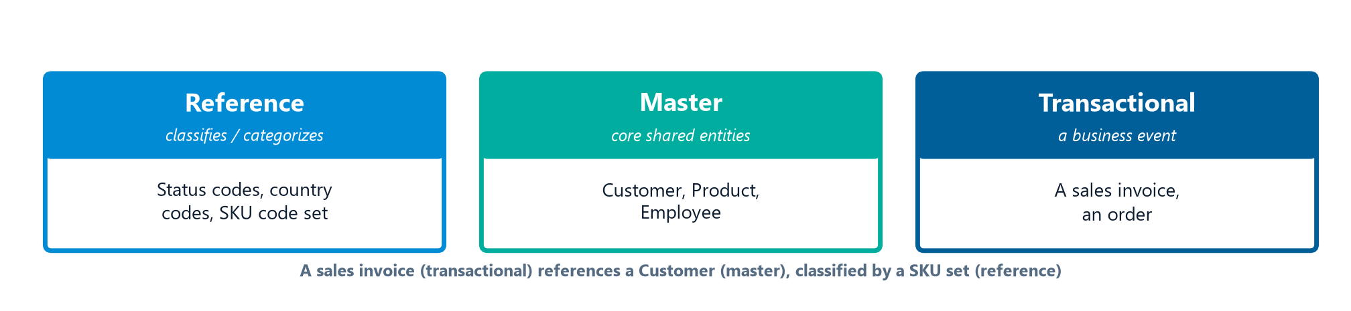
Definitions & Goals
Module 10 — Reference & Master Data
Reference Data — data used to characterize or classify other data, or relate it to information beyond the enterprise (codes, categories).
Master Data — data about business entities (customer, product, employee, location) that provides context for transactions; the most critical shared data.
MDM (Gartner): a technology-enabled discipline in which business and IT work together to ensure uniformity, accuracy, stewardship, semantic consistency, and accountability for the enterprise's official shared master data assets.
3 goals: accurate/complete/consistent data · enable enterprise-wide sharing · reduce risk & cost via stewardship.
CDMP Fundamentals | DAMA-DMBOK 2nd Edition
dama.org / cdmp.info
Notes:
: Definitions & Goals
Let's define our two data types. Reference data is any data used to characterize or classify other data, or to relate data to information beyond the enterprise — things like codes and categories. Master data is data about business entities — customers, products, employees, locations — that provides context for transactions, and it represents the most critical shared data across the enterprise. For MDM itself, memorize the Gartner definition: a technology-enabled discipline in which business and IT work together to ensure uniformity, accuracy, stewardship, semantic consistency, and accountability for the enterprise's official shared master data assets. Note those five qualities. The three goals are: ensure access to accurate, complete, and consistent reference and master data; enable sharing across the enterprise; and reduce risk and cost through proper stewardship.
---

Slide 4
Reference vs. Master vs. Transactional
Module 10 — Reference & Master Data
Type | What it is | Example
Reference Data | Classifies/categorizes other data | Status codes, country codes, SKU code set
Master Data | Core shared business entities | Customer, Product, Employee
Transactional Data | A discrete business event at a point in time | A sales invoice, an order
⭐ EXAM TIP: A sales invoice = transactional; the product code set = reference; the customer profile = master. This three-way distinction is heavily tested.
CDMP Fundamentals | DAMA-DMBOK 2nd Edition
dama.org / cdmp.info
Notes:
: Reference vs. Master vs. Transactional
This three-way distinction is the single most tested concept in the chapter, so let's nail it with the three cards on screen and a concrete example. Reference data classifies or categorizes other data — think status codes, country codes, or a product code set. Master data is the core shared business entity — the customer, the product, the employee. And transactional data records a discrete business event at a point in time — a sales invoice, an order, a withdrawal. So when you see a sales invoice, that's transactional. The product code set it references is reference data. And the customer profile it points to is master data. The exam will give you a scenario like this and ask you to classify each piece. Practice that mapping until it's instant: event is transactional, entity is master, code set is reference.
---

Slide 5
Business Drivers
Module 10 — Reference & Master Data
Reduce inconsistency from multiple versions of critical data
Improve data quality of customer, product, and key entities
Support regulatory compliance
Enable better decision-making with consistent master data
Support integration & interoperability; reduce redundancy & cost
⭐ EXAM TIP: A concrete MDM benefit: eliminating duplicate records (cheaper mailings, better cross-sell targeting).
CDMP Fundamentals | DAMA-DMBOK 2nd Edition
dama.org / cdmp.info
Notes:
: Business Drivers
Why do organizations invest in reference and master data management? To reduce the inconsistency that comes from having multiple versions of critical data. To improve the data quality of customers, products, and other key entities. To support regulatory compliance. To enable better decision-making with consistent, accurate master data. To support data integration and interoperability. And to reduce redundancy and the cost of managing duplicated data. The most concrete, quantifiable benefit the exam likes to cite is the elimination of duplicate records — which directly reduces the cost of duplicate mailings and improves the accuracy of cross-sell targeting. That's the kind of measurable operational win that justifies an MDM business case.
---

Slide 6
Reference Data — Chisholm's 6-Layer Taxonomy
Module 10 — Reference & Master Data
Layer | Source | Example
1. Internal | Within the enterprise | Department/cost-center codes
2. Industry | Industry groups | SIC, SWIFT codes
3. National | National bodies | State codes, zip codes
4. International | International bodies | ISO country/currency codes
5. Third-Party | Commercial providers | D&B DUNS numbers
6. Derived | Combined from other reference data | —
⭐ EXAM TIP: Internal → Industry → National → International → Third-Party → Derived.
CDMP Fundamentals | DAMA-DMBOK 2nd Edition
dama.org / cdmp.info
Notes:
: Reference Data — Chisholm's 6-Layer Taxonomy
Malcolm Chisholm gives us a useful six-layer taxonomy for reference data, organized by where the data comes from. Layer one is internal reference data, created and maintained within the enterprise — like department codes or cost-center codes. Layer two is industry reference data, set by industry groups — like SIC codes or SWIFT codes. Layer three is national reference data, defined by national bodies — like state codes or zip codes. Layer four is international reference data, from international bodies — like ISO country codes and ISO currency codes. Layer five is third-party reference data, commercially available — like Dun and Bradstreet DUNS numbers. And layer six is reference data derived from other reference data, created by combining or transforming existing reference data. The progression runs from the most local to the most external, then derived.
---

Slide 7
Reference Data Standards & Sources
Module 10 — Reference & Master Data
Body / Standard | Reference data
ISO 3166 / 4217 | Country codes / currency codes
SIC · NAICS | Industry classification
SWIFT / BIC | Bank & financial institution codes
D&B DUNS | Business entity identifiers (third-party)
GS1 · UPC / EAN | Product / item identifiers
⭐ EXAM TIP: Prefer external standards for interoperability, then map internal codes to them via cross-references.
CDMP Fundamentals | DAMA-DMBOK 2nd Edition
dama.org / cdmp.info
Notes:
: Reference Data Standards & Sources
A practical rule for reference data: wherever a recognized external standard already exists, adopt it instead of inventing your own codes. The exam likes a few examples. ISO gives us 3166 for country codes and 4217 for currency codes. SIC and NAICS classify industries. SWIFT, or BIC, codes identify banks. Dun and Bradstreet's DUNS number is a third-party business identifier. And GS1 standards, like UPC and EAN, identify products. The key governance distinction is internal versus external: internal code sets you define and maintain yourself, while external standards you adopt and track — you follow their updates rather than changing them. So prefer external standards for interoperability, and map your internal codes to them through cross-references.
---

Slide 8
Reference Data Types & the ICD Example
Module 10 — Reference & Master Data
Reference data types (simple → complex): Lists → Cross-Reference Tables (map between systems) → Taxonomies (hierarchical) → Ontologies (networks of concepts).
Reference data is organized into domains — sets of values that classify or categorize.
ICD medical codes: ICD-9 ≈ 13,000 codes; ICD-10 ≈ 68,000 codes (far more specific).
⭐ EXAM TIP: Lists → Cross-Reference → Taxonomies → Ontologies. ICD-10 ≈ 68,000 codes.
CDMP Fundamentals | DAMA-DMBOK 2nd Edition
dama.org / cdmp.info
Notes:
: Reference Data Types & the ICD Example
Reference data also comes in types of increasing complexity. The simplest is a list — just enumerated values, like status codes of Active and Inactive. Next, cross-reference tables map values between two or more classification systems. Then taxonomies provide hierarchical classification. And most complex are ontologies, which are networks of concepts and relationships. Reference data is organized into domains — sets of values that classify or categorize. A great example the exam uses is medical diagnostic codes: ICD-9 has approximately thirteen thousand codes, while ICD-10 expanded dramatically to approximately sixty-eight thousand codes for greater specificity. So remember the type progression — lists, cross-reference, taxonomies, ontologies — and that ICD-10 has about sixty-eight thousand codes.
---

Slide 9
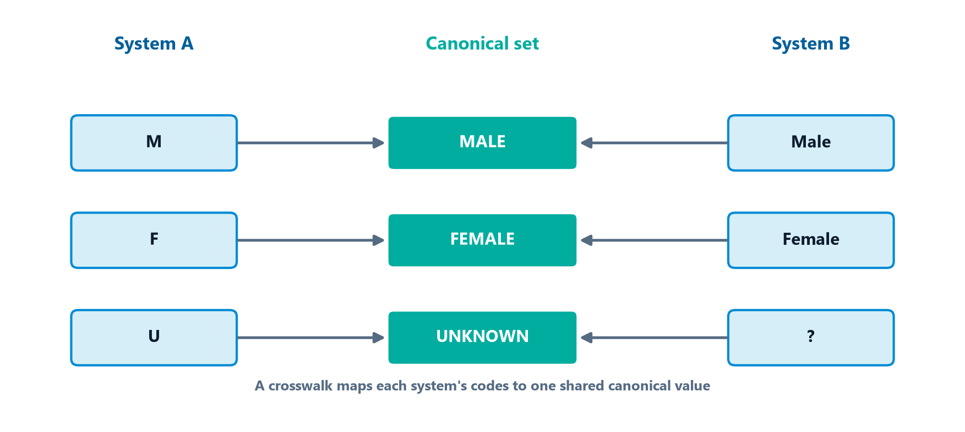
Managing Reference Data — Crosswalks & Repositories
Module 10 — Reference & Master Data
Different systems often use different codes for the same concept — managing reference data means reconciling them.
A cross-reference (crosswalk) table maps each system's codes to one shared canonical set.
Cross-reference (crosswalk) tables map values between classification systems (e.g., System A "M" / System B "Male" → canonical "MALE").
A reference data repository stores the canonical sets with their definitions, owners, and effective dates — one managed source.
⭐ EXAM TIP: A crosswalk maps between code sets; the repository is the single managed home for reference data.
CDMP Fundamentals | DAMA-DMBOK 2nd Edition
dama.org / cdmp.info
Notes:
: Managing Reference Data — Crosswalks & Repositories
Here's a problem reference data has to solve: different systems use different codes for the very same concept. One system stores gender as "M," another as "Male," a third as "1." Managing reference data means reconciling those — and the tool for that is the cross-reference table, or crosswalk, shown on screen. A crosswalk maps each system's codes to one shared, canonical set, so System A's "M" and System B's "Male" both resolve to a single canonical value like "MALE." And rather than scatter these code sets across spreadsheets, you keep them in a reference data repository — a single managed home that stores each canonical set along with its definitions, owners, and effective dates. So remember: a crosswalk maps between code sets, and the repository is the one managed place those sets live.
---

Slide 10
Master Data Domains
Module 10 — Reference & Master Data
Master data represents the most important shared entities, providing context for transactions; it must be consistent across systems.
Common domains:
  Party — Person, Organization, Customer, Employee, Supplier
  Product / Item
  Financial — Account, Cost Center, GL codes
  Location — Address, Geography
  Asset · Contract/Policy · Rule · Concept
⭐ EXAM TIP: The most common master-data domains are Party and Product.
CDMP Fundamentals | DAMA-DMBOK 2nd Edition
dama.org / cdmp.info
Notes:
: Master Data Domains
Master data represents the most important shared entities in the enterprise, providing context for transactional data, and it has to be consistent across multiple systems. The common master data domains are: party — which covers person, organization, customer, employee, and supplier; product or item; financial — accounts, cost centers, and general ledger codes; location — addresses and geography; asset; contract or policy; rule; and concept, like industry classifications. The two most common and most frequently managed domains are party and product — customer and product master data are where most MDM programs begin, because they're the entities that cause the most pain when they're inconsistent.
---

Slide 11
Customer & Product — The Most Common MDM Domains
Module 10 — Reference & Master Data
Party (especially Customer) and Product are the most frequently mastered domains.
Customer MDM — a single trusted customer-360 view; householding groups related individuals/accounts; B2B adds organization hierarchies.
Product MDM (PIM) — one consistent product definition across catalog, web, and ERP; categories and variants.
These domains drive the clearest ROI: de-duplicated customers (cheaper mailings, better cross-sell) and consistent products (accurate catalogs, fewer errors).
⭐ EXAM TIP: Party and Product are the most common master-data domains — and the usual MDM starting point.
CDMP Fundamentals | DAMA-DMBOK 2nd Edition
dama.org / cdmp.info
Notes:
: Customer & Product — The Most Common MDM Domains
Of all the master-data domains, two dominate in practice: party — especially customer — and product. Customer MDM aims to build a single, trusted customer-360 view, pulling together every interaction across channels. A key technique here is householding, which groups related individuals or accounts into one economic unit — a family, or in B2B, an organization with its hierarchy of subsidiaries. Product MDM, often called PIM, creates one consistent product definition across the catalog, the website, and the ERP, including categories and variants. These two domains tend to deliver the clearest return on investment: de-duplicated customers mean cheaper mailings and better cross-sell, and consistent products mean accurate catalogs and fewer order errors. For the exam, party and product are the most common master-data domains, and usually where an MDM program starts.
---

Slide 12
Master Data Hierarchies & Relationships
Module 10 — Reference & Master Data
Master data isn't just flat records — stewards also manage the hierarchies and relationships among entities:
  Organizational rollups (employee → team → division → company)
  Product taxonomies (SKU → category → line)
  Customer affiliations / households (members of one economic group)
Ragged (unbalanced) hierarchies have branches of differing depth — they must be modeled explicitly.
Maintaining correct hierarchies is core stewardship — wrong rollups corrupt every report built on them.
⭐ EXAM TIP: Managing hierarchies and relationships (not just values) is a defining reference/master-data stewardship duty.
CDMP Fundamentals | DAMA-DMBOK 2nd Edition
dama.org / cdmp.info
Notes:
: Master Data Hierarchies & Relationships
Master data is more than flat records — stewards also manage the hierarchies and relationships that connect entities. Think of organizational rollups, where an employee belongs to a team, which belongs to a division, which belongs to the company. Or product taxonomies, where a SKU rolls up to a category and a line. Or customer affiliations and households, grouping members of one economic group. A subtlety the exam may probe: ragged, or unbalanced, hierarchies have branches of different depths, and they have to be modeled explicitly rather than assumed uniform. And getting hierarchies right matters enormously, because a wrong rollup silently corrupts every report built on top of it. So remember: managing hierarchies and relationships, not just values, is a defining stewardship duty for reference and master data.
---

Slide 13
System of Record vs. System of Reference
Module 10 — Reference & Master Data
System of Record (SoR) — the authoritative source where an attribute originates and is maintained.
System of Reference — a trusted, governed copy that consumers read, sourced from the SoR (e.g., the MDM hub distributing master data).
MDM governance defines the system of record per attribute — different attributes of the same entity may originate in different systems.
⭐ EXAM TIP: SoR = where data is authoritatively maintained; system of reference = the trusted distribution copy consumers read.
CDMP Fundamentals | DAMA-DMBOK 2nd Edition
dama.org / cdmp.info
Notes:
: System of Record vs. System of Reference
Two terms the exam likes to contrast: system of record and system of reference. A system of record is the authoritative source where an attribute originates and is maintained — the place the data is truly mastered. A system of reference is a trusted, governed copy that consumers actually read from, fed by that system of record — the MDM hub distributing master data outward is a classic example. And here's the nuance: MDM governance defines the system of record per attribute, which means different attributes of the same customer might originate in different systems — the billing address from one, the credit rating from another. So lock in the distinction: system of record is where data is authoritatively maintained; system of reference is the trusted distribution copy that consumers read.
---

Slide 14
Entity Resolution & Matching
Module 10 — Reference & Master Data
Approach | How it works
Deterministic (rules-based) | Exact/near-exact rules; high precision; needs clean data
Probabilistic (statistical) | Statistical weights score match likelihood; handles inconsistencies
⭐ EXAM TIP: Deterministic = exact rules; Probabilistic = statistical scoring.
CDMP Fundamentals | DAMA-DMBOK 2nd Edition
dama.org / cdmp.info
Notes:
: Entity Resolution & Matching
Entity resolution is the process of identifying, matching, and linking records that refer to the same real-world entity — figuring out that "Bob Smith" in one system and "Robert Smith" in another are the same person. There are two matching approaches. Deterministic, or rules-based, matching uses exact or near-exact matching rules; it gives high precision but requires clean data to work well. Probabilistic, or statistical, matching uses statistical weights to score the likelihood of a match, which lets it handle data inconsistencies that would defeat exact rules. There's also an efficiency technique called blocking, or candidate generation: you use a coarse key — like a phonetic key derived from a last name — to shrink the comparison space before running detailed match scoring, so you're not comparing every record against every other record. Deterministic is exact rules; probabilistic is statistical scoring.
---

Slide 15
The 3 Matching Workflows & the Golden Record
Module 10 — Reference & Master Data
Workflow | Action
Duplicate Identification | Find duplicates; mark them without changing sources
Match and Link | Link records to a golden record without consolidating
Match and Merge | Merge matched records into one consolidated golden record
⭐ EXAM TIP: Match-and-link keeps sources separate; match-and-merge consolidates them.
CDMP Fundamentals | DAMA-DMBOK 2nd Edition
dama.org / cdmp.info
Notes:
: The 3 Matching Workflows & the Golden Record
Once you can match records, there are three workflows for what to do with the matches. Duplicate identification finds records representing the same entity and marks the duplicates, without changing the source systems. Match and link identifies matches and links them to a golden record, but without physically consolidating them — the sources stay separate. And match and merge identifies matches and actually merges them into a single, consolidated golden record. That golden record — also called the best version of truth, exactly as the diagram on screen shows — is the authoritative, consolidated record created from the matched records. And survivorship rules determine which attribute values "win" and survive into the golden record when sources disagree. The key distinction for the exam: match-and-link keeps the sources separate, while match-and-merge consolidates them into one.
---

Slide 16
Building the Golden Record — Survivorship & Trust
Module 10 — Reference & Master Data
The golden record is derived, not entered — survivorship rules decide which value "wins" when sources disagree:
  Most recent (latest update wins)
  Most complete (the populated value wins)
  Source priority (a ranked trusted source wins)
  Most frequent (the most-common value wins)
Trust / confidence scores weight each source; provenance records where each surviving value came from.
⭐ EXAM TIP: Survivorship rules + source trust construct the golden record — the best version of truth, assembled from many records.
CDMP Fundamentals | DAMA-DMBOK 2nd Edition
dama.org / cdmp.info
Notes:
: Building the Golden Record — Survivorship & Trust
Let's go deeper on how the golden record actually gets built, because it's derived, not typed in by hand. When two matched records disagree on a value, survivorship rules decide which one wins. The common rules: most recent, where the latest update wins; most complete, where a populated value beats a blank; source priority, where a ranked, trusted source wins; and most frequent, where the value that appears most often wins. To support these, each source carries a trust or confidence score that weights its values, and provenance metadata records exactly where each surviving value came from. So the golden record — the best version of truth — is assembled, attribute by attribute, by applying survivorship rules and source trust across all the matched records.
---

Slide 17
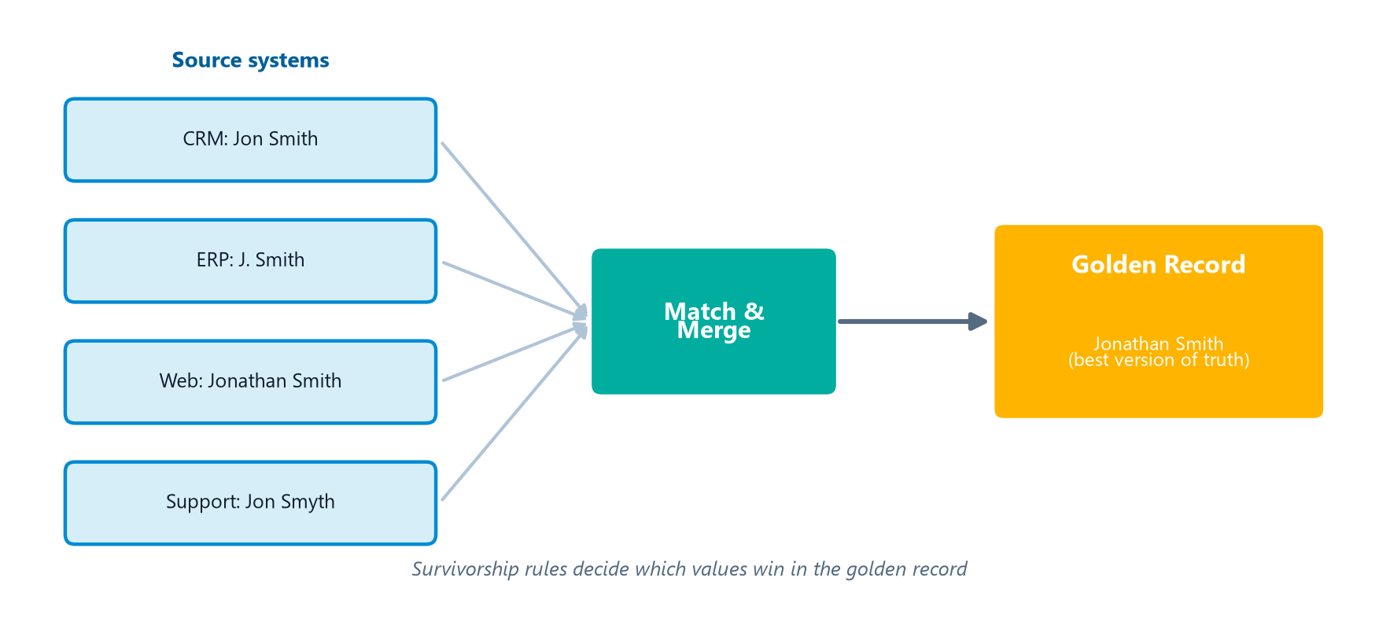
MDM Architecture Types (3)
Module 10 — Reference & Master Data
Registry indexes sources; the hub is the system of record; consolidated holds a physical copy.
⭐ EXAM TIP: Registry = index only (no data moved); Transaction Hub = central control; Consolidated = physical copy.
CDMP Fundamentals | DAMA-DMBOK 2nd Edition
dama.org / cdmp.info
Notes:
: MDM Architecture Types (3)
There are three primary MDM sharing architectures, drawn side by side on screen, and the exam tests them directly. The registry, or index, architecture maintains an index of where master data lives in the source systems — it does not store the master data itself; it just links to the sources. This makes it minimally invasive, and the sources remain authoritative. The transaction hub is a central master data hub where all transactions go through the hub, which becomes the system of record. This gives the strongest data governance and a single point of control, but it's complex to implement. And the consolidated, or repository, architecture maintains a physical consolidated copy of the master data, synchronized periodically. It's better for analytics, but it isn't always real-time, so it may have latency. The shorthand: registry is index-only with no data moved, transaction hub is central control, and consolidated is a physical copy.
---

Slide 18
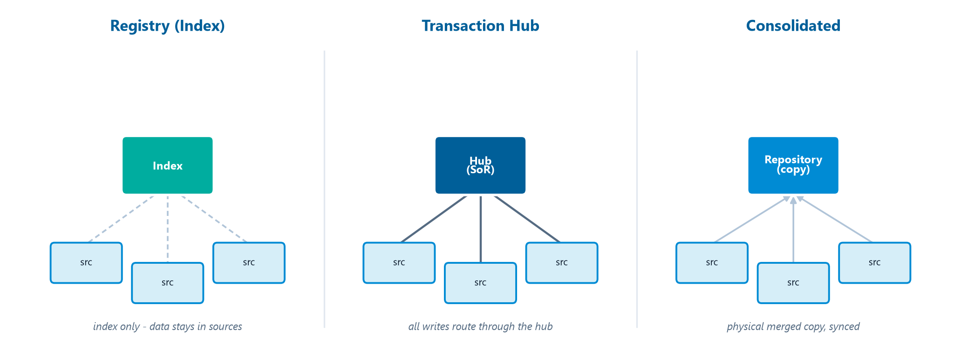
MDM Implementation Styles (5)
Module 10 — Reference & Master Data
Registry — cross-reference index; doesn't alter sources
Consolidation — physical merged copy
Coexistence — multiple authoritative sources kept synchronized
Transaction Hub — all transactions validated against the hub
Centralized — one system is the single source of truth
⭐ EXAM TIP: Use Registry when you cannot modify source systems; use Transaction Hub when new records must route through the hub before getting an enterprise ID.
CDMP Fundamentals | DAMA-DMBOK 2nd Edition
dama.org / cdmp.info
Notes:
: MDM Implementation Styles (5)
Closely related to the architectures are five implementation styles. Registry, as we covered, is the cross-reference index that doesn't alter the sources. Consolidation creates a physical merged copy. Coexistence allows multiple authoritative sources to coexist, kept synchronized between them — a hybrid approach. Transaction hub validates all transactions against the hub. And centralized makes one system the single source of truth for all consumers. Two exam scenarios to recognize: if you cannot modify the source systems — say, due to regulatory constraints — the right style is registry, because it only indexes. And if new records must route through the hub before being assigned an enterprise ID, that's the transaction hub style, with the hub as system of record.
---

Slide 19
MDM Hub Components
Module 10 — Reference & Master Data
Component | Function
Match & merge engine | Runs matching algorithms, builds golden records
Data stewardship interface | Presents suspected duplicates to human reviewers
Services layer (API gateway) | Standard interfaces so apps read/update master data without knowing the internal model
Workflow engine | Orchestrates stewardship tasks and approvals
⭐ EXAM TIP: The stewardship interface is where humans resolve uncertain matches; the services layer abstracts the hub's internals.
CDMP Fundamentals | DAMA-DMBOK 2nd Edition
dama.org / cdmp.info
Notes:
: MDM Hub Components
An MDM hub is built from several components, and the exam occasionally asks which component does what. The match and merge engine runs the matching algorithms and builds the golden records. The data stewardship interface is where suspected duplicate records are presented to human reviewers for resolution decisions — so when a match is uncertain, a human steward decides. The services layer, or API gateway, exposes standardized interfaces so that consuming applications can retrieve and update master data without needing to know the hub's internal data model — it abstracts the internals. And the workflow engine orchestrates the stewardship tasks and approvals. The two most testable: the stewardship interface is where humans resolve uncertain matches, and the services layer hides the hub's internal structure from consumers.
---

Slide 20
MDM Depends on Data Quality & Integration
Module 10 — Reference & Master Data
MDM is not a standalone tool — it stands on three other disciplines:
  Entity Resolution — deterministic + probabilistic matching to find the same entity
  Data Quality — profiling, cleansing, and standardization so records can match (you can't master dirty data)
  Data Integration — ETL/ELT to load and synchronize master data across systems
All of it sits under Data Governance, which sets stewardship, rules, and the system of record.
⭐ EXAM TIP: MDM depends on data quality — standardize and cleanse before matching, or matching fails.
CDMP Fundamentals | DAMA-DMBOK 2nd Edition
dama.org / cdmp.info
Notes:
: MDM Depends on Data Quality & Integration
One big-picture point before we move to governance: MDM is never a standalone tool — it stands on three other disciplines you've already studied. First, entity resolution, the deterministic and probabilistic matching that finds records referring to the same entity. Second, data quality — profiling, cleansing, and especially standardization — because records can only match if they've first been cleaned and put into a common form. The exam framing is blunt: you cannot master dirty data. And third, data integration, the ETL or ELT that loads and synchronizes master data across systems. All three operate under data governance, which sets the stewardship, the rules, and the system of record. So the key dependency to remember: MDM depends on data quality — you standardize and cleanse before you match, or the matching simply fails.
---

Slide 21
Governance & Reference Data Change Management
Module 10 — Reference & Master Data
Stewardship: define & manage domains, resolve classification conflicts, approve changes to reference values, manage hierarchies.
Reference data change management: treat value changes as formal changes; preserve historical values for backward compatibility; use effective-dated records to track changes over time.
Master data governance: assign stewards per domain, define the system of record per attribute, monitor matching & golden-record creation.
⭐ EXAM TIP: Reference data changes must be effective-dated and preserve history.
CDMP Fundamentals | DAMA-DMBOK 2nd Edition
dama.org / cdmp.info
Notes:
: Governance & Reference Data Change Management
Governance is critical for this knowledge area. Stewardship responsibilities include defining and managing the reference data domains, resolving conflicts between classification schemes, approving changes to reference data values, and managing hierarchies and relationships. Reference data change management has a specific exam angle: changes to reference data values must be handled as formal changes, historical values must be preserved for backward compatibility, and you use effective-dated records to track value changes over time. For master data governance, you assign stewards per domain, define the system of record for each attribute, manage data quality rules, and monitor the matching rules and golden record creation. The point to remember: reference data changes are effective-dated and preserve history — you never just overwrite an old code.
---

Slide 22
Activities, Tools & Metrics
Module 10 — Reference & Master Data
5 activities: define Reference Data strategy → define MDM strategy → identify reference data sources → establish governance → implement the MDM solution.
Tools: entity resolution engines, data quality (profiling/cleansing), integration (ETL/ELT), workflow.
6 metric categories: Completeness · Coverage · Quality · Matching · Timeliness · Usage.
⭐ EXAM TIP: Matching metrics use precision and recall; Coverage = % of entities with master records.
CDMP Fundamentals | DAMA-DMBOK 2nd Edition
dama.org / cdmp.info
Notes:
: Activities, Tools & Metrics
Let's cover activities, tools, and metrics together. The five activities are: define the reference data strategy, define the MDM strategy, identify reference data sources, establish reference data governance, and implement the MDM solution. The tools include entity resolution engines that do deterministic and probabilistic matching, data quality tools for profiling and cleansing, data integration tools for loading master data, and workflow tools for stewardship approvals. And the metrics fall into six categories: completeness, coverage, quality, matching, timeliness, and usage. Two worth noting: matching metrics use precision and recall — the same retrieval concepts from the last chapter — and coverage measures the percentage of enterprise entities that actually have master records. Six metric categories, with matching measured by precision and recall.
---

Slide 23
Key Numbers & Quick Facts (Cheat Sheet)
Module 10 — Reference & Master Data
Fact | Value
Reference / Master / Transactional | classify / entities / events
MDM definition | Gartner (uniformity, accuracy, stewardship…)
Chisholm reference layers | 6
Reference data types | Lists → Cross-Ref → Taxonomies → Ontologies
ICD-9 / ICD-10 codes | ~13,000 / ~68,000
Matching approaches | Deterministic · Probabilistic
Matching workflows | Duplicate ID · Match+Link · Match+Merge
MDM architectures | Registry · Transaction Hub · Consolidated
Implementation styles | 5
Golden record | authoritative consolidated record
Metric categories | 6
CDMP Fundamentals | DAMA-DMBOK 2nd Edition
dama.org / cdmp.info
Notes:
: Key Numbers & Quick Facts (Cheat Sheet)
Let's consolidate. Reference data classifies, master data is the entity, transactional data is the event. The MDM definition is Gartner's, emphasizing uniformity, accuracy, stewardship, and semantic consistency. Chisholm gives six reference data layers. Reference data types run from lists to cross-reference tables to taxonomies to ontologies. ICD-9 has about thirteen thousand codes, ICD-10 about sixty-eight thousand. The two matching approaches are deterministic and probabilistic. The three matching workflows are duplicate identification, match-and-link, and match-and-merge. The three architectures are registry, transaction hub, and consolidated, and there are five implementation styles. The golden record is the authoritative consolidated record. And there are six metric categories. Drill these.
---

Slide 24
Common Exam Traps
Module 10 — Reference & Master Data
❌ A sales invoice is master data → ✅ an invoice is transactional; the customer/product are master/reference
❌ Registry MDM stores the master data → ✅ Registry stores only an index to source data
❌ Match-and-link merges records → ✅ link keeps sources separate; merge consolidates
❌ Deterministic matching handles messy data → ✅ that's probabilistic; deterministic needs clean data
❌ Reference data = master data → ✅ reference classifies; master is the entity
⭐ EXAM TIP: When you can't touch the source systems, the MDM answer is Registry.
CDMP Fundamentals | DAMA-DMBOK 2nd Edition
dama.org / cdmp.info
Notes:
: Common Exam Traps
Here are the traps. First, a sales invoice is transactional data, not master data — the customer and product it references are the master and reference data. Second, the registry MDM architecture does not store the master data; it stores only an index pointing to the sources. Third, match-and-link does not merge records — link keeps the sources separate, while merge consolidates them. Fourth, deterministic matching needs clean data and uses exact rules; it's probabilistic matching that handles messy, inconsistent data. And fifth, reference data is not the same as master data — reference classifies, master is the entity itself. One more shortcut: when a scenario says you can't touch the source systems, the MDM answer is almost always registry.
---

Slide 25
Module Summary
Module 10 — Reference & Master Data
Reference data classifies; master data is the core shared entity; transactional data is the event.
MDM (Gartner) ensures uniformity, accuracy, stewardship, and semantic consistency; Chisholm gives 6 reference layers.
Entity resolution (deterministic vs probabilistic) feeds 3 matching workflows that build the golden record.
3 architectures — Registry (index), Transaction Hub (central), Consolidated (copy); 5 implementation styles.
Govern with effective-dated reference changes and per-attribute systems of record; measure across 6 categories.
CDMP Fundamentals | DAMA-DMBOK 2nd Edition
dama.org / cdmp.info
Notes:
: Module Summary
Let's wrap up. Reference data classifies other data, master data is the core shared entity, and transactional data is the event — that three-way distinction is everything in this chapter. MDM, by Gartner's definition, ensures uniformity, accuracy, stewardship, and semantic consistency, and Chisholm gives you six reference data layers. Entity resolution, whether deterministic or probabilistic, feeds three matching workflows that build the golden record. There are three architectures — registry as an index, transaction hub for central control, and consolidated as a physical copy — plus five implementation styles. You govern with effective-dated reference changes and per-attribute systems of record, and you measure across six categories. That's Chapter 10.
---

Slide 26
Let's Test Your Knowledge
Module 10 — Reference & Master Data
Heading: 5 practice questions — Reference & Master Data
Subtitle: Watch the data-type classification and the MDM architecture choices.
CDMP Fundamentals | DAMA-DMBOK 2nd Edition
dama.org / cdmp.info
Notes:
: Let's Test Your Knowledge
Time for five practice questions on reference and master data. These focus on classifying the data types and choosing the right MDM architecture for a given scenario. Read each carefully, decide on your answer, and then reveal the solution. Here we go.
---

Slide 27
Practice Question 1
Module 10 — Reference & Master Data
Q1
A sales invoice captures customer ID, product SKU, quantity, price, and date. The SKU links to a merchandising-team code set; the customer ID links to a shared cross-channel customer profile. Which classification best describes each?
A) Invoice = master; SKU = transactional; customer profile = reference
B) Invoice = transactional; SKU = reference; customer profile = master
C) Invoice = transactional; SKU = master; customer profile = reference
D) Invoice = reference; SKU = master; customer profile = transactional
Answer: The invoice records an event → transactional. The SKU code set classifies products → reference data. The shared customer profile is a core business entity → master data. This three-way mapping is the chapter's signature distinction.
CDMP Fundamentals | DAMA-DMBOK 2nd Edition
dama.org / cdmp.info
Notes:
: Practice Questions (Q1–Q3)
Question one: classify the invoice, the SKU code set, and the customer profile. The answer is B — the invoice is transactional because it records an event, the SKU code set is reference data because it classifies products, and the customer profile is master data because it's a core shared entity. This three-way mapping is the chapter's signature test.
Question two: a firm must reconcile customer data across twelve systems but cannot modify any source's write path. Which implementation style? The answer is B — registry, because it creates a cross-reference index without altering the source records. Coexistence, transaction hub, and centralized all write to or intercept the sources, which is forbidden here.
Question three: new customer records from any channel route through the MDM hub before getting an enterprise ID, and operational systems are no longer authoritative. Which style? The answer is B — transaction hub, where the hub is the system of record and every new record flows through it. Registry only indexes; coexistence keeps multiple authoritative sources.
Two more on the next slide.
---

Slide 28
Practice Question 2
Module 10 — Reference & Master Data
Q2
A financial firm must reconcile customer data across twelve source systems but cannot modify any source system's write path due to regulatory constraints. Which MDM implementation style is most appropriate?
A) Coexistence, because it synchronizes cleansed data back into every source
B) Registry, because it creates a cross-reference index without altering source records
C) Transaction hub, because it intercepts and transforms all writes before they reach sources
D) Centralized hub, because it becomes authoritative for all reads and writes
Answer: The Registry style builds an index/cross-reference to master data in the sources without changing them — ideal when sources can't be touched. Coexistence, transaction hub, and centralized all write to or intercept the sources.
CDMP Fundamentals | DAMA-DMBOK 2nd Edition
dama.org / cdmp.info
Notes:
: Practice Questions (Q1–Q3)
Question one: classify the invoice, the SKU code set, and the customer profile. The answer is B — the invoice is transactional because it records an event, the SKU code set is reference data because it classifies products, and the customer profile is master data because it's a core shared entity. This three-way mapping is the chapter's signature test.
Question two: a firm must reconcile customer data across twelve systems but cannot modify any source's write path. Which implementation style? The answer is B — registry, because it creates a cross-reference index without altering the source records. Coexistence, transaction hub, and centralized all write to or intercept the sources, which is forbidden here.
Question three: new customer records from any channel route through the MDM hub before getting an enterprise ID, and operational systems are no longer authoritative. Which style? The answer is B — transaction hub, where the hub is the system of record and every new record flows through it. Registry only indexes; coexistence keeps multiple authoritative sources.
Two more on the next slide.
---

Slide 29
Practice Question 3
Module 10 — Reference & Master Data
Q3
An organization's MDM is mature enough that operational systems should no longer be authoritative — new customer records from any channel are routed through the MDM hub before being assigned an enterprise ID. Which implementation style is this?
A) Coexistence style
B) Transaction hub
C) Federated MDM
D) Registry style
Answer: Routing every new record through the hub to obtain its enterprise identity, with the hub as the system of record, defines the Transaction Hub style. Registry only indexes; coexistence keeps multiple authoritative sources.
CDMP Fundamentals | DAMA-DMBOK 2nd Edition
dama.org / cdmp.info
Notes:
: Practice Questions (Q1–Q3)
Question one: classify the invoice, the SKU code set, and the customer profile. The answer is B — the invoice is transactional because it records an event, the SKU code set is reference data because it classifies products, and the customer profile is master data because it's a core shared entity. This three-way mapping is the chapter's signature test.
Question two: a firm must reconcile customer data across twelve systems but cannot modify any source's write path. Which implementation style? The answer is B — registry, because it creates a cross-reference index without altering the source records. Coexistence, transaction hub, and centralized all write to or intercept the sources, which is forbidden here.
Question three: new customer records from any channel route through the MDM hub before getting an enterprise ID, and operational systems are no longer authoritative. Which style? The answer is B — transaction hub, where the hub is the system of record and every new record flows through it. Registry only indexes; coexistence keeps multiple authoritative sources.
Two more on the next slide.
---

Slide 30
Practice Question 4
Module 10 — Reference & Master Data
Q4
An MDM sponsor wants a concrete operational benefit for the business case. Which is the most concrete benefit typically cited?
A) Conversion of unstructured data to structured formats enterprise-wide
B) Replacement of all legacy systems with a single ERP
C) Elimination of redundant customer records, reducing duplicate-mailing costs and improving cross-sell targeting
D) Fewer data governance steering-committee meetings per year
Answer: A hallmark MDM benefit is de-duplicating customer records, which directly cuts duplicate-mailing costs and sharpens cross-sell targeting — a measurable operational win. The other options are unrelated to MDM's core value.
CDMP Fundamentals | DAMA-DMBOK 2nd Edition
dama.org / cdmp.info
Notes:
: Practice Questions (Q4–Q5)
Question four: the most concrete operational benefit for an MDM business case? The answer is C — eliminating redundant customer records, which reduces duplicate-mailing costs and improves cross-sell targeting accuracy. That's a measurable, MDM-specific win. The other options — converting unstructured data, replacing all legacy systems, or fewer committee meetings — aren't core MDM benefits.
Question five: generating a phonetic key from last names to shrink the comparison space before detailed scoring. What's that technique called? The answer is D — blocking, also called candidate generation. By grouping records under a coarse key, you only compare plausible candidates in detail, dramatically reducing the number of comparisons. Threshold calibration and survivorship come later in the match process, and normalization is data cleanup.
That completes Module 10. Next up is Module 11, Data Warehousing and Business Intelligence — another high-weight chapter at around ten percent. I'll see you there.
---
*End of Module 10 scripts.*

Slide 31
Practice Question 5
Module 10 — Reference & Master Data
Q5
A data engineer generates a phonetic key from customers' last names to shrink the comparison space before detailed match scoring. This technique is known as:
A) Threshold calibration
B) Attribute normalization
C) Survivorship weighting
D) Blocking (candidate generation)
Answer: Blocking, or candidate generation, groups records by a coarse key (like a phonetic code) so only plausible candidates are compared in detail — drastically reducing the number of comparisons. Threshold calibration and survivorship apply later in the match process; normalization is data cleanup. End of Module 10 — Reference & Master Data.
CDMP Fundamentals | DAMA-DMBOK 2nd Edition
dama.org / cdmp.info
Notes:
: Practice Questions (Q4–Q5)
Question four: the most concrete operational benefit for an MDM business case? The answer is C — eliminating redundant customer records, which reduces duplicate-mailing costs and improves cross-sell targeting accuracy. That's a measurable, MDM-specific win. The other options — converting unstructured data, replacing all legacy systems, or fewer committee meetings — aren't core MDM benefits.
Question five: generating a phonetic key from last names to shrink the comparison space before detailed scoring. What's that technique called? The answer is D — blocking, also called candidate generation. By grouping records under a coarse key, you only compare plausible candidates in detail, dramatically reducing the number of comparisons. Threshold calibration and survivorship come later in the match process, and normalization is data cleanup.
That completes Module 10. Next up is Module 11, Data Warehousing and Business Intelligence — another high-weight chapter at around ten percent. I'll see you there.
---
*End of Module 10 scripts.*

