Slide 1
CDMP FUNDAMENTALS
Module 11: Data Warehousing & BI
DAMA-DMBOK 2nd Edition, Chapter 11
Exam weight: ~10% (≈10 questions) — Inmon, Kimball, star schema, OLAP, CDC
Module 11 — Data Warehousing & BI
100
90
Open
≥60%
MCQ
minutes
book
to pass
CDMP Fundamentals | DAMA-DMBOK 2nd Edition
dama.org / cdmp.info
Notes:
: Module Title Slide
Welcome to Module 11: Data Warehousing and Business Intelligence — DW/BI for short. This is Chapter 11 of the DMBOK, and it's a high-weight chapter at around ten percent, roughly eleven questions. This is where data management meets analytics — the warehouses, the star schemas, and the dashboards that turn raw data into decisions. The exam tests the classic Inmon-versus-Kimball debate and a lot of dimensional-modeling vocabulary, so let's dig in.
---

Slide 2
Module Overview & Learning Objectives
Module 11 — Data Warehousing & BI
By the end, you'll be able to:
  State the Inmon and Kimball definitions of a data warehouse
  Contrast the CIF vs Bus Architecture philosophies
  Explain ODS, data marts, conformed dimensions, and the bus matrix
  Compare star vs snowflake and the fact table types
  Distinguish the 3 OLAP types and 5 CDC techniques
  Recognize the BI delivery components and key terminology
CDMP Fundamentals | DAMA-DMBOK 2nd Edition
dama.org / cdmp.info
Notes:
: Module Overview & Learning Objectives
Here's our plan. You'll state both the Inmon and Kimball definitions of a data warehouse and contrast their two philosophies — the Corporate Information Factory versus the Bus Architecture. You'll explain the operational data store, data marts, conformed dimensions, and the bus matrix. You'll compare star and snowflake schemas and the fact table types. You'll distinguish the three OLAP types and the five change-data-capture techniques. And you'll recognize the BI delivery components and the key terminology. Let's begin with definitions.
---

Slide 3
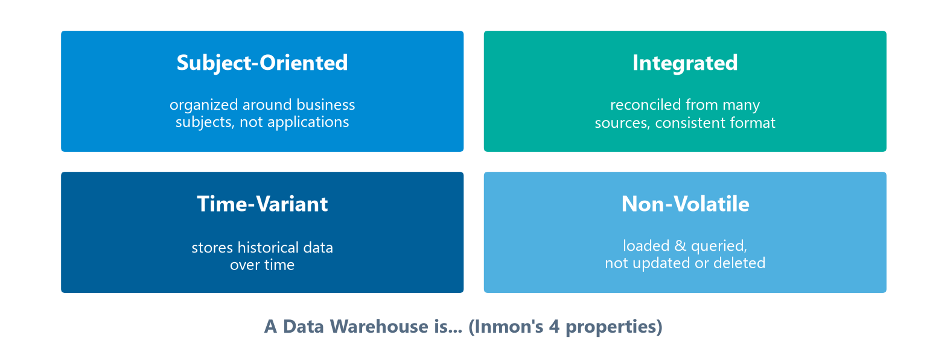
Definitions & Goals
Module 11 — Data Warehousing & BI
Inmon (the "Father of the Data Warehouse"): a subject-oriented, integrated, time-variant, and non-volatile collection of data supporting management's decision-making.
Subject-oriented, Integrated, Time-variant, Non-volatile.
Kimball: a copy of transaction data specifically structured for query and analysis.
BI: turning raw data into actionable information for decisions.
⭐ EXAM TIP: Memorize Inmon's four properties — Subject-oriented, Integrated, Time-variant, Non-volatile.
CDMP Fundamentals | DAMA-DMBOK 2nd Edition
dama.org / cdmp.info
Notes:
: Definitions & Goals
There are two famous definitions of a data warehouse. Bill Inmon, known as the father of the data warehouse, defines it as a subject-oriented, integrated, time-variant, and non-volatile collection of data in support of management's decision-making process. Memorize those four properties — the four quadrants on screen. Subject-oriented means organized around business subjects like customer and product, not around applications. Integrated means data from multiple sources is reconciled into a consistent format. Time-variant means it stores historical data over time. And non-volatile means data is loaded and queried but not updated or deleted — once it's in, it stays. Ralph Kimball offers a simpler definition: a copy of transaction data specifically structured for query and analysis. And Business Intelligence is the broader set of processes and tools that turn raw data into actionable information. The four Inmon properties are the single most testable fact here.
---

Slide 4
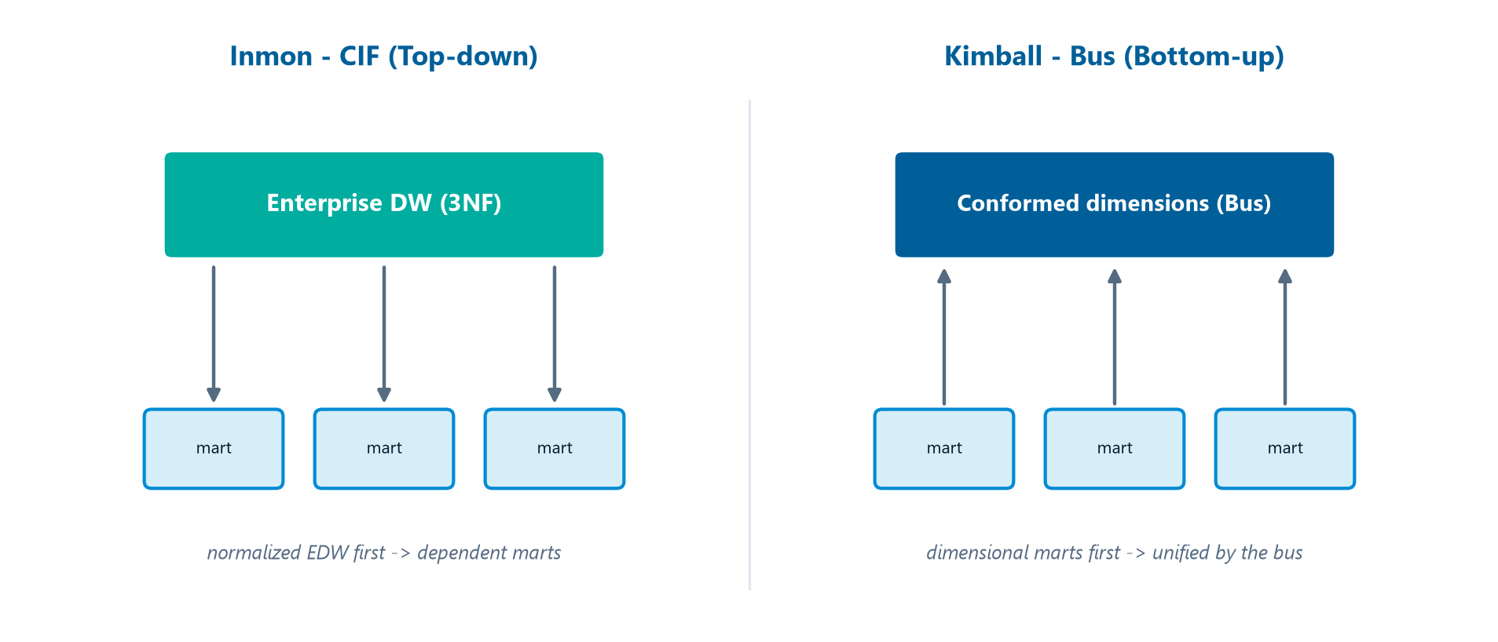
Inmon vs. Kimball
Module 11 — Data Warehousing & BI
Inmon builds the EDW first (top-down); Kimball builds dimensional marts first, unified by the bus (bottom-up).
⭐ EXAM TIP: Inmon = top-down, normalized EDW. Kimball = bottom-up, dimensional marts unified by conformed dimensions.
CDMP Fundamentals | DAMA-DMBOK 2nd Edition
dama.org / cdmp.info
Notes:
: Inmon vs. Kimball
The Inmon-versus-Kimball contrast is a classic exam topic, drawn side by side on screen, so let's make it crisp. Inmon's approach is top-down: you build a single, normalized, third-normal-form enterprise data warehouse first, and that EDW becomes the central integration point — his framework is called the Corporate Information Factory, or CIF. Data marts in Inmon's world are dependent, meaning they're fed from the central EDW. Kimball's approach is bottom-up: you build dimensional data marts first, and you integrate them not through a central normalized warehouse but through conformed dimensions — his framework is the Bus Architecture, where the collection of conformed marts effectively is the warehouse. So the shorthand: Inmon is top-down with a normalized EDW; Kimball is bottom-up with dimensional marts unified by conformed dimensions.
---

Slide 5
Business Drivers & The 7 Guiding Principles
Module 11 — Data Warehousing & BI
Drivers: reduce time-to-information · trend analysis & forecasting · standardize reporting · regulatory reporting · KPI/scorecard monitoring.
7 guiding principles:
Focus on business requirements 2. Start with a single subject area 3. Think enterprise
Promote data quality 5. Build for change 6. Maintain Metadata 7. Collaborate
⭐ EXAM TIP: Deliver iteratively (one subject area) but design for the enterprise.
CDMP Fundamentals | DAMA-DMBOK 2nd Edition
dama.org / cdmp.info
Notes:
: Business Drivers & The 7 Guiding Principles
The business drivers for DW/BI include reducing the time to information for decisions, enabling trend analysis and forecasting, standardizing reporting across the enterprise, supporting regulatory reporting, and monitoring performance against KPIs and scorecards. The DMBOK gives seven guiding principles, and you should recognize the themes. One, focus on business requirements — technology serves the business. Two, start with a single subject area — deliver iteratively, don't boil the ocean. Three, think enterprise — design for reuse even while delivering iteratively. Four, promote data quality. Five, build for change. Six, maintain metadata. And seven, collaborate between IT and business. The key tension to remember: deliver iteratively, one subject area at a time, but always design with the enterprise in mind.
---

Slide 6
The DW/BI Delivery Lifecycle
Module 11 — Data Warehousing & BI
DW/BI is delivered iteratively, one business process at a time (Kimball lifecycle):
Business requirements — understand the questions the business needs answered
Dimensional modeling — design the bus matrix, facts, and conformed dimensions
Physical design & ETL — build the schema, then the extract-transform-load pipelines
BI applications — deliver reports, dashboards, and analytics to users
Each iteration delivers a usable subject area; the enterprise bus matrix keeps them integrated.
⭐ EXAM TIP: Deliver iteratively (one subject area at a time) but design for the enterprise — the chapter's core principle.
CDMP Fundamentals | DAMA-DMBOK 2nd Edition
dama.org / cdmp.info
Notes:
: The DW/BI Delivery Lifecycle
Before we tour the components, here's how a data warehouse actually gets built — the Kimball lifecycle, delivered iteratively, one business process at a time. Step one is business requirements: understand the questions the business actually needs answered. Step two is dimensional modeling: design the bus matrix, the fact tables, and the conformed dimensions. Step three is physical design and ETL: build the schema, then the extract-transform-load pipelines that feed it. And step four is the BI applications: the reports, dashboards, and analytics the users finally touch. Each iteration delivers one usable subject area, and the enterprise bus matrix is what keeps those separate iterations integrated into a coherent whole. The principle to carry: deliver iteratively, but design for the enterprise.
---

Slide 7
Architecture Components
Module 11 — Data Warehousing & BI
Component | Key facts
Operational Data Store (ODS) | Integration point; current/near-real-time data (~30–90 days); NOT the DW
Data Warehouse | Integrated, historical, subject-oriented; strategic decisions
Data Mart | A subset of the DW for a department; dependent (from DW) or independent (from sources)
Data Lake | Raw data in native format; schema-on-read (see Ch 14)
⭐ EXAM TIP: The ODS holds current data (~30–90 days); the DW holds history.
CDMP Fundamentals | DAMA-DMBOK 2nd Edition
dama.org / cdmp.info
Notes:
: Architecture Components
Let's distinguish the main architecture components, because the exam loves to contrast them. The Operational Data Store, the ODS, is an integration point for operational data from multiple systems — it holds current, near-real-time data, typically thirty to ninety days of history, and it supports operational decisions and staging. The crucial point: the ODS is not the data warehouse. The data warehouse itself is the central repository of integrated, historical data for strategic and analytical decisions. A data mart is a subset of the data warehouse for a specific department or business area, and it can be dependent — sourced from the DW — or independent — sourced directly from operational systems. And a data lake stores raw data in native format using schema-on-read, covered more in Chapter 14. The headline distinction: the ODS holds current data; the warehouse holds history.
---

Slide 8
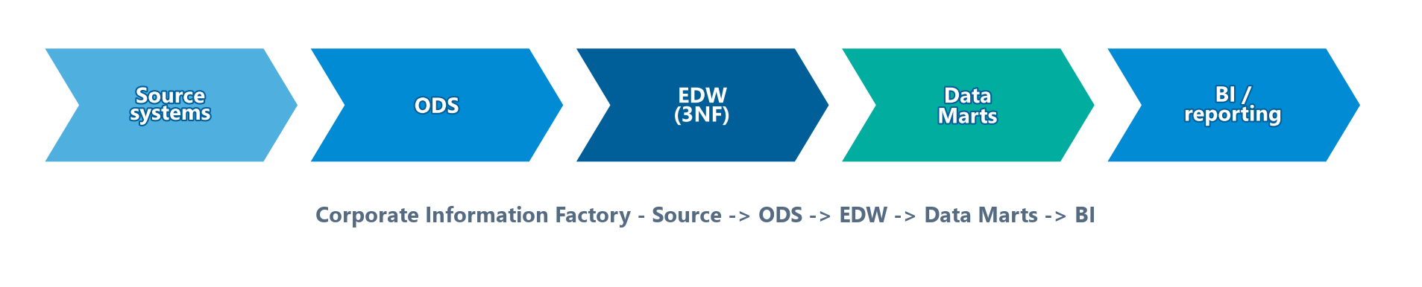
The Corporate Information Factory (CIF)
Module 11 — Data Warehousing & BI
Inmon's CIF places the Enterprise Data Warehouse (EDW) — atomic, normalized, historical, integrated data — at the center, feeding all downstream analytics.
Typical CIF data flow:
The Corporate Information Factory flow from source systems to BI.
⭐ EXAM TIP: In the CIF, the EDW is the single integrated repository; data marts are dependent, fed from it.
CDMP Fundamentals | DAMA-DMBOK 2nd Edition
dama.org / cdmp.info
Notes:
: The Corporate Information Factory (CIF)
Let's look closer at Inmon's Corporate Information Factory. At its center sits the Enterprise Data Warehouse — the EDW — which holds atomic, normalized, historical, integrated data spanning the whole organization, and it feeds all the downstream analytical environments. The typical CIF data flow runs like this — follow the chevrons on screen: data moves from the source systems, into the Operational Data Store, then into the Enterprise Data Warehouse, then out to the data marts, and finally to the BI and reporting tools. That sequence — source, ODS, EDW, data marts, BI tools — is worth memorizing, because the exam may ask you to put the components in order. And remember, in the CIF, the data marts are dependent — they're fed from the EDW, not built independently.
---

Slide 9
The DW Bus Matrix & Conformed Dimensions
Module 11 — Data Warehousing & BI
DW Bus Matrix — Kimball's enterprise planning tool: a matrix mapping business processes (fact tables) to the dimensions they share.
Conformed dimensions — dimensions with identical/compatible keys, attributes, and values shared across multiple fact tables/marts — they make cross-functional analysis possible.
Without conformed dimensions, each mart has its own "customer," and facts can't be compared across marts.
⭐ EXAM TIP: Conformed dimensions are the heart of Kimball's bus architecture — shared meaning enables enterprise reporting.
CDMP Fundamentals | DAMA-DMBOK 2nd Edition
dama.org / cdmp.info
Notes:
: The DW Bus Matrix & Conformed Dimensions
Now Kimball's key tools. The DW Bus Matrix is his enterprise planning tool — it's a matrix that maps the business processes, which become your fact tables, against the dimensions they share. Reading the matrix shows you which dimensions are common across subject areas, and those become conformed dimensions. A conformed dimension is a dimension with identical or compatible keys, attributes, and values that's shared across multiple fact tables or data marts. This is the absolute heart of Kimball's architecture, because conformed dimensions are what make cross-functional analysis possible. Without them, your Sales mart has one definition of customer and your Finance mart has another, and you simply cannot join or compare facts across the two. So conformed dimensions give you shared meaning, and shared meaning enables true enterprise reporting.
---

Slide 10
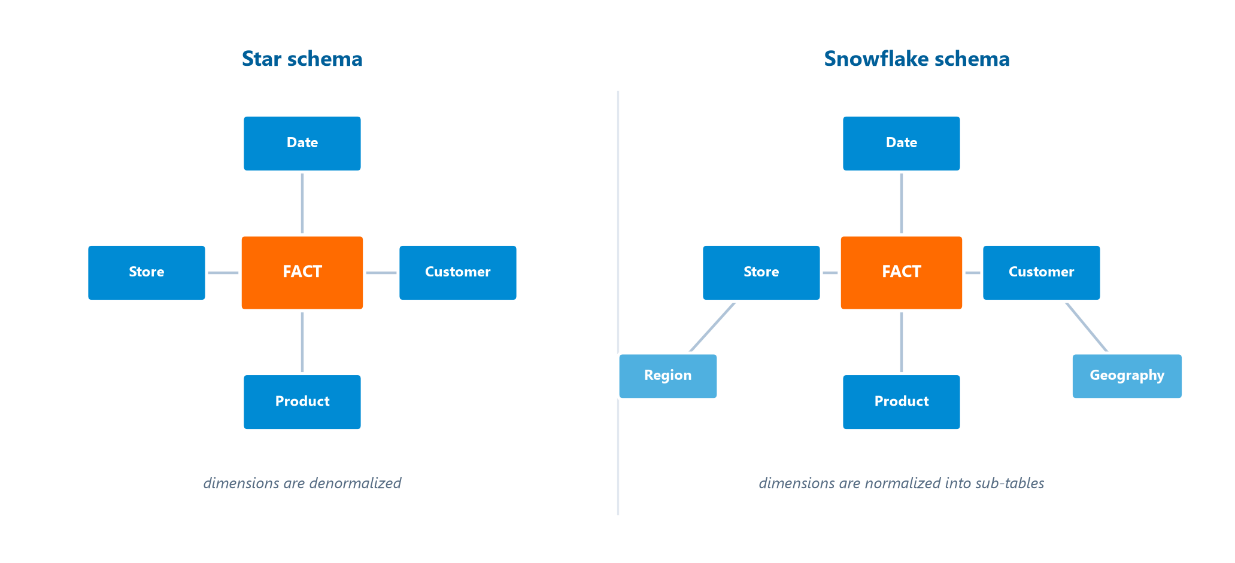
Dimensional Modeling — Star vs. Snowflake
Module 11 — Data Warehousing & BI
Star schema — a central fact table (numeric measures) surrounded by denormalized dimension tables (context: who/what/when/where). Best query performance.
Snowflake schema — dimensions are normalized into sub-dimensions; less redundancy but more complex to query.
Star keeps dimensions denormalized; snowflake normalizes them into sub-tables.
The 3NF integration layer reconciles source data; the dimensional presentation layer (star/snowflake) is optimized for business users.
⭐ EXAM TIP: Exposing the 3NF layer directly to users is risky — too many joins, slow adoption. Use a dimensional layer on top.
CDMP Fundamentals | DAMA-DMBOK 2nd Edition
dama.org / cdmp.info
Notes:
: Dimensional Modeling — Star vs. Snowflake
We covered dimensional modeling in Chapter 5, but it's central here too. As the diagram on screen shows, a star schema has a central fact table — holding the numeric, measurable data — surrounded by denormalized dimension tables that provide the context: the who, what, when, where, and how. Because the dimensions are denormalized, the star schema delivers the best query performance, which is why it dominates data warehousing. A snowflake schema is a variation where the dimension tables are normalized, split into sub-dimensions — this reduces redundancy but makes queries more complex with more joins. In a layered warehouse, a third-normal-form integration layer reconciles the source data, and then a dimensional presentation layer, the star or snowflake, sits on top, optimized for business users. And here's an exam point: exposing that 3NF integration layer directly to business users is risky, because the many joins make it complex to query, leading to slow adoption and incorrect analysis. That's why you build the dimensional layer on top.
---

Slide 11
Fact Table Types
Module 11 — Data Warehousing & BI
Type | One row per…
Transaction Fact | A transaction event
Periodic Snapshot | A period (e.g., daily inventory balance)
Accumulating Snapshot | A lifecycle (with multiple date stamps)
⭐ EXAM TIP: Transaction = per event; Periodic = per period; Accumulating = per lifecycle.
CDMP Fundamentals | DAMA-DMBOK 2nd Edition
dama.org / cdmp.info
Notes:
: Fact Table Types
There are three types of fact tables, distinguished by what a single row represents. A transaction fact table has one row per transaction event — the most granular and common type. A periodic snapshot fact table has one row per period — for example, a daily inventory balance, capturing the state at regular intervals. And an accumulating snapshot fact table has one row per lifecycle, with multiple date stamps that get updated as the process moves through its stages — useful for tracking something like an order from placement to delivery. Underlying all of this is the concept of grain — the level of detail captured in a single fact-table row — and defining the grain is one of the most important steps in dimensional design. So: transaction is per event, periodic is per period, accumulating is per lifecycle.
---

Slide 12
Key Dimensional Terminology
Module 11 — Data Warehousing & BI
Term | Definition
Surrogate Key | Artificial DW key, independent of source keys
Degenerate Dimension | A dimension stored in the fact table (e.g., order number)
Factless Fact Table | A fact table with no measures — records events (e.g., attendance)
SCD | Slowly Changing Dimension: Type 1 overwrite · Type 2 new row · Type 3 new column
⭐ EXAM TIP: A degenerate dimension lives in the fact table; a factless fact has no numeric measures.
CDMP Fundamentals | DAMA-DMBOK 2nd Edition
dama.org / cdmp.info
Notes:
: Key Dimensional Terminology
A few terms the exam likes to test. A surrogate key is an artificial key assigned within the data warehouse to uniquely identify dimension members, independent of the source system's keys — which protects the warehouse from changes in those source keys. A degenerate dimension is a dimension stored directly in the fact table with no separate dimension table — a classic example is an order number, which is dimensional in nature but has no other attributes worth a separate table. A factless fact table is a fact table with no numeric measures; it records that an event happened — like student attendance. And slowly changing dimensions handle attributes that change over time: Type 1 overwrites the old value, Type 2 adds a new row to preserve history, and Type 3 adds a new column. Two to remember especially: a degenerate dimension lives inside the fact table, and a factless fact has no measures.
---

Slide 13
Aggregates, Indexing & DW Performance
Module 11 — Data Warehousing & BI
A query-heavy warehouse is tuned for read performance, not transaction speed:
  Aggregate (summary) tables — pre-computed rollups (e.g., daily/monthly sales) speed common queries
  Materialized views — precomputed, periodically refreshed results
  Indexing — bitmap indexes suit low-cardinality dimension columns; B-tree for high-cardinality
  Partitioning — split large fact tables (usually by date) for query pruning and easier maintenance
⭐ EXAM TIP: Aggregates and bitmap indexes are classic DW performance techniques; partition fact tables by date.
CDMP Fundamentals | DAMA-DMBOK 2nd Edition
dama.org / cdmp.info
Notes:
: Aggregates, Indexing & DW Performance
A warehouse is tuned for reading, not for fast transactions, so the performance techniques are different from an operational database. Aggregate, or summary, tables pre-compute common rollups — daily or monthly sales totals — so a dashboard doesn't re-scan billions of rows. Materialized views do something similar: they store a precomputed result and refresh it periodically. On indexing, there's an exam favorite — bitmap indexes are ideal for low-cardinality dimension columns, like a gender or status flag with just a few distinct values, while traditional B-tree indexes suit high-cardinality columns. And partitioning splits a huge fact table into pieces, almost always by date, so queries prune to just the relevant slices and maintenance gets easier. So remember: aggregates and bitmap indexes for performance, and partition the fact table by date.
---

Slide 14
OLAP & MDX
Module 11 — Data Warehousing & BI
OLAP type | Storage | Note
ROLAP | Relational tables | Translates queries to SQL via MDX
MOLAP | Proprietary cubes | Fastest; pre-aggregated
HOLAP | Hybrid | Balances storage & performance
⭐ EXAM TIP: MOLAP = cubes, fastest; ROLAP = relational.
CDMP Fundamentals | DAMA-DMBOK 2nd Edition
dama.org / cdmp.info
Notes:
: OLAP & MDX
OLAP, Online Analytical Processing, is about multidimensional analysis — slicing, dicing, drilling down, and rolling up data — as opposed to OLTP, which handles operational transactions. OLAP databases are queried with MDX, the Multidimensional eXpression language. There are three OLAP types. ROLAP, relational OLAP, stores data in relational tables and translates queries via MDX. MOLAP, multidimensional OLAP, stores data in proprietary, pre-aggregated cubes and delivers the fastest query performance. And HOLAP, hybrid OLAP, combines relational and multidimensional storage to balance storage efficiency against performance. Also keep the OLTP-versus-OLAP contrast handy: OLTP is operational and row-oriented with high-frequency transactions, while OLAP is analytical and column-oriented with complex queries. The fact most likely tested: MOLAP uses cubes and is the fastest, while ROLAP is relational.
---

Slide 15
Change Data Capture — 5 Techniques
Module 11 — Data Warehousing & BI
Technique | Key fact
Audit Columns | Read Created/Updated date columns
Database Triggers | Fire on INSERT/UPDATE/DELETE → staging
Full Table Comparison | Diff full snapshots — resource-intensive
Transaction/Redo Logs | Read the DB log — most efficient, non-invasive
Message Queues | Sources publish change events; ETL subscribes
⭐ EXAM TIP: Reading the transaction/redo log is the most efficient, least invasive CDC method.
CDMP Fundamentals | DAMA-DMBOK 2nd Edition
dama.org / cdmp.info
Notes:
: Change Data Capture — 5 Techniques
To keep a warehouse current without reloading everything, you use change data capture, and the DMBOK lists five techniques. Audit columns means the source tables have created-date and updated-date columns that the ETL reads to find changed rows. Database triggers fire on inserts, updates, and deletes, capturing changes to a staging table — but they add overhead to the source. Full table comparison diffs a full source snapshot against the previous one, which is accurate but resource-intensive. Reading the database transaction or redo logs is the most efficient and least invasive method, because it reads changes that are already written. And message queues have source systems publish change events that the ETL subscribes to. The one to remember: reading the transaction or redo log is the most efficient, non-invasive CDC technique.
---

Slide 16
ETL & the Staging Area
Module 11 — Data Warehousing & BI
ETL phases: Extract (read sources) → Transform (cleanse, convert, aggregate, apply rules) → Load (write to target).
Staging area — temporary storage between source and target that decouples extraction from transformation, protects sources from repeated queries, and enables data quality checks before load.
⭐ EXAM TIP: The staging area lands raw data temporarily — it's not the final, user-facing layer.
CDMP Fundamentals | DAMA-DMBOK 2nd Edition
dama.org / cdmp.info
Notes:
: ETL & the Staging Area
ETL has three phases: Extract, where you read data from the source systems; Transform, where you cleanse, convert, aggregate, and apply business rules; and Load, where you write the result to the target — the staging area, the warehouse, or a data mart. The staging area deserves special attention. It's temporary storage that sits between source and target, and its primary purpose is to land raw source data so that extraction is decoupled from transformation. This protects the source systems from being hammered by repeated queries, and it gives you a place to run data quality checks before the final load. Importantly, the staging area is not the final, user-facing layer — it's a working space, holding raw data temporarily.
---

Slide 17
BI Delivery Components
Module 11 — Data Warehousing & BI
Component | Purpose
Standard / Operational reports | Recurring daily/weekly reports
Ad hoc reports | User-defined queries on demand
Dashboards | Visual KPIs, real/near-real-time
Scorecards | Performance vs strategic objectives
OLAP analysis | Slice, dice, drill-down, roll-up
Predictive analytics | Statistical models to forecast
⭐ EXAM TIP: Dashboards monitor operations; scorecards track strategic objectives.
CDMP Fundamentals | DAMA-DMBOK 2nd Edition
dama.org / cdmp.info
Notes:
: BI Delivery Components
Now the delivery side — how users actually consume the warehouse. Standard or operational reports are recurring reports for daily and weekly operations. Ad hoc reports are user-defined queries run on demand. Dashboards give a visual display of KPIs, often in real or near-real time. Scorecards measure performance against strategic objectives. OLAP analysis lets users slice, dice, drill down, and roll up multidimensional data. And predictive analytics applies statistical models to forecast future outcomes. There's also self-service BI, where business users create their own reports without IT involvement — but that only works if you've provided well-designed data models and governed metadata underneath. One distinction worth knowing: dashboards monitor operations, while scorecards track progress against strategic objectives.
---

Slide 18
BI Types — Strategic, Tactical & Operational
Module 11 — Data Warehousing & BI
BI type | Horizon | Use
Strategic BI | Long-term | Scorecards, KPIs, goal tracking for executives
Tactical BI | Medium-term | Analysis & comparison to support department decisions
Operational BI | Real-time / right-time | Embedded in operational processes; immediate action
⭐ EXAM TIP: Operational BI = real-time, in-the-moment; strategic BI = long-term scorecards.
CDMP Fundamentals | DAMA-DMBOK 2nd Edition
dama.org / cdmp.info
Notes:
: BI Types — Strategic, Tactical & Operational
Business intelligence comes in three flavors, distinguished by their time horizon. Strategic BI is long-term — the scorecards and KPIs executives use to track progress toward goals. Tactical BI is medium-term — the analysis and comparison that supports departmental decisions over weeks and months. And operational BI is real-time, or right-time — it's embedded directly in operational processes to drive immediate action, like flagging a fraudulent transaction as it happens. Notice the data implication: operational BI demands low-latency data, which is what pushes organizations toward real-time integration and the operational data store. For the exam: operational BI is real-time and in-the-moment, while strategic BI is the long-term scorecard.
---

Slide 19
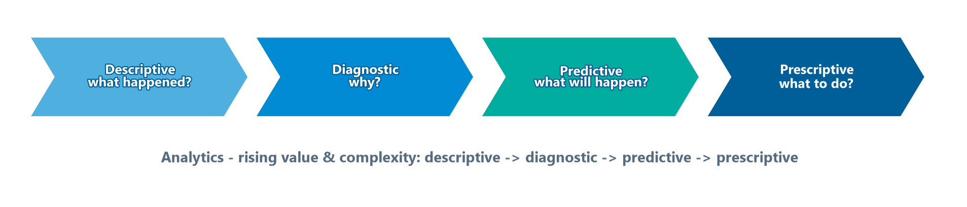
The Analytics Continuum & Data Mining
Module 11 — Data Warehousing & BI
Four stages of analytics, rising in value and complexity.
Descriptive — what happened? (reporting, dashboards)
Diagnostic — why did it happen? (drill-down, correlation)
Predictive — what will happen? (statistical models, data mining, machine learning)
Prescriptive — what should we do? (optimization, recommendations)
⭐ EXAM TIP: Value and complexity rise from descriptive → diagnostic → predictive → prescriptive.
CDMP Fundamentals | DAMA-DMBOK 2nd Edition
dama.org / cdmp.info
Notes:
: The Analytics Continuum & Data Mining
Analytics sits on a continuum of increasing value and complexity — the four stages on screen. Descriptive analytics asks what happened: that's your standard reporting and dashboards. Diagnostic analytics asks why it happened: drilling down, finding correlations. Predictive analytics asks what will happen: this is where statistical models, data mining, and machine learning come in. And prescriptive analytics asks what we should do about it: optimization and recommendation engines. Data mining is the engine for that predictive stage — it discovers patterns in large data sets through techniques like classification, clustering, association, and regression. The exam point is the progression itself: value and complexity climb from descriptive, to diagnostic, to predictive, to prescriptive.
---

Slide 20
The Semantic Layer & Self-Service BI
Module 11 — Data Warehousing & BI
A semantic layer is a business-friendly model over the warehouse — it maps technical tables/columns to business terms and metrics, so users query meaning, not SQL.
Self-service BI lets business users build their own reports and dashboards — but it requires well-designed models, governed conformed metrics, and trustworthy metadata, or users produce conflicting numbers.
⭐ EXAM TIP: Self-service BI only works on top of governed models and conformed metrics — otherwise everyone's "revenue" differs.
CDMP Fundamentals | DAMA-DMBOK 2nd Edition
dama.org / cdmp.info
Notes:
: The Semantic Layer & Self-Service BI
Two related concepts that make BI usable. A semantic layer is a business-friendly model that sits on top of the warehouse — it maps the technical tables and columns to the business terms and metrics people actually understand, so a user can ask for "revenue by region" without writing any SQL. Self-service BI then lets those business users build their own reports and dashboards. But — and this is the governance catch the exam likes — self-service only works if it sits on well-designed models, governed and conformed metrics, and trustworthy metadata. Without that, every department defines "revenue" slightly differently and you get a meeting full of conflicting numbers. So the lesson: self-service BI depends on governed models and conformed metrics underneath.
---

Slide 21
Governance & Metrics
Module 11 — Data Warehousing & BI
Governance areas: data lineage, Metadata (business definitions of DW objects), data quality (validate before load), access control, change management for source changes.
DW metrics: report freshness/latency, ETL error/reject rates, query performance, user adoption, availability.
⭐ EXAM TIP: DW/BI success depends on data quality and Metadata — they're guiding principles and governance areas.
CDMP Fundamentals | DAMA-DMBOK 2nd Edition
dama.org / cdmp.info
Notes:
: Governance & Metrics
Governance for DW/BI focuses on several areas: data lineage, tracking data from source through transformation to target; metadata management, the business definitions of all the warehouse objects; data quality, validating data before it loads and monitoring it ongoing; access control over sensitive data in reports; and change management for source-system changes that affect the warehouse. The metrics include report freshness, or the latency between source and warehouse; data quality error rates, like records rejected in ETL; query performance; user adoption, measured by active users and reports run; and availability. Notice that data quality and metadata appear both as guiding principles and as governance areas — that's no accident; the whole discipline depends on them.
---

Slide 22
Metadata & Lineage in DW/BI
Module 11 — Data Warehousing & BI
DW/BI runs on metadata:
  Business metadata — definitions of measures and dimensions (what "Net Revenue" means)
  Technical metadata — source-to-target mappings, ETL job details, schemas
  Data lineage — traces each value from source → ETL → warehouse → report
Lineage enables impact analysis ("what reports break if this source changes?") and builds trust in the numbers.
⭐ EXAM TIP: Data quality and metadata are both guiding principles and governance areas for DW/BI — trust depends on them.
CDMP Fundamentals | DAMA-DMBOK 2nd Edition
dama.org / cdmp.info
Notes:
: Metadata & Lineage in DW/BI
A data warehouse runs on metadata — three kinds you already know. Business metadata defines the measures and dimensions: what exactly "Net Revenue" means, and how it's calculated. Technical metadata captures the source-to-target mappings, the ETL job details, and the schemas. And data lineage traces each value along its whole journey — from the source system, through the ETL, into the warehouse, and out to the report. That lineage is enormously valuable: it powers impact analysis, letting you answer "which reports break if this source column changes," and it builds trust, because users can see exactly where a number came from. The exam framing ties the chapter together: data quality and metadata are both guiding principles and governance areas for DW/BI — the trustworthiness of the whole system rests on them.
---

Slide 23
Key Numbers & Quick Facts (Cheat Sheet)
Module 11 — Data Warehousing & BI
Fact | Value
Inmon's 4 properties | Subject-oriented, Integrated, Time-variant, Non-volatile
Father of the DW | Bill Inmon
Inmon / Kimball | CIF top-down / Bus bottom-up
ODS history | ~30–90 days (current)
Bus matrix | maps dimensions ↔ fact tables
Conformed dimension | shared across marts
Star / Snowflake | denormalized / normalized dimensions
Fact types | Transaction · Periodic · Accumulating
OLAP types | ROLAP · MOLAP (fastest) · HOLAP
Most efficient CDC | Transaction/redo logs
Guiding principles | 7
CDMP Fundamentals | DAMA-DMBOK 2nd Edition
dama.org / cdmp.info
Notes:
: Key Numbers & Quick Facts (Cheat Sheet)
Let's consolidate. Inmon's four properties are subject-oriented, integrated, time-variant, and non-volatile, and Inmon is the father of the data warehouse. Inmon's CIF is top-down; Kimball's bus is bottom-up. The ODS holds about thirty to ninety days of current data. The bus matrix maps dimensions to fact tables, and a conformed dimension is shared across marts. Star schemas have denormalized dimensions, snowflakes normalized. The three fact types are transaction, periodic, and accumulating. The OLAP types are ROLAP, MOLAP — the fastest — and HOLAP. The most efficient CDC method reads the transaction logs. And there are seven guiding principles. Review these until they're automatic.
---

Slide 24
Common Exam Traps
Module 11 — Data Warehousing & BI
❌ The ODS is the data warehouse → ✅ the ODS holds current data; the DW holds history
❌ Star schema normalizes dimensions → ✅ star = denormalized; snowflake = normalized
❌ Kimball is top-down → ✅ Kimball is bottom-up (dimensional marts); Inmon is top-down (EDW)
❌ ROLAP is fastest → ✅ MOLAP (cubes) is fastest
❌ A degenerate dimension has its own table → ✅ it lives inside the fact table
⭐ EXAM TIP: Conformed dimensions are what make enterprise reporting possible across data marts.
CDMP Fundamentals | DAMA-DMBOK 2nd Edition
dama.org / cdmp.info
Notes:
: Common Exam Traps
Here are the traps. First, the operational data store is not the data warehouse — the ODS holds current data, while the warehouse holds history. Second, a star schema has denormalized dimensions, not normalized ones; it's the snowflake that normalizes. Third, watch the Inmon-Kimball direction: Kimball is bottom-up with dimensional marts, while Inmon is top-down with a central EDW. Fourth, MOLAP, not ROLAP, is the fastest, because it uses pre-aggregated cubes. And fifth, a degenerate dimension does not have its own table — it lives inside the fact table. One overarching point: conformed dimensions are what make enterprise reporting possible across separate data marts, so when a question is about integrating marts, think conformed dimensions.
---

Slide 25
Module Summary
Module 11 — Data Warehousing & BI
A data warehouse is subject-oriented, integrated, time-variant, and non-volatile (Inmon); BI turns it into actionable insight.
Inmon's CIF (top-down, normalized EDW) vs Kimball's Bus (bottom-up, dimensional marts with conformed dimensions).
Star schemas (denormalized) beat snowflakes for query speed; know the 3 fact types and grain.
OLAP (ROLAP/MOLAP/HOLAP, queried by MDX); MOLAP is fastest; redo-log CDC is least invasive.
Deliver via reports, dashboards, scorecards, OLAP, predictive analytics — governed by quality and Metadata.
CDMP Fundamentals | DAMA-DMBOK 2nd Edition
dama.org / cdmp.info
Notes:
: Module Summary
Let's wrap up. A data warehouse is subject-oriented, integrated, time-variant, and non-volatile, per Inmon, and Business Intelligence turns it into actionable insight. The two philosophies are Inmon's Corporate Information Factory — top-down with a normalized enterprise warehouse — and Kimball's Bus Architecture — bottom-up with dimensional marts unified by conformed dimensions. Star schemas, with their denormalized dimensions, beat snowflakes for query speed, and you should know the three fact types and the concept of grain. OLAP comes in ROLAP, MOLAP, and HOLAP flavors queried by MDX, with MOLAP the fastest, and redo-log CDC is the least invasive. And you deliver through reports, dashboards, scorecards, OLAP, and predictive analytics, all governed by data quality and metadata. That's Chapter 11.
---

Slide 26
Let's Test Your Knowledge
Module 11 — Data Warehousing & BI
Heading: 5 practice questions — Data Warehousing & BI
Subtitle: Watch the Inmon/Kimball and conformed-dimension distinctions.
CDMP Fundamentals | DAMA-DMBOK 2nd Edition
dama.org / cdmp.info
Notes:
: Let's Test Your Knowledge
Time for five practice questions on data warehousing and BI. These focus on the Inmon CIF, the Kimball bus architecture and conformed dimensions, and the role of the staging area. Read each carefully, choose your answer, and then reveal the solution. Here we go.
---

Slide 27
Practice Question 1
Module 11 — Data Warehousing & BI
Q1
In Bill Inmon's Corporate Information Factory (CIF), which component serves as the single, integrated, subject-oriented repository that feeds all downstream analytical environments?
A) The exploration warehouse for unstructured/experimental data
B) The data mart layer of departmental subsets
C) The Enterprise Data Warehouse (EDW), storing atomic, normalized, historical data integrated across the organization
D) The Operational Data Store (ODS), providing near-real-time tactical data
Answer: In the CIF, the EDW is the central, integrated, subject-oriented, normalized, historical repository that feeds all downstream marts and analytics. Data marts are dependent (fed from the EDW), and the ODS holds only current operational data.
CDMP Fundamentals | DAMA-DMBOK 2nd Edition
dama.org / cdmp.info
Notes:
: Practice Questions (Q1–Q3)
Question one: in Inmon's CIF, which component is the single integrated, subject-oriented repository feeding all downstream analytics? The answer is C — the Enterprise Data Warehouse, the EDW, which holds atomic, normalized, historical, integrated data. The data marts are dependent and fed from it, and the ODS holds only current operational data.
Question two: the CIF data flow sequence? The answer is D — source, then ODS, then EDW, then data marts, then BI tools. The ODS integrates current data, the EDW holds the integrated history, dependent marts serve departments, and BI tools sit at the end.
Question three: Kimball's bus architecture unifies data marts through which design element? The answer is C — conformed dimensions, with identical or compatible keys, attributes, and values across all marts. That's what lets facts be compared across subject areas. It doesn't require identical grain or a shared 3NF layer.
Two more on the next slide.
---

Slide 28
Practice Question 2
Module 11 — Data Warehousing & BI
Q2
In the CIF, data flows from source systems through which sequence before reaching end-user analytical tools?
A) Source → staging → data marts → EDW → BI tools
B) Source → data marts → EDW → ODS → BI tools
C) Source → EDW → ODS → data marts → BI tools
D) Source → ODS → EDW → data marts → BI tools
Answer: The CIF flow is Source → ODS → EDW → Data Marts → BI/reporting tools. The ODS integrates current operational data, the EDW holds the integrated history, dependent data marts serve departments, and BI tools sit at the end.
CDMP Fundamentals | DAMA-DMBOK 2nd Edition
dama.org / cdmp.info
Notes:
: Practice Questions (Q1–Q3)
Question one: in Inmon's CIF, which component is the single integrated, subject-oriented repository feeding all downstream analytics? The answer is C — the Enterprise Data Warehouse, the EDW, which holds atomic, normalized, historical, integrated data. The data marts are dependent and fed from it, and the ODS holds only current operational data.
Question two: the CIF data flow sequence? The answer is D — source, then ODS, then EDW, then data marts, then BI tools. The ODS integrates current data, the EDW holds the integrated history, dependent marts serve departments, and BI tools sit at the end.
Question three: Kimball's bus architecture unifies data marts through which design element? The answer is C — conformed dimensions, with identical or compatible keys, attributes, and values across all marts. That's what lets facts be compared across subject areas. It doesn't require identical grain or a shared 3NF layer.
Two more on the next slide.
---

Slide 29
Practice Question 3
Module 11 — Data Warehousing & BI
Q3
Ralph Kimball's Bus Architecture enables an enterprise data warehouse by ensuring that individual data marts share which critical design element?
A) A common ETL scheduling framework
B) Identical grain definitions on all fact tables
C) Conformed dimensions that carry identical or compatible keys, attributes, and values across all marts
D) A centralized 3NF integration layer physically shared by all marts
Answer: Kimball's bus architecture unifies independent data marts through conformed dimensions — shared dimensions with consistent keys, attributes, and values — which let facts be compared and combined across subject areas. It does not require identical grain or a shared 3NF layer.
CDMP Fundamentals | DAMA-DMBOK 2nd Edition
dama.org / cdmp.info
Notes:
: Practice Questions (Q1–Q3)
Question one: in Inmon's CIF, which component is the single integrated, subject-oriented repository feeding all downstream analytics? The answer is C — the Enterprise Data Warehouse, the EDW, which holds atomic, normalized, historical, integrated data. The data marts are dependent and fed from it, and the ODS holds only current operational data.
Question two: the CIF data flow sequence? The answer is D — source, then ODS, then EDW, then data marts, then BI tools. The ODS integrates current data, the EDW holds the integrated history, dependent marts serve departments, and BI tools sit at the end.
Question three: Kimball's bus architecture unifies data marts through which design element? The answer is C — conformed dimensions, with identical or compatible keys, attributes, and values across all marts. That's what lets facts be compared across subject areas. It doesn't require identical grain or a shared 3NF layer.
Two more on the next slide.
---

Slide 30
Practice Question 4
Module 11 — Data Warehousing & BI
Q4
A company builds separate Sales, Finance, and HR data marts, each with its own definition of "customer." Per Kimball's Bus Architecture, what fundamental problem does this create?
A) A single point of failure across the enterprise DW
B) A violation of 3NF normalization rules
C) It prevents cross-functional analysis because the customer dimension is not conformed, making it impossible to join or compare facts across the marts
D) It forces all ETL processes to run sequentially
Answer: Without a conformed customer dimension, each mart's "customer" is incompatible, so you can't join or compare sales, finance, and HR facts about the same customers. Conforming the dimension is exactly what the bus architecture exists to ensure.
CDMP Fundamentals | DAMA-DMBOK 2nd Edition
dama.org / cdmp.info
Notes:
: Practice Questions (Q4–Q5)
Question four: a company builds separate Sales, Finance, and HR marts, each with its own definition of customer. What problem does that create? The answer is C — because the customer dimension is not conformed, you can't join or compare facts across the marts, which prevents cross-functional analysis. Conforming that dimension is exactly the problem the bus architecture solves.
Question five: the primary purpose of a DW staging area? The answer is C — to land raw source data temporarily, decoupling extraction from transformation, protecting the source systems from repeated queries, and enabling data quality checks before the final load. It's neither the aggregated summary layer nor the user-facing presentation layer.
That completes Module 11. Next up is Module 12, Metadata Management — one of the four highest-weighted chapters on the exam at around eleven percent. I'll see you there.
---
*End of Module 11 scripts.*

Slide 31
Practice Question 5
Module 11 — Data Warehousing & BI
Q5
What is the primary purpose of a DW staging area in the ETL process?
A) To host aggregated summary tables that speed up the presentation layer
B) To keep a full historical archive of source records for compliance
C) To land raw source data temporarily so extraction is decoupled from transformation, protecting sources from repeated queries and enabling data-quality checks before load
D) To store the final integrated, cleansed data that business users query
Answer: The staging area temporarily lands raw extracted data, decoupling extraction from transformation, shielding source systems from repeated heavy queries, and giving a place to run quality checks before the final load. It is neither the summary layer nor the user-facing presentation layer. End of Module 11 — Data Warehousing & Business Intelligence.
CDMP Fundamentals | DAMA-DMBOK 2nd Edition
dama.org / cdmp.info
Notes:
: Practice Questions (Q4–Q5)
Question four: a company builds separate Sales, Finance, and HR marts, each with its own definition of customer. What problem does that create? The answer is C — because the customer dimension is not conformed, you can't join or compare facts across the marts, which prevents cross-functional analysis. Conforming that dimension is exactly the problem the bus architecture solves.
Question five: the primary purpose of a DW staging area? The answer is C — to land raw source data temporarily, decoupling extraction from transformation, protecting the source systems from repeated queries, and enabling data quality checks before the final load. It's neither the aggregated summary layer nor the user-facing presentation layer.
That completes Module 11. Next up is Module 12, Metadata Management — one of the four highest-weighted chapters on the exam at around eleven percent. I'll see you there.
---
*End of Module 11 scripts.*

