Slide 1
CDMP FUNDAMENTALS
Module 12: Metadata Management
DAMA-DMBOK 2nd Edition, Chapter 12
Exam weight: ~11% (≈11 questions) — tied for most-tested. Master this chapter.
Module 12 — Metadata Management
100
90
Open
≥60%
MCQ
minutes
book
to pass
CDMP Fundamentals | DAMA-DMBOK 2nd Edition
dama.org / cdmp.info
Notes:
: Module Title Slide
Welcome to Module 12: Metadata Management. This is Chapter 12 of the DMBOK, and it's one of the four highest-weighted chapters on the exam — about eleven percent, roughly twelve questions. Metadata is, simply put, data about data — and managing it well is so foundational that the DMBOK says metadata management is often the starting point for improving data management overall. The exam tests the three types of metadata relentlessly, so we'll spend real time making sure you can classify any example correctly. Let's begin.
---

Slide 2
Module Overview & Learning Objectives
Module 12 — Metadata Management
By the end, you'll be able to:
  Define Metadata Management and its 4 goals
  Classify the 3 types (Business, Technical, Operational)
  List the library-science categories and the 8 guiding principles
  Compare the 4 Metadata architectures
  Explain lineage, stitching, and the metamodel
  Recognize the business glossary audiences, sources, and metrics
CDMP Fundamentals | DAMA-DMBOK 2nd Edition
dama.org / cdmp.info
Notes:
: Module Overview & Learning Objectives
Here's our plan. You'll define metadata management and its four goals. You'll classify the three main types — business, technical, and operational — which is the single most tested skill in this chapter. You'll learn the library-science categories and the eight guiding principles. You'll compare the four metadata architectures. You'll explain lineage, stitching, and the metamodel. And you'll recognize the business glossary audiences, the sources of metadata, and the metrics. Let's start with the definition.
---

Slide 3
Definition, Goals & Core Principle
Module 12 — Metadata Management
DMBOK2 Definition: planning, implementation, and control activities to enable access to high quality, integrated Metadata.
4 goals: (1) provide organizational understanding of business terms; (2) collect & integrate Metadata from diverse sources; (3) provide standard access; (4) ensure Metadata quality & security.
Core principle: One person's Metadata is another person's data — it depends on the level of abstraction.
⭐ EXAM TIP: "Metadata is data about data" — and managing it often starts improvements across all of data management.
CDMP Fundamentals | DAMA-DMBOK 2nd Edition
dama.org / cdmp.info
Notes:
: Definition, Goals & Core Principle
The DMBOK defines metadata management as the planning, implementation, and control activities to enable access to high-quality, integrated metadata. There are four goals: provide organizational understanding of business terms and their usage; collect and integrate metadata from diverse sources; provide a standard way to access metadata; and ensure metadata quality and security. There's also a lovely core principle worth remembering: one person's metadata is another person's data. In other words, whether something counts as metadata or data depends on your level of abstraction — a database administrator's metadata about a table is the actual data a metadata analyst works with. And keep in mind that famous DMBOK observation: managing metadata often provides the starting point for improvements across all of data management.
---

Slide 4
Business Drivers & Cost of Poor Metadata
Module 12 — Metadata Management
Good Metadata increases confidence in data, enables impact analysis, reduces research time, improves communication, lowers training costs, and supports compliance.
Poorly managed Metadata causes: redundant data & processes · replicated dictionaries · inconsistent definitions · conflicting versions · doubt about reliability.
⭐ EXAM TIP: Metadata enables accurate impact analysis — reducing the risk of project failure.
CDMP Fundamentals | DAMA-DMBOK 2nd Edition
dama.org / cdmp.info
Notes:
: Business Drivers & Cost of Poor Metadata
Why invest in metadata? Well-managed metadata increases confidence in data by providing context, enables accurate impact analysis, reduces the time spent researching data, improves communication between business and IT, lowers training costs by documenting knowledge, and supports regulatory compliance. The flip side is instructive: poorly managed metadata leads to redundant data and processes, replicated and conflicting dictionaries and repositories, inconsistent definitions of data elements, competing versions that reduce consumer confidence, and ultimately doubt about the reliability of both the metadata and the data. The exam-worthy driver to remember: good metadata enables accurate impact analysis, which directly reduces the risk of project failure.
---

Slide 5
The 8 Guiding Principles
Module 12 — Metadata Management
Organizational Commitment — secure senior support & funding
Strategy — define requirements before buying tools
Enterprise Perspective — extensible; iterative delivery
Socialization — communicate the purpose of each Metadata type
Access — ensure staff know how to access & use it
Quality — hold process owners accountable for Metadata quality
Audit — set, enforce, and audit standards
Improvement — provide a feedback mechanism for corrections
⭐ EXAM TIP: Define requirements before tools (Principle 2) — a recurring DMBOK theme.
CDMP Fundamentals | DAMA-DMBOK 2nd Edition
dama.org / cdmp.info
Notes:
: The 8 Guiding Principles
The DMBOK gives eight guiding principles for metadata management. One, organizational commitment — secure senior management support and funding. Two, strategy — and critically, define your requirements before you evaluate or purchase tools. Three, enterprise perspective — design for extensibility and deliver iteratively. Four, socialization — communicate the necessity and purpose of each type of metadata, which encourages business users to contribute their expertise. Five, access — make sure staff know how to access and use metadata. Six, quality — recognize that metadata is produced through existing processes, so hold the process owners accountable for its quality. Seven, audit — set, enforce, and audit metadata standards. And eight, improvement — create a feedback mechanism so consumers can report incorrect or out-of-date metadata. The principle the exam most loves: define requirements before tools.
---

Slide 6
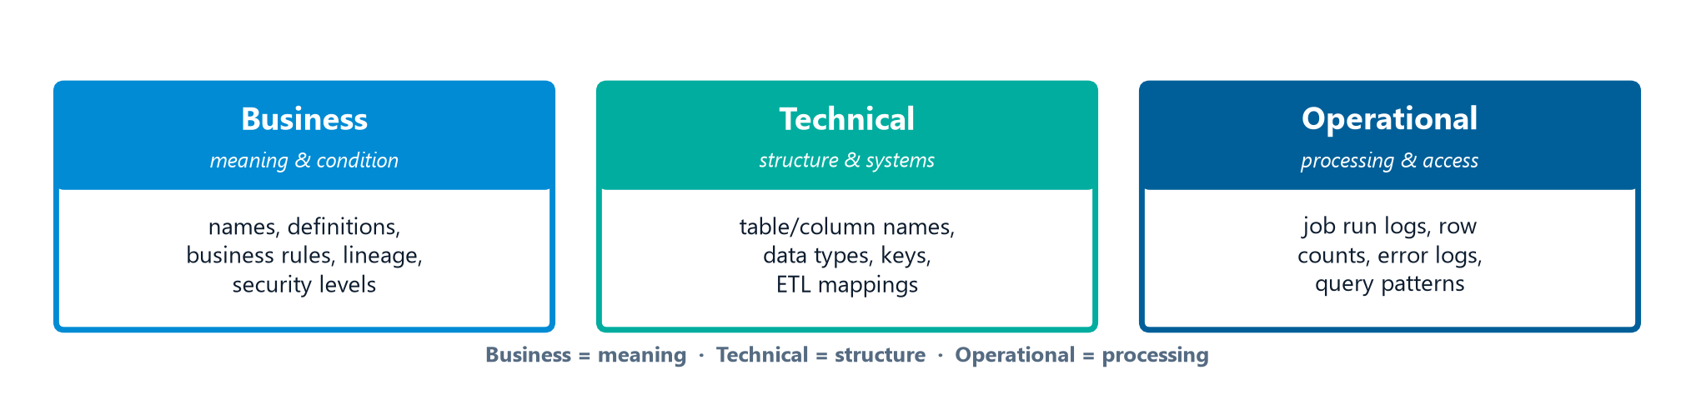
The 3 Types — Business Metadata
Module 12 — Metadata Management
Business Metadata focuses on the content and condition of data (plus governance details). It includes:
  Non-technical names and definitions of concepts, entities, attributes
  Business rules, transformation rules, calculations
  Data quality rules & results; data lineage; data standards
  Valid-value constraints; stewardship contacts; security/privacy levels
⭐ EXAM TIP: Owner, intended audience, definitions, and business rules = Business Metadata.
CDMP Fundamentals | DAMA-DMBOK 2nd Edition
dama.org / cdmp.info
Notes:
: The 3 Types — Business Metadata
Now the heart of the chapter, the three cards on screen: the three types of metadata. We'll take one per slide, because classifying examples correctly is the number-one exam skill here. First, business metadata. Business metadata focuses largely on the content and condition of data, plus governance details. It includes the non-technical names and definitions of concepts, subject areas, entities, and attributes; the business rules, transformation rules, calculations, and derivations; data quality rules and their results; data provenance and lineage; data standards; valid-value constraints; stewardship contact information; and security and privacy levels. The mental model: business metadata is about meaning — what the data means and the rules that govern it. So if a scenario mentions an owner, an intended audience, definitions, or business rules, think business metadata.
---

Slide 7
The 3 Types — Technical Metadata
Module 12 — Metadata Management
Technical Metadata describes the technical details of data, the systems that store it, and the processes that move it:
  Physical table/column names, column properties, data types, lengths, constraints
  Primary/foreign keys; access permissions; physical data models
  ETL job details; source-to-target mappings; file format schemas
  Backup/recovery rules; update cycle schedules
⭐ EXAM TIP: Data type, field length, PK constraints, table relationships = Technical Metadata.
CDMP Fundamentals | DAMA-DMBOK 2nd Edition
dama.org / cdmp.info
Notes:
: The 3 Types — Technical Metadata
Second, technical metadata. Technical metadata provides information about the technical details of data, the systems that store it, and the processes that move it. It includes physical database table and column names, column properties like data types and lengths and constraints, primary and foreign keys, access permissions, physical data models, ETL job details, file format schema definitions, source-to-target mapping documentation, content update schedules, and backup and recovery rules. The mental model: technical metadata is about structure and systems — the physical implementation. So whenever you see data types, field lengths, primary key constraints, or table relationships, that's technical metadata. This is the category most often confused with business metadata, so anchor on structure-and-systems versus meaning-and-rules.
---

Slide 8
The 3 Types — Operational Metadata
Module 12 — Metadata Management
Operational Metadata describes the processing and accessing of data:
  Job execution logs; history of extracts and results; rows loaded
  Audit/balance/control results; error logs
  Query access patterns, frequency, execution time
  Backup/retention dates; SLA requirements; purge criteria
⭐ EXAM TIP: An ETL job's last-run timestamp and row count = Operational Metadata.
CDMP Fundamentals | DAMA-DMBOK 2nd Edition
dama.org / cdmp.info
Notes:
: The 3 Types — Operational Metadata
Third, operational metadata. Operational metadata describes the details of processing and accessing data. It includes logs of job execution for batch programs, the history of extracts and their results, the number of rows loaded, audit and balance and control measurements, error logs, query access patterns and their frequency and execution time, backup and retention dates, disaster recovery provisions, SLA requirements, volumetric and usage patterns, and purge criteria. The mental model: operational metadata is about processing and access — what happened when the data was moved or used. So the classic example is an ETL job's last-run timestamp and the count of rows it loaded — that's operational metadata. Meaning is business, structure is technical, processing is operational.
---

Slide 9
Library-Science Categories
Module 12 — Metadata Management
Category | Purpose
Descriptive | Title, author, subject — enables identification & retrieval
Structural | Relationships within/among resources (pages, chapters)
Administrative | Version numbers, archive dates — manages over the lifecycle
⭐ EXAM TIP: Don't confuse these with the DMBOK three (Business/Technical/Operational). Both classifications are testable.
CDMP Fundamentals | DAMA-DMBOK 2nd Edition
dama.org / cdmp.info
Notes:
: Library-Science Categories
There's an alternative classification of metadata that comes from library and information science, and the exam sometimes tests it alongside the DMBOK three, so don't get them confused. Descriptive metadata includes things like title, author, and subject — it enables identification and retrieval of a resource. Structural metadata captures the relationships within and among resources — like the number of pages or chapters. And administrative metadata includes things like version numbers and archive dates, used to manage resources over their lifecycle. So you actually have two valid classification schemes: the DMBOK's business-technical-operational, and library science's descriptive-structural-administrative. Both are testable, so keep them in separate mental buckets.
---

Slide 10
ISO/IEC 11179 — Metadata Registry Standard
Module 12 — Metadata Management
A framework for a Metadata registry enabling Metadata-driven data exchange from exact data-element definitions.
Key parts:
  Part 1 — Framework · Part 3 — Basic Attributes · Part 4 — Data Definition rules
  Part 5 — Naming & Identification Principles · Part 6 — Registration
⭐ EXAM TIP: Part 5 = naming standards. (Same standard you saw in modeling and storage.)
CDMP Fundamentals | DAMA-DMBOK 2nd Edition
dama.org / cdmp.info
Notes:
: ISO/IEC 11179 — Metadata Registry Standard
ISO/IEC 11179 is the Metadata Registry Standard, and it provides a framework for defining a metadata registry that enables metadata-driven data exchange, based on exact definitions of data elements. It's organized into parts. Part 1 is the framework for generating and standardizing data elements. Part 3 covers the basic attributes of data elements. Part 4 covers the rules for formulating data definitions. Part 5 covers naming and identification principles. And Part 6 covers registration. The one you must remember is Part 5 for naming standards — and you've now seen this same standard appear in the data modeling and data storage chapters, so it's clearly worth knowing.
---

Slide 11
Sources of Metadata
Module 12 — Metadata Management
The DMBOK lists 15 sources of Metadata, including:
  Business glossary · application repositories · BI tools · CMDB (each asset = a Configuration Item)
  Data dictionaries · data integration tools · DB catalogs · data-mapping tools
  data quality tools · directories/catalogs · event messaging · modeling tools
  reference data repositories · service registries (SOA: version, location, availability)
⭐ EXAM TIP: A data dictionary defines structure & contents; a CMDB manages IT assets as Configuration Items.
CDMP Fundamentals | DAMA-DMBOK 2nd Edition
dama.org / cdmp.info
Notes:
: Sources of Metadata
The DMBOK lists fifteen sources of metadata, and while you don't need to memorize all fifteen, you should recognize the major ones. The business glossary documents business concepts and definitions. Application metadata repositories are often built into modeling and BI tools. BI tools produce metadata about classes, objects, and reports. Configuration management tools, the CMDB, manage IT assets, where each asset is a configuration item. Data dictionaries define the structure and contents of datasets. Data integration tools document lineage. Database catalogs describe database content. Modeling tools produce metadata about entities and relationships. And service registries, in a service-oriented architecture, manage technical information about services — where the most important metadata is the service version, location, and availability. Two to remember: a data dictionary defines structure and contents, and a CMDB manages IT assets as configuration items.
---

Slide 12
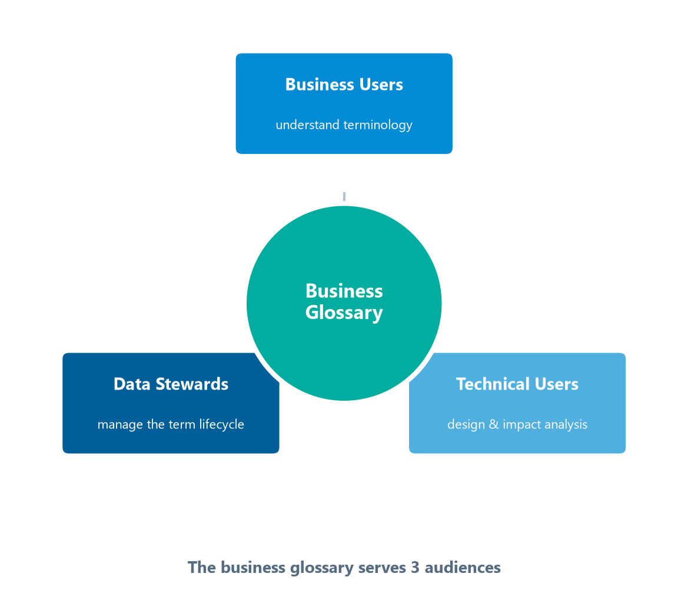
The Business Glossary & Its 3 Audiences
Module 12 — Metadata Management
A business glossary documents business concepts, terminology, definitions, and relationships. Its 3 core audiences:
Business Users (analysts, management) — understand terminology
Data Stewards — manage the term lifecycle; resolve differences
Technical Users — make design decisions; conduct impact analysis
Repository vs. catalog: a repository stores technical/structural Metadata for integration; a catalog is a business-friendly, searchable inventory for data consumers.
⭐ EXAM TIP: Glossary audiences = Business Users, Data Stewards, Technical Users.
CDMP Fundamentals | DAMA-DMBOK 2nd Edition
dama.org / cdmp.info
Notes:
: The Business Glossary & Its 3 Audiences
The business glossary is a central source of metadata, documenting business concepts, terminology, definitions, and relationships. It serves three core audiences — arranged around the glossary on screen — and the exam may ask you to name them. Business users — analysts, management, executives — who need to understand the terminology and the data. Data stewards, who manage the lifecycle of the terms, associate data assets with glossary terms, and resolve differences in definitions. And technical users, who make architecture, design, and development decisions and conduct impact analysis. While we're here, note a related distinction: a metadata repository stores technical and structural metadata to support system integration, whereas a metadata catalog provides a business-friendly, searchable inventory for data consumers. The glossary's three audiences are business users, data stewards, and technical users.
---

Slide 13
Data Catalogs & Self-Service Discovery
Module 12 — Metadata Management
A data catalog is a business-friendly, searchable inventory of data assets — it helps consumers find, understand, and trust data.
Repository vs. catalog: a repository stores technical/structural metadata for integration; a catalog is the discovery layer for data consumers.
Catalogs are curated and often crowdsourced — stewards certify assets while users add tags, ratings, and documentation.
They enable self-service: analysts discover trustworthy data without filing IT tickets.
⭐ EXAM TIP: Repository = technical store for integration; catalog = business-friendly discovery for consumers.
CDMP Fundamentals | DAMA-DMBOK 2nd Edition
dama.org / cdmp.info
Notes:
: Data Catalogs & Self-Service Discovery
We touched on the business glossary; its close cousin is the data catalog. A data catalog is a business-friendly, searchable inventory of an organization's data assets, built to help consumers find, understand, and trust data. Keep the repository-versus-catalog distinction straight, because the exam tests it: a metadata repository is the technical store that supports system integration, while a catalog is the discovery layer aimed at data consumers. Catalogs are typically curated and crowdsourced — stewards certify trusted assets, and users contribute tags, ratings, and documentation. And the payoff is self-service: analysts can discover trustworthy data on their own, without filing an IT ticket for every question. So remember: the repository is the technical store for integration; the catalog is the business-friendly discovery layer.
---

Slide 14
Metadata Architecture — Centralized & Distributed
Module 12 — Metadata Management
Architecture | How it works | Trade-off
Centralized | One repository holding copies of Metadata from sources | High availability & enhancement; costly replication/maintenance
Distributed | No persistent repository; a retrieval engine queries sources in real time | Always current; no user-defined entries, no global search
⭐ EXAM TIP: Distributed = no persistent repository (real-time from sources); Centralized = a single copy store.
CDMP Fundamentals | DAMA-DMBOK 2nd Edition
dama.org / cdmp.info
Notes:
: Metadata Architecture — Centralized & Distributed
There are four metadata architecture types, and we'll take them two at a time. A centralized architecture uses a single metadata repository containing copies of metadata pulled from various sources. Its advantages are high availability, quick retrieval, and the ability to transform and enhance the metadata. Its limitations are the complex processes needed to replicate source changes, costly maintenance, and the need for custom extraction modules. A distributed architecture is the opposite — it has no persistent repository at all. Instead, a metadata retrieval engine responds to requests in real time, pulling directly from the source systems. Its advantage is that the metadata is always as current as possible. Its limitations are that there are no user-defined metadata entries, query capability depends on the source systems being available, and there's no global search. The key exam fact: distributed means no persistent repository, real-time from sources.
---

Slide 15
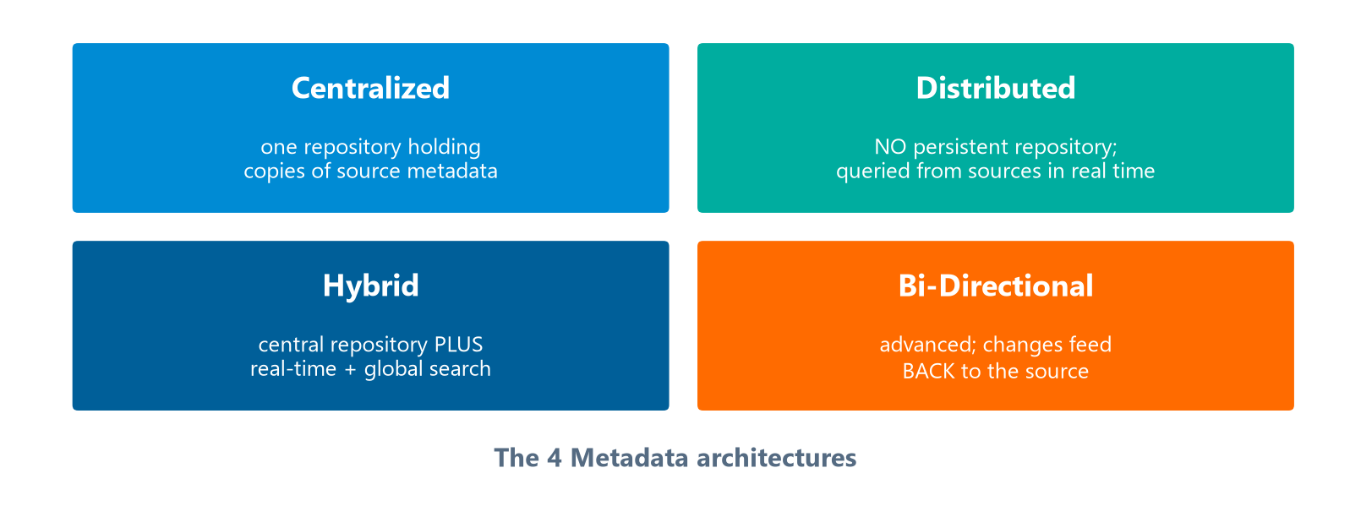
Metadata Architecture — Hybrid & Bi-Directional
Module 12 — Metadata Management
The centralized/distributed/hybrid approaches mimic data warehouse design approaches.
Centralized, Distributed, Hybrid, and Bi-Directional — and their defining traits.
⭐ EXAM TIP: Bi-directional is the advanced architecture where changes flow back to the source.
CDMP Fundamentals | DAMA-DMBOK 2nd Edition
dama.org / cdmp.info
Notes:
: Metadata Architecture — Hybrid & Bi-Directional
The other two architectures complete the four-quadrant chart on screen. A hybrid architecture combines the centralized and distributed approaches — metadata moves from the source systems into a centralized repository, giving you near-real-time retrieval plus enhanced metadata, lower manual IT intervention, and global search. Its limitation is that source system availability is still a constraint, and there's overhead in linking results with the augmented metadata. And the bi-directional architecture is the advanced one: metadata can change in any part of the architecture — the source, the integration layer, or the user interface — and changes are coordinated from the repository back into the original source. Its challenge is that you have to manage changes in both directions and build additional interfaces. One nice note: the centralized, distributed, and hybrid approaches actually mimic the approaches used to design data warehouses. The standout fact: bi-directional is the advanced architecture where changes feed back to the source.
---

Slide 16
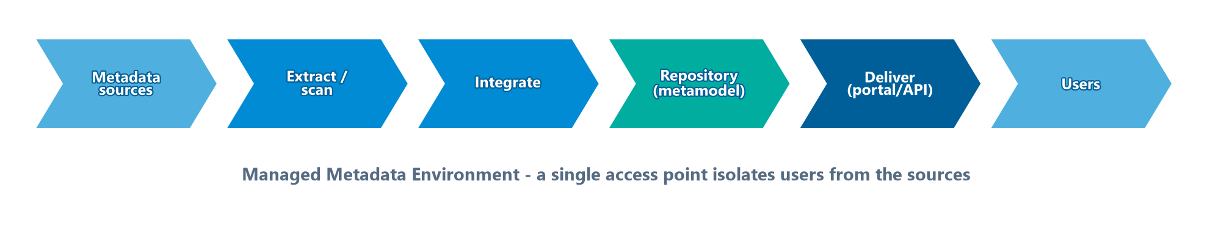
The Managed Metadata Environment (MME)
Module 12 — Metadata Management
The MME is the integrated set of layers that collects, stores, and delivers metadata from a single access point — users never touch the disparate sources directly.
Sources → extraction → integration → repository → delivery → users.
Layers: metadata sources → extraction / scanning → integration → repository (built on the metamodel) → delivery (portal, reports, APIs) → users.
Key principle: the MME isolates users from the underlying environments and gives them one place to find metadata.
⭐ EXAM TIP: The MME provides a single access point; the metamodel is the repository's own data model.
CDMP Fundamentals | DAMA-DMBOK 2nd Edition
dama.org / cdmp.info
Notes:
: The Managed Metadata Environment (MME)
The DMBOK's term for the whole integrated solution is the Managed Metadata Environment, or MME — the set of layers shown on screen that collects, stores, and delivers metadata from a single access point. Follow the flow. It starts with the metadata sources; then an extraction or scanning layer pulls metadata from them; an integration layer reconciles it; a repository stores it, built on the metamodel — which, remember, is the data model of the repository itself; a delivery layer exposes it through a portal, reports, and APIs; and finally users consume it. The key design principle is that the MME isolates users from all those underlying environments — they shouldn't need to know where metadata physically lives. So the two exam anchors: the MME gives a single access point, and the metamodel is the repository's own data model.
---

Slide 17
Activity 1 — Define the Metadata Strategy (5 Steps)
Module 12 — Metadata Management
Initiate strategy planning — charter, scope, objectives, communications plan
Conduct stakeholder interviews
Assess existing Metadata sources & information architecture
Develop the future Metadata architecture (target state)
Develop a phased implementation plan
⭐ EXAM TIP: Strategy describes the move from current to future state — and precedes tool selection.
CDMP Fundamentals | DAMA-DMBOK 2nd Edition
dama.org / cdmp.info
Notes:
: Activity 1 — Define the Metadata Strategy (5 Steps)
The activities begin with defining a metadata strategy, which describes how the organization will manage metadata and move from its current state to its future state. There are five steps. One, initiate the strategy planning by drafting a charter, scope, and objectives, and establishing a communications plan. Two, conduct key stakeholder interviews. Three, assess the existing metadata sources and information architecture. Four, develop the future metadata architecture — the target state for the managed metadata environment. And five, develop a phased implementation plan. The theme to remember: the strategy maps the journey from current to future state, and it comes before tool selection.
---

Slide 18
Activity 2 — Understand Requirements
Module 12 — Metadata Management
10 functionality requirements to capture:
  Volatility, Synchronization, History, Access rights, Structure
  Integration, Maintenance, Management, Quality, Security
Security matters because some Metadata reveals the existence of protected data and must not be exposed.
⭐ EXAM TIP: Some Metadata is itself sensitive — exposing it can reveal that protected data exists.
CDMP Fundamentals | DAMA-DMBOK 2nd Edition
dama.org / cdmp.info
Notes:
: Activity 2 — Understand Requirements
The second activity is understanding the metadata requirements — both what content is needed and what functionality. The DMBOK lists ten functionality-focused requirements: volatility, how often attributes update; synchronization, the timing of updates relative to source changes; history, whether to retain versions; access rights; structure, how the metadata is modeled; integration across sources; maintenance processes; management roles; quality; and security. That last one, security, has an important nuance the exam likes: some metadata cannot be exposed because it would reveal the existence of protected data. In other words, metadata can itself be sensitive — describing a hidden dataset can tip off an attacker that the dataset exists. So security requirements apply to metadata, not just to data.
---

Slide 19
Activity 3 — Define Architecture & the Metamodel
Module 12 — Metadata Management
Key principle: the managed Metadata environment should isolate users from disparate sources and provide a single access point — users shouldn't need to know the underlying environments.
Metamodel = the data model for the Metadata repository — one of the first design steps after strategy.
Standards: internal (naming, security, visibility) + external (exchange formats, API design).
⭐ EXAM TIP: A metamodel is "a model of the Metadata" — the repository's own data model.
CDMP Fundamentals | DAMA-DMBOK 2nd Edition
dama.org / cdmp.info
Notes:
: Activity 3 — Define Architecture & the Metamodel
The third activity is defining the metadata architecture, and there's a key design principle: the managed metadata environment should isolate end users from the disparate sources and provide a single access point. Users should be able to access metadata without any awareness of the differing underlying environments. A central artifact here is the metamodel — which is the data model for the metadata repository itself. Think of it as a model of the metadata. Creating the metamodel is one of the first design steps after the strategy is complete, and it has two levels: a high-level conceptual model showing system relationships, and a lower-level metamodel with the attribute details. You'll also apply standards — internal ones like naming and security, and external ones like data exchange formats and API design. Remember: a metamodel is the repository's own data model.
---

Slide 20
Activities 4–5 — Create, Maintain, Query
Module 12 — Metadata Management
Create & maintain — Metadata can be profiled for quality. Two scanning/integration approaches:
  Proprietary interface — single-step scan-and-load
  Semi-proprietary interface — two-step (scan → file → load); a more open architecture
Delivery: Metadata intranet, reports/glossaries, BI tools, web services/APIs.
Query, report & analyze: change impact analysis, lineage reports, resolving conflicting definitions.
⭐ EXAM TIP: Proprietary = one step; semi-proprietary = two steps (more open).
CDMP Fundamentals | DAMA-DMBOK 2nd Edition
dama.org / cdmp.info
Notes:
: Activities 4–5 — Create, Maintain, Query
The fourth activity is creating and maintaining metadata. Like any other data, metadata can be profiled and inspected for quality. Integration is done by scanning, and there are two approaches. The proprietary interface is a single-step scan-and-load, where the collector calls a format-specific loader directly. The semi-proprietary interface is a two-step process — the scanner outputs a format-specific data file, and then that file is loaded — which gives a more open architecture. Delivery happens through metadata intranet sites, reports and glossaries, BI tools, and web services and APIs. The fifth activity is querying, reporting, and analyzing metadata — which guides the use of data assets and produces things like change impact analysis and data lineage reports. So remember: proprietary scanning is one step, semi-proprietary is two steps and more open.
---

Slide 21
Active vs. Passive Metadata
Module 12 — Metadata Management
Passive metadata — stored and documented, then consulted by people (a static data dictionary, a glossary you look terms up in).
Active metadata — used by systems: it automatically triggers operations, enforces policies, and drives workflows without human intervention (metadata-driven pipelines, automated lineage, policy enforcement in a modern catalog).
The shift from passive to active metadata turns a catalog from a reference book into an operational engine.
⭐ EXAM TIP: Passive = stored & consulted; active = used to automatically drive operations and enforce policy.
CDMP Fundamentals | DAMA-DMBOK 2nd Edition
dama.org / cdmp.info
Notes:
: Active vs. Passive Metadata
Here's a distinction the exam draws and that's increasingly important in modern practice: active versus passive metadata. Passive metadata is stored and documented, and then consulted by people — think of a static data dictionary or a glossary you look terms up in. It sits there until a human goes and reads it. Active metadata, by contrast, is used by systems: it automatically triggers operations, enforces policies, and drives workflows without human intervention. Metadata-driven data pipelines, automated lineage capture, and a modern catalog that enforces access policies on its own are all examples. The shift from passive to active metadata is what turns a catalog from a reference book into an operational engine. So lock in the contrast: passive metadata is stored and consulted; active metadata is used to automatically drive operations and enforce policy.
---

Slide 22
Technique — Data Lineage & Stitching
Module 12 — Metadata Management
Two lineage types:
  "As Implemented" — current lineage based on the actual programming code
  "As Designed" — lineage from the mapping specification documents
Stitching = connecting lineage pieces from different tools into one holistic view from origin to destination.
⭐ EXAM TIP: As-Implemented = the code's reality; As-Designed = the documents' intent.
CDMP Fundamentals | DAMA-DMBOK 2nd Edition
dama.org / cdmp.info
Notes:
: Technique — Data Lineage & Stitching
A key technique is data lineage, and the DMBOK distinguishes two types. As-implemented lineage is the current, actual lineage based on the programming code — what the system really does. As-designed lineage is the lineage described in the mapping specification documents — what was intended. Those two can diverge, which is exactly why you document both. And stitching is the process of connecting lineage pieces captured by different tools into one holistic visualization that runs from the original source all the way to the final destination. Because lineage often spans many tools, stitching is what gives you the end-to-end picture. Remember: as-implemented reflects the code's reality, as-designed reflects the documents' intent.
---

Slide 23
Lineage Discovery Strategies & Big Data Ingest
Module 12 — Metadata Management
Two discovery strategies:
  Business focus — start at targets, trace back to sources; limited to prioritized elements; pairs with DQ
  Technical focus — start at sources, find all downstream consumers; enables impact reports ("what breaks if this column changes?")
Big Data ingest: apply Metadata tags on ingestion to a data lake; profiling can flag PII and quality issues.
⭐ EXAM TIP: Technical-focus lineage answers impact analysis ("what is affected if X changes?").
CDMP Fundamentals | DAMA-DMBOK 2nd Edition
dama.org / cdmp.info
Notes:
: Lineage Discovery Strategies & Big Data Ingest
There are two strategies for discovering lineage. The business-focus strategy starts at the target locations and traces back to the sources; it's limited to the prioritized data elements and pairs well with data quality measurements. The technical-focus strategy starts at the source systems and identifies all the downstream consumers; this is what enables impact reports — answering questions like "what systems are affected if this column's width changes?" — though it's more complex to manage. And for Big Data, metadata tags are applied to data upon ingestion into a data lake, where profiling during ingestion can identify data domains, relationships, quality issues, and importantly, sensitive or private data like PII. The exam connection: technical-focus lineage is the one that supports impact analysis.
---

Slide 24
Tools, Governance & Metrics
Module 12 — Metadata Management
Primary tool: Metadata Repository Management tools (integration layer + manual/connector entry + exchange).
Governance: the team sets standards and manages a maturity progression, e.g., Candidate → Approved → Published → Replaced/Retired.
8 suggested metrics include: repository completeness, management maturity (CMM-DMM), steward representation, usage, glossary activity, documentation quality, repository availability.
⭐ EXAM TIP: Metadata management maturity is measured with a CMM/DMM approach.
CDMP Fundamentals | DAMA-DMBOK 2nd Edition
dama.org / cdmp.info
Notes:
: Tools, Governance & Metrics
Let's cover tools, governance, and metrics together. The primary tool category is metadata repository management tools, which include an integration layer and an interface for manual updates, allow metadata to be entered manually or extracted via connectors, and enable the exchange and enrichment of metadata between repositories. For governance, the team defines standards and manages a maturity progression for terms — for example, candidate term, then approved, then published, then replaced or retired. And the DMBOK suggests eight metrics for metadata environments, including repository completeness, management maturity based on the CMM-DMM capability maturity model, steward representation, usage, business glossary activity, documentation quality, and repository availability. The metric most worth remembering: metadata management maturity is measured using a CMM or DMM approach.
---

Slide 25
Metadata Quality & Standards
Module 12 — Metadata Management
Metadata is itself data — so it needs the same quality discipline (completeness, accuracy, consistency) and a feedback loop for corrections.
Standards:
  Internal — naming (ISO/IEC 11179), security, and visibility rules
  External — exchange formats and API design for sharing metadata
A master catalog entry should include the source, the definition, the owner/steward, and the lineage.
⭐ EXAM TIP: Some metadata is itself sensitive — exposing it can reveal that protected data exists, so it must be secured.
CDMP Fundamentals | DAMA-DMBOK 2nd Edition
dama.org / cdmp.info
Notes:
: Metadata Quality & Standards
One easy thing to forget: metadata is itself data, which means it needs the same quality discipline you'd apply to any other data — completeness, accuracy, and consistency — plus a feedback loop so consumers can flag metadata that's wrong or out of date. There are two kinds of standards to manage. Internal standards govern naming — using ISO/IEC 11179 — along with security and visibility rules. External standards cover the exchange formats and the API design you use to share metadata with other systems. A complete master-catalog entry should capture, at minimum, the source, the definition, the owner or steward, and the lineage. And one security point the exam likes: some metadata is itself sensitive, because exposing it can reveal that protected data even exists — so metadata has to be secured, not just published.
---

Slide 26
Key Numbers & Quick Facts (Cheat Sheet)
Module 12 — Metadata Management
Fact | Value
Goals | 4
Guiding principles | 8
Main types | Business · Technical · Operational
Library-science types | Descriptive · Structural · Administrative
Architectures | 4 (Centralized, Distributed, Hybrid, Bi-Directional)
No persistent repository | Distributed
Advanced/feeds back to source | Bi-Directional
ISO/IEC 11179 Part 5 | Naming standards
Metadata sources | 15
Glossary audiences | Business Users · Data Stewards · Technical Users
Lineage types | As-Implemented · As-Designed
Maturity metric | CMM-DMM
CDMP Fundamentals | DAMA-DMBOK 2nd Edition
dama.org / cdmp.info
Notes:
: Key Numbers & Quick Facts (Cheat Sheet)
Let's consolidate. There are four goals and eight guiding principles. The three main types are business, technical, and operational; the library-science alternative is descriptive, structural, and administrative. There are four architectures — centralized, distributed, hybrid, and bi-directional — where distributed has no persistent repository and bi-directional feeds changes back to the source. ISO/IEC 11179 Part 5 covers naming. There are fifteen sources of metadata. The business glossary has three audiences. Lineage comes in as-implemented and as-designed forms. And maturity is measured with CMM-DMM. Drill these until they're automatic — this is a heavily weighted chapter.
---

Slide 27
Common Exam Traps
Module 12 — Metadata Management
❌ Data types & keys = business metadata → ✅ those are Technical metadata
❌ ETL run logs = technical metadata → ✅ job logs/row counts are Operational metadata
❌ Distributed architecture has a central repository → ✅ Distributed has NO persistent repository
❌ "As Designed" lineage = the code → ✅ As-Designed = mapping docs; As-Implemented = the code
❌ Buy the tool, then define needs → ✅ define requirements before tools
⭐ EXAM TIP: Business = meaning · Technical = structure/systems · Operational = processing/access.
CDMP Fundamentals | DAMA-DMBOK 2nd Edition
dama.org / cdmp.info
Notes:
: Common Exam Traps
Here are the traps, and most of them involve misclassifying metadata. First, data types and keys are technical metadata, not business metadata — business is about meaning, technical is about structure. Second, ETL run logs and row counts are operational metadata, not technical — operational is about processing and access. Third, the distributed architecture has no central repository; it pulls in real time, so don't let an answer give it a persistent store. Fourth, as-designed lineage comes from the mapping documents, while as-implemented comes from the code — don't swap them. And fifth, you define requirements before selecting tools, never the reverse. The mental model that defuses most traps: business equals meaning, technical equals structure and systems, operational equals processing and access.
---

Slide 28
Module Summary (Part 1)
Module 12 — Metadata Management
Metadata Management enables access to high-quality, integrated Metadata — one person's Metadata is another's data.
The 3 types: Business (meaning & rules), Technical (structure & systems), Operational (processing & access).
Alternative library-science split: Descriptive, Structural, Administrative.
8 guiding principles — including define requirements before tools and a feedback loop for corrections.
CDMP Fundamentals | DAMA-DMBOK 2nd Edition
dama.org / cdmp.info
Notes:
: Module Summary (Part 1)
Let's bring it together in two summary slides. Metadata management enables access to high-quality, integrated metadata, and remember that one person's metadata is another person's data. The three types are business metadata for meaning and rules, technical metadata for structure and systems, and operational metadata for processing and access — that classification is the most tested thing in the chapter. There's also the alternative library-science split: descriptive, structural, and administrative. And there are eight guiding principles, including defining requirements before tools and providing a feedback loop for corrections.
---

Slide 29
Module Summary (Part 2)
Module 12 — Metadata Management
4 architectures: Centralized (one copy), Distributed (no repository, real-time), Hybrid, Bi-Directional (feeds back to source).
Business glossary serves 3 audiences; a repository ≠ a catalog (technical vs business-friendly).
Lineage: As-Implemented (code) vs As-Designed (docs); stitching joins tool fragments; technical-focus enables impact analysis.
ISO/IEC 11179 (Part 5 = naming); maturity measured via CMM-DMM.
CDMP Fundamentals | DAMA-DMBOK 2nd Edition
dama.org / cdmp.info
Notes:
: Module Summary (Part 2)
Continuing the summary. There are four architectures: centralized, with a single copy store; distributed, with no persistent repository and real-time retrieval; hybrid, combining the two; and bi-directional, the advanced one that feeds changes back to the source. The business glossary serves three audiences, and a repository is not the same as a catalog — repository is technical and integration-oriented, catalog is business-friendly and searchable. Lineage comes in as-implemented and as-designed flavors, stitching joins fragments from different tools, and technical-focus discovery enables impact analysis. ISO/IEC 11179 Part 5 is naming, and maturity is measured via CMM-DMM. That's Chapter 12.
---

Slide 30
Let's Test Your Knowledge
Module 12 — Metadata Management
Heading: 5 practice questions — Metadata Management
Subtitle: Most questions here test the 3-type classification. Read each scenario closely.
CDMP Fundamentals | DAMA-DMBOK 2nd Edition
dama.org / cdmp.info
Notes:
: Let's Test Your Knowledge
Time for five practice questions on metadata management. Most of these test the three-type classification — business, technical, or operational — so read each scenario closely and identify whether it's about meaning, structure, or processing. This is one of the heaviest chapters on the exam, so make these points count. Here we go.
---

Slide 31
Practice Question 1
Module 12 — Metadata Management
Q1
An organization categorizes its metadata into three main types. Which option correctly identifies all three as defined in DMBOK2?
A) Structural, descriptive, and administrative
B) Functional, physical, and logical
C) Business, technical, and operational
D) Semantic, syntactic, and pragmatic
Answer: The DMBOK's three main metadata types are Business, Technical, and Operational. Option A is the library-science classification (a different scheme), and the others are distractors.
CDMP Fundamentals | DAMA-DMBOK 2nd Edition
dama.org / cdmp.info
Notes:
: Practice Questions (Q1–Q3)
Question one: which option lists the three main metadata types per DMBOK2? The answer is C — business, technical, and operational. Option A, structural-descriptive-administrative, is the library-science classification, which is a different scheme. Don't confuse the two.
Question two: the timestamp of the last ETL job and the number of rows loaded — which category? The answer is B, operational metadata, because it describes the processing and accessing of data. Notice that the other answer choices are themselves examples — a column's data type is technical, a business definition is business, and a registry identifier is technical.
Question three: a steward records the owner, the intended audience, and the business rules for a dataset. Which category? The answer is C, business metadata, because ownership, audience, and business rules concern the meaning and condition of the data. Technical would be structures and systems; operational would be processing logs.
Two more on the next slide.
---

Slide 32
Practice Question 2
Module 12 — Metadata Management
Q2
A team records the timestamp of the last ETL job execution and the number of rows loaded. Which metadata category is this?
A) The column data type and nullability of a fact table
B) Operational metadata
C) The business definition of "Net Revenue"
D) The ISO 11179 registration authority identifier
Answer: Job-execution timestamps and row counts describe the processing and accessing of data — that's Operational metadata. (Note: the other options are themselves examples of technical, business, and technical/registry metadata respectively.)
CDMP Fundamentals | DAMA-DMBOK 2nd Edition
dama.org / cdmp.info
Notes:
: Practice Questions (Q1–Q3)
Question one: which option lists the three main metadata types per DMBOK2? The answer is C — business, technical, and operational. Option A, structural-descriptive-administrative, is the library-science classification, which is a different scheme. Don't confuse the two.
Question two: the timestamp of the last ETL job and the number of rows loaded — which category? The answer is B, operational metadata, because it describes the processing and accessing of data. Notice that the other answer choices are themselves examples — a column's data type is technical, a business definition is business, and a registry identifier is technical.
Question three: a steward records the owner, the intended audience, and the business rules for a dataset. Which category? The answer is C, business metadata, because ownership, audience, and business rules concern the meaning and condition of the data. Technical would be structures and systems; operational would be processing logs.
Two more on the next slide.
---

Slide 33
Practice Question 3
Module 12 — Metadata Management
Q3
A data steward records the owner of a dataset, its intended audience, and the business rules governing its use. Which metadata category best fits?
A) Technical metadata
B) Physical metadata
C) Business metadata
D) Operational metadata
Answer: Ownership, intended audience, and business rules concern the meaning, content, and condition of data — that's Business metadata. Technical metadata would be structures and systems; operational would be processing logs.
CDMP Fundamentals | DAMA-DMBOK 2nd Edition
dama.org / cdmp.info
Notes:
: Practice Questions (Q1–Q3)
Question one: which option lists the three main metadata types per DMBOK2? The answer is C — business, technical, and operational. Option A, structural-descriptive-administrative, is the library-science classification, which is a different scheme. Don't confuse the two.
Question two: the timestamp of the last ETL job and the number of rows loaded — which category? The answer is B, operational metadata, because it describes the processing and accessing of data. Notice that the other answer choices are themselves examples — a column's data type is technical, a business definition is business, and a registry identifier is technical.
Question three: a steward records the owner, the intended audience, and the business rules for a dataset. Which category? The answer is C, business metadata, because ownership, audience, and business rules concern the meaning and condition of the data. Technical would be structures and systems; operational would be processing logs.
Two more on the next slide.
---

Slide 34
Practice Question 4
Module 12 — Metadata Management
Q4
What is the primary distinction between a metadata repository and a metadata catalog?
A) A repository is always cloud-based; a catalog is always on-premises
B) A repository is used only by data scientists; a catalog only by data engineers
C) A repository stores technical and structural metadata for system integration, while a catalog provides a business-friendly, searchable inventory for data consumers
D) A catalog stores lineage; a repository stores only business definitions
Answer: A metadata repository is the technical store supporting integration and tooling, while a catalog is the business-friendly, searchable inventory that helps consumers discover and understand data. Deployment location and user role (A, B) are not the distinction.
CDMP Fundamentals | DAMA-DMBOK 2nd Edition
dama.org / cdmp.info
Notes:
: Practice Questions (Q4–Q5)
Question four: the primary distinction between a metadata repository and a metadata catalog? The answer is C — a repository stores technical and structural metadata for system integration, while a catalog provides a business-friendly, searchable inventory for data consumers. The deployment location and the user's job title, in options A and B, are not the real distinction.
Question five: what best characterizes active metadata management? The answer is C — using metadata to automatically trigger data operations, enforce policies, and drive workflows without human intervention. Active metadata is metadata that's put to work. The other options — quarterly steward reviews, after-the-fact documentation, and static dictionaries — are all passive approaches, where the metadata just sits there.
That completes Module 12. Next up is our final knowledge-area chapter and the last of the four heavy hitters — Module 13, Data Quality. I'll see you there.
---
*End of Module 12 scripts.*

Slide 35
Practice Question 5
Module 12 — Metadata Management
Q5
Which statement best characterizes active metadata management?
A) Assigning stewards to review and approve all metadata changes quarterly
B) Manually documenting metadata after a project is completed
C) Using metadata to automatically trigger data operations, enforce policies, and drive workflows without human intervention
D) Publishing a static data dictionary and requiring users to consult it
Answer: Active metadata is used, not just stored — it automatically triggers operations, enforces policies, and drives workflows. Quarterly reviews, after-the-fact documentation, and static dictionaries are all passive approaches. End of Module 12 — Metadata Management.
CDMP Fundamentals | DAMA-DMBOK 2nd Edition
dama.org / cdmp.info
Notes:
: Practice Questions (Q4–Q5)
Question four: the primary distinction between a metadata repository and a metadata catalog? The answer is C — a repository stores technical and structural metadata for system integration, while a catalog provides a business-friendly, searchable inventory for data consumers. The deployment location and the user's job title, in options A and B, are not the real distinction.
Question five: what best characterizes active metadata management? The answer is C — using metadata to automatically trigger data operations, enforce policies, and drive workflows without human intervention. Active metadata is metadata that's put to work. The other options — quarterly steward reviews, after-the-fact documentation, and static dictionaries — are all passive approaches, where the metadata just sits there.
That completes Module 12. Next up is our final knowledge-area chapter and the last of the four heavy hitters — Module 13, Data Quality. I'll see you there.
---
*End of Module 12 scripts.*

