Slide 1
CDMP FUNDAMENTALS
Module 13: Data Quality
DAMA-DMBOK 2nd Edition, Chapter 13
Exam weight: ~11% (≈11 questions) — tied for most-tested. Master this chapter.
Module 13 — Data Quality
100
90
Open
≥60%
MCQ
minutes
book
to pass
CDMP Fundamentals | DAMA-DMBOK 2nd Edition
dama.org / cdmp.info
Notes:
: Module Title Slide
Welcome to Module 13: Data Quality. This is Chapter 13 of the DMBOK, and it's the last of our four highest-weighted chapters — about eleven percent of the exam, roughly twelve questions. Data quality is, in many ways, the point of everything else we've covered: all that governance, modeling, and metadata exists to deliver data that's actually trustworthy and usable. The exam tests the quality dimensions heavily, along with the improvement cycle and root cause analysis. Let's make these points count.
---

Slide 2
Module Overview & Learning Objectives
Module 13 — Data Quality
By the end, you'll be able to:
  Define Data Quality as fitness for purpose and state its 3 goals
  List the DAMA UK 6 dimensions and the Strong & Wang 15
  Apply the DQ score formula and explain data profiling
  Run the PDCA cycle and root cause analysis (5 Whys, Ishikawa, Pareto)
  Use Statistical Process Control (common vs special cause)
  Recognize the 9 business rule types and CDEs
CDMP Fundamentals | DAMA-DMBOK 2nd Edition
dama.org / cdmp.info
Notes:
: Module Overview & Learning Objectives
Here's our plan. You'll define data quality as fitness for purpose and state its three goals. You'll list the DAMA UK six dimensions and the Strong and Wang fifteen. You'll apply the data quality score formula and explain data profiling. You'll run the PDCA cycle and the root cause analysis techniques — the five whys, Ishikawa, and Pareto. You'll use statistical process control, distinguishing common from special cause variation. And you'll recognize the nine business rule types and the concept of critical data elements. Let's begin.
---

Slide 3
Definition & Goals
Module 13 — Data Quality
DMBOK2 Definition: the planning, implementation, and control of activities that apply quality management techniques to data to assure it is fit for purpose and meets consumer needs.
"Fitness for purpose" — quality is relative to the intended use, not an absolute standard.
3 goals: (1) develop a managed approach to fit-for-purpose data; (2) define requirements based on consumer needs; (3) identify and correct defects in data and the processes that create them.
⭐ EXAM TIP: Data quality = fit for purpose / fit for use — the most-tested phrase in the chapter.
CDMP Fundamentals | DAMA-DMBOK 2nd Edition
dama.org / cdmp.info
Notes:
: Definition & Goals
The DMBOK defines data quality as the planning, implementation, and control of activities that apply quality management techniques to data, in order to assure it is fit for consumption and meets the needs of data consumers. The phrase you must internalize is fitness for purpose — or fitness for use. This is the single most important idea in the chapter: quality is not absolute, it's relative to how the data will actually be used. The same data might be high quality for one purpose and inadequate for another. There are three goals: develop a managed approach to making data fit for purpose; define quality requirements based on the needs of data consumers; and identify and correct defects in the data and the processes that create defective data. Fit for purpose — say it to yourself, because it underlies almost every answer in this chapter.
---

Slide 4
Business Drivers
Module 13 — Data Quality
Poor data quality is costly — Gartner estimated ~$9.7M per year per organization.
Drivers: regulatory compliance · trust in decisions · operational efficiency · customer satisfaction · enabling analytics, MDM, and governance.
⭐ EXAM TIP: Unreliable data erodes trust and slows decision-making — a recurring driver.
CDMP Fundamentals | DAMA-DMBOK 2nd Edition
dama.org / cdmp.info
Notes:
: Business Drivers
Why does data quality matter to the business? Because poor quality is expensive — Gartner has estimated the cost at roughly nine-point-seven million dollars per year per organization. The drivers include regulatory compliance, which requires reliable data; trust in decision-making, since unreliable data undermines confidence and slows decisions; operational efficiency; customer satisfaction; and the simple fact that successful analytics, master data management, and governance all depend on quality data underneath. The recurring theme the exam likes: unreliable data erodes trust, and once trust is lost, it's hard to regain.
---

Slide 5
The Cost of Poor Data Quality & the Business Case
Module 13 — Data Quality
Poor data quality is expensive — Gartner estimated ~$9.7M per year per organization.
Costs fall into four categories:
  Scrap & rework — reprocessing, fixing errors, manual work-arounds
  Lost opportunity — bad decisions, missed customers, weak analytics
  Compliance & penalties — regulatory fines, failed audits
  Reputation — eroded customer and stakeholder trust
Prevention is cheaper than correction — fixing at the point of creation costs far less than downstream cleanup, and far less again than a failure in production (Principles 2 & 6).
Building the business case: quantify the current cost of poor quality → estimate the value of improvement → prioritize CDEs by business impact.
⭐ EXAM TIP: DMBOK stresses prevention over correction; the source is the cheapest place to fix data.
CDMP Fundamentals | DAMA-DMBOK 2nd Edition
dama.org / cdmp.info
Notes:
: The Cost of Poor Data Quality & the Business Case
Before we get into the how, let's make the case for why data quality is worth the investment. Gartner estimated that poor data quality costs the average organization about nine-point-seven million dollars every year. The costs on screen fall into four buckets: scrap and rework — all the reprocessing and manual work-arounds; lost opportunity — the bad decisions and missed customers; compliance and penalties — the fines and failed audits; and reputation — the erosion of trust that's hardest to win back. Here's the principle that drives the whole chapter: prevention is cheaper than correction. Fixing data the moment it's created costs a fraction of cleaning it up downstream, and a tiny fraction of what a failure in production costs. So when you build the business case, you quantify the current cost of poor quality, estimate the value of fixing it, and prioritize your critical data elements by business impact.
---

Slide 6
The 9 Guiding Principles
Module 13 — Data Quality
Data quality is everyone's concern — not just IT
Proactive management — prevention beats correction
Fit for purpose — quality relative to intended use
Define requirements from consumer needs
Data is produced through processes — root causes live in processes
Manage at the source — fix at the point of creation
Continuous improvement — ongoing, not one-time
Organizational commitment — needs executive support
Data quality enables trust
⭐ EXAM TIP: Manage quality at the source, and prevention beats correction.
CDMP Fundamentals | DAMA-DMBOK 2nd Edition
dama.org / cdmp.info
Notes:
: The 9 Guiding Principles
The DMBOK gives nine guiding principles for data quality. One, data quality is everyone's concern, not just the IT department's. Two, it requires proactive management, because prevention beats correction. Three, data must be fit for purpose — quality is relative to intended use. Four, define requirements based on consumer needs. Five, data is produced through processes, so the root causes of bad data live in those processes. Six, manage quality at the source — fix it at the point of creation. Seven, continuous improvement — quality work is ongoing, never a one-time project. Eight, it requires organizational commitment, including executive support. And nine, data quality enables trust. Two principles the exam returns to again and again: manage quality at the source, and prevention beats correction.
---

Slide 7
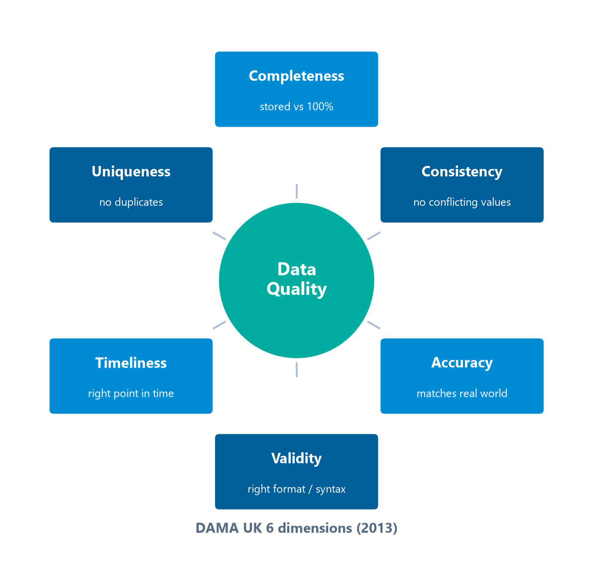
DQ Dimensions — The DAMA UK 6
Module 13 — Data Quality
The six dimensions: Completeness, Uniqueness, Timeliness, Validity, Accuracy, Consistency.
⭐ EXAM TIP: The DAMA UK 6 (2013) is the most commonly referenced DQ dimension set for CDMP.
CDMP Fundamentals | DAMA-DMBOK 2nd Edition
dama.org / cdmp.info
Notes:
: DQ Dimensions — The DAMA UK 6
Data quality is measured along dimensions, and the most commonly referenced set for the CDMP is the DAMA UK six, from 2013 — the six arranged around the Data Quality hub on screen. Completeness is the proportion of stored data against the potential of one hundred percent complete. Uniqueness means no entity is recorded more than once, based on business rules. Timeliness means the data represents reality from the required point in time. Validity means the data conforms to the syntax — the format, type, and range — defined by business rules. Accuracy means the data correctly describes the real-world object it represents. And consistency means there's no conflict between two values that both relate to the same fact, across different systems. Memorize these six — completeness, uniqueness, timeliness, validity, accuracy, and consistency — because they're the dimension set the exam most often uses.
---

Slide 8
DQ Dimensions — Strong & Wang (1996)
Module 13 — Data Quality
Category | Dimensions
Intrinsic | Accuracy, Objectivity, Believability, Reputation
Contextual | Relevancy, Completeness, Timeliness, Appropriate Amount, Value-Added
Representational | Interpretability, Format, Ease of Understanding, Concise & Consistent Representation
Accessibility | Accessibility, Access Security
⭐ EXAM TIP: Strong & Wang = 15 dimensions in 4 categories (Intrinsic, Contextual, Representational, Accessibility).
CDMP Fundamentals | DAMA-DMBOK 2nd Edition
dama.org / cdmp.info
Notes:
: DQ Dimensions — Strong & Wang (1996)
There's an older, broader framework you should also know: Strong and Wang, from 1996, which defines fifteen dimensions grouped into four categories. The intrinsic category — qualities the data has in itself — includes accuracy, objectivity, believability, and reputation. The contextual category — qualities relative to the task — includes relevancy, completeness, timeliness, appropriate amount, and value-added. The representational category — how the data is presented — includes interpretability, format, ease of understanding, and concise and consistent representation. And the accessibility category includes accessibility and access security. You don't need to recite all fifteen, but you must know the framework: fifteen dimensions in four categories — intrinsic, contextual, representational, and accessibility.
---

Slide 9
Distinguishing Key Dimensions
Module 13 — Data Quality
Accuracy — does the value match the real world? (verify against an authoritative external reference, e.g., a postal database)
Validity — does it conform to format/syntax rules? (a value can be valid but inaccurate)
Completeness — are required (mandatory) fields populated? Optional fields may be absent.
Consistency — internal (non-contradictory within one system) vs cross-system (same entity identical across systems).
Timeliness — currency (reflects current reality) + availability (accessible when needed).
⭐ EXAM TIP: A value can satisfy validity (right format) yet fail accuracy (wrong real-world value).
CDMP Fundamentals | DAMA-DMBOK 2nd Edition
dama.org / cdmp.info
Notes:
: Distinguishing Key Dimensions
Let's sharpen the distinctions between the dimensions that the exam most loves to test against each other. Accuracy asks: does the value match the real world? You verify it against an authoritative external reference — for example, validating an address against a postal authority database. Validity asks a different question: does the value conform to the format and syntax rules? And here's the critical insight — a value can be perfectly valid yet completely inaccurate. A date like January first, nineteen-hundred might be valid in format but wrong in reality. Completeness is about whether the mandatory fields are populated; optional fields may be absent. Consistency has two flavors: internal consistency, meaning values don't contradict each other within a single system, and cross-system consistency, meaning the same entity is represented identically across multiple systems. And timeliness has two aspects: currency, whether the data reflects current reality, and availability, whether it can be accessed when needed. The headline: valid does not mean accurate.
---

Slide 10
Measuring the Data Quality Dimensions
Module 13 — Data Quality
Dimension | How it's measured
Completeness | % of mandatory fields populated
Validity | % of values conforming to format / domain / range rules
Accuracy | % matching an authoritative reference (e.g., a postal database)
Uniqueness | duplicate rate — 1 − (distinct ÷ total) for the key
Consistency | % reconciled across systems for the same fact
Timeliness | currency (age vs required) + availability (on time)
⭐ EXAM TIP: Validity is tested against rules; accuracy against the real world — different measurements that the exam loves to blur.
CDMP Fundamentals | DAMA-DMBOK 2nd Edition
dama.org / cdmp.info
Notes:
: Measuring the Data Quality Dimensions
Knowing the dimensions is one thing; measuring them is another, and the exam expects you to connect each dimension to a concrete test. Look at the table on screen. Completeness is the percentage of mandatory fields that are populated. Validity is the percentage of values that conform to the format, domain, and range rules. Accuracy is the percentage that match an authoritative reference — like checking an address against a postal database. Uniqueness is the duplicate rate. Consistency is the percentage of values that reconcile across systems for the same fact. And timeliness combines currency — is it up to date — with availability — is it there when needed. Each of these is an assertion test, and the results roll up into the data quality score, valid over total. The distinction to lock in: validity is measured against your rules, accuracy against the real world.
---

Slide 11
ISO 8000 & Measuring Data Quality
Module 13 — Data Quality
ISO 8000 — the international standard for data quality (data exchange & characterization).
DQ Score = (Valid Records ÷ Total Records) × 100%.
Exception Rate = (Records with Exceptions ÷ Total Records) × 100%.
Example: 950 of 1,000 pass → 95% DQ score, 5% exception rate.
⭐ EXAM TIP: DQ score = valid ÷ total × 100%. Know the simple ratio.
CDMP Fundamentals | DAMA-DMBOK 2nd Edition
dama.org / cdmp.info
Notes:
: ISO 8000 & Measuring Data Quality
There's an international standard for data quality, ISO 8000, which focuses on data exchange and the characterization of data quality — just know that it exists and what it's for. For measurement, the basic data quality score is simply the number of valid records divided by the total number of records, times one hundred percent. The exception rate is the inverse: records with exceptions divided by total records, times one hundred. So if nine hundred fifty out of a thousand records pass a quality rule, you have a ninety-five percent data quality score and a five percent exception rate. It's a simple ratio, but the exam may ask you to compute or recognize it, so keep the formula handy: valid over total, times one hundred.
---

Slide 12
Data Profiling
Module 13 — Data Quality
Data profiling = the statistical examination of data to understand its structure, content, and quality.
Profiling activities:
  Column analysis — min/max, null counts, distinct values, type conformance
  Cross-column analysis — dependencies, correlations
  Cross-table analysis — referential integrity, orphan records
  Pattern analysis — format consistency, value distribution
⭐ EXAM TIP: Profiling is usually the first step in assessing data quality.
CDMP Fundamentals | DAMA-DMBOK 2nd Edition
dama.org / cdmp.info
Notes:
: Data Profiling
Data profiling is the statistical examination of data to understand its structure, content, and quality — and it's typically the very first step when you assess data quality, because you can't fix what you haven't measured. Profiling includes several activities. Column analysis looks at a single column — minimum and maximum values, null counts, distinct values, and conformance to the data type. Cross-column analysis looks at dependencies and correlations between columns. Cross-table analysis checks referential integrity and finds orphan records — records that reference something that doesn't exist. And pattern analysis examines format consistency and value distribution. So when a question describes statistically examining data to find anomalies before remediation, that's data profiling, and it comes first.
---

Slide 13
Data Cleansing, Standardization & Matching
Module 13 — Data Quality
Once profiling exposes issues, remediation applies the DQ tools:
  Parsing & standardization — split values into components and enforce standard formats (names, addresses, phone)
  Matching / deduplication — find duplicate or near-duplicate records
  Cleansing / correction — correct or remove invalid values
  Enhancement / enrichment — add value from trusted external sources
Correction vs. prevention: cleansing treats the symptom; only a process change at the source stops the defect recurring.
⭐ EXAM TIP: Downstream cleansing is a stopgap — DMBOK says fix the root cause at the source.
CDMP Fundamentals | DAMA-DMBOK 2nd Edition
dama.org / cdmp.info
Notes:
: Data Cleansing, Standardization & Matching
Once profiling has shown you where the problems are, you remediate using a set of standard data quality tools. Parsing and standardization break values into their components and enforce consistent formats — essential for names and addresses. Matching, or deduplication, finds records that represent the same thing. Cleansing corrects or removes invalid values. And enhancement enriches your data with value from trusted external sources. But here's the critical exam point: all of this is correction, and correction treats the symptom. The only thing that truly prevents a defect from coming back is changing the process at the source. So cleansing is a stopgap — necessary, but never the end of the story.
---

Slide 14
The 9 Business Rule Types
Module 13 — Data Quality
Rule | Example | Rule | Example
Definition | what an entity is | Referential Integrity | order → valid customer
Structural | required structure | Uniqueness | SSN unique
Domain | allowed values | Completeness | First Name not null
Range | 0 ≤ Age ≤ 150 | Derivation | Total = Qty × Price
 |  | Trigger | if VIP → apply discount
⭐ EXAM TIP: Domain = allowed value set; Range = numeric bounds; Derivation = calculated value.
CDMP Fundamentals | DAMA-DMBOK 2nd Edition
dama.org / cdmp.info
Notes:
: The 9 Business Rule Types
Data quality is enforced through business rules, and the DMBOK lists nine types. A definition rule states what an entity or attribute is. A structural rule says how data must be structured — an address must have a street, city, and postal code. A domain rule lists the valid values — status must be Active, Inactive, or Pending. A range rule sets numeric bounds — age must be between zero and one hundred fifty. A referential integrity rule enforces foreign key relationships — an order must reference a valid customer. A uniqueness rule forbids duplicates. A completeness rule marks required fields. A derivation rule defines calculated values — total equals quantity times unit price. And a trigger rule is conditional — if the customer is a VIP, a discount must be applied. The three most confused: domain is the allowed value set, range is numeric bounds, and derivation is a calculated value.
---

Slide 15
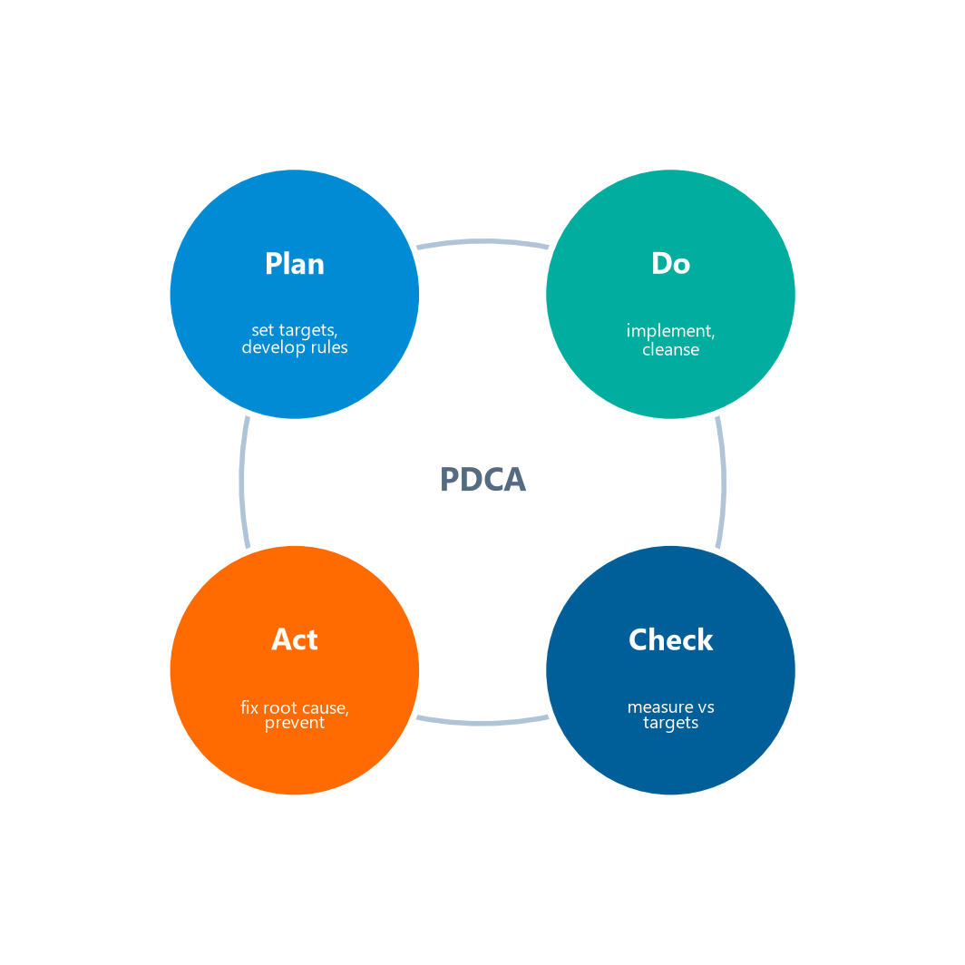
The PDCA / Shewhart Cycle
Module 13 — Data Quality
The DQ management cycle is PDCA — from the Shewhart cycle (1920s manufacturing), popularized by W. Edwards Deming:
The continuous Plan-Do-Check-Act improvement loop.
⭐ EXAM TIP: PDCA = Plan, Do, Check, Act — Shewhart (1920s), popularized by Deming.
CDMP Fundamentals | DAMA-DMBOK 2nd Edition
dama.org / cdmp.info
Notes:
: The PDCA / Shewhart Cycle
The improvement engine for data quality is the PDCA cycle — the loop on screen — which stands for Plan, Do, Check, Act. It originated as the Shewhart cycle, developed by Walter Shewhart in the nineteen-twenties for manufacturing, and it was later popularized for quality management by W. Edwards Deming — a name you've seen before in the ethics chapter. In the Plan phase, you identify data quality issues, assess their impact, set quality targets, and develop quality rules. In the Do phase, you implement those rules and controls, cleanse data, and apply corrections. In the Check phase, you measure quality and monitor trends against your targets. And in the Act phase, you investigate root causes, implement process improvements, and prevent recurrence. Remember the four letters — Plan, Do, Check, Act — and the lineage from Shewhart to Deming.
---

Slide 16
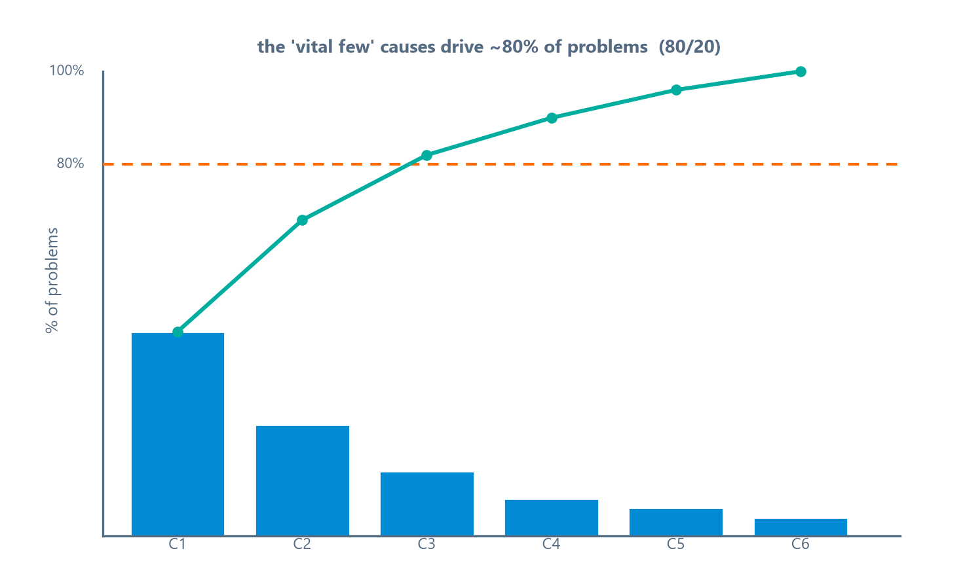
Root Cause Analysis
Module 13 — Data Quality
Purpose: find the underlying cause of DQ issues to prevent recurrence.
Three techniques:
  5 Whys — ask "why" repeatedly to drill to the root
  Ishikawa (fishbone) diagram — visualize cause-and-effect
  Pareto analysis — the 80/20 rule: ~20% of causes drive ~80% of problems
⭐ EXAM TIP: Ishikawa = fishbone (cause-effect); Pareto = 80/20.
CDMP Fundamentals | DAMA-DMBOK 2nd Edition
dama.org / cdmp.info
Notes:
: Root Cause Analysis
The Act phase relies on root cause analysis — finding the underlying cause of a data quality issue so you can prevent it from recurring, rather than just cleaning up the symptom over and over. The DMBOK names three techniques. The five whys is the simplest: you ask "why" repeatedly, usually about five times, until you drill down to the root cause. The Ishikawa diagram, also called a fishbone diagram, visualizes cause-and-effect relationships in a fish-skeleton shape. And Pareto analysis applies the eighty-twenty rule, charted on screen — the idea that roughly twenty percent of the causes are responsible for about eighty percent of the problems, so you focus your effort there. Common root causes include missing entry validation, poor process design, migration errors, and a lack of stewardship. For the exam: Ishikawa is the fishbone cause-effect diagram, and Pareto is the eighty-twenty rule.
---

Slide 17
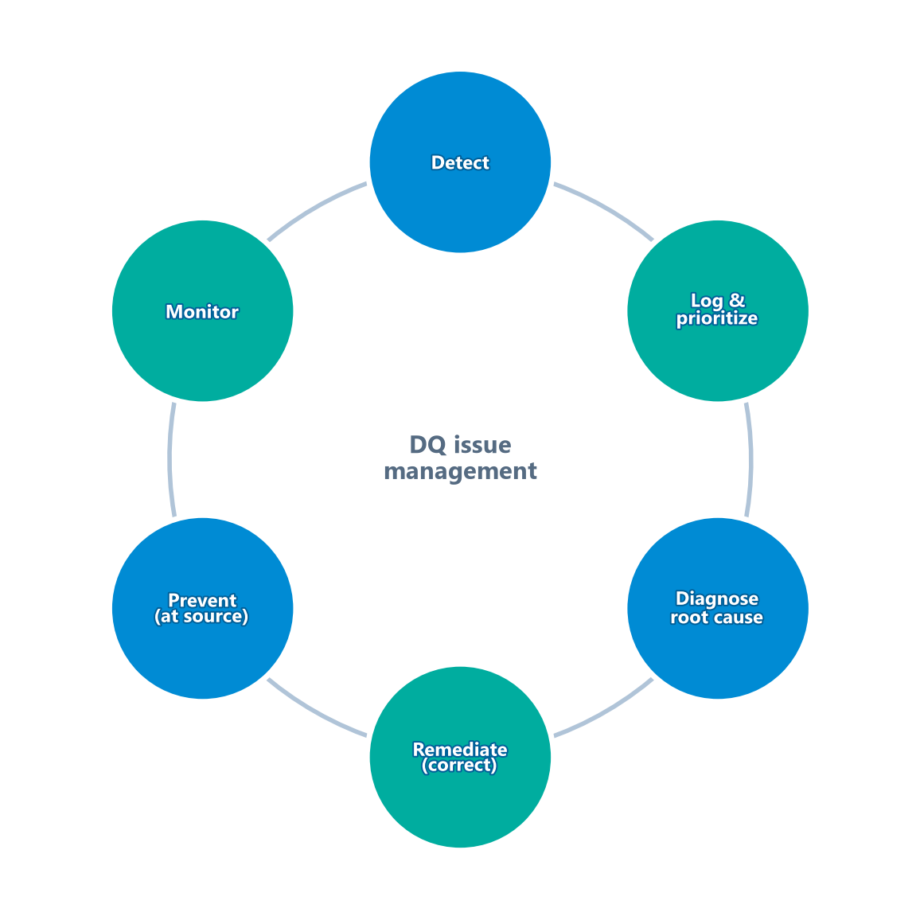
Managing Data Quality Issues
Module 13 — Data Quality
DQ issues move through a managed, repeatable workflow:
Detect → Log & prioritize → Diagnose → Remediate → Prevent → Monitor.
Maintain a DQ issue log: issue, affected CDE, business impact, owner, status, resolution time.
Feedback loop: report issues back to data producers — don't just clean for consumers.
⭐ EXAM TIP: Issue management is continuous; open-issue count and resolution time are key DQ metrics.
CDMP Fundamentals | DAMA-DMBOK 2nd Edition
dama.org / cdmp.info
Notes:
: Managing Data Quality Issues
Data quality issues need to be managed, not just noticed — and the cycle on screen shows the workflow. You detect an issue, through profiling, monitoring, or a consumer report. You log and prioritize it by severity and business impact. You diagnose the root cause. You remediate — correct the data. You prevent — put a control at the source so it doesn't recur. And you monitor to confirm the fix holds. All of this lives in a data quality issue log that tracks the issue, the affected critical data element, the impact, the owner, the status, and the resolution time. And don't forget the feedback loop: report issues back to the data producers, not just to the consumers who reported them. For the exam, remember that issue management is continuous, and that open-issue count and resolution time are core metrics.
---

Slide 18
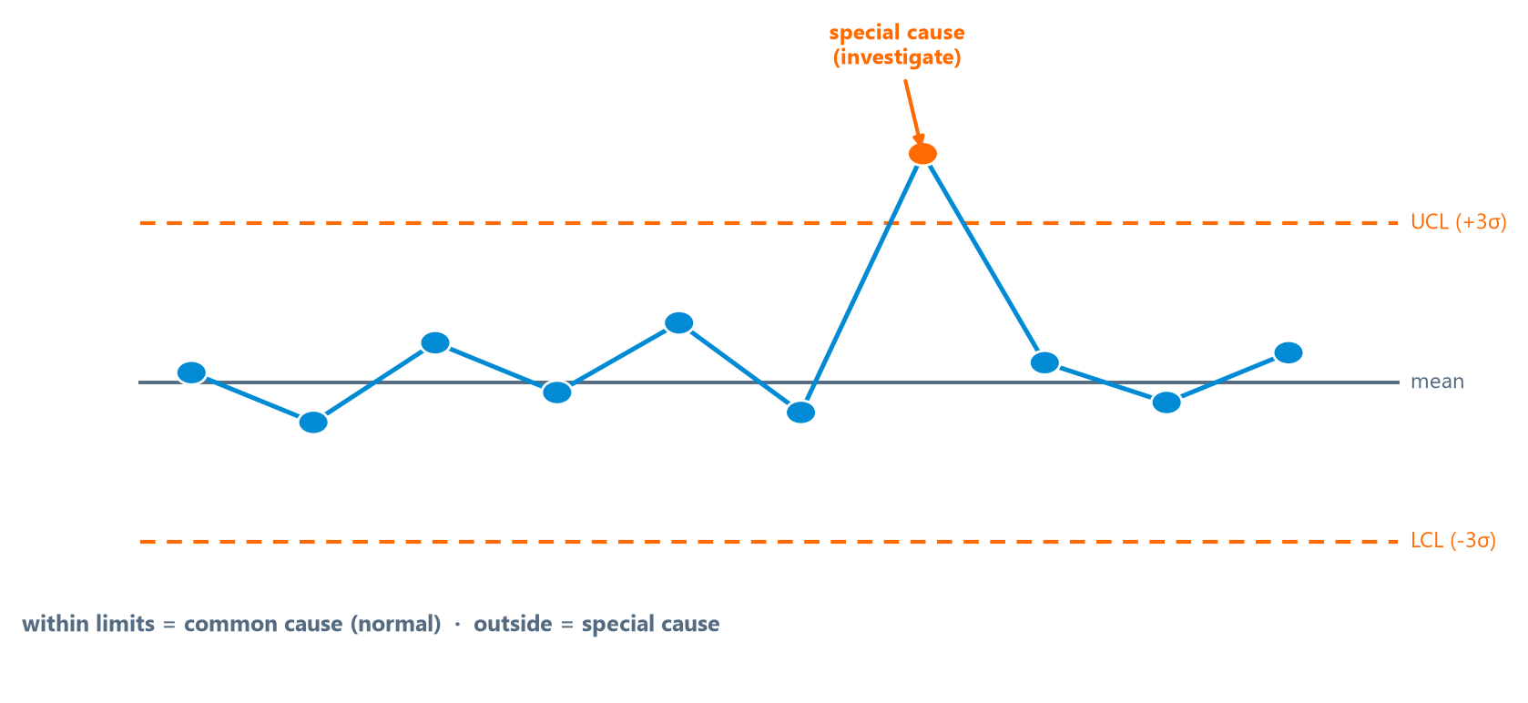
Statistical Process Control (SPC)
Module 13 — Data Quality
SPC (Shewhart, 1920s) monitors DQ over time using control charts.
Control limits = bounds typically 3 sigma (standard deviations) from the mean.
Points within the ±3σ limits are common cause; a point outside is special cause.
⭐ EXAM TIP: Inside limits = common cause (normal); outside limits = special cause (act on it).
CDMP Fundamentals | DAMA-DMBOK 2nd Edition
dama.org / cdmp.info
Notes:
: Statistical Process Control (SPC)
Statistical Process Control, or SPC, is another technique borrowed from manufacturing — again from Shewhart in the nineteen-twenties — and it's used to monitor data quality over time using control charts. The control chart on screen plots your measurements over time and shows whether a process is stable. The control limits are the upper and lower bounds, typically set at three sigma — three standard deviations — from the mean. Now the key distinction: common cause variation is the natural, expected variation that stays within the control limits — you leave it alone. Special cause variation is unexpected variation that falls outside the control limits — that signals something has genuinely changed, and you investigate it. So the rule of thumb: inside the limits is common cause and normal; outside the limits is special cause, and you act on it.
---

Slide 19
The 6 Data Quality Activities
Module 13 — Data Quality
Define high-quality data — understand consumers and their needs
Define a DQ strategy — assess maturity, governance, tools, business case
Identify critical data & business rules — focus on CDEs
Perform an initial DQ assessment — profile against rules; quantify issues
Identify & prioritize improvements — root cause analysis; correct vs prevent
Define & implement DQ controls — build quality into source processes; monitor
⭐ EXAM TIP: The arc: define quality → strategy → identify critical data → assess → improve → control.
CDMP Fundamentals | DAMA-DMBOK 2nd Edition
dama.org / cdmp.info
Notes:
: The 6 Data Quality Activities
The DMBOK organizes data quality work into six activities, and they tell a logical story. First, define what high-quality data means by understanding your consumers and their needs. Second, define a data quality strategy — assessing your current maturity, governance structure, tools, and business case. Third, identify the critical data and the business rules — focusing on the critical data elements. Fourth, perform an initial data quality assessment, profiling the data against the rules and quantifying the issues. Fifth, identify and prioritize improvements, using root cause analysis and deciding between correction and prevention. And sixth, define and implement data quality controls, building quality checks into the source processes and monitoring them. The arc to remember: define quality, set strategy, identify critical data, assess, improve, and control.
---

Slide 20
Operational Data Quality — Controls, SLAs & Monitoring
Module 13 — Data Quality
Activity 6 is about making quality stick by building controls into operations:
  Quality at the source — validate at the point of entry, not after the fact
  Inline vs. batch controls — inline = real-time validation at capture; batch = scheduled checks & reports
  Exception reporting — route records that fail rules to a steward for review
  Data Quality SLAs — agreed quality thresholds per CDE, with monitoring and escalation
  Continuous monitoring — automated rules run on a schedule; trends tracked on the scorecard
⭐ EXAM TIP: The cheapest, most durable control is validation at the source, not downstream cleanup.
CDMP Fundamentals | DAMA-DMBOK 2nd Edition
dama.org / cdmp.info
Notes:
: Operational Data Quality — Controls, SLAs & Monitoring
The sixth activity is where quality becomes operational — where you make it stick. The headline is quality at the source: validate data at the point of entry, not after it's already wrong. You can apply controls inline, validating in real time as data is captured, or in batch, running scheduled checks and reports. Records that fail your rules go to exception reporting, where a steward reviews them. You formalize expectations with data quality SLAs — agreed thresholds for each critical data element, with monitoring and escalation when they're breached. And you run continuous monitoring, with automated rules on a schedule and trends tracked on the scorecard. The exam point is simple: the cheapest, most durable control is validation at the source.
---

Slide 21
Critical Data Elements & Tools
Module 13 — Data Quality
Critical Data Elements (CDEs) = the most important data for business decisions — the highest priority for DQ management.
DQ tools: data profiling · parsing & standardization · matching (find duplicates) · cleansing/remediation · monitoring · address standardization.
⭐ EXAM TIP: You can't fix everything — prioritize CDEs by business impact.
CDMP Fundamentals | DAMA-DMBOK 2nd Edition
dama.org / cdmp.info
Notes:
: Critical Data Elements & Tools
A recurring theme is that you can't fix everything at once, so you prioritize. Critical data elements, or CDEs, are the most important data elements for business decisions, and they're the highest priority for data quality management. You focus your limited effort where the business impact is greatest. On the tools side, the DMBOK lists several categories: data profiling tools for statistical analysis, parsing and standardization tools to fix format inconsistencies, data matching tools to find duplicates, cleansing and remediation tools to correct or remove invalid records, monitoring tools to continuously check quality, and address standardization tools to validate postal addresses. The key idea: identify your critical data elements and concentrate your quality efforts there.
---

Slide 22
Governance, Metrics & the DQ Scorecard
Module 13 — Data Quality
Critical success factors: executive sponsorship · clear ownership · quality at the source · defined metrics · feedback loops from consumers to producers.
Metrics: completeness/accuracy per CDE · timeliness of refresh · open DQ issues · resolution time · DQ score trends over time.
DQ Scorecard aggregates metrics across dimensions and domains for executive visibility; should show trends.
⭐ EXAM TIP: Build quality at the source and feed issues back to producers — don't just clean downstream.
CDMP Fundamentals | DAMA-DMBOK 2nd Edition
dama.org / cdmp.info
Notes:
: Governance, Metrics & the DQ Scorecard
Let's close the activities with governance and metrics. The critical success factors for data quality include executive sponsorship, clear ownership and stewardship, integrating quality into business processes — that is, quality at the source — defined metrics, and feedback mechanisms that route issues from consumers back to producers. The metrics include the completeness and accuracy rates per critical data element, the timeliness of data refresh, the number of open data quality issues, the issue resolution time, and the trend of data quality scores over time. And the data quality scorecard aggregates these metrics across dimensions and data domains to give executives visibility into the state of data quality — and it should always show trends over time, not just a snapshot. The big idea: build quality at the source and feed problems back to the producers, rather than endlessly cleaning data downstream.
---

Slide 23
Data Quality Roles & Responsibilities
Module 13 — Data Quality
Role | Responsibility
Data Quality Analyst | profiles data, measures dimensions, runs root-cause analysis
Data Steward | defines rules, prioritizes CDEs, resolves issues
Data Owner | accountable for a domain's quality; approves rules
Data Producer | captures data correctly at the source
Data Consumer | reports issues; defines fitness-for-purpose needs
⭐ EXAM TIP: Quality requirements come from consumers; quality is built by producers at the source.
CDMP Fundamentals | DAMA-DMBOK 2nd Edition
dama.org / cdmp.info
Notes:
: Data Quality Roles & Responsibilities
We said in the very first principle that data quality is everyone's concern — but "everyone" can't be accountable for everything, so let's pin down the roles on screen. The data quality analyst profiles data, measures the dimensions, and runs root-cause analysis. The data steward defines the rules, prioritizes the critical data elements, and resolves issues. The data owner is accountable for a whole domain's quality and approves the rules. The data producer captures data correctly at the source. And the data consumer reports issues and defines what fitness-for-purpose actually means for their use. Picture the chain: producers create the data, consumers use it, and a feedback loop runs from consumers back to producers. That loop is the engine of improvement. The exam framing: requirements come from consumers, but quality is built by producers at the source.
---

Slide 24
Key Numbers & Quick Facts (Cheat Sheet)
Module 13 — Data Quality
Fact | Value
Definition | Fit for purpose / fit for use
Goals | 3
Guiding principles | 9
DAMA UK dimensions | 6
Strong & Wang | 15 in 4 categories
ISO standard | ISO 8000
DQ score | valid ÷ total × 100%
Business rule types | 9
Quality cycle | PDCA (Shewhart → Deming)
RCA techniques | 5 Whys · Ishikawa · Pareto (80/20)
SPC limits | 3 sigma
Activities | 6
CDMP Fundamentals | DAMA-DMBOK 2nd Edition
dama.org / cdmp.info
Notes:
: Key Numbers & Quick Facts (Cheat Sheet)
Let's consolidate. Data quality means fit for purpose, or fit for use. There are three goals and nine guiding principles. The DAMA UK gives six dimensions; Strong and Wang give fifteen in four categories. The international standard is ISO 8000. The data quality score is valid divided by total, times one hundred percent. There are nine business rule types. The improvement cycle is PDCA, from Shewhart and popularized by Deming. The root cause techniques are the five whys, Ishikawa — the fishbone — and Pareto, the eighty-twenty rule. SPC control limits sit at three sigma. And there are six data quality activities. Drill these — this is a heavily weighted chapter.
---

Slide 25
Common Exam Traps
Module 13 — Data Quality
❌ Validity = accuracy → ✅ validity is format/syntax; accuracy is real-world correctness (valid ≠ accurate)
❌ Quality is absolute → ✅ quality is fit for purpose (relative to use)
❌ Fix data downstream → ✅ manage quality at the source; prevention beats correction
❌ Special cause = normal variation → ✅ special cause is outside limits — investigate it
❌ Pareto = fishbone → ✅ Pareto = 80/20; Ishikawa = fishbone
⭐ EXAM TIP: "Fit for purpose," "at the source," and "prevention over correction" are signature DQ phrases.
CDMP Fundamentals | DAMA-DMBOK 2nd Edition
dama.org / cdmp.info
Notes:
: Common Exam Traps
Here are the traps. First, and most important: validity is not accuracy. Validity is about correct format and syntax, while accuracy is about correctly matching the real world — a value can be valid yet inaccurate. Second, quality is never absolute; it's fitness for purpose, relative to the intended use. Third, the right approach is to manage quality at the source, where prevention beats downstream correction. Fourth, special cause variation is the abnormal kind, outside the control limits — don't mistake it for normal variation. And fifth, don't confuse the root cause tools: Pareto is the eighty-twenty rule, while Ishikawa is the fishbone diagram. The signature phrases that point to right answers in this chapter are "fit for purpose," "at the source," and "prevention over correction."
---

Slide 26
Module Summary (Part 1)
Module 13 — Data Quality
Data Quality applies quality management to make data fit for purpose — quality is relative to intended use.
Measure with the DAMA UK 6 (Completeness, Uniqueness, Timeliness, Validity, Accuracy, Consistency) or Strong & Wang's 15 in 4 categories.
Validity ≠ Accuracy: format-correct vs real-world-correct.
DQ score = valid ÷ total × 100%; profiling is the first assessment step.
CDMP Fundamentals | DAMA-DMBOK 2nd Edition
dama.org / cdmp.info
Notes:
: Module Summary (Part 1)
Let's wrap up in two summary slides. Data quality applies quality management techniques to make data fit for purpose, and quality is always relative to the intended use. You measure it with the DAMA UK six dimensions — completeness, uniqueness, timeliness, validity, accuracy, and consistency — or with Strong and Wang's fifteen dimensions in four categories. Remember that validity and accuracy are different: validity is format-correct, accuracy is real-world-correct. The data quality score is valid over total times one hundred percent, and data profiling is the first step in any assessment.
---

Slide 27
Module Summary (Part 2)
Module 13 — Data Quality
Manage quality through PDCA (Plan-Do-Check-Act; Shewhart → Deming).
Root cause analysis: 5 Whys, Ishikawa (fishbone), Pareto (80/20) — fix causes, not just symptoms.
SPC uses control charts at 3 sigma: common cause (normal) vs special cause (investigate).
Prioritize CDEs, build controls at the source, and report a DQ scorecard with trends.
CDMP Fundamentals | DAMA-DMBOK 2nd Edition
dama.org / cdmp.info
Notes:
: Module Summary (Part 2)
Continuing the summary. You manage quality through the PDCA cycle — Plan, Do, Check, Act — which traces from Shewhart to Deming. Root cause analysis uses the five whys, the Ishikawa fishbone diagram, and Pareto's eighty-twenty rule, so you fix causes rather than symptoms. Statistical process control uses control charts at three sigma, distinguishing common cause variation, which is normal, from special cause variation, which you investigate. And you prioritize your critical data elements, build controls at the source, and report a data quality scorecard that shows trends over time. That completes Chapter 13, and with it, all eleven knowledge areas.
---

Slide 28
Let's Test Your Knowledge
Module 13 — Data Quality
Heading: 5 practice questions — Data Quality
Subtitle: Watch the dimension distinctions — validity vs accuracy, internal vs cross-system consistency.
CDMP Fundamentals | DAMA-DMBOK 2nd Edition
dama.org / cdmp.info
Notes:
: Let's Test Your Knowledge
Time for five practice questions on data quality. These focus on the dimension distinctions that the exam loves — especially validity versus accuracy, and internal versus cross-system consistency. Read each scenario closely, identify which dimension is really at stake, choose your answer, and then reveal the solution. Here we go.
---

Slide 29
Practice Question 1
Module 13 — Data Quality
Q1
Which statement best defines the data quality dimension of accuracy?
A) Data values correctly represent the real-world entity or event they describe
B) Data values are present in all mandatory fields
C) Data values are delivered within the agreed service window
D) Data values conform to the prescribed format and length
Answer: Accuracy means the data correctly describes the real-world object or event it represents. Option B is completeness, C is timeliness, and D is validity — a value can be perfectly valid in format yet still inaccurate.
CDMP Fundamentals | DAMA-DMBOK 2nd Edition
dama.org / cdmp.info
Notes:
: Practice Questions (Q1–Q3)
Question one: which statement best defines accuracy? The answer is A — data values correctly represent the real-world entity or event they describe. That's the essence of accuracy: matching reality. Option B is completeness, C is timeliness, and D is validity — and remember, a value can be valid in format yet inaccurate in fact.
Question two: how is completeness handled for mandatory versus optional attributes? The answer is D — mandatory attributes must be populated for a record to be valid, while optional attributes may be absent without hurting the completeness score. You don't hold an optional field to a one-hundred-percent requirement.
Question three: a date of birth differs between the CRM and the billing system. What kind of problem? The answer is D — a cross-system consistency failure, because the same fact has conflicting values across two systems. Both formats are valid, the conflict isn't within one system, and it's a contradiction, not staleness.
Two more on the next slide.
---

Slide 30
Practice Question 2
Module 13 — Data Quality
Q2
In DMBOK2, how is the completeness dimension handled for mandatory vs. optional attributes?
A) Optional attributes are excluded from all completeness calculations regardless of context
B) Completeness is measured only at the record level, ignoring attribute types
C) Both mandatory and optional attributes face the same 100% population requirement
D) Mandatory attributes must be populated for a record to be valid, while optional attributes may be absent without affecting completeness scores
Answer: Completeness depends on whether an attribute is mandatory or optional. Mandatory fields must be populated; optional fields may be absent without penalizing the score. Treating optional fields as if they were mandatory misstates completeness.
CDMP Fundamentals | DAMA-DMBOK 2nd Edition
dama.org / cdmp.info
Notes:
: Practice Questions (Q1–Q3)
Question one: which statement best defines accuracy? The answer is A — data values correctly represent the real-world entity or event they describe. That's the essence of accuracy: matching reality. Option B is completeness, C is timeliness, and D is validity — and remember, a value can be valid in format yet inaccurate in fact.
Question two: how is completeness handled for mandatory versus optional attributes? The answer is D — mandatory attributes must be populated for a record to be valid, while optional attributes may be absent without hurting the completeness score. You don't hold an optional field to a one-hundred-percent requirement.
Question three: a date of birth differs between the CRM and the billing system. What kind of problem? The answer is D — a cross-system consistency failure, because the same fact has conflicting values across two systems. Both formats are valid, the conflict isn't within one system, and it's a contradiction, not staleness.
Two more on the next slide.
---

Slide 31
Practice Question 3
Module 13 — Data Quality
Q3
A customer's date of birth is stored as 1985-03-10 in the CRM but 1958-03-10 in the billing system. This is an example of which problem?
A) Validity failure because the date format is wrong
B) Internal consistency failure within the CRM
C) Timeliness failure because the records are out of date
D) Cross-system consistency failure between two authoritative sources
Answer: The same fact (one customer's DOB) has conflicting values across two systems — a cross-system consistency failure. Both formats are valid, the conflict isn't within a single system (so not internal consistency), and the issue is contradiction, not staleness.
CDMP Fundamentals | DAMA-DMBOK 2nd Edition
dama.org / cdmp.info
Notes:
: Practice Questions (Q1–Q3)
Question one: which statement best defines accuracy? The answer is A — data values correctly represent the real-world entity or event they describe. That's the essence of accuracy: matching reality. Option B is completeness, C is timeliness, and D is validity — and remember, a value can be valid in format yet inaccurate in fact.
Question two: how is completeness handled for mandatory versus optional attributes? The answer is D — mandatory attributes must be populated for a record to be valid, while optional attributes may be absent without hurting the completeness score. You don't hold an optional field to a one-hundred-percent requirement.
Question three: a date of birth differs between the CRM and the billing system. What kind of problem? The answer is D — a cross-system consistency failure, because the same fact has conflicting values across two systems. Both formats are valid, the conflict isn't within one system, and it's a contradiction, not staleness.
Two more on the next slide.
---

Slide 32
Practice Question 4
Module 13 — Data Quality
Q4
DMBOK2 distinguishes two aspects of timeliness. Which pairing correctly describes currency and availability?
A) Currency refers to whether data reflects the current state of the real world; availability refers to whether data can be accessed when needed
B) Currency and availability are synonyms in the timeliness dimension
C) Currency measures how quickly data is delivered; availability measures conformance to business rules
D) Currency applies only to financial data; availability only to master data
Answer: Currency is about whether the data is up to date with reality, while availability is about whether it can be accessed when needed. Together they make up timeliness; they are not synonyms, nor are they limited to specific data types.
CDMP Fundamentals | DAMA-DMBOK 2nd Edition
dama.org / cdmp.info
Notes:
: Practice Questions (Q4–Q5)
Question four: which pairing correctly describes the two aspects of timeliness, currency and availability? The answer is A — currency is whether the data reflects the current state of the real world, and availability is whether the data can be accessed when needed. They're distinct aspects, not synonyms, and they aren't limited to particular data types.
Question five: how should you measure the accuracy of customer address records? The answer is A — compare the addresses against an authoritative external reference, such as a postal authority database. Accuracy requires checking against the real world. Null-checking measures completeness, a regex check measures validity, and a twenty-four-hour entry check measures timeliness — none of those verify real-world correctness.
That completes Module 13, and you've now finished all eleven knowledge areas of the DAMA Wheel. There's just one chapter left — Module 14, Big Data and Data Science. I'll see you there for the finish.
---
*End of Module 13 scripts.*

Slide 33
Practice Question 5
Module 13 — Data Quality
Q5
A team wants to measure the accuracy of customer address records. Which method is most appropriate?
A) Comparing addresses against an authoritative external reference such as a postal authority database
B) Checking that the address field is not null
C) Verifying the address matches a street-address regex pattern
D) Confirming addresses were entered within 24 hours of registration
Answer: Accuracy requires checking against the real world, so validating addresses against an authoritative postal database is the right method. Null-checking measures completeness, regex measures validity (format), and the 24-hour check measures timeliness — none verify real-world correctness. End of Module 13 — Data Quality.
CDMP Fundamentals | DAMA-DMBOK 2nd Edition
dama.org / cdmp.info
Notes:
: Practice Questions (Q4–Q5)
Question four: which pairing correctly describes the two aspects of timeliness, currency and availability? The answer is A — currency is whether the data reflects the current state of the real world, and availability is whether the data can be accessed when needed. They're distinct aspects, not synonyms, and they aren't limited to particular data types.
Question five: how should you measure the accuracy of customer address records? The answer is A — compare the addresses against an authoritative external reference, such as a postal authority database. Accuracy requires checking against the real world. Null-checking measures completeness, a regex check measures validity, and a twenty-four-hour entry check measures timeliness — none of those verify real-world correctness.
That completes Module 13, and you've now finished all eleven knowledge areas of the DAMA Wheel. There's just one chapter left — Module 14, Big Data and Data Science. I'll see you there for the finish.
---
*End of Module 13 scripts.*

