Slide 1
CDMP FUNDAMENTALS
Module 14: Big Data & Data Science
DAMA-DMBOK 2nd Edition, Chapter 14
Exam weight: ~2% (≈2 questions) — Big Data Vs, Lambda, data lake, ML types
Module 14 — Big Data & Data Science
100
90
Open
≥60%
MCQ
minutes
book
to pass
CDMP Fundamentals | DAMA-DMBOK 2nd Edition
dama.org / cdmp.info
Notes:
: Module Title Slide
Welcome to Module 14: Big Data and Data Science — our final chapter. This is Chapter 14 of the DMBOK, and at about two percent of the exam, it's one of the lighter chapters by weight. But it's also the most forward-looking, covering the technologies and techniques that are reshaping our field — data lakes, Hadoop, machine learning. There are a handful of precise facts the exam likes here, so let's learn them, and then celebrate finishing the course.
---

Slide 2
Module Overview & Learning Objectives
Module 14 — Big Data & Data Science
By the end, you'll be able to:
  Define Big Data and the Vs (Laney's 3 → 6)
  Explain the Lambda architecture and the data lake
  Describe Hadoop, HDFS, and MapReduce
  Distinguish the 3 types of machine learning
  Recognize PMML, NoSQL types, and Datensparsamkeit
  Avoid the "data swamp" through governance
CDMP Fundamentals | DAMA-DMBOK 2nd Edition
dama.org / cdmp.info
Notes:
: Module Overview & Learning Objectives
Here's our final plan. You'll define Big Data and the famous Vs, from Laney's original three to the expanded six. You'll explain the Lambda architecture and the data lake. You'll describe Hadoop, HDFS, and MapReduce. You'll distinguish the three types of machine learning. You'll recognize PMML, the NoSQL types, and the privacy concept of Datensparsamkeit. And you'll understand how to avoid the dreaded data swamp through governance. Let's begin.
---

Slide 3
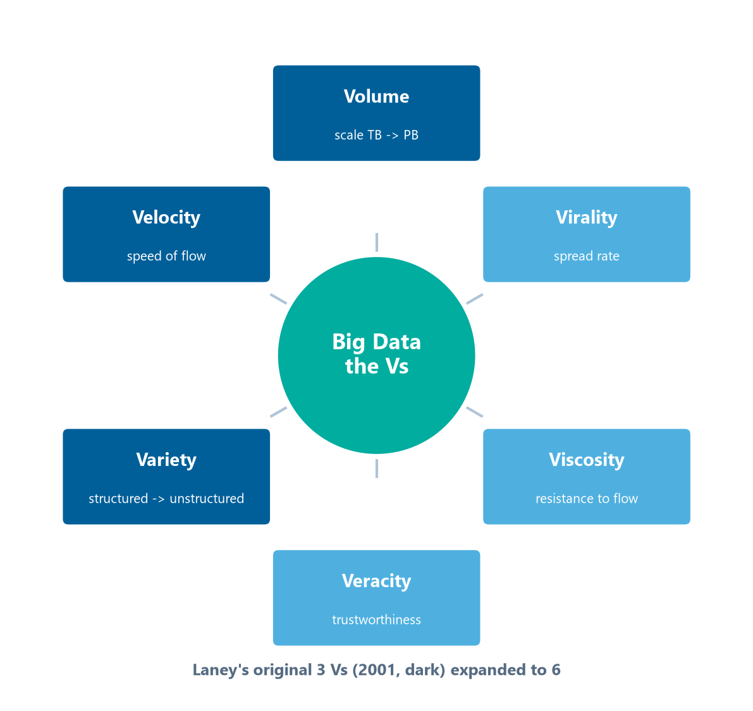
Definitions & Goals
Module 14 — Big Data & Data Science
Big Data — extremely large data sets (high Volume, Velocity, Variety) that can't be managed with traditional tools.
Data Science — combines statistics, math, programming, and domain knowledge to extract insights.
3 goals: (1) enable analytics on large, diverse data beyond traditional tools; (2) derive competitive insights from new sources (social, IoT, logs); (3) support data science & machine learning.
⭐ EXAM TIP: Big Data = data too big/fast/varied for traditional data management tools.
CDMP Fundamentals | DAMA-DMBOK 2nd Edition
dama.org / cdmp.info
Notes:
: Definitions & Goals
Let's define our terms. Big Data refers to extremely large data sets, characterized by high volume, velocity, and variety, that simply cannot be managed with traditional data management tools. That last phrase is the key — what makes data "big" isn't just size, it's that it overwhelms conventional tools. Data science is the interdisciplinary field that combines statistics, mathematics, programming, and crucially, domain knowledge, to extract insights from that data. There are three goals: enable analytics on large, diverse data sets beyond traditional tools; derive competitive insights from new data sources like social media, IoT, and logs; and support data science and machine learning initiatives. Remember: Big Data is data too big, too fast, or too varied for traditional tools.
---

Slide 4
The Vs of Big Data
Module 14 — Big Data & Data Science
V | Meaning
Volume | Scale (TB → PB → EB)
Velocity | Speed of generation/processing
Variety | Structured, semi-structured, unstructured
⭐ EXAM TIP: Laney, 2001 = the original 3 Vs. Expanded set = 6 Vs.
CDMP Fundamentals | DAMA-DMBOK 2nd Edition
dama.org / cdmp.info
Notes:
: The Vs of Big Data
The classic way to characterize Big Data is through the Vs, arranged around the hub on screen. Doug Laney of the META Group introduced the original three Vs back in 2001 — and that date and attribution are testable. The three are volume, the sheer scale of data measured in terabytes, petabytes, even exabytes; velocity, the speed at which data is generated and must be processed; and variety, the different types and formats, from structured to semi-structured to unstructured. Over time the model expanded to six Vs, adding veracity, the accuracy and trustworthiness of the data; viscosity, the resistance to data flow and processing; and virality, the rate at which data spreads and is shared. So for the exam: Laney, 2001, gave us the original three Vs, and the expanded model has six.
---

Slide 5
Business Drivers
Module 14 — Big Data & Data Science
Social media, IoT, and machine-generated data exceeding traditional capacity
Competitive advantage from unstructured-data insights
Lower cost via commodity hardware (vs proprietary DW appliances)
Real-time analytics & event-driven processing
Support for machine learning and AI
⭐ EXAM TIP: Big Data trades expensive appliances for commodity, distributed hardware.
CDMP Fundamentals | DAMA-DMBOK 2nd Edition
dama.org / cdmp.info
Notes:
: Business Drivers
What's driving organizations toward Big Data? Social media, the Internet of Things, and machine-generated data are producing volumes that exceed traditional database capacity. There's competitive advantage to be found in the insights buried in large unstructured datasets. There's cost reduction, because Big Data platforms run on cheap commodity hardware rather than expensive proprietary data warehouse appliances. There's the need for real-time analytics and event-driven processing. And there's the demand to support machine learning and AI applications. The key economic shift to remember: Big Data trades expensive specialized appliances for inexpensive, distributed commodity hardware.
---

Slide 6
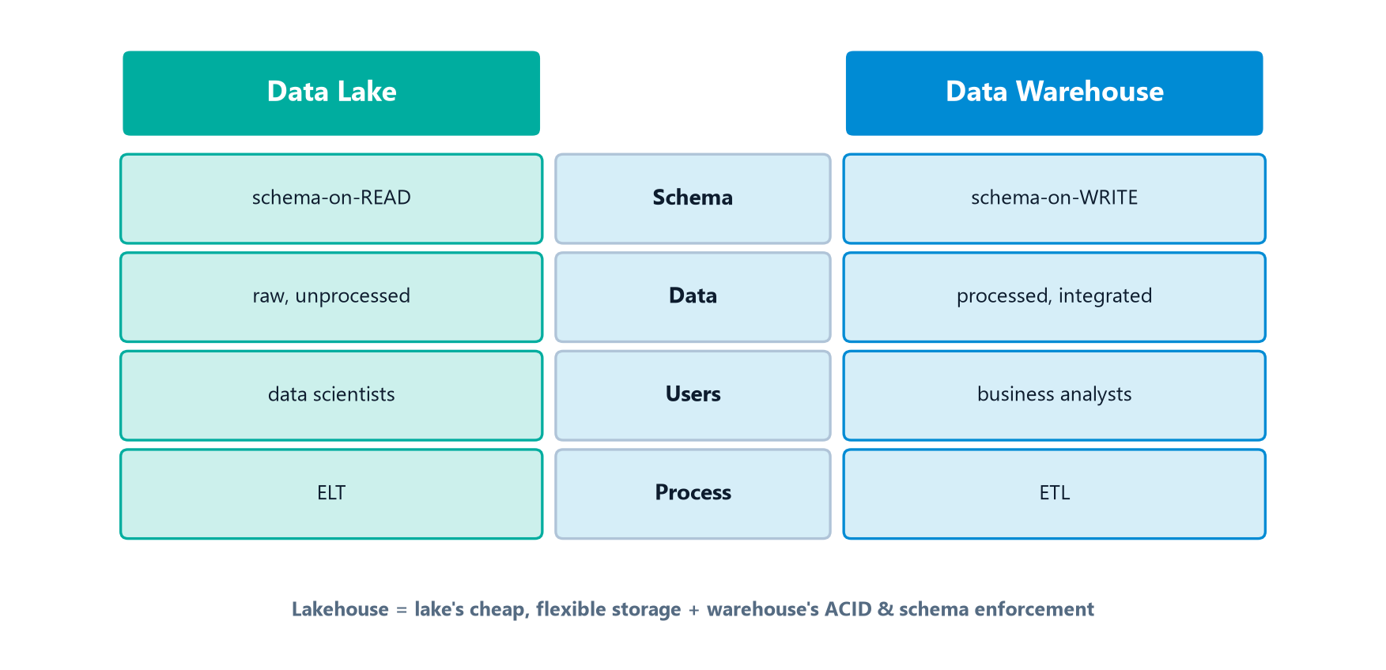
Lambda Architecture (and CAP)
Module 14 — Big Data & Data Science
The Lambda architecture has 3 layers, and it applies the CAP theorem (from Chapter 6):
Kappa architecture simplifies this by treating all data as a stream (eliminates the batch layer).
⭐ EXAM TIP: Speed = A+P, Batch = C+A, Serving = merge. Kappa = streaming only.
CDMP Fundamentals | DAMA-DMBOK 2nd Edition
dama.org / cdmp.info
Notes:
: Lambda Architecture (and CAP)
The classic Big Data processing architecture is the Lambda architecture, and notice it directly applies the CAP theorem we learned back in Chapter 6. It has three layers. The speed layer provides real-time views and, in CAP terms, favors availability and partition tolerance. The batch layer provides comprehensive, accurate views and favors consistency and availability. And the serving layer merges the batch and speed views to respond to queries. There's also a newer alternative called the Kappa architecture, which simplifies things by treating all data as a stream and eliminating the separate batch layer entirely — useful when you only need real-time processing. So remember: in Lambda, the speed layer is availability plus partition tolerance, the batch layer is consistency plus availability, and the serving layer merges them; Kappa is streaming-only.
---

Slide 7
The Data Lake
Module 14 — Big Data & Data Science
Aspect | Data Lake | Data Warehouse
Schema | Schema-on-read | Schema-on-write
Data | Raw, unprocessed | Processed, integrated
Users | Data scientists | Business analysts
Process | ELT | ETL
⭐ EXAM TIP: Lake = schema-on-read, ELT, raw; Warehouse = schema-on-write, ETL, processed.
CDMP Fundamentals | DAMA-DMBOK 2nd Edition
dama.org / cdmp.info
Notes:
: The Data Lake
The data lake is one of the most important concepts in this chapter. A data lake is a repository that stores raw data in its native format until it's needed, using schema-on-read — meaning the structure is applied when you read the data, not when you write it. Contrast that with a data warehouse, which uses schema-on-write. Let's line them up, exactly as the side-by-side comparison on screen shows: the lake uses schema-on-read while the warehouse uses schema-on-write; the lake holds raw, unprocessed data while the warehouse holds processed, integrated data; the lake serves data scientists while the warehouse serves business analysts; and the lake uses ELT while the warehouse uses ETL. There's also a newer hybrid called the lakehouse, which combines the lake's low-cost, flexible storage with the warehouse's ACID transactions and schema enforcement on a single platform. The headline contrast: lake is schema-on-read, ELT, and raw; warehouse is schema-on-write, ETL, and processed.
---

Slide 8
Hadoop, HDFS & MapReduce
Module 14 — Big Data & Data Science
Hadoop — open-source distributed computing framework on commodity hardware; fails gracefully, stores multiple copies.
  HDFS — Hadoop Distributed File System
  MPP Shared-Nothing — Massively Parallel Processing; each node independent (no shared memory/disk)
MapReduce — 3 steps:
Map — distribute & process in parallel across nodes
Shuffle/Sort — group & sort intermediate results
Reduce — aggregate & combine results
⭐ EXAM TIP: MapReduce = Map → Shuffle/Sort → Reduce. Hadoop uses shared-nothing MPP.
CDMP Fundamentals | DAMA-DMBOK 2nd Edition
dama.org / cdmp.info
Notes:
: Hadoop, HDFS & MapReduce
Hadoop is the foundational open-source framework for Big Data — a distributed computing framework that runs on commodity hardware, is designed to fail gracefully, and stores multiple copies of data for resilience. Two key components: HDFS, the Hadoop Distributed File System, which handles the distributed storage; and its use of MPP shared-nothing architecture — Massively Parallel Processing where each node is completely independent, with no shared memory or disk, which is what lets it scale across cheap hardware. The processing paradigm is MapReduce, which has three steps. Map distributes the data and the task across the nodes and processes them in parallel. Shuffle and sort groups and sorts the intermediate results. And reduce aggregates and combines those results into the final output. So memorize the MapReduce sequence: Map, then Shuffle and Sort, then Reduce — and remember Hadoop uses shared-nothing MPP.
---

Slide 9
Spark, ELT & Streaming
Module 14 — Big Data & Data Science
Apache Spark — like MapReduce but stores intermediate results in memory (RAM), drastically cutting disk I/O — far faster for iterative workloads.
Apache Kafka — a distributed, durable, append-only log; multiple independent consumers read the same stream at their own pace.
ELT in Big Data — load raw data into the lake first, transform within Hadoop/Spark; the target does the processing.
⭐ EXAM TIP: Spark = in-memory (vs MapReduce's disk); ELT loads first in Big Data.
CDMP Fundamentals | DAMA-DMBOK 2nd Edition
dama.org / cdmp.info
Notes:
: Spark, ELT & Streaming
A few modern technologies that build on Hadoop. Apache Spark works like MapReduce but with one defining difference: it stores its intermediate processing results in memory, in RAM, rather than writing them to disk between steps. That dramatically reduces disk I/O and makes Spark far faster than MapReduce for iterative workloads like machine learning. Apache Kafka is a streaming platform — a distributed, durable, append-only log that lets multiple independent consumers read the same event stream, each at their own pace. And in Big Data environments, the preferred pattern is ELT — you load the raw data into the lake first, then transform it within Hadoop or Spark, letting the powerful target system do the processing work. Two facts to anchor: Spark is in-memory, and ELT loads first.
---

Slide 10
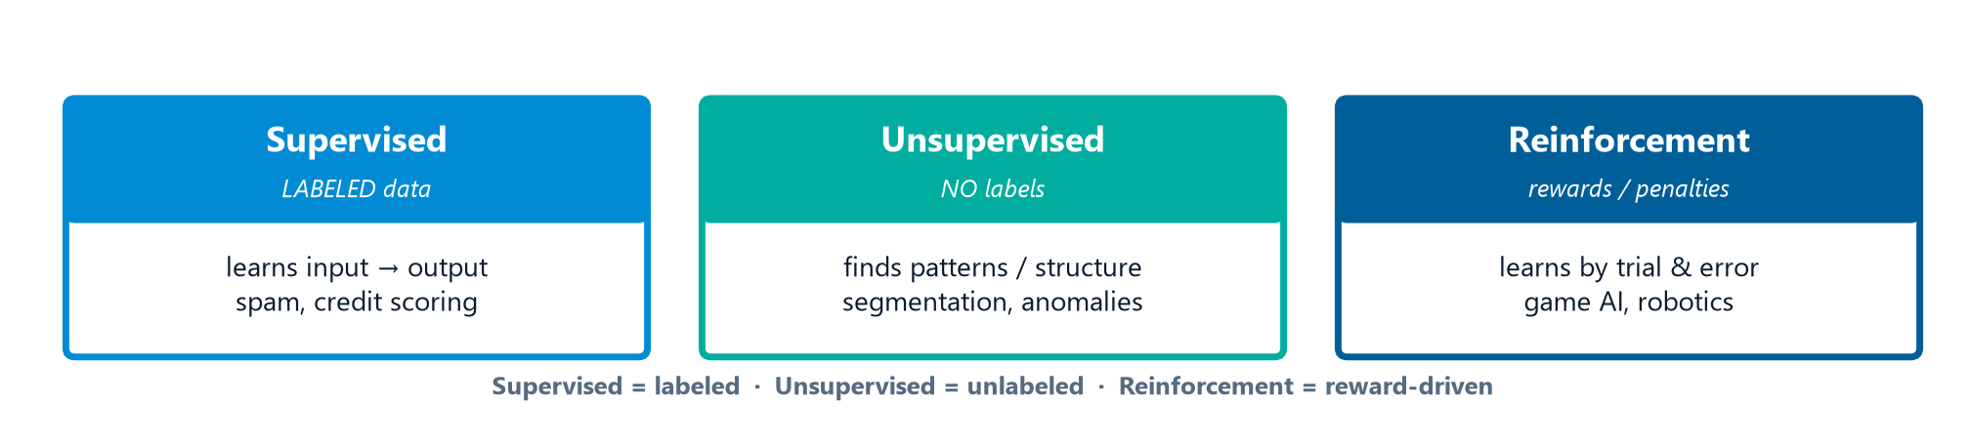
Machine Learning — 3 Types
Module 14 — Big Data & Data Science
Machine Learning — a subset of AI that lets computers learn from data without being explicitly programmed.
Supervised, Unsupervised, and Reinforcement learning.
⭐ EXAM TIP: Supervised = labeled; Unsupervised = unlabeled patterns; Reinforcement = reward-driven.
CDMP Fundamentals | DAMA-DMBOK 2nd Edition
dama.org / cdmp.info
Notes:
: Machine Learning — 3 Types
Machine learning is a subset of artificial intelligence that gives computers the ability to learn from data without being explicitly programmed. There are three main types — the three cards on screen — and the exam tests the distinction. Supervised learning uses training data that includes labeled inputs and outputs, so the algorithm learns the mapping from input to output — examples are spam detection and credit scoring. Unsupervised learning uses data with no labels, so the algorithm finds patterns or structure on its own — examples are customer segmentation and anomaly detection. And reinforcement learning has an agent that learns by receiving rewards or penalties for its actions — think game-playing AI and robotics. The quick test: supervised means labeled data, unsupervised means unlabeled pattern-finding, and reinforcement means learning from rewards.
---

Slide 11
Algorithms, PMML & Responsible AI
Module 14 — Big Data & Data Science
Common algorithms: regression (continuous), classification (categories), clustering (unsupervised grouping), decision trees/random forests, neural networks (deep learning).
PMML (Predictive Model Markup Language) — XML standard for representing predictive models; enables model portability between tools.
Apache Mahout — open-source ML library for Hadoop.
Model explainability matters because regulators, auditors, and affected individuals may require understandable justifications for ML-driven decisions.
⭐ EXAM TIP: PMML = XML model portability. Explainability supports accountability & compliance.
CDMP Fundamentals | DAMA-DMBOK 2nd Edition
dama.org / cdmp.info
Notes:
: Algorithms, PMML & Responsible AI
A quick tour of the algorithms and standards. Common algorithms include regression for predicting continuous values, classification for assigning categories, clustering for grouping similar items in an unsupervised way, decision trees and random forests for rule-based classification, and neural networks for deep learning and pattern recognition. PMML, the Predictive Model Markup Language, is an XML-based standard for representing predictive models, and its key benefit is enabling model portability between different tools — so you can build a model in one tool and deploy it in another. Apache Mahout is an open-source machine learning library for Hadoop. And on responsible AI, model explainability is increasingly important because regulators, auditors, and the individuals affected by automated decisions may require understandable justifications for those decisions. Remember: PMML equals XML model portability, and explainability supports accountability and compliance.
---

Slide 12
NLP, NoSQL & BASE
Module 14 — Big Data & Data Science
NLP (Natural Language Processing) — computers understand/generate human language.
  Sentiment analysis — emotional tone (positive/negative/neutral) of text
  Text mining — extract structured info from unstructured text
NoSQL types: Key-Value (caching) · Document (JSON) · Column-Family (analytical/sparse) · Graph (relationship networks — fraud, social).
NoSQL follows BASE (Basically Available, Soft State, Eventual Consistency).
⭐ EXAM TIP: Graph DBs excel at traversing highly connected data (fraud, social networks).
CDMP Fundamentals | DAMA-DMBOK 2nd Edition
dama.org / cdmp.info
Notes:
: NLP, NoSQL & BASE
A few more Big Data technologies. Natural Language Processing, NLP, is the field of AI focused on enabling computers to understand, interpret, and generate human language. Two NLP applications worth knowing: sentiment analysis, which determines the emotional tone of text — positive, negative, or neutral — used for social media monitoring; and text mining, which extracts structured information from unstructured text. On the database side, the NoSQL types — which we met in Chapter 6 — include key-value stores for caching, document stores for JSON data, column-family stores for analytical and sparse data, and graph databases for relationship networks. And NoSQL databases follow the BASE properties: Basically Available, Soft State, and Eventual Consistency. The exam favorite here: graph databases excel at traversing highly connected data, like fraud rings and social networks.
---

Slide 13
Data Science Activities (7)
Module 14 — Big Data & Data Science
Define Big Data strategy & business needs
Choose data sources (internal/external)
Acquire & ingest (streaming/batch; tag Metadata on ingestion)
Develop models (EDA, feature engineering, training, validation)
Deploy & monitor models (via PMML; watch for drift)
Publish insights (visualization, storytelling)
Monitor the Big Data environment
⭐ EXAM TIP: Apply Metadata tags at ingestion — and watch for model drift after deployment.
CDMP Fundamentals | DAMA-DMBOK 2nd Edition
dama.org / cdmp.info
Notes:
: Data Science Activities (7)
The DMBOK lays out seven data science activities. One, define the Big Data strategy and business needs. Two, choose your data sources, both internal and external. Three, acquire and ingest the data, through either streaming or batch ingestion — and importantly, apply metadata tags during ingestion. Four, develop the data science models, through exploratory data analysis, feature engineering, training, and validation. Five, deploy and monitor the models — often using PMML — and watch for model drift, where performance degrades over time. Six, publish the insights through visualization and storytelling. And seven, monitor the Big Data environment itself. Two practical exam points: apply metadata tags at ingestion, and watch for model drift after deployment.
---

Slide 14
Privacy, Visualization & Governance
Module 14 — Big Data & Data Science
Datensparsamkeit — the German concept of data minimization: collect only what's necessary — foundational to GDPR / privacy-by-design. It pushes back against Big Data's "collect everything" tendency.
Visualization: R (open-source statistical language), Python, Tableau, Power BI.
Governance — the "data swamp" risk: without governance and Metadata tagging, a data lake becomes an unusable data swamp. Tags identify PII, domains, and quality issues at ingestion.
⭐ EXAM TIP: Datensparsamkeit = data minimization. No governance → data swamp.
CDMP Fundamentals | DAMA-DMBOK 2nd Edition
dama.org / cdmp.info
Notes:
: Privacy, Visualization & Governance
Let's cover privacy, visualization, and governance together. There's a wonderful German term the exam likes: Datensparsamkeit, which means data minimization — the principle of collecting only the data that's strictly necessary for the stated purpose. It's foundational to GDPR and privacy-by-design, and it pushes back against Big Data's natural tendency to collect everything "just in case." For visualization, the key tools are R, the open-source statistical programming language; Python; and BI tools like Tableau and Power BI. And on governance, here's the crucial concept: without governance and metadata tagging, a data lake degrades into a data swamp — an unusable mess where data can't be found or trusted. Metadata tags applied at ingestion identify PII, data domains, and quality issues, enabling governance even without a predefined schema. So: Datensparsamkeit is data minimization, and a lack of governance turns a lake into a swamp.
---

Slide 15
Key Numbers & Quick Facts (Cheat Sheet)
Module 14 — Big Data & Data Science
Fact | Value
3 Vs origin | Doug Laney, META Group, 2001
3 Vs / 6 Vs | Volume, Velocity, Variety / + Veracity, Viscosity, Virality
Lambda layers | Speed (A+P) · Batch (C+A) · Serving
Kappa | streaming only (no batch)
Data Lake | schema-on-read · ELT · raw
MapReduce | Map → Shuffle/Sort → Reduce
Hadoop | shared-nothing MPP · HDFS
Spark | in-memory
ML types | Supervised · Unsupervised · Reinforcement
PMML | XML model portability
Datensparsamkeit | data minimization
Data swamp | ungoverned data lake
CDMP Fundamentals | DAMA-DMBOK 2nd Edition
dama.org / cdmp.info
Notes:
: Key Numbers & Quick Facts (Cheat Sheet)
Let's consolidate the final chapter's facts. The three Vs came from Doug Laney at META Group in 2001 — volume, velocity, variety — expanded to six with veracity, viscosity, and virality. The Lambda architecture has speed, batch, and serving layers, and Kappa is streaming-only. A data lake uses schema-on-read, ELT, and raw data. MapReduce goes Map, Shuffle and Sort, Reduce. Hadoop uses shared-nothing MPP and HDFS, while Spark is in-memory. The machine learning types are supervised, unsupervised, and reinforcement. PMML provides XML model portability. Datensparsamkeit is data minimization. And an ungoverned data lake becomes a data swamp. That's your cheat sheet.
---

Slide 16
Common Exam Traps
Module 14 — Big Data & Data Science
❌ Laney coined 4 Vs → ✅ Laney (2001) = the original 3 Vs
❌ Data lake uses schema-on-write → ✅ lake = schema-on-read (ELT); warehouse = schema-on-write
❌ Supervised learning uses unlabeled data → ✅ supervised = labeled; unsupervised = unlabeled
❌ Spark is disk-based like MapReduce → ✅ Spark is in-memory
❌ Big Data needs proprietary appliances → ✅ it uses commodity, shared-nothing hardware
⭐ EXAM TIP: "Schema-on-read," "in-memory," and "data minimization" are signature Big Data phrases.
CDMP Fundamentals | DAMA-DMBOK 2nd Edition
dama.org / cdmp.info
Notes:
: Common Exam Traps
The final chapter's traps. First, Laney's original contribution in 2001 was three Vs, not four — the others came later. Second, a data lake uses schema-on-read with ELT, not schema-on-write; that's the warehouse. Third, supervised learning uses labeled data, while unsupervised uses unlabeled data — don't reverse them. Fourth, Spark is in-memory, which is exactly what distinguishes it from disk-based MapReduce. And fifth, Big Data doesn't require proprietary appliances; it deliberately uses commodity, shared-nothing hardware. The signature phrases that point to right answers here are schema-on-read, in-memory, and data minimization.
---

Slide 17
Module Summary
Module 14 — Big Data & Data Science
Big Data is data too voluminous, fast, and varied for traditional tools — Laney's 3 Vs (2001), expanded to 6.
Lambda (speed/batch/serving, via CAP) and the data lake (schema-on-read, ELT) are the core architectures; ungoverned lakes become swamps.
Hadoop (shared-nothing MPP, HDFS) runs MapReduce (Map→Shuffle→Reduce); Spark is the in-memory successor.
ML is supervised, unsupervised, or reinforcement; PMML gives model portability.
Datensparsamkeit (data minimization) keeps Big Data ethical and compliant.
CDMP Fundamentals | DAMA-DMBOK 2nd Edition
dama.org / cdmp.info
Notes:
: Module Summary
Let's summarize Chapter 14. Big Data is data too voluminous, too fast, and too varied for traditional tools — captured by Laney's three Vs from 2001, expanded to six. The core architectures are Lambda, with its speed, batch, and serving layers built on CAP, and the data lake, with schema-on-read and ELT — and remember, an ungoverned lake becomes a swamp. Hadoop, using shared-nothing MPP and HDFS, runs MapReduce, and Spark is the faster in-memory successor. Machine learning comes in supervised, unsupervised, and reinforcement varieties, and PMML gives you model portability. And Datensparsamkeit — data minimization — keeps Big Data ethical and compliant. That completes the chapter.
---

Slide 18
🎓 Course Wrap-Up — You've Covered It All
Module 14 — Big Data & Data Science
Congratulations — you've completed all 14 chapters of the DMBOK2!
You now hold the full picture:
  Governance at the center (Ch3) directing the 11 knowledge areas
  The big-weight four: Governance, Modeling, Metadata, Data Quality (~44%)
  Plus Reference/Master Data and DW/BI (~20% more)
Next steps: revisit the cheat sheets, take full practice exams, and tab your DMBOK2 for the open-book exam.
⭐ EXAM TIP: Aim for 70%+ to keep the Practitioner/Master path open. You've got this.
CDMP Fundamentals | DAMA-DMBOK 2nd Edition
dama.org / cdmp.info
Notes:
: Course Wrap-Up — You've Covered It All
And with that, congratulations — you've completed all fourteen chapters of the DMBOK Second Edition! Take a moment to appreciate how far you've come. You now hold the complete picture of data management: Data Governance sitting at the center of the DAMA Wheel, directing the eleven knowledge areas around it. You've mastered the big-weight four — Governance, Data Modeling, Metadata, and Data Quality — which together make up about forty-four percent of the exam, plus Reference and Master Data and Data Warehousing and BI for another twenty percent. Here's what to do next. Revisit the cheat-sheet slides in each module until the numbers and lists are automatic. Take full-length practice exams under timed conditions. And tab and bookmark your DMBOK for the open-book portion of the exam. One last piece of advice: aim for seventy percent or higher, which keeps the Practitioner and Master paths open for your future. You've put in the work — now go pass that exam. You've got this.
---

Slide 19
Let's Test Your Knowledge
Module 14 — Big Data & Data Science
Heading: 5 practice questions — Big Data & Data Science
Subtitle: The final set. Watch the architecture and ML distinctions.
CDMP Fundamentals | DAMA-DMBOK 2nd Edition
dama.org / cdmp.info
Notes:
: Let's Test Your Knowledge
Time for the final set of five practice questions, on Big Data and data science. These focus on the architecture distinctions — Spark versus MapReduce, Lambda versus Kappa — and on machine learning governance. Read each carefully, choose your answer, and then reveal the solution. Here we go, one last time.
---

Slide 20
Practice Question 1
Module 14 — Big Data & Data Science
Q1
Which characteristic most distinguishes Apache Spark from the original Hadoop MapReduce framework?
A) Spark is limited to batch processing, while MapReduce natively supports streaming
B) Spark requires a separate cluster manager, while MapReduce has a built-in scheduler
C) Spark stores intermediate results in memory (RAM), dramatically reducing disk I/O for iterative workloads
D) Spark uses HDFS exclusively, while MapReduce supports multiple storage backends
Answer: Spark's defining advantage is in-memory processing — keeping intermediate results in RAM rather than writing them to disk between steps, which makes it far faster than MapReduce for iterative workloads like machine learning. The other statements are inaccurate.
CDMP Fundamentals | DAMA-DMBOK 2nd Edition
dama.org / cdmp.info
Notes:
: Practice Questions (Q1–Q3)
Question one: what most distinguishes Apache Spark from Hadoop MapReduce? The answer is C — Spark stores intermediate results in memory, in RAM, dramatically reducing disk I/O for iterative workloads. That in-memory processing is its defining advantage. The other statements are simply inaccurate.
Question two: when are graph databases most advantageous over relational databases? The answer is D — when you need to traverse highly connected data to discover relationships, like fraud networks or social connections. Graph databases use index-free adjacency to follow relationships efficiently. Relational databases handle the other scenarios just fine.
Question three: an organization processes only real-time streaming data and finds the batch layer adds needless complexity. Which architecture simplifies it? The answer is B — Kappa architecture, which treats all data as a stream and eliminates the separate batch layer. Lambda keeps the batch layer; data mesh and medallion address entirely different concerns.
Two more on the final slide.
---

Slide 21
Practice Question 2
Module 14 — Big Data & Data Science
Q2
Graph databases are most advantageous over relational databases when the primary analytical need involves:
A) Maintaining strict referential integrity across normalized tables
B) Executing complex multi-table aggregate queries for financial reporting
C) Storing large volumes of flat transactional records with well-defined schemas
D) Traversing highly connected data to discover relationships, such as fraud networks or social connections
Answer: Graph databases shine at traversing highly connected data — following relationships across many hops, as in fraud-ring detection or social-network analysis — because of index-free adjacency. Relational databases handle the other scenarios well.
CDMP Fundamentals | DAMA-DMBOK 2nd Edition
dama.org / cdmp.info
Notes:
: Practice Questions (Q1–Q3)
Question one: what most distinguishes Apache Spark from Hadoop MapReduce? The answer is C — Spark stores intermediate results in memory, in RAM, dramatically reducing disk I/O for iterative workloads. That in-memory processing is its defining advantage. The other statements are simply inaccurate.
Question two: when are graph databases most advantageous over relational databases? The answer is D — when you need to traverse highly connected data to discover relationships, like fraud networks or social connections. Graph databases use index-free adjacency to follow relationships efficiently. Relational databases handle the other scenarios just fine.
Question three: an organization processes only real-time streaming data and finds the batch layer adds needless complexity. Which architecture simplifies it? The answer is B — Kappa architecture, which treats all data as a stream and eliminates the separate batch layer. Lambda keeps the batch layer; data mesh and medallion address entirely different concerns.
Two more on the final slide.
---

Slide 22
Practice Question 3
Module 14 — Big Data & Data Science
Q3
An organization processes only real-time streaming data and finds the batch layer adds complexity with no analytical benefit. Which architecture best simplifies this?
A) Lambda architecture, for its proven batch/speed separation
B) Kappa architecture, because it treats all data as a stream and eliminates the separate batch layer
C) Data mesh architecture, because it decentralizes ownership
D) Medallion architecture, because it organizes data into Bronze/Silver/Gold tiers
Answer: Kappa architecture treats all data as a stream, eliminating the batch layer that Lambda maintains — ideal when an organization only needs real-time stream processing. Data mesh and medallion address different concerns (ownership and layering).
CDMP Fundamentals | DAMA-DMBOK 2nd Edition
dama.org / cdmp.info
Notes:
: Practice Questions (Q1–Q3)
Question one: what most distinguishes Apache Spark from Hadoop MapReduce? The answer is C — Spark stores intermediate results in memory, in RAM, dramatically reducing disk I/O for iterative workloads. That in-memory processing is its defining advantage. The other statements are simply inaccurate.
Question two: when are graph databases most advantageous over relational databases? The answer is D — when you need to traverse highly connected data to discover relationships, like fraud networks or social connections. Graph databases use index-free adjacency to follow relationships efficiently. Relational databases handle the other scenarios just fine.
Question three: an organization processes only real-time streaming data and finds the batch layer adds needless complexity. Which architecture simplifies it? The answer is B — Kappa architecture, which treats all data as a stream and eliminates the separate batch layer. Lambda keeps the batch layer; data mesh and medallion address entirely different concerns.
Two more on the final slide.
---

Slide 23
Practice Question 4
Module 14 — Big Data & Data Science
Q4
Which governance challenge is most commonly cited when organizations scale data science teams?
A) Lack of standardized processes for model versioning, reproducibility, and accountability for model outputs
B) Excess of clearly documented model lineage making audits too time-consuming
C) Difficulty recruiting data engineers due to low salaries
D) Overabundance of labeled training data reducing the need for feature engineering
Answer: As data science scales, the key governance gap is the lack of standardized model versioning, reproducibility, and accountability — without these, model results can't be trusted, audited, or reproduced. The other options describe implausible "problems."
CDMP Fundamentals | DAMA-DMBOK 2nd Edition
dama.org / cdmp.info
Notes:
: Practice Questions (Q4–Q5)
Question four: which governance challenge is most commonly cited as data science teams scale? The answer is A — a lack of standardized processes for model versioning, reproducibility, and accountability for model outputs. Without these, you can't trust, audit, or reproduce your models. The other options describe implausible "problems," like too much documentation or too much labeled data.
Question five: why is model explainability important in responsible AI? The answer is A — because regulators, auditors, and affected individuals may require understandable justifications for decisions made by or with machine learning models. Explainability is central to accountability and compliance. It does not replace bias assessments, it's not limited to unsupervised learning, and explainable models don't automatically outperform black-box models on accuracy.
And that is the final question of the course. You've now worked through every knowledge area and every chapter the CDMP Fundamentals exam covers. Congratulations on completing the course — go review those cheat sheets, take your practice exams, and walk into that exam with confidence. I wish you the very best. You've got this.
---
*End of Module 14 scripts. End of course. Congratulations! 🎓*

Slide 24
Practice Question 5
Module 14 — Big Data & Data Science
Q5
In responsible AI, model explainability is considered important primarily because:
A) Regulators, auditors, and affected individuals may require understandable justifications for decisions made by or with ML models
B) Explainability tools eliminate the need for separate bias and fairness assessments
C) Explainability is only relevant for unsupervised learning
D) Explainable models always outperform black-box models on accuracy
Answer: Explainability matters because regulators, auditors, and affected individuals may demand understandable justifications for automated decisions — central to accountability and compliance. It does not replace bias assessments, isn't limited to unsupervised learning, and doesn't guarantee higher accuracy. End of Module 14 — Big Data & Data Science. End of course. Congratulations! 🎓
CDMP Fundamentals | DAMA-DMBOK 2nd Edition
dama.org / cdmp.info
Notes:
: Practice Questions (Q4–Q5)
Question four: which governance challenge is most commonly cited as data science teams scale? The answer is A — a lack of standardized processes for model versioning, reproducibility, and accountability for model outputs. Without these, you can't trust, audit, or reproduce your models. The other options describe implausible "problems," like too much documentation or too much labeled data.
Question five: why is model explainability important in responsible AI? The answer is A — because regulators, auditors, and affected individuals may require understandable justifications for decisions made by or with machine learning models. Explainability is central to accountability and compliance. It does not replace bias assessments, it's not limited to unsupervised learning, and explainable models don't automatically outperform black-box models on accuracy.
And that is the final question of the course. You've now worked through every knowledge area and every chapter the CDMP Fundamentals exam covers. Congratulations on completing the course — go review those cheat sheets, take your practice exams, and walk into that exam with confidence. I wish you the very best. You've got this.
---
*End of Module 14 scripts. End of course. Congratulations! 🎓*

