Slide 1
Certified ScrumMaster (CSM) Exam Prep Masterclass
Module 0: Course Introduction and Exam Orientation
Learn Scrum, then learn how the exam asks about it
Certified ScrumMaster (CSM) Exam Prep Masterclass
Module 0
Notes:
Welcome to the Certified ScrumMaster Exam Prep Masterclass. This is Module 0, the course introduction. In the next few minutes you will see who the course is for and what you will be able to do. You will see how the exam works, what the course is built on, and how each module is organized. Then you will learn how to get the most from it. The idea is simple: learn Scrum, and then learn how the exam asks about it.

Slide 2
Who This Course Is For
Module 0
You are preparing for the CSM exam, with or without a class behind you
New to Scrum: each idea is taught briefly from zero
Already in a class: you get fast revision of what the exam asks
About half of the course goes to how the exam asks: traps, practice questions and technique
You will meet a team in each module, and act as its Scrum Master
CSM Exam Prep Masterclass | Certified ScrumMaster
Module 0: Course Introduction and Exam Orientation
2 / 14
Notes:
This course is for you if you are preparing for the CSM exam, with or without a class behind you. If Scrum is new, each idea is taught briefly from zero. If you already attended a class, you get a fast revision of what the exam asks. Either way, about half of the course goes to how the exam asks: the traps, the practice questions and the technique. And in every module you will meet a team, and act as its Scrum Master.

Slide 3
What You Will Be Able to Do
Module 0
Explain Scrum in the Guide's own terms: its theory, its pillars, its values
Describe the accountabilities, events and artifacts, and how they connect
Handle Scrum Master situations: facilitating, coaching, impediments, the organization
Spot the common traps before they spot you
Manage the clock on a 50-question exam
EXAM TIP The aim is applying Scrum, not only remembering it. Situational questions reward that.
CSM Exam Prep Masterclass | Certified ScrumMaster
Module 0: Course Introduction and Exam Orientation
3 / 14
Notes:
By the end of the course you will be able to do five things. Explain Scrum in the Guide's own terms: its theory, its pillars and its values. Describe the accountabilities, the events and the artifacts, and how they connect. Handle Scrum Master situations such as facilitating, coaching, impediments and the organization. Spot the common traps before they spot you. And manage the clock on a fifty-question exam. The aim is applying Scrum, not only remembering it.

Slide 4
The Exam in Numbers
Module 0
Item | Detail
Questions and time | 50 multiple-choice questions in 60 minutes
To pass | 37 correct (74%)
Questions come from | The learning objectives and the Scrum Guide
Delivery | Online, after the course; not proctored
Open book | The Scrum Guide and your course materials
EXAM TIP Confirm the current format, fees and eligibility on Scrum Alliance's site before you book. Module 18 covers technique.
CSM Exam Prep Masterclass | Certified ScrumMaster
Module 0: Course Introduction and Exam Orientation
4 / 14
Notes:
The exam in numbers. Fifty multiple-choice questions in sixty minutes. You need thirty-seven correct, which is seventy-four percent. The questions come from the learning objectives and the Scrum Guide. The exam is taken online after the course, and it is not proctored. It is open book: you may use the Scrum Guide and your course materials. Always confirm the current format, fees and eligibility on Scrum Alliance's site before you book. Module eighteen covers exam technique.

Slide 5
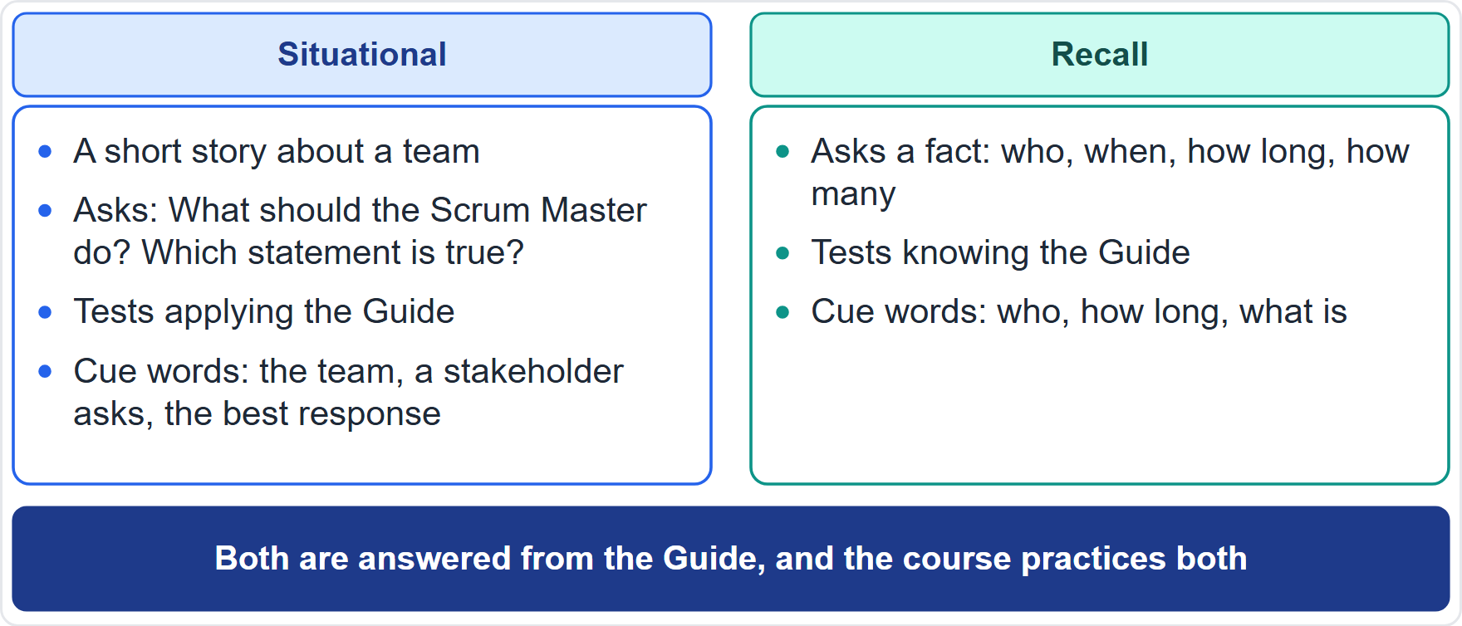
What the Questions Look Like
Module 0
Situational: a short story about a team; what should the Scrum Master do?
Recall: a fact; who, when, how long, how many
Both are answered from the Guide
In every topic module: three situational and two recall practice questions
EXAM TIP For a situational question, return to the Guide's rules and the Scrum Master's accountabilities.
CSM Exam Prep Masterclass | Certified ScrumMaster
Module 0: Course Introduction and Exam Orientation
5 / 14
Notes:
What do the questions look like? Think of two kinds. A situational question tells a short story about a team, and asks what the Scrum Master should do, or which statement is true. A recall question asks a fact: who, when, how long, or how many. Both are answered from the Guide, and the course practices both. Every topic module has three situational questions and two recall questions. For a situational question, return to the Guide's rules and the Scrum Master's accountabilities.

Slide 6
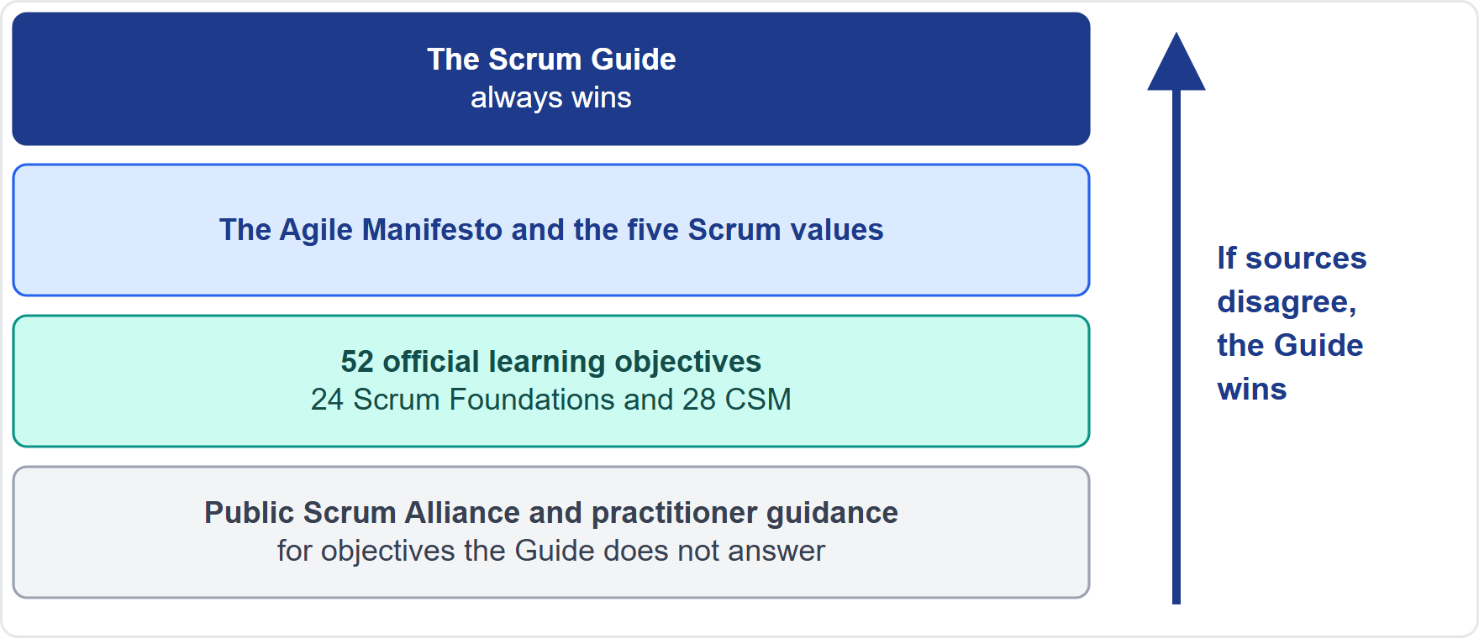
The Official Basis
Module 0
The Scrum Guide comes first and always wins
The Agile Manifesto and the five Scrum values
52 learning objectives: 24 Scrum Foundations, 28 CSM
Public guidance for what the Guide does not answer
CSM Exam Prep Masterclass | Certified ScrumMaster
Module 0: Course Introduction and Exam Orientation
6 / 14
Notes:
What is the course built on? The Scrum Guide comes first, and it always wins. Next come the Agile Manifesto and the five Scrum values. Then the fifty-two official learning objectives: twenty-four for Scrum Foundations and twenty-eight for the CSM. For the objectives the Guide does not answer, such as facilitation, technical debt or the organization, the course uses public Scrum Alliance and practitioner guidance. If any source disagrees with the Guide, the Guide wins.

Slide 7
What Is In, and What Is Out
Module 0
In | Out
Everything in the Guide | Story points and user stories as required methods
The Manifesto and how Scrum reflects it | Velocity as a method
The five Scrum values | Kanban and scaling frameworks
All 52 learning objectives, including facilitation, debt and the organization | Certification fees and renewal
EXAM TIP Module 18 explains why Scrum Alliance treats story points as absent from the Guide.
CSM Exam Prep Masterclass | Certified ScrumMaster
Module 0: Course Introduction and Exam Orientation
7 / 14
Notes:
What is in, and what is out? In: everything in the Guide, the Manifesto and how Scrum reflects it, the five values, and all fifty-two learning objectives. Out: story points and user stories as required methods, velocity as a method, Kanban and scaling frameworks, and certification fees and renewal. Module eighteen explains why Scrum Alliance treats story points as absent from the Guide.

Slide 8
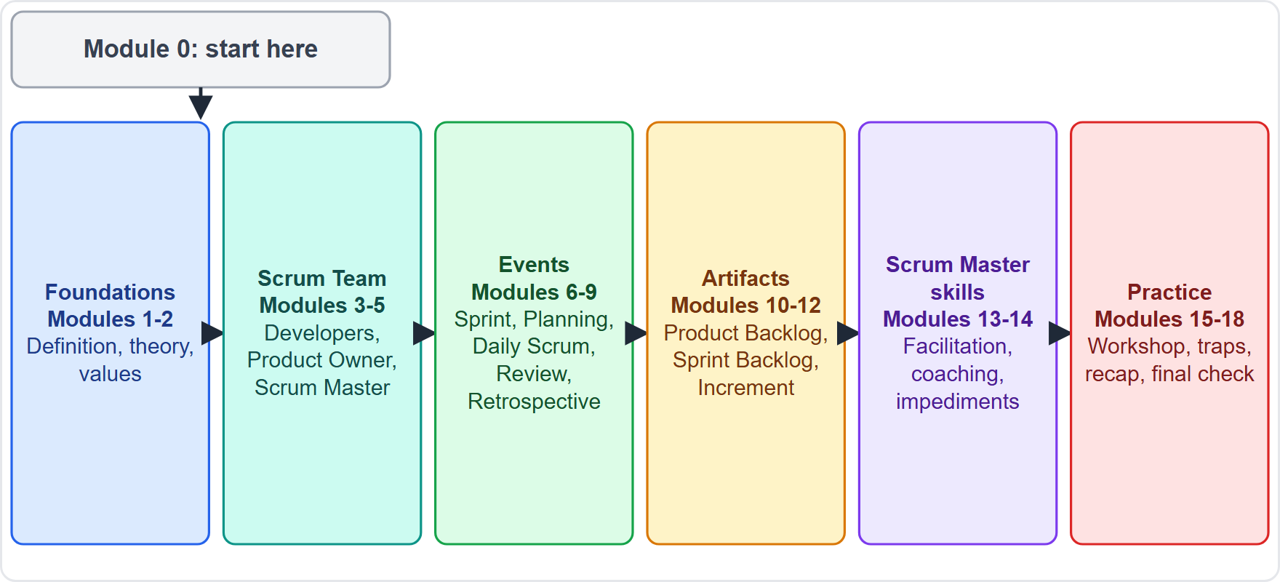
How the Course Is Built
Module 0
1 to 2: Foundations
3 to 5: the Scrum Team
6 to 9: the Sprint and its events
10 to 12: the artifacts and commitments
13 to 14: Scrum Master skills
15 to 18: practice and the final check
CSM Exam Prep Masterclass | Certified ScrumMaster
Module 0: Course Introduction and Exam Orientation
8 / 14
Notes:
The course has nineteen modules. Modules one and two lay the foundations. Modules three to five cover the Scrum Team. Modules six to nine cover the Sprint and its events. Modules ten to twelve cover the artifacts and their commitments. Modules thirteen and fourteen cover Scrum Master skills. And modules fifteen to eighteen are for practice: a scenario workshop, a traps clinic, a quick-reference recap, and the exam technique with a final check.

Slide 9
Labels You Will See
Module 0
Label | What it means
Exam Tip | A rule of thumb for answering
Beyond the Guide | Content a learning objective asks for but the Guide does not state: practical steps, lists, examples
Old wording | A term from the earlier edition that a question may still use, shown only where it is a trap
EXAM TIP Beyond-the-Guide content comes from public Scrum sources. It is exam practice, not Guide text.
CSM Exam Prep Masterclass | Certified ScrumMaster
Module 0: Course Introduction and Exam Orientation
9 / 14
Notes:
You will see three labels. Exam Tip marks a rule of thumb for answering. Beyond the Guide marks content that a learning objective asks for but the Guide does not state, such as practical steps, lists and examples. It comes from public Scrum sources, so treat it as exam practice, not as Guide text. And Old wording marks a term from the earlier edition of the Guide that a question may still use. It appears only where it is a trap.

Slide 10
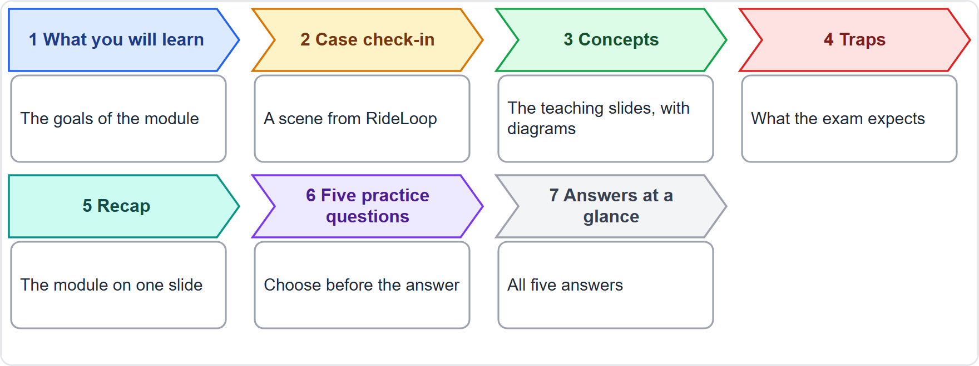
How Each Module Works
Module 0
What you will learn, then a case check-in
The concepts, with diagrams
Traps: what the exam expects
A recap, then five questions with an answers slide
EXAM TIP Pause on each question and choose before the answer is given.
CSM Exam Prep Masterclass | Certified ScrumMaster
Module 0: Course Introduction and Exam Orientation
10 / 14
Notes:
Every topic module has the same shape. It starts with what you will learn, and a short case check-in. Then come the concepts, with diagrams. Then the traps: what the exam expects. Then a recap, and five practice questions with an answers slide. When a question appears, pause, and choose your answer before the answer is given. That habit is worth more than any other single thing in this course.

Slide 11
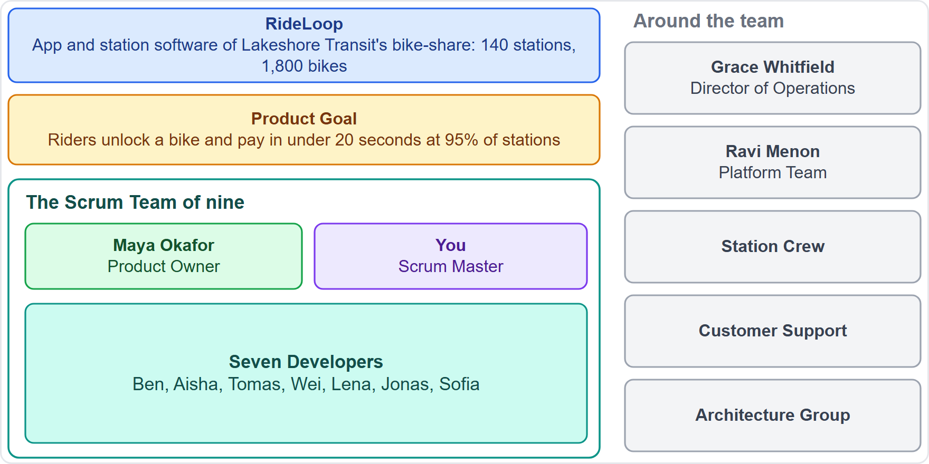
Meet the Running Case: RideLoop
Module 0
RideLoop: the app and station software of Lakeshore Transit's bike-share
Product Goal: unlock a bike and pay in under 20 seconds at 95% of stations
You are the Scrum Master; Maya is the Product Owner; seven Developers
Around them: Grace, the Platform Team, the Station Crew, Customer Support
Fictional; any resemblance to a real product is accidental
CSM Exam Prep Masterclass | Certified ScrumMaster
Module 0: Course Introduction and Exam Orientation
11 / 14
Notes:
Meet the running case. RideLoop is the app and station software of a city bike-share, run by Lakeshore Transit. The Product Goal: riders unlock a bike and pay in under twenty seconds at ninety-five percent of stations. You are the Scrum Master. Maya Okafor is the Product Owner, and there are seven Developers. Around them are Grace Whitfield, the Director of Operations, the Platform Team, the Station Crew, and Customer Support. The case is fictional.

Slide 12
How to Use the Course
Module 0
Read the Scrum Guide once, about 20 minutes, before Module 1; again at the end
Take the modules in order; the numbers match the study summaries
Answer each question before the answer is shown; redo the ones you missed
Use Module 15 to practice the method, Module 16 to spot traps
Use Module 17 daily in the last two days; Module 18 for the final check
EXAM TIP The practice plan in Module 18 spreads the course over three weeks.
CSM Exam Prep Masterclass | Certified ScrumMaster
Module 0: Course Introduction and Exam Orientation
12 / 14
Notes:
How to use the course. Read the Scrum Guide once before Module one, which takes about twenty minutes, and again at the end. Take the modules in order. Answer each question before the answer is shown, and redo the ones you missed. Use Module fifteen to practice the method, and Module sixteen to spot traps. In the last two days, use Module seventeen every day, and Module eighteen for the final check.

Slide 13
Credits, License and Disclaimer
Module 0
The Scrum Guide is by Ken Schwaber and Jeff Sutherland, offered under the Creative Commons Attribution Share-Alike license
The explanations here are in our own words, with short marked quotations
All questions and the RideLoop case are original
Certified ScrumMaster® is a mark of Scrum Alliance, Inc.
This is independent study material, not affiliated with or endorsed by Scrum Alliance
CSM Exam Prep Masterclass | Certified ScrumMaster
Module 0: Course Introduction and Exam Orientation
13 / 14
Notes:
Credits and disclaimer. The Scrum Guide is by Ken Schwaber and Jeff Sutherland, and it is offered under the Creative Commons Attribution Share-Alike license. The explanations in this course are written in our own words, with short, marked quotations. All questions and the RideLoop case are original. Certified ScrumMaster is a mark of Scrum Alliance. This is independent study material, not affiliated with or endorsed by Scrum Alliance.

Slide 14
Next Steps
Module 0
1
Read the Scrum Guide
2
Then Module 1
3
Keep going in order
the definition, the theory and the pillars
answering every question before the answer
once, about 20 minutes
4
Confirm
5
exam details on Scrum Alliance's site
You are the Scrum Master of RideLoop. Welcome to the team
CSM Exam Prep Masterclass | Certified ScrumMaster
Module 0: Course Introduction and Exam Orientation
14 / 14
Notes:
Next steps. First, read the Scrum Guide once; it takes about twenty minutes. Then start Module one: the definition, the theory and the pillars. Keep going in order, and answer every question before the answer. Confirm the exam details on Scrum Alliance's site. And remember: from the next module on, you are the Scrum Master of RideLoop. Welcome to the team.

