Slide 1
Module 1: Scrum Definition, Theory and Empiricism
What Scrum is, why it works, and what you lose with only part of it
Scrum Foundations 1.1, 1.3 to 1.6
Certified ScrumMaster (CSM) Exam Prep Masterclass
Module 1
Notes:
Welcome to Module 1: Scrum Definition, Theory and Empiricism. This is the foundation for everything else in the course. You will learn what Scrum is, why it works, and what a team loses when it uses only some of it. Pay special attention to the three pillars, because they are easy to mix up with the values.

Slide 2
What You Will Learn
Module 1
Define Scrum in your own words
Explain empiricism and lean thinking
Name the three pillars and how they depend on each other
Give benefits of working iteratively and incrementally
Explain why partial Scrum is not Scrum, and what it costs
Spot the traps: pillars versus values, framework versus method
CSM Exam Prep Masterclass | Certified ScrumMaster
Module 1: Scrum Definition, Theory and Empiricism
2 / 22
Notes:
By the end of this module you will be able to do six things. Define Scrum in your own words. Explain empiricism and lean thinking. Name the three pillars and how they depend on each other. Give benefits of working iteratively and incrementally. Explain why partial Scrum is not Scrum, and what it costs. And spot the classic traps: pillars versus values, and framework versus method.

Slide 3
Case Check-In: A Plan for the Year
Module 1
CASE CHECK-IN · RideLoop
Grace Whitfield asks for a detailed plan, with dates, for the next twelve months
You explain that the team plans one Sprint at a time and learns from each Increment
In Sprint 6 the team skipped the Retrospective to save time
The same complaint about the slow station map then came back twice
CSM Exam Prep Masterclass | Certified ScrumMaster
Module 1: Scrum Definition, Theory and Empiricism
3 / 22
Notes:
Back at RideLoop. Grace Whitfield, the Director of Operations, asks for a detailed plan, with dates, for the next twelve months. You explain that the team plans one Sprint at a time, and learns from each Increment. Then there is a second story. In Sprint six, the team skipped the Retrospective to save time. The same complaint about the slow station map then came back twice. One story is about empiricism. The other is about leaving parts of Scrum out.

Slide 4
Scrum in One Sentence
Module 1
Part | What it means
Lightweight framework | Few rules, purposely incomplete
People, teams, organizations | Scrum serves all three levels
Generate value | The aim is value, not output
Adaptive solutions | Learn and adjust as you go
Complex problems | Results cannot be fully predicted
"a lightweight framework that helps people, teams and organizations generate value through adaptive solutions for complex problems"
EXAM TIP Scrum is a framework, not a detailed method.
CSM Exam Prep Masterclass | Certified ScrumMaster
Module 1: Scrum Definition, Theory and Empiricism
4 / 22
Notes:
Start with the definition. The Guide says Scrum is "a lightweight framework that helps people, teams and organizations generate value through adaptive solutions for complex problems." Let us unpack it. Lightweight framework: few rules, and purposely incomplete. People, teams and organizations: Scrum serves all three levels. Generate value: the aim is value, not output. Adaptive solutions: the team learns and adjusts as it goes. Complex problems: work whose results cannot be fully predicted. For the exam, remember that Scrum is a framework, not a detailed method.

Slide 5
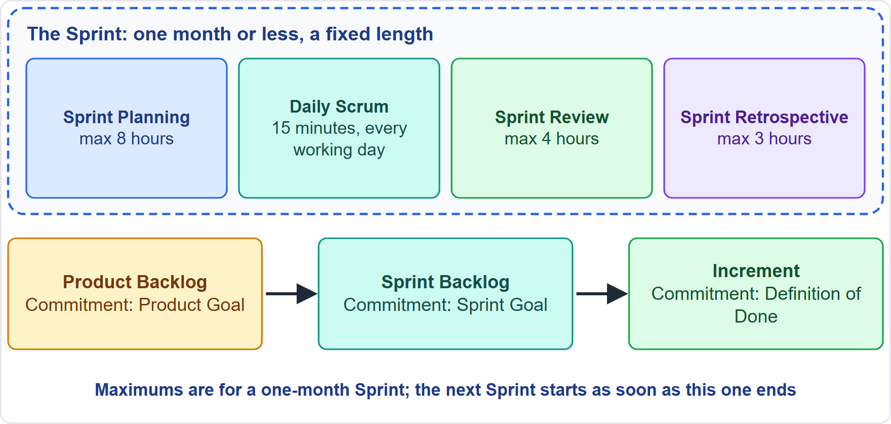
Scrum in a Nutshell
Module 1
A Product Owner orders the work into a Product Backlog
The Scrum Team turns a selection into an Increment (a usable step) in a Sprint
The team and stakeholders (people with an interest in the product) inspect the result and adjust
Repeat
EXAM TIP The Scrum Master fosters the environment in which these steps happen.
CSM Exam Prep Masterclass | Certified ScrumMaster
Module 1: Scrum Definition, Theory and Empiricism
5 / 22
Notes:
Here is Scrum in a nutshell. First, a Product Owner puts the work in order in the Product Backlog. Next, the Scrum Team picks some of that work and, within a Sprint, turns it into an Increment: a usable step toward the goal. Then the team and its stakeholders, the people with an interest in the product, look at the result together and decide what to change. After that, it starts again. A Scrum Master looks after the environment in which all of this happens.

Slide 6
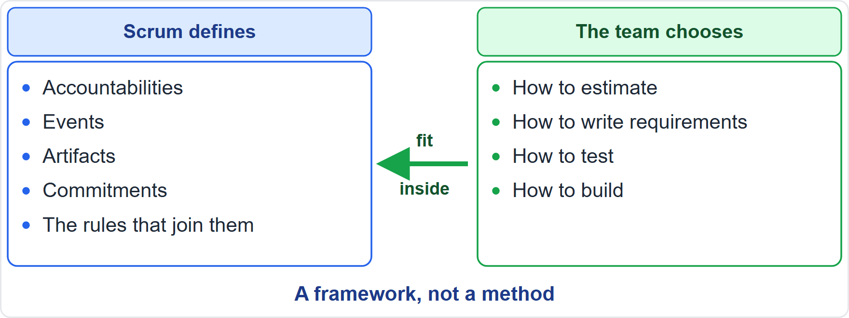
A Framework, Not a Method
Module 1
Purposely incomplete: only what the theory needs
Rules guide relationships and interactions
Other techniques fit inside; Scrum wraps around existing practices or makes some unnecessary
Estimating, requirements and testing are the team's choice
Try it as it is, then judge by the results
EXAM TIP An option that says Scrum prescribes a technique is wrong.
CSM Exam Prep Masterclass | Certified ScrumMaster
Module 1: Scrum Definition, Theory and Empiricism
6 / 22
Notes:
Scrum is a framework, not a method. The Guide calls it purposely incomplete: it defines only the parts the theory needs. Its rules guide relationships and interactions, rather than giving detailed instructions. Other techniques can be used inside it, and Scrum wraps around existing practices or makes some of them unnecessary. So how to estimate, how to write requirements and how to test are the team's choices, not Scrum's. The Guide invites you to try Scrum as it is, and judge by the results. If an exam option says that Scrum prescribes one of these techniques, it is wrong.

Slide 7
Scrum Theory: Empiricism and Lean Thinking
Module 1
Idea | What it means
Empiricism | Knowledge comes from experience; decisions rest on what is observed
Lean thinking | Reduce waste; focus on the essentials
Old wording: the earlier edition said empirical process control and difficult to master; the current Guide says empiricism and lean thinking
EXAM TIP When both appear as options, answer with empiricism and lean thinking.
CSM Exam Prep Masterclass | Certified ScrumMaster
Module 1: Scrum Definition, Theory and Empiricism
7 / 22
Notes:
Scrum theory rests on two ideas. Empiricism: knowledge comes from experience, and decisions rest on what is observed. And lean thinking: reduce waste and focus on the essentials. A note on wording. The earlier edition of the Guide talked about empirical process control, and called Scrum difficult to master. The current Guide uses empiricism and lean thinking. If a question offers both, answer with empiricism and lean thinking.

Slide 8
Complex Work: Only the Past Informs the Future
Module 1
Up-front prediction | Empiricism
Plan everything, then follow the plan | Plan a little, learn, plan again
Change is an exception | New information is expected
Progress is judged against the plan | Progress is judged by the inspected Increment
Risk is handled at the start | Risk is limited in every short cycle
EXAM TIP Burn-downs and other forecasts help, but they do not replace empiricism: only what has already happened should drive forward-looking decisions.
CSM Exam Prep Masterclass | Certified ScrumMaster
Module 1: Scrum Definition, Theory and Empiricism
8 / 22
Notes:
Why empiricism? Because Scrum is built for complex work, where outcomes cannot be known in advance. Decisions about the future can use only what has already happened. Compare the two styles. Up-front prediction plans everything, then follows the plan. It treats change as an exception, judges progress against the plan, and handles risk at the start. Empiricism plans a little, learns, and plans again. It expects new information, judges progress by the inspected Increment, and limits risk in every short cycle. Burn-down charts and similar forecasts are useful, but they do not replace empiricism: only what has already happened should drive forward-looking decisions. That is also your answer to Grace's twelve-month plan.

Slide 9
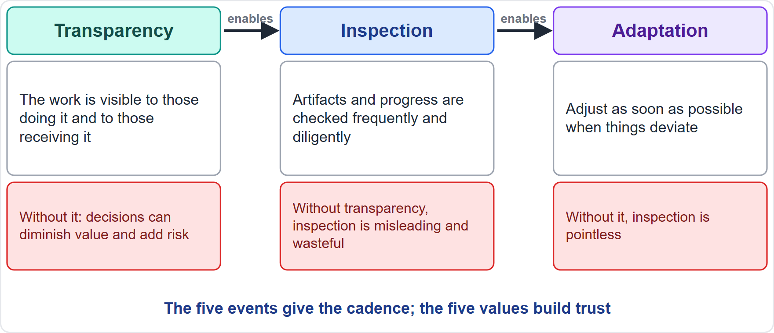
The Three Pillars
Module 1
Transparency: the work is visible to those doing it and those receiving it
Inspection: frequent, diligent checks; the five events set the rhythm
Adaptation: adjust as soon as things go off track
EXAM TIP Pillars are transparency, inspection, adaptation. Commitment, focus, openness, respect and courage are values.
CSM Exam Prep Masterclass | Certified ScrumMaster
Module 1: Scrum Definition, Theory and Empiricism
9 / 22
Notes:
The three pillars are transparency, inspection and adaptation. Transparency: the work is visible to those doing it and to those receiving it. Inspection: the artifacts and progress are checked frequently and diligently, and the five events give the rhythm. Adaptation: when something goes outside acceptable limits, adjust as soon as possible. Do not confuse these with the values. Commitment, focus, openness, respect and courage are values, not pillars.

Slide 10
What Goes Wrong Without a Pillar
Module 1
Problem | Result
No transparency | Inspection misleads; decisions can diminish value and add risk
No adaptation | Inspection is pointless
Slow adaptation | Deviation grows; adapt as soon as possible
People not empowered | Adapting becomes harder
EXAM TIP Choose the answer that keeps the chain intact: transparency, then inspection, then adaptation.
CSM Exam Prep Masterclass | Certified ScrumMaster
Module 1: Scrum Definition, Theory and Empiricism
10 / 22
Notes:
The pillars form a chain: transparency enables inspection, and inspection enables adaptation. Break the chain and see what goes wrong. Without transparency, inspection is misleading and wasteful, and decisions can diminish value and increase risk. Without adaptation, inspection is pointless, because the events are designed to provoke change. Slow adaptation lets deviation grow, so adapt as soon as possible. And adapting is harder when people are not empowered. In a question, look for the answer that keeps the chain intact.

Slide 11
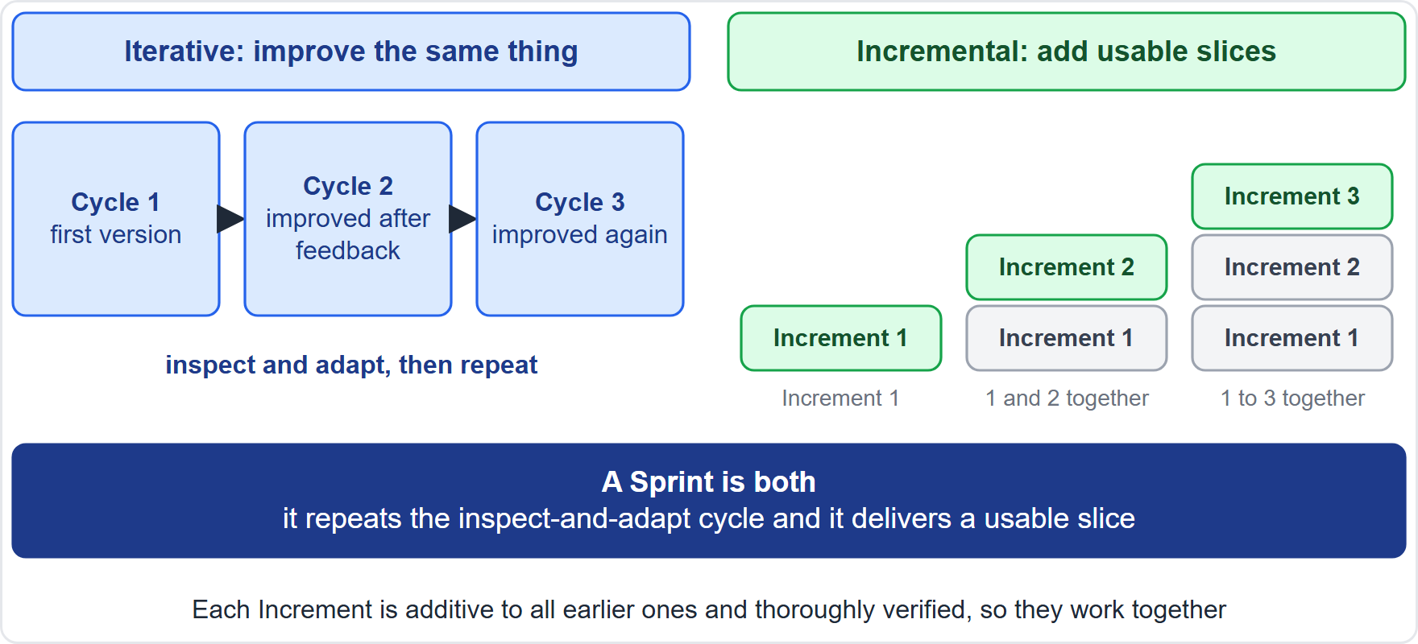
Iterative and Incremental
Module 1
Iterative: repeat cycles, using what was learned to improve the next
Incremental: build in usable slices, each added to the earlier ones
A Sprint is both
EXAM TIP The Guide's aim: optimize predictability and control risk.
CSM Exam Prep Masterclass | Certified ScrumMaster
Module 1: Scrum Definition, Theory and Empiricism
11 / 22
Notes:
Scrum works iteratively and incrementally. Iterative means repeating cycles, and using what you learned to improve the next one. Incremental means building the product in usable slices, each added to the earlier ones. A Sprint is both: it repeats the inspect and adapt cycle, and it produces an Increment. The Sprint is also the container that holds the other four events. The Guide's aim for this approach is to optimize predictability and to control risk.

Slide 12
Benefits of Working This Way
BEYOND THE GUIDE
Module 1
Benefit | Why
Earlier feedback | Stakeholders inspect a real Increment each Sprint
Earlier value | Usable Increments from the first Sprints
Lower risk | Each Sprint limits cost and effort
Better predictability | Progress is checked at least monthly
Response to change | The Product Backlog can be reordered
Continuous learning | Every Retrospective feeds the next Sprint
EXAM TIP Name at least three. Wrong options promise a fixed scope or no change after planning.
CSM Exam Prep Masterclass | Certified ScrumMaster
Module 1: Scrum Definition, Theory and Empiricism
12 / 22
Notes:
The Guide names two aims: predictability and risk control. The benefits usually taught for this learning objective go a little further, so this slide carries the tag Beyond the Guide. Earlier feedback, because stakeholders inspect a real Increment every Sprint. Earlier value, from the first Sprints. Lower risk, because each Sprint limits cost and effort. Better predictability, because progress is checked at least every month. Response to change, because the Product Backlog can be reordered. And continuous learning, because every Retrospective feeds the next Sprint. If asked, name at least three.

Slide 13
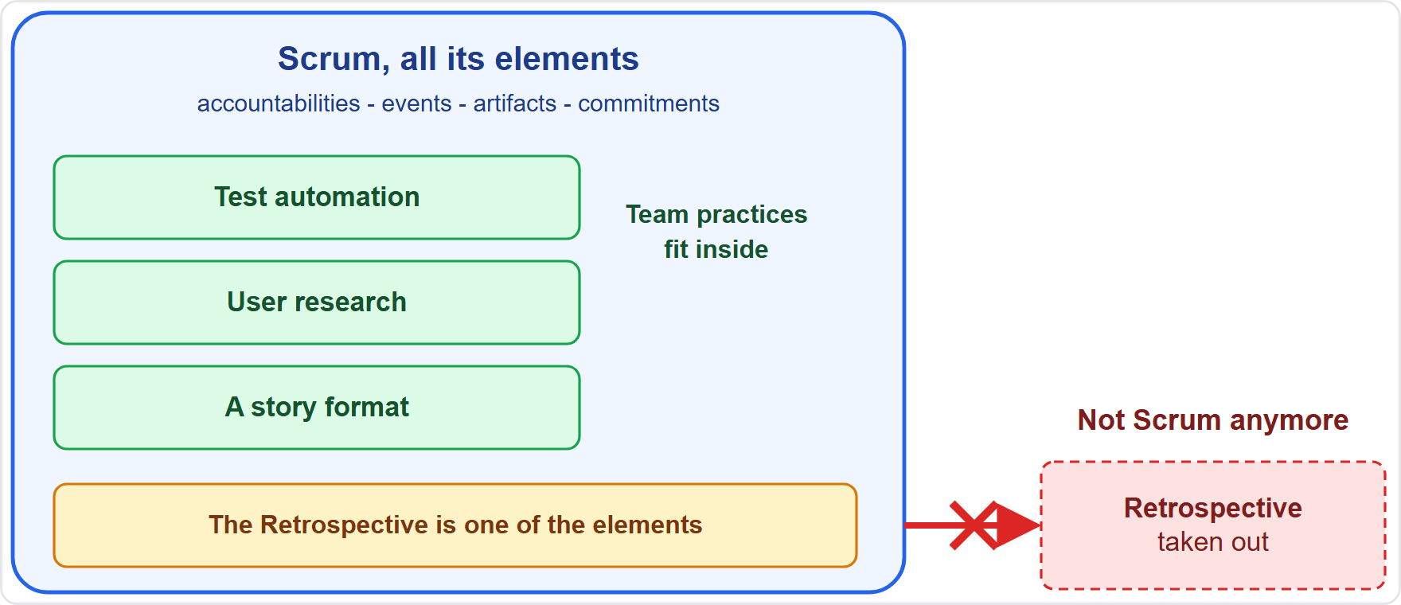
Scrum Is Immutable
Module 1
Using only parts is possible, but the result is not Scrum
It exists only in its entirety
Each element has a purpose essential to the whole
Leaving parts out covers up problems
EXAM TIP Restore the missing element. Never endorse the shortcut.
CSM Exam Prep Masterclass | Certified ScrumMaster
Module 1: Scrum Definition, Theory and Empiricism
13 / 22
Notes:
Scrum is immutable. The Guide says that using only parts of Scrum is possible, but "the result is not Scrum." Scrum exists only in its entirety, and each element serves a purpose that is essential to its value. Leaving elements out covers up problems and limits the benefits. At the same time, Scrum is a container: you may add techniques inside it. Adding is fine; removing parts is not. When a team skips a part, the best answer restores it and explains what it protects. The diagram shows it: techniques fit inside the container, but take the Retrospective out and it is not Scrum anymore.

Slide 14
Disadvantages of Partial Scrum
BEYOND THE GUIDE
Module 1
If this is left out | What is lost
Retrospective | The same problems repeat
Definition of Done | Nobody knows what done means; quality drifts
Sprint Review | Feedback arrives late
A single Product Owner | Priorities become unclear
Fixed-length Sprints | The rhythm of inspection and adaptation
Scrum Master | Scrum erodes into old habits
EXAM TIP Name at least two. The Guide's own reason: problems stay hidden.
CSM Exam Prep Masterclass | Certified ScrumMaster
Module 1: Scrum Definition, Theory and Empiricism
14 / 22
Notes:
What do you lose when a part is left out? No Retrospective: the same problems repeat, as at RideLoop. No Definition of Done: nobody knows what done means, and quality drifts. No Sprint Review: feedback arrives late. No single Product Owner: priorities become unclear. No fixed-length Sprints: the regular rhythm of inspection and adaptation is lost. No Scrum Master: Scrum erodes back into old habits. Overall, problems stay hidden, and a team can call itself Scrum without getting Scrum's results. The Guide does not list these consequences, so they go beyond it; they show why leaving a part out costs a team.

Slide 15
Traps: What the Exam Expects
Module 1
Pillars versus values: keep the two lists apart
Framework, not method; technique choices belong to the team
Empiricism: decisions from observation, not early prediction
Adapt as soon as possible; inspection without adaptation is pointless
Partial Scrum is not Scrum; restore what is missing
Counts: five events, three artifacts, three commitments, three accountabilities, three pillars, five values
EXAM TIP Scrum is not only for software.
CSM Exam Prep Masterclass | Certified ScrumMaster
Module 1: Scrum Definition, Theory and Empiricism
15 / 22
Notes:
Here are the traps. Pillars are transparency, inspection and adaptation. Values are commitment, focus, openness, respect and courage. Scrum is a framework, and technique choices belong to the team. Empiricism means decisions from observation, never from early detailed prediction. Adapt as soon as possible, because inspection without adaptation is pointless. Partial Scrum is not Scrum, so restore what is missing. Scrum is not only for software: the Guide uses the word developers for everyone who does the work. And keep the numbers apart: five events, three artifacts, three commitments, three accountabilities, three pillars, five values.

Slide 16
Module Recap
Module 1
1
Scrum
2
Theory
3
Pillars
a lightweight framework for value from complex work
empiricism and lean thinking
transparency, inspection, adaptation, in a chain
4
Approach
5
Immutable
6
Cost of partial Scrum
iterative and incremental, for predictability and lower risk
partial Scrum is not Scrum
hidden problems, lost benefits
CSM Exam Prep Masterclass | Certified ScrumMaster
Module 1: Scrum Definition, Theory and Empiricism
16 / 22
Notes:
Recap. Scrum is a lightweight framework for generating value from complex work. Its theory is empiricism and lean thinking. The pillars are transparency, inspection and adaptation, in a chain. The approach is iterative and incremental, to optimize predictability and control risk. Partial Scrum is not Scrum, and it costs you hidden problems and lost benefits. Now test yourself with five questions.

Slide 17
Practice Question 1
Module 1
Q1
Grace Whitfield asks why the RideLoop team cannot plan the whole year in detail and then follow the plan. Which explanation of Scrum is best?
A
Scrum assumes the work is simple and predictable, so a detailed plan followed to the letter is the safest approach
B
In complex work what will happen is unknown, so the team plans a little, inspects the result and adapts
C
A year-long plan is allowed if the Scrum Master approves it in detail before the first Sprint can start
D
Scrum applies only to the first Sprint of a product, after which a conventional project plan takes over
CSM Exam Prep Masterclass | Certified ScrumMaster
Module 1: Scrum Definition, Theory and Empiricism
17 / 22
Notes:
Question one. Grace Whitfield asks why the RideLoop team cannot plan the whole year in detail and then follow the plan. Which explanation of Scrum is best? The four options are on the screen. Choose your answer. [PAUSE 12] The answer is B. In complex work what will happen is unknown, so decisions rest on what has been observed: plan a little, inspect the result and adapt. The other options contradict the theory or the scope of the framework.

Slide 18
Practice Question 2
Module 1
Q2
Stakeholders say they cannot tell what the RideLoop team has really finished, because many items are almost done. Which pillar is weak, and what helps most?
A
Adaptation, so the team should hold more planning meetings before each Sprint starts
B
Inspection, so the team should send every stakeholder a weekly status report
C
Transparency, so the team should make the work visible and agree on what Done means
D
Courage, so the team should push harder to finish more items in each Sprint
CSM Exam Prep Masterclass | Certified ScrumMaster
Module 1: Scrum Definition, Theory and Empiricism
18 / 22
Notes:
Question two. Stakeholders say they cannot tell what the RideLoop team has really finished, because many items are almost done. Which pillar is weak, and what helps most? The four options are on the screen. Choose your answer. [PAUSE 12] The answer is C. Transparency means the work is visible and everyone shares one understanding of what is finished, and the Definition of Done provides that. Reports and meetings do not, and courage is a value, not a pillar.

Slide 19
Practice Question 3
Module 1
Q3
Grace suggests that whenever items are late, the Sprint should simply run until they are finished. What is the best response from the Scrum Master?
A
Agree, since adjusting the Sprint length to the amount of work is a healthy adaptation of Scrum
B
Report the idea to the organization as a violation that management must punish
C
Ask Maya to decide each time whether the Sprint may be extended, since the Product Owner is accountable for the value
D
Explain that using only parts of Scrum is not Scrum, since fixed Sprints protect the chance to inspect and adapt
CSM Exam Prep Masterclass | Certified ScrumMaster
Module 1: Scrum Definition, Theory and Empiricism
19 / 22
Notes:
Question three. Grace suggests that whenever items are late, the Sprint should simply run until they are finished. What is the best response from the Scrum Master? The four options are on the screen. Choose your answer. [PAUSE 12] The answer is D. Partial Scrum is not Scrum. Sprints have a fixed length to give a regular chance to inspect and adapt. The Scrum Master helps people understand why, instead of policing them.

Slide 20
Practice Question 4
Module 1
Q4
Which three are the empirical pillars of Scrum?
A
Transparency, inspection and adaptation
B
Commitment, focus and openness
C
Respect, courage and transparency
D
Planning, review and retrospective
CSM Exam Prep Masterclass | Certified ScrumMaster
Module 1: Scrum Definition, Theory and Empiricism
20 / 22
Notes:
Question four. Which three are the empirical pillars of Scrum? The four options are on the screen. Choose your answer. [PAUSE 12] The answer is A: transparency, inspection and adaptation. Option B lists values, option C mixes a value with a pillar, and option D lists events.

Slide 21
Practice Question 5
Module 1
Q5
Which of these is a benefit of working iteratively and incrementally?
A
The scope is fixed at the start, so nobody needs to revisit it
B
Stakeholders can wait until the final release before giving feedback
C
Risk stays low because each Sprint limits cost and effort
D
Plans never need to change once the Product Backlog is complete
CSM Exam Prep Masterclass | Certified ScrumMaster
Module 1: Scrum Definition, Theory and Empiricism
21 / 22
Notes:
Question five. Which of these is a benefit of working iteratively and incrementally? The four options are on the screen. Choose your answer. [PAUSE 12] The answer is C. Short cycles limit cost and effort, so the cost of being wrong stays small. The other options describe the opposite of Scrum: a fixed scope, late feedback, and plans that never change.

Slide 22
Answers at a Glance
Module 1
Question | Answer | Why
Q1 | B | Complex work needs empiricism: plan a little, inspect, adapt
Q2 | C | Transparency: visible work and a shared meaning of Done
Q3 | D | Partial Scrum is not Scrum; fixed Sprints protect inspection and adaptation
Q4 | A | The pillars are transparency, inspection and adaptation
Q5 | C | Short cycles limit cost and effort, so risk stays low
CSM Exam Prep Masterclass | Certified ScrumMaster
Module 1: Scrum Definition, Theory and Empiricism
22 / 22
Notes:
Here are all five answers together. Question one: B. Complex work needs empiricism. Question two: C. Transparency means visible work and a shared meaning of Done. Question three: D. Partial Scrum is not Scrum. Question four: A. The pillars are transparency, inspection and adaptation. Question five: C. Short cycles keep risk low. That completes Module 1. Next, Module 2 covers the Scrum values and the Agile Manifesto.

