Slide 1
Module 2: Scrum Values and the Agile Manifesto
The behaviors behind Scrum, and the mindset it reflects
Scrum Foundations 1.2, 1.7
Certified ScrumMaster (CSM) Exam Prep Masterclass
Module 2
Notes:
Welcome to Module 2: Scrum Values and the Agile Manifesto. Module 1 gave you the theory. This module covers the behaviors that make the theory work, and the mindset that Scrum reflects. Two lists to learn, and one skill: matching each Manifesto idea to the Scrum feature that carries it.

Slide 2
What You Will Learn
Module 2
List the five Scrum values and say what each means
Explain what the values do for a Scrum Team
Tell values from pillars
State the Manifesto's four values and twelve principles
Match Manifesto ideas to the Scrum features that reflect them
Spot the traps: false values, the idea that only the left side counts, Manifesto equals Scrum
CSM Exam Prep Masterclass | Certified ScrumMaster
Module 2: Scrum Values and the Agile Manifesto
2 / 21
Notes:
By the end of this module you will be able to do six things. List the five Scrum values and say what each means. Explain what the values do for a Scrum Team. Tell values from pillars. State the Manifesto's four values and twelve principles. Match Manifesto ideas to the Scrum features that reflect them. And spot the traps: false values, the idea that only the left side counts, and the mistake of treating the Manifesto as Scrum.

Slide 3
Case Check-In: One More Feature
Module 2
CASE CHECK-IN · RideLoop
Sprint 8, day four: Grace asks Maya for one more small feature this Sprint
Maya is tempted to say yes to keep the peace
The Developers worry that the Sprint Goal is at risk
You ask yourself which value the team needs most
CSM Exam Prep Masterclass | Certified ScrumMaster
Module 2: Scrum Values and the Agile Manifesto
3 / 21
Notes:
A scene from RideLoop. It is day four of Sprint eight, and Grace Whitfield asks Maya for one more small feature this Sprint. Maya is tempted to say yes, just to keep the peace. The Developers worry that the Sprint Goal is now at risk. You are the Scrum Master, and you ask yourself which value the team needs most. Hold that thought; by the end of the next few slides you will know.

Slide 4
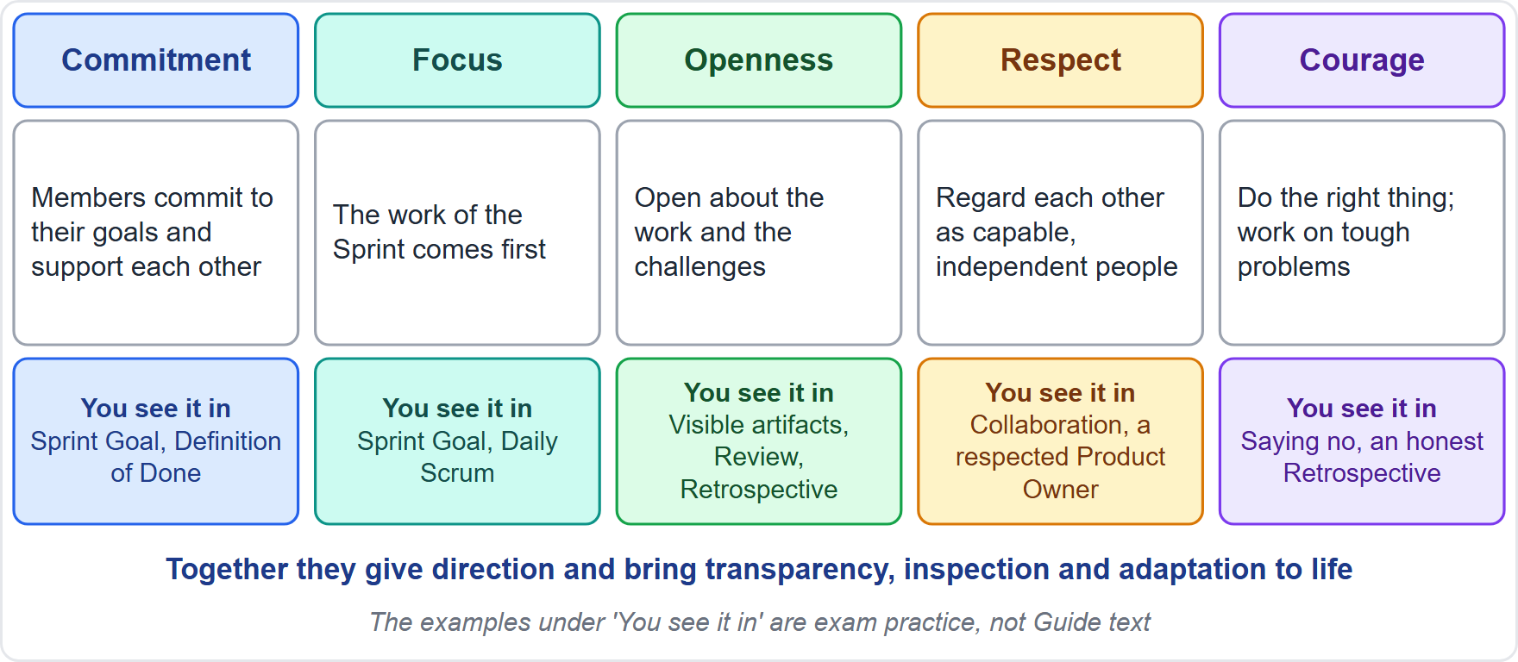
The Five Scrum Values
Module 2
Commitment
Focus
Openness
Respect
Courage
EXAM TIP Memory aid: commit, focus, be open, respect, have courage.
CSM Exam Prep Masterclass | Certified ScrumMaster
Module 2: Scrum Values and the Agile Manifesto
4 / 21
Notes:
The five Scrum values are commitment, focus, openness, respect and courage. A simple memory aid: commit, focus, be open, respect, have courage. Say them to yourself a couple of times now, because answer lists can include impostors, and you want to spot the wrong ones at a glance. The diagram adds where you see each value in practice; those examples are exam practice, not Guide text.

Slide 5
What Each Value Means
Module 2
Value | Meaning in the Guide
Commitment | The team commits to its goals and supports each other
Focus | Attention on the work of the Sprint, for the best progress toward the goals
Openness | Honest with stakeholders about the work and its difficulties
Respect | Members regard each other as capable, independent people
Courage | Do the right thing and tackle tough problems
EXAM TIP Questions add false values: trust, transparency, collaboration, discipline, accountability.
CSM Exam Prep Masterclass | Certified ScrumMaster
Module 2: Scrum Values and the Agile Manifesto
5 / 21
Notes:
What does each value mean? Commitment: the team commits to its goals and supports each other. Focus: attention goes to the work of the Sprint, for the best progress toward the goals. Openness: honesty with stakeholders about the work and its difficulties. Respect: members regard each other as capable, independent people. Courage: doing the right thing and tackling tough problems. And remember the impostors: trust, transparency, collaboration, discipline and accountability are not on the list.

Slide 6
What the Values Do
Module 2
The values steer the team's work, actions and behavior
Decisions, and how the team applies Scrum, should reinforce the values, never weaken them
Members learn the values by working with the events and artifacts
Lived well, the values bring the pillars to life and build trust
EXAM TIP Choose the answer that strengthens a value. Reject one that hides bad news, accepts every request or splits attention.
CSM Exam Prep Masterclass | Certified ScrumMaster
Module 2: Scrum Values and the Agile Manifesto
6 / 21
Notes:
What do the values do? They steer the team's work, actions and behavior. Every decision, and how the team applies Scrum, should reinforce the values and never weaken them. Team members learn the values by working with the events and artifacts. And when people live them, the three pillars come to life and trust grows. In a scenario question, choose the answer that strengthens a value, and reject the one that hides bad news, accepts every request, or splits attention.

Slide 7
Where Each Value Shows Up
BEYOND THE GUIDE
Module 2
Value | Typical places
Commitment | The Sprint Goal, the Definition of Done, helping each other
Focus | The Sprint Goal, the Daily Scrum, a sustainable pace
Openness | Visible artifacts; honest Daily Scrum, Review and Retrospective; early impediments
Respect | Planning together; respecting the Product Owner's decisions; no blame
Courage | Saying no or negotiating (Maya and the extra feature); saying an item will not fit; refusing to call unfinished work Done; raising hard problems
CSM Exam Prep Masterclass | Certified ScrumMaster
Module 2: Scrum Values and the Agile Manifesto
7 / 21
Notes:
Where do you see each value in action? This slide goes beyond the Guide, but it helps with scenarios. Commitment shows in the Sprint Goal and the Definition of Done. Focus shows in the Sprint Goal and the Daily Scrum. Openness shows in visible artifacts and honest events. Respect shows when the team plans together and honors the Product Owner's decisions. Courage shows when someone says an item will not fit, or refuses to call unfinished work Done. And it answers the RideLoop question from the start of the module. Maya needs courage to say no, or to negotiate, when Grace asks for one more feature in the middle of the Sprint.

Slide 8
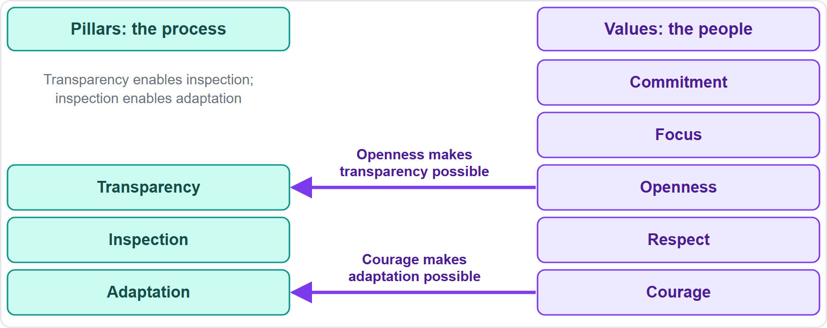
Values and Pillars
Module 2
Pillars: transparency, inspection, adaptation
Values: commitment, focus, openness, respect, courage
Openness makes transparency possible
Courage makes adaptation possible
EXAM TIP Never add transparency to the values.
CSM Exam Prep Masterclass | Certified ScrumMaster
Module 2: Scrum Values and the Agile Manifesto
8 / 21
Notes:
Values and pillars are different lists. The pillars, transparency, inspection and adaptation, make the process empirical. The values, commitment, focus, openness, respect and courage, describe how people behave. They work together. Without openness there is no real transparency, because people hide problems. Without courage the team does not adapt when inspection shows an uncomfortable truth. So never add transparency to the list of values.

Slide 9
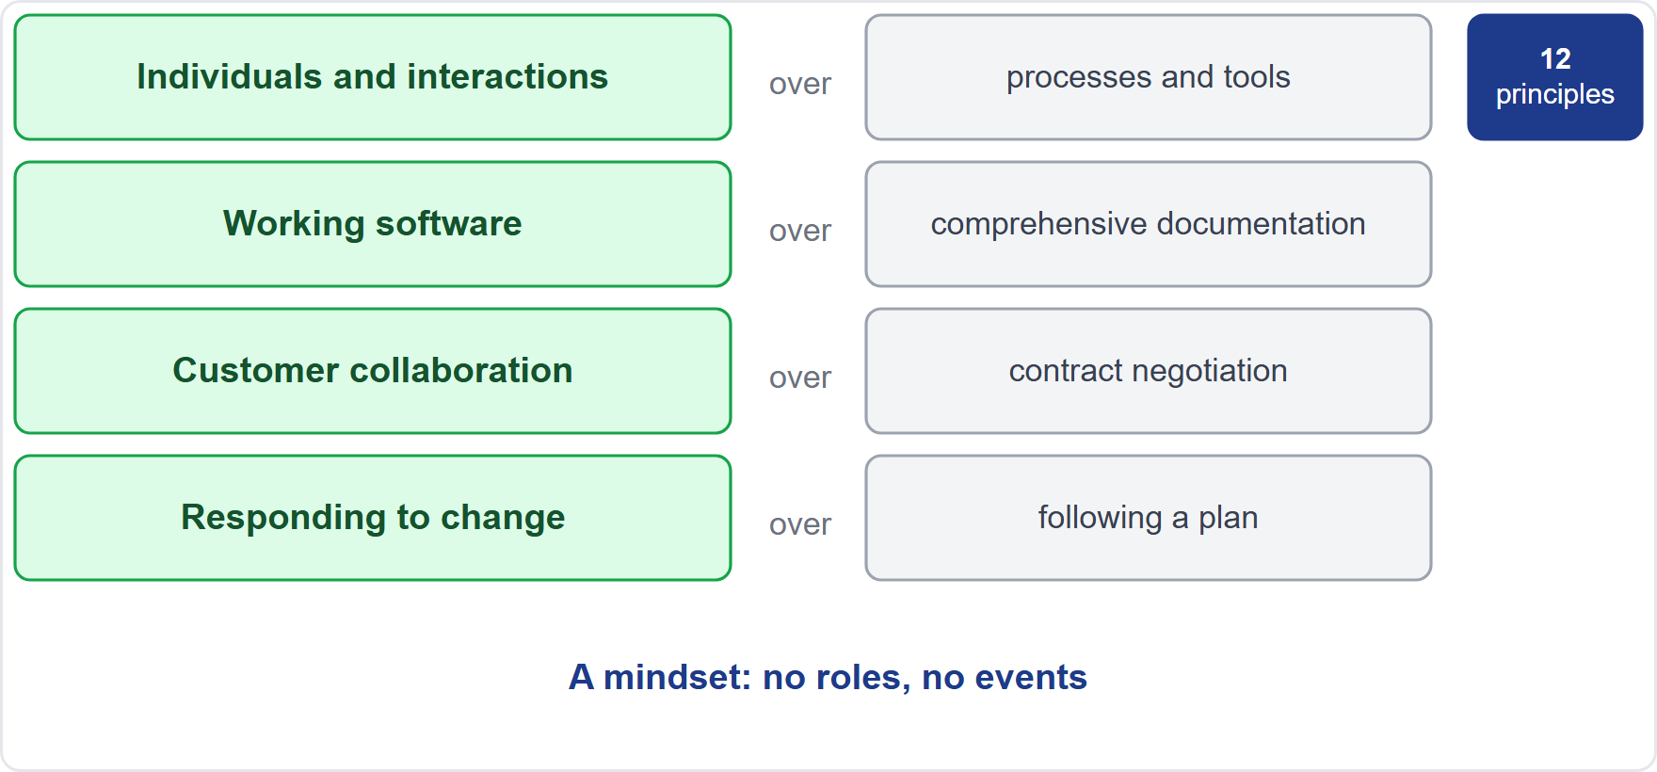
The Agile Manifesto
Module 2
Written more than twenty years ago by seventeen practitioners, among them Ken Schwaber and Jeff Sutherland
Four values, twelve principles
A mindset, not a framework
The Guide never mentions it; the learning objectives do
CSM Exam Prep Masterclass | Certified ScrumMaster
Module 2: Scrum Values and the Agile Manifesto
9 / 21
Notes:
Now the Agile Manifesto. It was written more than twenty years ago by seventeen practitioners, among them Ken Schwaber and Jeff Sutherland, the creators of Scrum. It has four values and twelve principles, and it is a mindset, not a framework. Notice that the Scrum Guide never mentions it. The learning objectives do, which is why the exam can ask about it. The diagram shows the four value pairs, each with the left side valued more than the right, and the twelve principles behind them.

Slide 10
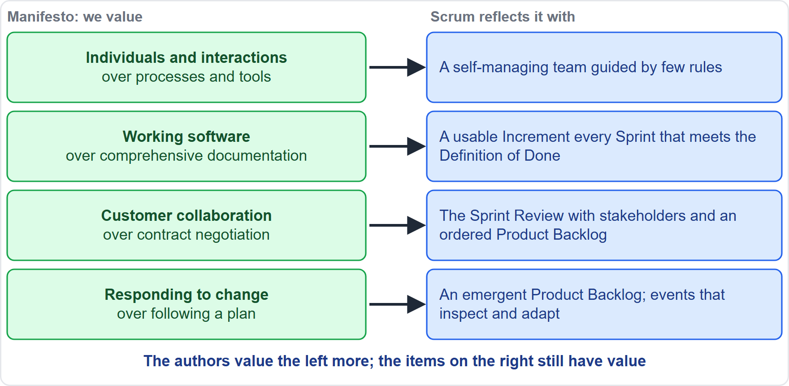
The Four Values and Scrum
BEYOND THE GUIDE
Module 2
Individuals and interactions: a self-managing team guided by few rules
Working software: a usable Increment that meets the Definition of Done
Customer collaboration: the Sprint Review and an ordered Product Backlog
Responding to change: an emergent Product Backlog and events to inspect and adapt
EXAM TIP The Manifesto values the left side more. The right side still has value.
CSM Exam Prep Masterclass | Certified ScrumMaster
Module 2: Scrum Values and the Agile Manifesto
10 / 21
Notes:
The Manifesto values the left side more than the right. Individuals and interactions over processes and tools: Scrum has a self-managing team guided by few rules. Working software over comprehensive documentation: every Sprint produces a usable Increment that meets the Definition of Done. Customer collaboration over contract negotiation: stakeholders join the Sprint Review, and the Product Owner keeps the Product Backlog ordered. Responding to change over following a plan: the Product Backlog is emergent, and the events exist to inspect and adapt. The right side still has value. The Guide never mentions the Manifesto, so this matching goes beyond it.

Slide 11
Principles 1 to 6 and Scrum
BEYOND THE GUIDE
Module 2
Manifesto principle | Where Scrum shows it
Early and continuous delivery | An Increment every Sprint
Welcome changing requirements | An emergent, reorderable Product Backlog
Deliver frequently, favor the shorter timescale | Sprints of one month or less
Business people and developers work together daily | Stakeholder collaboration; refining and planning together
Motivated individuals, trusted | A self-managing, empowered team
Face-to-face conversation | Events at the same time and place
CSM Exam Prep Masterclass | Certified ScrumMaster
Module 2: Scrum Values and the Agile Manifesto
11 / 21
Notes:
Principles one to six, the first half of the twelve. The Guide does not mention them, so this matching goes beyond it. Early and continuous delivery: an Increment every Sprint. Welcome changing requirements: the Product Backlog can be reordered. Deliver frequently: Sprints of one month or less. Business people and developers work together daily: stakeholders collaborate, and the team refines and plans together. Motivated individuals, trusted: a self-managing, empowered team. Face-to-face conversation: events bring people together at the same time and place.

Slide 12
Principles 7 to 12 and Scrum
BEYOND THE GUIDE
Module 2
Manifesto principle | Where Scrum shows it
Working software measures progress | A usable Increment; the Definition of Done
Sustainable pace | Sprints at a pace the team can keep
Technical excellence and good design | Quality built in through the Definition of Done
Simplicity: work not done | Lean thinking; an ordered Product Backlog
Self-organizing teams | The Developers decide how
Regular reflection | The Sprint Retrospective
CSM Exam Prep Masterclass | Certified ScrumMaster
Module 2: Scrum Values and the Agile Manifesto
12 / 21
Notes:
Principles seven to twelve, the second half. Again, this matching goes beyond the Guide. Working software measures progress: a usable Increment, and the Definition of Done. Sustainable pace: Sprints at a pace the team can keep. Technical excellence and good design: quality built in through the Definition of Done. Simplicity, the art of maximizing the work not done: lean thinking and an ordered Product Backlog. Self-organizing teams: the Developers decide how. Regular reflection: the Sprint Retrospective. You do not need the exact wording; you need the matches.

Slide 13
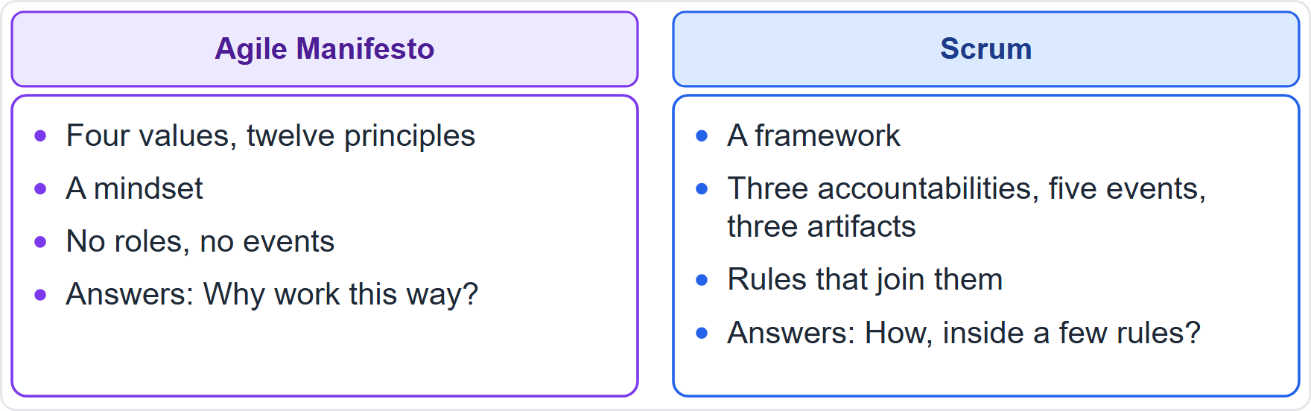
Manifesto and Scrum Compared
Module 2
Manifesto: four values, twelve principles, a mindset
Scrum: a framework with accountabilities, events, artifacts
The Manifesto prescribes no events or roles
EXAM TIP An answer that says Scrum is aligned simply because it is agile is circular. Name the feature.
CSM Exam Prep Masterclass | Certified ScrumMaster
Module 2: Scrum Values and the Agile Manifesto
13 / 21
Notes:
Do not confuse the two. The Manifesto is a mindset of four values and twelve principles, and it answers the question: why work this way? Scrum is a framework with accountabilities, events and artifacts, and it answers the question: how, inside a few rules? The Manifesto prescribes no events and no roles. And if an option says Scrum is aligned with the Manifesto simply because it is agile, that answer is circular. Name the feature.

Slide 14
Traps: What the Exam Expects
Module 2
Values versus pillars: keep the two lists apart
Respect means capable, independent people
The Manifesto prefers the left side; the right still has value
The Manifesto is not Scrum: no events, no roles
Counts: Manifesto four values, twelve principles; Scrum five values, three pillars
Sustainable pace: overtime to hit a plan goes against it
EXAM TIP Reject answers that hide problems, dodge hard truths, scatter attention, blame people or drop the team's goals.
CSM Exam Prep Masterclass | Certified ScrumMaster
Module 2: Scrum Values and the Agile Manifesto
14 / 21
Notes:
Here are the traps. Values and pillars are separate lists. Respect means treating people as capable, independent people. The Manifesto prefers the left side, but the right side still has value. The Manifesto is not Scrum. Keep the counts apart: four values and twelve principles for the Manifesto, five values and three pillars for Scrum. And overtime to hit a plan goes against a sustainable pace. In scenarios, reject answers that hide problems, dodge hard truths, scatter attention, blame people, or drop the team's goals.

Slide 15
Module Recap
Module 2
1
Values
2
Role of values
3
Manifesto
commitment, focus, openness, respect, courage
direct the team and make the pillars real
four values, twelve principles, a mindset
4
Alignment
5
Left over right
6
Not the same
match an idea to a specific Scrum feature
the right side keeps its value
the Manifesto has no roles or events
CSM Exam Prep Masterclass | Certified ScrumMaster
Module 2: Scrum Values and the Agile Manifesto
15 / 21
Notes:
Recap. The values are commitment, focus, openness, respect and courage. They direct the team and make the pillars real. The Manifesto has four values and twelve principles, and it is a mindset. For alignment questions, match an idea to a specific Scrum feature. Left over right does not mean the right side is worthless. And the Manifesto has no roles or events; Scrum does. Now test yourself.

Slide 16
Practice Question 1
Module 2
Q1
On day three of Sprint 9, Wei finds that an item is much harder than expected, but the team is proud of its record and nobody wants to say so. Which Scrum value should the Scrum Master help the team practice most?
A
Respect, by making sure that nobody criticizes Wei for the delay on the item
B
Openness, by sharing the problem with the team and Maya
C
Commitment, by insisting that the original plan for the item is kept
D
Focus, by asking the whole team to work harder on the item
CSM Exam Prep Masterclass | Certified ScrumMaster
Module 2: Scrum Values and the Agile Manifesto
16 / 21
Notes:
Question one. On day three of Sprint nine, Wei finds that an item is much harder than expected, but the team is proud of its record and nobody wants to say so. Which Scrum value should the Scrum Master help the team practice most? The four options are on the screen. Choose your answer. [PAUSE 12] The answer is B, openness. Sharing the problem early lets the Developers adapt the plan and talk scope with the Product Owner. Keeping the plan at any cost, or working harder, hides the problem.

Slide 17
Practice Question 2
Module 2
Q2
A RideLoop manager says the Manifesto prefers working software over comprehensive documentation, so the team should stop documenting anything. What is the best reply?
A
Agree, since documentation has no value in Scrum and the Definition of Done should never include it
B
Agree for the first few Sprints, until the team has built enough working software to need documents
C
Disagree, since Scrum requires a detailed document for every Increment before it can be shown at the Review
D
Explain that the items on the right still have value, and the team decides which documentation its Definition of Done needs
CSM Exam Prep Masterclass | Certified ScrumMaster
Module 2: Scrum Values and the Agile Manifesto
17 / 21
Notes:
Question two. A RideLoop manager says the Manifesto prefers working software over comprehensive documentation, so the team should stop documenting anything. What is the best reply? The four options are on the screen. Choose your answer. [PAUSE 12] The answer is D. The Manifesto values the left side more, but the right side keeps its value. Scrum does not prescribe documentation either way. The Definition of Done decides what the product needs.

Slide 18
Practice Question 3
Module 2
Q3
The RideLoop Developers work evenings in the last days of every Sprint to finish everything they planned. Which Manifesto principle and Guide idea does this go against?
A
A sustainable pace, because it supports the team's focus and consistency
B
Frequent delivery, because working extra hours makes the Sprints longer
C
Customer collaboration, because customers dislike a team that works overtime
D
Simplicity, because working overtime adds extra work to every Sprint
CSM Exam Prep Masterclass | Certified ScrumMaster
Module 2: Scrum Values and the Agile Manifesto
18 / 21
Notes:
Question three. The RideLoop Developers work evenings in the last days of every Sprint to finish everything they planned. Which Manifesto principle and Guide idea does this go against? The four options are on the screen. Choose your answer. [PAUSE 12] The answer is A, a sustainable pace. The Guide links a sustainable pace in Sprints to better focus and consistency. Overtime to hit a plan is not sustainable.

Slide 19
Practice Question 4
Module 2
Q4
Which list names the five Scrum values?
A
Commitment, focus, trust, respect, courage
B
Commitment, focus, openness, respect, courage
C
Transparency, focus, openness, respect, courage
D
Commitment, discipline, openness, respect, courage
CSM Exam Prep Masterclass | Certified ScrumMaster
Module 2: Scrum Values and the Agile Manifesto
19 / 21
Notes:
Question four. Which list names the five Scrum values? The four options are on the screen. Choose your answer. [PAUSE 12] The answer is B: commitment, focus, openness, respect, courage. Transparency is a pillar, and trust and discipline are not Scrum values.

Slide 20
Practice Question 5
Module 2
Q5
Which pairing of a Manifesto idea with the Scrum feature that reflects it is correct?
A
Responding to change: the fixed length of every Sprint
B
Working software: the Daily Scrum every working day
C
Frequent delivery: the Sprint Retrospective
D
Self-organizing teams: a self-managing Scrum Team
CSM Exam Prep Masterclass | Certified ScrumMaster
Module 2: Scrum Values and the Agile Manifesto
20 / 21
Notes:
Question five. Which pairing of a Manifesto idea with the Scrum feature that reflects it is correct? The four options are on the screen. Choose your answer. [PAUSE 12] The answer is D. Self-organizing teams match a self-managing Scrum Team. Responding to change matches the emergent Product Backlog, working software matches the Increment, and frequent delivery matches short Sprints.

Slide 21
Answers at a Glance
Module 2
Question | Answer | Why
Q1 | B | Openness: share the problem early so the plan can adapt
Q2 | D | The right-hand items keep their value; the Definition of Done decides
Q3 | A | A sustainable pace improves focus and consistency
Q4 | B | Commitment, focus, openness, respect, courage
Q5 | D | Self-organizing teams match a self-managing Scrum Team
CSM Exam Prep Masterclass | Certified ScrumMaster
Module 2: Scrum Values and the Agile Manifesto
21 / 21
Notes:
Here are all five answers together. Question one: B, openness. Question two: D, the right-hand items keep their value. Question three: A, a sustainable pace. Question four: B, commitment, focus, openness, respect, courage. Question five: D, self-organizing teams match a self-managing Scrum Team. That completes Module 2. Next, Module 3 covers the Scrum Team and the Developers.

