Slide 1
Module 3: The Scrum Team and the Developers
One team, three accountabilities
Scrum Foundations 2.1, 2.2 · CSM 1.1, 1.3
Certified ScrumMaster (CSM) Exam Prep Masterclass
Module 3
Notes:
Welcome to Module 3: The Scrum Team and the Developers. So far you have seen the theory and the values. Now we meet the people. You will learn what a Scrum Team is, why it has no sub-teams, what the Developers are accountable for, and how the three accountabilities work together in a Sprint.

Slide 2
What You Will Learn
Module 3
Describe the Scrum Team: members, size, focus
Explain cross-functional and self-managing
Give benefits of such a team
State what the Developers are accountable for
Show how the three accountabilities interact in a Sprint
Spot the traps: sub-teams, assigned work, only one party accountable
CSM Exam Prep Masterclass | Certified ScrumMaster
Module 3: The Scrum Team and the Developers
2 / 21
Notes:
By the end of this module you will be able to do six things. Describe the Scrum Team: its members, its size and its focus. Explain what cross-functional and self-managing mean. Give benefits of such a team. State what the Developers are accountable for. Show how the three accountabilities interact in a Sprint. And spot the traps: sub-teams, assigned work, and answers that say only one party is accountable.

Slide 3
Case Check-In: A Separate Data Team?
Module 3
CASE CHECK-IN · RideLoop
The Architecture Group suggests a separate data team for the analytics pipeline
The Developers would hand that work over
Sofia, the data engineer, is the only one who knows the pipeline today
You ask: share the skill, or hand over the work?
CSM Exam Prep Masterclass | Certified ScrumMaster
Module 3: The Scrum Team and the Developers
3 / 21
Notes:
At RideLoop, the Architecture Group has an idea. Create a separate data team for the analytics pipeline, and let the Developers hand that work over. Sofia, the data engineer, is the only person who knows the pipeline today, so the idea sounds tempting. As Scrum Master, you ask a different question: should the Scrum Team share that skill, or hand the work to someone else? The next slides give you the answer.

Slide 4
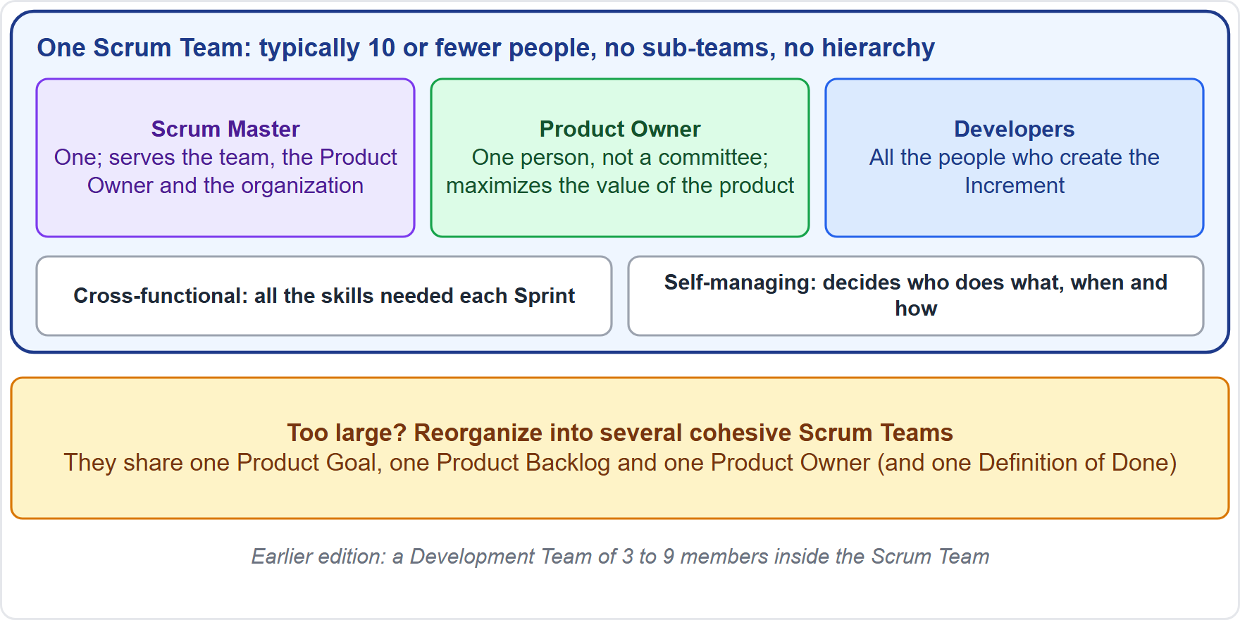
The Scrum Team at a Glance
Module 3
Three accountabilities in one team: a Scrum Master, a Product Owner and Developers
No sub-teams, no hierarchy
Focus: the Product Goal, one objective at a time
Typically ten or fewer people; if larger, form several teams that share one Product Goal, Product Backlog and Product Owner
Old wording: Development Team of three to nine; self-organizing
EXAM TIP A sub-team, a team lead or a manager who assigns work contradicts the Guide.
CSM Exam Prep Masterclass | Certified ScrumMaster
Module 3: The Scrum Team and the Developers
4 / 21
Notes:
The Scrum Team is one team with three accountabilities: a Scrum Master, a Product Owner, and Developers. Inside it there are no sub-teams and no hierarchy. The team focuses on the Product Goal, one objective at a time. It is typically ten or fewer people. If it grows beyond that, it becomes several Scrum Teams that share one Product Goal, one Product Backlog and one Product Owner. In the earlier edition you will find a Development Team of three to nine, called self-organizing. A sub-team, a team lead or a manager who assigns work contradicts the Guide.

Slide 5
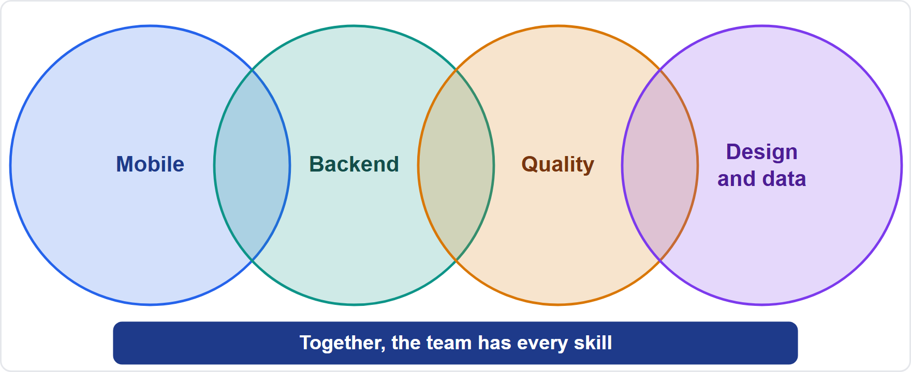
Cross-Functional and Self-Managing
Module 3
Cross-functional: together, the members have every skill needed each Sprint
Self-managing: the members decide who does what, when and how
Not everyone does everything
Not no rules and not no Product Owner
At RideLoop: share the skill (Sofia pairs with Tomas and Wei) instead of handing the pipeline to a separate team
CSM Exam Prep Masterclass | Certified ScrumMaster
Module 3: The Scrum Team and the Developers
5 / 21
Notes:
Two words define how the team works. Cross-functional means that together the members have every skill needed to create value each Sprint. It does not mean everybody does everything. The diagram shows it: no single person covers all the skills, but the team does. Self-managing means the members decide who does what, when and how. It does not mean no rules, and it does not mean no Product Owner. The team works within the framework, toward the Product Goal. That settles the RideLoop question: the team shares the skill, with Sofia pairing with Tomas and Wei, instead of handing the pipeline to a separate team.

Slide 6
Responsible, Accountable, Empowered
Module 3
Responsible for all product activities: stakeholder work, verification, maintenance, operation, research and more
Accountable, as the whole team, for "creating a valuable, useful Increment every Sprint"
Empowered by the organization to manage its own work; if managers override it, the Scrum Master helps them understand
A sustainable pace improves focus and consistency
EXAM TIP An option that makes only the Developers, or only the Product Owner, accountable for the Increment is wrong.
CSM Exam Prep Masterclass | Certified ScrumMaster
Module 3: The Scrum Team and the Developers
6 / 21
Notes:
Three more facts about the team. It is responsible for all product activities: working with stakeholders, verification, maintenance, operation, experiments, research and development, and anything else required. As a whole, it is accountable for "creating a valuable, useful Increment every Sprint." The organization structures and empowers it to manage its own work, and if managers override the team, the Scrum Master helps them understand. And a sustainable pace improves its focus and consistency. If an option says only the Developers, or only the Product Owner, is accountable for the Increment, it is wrong.

Slide 7
Benefits of This Kind of Team
BEYOND THE GUIDE
Module 3
Benefit | Why
Fewer hand-offs | Everything needed is inside the team
Faster decisions and adaptation | Whoever learns something decides at once
Higher quality | Shared ownership of the Increment
Motivation and ownership | People choose how to do the work
Skill sharing | Knowledge spreads; less reliance on one expert
Better collaboration | One team, one goal, one Product Backlog
EXAM TIP Name at least three.
CSM Exam Prep Masterclass | Certified ScrumMaster
Module 3: The Scrum Team and the Developers
7 / 21
Notes:
Why build teams this way? The Guide states the design; the usual benefits go beyond it, so this slide carries the tag Beyond the Guide. Fewer hand-offs, because everything needed is inside the team. Faster decisions and adaptation, because whoever learns something can decide at once. Higher quality, through shared ownership. Motivation and ownership, because people choose how to do the work. Skill sharing, so knowledge spreads. And better collaboration: one team, one goal, one Product Backlog. Name at least three.

Slide 8
The Developers
Module 3
The people who build the usable Increment, whatever part they work on, every Sprint
The skills needed are broad and depend on the domain of work
"Developers" is inclusive: testers, designers, analysts and other specialists who build the Increment
At RideLoop: seven Developers, including Lena and Jonas
EXAM TIP A person does not need the job title developer.
CSM Exam Prep Masterclass | Certified ScrumMaster
Module 3: The Scrum Team and the Developers
8 / 21
Notes:
Now the Developers. They are the people on the Scrum Team who build the usable Increment, whatever part they work on, every Sprint. The skills needed are broad, and depend on the domain of work. The word is inclusive: testers, designers, analysts and other specialists who build the Increment are Developers. At RideLoop there are seven Developers, and that includes Lena, the quality engineer, and Jonas, the designer. A person does not need the job title developer.

Slide 9
What the Developers Are Always Accountable For
Module 3
Accountability | What it means
The Sprint Backlog | They select the work and plan how
Quality | They follow a Definition of Done; unfinished work is not part of the Increment
Daily adaptation | They adapt the plan each day toward the Sprint Goal
Mutual accountability | They hold each other to professional standards
EXAM TIP The Developers own the how and the Sprint plan. They do not own the order of the Product Backlog.
CSM Exam Prep Masterclass | Certified ScrumMaster
Module 3: The Scrum Team and the Developers
9 / 21
Notes:
The Developers are always accountable for four things. First, the Sprint Backlog: they select the work and plan how to do it. Second, quality: they follow a Definition of Done, and unfinished work is not part of the Increment. Third, daily adaptation: they adapt the plan each day toward the Sprint Goal. Fourth, mutual accountability: they hold each other to professional standards. The Developers own the how and the Sprint plan. They do not own the order of the Product Backlog.

Slide 10
Other Developer Duties in the Guide
Module 3
Duty | Where
Select items for the Sprint, in discussion with the Product Owner | Sprint Planning
Plan the work and decide how | Sprint Planning
Size Product Backlog items | Product Backlog
Run the Daily Scrum and choose its structure | Daily Scrum
Negotiate scope with the Product Owner when work turns out different | Sprint Goal
Meet the Definition of Done | Definition of Done
CSM Exam Prep Masterclass | Certified ScrumMaster
Module 3: The Scrum Team and the Developers
10 / 21
Notes:
The Guide gives the Developers more duties, spread across the framework. In Sprint Planning they select items, in discussion with the Product Owner, and plan the work. They size Product Backlog items, because the people who will do the work are best placed to judge it. They run the Daily Scrum and choose its structure. When work turns out different from expected, they negotiate scope with the Product Owner, without harming the Sprint Goal. And they meet the Definition of Done.

Slide 11
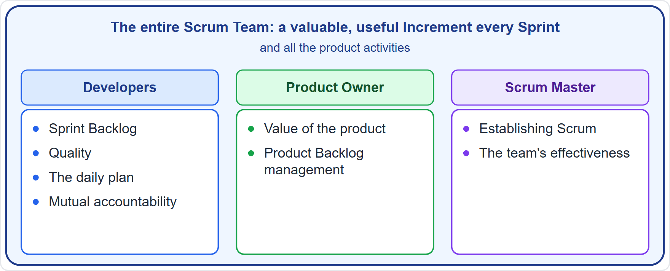
Who Is Accountable for What
Module 3
Entire team: the Increment, product activities, the events
Developers: Sprint plan, quality, daily plan
Product Owner: value, Product Backlog
Scrum Master: Scrum and effectiveness
CSM Exam Prep Masterclass | Certified ScrumMaster
Module 3: The Scrum Team and the Developers
11 / 21
Notes:
Think of accountability in layers. The outer layer is the entire Scrum Team: it holds the Increment, all the product activities, and the events. Inside it, the Developers hold the Sprint plan, quality and the daily plan. The Product Owner holds the value of the product and the Product Backlog. The Scrum Master holds the establishing of Scrum and the effectiveness of the team. Each one adds a part, and the whole team stands behind the result.

Slide 12
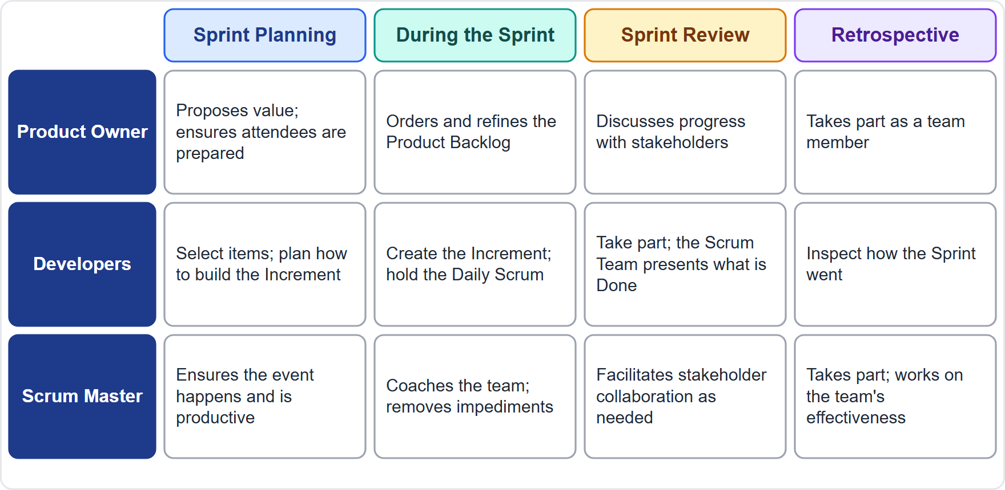
How the Three Work Together in a Sprint
Module 3
Planning: the Product Owner proposes value, the Developers select and plan, the Scrum Master ensures the event works
During the Sprint: the Product Owner refines the Product Backlog (adds detail to items), the Developers build and adapt daily, the Scrum Master coaches and clears impediments
Review: the Scrum Team shows its results to key stakeholders, and they discuss progress toward the Product Goal
Retrospective: all three take part as team members
CSM Exam Prep Masterclass | Certified ScrumMaster
Module 3: The Scrum Team and the Developers
12 / 21
Notes:
How do the three work together? In Sprint Planning, the Product Owner proposes value, the Developers select and plan, and the Scrum Master ensures the event works. During the Sprint, the Product Owner refines the Product Backlog, which means adding detail to items. The Developers build and adapt their plan daily, and the Scrum Master coaches and helps remove impediments. At the Sprint Review, the Scrum Team shows its results to key stakeholders, and they discuss progress toward the Product Goal. At the Retrospective, all three take part as members of the team.

Slide 13
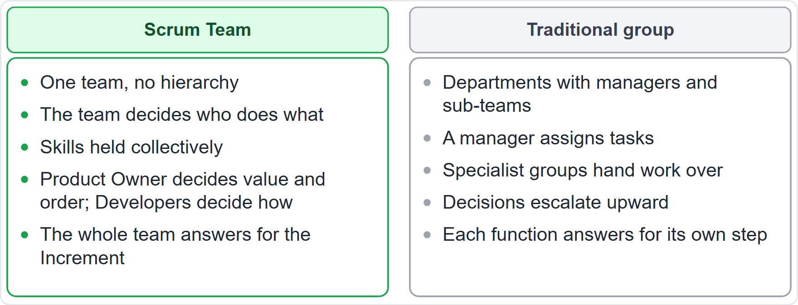
Scrum Team or Work Group?
BEYOND THE GUIDE
Module 3
Scrum Team: one team, no hierarchy, the team decides who does what
Traditional group: departments, managers who assign, hand-offs
CSM Exam Prep Masterclass | Certified ScrumMaster
Module 3: The Scrum Team and the Developers
13 / 21
Notes:
Compare a Scrum Team with a traditional work group. This comparison goes beyond the Guide, but it explains the exam logic. A Scrum Team is one team with no hierarchy, and it decides who does what. Its skills are held collectively, and the entire team is accountable for the Increment. A traditional group has departments with managers, who assign tasks and hand work from one specialist group to the next. When an option sounds like the right-hand column, it contradicts Scrum.

Slide 14
Traps: What the Exam Expects
Module 3
No sub-teams, no hierarchies: a test team, a design team or a team lead inside the Scrum Team is wrong
Typically ten or fewer, because small teams talk to each other more easily and get more done; a larger group becomes several Scrum Teams
Cross-functional is collective, not everyone does everything
Self-managing: nobody outside assigns tasks
The whole Scrum Team is accountable for the Increment
Old wording: Development Team, self-organizing, three to nine members
EXAM TIP The Developers decide how. Nobody else tells them.
CSM Exam Prep Masterclass | Certified ScrumMaster
Module 3: The Scrum Team and the Developers
14 / 21
Notes:
Here are the traps. No sub-teams and no hierarchies: a test team, a design team or a team lead inside the Scrum Team is wrong. Typically ten or fewer, because small teams talk to each other more easily and get more done; a larger group becomes several Scrum Teams. Cross-functional is collective, not everyone doing everything. Self-managing means nobody outside assigns the tasks. The whole Scrum Team is accountable for the Increment. And watch the old wording: Development Team, self-organizing, and three to nine members. The Developers decide how, and nobody else tells them.

Slide 15
Module Recap
Module 3
1
Team
2
Size
3
Cross-functional and self-managing
one Scrum Master, one Product Owner, Developers
typically ten or fewer
all skills, own decisions
4
Accountable
5
Developers
6
Together
the entire team for the Increment
Sprint plan, quality, daily adaptation, mutual accountability
one team toward one Product Goal
CSM Exam Prep Masterclass | Certified ScrumMaster
Module 3: The Scrum Team and the Developers
15 / 21
Notes:
Recap. The Scrum Team is one team: a Scrum Master, a Product Owner and Developers. It is typically ten or fewer people. It is cross-functional and self-managing: all the skills, and its own decisions. The whole team answers for the Increment. The Developers are accountable for the Sprint plan, quality, daily adaptation and mutual accountability. And together they work toward one Product Goal. Now test yourself.

Slide 16
Practice Question 1
Module 3
Q1
Jonas Berg, the RideLoop UX designer, says that designers are not developers, so the Daily Scrum is not for Jonas. What is the best reply?
A
You are right: designers are not Developers, so they attend only the Sprint Review and the Retrospective
B
Designers join the Daily Scrum only when they report to a Developer who speaks for them there
C
Developers are everyone on the team who helps create the Increment, so you take part
D
Designers may attend the Daily Scrum, but only to listen, because only coders build the Increment
CSM Exam Prep Masterclass | Certified ScrumMaster
Module 3: The Scrum Team and the Developers
16 / 21
Notes:
Question one. Jonas Berg, the RideLoop UX designer, says that designers are not developers, so the Daily Scrum is not for Jonas. What is the best reply? The four options are on the screen. Choose your answer. [PAUSE 12] The answer is C. A Developer is anyone on the Scrum Team who builds some part of the usable Increment, and the word covers everyone who does the work. A designer who helps create the Increment is a Developer.

Slide 17
Practice Question 2
Module 3
Q2
The RideLoop Developers ask Maya to assign each of them a share of the Sprint Backlog items. What should the Scrum Master do?
A
Coach the Developers to decide who does what, since the team is self-managing
B
Ask Grace to assign the items, since a Director of Operations has authority over the teams
C
Assign the items fairly, since the Scrum Master is accountable for the team's effectiveness
D
Let Maya decide, since the Product Owner is accountable for the value of the product
CSM Exam Prep Masterclass | Certified ScrumMaster
Module 3: The Scrum Team and the Developers
17 / 21
Notes:
Question two. The RideLoop Developers ask Maya to assign each of them a share of the Sprint Backlog items. What should the Scrum Master do? The four options are on the screen. Choose your answer. [PAUSE 12] The answer is A. A self-managing Scrum Team decides internally who does what, when and how, and the Scrum Master coaches it in self-management. Assignment by the Product Owner, the Scrum Master or a manager takes that away.

Slide 18
Practice Question 3
Module 3
Q3
After a Sprint in which the Increment did not meet the Definition of Done, Grace asks who is accountable. What is the best answer?
A
Only the Developers, because they wrote the code and ran the tests
B
Only Maya, because the Product Owner is accountable for the value of the product
C
Only the Scrum Master, because the Scrum Master is accountable for the team's effectiveness
D
The entire Scrum Team, since it answers for the Increment every Sprint
CSM Exam Prep Masterclass | Certified ScrumMaster
Module 3: The Scrum Team and the Developers
18 / 21
Notes:
Question three. After a Sprint in which the Increment did not meet the Definition of Done, Grace asks who is accountable. What is the best answer? The four options are on the screen. Choose your answer. [PAUSE 12] The answer is D. The whole Scrum Team answers for the Increment each Sprint. The Developers follow the Definition of Done, but the whole team stands behind the Increment.

Slide 19
Practice Question 4
Module 3
Q4
Which set lists what the Developers are always accountable for?
A
The order of the Product Backlog, the wording of the Sprint Goal, and the results of the Sprint Review
B
Establishing Scrum, causing the removal of impediments, and the effectiveness of the whole Scrum Team
C
The Sprint plan, quality through the Definition of Done, daily adaptation, and holding each other accountable
D
The Product Goal, the expectations of stakeholders, and the maximum value of the product each Sprint
CSM Exam Prep Masterclass | Certified ScrumMaster
Module 3: The Scrum Team and the Developers
19 / 21
Notes:
Question four. Which set lists what the Developers are always accountable for? The four options are on the screen. Choose your answer. [PAUSE 12] The answer is C: the Sprint plan, quality through the Definition of Done, daily adaptation, and holding each other accountable. The other sets belong to the Product Owner and the Scrum Master.

Slide 20
Practice Question 5
Module 3
Q5
Which is a benefit of a cross-functional, self-managing Scrum Team?
A
The team can work without a Product Owner because the Developers decide what is valuable
B
The team can adapt quickly, because it need not wait for people outside it
C
The team can skip the Definition of Done because the members trust each other
D
The team can ignore stakeholders because it already knows what the product should be
CSM Exam Prep Masterclass | Certified ScrumMaster
Module 3: The Scrum Team and the Developers
20 / 21
Notes:
Question five. Which is a benefit of a cross-functional, self-managing Scrum Team? The four options are on the screen. Choose your answer. [PAUSE 12] The answer is B. With all the skills inside the team, there are fewer hand-offs and delays, and the team adapts the moment it learns something. It still has a Product Owner, a Definition of Done and stakeholders.

Slide 21
Answers at a Glance
Module 3
Question | Answer | Why
Q1 | C | Developers means everyone who helps create the Increment
Q2 | A | A self-managing team decides who does what
Q3 | D | The entire Scrum Team is accountable for the Increment
Q4 | C | Sprint plan, quality, daily adaptation, mutual accountability
Q5 | B | Fewer hand-offs: create and adapt without waiting
CSM Exam Prep Masterclass | Certified ScrumMaster
Module 3: The Scrum Team and the Developers
21 / 21
Notes:
Here are all five answers together. Question one: C. Developers means everyone who helps create the Increment. Question two: A. A self-managing team decides who does what. Question three: D. The whole Scrum Team answers for the Increment. Question four: C. Sprint plan, quality, daily adaptation, mutual accountability. Question five: B. Fewer hand-offs. That completes Module 3. Next, Module 4 covers the Product Owner.

