Slide 1
Module 4: The Product Owner
One person accountable for the value of the product
CSM 1.4 to 1.6
Certified ScrumMaster (CSM) Exam Prep Masterclass
Module 4
Notes:
Welcome to Module 4: The Product Owner. In the last module you met the whole Scrum Team. Now we look closely at one accountability: the person responsible for the value of the product. You will learn what that means, why it must be one person, and where the Product Owner's authority ends and collaboration begins.

Slide 2
What You Will Learn
Module 4
State what the Product Owner is accountable for
Explain why the Product Owner is one person, with at least two reasons
Show how the Product Owner keeps authority while collaborating
Place the Product Owner in each event
Spot the traps: committees, assigned work, sizing, cancelling a Sprint
CSM Exam Prep Masterclass | Certified ScrumMaster
Module 4: The Product Owner
2 / 19
Notes:
By the end of this module you will be able to do five things. State what the Product Owner is accountable for. Explain why the Product Owner is one person, giving at least two reasons. Show how the Product Owner keeps authority while collaborating with the Developers and stakeholders. Place the Product Owner in each event. And spot the traps: committees, assigned work, sizing, and cancelling a Sprint.

Slide 3
Case Check-In: Everyone Wants Their Item First
Module 4
CASE CHECK-IN · RideLoop
Grace and the Station Crew each want their item at the top of the Product Backlog
Both go straight to a Developer instead of to Maya
Ben is asked to add an item to the Sprint right away
You ask: who decides the order of the Product Backlog?
CSM Exam Prep Masterclass | Certified ScrumMaster
Module 4: The Product Owner
3 / 19
Notes:
At RideLoop, Grace Whitfield and the Station Crew each want their item at the top of the Product Backlog. Instead of talking to Maya, both go straight to a Developer. Ben is asked to add an item to the Sprint right away. Ben looks at you for help. You are the Scrum Master, and the question in your mind is simple: who decides the order of the Product Backlog? This module gives the answer.

Slide 4
Accountable for the Value of the Product
Module 4
Accountable for "maximizing the value of the product" the Scrum Team creates
How varies by organization, team and person; the Guide fixes who decides
Decisions are visible in the Product Backlog and in the Increment at the Review
The work may be delegated; the accountability stays
Old wording: sole person responsible and the Development Team belong to the earlier edition
EXAM TIP Delegating the work never transfers accountability.
CSM Exam Prep Masterclass | Certified ScrumMaster
Module 4: The Product Owner
4 / 19
Notes:
The Product Owner is accountable for "maximizing the value of the product" that the Scrum Team creates. How that is done varies widely across organizations, teams and people. The Guide does not fix the method; it fixes who decides. The decisions are visible in the Product Backlog and in the Increment shown at the Sprint Review. The work may be delegated, but the accountability stays with the Product Owner. In the earlier edition, you will find the words sole person responsible. Delegating never transfers accountability.

Slide 5
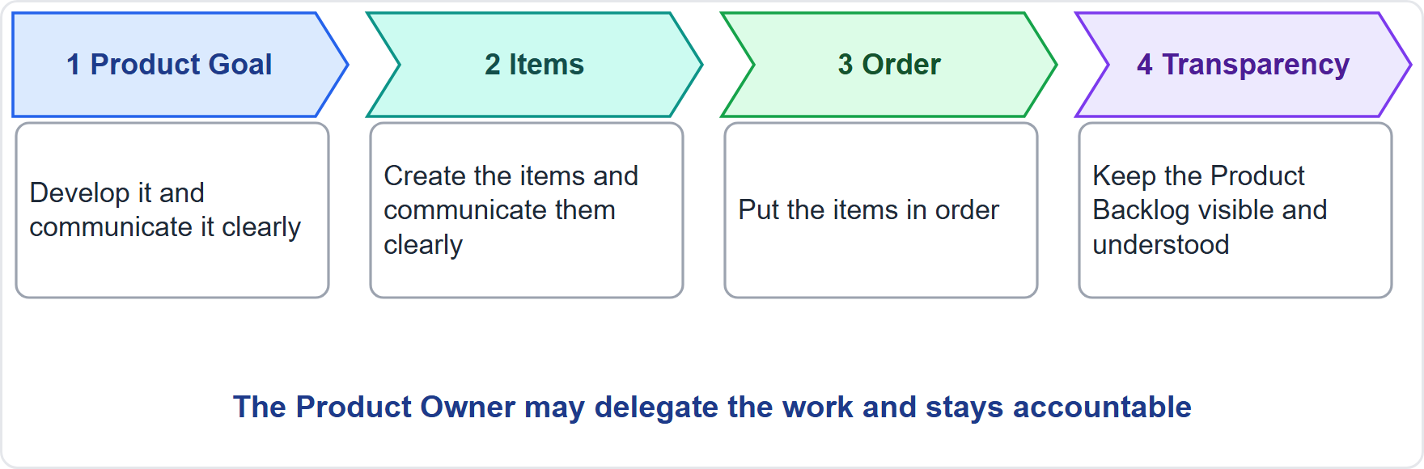
Product Backlog Management
Module 4
Develop and communicate the Product Goal
Create and communicate the items
Order the items
Keep the Product Backlog transparent and understood
CSM Exam Prep Masterclass | Certified ScrumMaster
Module 4: The Product Owner
5 / 19
Notes:
The Product Owner is accountable too for managing the Product Backlog well, in four parts. Develop and clearly communicate the Product Goal. Create and clearly communicate the Product Backlog items. Order the items. And make sure everyone can see and understand the Product Backlog. The Product Owner may do this work personally, or delegate it to others. Either way, the accountability stays.

Slide 6
The Product Owner Across the Guide
Module 4
Where | Role
Sprint Planning | Prepares attendees; puts forward the value; discusses items with the Developers, who select; helps shape the Sprint Goal
During the Sprint | Negotiates scope with the Developers, protecting the Sprint Goal
Cancelling a Sprint | The Product Owner alone, if the Sprint Goal is obsolete
Sprint Review | Discusses progress; the Product Backlog may be adjusted
CSM Exam Prep Masterclass | Certified ScrumMaster
Module 4: The Product Owner
6 / 19
Notes:
Where else does the Guide give the Product Owner a role? In Sprint Planning, the Product Owner prepares attendees, puts forward the value, discusses items with the Developers, who select them, and helps shape the Sprint Goal. During the Sprint, the Product Owner negotiates scope with the Developers when the work turns out different, always protecting the Sprint Goal. The Product Owner alone can cancel a Sprint, and only when the Sprint Goal is obsolete. At the Review, the Product Owner discusses progress, and the Product Backlog may be adjusted.

Slide 7
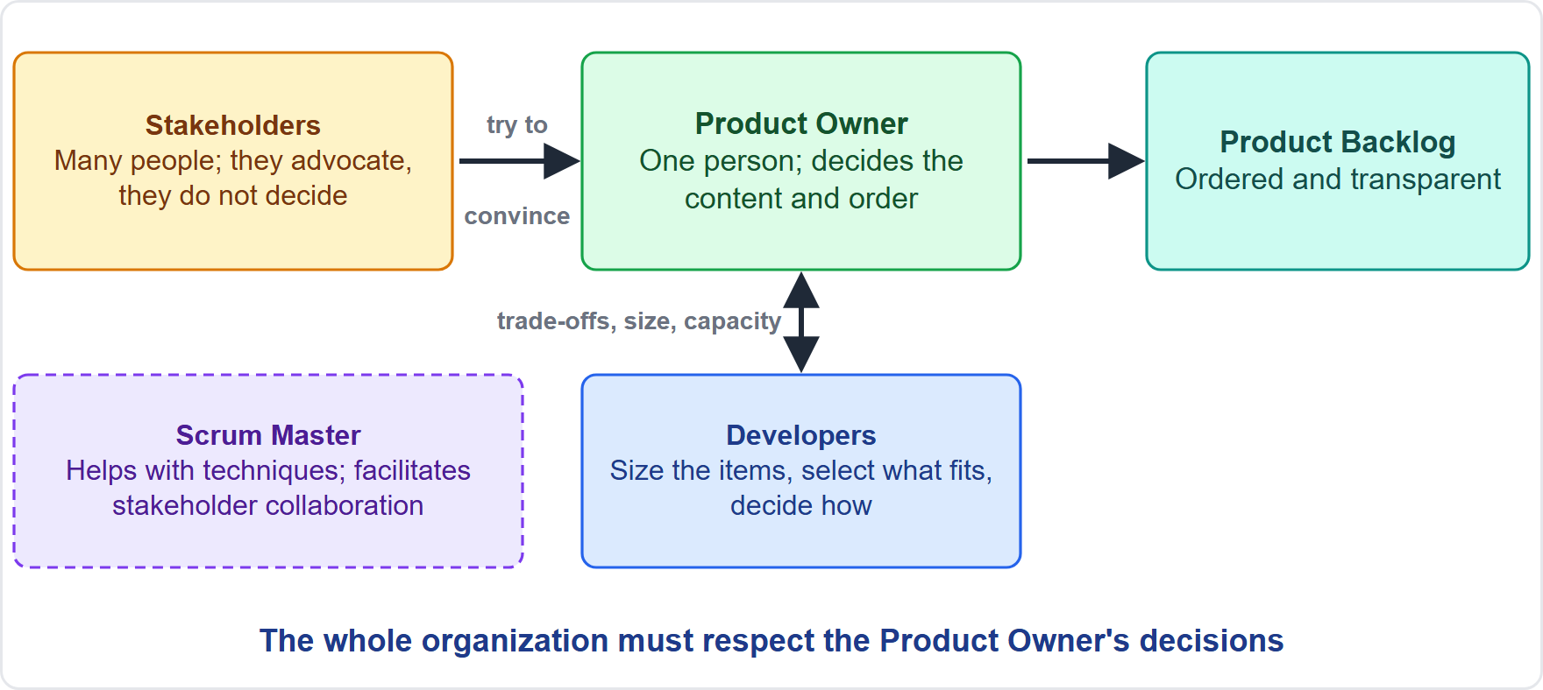
One Person, Not a Committee
Module 4
"One person, not a committee"
May represent the needs of many stakeholders
Stakeholders try to convince the Product Owner
The whole organization must respect the decisions
At RideLoop: Grace and the Station Crew make their case to Maya, and Ben points them to Maya
EXAM TIP A committee, a vote or a manager deciding the order is wrong.
CSM Exam Prep Masterclass | Certified ScrumMaster
Module 4: The Product Owner
7 / 19
Notes:
The Guide puts it plainly: "one person, not a committee." That person may represent the needs of many stakeholders, but those who want to change the Product Backlog must try to convince the Product Owner. And for this to work, the whole organization must respect the Product Owner's decisions. The diagram shows the flow of influence. At RideLoop, that means Grace and the Station Crew make their case to Maya, and Ben points them to Maya. If an exam option has a committee, a vote or a manager deciding the order of the Product Backlog, it is wrong.

Slide 8
Why One Person?
BEYOND THE GUIDE
Module 4
Reason | Explanation
Clear accountability | One person answers for the value; success and failure have an owner
Faster decisions | The Developers get one answer, not a negotiation
One ordered Product Backlog | No competing priorities or compromises
No deadlock | Conflicting interests are balanced by one decision maker
One voice | The team and stakeholders know whom to ask
EXAM TIP Name at least two. Stakeholders advocate; the Product Owner decides.
CSM Exam Prep Masterclass | Certified ScrumMaster
Module 4: The Product Owner
8 / 19
Notes:
Why one person? The learning objective asks for at least two reasons, and these go beyond the Guide. Clear accountability: one person answers for the value, so success and failure have an owner. Faster decisions: the Developers get one answer instead of a negotiation. One ordered Product Backlog, without competing priorities. No deadlock, because conflicting interests are balanced by one decision maker. And one voice for the team and the stakeholders. Stakeholders advocate; the Product Owner decides.

Slide 9
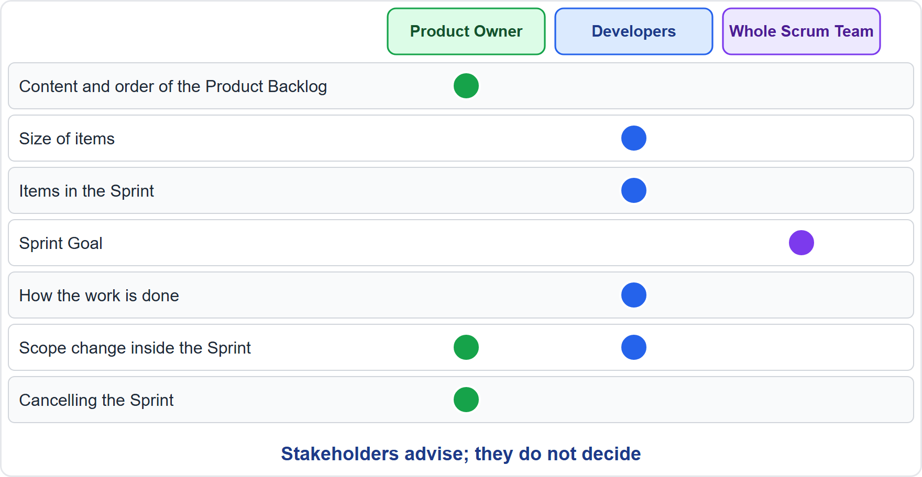
Authority and Collaboration
Module 4
Product Owner: the Product Backlog and the Product Goal
Developers: sizing, selecting items, how
Whole team: the Sprint Goal
Product Owner with Developers: scope changes in the Sprint
EXAM TIP The Product Owner helps with trade-offs on sizing but does not set sizes.
CSM Exam Prep Masterclass | Certified ScrumMaster
Module 4: The Product Owner
9 / 19
Notes:
How does the Product Owner keep authority while collaborating? The Product Owner decides the content and order of the Product Backlog, and develops the Product Goal. The Developers decide the sizing, select the items for the Sprint in discussion with the Product Owner, and decide how the work is done. The whole Scrum Team shapes the Sprint Goal. Scope changes inside the Sprint are negotiated between the Product Owner and the Developers. The Product Owner can help with trade-offs on sizing, but does not set the sizes.

Slide 10
The Product Owner in the Events
Module 4
Event | The Product Owner's place
Sprint Planning | A member of the team: prepares attendees, proposes value, discusses items
Daily Scrum | Not required; takes part only as a Developer, if working on Sprint Backlog items
Sprint Review | Takes part; the Product Backlog may be adjusted
Sprint Retrospective | Takes part as a member of the team
CSM Exam Prep Masterclass | Certified ScrumMaster
Module 4: The Product Owner
10 / 19
Notes:
The Product Owner is a member of the Scrum Team, so the Product Owner takes part in the events. In Sprint Planning, the Product Owner prepares attendees, proposes value and discusses items. The Daily Scrum is the Developers' event, so the Product Owner is not required there. If the Product Owner is actively working on Sprint Backlog items, they take part as a Developer. At the Sprint Review and the Retrospective, the Product Owner takes part as a member of the team.

Slide 11
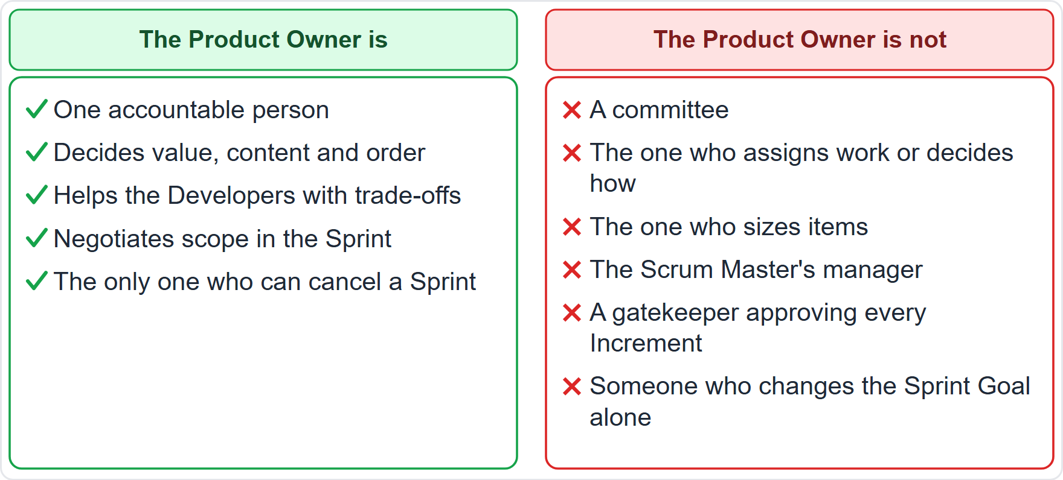
What the Product Owner Is Not
Module 4
Not a committee
Not the one who assigns work or decides how
Not the one who sizes items
Not the Scrum Master's manager
Not a gatekeeper for every Increment
CSM Exam Prep Masterclass | Certified ScrumMaster
Module 4: The Product Owner
11 / 19
Notes:
It also helps to know what the Product Owner is not. Not a committee. Not the person who assigns work or decides how it is built. Not the person who sizes the items. Not the Scrum Master's manager, because there are no hierarchies in the Scrum Team. And not a gatekeeper who approves every Increment: the Guide gives no such role, and work counts when it meets the Definition of Done.

Slide 12
Traps: What the Exam Expects
Module 4
One person, never a committee, board or vote
Accountable, not necessarily doing: work may be delegated
Stakeholders convince; they do not command
Developers size, select the items and decide how
Only the Product Owner can cancel a Sprint
Several teams, one product: one Product Owner, one Product Backlog, one Product Goal
EXAM TIP The Product Owner is part of the Scrum Team and takes part in the Retrospective.
CSM Exam Prep Masterclass | Certified ScrumMaster
Module 4: The Product Owner
12 / 19
Notes:
Here are the traps. One person: never a committee, a board or a vote. Accountable, not necessarily doing: the work may be delegated. Stakeholders convince; they do not command. The Developers size the items, select them for the Sprint, and decide how. Only the Product Owner can cancel a Sprint. And when several Scrum Teams work on one product, they share one Product Owner, one Product Backlog and one Product Goal. The Product Owner is part of the Scrum Team.

Slide 13
Module Recap
Module 4
1
Accountable for
2
One person
3
Authority
the value of the product and the Product Backlog
clear accountability, one order
content and order of the Product Backlog
4
Collaboration
5
Scope
6
Cancel
Developers size, select and decide how
negotiated with the Developers, never at the Sprint Goal's expense
the Product Owner alone
CSM Exam Prep Masterclass | Certified ScrumMaster
Module 4: The Product Owner
13 / 19
Notes:
Recap. The Product Owner is accountable for the value of the product and for Product Backlog management. It is one person, for clear accountability and one order. The Product Owner has authority over the content and order of the Product Backlog. The Developers size, select and decide how. Scope is negotiated without harming the Sprint Goal. And only the Product Owner can cancel a Sprint. Now test yourself.

Slide 14
Practice Question 1
Module 4
Q1
Grace's steering group proposes that three managers jointly act as Product Owner, so that everyone's interests are covered. What should the Scrum Master explain?
A
A committee is allowed if one member holds the casting vote on the order of the Product Backlog
B
The Product Owner is a single person, and the managers can make their case to that person
C
A committee may own the Product Goal, as long as one person owns the Product Backlog
D
Three managers are allowed if they meet weekly to agree the order of the Product Backlog
CSM Exam Prep Masterclass | Certified ScrumMaster
Module 4: The Product Owner
14 / 19
Notes:
Question one. Grace's steering group proposes that three managers jointly act as Product Owner, so that everyone's interests are covered. What should the Scrum Master explain? The four options are on the screen. Choose your answer. [PAUSE 12] The answer is B. The Product Owner is a single person, who may represent the needs of many stakeholders. The managers make their case to that person. A casting vote or a weekly meeting does not restore single accountability.

Slide 15
Practice Question 2
Module 4
Q2
Under pressure from Grace, Maya wants the Developers to size every item as small, so that more items fit in the Sprint. What is correct?
A
Maya is accountable for the Product Backlog, so Maya sets the size of each item before the Sprint starts
B
The Scrum Master helps by setting the sizes, since the Scrum Master is accountable for predictability and effectiveness
C
The stakeholders vote on the size of each item, since they know how much value each item carries
D
The Developers who will do the work size the items, and Maya helps them understand trade-offs
CSM Exam Prep Masterclass | Certified ScrumMaster
Module 4: The Product Owner
15 / 19
Notes:
Question two. Under pressure from Grace, Maya wants the Developers to size every item as small, so that more items fit in the Sprint. What is correct? The four options are on the screen. Choose your answer. [PAUSE 12] The answer is D. Sizing belongs to the Developers. Maya can help them understand trade-offs, for example by simplifying an item, but Maya cannot dictate the size. Neither the Scrum Master nor a stakeholder vote sets sizes.

Slide 16
Practice Question 3
Module 4
Q3
Midway through a Sprint, Lakeshore Transit decides to replace the unlock flow with a partner's solution, so the Sprint Goal is obsolete. Who has the authority to cancel the Sprint?
A
Maya, since the Product Owner alone cancels a Sprint when its Sprint Goal becomes obsolete
B
You, the Scrum Master, since you make sure the Sprint stays within its timebox
C
The Developers, since they see first that the Sprint Goal no longer makes sense
D
Grace, since the Director of Operations owns the budget for the work
CSM Exam Prep Masterclass | Certified ScrumMaster
Module 4: The Product Owner
16 / 19
Notes:
Question three. Midway through a Sprint, Lakeshore Transit decides to replace the unlock flow with a partner's solution, so the Sprint Goal is obsolete. Who has the authority to cancel the Sprint? The four options are on the screen. Choose your answer. [PAUSE 12] The answer is A. The Product Owner alone can cancel a Sprint, and only when the Sprint Goal has become obsolete. Others may raise the concern with the Product Owner.

Slide 17
Practice Question 4
Module 4
Q4
Which is a reason why the Product Owner is one person and not a committee?
A
A single person can attend the Daily Scrum, which a committee would not be permitted to do
B
A single person is cheaper, because committee members are paid separately for their time
C
Stakeholders then have no way to share their needs with the Scrum Team at all
D
One accountable person gives clear accountability and one ordered Product Backlog
CSM Exam Prep Masterclass | Certified ScrumMaster
Module 4: The Product Owner
17 / 19
Notes:
Question four. Which is a reason why the Product Owner is one person and not a committee? The four options are on the screen. Choose your answer. [PAUSE 12] The answer is D. One person answers for the value and produces one order of the Product Backlog. Stakeholders can still share their needs and try to convince the Product Owner, so option C is wrong.

Slide 18
Practice Question 5
Module 4
Q5
Which list describes what effective Product Backlog management includes?
A
Selecting the Sprint's items, sizing every item, and writing the Sprint Goal alone before the event
B
Establishing Scrum, removing impediments, and coaching the Developers in self-management
C
Developing the Product Goal, creating and ordering items, and making the Product Backlog understood
D
Planning the Developers' daily work, approving each Increment, and running the Daily Scrum
CSM Exam Prep Masterclass | Certified ScrumMaster
Module 4: The Product Owner
18 / 19
Notes:
Question five. Which list describes what effective Product Backlog management includes? The four options are on the screen. Choose your answer. [PAUSE 12] The answer is C. It covers developing and communicating the Product Goal, creating and communicating items, ordering them, and making sure everyone understands the Product Backlog. The other lists describe the Developers and the Scrum Master.

Slide 19
Answers at a Glance
Module 4
Question | Answer | Why
Q1 | B | The Product Owner is a single person; managers make their case to that person
Q2 | D | The Developers size; the Product Owner helps with trade-offs
Q3 | A | The Product Owner alone can cancel a Sprint, and only if the Sprint Goal is obsolete
Q4 | D | Clear accountability and one ordered Product Backlog
Q5 | C | Goal, items, order and transparency
CSM Exam Prep Masterclass | Certified ScrumMaster
Module 4: The Product Owner
19 / 19
Notes:
Here are all five answers together. Question one: B. A single person, not a group. Question two: D. The Developers size the items. Question three: A. The Product Owner alone can cancel a Sprint. Question four: D. Clear accountability and one ordered Product Backlog. Question five: C. Goal, items, order and transparency. That completes Module 4. Next, Module 5 covers the Scrum Master.

