Slide 1
Module 5: The Scrum Master
A true leader who serves
CSM 1.2, 3.1, 3.4
Certified ScrumMaster (CSM) Exam Prep Masterclass
Module 5 · Part 1
Notes:
Welcome to Module 5: The Scrum Master. This is the role the exam is named after. You will learn the two accountabilities, the three audiences the Scrum Master serves, what the role is not, and how to choose the best action in a situation. This module is in two parts.

Slide 2
What You Will Learn
Part 1
State the Scrum Master's two accountabilities
Describe how the Scrum Master serves the team, the Product Owner and the organization
Give three scenarios where the Scrum Master leads
Give three ways to support the Product Owner
Say what the Scrum Master is not
Pick the best action in a situation
CSM Exam Prep Masterclass | Certified ScrumMaster
Module 5: The Scrum Master
2 / 25
Notes:
By the end of this module you will be able to do six things. State the Scrum Master's two accountabilities. Describe how the Scrum Master serves the team, the Product Owner and the organization. Give three scenarios where the Scrum Master leads. Give three ways to support the Product Owner. Say what the Scrum Master is not. And pick the best action in a situation, which is what situational questions test.

Slide 3
Case Check-In: Reports and Assignments
Part 1
CASE CHECK-IN · RideLoop
Grace asks you for a weekly report on each Developer's progress
Grace also asks you to assign the tasks to speed things up
The Developers, tired of planning, ask you to decide who does what
You are accountable for Scrum and the team's effectiveness, not for either request
CSM Exam Prep Masterclass | Certified ScrumMaster
Module 5: The Scrum Master
3 / 25
Notes:
You are the Scrum Master at RideLoop, and two requests land on your desk. Grace Whitfield asks for a weekly report on each Developer's progress, and wants you to assign the tasks to speed things up. At the same time, the Developers, tired of planning, ask you to decide who does what. Both requests sound reasonable, but you are accountable for Scrum and the team's effectiveness, not for either request. This module explains why, and what to do instead.

Slide 4
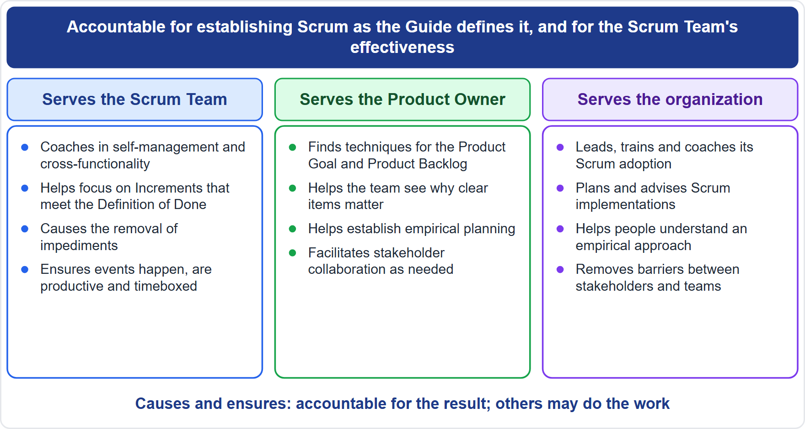
The Role at a Glance
Part 1
Two accountabilities: Scrum itself, and the team's effectiveness
A true leader who serves the team and the larger organization
Three audiences: the team, the Product Owner, the organization
EXAM TIP Not the Scrum Master's job: product value, the Sprint plan, quality, a delivery date.
CSM Exam Prep Masterclass | Certified ScrumMaster
Module 5: The Scrum Master
4 / 25
Notes:
The Scrum Master has two accountabilities: establishing Scrum, and the Scrum Team's effectiveness. The Guide calls Scrum Masters true leaders who serve the team and the larger organization. They serve three audiences, as the diagram shows: the Scrum Team, the Product Owner, and the organization. And notice what is missing. The Scrum Master is not accountable for product value, the Sprint plan, quality, or a delivery date.

Slide 5
Accountability 1: Establishing Scrum
Part 1
Scrum "as defined in the Scrum Guide": the roles, events, artifacts, commitments and the rules that bind them
Done by helping everyone understand theory and practice, in the team and the organization
The means are teaching and coaching, not policing
Part of the job: show what a dropped event or a weak Definition of Done costs
EXAM TIP Scrum is immutable. Partial Scrum is not Scrum (Module 1).
CSM Exam Prep Masterclass | Certified ScrumMaster
Module 5: The Scrum Master
5 / 25
Notes:
The first accountability is "establishing Scrum as defined in the Scrum Guide." That means the roles, events, artifacts, commitments and the rules that bind them. The method is to help everyone grasp both the theory and the practice of Scrum, inside the team and across the organization. The means are teaching and coaching, not policing. Part of the job is showing people what a dropped event, or a weak Definition of Done, really costs them. Remember from Module 1: Scrum is immutable, and partial Scrum is not Scrum.

Slide 6
Accountability 2: The Team's Effectiveness
Part 1
Enable the team to improve its practices
Always within the Scrum framework
About the team, not each person's output
Never fix a problem by adding a role, event or artifact that Scrum lacks
EXAM TIP A project manager, a hardening Sprint or an extra approval meeting is wrong.
CSM Exam Prep Masterclass | Certified ScrumMaster
Module 5: The Scrum Master
6 / 25
Notes:
The second accountability is the team's effectiveness. The Scrum Master enables the team to improve its practices, always within the Scrum framework. Effectiveness is about the team, not about each person's output. And it rules out a whole family of wrong answers: when a problem appears, the fix is never to add a role, an event or an artifact that Scrum does not have. A project manager, a hardening Sprint, or an extra approval meeting is wrong.

Slide 7
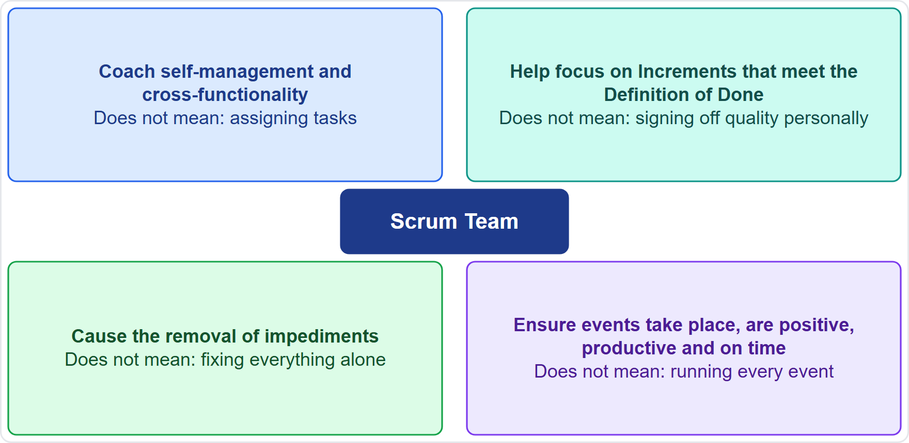
Serving the Scrum Team
Part 1
Coach self-management and cross-functionality
Help the team focus on valuable Increments that meet the Definition of Done
Cause the removal of impediments
Make sure every event happens, adds value and ends on time
EXAM TIP Cause and ensure mean accountable for the result, not for doing all the work.
CSM Exam Prep Masterclass | Certified ScrumMaster
Module 5: The Scrum Master
7 / 25
Notes:
How does the Scrum Master serve the Scrum Team? In four ways. Coach the members in self-management and cross-functionality. Help the team focus on valuable Increments that meet the Definition of Done. Cause the removal of impediments to progress. And ensure that every event takes place, is worthwhile, and ends on time. Notice the verbs cause and ensure. They make the Scrum Master accountable for the result, but not for doing all the work personally.

Slide 8
Serving the Product Owner
BEYOND THE GUIDE
Part 1
Way | Example
Techniques for the Product Goal and Product Backlog | Offer ways to keep the Product Backlog ordered and refined
Clear, concise items | Show why a usable item matters for finishing it in a Sprint
Empirical planning | Plan from what has happened, adjust each Sprint
Stakeholder collaboration, when asked or needed | Set up conversations; make the Review a working session
EXAM TIP Name at least three. The Scrum Master never orders the Product Backlog or sets the Product Goal.
CSM Exam Prep Masterclass | Certified ScrumMaster
Module 5: The Scrum Master
8 / 25
Notes:
How does the Scrum Master serve the Product Owner? The Guide gives four ways, and the learning objective asks for at least three. Offer techniques for the Product Goal and the Product Backlog. Help the team see why clear, concise items matter. Support empirical planning, which means planning from what has happened and adjusting each Sprint. And facilitate stakeholder collaboration when asked or needed: set up conversations, and make the Review a working session. The examples on this slide go beyond the Guide. What the Scrum Master never does: order the Product Backlog or set the Product Goal.

Slide 9
Serving the Organization
Part 1
Way | What it means
Lead, train and coach its Scrum adoption | The role reaches managers, stakeholders and other teams
Plan and advise Scrum rollouts | Advise; do not manage the adopting teams
Teach an empirical approach to people outside the team | Transparency, inspection and adaptation for stakeholders
Remove barriers between stakeholders and teams | Clear what blocks them from working together
CSM Exam Prep Masterclass | Certified ScrumMaster
Module 5: The Scrum Master
9 / 25
Notes:
The third audience is the organization. The Scrum Master leads, trains and coaches the organization as it adopts Scrum. The Scrum Master plans and advises Scrum rollouts, which means advising, not managing the teams that adopt it. The Scrum Master helps people outside the team understand an empirical approach to complex work: transparency, inspection and adaptation. And the Scrum Master removes barriers between stakeholders and Scrum Teams, clearing what blocks them from working together. This is why the role reaches managers, stakeholders and other teams.

Slide 10
A True Leader Who Serves
Part 1
The Guide's phrase: true leaders who serve the team and the larger organization
Leadership through service, influence and example, not authority
Neither a boss nor an assistant who does whatever anyone asks
Old wording: servant-leader in the earlier edition; same meaning
EXAM TIP Reject answers that command, and answers that do nothing.
CSM Exam Prep Masterclass | Certified ScrumMaster
Module 5: The Scrum Master
10 / 25
Notes:
The Guide describes Scrum Masters as true leaders who serve. Leadership here comes from service, influence and example, not from authority. The Scrum Master is neither a boss nor an assistant who does whatever anyone asks. The earlier edition used the word servant-leader; the meaning is the same. In the exam, reject answers that command, and equally reject answers that do nothing. The right answer sits between them.

Slide 11
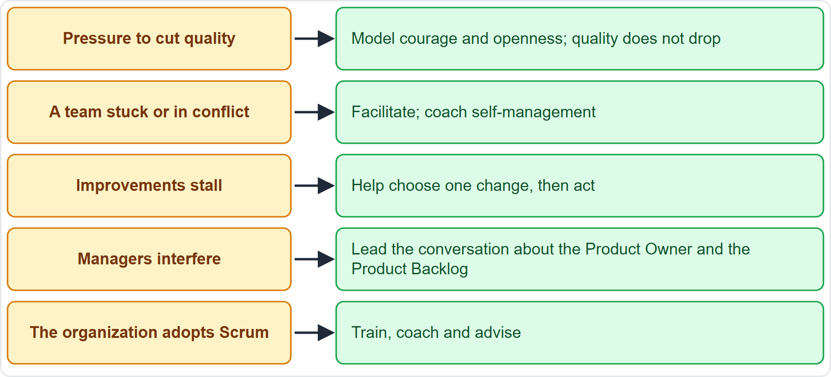
Leading in Practice
BEYOND THE GUIDE
Part 1
Pressure to cut quality
A team stuck or in conflict
Improvements stall in the Retrospectives
Managers or stakeholders interfere
The organization adopts Scrum
EXAM TIP Name at least three.
CSM Exam Prep Masterclass | Certified ScrumMaster
Module 5: The Scrum Master
11 / 25
Notes:
The learning objective asks for three scenarios where the Scrum Master leads. The Guide does not list them, so these go beyond it. Pressure to cut quality: model courage and openness. A team that is stuck or in conflict: facilitate, and coach self-management. Improvements that stall in the Retrospectives: help the team pick one change and act on it. Managers who interfere: lead the conversation about working through the Product Owner. And an organization adopting Scrum: train, coach and advise.

Slide 12
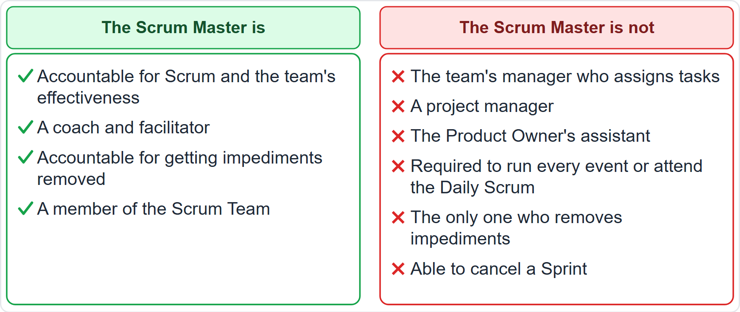
What the Scrum Master Is Not
Part 1
Not the team's manager who assigns tasks
Not a project manager
Not the Product Owner's assistant
Not required to run every event or attend the Daily Scrum
Not the only one who removes impediments
Cannot cancel a Sprint
CSM Exam Prep Masterclass | Certified ScrumMaster
Module 5: The Scrum Master
12 / 25
Notes:
Now what the Scrum Master is not. Not the team's manager who assigns tasks, because the team is self-managing and there is no hierarchy. Not a project manager, because Scrum has none. Not the Product Owner's assistant, and not the one who orders the Product Backlog. Not required to run every event or to attend the Daily Scrum. Not the only person who removes impediments. And not able to cancel a Sprint. That is the Product Owner's authority alone.

Slide 13
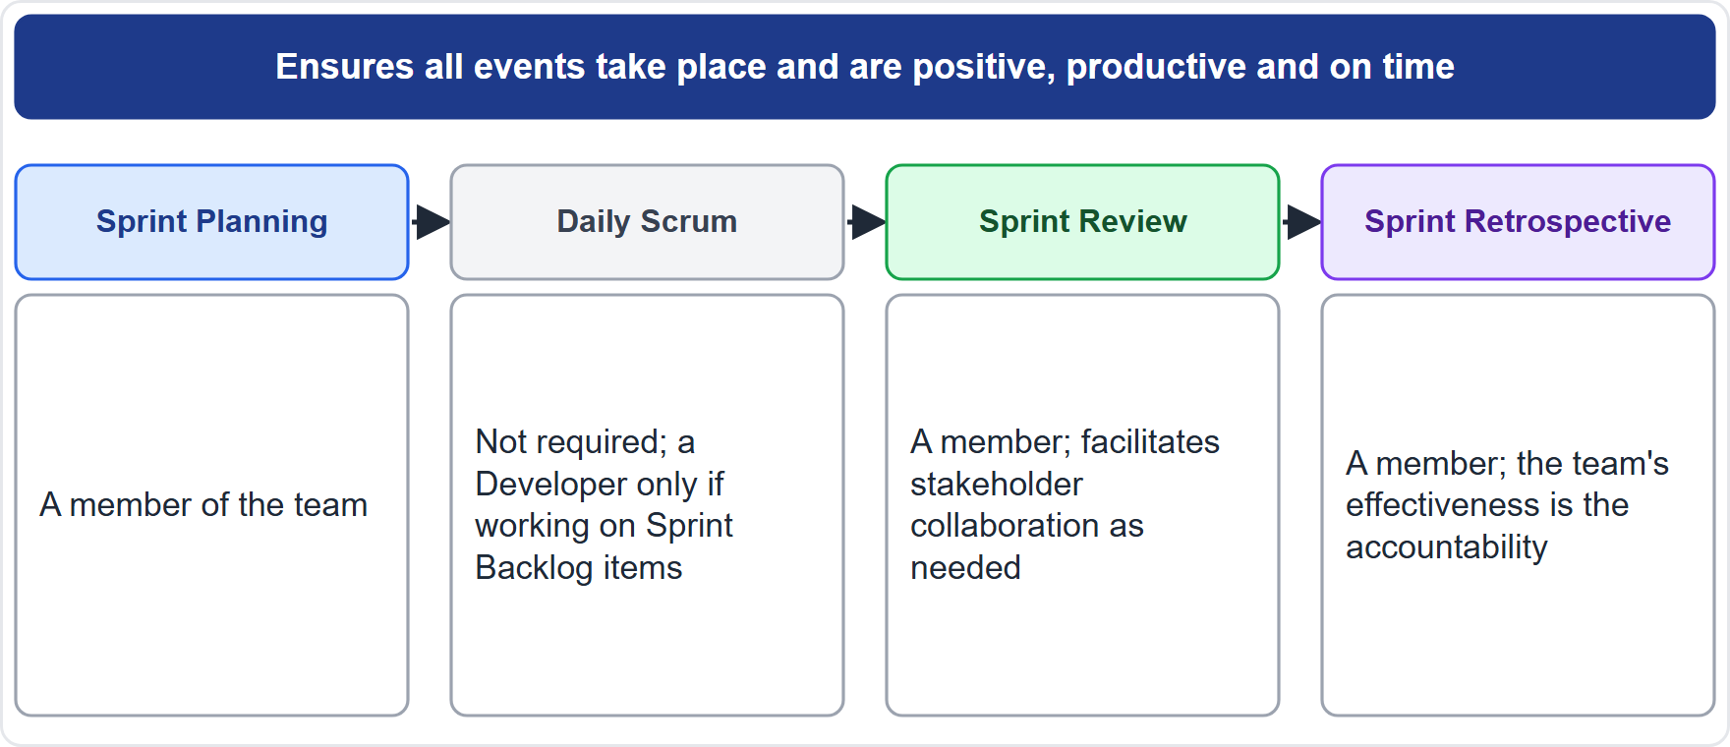
The Scrum Master in the Events
Part 1
The Sprint: ensure all events happen and end on time
Planning: a member of the team
Daily Scrum: not required; a Developer only if working on Sprint Backlog items
Review: a member; facilitates stakeholder collaboration as needed
Retrospective: a member; effectiveness is their accountability
EXAM TIP The Daily Scrum is the Developers' event.
CSM Exam Prep Masterclass | Certified ScrumMaster
Module 5: The Scrum Master
13 / 25
Notes:
Where does the Scrum Master appear in the events? Across the whole Sprint, the Scrum Master makes sure every event happens, adds value, and ends on time. In Sprint Planning, a member of the team. At the Daily Scrum, not required: it is the Developers' event, and the Scrum Master takes part only as a Developer if actively working on Sprint Backlog items. At the Review, a member who facilitates stakeholder collaboration as needed. At the Retrospective, a member whose accountability is the team's effectiveness.

Slide 14
Situations and Best Actions (1)
BEYOND THE GUIDE
Part 2
Situation | Best action
A blocker the team cannot remove | Make it visible; work with the right people to clear it fast
A manager asks who works on what (Grace) | Explain self-management; point to the Sprint Backlog and the Review
The Product Owner adds work mid-Sprint | Help negotiate scope without endangering the Sprint Goal; new ideas go to the Product Backlog
The team wants to skip the Retrospective | Explain what is lost; help the team see the effect
The Product Backlog is vague | Offer the Product Owner techniques; show why clear items matter
CSM Exam Prep Masterclass | Certified ScrumMaster
Module 5: The Scrum Master
14 / 25
Notes:
Part two is about situations. Here are common ones with the best action. They go beyond the Guide, but they follow from it. A blocker the team cannot remove: make it visible, and work with the right people to clear it fast. A manager asks who works on what, as Grace did: explain self-management, and point to the Sprint Backlog. The Product Owner adds work mid-Sprint: help negotiate scope without endangering the Sprint Goal. The team wants to skip the Retrospective: explain what is lost. The Product Backlog is vague: offer techniques.

Slide 15
Situations and Best Actions (2)
BEYOND THE GUIDE
Part 2
Situation | Best action
Stakeholders skip the Review | Help the Product Owner and team engage them
The team wants to relax the Definition of Done | Remind them that quality does not decrease; unfinished work is not part of the Increment
Developers disagree on a design | Facilitate; the Developers decide
The team asks you to decide who does what (the RideLoop Developers) | Coach the team to decide
A manager wants an event skipped | Explain what the event is for and what the organization loses
Other teams want to adopt Scrum | Lead, train and coach; plan and advise
CSM Exam Prep Masterclass | Certified ScrumMaster
Module 5: The Scrum Master
15 / 25
Notes:
More situations. Again, they go beyond the Guide. Stakeholders skip the Review: help the Product Owner and the team engage them. The team wants to relax the Definition of Done: remind them that quality does not decrease, and unfinished work is not part of the Increment. Developers disagree on a design: facilitate, because the Developers decide. The team asks you to decide who does what, as the RideLoop Developers did: coach the team to decide. A manager wants an event skipped: explain what the event is for, and what the organization loses. Other teams want Scrum: lead, train and coach, and advise on the rollout.

Slide 16
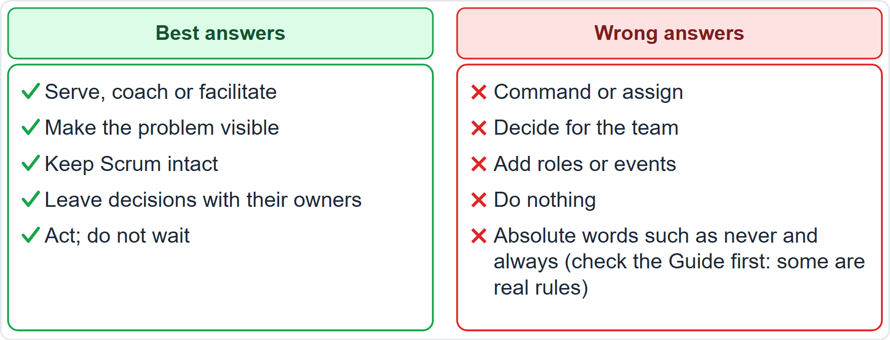
Best and Wrong Answer Patterns
BEYOND THE GUIDE
Part 2
Best: serve, coach or facilitate; make it visible; keep Scrum intact; leave decisions with their owners; act
Wrong: command or assign; decide for the team; add roles or events; do nothing
EXAM TIP Absolute words are a warning, but some are real rules: only the Product Owner cancels a Sprint.
CSM Exam Prep Masterclass | Certified ScrumMaster
Module 5: The Scrum Master
16 / 25
Notes:
You can often choose by pattern. Best answers serve, coach or facilitate. They make the problem visible, keep Scrum intact, leave decisions with their owners, and act instead of waiting. Wrong answers command or assign work, decide for the team, add roles or events, or do nothing. Absolute words like never and always are a warning, but check the Guide before rejecting one. Only the Product Owner cancels a Sprint is a real rule. These patterns come from practice, not from the Guide.

Slide 17
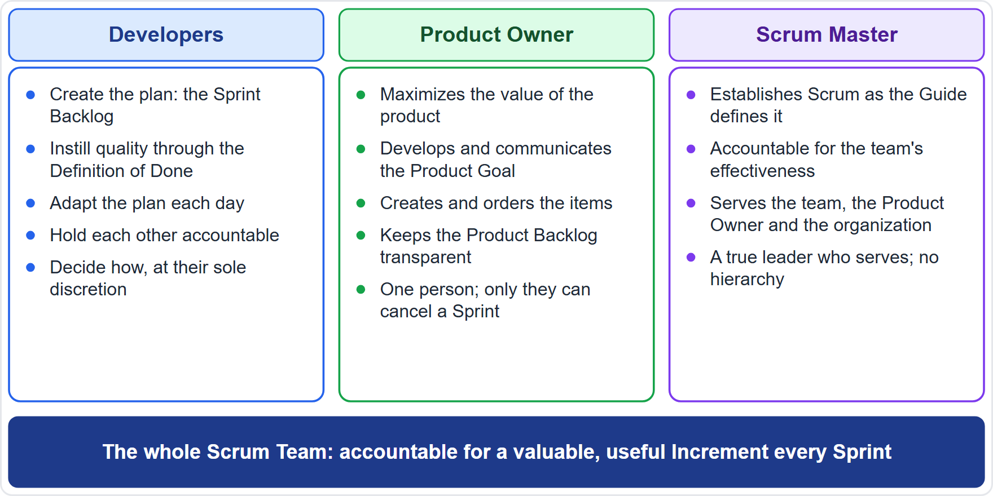
Three Accountabilities Compared
Part 2
Scrum Master: Scrum, and the team's effectiveness
Product Owner: the value of the product and Product Backlog management
Developers: Sprint plan, quality, daily adaptation, mutual accountability
How the work is done: the Developers decide
CSM Exam Prep Masterclass | Certified ScrumMaster
Module 5: The Scrum Master
17 / 25
Notes:
Compare the three accountabilities once more. The Scrum Master is accountable for Scrum and the team's effectiveness. The Product Owner is accountable for the value of the product and for Product Backlog management. The Developers are accountable for the Sprint plan, quality, daily adaptation and mutual accountability. And how the work is done is decided by the Developers. When an option moves a decision to the wrong person, it is wrong.

Slide 18
Traps: What the Exam Expects
Part 2
Serve and lead, do not command or manage
Not passive either: act when the team cannot solve a problem
Ensure and cause: accountable for the result
Only the Product Owner cancels a Sprint
Improve within Scrum: no project manager, hardening Sprint or approval gate
Old wording: servant-leader, Development Team
EXAM TIP The Scrum Master may work on Sprint Backlog items and then joins the Daily Scrum as a Developer.
CSM Exam Prep Masterclass | Certified ScrumMaster
Module 5: The Scrum Master
18 / 25
Notes:
Here are the traps. Serve and lead; do not command or manage. But do not be passive either: act when the team cannot solve a problem. Ensure and cause mean accountable for the result. Only the Product Owner cancels a Sprint. Improve within Scrum; do not add a project manager, a hardening Sprint or an approval gate. Watch the old wording: servant-leader and Development Team. And the Scrum Master may work on Sprint Backlog items, then joins the Daily Scrum as a Developer.

Slide 19
Module Recap
Part 2
1
Accountable for
2
Serves
3
Leads
Scrum and the team's effectiveness
the team, the Product Owner, the organization
through service, influence and example
4
Decisions
5
Daily Scrum
6
Best answer
stay with their owners
the Developers' event
serve, make visible, keep Scrum intact, act
CSM Exam Prep Masterclass | Certified ScrumMaster
Module 5: The Scrum Master
19 / 25
Notes:
Recap. The Scrum Master is accountable for Scrum and for the team's effectiveness. The role serves the team, the Product Owner and the organization. It leads through service, influence and example. Decisions stay with their owners. The Daily Scrum is the Developers' event. And the best answer serves, makes the problem visible, keeps Scrum intact, and acts. Now test yourself.

Slide 20
Practice Question 1
Part 2
Q1
At the Daily Scrum, Ben reports that the shared payment test environment run by Ravi's Platform Team has been down for two days, and the Developers have no authority to fix it. What is the best action for the Scrum Master?
A
Tell the Developers to solve it themselves, because the Scrum Master only coaches and never intervenes
B
Ask Maya to cancel the Sprint, because the plan can no longer be met
C
Work with Ravi's team, who own the environment, to get it restored quickly
D
Record the problem and raise it at the next Sprint Retrospective
CSM Exam Prep Masterclass | Certified ScrumMaster
Module 5: The Scrum Master
20 / 25
Notes:
Question one. At the Daily Scrum, Ben reports that the shared payment test environment run by Ravi's Platform Team has been down for two days, and the Developers have no authority to fix it. What is the best action for the Scrum Master? The four options are on the screen. Choose your answer. [PAUSE 12] The answer is C. The Scrum Master is accountable for causing the removal of impediments, which can mean working with others in the organization. Leaving the team alone gives that up, and waiting for the Retrospective delays the fix.

Slide 21
Practice Question 2
Part 2
Q2
Several stakeholders have started giving work directly to individual RideLoop Developers during the Sprint, and the Sprint Goal is at risk. What is the best action for the Scrum Master?
A
Tell the Developers to follow the stakeholders' requests, because the stakeholders pay for the product
B
Help the stakeholders learn to influence the work through Maya and the Product Backlog
C
Forbid any contact between the stakeholders and the Developers for the rest of the Sprint
D
Cancel the Sprint so that the stakeholders and Maya can agree on what is really needed
CSM Exam Prep Masterclass | Certified ScrumMaster
Module 5: The Scrum Master
21 / 25
Notes:
Question two. Several stakeholders have started giving work directly to individual RideLoop Developers during the Sprint, and the Sprint Goal is at risk. What is the best action for the Scrum Master? The four options are on the screen. Choose your answer. [PAUSE 12] The answer is B. The Product Backlog is the single source of work, and those who want it changed convince the Product Owner. The Scrum Master helps stakeholders understand this. A ban on contact is wrong, and only the Product Owner can cancel a Sprint.

Slide 22
Practice Question 3
Part 2
Q3
Wei and Tomas disagree about the design of a feature and ask the Scrum Master to make the final decision. What is the best action?
A
Decide using your own technical experience, so that the work can continue without delay
B
Ask Maya to choose the design, since the Product Owner is accountable for the product
C
Escalate to Grace, so that someone with authority makes the decision for the team
D
Facilitate a conversation so that the Developers reach their own decision
CSM Exam Prep Masterclass | Certified ScrumMaster
Module 5: The Scrum Master
22 / 25
Notes:
Question three. Wei and Tomas disagree about the design of a feature and ask the Scrum Master to make the final decision. What is the best action? The four options are on the screen. Choose your answer. [PAUSE 12] The answer is D. How the work is done is at the Developers' sole discretion, so the Scrum Master facilitates and the Developers decide. The Product Owner does not decide the design either, and escalating adds a hierarchy.

Slide 23
Practice Question 4
Part 2
Q4
What are the Scrum Master's two accountabilities?
A
Establishing Scrum, and the effectiveness of the Scrum Team
B
Maximizing the value of the product, and managing the Product Backlog for the whole organization
C
Creating the Sprint plan, and instilling quality through the Definition of Done in every item
D
Managing the Developers' tasks, and reporting each person's progress to the stakeholders
CSM Exam Prep Masterclass | Certified ScrumMaster
Module 5: The Scrum Master
23 / 25
Notes:
Question four. What are the Scrum Master's two accountabilities? The four options are on the screen. Choose your answer. [PAUSE 12] The answer is A: establishing Scrum as defined in the Guide, and the Scrum Team's effectiveness. Value and the Product Backlog belong to the Product Owner, the Sprint plan and quality to the Developers, and managing tasks is not part of the role at all.

Slide 24
Practice Question 5
Part 2
Q5
Which list contains ways the Scrum Master serves the Product Owner?
A
Deciding the order of the Product Backlog, setting the Product Goal, and approving each item
B
Finding techniques for the Product Goal and Product Backlog, and facilitating stakeholder collaboration
C
Selecting the items for the Sprint, sizing them, and planning the work to be done
D
Leading the organization's Scrum adoption and removing barriers between stakeholders and teams
CSM Exam Prep Masterclass | Certified ScrumMaster
Module 5: The Scrum Master
24 / 25
Notes:
Question five. Which list contains ways the Scrum Master serves the Product Owner? The four options are on the screen. Choose your answer. [PAUSE 12] The answer is B: finding techniques for the Product Goal and the Product Backlog, and facilitating stakeholder collaboration. Ordering and the Product Goal belong to the Product Owner, selection to the Developers, and the last option describes serving the organization.

Slide 25
Answers at a Glance
Part 2
Question | Answer | Why
Q1 | C | The Scrum Master causes the removal of impediments, with others when needed
Q2 | B | Stakeholders influence the work through the Product Owner and the Product Backlog
Q3 | D | The Developers decide how; the Scrum Master facilitates
Q4 | A | Establishing Scrum, and the team's effectiveness
Q5 | B | Techniques and stakeholder collaboration serve the Product Owner
CSM Exam Prep Masterclass | Certified ScrumMaster
Module 5: The Scrum Master
25 / 25
Notes:
Here are all five answers together. Question one: C. Cause the removal of the impediment, with others when needed. Question two: B. Stakeholders influence the work through the Product Owner. Question three: D. The Developers decide how. Question four: A. Establishing Scrum, and the team's effectiveness. Question five: B. Techniques and stakeholder collaboration. That completes Module 5. Next, Module 6 covers the Sprint and the Scrum events.

