Slide 1
Module 6: The Sprint and the Scrum Events
The container, the four events and their limits
Scrum Foundations 3.1 to 3.4 · CSM 1.7, 1.14
Certified ScrumMaster (CSM) Exam Prep Masterclass
Module 6
Notes:
Welcome to Module 6: The Sprint and the Scrum Events. You now know the team. This module shows the rhythm they work in. You will learn what a Sprint is, the four events inside it, the timeboxes you must memorize, how to choose a Sprint length, and when a Sprint can be cancelled.

Slide 2
What You Will Learn
Module 6
State the purpose and maximum length of a Sprint
Name the four events with purpose, participants, sequence and timebox
Give three benefits of a timebox
Choose a suitable Sprint length
Give an example of inspecting and adapting at each event
Say when a Sprint can be cancelled
CSM Exam Prep Masterclass | Certified ScrumMaster
Module 6: The Sprint and the Scrum Events
2 / 22
Notes:
By the end of this module you will be able to do six things. State the purpose and maximum length of a Sprint. Name the four events with their purpose, participants, sequence and timebox. Give three benefits of a timebox. Choose a suitable Sprint length. Give an example of inspecting and adapting at each event. And say when a Sprint can be cancelled, and by whom.

Slide 3
Case Check-In: How Long Should a Sprint Be?
Module 6
CASE CHECK-IN · RideLoop
Four months ago the team chose two-week Sprints
Grace now suggests six-week Sprints because the product is complex
Grace also wants to skip the Review and the Retrospective in a busy Sprint to save time
You prepare your answers
CSM Exam Prep Masterclass | Certified ScrumMaster
Module 6: The Sprint and the Scrum Events
3 / 22
Notes:
At RideLoop, the team chose two-week Sprints four months ago. Now Grace Whitfield suggests six-week Sprints, because, in Grace's words, the product is complex. Grace also wants to skip the Review and the Retrospective in a busy Sprint, to save time. As Scrum Master, you prepare your answers. By the end of this module, you will know exactly what to say, and which Guide statements to point to.

Slide 4
The Sprint
Module 6
A fixed-length event of one month or less
Sprints turn ideas into value and set the pulse of Scrum
A new Sprint starts immediately after the last one
All the work happens inside Sprints, events included
Think of each Sprint as a short project
EXAM TIP Never longer than a month, never stretched to finish, never shortened because work is done early.
CSM Exam Prep Masterclass | Certified ScrumMaster
Module 6: The Sprint and the Scrum Events
4 / 22
Notes:
Sprints turn ideas into value, and they set the pulse of Scrum. A Sprint is a fixed-length event of one month or less. A new Sprint starts immediately after the last one ends. All the work necessary to reach the Product Goal, the events included, happens inside Sprints. You can think of each Sprint as a short project. For the exam: never longer than a month, never stretched to finish, and never shortened because the work is done early.

Slide 5
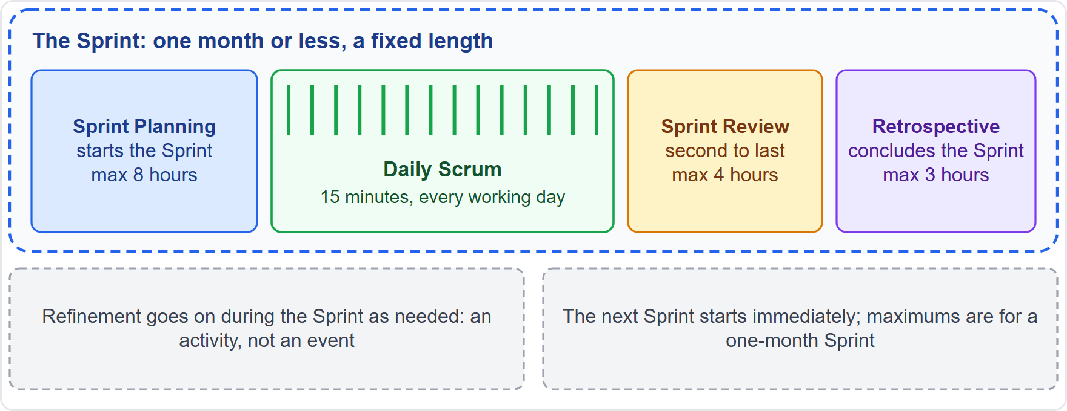
The Five Events
Module 6
The Sprint is the container for the other events
Each event is a formal chance to inspect and adapt
Skipping or changing an event loses that chance
Events create regularity and reduce the need for meetings that Scrum does not define
Best held at the same time and place
EXAM TIP Five events: the Sprint plus four.
CSM Exam Prep Masterclass | Certified ScrumMaster
Module 6: The Sprint and the Scrum Events
5 / 22
Notes:
There are five events. The Sprint is the container, and inside it sit four more: Sprint Planning, the Daily Scrum, the Sprint Review and the Sprint Retrospective. Each one is a formal chance for the team to inspect and adapt. So if a team skips an event, or changes it, that chance is lost. That is your answer to Grace's wish to skip the Review and the Retrospective. Events create regularity and minimize the need for meetings that Scrum does not define, and ideally they happen at the same time and in the same place, which keeps things simple.

Slide 6
The Four Events: Purpose and Participants
Module 6
Event | Purpose | Who
Sprint Planning | Starts the Sprint and sets out the work | Scrum Team; guests for advice
Daily Scrum | Inspect progress toward the Sprint Goal; adapt the plan | The Developers
Sprint Review | Inspect the outcome; decide future adaptations | Scrum Team and key stakeholders
Sprint Retrospective | Plan ways to raise quality and effectiveness | Scrum Team
CSM Exam Prep Masterclass | Certified ScrumMaster
Module 6: The Sprint and the Scrum Events
6 / 22
Notes:
Here is the purpose and the participants of each event. Sprint Planning starts the Sprint and sets out the work. The Scrum Team takes part, and guests may come for advice. The Daily Scrum is for the Developers: they check progress toward the Sprint Goal and adjust their plan. The Sprint Review inspects the outcome of the Sprint with key stakeholders, and decides future adaptations. The Retrospective is for the Scrum Team, to plan ways to raise quality and effectiveness.

Slide 7
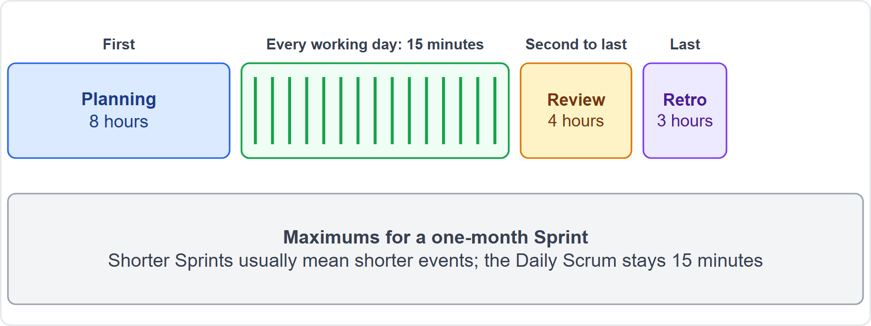
Timeboxes and Sequence
Module 6
Planning 8 hours · Daily Scrum 15 minutes · Review 4 hours · Retrospective 3 hours
Maximums for a one-month Sprint; shorter Sprints usually mean shorter events
The Daily Scrum is 15 minutes whatever the Sprint length
Order: Planning, Daily Scrums, Review, Retrospective
EXAM TIP The Review is second to last. The Retrospective concludes the Sprint.
CSM Exam Prep Masterclass | Certified ScrumMaster
Module 6: The Sprint and the Scrum Events
7 / 22
Notes:
Memorize these timeboxes, for a one-month Sprint. Sprint Planning: eight hours. Daily Scrum: fifteen minutes. Sprint Review: four hours. Sprint Retrospective: three hours. They are maximums. For shorter Sprints, Planning, Review and Retrospective are usually shorter, but the Daily Scrum is fifteen minutes whatever the Sprint length. The order is Planning, then the Daily Scrums, then the Review, and finally the Retrospective. The Review is second to last, and the Retrospective concludes the Sprint.

Slide 8
During the Sprint
Module 6
Rule | Meaning
No change that endangers the Sprint Goal | The goal is stable; the plan can change
Quality does not decrease | The Definition of Done is not lowered
The Product Backlog is refined as needed | Refinement goes on during the Sprint
Scope can be re-discussed with the Product Owner | As understanding grows; the goal stays intact
CSM Exam Prep Masterclass | Certified ScrumMaster
Module 6: The Sprint and the Scrum Events
8 / 22
Notes:
During the Sprint, four rules apply. No change is made that would endanger the Sprint Goal: the goal is stable, though the plan can change. Quality does not decrease, so the Definition of Done is never lowered to save time. Refinement of the Product Backlog continues as needed. And scope can be re-discussed with the Product Owner as understanding grows, as long as the Sprint Goal stays intact.

Slide 9
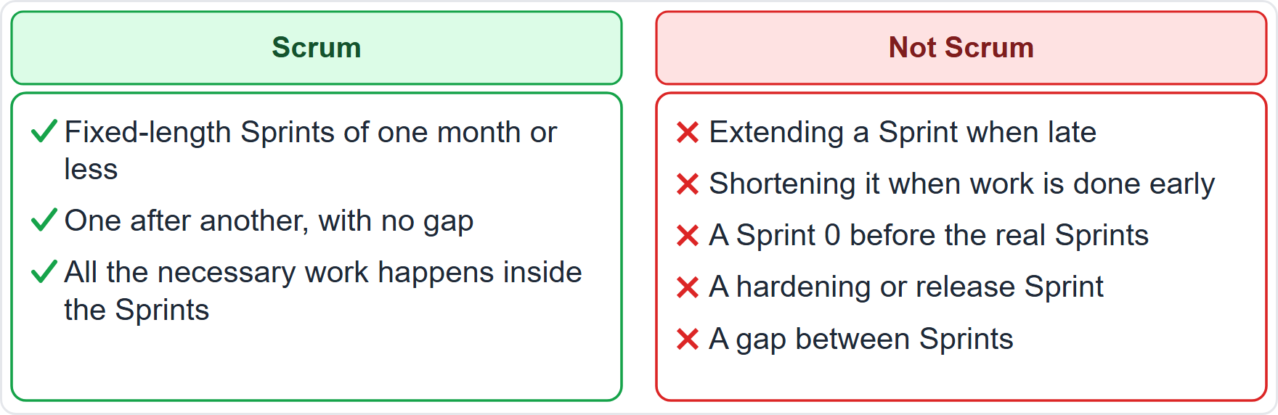
What Is Not in Scrum
BEYOND THE GUIDE
Module 6
Extending a Sprint because the team is late
Shortening a Sprint because work finished early
A Sprint 0 before the real Sprints
A hardening or release Sprint
A gap between Sprints
EXAM TIP All necessary work happens inside Sprints, and the next one starts at once.
CSM Exam Prep Masterclass | Certified ScrumMaster
Module 6: The Sprint and the Scrum Events
9 / 22
Notes:
Some practices you may meet are not in Scrum. This slide is beyond the Guide, but it follows from the rules. Extending a Sprint because the team is late. Shortening a Sprint because work finished early. A Sprint zero before the real Sprints. A hardening or release Sprint. A gap between Sprints. All the necessary work happens inside Sprints, one after another, and the next one starts at once. If an exam option adds any of these, it is wrong.

Slide 10
Benefits of a Timebox
BEYOND THE GUIDE
Module 6
Benefit | Why
Regularity | Everyone knows when events happen
Focus | A fixed limit stops endless discussion
Faster decisions | A deadline forces a decision
Limited waste and risk | A wrong direction is found early
A rhythm of inspection | Each timebox ends with a look at the result
Fewer unplanned meetings | The events minimize the need for extra meetings
EXAM TIP Name at least three.
CSM Exam Prep Masterclass | Certified ScrumMaster
Module 6: The Sprint and the Scrum Events
10 / 22
Notes:
The learning objective asks for at least three benefits of a timebox. These go beyond the Guide. Regularity: everyone knows when events happen. Focus: a fixed limit stops endless discussion. Faster decisions: a deadline forces one. Limited waste and risk: a wrong direction is found early. A rhythm of inspection: each timebox ends with a look at the result. And fewer unplanned meetings, because the events minimize the need for extra ones. Name at least three.

Slide 11
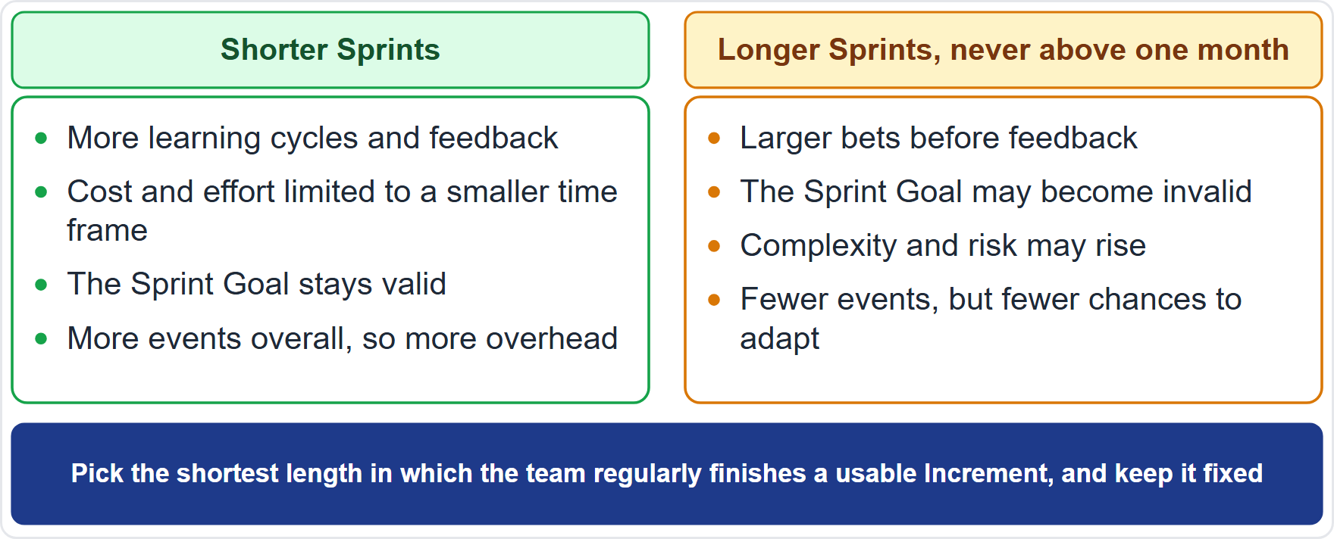
Choosing a Sprint Length
Module 6
The Guide sets the boundary: one month or less
Too long: the goal can lose its meaning, and complexity and risk can grow
Shorter: more learning cycles, less cost and effort at risk
No preferred length: two weeks is a popular practice, not a rule
CSM Exam Prep Masterclass | Certified ScrumMaster
Module 6: The Sprint and the Scrum Events
11 / 22
Notes:
How long should a Sprint be? The Guide sets one boundary: one month or less. It also gives the reasoning. A very long Sprint can leave the goal out of date, and let complexity and risk grow. Shorter Sprints give more learning cycles and limit the cost and effort at risk. The Guide names no preferred length. Two weeks is a popular practice, not a rule. So, for Grace's six-week idea, the answer is simple: not allowed.

Slide 12
Factors in the Choice
BEYOND THE GUIDE
Module 6
Factor | Points to
How fast feedback or the market moves | Shorter Sprints
How uncertain or risky the work is | Shorter Sprints
How long a usable Increment takes | A length where the Definition of Done can be met
Stakeholder availability | A length that lets them attend the Review
Event overhead | Very short Sprints mean frequent events
Team experience | Try a length for a few Sprints, then keep it stable
EXAM TIP Pick the shortest length in which the team regularly finishes a usable Increment, and keep it fixed.
CSM Exam Prep Masterclass | Certified ScrumMaster
Module 6: The Sprint and the Scrum Events
12 / 22
Notes:
When choosing a length, weigh these factors. This slide goes beyond the Guide. How fast feedback is needed, or how fast the market changes: shorter. How uncertain or risky the work is: shorter, so the team learns sooner. How long a usable Increment takes: choose a length in which the Definition of Done can be met. Stakeholder availability: choose a length that lets them attend the Review. Event overhead: very short Sprints mean frequent events. Team experience: try a length for a few Sprints, then keep it stable. The rule of thumb: pick the shortest length in which the team regularly finishes a usable Increment, and keep it fixed.

Slide 13
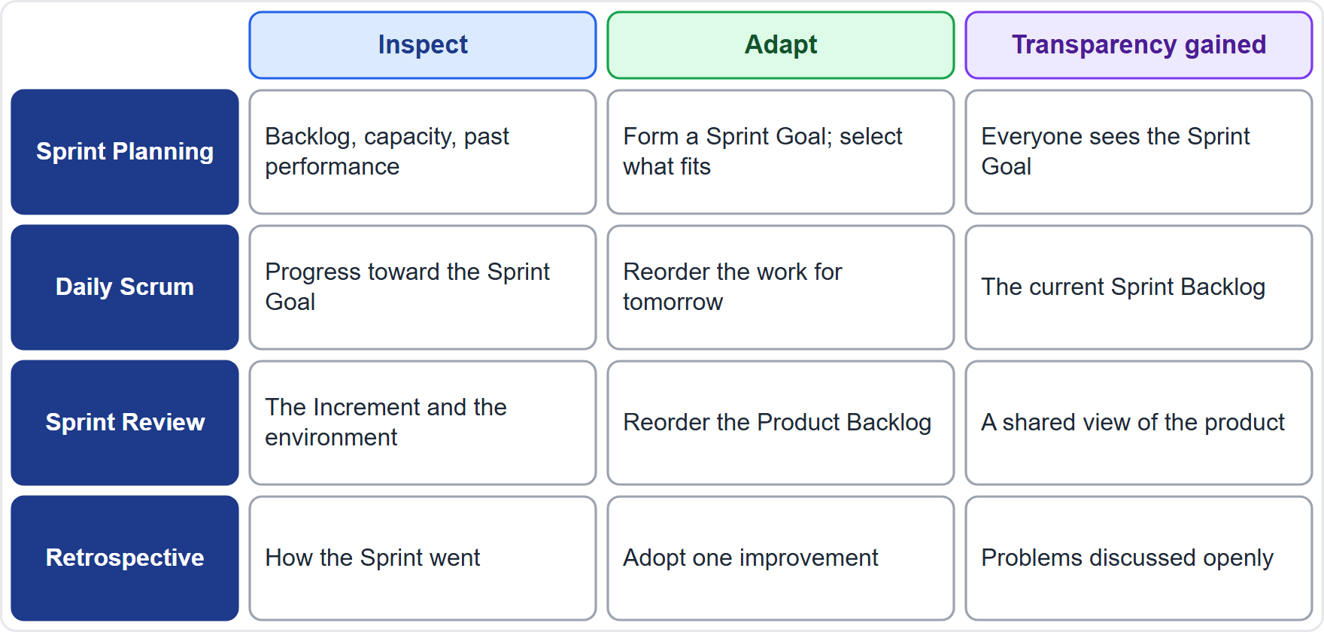
Inspect and Adapt at Each Event
BEYOND THE GUIDE
Module 6
Planning: inspect backlog, capacity and past performance; adapt by forming a Sprint Goal and selecting what fits
Daily Scrum: inspect progress; adapt the plan for tomorrow
Review: inspect the Increment; adapt the Product Backlog
Retrospective: inspect the way of working; adopt an improvement
EXAM TIP Give at least one example per event.
CSM Exam Prep Masterclass | Certified ScrumMaster
Module 6: The Sprint and the Scrum Events
13 / 22
Notes:
The learning objective asks for an example of inspecting and adapting at each event. These examples go beyond the Guide. In Sprint Planning, the team inspects the Product Backlog, its capacity and its past performance, and adapts by forming a Sprint Goal and selecting what fits. At the Daily Scrum, the Developers inspect progress and adapt the plan for tomorrow. At the Review, the team inspects the Increment and adapts the Product Backlog. At the Retrospective, it inspects its way of working and adopts an improvement.

Slide 14
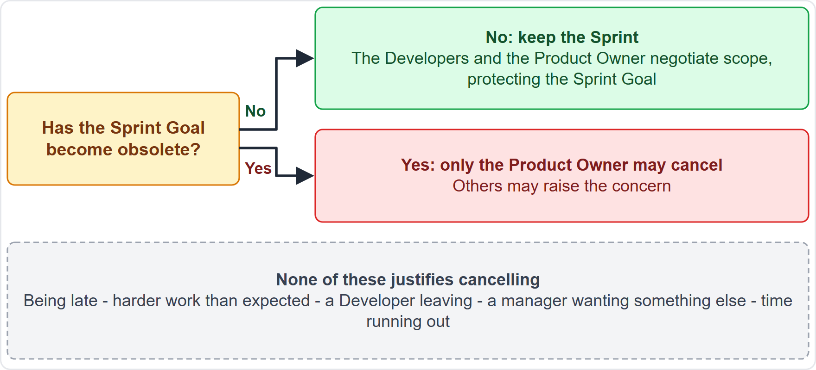
Cancelling a Sprint
Module 6
Only when the Sprint Goal is obsolete
Only the Product Owner decides; others may raise the concern
Late, harder work or a manager's wish: negotiate scope instead
Old wording: the earlier edition had a longer section on cancelling
EXAM TIP Being behind is not a reason to cancel.
CSM Exam Prep Masterclass | Certified ScrumMaster
Module 6: The Sprint and the Scrum Events
14 / 22
Notes:
When can a Sprint be cancelled? Only when the Sprint Goal becomes obsolete. And that decision belongs to the Product Owner alone; others may raise the concern. Being late, finding the work harder, losing a Developer, or a manager wanting something else are not reasons to cancel. In those cases the Developers and the Product Owner negotiate scope, protecting the Sprint Goal. The earlier edition of the Guide had a longer section on cancelling; the current one keeps only the condition and the authority.

Slide 15
Traps: What the Exam Expects
Module 6
Fixed length, one month or less; a new Sprint starts at once
Maximums: 8 hours, 15 minutes, 4 hours, 3 hours (one-month Sprint)
Review second to last; Retrospective concludes
Skipping an event loses a chance to inspect and adapt
Only the Product Owner cancels, and only if the goal is obsolete
Say events, not ceremonies; the Guide uses meetings only for meetings outside Scrum
EXAM TIP Refinement is an ongoing activity, not an event.
CSM Exam Prep Masterclass | Certified ScrumMaster
Module 6: The Sprint and the Scrum Events
15 / 22
Notes:
Here are the traps. Fixed length, one month or less, and a new Sprint starts at once. The maximum timeboxes for a one-month Sprint: eight hours, fifteen minutes, four hours and three hours. The Review is second to last, and the Retrospective concludes the Sprint. Skipping an event loses a chance to inspect and adapt. Only the Product Owner cancels, and only if the goal is obsolete. And the Guide calls them events, not ceremonies; it uses the word meetings only for meetings outside Scrum. Refinement is an ongoing activity, not an event.

Slide 16
Module Recap
Module 6
1
Sprint
2
Events
3
Timeboxes
fixed length, one month or less, the container
Planning, Daily Scrum, Review, Retrospective
8 hours, 15 minutes, 4 hours, 3 hours
4
Length
5
During the Sprint
6
Cancel
shorter limits risk and gives more learning
protect the goal and quality; renegotiate scope
the Product Owner alone, for an obsolete goal
CSM Exam Prep Masterclass | Certified ScrumMaster
Module 6: The Sprint and the Scrum Events
16 / 22
Notes:
Recap. The Sprint is a fixed-length container of one month or less. The four events are Planning, the Daily Scrum, the Review and the Retrospective. The timeboxes for a one-month Sprint are eight hours, fifteen minutes, four hours and three hours. Shorter Sprints limit risk and give more learning. During the Sprint, protect the goal and the quality, and renegotiate scope. Only the Product Owner cancels. Now test yourself.

Slide 17
Practice Question 1
Module 6
Q1
Two days before the end of Sprint 8, the Developers realize that three items will not be finished. They ask to extend the Sprint by three days. What is the best answer?
A
Explain that Sprints are fixed length, and help the Developers and Maya decide about the unfinished items
B
Help the Developers by agreeing, since they decide how long the Sprint takes and know how much time they still need
C
Ask Maya to approve a longer Sprint, because the Product Owner is accountable for the schedule
D
Cancel the Sprint and start a new one to plan the unfinished items again from scratch
CSM Exam Prep Masterclass | Certified ScrumMaster
Module 6: The Sprint and the Scrum Events
17 / 22
Notes:
Question one. Two days before the end of Sprint eight, the Developers realize that three items will not be finished. They ask to extend the Sprint by three days. What is the best answer? The four options are on the screen. Choose your answer. [PAUSE 12] The answer is A. Sprints are fixed length, so a Sprint is not extended. The unfinished items return to the Product Backlog, and the Developers and Maya can renegotiate scope. Cancelling is only for an obsolete Sprint Goal.

Slide 18
Practice Question 2
Module 6
Q2
A new Scrum Team that Lakeshore Transit is starting for another product wants a four-week Sprint 0 to set up the environment and gather all requirements before its first Sprint. How should the Scrum Master respond?
A
Help the team prepare, since preparing the environment and the requirements is part of Scrum and happens before the first Sprint
B
Explain that Scrum requires the first Sprint to be exactly two weeks long, so a Sprint 0 is not permitted
C
Explain that all necessary work happens within Sprints, and help the team start with a first small Increment
D
Agree, as long as the Sprint 0 is shorter than one month and ends with a signed requirements document
CSM Exam Prep Masterclass | Certified ScrumMaster
Module 6: The Sprint and the Scrum Events
18 / 22
Notes:
Question two. A new Scrum Team that Lakeshore Transit is starting for another product wants a four-week Sprint zero to set up the environment and gather all requirements before its first Sprint. How should the Scrum Master respond? The four options are on the screen. Choose your answer. [PAUSE 12] The answer is C. All necessary work happens within Sprints, and a separate preparation phase is not part of Scrum. The team starts small. The Guide does not require two weeks either.

Slide 19
Practice Question 3
Module 6
Q3
Halfway through the Sprint, the Developers conclude that the work is harder than expected and that the Sprint Goal may be missed. What is the best action?
A
Ask the Scrum Master to cancel the Sprint, because the Sprint Goal can no longer be reached in the time left
B
Extend the Sprint by a few days so that the Developers can finish all the planned work at the same quality
C
Lower the Definition of Done for the harder items so that they fit in the original Sprint timebox
D
Work with Maya to renegotiate the scope of the Sprint Backlog, since the Sprint Goal must be protected
CSM Exam Prep Masterclass | Certified ScrumMaster
Module 6: The Sprint and the Scrum Events
19 / 22
Notes:
Question three. Halfway through the Sprint, the Developers conclude that the work is harder than expected and that the Sprint Goal may be missed. What is the best action? The four options are on the screen. Choose your answer. [PAUSE 12] The answer is D. The Developers and the Product Owner negotiate the scope of the Sprint Backlog without affecting the Sprint Goal. Quality is not lowered, the Sprint is not extended, and cancelling is for an obsolete goal only.

Slide 20
Practice Question 4
Module 6
Q4
Which set of maximum timeboxes is correct for a one-month Sprint?
A
Planning 8 hours, Daily Scrum 15 minutes, Review 4 hours, Retrospective 3 hours
B
Planning 4 hours, Daily Scrum 15 minutes, Review 8 hours, Retrospective 3 hours
C
Planning 8 hours, Daily Scrum 30 minutes, Review 4 hours, Retrospective 4 hours
D
Planning 2 hours, Daily Scrum 15 minutes, Review 1 hour, Retrospective 1 hour
CSM Exam Prep Masterclass | Certified ScrumMaster
Module 6: The Sprint and the Scrum Events
20 / 22
Notes:
Question four. Which set of maximum timeboxes is correct for a one-month Sprint? The four options are on the screen. Choose your answer. [PAUSE 12] The answer is A: Planning eight hours, Daily Scrum fifteen minutes, Review four hours, Retrospective three hours. Option B swaps the Planning and Review times. The other two options invent different numbers.

Slide 21
Practice Question 5
Module 6
Q5
Which of these is a benefit of a timebox?
A
It guarantees that every planned item will be finished within the Sprint
B
It removes the need to inspect and adapt, because the schedule is fixed
C
It keeps discussion focused and forces decisions, which limits waste and risk
D
It allows an event to be extended whenever the team feels more time is needed
CSM Exam Prep Masterclass | Certified ScrumMaster
Module 6: The Sprint and the Scrum Events
21 / 22
Notes:
Question five. Which of these is a benefit of a timebox? The four options are on the screen. Choose your answer. [PAUSE 12] The answer is C. A fixed limit keeps discussion focused and forces decisions, which limits waste and risk. It does not guarantee that every item is finished, it does not replace inspection, and because it is a maximum, it is not extended whenever the team wants more time.

Slide 22
Answers at a Glance
Module 6
Question | Answer | Why
Q1 | A | Sprints are fixed length; renegotiate scope about the unfinished items
Q2 | C | All necessary work happens inside Sprints; no Sprint 0
Q3 | D | Negotiate scope with the Product Owner without affecting the Sprint Goal
Q4 | A | 8 hours, 15 minutes, 4 hours, 3 hours
Q5 | C | Focus and forced decisions limit waste and risk
CSM Exam Prep Masterclass | Certified ScrumMaster
Module 6: The Sprint and the Scrum Events
22 / 22
Notes:
Here are all five answers together. Question one: A. Sprints are fixed length. Question two: C. All necessary work happens inside Sprints, and there is no Sprint zero. Question three: D. Negotiate scope without affecting the Sprint Goal. Question four: A. Eight hours, fifteen minutes, four hours, three hours. Question five: C. Focus and forced decisions limit waste and risk. That completes Module 6. Next, Module 7 takes Sprint Planning in depth.

