Slide 1
Module 7: Sprint Planning
Why this Sprint, what, and how
Scrum Foundations 3.4 · CSM 1.8
Certified ScrumMaster (CSM) Exam Prep Masterclass
Module 7
Notes:
Welcome to Module 7: Sprint Planning. This is where every Sprint begins. You will learn what it is for, who takes part, how long it can last, and its three topics: why, what and how. You will also practice running one, a CSM learning objective, and meet the exam's traps.

Slide 2
What You Will Learn
Module 7
State the purpose, participants and maximum timebox
Explain the three topics and what each produces
Say who decides what
Perform a Sprint Planning and write a good Sprint Goal
Show how the team inspects and adapts
Spot the traps: approvals, assigned work, estimation techniques
CSM Exam Prep Masterclass | Certified ScrumMaster
Module 7: Sprint Planning
2 / 21
Notes:
By the end of this module you will be able to do six things. State the purpose, participants and maximum timebox of Sprint Planning. Explain the three topics and what each produces. Say who decides what: the Developers choose the work and decide how to do it. Perform a Sprint Planning step by step, with a good Sprint Goal. Show how the team inspects and adapts. And spot the traps: approvals, assigned work, and estimating techniques the Guide never mentions.

Slide 3
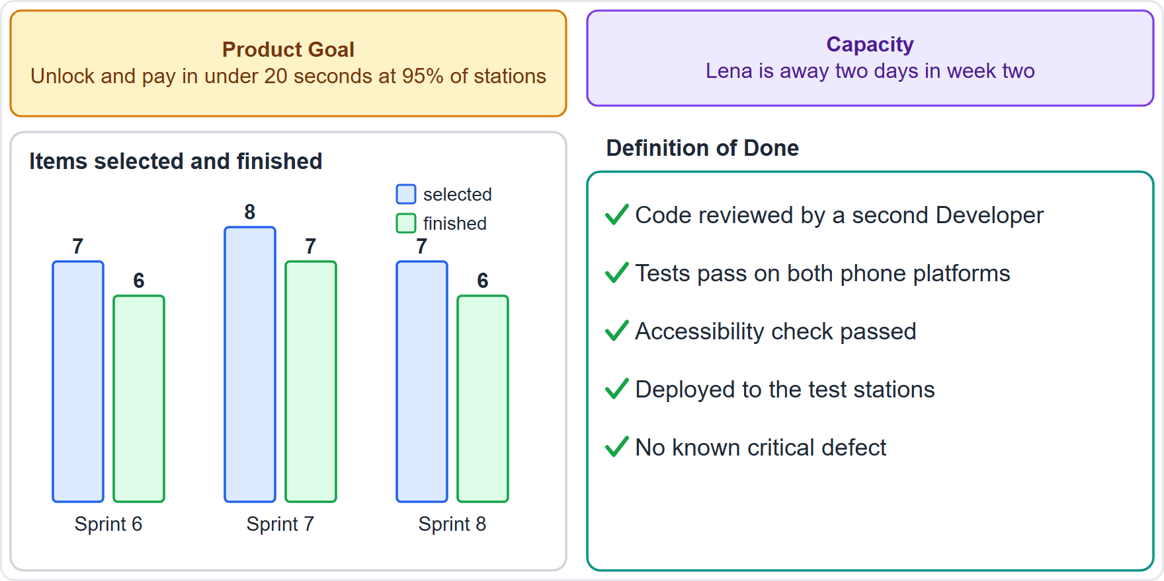
Case Check-In: Sprint 9 Planning at RideLoop
Module 7
CASE CHECK-IN · RideLoop
You are the Scrum Master; Maya is the Product Owner
Last three Sprints: 7, 8, 7 items selected, 6, 7, 6 finished
Lena is away for two days in week two
Grace Whitfield, the Director of Operations, wants to see the plan before the Sprint begins
CSM Exam Prep Masterclass | Certified ScrumMaster
Module 7: Sprint Planning
3 / 21
Notes:
Meet the RideLoop team on the Monday morning that Sprint nine begins. You are the Scrum Master, and Maya is the Product Owner. The Product Goal is that riders unlock a bike and pay in under twenty seconds at ninety-five percent of stations. In the last three Sprints the Developers selected seven, eight and seven items, and finished six, seven and six. Lena is away for two days in week two. And Grace Whitfield, the Director of Operations, wants to see the plan before the Sprint begins.

Slide 4
Purpose, Participants and Timebox
Module 7
Item | What the Guide says
Purpose | Starts the Sprint: the first event
Who plans | The whole Scrum Team, together
Preparation | The Product Owner makes sure attendees can discuss the top items and the Product Goal
Others | Invited guests give advice only
Timebox | At most eight hours for a one-month Sprint; usually less for a shorter one
EXAM TIP Sprint Planning belongs to the whole Scrum Team. No manager hands it down.
CSM Exam Prep Masterclass | Certified ScrumMaster
Module 7: Sprint Planning
4 / 21
Notes:
Start with the facts. Sprint Planning is the first event of the Sprint, and it sets out the work the Sprint will cover. The whole Scrum Team builds the plan together. The Product Owner makes sure attendees can discuss the top Product Backlog items and how they serve the Product Goal. The team can invite other people, but only for advice. The timebox is at most eight hours for a one-month Sprint, and usually less for a shorter one. The exam tip: no manager hands the plan down.

Slide 5
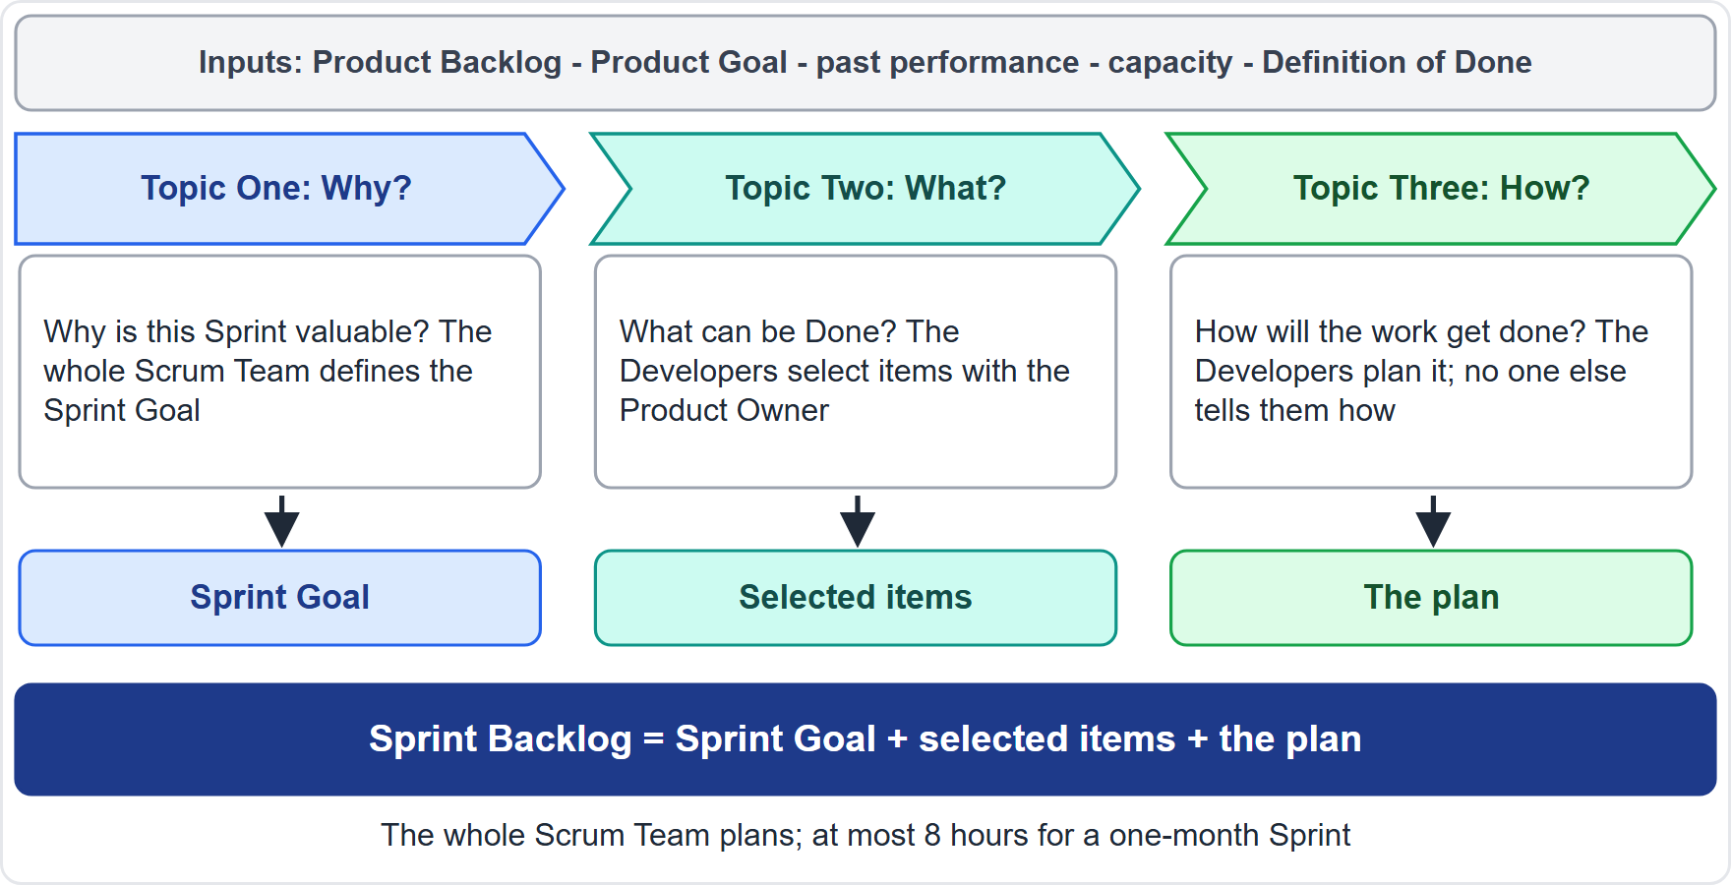
The Three Topics
Module 7
Three topics, in order: why, what, how
Together they produce the Sprint Backlog: the goal, the items and the plan
Old wording: the earlier edition had only two topics (what, how) and called the Sprint Backlog a forecast by the Development Team
EXAM TIP Two topics, a forecast or a Development Team in a question means the earlier wording. The current Guide has three topics.
CSM Exam Prep Masterclass | Certified ScrumMaster
Module 7: Sprint Planning
5 / 21
Notes:
Here are the three topics in one picture. Topic One asks why this Sprint is valuable, and produces the Sprint Goal. Topic Two asks what can be Done this Sprint, and produces the selected Product Backlog items. Topic Three asks how the chosen work will get done, and produces the plan. Together, the goal, the items and the plan form the Sprint Backlog. The earlier edition of the Guide had only two topics, and called the Sprint Backlog a forecast by the Development Team. A question using those words uses the earlier wording.

Slide 6
Topic One: Why Is This Sprint Valuable?
Module 7
The Product Owner puts forward how the product could add value this Sprint
The whole Scrum Team shapes that into a Sprint Goal: why the Sprint matters to stakeholders
One objective for the whole Sprint, final before Planning ends
EXAM TIP The Sprint Goal is created in Sprint Planning, not after the Sprint starts and not by stakeholders at the Sprint Review.
CSM Exam Prep Masterclass | Certified ScrumMaster
Module 7: Sprint Planning
6 / 21
Notes:
Topic One is why. The Product Owner puts forward how the product could add value in this Sprint. Then the whole Scrum Team shapes that into a Sprint Goal, a statement of why the Sprint matters to stakeholders. The Sprint Goal is one objective for the whole Sprint. And it has a firm deadline: it must be final before Sprint Planning ends. It is not written after the Sprint starts, and stakeholders do not supply it at the Review.

Slide 7
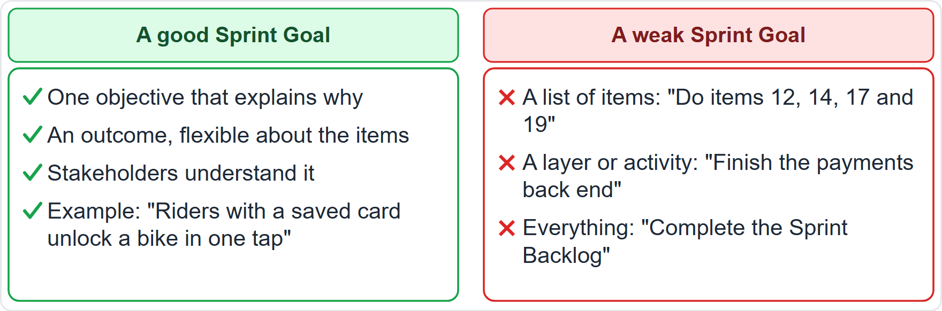
A Good Sprint Goal and a Weak One
BEYOND THE GUIDE
Module 7
The Guide: the Sprint Goal gives flexibility in the exact work
It creates coherence and focus: the team works together, not on separate initiatives
Good: one outcome that explains why
Weak: a list, a layer or everything
EXAM TIP When asked for the best Sprint Goal, choose the outcome stakeholders understand, not a list or a layer.
CSM Exam Prep Masterclass | Certified ScrumMaster
Module 7: Sprint Planning
7 / 21
Notes:
What does a good Sprint Goal look like? The Guide says it gives flexibility in the exact work, and creates coherence and focus. A good goal is one objective that explains why the Sprint is valuable: riders with a saved card unlock a bike in one tap. A weak goal is a list of items, a technical layer such as finish the payments back end, or simply everything. For the best Sprint Goal, choose the outcome stakeholders understand. The examples of a good and a weak goal go beyond the Guide.

Slide 8
Topic Two: What Can Be Done This Sprint?
Module 7
The Developers choose the items, in discussion with the Product Owner
The team may refine items on the spot
Confidence grows with past performance, coming capacity and the Definition of Done (the team's quality bar)
No history yet? A modest set; inspect the result
An item that fits one Sprint is ready; refine or split the rest
EXAM TIP The Product Owner does not assign the load.
CSM Exam Prep Masterclass | Certified ScrumMaster
Module 7: Sprint Planning
8 / 21
Notes:
Topic Two is what. In discussion with the Product Owner, the Developers choose which Product Backlog items to take into the Sprint. The Product Owner does not assign them. The team can refine items on the spot. A forecast is more reliable when the Developers know their past performance, their coming capacity, and their Definition of Done, the team's shared quality bar. At RideLoop, with Lena away, that means a modest set. A new team with no history does the same with capacity and the Definition of Done, then inspects the result. An item that fits within one Sprint is ready for selection; if it is too large, refine or split it.

Slide 9
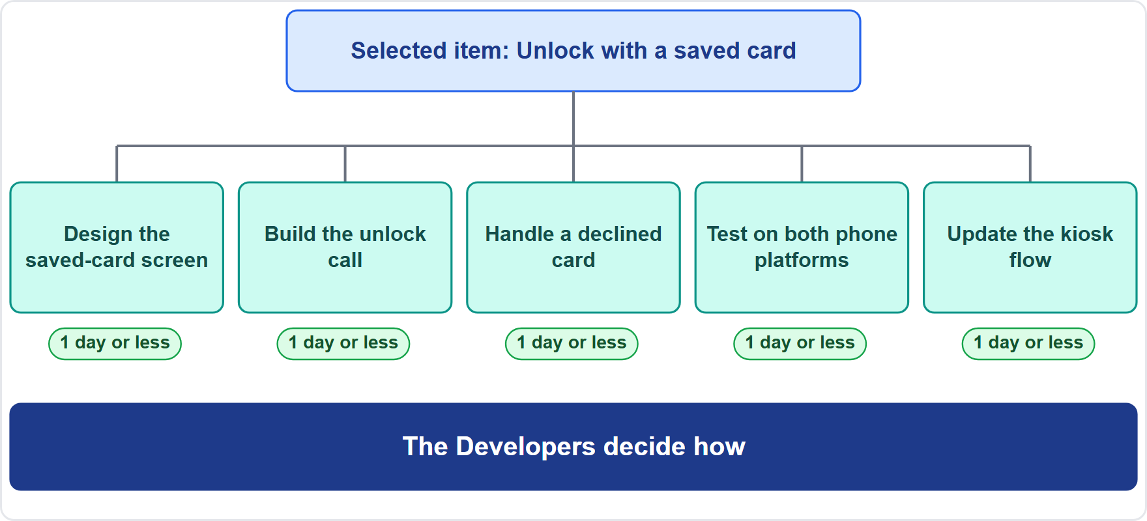
Topic Three: How Will the Work Get Done?
Module 7
The Developers work out what must be done to reach an Increment (a usable step) that meets the Definition of Done
Often: pieces of work of a day or less
Sole discretion of the Developers: nobody directs how
EXAM TIP One day or less is what teams often do, not a rule. Nobody dictates the how.
CSM Exam Prep Masterclass | Certified ScrumMaster
Module 7: Sprint Planning
9 / 21
Notes:
Topic Three is how. For each selected item, the Developers work out what must be done to reach an Increment, a usable step toward the Product Goal, that satisfies the Definition of Done. Teams often break an item into pieces of work that take a day or less, as the diagram shows. Notice the word often: it is a habit, not a rule. And the how belongs to the Developers alone, at their sole discretion. Nobody else directs how items become Increments, not the Product Owner, not the Scrum Master, and not a manager.

Slide 10
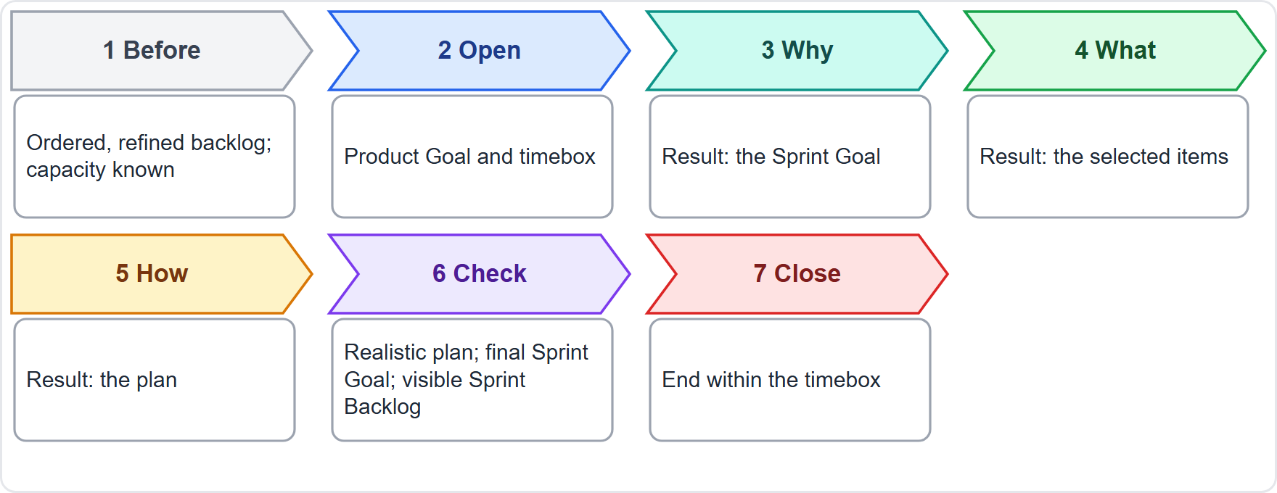
Performing a Sprint Planning, Step by Step
BEYOND THE GUIDE
Module 7
Before: ordered, refined Product Backlog; capacity known
Open: Product Goal and timebox
Why, what, how: the three topics, in order
Check and close: realistic plan, final Sprint Goal, visible Sprint Backlog; end on time
EXAM TIP The Guide gives the three topics. The steps around them are good practice for the objective perform a Sprint Planning.
CSM Exam Prep Masterclass | Certified ScrumMaster
Module 7: Sprint Planning
10 / 21
Notes:
Now you perform a Sprint Planning. The steps around the three topics are good practice, tagged Beyond the Guide. Before the event, order the Product Backlog, refine the top items, and know the team's capacity. Open by stating the Product Goal and the timebox. Then work through why, what and how. Before closing, check that the plan is realistic, the Sprint Goal is final, and the Sprint Backlog is visible. Then end on time.

Slide 11
Who Does What in Sprint Planning
Module 7
Who | Role
Product Owner | Prepares attendees; puts forward the value; discusses items; helps shape the Sprint Goal
Developers | Select the items; forecast; plan how; own the plan
Scrum Master | Team member; ensures the event happens, is productive and on time; helps an unprepared Product Owner prepare
Invited others | Advise; do not decide
EXAM TIP The Scrum Master takes part as a team member, but does not choose the items or the goal.
CSM Exam Prep Masterclass | Certified ScrumMaster
Module 7: Sprint Planning
11 / 21
Notes:
Who does what? The Product Owner prepares the attendees, puts forward the value, discusses items with the Developers, and helps shape the Sprint Goal. The Developers select the items, forecast what they can do, plan how, and own the plan. The Scrum Master is a member of the team. They make sure the event takes place, is positive and productive, and stays within the timebox. They also help an unprepared Product Owner find techniques to prepare. Invited guests give advice. They do not decide.

Slide 12
Inspect and Adapt in Sprint Planning
BEYOND THE GUIDE
Module 7
Inspect | Adapt | Transparency
The Product Backlog and Product Goal; past performance; capacity; the Definition of Done | Select a realistic set; set a Sprint Goal; refine or split items | The Sprint Goal and Sprint Backlog make the plan visible to everyone
EXAM TIP Inspecting and adapting at an event exists to increase transparency. Expect a question that asks you to recognize an example.
CSM Exam Prep Masterclass | Certified ScrumMaster
Module 7: Sprint Planning
12 / 21
Notes:
Every event is a chance to inspect and adapt, and the purpose is transparency. In Sprint Planning the team inspects the Product Backlog and Product Goal, its past performance, its capacity and its Definition of Done. It adapts by selecting a realistic set of items, setting a Sprint Goal, and refining or splitting items that do not fit. The Sprint Goal and Sprint Backlog then make the plan visible. These examples go beyond the Guide, but expect a question that asks you to recognize one.

Slide 13
Common Problems and Better Practice
BEYOND THE GUIDE
Module 7
Problem | Better practice
No Sprint Goal, or a list of tasks | One objective, final before Planning ends
The Product Owner assigns the work | The Developers select
Items too big for a Sprint | Refine or split
Planning runs over the timebox | Prepare beforehand; at the limit conclude with what you have, do not extend
The plan ignores the Definition of Done | Plan the work to meet it
Overcommitment | Use past performance and capacity
CSM Exam Prep Masterclass | Certified ScrumMaster
Module 7: Sprint Planning
13 / 21
Notes:
These problems show up, with the better practice. Both go beyond the Guide. No Sprint Goal, or a list of tasks: define one objective. The Product Owner assigns the work: the Developers select. Items too big for a Sprint: refine or split them. Planning runs over the timebox: prepare the Product Backlog beforehand, and at the limit the Scrum Master helps the team conclude with what it has. Do not extend. The plan ignores the Definition of Done: plan the work to meet it. Overcommitment: use past performance.

Slide 14
Sprint Planning Traps: What the Exam Expects
Module 7
Three topics: why, what, how; the Sprint Goal is final before Planning ends
Developers select with the Product Owner and decide how
Whole Scrum Team plans; guests advise only
Timebox: at most eight hours (one-month Sprint); conclude, do not extend
Not in the Guide: estimation technique (story points, velocity), item format, set number of items, Sprint Backlog approval
Old wording: two topics, a forecast
EXAM TIP When two answers look right, choose the one that leaves each decision with the people accountable.
CSM Exam Prep Masterclass | Certified ScrumMaster
Module 7: Sprint Planning
14 / 21
Notes:
Here is what the exam expects. Three topics: why, what and how. The Sprint Goal is created in Sprint Planning and final before it ends. The Developers select the items with the Product Owner and decide how, and nobody approves or directs them. The whole Scrum Team plans, and guests only advise. The timebox is at most eight hours for a one-month Sprint; at the limit, conclude and do not extend. The Guide prescribes no estimation technique, such as story points or velocity, no item format, no set number of items, and no approval of the Sprint Backlog. The earlier edition has two topics and a forecast; that is old wording. When two answers look right, pick the one that leaves each decision with the people accountable for it.

Slide 15
Module Recap
Module 7
1
Purpose
2
Why
3
What
starts the Sprint; the whole Scrum Team plans
the Sprint Goal, final before Planning ends
the Developers select, with the Product Owner
4
How
5
Output
6
Timebox
the Developers plan, at their sole discretion
the Sprint Backlog, which is the goal, the items and the plan
eight hours at most for a one-month Sprint
CSM Exam Prep Masterclass | Certified ScrumMaster
Module 7: Sprint Planning
15 / 21
Notes:
Recap. The whole Scrum Team makes the plan. Why produces the Sprint Goal, final before Planning ends. What is the Developers' selection, made with the Product Owner. How is the Developers' plan, at their sole discretion. The output is the Sprint Backlog: goal, items and plan. The timebox is at most eight hours for a one-month Sprint. Now test yourself with five questions.

Slide 16
Practice Question 1
Module 7
Q1
At Sprint 9 Planning at RideLoop, four possible Sprint Goals are suggested. Which one is the best?
A
Complete items 12, 14, 17 and 19 from the top of the Product Backlog
B
Finish the payments back end so that the mobile work can start
C
Riders with a saved card can unlock a bike in one tap
D
Close every defect that the testers have reported on the app
CSM Exam Prep Masterclass | Certified ScrumMaster
Module 7: Sprint Planning
16 / 21
Notes:
Question one. At Sprint nine Planning at RideLoop, four possible Sprint Goals are suggested. Which one is the best? The four options are on the screen. Choose your answer. [PAUSE 12] The answer is C. A Sprint Goal is one objective that tells stakeholders why the Sprint is valuable. A list of items, a technical layer or an open-ended activity does not communicate value.

Slide 17
Practice Question 2
Module 7
Q2
Grace Whitfield tells Maya that seven named items must be finished this Sprint, and Maya presents the list to the Developers as final. What is the best response from the Scrum Master?
A
Explain that the Developers select the items in discussion with the Product Owner, based on what they can do
B
Edit Maya's list before the event so that it fits the Developers' capacity, then present it to the team as the plan
C
Ask the stakeholders to vote on which of the seven items stay in the Sprint
D
Accept the list, since Grace funds the work and the Product Owner decides which work goes into the Sprint
CSM Exam Prep Masterclass | Certified ScrumMaster
Module 7: Sprint Planning
17 / 21
Notes:
Question two. Grace Whitfield tells Maya that seven named items must be finished this Sprint, and Maya presents the list to the Developers as final. What is the best response from the Scrum Master? The four options are on the screen. Choose your answer. [PAUSE 12] The answer is A. The Developers select the items in discussion with the Product Owner, using their past performance, capacity and Definition of Done. The Product Owner can propose value, but does not assign the load.

Slide 18
Practice Question 3
Module 7
Q3
Before the Sprint starts, Grace asks to approve the design of the items in the Sprint Backlog. What is the best response?
A
Agree to the approval, since a Director of Operations is accountable for what the teams deliver to riders and for the budget
B
Ask Maya to approve the design, since the Product Owner is accountable for the value of the product and its Product Backlog
C
Ask the Scrum Master to approve the design, since the Scrum Master is accountable for the effectiveness of the team and its results
D
Decline the approval, since the Developers alone decide how items become Increments, and offer the visible plan and the Sprint Review
CSM Exam Prep Masterclass | Certified ScrumMaster
Module 7: Sprint Planning
18 / 21
Notes:
Question three. Before the Sprint starts, Grace asks to approve the design of the items in the Sprint Backlog. What is the best response? The four options are on the screen. Choose your answer. [PAUSE 12] The answer is D. The Developers plan the work, and nobody else decides for them how items become Increments. Grace can inspect the visible plan, and see the results at the Sprint Review.

Slide 19
Practice Question 4
Module 7
Q4
What does the Sprint Backlog consist of at the end of Sprint Planning?
A
The ordered Product Backlog together with the Sprint Goal and the order that the Product Owner has set
B
The Sprint Goal, the selected Product Backlog items and the plan for delivering them
C
The selected items, each with an estimate of the effort and a named owner for the work
D
The task list for the first day of work for each Developer, as agreed with the Scrum Master
CSM Exam Prep Masterclass | Certified ScrumMaster
Module 7: Sprint Planning
19 / 21
Notes:
Question four. What does the Sprint Backlog consist of at the end of Sprint Planning? The four options are on the screen. Choose your answer. [PAUSE 12] The answer is B. The Sprint Goal, the selected items and the plan for delivering them together make up the Sprint Backlog. The Guide does not require an estimate or a named owner for each item.

Slide 20
Practice Question 5
Module 7
Q5
What is the maximum timebox of Sprint Planning for a one-month Sprint?
A
Eight hours
B
Four hours
C
Three hours
D
Fifteen minutes
CSM Exam Prep Masterclass | Certified ScrumMaster
Module 7: Sprint Planning
20 / 21
Notes:
Question five. What is the maximum timebox of Sprint Planning for a one-month Sprint? The four options are on the screen. Choose your answer. [PAUSE 12] The answer is A, eight hours, and the event is usually shorter for a shorter Sprint. Four hours is the Sprint Review, three hours is the Retrospective, and fifteen minutes is the Daily Scrum.

Slide 21
Answers at a Glance
Module 7
Question | Answer | Why
Q1 | C | The Sprint Goal is one outcome that stakeholders understand, not a list, a layer or an activity
Q2 | A | The Developers select the items with the Product Owner; nobody assigns the load
Q3 | D | The how is at the Developers' sole discretion; the plan is visible and the Review shows the results
Q4 | B | The Sprint Backlog is the goal, the selected items and the plan
Q5 | A | Eight hours at most for a one-month Sprint; four, three and fifteen minutes belong to other events
CSM Exam Prep Masterclass | Certified ScrumMaster
Module 7: Sprint Planning
21 / 21
Notes:
Here are all five answers together. Question one: C. The Sprint Goal is one outcome that stakeholders understand. Question two: A. The Developers select the items with the Product Owner. Question three: D. The how is the Developers' call, and Grace can see the plan and the Review. Question four: B. The Sprint Backlog is the goal, the selected items and the plan. Question five: A. Eight hours at most for a one-month Sprint; the other times belong to other events. That completes Module 7. Next, Module 8 covers the Daily Scrum.

