Slide 1
Module 8: Daily Scrum
The Developers' own planning event
Scrum Foundations 3.4 · CSM 1.12, 1.13
Certified ScrumMaster (CSM) Exam Prep Masterclass
Module 8
Notes:
Welcome to Module 8: Daily Scrum. Fifteen minutes a day, and more exam traps than almost any other event. In this module you will learn what the Daily Scrum is for, who it belongs to, how the Developers run it, and how it differs from a status meeting. That last point is a learning objective of its own.

Slide 2
What You Will Learn
Module 8
State the purpose, participants and timebox of the Daily Scrum
Explain how the Developers conduct one
Give three ways it differs from a status meeting
Explain why its constraints help the Developers
Say what the Scrum Master does and does not do there
Spot the traps: status reports, long talks, mandatory questions
CSM Exam Prep Masterclass | Certified ScrumMaster
Module 8: Daily Scrum
2 / 20
Notes:
By the end of this module you will be able to do six things. State the purpose, participants and timebox of the Daily Scrum. Explain how the Developers conduct one. Give three ways it differs from a status meeting. Explain why its constraints help the Developers. Say what the Scrum Master does, and does not do, there. And spot the traps: status reports, long talks, and mandatory questions.

Slide 3
Case Check-In: The Status Report
Module 8
CASE CHECK-IN · RideLoop
The team meets at 9:30 in the operations room, every working day
Grace has started to sit in and asks each Developer for a status report
The talk now runs 25 minutes and the plan for the day gets lost
You think about what the event is for
CSM Exam Prep Masterclass | Certified ScrumMaster
Module 8: Daily Scrum
3 / 20
Notes:
At RideLoop, the team meets at nine thirty in the operations room, every working day. Lately, Grace Whitfield has started to sit in, and Grace asks each Developer for a status report. The talk now runs twenty-five minutes, and the plan for the day gets lost. You are the Scrum Master, and you think about what this event is actually for. By the end of the module, you will know how to explain it to Grace.

Slide 4
Purpose, Participants and Rules
Module 8
Item | Rule
Purpose | Check progress toward the Sprint Goal; adjust the Sprint Backlog and the coming work
Who | The Developers
Length | 15 minutes
When and where | "the same time and place every working day"
Product Owner, Scrum Master | Take part only as Developers, when working on Sprint Backlog items
Structure | The Developers choose; it must focus on the Sprint Goal and end with a plan for the next day
EXAM TIP The output is "an actionable plan for the next day of work."
CSM Exam Prep Masterclass | Certified ScrumMaster
Module 8: Daily Scrum
4 / 20
Notes:
Here are the rules. The purpose: check progress toward the Sprint Goal, and adjust the Sprint Backlog and the coming work. It is for the Developers. It lasts fifteen minutes, at a fixed time and place each working day. The Product Owner and Scrum Master take part only as Developers, and only when they are working on Sprint Backlog items. The Developers choose the structure, but it must focus on the Sprint Goal and end with "an actionable plan for the next day of work."

Slide 5
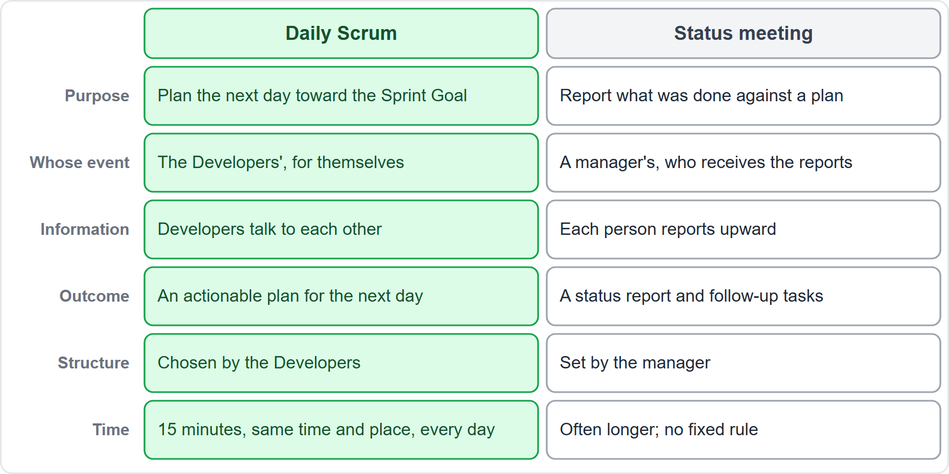
Daily Scrum or Status Meeting?
Module 8
The Daily Scrum is the Developers' own planning event
A status meeting is a report to someone who oversees the work
Same room, different purpose
EXAM TIP The Daily Scrum is not status reporting.
CSM Exam Prep Masterclass | Certified ScrumMaster
Module 8: Daily Scrum
5 / 20
Notes:
The Daily Scrum is often confused with a status meeting, so look at the picture. The Daily Scrum is the Developers' own planning event, for themselves, toward the Sprint Goal. A status meeting is a report to someone who oversees the work. The room can be the same, and the clock can be the same, but the purpose is different. If an option turns the Daily Scrum into status reporting, it is wrong.

Slide 6
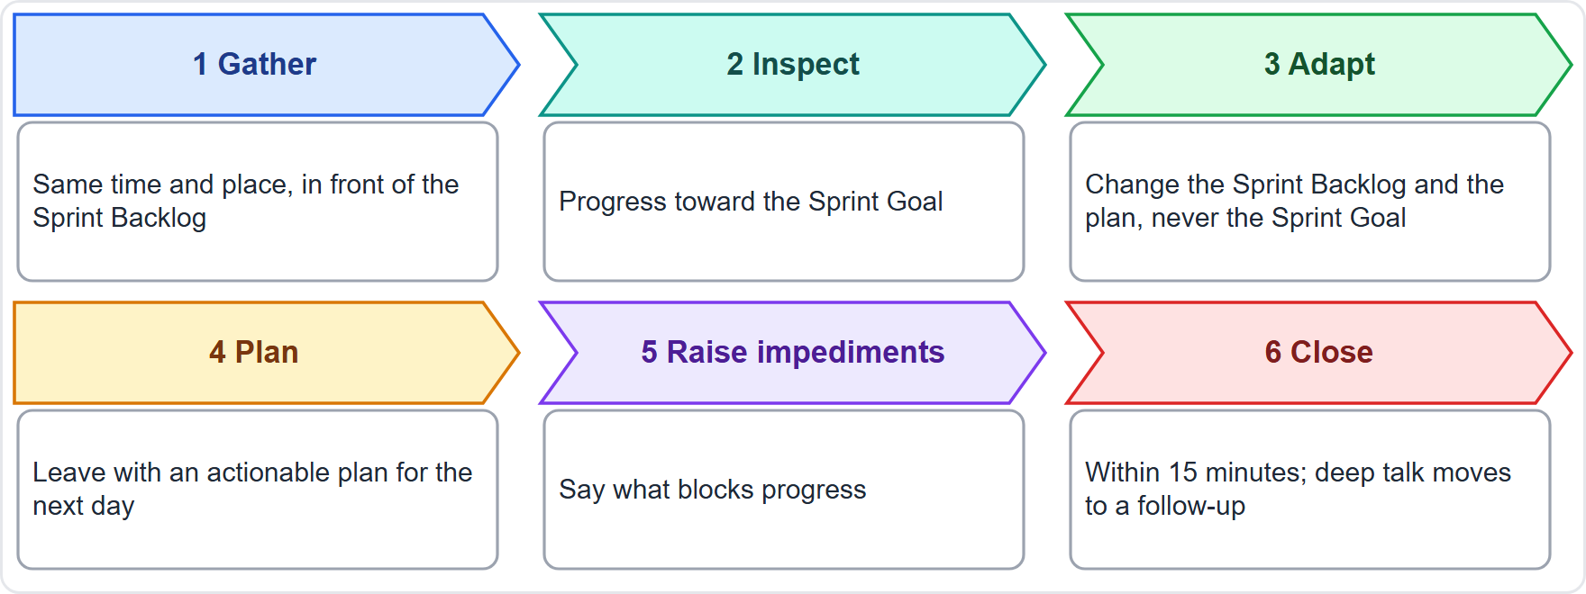
How the Developers Conduct a Daily Scrum
BEYOND THE GUIDE
Module 8
Gather at the same time and place
Inspect progress toward the Sprint Goal
Adapt the Sprint Backlog, never the Sprint Goal
Plan the next day of work
Raise impediments
Close within 15 minutes
CSM Exam Prep Masterclass | Certified ScrumMaster
Module 8: Daily Scrum
6 / 20
Notes:
How do the Developers conduct one? The Guide leaves the format to them, so this slide shows a typical flow that satisfies its rules, and it goes beyond the Guide. Gather at the same time and place, in front of the Sprint Backlog. Inspect progress toward the Sprint Goal. Adapt the Sprint Backlog and the plan, but never the Sprint Goal. Plan the next day of work. Raise impediments. And close within fifteen minutes, moving deep conversations to a follow-up.

Slide 7
Ways to Structure It
BEYOND THE GUIDE
Module 8
Format | How it works
Walk the board | Go through the Sprint Backlog item by item
By Sprint Goal | Ask what stands between the team and the goal today
Discussion | Free talk about the plan, with discipline
Three questions | An example only: what helped, what next, what blocks
Old wording: the earlier edition offered the three questions as an example; the Developers now choose their own structure
CSM Exam Prep Masterclass | Certified ScrumMaster
Module 8: Daily Scrum
7 / 20
Notes:
There is more than one way to structure it. These formats go beyond the Guide, which leaves the structure to the Developers. Walk the board: go through the Sprint Backlog item by item. Work by Sprint Goal: ask what stands between the team and the goal today. Use free discussion about the plan, with discipline. Or use the three questions, an example only: what helped, what is next, and what blocks. The earlier edition of the Guide offered those three questions as an example. The current Guide removed them, and lets the Developers choose.

Slide 8
Not a Status Meeting
BEYOND THE GUIDE
Module 8
 | Daily Scrum | Status meeting
Purpose | Plan the next day toward the Sprint Goal | Report on past work
Whose event | The Developers' | A manager's
Direction | Developers talk to each other | Each person reports up
Outcome | An actionable plan and an updated Sprint Backlog | A report
Structure | Chosen by the Developers | Set by the manager
Focus | The Sprint Goal | Individual tasks and hours
EXAM TIP Name at least three differences.
CSM Exam Prep Masterclass | Certified ScrumMaster
Module 8: Daily Scrum
8 / 20
Notes:
The learning objective asks for at least three differences from a status meeting. The comparison goes beyond the Guide, but each difference follows from it. Purpose: the Daily Scrum plans the next day toward the Sprint Goal, while a status meeting reports on past work. Whose event: the Developers', not a manager's. Direction: Developers talk to each other, rather than each person reporting up. Outcome: an actionable plan and an updated Sprint Backlog, not a report. And structure: chosen by the Developers, not by a manager. And focus: the Sprint Goal, not individual tasks and hours. That is six, and the objective asks for only three.

Slide 9
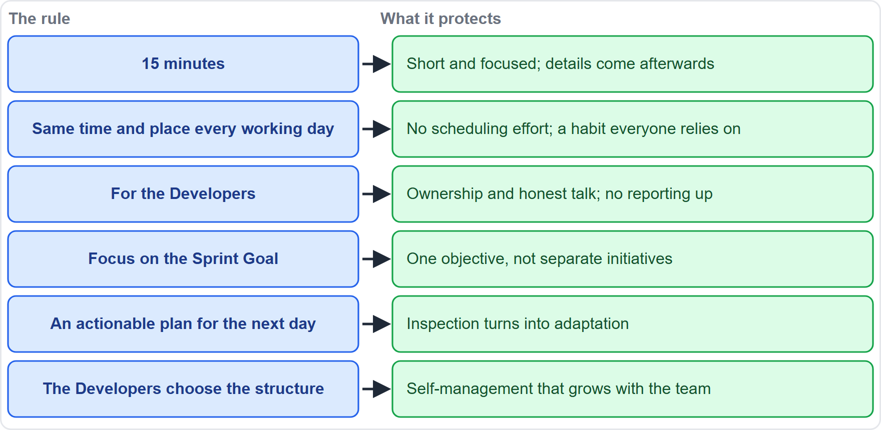
Why the Constraints Help
Module 8
15 minutes: short and focused; details afterwards
Same time and place: no scheduling effort
For the Developers: ownership and honest talk
Sprint Goal focus: one objective
A plan for the next day: inspection becomes adaptation
Own structure: self-management
CSM Exam Prep Masterclass | Certified ScrumMaster
Module 8: Daily Scrum
9 / 20
Notes:
The constraints are not bureaucracy; they protect the Developers. Fifteen minutes keeps the event short and focused, and details come afterwards. The same time and place removes scheduling effort. Making it for the Developers gives them ownership and room for honest talk, with no reporting up. Focusing on the Sprint Goal keeps one objective in view. A plan for the next day turns inspection into adaptation. And choosing their own structure builds self-management.

Slide 10
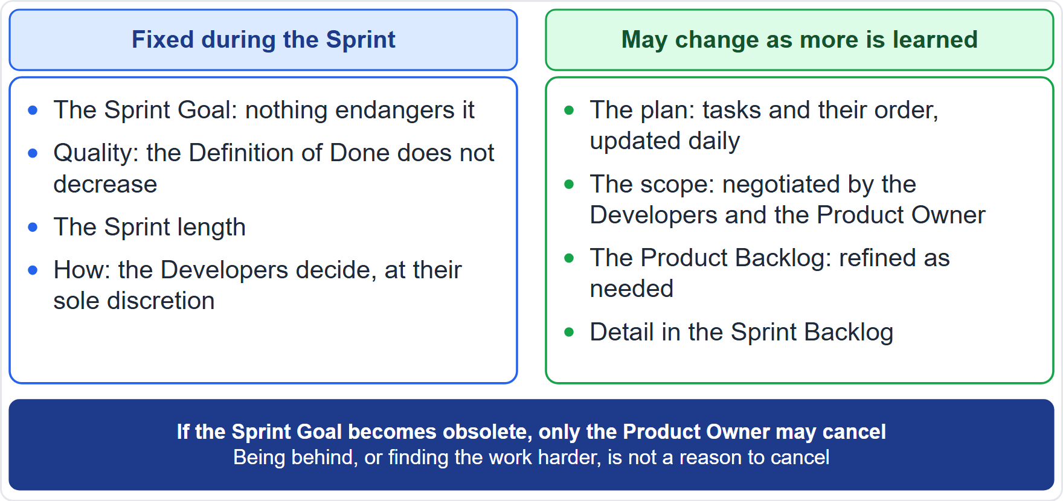
The Plan Changes, the Goal Does Not
Module 8
The Daily Scrum is the Developers' inspection point for the Sprint Backlog
They adapt the plan, not the Sprint Goal
If the work differs from expectations, they negotiate scope with the Product Owner
Adapt as soon as something new is learned
EXAM TIP The Developers often meet during the day too, for detailed re-planning.
CSM Exam Prep Masterclass | Certified ScrumMaster
Module 8: Daily Scrum
10 / 20
Notes:
The Daily Scrum is the Developers' inspection point for the Sprint Backlog. What they adapt is the plan, never the Sprint Goal. If the work turns out different from what they expected, they negotiate scope with the Product Owner, without harming the Sprint Goal. Adaptation happens as soon as something new is learned. And the Developers can adjust the plan at other moments too: they often meet during the day for more detailed re-planning.

Slide 11
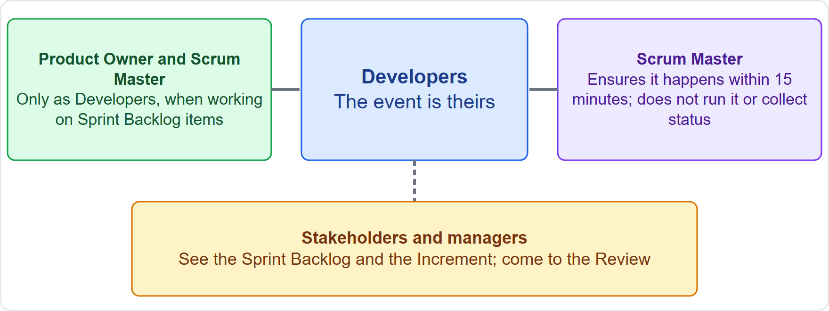
Who May Attend
Module 8
Developers: the event is theirs
Product Owner, Scrum Master: only as Developers, when working on Sprint Backlog items
Scrum Master: makes sure it happens in 15 minutes; does not run it or collect status
Stakeholders, managers: see the Sprint Backlog; come to the Review
CSM Exam Prep Masterclass | Certified ScrumMaster
Module 8: Daily Scrum
11 / 20
Notes:
Who takes part? The event belongs to the Developers. The Product Owner and Scrum Master take part only as Developers, when they are actively working on Sprint Backlog items. The Scrum Master makes sure the event happens and stays within fifteen minutes, but does not run it and does not collect status. Stakeholders and managers who want to know progress can see the Sprint Backlog and the Increment, and they come to the Sprint Review. At RideLoop, that is the answer for Grace: read the Sprint Backlog and come to the Review, but the Daily Scrum is not a report to Grace.

Slide 12
Common Problems and Better Practice
BEYOND THE GUIDE
Module 8
Problem | Better practice
Each person reports to the Scrum Master | Developers talk to each other about the plan
It runs past 15 minutes | Park deeper topics for a follow-up
The time and place keep changing | Fix them
Nothing changes afterwards | End with a plan and an updated Sprint Backlog
Only yesterday is reported | Look forward to today and tomorrow
The Scrum Master runs it | The Developers run it
CSM Exam Prep Masterclass | Certified ScrumMaster
Module 8: Daily Scrum
12 / 20
Notes:
Common problems, with better practice; both go beyond the Guide. Everyone reports to the Scrum Master: the Developers should talk to each other about the plan. It runs past fifteen minutes: park deeper topics for a follow-up. The time and place keep changing: fix them. Nothing changes afterwards: end with a plan and an updated Sprint Backlog. Only yesterday is reported: look forward to today and tomorrow. And the Scrum Master runs it: instead, the Developers run it.

Slide 13
Traps: What the Exam Expects
Module 8
Purpose: plan toward the Sprint Goal, not report status
15 minutes, every working day, same time and place
The Developers' event; the Product Owner and Scrum Master join only as Developers
The Developers choose the structure; the three questions are old
The Scrum Master does not run it or collect status
The Sprint Goal does not change; the plan does
EXAM TIP The Daily Scrum improves communication, surfaces impediments and speeds decisions, so it removes the need for other meetings. An extra status meeting goes against that.
CSM Exam Prep Masterclass | Certified ScrumMaster
Module 8: Daily Scrum
13 / 20
Notes:
Here are the traps. The purpose is to plan toward the Sprint Goal, not to report status. Fifteen minutes, every working day, at the same time and place. It is the Developers' event, and the Product Owner and Scrum Master join only as Developers. The Developers choose the structure; the three questions are old. The Scrum Master does not run it or collect status. And the Sprint Goal does not change at the Daily Scrum; the plan does. The Guide adds that Daily Scrums improve communication, identify impediments and promote quick decisions, and so eliminate the need for other meetings. An extra status meeting goes against that.

Slide 14
Module Recap
Module 8
1
Purpose
2
Rules
3
Owners
check progress toward the Sprint Goal and adjust the plan
15 minutes, same time and place, every working day
the Developers choose the structure
4
Output
5
Not
6
Scrum Master
an actionable plan for the next day
a status meeting
ensures it happens; does not run it
CSM Exam Prep Masterclass | Certified ScrumMaster
Module 8: Daily Scrum
14 / 20
Notes:
Recap. The Daily Scrum checks progress toward the Sprint Goal and adjusts the plan. It lasts fifteen minutes, at one fixed time and place, every working day. The Developers own it and choose the structure. The output is an actionable plan for the next day. It is not a status meeting. And the Scrum Master ensures it happens but does not run it. Now test yourself.

Slide 15
Practice Question 1
Module 8
Q1
A discussion about a design problem makes the RideLoop Daily Scrum run to 25 minutes every day. What is the best action?
A
Extend the Daily Scrum to 25 minutes, so that the design problem can be solved inside the event
B
Keep the Daily Scrum to 15 minutes, and let the people concerned continue afterwards
C
Ask Maya to decide the design, so that the discussion no longer takes time away from the event
D
Stop the Daily Scrum until the Developers have solved the design problem
CSM Exam Prep Masterclass | Certified ScrumMaster
Module 8: Daily Scrum
15 / 20
Notes:
Question one. A discussion about a design problem makes the RideLoop Daily Scrum run to twenty-five minutes every day. What is the best action? The four options are on the screen. Choose your answer. [PAUSE 12] The answer is B. The Daily Scrum stays at fifteen minutes, and the people concerned continue the discussion afterwards. The Developers often meet during the day for details. Extending the event or stopping it loses its purpose.

Slide 16
Practice Question 2
Module 8
Q2
A new contractor tells the RideLoop team that every Daily Scrum must follow three questions: what did I do yesterday, what will I do today, and what is blocking me. What does the Guide say?
A
The Developers may choose any structure that centers on the Sprint Goal and ends with a plan
B
The three questions are mandatory, so a team that uses another structure is not doing Scrum
C
The Scrum Master chooses the questions for each Daily Scrum and checks that every Developer answers them
D
Maya may set the agenda of the Daily Scrum, because the Product Owner is accountable for progress
CSM Exam Prep Masterclass | Certified ScrumMaster
Module 8: Daily Scrum
16 / 20
Notes:
Question two. A new contractor tells the RideLoop team that every Daily Scrum must follow three questions: what did I do yesterday, what will I do today, and what is blocking me. What does the Guide say? The four options are on the screen. Choose your answer. [PAUSE 12] The answer is A. The Developers choose the structure, as long as the event focuses on the Sprint Goal and produces a plan. The three questions were an example in the earlier edition.

Slide 17
Practice Question 3
Module 8
Q3
You, the Scrum Master, are also working on a Sprint Backlog item. Must you attend the Daily Scrum?
A
No, the Scrum Master may never attend, because the Daily Scrum is reserved for the Developers
B
Yes, to run the meeting and to record each Developer's progress for Maya
C
Yes, as a Developer, because you are doing hands-on work on Sprint Backlog items
D
Only if Maya asks for it, since the Product Owner is accountable for the progress of the Sprint
CSM Exam Prep Masterclass | Certified ScrumMaster
Module 8: Daily Scrum
17 / 20
Notes:
Question three. You, the Scrum Master, are also working on a Sprint Backlog item. Must you attend the Daily Scrum? The four options are on the screen. Choose your answer. [PAUSE 12] The answer is C. A Scrum Master who is actively working on Sprint Backlog items takes part as a Developer. Otherwise the event belongs to the Developers, and the Scrum Master does not run it or collect status.

Slide 18
Practice Question 4
Module 8
Q4
Which statement is a difference between the Daily Scrum and a status meeting?
A
The Daily Scrum is longer than a status meeting, so that every person can report in detail
B
The Daily Scrum is the Developers' own planning event, not a report to a manager
C
The Daily Scrum is led by Maya, who collects and records the status of each Developer
D
The Daily Scrum reports on past work, while a status meeting plans the next day of work
CSM Exam Prep Masterclass | Certified ScrumMaster
Module 8: Daily Scrum
18 / 20
Notes:
Question four. Which statement is a difference between the Daily Scrum and a status meeting? The four options are on the screen. Choose your answer. [PAUSE 12] The answer is B. The Daily Scrum is the Developers' own planning event, not a report to a manager. Option D reverses the two meetings, and option C gives the event to the Product Owner.

Slide 19
Practice Question 5
Module 8
Q5
What must the Daily Scrum focus on and produce?
A
The status of each person's tasks, and a written report for the Scrum Master each day
B
A review of the Increment with stakeholders, and a revised Product Backlog for the next Sprint
C
The Sprint Goal for the next Sprint, and a list of impediments for the management
D
Progress toward the Sprint Goal, and a concrete plan for the next working day
CSM Exam Prep Masterclass | Certified ScrumMaster
Module 8: Daily Scrum
19 / 20
Notes:
Question five. What must the Daily Scrum focus on and produce? The four options are on the screen. Choose your answer. [PAUSE 12] The answer is D: progress toward the Sprint Goal, and a concrete plan for the next working day. Status reports, a review of the Increment, and the next Sprint's goal all belong elsewhere.

Slide 20
Answers at a Glance
Module 8
Question | Answer | Why
Q1 | B | Keep to 15 minutes; detailed talk happens afterwards
Q2 | A | The Developers choose the structure; the three questions are old
Q3 | C | Takes part as a Developer when working on Sprint Backlog items
Q4 | B | The Developers' own planning, not a report upward
Q5 | D | Progress toward the Sprint Goal and a plan for the next day
CSM Exam Prep Masterclass | Certified ScrumMaster
Module 8: Daily Scrum
20 / 20
Notes:
Here are all five answers together. Question one: B. Keep to fifteen minutes. Question two: A. The Developers choose the structure. Question three: C. A Scrum Master working on Sprint Backlog items takes part as a Developer. Question four: B. The Developers' own planning, not a report upward. Question five: D. Progress toward the Sprint Goal, and a plan. That completes Module 8. Next, Module 9 covers the Sprint Review and the Sprint Retrospective.

