Slide 1
Module 9: Sprint Review and Sprint Retrospective
The two events that close every Sprint
Scrum Foundations 3.4 · CSM 1.9 to 1.11
Certified ScrumMaster (CSM) Exam Prep Masterclass
Module 9
Notes:
Welcome to Module 9: Sprint Review and Sprint Retrospective. These two events close every Sprint. The Review looks at the product, and the Retrospective looks at how the team works. In this module you will learn what each one is for, how to run them, and what a team loses if it skips the Retrospective.

Slide 2
What You Will Learn
Module 9
State the purpose, participants and timebox of the Review and of the Retrospective
Perform a Sprint Review
Perform a Sprint Retrospective
Give three effects of skipping the Retrospective
Tell the two events apart
Spot the traps: the Review as a gate, the Review as a demo for approval
CSM Exam Prep Masterclass | Certified ScrumMaster
Module 9: Sprint Review and Sprint Retrospective
2 / 21
Notes:
By the end of this module you will be able to do six things. State the purpose, participants and timebox of the Review and of the Retrospective. Perform a Sprint Review. Perform a Sprint Retrospective. Give three effects of skipping the Retrospective. Tell the two events apart. And spot the traps: the Review treated as a gate, and the Review treated as a demo for approval.

Slide 3
Case Check-In: A Sign-Off in Disguise
Module 9
CASE CHECK-IN · RideLoop
At the end of Sprint 7, Grace arrives at the Review with a checklist and asks the team to sign the Sprint off
Two items are almost done but not Done
The Retrospective is next, and the same complaints keep returning
You prepare to explain both events
CSM Exam Prep Masterclass | Certified ScrumMaster
Module 9: Sprint Review and Sprint Retrospective
3 / 21
Notes:
At the end of Sprint seven, Grace Whitfield arrives at the Review with a checklist and asks the team to sign the Sprint off. Two items are almost done, but not Done. The Retrospective comes next, and the same complaints about the slow station map keep returning. As Scrum Master, you prepare to explain what both events are really for. Grace's checklist and the almost-done items will both come back in this module.

Slide 4
The Sprint Review
Module 9
Item | Rule
Purpose | Inspect the outcome of the Sprint and decide on future adaptations
Who | The Scrum Team and key stakeholders
What happens | They look at what was accomplished and what changed in the environment, then collaborate on what to do next
Product Backlog | May be adjusted to meet new opportunities
Nature | A working session, not just a presentation
Position, timebox | Second to last event; at most 4 hours for a one-month Sprint
CSM Exam Prep Masterclass | Certified ScrumMaster
Module 9: Sprint Review and Sprint Retrospective
4 / 21
Notes:
First the Sprint Review. Its purpose is to examine the outcome of the Sprint and decide what to adapt next. The Scrum Team and key stakeholders attend. Together they look at what was accomplished and what has changed around the product, and then agree the next steps together. The Product Backlog may change to catch new opportunities. It is a working session, not just a presentation. It is the second to last event, and takes four hours at most for a one-month Sprint.

Slide 5
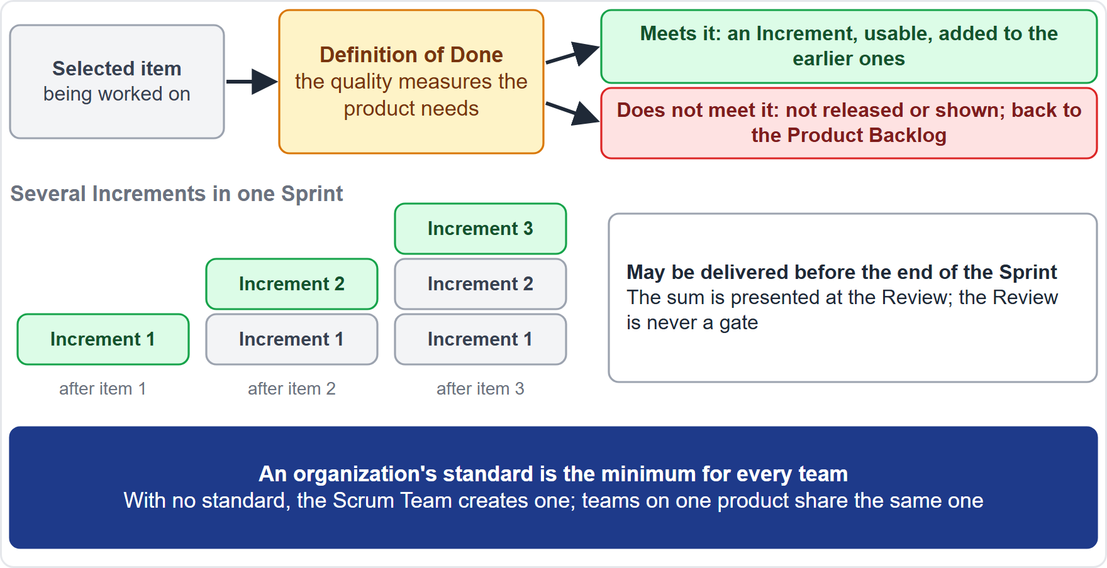
What Is Shown, and What Is Not
Module 9
The Increments of the Sprint are presented at the Review
An Increment may be delivered before the end of the Sprint
The Review is never a gate to releasing value
An item that misses the Definition of Done is neither released nor shown; it returns to the Product Backlog
EXAM TIP The Review is not an approval gate.
CSM Exam Prep Masterclass | Certified ScrumMaster
Module 9: Sprint Review and Sprint Retrospective
5 / 21
Notes:
What is shown at the Review? The Increments of the Sprint are presented there. But an Increment may be delivered earlier than the Review, so the Review is never a gate to releasing value. And here is the key rule. An item that misses the Definition of Done is neither released nor shown at the Review. It returns to the Product Backlog. So Grace's almost-done items stay out of the demonstration, however good they look. And Grace's checklist cannot turn the Review into a sign-off: it is a working session about what to do next, not an approval gate.

Slide 6
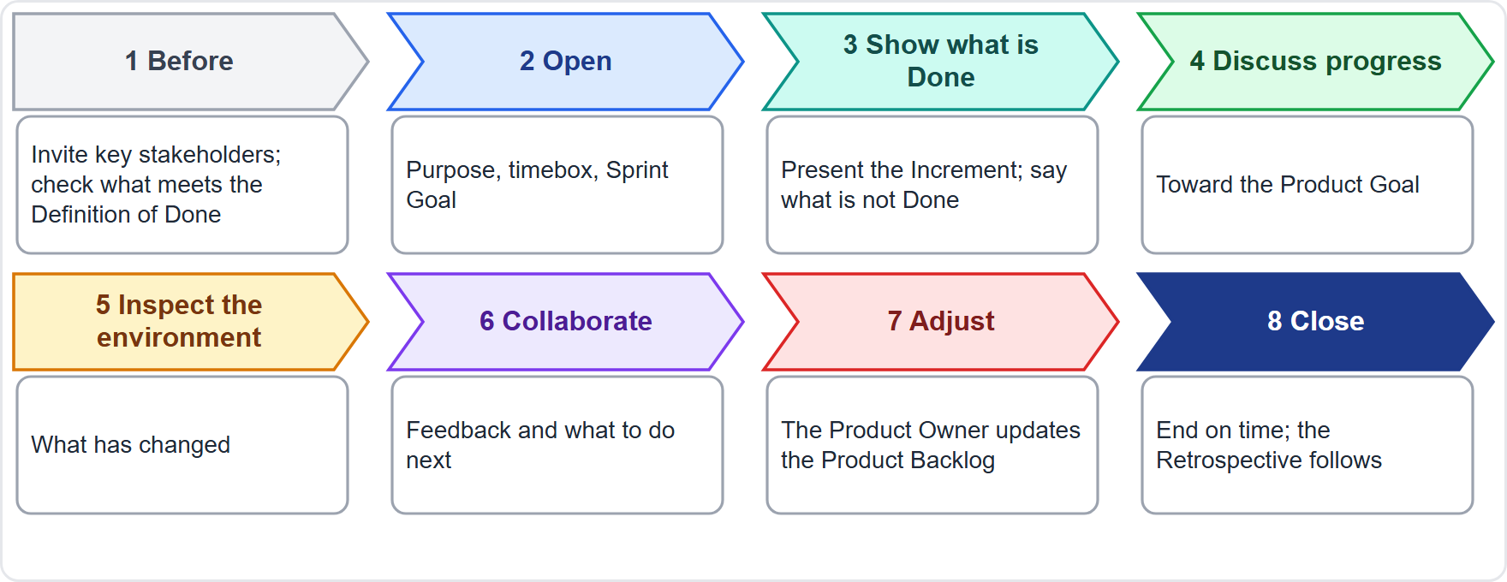
Performing a Sprint Review
BEYOND THE GUIDE
Module 9
Before: invite key stakeholders; check what meets the Definition of Done
Open: purpose, timebox, Sprint Goal
Show what is Done and say what is not
Discuss progress toward the Product Goal and the environment
Collaborate on what to do next
Adjust the Product Backlog; close on time
CSM Exam Prep Masterclass | Certified ScrumMaster
Module 9: Sprint Review and Sprint Retrospective
6 / 21
Notes:
How do you perform a Sprint Review? The Guide describes the event, and the steps are good practice, so this slide goes beyond the Guide. Before: invite the key stakeholders, and check what meets the Definition of Done. Open with the purpose, the timebox and the Sprint Goal. Show what is Done, and say what is not. Discuss progress toward the Product Goal and what has changed around the product. Collaborate on what to do next. Then the Product Owner adjusts the Product Backlog, and you close on time.

Slide 7
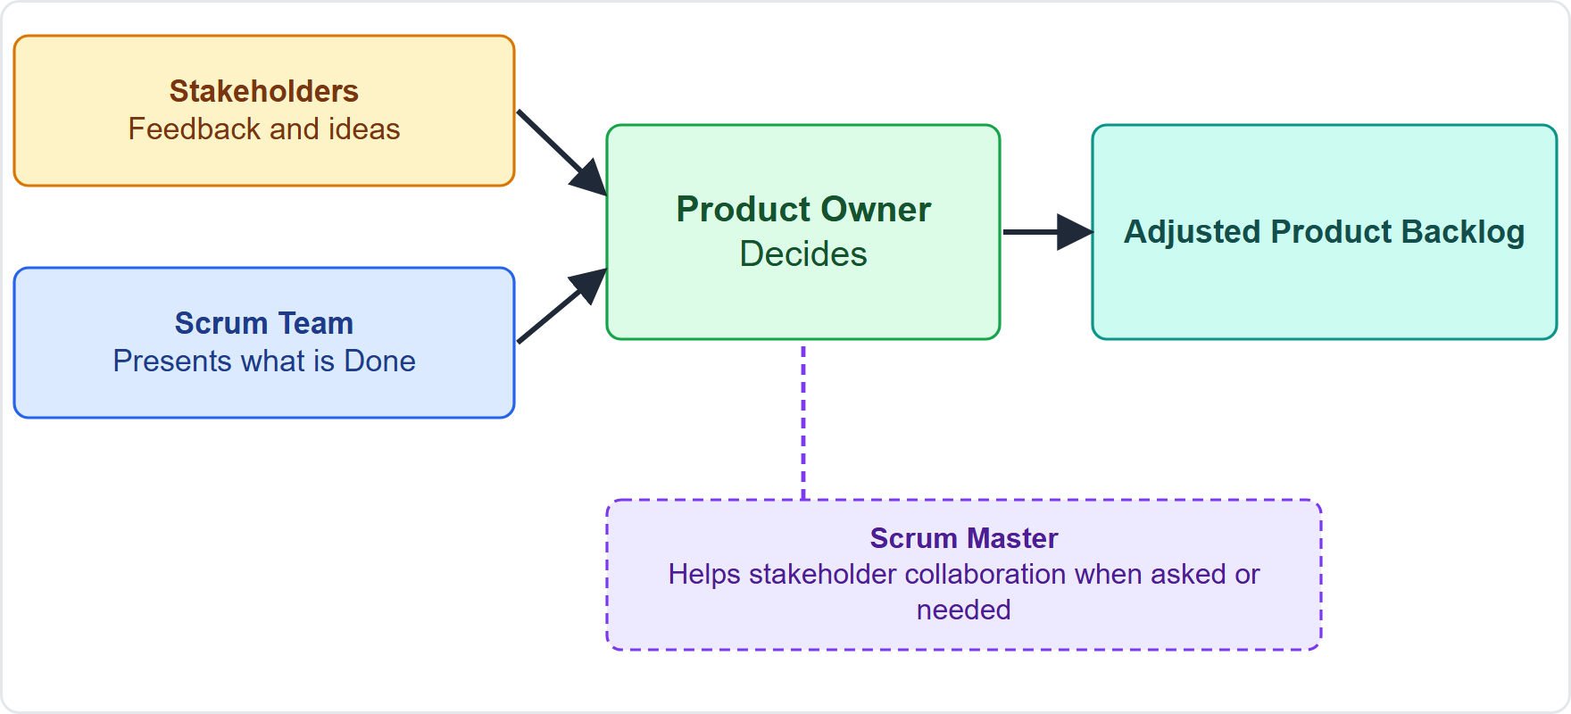
Who Decides at the Review?
Module 9
Stakeholders give feedback and ideas; they do not order the Product Backlog
The Product Owner decides how to adjust it
The Scrum Team presents what is Done
The Scrum Master helps stakeholder collaboration when asked or needed
EXAM TIP A stakeholder who wants a new feature first must convince the Product Owner.
CSM Exam Prep Masterclass | Certified ScrumMaster
Module 9: Sprint Review and Sprint Retrospective
7 / 21
Notes:
Who decides at the Review? Stakeholders give feedback and ideas, but they do not order the Product Backlog. The Product Owner decides how to adjust it. The Scrum Team presents what is Done. And the Scrum Master helps stakeholder collaboration when asked or needed. If a stakeholder wants a new feature first, the route is the same as always: convince the Product Owner.

Slide 8
Inspect and Adapt at the Review
BEYOND THE GUIDE
Module 9
Inspect | Adapt | Transparency
The Increment and what has changed in the environment | The Product Owner reorders the Product Backlog after feedback | Everyone sees the real state of the product and the Product Goal
CSM Exam Prep Masterclass | Certified ScrumMaster
Module 9: Sprint Review and Sprint Retrospective
8 / 21
Notes:
The learning objective asks for an example of inspecting and adapting at each event. This one goes beyond the Guide. At the Review, the team inspects the Increment and what has changed in the environment. It adapts when the Product Owner reorders the Product Backlog after the feedback. The transparency gained: everyone sees the real state of the product and of the Product Goal.

Slide 9
Review Traps
Module 9
A working session, not a one-way presentation or status report
Not a gate: work can be delivered earlier
Not Done is not shown: it returns to the Product Backlog
Stakeholders advise; the Product Owner adjusts the Product Backlog
Old wording: an informal meeting with target dates is the earlier edition
EXAM TIP Never present unfinished work to look good.
CSM Exam Prep Masterclass | Certified ScrumMaster
Module 9: Sprint Review and Sprint Retrospective
9 / 21
Notes:
The Review traps. It is a working session, not a one-way presentation or a status report. It is not a gate, because work can be delivered earlier. What is not Done is not shown, and returns to the Product Backlog. Stakeholders advise, and the Product Owner adjusts the Product Backlog. And in the earlier edition, the Review was called an informal meeting with target dates; treat that as old wording. Never present unfinished work just to look good.

Slide 10
The Sprint Retrospective
Module 9
Item | Rule
Purpose | Plan ways to raise quality and effectiveness
Inspects | How the Sprint went: individuals, interactions, processes, tools and the Definition of Done
Discusses | What went well, what problems arose and how they were or were not solved; assumptions that misled the team
Output | The most helpful changes; the biggest ones are tackled right away and may enter the next Sprint Backlog
Who | The Scrum Team
Position, timebox | Concludes the Sprint; at most 3 hours for a one-month Sprint
CSM Exam Prep Masterclass | Certified ScrumMaster
Module 9: Sprint Review and Sprint Retrospective
10 / 21
Notes:
The purpose of the Retrospective is to plan ways to raise quality and effectiveness. The team then looks at how the Sprint went: individuals, interactions, processes, tools, and the Definition of Done. It discusses what went well, what problems arose, and how they were or were not solved, and it looks at assumptions that misled the team. The output is the most helpful changes. The biggest ones are tackled right away, and may enter the next Sprint Backlog. The event concludes the Sprint, with three hours at most.

Slide 11
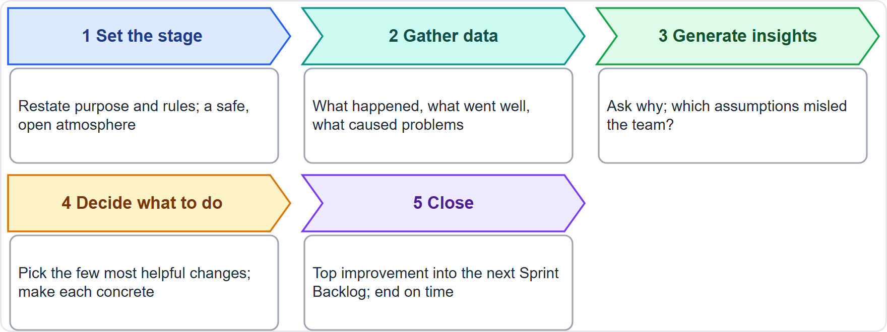
Performing a Sprint Retrospective
BEYOND THE GUIDE
Module 9
Set the stage: purpose, rules, a safe atmosphere
Gather data: what happened, what went well, what caused problems
Generate insights: ask why; which assumptions misled the team
Decide: the few most helpful changes, made concrete
Close: add the top improvement to the next Sprint Backlog
EXAM TIP Formats such as start, stop, continue are only examples.
CSM Exam Prep Masterclass | Certified ScrumMaster
Module 9: Sprint Review and Sprint Retrospective
11 / 21
Notes:
How do you perform a Retrospective? Again, this goes beyond the Guide. Set the stage: restate the purpose and rules, and create a safe, open atmosphere. Gather data: what happened, what went well, what caused problems. Generate insights by asking why, and which assumptions misled the team. Decide: choose the few most helpful changes and make each concrete. Close: add the most impactful improvement to the next Sprint Backlog. Formats such as start, stop, continue are only examples.

Slide 12
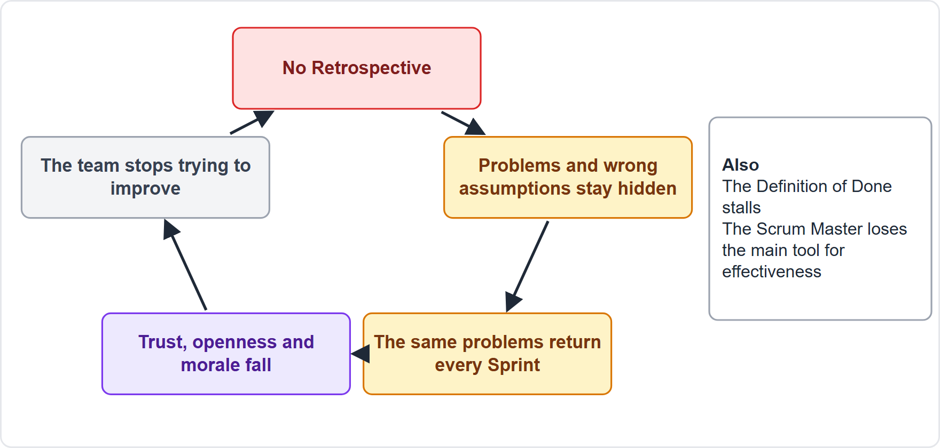
Effects of Skipping the Retrospective
BEYOND THE GUIDE
Module 9
Problems repeat
No improvement: the one event for it is gone
Wrong assumptions stay hidden
Trust and openness erode
Morale and ownership fall
The Definition of Done stalls
EXAM TIP Name at least three. The Guide's reason: skipping an event loses a chance to inspect and adapt.
CSM Exam Prep Masterclass | Certified ScrumMaster
Module 9: Sprint Review and Sprint Retrospective
12 / 21
Notes:
The learning objective asks for at least three effects of skipping the Retrospective. This list goes beyond the Guide, but follows from its warning that skipping any event loses a chance to inspect and adapt. Problems repeat. There is no improvement, because the one event planned for it is gone. Wrong assumptions stay hidden. Trust and openness erode. Morale and ownership fall. And the Definition of Done stalls. That is what happened at RideLoop with the station map.

Slide 13
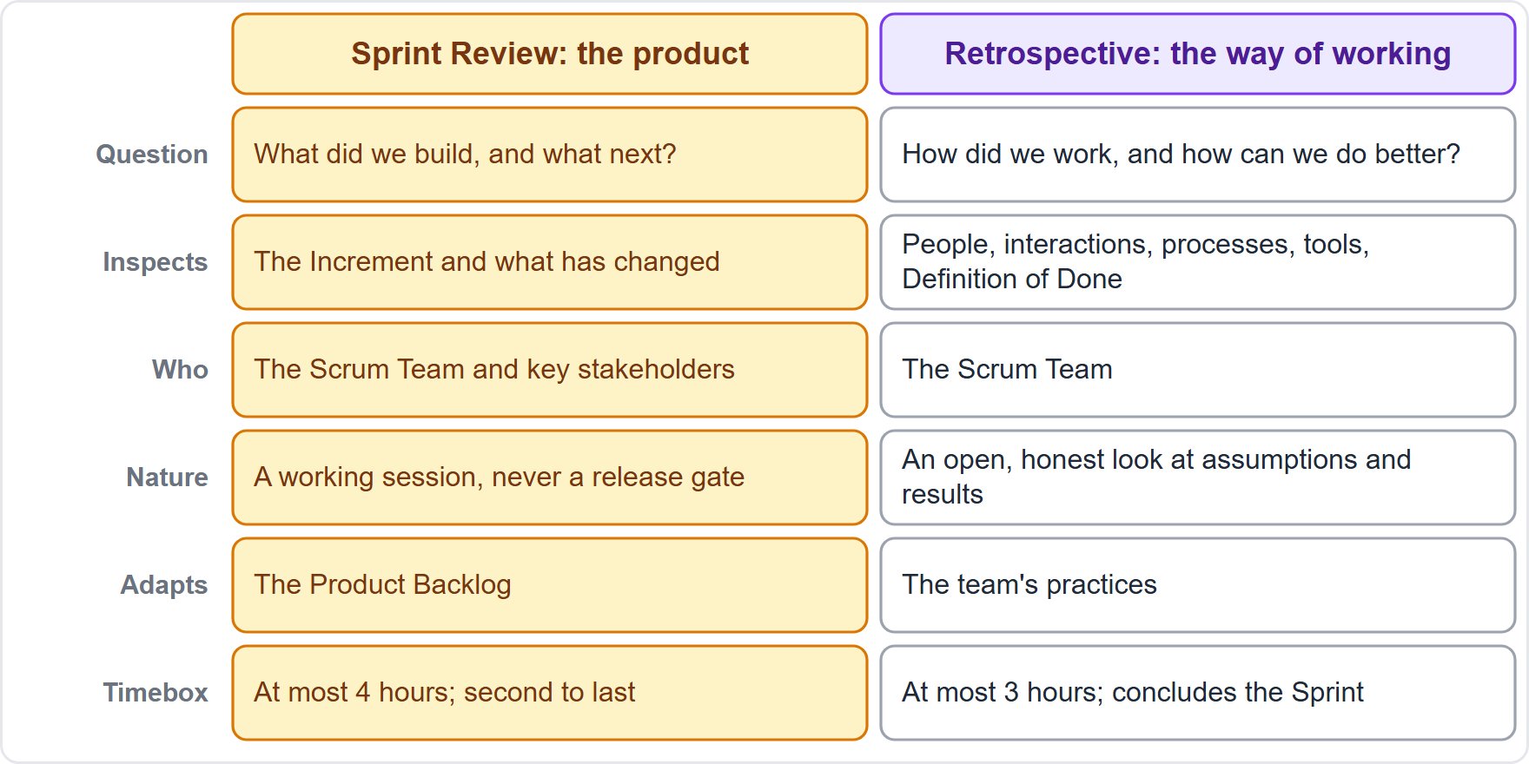
Review and Retrospective Compared
Module 9
Review: the outcome; the Scrum Team and stakeholders; adapts the Product Backlog; 4 hours
Retrospective: the way of working; the Scrum Team; adapts practices; 3 hours
Review: what did we build, what next? Retrospective: how did we work, how can we do better?
CSM Exam Prep Masterclass | Certified ScrumMaster
Module 9: Sprint Review and Sprint Retrospective
13 / 21
Notes:
Compare the two events. The Review inspects the outcome, with the Scrum Team and key stakeholders, adapts the Product Backlog, and lasts four hours at most. The Retrospective inspects the way of working, with the Scrum Team alone, adapts the team's practices, and lasts three hours at most. A simple way to remember: the Review asks, what did we build, and what next? The Retrospective asks, how did we work, and how can we do better?

Slide 14
Retrospective Traps
Module 9
Concludes the Sprint; it comes after the Review, not before Planning
The Scrum Team only; managers belong at the Review
The biggest improvements are tackled right away
Skipping it loses the planned chance to improve; the best answer restores it
The Scrum Master takes part as a member
Old wording: peer team member and a mandatory process improvement item are the earlier edition
EXAM TIP The Retrospective inspects people, process, tools and the Definition of Done, not the Increment.
CSM Exam Prep Masterclass | Certified ScrumMaster
Module 9: Sprint Review and Sprint Retrospective
14 / 21
Notes:
The Retrospective traps. It concludes the Sprint; it comes after the Review, not before the next Planning. It is for the Scrum Team only, and managers belong at the Review. The biggest improvements are tackled right away. Skipping it loses the planned chance to improve, and the best answer restores it. The Scrum Master takes part as a member. In the earlier edition you will find a peer team member and a mandatory process improvement item; that is old wording. The tip: the Retrospective inspects people, process, tools and the Definition of Done, not the Increment.

Slide 15
Module Recap
Module 9
1
Review
2
Retrospective
3
Timeboxes
inspect the outcome with stakeholders; adjust the Product Backlog
plan improvements; concludes the Sprint
4 hours and 3 hours at most
4
Not Done
5
Skipping the Retrospective
6
Both
never presented; back to the Product Backlog
formal chances to inspect and adapt
problems repeat, no improvement
CSM Exam Prep Masterclass | Certified ScrumMaster
Module 9: Sprint Review and Sprint Retrospective
15 / 21
Notes:
Recap. The Review inspects the outcome with stakeholders and adjusts the Product Backlog. The Retrospective plans improvements and concludes the Sprint. The timeboxes are four hours and three hours at most. Not Done is never presented, and returns to the Product Backlog. Skipping the Retrospective means problems repeat and nothing improves. Both events are formal chances to inspect and adapt. Now test yourself.

Slide 16
Practice Question 1
Module 9
Q1
The RideLoop team plans a one-hour slide presentation for the Sprint Review and does not expect any questions. What should the Scrum Master advise?
A
Agree, because the Review is a presentation of the Increment by the Scrum Team to the stakeholders
B
Cancel the Review, because the slides can be sent to the stakeholders for written feedback instead
C
Make it a working session where the team and stakeholders review what was done and decide next steps
D
Ask the stakeholders to send written feedback after the presentation, so the Review stays within one hour
CSM Exam Prep Masterclass | Certified ScrumMaster
Module 9: Sprint Review and Sprint Retrospective
16 / 21
Notes:
Question one. The RideLoop team plans a one-hour slide presentation for the Sprint Review and does not expect any questions. What should the Scrum Master advise? The four options are on the screen. Choose your answer. [PAUSE 12] The answer is C. The Review is meant to be a working session, and a one-way presentation misses its point. Attendees collaborate on what to do next, and the Product Backlog may be adjusted.

Slide 17
Practice Question 2
Module 9
Q2
At the Sprint 7 Review, Grace wants to see an item that is almost done but does not yet meet the Definition of Done, so that progress can be seen. What should happen?
A
Show it and mark it as ninety percent finished, so the stakeholders can see how far the work has come
B
Ask the stakeholders to approve the item at the Review, so that Maya can accept it as Done
C
Change the Definition of Done for this item so that it counts as Done, and present it with the Increment
D
The item cannot be presented or released, and it returns to the Product Backlog
CSM Exam Prep Masterclass | Certified ScrumMaster
Module 9: Sprint Review and Sprint Retrospective
17 / 21
Notes:
Question two. At the Sprint seven Review, Grace wants to see an item that is almost done but does not yet meet the Definition of Done, so that progress can be seen. What should happen? The four options are on the screen. Choose your answer. [PAUSE 12] The answer is D. The item cannot be presented or released, and it returns to the Product Backlog. Lowering the Definition of Done for one item would undermine transparency.

Slide 18
Practice Question 3
Module 9
Q3
A senior Lakeshore Transit manager asks to attend every RideLoop Retrospective to hear what the team's problems are. What is the best response from the Scrum Master?
A
Agree, since managers should know the team's problems so that they can support it with the right decisions
B
Agree, but only if the manager takes notes and shares them with the team after each Retrospective
C
Explain that the Retrospective is for the Scrum Team to inspect its own way of working in a safe setting
D
Make the Retrospective a report to the manager, so that every Developer states what went wrong
CSM Exam Prep Masterclass | Certified ScrumMaster
Module 9: Sprint Review and Sprint Retrospective
18 / 21
Notes:
Question three. A senior Lakeshore Transit manager asks to attend every RideLoop Retrospective to hear what the team's problems are. What is the best response from the Scrum Master? The four options are on the screen. Choose your answer. [PAUSE 12] The answer is C. The Retrospective is the Scrum Team's own inspection of its way of working, and openness needs a safe setting. The manager's interest can be served at the Review.

Slide 19
Practice Question 4
Module 9
Q4
What does the Scrum Team inspect in the Sprint Retrospective?
A
The Product Backlog and the order of its items, with the stakeholders present
B
Individuals, interactions, processes, tools and the Definition of Done
C
The Increment and whether it can be released to users
D
The Developers' individual performance, for the managers
CSM Exam Prep Masterclass | Certified ScrumMaster
Module 9: Sprint Review and Sprint Retrospective
19 / 21
Notes:
Question four. What does the Scrum Team inspect in the Sprint Retrospective? The four options are on the screen. Choose your answer. [PAUSE 12] The answer is B: individuals, interactions, processes, tools and the Definition of Done. The Product Backlog and the Increment are inspected at the Review, and individual performance for managers is not the purpose.

Slide 20
Practice Question 5
Module 9
Q5
Which of these is an effect of skipping the Sprint Retrospective?
A
The Sprint becomes longer, because the Retrospective counts as part of the timebox of the Sprint
B
The same problems return, because the event for improving the team's way of working is gone
C
Maya loses authority over the content and order of the Product Backlog
D
The stakeholders can no longer see the Increment at the Sprint Review
CSM Exam Prep Masterclass | Certified ScrumMaster
Module 9: Sprint Review and Sprint Retrospective
20 / 21
Notes:
Question five. Which of these is an effect of skipping the Sprint Retrospective? The four options are on the screen. Choose your answer. [PAUSE 12] The answer is B. The same problems keep returning, because the one event for improving the way of working is gone. Skipping it does not change the Sprint length, the Product Owner's authority, or the Review.

Slide 21
Answers at a Glance
Module 9
Question | Answer | Why
Q1 | C | The Review is a working session, not a one-way presentation
Q2 | D | Work that misses the Definition of Done is not presented
Q3 | C | The Retrospective is the Scrum Team's own inspection
Q4 | B | People, process, tools and the Definition of Done
Q5 | B | Problems repeat when the Retrospective is skipped
CSM Exam Prep Masterclass | Certified ScrumMaster
Module 9: Sprint Review and Sprint Retrospective
21 / 21
Notes:
Here are all five answers together. Question one: C. The Review is a working session. Question two: D. Work that misses the Definition of Done is not presented. Question three: C. The Retrospective is the Scrum Team's own inspection. Question four: B. People, process, tools and the Definition of Done. Question five: B. Problems repeat. That completes Module 9. Next, Module 10 covers the Product Backlog, the Product Goal and refinement.

