Slide 1
Module 10: Product Backlog, Product Goal and Refinement
The first artifact, its commitment, and how it stays useful
Scrum Foundations 3.5, 3.6, 4.1 to 4.3, 4.6
Certified ScrumMaster (CSM) Exam Prep Masterclass
Module 10
Notes:
Welcome to Module 10: Product Backlog, Product Goal and Refinement. This starts the artifacts block. You will learn what the Product Backlog is, why it is never finished, how items become ready for a Sprint through refinement, and what the Product Goal does. You will also see how the three commitments fit together.

Slide 2
What You Will Learn
Module 10
State the purpose and attributes of the Product Backlog
Explain why it is emergent
Name three attributes of a Product Backlog item
Describe refinement: three activities, two reasons
Explain the Product Goal and the three commitments
Spot the traps: a complete Backlog, refinement as an event, required formats
CSM Exam Prep Masterclass | Certified ScrumMaster
Module 10: Product Backlog, Product Goal and Refinement
2 / 22
Notes:
By the end of this module you will be able to do six things. State the purpose and attributes of the Product Backlog. Explain why it is emergent. Name three attributes of a Product Backlog item. Describe refinement, with three activities and two reasons. Explain the Product Goal and the three commitments. And spot the traps: a complete backlog, refinement as an event, and required formats.

Slide 3
Case Check-In: A Backlog of 140 Items
Module 10
CASE CHECK-IN · RideLoop
The Product Backlog holds about 140 items; only the top 12 are refined
Grace wants every item fully detailed and sized now
The Station Crew's item to report a broken bike with a photo sits at position 60
You ask what a healthy Product Backlog looks like
CSM Exam Prep Masterclass | Certified ScrumMaster
Module 10: Product Backlog, Product Goal and Refinement
3 / 22
Notes:
At RideLoop, the Product Backlog holds about one hundred and forty items, and only the top twelve are refined. Grace Whitfield wants every item fully detailed and sized right now. Meanwhile, the Station Crew's item, to report a broken bike with a photo, sits at position sixty, and they are frustrated. As Scrum Master, you ask what a healthy Product Backlog looks like. This module gives you the answer.

Slide 4
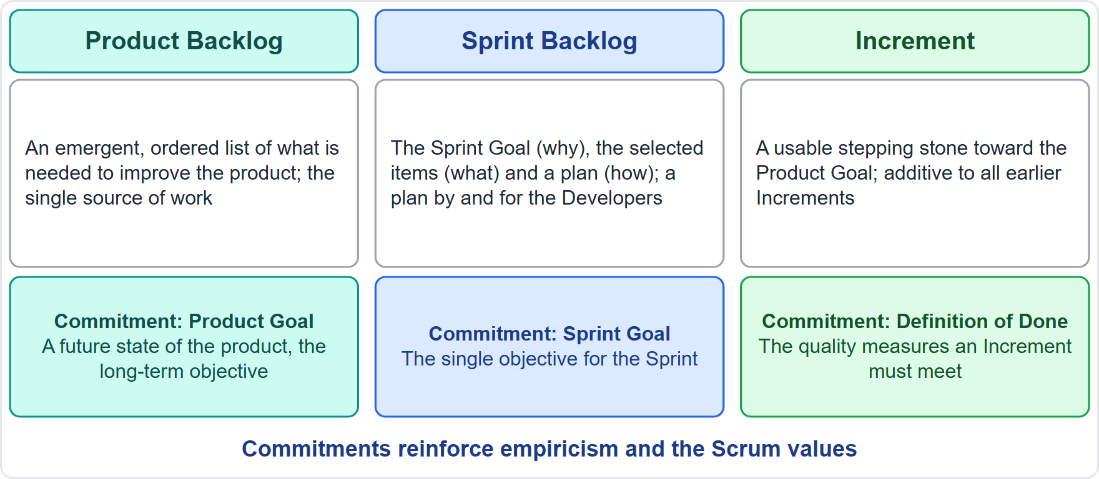
Artifacts and Commitments
Module 10
Artifacts represent work or value and are built for transparency
Each artifact holds one commitment
Product Backlog with the Product Goal
Sprint Backlog with the Sprint Goal
Increment with the Definition of Done
EXAM TIP A common trap swaps the pairs.
CSM Exam Prep Masterclass | Certified ScrumMaster
Module 10: Product Backlog, Product Goal and Refinement
4 / 22
Notes:
First, the big picture. Scrum's artifacts represent work or value, and they are built for transparency, so that everyone who inspects them starts from the same facts. Each artifact holds one commitment. The Product Backlog holds the Product Goal. The Sprint Backlog holds the Sprint Goal. The Increment holds the Definition of Done. Three artifacts, three commitments, always in those pairs. A common trap swaps them.

Slide 5
The Product Backlog
Module 10
"an emergent, ordered list of what is needed to improve the product"
The single source of work for the Scrum Team
The Product Owner is accountable; the work may be delegated
Work that is not in it is not what the team undertakes
At RideLoop: only the top 12 of about 140 items are refined; Maya orders the rest, and the Station Crew convinces Maya
EXAM TIP Emergent and ordered, never complete and never fixed up front.
CSM Exam Prep Masterclass | Certified ScrumMaster
Module 10: Product Backlog, Product Goal and Refinement
5 / 22
Notes:
The Guide defines the Product Backlog as "an emergent, ordered list of what is needed to improve the product." It is the single source of work for the Scrum Team. The Product Owner is accountable for it, though the work may be delegated. And what is not in the Product Backlog is not what the team undertakes. At RideLoop, that means a healthy Product Backlog is not fully detailed up front: only the top twelve of about one hundred and forty items are refined. Maya orders the rest, and the Station Crew convinces Maya; they do not push their item up themselves. For the exam, remember two words: emergent, and ordered.

Slide 6
Attributes of the Product Backlog
Module 10
Attribute | Meaning
Emergent | Changes as the product and understanding change
Ordered | In a sequence set by the Product Owner
Single source of work | Everything the team works on comes from it
Owned by one person | The Product Owner is accountable
Transparent | Visible and understood by everyone
Holds the Product Goal | The rest emerges to fulfill it
Refined continuously | Items are detailed as needed
EXAM TIP Name at least three.
CSM Exam Prep Masterclass | Certified ScrumMaster
Module 10: Product Backlog, Product Goal and Refinement
6 / 22
Notes:
The learning objective asks for at least three attributes. Emergent: it changes as the product and the understanding change. Ordered: in a sequence set by the Product Owner. The single source of work. Owned by one person, the Product Owner. Transparent: visible and understood by everyone. It holds the Product Goal, with the rest emerging to fulfill it. And refined continuously, with items detailed as needed. Pick any three that you can explain.

Slide 7
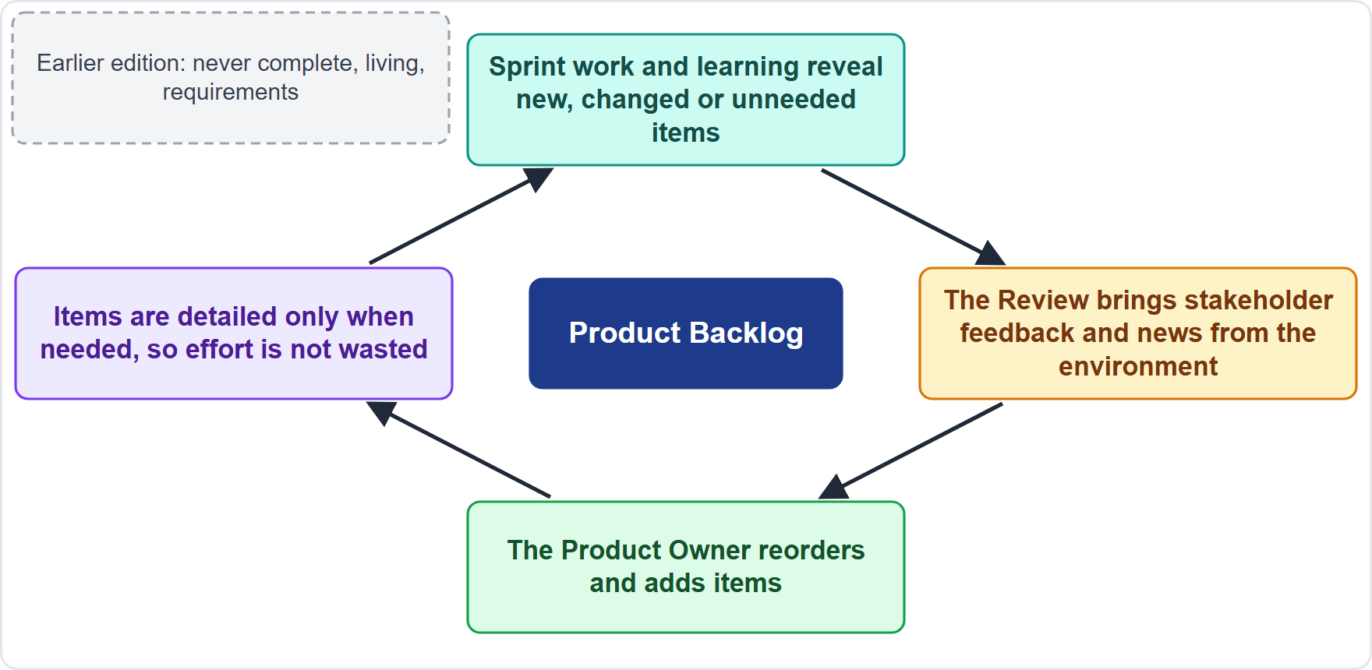
Why It Is Emergent
BEYOND THE GUIDE
Module 10
The work is complex; the full need is unknown at the start
Every Review brings feedback and changes
Learning reveals new, changed or unneeded items
Items are detailed only when needed
EXAM TIP Old wording: never complete, living, the single source of requirements.
CSM Exam Prep Masterclass | Certified ScrumMaster
Module 10: Product Backlog, Product Goal and Refinement
7 / 22
Notes:
Why is the Product Backlog emergent? These reasons go beyond the Guide, but they follow from its theory. The work is complex, so the full need is unknown at the start. Every Sprint Review brings feedback and changes in the environment. Learning during the Sprints reveals new, changed or unneeded items. And items are detailed only when needed, so effort is not wasted. The earlier edition said never complete, living, and requirements; the current wording is emergent and work.

Slide 8
Product Backlog Items
Module 10
Attribute | Notes
Description | What the item is, so everyone understands it
Order | Its position in the Product Backlog
Size | How big it is, decided by the Developers
Value | Often added to help the ordering [Beyond the Guide]
Test or acceptance notes | Often added to show when it is complete [Beyond the Guide]
Attributes vary with the domain of work
Old wording: the earlier edition said estimate; user stories and story points are not in the Guide
CSM Exam Prep Masterclass | Certified ScrumMaster
Module 10: Product Backlog, Product Goal and Refinement
8 / 22
Notes:
What attributes does an item have? The Guide names three: a description, so that everyone understands the item; its order in the Product Backlog; and its size, which the Developers decide. It adds that the attributes depend on the domain of the work. Many teams also add value, which helps ordering, and test or acceptance notes, which show when the item is complete; those two go beyond the Guide. In the earlier edition you will find the word estimate. User stories and story points are not in the Guide at all.

Slide 9
Ready for Selection, and Who Sizes
Module 10
An item is ready when the Scrum Team can get it Done within one Sprint
Items usually get there through refinement
The Developers size items, because they will do the work
The Product Owner may help them understand and select trade-offs
EXAM TIP Large or vague items are refined first.
CSM Exam Prep Masterclass | Certified ScrumMaster
Module 10: Product Backlog, Product Goal and Refinement
9 / 22
Notes:
When is an item ready for Sprint Planning? When the Scrum Team can get it Done within one Sprint. Items usually reach that state through refinement. Who sizes them? The Developers, because they will do the work. The Product Owner may help them understand and select trade-offs, for example by simplifying an item, but does not set the size. Large or vague items are refined first.

Slide 10
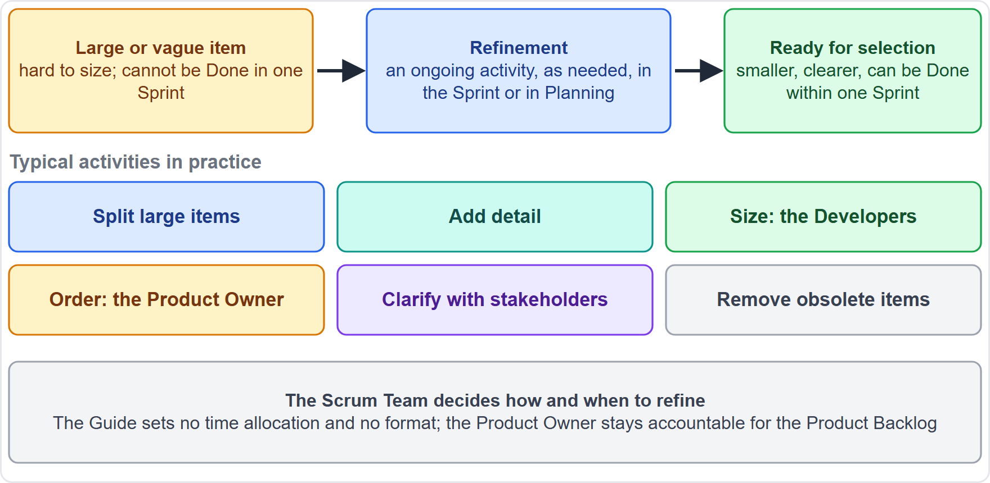
Product Backlog Refinement
Module 10
Breaking down and defining items into smaller, more precise ones
An ongoing activity, also during the Sprint and in Planning
Not an event: no required time, length or format
The Product Owner and the Developers collaborate
EXAM TIP Refinement is an activity, not one of the five events.
CSM Exam Prep Masterclass | Certified ScrumMaster
Module 10: Product Backlog, Product Goal and Refinement
10 / 22
Notes:
Refinement means breaking down and further defining items into smaller, more precise ones. It is an ongoing activity. The Product Backlog is refined whenever needed during the Sprint, and the Scrum Team may refine items in Sprint Planning too. Refinement is not one of the five events. The Guide sets no required time, length or format. The Product Owner and the Developers collaborate on it.

Slide 11
Refinement Activities
BEYOND THE GUIDE
Module 10
Activity | What it is
Split large items | The Guide's own idea of breaking down
Add detail | Description, often value and a sign of being done
Size the items | The Developers
Order or reorder | The Product Owner, using what was learned
Clarify with stakeholders and users | Questions, examples, constraints, dependencies
Remove or update stale items | Keeps the Product Backlog useful
EXAM TIP Name at least three.
CSM Exam Prep Masterclass | Certified ScrumMaster
Module 10: Product Backlog, Product Goal and Refinement
11 / 22
Notes:
The learning objective asks for three refinement activities. They go beyond the Guide. Split large items into smaller ones, which is the Guide's own idea of breaking down. Add detail, such as a description and often the value. Size the items, which is for the Developers. Order or reorder them, which is for the Product Owner. Clarify with stakeholders and users: questions, examples, constraints and dependencies. And remove or update items that are stale, which keeps the Product Backlog useful. Name any three.

Slide 12
Reasons for Refinement
BEYOND THE GUIDE
Module 10
Reason | Why
Shared understanding | Everyone knows why an item matters and what it needs
Ready items for Planning | Planning is faster and more reliable
Better forecasts | Smaller, clearer items build confidence in what fits
Transparency | The Product Backlog is visible and understood
Early risks and dependencies | Problems appear before the Sprint
Adaptation | New information changes the order of work
EXAM TIP Give at least two.
CSM Exam Prep Masterclass | Certified ScrumMaster
Module 10: Product Backlog, Product Goal and Refinement
12 / 22
Notes:
And at least two reasons for refinement. These also go beyond the Guide. Shared understanding: everyone knows why an item matters and what it needs. Ready items for Planning, which makes Planning faster and more reliable. Better forecasts, because smaller, clearer items build confidence. Transparency: the Product Backlog is visible and understood. Early discovery of risks and dependencies, before the Sprint. And adaptation, because new information changes the order of the work.

Slide 13
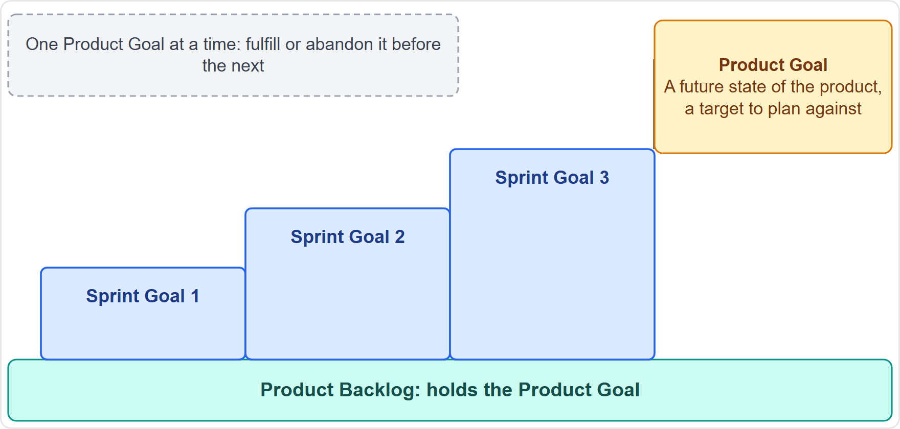
The Product Goal
Module 10
A future state of the product, a target to plan against
The team's long-term objective, in the Product Backlog
One at a time: fulfill or abandon it before the next
A product has a clear boundary, known stakeholders and defined users, and exists to deliver value
EXAM TIP The Product Owner develops and communicates it.
CSM Exam Prep Masterclass | Certified ScrumMaster
Module 10: Product Backlog, Product Goal and Refinement
13 / 22
Notes:
The Product Goal describes "a future state of the product" that serves as a target for the team to plan against. It is the team's long-term objective, and it lives in the Product Backlog. The Product Owner develops and communicates it. The team works on one Product Goal at a time: it must fulfill or abandon one before taking on the next. A product has a clear boundary, known stakeholders and defined users, and exists to deliver value.

Slide 14
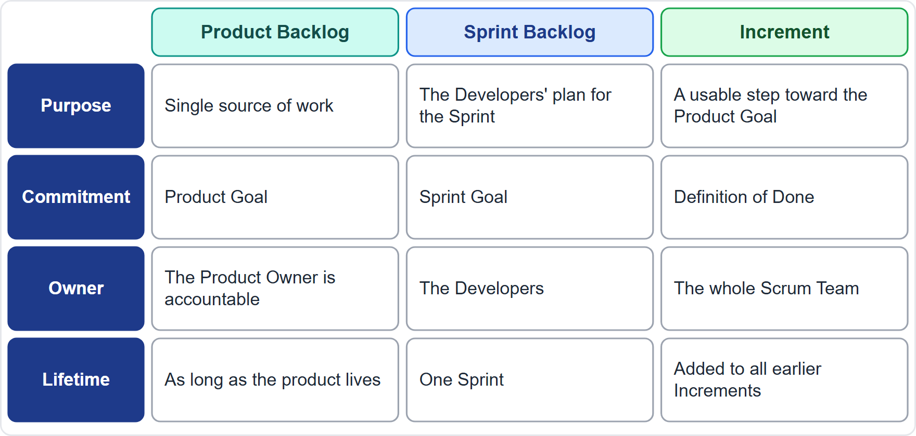
The Three Artifacts Compared
Module 10
Product Backlog: single source of work; Product Goal; the Product Owner
Sprint Backlog: the Developers' plan; Sprint Goal; one Sprint
Increment: a usable step; Definition of Done; the whole team
CSM Exam Prep Masterclass | Certified ScrumMaster
Module 10: Product Backlog, Product Goal and Refinement
14 / 22
Notes:
Compare the three artifacts. The Product Backlog is the single source of work, its commitment is the Product Goal, and the Product Owner is accountable for it. The Sprint Backlog is the Developers' plan for the Sprint, with the Sprint Goal, and lives for one Sprint. The Increment is a usable step toward the Product Goal, with the Definition of Done, and the whole Scrum Team is accountable for it.

Slide 15
Traps: What the Exam Expects
Module 10
Emergent and ordered, never complete up front
Single source of work; the Product Owner orders it, stakeholders convince
The Developers size; the Product Owner helps with trade-offs
Refinement: an activity, ongoing, no prescribed time
Ready: can be Done within one Sprint
One Product Goal at a time; user stories and story points are not required
EXAM TIP Old wording: estimate and the ten percent of capacity guideline. Grooming is an older name for refinement.
CSM Exam Prep Masterclass | Certified ScrumMaster
Module 10: Product Backlog, Product Goal and Refinement
15 / 22
Notes:
Here are the traps. The Product Backlog is emergent and ordered, never complete up front. It is the single source of work: the Product Owner orders it, and stakeholders convince. The Developers size, and the Product Owner helps with trade-offs. Refinement is an ongoing activity with no prescribed time. Ready means it can be Done within one Sprint. One Product Goal at a time. And user stories and story points are not required. Estimate and the ten percent guideline are old wording, and grooming is an older name for refinement.

Slide 16
Module Recap
Module 10
1
Product Backlog
2
Items
3
Ready
emergent, ordered, the single source of work
description, order, size; sized by the Developers
Done within one Sprint
4
Refinement
5
Product Goal
6
Commitments
ongoing; split, detail, size, order, clarify
one future state at a time
Product Goal, Sprint Goal, Definition of Done
CSM Exam Prep Masterclass | Certified ScrumMaster
Module 10: Product Backlog, Product Goal and Refinement
16 / 22
Notes:
Recap. The Product Backlog is emergent, ordered, and the single source of work. Items have a description, an order and a size, and the Developers size them. An item is ready when it can be Done within one Sprint. Refinement is ongoing: split, detail, size, order and clarify. The Product Goal is one future state at a time. And the commitments are Product Goal, Sprint Goal and Definition of Done. Now test yourself.

Slide 17
Practice Question 1
Module 10
Q1
The RideLoop Developers do all refinement in one session on the day before each Sprint and never during the Sprint. What does the Guide say?
A
Refinement is an ongoing activity, and the Product Backlog is refined as needed, also during the Sprint
B
Refinement is required to be a single session held on the day before each Sprint begins
C
Refinement may happen only in Sprint Planning, where the whole Scrum Team is present and can discuss items
D
Refinement is forbidden during the Sprint, because the Developers must not be disturbed while they work
CSM Exam Prep Masterclass | Certified ScrumMaster
Module 10: Product Backlog, Product Goal and Refinement
17 / 22
Notes:
Question one. The RideLoop Developers do all refinement in one session on the day before each Sprint and never during the Sprint. What does the Guide say? The four options are on the screen. Choose your answer. [PAUSE 12] The answer is A. The Product Backlog is refined whenever needed, including during the Sprint, and the team may also refine items in Sprint Planning. The Guide neither prescribes a refinement session nor limits when it happens.

Slide 18
Practice Question 2
Module 10
Q2
A contractor tells Maya that Scrum requires every Product Backlog item to be a user story sized in story points. What is the right answer?
A
The Guide requires user stories, because they describe the value of an item to its users best
B
The Guide requires story points, because they size items without using hours
C
The Scrum Master decides the format of the items, so that the Product Backlog looks consistent
D
The Guide requires neither, because the attributes of an item, such as description, order and size, vary with the domain
CSM Exam Prep Masterclass | Certified ScrumMaster
Module 10: Product Backlog, Product Goal and Refinement
18 / 22
Notes:
Question two. A contractor tells Maya that Scrum requires every Product Backlog item to be a user story sized in story points. What is the right answer? The four options are on the screen. Choose your answer. [PAUSE 12] The answer is D. The Guide names description, order and size, and says the attributes vary with the domain. It mentions neither user stories nor story points.

Slide 19
Practice Question 3
Module 10
Q3
In the middle of Sprint 9, a new city regulation creates an urgent item for RideLoop. What is the correct way to handle it?
A
Maya orders it in the Product Backlog and negotiates with the Developers whether it enters the Sprint
B
Grace adds it straight to the Sprint Backlog, because an urgent legal item overrides the Sprint's plan
C
The Developers drop an item at random and take the new one, since they know best what fits
D
The Scrum Master cancels the Sprint, as a new regulation always makes the Sprint Goal obsolete
CSM Exam Prep Masterclass | Certified ScrumMaster
Module 10: Product Backlog, Product Goal and Refinement
19 / 22
Notes:
Question three. In the middle of Sprint nine, a new city regulation creates an urgent item for RideLoop. What is the correct way to handle it? The four options are on the screen. Choose your answer. [PAUSE 12] The answer is A. The Product Owner orders it in the Product Backlog and negotiates with the Developers whether it enters the Sprint, without endangering the Sprint Goal. Cancelling is only for an obsolete Sprint Goal.

Slide 20
Practice Question 4
Module 10
Q4
Which pairing of artifacts and commitments is correct?
A
Product Backlog with the Definition of Done, Sprint Backlog with the Sprint Goal, Increment with the Product Goal
B
Product Backlog with the Sprint Goal, Sprint Backlog with the Product Goal, Increment with the Definition of Done
C
Product Backlog with the Product Goal, Sprint Backlog with the Definition of Done, Increment with the Sprint Goal
D
Product Backlog with the Product Goal, Sprint Backlog with the Sprint Goal, Increment with the Definition of Done
CSM Exam Prep Masterclass | Certified ScrumMaster
Module 10: Product Backlog, Product Goal and Refinement
20 / 22
Notes:
Question four. Which pairing of artifacts and commitments is correct? The four options are on the screen. Choose your answer. [PAUSE 12] The answer is D. The Product Backlog holds the Product Goal, the Sprint Backlog holds the Sprint Goal, and the Increment holds the Definition of Done. The other options each swap at least one pair.

Slide 21
Practice Question 5
Module 10
Q5
When is a Product Backlog item deemed ready for selection in Sprint Planning?
A
When the stakeholders have approved the item in writing before the Sprint starts
B
When the Developers have sized the item in story points at the refinement session
C
When the Scrum Team can get the item Done within one Sprint
D
When the item is placed at the very top of the Product Backlog by the Product Owner
CSM Exam Prep Masterclass | Certified ScrumMaster
Module 10: Product Backlog, Product Goal and Refinement
21 / 22
Notes:
Question five. When is a Product Backlog item deemed ready for selection in Sprint Planning? The four options are on the screen. Choose your answer. [PAUSE 12] The answer is C. When the Scrum Team can get the item Done within one Sprint. Items usually reach that point through refinement. Written approval, story points and position alone do not make an item ready.

Slide 22
Answers at a Glance
Module 10
Question | Answer | Why
Q1 | A | Refinement is ongoing, also during the Sprint
Q2 | D | The Guide requires neither user stories nor story points
Q3 | A | The Product Owner orders the Product Backlog and negotiates scope
Q4 | D | Product Goal, Sprint Goal, Definition of Done in that order
Q5 | C | Ready means it can be Done within one Sprint
CSM Exam Prep Masterclass | Certified ScrumMaster
Module 10: Product Backlog, Product Goal and Refinement
22 / 22
Notes:
Here are all five answers together. Question one: A. Refinement is ongoing. Question two: D. The Guide requires neither user stories nor story points. Question three: A. The Product Owner orders the Product Backlog and negotiates scope. Question four: D. Product Goal, Sprint Goal, Definition of Done. Question five: C. Ready means it can be Done within one Sprint. That completes Module 10. Next, Module 11 covers the Sprint Backlog and the Sprint Goal.

