Slide 1
Module 11: Sprint Backlog and Sprint Goal
The Developers' plan, and the goal that holds the Sprint together
Scrum Foundations 4.1, 4.4, 4.6, 4.7
Certified ScrumMaster (CSM) Exam Prep Masterclass
Module 11
Notes:
Welcome to Module 11: Sprint Backlog and Sprint Goal. In Module 7 you saw them created. Now we look at the artifact itself and its commitment. You will learn what the Sprint Backlog is made of, who owns it, what may change in a Sprint and what may not, and why the Sprint Goal stays fixed.

Slide 2
What You Will Learn
Module 11
State the purpose and attributes of the Sprint Backlog
Explain the Sprint Goal as its commitment
Show how the Sprint Backlog can change without endangering the goal
Give two reasons the Sprint Goal does not change
Tell the Sprint Goal from the Product Goal
Spot the traps: a frozen plan, a changing goal, a list of items
CSM Exam Prep Masterclass | Certified ScrumMaster
Module 11: Sprint Backlog and Sprint Goal
2 / 20
Notes:
By the end of this module you will be able to do six things. State the purpose and attributes of the Sprint Backlog. Explain the Sprint Goal as its commitment. Show how the Sprint Backlog can change without endangering the goal. Give two reasons the Sprint Goal does not change. Tell the Sprint Goal from the Product Goal. And spot the traps: a frozen plan, a changing goal, and a goal treated as a list of items.

Slide 3
Case Check-In: A Smaller Version
Module 11
CASE CHECK-IN · RideLoop
Sprint 9, day four: Wei finds that a smaller version of Unlock with a saved card would still meet the Sprint Goal
That would free room for the Fix the slow station map item
The board on the wall has not been updated since Monday
You wonder who may change what
CSM Exam Prep Masterclass | Certified ScrumMaster
Module 11: Sprint Backlog and Sprint Goal
3 / 20
Notes:
It is day four of Sprint nine at RideLoop. Wei finds that a smaller version of the item, Unlock with a saved card, would still meet the Sprint Goal. That would free room for the item, Fix the slow station map. At the same time, you notice that the board on the wall has not been updated since Monday. As Scrum Master, you wonder who may change what, and what must never change.

Slide 4
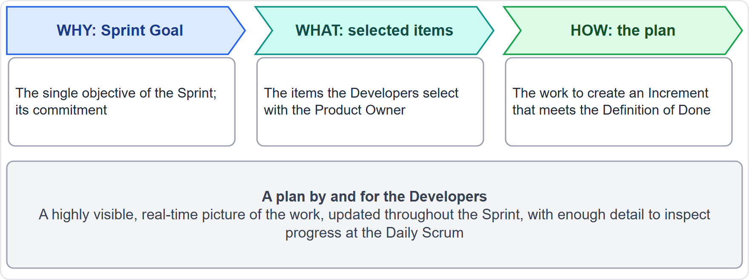
The Sprint Backlog
Module 11
Why: the Sprint Goal
What: the items chosen from the Product Backlog
How: an actionable plan for delivering the Increment
The Developers' own plan
EXAM TIP It is more than a task list: goal + items + plan.
CSM Exam Prep Masterclass | Certified ScrumMaster
Module 11: Sprint Backlog and Sprint Goal
4 / 20
Notes:
The Sprint Backlog has three parts. The Sprint Goal answers why. The items chosen from the Product Backlog answer what. And an actionable plan for delivering the Increment answers how. Together they are the Developers' own plan. So for the exam: the Sprint Backlog is more than a task list. It is the goal, plus the items, plus the plan. The diagram adds that everyone can see the work as it stands, because the plan is updated throughout the Sprint, in enough detail for the Daily Scrum.

Slide 5
Attributes of the Sprint Backlog
Module 11
Attribute | Meaning
The Developers' own | They own it and update it
Highly visible, real-time | A live picture of the work
Updated all through the Sprint | As the team learns
Enough detail | To inspect progress at the Daily Scrum
Three parts | Sprint Goal, selected items, plan
Made in Sprint Planning | Together they are the Sprint Backlog
EXAM TIP Name at least three. Old wording: forecast, and a required process improvement item.
CSM Exam Prep Masterclass | Certified ScrumMaster
Module 11: Sprint Backlog and Sprint Goal
5 / 20
Notes:
The learning objective asks for attributes. It is the Developers' own plan, and they update it. It shows the work as it stands, live and visible to everyone. It is updated all through the Sprint as the team learns. It has enough detail for the Developers to inspect progress at the Daily Scrum. It has three parts, the goal, the items and the plan, and together they are the Sprint Backlog. And it is made in Sprint Planning. The earlier edition called it a forecast, and required one process improvement item in it. That is why the RideLoop board, last updated on Monday, is a problem: a live, visible picture cannot be frozen.

Slide 6
The Sprint Goal
Module 11
"the single objective for the Sprint," a commitment by the Developers
Gives flexibility in the exact work
Creates coherence and focus: the team works together, not on separate initiatives
Created in Sprint Planning, final before it ends, then added to the Sprint Backlog
During the Sprint, the Developers keep it in mind
EXAM TIP It is a commitment of the Sprint Backlog, not of the Product Backlog.
CSM Exam Prep Masterclass | Certified ScrumMaster
Module 11: Sprint Backlog and Sprint Goal
6 / 20
Notes:
The Sprint Goal is "the single objective for the Sprint," and it is a commitment by the Developers. It gives flexibility in the exact work, and it creates coherence and focus, so the team works together rather than on separate initiatives. It is created in Sprint Planning, finalized before the event ends, and added to the Sprint Backlog. During the Sprint, the Developers keep it in mind. It is the commitment of the Sprint Backlog, not of the Product Backlog.

Slide 7
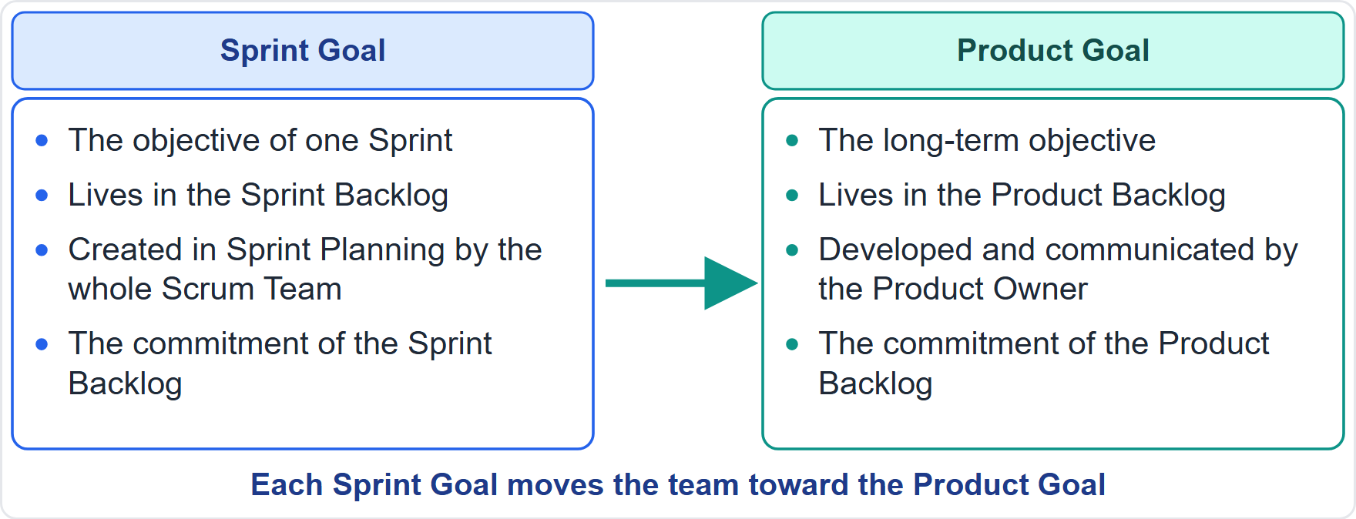
Sprint Goal and Product Goal
Module 11
Sprint Goal: one Sprint, in the Sprint Backlog, created in Planning
Product Goal: the long-term objective, in the Product Backlog
Each Sprint Goal moves the team toward the Product Goal
CSM Exam Prep Masterclass | Certified ScrumMaster
Module 11: Sprint Backlog and Sprint Goal
7 / 20
Notes:
Do not confuse the two goals. The Sprint Goal is the objective of one Sprint. It lives in the Sprint Backlog, and the whole Scrum Team creates it in Sprint Planning. The Product Goal is the team's long-range target. It lives in the Product Backlog, and the Product Owner develops and communicates it. Each Sprint Goal moves the team toward the Product Goal. One is the step; the other is the destination.

Slide 8
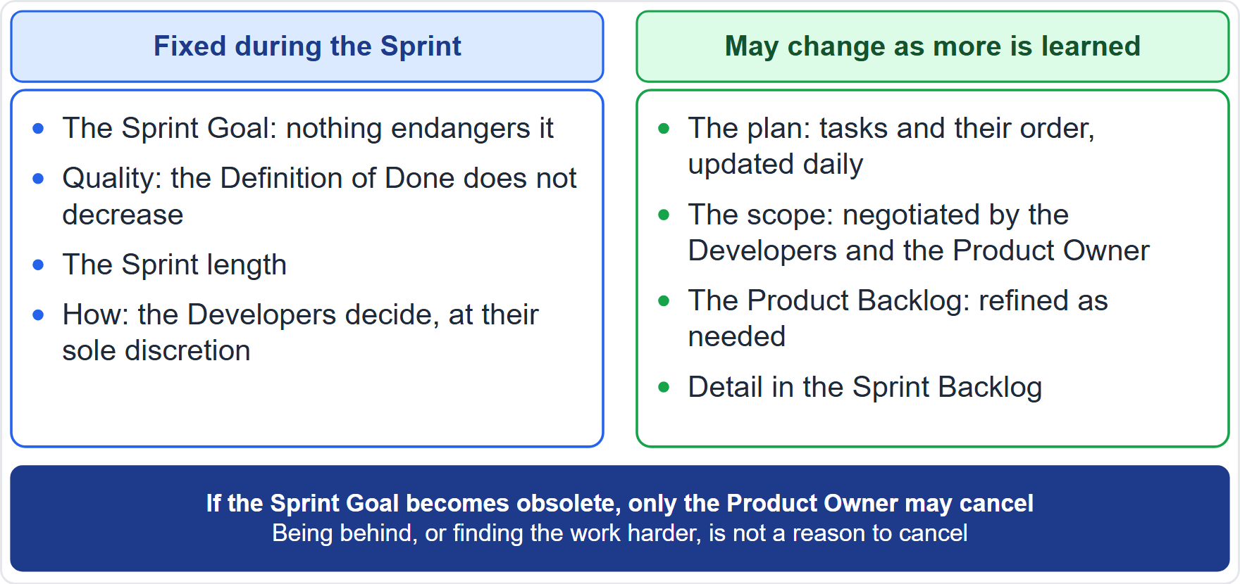
What May and May Not Change
Module 11
May change: the plan, the detail, the scope
May not change: the Sprint Goal, quality, the Sprint length
Scope is renegotiated with the Product Owner
The Developers still decide how
EXAM TIP The goal is fixed; the scope is flexible.
CSM Exam Prep Masterclass | Certified ScrumMaster
Module 11: Sprint Backlog and Sprint Goal
8 / 20
Notes:
What may change during a Sprint, and what may not? The plan may change, the detail may change, and the scope may change. The Sprint Goal may not change. Quality may not decrease, and the Sprint length stays fixed. Scope is renegotiated with the Product Owner, and the Developers still decide how the work is done. The simple version: the goal is fixed, and the scope is flexible.

Slide 9
Who May Change the Sprint Backlog
Module 11
Who | What they can do
The Developers | Own it; update the plan any time
The Product Owner | Negotiates scope with the Developers; does not add items directly
Stakeholders, managers | Influence the Product Backlog through the Product Owner
The Scrum Master | Helps both sides; does not change it
CSM Exam Prep Masterclass | Certified ScrumMaster
Module 11: Sprint Backlog and Sprint Goal
9 / 20
Notes:
Who may change the Sprint Backlog? The Developers own it, and update the plan at any time. The Product Owner negotiates scope with the Developers, but does not add items directly. Stakeholders and managers do not change it; they influence the Product Backlog through the Product Owner. And the Scrum Master helps both sides, but does not change the Sprint Backlog. So Wei and the team may swap in the smaller item, after talking with Maya.

Slide 10
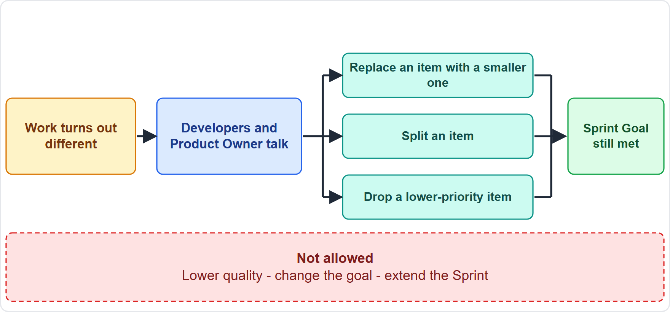
Negotiating Scope
BEYOND THE GUIDE
Module 11
The work turns out different from expected
The Developers and the Product Owner talk
Replace an item with a smaller one, split it, or drop a lower-priority item
Not allowed: lower quality, change the goal, extend the Sprint
CSM Exam Prep Masterclass | Certified ScrumMaster
Module 11: Sprint Backlog and Sprint Goal
10 / 20
Notes:
How is scope negotiated? This slide goes beyond the Guide with typical examples. The work turns out different from what was expected. The Developers and the Product Owner talk. They may replace an item with a smaller one, split an item, or drop a lower-priority item, as long as the Sprint Goal is still met. What is not allowed: lowering quality, changing the goal, or extending the Sprint.

Slide 11
Why the Sprint Goal Does Not Change
BEYOND THE GUIDE
Module 11
Reason | Why
It is a commitment | Changing it would empty the commitment of meaning
Focus and coherence | A stable goal keeps the team together
A stable target for inspection | The Daily Scrum and the Review inspect against a known goal
Predictability and trust | Stakeholders can rely on what the Sprint is for
Flexibility sits in the scope | The goal stays, so the scope can flex
Cancelling is the right response | If the goal is obsolete, the Product Owner cancels
EXAM TIP Give at least two.
CSM Exam Prep Masterclass | Certified ScrumMaster
Module 11: Sprint Backlog and Sprint Goal
11 / 20
Notes:
The learning objective asks for reasons why the Sprint Goal does not change. These go beyond the Guide. It is a commitment, and changing it would empty the commitment of meaning. It gives focus and coherence. It is a stable target for inspection at the Daily Scrum and the Review. It supports predictability and trust, because stakeholders can rely on what the Sprint is for. The flexibility sits in the scope, so the goal can stay. And if the goal is truly obsolete, the right response is to cancel, not to quietly change it.

Slide 12
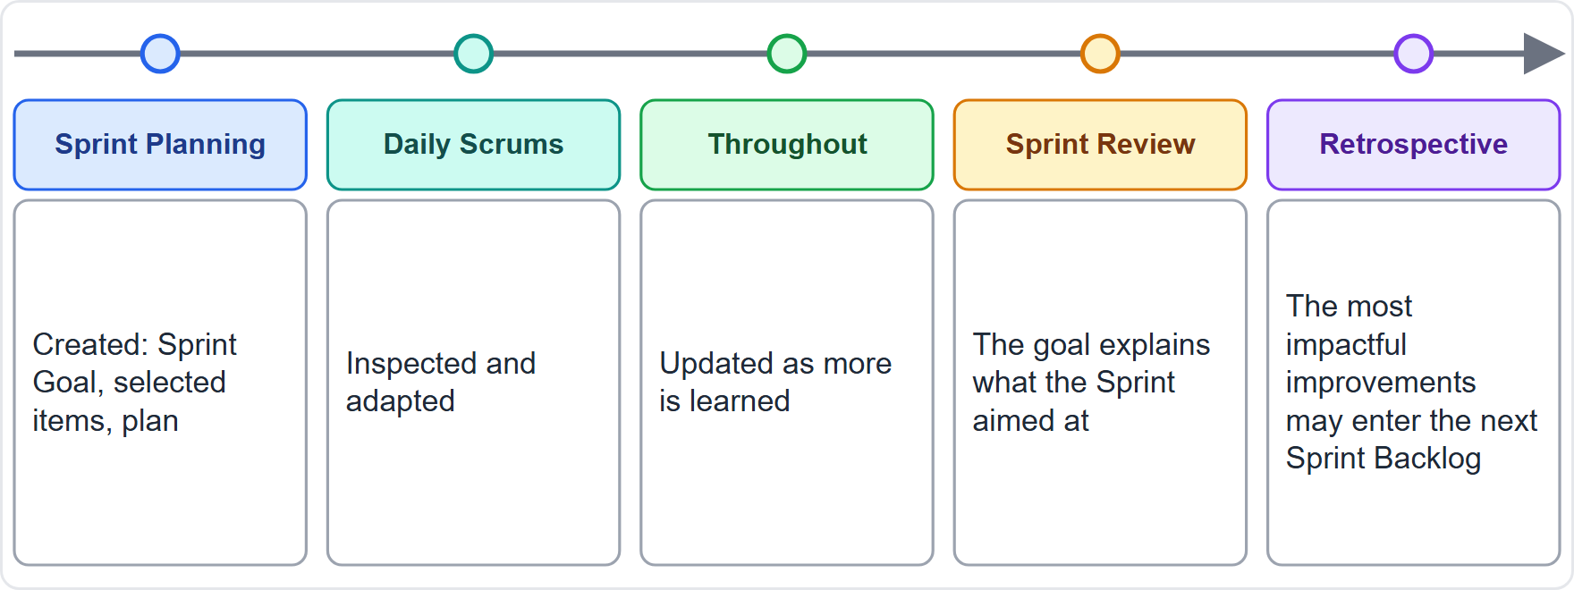
How the Sprint Backlog Is Used
Module 11
Planning: created
Daily Scrum: inspected and adapted
All Sprint: updated as the team learns
Review: the goal explains what the Sprint aimed at
Retrospective: top improvements may enter the next one
CSM Exam Prep Masterclass | Certified ScrumMaster
Module 11: Sprint Backlog and Sprint Goal
12 / 20
Notes:
Follow the Sprint Backlog through the Sprint. In Planning it is created. At the Daily Scrum it is inspected and adapted. All through the Sprint, it is updated as the team learns. At the Review, the Sprint Goal explains what the Sprint aimed at, while the Increment is shown. And at the Retrospective, the most impactful improvements may be added to the next Sprint Backlog.

Slide 13
Traps: What the Exam Expects
Module 11
Goal + items + plan, not only a task list
The Developers own it; nobody assigns or adds tasks
Updated throughout the Sprint, not frozen
The goal is fixed; scope is negotiated
Quality does not decrease to protect scope
An obsolete goal lets the Product Owner cancel; being behind does not
EXAM TIP The Sprint Goal is not a list of items. One missed item does not automatically miss the goal.
CSM Exam Prep Masterclass | Certified ScrumMaster
Module 11: Sprint Backlog and Sprint Goal
13 / 20
Notes:
Here are the traps. The Sprint Backlog is goal, items and plan, not only a task list. The Developers own it, and nobody assigns or adds tasks. It is updated throughout the Sprint, not frozen. The goal is fixed, and scope is negotiated. Quality does not decrease to protect scope. An obsolete goal lets the Product Owner cancel, while being behind does not. And the Sprint Goal is not a list of items: one missed item does not automatically miss the goal.

Slide 14
Module Recap
Module 11
1
Sprint Backlog
2
Sprint Goal
3
Changes
goal, items, plan; the Developers' own
one objective, a commitment
plan and scope yes; goal and quality no
4
Scope
5
Why fixed
6
Product Goal
negotiated with the Product Owner
commitment, focus, stable target
the long-term target above it
CSM Exam Prep Masterclass | Certified ScrumMaster
Module 11: Sprint Backlog and Sprint Goal
14 / 20
Notes:
Recap. The Sprint Backlog is the goal, the items and the plan, and it belongs to the Developers. The Sprint Goal is one objective, and a commitment. The plan and the scope may change; the goal and the quality may not. Scope is negotiated with the Product Owner. The goal stays fixed because it is a commitment that gives focus and a stable target. And the Product Goal is the long-term target above it.

Slide 15
Practice Question 1
Module 11
Q1
Midway through Sprint 9, Grace asks Maya to add a new, unrelated item to the Sprint Backlog. What should happen?
A
Maya adds it to the Sprint Backlog without telling the Developers, since the Product Owner is accountable for the value of the product and its order
B
Maya adds it to the Product Backlog, and negotiates with the Developers if it must enter, so that the Sprint Goal is protected
C
Grace adds it to the Sprint Backlog directly, because Grace is the main stakeholder and holds the budget for the work
D
You add it to the Sprint Backlog yourself, so that Grace is kept informed of the progress of the whole Sprint
CSM Exam Prep Masterclass | Certified ScrumMaster
Module 11: Sprint Backlog and Sprint Goal
15 / 20
Notes:
Question one. Midway through Sprint nine, Grace asks Maya to add a new, unrelated item to the Sprint Backlog. What should happen? The four options are on the screen. Choose your answer. [PAUSE 12] The answer is B. The Sprint Backlog is the Developers' plan. New work goes to the Product Backlog, and Maya negotiates with the Developers if it must enter this Sprint, without endangering the Sprint Goal. Nobody else adds items to the Sprint Backlog.

Slide 16
Practice Question 2
Module 11
Q2
On day four, Grace wants to change the Sprint Goal to a new priority, although the current goal is still valuable. What is the best answer?
A
Keep the Sprint Goal, because it is a commitment, and put the new priority in the Product Backlog
B
Change it, because the stakeholders pay for the product and finally decide what the Sprint Goal should be
C
Let the Developers change it, since they know best which goal they can reach before the Sprint ends
D
Extend the Sprint so that both the old and the new goal can be reached before the Sprint Review
CSM Exam Prep Masterclass | Certified ScrumMaster
Module 11: Sprint Backlog and Sprint Goal
16 / 20
Notes:
Question two. On day four, Grace wants to change the Sprint Goal to a new priority, although the current goal is still valuable. What is the best answer? The four options are on the screen. Choose your answer. [PAUSE 12] The answer is A. The Sprint Goal does not change during the Sprint. The new priority is a Product Backlog matter, and only the Product Owner could cancel a Sprint, and only if the goal were obsolete.

Slide 17
Practice Question 3
Module 11
Q3
The team treats the Sprint Goal as a list of items, and when one item fails it declares the Sprint a failure. What does the Guide suggest?
A
All items must be completed, otherwise the Sprint has failed and the team must explain this at the Sprint Review
B
The Sprint Goal is one objective that leaves flexibility in the work, so items may be adjusted
C
The Sprint Goal is optional, so one missed item has no effect on whether the Sprint succeeded
D
Maya may decide whether the Sprint succeeded, based on the number of items that were completed
CSM Exam Prep Masterclass | Certified ScrumMaster
Module 11: Sprint Backlog and Sprint Goal
17 / 20
Notes:
Question three. The team treats the Sprint Goal as a list of items, and when one item fails it declares the Sprint a failure. What does the Guide suggest? The four options are on the screen. Choose your answer. [PAUSE 12] The answer is B. The Sprint Goal is one objective for the Sprint, and it leaves flexibility in the exact work. The Developers and the Product Owner negotiate scope without affecting the goal.

Slide 18
Practice Question 4
Module 11
Q4
Which statement describes the Sprint Backlog?
A
It is the Developers' own plan, kept visible and updated all through the Sprint
B
It is owned by Maya and frozen at the end of Sprint Planning, so that nobody can change it
C
It is owned by the Scrum Master and reported to the stakeholders at the end of each day
D
It is the long-term list of everything that the product may ever need, in order
CSM Exam Prep Masterclass | Certified ScrumMaster
Module 11: Sprint Backlog and Sprint Goal
18 / 20
Notes:
Question four. Which statement describes the Sprint Backlog? The four options are on the screen. Choose your answer. [PAUSE 12] The answer is A. It is the Developers' own plan, kept visible and updated all through the Sprint. It is not owned by the Product Owner, it is not frozen, and the long-term list is the Product Backlog.

Slide 19
Practice Question 5
Module 11
Q5
Which is a reason why the Sprint Goal does not change during the Sprint?
A
It guarantees that every item planned for the Sprint will be finished on time
B
The stakeholders are not allowed to see the Sprint Backlog while the Sprint is running
C
The Product Owner has no authority over the scope of any work in the Sprint
D
It is a commitment that gives focus, and a stable target to inspect against
CSM Exam Prep Masterclass | Certified ScrumMaster
Module 11: Sprint Backlog and Sprint Goal
19 / 20
Notes:
Question five. Which is a reason why the Sprint Goal does not change during the Sprint? The four options are on the screen. Choose your answer. [PAUSE 12] The answer is D. It is a commitment that gives coherence and focus, and a stable target to inspect against, while the scope stays flexible. It does not guarantee that every item is finished.

Slide 20
Answers at a Glance
Module 11
Question | Answer | Why
Q1 | B | New work goes to the Product Backlog; scope is negotiated
Q2 | A | The Sprint Goal does not change; only the Product Owner may cancel
Q3 | B | The goal is one objective with flexible work
Q4 | A | The Developers' own plan, updated all Sprint
Q5 | D | A commitment, focus and a stable target
CSM Exam Prep Masterclass | Certified ScrumMaster
Module 11: Sprint Backlog and Sprint Goal
20 / 20
Notes:
Here are all five answers together. Question one: B. New work goes to the Product Backlog, and scope is negotiated. Question two: A. The Sprint Goal does not change. Question three: B. The goal is one objective with flexible work. Question four: A. The Developers' own plan. Question five: D. A commitment, focus, and a stable target. That completes Module 11. Next, Module 12 covers the Increment and the Definition of Done.

