Slide 1
Module 12: Increment and Definition of Done
What counts as Done, and who decides
Scrum Foundations 4.1, 4.5, 4.6, 4.8, 4.9 · CSM 1.15, 1.16
Certified ScrumMaster (CSM) Exam Prep Masterclass
Module 12
Notes:
Welcome to Module 12: Increment and Definition of Done. This completes the three artifacts. You will learn what an Increment is, how several can appear in one Sprint, what the Definition of Done commits the team to, and how to build and strengthen one. These ideas also protect you from the almost-done trap.

Slide 2
What You Will Learn
Module 12
State the purpose and attributes of the Increment
Explain how several Increments can arise in one Sprint
Explain the Definition of Done as the commitment of the Increment
Give three advantages of a strong one, and one way to create it
Explain how it evolves, and why teams on one product share it
Spot the traps: almost done, relaxing it, the Review as a gate
CSM Exam Prep Masterclass | Certified ScrumMaster
Module 12: Increment and Definition of Done
2 / 21
Notes:
By the end of this module you will be able to do six things. State the purpose and attributes of the Increment. Explain how several Increments can arise in one Sprint. Explain the Definition of Done as the commitment of the Increment. Give three advantages of a strong one, and one way to create it. Explain how it evolves, and why teams on one product share it. And spot the traps: almost done, relaxing it, and treating the Review as a gate.

Slide 3
Case Check-In: Defects at the Stations
Module 12
CASE CHECK-IN · RideLoop
Lena reports that defects keep reaching the test stations
The kiosk firmware tests are manual and are skipped when time is short
The team's Definition of Done has five lines and says nothing about them
You ask what Done should mean here
CSM Exam Prep Masterclass | Certified ScrumMaster
Module 12: Increment and Definition of Done
3 / 21
Notes:
At RideLoop, Lena reports that defects keep reaching the test stations. The kiosk firmware tests are manual, and they get skipped when time is short. The team's Definition of Done has five lines, and none of them mentions those tests. As Scrum Master, you ask what Done should really mean for this product. By the end of the module, you will have a method for answering that.

Slide 4
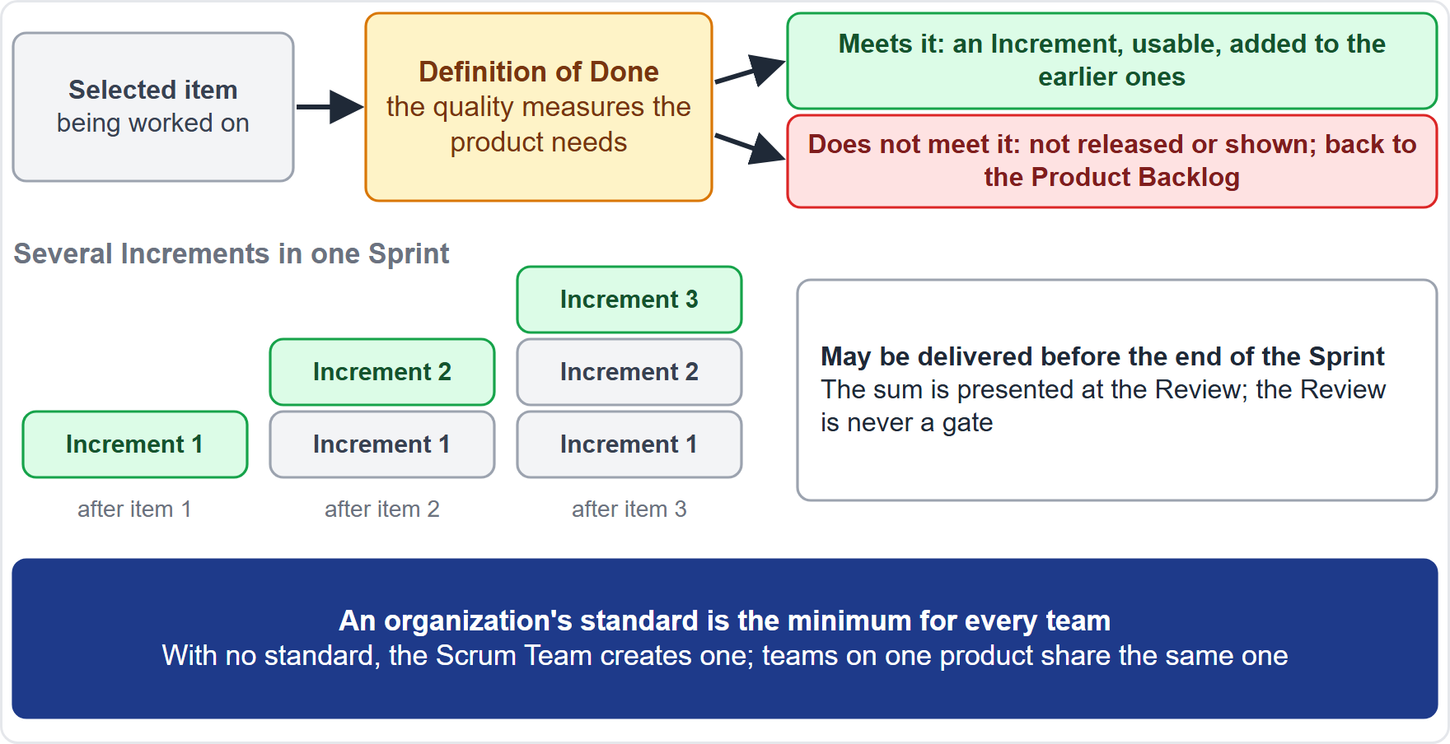
The Increment
Module 12
A usable step toward the Product Goal
Additive to all earlier Increments, and thoroughly verified
Born the moment an item meets the Definition of Done: "an Increment is born"
Items that miss it return to the Product Backlog
CSM Exam Prep Masterclass | Certified ScrumMaster
Module 12: Increment and Definition of Done
4 / 21
Notes:
An Increment is a usable step toward the Product Goal. It is additive to all earlier Increments, and it is thoroughly verified, so that all the Increments work together. The Guide puts the birth moment very simply: "The moment a Product Backlog item meets the Definition of Done, an Increment is born." An item that misses the Definition of Done does not become part of an Increment. It returns to the Product Backlog.

Slide 5
Attributes of an Increment
Module 12
Attribute | Meaning
A step toward the Product Goal | Each Increment moves the product closer
Additive | It adds to all earlier Increments
Thoroughly verified | Checked so that all Increments work together
Usable | It must be usable to provide value
Meets the Definition of Done | No Definition of Done met, no Increment
Inspectable | The sum is presented at the Sprint Review
EXAM TIP Name at least three.
CSM Exam Prep Masterclass | Certified ScrumMaster
Module 12: Increment and Definition of Done
5 / 21
Notes:
The learning objective asks for attributes of the Increment. It is a step toward the Product Goal. It is additive, building on every earlier Increment. It is thoroughly verified, checked so that all the Increments work together. It must be usable to provide value. It meets the Definition of Done: no Definition of Done met, no Increment. And it is inspectable, because the total of all the Increments is shown at the Sprint Review. Name any three.

Slide 6
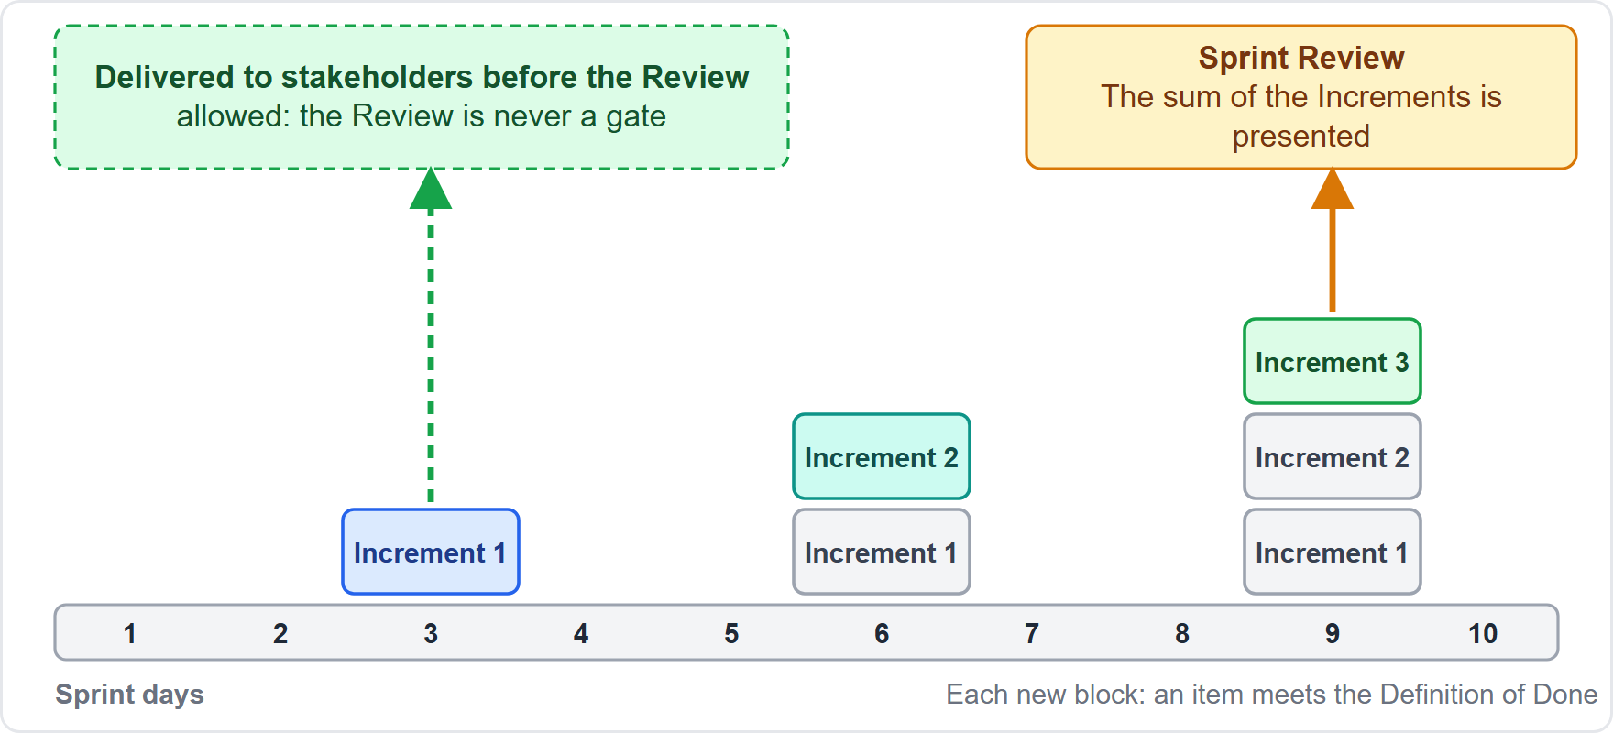
Several Increments in a Sprint
Module 12
Multiple Increments can arise in one Sprint, one for each Done item
The sum is presented at the Sprint Review
An Increment may be delivered earlier
The Review is never a gate to releasing value
EXAM TIP Old wording: potentially releasable, and a single Increment at the end.
CSM Exam Prep Masterclass | Certified ScrumMaster
Module 12: Increment and Definition of Done
6 / 21
Notes:
How many Increments can a Sprint produce? Several. Each time an item meets the Definition of Done, a new Increment exists and is added to the earlier ones. The total of them is shown at the Sprint Review. But an Increment may be delivered to stakeholders earlier than that. The Review is never a gate to releasing value. In the earlier edition, you will find potentially releasable, and a single Increment at the end of the Sprint.

Slide 7
The Definition of Done
Module 12
A formal description of the Increment's state when it meets the quality measures the product needs
It is the commitment of the Increment
It creates transparency: everyone shares an understanding of what was completed
An item that misses it is not released and not shown; it returns to the Product Backlog
EXAM TIP Almost done is not Done.
CSM Exam Prep Masterclass | Certified ScrumMaster
Module 12: Increment and Definition of Done
7 / 21
Notes:
The Definition of Done is the formal statement of the condition the Increment must reach, in terms of the quality measures the product needs. It is the commitment of the Increment. It creates transparency, because everyone shares an understanding of what was completed. And if an item misses it, the item cannot be released or even shown at the Review. It goes back to the Product Backlog. Almost done is not Done.

Slide 8
Whose Definition, and Which Standard
Module 12
Situation | Rule
The Developers | Required to conform to it
The organization has a standard | Every Scrum Team follows it as a minimum
No standard exists | The Scrum Team creates one that suits the product
Several teams, one product | They define and follow the same Definition of Done together
EXAM TIP The Scrum Master and the Product Owner do not relax it for a date.
CSM Exam Prep Masterclass | Certified ScrumMaster
Module 12: Increment and Definition of Done
8 / 21
Notes:
Whose is it, and which standard applies? The Developers are required to conform to it. If the organization has a standard, every Scrum Team follows it as a minimum, and may add to it. If no standard exists, the Scrum Team creates one that suits the product. And when several teams work on one product, they define and follow the same Definition of Done together. Neither the Scrum Master nor the Product Owner relaxes it to meet a date.

Slide 9
Advantages of a Strong Definition of Done
BEYOND THE GUIDE
Module 12
Advantage | Why
Shared understanding | Everyone knows what Done means
Built-in quality | Quality does not decrease
Less rework | Defects are caught before an item is Done
Less technical debt | Shortcuts are not accepted as Done
Better forecasts | The Developers know what each item takes
Release readiness | A usable Increment can go out at any time
Trust | Stakeholders can rely on what they see
EXAM TIP Name at least three.
CSM Exam Prep Masterclass | Certified ScrumMaster
Module 12: Increment and Definition of Done
9 / 21
Notes:
The learning objective asks for at least three advantages of a strong Definition of Done. These go beyond the Guide. A shared understanding of what Done means. Built-in quality, so quality does not decrease. Less rework, because defects are caught before an item is Done. Less technical debt, because shortcuts are not accepted as Done. Better forecasts, because the Developers know what each item takes. Release readiness: a usable Increment can go out at any time. And trust, because stakeholders can rely on what they see at the Review.

Slide 10
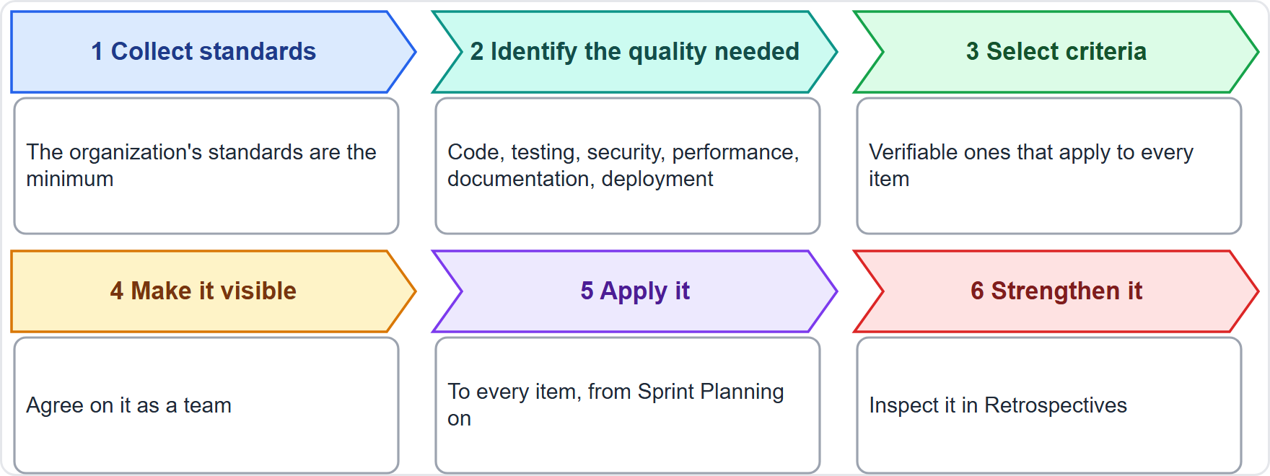
Creating a Definition of Done
BEYOND THE GUIDE
Module 12
Collect the organization's standards, the minimum
Identify the quality the product needs
Select criteria that are verifiable and apply to every item
Agree and make it visible
Apply it to every item; strengthen it in Retrospectives
EXAM TIP Give one way if asked; this is a good one.
CSM Exam Prep Masterclass | Certified ScrumMaster
Module 12: Increment and Definition of Done
10 / 21
Notes:
How do you create a Definition of Done? The Guide says who does it, but not how, so this method goes beyond the Guide. First, collect the organization's standards: that is the minimum. Second, identify the quality the product needs, such as testing, security and deployment. Third, select criteria that are verifiable and apply to every item. Fourth, agree on them and make them visible. Fifth, apply them to every item. Sixth, strengthen them in Retrospectives. If a question asks for one way, this is a good one to give.

Slide 11
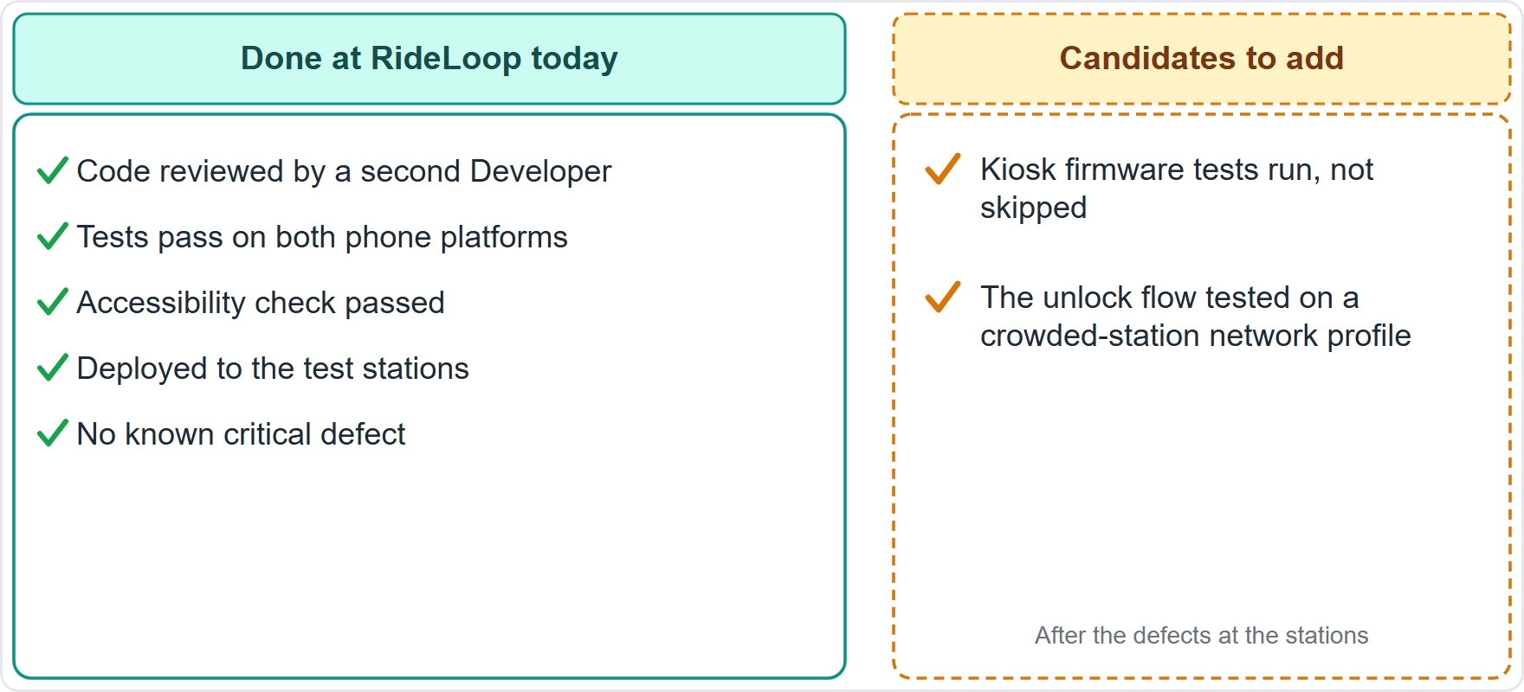
Example: The RideLoop Definition of Done
BEYOND THE GUIDE
Module 12
Today: reviewed, tests on both platforms, accessible, deployed to the test stations, no known critical defect
Candidates: kiosk firmware tests run, and the unlock flow tested on a crowded-station network profile
Each criterion is verifiable: yes or no
CSM Exam Prep Masterclass | Certified ScrumMaster
Module 12: Increment and Definition of Done
11 / 21
Notes:
Here is RideLoop's. It is an example from the case, not Guide text. Today it has five lines: code reviewed by a second Developer, tests passing on both phone platforms, an accessibility check, deployment to the test stations, and no known critical defect. After the defects at the stations, the team considers adding two candidates: the kiosk firmware tests are run, not skipped, and the unlock flow is tested on a crowded-station network profile. Notice that each criterion is a yes or no.

Slide 12
How a Definition of Done Evolves
BEYOND THE GUIDE
Module 12
A living agreement, strengthened over time, not relaxed
Triggers: Retrospective lessons, escaped defects, new tooling, new standards, a growing product
It can reveal work missing from items called Done earlier
The Retrospective inspects it; the team improves it
Old wording: the earlier edition expected definitions to expand as teams mature
EXAM TIP When defects escape, the answer is to strengthen it.
CSM Exam Prep Masterclass | Certified ScrumMaster
Module 12: Increment and Definition of Done
12 / 21
Notes:
How does a Definition of Done evolve? It is a living agreement. It is strengthened over time, not relaxed. The triggers are lessons from Retrospectives, defects that escaped, new tooling, new standards, and a growing product. A stronger definition can even reveal work missing from items that were called Done earlier. The earlier edition expected definitions to expand as teams mature. So when defects escape, the answer is to strengthen it. The Retrospective is where the team inspects it and improves it. The Guide mentions the Retrospective inspecting the Definition of Done, but says nothing about how it evolves, so this goes beyond it.

Slide 13
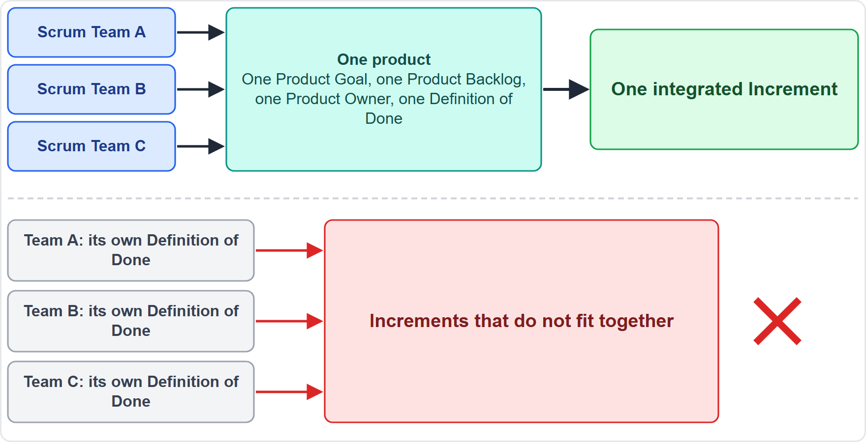
Several Teams, One Definition of Done
BEYOND THE GUIDE
Module 12
One integrated Increment: work to different standards does not fit together
Consistent quality across the product
Shared transparency for stakeholders
No hidden unfinished work from a weaker standard
EXAM TIP Give at least two reasons.
CSM Exam Prep Masterclass | Certified ScrumMaster
Module 12: Increment and Definition of Done
13 / 21
Notes:
Why do several Scrum Teams on one product share one Definition of Done? These reasons go beyond the Guide, and the objective asks for at least two. Different standards would not fit together, so the Increment would not be integrated. Quality stays consistent across the product. Stakeholders get shared transparency about what Done means. And a weaker standard in one team would hide unfinished work that surfaces later.

Slide 14
Traps: What the Exam Expects
Module 12
Done means the Definition of Done is met; almost done is not Done
Not met: not presented, not released, back to the Product Backlog
The Developers conform; nobody relaxes it to meet a date
Organizational standard first, as a minimum; otherwise the Scrum Team creates one
An Increment must be usable, and may be delivered before the Review
No hardening Sprint: quality is built into every item
EXAM TIP The Definition of Done is the commitment of the Increment, not of the Sprint Backlog.
CSM Exam Prep Masterclass | Certified ScrumMaster
Module 12: Increment and Definition of Done
14 / 21
Notes:
Here are the traps. Done means the Definition of Done is met; almost done is not Done. An item that does not meet it is not presented, not released, and goes back to the Product Backlog. The Developers conform, and nobody relaxes it to meet a date. The organization's standard comes first, as a minimum; otherwise the Scrum Team creates one. An Increment must be usable, and may be delivered before the Review. And there is no hardening Sprint: quality is built into every item.

Slide 15
Module Recap
Module 12
1
Increment
2
Born
3
Several
usable, additive, thoroughly verified
when an item meets the Definition of Done
per Sprint; the Review is not a gate
4
Definition of Done
5
Strong one
6
Evolves
the Increment's commitment; shared understanding
quality, less rework and debt, trust
stronger; shared by teams on one product
CSM Exam Prep Masterclass | Certified ScrumMaster
Module 12: Increment and Definition of Done
15 / 21
Notes:
Recap. An Increment is usable, additive, and thoroughly verified. It is born when an item meets the Definition of Done. Several can appear in one Sprint, and the Review is not a gate. The Definition of Done is the commitment of the Increment, and it gives a shared understanding. A strong one brings quality, less rework and less debt, and trust. It evolves stronger, and teams on one product share it. Now test yourself.

Slide 16
Practice Question 1
Module 12
Q1
A RideLoop Developer finishes an item on day three that meets the Definition of Done. Maya wants to wait until the Sprint Review to release it. What does the Guide say?
A
The Review must approve every release, so no Increment may go to users before the stakeholders accept it there
B
Items can be released only after the Retrospective, which confirms that the way of working was sound
C
An Increment may be delivered before the end of the Sprint; the Review is never a gate to releasing value
D
You must approve each release, because the Scrum Master is accountable for Scrum in the team
CSM Exam Prep Masterclass | Certified ScrumMaster
Module 12: Increment and Definition of Done
16 / 21
Notes:
Question one. A RideLoop Developer finishes an item on day three that meets the Definition of Done. Maya wants to wait until the Sprint Review to release it. What does the Guide say? The four options are on the screen. Choose your answer. [PAUSE 12] The answer is C. An Increment may be delivered before the end of the Sprint, and the Review is never a gate to releasing value. The Review is for inspection, not for permission.

Slide 17
Practice Question 2
Module 12
Q2
Lakeshore Transit has a security standard that all products must meet. The RideLoop team wants a weaker Definition of Done to move faster. What is the answer?
A
The team may ignore the standard for low-risk work if Maya agrees to the lower quality
B
Maya decides which parts of the standard apply, since the Product Owner is accountable for the value of the product
C
The team may follow the standard only in the last Sprint before release, when the risk is highest
D
The organization's standard is the minimum; the team may add criteria but may not weaken it
CSM Exam Prep Masterclass | Certified ScrumMaster
Module 12: Increment and Definition of Done
17 / 21
Notes:
Question two. Lakeshore Transit has a security standard that all products must meet. The RideLoop team wants a weaker Definition of Done to move faster. What is the answer? The four options are on the screen. Choose your answer. [PAUSE 12] The answer is D. When the Definition of Done is part of the organization's standards, every Scrum Team follows it as a minimum. A team may add criteria to suit its product, but may not weaken it.

Slide 18
Practice Question 3
Module 12
Q3
Three Scrum Teams work on one Lakeshore Transit product, each with its own Definition of Done, and integration problems appear every Sprint. What should the Scrum Master advise?
A
Let each team keep its own Definition of Done and add an integration phase at the end
B
Ask Maya to choose the strongest team's Definition of Done for the other two teams
C
The teams should agree one Definition of Done together, and all follow it
D
Add a hardening Sprint at the end of each month to fix the integration problems
CSM Exam Prep Masterclass | Certified ScrumMaster
Module 12: Increment and Definition of Done
18 / 21
Notes:
Question three. Three Scrum Teams work on one Lakeshore Transit product, each with its own Definition of Done, and integration problems appear every Sprint. What should the Scrum Master advise? The four options are on the screen. Choose your answer. [PAUSE 12] The answer is C. The teams should agree one Definition of Done together and all follow it, so that every Increment works together. A hardening Sprint is not part of Scrum.

Slide 19
Practice Question 4
Module 12
Q4
Which is an advantage of a strong Definition of Done?
A
It removes the need for Retrospectives, because quality is already checked for each item
B
It gives everyone a shared understanding of what is complete, so that quality is built into every item
C
It lets the Scrum Master approve each release, so that no Increment reaches users unchecked
D
It guarantees that Sprints become shorter, because there is no rework left to do
CSM Exam Prep Masterclass | Certified ScrumMaster
Module 12: Increment and Definition of Done
19 / 21
Notes:
Question four. Which is an advantage of a strong Definition of Done? The four options are on the screen. Choose your answer. [PAUSE 12] The answer is B. It gives everyone a shared understanding of what is complete and builds quality into every item. It does not remove the need for Retrospectives, and it adds no approval gate for the Scrum Master.

Slide 20
Practice Question 5
Module 12
Q5
Which is a sound way to create a Definition of Done?
A
Start from the organization's standards as the minimum, then select verifiable quality criteria for the product
B
Let Maya write it alone, then ask the Developers to sign it before the next Sprint starts
C
Copy another company's Definition of Done and keep it unchanged for the whole life of the product
D
Ask the stakeholders to write it, because they know best what quality they expect to see at the Review
CSM Exam Prep Masterclass | Certified ScrumMaster
Module 12: Increment and Definition of Done
20 / 21
Notes:
Question five. Which is a sound way to create a Definition of Done? The four options are on the screen. Choose your answer. [PAUSE 12] The answer is A. Start from the organization's standards as the minimum, then let the Scrum Team select verifiable criteria that suit the product. Make them visible, apply them to every item, and strengthen them in Retrospectives.

Slide 21
Answers at a Glance
Module 12
Question | Answer | Why
Q1 | C | An Increment may be delivered early; the Review is not a gate
Q2 | D | The organization's standard is the minimum
Q3 | C | Teams on one product share one Definition of Done
Q4 | B | Shared understanding and built-in quality
Q5 | A | Standards first, then verifiable criteria for the product
CSM Exam Prep Masterclass | Certified ScrumMaster
Module 12: Increment and Definition of Done
21 / 21
Notes:
Here are all five answers together. Question one: C. An Increment may be delivered early. Question two: D. The organization's standard is the minimum. Question three: C. Teams on one product share one Definition of Done. Question four: B. Shared understanding and built-in quality. Question five: A. Standards first, then verifiable criteria. That completes Module 12. Next, Module 13 covers facilitation, teaching, mentoring and coaching.

