Slide 1
Module 13: Facilitation, Teaching, Mentoring and Coaching
Four ways to help, and the tools to decide together
CSM 2.1 to 2.3
Certified ScrumMaster (CSM) Exam Prep Masterclass
Module 13
Notes:
Welcome to Module 13: Facilitation, Teaching, Mentoring and Coaching. Until now we studied the framework. This module is about the Scrum Master's skills. You will learn when a Scrum Master facilitates, which tools help a group decide, and how to tell four ways of helping apart. Most of the content goes beyond the Guide, but the learning objectives ask for it.

Slide 2
What You Will Learn
Module 13
Give three situations where the Scrum Master facilitates
Name three techniques for group decisions, and when to use each
Tell facilitating, teaching, mentoring and coaching apart
Ask the test question: who has the answer?
Spot the traps: deciding for the team, a coach who gives answers
CSM Exam Prep Masterclass | Certified ScrumMaster
Module 13: Facilitation, Teaching, Mentoring and Coaching
2 / 22
Notes:
By the end of this module you will be able to do five things. Give three situations where the Scrum Master facilitates. Name three techniques for group decisions, and when to use each. Tell facilitating, teaching, mentoring and coaching apart. Ask the test question: who has the answer? And spot the traps: deciding for the team, and a coach who gives answers.

Slide 3
Case Check-In: Who Talks, Who Decides
Module 13
CASE CHECK-IN · RideLoop
In Retrospectives Ben talks most; Jonas and Sofia rarely speak
Decisions drag on, or are taken by whoever speaks last and loudest
You wonder which stance each moment needs
Which technique gives everyone a voice?
CSM Exam Prep Masterclass | Certified ScrumMaster
Module 13: Facilitation, Teaching, Mentoring and Coaching
3 / 22
Notes:
At RideLoop, a pattern shows in the Retrospectives. Ben talks the most, while Jonas and Sofia rarely speak. Decisions drag on, or they are taken by whoever speaks last and loudest. You are the Scrum Master, and you wonder which stance each moment needs. You also wonder which technique would give everyone a voice. Keep both questions in mind as we go.

Slide 4
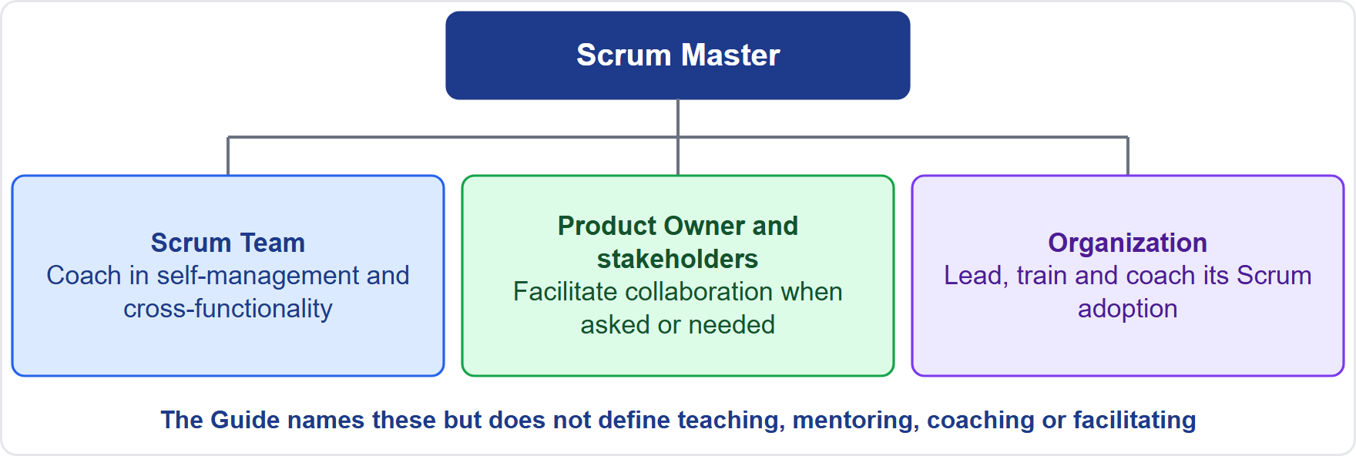
What the Guide Says
Module 13
Coach the team in self-management and cross-functionality
Facilitate stakeholder collaboration when asked or needed
Lead, train and coach the organization as it adopts Scrum
The Guide does not define the four stances; the learning objectives do
Old wording: the earlier edition had the Scrum Master facilitating events as requested or needed
EXAM TIP Today the Scrum Master ensures events happen and are worthwhile; facilitation is a skill, not a duty to run every event.
CSM Exam Prep Masterclass | Certified ScrumMaster
Module 13: Facilitation, Teaching, Mentoring and Coaching
4 / 22
Notes:
First, what the Guide says. The Scrum Master coaches the team in self-management and cross-functionality. The Scrum Master facilitates stakeholder collaboration when asked or needed. And the Scrum Master leads, trains and coaches the organization as it adopts Scrum. But the Guide does not define the stances. The learning objectives do. In the earlier edition, the Scrum Master facilitated events as requested; today the Scrum Master ensures they happen and are worthwhile.

Slide 5
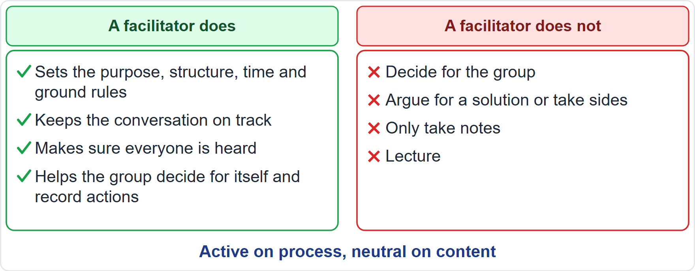
Facilitation
BEYOND THE GUIDE
Module 13
Helps a group understand its shared aim and plan how to reach it
Active on process: purpose, structure, time, ground rules, everyone heard
Neutral on content: no side-taking
Not only for events; anywhere a group needs to work together
EXAM TIP A Scrum Master who decides for the team or argues for an option is not facilitating.
CSM Exam Prep Masterclass | Certified ScrumMaster
Module 13: Facilitation, Teaching, Mentoring and Coaching
5 / 22
Notes:
Facilitation means helping a group understand its shared aim and plan how to reach it. The facilitator is active on the process: purpose, structure, time, ground rules, and making sure everyone is heard. And neutral on the content: no side-taking. It is not only for events; it applies anywhere a group needs to work together. A Scrum Master who decides for the team, or argues for one option, is not facilitating. The Guide mentions facilitating once, for stakeholder collaboration, and never defines it, so this definition goes beyond it.

Slide 6
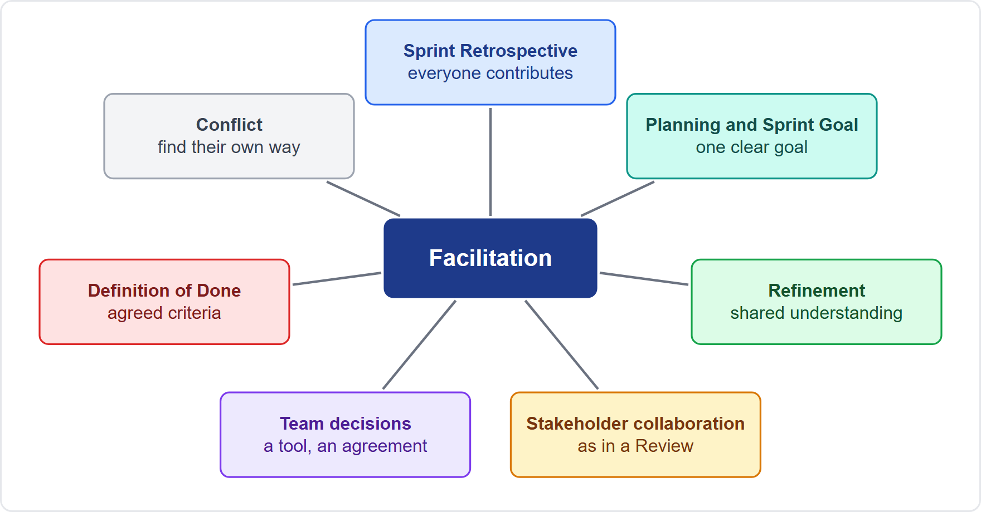
Where the Scrum Master Facilitates
BEYOND THE GUIDE
Module 13
Sprint Retrospective: everyone contributes
Planning and the Sprint Goal: one clear goal
Refinement: shared understanding
Stakeholder collaboration: as in a Review
Team decisions: a tool, a working agreement
Definition of Done: agreed criteria
Conflict: people find their own way
EXAM TIP Name at least three.
CSM Exam Prep Masterclass | Certified ScrumMaster
Module 13: Facilitation, Teaching, Mentoring and Coaching
6 / 22
Notes:
The learning objective asks for at least three situations. In the Retrospective, everyone contributes and the team reaches concrete improvements. In Sprint Planning, the Scrum Master helps the team agree one clear Sprint Goal. In refinement, a shared understanding of items. In stakeholder collaboration, as in a Review. In team decisions, like choosing a tool. In agreeing the Definition of Done. And in conflict, where people find their own way forward. The Guide does not list these situations; the list goes beyond it.

Slide 7
Decision Techniques (1)
BEYOND THE GUIDE
Module 13
Technique | How it works | Best for
Dot voting | Each person places the same number of dots on preferred options | Choosing several options from a longer list
Roman voting | Thumb up, sideways or down | A quick check on one proposal
Fist of Five | From a closed fist (block) to five fingers (full support); agree the required level first | The strength of support for a proposal
EXAM TIP In a Fist of Five, those below the agreed level state concerns, the proposal is adapted, then the group votes again.
CSM Exam Prep Masterclass | Certified ScrumMaster
Module 13: Facilitation, Teaching, Mentoring and Coaching
7 / 22
Notes:
Three techniques for group decisions; they go beyond the Guide. Dot voting: each person places the same number of dots on the options they prefer, which is ideal for choosing several options from a longer list. Roman voting: a thumb up, sideways or down, for a quick check on one proposal. Fist of Five: from a closed fist, which means block, to five fingers, full support, to see how strong the support is. Agree the required level first. Those below it state their concerns, the proposal is adapted, and the group votes again.

Slide 8
Decision Techniques (2)
BEYOND THE GUIDE
Module 13
Technique | How it works | Best for
1-2-4-All | Think alone, then in pairs, then in fours, then share with all | Hard topics, or a group far from agreement
Consensus | Seek agreement everyone can live with; set the level beforehand | Decisions everyone must support in practice
Majority vote | More than half wins | Small, low-impact choices
EXAM TIP Consensus is slow, and a majority vote can leave a minority disengaged.
CSM Exam Prep Masterclass | Certified ScrumMaster
Module 13: Facilitation, Teaching, Mentoring and Coaching
8 / 22
Notes:
Three more, also beyond the Guide. One-two-four-all: each person thinks alone, then in pairs, then in fours, and then the groups share with everyone. It suits hard topics, or a group far from agreement. Consensus: the group seeks agreement that everyone can live with, with the level set beforehand. It suits decisions everyone must support in practice, but it is slow. Majority vote: more than half wins, for small, low-impact choices, though a minority may disengage.

Slide 9
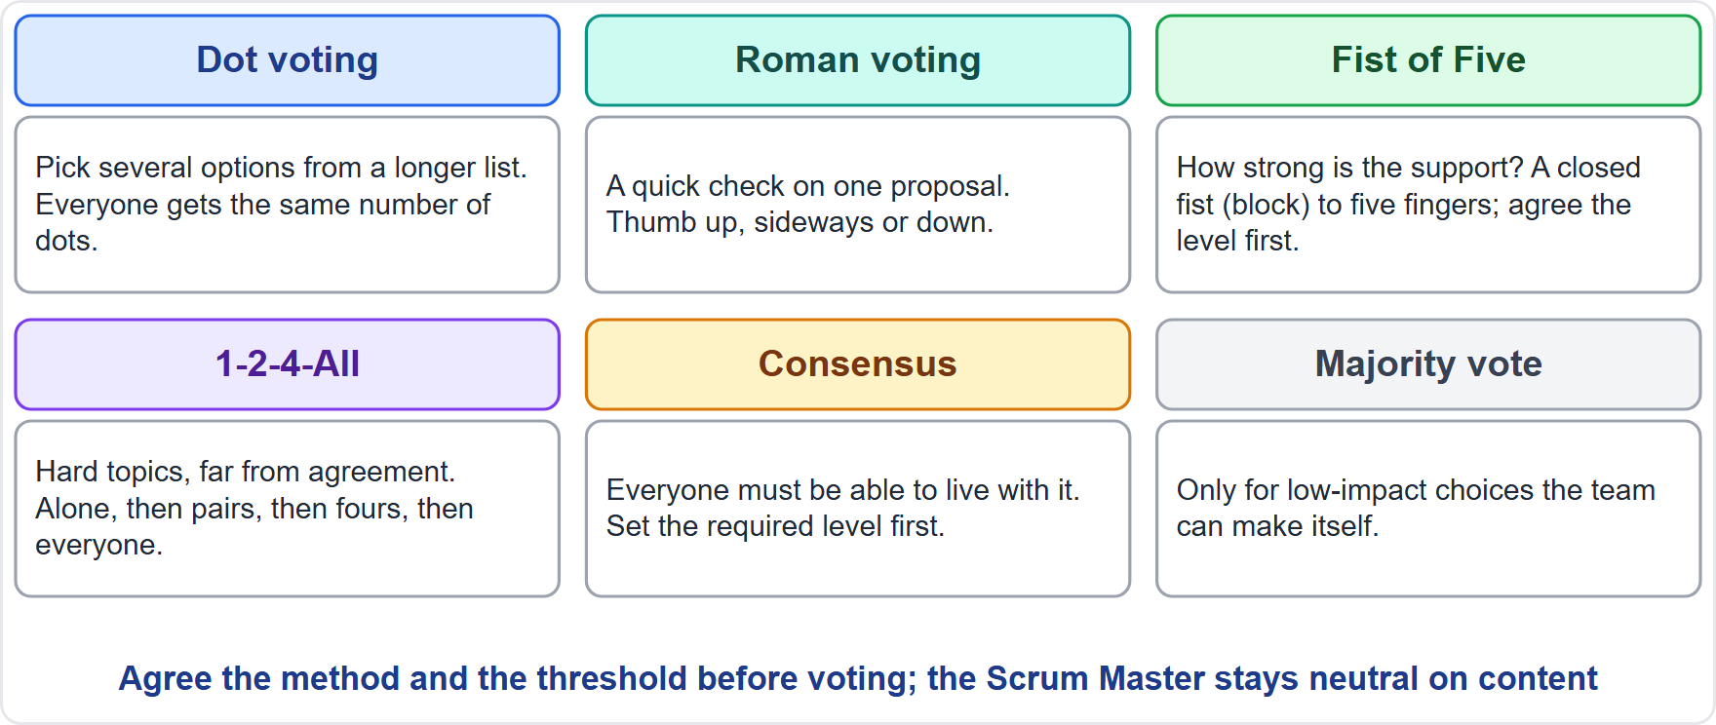
Choosing a Technique
Module 13
Several items from a list: dot voting
A quick yes or no: Roman voting
How strong is the support: Fist of Five
A hard topic: 1-2-4-All, then a vote
Everyone must live with it: consensus
A small choice: majority vote
At RideLoop: 1-2-4-All gives Jonas and Sofia a real chance to speak before the group decides
CSM Exam Prep Masterclass | Certified ScrumMaster
Module 13: Facilitation, Teaching, Mentoring and Coaching
9 / 22
Notes:
Match the technique to the need. Several items from a list: dot voting. A quick yes or no: Roman voting. How strong is the support: Fist of Five. A hard topic: one-two-four-all, then a vote. Everyone must live with the result: consensus. A small choice: majority vote. For Ben, Jonas and Sofia, one-two-four-all would give the quieter voices a real chance to contribute before the group decides.

Slide 10
Principles for Any Technique
BEYOND THE GUIDE
Module 13
Agree the method and the threshold before voting
Make sure everyone understands the proposal
Use techniques for the team's own decisions
The Product Owner still orders the Product Backlog; the Developers still decide how
A decision is only the start: record it, assign actions, check later
EXAM TIP Techniques do not move accountability.
CSM Exam Prep Masterclass | Certified ScrumMaster
Module 13: Facilitation, Teaching, Mentoring and Coaching
10 / 22
Notes:
A few principles apply to any technique; they come from practice, not the Guide. Agree the method and the threshold before voting. Make sure everyone understands the proposal. Use techniques for the team's own decisions: the Product Owner still orders the Product Backlog, and the Developers still decide how to build. And remember that a decision is only the start. Record it, assign actions, and check later. Techniques never move accountability.

Slide 11
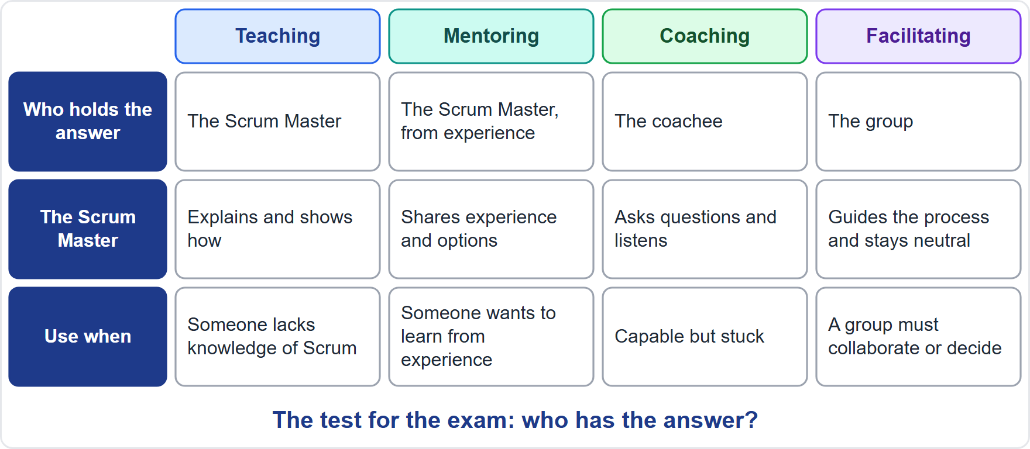
Four Stances
BEYOND THE GUIDE
Module 13
Teaching and mentoring: the Scrum Master holds the knowledge or experience and shares it
Coaching: the coachee holds the answer; the Scrum Master asks
Facilitating: the group holds the answer; the Scrum Master guides the process
EXAM TIP The test is: who has the answer?
CSM Exam Prep Masterclass | Certified ScrumMaster
Module 13: Facilitation, Teaching, Mentoring and Coaching
11 / 22
Notes:
Now the four stances. The Guide does not define them, so this slide goes beyond the Guide. One question tells them apart: who has the answer? In teaching and mentoring, the Scrum Master holds the knowledge or the experience, and shares it. In coaching, the coachee holds the answer, and the Scrum Master asks questions. In facilitating, the group holds the answer, and the Scrum Master guides the process. Ask that question in every scenario, and the stance becomes clear.

Slide 12
Teaching and Mentoring
BEYOND THE GUIDE
Module 13
 | Teaching | Mentoring
What it is | Helping others learn new things: sharing knowledge or skills | A trusted counselor sharing experience
Answer held by | The Scrum Master | The Scrum Master, from experience
Direction | Telling and showing | Sharing and advising
Needs expertise? | Yes | Yes, in depth
Example | Explaining the Sprint rules to a new Developer | Sharing how you split large items with a new Product Owner
CSM Exam Prep Masterclass | Certified ScrumMaster
Module 13: Facilitation, Teaching, Mentoring and Coaching
12 / 22
Notes:
Teaching is helping others learn new things, by sharing knowledge or skills. The Scrum Master holds the answer and uses telling and showing, such as explaining the Sprint rules to a new Developer. Mentoring is being a trusted counselor who shares experience. It also means sharing and advising, but it needs real experience in depth, such as sharing how you split large items with a new Product Owner. The Guide mentions coaching but not teaching or mentoring, so these definitions go beyond it.

Slide 13
Coaching and Facilitating
BEYOND THE GUIDE
Module 13
 | Coaching | Facilitating
What it is | Unlocking potential: helping people learn and find their own answers | Helping a group reach its aim while neutral on content
Answer held by | The coachee | The group
Direction | Asking and drawing out | Guiding the process
Needs expertise? | Not necessarily | No; neutral on content
Example | Helping a Developer find their own way to give feedback | Running a Retrospective or a decision session
CSM Exam Prep Masterclass | Certified ScrumMaster
Module 13: Facilitation, Teaching, Mentoring and Coaching
13 / 22
Notes:
Coaching is unlocking potential by helping people learn and find their own answers. The coachee holds the answer, and the Scrum Master asks and draws out. The coach does not necessarily need expertise in the subject. Facilitating is helping a group reach its aim while staying neutral on content. The group holds the answer, and the Scrum Master guides the process, as in a Retrospective or a decision session. The Guide mentions coaching but does not define it, and these definitions go beyond it.

Slide 14
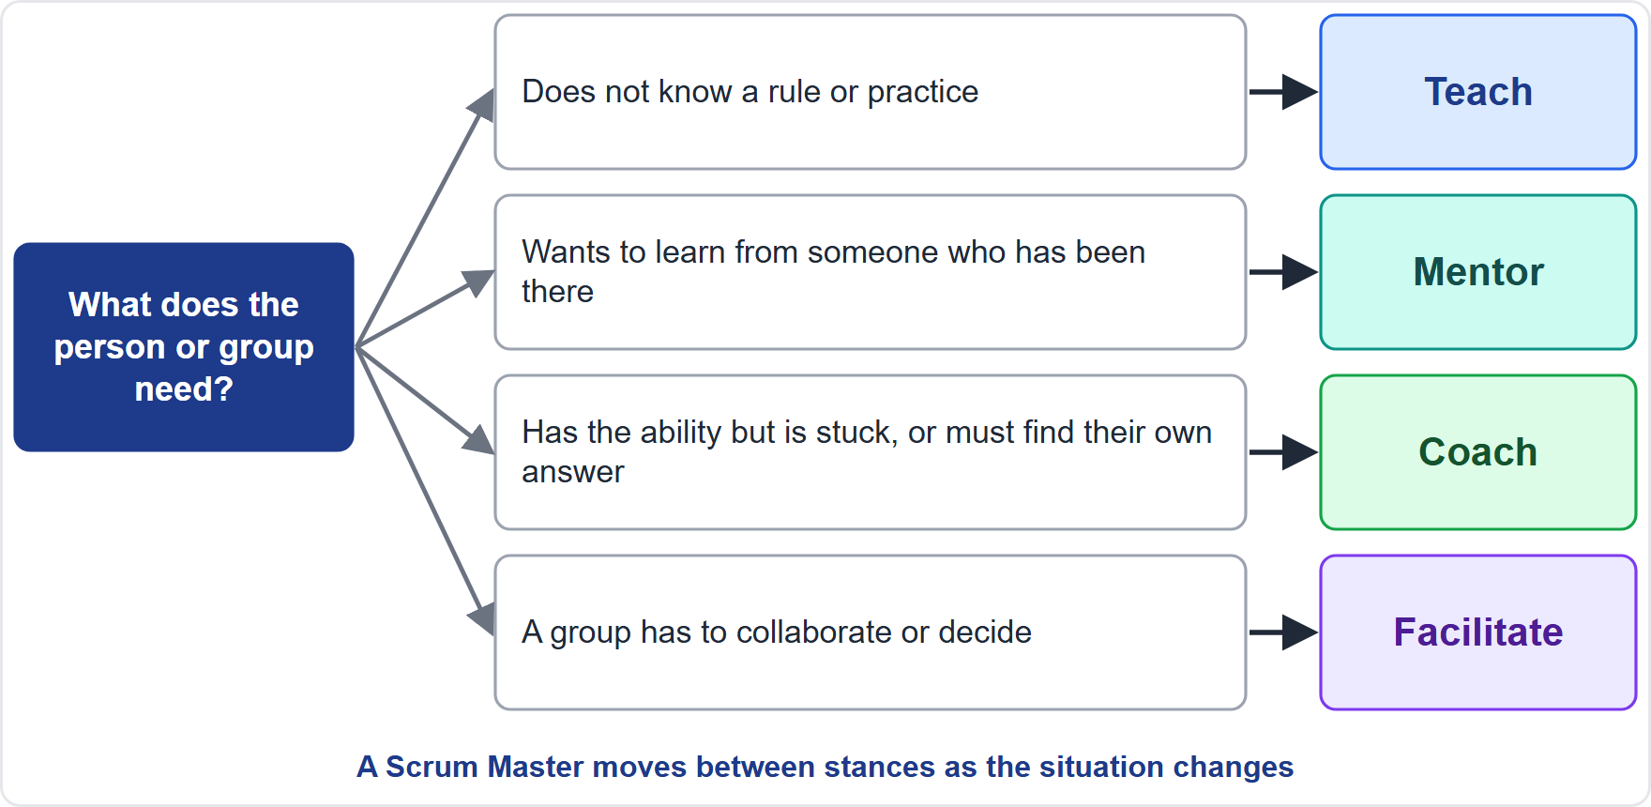
Which Stance Fits?
BEYOND THE GUIDE
Module 13
Lacks knowledge of Scrum: teach
Wants to learn from experience: mentor
Has the ability but is stuck: coach
A group must decide or collaborate: facilitate
EXAM TIP Coaching is the default for self-management.
CSM Exam Prep Masterclass | Certified ScrumMaster
Module 13: Facilitation, Teaching, Mentoring and Coaching
14 / 22
Notes:
Which stance fits which situation? When the person lacks knowledge of Scrum, teach. When someone wants to learn from a person who has been there, mentor. When a person has the ability but is stuck, or must find their own answer, coach. When a group has to collaborate or decide, facilitate. A Scrum Master moves between these as the situation changes. Coaching is the default for self-management. Choosing between the four stances is practice that goes beyond the Guide.

Slide 15
Traps: What the Exam Expects
Module 13
Facilitation is neutral; note-taking and scheduling are not facilitation
Coaching does not give the answer; it asks
Teaching fits a lack of Scrum knowledge
Mentoring needs real experience
Match the technique to the need; agree the threshold first
Deciding for the team to save time is a typical wrong answer
EXAM TIP Techniques never move accountability.
CSM Exam Prep Masterclass | Certified ScrumMaster
Module 13: Facilitation, Teaching, Mentoring and Coaching
15 / 22
Notes:
Here are the traps. Facilitation is neutral, and taking notes or scheduling is not facilitation. Coaching does not give the answer; it asks. Teaching fits a lack of Scrum knowledge. Mentoring needs real experience. Match the technique to the need, and agree the threshold first. And deciding for the team to save time is a typical wrong answer. The best answer helps the team decide, and techniques never move accountability.

Slide 16
Module Recap
Module 13
1
Facilitating
2
Techniques
3
Teaching and mentoring
neutral on content, active on process
dot voting, Roman voting, Fist of Five, 1-2-4-All, consensus, majority
the Scrum Master shares
4
Coaching
5
Test
6
Accountability
the coachee answers
who has the answer?
stays where the Guide puts it
CSM Exam Prep Masterclass | Certified ScrumMaster
Module 13: Facilitation, Teaching, Mentoring and Coaching
16 / 22
Notes:
Recap. Facilitating is neutral on content and active on process. The decision techniques are dot voting, Roman voting, Fist of Five, one-two-four-all, consensus and majority vote. Teaching and mentoring are where the Scrum Master shares. Coaching is where the coachee answers. The test is: who has the answer? And accountability stays where the Guide puts it. Now test yourself.

Slide 17
Practice Question 1
Module 13
Q1
The RideLoop Developers cannot decide between two test tools and the discussion has gone in circles. What should the Scrum Master do?
A
Choose the tool and tell the team, since a quick decision by the Scrum Master saves everyone's time
B
Ask Maya to choose the tool, since the Product Owner is accountable for the value and the budget of the product
C
Postpone the decision to the next Sprint, when the Developers may have more information about both tools
D
Facilitate a technique such as Fist of Five with an agreed level of support, so that the Developers decide
CSM Exam Prep Masterclass | Certified ScrumMaster
Module 13: Facilitation, Teaching, Mentoring and Coaching
17 / 22
Notes:
Question one. The RideLoop Developers cannot decide between two test tools and the discussion has gone in circles. What should the Scrum Master do? The four options are on the screen. Choose your answer. [PAUSE 12] The answer is D. The Scrum Master facilitates a technique such as Fist of Five with an agreed level of support, so that the Developers decide. Neither the Scrum Master nor the Product Owner chooses for them.

Slide 18
Practice Question 2
Module 13
Q2
Hana, a new Product Owner on another Lakeshore Transit team, asks you, an experienced Scrum Master, how stakeholder conflicts were handled before. Which stance are you taking by sharing your experience and options?
A
Coaching, because you are helping Hana reflect on the situation
B
Facilitating, because you are guiding a group conversation about the conflict
C
Mentoring, because you are sharing experience and possible answers
D
Teaching, because you are explaining what the Guide says about stakeholders
CSM Exam Prep Masterclass | Certified ScrumMaster
Module 13: Facilitation, Teaching, Mentoring and Coaching
18 / 22
Notes:
Question two. Hana, a new Product Owner on another Lakeshore Transit team, asks you, an experienced Scrum Master, how stakeholder conflicts were handled before. Which stance are you taking by sharing your experience and options? The four options are on the screen. Choose your answer. [PAUSE 12] The answer is C, mentoring. Coaching would draw the answer out of Hana, and facilitating would structure a group conversation.

Slide 19
Practice Question 3
Module 13
Q3
Ben says that arguments with a teammate keep happening and that Ben does not know what to do. You want Ben to find a way forward. Which approach is best?
A
Tell Ben exactly what to say and do in the next argument, so that the conflict stops quickly
B
Coach Ben: ask what has been tried, what outcome is wanted and which options exist
C
Move Ben to another team, so that the two people no longer have to work together every day
D
Ignore it until the Retrospective, as conflicts between team members usually solve themselves over time
CSM Exam Prep Masterclass | Certified ScrumMaster
Module 13: Facilitation, Teaching, Mentoring and Coaching
19 / 22
Notes:
Question three. Ben says that arguments with a teammate keep happening and that Ben does not know what to do. You want Ben to find a way forward. Which approach is best? The four options are on the screen. Choose your answer. [PAUSE 12] The answer is B. Coach Ben: ask what has been tried, what outcome is wanted, and which options exist. Telling Ben, moving Ben, or waiting does not build Ben's own capability.

Slide 20
Practice Question 4
Module 13
Q4
Which list contains only techniques for group decision making?
A
Dot voting, Roman voting, Fist of Five and 1-2-4-All
B
Dot voting, the Daily Scrum, Fist of Five and consensus
C
Roman voting, the Sprint Review, majority vote and 1-2-4-All
D
Fist of Five, the Product Backlog, consensus and dot voting
CSM Exam Prep Masterclass | Certified ScrumMaster
Module 13: Facilitation, Teaching, Mentoring and Coaching
20 / 22
Notes:
Question four. Which list contains only techniques for group decision making? The four options are on the screen. Choose your answer. [PAUSE 12] The answer is A: dot voting, Roman voting, Fist of Five and one-two-four-all. The Daily Scrum, the Sprint Review and the Product Backlog are Scrum events and artifacts, not decision techniques.

Slide 21
Practice Question 5
Module 13
Q5
Who holds the answer when the Scrum Master is coaching?
A
The Scrum Master, who has the most experience of Scrum in the organization
B
The whole group, which decides while the Scrum Master helps by guiding the process
C
Maya, who is accountable for the value of the product
D
The coachee, whom the Scrum Master helps through questions
CSM Exam Prep Masterclass | Certified ScrumMaster
Module 13: Facilitation, Teaching, Mentoring and Coaching
21 / 22
Notes:
Question five. Who holds the answer when the Scrum Master is coaching? The four options are on the screen. Choose your answer. [PAUSE 12] The answer is D, the coachee. The Scrum Master draws the answer out with questions. In teaching and mentoring the Scrum Master holds the knowledge, and in facilitating the group holds the answer.

Slide 22
Answers at a Glance
Module 13
Question | Answer | Why
Q1 | D | Facilitate a technique; the Developers decide
Q2 | C | Sharing experience and options is mentoring
Q3 | B | Coaching draws out the person's own answer
Q4 | A | Dot voting, Roman voting, Fist of Five, 1-2-4-All
Q5 | D | In coaching, the coachee holds the answer
CSM Exam Prep Masterclass | Certified ScrumMaster
Module 13: Facilitation, Teaching, Mentoring and Coaching
22 / 22
Notes:
Here are all five answers together. Question one: D. Facilitate a technique, and the Developers decide. Question two: C. Sharing experience is mentoring. Question three: B. Coaching draws out the person's own answer. Question four: A. Dot voting, Roman voting, Fist of Five and one-two-four-all. Question five: D. The coachee holds the answer. That completes Module 13. Next, Module 14 covers impediments, technical debt and the organization.

