Slide 1
Module 14: Impediments, Technical Debt and the Organization
What blocks the team, what slows the product, and what must change around them
CSM 3.2, 3.3, 3.5 to 3.9
Certified ScrumMaster (CSM) Exam Prep Masterclass
Module 14
Notes:
Welcome to Module 14: Impediments, Technical Debt and the Organization. This is the last topic module, and it applies the Scrum Master's service beyond the team. You will learn how to deal with what blocks the team, what slows the product, and what must change around the team.

Slide 2
What You Will Learn
Module 14
Give three organizational impediments and two ways to help the team
Apply one technique to resolve an impediment
Explain the impact of technical debt
Name three practices that raise quality
Describe one organizational design change from adopting Scrum
Say why Scrum has no project manager
CSM Exam Prep Masterclass | Certified ScrumMaster
Module 14
2 / 25
Notes:
By the end of this module you will be able to do six things. Give three organizational impediments and two ways to help the team. Apply one technique to resolve an impediment. Explain the impact of technical debt. Name three practices that raise quality. Describe one organizational design change from adopting Scrum. And say why Scrum has no project manager.

Slide 3
Case Check-In: Waiting for Others
Module 14
CASE CHECK-IN · RideLoop
Ravi's Platform Team takes days to answer requests for the payment test environment
The Architecture Group demands a three-week review before any change to the kiosk firmware
The old firmware slows every change, and defects are rising
You ask what is yours to remove, and what belongs to the organization
CSM Exam Prep Masterclass | Certified ScrumMaster
Module 14
3 / 25
Notes:
At RideLoop, the team waits for others. Ravi's Platform Team takes days to answer requests for the payment test environment. The Architecture Group demands a three-week review before any change to the kiosk firmware. The old firmware slows every change, and defects are rising. You are the Scrum Master, and you ask what is yours to remove, and what belongs to the organization. This module helps you separate the two.

Slide 4
What an Impediment Is
Module 14
Anything that blocks or slows the team's progress
The Scrum Master is accountable for "causing the removal of impediments"
And for removing barriers between stakeholders and Scrum Teams
Raised early: the Daily Scrum surfaces them every working day
EXAM TIP Accountable for the result, not for fixing every impediment personally.
CSM Exam Prep Masterclass | Certified ScrumMaster
Module 14
4 / 25
Notes:
An impediment is anything that blocks or slows the team's progress. The Guide makes the Scrum Master accountable for "causing the removal of impediments," and for removing barriers between stakeholders and Scrum Teams. Impediments should be raised early; the Daily Scrum surfaces them every working day. And note the accountability: it is for the result. The Scrum Master need not fix every impediment personally.

Slide 5
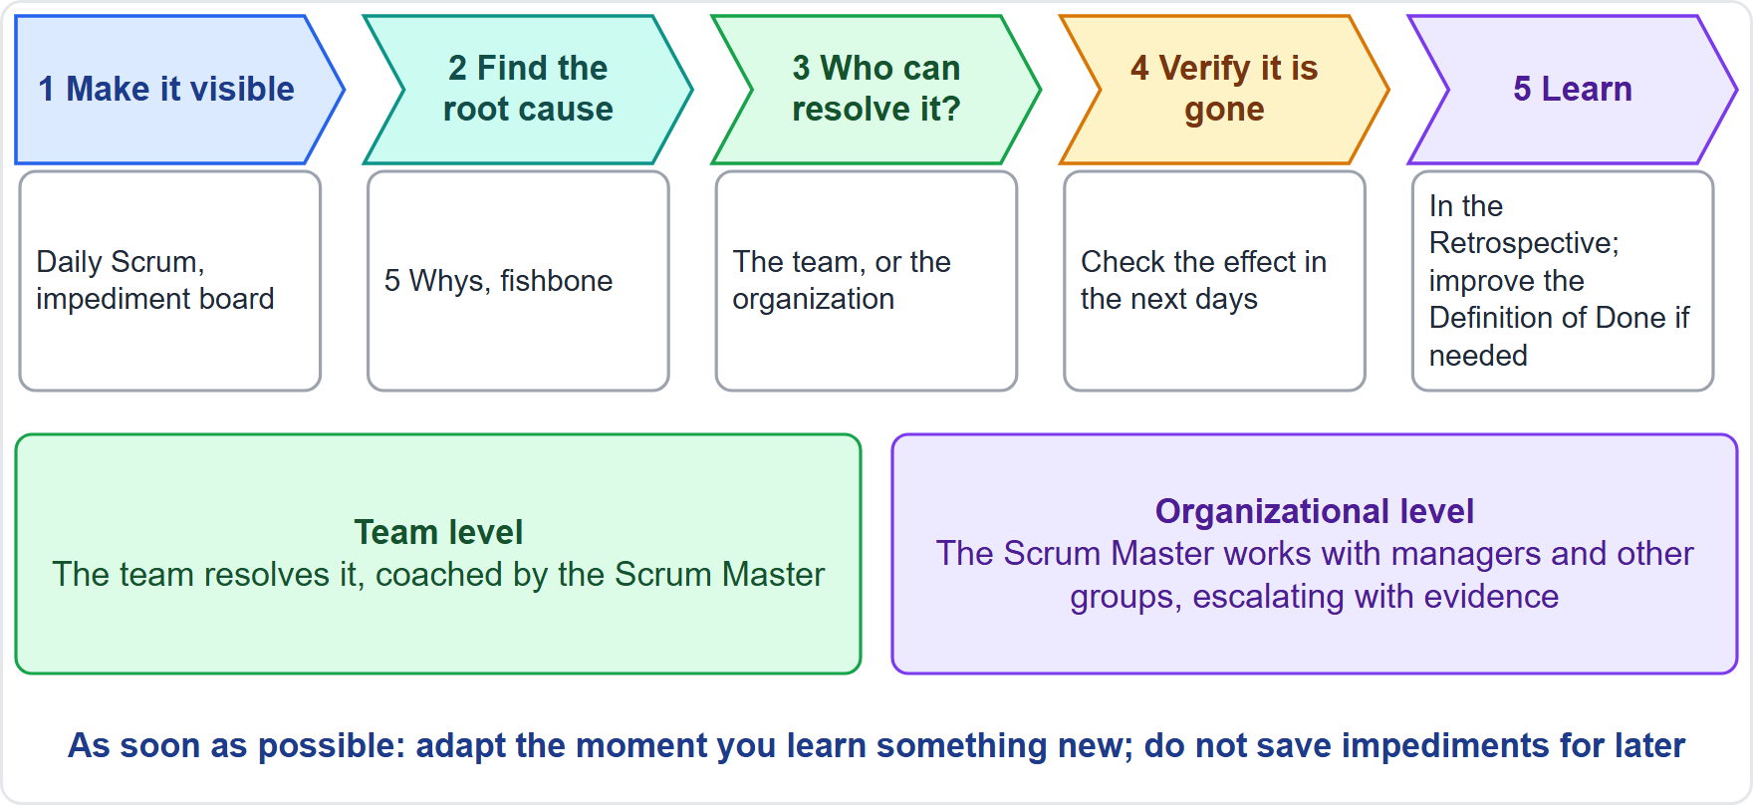
Resolving an Impediment
BEYOND THE GUIDE
Module 14
Make it visible
Find the root cause
Can the team resolve it? Yes: the team acts, with coaching. No: the Scrum Master works with the organization and escalates with evidence
Verify it is gone; learn in the Retrospective
CSM Exam Prep Masterclass | Certified ScrumMaster
Module 14
5 / 25
Notes:
How do you resolve one? First, make it visible. Second, find the root cause. Third, decide whether the team can resolve it. If yes, the team acts, with the Scrum Master's coaching. If not, the Scrum Master works with the organization and escalates with evidence. Finally, verify that the impediment is gone, and learn from it in the Retrospective. The Guide gives only the accountability, so this method goes beyond it, but it is the pattern behind most impediment questions.

Slide 6
Two Levels of Impediment
Module 14
Level | Examples | Who resolves
Team level | A broken build, an unclear item, a missing skill, a conflict | The team, with the Scrum Master's coaching
Organizational level | People split across projects, slow approvals, no test environment, managers overruling the Product Owner | The Scrum Master, with managers and other groups
EXAM TIP For an organizational impediment the Scrum Master works with the organization.
CSM Exam Prep Masterclass | Certified ScrumMaster
Module 14
6 / 25
Notes:
Impediments live at two levels. At the team level: a broken build, an unclear item, a missing skill, a conflict. The team resolves these, with the Scrum Master's coaching. At the organizational level: people split across projects, slow approvals, no test environment, managers overruling the Product Owner. The Scrum Master works on these with managers and other groups. Telling the team to cope with an organizational impediment is the wrong answer.

Slide 7
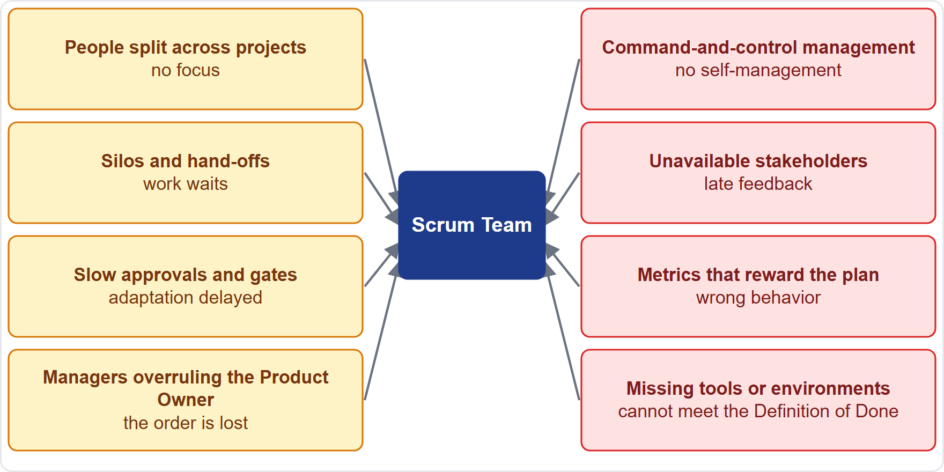
Organizational Impediments
BEYOND THE GUIDE
Module 14
People split across projects
Silos and hand-offs
Slow approvals and gates
Managers overruling the Product Owner
Command-and-control management
Unavailable stakeholders
Metrics that reward the plan
Missing tools or environments
EXAM TIP Name at least three.
CSM Exam Prep Masterclass | Certified ScrumMaster
Module 14
7 / 25
Notes:
The learning objective asks for at least three organizational impediments. These go beyond the Guide. People split across several projects, so they cannot focus. Functional silos and hand-offs, so work waits. Slow approvals and gates, so adaptation is delayed. Managers overruling the Product Owner. Command-and-control management, which blocks self-management. Unavailable stakeholders, which delays feedback. Metrics that reward the plan. And missing tools or environments. The Architecture Group's review at RideLoop is an example of a slow gate.

Slide 8
How the Scrum Master Helps the Team
BEYOND THE GUIDE
Module 14
Way | What it looks like
Make it visible | At the Daily Scrum, on a board, with its cost in lost time
Coach the team to resolve what it can | Questions, not answers
Remove what it cannot | Work with managers, other teams, stakeholders
Find the root cause | Look past the symptom
Escalate with evidence | Bring data to those who can act
Facilitate a resolution session | Bring the right people together, neutrally
Follow through | Check it is gone; use the Retrospective
EXAM TIP Name at least two.
CSM Exam Prep Masterclass | Certified ScrumMaster
Module 14
8 / 25
Notes:
At least two ways the Scrum Master helps the team with impediments. These go beyond the Guide. Make the impediment visible: at the Daily Scrum, on a board, with its cost in lost time. Coach the team to resolve what it can. Remove what it cannot, by working with managers and other teams. Find the root cause: look past the symptom. Escalate with evidence. Facilitate a resolution session, bringing the right people together, neutrally. And follow through: check it is gone, and use the Retrospective to stop it coming back.

Slide 9
Techniques to Resolve an Impediment
BEYOND THE GUIDE
Module 14
Technique | Good for
5 Whys: ask why about five times | One problem with a chain of causes
Fishbone diagram: group causes by people, process, tools, environment, policy | Many possible causes
Prioritized impediment board | Many impediments at once
Escalation with data | Organizational impediments
Facilitated working session | Agreement between groups
Small experiment | Unclear solutions; supports empiricism
Retrospective problem-solving | Recurring problems
EXAM TIP Be ready to apply at least one.
CSM Exam Prep Masterclass | Certified ScrumMaster
Module 14
9 / 25
Notes:
You should be able to apply at least one technique. These techniques go beyond the Guide. The five whys: ask why about five times to find the root cause. A fishbone diagram: group possible causes by people, process, tools, environment and policy. A prioritized impediment board, when there are many. Escalation with data, for organizational impediments. A facilitated working session, when groups must agree. A small experiment, when the solution is unclear. And Retrospective problem-solving, for recurring problems.

Slide 10
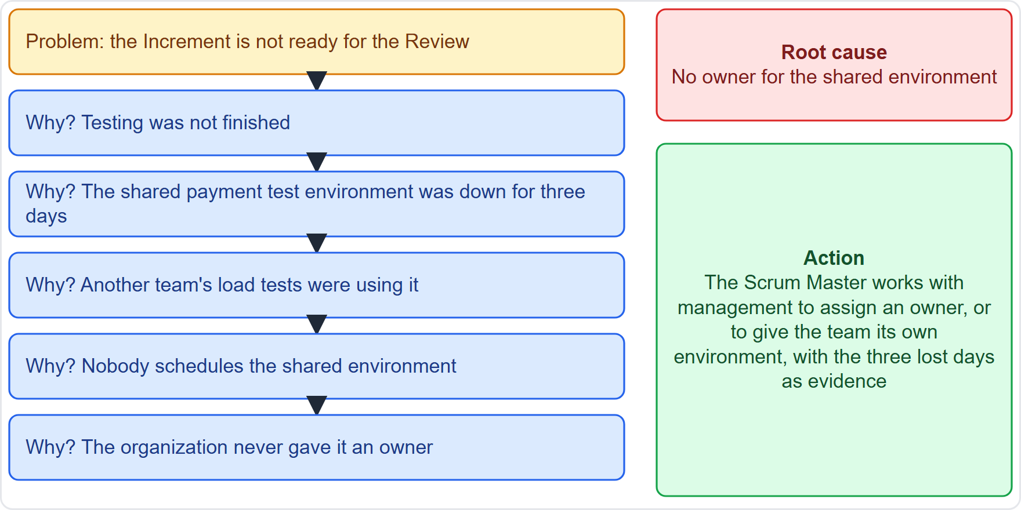
The 5 Whys: A Worked Example
BEYOND THE GUIDE
Module 14
Problem: the Increment is not ready for the Review
Why? Testing was not finished
Why? The shared test environment was down for three days
Why? Another team's load tests were using it
Why? Nobody schedules it. Why? No owner was ever assigned
Root cause: no owner; action: work with management, with the lost days as evidence
CSM Exam Prep Masterclass | Certified ScrumMaster
Module 14
10 / 25
Notes:
Here is a worked example of the five whys; it goes beyond the Guide. The Increment is not ready for the Review. Why? Testing was not finished. Why? The shared test environment was down for three days. Why? Another team's load tests were using it. Why? Nobody schedules the shared environment. Why? The organization never assigned it an owner. The root cause is the missing owner. The action: the Scrum Master works with management to assign one, or give the team its own environment, using the three lost days as evidence.

Slide 11
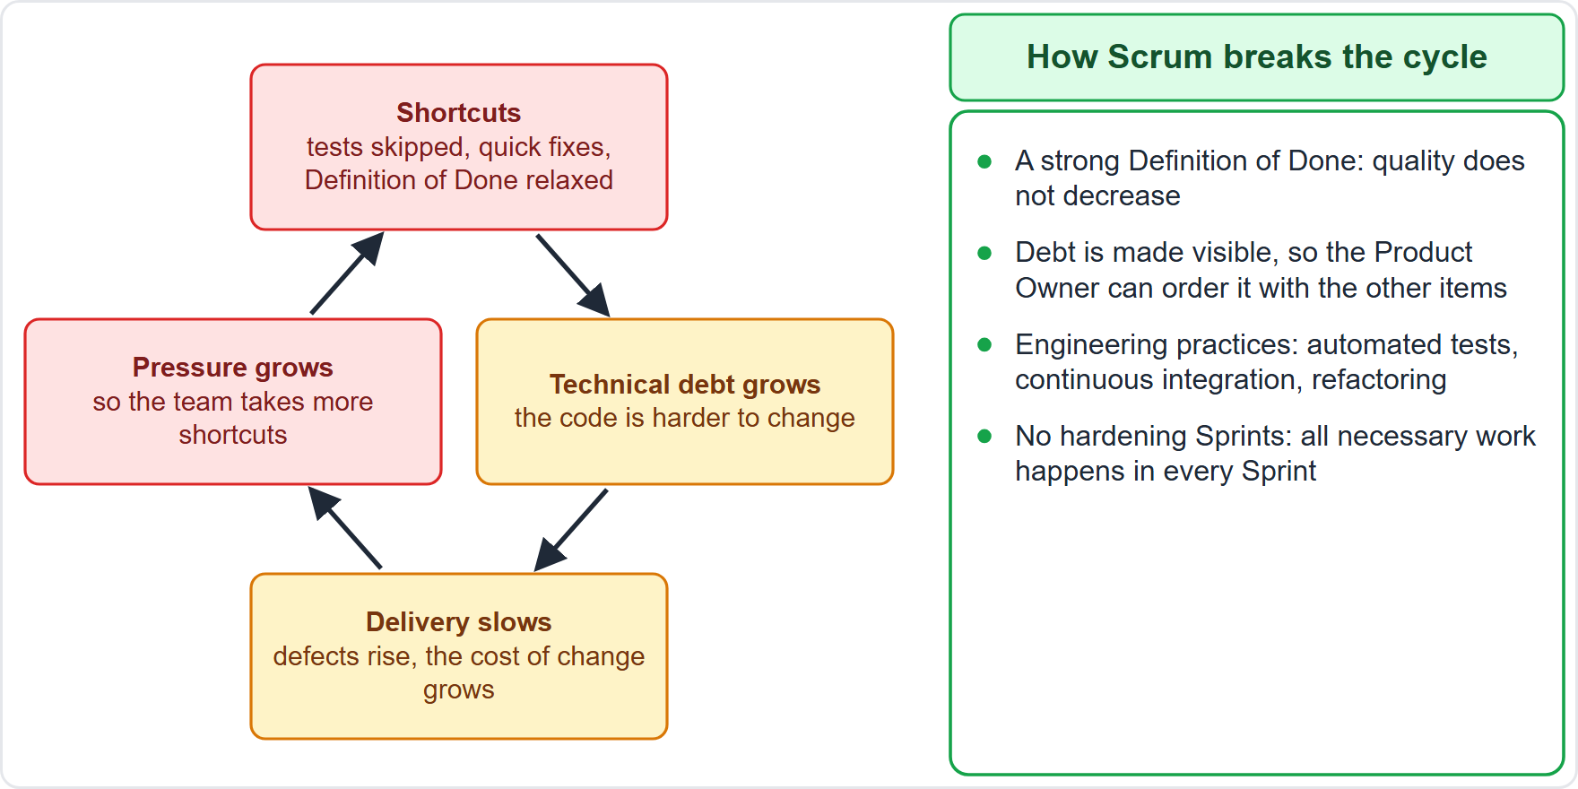
Technical Debt
BEYOND THE GUIDE
Module 14
The future cost of rework from taking an easy shortcut now
Like financial debt, it carries interest: the longer it stays, the more it costs
The Guide does not mention technical debt
A strong Definition of Done and visibility break the cycle
CSM Exam Prep Masterclass | Certified ScrumMaster
Module 14
11 / 25
Notes:
Now technical debt. The Guide does not mention it, but the learning objectives do. It means the future cost of rework from taking an easy shortcut now instead of a better approach. Like financial debt, it carries interest: the longer it stays, the more it costs. The diagram shows the cycle. Shortcuts create debt, debt slows delivery, pressure grows, and more shortcuts follow. A strong Definition of Done and visibility break the cycle.

Slide 12
The Impact of Accumulating Debt
BEYOND THE GUIDE
Module 14
Impact | Why
Slower delivery | Every change takes longer
Higher cost | Rework and workarounds eat effort
More defects | Fragile parts break
Less predictability | Forecasts become unreliable
Less ability to respond to change | The product is hard to adapt
Lower morale | Working in a poor code base is frustrating
Risk to the Increment | It may stop being usable or truly Done
EXAM TIP Name the impact, not the metaphor.
CSM Exam Prep Masterclass | Certified ScrumMaster
Module 14
12 / 25
Notes:
What is the impact of accumulating technical debt? The Guide never mentions it, so this list goes beyond the Guide. Delivery gets slower, because every change takes longer. The cost rises, because rework and workarounds eat effort. There are more defects, because fragile parts break. Forecasts become less reliable. The product is harder to adapt to change. Morale falls, because working in a poor code base is frustrating. And the Increment itself may stop being usable. In the exam, name the impact, not the metaphor.

Slide 13
How Scrum Deals with Debt
BEYOND THE GUIDE
Module 14
The Definition of Done is the first defense: unfinished quality is not Done
Quality does not decrease during the Sprint
Make the debt visible, for example as Product Backlog items, so the Product Owner can weigh it
The Developers are accountable for quality; the Product Owner orders debt work; the Scrum Master helps everyone see the impact
No separate debt or hardening Sprints: all work is inside every Sprint
EXAM TIP Lowering the Definition of Done increases debt.
CSM Exam Prep Masterclass | Certified ScrumMaster
Module 14
13 / 25
Notes:
How does Scrum deal with debt? The Guide never mentions it, so this goes beyond the Guide. The Definition of Done is the first defense: unfinished quality is not Done, and quality does not decrease during the Sprint. The debt is made visible, for example as Product Backlog items, so the Product Owner can weigh it against new features. The Developers are accountable for quality, the Product Owner orders the debt work, and the Scrum Master helps everyone see the impact. And there are no separate debt or hardening Sprints.

Slide 14
Practices That Raise Quality
BEYOND THE GUIDE
Module 14
Practice | How it helps
Test-driven development | Write a failing test first; clean, testable design
Automated testing | Fast, repeatable checks
Continuous integration | Problems appear early; the product always works together
Continuous delivery | Reliable, frequent, low-risk delivery
Refactoring | Improves code structure before debt grows
Pair and mob programming | Shared knowledge, instant review
Code reviews, coding standards | Early defect discovery
Simple design | Less to maintain
EXAM TIP The Developers choose; the Scrum Master encourages and removes barriers. Name at least three.
CSM Exam Prep Masterclass | Certified ScrumMaster
Module 14
14 / 25
Notes:
Now practices. The learning objective asks for at least three that raise quality. They come from extreme programming and DevOps, not from the Guide. Test-driven development: write a failing test first. Automated testing: fast, repeatable checks. Continuous integration: problems appear early. Continuous delivery: reliable, frequent releases. Refactoring: improve the code before debt grows. Pair and mob programming: shared knowledge and instant review. Code reviews and standards: early defect discovery. And simple design. The Developers choose which to use; the Scrum Master encourages and removes barriers.

Slide 15
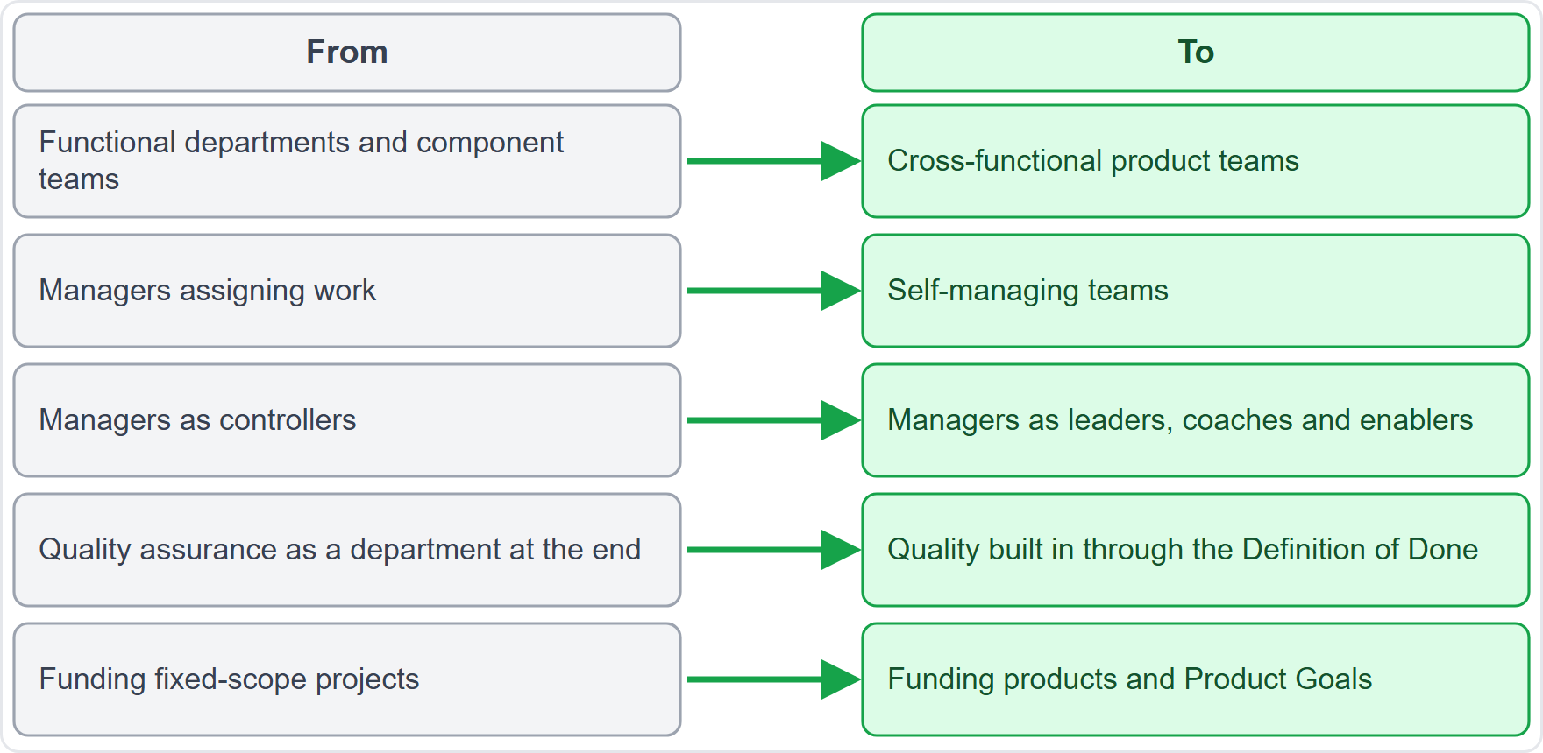
Organizational Design Changes
BEYOND THE GUIDE
Module 14
Departments become cross-functional product teams
Assigned work becomes self-managing teams
Managers move from controllers to enablers
Quality moves from a final department to built in
Funding moves from projects to products
EXAM TIP Summarize at least one. Managers and project managers are changed most.
CSM Exam Prep Masterclass | Certified ScrumMaster
Module 14
15 / 25
Notes:
Adopting Scrum changes the organization, and the objective asks you to summarize at least one change. These changes go beyond the Guide. Departments become cross-functional product teams. Assigned work becomes self-managing teams. Managers move from controllers to leaders, coaches and enablers. Quality moves from a final department to something built in. And funding moves from fixed projects to products and Product Goals. Managers and project managers are changed the most.

Slide 16
Why Scrum Has No Project Manager
BEYOND THE GUIDE
Module 14
Self-management: the team decides who does what, when and how
No hierarchy inside the Scrum Team
Empiricism instead of detailed up-front control
The duties are shared among the three accountabilities
One goal: one Product Goal, one Product Backlog, one Product Owner
EXAM TIP The skills stay; a role above the team does not.
CSM Exam Prep Masterclass | Certified ScrumMaster
Module 14
16 / 25
Notes:
Why does Scrum have no project manager? The Guide never mentions the role, so this reasoning goes beyond it. Self-management: the team decides who does what, when and how. There is no hierarchy inside the Scrum Team. Scrum relies on empiricism, not detailed up-front control. The duties are shared among the three accountabilities. And there is one goal, with one Product Backlog and one Product Owner. The skills of project management stay; what does not exist is a role above the team.

Slide 17
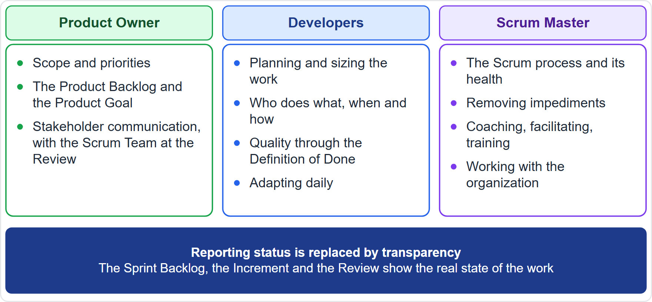
Where Project Management Duties Go
BEYOND THE GUIDE
Module 14
Scope and priorities: the Product Owner
Planning, estimating, quality: the Developers
Process and impediments: the Scrum Master
Reporting is replaced by transparency of the artifacts
Former project managers can serve as Product Owner, Scrum Master or Developer
CSM Exam Prep Masterclass | Certified ScrumMaster
Module 14
17 / 25
Notes:
Where do the duties go? This mapping goes beyond the Guide. Scope and priorities go to the Product Owner. Planning, estimating and quality go to the Developers. Process and impediments go to the Scrum Master. Reporting is replaced by transparency of the artifacts. Nobody assigns tasks, because the Developers decide. And people who used to be project managers can serve as Product Owner, Scrum Master or Developer, or in other roles in the organization.

Slide 18
Traps: What the Exam Expects
Module 14
Accountable for removal, not for fixing alone, and not for waiting
Visible first; waiting for the Retrospective is slow
Organizational impediments need work with the organization
Root cause over symptom; the Definition of Done is the main defense against debt
No hardening Sprints; practices are the Developers' choice
No project manager; nobody assigns tasks or sits above the team
EXAM TIP Technical debt is not in the Guide. Answer from its impact.
CSM Exam Prep Masterclass | Certified ScrumMaster
Module 14
18 / 25
Notes:
Here are the traps. The Scrum Master is accountable for removal: not for fixing alone, and not for waiting. Make impediments visible first; waiting for the Retrospective is slow. Organizational impediments need work with the organization. Root cause beats symptom, and the Definition of Done is the main defense against debt. No hardening Sprints, and practices are the Developers' choice. And there is no project manager: nobody assigns tasks or sits above the team. Technical debt is not in the Guide, so answer from its impact.

Slide 19
Module Recap
Module 14
1
Impediments
2
Organizational ones
3
Debt
make visible, find the cause, remove with the right people
the Scrum Master works with the organization
slower, costlier, riskier; the Definition of Done guards against it
4
Practices
5
Organization
6
No project manager
automation, integration, refactoring, pairing
product teams, self-management, enabling managers
duties are shared
CSM Exam Prep Masterclass | Certified ScrumMaster
Module 14
19 / 25
Notes:
Recap. For impediments: make them visible, find the cause, and remove them with the right people. For organizational ones, the Scrum Master works with the organization. Debt makes delivery slower, costlier and riskier, and the Definition of Done guards against it. Practices such as automation, integration and refactoring help. The organization moves to product teams, self-management and enabling managers. And there is no project manager. Now test yourself.

Slide 20
Practice Question 1
Module 14
Q1
An impediment needs a decision from a Lakeshore Transit executive whom the Scrum Master cannot reach directly. What should the Scrum Master do?
A
Ask the Developers to solve it themselves, because only they can take a decision about the product
B
Ignore it until next Sprint, as the executive may decide differently once the quarter has ended
C
Make the impediment visible with evidence of its cost, and work with those who can reach the executive
D
Cancel the Sprint and ask Maya to plan a new one without the blocked work
CSM Exam Prep Masterclass | Certified ScrumMaster
Module 14
20 / 25
Notes:
Question one. An impediment needs a decision from a Lakeshore Transit executive whom the Scrum Master cannot reach directly. What should the Scrum Master do? The four options are on the screen. Choose your answer. [PAUSE 12] The answer is C. Make the impediment visible with evidence of its cost, and work with those who can reach the executive. Cancelling a Sprint is for an obsolete Sprint Goal only.

Slide 21
Practice Question 2
Module 14
Q2
After adopting Scrum, Lakeshore Transit merges its separate analysis, development and test departments into cross-functional product teams. How is this described?
A
An organizational design change caused by adopting Scrum
B
A violation of Scrum, because the departments must stay separate
C
A temporary phase that ends when the first release is complete
D
An example of a hardening Sprint carried out by the whole organization
CSM Exam Prep Masterclass | Certified ScrumMaster
Module 14
21 / 25
Notes:
Question two. After adopting Scrum, Lakeshore Transit merges its separate analysis, development and test departments into cross-functional product teams. How is this described? The four options are on the screen. Choose your answer. [PAUSE 12] The answer is A, an organizational design change caused by adopting Scrum. Cross-functional teams hold all the skills for an Increment.

Slide 22
Practice Question 3
Module 14
Q3
Maya wants only new features, while the code base is getting harder to change and defects are rising. What is the best way for the Scrum Master to help?
A
Agree and ask the team to hurry, because new features create the value the stakeholders are waiting for
B
Plan a hardening Sprint after the next release, in which the Developers fix the defects and clean the code
C
Ask the Developers to work overtime to clear the defects while they continue to deliver the new features
D
Make the debt and its impact visible so that Maya weighs it, and keep quality in the Definition of Done
CSM Exam Prep Masterclass | Certified ScrumMaster
Module 14
22 / 25
Notes:
Question three. Maya wants only new features, while the code base is getting harder to change and defects are rising. What is the best way for the Scrum Master to help? The four options are on the screen. Choose your answer. [PAUSE 12] The answer is D. Make the debt and its impact visible so Maya can weigh it, and keep quality in the Definition of Done. A separate hardening Sprint is not part of Scrum.

Slide 23
Practice Question 4
Module 14
Q4
Which set contains practices that raise quality and reduce technical debt?
A
Longer Sprints, fewer meetings and more documentation for every change
B
Automated testing, continuous integration and refactoring
C
Hiring more managers, adding approval gates and a hardening Sprint
D
Larger Product Backlog items, fewer reviews and testing at the end
CSM Exam Prep Masterclass | Certified ScrumMaster
Module 14
23 / 25
Notes:
Question four. Which set contains practices that raise quality and reduce technical debt? The four options are on the screen. Choose your answer. [PAUSE 12] The answer is B: automated testing, continuous integration and refactoring. They give fast feedback and keep the code clean. The other options add things Scrum does not have, or do not address quality.

Slide 24
Practice Question 5
Module 14
Q5
Why does Scrum have no project manager?
A
Because project management is considered unimportant, so nobody in a Scrum Team needs those skills
B
Because the Scrum Master takes the project manager's role and assigns the tasks to the Developers
C
Because the team is self-managing without hierarchy, and the duties are shared among three accountabilities
D
Because the Product Owner replaces the project manager and controls the plan of the Developers
CSM Exam Prep Masterclass | Certified ScrumMaster
Module 14
24 / 25
Notes:
Question five. Why does Scrum have no project manager? The four options are on the screen. Choose your answer. [PAUSE 12] The answer is C. The team is self-managing without hierarchy, and the duties are shared among three accountabilities. The Scrum Master does not take the project manager's role, and the Product Owner does not control the Developers' plan.

Slide 25
Answers at a Glance
Module 14
Question | Answer | Why
Q1 | C | Make it visible with evidence and work with those who can act
Q2 | A | A typical organizational design change caused by Scrum
Q3 | D | Make the debt visible; keep quality in the Definition of Done
Q4 | B | Automated testing, continuous integration and refactoring
Q5 | C | Self-management and shared duties, not a role above the team
CSM Exam Prep Masterclass | Certified ScrumMaster
Module 14
25 / 25
Notes:
Here are all five answers together. Question one: C. Make it visible with evidence and work with those who can act. Question two: A. A typical organizational design change. Question three: D. Make the debt visible, and keep quality in the Definition of Done. Question four: B. Automated testing, continuous integration and refactoring. Question five: C. Self-management and shared duties. That completes the topic modules. Next, Module 15 is a scenario workshop.

