Slide 1
Module 15: Scenario Workshop
Eleven situations, one method
Applies all objectives
Certified ScrumMaster (CSM) Exam Prep Masterclass
Module 15
Notes:
Welcome to Module 15: Scenario Workshop. You now know the framework. Most exam questions ask you to apply it in a situation. In this module you will learn a five-step method, and then use it on eleven worked scenarios. Every scenario is new: none of them appeared in the practice questions of the earlier modules.

Slide 2
What You Will Learn
Module 15
Use a five-step method on any situational question
Name the owner of a decision before you read the options
Find the rule: stated, implied or absent in the Guide
Remove options by the way they go wrong, then choose the best of the rest
Solve eleven worked scenarios across roles, events, artifacts and the organization
CSM Exam Prep Masterclass | Certified ScrumMaster
Module 15: Scenario Workshop
2 / 20
Notes:
By the end of this module you will be able to do five things. Use a five-step method on any situational question. Name the owner of a decision before you read the options. Find the rule: stated, implied or absent in the Guide. Remove options by the way they go wrong, then choose the best of the rest. And solve eleven worked scenarios across roles, events, artifacts and the organization.

Slide 3
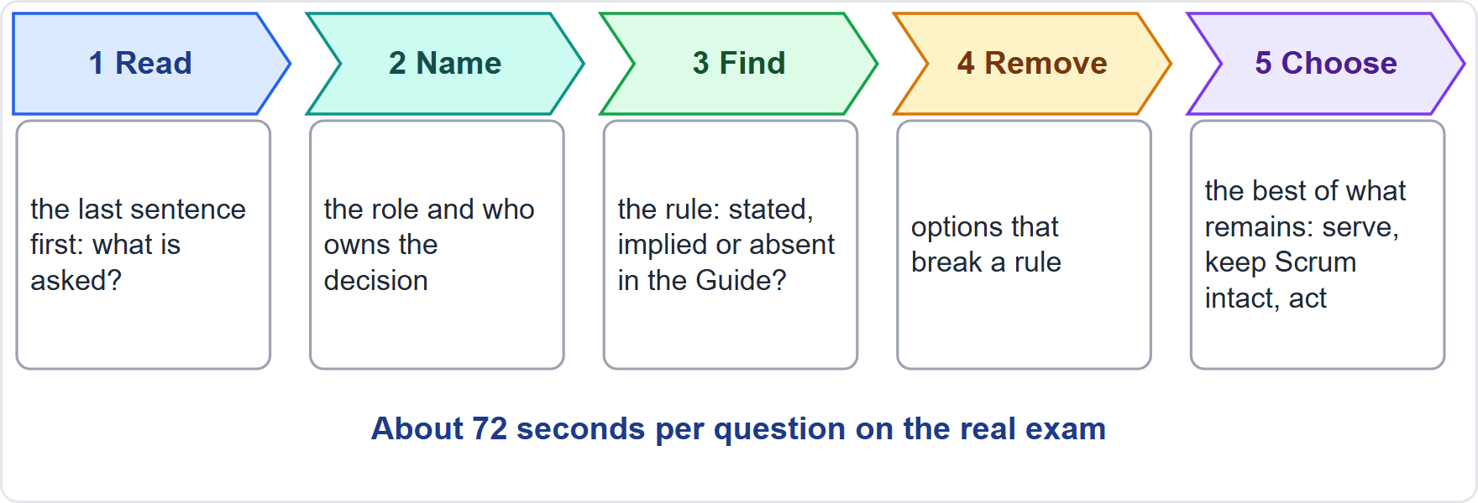
The Five-Step Method
BEYOND THE GUIDE
Module 15
1. Read the last sentence first
2. Name the role and the owner of the decision
3. Find the rule in the Guide
4. Remove options that break a rule
5. Choose the best of what remains
EXAM TIP You have about 72 seconds a question. The method is quick once it is a habit.
CSM Exam Prep Masterclass | Certified ScrumMaster
Module 15: Scenario Workshop
3 / 20
Notes:
Here is the method. It is the course's own, not the Guide's. Step one: read the last sentence first, because that is what is actually asked. Step two: name the role and the owner of the decision. Step three: find the rule in the Guide. Step four: remove the options that break a rule. Step five: choose the best of what remains. On the real exam you have about seventy-two seconds a question, but the method is quick once it becomes a habit.

Slide 4
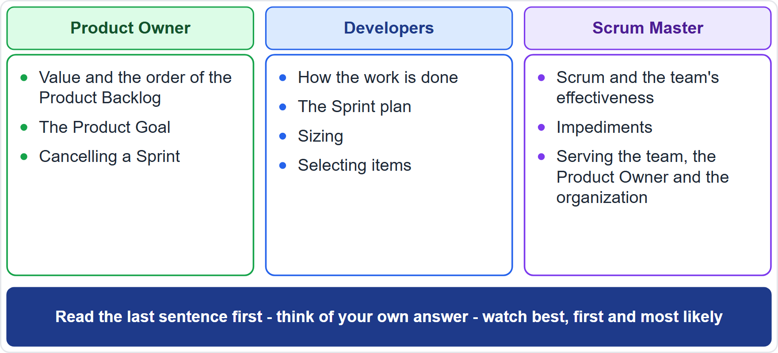
Steps 1 and 2: Read, Then Name the Owner
BEYOND THE GUIDE
Module 15
Read the last sentence first: best action, what the Guide says, or which statement is correct?
Think of your own answer before reading the options
Product Owner: value and the order of the Product Backlog
Developers: how, and the Sprint plan
Scrum Master: Scrum, and the team's effectiveness
Watch the words best, first, most likely
CSM Exam Prep Masterclass | Certified ScrumMaster
Module 15: Scenario Workshop
4 / 20
Notes:
Steps one and two of the course's own method. Read the last sentence first. Is it asking for the best action, for what the Guide says, or for which statement is correct? Then think of your own answer before you read the options. Next, name the owner. The Product Owner owns value and the order of the Product Backlog. The Developers own how the work is done, and the Sprint plan. The Scrum Master owns Scrum and the team's effectiveness. And watch the words best, first and most likely.

Slide 5
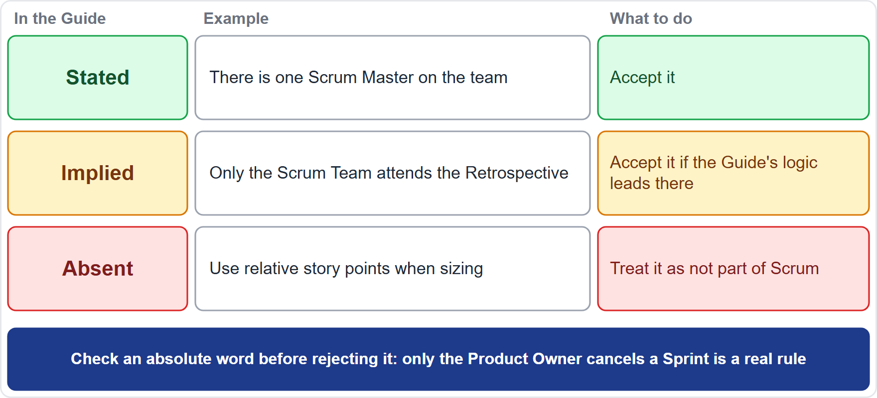
Step 3: Find the Rule
BEYOND THE GUIDE
Module 15
Stated: one Scrum Master on the team. Accept it
Implied: only the Scrum Team attends the Retrospective. Accept it if the Guide's logic leads there
Absent: relative story points when sizing. Not part of Scrum
Check an absolute word before rejecting it
EXAM TIP Only the Product Owner cancels a Sprint is a real rule.
CSM Exam Prep Masterclass | Certified ScrumMaster
Module 15: Scenario Workshop
5 / 20
Notes:
Step three: find the rule. This step goes beyond the Scrum Guide. Scrum Alliance's study guide suggests asking whether an answer is stated, implied or absent in the Guide. Stated: there is one Scrum Master on the team; accept it. Implied: only the Scrum Team attends the Retrospective; accept it if the Guide's logic leads there. Absent: use relative story points when sizing; treat it as not part of Scrum. And check an absolute word before rejecting it. Only the Product Owner cancels a Sprint is a real rule.

Slide 6
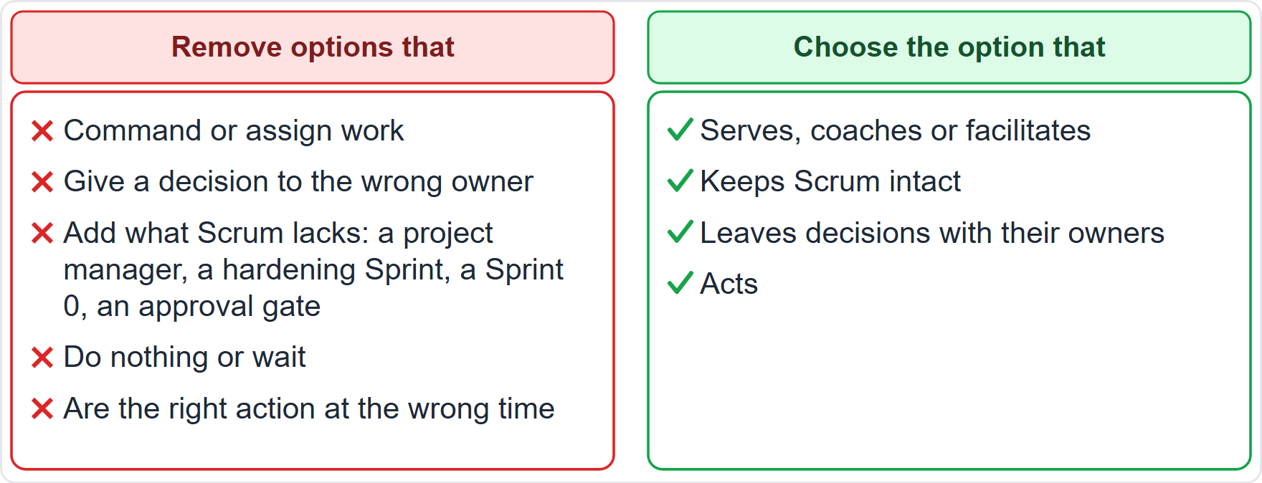
Steps 4 and 5: Remove, Then Choose
BEYOND THE GUIDE
Module 15
Remove options that command or assign work
Remove options that give a decision to the wrong owner
Remove options that add a project manager, a hardening Sprint, a Sprint 0 or an approval gate
Remove options that do nothing or wait
Choose what serves, keeps Scrum intact, leaves decisions with their owners, and acts
CSM Exam Prep Masterclass | Certified ScrumMaster
Module 15: Scenario Workshop
6 / 20
Notes:
Steps four and five of the course's own method. Remove options that command or assign work. Remove options that give a decision to the wrong owner. Remove options that add what Scrum lacks, such as a project manager, a hardening Sprint, a Sprint zero, or an approval gate. Remove options that do nothing or wait. Then choose the one that serves, coaches or facilitates, keeps Scrum intact, leaves decisions with their owners, and acts. Let us practice.

Slide 7
Worked Scenario 1: A Plan Handed Down
Module 15
Q1
Maya arrives at Sprint Planning with a finished Sprint Goal and a list of items the Developers must commit to. What should the Scrum Master do?
A
Accept it, because the Product Owner decides everything about the Sprint and the Developers must deliver it
B
Ask the Developers to sign the list, so that every item becomes a personal commitment of the person who signs
C
Explain that the whole Scrum Team shapes the Sprint Goal and the Developers select the items
D
Cancel Sprint Planning and ask Maya to return with the stakeholders' written agreement on the list
CSM Exam Prep Masterclass | Certified ScrumMaster
Module 15: Scenario Workshop
7 / 20
Notes:
Scenario one. Maya arrives at Sprint Planning with a finished Sprint Goal and a list of items the Developers must commit to. What should the Scrum Master do? Choose your answer. [PAUSE 12] Step one: the question asks for the Scrum Master's best action. Step two: the Developers select the items, and the whole team shapes the Sprint Goal. Step three: that rule is stated. Step four: A gives the decision to the wrong owner, and B and D add a signature and a stakeholder approval. Step five: the answer is C.

Slide 8
Worked Scenario 2: Tasks and Reports
Module 15
Q2
A Lakeshore Transit department manager asks the Scrum Master to assign tasks to individual Developers and to send a weekly report on each person's progress. What should the Scrum Master do?
A
Explain that the Developers decide who does what, and point the manager to the Sprint Backlog
B
Agree, because being accountable for the team's effectiveness gives the Scrum Master authority over its members
C
Assign the tasks but let each Developer choose how to do them
D
Ask Maya to assign the tasks, since the Product Owner orders the work
CSM Exam Prep Masterclass | Certified ScrumMaster
Module 15: Scenario Workshop
8 / 20
Notes:
Scenario two. A Lakeshore Transit department manager asks the Scrum Master to assign tasks to individual Developers and to send a weekly report on each person's progress. What should the Scrum Master do? Choose your answer. [PAUSE 12] The owner of who does what is the Developers. The rule is stated: the team is self-managing, and the Sprint Backlog is visible. Options B, C and D all assign tasks, which removes self-management. The answer is A: explain, and point the manager to the Sprint Backlog.

Slide 9
Worked Scenario 3: Two Task Lists
Module 15
Q3
Some RideLoop Developers also receive daily task lists from their department managers, and the lists conflict with the Sprint Backlog. What should the Scrum Master do?
A
Ask the Developers to follow the managers' lists first, because line managers hold authority over their time
B
Help the managers by merging their lists into the Product Backlog without telling Maya, so that the work becomes visible
C
Cancel the Sprint and restart it once the managers have agreed a single list of tasks
D
Help the managers understand that the Scrum Team manages its own work, and work with them on the conflict
CSM Exam Prep Masterclass | Certified ScrumMaster
Module 15: Scenario Workshop
9 / 20
Notes:
Scenario three. Some RideLoop Developers also receive daily task lists from their department managers, and the lists conflict with the Sprint Backlog. What should the Scrum Master do? Choose your answer. [PAUSE 12] The Scrum Master serves the organization by helping it understand Scrum and removing barriers. Option A undermines self-management. Option B bypasses the Product Owner. Option C misuses cancelling, which only the Product Owner may do, and only for an obsolete Sprint Goal. The answer is D.

Slide 10
Worked Scenario 4: Who Builds What
Module 15
Q4
Maya tells the Developers which person should build each item and in which order the tasks must be done. What is the best response from the Scrum Master?
A
Agree, because the Product Owner is accountable for the value and therefore decides who builds what
B
Coach both: how the work is done is the Developers' call, and Maya steers through the Product Backlog
C
Ask Grace to review the plan, since Grace knows each person's skills and availability
D
Ask the Developers to follow the instructions this time and raise the point in the next Retrospective
CSM Exam Prep Masterclass | Certified ScrumMaster
Module 15: Scenario Workshop
10 / 20
Notes:
Scenario four. Maya tells the Developers which person should build each item and in which order the tasks must be done. What is the best response from the Scrum Master? Choose your answer. [PAUSE 12] The owner of how is the Developers, and the rule is stated: nobody else tells them how to turn items into Increments. Option A picks the wrong owner. Option C adds a manager's review. Option D waits a whole Sprint. The answer is B: coach both people.

Slide 11
Worked Scenario 5: A Scrum Master Who Can Test
Module 15
Q5
The Scrum Master has strong testing skills, and the Developers ask for help with several Sprint Backlog items that are behind. What is appropriate?
A
Decline, because a Scrum Master must never do any work on the product, whatever the situation
B
Help, but step down as Scrum Master until the end of the Sprint, and then return
C
Help with the items and join the Daily Scrum as a Developer
D
Help, but only after Maya has approved it in writing
CSM Exam Prep Masterclass | Certified ScrumMaster
Module 15: Scenario Workshop
11 / 20
Notes:
Scenario five. The Scrum Master has strong testing skills, and the Developers ask for help with several Sprint Backlog items that are behind. What is appropriate? Choose your answer. [PAUSE 12] The rule is stated: a Scrum Master who is actively working on Sprint Backlog items takes part in the Daily Scrum as a Developer. Option A uses the absolute word never, which the Guide does not support. Options B and D add steps nobody requires. The answer is C.

Slide 12
Worked Scenario 6: Skipping Events
Module 15
Q6
Grace wants the team to skip the Sprint Retrospective and the Sprint Review in the coming Sprint to save time for coding. What should the Scrum Master do?
A
Explain that skipping an event loses a chance to inspect and adapt, and help Grace see the value of both
B
Agree for one Sprint, because the team can recover the lost time when the delivery pressure has eased
C
Replace both events with an email summary sent to the stakeholders, so that they still receive the information
D
Let the team decide event by event whether the time spent on it is worth the value it brings
CSM Exam Prep Masterclass | Certified ScrumMaster
Module 15: Scenario Workshop
12 / 20
Notes:
Scenario six. Grace wants the team to skip the Sprint Retrospective and the Sprint Review in the coming Sprint to save time for coding. What should the Scrum Master do? Choose your answer. [PAUSE 12] The Guide says that failing to operate any event as prescribed loses opportunities to inspect and adapt. Options B and D accept that loss. Option C replaces a working session with a report. The answer is A: explain, and help Grace see the value of both events.

Slide 13
Worked Scenario 7: An Unprepared Product Owner
Module 15
Q7
Maya arrives at Sprint Planning without having thought about what the Sprint should achieve, and the Product Backlog is in disorder. How can the Scrum Master best help?
A
Help Maya by choosing the Sprint Goal, since the Scrum Master has seen the stakeholders' needs
B
Help Maya with techniques to prepare, so that attendees can discuss the top items and the Product Goal
C
Cancel Sprint Planning and reschedule it for next week, once the Product Backlog is in order again
D
Ask the Developers to order the Product Backlog during the meeting, because they know the work best
CSM Exam Prep Masterclass | Certified ScrumMaster
Module 15: Scenario Workshop
13 / 20
Notes:
Scenario seven. Maya arrives at Sprint Planning without having thought about what the Sprint should achieve, and the Product Backlog is in disorder. How can the Scrum Master best help? Choose your answer. [PAUSE 12] Maya owns the order of the Product Backlog and prepares the attendees. The Scrum Master serves the Product Owner by finding techniques. Options A and D take over Maya's accountability. Option C throws away the start of the Sprint. The answer is B.

Slide 14
Worked Scenario 8: Managers at the Daily Scrum
Module 15
Q8
Several Lakeshore Transit managers want to attend every RideLoop Daily Scrum to hear progress. What is the best way to meet their need?
A
Make the Daily Scrum a report to them, so that they hear each Developer's progress every morning
B
Add a second status meeting for the managers right after the Daily Scrum, so the Developers keep their own
C
Ask the Developers to email daily progress reports to the managers, so that the managers need not attend
D
Show them the Sprint Backlog and the Increment, and invite them to the Review instead
CSM Exam Prep Masterclass | Certified ScrumMaster
Module 15: Scenario Workshop
14 / 20
Notes:
Scenario eight. Several Lakeshore Transit managers want to attend every RideLoop Daily Scrum to hear progress. What is the best way to meet their need? Choose your answer. [PAUSE 12] The Daily Scrum is the Developers' planning event, and the Sprint Backlog is a visible, live picture of the work. Option A turns it into a status meeting. Option B adds the extra meeting Scrum tries to remove. Option C replaces planning with reporting. The answer is D.

Slide 15
Worked Scenario 9: A Long List of Ideas
Module 15
Q9
The RideLoop Retrospective has produced a long list of ideas. What should the Scrum Team do?
A
Implement every idea at once, so that none of the improvements is lost or forgotten
B
Choose the most helpful changes, tackle the biggest soon, and add them to the next Sprint Backlog
C
Keep the list until the end of the project, when all the improvements can be reviewed together
D
Give the list to the Scrum Master to implement, since the Scrum Master answers for the team's effectiveness
CSM Exam Prep Masterclass | Certified ScrumMaster
Module 15: Scenario Workshop
15 / 20
Notes:
Scenario nine. The RideLoop Retrospective has produced a long list of ideas. What should the Scrum Team do? Choose your answer. [PAUSE 12] The team identifies the most helpful changes, tackles the most impactful as soon as possible, and may add them to the next Sprint Backlog. Option A is unrealistic. Option C waits too long. Option D gives the team's improvements to the wrong owner. The answer is B.

Slide 16
Worked Scenario 10: Slow Planning
Module 15
Q10
Sprint Planning takes too long because items are unclear and too large. Which practice would help most?
A
Refine the Product Backlog regularly, so that items are small, clear and ready for selection
B
Add a second Sprint Planning each Sprint, so that there is more time to discuss the unclear items
C
Ask the stakeholders to select the items, so that the Developers do not have to discuss them
D
Stop selecting items at Sprint Planning and let the Developers pick work as they go
CSM Exam Prep Masterclass | Certified ScrumMaster
Module 15: Scenario Workshop
16 / 20
Notes:
Scenario ten. Sprint Planning takes too long because items are unclear and too large. Which practice would help most? Choose your answer. [PAUSE 12] Refinement breaks items into smaller, clearer ones that are ready for selection. Option B adds an event Scrum does not have. Option C gives the selection to the wrong owner. Option D removes the plan that Sprint Planning creates. The answer is A.

Slide 17
Worked Scenario 11: People on Three Projects
Module 15
Q11
The RideLoop Developers are each assigned to two other projects by their functional managers, and the Sprint Goals keep slipping. What is the best action for the Scrum Master?
A
Tell the Developers to work faster, so that the Sprint Goals are reached in spite of the other projects
B
Help the Developers by reducing the Definition of Done for the Sprint, so that the planned items fit in the reduced time
C
Work with the managers to make the impact visible and help dedicate the people to the Scrum Team
D
Wait for the Retrospective to raise the problem with the whole team, as the first chance
CSM Exam Prep Masterclass | Certified ScrumMaster
Module 15: Scenario Workshop
17 / 20
Notes:
Scenario eleven. The RideLoop Developers are each assigned to two other projects by their functional managers, and the Sprint Goals keep slipping. What is the best action for the Scrum Master? Choose your answer. [PAUSE 12] People split across projects are an organizational impediment, and the Scrum Master is accountable for causing its removal, with the organization. Option A presses the team. Option B lowers quality. Option D waits. The answer is C.

Slide 18
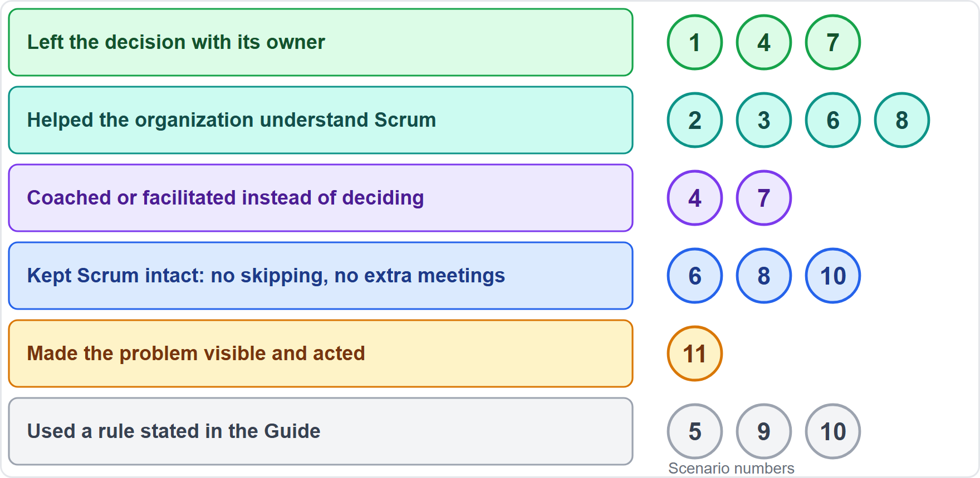
Patterns Across the Scenarios
BEYOND THE GUIDE
Module 15
Left the decision with its owner: 1, 4, 7
Helped the organization understand Scrum: 2, 3, 6, 8
Coached or facilitated instead of deciding: 4, 7
Kept Scrum intact: 6, 8, 10
Made it visible and acted: 11
Used a stated rule: 5, 9, 10
EXAM TIP The best answer is rarely the fastest fix. It is the one that keeps Scrum working.
CSM Exam Prep Masterclass | Certified ScrumMaster
Module 15: Scenario Workshop
18 / 20
Notes:
Look at what the right answers had in common. They left the decision with its owner, in scenarios one, four and seven. They helped the organization understand Scrum, in two, three, six and eight. They coached or facilitated instead of deciding, in four and seven. They kept Scrum intact, with no skipping and no extra meetings, in six, eight and ten. They made the problem visible and acted, in eleven. And they used a rule stated in the Guide, in five, nine and ten. The best answer is rarely the fastest fix. These patterns are the course's own reading of the scenarios, not Guide text.

Slide 19
Module Recap
Module 15
1
Five steps
2
Owner first
3
Rule
read, owner, rule, remove, choose
Product Owner, Developers, Scrum Master
stated, implied or absent
4
Remove
5
Choose
6
Practice
commands, wrong owners, extras, waiting
serve, keep Scrum intact, act
the final check in Module 18
CSM Exam Prep Masterclass | Certified ScrumMaster
Module 15: Scenario Workshop
19 / 20
Notes:
Recap. Five steps: read, owner, rule, remove, choose. Owner first: the Product Owner, the Developers, the Scrum Master. The rule is stated, implied or absent. Remove commands, wrong owners, extras, and waiting. Choose what serves, keeps Scrum intact and acts. And for more practice, the final check in Module 18 gives you fifteen mixed questions to try under time pressure.

Slide 20
Answers at a Glance
Module 15
Question | Answer | Why
Q1 | C | The Developers select; the whole team shapes the goal
Q2 | A | The Developers decide who does what
Q3 | D | Help the managers understand self-management
Q4 | B | How is at the Developers' sole discretion
Q5 | C | A Scrum Master working on items joins as a Developer
Q6 | A | Skipping an event loses a chance to inspect and adapt
Q7 | B | Serve the Product Owner with techniques
Q8 | D | The Daily Scrum is the Developers' event
Q9 | B | Choose the most helpful changes; add the top ones
Q10 | A | Refinement makes items ready
Q11 | C | Work with the managers; make the impact visible
CSM Exam Prep Masterclass | Certified ScrumMaster
Module 15: Scenario Workshop
20 / 20
Notes:
Here are all eleven answers together. One: C. The Developers select, and the whole team shapes the goal. Two: A. The Developers decide who does what. Three: D. Help the managers understand self-management. Four: B. How is at the Developers' sole discretion. Five: C. A Scrum Master working on items joins as a Developer. Six: A. Skipping an event loses a chance to inspect and adapt. Seven: B. Serve the Product Owner with techniques. Eight: D. The Daily Scrum is the Developers' event. Nine: B. Choose the most helpful changes, and add the top ones. Ten: A. Refinement makes items ready. Eleven: C. Work with the managers, and make the impact visible. That completes the workshop. Next, Module 16 collects the traps that recur across the modules in one place.

