Slide 1
Module 16: Traps and Misconceptions Clinic
Fifteen wrong beliefs, and how to spot them
Applies all objectives
Certified ScrumMaster (CSM) Exam Prep Masterclass
Module 16
Notes:
Welcome to Module 16: Traps and Misconceptions Clinic. By now you know the framework. This module collects, in one place, the fifteen wrong beliefs that recur across the topic modules. For each one you will hear the myth, what the Guide says, and the wording that disguises it. There are no practice questions here; the final check is in Module 18.

Slide 2
What You Will Learn
Module 16
Recognize fifteen wrong beliefs that recur across the modules
Say what the Guide says about each
Spot the wording the exam uses to disguise them
Know which module has the detail
Run a ten-second trap check on any option
CSM Exam Prep Masterclass | Certified ScrumMaster
Module 16: Traps and Misconceptions Clinic
2 / 20
Notes:
By the end of this module you will be able to do five things. Recognize fifteen wrong beliefs that recur across the modules. Say what the Guide says about each. Spot the wording the exam uses to disguise them. Know which module has the detail. And run a ten-second trap check on any option.

Slide 3
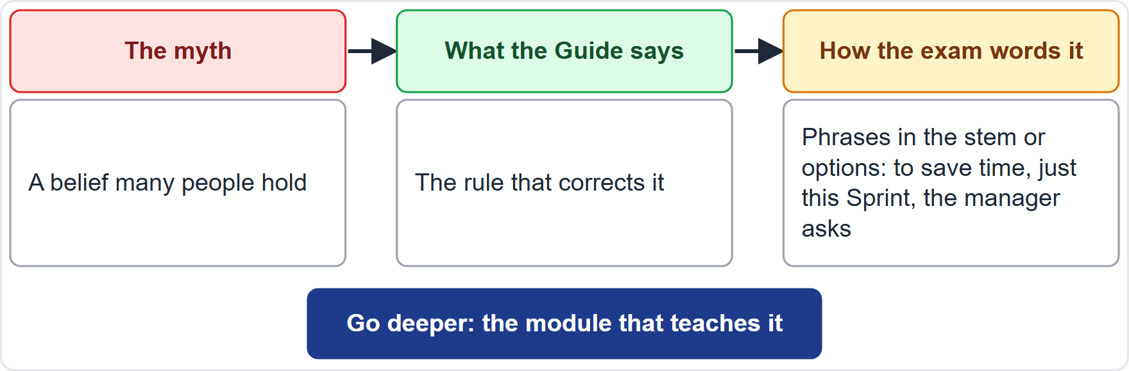
How to Read a Trap
BEYOND THE GUIDE
Module 16
The myth: what many people believe
The Guide: the rule that corrects it
The wording: how a question disguises the myth
Go deeper: the module with the detail
CSM Exam Prep Masterclass | Certified ScrumMaster
Module 16: Traps and Misconceptions Clinic
3 / 20
Notes:
Each trap on the next slides has the same shape, which is the course's own format. First the myth: what many people believe. Second, what the Guide says: the rule that corrects it. Third, the wording: the phrases a question uses to disguise the myth, such as to save time, just this Sprint, or the manager asks. And finally a pointer to the module with the detail. Learn the wording, and the traps become easy to see.

Slide 4
Trap 1: Scrum Prescribes the Techniques
Module 16
Myth
The Guide
Scrum tells you how to estimate, write requirements and test
a purposely incomplete framework; those choices belong to the team; user stories and story points are not in it
The wording
Go deeper
Scrum requires user stories sized in story points
Modules 1 and 10
EXAM TIP An option that makes a technique mandatory is wrong.
CSM Exam Prep Masterclass | Certified ScrumMaster
Module 16: Traps and Misconceptions Clinic
4 / 20
Notes:
Trap one. The myth: Scrum tells you how to estimate, write requirements and test. The Guide says Scrum is a purposely incomplete framework, so those choices belong to the team, and user stories and story points are not in it. In the exam you may see an option such as: Scrum requires user stories sized in story points. Any option that makes a technique mandatory is wrong. See Modules one and ten.

Slide 5
Trap 2: Pillars and Values Are One List
Module 16
Myth
The Guide
transparency is a value; courage is a pillar
pillars are transparency, inspection, adaptation; values are commitment, focus, openness, respect, courage
The wording
Go deeper
lists that mix in trust, discipline, collaboration or accountability
Modules 1 and 2
EXAM TIP Learn both lists separately, five and three.
CSM Exam Prep Masterclass | Certified ScrumMaster
Module 16: Traps and Misconceptions Clinic
5 / 20
Notes:
Trap two. The myth: transparency is a value, or courage is a pillar. The Guide has two lists. The pillars are transparency, inspection and adaptation. The values are commitment, focus, openness, respect and courage. In the exam, watch for lists that mix in trust, discipline, collaboration or accountability. Learn both lists separately: three and five. See Modules one and two.

Slide 6
Trap 3: Scrum Works Without Some Parts
Module 16
Myth
The Guide
the team can skip the Retrospective to save time
partial Scrum is not Scrum; skipping any event loses a chance to inspect and adapt
The wording
Go deeper
to save time, just this Sprint, only for now
Modules 1, 6 and 9
EXAM TIP The best answer restores the missing part and explains what it protects.
CSM Exam Prep Masterclass | Certified ScrumMaster
Module 16: Traps and Misconceptions Clinic
6 / 20
Notes:
Trap three. The myth: the team can skip the Retrospective to save time. The Guide says partial Scrum is not Scrum, and skipping any event loses a chance to inspect and adapt. The disguise: to save time, just this Sprint, only for now. The best answer restores the missing part and explains what it protects. It never endorses the shortcut. See Modules one, six and nine.

Slide 7
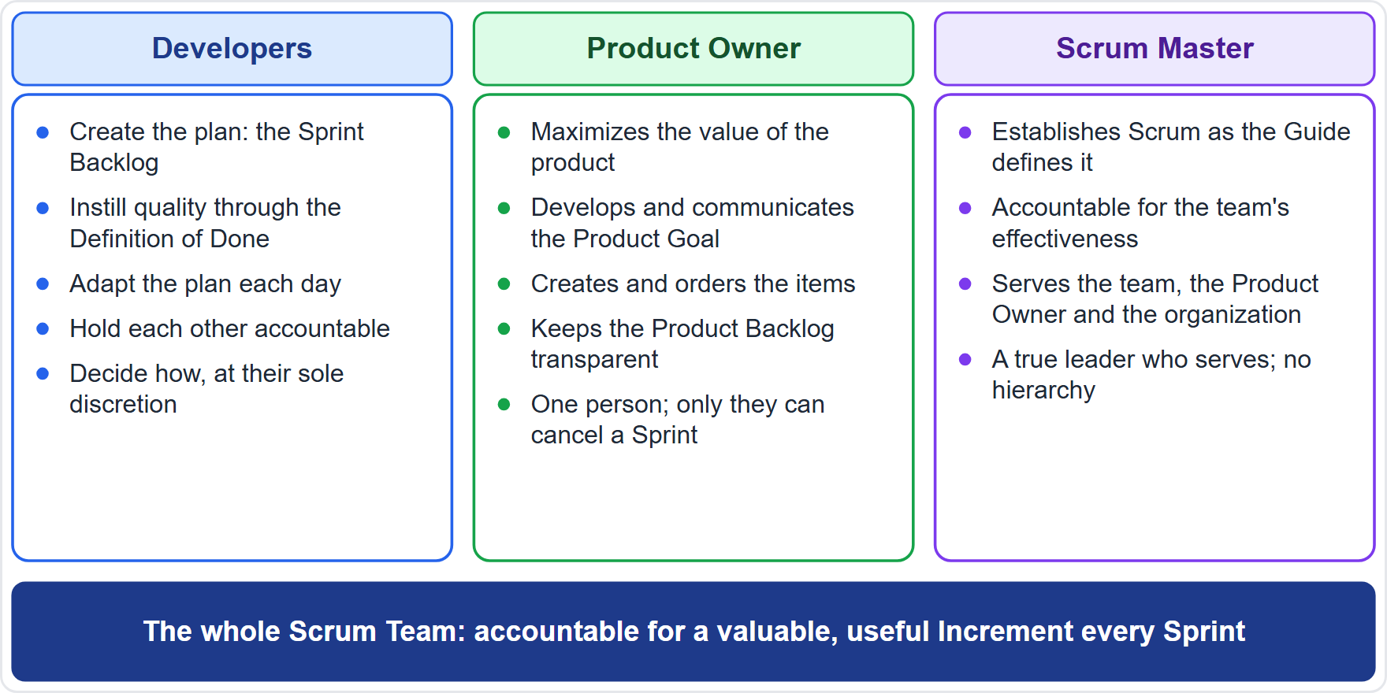
Trap 4: The Scrum Master Is the Manager
Module 16
Myth: the Scrum Master assigns tasks, approves work and reports on each person
The Guide: a true leader who serves; the team is self-managing; no hierarchy
The wording: assign the tasks, a weekly report on each Developer, approve the design
Go deeper: Modules 5 and 14
CSM Exam Prep Masterclass | Certified ScrumMaster
Module 16: Traps and Misconceptions Clinic
7 / 20
Notes:
Trap four. The myth: the Scrum Master assigns tasks, approves work and reports on each person. The Guide describes a true leader who serves; the team is self-managing, and there is no hierarchy. The disguise: assign the tasks, a weekly report on each Developer, approve the design. The Scrum Master is accountable for Scrum and for the team's effectiveness, as the diagram shows. See Modules five and fourteen.

Slide 8
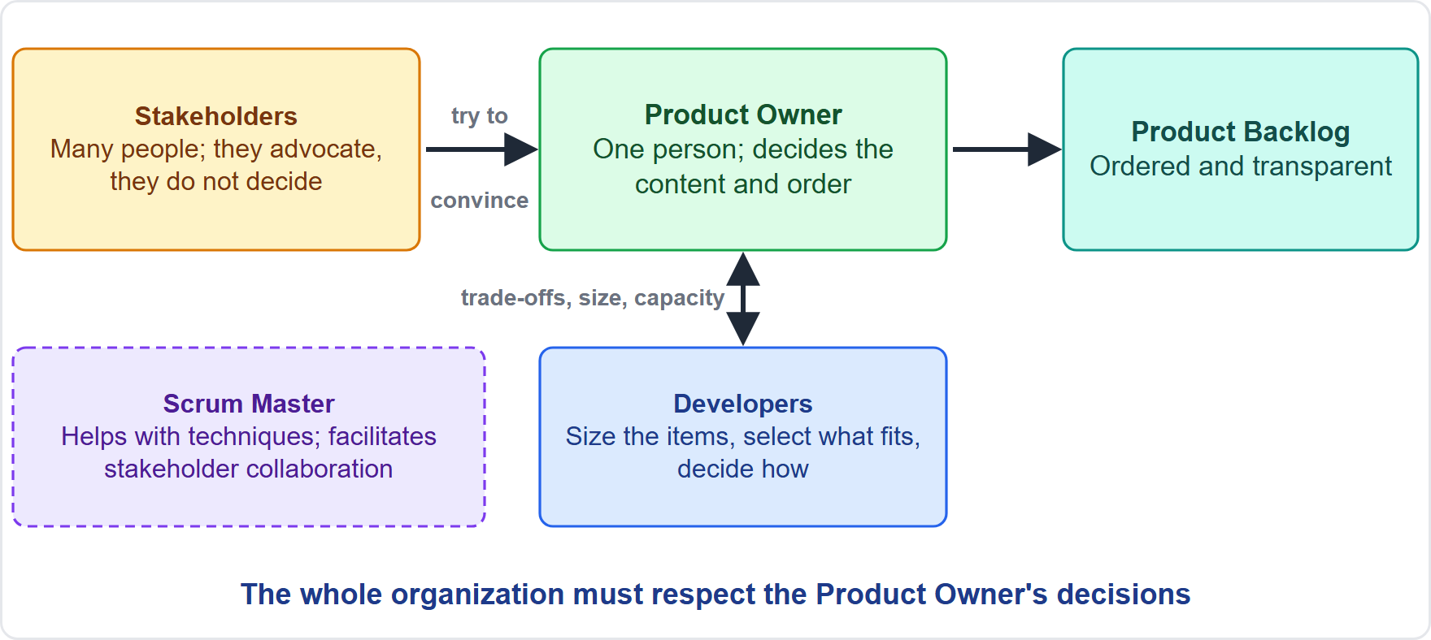
Trap 5: A Committee Can Own the Product Backlog
Module 16
Myth: a steering group, a vote or a manager can order the Product Backlog
The Guide: the Product Owner is one person; stakeholders try to convince; the organization respects the decisions
The wording: three managers act as Product Owner, the stakeholders vote
Go deeper: Module 4
CSM Exam Prep Masterclass | Certified ScrumMaster
Module 16: Traps and Misconceptions Clinic
8 / 20
Notes:
Trap five. The myth: a steering group, a vote or a manager can order the Product Backlog. The Guide says the Product Owner is one person. Stakeholders try to convince the Product Owner, and the organization respects the decisions. The disguise: three managers act as Product Owner, or the stakeholders vote. The diagram shows the correct flow of influence. See Module four.

Slide 9
Trap 6: The Product Owner Tells the Developers How
Module 16
Myth
The Guide
the Product Owner assigns work, sets sizes or dictates the design
the Developers select the items, size them and decide how, at their sole discretion
The wording
Go deeper
Maya tells who builds what, size every item as small
Modules 4, 7 and 10
EXAM TIP The Product Owner steers through the Product Backlog, not through the Developers' tasks.
CSM Exam Prep Masterclass | Certified ScrumMaster
Module 16: Traps and Misconceptions Clinic
9 / 20
Notes:
Trap six. The myth: the Product Owner assigns work, sets sizes or dictates the design. The Guide says the Developers select the items, size them and decide how, at their sole discretion. The disguise: Maya tells who builds what, or: size every item as small. The Product Owner steers through the Product Backlog, not through the Developers' tasks. See Modules four, seven and ten.

Slide 10
Trap 7: A Sprint Can Be Stretched or Prepared For
Module 16
Myth
The Guide
extend a late Sprint, add a Sprint 0 or a hardening Sprint, run six weeks
fixed length of one month or less; the next Sprint starts immediately; all the work happens inside Sprints
The wording
Go deeper
extend by three days, a four-week setup phase, six-week Sprints
Module 6
EXAM TIP Complexity argues for shorter Sprints, not longer.
CSM Exam Prep Masterclass | Certified ScrumMaster
Module 16: Traps and Misconceptions Clinic
10 / 20
Notes:
Trap seven. The myth: extend a late Sprint, add a Sprint zero or a hardening Sprint, or run six weeks. The Guide says a Sprint has a fixed length of one month or less, the next one starts immediately, and all the work happens inside Sprints. The disguise: extend by three days, a four-week setup phase, six-week Sprints. Complexity argues for shorter Sprints, not longer. See Module six.

Slide 11
Trap 8: Anyone Can Cancel a Sprint
Module 16
Myth
The Guide
the team, the Scrum Master or a manager can cancel a late Sprint
only the Product Owner, and only when the Sprint Goal becomes obsolete
The wording
Go deeper
the work is harder than expected, the plan can no longer be met
Modules 4, 6 and 11
EXAM TIP Being behind means negotiate scope, not cancel.
CSM Exam Prep Masterclass | Certified ScrumMaster
Module 16: Traps and Misconceptions Clinic
11 / 20
Notes:
Trap eight. The myth: the team, the Scrum Master or a manager can cancel a late Sprint. The Guide says only the Product Owner can, and only when the Sprint Goal becomes obsolete. The disguise: the work is harder than expected, or the plan can no longer be met. Being behind is not a reason; the Developers and the Product Owner negotiate scope. See Modules four, six and eleven.

Slide 12
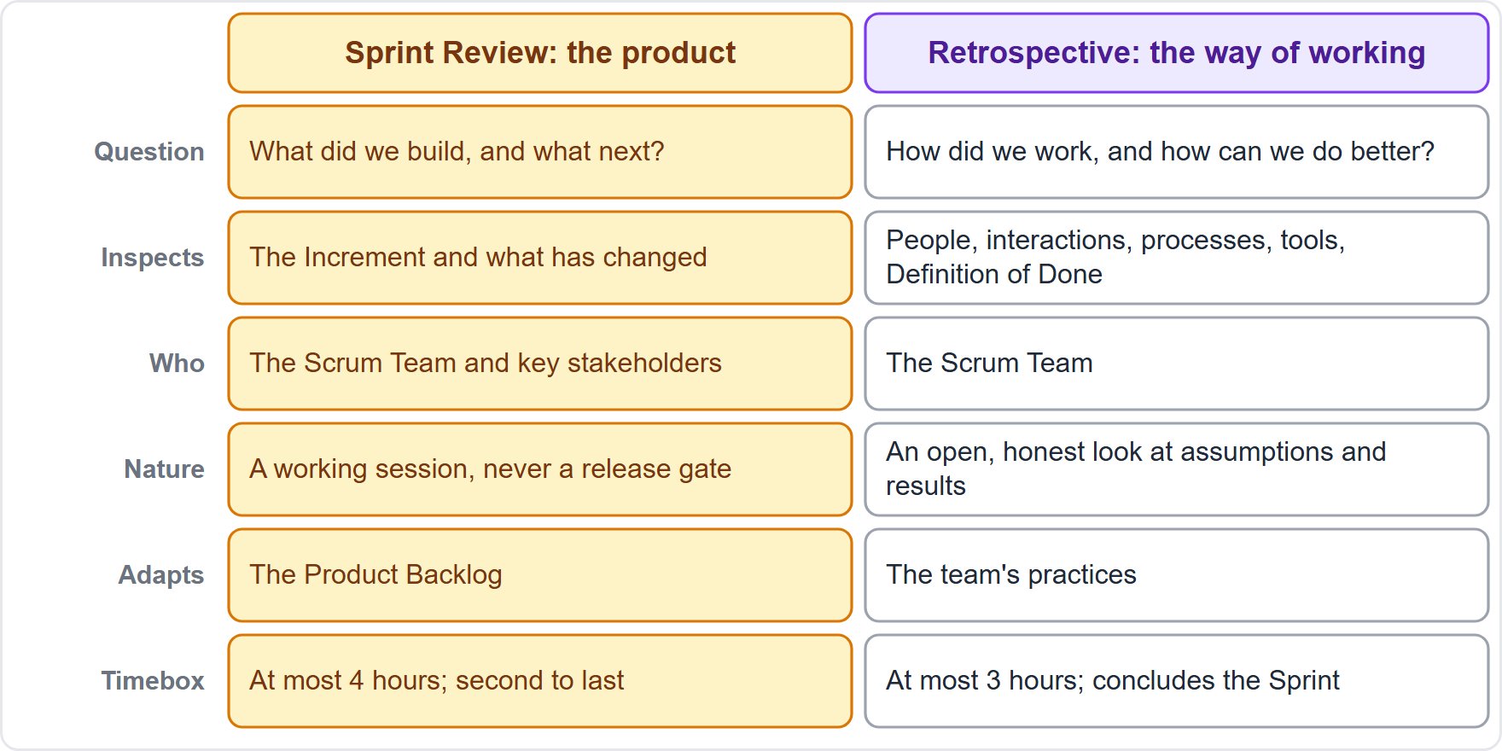
Trap 9: The Review Is a Demo for Approval
Module 16
Myth: the Review is a presentation, a sign-off or a gate to release
The Guide: a working session; an Increment may be delivered earlier; not Done is not shown
The wording: the stakeholders accept the Sprint, show the almost-done item
Go deeper: Modules 9 and 12
CSM Exam Prep Masterclass | Certified ScrumMaster
Module 16: Traps and Misconceptions Clinic
12 / 20
Notes:
Trap nine. The myth: the Sprint Review is a presentation, a sign-off, or a gate to release. The Guide says it is a working session. An Increment may be delivered earlier, and an item that is not Done is not shown. The disguise: the stakeholders accept the Sprint, or: show the almost-done item. The diagram contrasts the Review, which looks at the outcome, with the Retrospective. See Modules nine and twelve.

Slide 13
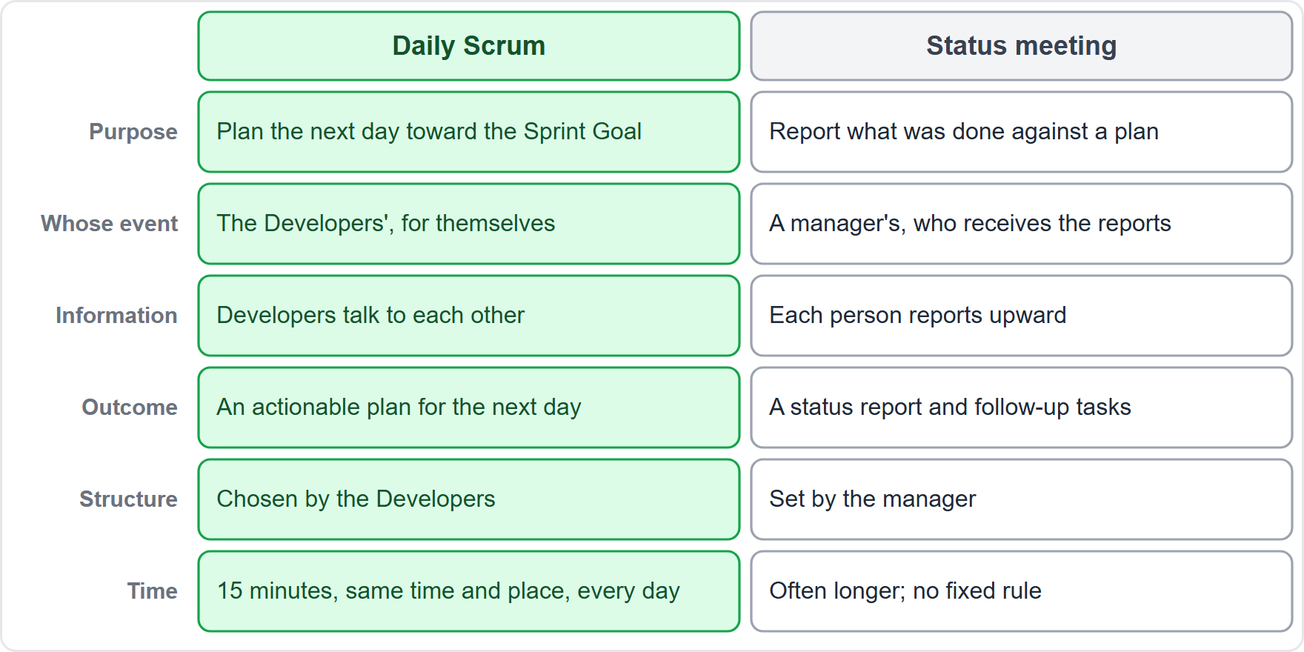
Trap 10: The Daily Scrum Is a Status Meeting
Module 16
Myth: each Developer reports to the Scrum Master or the Product Owner; three questions are mandatory
The Guide: the Developers' own 15-minute planning toward the Sprint Goal; they choose the structure
The wording: report individual status, managers attend, the Scrum Master runs it
Go deeper: Module 8
CSM Exam Prep Masterclass | Certified ScrumMaster
Module 16: Traps and Misconceptions Clinic
13 / 20
Notes:
Trap ten. The myth: each Developer reports to the Scrum Master or the Product Owner, using three mandatory questions. The Guide says the Daily Scrum is the Developers' own fifteen-minute planning toward the Sprint Goal, and they choose the structure. The disguise: report individual status, managers attend, the Scrum Master runs it. The diagram shows the difference. See Module eight.

Slide 14
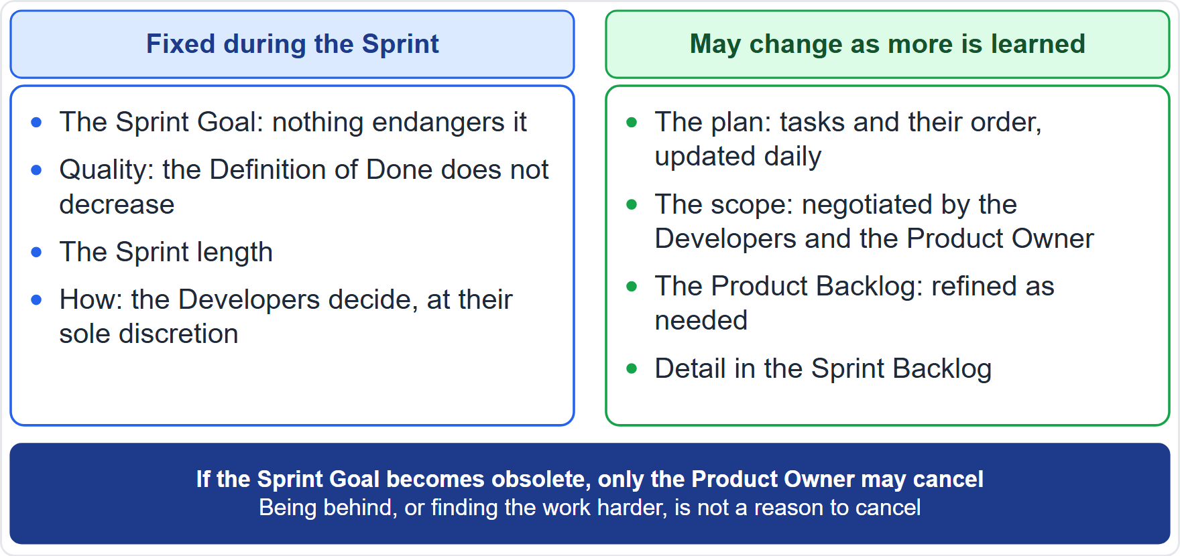
Trap 11: The Sprint Goal Moves With the Priorities
Module 16
Myth: change the goal when a new priority arrives, or treat it as a list of items
The Guide: one objective, a commitment; the goal is fixed and the scope is negotiated
The wording: change the Sprint Goal on day four, one item failed so the Sprint failed
Go deeper: Modules 7 and 11
CSM Exam Prep Masterclass | Certified ScrumMaster
Module 16: Traps and Misconceptions Clinic
14 / 20
Notes:
Trap eleven. The myth: change the Sprint Goal when a new priority arrives, or treat the goal as a list of items. The Guide says it is one objective and a commitment. The goal is fixed, and the scope is negotiated. The disguise: change the Sprint Goal on day four, or: one item failed, so the Sprint failed. New priorities go to the Product Backlog. See Modules seven and eleven. The diagram shows what stays fixed in the Sprint and what may change.

Slide 15
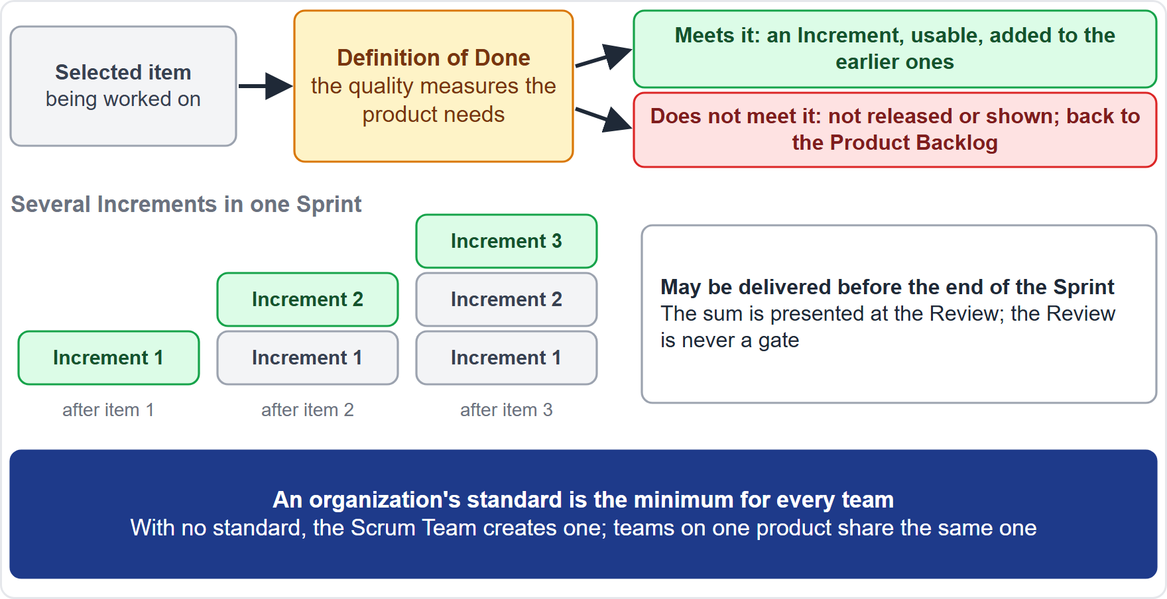
Trap 12: Almost Done Counts
Module 16
Myth: count nearly finished work, or relax the Definition of Done for a date
The Guide: an item that misses it is not Done, not shown and back in the Product Backlog
The wording: just this once, ninety percent finished, change the definition for this item
Go deeper: Module 12
CSM Exam Prep Masterclass | Certified ScrumMaster
Module 16: Traps and Misconceptions Clinic
15 / 20
Notes:
Trap twelve. The myth: count nearly finished work, or relax the Definition of Done to meet a date. The Guide says an item that misses the Definition of Done is not Done, is not shown, and goes back to the Product Backlog. The disguise: just this once, ninety percent finished, or: change the definition for this item. Quality does not decrease. See Module twelve.

Slide 16
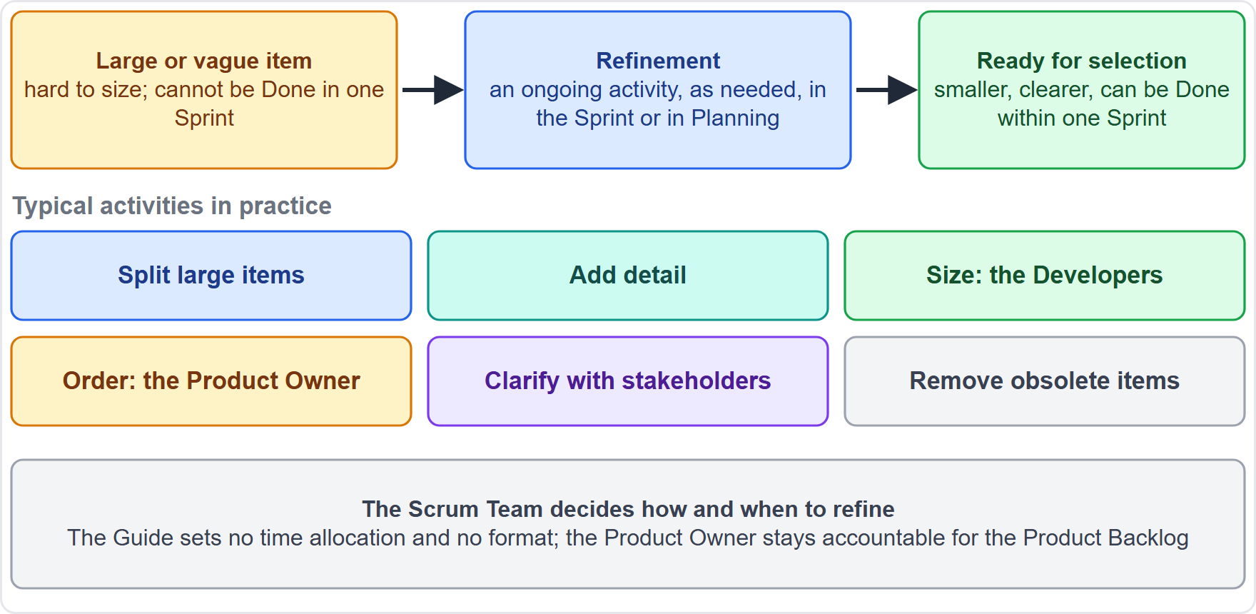
Trap 13: The Product Backlog Must Be Complete
Module 16
Myth: every item must be fully detailed and sized before the first Sprint; refinement is an event
The Guide: emergent and ordered; refinement is an ongoing activity; ready means Done within one Sprint
The wording: a complete Product Backlog first, one refinement session before each Sprint
Go deeper: Module 10
CSM Exam Prep Masterclass | Certified ScrumMaster
Module 16: Traps and Misconceptions Clinic
16 / 20
Notes:
Trap thirteen. The myth: every item must be fully detailed and sized before the first Sprint, and refinement is an event. The Guide says the Product Backlog is emergent and ordered, refinement is an ongoing activity, and an item is ready when it can be Done within one Sprint. The disguise: a complete Product Backlog first, or: one refinement session before each Sprint. See Module ten.

Slide 17
Trap 14: Facilitating Means Deciding
Module 16
Myth
The Guide
the Scrum Master decides to save time; a coach gives the answers
the Scrum Master coaches and facilitates; facilitation is neutral on content
The wording
Go deeper
choose the tool and tell the team, tell the Developer exactly what to do
Module 13
EXAM TIP Ask: who has the answer? Coaching draws it out; facilitating guides the group to its own.
CSM Exam Prep Masterclass | Certified ScrumMaster
Module 16: Traps and Misconceptions Clinic
17 / 20
Notes:
Trap fourteen. The myth: the Scrum Master decides to save time, or a coach gives the answers. The Guide says the Scrum Master coaches and facilitates, and facilitation is neutral on content. The disguise: choose the tool and tell the team, or: tell the Developer exactly what to do. Ask the test question: who has the answer? Coaching draws it out. See Module thirteen.

Slide 18
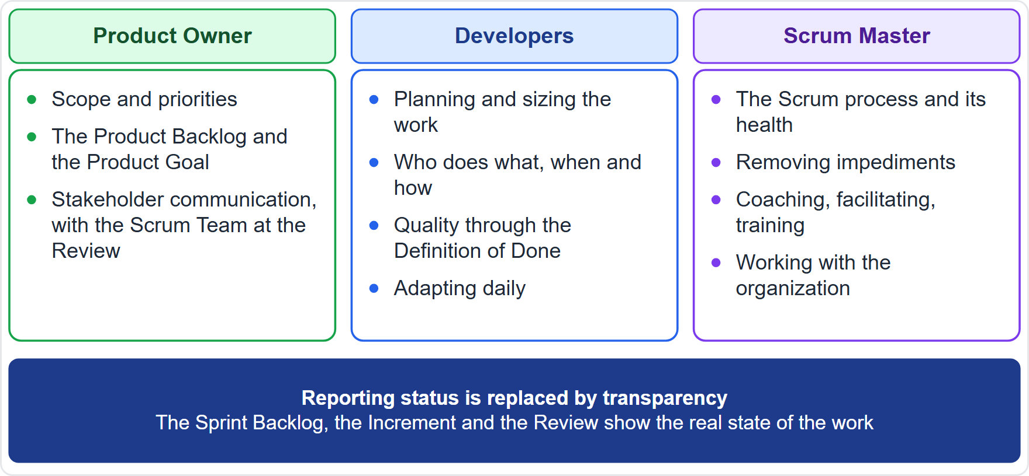
Trap 15: Debt Gets Its Own Sprint, Scrum Has a Project Manager
Module 16
Myth: schedule a hardening Sprint for technical debt; somebody must be the project manager
The Guide: the Definition of Done is the main defense; all work is inside every Sprint; three accountabilities, no hierarchy
The wording: plan a hardening Sprint, who is the project manager
Go deeper: Module 14
CSM Exam Prep Masterclass | Certified ScrumMaster
Module 16: Traps and Misconceptions Clinic
18 / 20
Notes:
Trap fifteen. The myth: schedule a hardening Sprint to pay off technical debt, and somebody must be the project manager. The Guide says the Definition of Done is the main defense against debt, all work happens inside every Sprint, and there are three accountabilities with no hierarchy. The disguise: plan a hardening Sprint, or: who is the project manager? The diagram shows where the duties go. See Module fourteen.

Slide 19
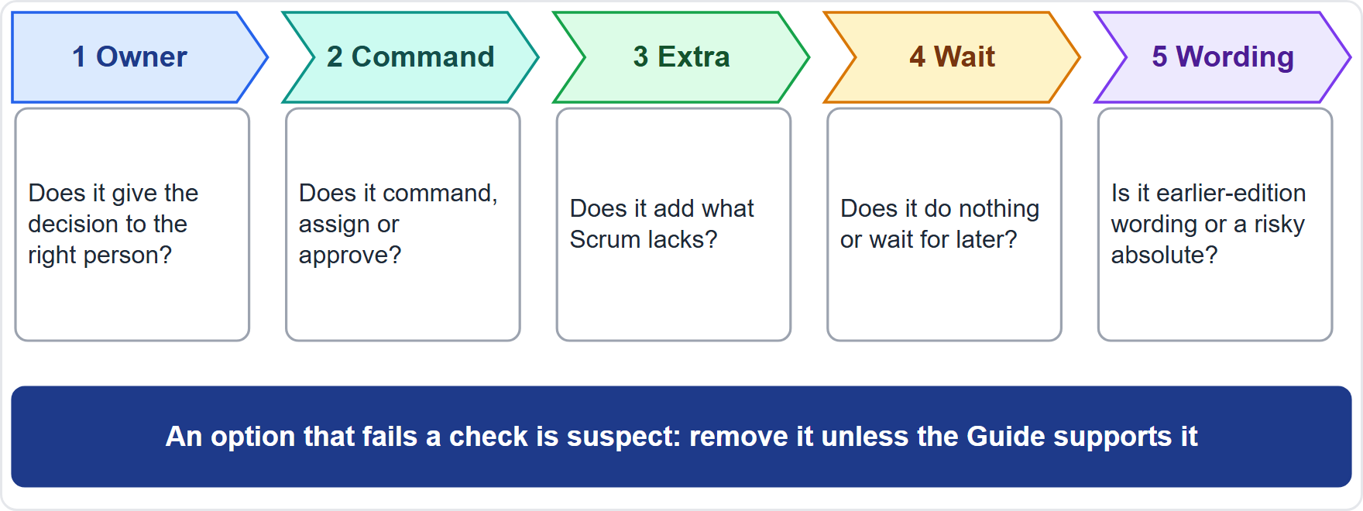
The Ten-Second Trap Check
BEYOND THE GUIDE
Module 16
Owner: the right person decides?
Command: does it command, assign or approve?
Extra: does it add what Scrum lacks?
Wait: does it do nothing, or postpone?
Wording: old terms or a risky absolute?
EXAM TIP Check an absolute word against the Guide before you reject it.
CSM Exam Prep Masterclass | Certified ScrumMaster
Module 16: Traps and Misconceptions Clinic
19 / 20
Notes:
Here is a quick check for any option, in about ten seconds; it is the course's method, not the Guide's. Owner: does it give the decision to the right person? Command: does it command, assign or approve? Extra: does it add what Scrum lacks? Wait: does it do nothing, or postpone? Wording: does it use old terms, or a risky absolute? An option that fails a check is suspect: remove it unless the Guide supports it. And check an absolute word against the Guide before you reject it.

Slide 20
Module Recap
Module 16
1
Techniques
2
Pillars and values
3
Partial Scrum
are the team's choice
are two lists
is not Scrum
4
Owners
5
Sprints
6
Done
the Product Owner orders; the Developers decide how; the Scrum Master serves
are fixed; only the Product Owner cancels
means the Definition of Done is met
CSM Exam Prep Masterclass | Certified ScrumMaster
Module 16: Traps and Misconceptions Clinic
20 / 20
Notes:
Recap. Techniques are the team's choice. Pillars and values are two lists. Partial Scrum is not Scrum. The owners: the Product Owner orders, the Developers decide how, and the Scrum Master serves. Sprints are fixed, and only the Product Owner cancels. And Done means the Definition of Done is met. Next, Module 17 gives you quick-reference pages for last-day revision.

