Slide 1
Module 17: Quick-Reference Recap
The whole course on a few pages
For the last two days before the exam
Certified ScrumMaster (CSM) Exam Prep Masterclass
Module 17
Notes:
Welcome to Module 17: Quick-Reference Recap. This is the course on a few pages, for the last two days before the exam. There is one page for each topic module, then the numbers to know, and the key terms. Use it to test yourself: look at a page, cover the text, and say the facts aloud before you listen to them.

Slide 2
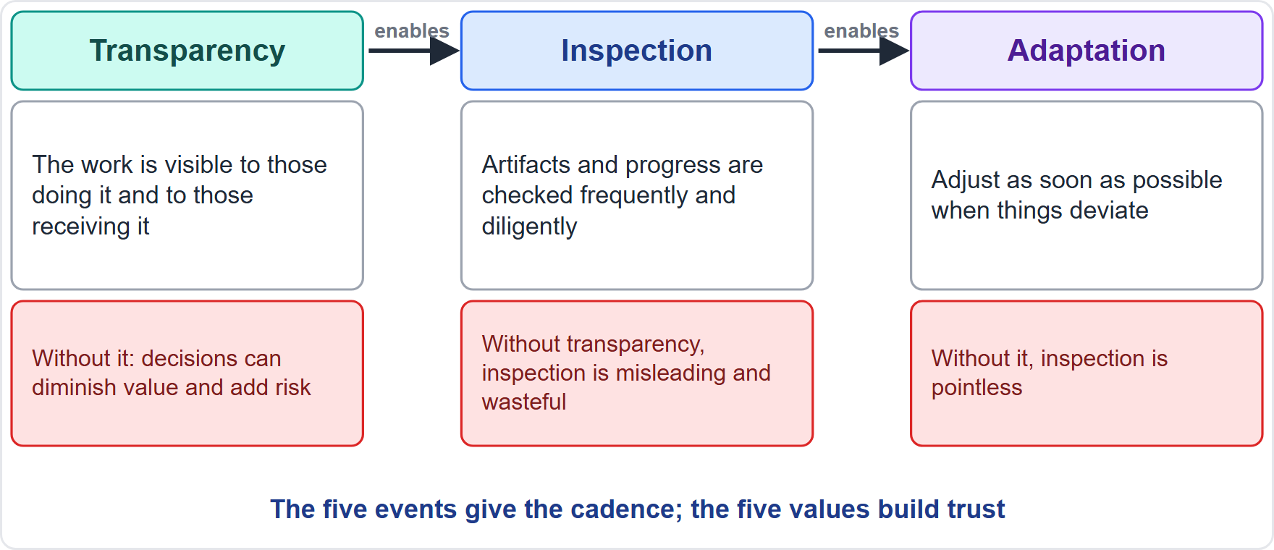
Module 1: Scrum Definition, Theory and Empiricism
Module 17
Scrum: a lightweight framework for value from complex work
Theory: empiricism and lean thinking
Pillars: transparency, inspection, adaptation
Approach: iterative and incremental
Partial Scrum is not Scrum
Old wording: empirical process control
CSM Exam Prep Masterclass | Certified ScrumMaster
Module 17: Quick-Reference Recap
2 / 19
Notes:
Module one in one page. Scrum is a lightweight framework for value from complex work. Its theory is empiricism and lean thinking. The pillars are transparency, inspection and adaptation, in a chain. The approach is iterative and incremental. Partial Scrum is not Scrum. And empirical process control is the earlier edition's wording.

Slide 3
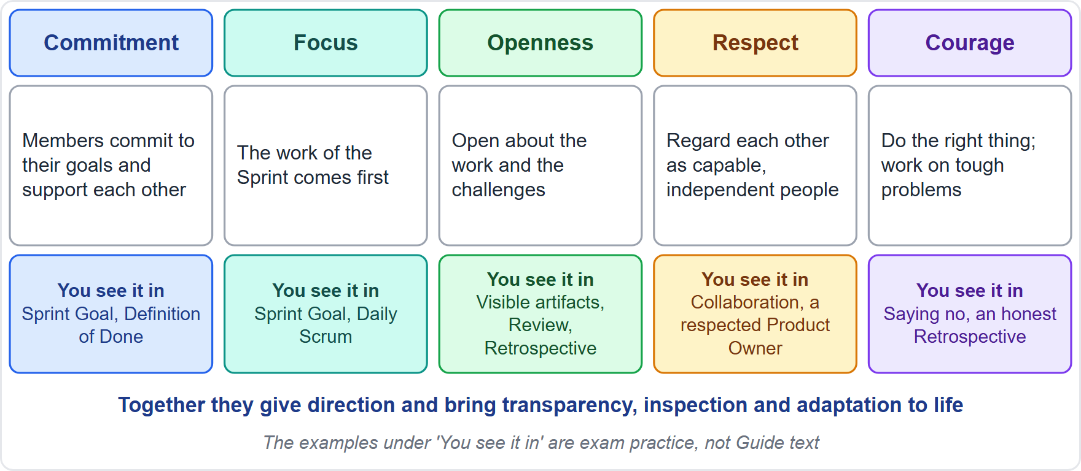
Module 2: Scrum Values and the Agile Manifesto
Module 17
Values: commitment, focus, openness, respect, courage
They give direction and make the pillars real
Manifesto: 4 values, 12 principles
Left over right; the right keeps its value
Match: Increment with working software, emergent backlog with change, Retrospective with reflection
A mindset, not a framework
CSM Exam Prep Masterclass | Certified ScrumMaster
Module 17: Quick-Reference Recap
3 / 19
Notes:
Module two in one page. The five values are commitment, focus, openness, respect and courage. They give direction and make the pillars real. The Manifesto has four values and twelve principles. Left over right, but the right side keeps its value. Match an idea to a Scrum feature: the Increment with working software, the emergent Product Backlog with change, the Retrospective with reflection. The Manifesto is a mindset; Scrum is a framework.

Slide 4
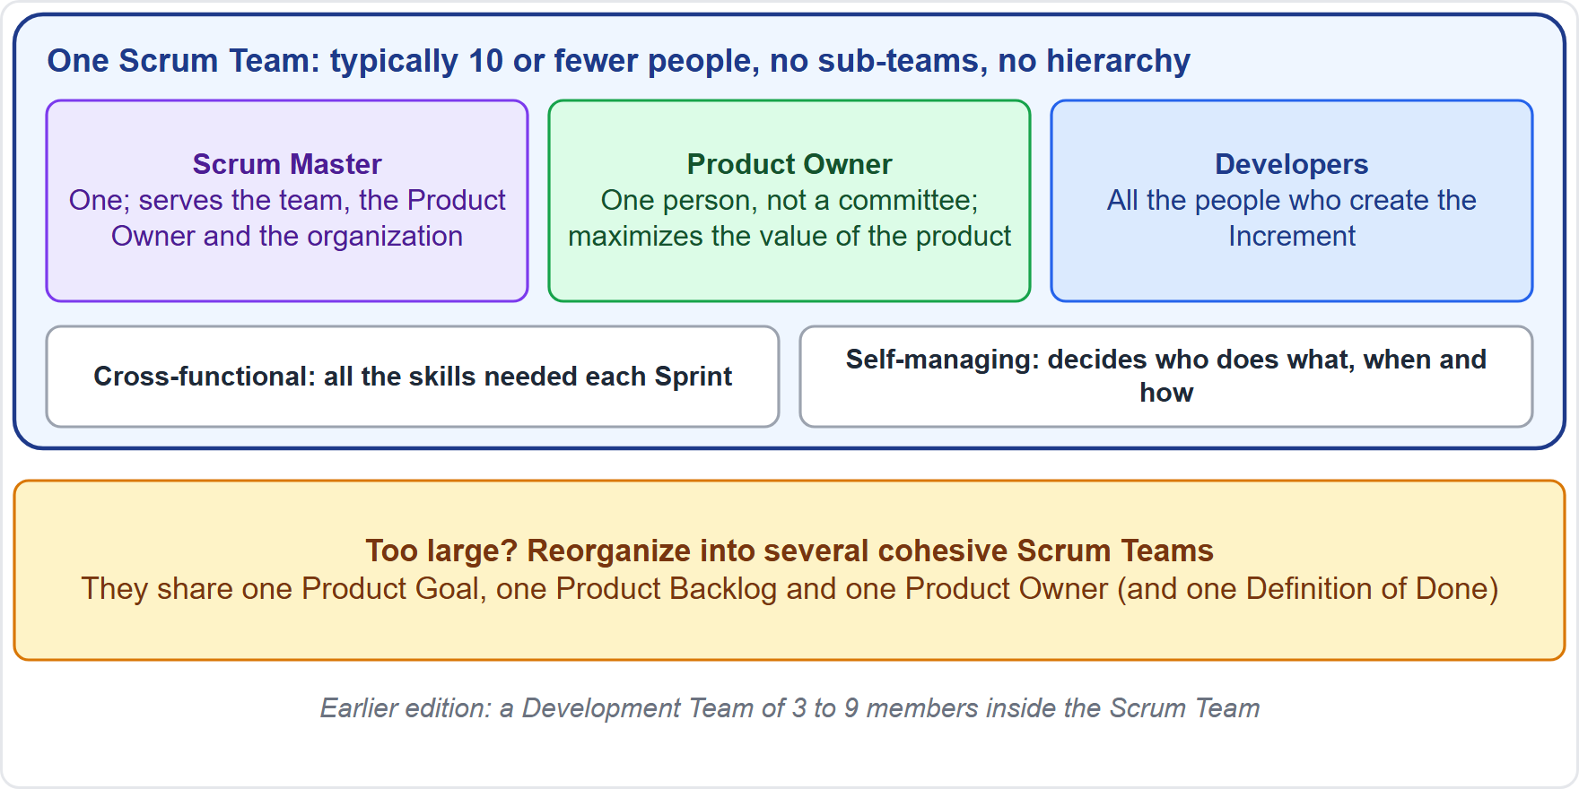
Module 3: The Scrum Team and the Developers
Module 17
Team: a Scrum Master, a Product Owner, Developers
No sub-teams, no hierarchy
Size: typically 10 or fewer
Cross-functional (collective skills) and self-managing
Whole team answers for the Increment
Developers: Sprint plan, quality, daily adaptation, mutual accountability
CSM Exam Prep Masterclass | Certified ScrumMaster
Module 17: Quick-Reference Recap
4 / 19
Notes:
Module three in one page. A Scrum Master, a Product Owner, and Developers. No sub-teams and no hierarchy. Typically ten or fewer people. Cross-functional means collective skills, and self-managing means deciding who does what. The whole team answers for the Increment. The Developers are accountable for the Sprint plan, quality, daily adaptation and mutual accountability.

Slide 5
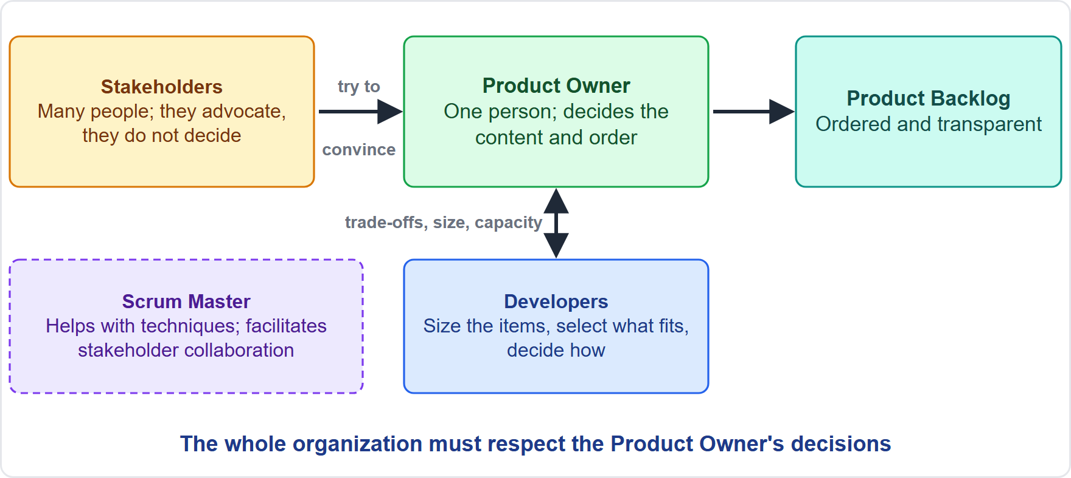
Module 4: The Product Owner
Module 17
Accountable: value, and Product Backlog management
A single person; work may be delegated, accountability not
Stakeholders convince; the organization respects the decisions
Developers size and select
The Product Owner alone cancels a Sprint
At the Daily Scrum only as a Developer
CSM Exam Prep Masterclass | Certified ScrumMaster
Module 17: Quick-Reference Recap
5 / 19
Notes:
Module four in one page. The Product Owner is accountable for the value of the product and for Product Backlog management. A single person; the work may be delegated, the accountability stays. Stakeholders convince, and the organization respects the decisions. The Developers size and select. The Product Owner alone cancels a Sprint. And at the Daily Scrum, the Product Owner takes part only as a Developer.

Slide 6
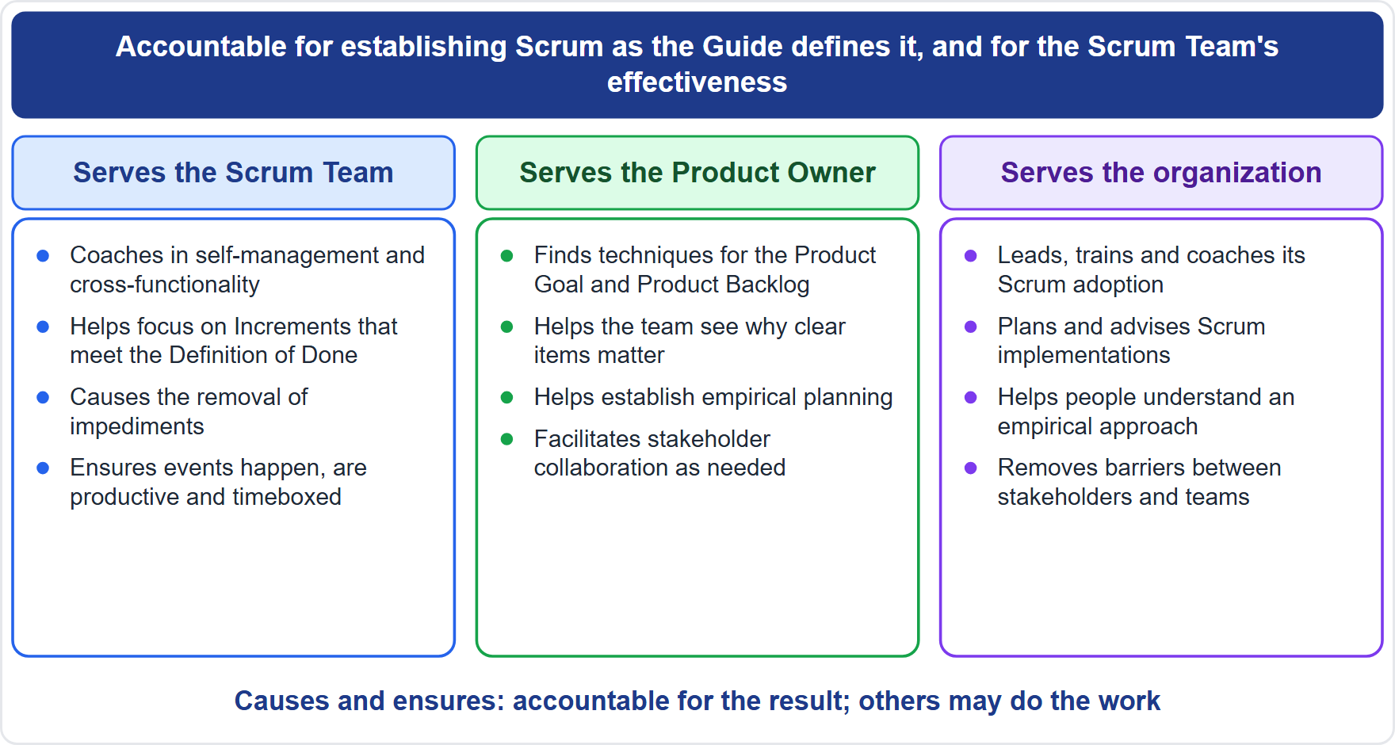
Module 5: The Scrum Master
Module 17
Accountable: Scrum itself; the team's effectiveness
A true leader who serves
Serves the team, the Product Owner, the organization
Daily Scrum: the Developers' event
Decisions stay with their owners
Best answer: serve, make visible, keep Scrum intact, act
CSM Exam Prep Masterclass | Certified ScrumMaster
Module 17: Quick-Reference Recap
6 / 19
Notes:
Module five in one page. The Scrum Master is accountable for Scrum itself and for the team's effectiveness, as a true leader who serves. The Scrum Master serves the team, the Product Owner and the organization. The Daily Scrum is the Developers' event. Decisions stay with their owners. And the best answer serves, makes the problem visible, keeps Scrum intact, and acts. The diagram recalls the three audiences the Scrum Master serves.

Slide 7
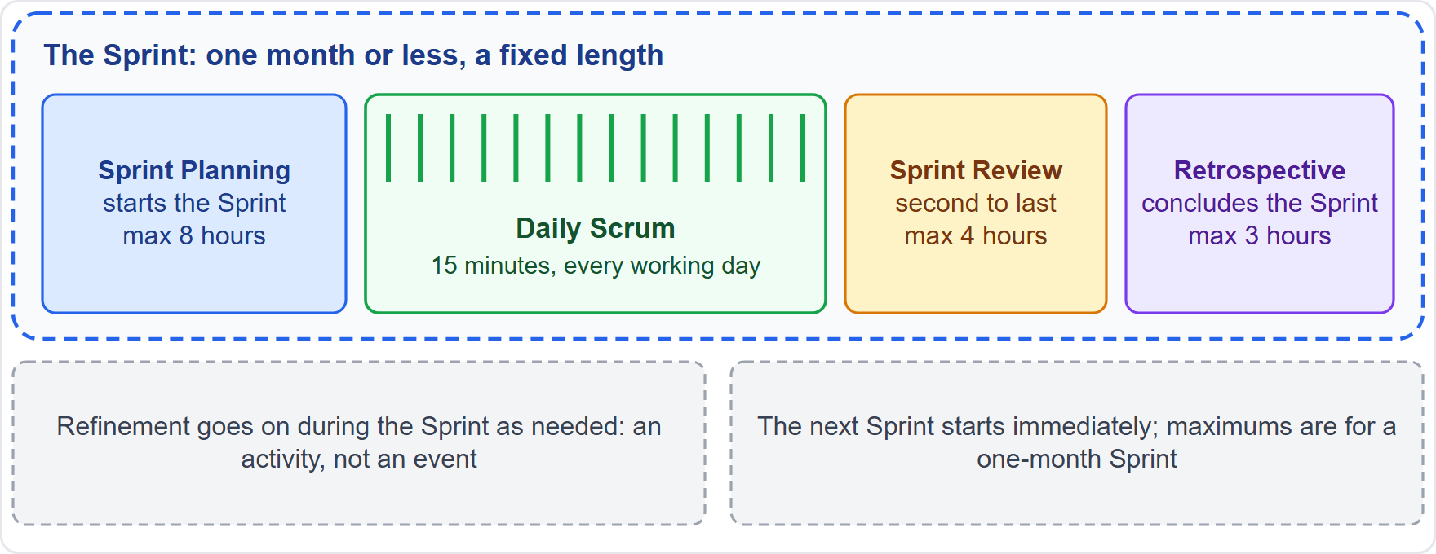
Module 6: The Sprint and the Scrum Events
Module 17
Sprint: fixed, one month or less, the container
Five events: the Sprint plus four
Maximums (one month): 8 h, 15 min, 4 h, 3 h
Review second to last; Retrospective concludes
Shorter Sprints limit risk
Not Scrum: Sprint 0, hardening Sprint, extending
CSM Exam Prep Masterclass | Certified ScrumMaster
Module 17: Quick-Reference Recap
7 / 19
Notes:
Module six in one page. The Sprint is fixed, one month or less, and it is the container. Five events: the Sprint plus four. The maximums for a one-month Sprint are eight hours, fifteen minutes, four hours and three hours. The Review is second to last, and the Retrospective concludes the Sprint. Shorter Sprints limit risk. And Sprint zero, hardening Sprints and extending a Sprint are not Scrum.

Slide 8
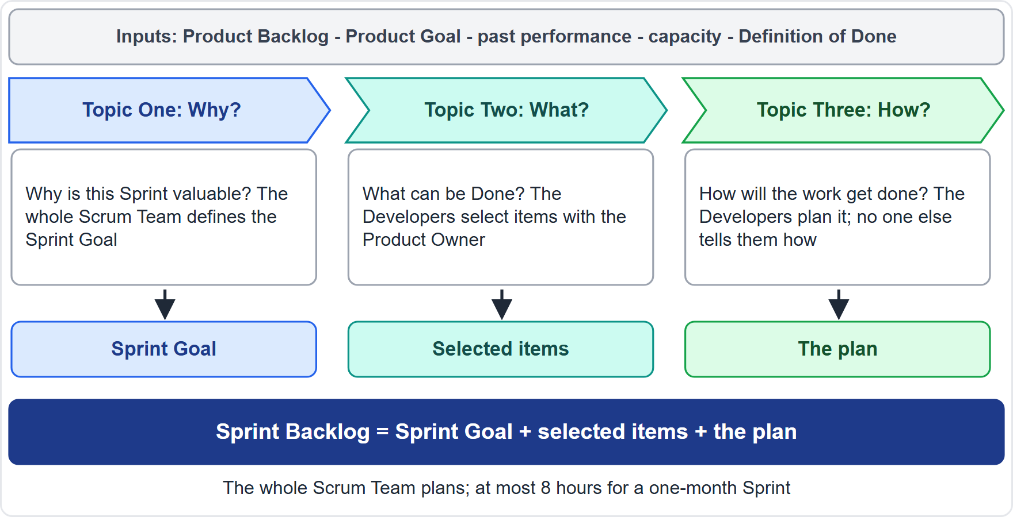
Module 7: Sprint Planning
Module 17
Topics: why, what, how
Output: Sprint Backlog (goal, items, plan)
The whole Scrum Team plans
Developers select and decide how
At most 8 hours for a one-month Sprint
Not in the Guide: an estimation technique
CSM Exam Prep Masterclass | Certified ScrumMaster
Module 17: Quick-Reference Recap
8 / 19
Notes:
Module seven in one page. Three topics: why, what and how. The output is the Sprint Backlog: goal, items and plan. The whole Scrum Team plans. The Developers select the items and decide how. Eight hours at most for a one-month Sprint. And an estimation technique is not in the Guide.

Slide 9
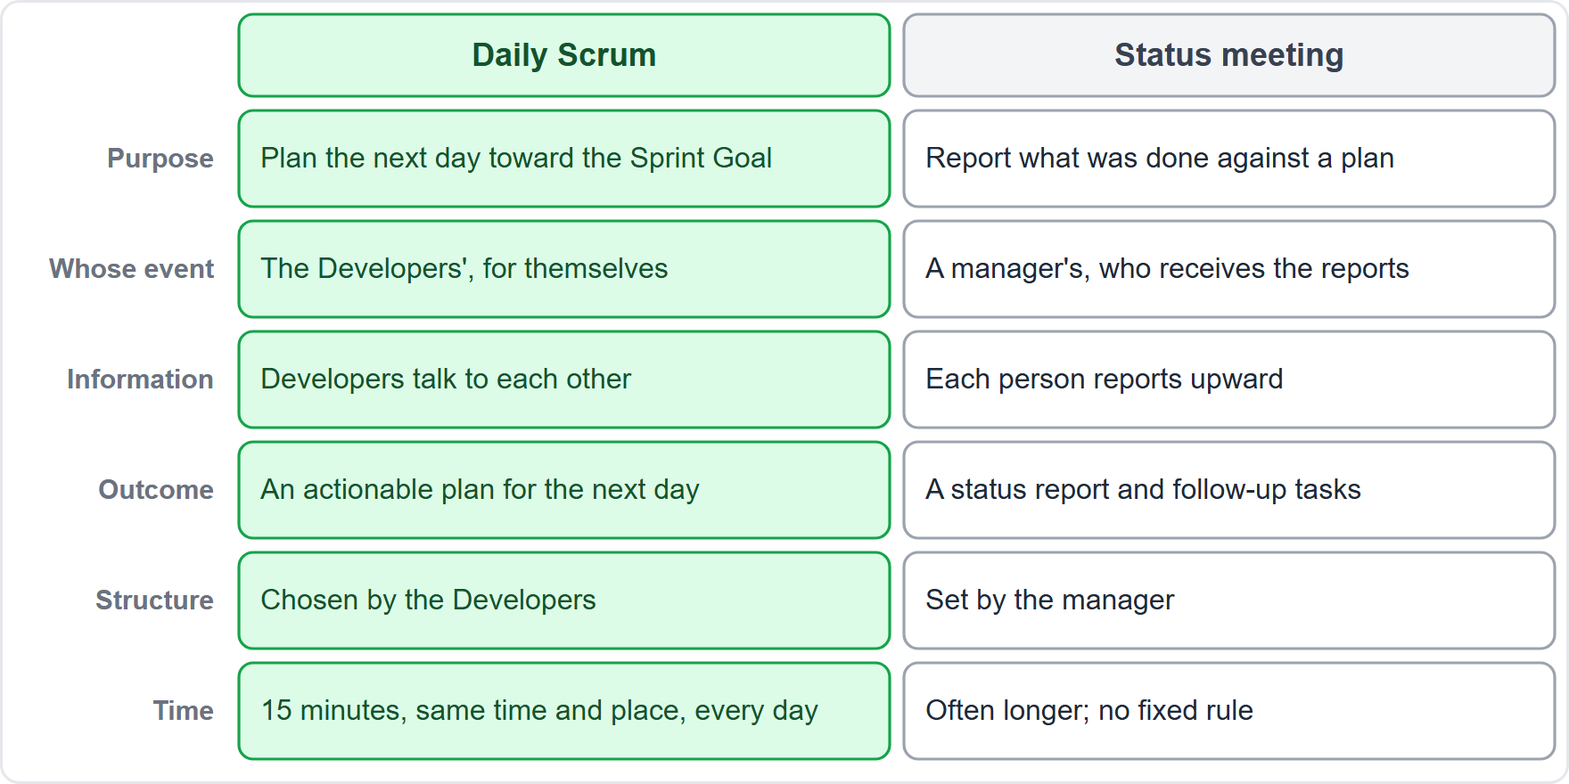
Module 8: Daily Scrum
Module 17
Purpose: progress toward the Sprint Goal; adjust the plan
15 minutes, every working day, fixed time and place
The Developers' event
The Developers choose the structure
Output: a plan for the next day
Not a status meeting
CSM Exam Prep Masterclass | Certified ScrumMaster
Module 17: Quick-Reference Recap
9 / 19
Notes:
Module eight in one page. The purpose is to check progress toward the Sprint Goal and adjust the plan. Fifteen minutes, every working day, at a fixed time and place. It is the Developers' event, and they choose the structure. The output is a plan for the next day. It is not a status meeting.

Slide 10
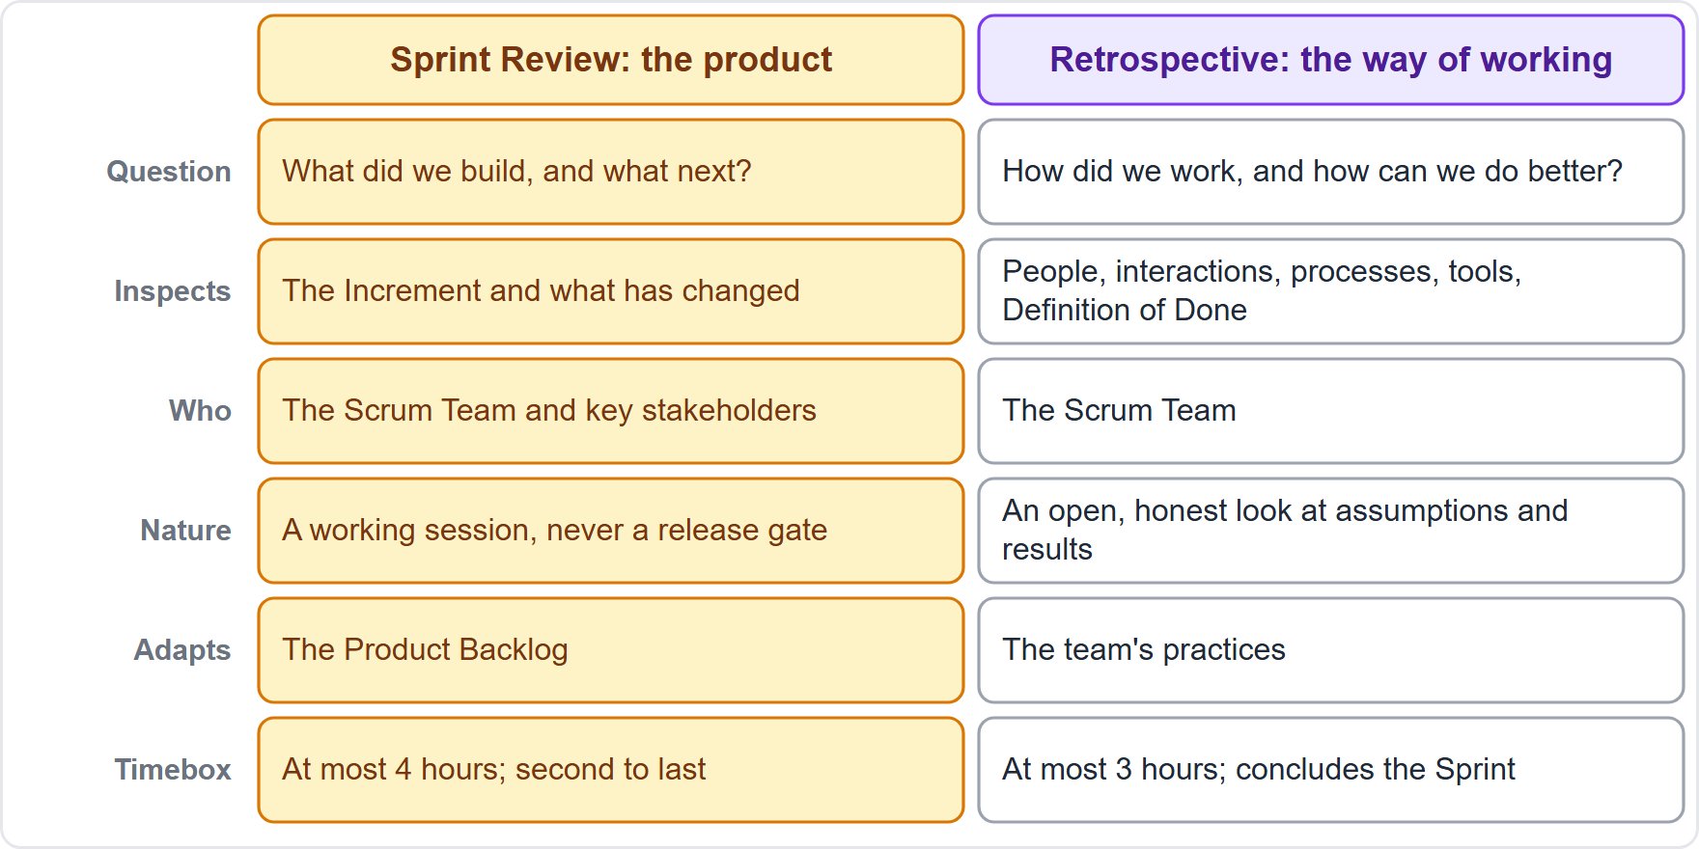
Module 9: Sprint Review and Sprint Retrospective
Module 17
Review: the outcome; Scrum Team and key stakeholders; adapts the Product Backlog; 4 h
Retrospective: the way of working; the Scrum Team; plans improvements; 3 h
Review is never a gate
Not Done is not shown
Skipping the Retrospective: problems repeat
CSM Exam Prep Masterclass | Certified ScrumMaster
Module 17: Quick-Reference Recap
10 / 19
Notes:
Module nine in one page. The Review inspects the outcome with key stakeholders, adapts the Product Backlog, and takes four hours at most. The Retrospective inspects the way of working, with the Scrum Team, plans improvements, and takes three hours at most. The Review is never a gate. What is not Done is not shown. And skipping the Retrospective means problems repeat.

Slide 11
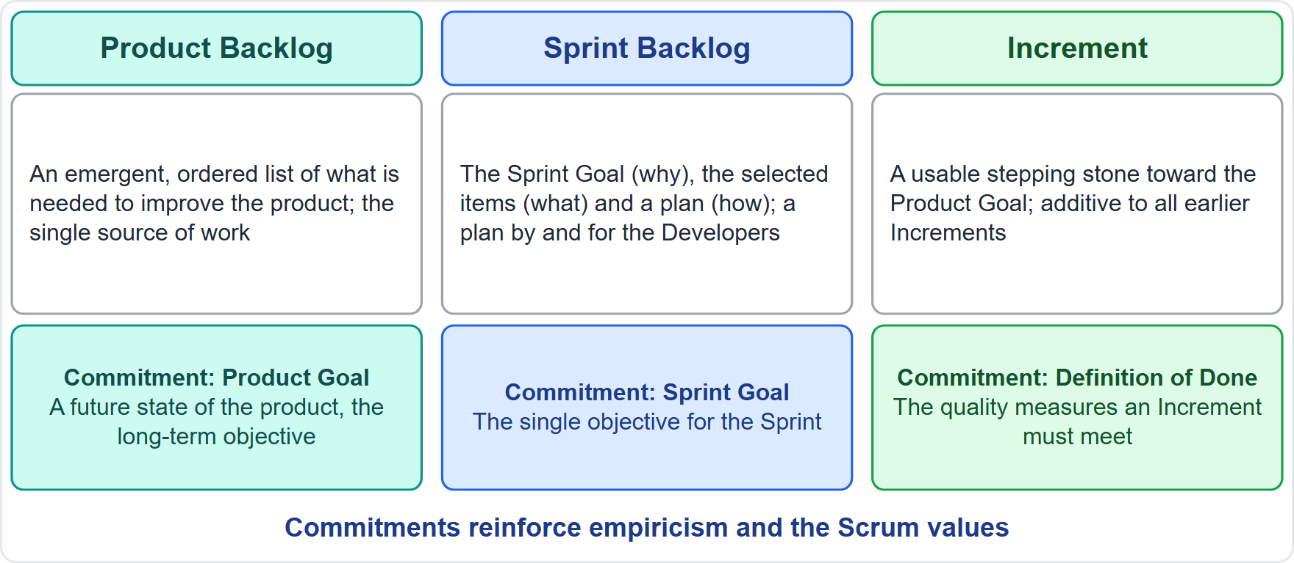
Module 10: Product Backlog, Product Goal and Refinement
Module 17
Product Backlog: emergent, ordered, single source of work
Commitments: Product Goal, Sprint Goal, Definition of Done
Item: description, order, size
Ready: Done within one Sprint
Refinement: ongoing, not an event
One Product Goal at a time
CSM Exam Prep Masterclass | Certified ScrumMaster
Module 17: Quick-Reference Recap
11 / 19
Notes:
Module ten in one page. The Product Backlog is emergent, ordered, and the single source of work. The commitments are the Product Goal, the Sprint Goal and the Definition of Done. An item has a description, an order and a size. Ready means it can be Done within one Sprint. Refinement is ongoing and not an event. And one Product Goal at a time.

Slide 12
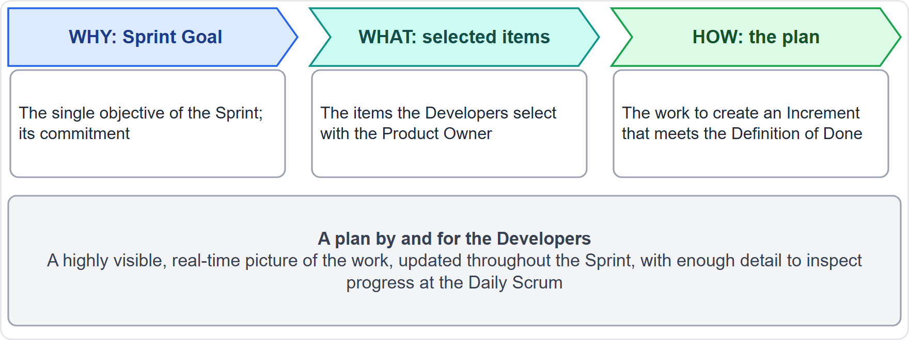
Module 11: Sprint Backlog and Sprint Goal
Module 17
Sprint Backlog: goal + items + plan; the Developers' own
Updated all through the Sprint
Sprint Goal: one objective, a commitment
Plan and scope may change; goal and quality may not
Scope is negotiated with the Product Owner
Obsolete goal: the Product Owner may cancel
CSM Exam Prep Masterclass | Certified ScrumMaster
Module 17: Quick-Reference Recap
12 / 19
Notes:
Module eleven in one page. The Sprint Backlog is the goal, the items and the plan, and it belongs to the Developers. It is updated all through the Sprint. The Sprint Goal is one objective and a commitment. The plan and the scope may change; the goal and the quality may not. Scope is negotiated with the Product Owner. And an obsolete goal lets the Product Owner cancel.

Slide 13
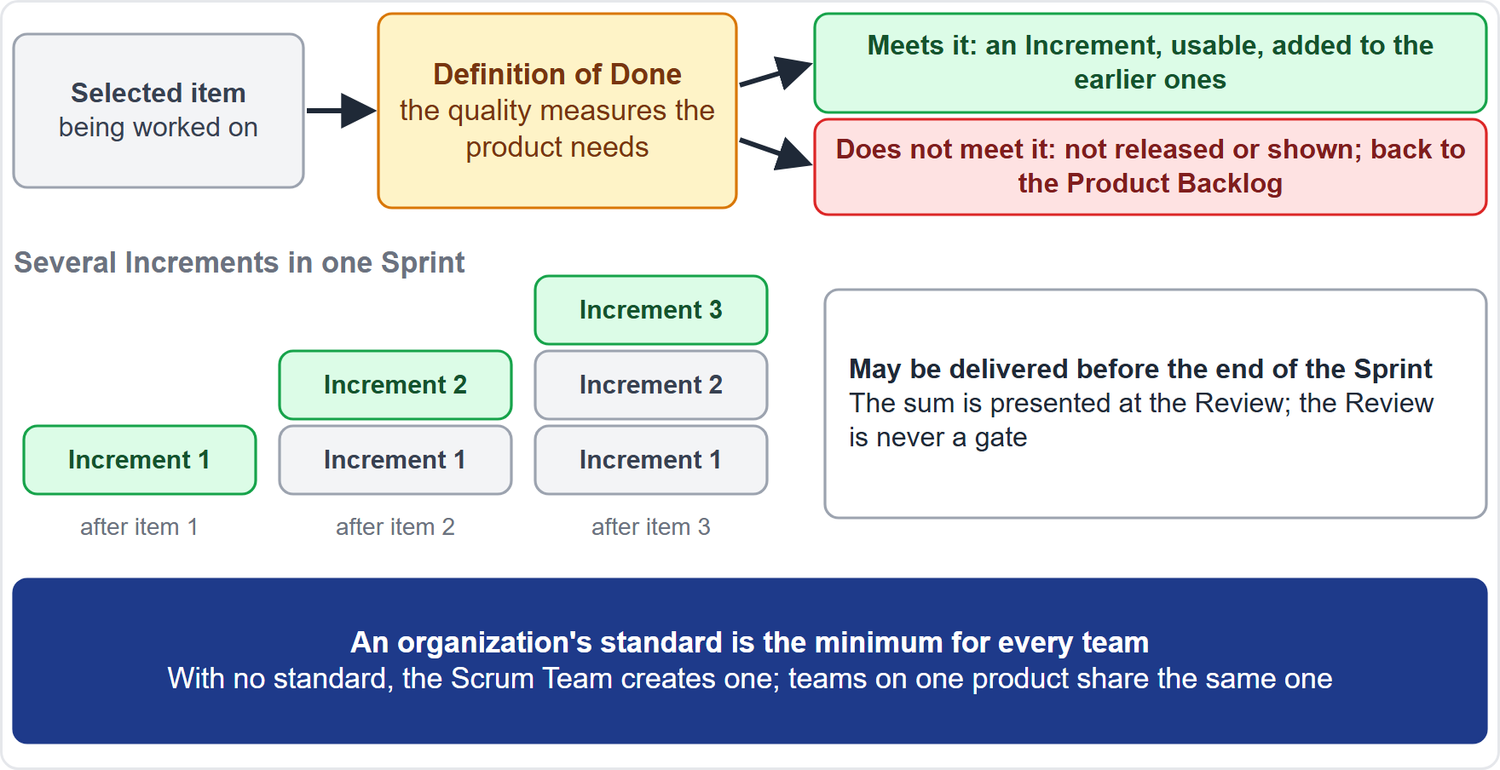
Module 12: Increment and Definition of Done
Module 17
Increment: usable, additive, thoroughly verified
Born when an item meets the Definition of Done
Several per Sprint; the Review is no gate
Definition of Done: shared understanding; the Developers conform
Organization's standard is the minimum
Teams on one product share one
CSM Exam Prep Masterclass | Certified ScrumMaster
Module 17: Quick-Reference Recap
13 / 19
Notes:
Module twelve in one page. An Increment is usable, additive, and thoroughly verified. It is born when an item meets the Definition of Done. Several can arise in a Sprint, and the Review is no gate. The Definition of Done gives a shared understanding, and the Developers conform to it. The organization's standard is the minimum. And teams on one product share one.

Slide 14
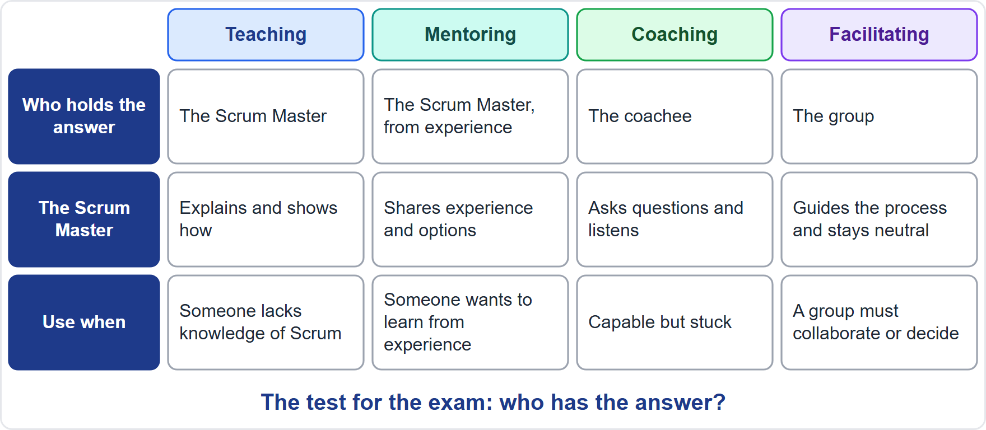
Module 13: Facilitation, Teaching, Mentoring and Coaching
Module 17
Facilitating: neutral on content, active on process
Techniques: dot, Roman, Fist of Five, 1-2-4-All, consensus, majority
Teaching, mentoring: the Scrum Master shares
Coaching: the coachee answers
Test: who has the answer?
CSM Exam Prep Masterclass | Certified ScrumMaster
Module 17: Quick-Reference Recap
14 / 19
Notes:
Module thirteen in one page. Facilitating is neutral on content and active on process. The techniques: dot voting, Roman voting, Fist of Five, one-two-four-all, consensus and majority vote. Teaching and mentoring: the Scrum Master shares. Coaching: the coachee answers. And the test question: who has the answer?

Slide 15
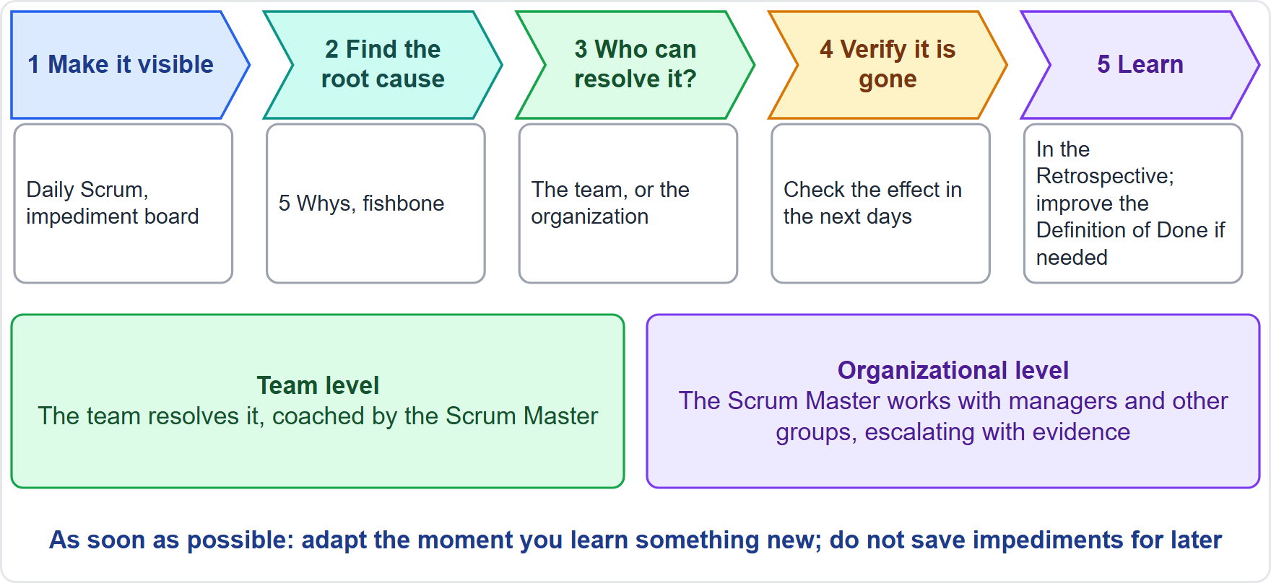
Module 14: Impediments, Technical Debt and the Organization
Module 17
Impediments: visible, root cause, right people, verify
Levels: team, or organizational
Techniques: 5 Whys, fishbone, board, escalation with data
Debt: slower, costlier, riskier; the Definition of Done guards
Practices: automated testing, CI, refactoring
No project manager
CSM Exam Prep Masterclass | Certified ScrumMaster
Module 17: Quick-Reference Recap
15 / 19
Notes:
Module fourteen in one page. For impediments: make them visible, find the root cause, resolve with the right people, and verify. There are team and organizational levels. Techniques: five whys, fishbone, a board, and escalation with data. Debt makes delivery slower, costlier and riskier, and the Definition of Done guards against it. Practices: automated testing, continuous integration and refactoring. And there is no project manager.

Slide 16
Numbers to Know (1): The Framework
Module 17
Fact | Value
Scrum Team | A Scrum Master, a Product Owner and Developers; typically 10 or fewer
Accountabilities | 3: Developers, Product Owner, Scrum Master
Events | 5: the Sprint plus four
Artifacts | 3, each with 1 commitment
Commitments | Product Goal, Sprint Goal, Definition of Done
Pillars | 3: transparency, inspection, adaptation
Values | 5: commitment, focus, openness, respect, courage
CSM Exam Prep Masterclass | Certified ScrumMaster
Module 17: Quick-Reference Recap
16 / 19
Notes:
The numbers of the framework. The Scrum Team has a Scrum Master, a Product Owner and Developers, typically ten or fewer people. Three accountabilities. Five events: the Sprint plus four. Three artifacts, each with one commitment: the Product Goal, the Sprint Goal and the Definition of Done. Three pillars: transparency, inspection and adaptation. Five values, in this order: commitment, focus, openness, respect, courage. Keep these counts apart.

Slide 17
Numbers to Know (2): Time and Rules
Module 17
Fact | Value
Sprint length | One month or less, fixed; the next starts at once
Sprint Planning | 8 hours at most (one-month Sprint); 3 topics
Daily Scrum | 15 minutes, every working day
Sprint Review | 4 hours at most (one-month Sprint)
Sprint Retrospective | 3 hours at most; concludes the Sprint
Planned work items | Often one day or less
Product Owner | One person; the only one who cancels a Sprint
Product Goal | One at a time
Exam | 50 questions, 60 minutes, 37 correct
CSM Exam Prep Masterclass | Certified ScrumMaster
Module 17: Quick-Reference Recap
17 / 19
Notes:
The numbers of time and rules. A Sprint is one month or less, fixed, and the next one starts at once. Sprint Planning: eight hours at most for a one-month Sprint, with three topics. The Daily Scrum: fifteen minutes, every working day. The Sprint Review: four hours at most. The Retrospective: three hours at most, and it concludes the Sprint. Work items are often one day or less. The Product Owner is one person, and the only one who cancels a Sprint. One Product Goal at a time. And the exam: fifty questions, sixty minutes, thirty-seven correct.

Slide 18
Key Terms (1): A to I
Module 17
Term | In a few words
Adaptation | Adjust as soon as things go off track
Artifact | Work or value made visible
Cross-functional | The team together has every skill
Daily Scrum | The Developers' 15-minute planning event
Definition of Done | The Increment's quality bar; its commitment
Developers | Those who build the Increment
Empiricism | Knowledge from experience and observation
Event | A formal chance to inspect and adapt
Impediment | Anything that blocks the team
Increment | A usable, additive step toward the Product Goal
Inspection | Frequent, diligent checking
CSM Exam Prep Masterclass | Certified ScrumMaster
Module 17: Quick-Reference Recap
18 / 19
Notes:
Key terms, first half. Read the table at your own pace; I will point out the pairs that are easy to confuse. An artifact represents work or value, while an event is a formal chance to inspect and adapt. Inspection is checking, and adaptation is adjusting. The Definition of Done is the quality bar of the Increment, and it is that artifact's commitment. And the Developers are everyone who builds the Increment, not just programmers.

Slide 19
Key Terms (2): L to T
Module 17
Term | In a few words
Lean thinking | Cut waste; focus on the essentials
Product Backlog | Emergent, ordered list; single source of work
Product Goal | The long-term target; commitment of the Product Backlog
Product Owner | One person accountable for value and the Product Backlog
Refinement | Ongoing breaking down and defining of items
Scrum Master | Accountable for Scrum and effectiveness; serves
Self-managing | The team decides who, what, when, how
Sprint | Fixed container of one month or less
Sprint Backlog | Goal, items and plan; the Developers' plan
Sprint Goal | One objective; commitment of the Sprint Backlog
Technical debt | Shortcuts that make change slower and riskier
Timebox, Transparency | A fixed maximum; visible work
CSM Exam Prep Masterclass | Certified ScrumMaster
Module 17: Quick-Reference Recap
19 / 19
Notes:
Key terms, second half. Again, look for the pairs. The Product Goal is the long-term target and belongs to the Product Backlog. The Sprint Goal is one Sprint's objective and belongs to the Sprint Backlog. The Product Backlog is the list of everything needed; the Sprint Backlog is the Developers' plan for one Sprint. Technical debt is not in the Guide, so know it by its effects. And remember a timebox is a maximum, never a target.

