Slide 1
Module 18: Exam Technique and Final Check
How the exam works, how to read it, and a last test
Applies all objectives
Certified ScrumMaster (CSM) Exam Prep Masterclass
Module 18 · Part 1
Notes:
Welcome to Module 18: Exam Technique and Final Check. This is the last module. In part one you will learn how the exam works, how to read a question, what best answers and wrong answers usually look like, and how to plan your last weeks. In part two you will test yourself with fifteen mixed questions.

Slide 2
What You Will Learn
Part 1
State the exam format and what the open-book rule really allows
Read a question with a method
Recognize what best and wrong answers usually do
Plan your pace and your last weeks
Test yourself with fifteen mixed questions
CSM Exam Prep Masterclass | Certified ScrumMaster
Module 18: Exam Technique and Final Check
2 / 29
Notes:
By the end of this module you will be able to do five things. State the exam format, and what the open-book rule really allows. Read a question with a method. Recognize what best answers and wrong answers usually do. Plan your pace and your last weeks. And test yourself with fifteen mixed questions.

Slide 3
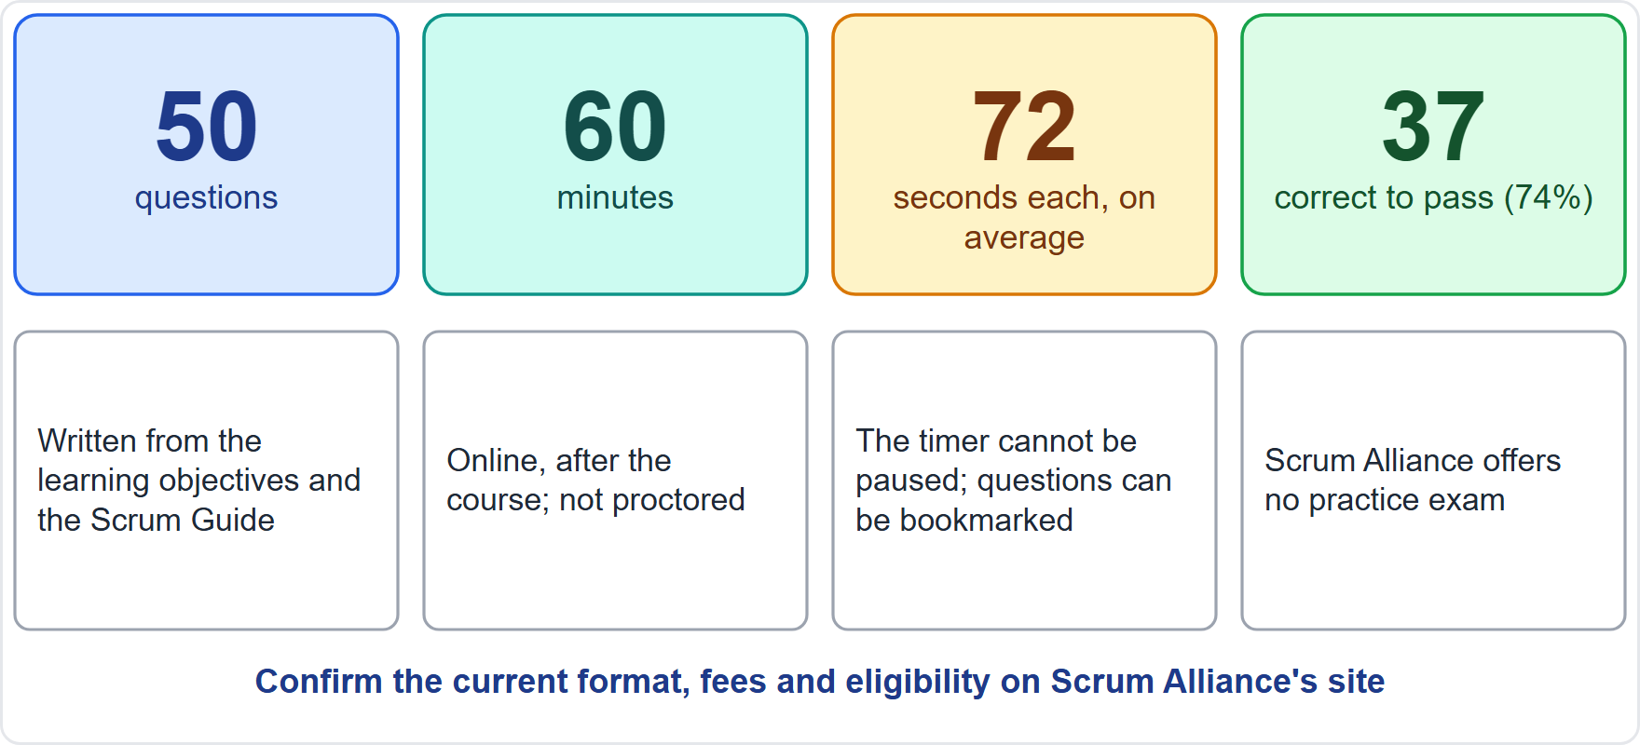
The Exam in Numbers
Part 1
50 multiple-choice questions in 60 minutes: about 72 seconds each
37 correct (74%) to pass
Written from the learning objectives and the Scrum Guide
Online, after the course; not proctored; the timer cannot be paused
Scrum Alliance offers no practice exam
EXAM TIP Confirm the current format, fees and eligibility on Scrum Alliance's site before you book.
CSM Exam Prep Masterclass | Certified ScrumMaster
Module 18: Exam Technique and Final Check
3 / 29
Notes:
The exam in numbers. Fifty multiple-choice questions in sixty minutes, which is about seventy-two seconds each. You need thirty-seven correct, which is seventy-four percent. The questions are written from the learning objectives and the Scrum Guide. The exam is taken online after the course, it is not proctored, and the timer cannot be paused, though you can bookmark questions. Scrum Alliance offers no practice exam. Always confirm the current format, fees and eligibility on its site before you book.

Slide 4
Open Book: What It Really Means
Part 1
Scrum Alliance's support article: you may use the Scrum Guide and the training materials from your course
A trainer's study guide on the same site allows any written or online resource
Rely on the narrower rule
At 72 seconds a question you can look up only a handful of items
EXAM TIP Know the framework. Use the Guide to confirm a fact, not to learn it.
CSM Exam Prep Masterclass | Certified ScrumMaster
Module 18: Exam Technique and Final Check
4 / 29
Notes:
The exam is open book, but be careful what that means. Scrum Alliance's support article says you may use the Scrum Guide and the training materials from your course. A trainer's study guide on the same site allows any written or online resource. Rely on the narrower rule, and confirm the current rule on the site. And think about the clock: at seventy-two seconds a question, you can look up only a handful of items. Know the framework; use the Guide to confirm.

Slide 5
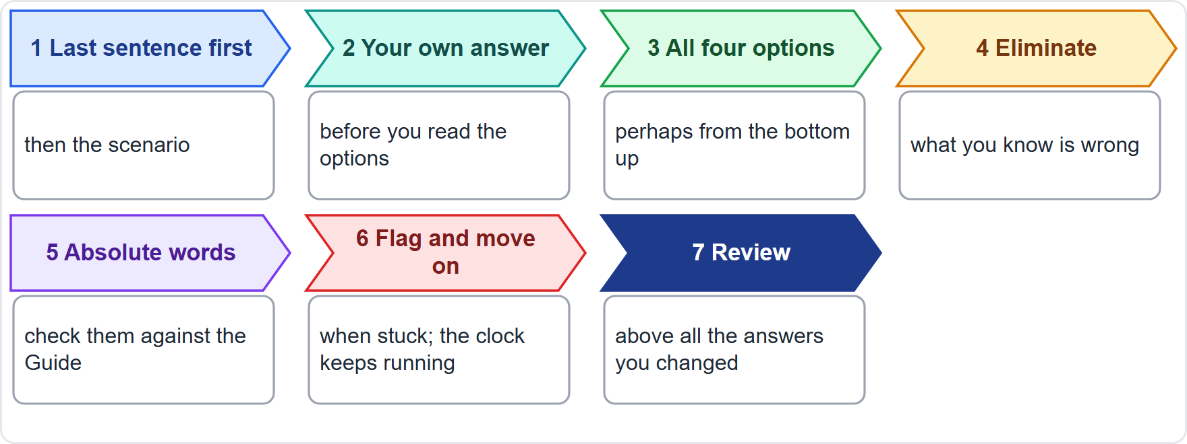
Reading a Question
BEYOND THE GUIDE
Part 1
Last sentence first; then the scenario
Your own answer before the options
All four options, perhaps from the bottom up
Eliminate what you know is wrong
Absolute words (all, always, never, only): check the Guide
Flag and move on; review before you submit
CSM Exam Prep Masterclass | Certified ScrumMaster
Module 18: Exam Technique and Final Check
5 / 29
Notes:
How to read a question. These moves go beyond the Guide, but they work. Read the last sentence first, then the scenario. Think of your own answer before you read the options. Read all four options, perhaps from the bottom up, so that the first reasonable one does not win. Eliminate what you know is wrong. Be careful with absolute words like all, always, never and only, and check them against the Guide. Flag and move on when stuck. Review before you submit.

Slide 6
Stated, Implied or Absent: A Reminder
Part 1
Stated: the Guide says it. Accept it
Implied: the Guide's logic leads there. Usually accept it
Absent: the Guide never says it. Treat it as not part of Scrum
The Guide is short, so many options turn on this test
EXAM TIP Module 15 practiced this on eleven scenarios.
CSM Exam Prep Masterclass | Certified ScrumMaster
Module 18: Exam Technique and Final Check
6 / 29
Notes:
A reminder of a test from Module 15, which practiced it on eleven scenarios. Is the answer stated, implied or absent in the Guide? Stated: the Guide says it, so accept it. Implied: the Guide's logic leads there, so usually accept it. Absent: the Guide never says it, so treat it as not part of Scrum. The Guide is short, so many options turn on exactly this test.

Slide 7
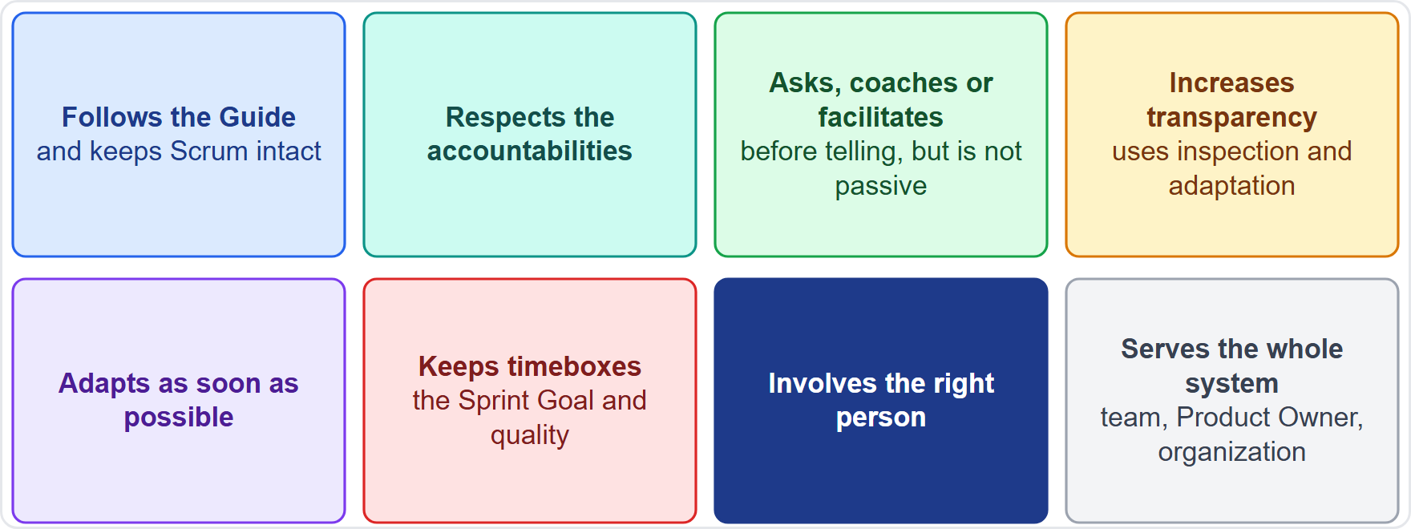
What the Best Answer Usually Does
BEYOND THE GUIDE
Part 1
Follows the Guide and keeps Scrum intact
Respects the accountabilities
Asks, coaches or facilitates before telling, but acts when stuck
Increases transparency; inspects and adapts
Adapts as soon as possible
Keeps timeboxes, the Sprint Goal and quality
Involves the right person
Serves the whole system
CSM Exam Prep Masterclass | Certified ScrumMaster
Module 18: Exam Technique and Final Check
7 / 29
Notes:
What does the best answer usually do? This is practice, not Guide text. It follows the Guide and keeps Scrum intact. It respects the accountabilities. It asks, coaches or facilitates before telling, but it acts when the team is stuck. It increases transparency, and uses inspection and adaptation. It adapts as soon as possible. It keeps the timeboxes, the Sprint Goal and the quality. It involves the right person. And it serves the whole system: the team, the Product Owner and the organization.

Slide 8
What the Wrong Answers Usually Do
BEYOND THE GUIDE
Part 1
Distractor | Example
Commands or manages | The Scrum Master assigns tasks or approves work
Wrong owner | The Scrum Master orders the Product Backlog
Adds something Scrum lacks | A project manager, a hardening Sprint, a Sprint 0, an approval gate
Passive | Wait for the Retrospective; let the team cope
Right action, wrong time | A good idea in the wrong event
Old wording | Development Team, three questions, servant-leader as a boss
Absolute wording | Always, never, only the Scrum Master
CSM Exam Prep Masterclass | Certified ScrumMaster
Module 18: Exam Technique and Final Check
8 / 29
Notes:
And what do wrong answers usually do? This pattern list comes from practice, not from the Guide. They command or manage, for example the Scrum Master assigns tasks. They pick the wrong owner, for example the Scrum Master orders the Product Backlog. They add something Scrum lacks: a project manager, a hardening Sprint, a Sprint zero, or an approval gate. They are passive: wait for the Retrospective. They offer a right action at the wrong time. They use old wording, such as Development Team, the three questions, or servant-leader as a boss. Or they use absolute words.

Slide 9
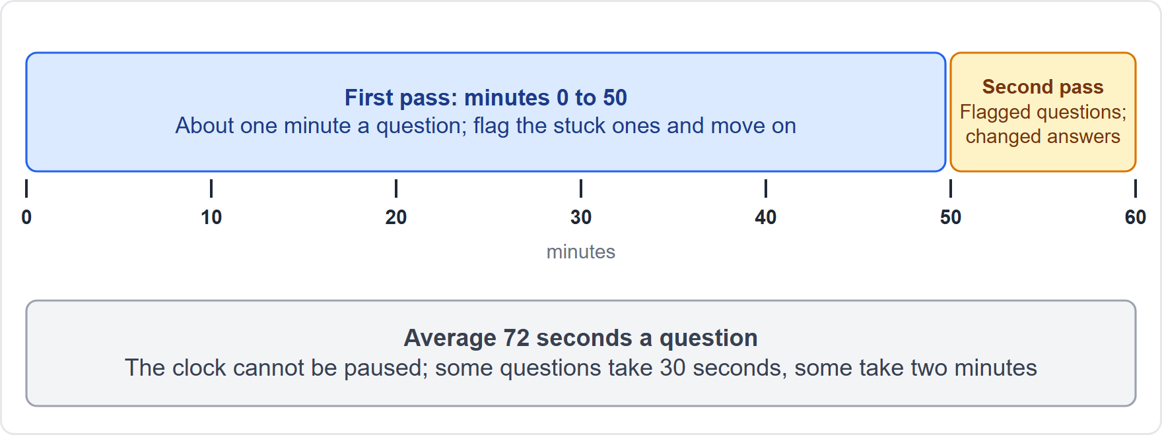
Pace and Flagging
BEYOND THE GUIDE
Part 1
Average 72 seconds a question: some take 30, some take 120
Aim for about one minute on a first pass: that leaves about ten minutes to come back
Flag a stuck question and move on
Bookmark to return; the clock keeps running
Review before submitting, above all answers you changed
EXAM TIP Do not spend three minutes on one question and lose three others.
CSM Exam Prep Masterclass | Certified ScrumMaster
Module 18: Exam Technique and Final Check
9 / 29
Notes:
Pace; these exam tips go beyond the Guide. You have about seventy-two seconds a question on average: some questions will take thirty seconds, some will take two minutes. Aim for about a minute on a first pass. That leaves about ten minutes to come back. If a question is stuck, flag it and move on. You can bookmark it, but the clock keeps running. Review before you submit, above all the answers you changed. Do not spend three minutes on one question and lose three others.

Slide 10
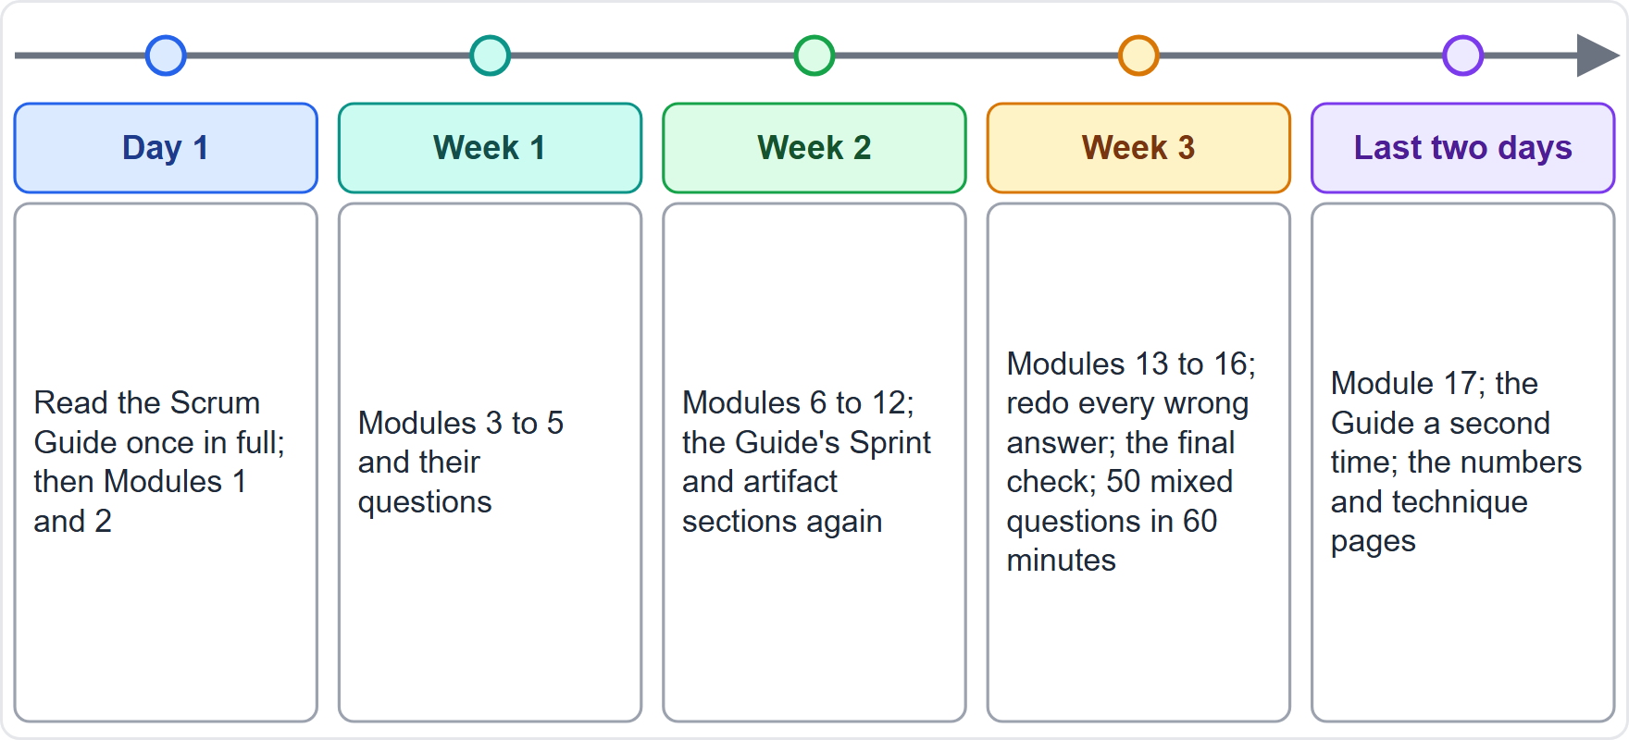
The Three-Week Practice Plan
BEYOND THE GUIDE
Part 1
Day 1: the Scrum Guide once in full, then Modules 1 and 2
Week 1: Modules 3 to 5, then their questions
Week 2: Modules 6 to 12; the Guide's Sprint and artifact sections again
Week 3: Modules 13 to 16; redo every wrong answer; the final check, then 50 mixed questions in 60 minutes
Last two days: Module 17; the Guide again; the numbers and technique pages
CSM Exam Prep Masterclass | Certified ScrumMaster
Module 18: Exam Technique and Final Check
10 / 29
Notes:
A three-week plan; it is the course's suggestion, not part of the Guide. Day one: read the Scrum Guide once in full, then Modules one and two. Week one: Modules three to five, with their questions. Week two: Modules six to twelve, and the Guide's Sprint and artifact sections again. Week three: Modules thirteen to sixteen, which add the workshop and the traps clinic. Redo every question you got wrong. Then take the final check, and a mixed set of fifty questions from the course in sixty minutes. The last two days: Module seventeen, the Guide a second time, and the numbers and technique pages.

Slide 11
The Last Two Days and Exam Day
BEYOND THE GUIDE
Part 1
Module 17 every day: cover the text and say the facts aloud
Read the Guide a second time, about 20 minutes
Exam day: a quiet place, a stable connection, the Guide and your course materials ready
Remember the clock cannot be paused
Start with the last sentence
EXAM TIP Redo the questions you got wrong; they teach the most.
CSM Exam Prep Masterclass | Certified ScrumMaster
Module 18: Exam Technique and Final Check
11 / 29
Notes:
The last two days; these tips go beyond the Guide. Use Module seventeen every day: cover the text and say the facts aloud. Read the Guide a second time; it takes about twenty minutes. On exam day, choose a quiet place and a stable connection, and have the Guide and your course materials ready. Remember that the clock cannot be paused. Start every question with the last sentence. And redo the questions you got wrong earlier; they teach the most.

Slide 12
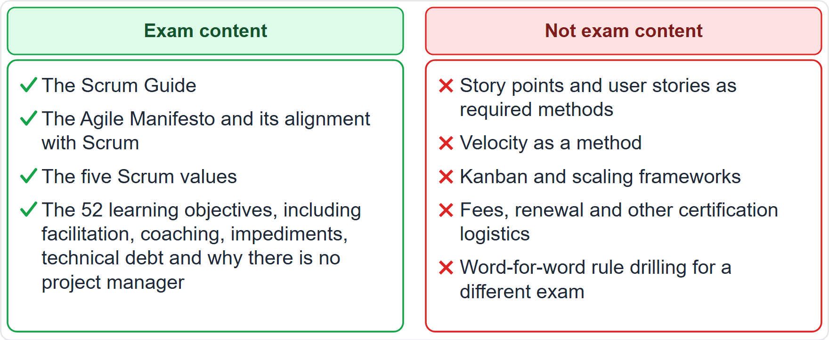
What Is Not Exam Content
BEYOND THE GUIDE
Part 1
In: the Guide, the Manifesto, the five values, the 52 learning objectives
Out: story points, user stories and velocity as required methods
Out: Kanban and scaling frameworks
Out: fees, renewal and other certification logistics
Out: word-for-word rule drilling for a different exam
EXAM TIP Scrum Alliance's own advice names relative story points as something absent from the Guide.
CSM Exam Prep Masterclass | Certified ScrumMaster
Module 18: Exam Technique and Final Check
12 / 29
Notes:
A word on scope, so that you do not waste study time. This scope note is exam guidance, not Guide text. The exam draws on the Scrum Guide, the Agile Manifesto, the five Scrum values, and the fifty-two learning objectives. It does not ask for story points, user stories or velocity as required methods. Not Kanban, not scaling frameworks, not fees or renewal rules, and not word-for-word rule drilling for a different exam. Scrum Alliance's own advice names relative story points as something absent from the Guide.

Slide 13
Part 1 Recap
Part 1
1
Format
2
Open book
3
Read
50 questions, 60 minutes, 37 correct
the Guide and your course materials; know the framework
last sentence first, eliminate, check absolutes
4
Best answers
5
Plan
6
Next
serve and keep Scrum intact; wrong ones command, add, wait
three weeks, then Module 17
the final check
CSM Exam Prep Masterclass | Certified ScrumMaster
Module 18: Exam Technique and Final Check
13 / 29
Notes:
Part one recap. Fifty questions, sixty minutes, thirty-seven correct. Open book means the Guide and your course materials, so know the framework. Read the last sentence first, eliminate, and check absolutes. Best answers serve and keep Scrum intact; wrong answers command, add, or wait. Follow the three-week plan, then Module seventeen. The exam tests applying the framework, so practice the method from Module fifteen. Now the final check: fifteen questions, about a minute each.

Slide 14
Final Check, Question 1
Part 2
Q1
At the end of each Sprint the RideLoop team demonstrates progress, but nobody ever changes the Product Backlog or the way the team works afterwards. Which pillar is missing?
A
Transparency, because the work is hidden from the stakeholders
B
Courage, because the pillars are the Scrum values
C
Inspection, because the team never looks at its work
D
Adaptation, because inspection without adaptation is pointless
CSM Exam Prep Masterclass | Certified ScrumMaster
Module 18: Exam Technique and Final Check
14 / 29
Notes:
Question one. At the end of each Sprint the RideLoop team demonstrates progress, but nobody ever changes the Product Backlog or the way the team works afterwards. Which pillar is missing? The four options are on the screen. [PAUSE 10] The answer is D, adaptation. Inspection without adaptation is pointless. Transparency is present, and courage is a value, not a pillar.

Slide 15
Final Check, Question 2
Part 2
Q2
In a Retrospective, Sofia wants to raise a conflict with a colleague but fears the reaction. Which two values should the Scrum Master help the team strengthen?
A
Openness and courage
B
Commitment and focus
C
Respect and focus
D
Courage and commitment
CSM Exam Prep Masterclass | Certified ScrumMaster
Module 18: Exam Technique and Final Check
15 / 29
Notes:
Question two. In a Retrospective, Sofia wants to raise a conflict with a colleague but fears the reaction. Which two values should the Scrum Master help the team strengthen? The four options are on the screen. [PAUSE 10] The answer is A, openness and courage. Raising a hard problem takes the courage to do the right thing, and openness about the work and its challenges.

Slide 16
Final Check, Question 3
Part 2
Q3
What should a Scrum Team do when it has become too large to stay nimble?
A
Appoint a team lead for each group of five Developers, so that coordination stays manageable
B
Split the Developers into two sub-teams inside the Scrum Team, each reporting to the Scrum Master
C
Reorganize into several cohesive Scrum Teams that share the same Product Goal, Backlog and Owner
D
Add a project manager above the Scrum Team to coordinate the work of all the Developers
CSM Exam Prep Masterclass | Certified ScrumMaster
Module 18: Exam Technique and Final Check
16 / 29
Notes:
Question three. What should a Scrum Team do when it has become too large to stay nimble? The four options are on the screen. [PAUSE 10] The answer is C. It becomes several cohesive Scrum Teams that share one Product Goal, one Product Backlog and one Product Owner. Team leads, sub-teams and project managers are hierarchies that Scrum does not have.

Slide 17
Final Check, Question 4
Part 2
Q4
A Lakeshore Transit director wants a feature moved to the top of the Product Backlog and approaches Ben directly. What is the best way to handle this?
A
Ben adds the feature to the Sprint Backlog immediately
B
The director makes the case to Maya, who decides the order
C
You reorder the Product Backlog to keep the director satisfied
D
The Developers vote on whether to accept the request
CSM Exam Prep Masterclass | Certified ScrumMaster
Module 18: Exam Technique and Final Check
17 / 29
Notes:
Question four. A Lakeshore Transit director wants a feature moved to the top of the Product Backlog and approaches Ben directly. What is the best way to handle this? The four options are on the screen. [PAUSE 10] The answer is B. The director makes the case to Maya, who decides the order. Developers and the Scrum Master do not set the order of the Product Backlog.

Slide 18
Final Check, Question 5
Part 2
Q5
After a successful first Sprint, Lakeshore Transit asks you to help three more teams adopt Scrum. Which response fits the Scrum Master's accountabilities?
A
Decline, because a Scrum Master serves only the Scrum Team
B
Accept and take over the management of all four teams
C
Help by asking the first team's Developers to stop their Sprint and train the other teams
D
Accept, and help to lead, train and coach the organization
CSM Exam Prep Masterclass | Certified ScrumMaster
Module 18: Exam Technique and Final Check
18 / 29
Notes:
Question five. After a successful first Sprint, Lakeshore Transit asks you to help three more teams adopt Scrum. Which response fits the Scrum Master's accountabilities? The four options are on the screen. [PAUSE 10] The answer is D. The Scrum Master serves the organization by leading, training and coaching its adoption, and advising on rollouts. Managing the teams would create a hierarchy.

Slide 19
Final Check, Question 6
Part 2
Q6
A Lakeshore Transit team works in a fast-changing market with high uncertainty and releases rarely. Which Sprint length best fits the Guide's reasoning?
A
Six weeks, so that the team has more time in each Sprint to complete large and complex items
B
Two months, to reduce the number of events and the time spent on planning and reviews
C
A shorter Sprint, if a usable Increment fits, to give more learning cycles and limit risk
D
A length that changes from day to day, depending on how much the market has moved
CSM Exam Prep Masterclass | Certified ScrumMaster
Module 18: Exam Technique and Final Check
19 / 29
Notes:
Question six. A Lakeshore Transit team works in a fast-changing market with high uncertainty and releases rarely. Which Sprint length best fits the Guide's reasoning? The four options are on the screen. [PAUSE 10] The answer is C, a shorter Sprint. It gives more learning cycles and limits risk. Sprints longer than one month are not allowed, and a changing length removes consistency.

Slide 20
Final Check, Question 7
Part 2
Q7
At Sprint Planning, one top-ordered item is far too large to be finished in a Sprint. What should the Scrum Team do?
A
Refine or split it, so that part of it can be Done within the Sprint
B
Select it anyway and hope that the Developers can finish it in time
C
Leave it out and never refine it, because it cannot be finished in a Sprint
D
Ask the Scrum Master to reduce its size before the event ends
CSM Exam Prep Masterclass | Certified ScrumMaster
Module 18: Exam Technique and Final Check
20 / 29
Notes:
Question seven. At Sprint Planning, one top-ordered item is far too large to be finished in a Sprint. What should the Scrum Team do? The four options are on the screen. [PAUSE 10] The answer is A. Refine or split it, so that part of it can be Done within the Sprint, and keep the rest in the Product Backlog.

Slide 21
Final Check, Question 8
Part 2
Q8
Is the Daily Scrum the only time the Developers can adjust their plan?
A
Yes, any change to the plan must wait for the next Daily Scrum, so that the plan stays stable
B
No, they often meet during the day for more detailed discussions about re-planning
C
Yes, because the plan is fixed once Sprint Planning has ended and cannot be changed
D
No, but every change then needs Maya's approval before the Developers may act on it
CSM Exam Prep Masterclass | Certified ScrumMaster
Module 18: Exam Technique and Final Check
21 / 29
Notes:
Question eight. Is the Daily Scrum the only time the Developers can adjust their plan? The four options are on the screen. [PAUSE 10] The answer is B. No. The Developers often meet during the day for more detailed discussions about re-planning, and they need no approval to do so.

Slide 22
Final Check, Question 9
Part 2
Q9
Maya says the Increment may not be given to users until after the Sprint Review. What does the Guide say?
A
An Increment may be delivered before the end of the Sprint; the Review is never a gate to releasing value
B
The Review approves the release, so users may get an Increment only after the stakeholders accept it there
C
Only the stakeholders may release an Increment, because they are the ones who pay for the product
D
An Increment must wait for the Retrospective, because the team must first inspect how it was built
CSM Exam Prep Masterclass | Certified ScrumMaster
Module 18: Exam Technique and Final Check
22 / 29
Notes:
Question nine. Maya says the Increment may not be given to users until after the Sprint Review. What does the Guide say? The four options are on the screen. [PAUSE 10] The answer is A. An Increment may be delivered before the end of the Sprint, and the Review is never a gate to releasing value.

Slide 23
Final Check, Question 10
Part 2
Q10
How many Product Goals does a Scrum Team work on at a time, and where does the Product Goal live?
A
Several, in a separate planning document
B
One for each Developer, in the Sprint Backlog
C
None, because the Product Goal is the same as the Sprint Goal
D
One at a time, in the Product Backlog
CSM Exam Prep Masterclass | Certified ScrumMaster
Module 18: Exam Technique and Final Check
23 / 29
Notes:
Question ten. How many Product Goals does a Scrum Team work on at a time, and where does the Product Goal live? The four options are on the screen. [PAUSE 10] The answer is D. One at a time, in the Product Backlog. The team fulfills or abandons one before taking on the next.

Slide 24
Final Check, Question 11
Part 2
Q11
When is the Sprint Goal created?
A
Before Sprint Planning, by the Product Owner alone, as a plan for the Sprint
B
During Sprint Planning, and then added to the Sprint Backlog
C
After the Sprint, during the Retrospective
D
On the first day of the Sprint, by the Developers alone
CSM Exam Prep Masterclass | Certified ScrumMaster
Module 18: Exam Technique and Final Check
24 / 29
Notes:
Question eleven. When is the Sprint Goal created? The four options are on the screen. [PAUSE 10] The answer is B. During Sprint Planning, and then added to the Sprint Backlog, where it is the commitment. It must be finalized before the event ends.

Slide 25
Final Check, Question 12
Part 2
Q12
If the organization has no standard Definition of Done, who creates one?
A
The Product Owner alone, who is accountable for the quality of the product
B
The Scrum Master alone, who is accountable for establishing Scrum
C
The Scrum Team, which creates one that suits the product
D
The stakeholders, who know best the quality they expect at the Review
CSM Exam Prep Masterclass | Certified ScrumMaster
Module 18: Exam Technique and Final Check
25 / 29
Notes:
Question twelve. If the organization has no standard Definition of Done, who creates one? The four options are on the screen. [PAUSE 10] The answer is C. The Scrum Team creates one that suits the product, and the Developers conform to it. If a standard exists, it is the minimum.

Slide 26
Final Check, Question 13
Part 2
Q13
The Retrospective produced twenty improvement ideas, and the team wants to pick the few to try next Sprint. Which technique fits best?
A
Roman voting on each of the twenty ideas in turn, one after another
B
Dot voting, with each person placing a few dots on the ideas
C
Consensus on all twenty ideas, so that everyone can live with each improvement
D
The Scrum Master picks the five ideas that look most useful, to save time
CSM Exam Prep Masterclass | Certified ScrumMaster
Module 18: Exam Technique and Final Check
26 / 29
Notes:
Question thirteen. The Retrospective produced twenty improvement ideas, and the team wants to pick the few to try next Sprint. Which technique fits best? The four options are on the screen. [PAUSE 10] The answer is B, dot voting, which suits selecting several options from a longer list. The Scrum Master facilitates, but does not pick.

Slide 27
Final Check, Question 14
Part 2
Q14
Which description of technical debt is best?
A
The future cost of rework caused by choosing an easy shortcut now instead of a better approach
B
A financial loan that the team takes from the organization to buy tools and repays over several Sprints
C
A list of unfinished Product Backlog items that the team carries from one Sprint to the next
D
A debt owed to stakeholders when the team does not deliver everything that was promised
CSM Exam Prep Masterclass | Certified ScrumMaster
Module 18: Exam Technique and Final Check
27 / 29
Notes:
Question fourteen. Which description of technical debt is best? The four options are on the screen. [PAUSE 10] The answer is A. The future cost of rework caused by choosing an easy or limited solution now. It is a metaphor, not money borrowed, and the Guide does not mention it.

Slide 28
Final Check, Question 15
Part 2
Q15
Why can a Sprint horizon that is too long be a problem?
A
The events take more time than the Guide allows
B
The Product Owner loses authority over the content and order of the Product Backlog
C
The Developers can no longer see the Sprint Backlog
D
The goal can lose its meaning, and complexity and risk can grow
CSM Exam Prep Masterclass | Certified ScrumMaster
Module 18: Exam Technique and Final Check
28 / 29
Notes:
Question fifteen. Why can a Sprint horizon that is too long be a problem? The four options are on the screen. [PAUSE 10] The answer is D. The goal can lose its meaning, and complexity and risk can grow. Shorter Sprints give more learning cycles and limit the cost and effort at risk.

Slide 29
Answers at a Glance
Part 2
Question | Answer | Why
Q1 | D | Inspection without adaptation is pointless
Q2 | A | Openness and courage
Q3 | C | Several Scrum Teams, one Product Goal and Product Backlog
Q4 | B | The director convinces the Product Owner
Q5 | D | Lead, train and coach the organization
Q6 | C | Shorter Sprints give more learning and limit risk
Q7 | A | Refine or split the large item
Q8 | B | The Developers often meet during the day
Q9 | A | The Review is never a gate
Q10 | D | One Product Goal, in the Product Backlog
Q11 | B | Created in Sprint Planning
Q12 | C | The Scrum Team creates it
Q13 | B | Dot voting for several options
Q14 | A | The future cost of rework from shortcuts
Q15 | D | A long Sprint risks an out-of-date goal
CSM Exam Prep Masterclass | Certified ScrumMaster
Module 18: Exam Technique and Final Check
29 / 29
Notes:
Here are all fifteen answers. One: D. Inspection without adaptation is pointless. Two: A. Openness and courage. Three: C. Several Scrum Teams, one Product Goal and one Product Backlog. Four: B. The director convinces the Product Owner. Five: D. Lead, train and coach the organization. Six: C. Shorter Sprints give more learning and limit risk. Seven: A. Refine or split the large item. Eight: B. The Developers often meet during the day. Nine: A. The Review is never a gate. Ten: D. One Product Goal, in the Product Backlog. Eleven: B. Created in Sprint Planning. Twelve: C. The Scrum Team creates it. Thirteen: B. Dot voting for several options. Fourteen: A. The future cost of rework from shortcuts. Fifteen: D. A long Sprint risks an out-of-date goal. Count how many you got right, and redo the ones you missed, with the module that teaches them. That completes the course. Good luck with the exam.

