Slide 1
Course Introduction and Exam Orientation
Start here: the exam, the curriculum and how this course works
Start here · Orientation
YOU WILL BE ABLE TO
State the exam format, the pass mark and the validity
Name the four domains and their weights
Read the course labels, and meet the Harbor Books case
Know that the course is independent and educational
KCNA Exam Prep Masterclass
Module 0
Notes:
Welcome to the K C N A Exam Prep Masterclass: Kubernetes and Cloud Native Associate. This first module is your orientation. By the end you will be able to do four things. State the exam format, the pass mark and the validity. Name the four domains and their weights. Read the course labels, and meet the Harbor Books case. And know that this course is independent and educational.

Slide 2
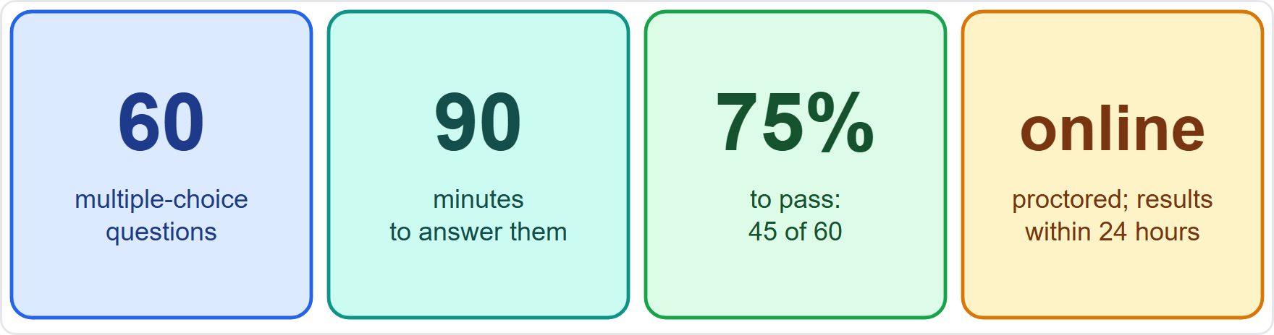
The KCNA Exam in Numbers
MOVING
Module 0
60 multiple-choice questions in 90 minutes
The pass mark is 75%: that is 45 of 60 correct
It is taken online with a proctor, and results come by email within 24 hours
That is about 90 seconds a question; Module 16 shows how to use the time
As of 30 October 2026: these are the figures on the Linux Foundation pages; confirm them on the LF site before you book
EXAM TIP Plan for about 90 seconds a question, and flag the hard ones for later.
KCNA Exam Prep Masterclass | Kubernetes and Cloud Native Associate
Module 0: Course Introduction and Exam Orientation
2 / 11
Notes:
This slide is tagged moving. The K C N A exam has sixty multiple-choice questions, and you have ninety minutes. The pass mark is seventy-five percent. That is forty-five of the sixty questions answered correctly. You take it online, with a proctor, and results come by email within twenty-four hours. That works out to about ninety seconds a question, and Module 16 shows how to use the time. As of the thirtieth of October, twenty twenty-six, these are the figures on the Linux Foundation pages. Confirm them on the L F site before you book. Exam tip: plan for about ninety seconds a question, and flag the hard ones for later.

Slide 3
Booking, Validity and Renewal
MOVING
Module 0
Topic | What to know
Prerequisites | none
Booking window | 12 months to schedule and take the exam
Validity | the result stays valid for 2 years
Renewal | passing the CKA or the CKAD (the administrator and application developer exams) renews the KCNA
Price and retakes | not stated in this course: the pages change and do not agree, so check the LF site
As of 30 October 2026: this is what the Linux Foundation pages say
EXAM TIP Book when you are ready, not when the window is about to close.
KCNA Exam Prep Masterclass | Kubernetes and Cloud Native Associate
Module 0: Course Introduction and Exam Orientation
3 / 11
Notes:
This slide is tagged moving. The exam has no prerequisites. You have twelve months to schedule and take it. The result stays valid for two years, and passing the C K A or the C K A D, the administrator and application developer exams, renews the K C N A. This course does not state the price or the retake terms, because the pages change and do not agree. Check the L F site. As of the thirtieth of October, twenty twenty-six, this is what the Linux Foundation pages say. Exam tip: book when you are ready, not when the window is about to close.

Slide 4
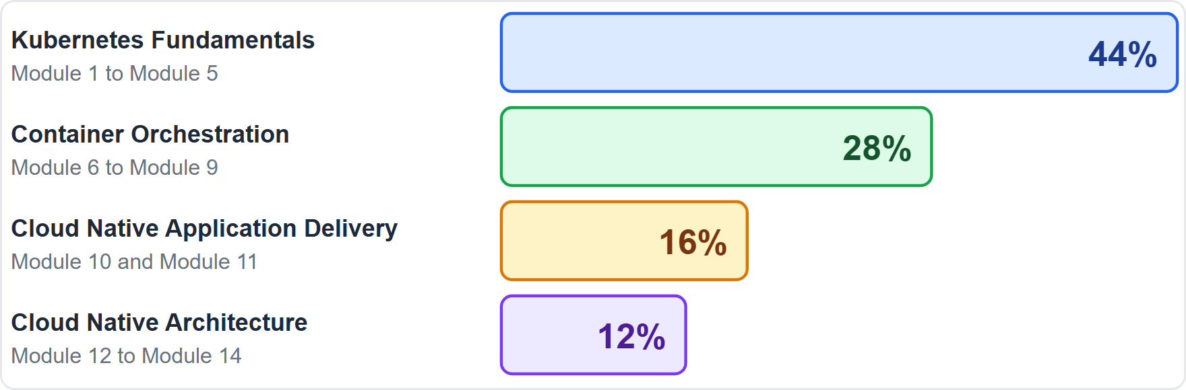
The Curriculum: Four Domains
MOVING
Module 0
Kubernetes Fundamentals, 44%: Module 1 to Module 5
Container Orchestration, 28%: Module 6 to Module 9
Cloud Native Application Delivery, 16%: Module 10 and Module 11
Cloud Native Architecture, 12%: Module 12 to Module 14
13 topics in all; the Cloud Native Computing Foundation (CNCF) publishes domain weights, not weights per topic
As of 30 October 2026: this curriculum applies to exams taken from late November 2025 onward
EXAM TIP The biggest domain is Kubernetes Fundamentals: give it the most study time.
KCNA Exam Prep Masterclass | Kubernetes and Cloud Native Associate
Module 0: Course Introduction and Exam Orientation
4 / 11
Notes:
This slide is tagged moving. The curriculum has four domains. Kubernetes Fundamentals is forty-four percent, and it is taught in Module 1 to Module 5. Container Orchestration is twenty-eight percent, in Module 6 to Module 9. Cloud Native Application Delivery is sixteen percent, in Module 10 and Module 11. And Cloud Native Architecture is twelve percent, in Module 12 to Module 14. There are thirteen topics in all. The Cloud Native Computing Foundation, the C N C F, publishes domain weights, not weights per topic. As of the thirtieth of October, twenty twenty-six, this curriculum applies to exams taken on or after the twenty-fourth of November, twenty twenty-five. Exam tip: the biggest domain is Kubernetes Fundamentals, so give it the most study time.

Slide 5
Old Curriculum, New Curriculum
OLD WORDING
Module 0
Old domain (weight) | Where it is now
Kubernetes Fundamentals (46%) | Kubernetes Fundamentals (44%)
Container Orchestration (22%) | Container Orchestration (28%)
Cloud Native Architecture (16%) | Cloud Native Architecture (12%)
Cloud Native Observability (8%) | inside Cloud Native Architecture: Module 13
Cloud Native Application Delivery (8%) | Cloud Native Application Delivery (16%)
Older prep material uses the five-domain split, so you may meet its names
Old sub-topics such as Prometheus, Cost Management and Service Mesh still appear in this course, under their new homes
EXAM TIP If a question uses an old name, map it to its new home and answer the same way.
KCNA Exam Prep Masterclass | Kubernetes and Cloud Native Associate
Module 0: Course Introduction and Exam Orientation
5 / 11
Notes:
This slide is tagged old wording. Older prep material uses the earlier curriculum, with five domains. Kubernetes Fundamentals was forty-six percent, and is now forty-four. Container Orchestration was twenty-two percent, and is now twenty-eight. Cloud Native Architecture was sixteen percent, and is now twelve. Cloud Native Observability was eight percent, and now sits inside Cloud Native Architecture, in Module 13. And Cloud Native Application Delivery was eight percent, and is now sixteen. Old sub-topics such as Prometheus, Cost Management and Service Mesh still appear in this course, under their new homes. Exam tip: if a question uses an old name, map it to its new home and answer the same way.

Slide 6
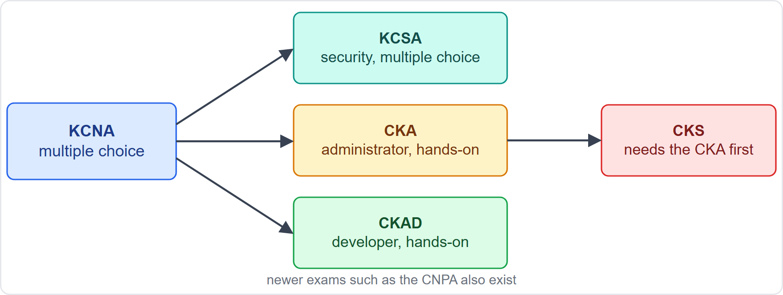
Where the KCNA Sits
MOVING
Module 0
The KCNA and the KCSA (the cloud native security associate exam) are multiple-choice associate exams
The CKA (administrator), CKAD (application developer) and CKS (security specialist) are performance-based: you solve tasks in a command line
The CKS requires that you pass the CKA first
Newer exams such as the CNPA exist too; this is a map, not a sales pitch
As of 30 October 2026: this is the family listed on the Linux Foundation pages
EXAM TIP The KCNA tests knowledge; the hands-on exams test doing.
KCNA Exam Prep Masterclass | Kubernetes and Cloud Native Associate
Module 0: Course Introduction and Exam Orientation
6 / 11
Notes:
This slide is tagged moving. The K C N A and the K C S A, the cloud native security associate exam, are multiple-choice associate exams. The C K A, the C K A D and the C K S are performance-based. You solve tasks in a command line. The C K S requires that you pass the C K A first. Newer exams such as the C N P A exist too. This is a map, not a sales pitch. As of the thirtieth of October, twenty twenty-six, this is the family listed on the Linux Foundation pages. Exam tip: the K C N A tests knowledge, and the hands-on exams test doing.

Slide 7
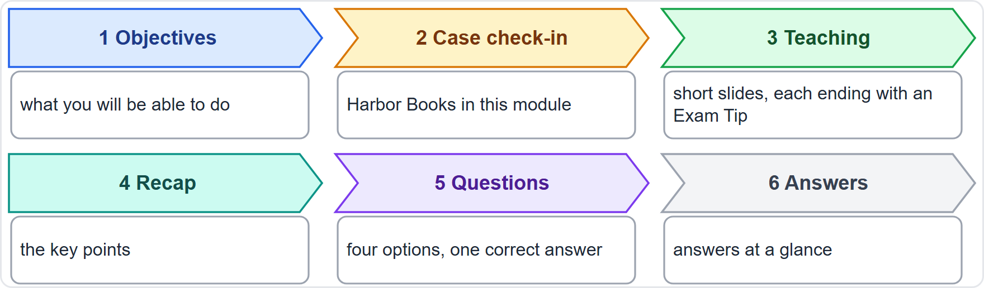
How the Course Is Organized
Module 0
17 modules, numbered 00 to 16: 14 content modules in the four domains, plus this introduction, a quick-reference recap and exam technique
Each content module has objectives, a case check-in, teaching slides, a recap, practice questions and answers at a glance
There are 105 practice questions, each with four options and one correct answer
The script asks the question, pauses, then gives the answer and the reason
Every teaching slide ends with an Exam Tip
EXAM TIP Answer each question before the pause ends, then read the reason.
KCNA Exam Prep Masterclass | Kubernetes and Cloud Native Associate
Module 0: Course Introduction and Exam Orientation
7 / 11
Notes:
The course has seventeen modules, numbered zero zero to sixteen. Fourteen are content modules in the four domains. The other three are this introduction, a quick-reference recap, and exam technique. Each content module has objectives, a case check-in, teaching slides, a recap, practice questions, and answers at a glance. There are one hundred and five practice questions, each with four options and one correct answer. In the video, the question is read, there is a pause, and then you hear the answer and the reason. Every teaching slide ends with an Exam Tip. Exam tip: answer each question before the pause ends, then read the reason.

Slide 8
Labels You Will See
Module 0
Label | What it tells you
Beyond the curriculum | useful context that the curriculum does not list; lower priority for the exam
Archived topic | from the earlier curriculum, or at recognition level: know what it is and what it is for
Moving | a fact that changes over time; the slide gives an "as of" date
Old wording | a name that older material still uses
Slides without a label cover the current curriculum directly
EXAM TIP Spend your first study hours on slides with no label, and your last on the labeled ones.
KCNA Exam Prep Masterclass | Kubernetes and Cloud Native Associate
Module 0: Course Introduction and Exam Orientation
8 / 11
Notes:
Four labels appear in slide titles. Beyond the curriculum marks useful context that the curriculum does not list. It is lower priority for the exam. Archived topic marks something from the earlier curriculum, or at recognition level. Know what it is and what it is for. Moving marks a fact that changes over time. The slide gives an as of date. And Old wording marks a name that older material still uses. Slides without a label cover the current curriculum directly. Exam tip: spend your first study hours on slides with no label, and your last on the labeled ones.

Slide 9
Meet Harbor Books, the Running Case
Module 0
The shop
The parts
The clusters
Harbor Books, a fictional online bookshop; nothing in it comes from a real company or a real exam
storefront, catalog, orders, postgres, cache, mailer and nightly-report
one for production and one for staging, with the namespaces shop and platform
The people
The story
a developer, a platform engineer, a security lead and a shop owner
a monolith grows into services, and the team adopts Kubernetes to run them safely
EXAM TIP The case only gives you a story to hang each idea on; the exam asks about the idea.
KCNA Exam Prep Masterclass | Kubernetes and Cloud Native Associate
Module 0: Course Introduction and Exam Orientation
9 / 11
Notes:
Harbor Books is the running case. It is a fictional online bookshop. Nothing in it comes from a real company or a real exam. Its parts are the storefront, catalog, orders, postgres, cache, mailer and nightly report. It has one production cluster and one staging cluster, with the namespaces shop and platform. The people are a developer, a platform engineer, a security lead and a shop owner. The story is simple. A monolith grows into services, and the team adopts Kubernetes to run them safely. Exam tip: the case gives you a story to hang each idea on, and the exam asks about the idea.

Slide 10
Independence, Trademarks and Good Study Habits
Module 0
This course is independent: it is not affiliated with or endorsed by the Linux Foundation or the CNCF
It is educational, not official exam preparation; KCNA, Kubernetes, CNCF and the project names belong to their owners
The course shows no logos, and gives no price or retake terms
Confirm exam facts on the Linux Foundation site before you book
Study well: answer before the pause, read the reason, and repeat the questions you missed
EXAM TIP A study plan beats a long cram: a little every day, with questions.
KCNA Exam Prep Masterclass | Kubernetes and Cloud Native Associate
Module 0: Course Introduction and Exam Orientation
10 / 11
Notes:
A few words about this course. It is independent. It is not affiliated with or endorsed by the Linux Foundation or the C N C F. It is educational, not official exam preparation. K C N A, Kubernetes, C N C F and the project names belong to their owners. The course shows no logos, and gives no price or retake terms. Confirm the exam facts on the Linux Foundation site before you book. And study well. Answer before the pause, read the reason, and repeat the questions you missed. Exam tip: a study plan beats a long cram. A little every day, with questions.

Slide 11
Module Recap
Module 0
1
The exam
2
Booking
3
The curriculum
60 multiple-choice questions, 90 minutes, 75% to pass, online and proctored
12 months to schedule, valid for 2 years, renewed by the CKA or the CKAD
four domains, with Kubernetes Fundamentals the largest; older material uses five
4
The course
5
The notice
14 content modules, labels for Beyond the curriculum, Archived topic, Moving and Old wording
independent, educational, no logos; confirm the facts on the LF site
KCNA Exam Prep Masterclass | Kubernetes and Cloud Native Associate
Module 0: Course Introduction and Exam Orientation
11 / 11
Notes:
To recap. The exam has sixty multiple-choice questions, ninety minutes, seventy-five percent to pass, online and proctored. You have twelve months to schedule it, the result is valid for two years, and the C K A or the C K A D renews it. The curriculum has four domains, with Kubernetes Fundamentals the largest, and older material uses five. The course has fourteen content modules, and labels for Beyond the curriculum, Archived topic, Moving and Old wording. And the notice: independent, educational, no logos, and confirm the facts on the L F site. Now start with Module 1.

