Slide 1
Module 1: Containers and Containerization
How applications are packaged and run
Kubernetes Fundamentals · Containerization
YOU WILL BE ABLE TO
Explain why containers are used and how they differ from virtual machines
Describe images, layers, registries, tags and digests
State what the OCI standards and the container runtime stack do
Choose the right image pull policy
KCNA Exam Prep Masterclass
Module 1 · Part 1
Notes:
Welcome to Module 1: Containers and Containerization. This module is in the Kubernetes Fundamentals domain, and it covers the topic called Containerization. By the end you will be able to do four things. Explain why containers are used and how they differ from virtual machines. Describe images, layers, registries, tags and digests. State what the O C I standards and the container runtime stack do. And choose the right image pull policy.

Slide 2
Case Check-In: Harbor Books Packs the Storefront
Part 1
CASE CHECK-IN · Harbor Books
The developer has the storefront as code, plus a list of the libraries it needs
The team wants it to run the same way on a laptop, in testing and in the cluster
Today the shop is deployed by copying files to servers, and every server is slightly different
In this module the storefront becomes a container image
KCNA Exam Prep Masterclass | Kubernetes and Cloud Native Associate
Module 1: Containers and Containerization
2 / 21
Notes:
At Harbor Books, the developer has the storefront as code, plus a list of the libraries it needs. The team wants it to run the same way on a laptop, in testing and in the cluster. Today the shop is deployed by copying files to servers, and every server is slightly different. That is the problem containers solve. In this module the storefront becomes a container image.

Slide 3
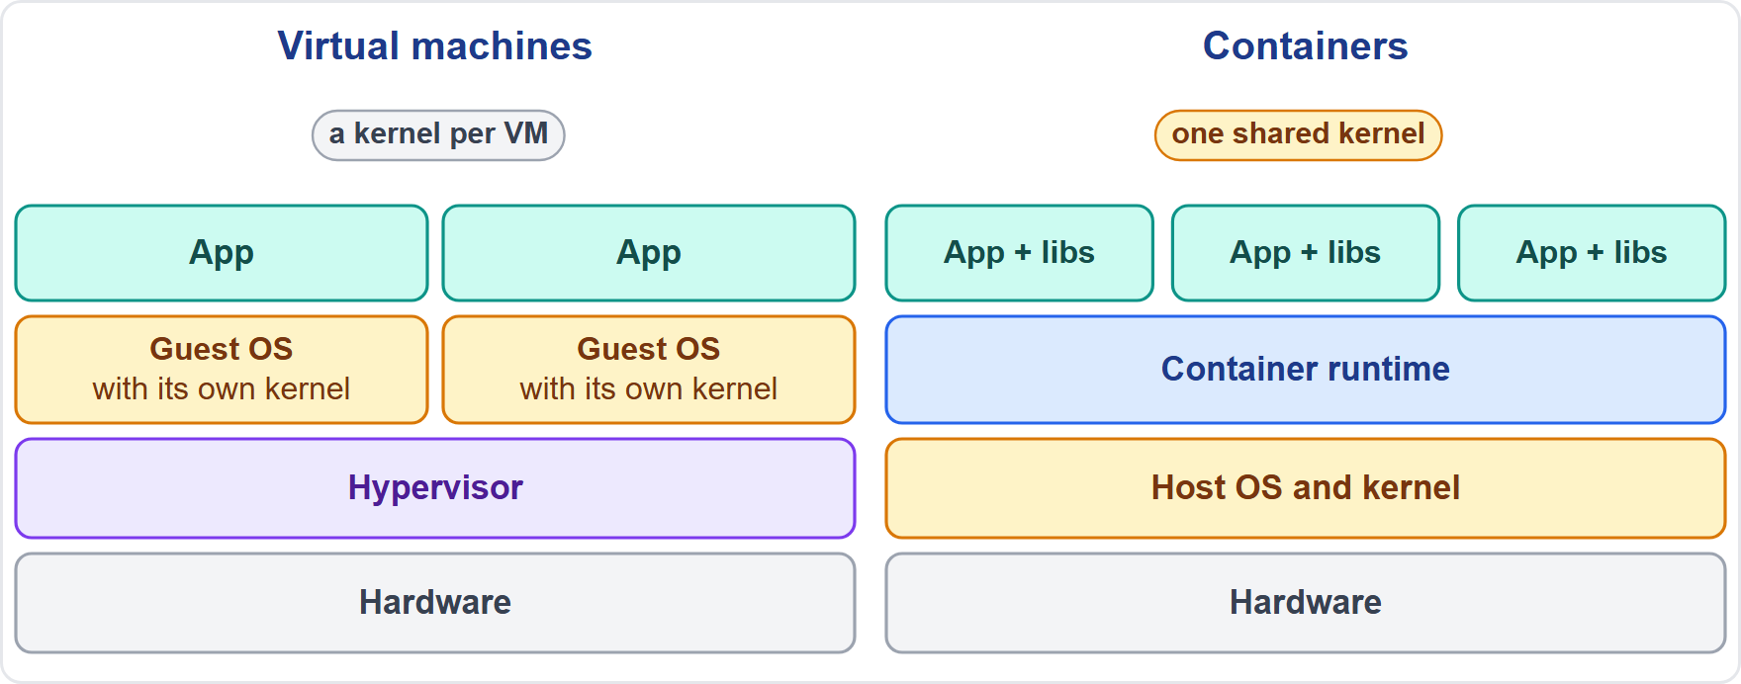
Why Containers: Portable, Dense, Consistent
Part 1
A container packages an app with the files it needs, so it behaves the same wherever it runs
Containers decouple the app from the host infrastructure
A virtual machine is a whole operating system with its own kernel
A container is an isolated process that shares the host's kernel, so more apps fit on less infrastructure
EXAM TIP A container is an isolated process, not a small virtual machine.
KCNA Exam Prep Masterclass | Kubernetes and Cloud Native Associate
Module 1: Containers and Containerization
3 / 21
Notes:
A container packages an app with the files it needs, so it behaves the same wherever it runs. Containers decouple the app from the host infrastructure. Compare that with a virtual machine. A virtual machine is a whole operating system with its own kernel. A container is an isolated process that shares the host's kernel, so more apps fit on less infrastructure. The diagram shows two virtual machines, each with a guest operating system, next to three containers on one shared kernel. Exam tip: a container is an isolated process, not a small virtual machine.

Slide 4
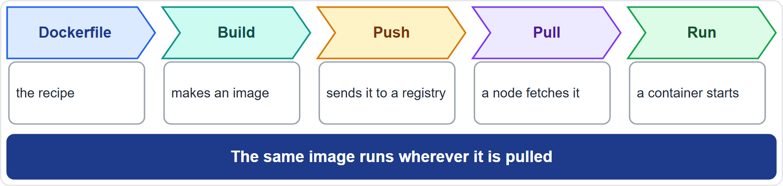
From Image to Running Container
Part 1
A container image is a ready-to-run package: the code, the runtime it needs and its libraries
A container is a running instance of an image; one image can start many containers
The life cycle is build, ship, run: build the image, push it to a registry, pull and run it on a node
Images are immutable: a change means a new image
EXAM TIP The image is the template; the container is what runs.
KCNA Exam Prep Masterclass | Kubernetes and Cloud Native Associate
Module 1: Containers and Containerization
4 / 21
Notes:
A container image is a ready-to-run package: the code, the runtime it needs and its libraries. A container is a running instance of an image, and one image can start many containers. The life cycle has three steps: build, ship, run. You build the image from a Docker file, push it to a registry, then a node pulls it and runs it. Images are immutable, which means a change produces a new image. Exam tip: the image is the template, and the container is what runs.

Slide 5
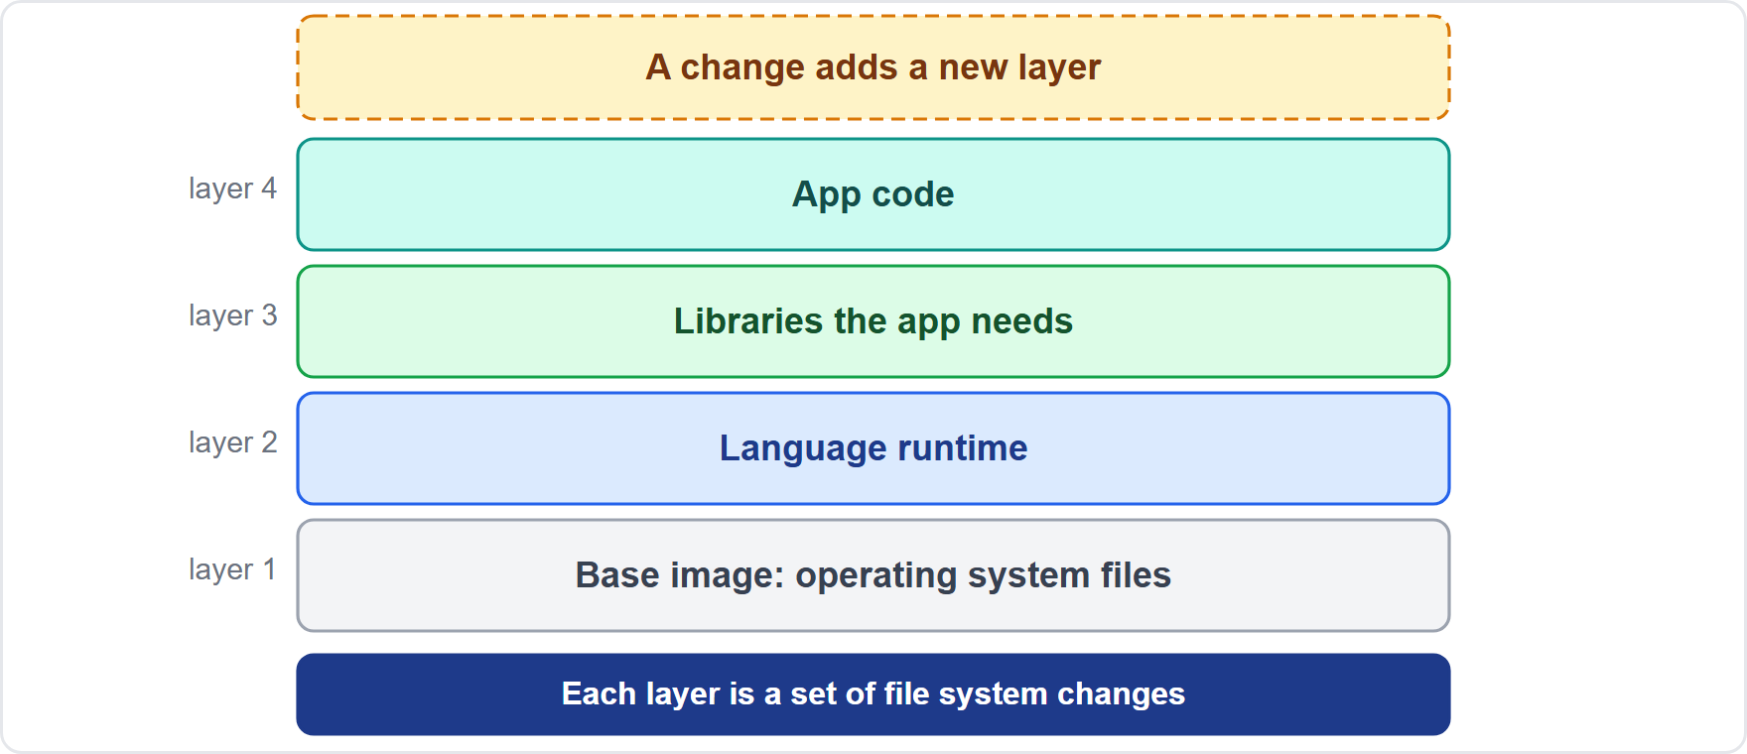
Image Layers
Part 1
An image is built from layers; each layer is a set of file system changes
You start from a base image and add layers for libraries and your own code
Because images are immutable, a change adds a layer on top
A node downloads only the layers it does not already have
EXAM TIP Layers make images efficient: shared layers are stored and pulled once.
KCNA Exam Prep Masterclass | Kubernetes and Cloud Native Associate
Module 1: Containers and Containerization
5 / 21
Notes:
An image is built from layers. Each layer is a set of file system changes. You start from a base image and add layers for libraries and your own code. Because images are immutable, a change adds a layer on top instead of editing what is below. And when a node pulls an image, it downloads only the layers it does not already have. Exam tip: layers make images efficient, because shared layers are stored and pulled once.

Slide 6
Registries, Tags and Digests
Part 1
Part of the name | Example | What it means
Registry | registry.harborbooks.example | where the image is stored; if you leave it out, Kubernetes assumes the Docker public registry
Name | storefront | the image itself
Tag | :1.4 | a label for a version; it can be moved to another image; no tag means latest
Digest | @sha256:... | a hash of the image content; it never changes
A tag can be moved; a digest identifies one exact image
To run exactly the same image everywhere, reference it by digest
EXAM TIP Tags move, digests do not.
KCNA Exam Prep Masterclass | Kubernetes and Cloud Native Associate
Module 1: Containers and Containerization
6 / 21
Notes:
An image name has up to four parts. The registry says where the image is stored. If you leave it out, Kubernetes assumes the Docker public registry. Then comes the name of the image itself. Then an optional tag, a label for a version. A tag can be moved to a different image, and no tag means the tag latest. Last, an optional digest, a hash of the image content, which never changes. To run exactly the same image everywhere, reference it by digest. Exam tip: tags move, digests do not.

Slide 7
Image Pull Policy
Part 1
imagePullPolicy | What the kubelet does
IfNotPresent | pulls the image only if it is not already on the node
Always | asks the runtime to pull every time a container starts; layers already cached are reused
Never | does not pull; the container fails to start if the image is missing
If you leave the policy out and use the tag latest, or no tag, it becomes Always
If you leave it out and use a version tag or a digest, it becomes IfNotPresent
EXAM TIP latest or no tag means Always; a version tag means IfNotPresent.
KCNA Exam Prep Masterclass | Kubernetes and Cloud Native Associate
Module 1: Containers and Containerization
7 / 21
Notes:
The image pull policy decides when the kube let pulls an image. If Not Present pulls only when the image is not already on the node. Always asks the runtime to pull every time a container starts, and layers that are already cached are reused. Never does not pull at all, and the container fails to start if the image is missing. When you leave the policy out, Kubernetes chooses. The tag latest, or no tag, gives Always. A version tag or a digest gives If Not Present. Exam tip: latest or no tag means Always, and a version tag means If Not Present.

Slide 8
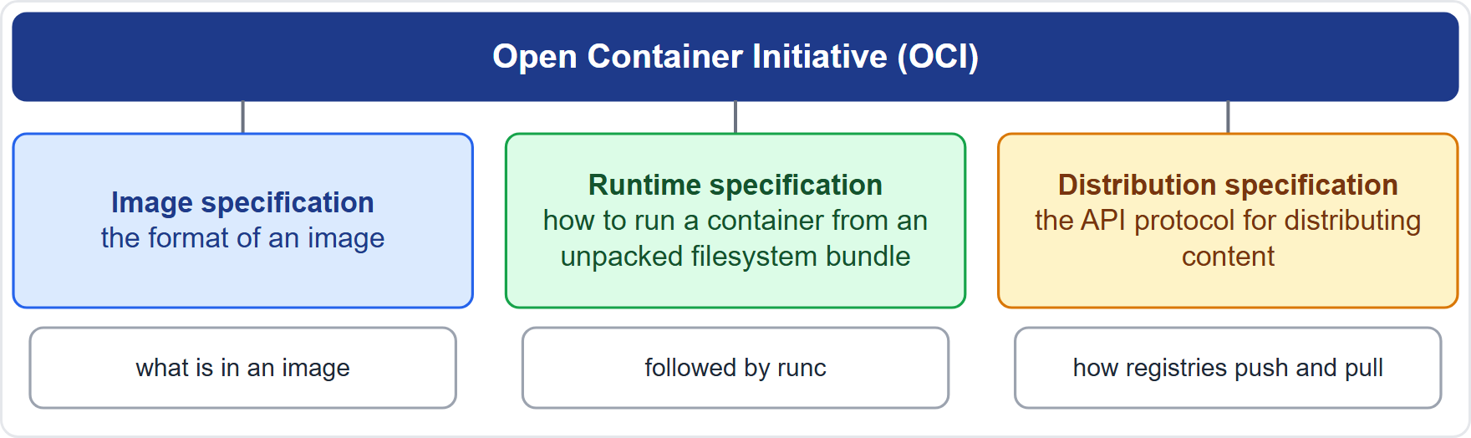
OCI: The Open Standards
ARCHIVED TOPIC
Part 1
The Open Container Initiative (OCI) develops open standards for containers
Image specification: the format of an image
Runtime specification: how to run a container from an unpacked filesystem bundle
Distribution specification: the API protocol for distributing content through registries
runc runs containers according to the OCI specification
EXAM TIP OCI means image, runtime and distribution.
KCNA Exam Prep Masterclass | Kubernetes and Cloud Native Associate
Module 1: Containers and Containerization
8 / 21
Notes:
This slide is tagged archived topic, so it comes from the older curriculum and is kept at recognition level. The Open Container Initiative, O C I, develops open standards for containers. The image specification defines the format of an image. The runtime specification defines how to run a container from an unpacked file system bundle. The distribution specification defines the A P I protocol for distributing content through registries. And run C runs containers according to the O C I specification. Exam tip: O C I means image, runtime and distribution.

Slide 9
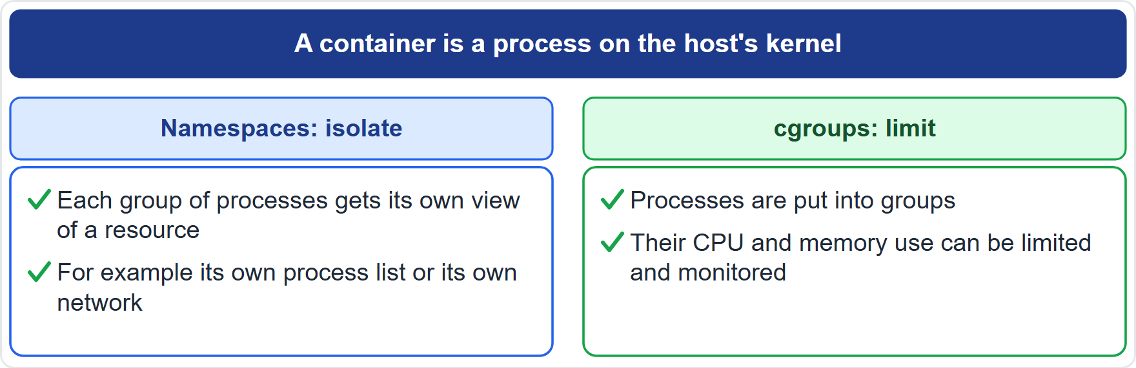
What a Container Is Made Of: Namespaces and cgroups
BEYOND THE CURRICULUM
Part 1
A container is a process on the host's kernel, isolated and limited by Linux features
Namespaces give a process its own isolated view of a system resource
Control groups (cgroups) put processes in groups whose resource use can be limited and monitored
The kubelet and the runtime use cgroups to enforce CPU and memory requests and limits
EXAM TIP Namespaces isolate and cgroups limit; a Linux namespace is not a Kubernetes namespace.
KCNA Exam Prep Masterclass | Kubernetes and Cloud Native Associate
Module 1: Containers and Containerization
9 / 21
Notes:
This slide is tagged beyond the curriculum, because it explains what a container is under the hood. A container is a process on the host's kernel, isolated and limited by Linux features. Namespaces give a process its own isolated view of a system resource. Control groups, called C groups, put processes in groups whose resource use can be limited and monitored. The kube let and the runtime use C groups to enforce C P U and memory requests and limits. Exam tip: namespaces isolate and C groups limit, and a Linux namespace is not a Kubernetes namespace.

Slide 10
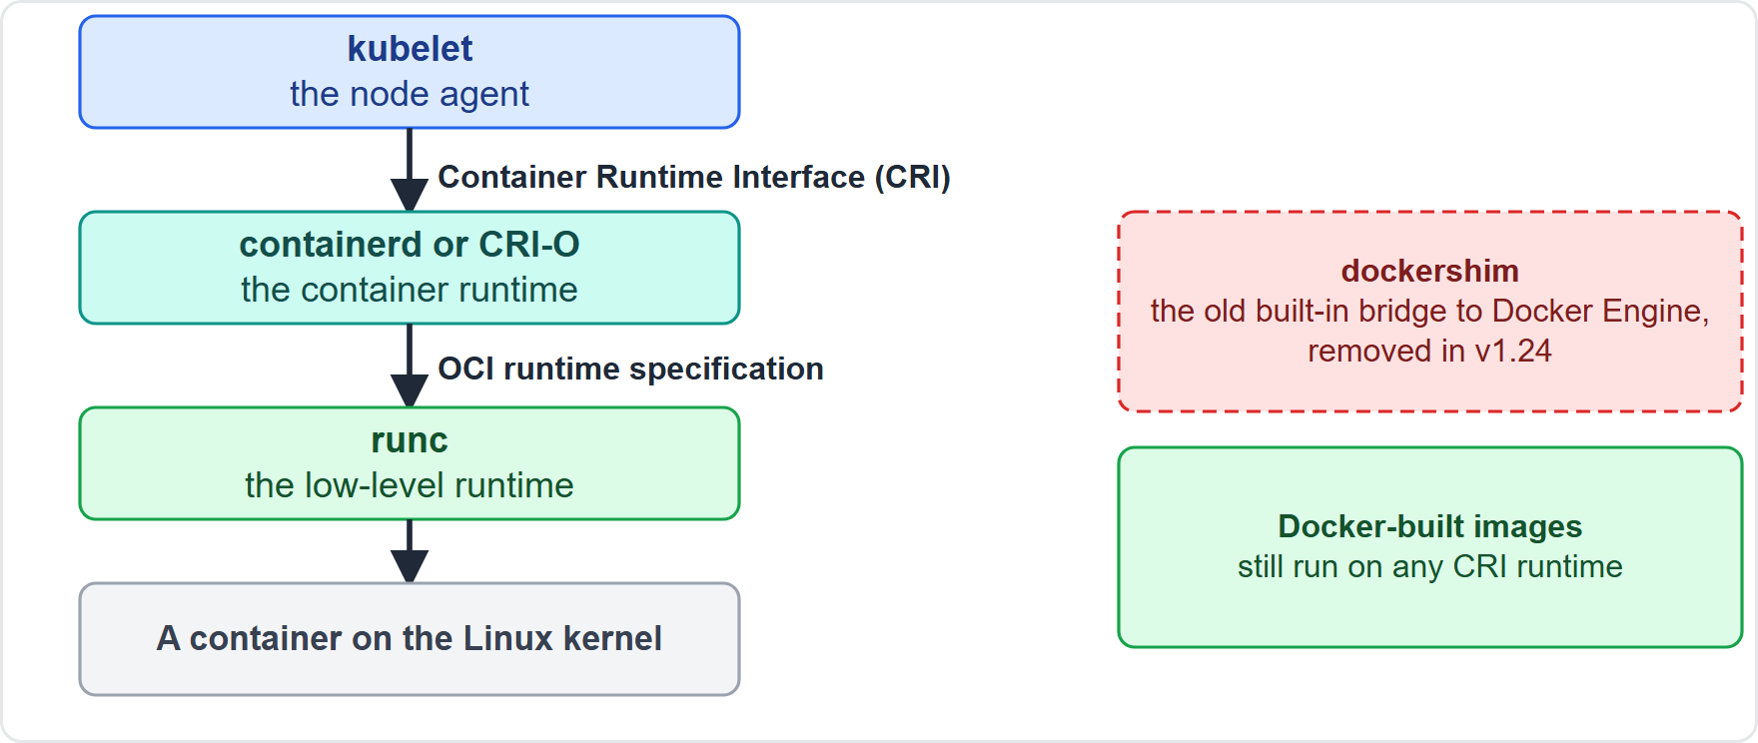
The Runtime Stack: CRI, containerd, CRI-O, runc
BEYOND THE CURRICULUM · OLD WORDING
Part 1
The kubelet talks to a runtime through the Container Runtime Interface (CRI)
containerd and CRI-O are runtimes that implement the CRI
A low-level runtime such as runc creates the container
dockershim, the built-in bridge to Docker Engine, was removed in v1.24; Docker-built images still run
EXAM TIP Kubernetes needs a CRI runtime such as containerd or CRI-O; dockershim is gone.
KCNA Exam Prep Masterclass | Kubernetes and Cloud Native Associate
Module 1: Containers and Containerization
10 / 21
Notes:
This slide is tagged beyond the curriculum and old wording. The kube let talks to a container runtime through the Container Runtime Interface, the C R I. Container D and C R I O are runtimes that implement the C R I. A low-level runtime such as run C creates the container. The old built-in bridge to Docker Engine was called docker shim, and it was removed in version one point twenty-four. Images built with Docker still run on any runtime. Exam tip: Kubernetes needs a C R I runtime such as container D or C R I O, and docker shim is gone.

Slide 11
Dockerfile and Multi-Stage Builds
BEYOND THE CURRICULUM
Part 1
A Dockerfile is a text file of instructions for building an image
A multi-stage build uses several FROM lines; each one starts a new stage
Build the app in one stage, then copy only the result into the final stage with COPY --from
Everything you do not copy is left behind, so the final image is smaller
DOCKERFILE
FROM golang:1.22 AS build
WORKDIR /src
COPY . .
RUN go build -o /bin/storefront .
FROM alpine:3.20
COPY --from=build /bin/storefront /bin/storefront
CMD ["/bin/storefront"]
Build in one stage, ship in another
EXAM TIP Multi-stage builds keep build tools out of the final image.
KCNA Exam Prep Masterclass | Kubernetes and Cloud Native Associate
Module 1: Containers and Containerization
11 / 21
Notes:
This slide is tagged beyond the curriculum. A Docker file is a text file of instructions for building an image. A multi-stage build uses several From lines, and each one starts a new stage. In the snippet, the first stage builds the storefront. The second stage starts from a small base image and copies only the finished program from the first, with copy dash dash from. Everything you do not copy is left behind, so the final image is smaller. Exam tip: multi-stage builds keep build tools out of the final image.

Slide 12
What the Exam Asks: Containers
Part 2
Container or VM
Image or container
Tag or digest
containers share the host's kernel; a virtual machine brings its own
the image is the template; the container is a running instance
tags can move; a digest never changes
Pull policy
Docker or CRI
OCI
latest or no tag means Always; a version tag means IfNotPresent
Kubernetes needs a CRI runtime; dockershim was removed in v1.24
the image, runtime and distribution specifications
EXAM TIP When a question mixes these terms, decide first which layer it is about: package, standard or runtime.
KCNA Exam Prep Masterclass | Kubernetes and Cloud Native Associate
Module 1: Containers and Containerization
12 / 21
Notes:
Six pairs to keep apart. Container or V M: containers share the host's kernel, and a virtual machine brings its own. Image or container: the image is the template, and the container is a running instance. Tag or digest: tags can move, and a digest never changes. Pull policy: latest or no tag means Always, and a version tag means If Not Present. Docker or C R I: Kubernetes needs a C R I runtime, and docker shim was removed in version one point twenty-four. And O C I: image, runtime and distribution. Exam tip: decide first which layer a question is about.

Slide 13
Module Recap
Part 2
1
Containers
2
Images
3
Names and policy
isolated processes that share the host kernel, so they are lighter than virtual machines
immutable stacks of layers; the container is the running instance
registry, name, tag or digest; pull policy follows the tag
4
Standards and runtimes
5
Builds
a Dockerfile, and multi-stage builds for smaller images
OCI image, runtime and distribution; kubelet, CRI, containerd or CRI-O, runc
KCNA Exam Prep Masterclass | Kubernetes and Cloud Native Associate
Module 1: Containers and Containerization
13 / 21
Notes:
To recap. Containers are isolated processes that share the host kernel, so they are lighter than virtual machines. Images are immutable stacks of layers, and the container is the running instance. An image name has a registry, a name, and a tag or a digest, and the pull policy follows the tag. The standards are the O C I image, runtime and distribution specifications, and the runtime chain is kube let, C R I, container D or C R I O, then run C. Builds use a Docker file, and multi-stage builds give smaller images. Now seven practice questions.

Slide 14
Practice Question 1
Part 2
Q1
Which statement correctly compares containers with virtual machines?
A
Each container runs its own operating system kernel, as a virtual machine does
B
Containers share the host's kernel, so they are lighter than virtual machines
C
Containers need a hypervisor to run, while virtual machines do not need one
D
Containers cannot be isolated from one another, but virtual machines can be
KCNA Exam Prep Masterclass | Kubernetes and Cloud Native Associate
Module 1: Containers and Containerization
14 / 21
Notes:
Question one. Which statement correctly compares containers with virtual machines? The four options are on the screen.
[PAUSE 12]
The answer is B. Containers are isolated processes that share the host's kernel, which is why more of them fit on the same infrastructure. A virtual machine carries a whole operating system with its own kernel. Containers do not need a hypervisor, and they are isolated from each other.

Slide 15
Practice Question 2
Part 2
Q2
The Harbor Books team tests an image and then wants production to run exactly the same image. How should the Pod refer to it?
A
By the tag latest, because latest always points to the build that was tested
B
By a version tag, because a tag cannot be moved after it has been pushed
C
By the image name only, because a registry keeps just one version of an image
D
By its digest, because a digest identifies one exact image and never changes
KCNA Exam Prep Masterclass | Kubernetes and Cloud Native Associate
Module 1: Containers and Containerization
15 / 21
Notes:
Question two. The Harbor Books team tests an image and then wants production to run exactly the same image. How should the Pod refer to it? The four options are on the screen.
[PAUSE 12]
The answer is D. A digest is a hash of the image content, so it identifies one exact image. Tags, including latest, can be moved to point to a different image, and a registry can hold many versions under one name.

Slide 16
Practice Question 3
Part 2
Q3
A container uses the image storefront:1.4 and the Pod does not set imagePullPolicy. Which policy does Kubernetes apply?
A
IfNotPresent, because the tag is a version tag and not latest
B
Always, because Kubernetes pulls the image again at each container start
C
Never, because versioned tags are expected to be on the node already
D
Always, because a digest is needed to cache an image on a node
KCNA Exam Prep Masterclass | Kubernetes and Cloud Native Associate
Module 1: Containers and Containerization
16 / 21
Notes:
Question three. A container uses the image storefront colon one point four, and the Pod does not set an image pull policy. Which policy does Kubernetes apply? The four options are on the screen.
[PAUSE 12]
The answer is A. When the policy is left out, a version tag gives If Not Present, and so does a digest. Only latest, or no tag at all, gives Always. Never is used only when it is set explicitly.

Slide 17
Practice Question 4
Part 2
Q4
The Harbor Books team pushes a rebuilt storefront image as storefront:1.5. A node already runs storefront:1.4, and only the top layer differs. What does the node download?
A
The whole image again, because images cannot be partly cached on a node
B
Nothing, because the node already has an image with the storefront name
C
Only the layers that the node does not already have in its cache
D
Only the first layer, because all later layers are read from the registry
KCNA Exam Prep Masterclass | Kubernetes and Cloud Native Associate
Module 1: Containers and Containerization
17 / 21
Notes:
Question four. The Harbor Books team pushes a rebuilt storefront image as storefront colon one point five. A node already runs storefront colon one point four, and only the top layer differs. What does the node download? The four options are on the screen.
[PAUSE 12]
The answer is C. Images are stacks of layers, and the runtime downloads only the layers that are not already cached. Tag one point five is a different reference from one point four, so a pull is needed, but the shared layers are reused.

Slide 18
Practice Question 5
Part 2
Q5
Which OCI specification defines how images are pushed to and pulled from a registry?
A
The image specification, which defines the format of an image
B
The runtime specification, which defines how a container is run
C
The Pod specification, which defines containers in a manifest
D
The distribution specification, which defines the registry API protocol
KCNA Exam Prep Masterclass | Kubernetes and Cloud Native Associate
Module 1: Containers and Containerization
18 / 21
Notes:
Question five. Which O C I specification defines how images are pushed to and pulled from a registry? The four options are on the screen.
[PAUSE 12]
The answer is D. The distribution specification defines the A P I protocol for distributing content. The image specification defines the image format, the runtime specification defines how a bundle is run, and the Pod specification belongs to Kubernetes, not to the O C I.

Slide 19
Practice Question 6
Part 2
Q6
What is the Container Runtime Interface (CRI)?
A
The interface that the kubelet uses to talk to a container runtime
B
The standard format in which container images are stored in a registry
C
A kernel feature that groups processes so that their resource use is limited
D
The API protocol with which a registry accepts and serves image layers
KCNA Exam Prep Masterclass | Kubernetes and Cloud Native Associate
Module 1: Containers and Containerization
19 / 21
Notes:
Question six. What is the Container Runtime Interface, the C R I? The four options are on the screen.
[PAUSE 12]
The answer is A. The C R I is how the kube let talks to a runtime such as container D or C R I O. The image format and the registry protocol are O C I specifications, and grouping processes to limit resources describes C groups.

Slide 20
Practice Question 7
Part 2
Q7
A team reads that dockershim was removed in v1.24. What does that mean for its cluster?
A
Images built with Docker have to be rebuilt, because they are not OCI images
B
Docker Engine is still built into the kubelet, but it is switched off by default
C
Nodes need a runtime that implements the CRI, such as containerd or CRI-O
D
Containers need a hypervisor to be installed on each worker node
KCNA Exam Prep Masterclass | Kubernetes and Cloud Native Associate
Module 1: Containers and Containerization
20 / 21
Notes:
Question seven. A team reads that docker shim was removed in version one point twenty-four. What does that mean for its cluster? The four options are on the screen.
[PAUSE 12]
The answer is C. Kubernetes needs a C R I compatible runtime on each node. Images built with Docker still run on any runtime, the direct Docker Engine integration is gone rather than switched off, and no hypervisor is needed for containers.

Slide 21
Answers at a Glance
Part 2
Question | Answer | Why
Q1 | B | Containers share the host's kernel
Q2 | D | A digest identifies one exact image
Q3 | A | A version tag gives IfNotPresent
Q4 | C | Only missing layers are downloaded
Q5 | D | The distribution specification covers registries
Q6 | A | The CRI connects the kubelet and the runtime
Q7 | C | Nodes need a CRI-compatible runtime
KCNA Exam Prep Masterclass | Kubernetes and Cloud Native Associate
Module 1: Containers and Containerization
21 / 21
Notes:
Here are the answers at a glance. Question one, B: containers share the host's kernel. Question two, D: a digest identifies one exact image. Question three, A: a version tag gives If Not Present. Question four, C: only missing layers are downloaded. Question five, D: the distribution specification covers registries. Question six, A: the C R I connects the kube let and the runtime. Question seven, C: nodes need a C R I compatible runtime.

