Slide 1
Module 2: Kubernetes Architecture, API and Objects
How a cluster is built and how you describe what you want
Kubernetes Fundamentals · Kubernetes Core Concepts
YOU WILL BE ABLE TO
Name the control plane and node components and what each does
Explain declarative configuration, desired state and reconciliation
Read the API's groups, versions and kinds and the parts of a manifest
Use labels, selectors, annotations, namespaces and owner references
Recognize custom resources, operators and the ways to get a cluster
KCNA Exam Prep Masterclass
Module 2 · Part 1
Notes:
Welcome to Module 2: Kubernetes Architecture, API and Objects. This module is in the Kubernetes Fundamentals domain, and it covers the first part of the topic called Kubernetes Core Concepts. By the end you will be able to do five things. Name the control plane and node components, and what each does. Explain declarative configuration and reconciliation. Read the A P I's groups, versions and kinds, and the parts of a manifest. Use labels, selectors, annotations, namespaces and owner references. And recognize custom resources, operators and the ways to get a cluster.

Slide 2
Case Check-In: Harbor Books Gets a Cluster
Part 1
CASE CHECK-IN · Harbor Books
The platform engineer is handed a new cluster and has to learn what is inside it
The team will describe the shop in files and let Kubernetes make it so
People will need to find all the storefront Pods, and to keep staging apart from production
In this module you map the parts of the cluster and the objects the team will use
KCNA Exam Prep Masterclass | Kubernetes and Cloud Native Associate
Module 2: Kubernetes Architecture, API and Objects
2 / 31
Notes:
At Harbor Books, the platform engineer is handed a new cluster and has to learn what is inside it. The team will describe the shop in files and let Kubernetes make it so. People will need to find all the storefront Pods, and to keep staging apart from production. In this module you map the parts of the cluster, and the objects the team will use.

Slide 3
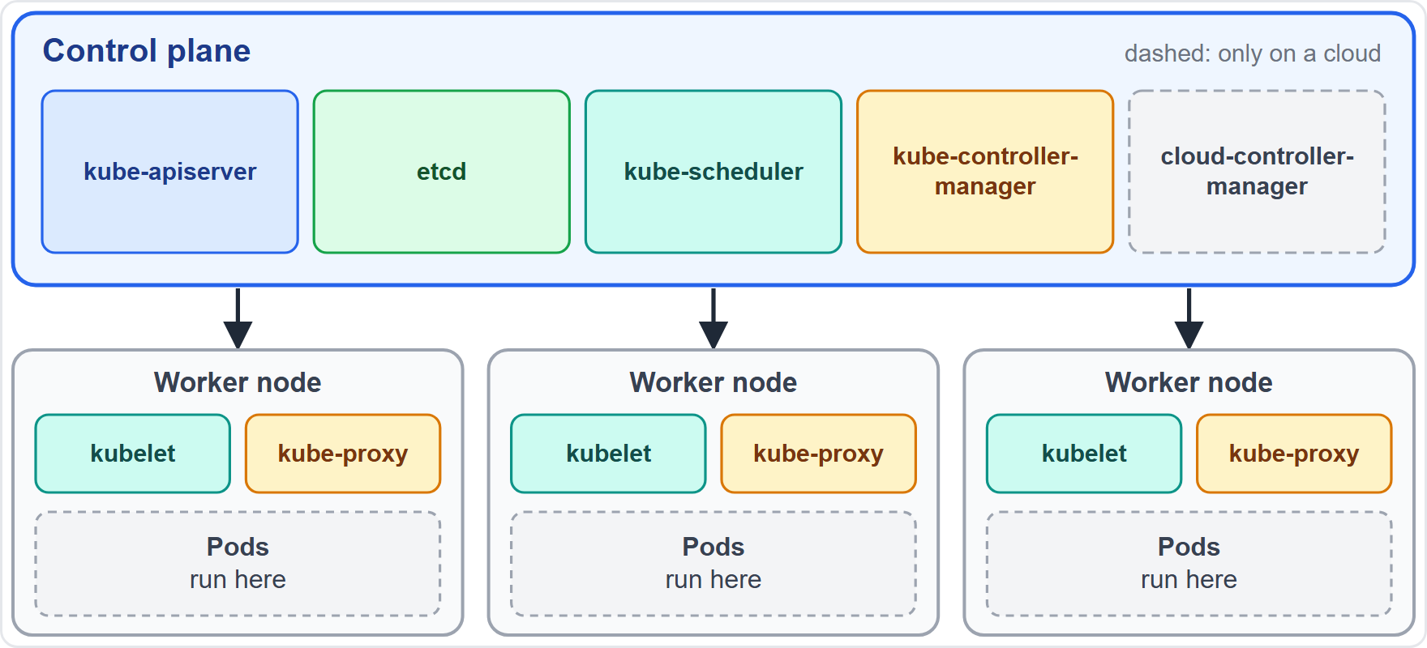
A Cluster: Control Plane and Nodes
Part 1
A cluster is a control plane plus worker nodes
The control plane makes global decisions and manages the nodes and the Pods
Nodes are the worker machines that run the Pods; a node can be a virtual or a physical machine
In production the control plane usually runs across several machines
EXAM TIP The control plane decides; the nodes run the Pods.
KCNA Exam Prep Masterclass | Kubernetes and Cloud Native Associate
Module 2: Kubernetes Architecture, API and Objects
3 / 31
Notes:
A cluster is a control plane plus worker nodes. The control plane makes global decisions, and it manages the nodes and the Pods. Nodes are the worker machines that run the Pods, and a node can be a virtual machine or a physical machine. In production, the control plane usually runs across several machines. The diagram shows the five control plane components above three nodes, each running a kube let, a kube proxy and some Pods. Exam tip: the control plane decides, and the nodes run the Pods.

Slide 4
Control Plane Components
Part 1
Component | What it does
kube-apiserver | serves the Kubernetes API; the front end of the control plane
etcd | keeps all cluster data in a consistent, highly available key-value store
kube-scheduler | picks a node for each new Pod that has none
kube-controller-manager | runs the controllers that keep the cluster at its desired state
cloud-controller-manager | links the cluster to a cloud provider's API; a local or on-premises cluster has none
etcd holds all cluster data, so it needs a backup plan
EXAM TIP API server is the front door, etcd is the memory, the scheduler places Pods and the controller manager runs the loops.
KCNA Exam Prep Masterclass | Kubernetes and Cloud Native Associate
Module 2: Kubernetes Architecture, API and Objects
4 / 31
Notes:
The control plane has up to five components. The kube A P I server serves the Kubernetes A P I, and it is the front end of the control plane. E T C D keeps all cluster data in a consistent, highly available key value store. The kube scheduler picks a node for each new Pod that has none. The kube controller manager runs the controllers that keep the cluster at its desired state. And the cloud controller manager links the cluster to a cloud provider's A P I. A local or on-premises cluster has none. Because E T C D holds all cluster data, it needs a backup plan. Exam tip: the A P I server is the front door, E T C D is the memory, the scheduler places Pods and the controller manager runs the loops.

Slide 5
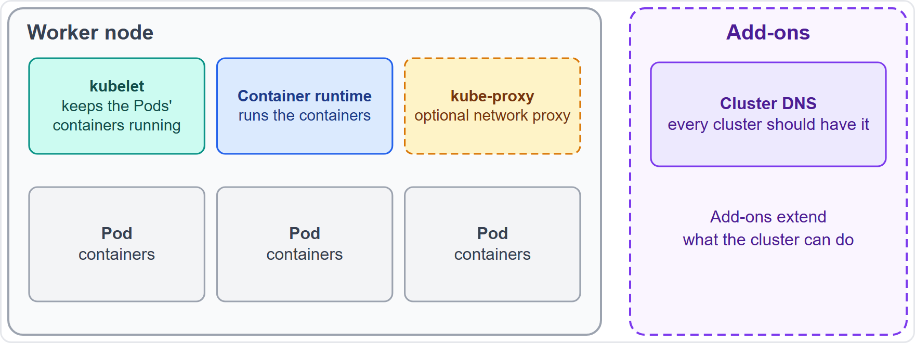
Node Components and Add-ons
Part 1
The kubelet is an agent on each node that makes sure the containers of its Pods are running
kube-proxy is a network proxy on each node that implements part of the Service idea; it is optional, because some network plugins do the job themselves
The container runtime runs the containers (module 1)
Add-ons extend the cluster; every cluster should have cluster DNS
EXAM TIP kubelet and kube-proxy run on every node; the scheduler and API server do not.
KCNA Exam Prep Masterclass | Kubernetes and Cloud Native Associate
Module 2: Kubernetes Architecture, API and Objects
5 / 31
Notes:
Every node runs a few components. The kube let is an agent that makes sure the containers of its Pods are running. Kube proxy is a network proxy that implements part of the Service idea. It is optional, because some network plugins do the job themselves. The container runtime runs the containers, as you saw in module one. Add-ons extend the cluster, and every cluster should have cluster D N S. Exam tip: kube let and kube proxy run on every node. The scheduler and the A P I server do not.

Slide 6
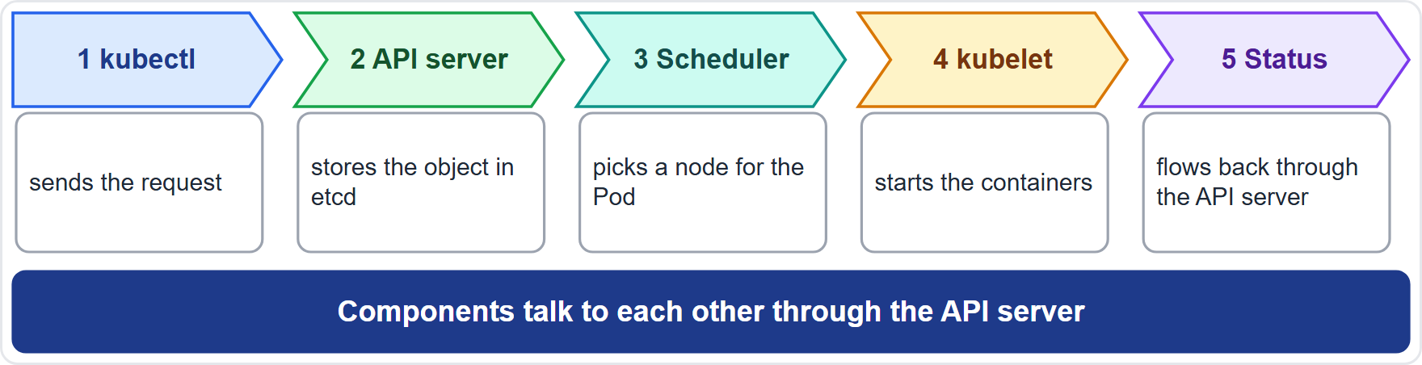
Following a Request: From kubectl to a Running Pod
Part 1
You send a request with kubectl to the API server
The object is stored in etcd
The scheduler notices a Pod with no node and picks a node
The kubelet on that node starts the containers and reports status
Components talk to each other through the API server
EXAM TIP When a question asks who stores, who places and who runs, the answers are etcd, the scheduler and the kubelet.
KCNA Exam Prep Masterclass | Kubernetes and Cloud Native Associate
Module 2: Kubernetes Architecture, API and Objects
6 / 31
Notes:
Follow one request through the cluster. You send it with kube control to the A P I server. The object is stored in E T C D. The scheduler notices a Pod with no node, and picks a node. The kube let on that node starts the containers and reports status. The components talk to each other through the A P I server, and never directly. Exam tip: when a question asks who stores, who places and who runs, the answers are E T C D, the scheduler and the kube let.

Slide 7
Declarative Versus Imperative
Part 1
Technique | Works on | Example
Imperative commands | live objects | kubectl create deployment storefront --image=...
Imperative object configuration | individual files | kubectl create -f storefront.yaml
Declarative object configuration | directories of files | kubectl apply -f ./manifests
Declarative means you state the desired result in files; Kubernetes works out the steps
kubectl apply is the recommended way to manage applications in production
EXAM TIP Declarative describes the end state; imperative gives the steps.
KCNA Exam Prep Masterclass | Kubernetes and Cloud Native Associate
Module 2: Kubernetes Architecture, API and Objects
7 / 31
Notes:
There are three ways to manage objects. Imperative commands work on live objects, for example kube control create deployment with an image. Imperative object configuration works on individual files, with kube control create dash f. And declarative object configuration works on directories of files, with kube control apply dash f. Declarative means you state the desired result in files, and Kubernetes works out the steps. Kube control apply is the recommended way to manage applications in production. Exam tip: declarative describes the end state, and imperative gives the steps.

Slide 8
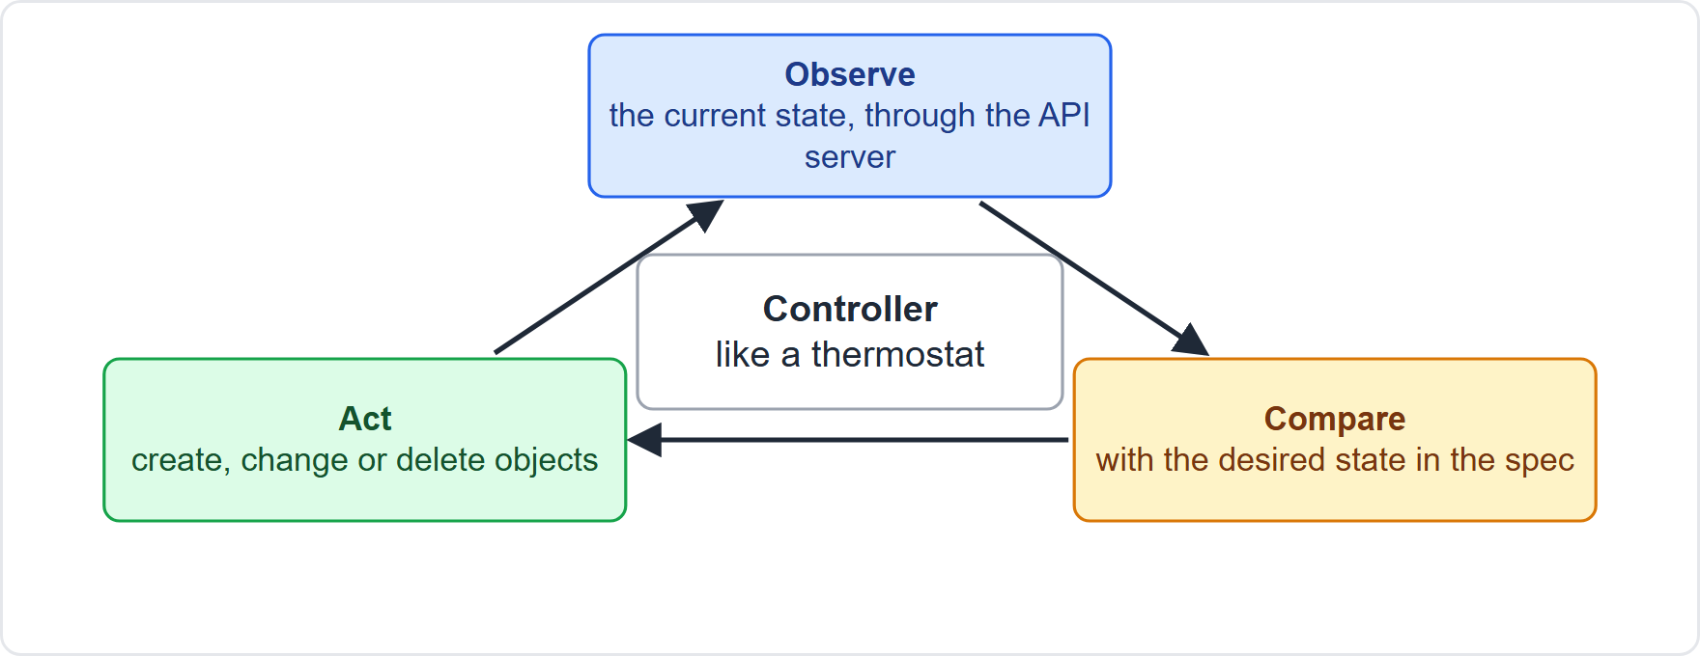
Controllers and the Reconciliation Loop
Part 1
A controller is a control loop that watches the cluster's state through the API server
It acts to narrow the gap between the current state and the desired state
A thermostat is the classic example: it compares the room to the setting and acts
kube-controller-manager runs many controllers in one process
EXAM TIP Self-healing in Kubernetes is just controllers reconciling.
KCNA Exam Prep Masterclass | Kubernetes and Cloud Native Associate
Module 2: Kubernetes Architecture, API and Objects
8 / 31
Notes:
A controller is a control loop that watches the cluster's state through the A P I server. It acts to narrow the gap between the current state and the desired state. A thermostat is the classic example: it compares the room to the setting, and acts. The diagram shows the cycle: observe, compare, act, and repeat. The kube controller manager runs many controllers in one process. Exam tip: self-healing in Kubernetes is just controllers reconciling.

Slide 9
The API: Groups, Versions and Kinds
Part 1
Group | Path | apiVersion | Kinds, for example
Core | /api/v1 | v1 | Pod, Service, ConfigMap, Namespace
Named | /apis/GROUP/VERSION | apps/v1, batch/v1 | Deployment, StatefulSet, Job, CronJob
alpha (for example v1alpha1): off by default; support can be dropped at any time
beta (for example v1beta1): new built-in beta versions are also off by default
stable (v1, v2): named vX with an integer
EXAM TIP apiVersion is group and version; the core group is written as plain v1.
KCNA Exam Prep Masterclass | Kubernetes and Cloud Native Associate
Module 2: Kubernetes Architecture, API and Objects
9 / 31
Notes:
The A P I is organized into groups. The core group lives under slash A P I slash v one, and its A P I version is written as plain v one. It holds Pod, Service, Config Map and Namespace. Named groups live under slash A P I S, then the group, then the version. For example, apps slash v one holds Deployment and Stateful Set. And batch slash v one holds Job and Cron Job. Versions have levels. Alpha versions, like v one alpha one, are off by default, and support can be dropped at any time. Built-in beta versions are also off by default. Stable versions are named v X, with an integer. Exam tip: A P I version is group and version, and the core group is written as plain v one.

Slide 10
Anatomy of a Manifest
Part 1
apiVersion: which version of the API you use; kind: what kind of object
metadata: identifying data, such as a name, a UID (unique ID) and an optional namespace
spec: the desired state, which you write
status: the current state, which Kubernetes writes and keeps updated
An object is a record of intent: once created, Kubernetes works to keep it so
YAML
apiVersion: v1
kind: Pod
metadata:
name: storefront
namespace: shop
labels:
app: storefront
spec:
containers:
- name: storefront
image: harborbooks/storefront:1.4
A minimal Pod manifest
EXAM TIP You write the spec; Kubernetes writes the status.
KCNA Exam Prep Masterclass | Kubernetes and Cloud Native Associate
Module 2: Kubernetes Architecture, API and Objects
10 / 31
Notes:
A manifest has a few required fields. A P I version says which version of the A P I you use. Kind says what kind of object it is. Metadata holds identifying data, such as a name, a U I D, which is a unique I D, and an optional namespace. And spec is the desired state, which you write. There is also status, the current state, which Kubernetes writes and keeps updated. The snippet is a minimal Pod. An object is a record of intent: after you create it, Kubernetes works to keep it that way. Exam tip: you write the spec, and Kubernetes writes the status.

Slide 11
Kinds You Will Meet
Part 1
Kind | What it is | Module
Pod | one or more containers run together | Module 3
Deployment, StatefulSet, DaemonSet, Job, CronJob | controllers that run Pods | Module 3
ConfigMap, Secret | configuration and sensitive settings | Module 4
Service, Ingress | stable network access to Pods | Module 6
PersistentVolumeClaim | a request for storage | Module 7
Namespace, Node | a scope for names; a worker machine | Module 2
EXAM TIP Learn the kind names now; the next modules explain each one.
KCNA Exam Prep Masterclass | Kubernetes and Cloud Native Associate
Module 2: Kubernetes Architecture, API and Objects
11 / 31
Notes:
This slide is a map of kinds you will meet. A Pod is one or more containers run together. Deployment, Stateful Set, Daemon Set, Job and Cron Job are controllers that run Pods, in module three. Config Map and Secret hold configuration and sensitive settings, in module four. Service and Ingress give stable network access to Pods, in module six. A Persistent Volume Claim is a request for storage, in module seven. And Namespace and Node are covered in this module. Exam tip: learn the kind names now, and the next modules explain each one.

Slide 12
kubectl: the Command Line
Part 1
kubectl talks to the cluster's control plane through the API; you can create, inspect, update and delete objects
Syntax: kubectl [command] [TYPE] [NAME] [flags]
Resource types are case-insensitive; names are case-sensitive
kubectl explain documents a resource; kubectl api-resources lists the kinds
TERMINAL
kubectl get pods -n shop
kubectl describe pod storefront -n shop
kubectl apply -f storefront.yaml
kubectl delete pod storefront -n shop
kubectl explain pods
kubectl api-resources
Everyday kubectl commands
EXAM TIP get lists, describe explains, apply declares, delete removes.
KCNA Exam Prep Masterclass | Kubernetes and Cloud Native Associate
Module 2: Kubernetes Architecture, API and Objects
12 / 31
Notes:
Kube control talks to the cluster's control plane through the A P I. You use it to create, inspect, update and delete objects. The syntax is kube control, then a command, a type, a name, and flags. Resource types are case insensitive, and names are case sensitive. Kube control explain documents a resource, and kube control A P I resources lists the kinds. The snippet shows get, describe, apply and delete. Exam tip: get lists, describe explains, apply declares, and delete removes.

Slide 13
kubeconfig: Clusters, Users and Contexts
Part 1
A kubeconfig file lists clusters, users and contexts
A context ties a cluster, a user and a namespace together; current-context says which one is active
By default kubectl reads the config file in the .kube folder of your home directory; KUBECONFIG or --kubeconfig points elsewhere
kubectl config get-contexts lists contexts and kubectl config use-context switches
Use kubeconfig files only from trusted sources
YAML
apiVersion: v1
kind: Config
clusters:
- name: production
cluster: {server: "https://k8s.harborbooks.example"}
users:
- name: platform-engineer
contexts:
- name: prod-shop
context: {cluster: production, user: platform-engineer, namespace: shop}
current-context: prod-shop
A small kubeconfig
EXAM TIP The context decides which cluster, user and namespace the next command uses.
KCNA Exam Prep Masterclass | Kubernetes and Cloud Native Associate
Module 2: Kubernetes Architecture, API and Objects
13 / 31
Notes:
A kube config file lists clusters, users and contexts. A context ties a cluster, a user and a namespace together, and current context says which one is active. By default, kube control reads the config file in the dot kube folder of your home directory. The kube config environment variable, or the kube config flag, points elsewhere. Kube control config get contexts lists contexts, and kube control config use context switches. Use kube config files only from trusted sources. Exam tip: the context decides which cluster, user and namespace the next command uses.

Slide 14
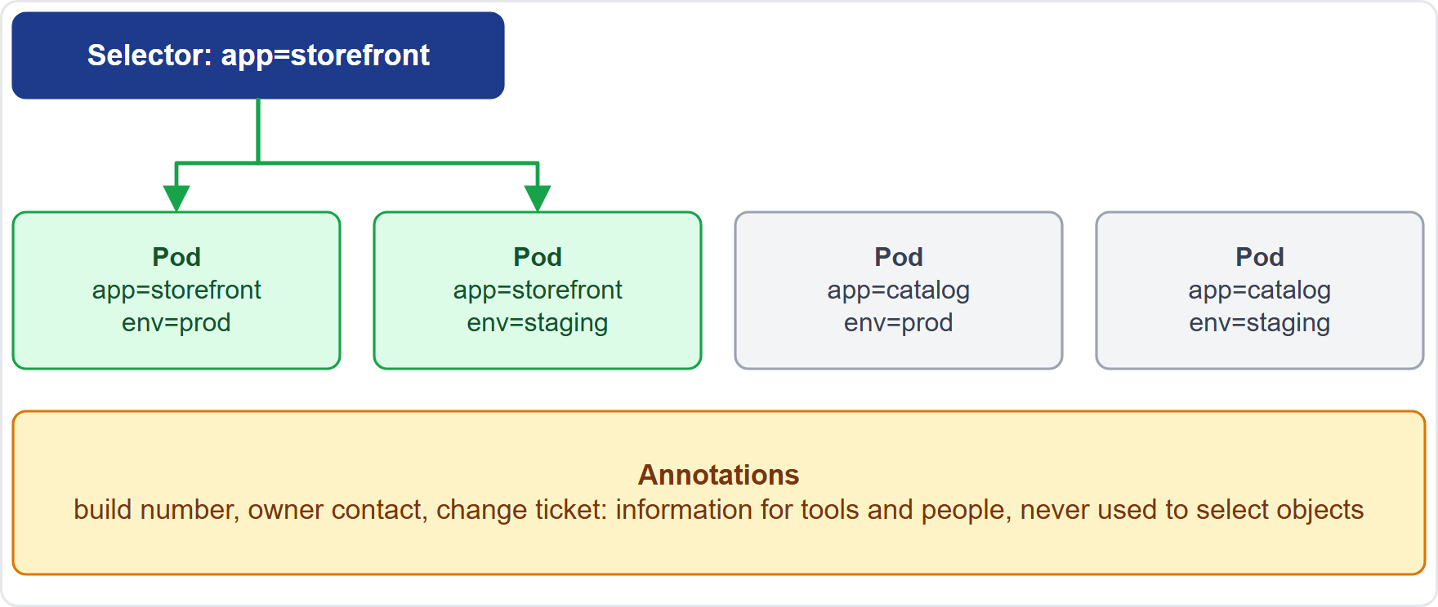
Labels, Selectors and Annotations
Part 1
Labels are key/value pairs on objects: identifying attributes that are meaningful to users
A selector filters objects by their labels; selecting by label is the main way Kubernetes groups objects
Services and controllers use selectors to find their Pods
Annotations hold non-identifying metadata for tools and people; they can be large and unstructured
EXAM TIP Labels select; annotations do not.
KCNA Exam Prep Masterclass | Kubernetes and Cloud Native Associate
Module 2: Kubernetes Architecture, API and Objects
14 / 31
Notes:
Labels are key value pairs on objects. They hold identifying attributes that are meaningful to users. A selector filters objects by their labels, and selecting by label is the main way Kubernetes groups objects. Services and controllers use selectors to find their Pods. In the diagram, the selector app equals storefront picks the first two Pods. Annotations are different. They hold non-identifying metadata for tools and people, and they can be large and unstructured. Exam tip: labels select, and annotations do not.

Slide 15
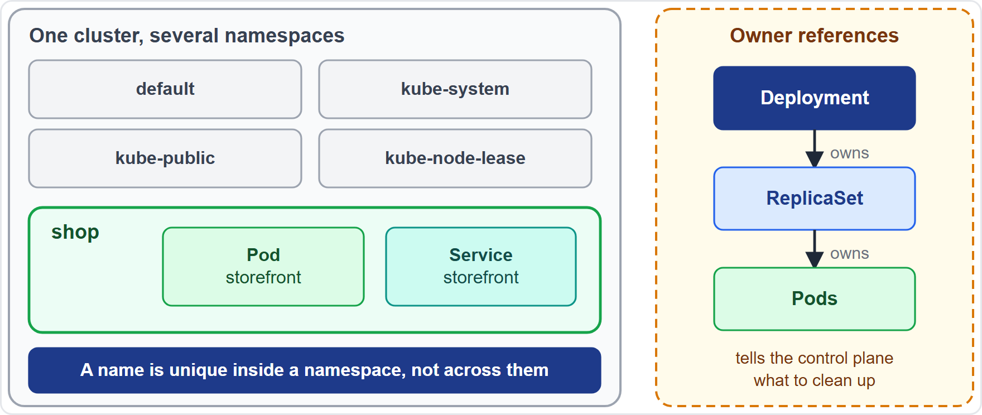
Namespaces and Owner References
Part 1
Namespaces isolate groups of resources within one cluster; a name must be unique inside one namespace, and another namespace may reuse it
Namespaces cannot be nested, and each object is in one namespace
Four start with every cluster: default, kube-node-lease, kube-public and kube-system
Owner references record which objects depend on which, so the control plane cleans up the right ones
Ownership is not the same as labels and selectors
EXAM TIP A namespace scopes names and policies; ownership drives clean-up.
KCNA Exam Prep Masterclass | Kubernetes and Cloud Native Associate
Module 2: Kubernetes Architecture, API and Objects
15 / 31
Notes:
Namespaces isolate groups of resources within one cluster. A name must be unique inside one namespace, and another namespace may reuse it. Namespaces cannot be nested, and each object is in one namespace. Four start with every cluster: default, kube node lease, kube public and kube system. Owner references record which objects depend on which, so the control plane cleans up the right ones. For example, a Replica Set owns its Pods. Ownership is not the same as labels and selectors. Exam tip: a namespace scopes names and policies, and ownership drives clean-up.

Slide 16
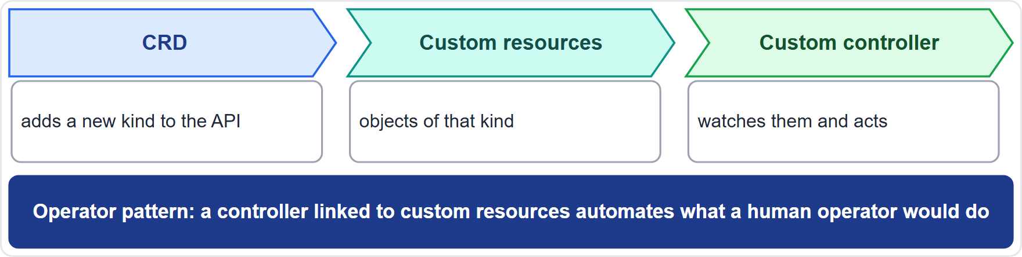
Custom Resources, Controllers and Operators
Part 1
A CustomResourceDefinition (CRD) adds a new kind to the API, without building a custom API server
Custom resources are used with kubectl just like built-in objects
A custom controller keeps them at their desired state
The operator pattern links a controller to custom resources to automate what a human operator would do
EXAM TIP A CRD adds a kind; an operator adds the controller that acts on it.
KCNA Exam Prep Masterclass | Kubernetes and Cloud Native Associate
Module 2: Kubernetes Architecture, API and Objects
16 / 31
Notes:
You can extend the A P I. A Custom Resource Definition, or C R D, adds a new kind to the A P I, without building a custom A P I server. Custom resources are the objects of that kind, and you use them with kube control just like built-in objects. A custom controller keeps them at their desired state. The operator pattern links a controller to custom resources, to automate what a human operator would do. Exam tip: a C R D adds a kind, and an operator adds the controller that acts on it.

Slide 17
Where Clusters Come From
BEYOND THE CURRICULUM
Part 2
Option | What it is
Managed service | you choose a service instead of running the cluster yourself
kubeadm | a tool that installs Kubernetes and sets up a secure cluster
kind | local clusters that use Docker containers as nodes
minikube | a local cluster for macOS, Linux and Windows
k3s | lightweight, fully conformant Kubernetes in a single binary
Self-managed means you run the control plane and the nodes yourself
EXAM TIP kubeadm builds clusters; kind and minikube are for learning; k3s is the lightweight one.
KCNA Exam Prep Masterclass | Kubernetes and Cloud Native Associate
Module 2: Kubernetes Architecture, API and Objects
17 / 31
Notes:
This slide is tagged beyond the curriculum. You can choose a managed service, instead of running the cluster yourself. Self-managed means you run the control plane and the nodes yourself. Kube A D M is a tool that installs Kubernetes and sets up a secure cluster. Kind runs local clusters that use Docker containers as nodes. Mini kube is a local cluster for Mac, Linux and Windows. And K three S is lightweight, fully conformant Kubernetes in a single binary. Exam tip: kube A D M builds clusters, kind and mini kube are for learning, and K three S is the lightweight one.

Slide 18
What the Exam Asks: Architecture
Part 2
Control plane or node
Declarative or imperative
spec or status
API server, etcd, scheduler and controller manager decide; kubelet and kube-proxy run on every node
you write the spec; Kubernetes writes the status
declarative states the result and uses apply
Label or annotation
Group or version
CRD or operator
labels select; annotations only inform
apps/v1 is group and version; the core group is plain v1
a CRD adds a kind; an operator adds a controller for it
EXAM TIP For a "which component" question, picture the request path: API server, etcd, scheduler, kubelet.
KCNA Exam Prep Masterclass | Kubernetes and Cloud Native Associate
Module 2: Kubernetes Architecture, API and Objects
18 / 31
Notes:
Six pairs to keep apart. Control plane or node: the A P I server, E T C D, scheduler and controller manager decide, while the kube let and kube proxy run on every node. Declarative or imperative: declarative states the result and uses apply. Spec or status: you write the spec, and Kubernetes writes the status. Label or annotation: labels select, and annotations only inform. Group or version: apps slash v one is group and version, and the core group is plain v one. C R D or operator: a C R D adds a kind, and an operator adds a controller for it. Exam tip: picture the request path.

Slide 19
Module Recap
Part 2
1
Cluster
2
Declarative
3
API and manifests
a control plane (API server, etcd, scheduler, controller manager) and nodes (kubelet, kube-proxy, runtime)
state the desired result; controllers reconcile the current state toward it
group and version, kind, metadata, spec, status; use kubectl and a kubeconfig
4
Organizing objects
5
Extending
CRDs add kinds, operators add controllers
labels select, annotations inform, namespaces scope names, owner references drive clean-up
KCNA Exam Prep Masterclass | Kubernetes and Cloud Native Associate
Module 2: Kubernetes Architecture, API and Objects
19 / 31
Notes:
To recap. A cluster has a control plane, with the A P I server, E T C D, scheduler and controller manager, and nodes, with the kube let, kube proxy and runtime. Declarative means you state the desired result, and controllers reconcile the current state toward it. The A P I has groups and versions, and a manifest has kind, metadata, spec and status. You use kube control and a kube config. Labels select, annotations inform, namespaces scope names, and owner references drive clean-up. And C R Ds add kinds, while operators add controllers. Now eleven practice questions.

Slide 20
Practice Question 1
Part 2
Q1
Where does Kubernetes keep all of its cluster data?
A
In the kubelet that runs on each worker node of the cluster
B
In memory inside the kube-scheduler, which rebuilds it after a restart
C
In etcd, a consistent and highly available key-value store
D
In the image cache of the container runtime on every node
KCNA Exam Prep Masterclass | Kubernetes and Cloud Native Associate
Module 2: Kubernetes Architecture, API and Objects
20 / 31
Notes:
Question one. Where does Kubernetes keep all of its cluster data? The four options are on the screen.
[PAUSE 12]
The answer is C. E T C D is the backing store for all cluster data, which is why it needs a backup plan. The kube let runs Pods, the scheduler picks nodes, and the runtime's image cache holds images, not cluster state.

Slide 21
Practice Question 2
Part 2
Q2
A Harbor Books Pod has been created but is not yet assigned to any node. Which component picks a node for it?
A
The kube-scheduler, which selects a node for each new Pod without one
B
The kubelet, which assigns Pods to the nodes that have free memory
C
The kube-proxy, which decides where Pods run according to Service rules
D
The etcd store, which places each new object on the least busy node
KCNA Exam Prep Masterclass | Kubernetes and Cloud Native Associate
Module 2: Kubernetes Architecture, API and Objects
21 / 31
Notes:
Question two. A Harbor Books Pod has been created but is not yet assigned to any node. Which component picks a node for it? The four options are on the screen.
[PAUSE 12]
The answer is A. The kube scheduler watches for new Pods with no node and selects one. The kube let runs the Pods that are assigned to its node, kube proxy maintains network rules, and E T C D only stores data.

Slide 22
Practice Question 3
Part 2
Q3
What does the kubelet do?
A
It chooses a node for every Pod that has not yet been assigned to one
B
It runs the controller loops that keep the cluster at its desired state
C
It maintains the network rules that implement part of the Service idea
D
It makes sure the containers described in its node's Pods are running
KCNA Exam Prep Masterclass | Kubernetes and Cloud Native Associate
Module 2: Kubernetes Architecture, API and Objects
22 / 31
Notes:
Question three. What does the kube let do? The four options are on the screen.
[PAUSE 12]
The answer is D. The kube let is the agent on each node that makes sure the containers of its Pods are running. Choosing nodes is the scheduler's job, the controller loops belong to the controller manager, and network rules belong to kube proxy.

Slide 23
Practice Question 4
Part 2
Q4
The Harbor Books team keeps its storefront manifests in a directory and wants Kubernetes to create or update whatever differs. Which command follows the declarative approach?
A
kubectl create deployment storefront --image=harborbooks/storefront:1.4
B
kubectl apply -f ./manifests
C
kubectl scale deployment storefront --replicas=3
D
kubectl delete -f ./manifests
KCNA Exam Prep Masterclass | Kubernetes and Cloud Native Associate
Module 2: Kubernetes Architecture, API and Objects
23 / 31
Notes:
Question four. The Harbor Books team keeps its storefront manifests in a directory and wants Kubernetes to create or update whatever differs. Which command follows the declarative approach? The four options are on the screen.
[PAUSE 12]
The answer is B. Declarative configuration states the desired result in files, and kube control apply makes the cluster match them. Creating a Deployment from flags and scaling it are imperative commands, and deleting removes objects.

Slide 24
Practice Question 5
Part 2
Q5
A controller finds fewer running Pods than the desired state asks for. What does it do?
A
It creates or requests the changes that move the current state toward the desired state
B
It waits for an administrator to approve the change before it acts
C
It rewrites the spec so that it matches the Pods that are running now
D
It stops watching the object until the next Kubernetes release arrives
KCNA Exam Prep Masterclass | Kubernetes and Cloud Native Associate
Module 2: Kubernetes Architecture, API and Objects
24 / 31
Notes:
Question five. A controller finds fewer running Pods than the desired state asks for. What does it do? The four options are on the screen.
[PAUSE 12]
The answer is A. A controller is a control loop. It compares the current state with the desired state and acts to close the gap. It does not wait for approval, it does not edit the spec you wrote, and it keeps watching.

Slide 25
Practice Question 6
Part 2
Q6
Which apiVersion belongs in a Deployment manifest?
A
v1, the version of the core group
B
batch/v1, the group of Jobs
C
apps/v1, the group of workload controllers
D
apps/v1alpha1, an early version of the same group
KCNA Exam Prep Masterclass | Kubernetes and Cloud Native Associate
Module 2: Kubernetes Architecture, API and Objects
25 / 31
Notes:
Question six. Which A P I version belongs in a Deployment manifest? The four options are on the screen.
[PAUSE 12]
The answer is C. Deployments are in the apps group, version v one, written apps slash v one. The core group is written as plain v one and holds kinds such as Pod and Service. Batch slash v one holds Jobs and Cron Jobs, and an alpha version is off by default.

Slide 26
Practice Question 7
Part 2
Q7
Which statement about API versions is correct?
A
Alpha versions are switched on by default and supported for many releases
B
Beta versions such as v1beta1 are the only ones that are safe for production
C
A stable version name contains the word stable, as in stable1
D
A stable version is named vX with an integer X, such as v1
KCNA Exam Prep Masterclass | Kubernetes and Cloud Native Associate
Module 2: Kubernetes Architecture, API and Objects
26 / 31
Notes:
Question seven. Which statement about A P I versions is correct? The four options are on the screen.
[PAUSE 12]
The answer is D. Stable versions are named v X, where X is an integer. Alpha versions are off by default and may be dropped at any time. Built-in beta versions are also off by default. And no version name contains the word stable.

Slide 27
Practice Question 8
Part 2
Q8
A Service must find all the storefront Pods. Which feature does it use?
A
Annotations, which carry non-identifying information about each Pod
B
A label selector, which picks the Pods that carry matching labels
C
Owner references, which record that a Deployment owns its Pods
D
A namespace, which groups every Pod that the cluster has ever run
KCNA Exam Prep Masterclass | Kubernetes and Cloud Native Associate
Module 2: Kubernetes Architecture, API and Objects
27 / 31
Notes:
Question eight. A Service must find all the storefront Pods. Which feature does it use? The four options are on the screen.
[PAUSE 12]
The answer is B. Selecting by label is how Services and controllers find their Pods: they pick the Pods whose labels match. Annotations are not used to select, owner references drive clean-up, and a namespace scopes names rather than choosing Pods.

Slide 28
Practice Question 9
Part 2
Q9
Two teams want to use the same object name in one cluster without a clash. What provides the separation?
A
A label, which makes the name unique across the whole cluster
B
An annotation, which reserves the name for one of the two teams
C
A namespace, which scopes names so that each namespace can reuse them
D
A UID, which Kubernetes then uses in place of the object's name
KCNA Exam Prep Masterclass | Kubernetes and Cloud Native Associate
Module 2: Kubernetes Architecture, API and Objects
28 / 31
Notes:
Question nine. Two teams want to use the same object name in one cluster without a clash. What provides the separation? The four options are on the screen.
[PAUSE 12]
The answer is C. A name must be unique inside one namespace, and another namespace may reuse it, so two teams can each use their own. Labels and annotations do not scope names, and the U I D is generated by Kubernetes in addition to the name.

Slide 29
Practice Question 10
Part 2
Q10
What does a CustomResourceDefinition do?
A
It adds a new kind of object to the API without a custom API server
B
It starts a controller that restarts Pods when their containers fail
C
It tells the scheduler which nodes a Pod is allowed to run on
D
It stores a backup copy of all the data held in the cluster
KCNA Exam Prep Masterclass | Kubernetes and Cloud Native Associate
Module 2: Kubernetes Architecture, API and Objects
29 / 31
Notes:
Question ten. What does a Custom Resource Definition do? The four options are on the screen.
[PAUSE 12]
The answer is A. A C R D defines a new kind that is served by the existing A P I server, and its objects are used with kube control like built-in ones. Restarting containers is the kube let's job, node choice is scheduling, and backups are a separate task.

Slide 30
Practice Question 11
Part 2
Q11
The Harbor Books team installs software that adds a Database kind to the API, plus a controller that creates, backs up and repairs databases from those objects. What is this pattern called?
A
A kube-proxy mode, which routes traffic to the databases
B
A ReplicaSet strategy, which keeps a set number of Pods
C
A cloud-controller-manager, which links the cluster to a cloud
D
An operator, which links a controller to custom resources
KCNA Exam Prep Masterclass | Kubernetes and Cloud Native Associate
Module 2: Kubernetes Architecture, API and Objects
30 / 31
Notes:
Question eleven. The Harbor Books team installs software that adds a Database kind to the A P I, plus a controller that creates, backs up and repairs databases from those objects. What is this pattern called? The four options are on the screen.
[PAUSE 12]
The answer is D. An operator is a controller linked to custom resources that automates what a human operator would do. Kube proxy handles networking, a Replica Set keeps a number of Pods running, and the cloud controller manager talks to a cloud provider.

Slide 31
Answers at a Glance
Part 2
Question | Answer | Why
Q1 | C | etcd holds all cluster data
Q2 | A | The scheduler picks a node for a new Pod
Q3 | D | The kubelet makes sure its Pods' containers run
Q4 | B | kubectl apply is declarative
Q5 | A | A controller closes the gap to the desired state
Q6 | C | Deployments are in apps/v1
Q7 | D | Stable versions are vX with an integer
Q8 | B | A label selector picks the Pods
Q9 | C | Names are unique within a namespace
Q10 | A | A CRD adds a kind
Q11 | D | An operator is a controller plus custom resources
KCNA Exam Prep Masterclass | Kubernetes and Cloud Native Associate
Module 2: Kubernetes Architecture, API and Objects
31 / 31
Notes:
Here are the answers at a glance. Question one, C: E T C D holds all cluster data. Question two, A: the scheduler picks a node for a new Pod. Question three, D: the kube let makes sure its Pods' containers run. Question four, B: kube control apply is declarative. Question five, A: a controller closes the gap to the desired state. Question six, C: Deployments are in apps slash v one. Question seven, D: stable versions are v X with an integer. Question eight, B: a label selector picks the Pods. Question nine, C: names are unique within a namespace. Question ten, A: a C R D adds a kind. Question eleven, D: an operator is a controller plus custom resources.

