Slide 1
Module 3: Workloads and Controllers
Choosing the right object to run an application
Kubernetes Fundamentals · Kubernetes Core Concepts
YOU WILL BE ABLE TO
Explain what a Pod is and how its containers share resources
Describe init, sidecar and ephemeral containers and the three probes
Compare Deployment, StatefulSet, DaemonSet, Job and CronJob
Choose the right controller for a scenario
KCNA Exam Prep Masterclass
Module 3 · Part 1
Notes:
Welcome to Module 3: Workloads and Controllers. This module is in the Kubernetes Fundamentals domain, the largest on the K C N A exam, and it covers the topic called Kubernetes Core Concepts. By the end you will be able to do four things. Explain what a Pod is and how its containers share resources. Describe init, sidecar and ephemeral containers, and the three probes. Compare Deployment, Stateful Set, Daemon Set, Job and Cron Job. And choose the right controller for a scenario.

Slide 2
Case Check-In: Harbor Books Needs Its Shop Running
Part 1
CASE CHECK-IN · Harbor Books
The platform engineer has the container images (module 1) and a cluster (module 2)
The shop has parts with different needs: a storefront and a catalog that can be replaced at will, a database that must keep its identity, a log collector for every node, and a nightly sales report
Today each part is a plain Pod: when one dies, nobody brings it back
In this module you will pick the right controller for each part
KCNA Exam Prep Masterclass | Kubernetes and Cloud Native Associate
Module 3: Workloads and Controllers
2 / 26
Notes:
Here is Harbor Books. The platform engineer already has the container images from module one, and a cluster from module two. But the shop is not made of one kind of part. The storefront and the catalog can be replaced at will. The database must keep its identity. Every node needs a log collector, and a sales report has to run each night. Today each part is a plain Pod, and when one dies, nobody brings it back. In this module you pick the right controller for each part.

Slide 3
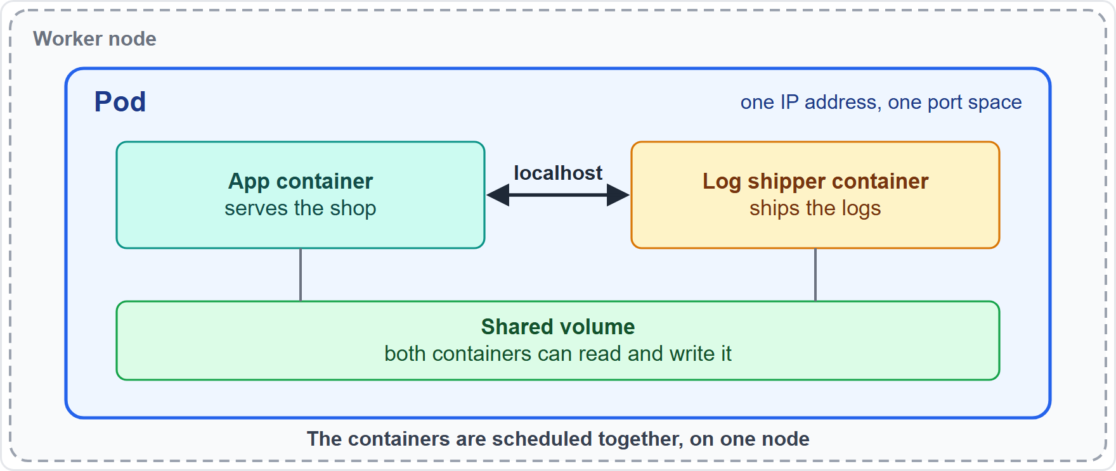
The Pod: the Smallest Deployable Unit
Part 1
A Pod wraps one or more containers that share network and storage
The containers run together and are scheduled together on one node
They share one IP address and port space, so they reach each other on localhost
A Pod is ephemeral: it is never moved to another node, only replaced by a new Pod
You rarely create a Pod directly: a controller creates and replaces Pods for you
EXAM TIP Kubernetes schedules and manages Pods, not single containers.
KCNA Exam Prep Masterclass | Kubernetes and Cloud Native Associate
Module 3: Workloads and Controllers
3 / 26
Notes:
A Pod is the smallest deployable unit in Kubernetes. It wraps one or more containers that share network and storage, and the containers are scheduled together on one node. They share one I P address and one port space, so they reach each other on local host. A Pod is ephemeral. Kubernetes never moves a Pod to another node. It replaces it with a new Pod. That is why you rarely create a Pod yourself: a controller creates and replaces Pods for you. Exam tip: Kubernetes schedules and manages Pods, not single containers.

Slide 4
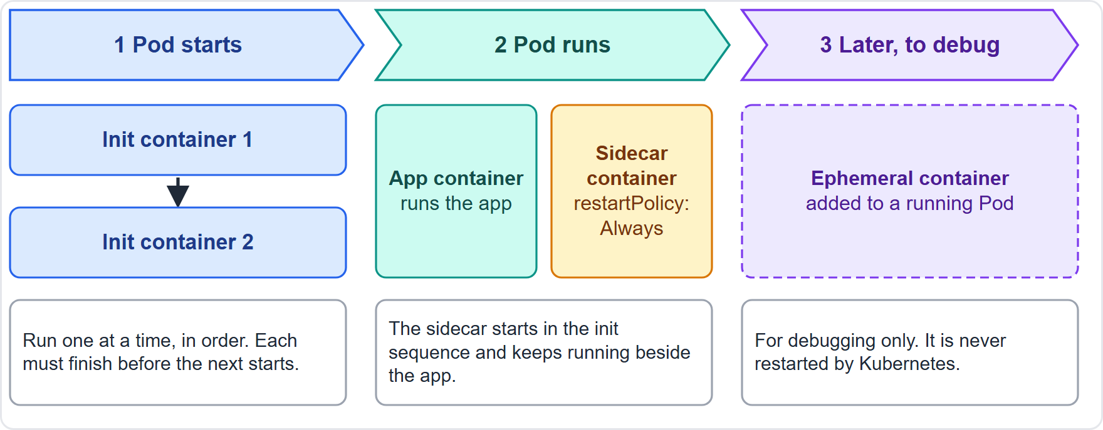
Init, Sidecar and Ephemeral Containers
MOVING
Part 1
Init containers run one at a time, in order, and must finish before the app containers start
A sidecar container is an init container with restartPolicy: Always: it starts in the init sequence and keeps running beside the app
Ephemeral containers are added to a running Pod to debug it and are never restarted
As of 30 October 2026: native sidecar containers are stable since v1.33
EXAM TIP Init containers finish and stop, sidecars keep running, and ephemeral containers exist only to debug.
KCNA Exam Prep Masterclass | Kubernetes and Cloud Native Associate
Module 3: Workloads and Controllers
4 / 26
Notes:
This slide is tagged moving, because one fact is tied to a version. Init containers run one at a time, in order, and each must finish before the app containers start. A sidecar container is an init container with the restart policy Always. It starts in the init sequence and keeps running beside the app. Ephemeral containers are different: you add one to a running Pod to debug it, and Kubernetes never restarts it. As of the thirtieth of October, twenty twenty-six, native sidecar containers are stable since version one point thirty-three. Exam tip: init containers finish and stop, sidecars keep running, and ephemeral containers only debug.

Slide 5
Pod Phases and Restart Policy
Part 1
Phase | What it means
Pending | accepted by the cluster, but containers are not ready: waiting to be scheduled or pulling images
Running | bound to a node; at least one container is running, starting or restarting
Succeeded | all containers ended successfully and will not restart
Failed | all containers ended and at least one ended in failure
Unknown | the Pod's state could not be obtained, usually a problem reaching the node
restartPolicy is Always (the default), OnFailure or Never
Restarts back off: 10s, 20s, 40s and so on, capped at 300 seconds (5 minutes)
CrashLoopBackOff is a status you see in kubectl, not a Pod phase
EXAM TIP There are five phases only; a repeated crash shows as CrashLoopBackOff in the status, not as a new phase.
KCNA Exam Prep Masterclass | Kubernetes and Cloud Native Associate
Module 3: Workloads and Controllers
5 / 26
Notes:
A Pod is always in one of five phases. Pending means the cluster accepted it, but its containers are not ready yet, perhaps because it waits to be scheduled or is pulling images. Running means it is bound to a node and at least one container is running, starting or restarting. Succeeded means every container ended successfully and will not restart. Failed means every container ended and at least one ended in failure. Unknown means the state could not be obtained, usually because the node cannot be reached. The restart policy is Always by default, or On Failure, or Never. Restarts back off: ten seconds, twenty, forty and so on, capped at three hundred seconds, which is five minutes. Crash Loop Back Off is a status you see in kube control, not a phase. Exam tip: there are five phases only.

Slide 6
Probes: Startup, Liveness and Readiness
Part 1
Startup probe: has the app started? Until it succeeds, the other probes wait
Liveness probe: is the container still healthy? If it fails, the kubelet restarts the container
Readiness probe: can it take traffic? If it fails, the Pod is removed from Service endpoints, not restarted
Checks can be an HTTP request, a TCP connection, a command or gRPC; by default a probe runs every 10 seconds and fails after 3 failures
YAML
containers:
- name: storefront
image: harborbooks/storefront:1.4
readinessProbe:
httpGet:
path: /ready
port: 8080
periodSeconds: 10
livenessProbe:
tcpSocket:
port: 8080
Probes on the storefront container
EXAM TIP Liveness restarts the container; readiness only stops traffic.
KCNA Exam Prep Masterclass | Kubernetes and Cloud Native Associate
Module 3: Workloads and Controllers
6 / 26
Notes:
Kubernetes has three probes. A startup probe asks whether the app has started. Until it succeeds, the other probes wait. A liveness probe asks whether the container is still healthy, and if it fails, the kube let restarts the container. A readiness probe asks whether the container can take traffic, and if it fails, the Pod is removed from Service endpoints. It is not restarted. A check can be an H T T P request, a T C P connection, a command, or g R P C. By default a probe runs every ten seconds and fails after three failures. The snippet shows a readiness probe on the storefront container, and a liveness probe that checks a T C P port. Exam tip: liveness restarts the container, and readiness only stops traffic.

Slide 7
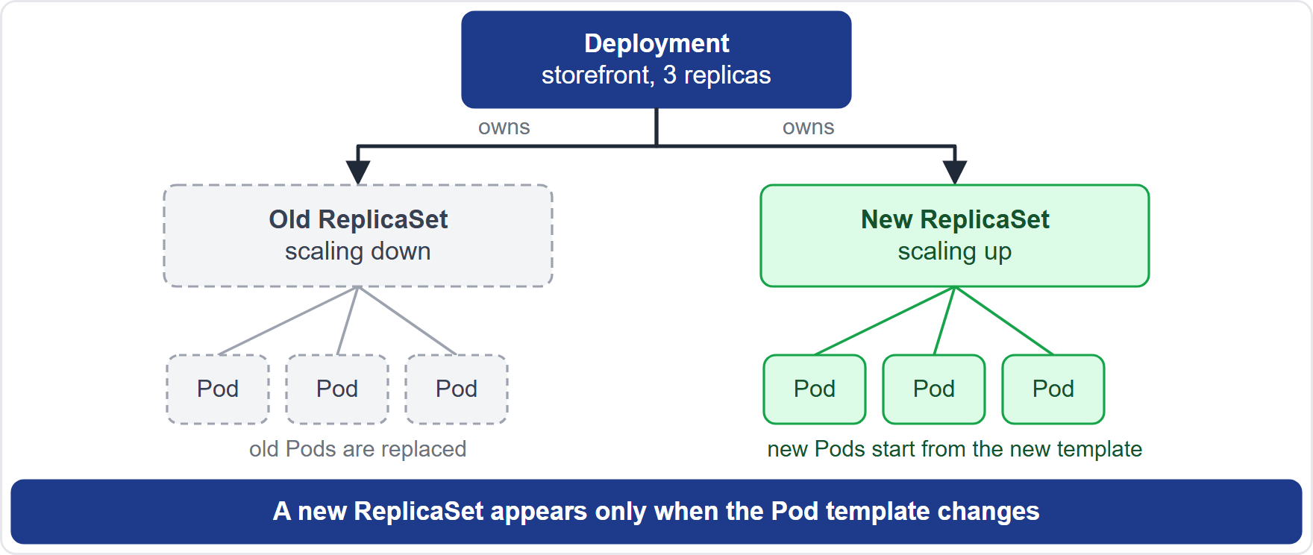
ReplicaSet and Deployment: Who Owns Whom
Part 1
A ReplicaSet keeps a set number of identical Pods running; it finds them with a selector and creates new ones from a Pod template
It owns its Pods through ownerReferences
A Deployment creates and manages ReplicaSets: during a rollout there are two, the new one scaling up and the old one scaling down
The docs recommend a Deployment instead of a bare ReplicaSet
EXAM TIP You normally create a Deployment; the ReplicaSet and the Pods follow from it.
KCNA Exam Prep Masterclass | Kubernetes and Cloud Native Associate
Module 3: Workloads and Controllers
7 / 26
Notes:
A Replica Set keeps a set number of identical Pods running. It finds its Pods with a selector, it counts them against a replica count, and it creates new ones from a Pod template. It owns its Pods through owner references. A Deployment creates and manages Replica Sets. During a rollout there are two: the new one scales up while the old one scales down. The documentation recommends using a Deployment instead of a bare Replica Set. Exam tip: you normally create a Deployment. The Replica Set and the Pods follow from it.

Slide 8
The Deployment and the Rolling Update
Part 1
A Deployment declares the desired state: how many Pods (replicas), which Pods (selector) and what each looks like (template)
A rollout starts only when the Pod template changes, for example a new image; changing replicas just scales
The default strategy is RollingUpdate: maxSurge and maxUnavailable are both 25%, so during an update at most 125% and at least 75% of the desired Pods exist
The other strategy is Recreate
YAML
kind: Deployment
spec:
replicas: 3
selector:
matchLabels: {app: storefront}
template:
metadata:
labels: {app: storefront}
spec:
containers:
- name: storefront
image: harborbooks/storefront:1.4
A Deployment for the storefront
EXAM TIP Change the Pod template to roll out; change replicas to scale.
KCNA Exam Prep Masterclass | Kubernetes and Cloud Native Associate
Module 3: Workloads and Controllers
8 / 26
Notes:
A Deployment declares the desired state: how many Pods, with replicas, which Pods, with the selector, and what each Pod looks like, with the template. A rollout starts only when the Pod template changes, for example a new image. Changing replicas only scales. The default strategy is Rolling Update. Max surge and max unavailable are both twenty-five percent, so during an update at most one hundred twenty-five percent, and at least seventy-five percent, of the desired Pods exist. The other strategy is Recreate. Exam tip: change the Pod template to roll out, and change replicas to scale.

Slide 9
Rollout History and Rollback
Part 1
set image changes the Pod template, which starts a rollout
rollout status watches it, rollout history lists the revisions, and rollout undo returns to the previous revision or, with --to-revision, to a chosen one
A Deployment keeps 10 old ReplicaSets by default (revisionHistoryLimit) so that it can roll back
A rollout that cannot make progress is reported after 600 seconds by default (progressDeadlineSeconds)
TERMINAL
kubectl set image deployment/storefront \
storefront=harborbooks/storefront:1.5
kubectl rollout status deployment/storefront
kubectl rollout history deployment/storefront
kubectl rollout undo deployment/storefront
kubectl rollout undo deployment/storefront --to-revision=2
Update the storefront, watch the rollout and roll back
EXAM TIP rollout undo is the rollback command; the old ReplicaSets are what make it possible.
KCNA Exam Prep Masterclass | Kubernetes and Cloud Native Associate
Module 3: Workloads and Controllers
9 / 26
Notes:
These commands show a release. Set image changes the Pod template, which starts a rollout. Rollout status watches it. Rollout history lists the revisions. Rollout undo goes back to the previous revision, or, with to revision, to a chosen one. A Deployment keeps ten old Replica Sets by default, set by revision history limit, so it can roll back. A rollout that cannot make progress is reported after six hundred seconds by default, set by progress deadline seconds. Exam tip: rollout undo is the rollback command, and the old Replica Sets make it possible.

Slide 10
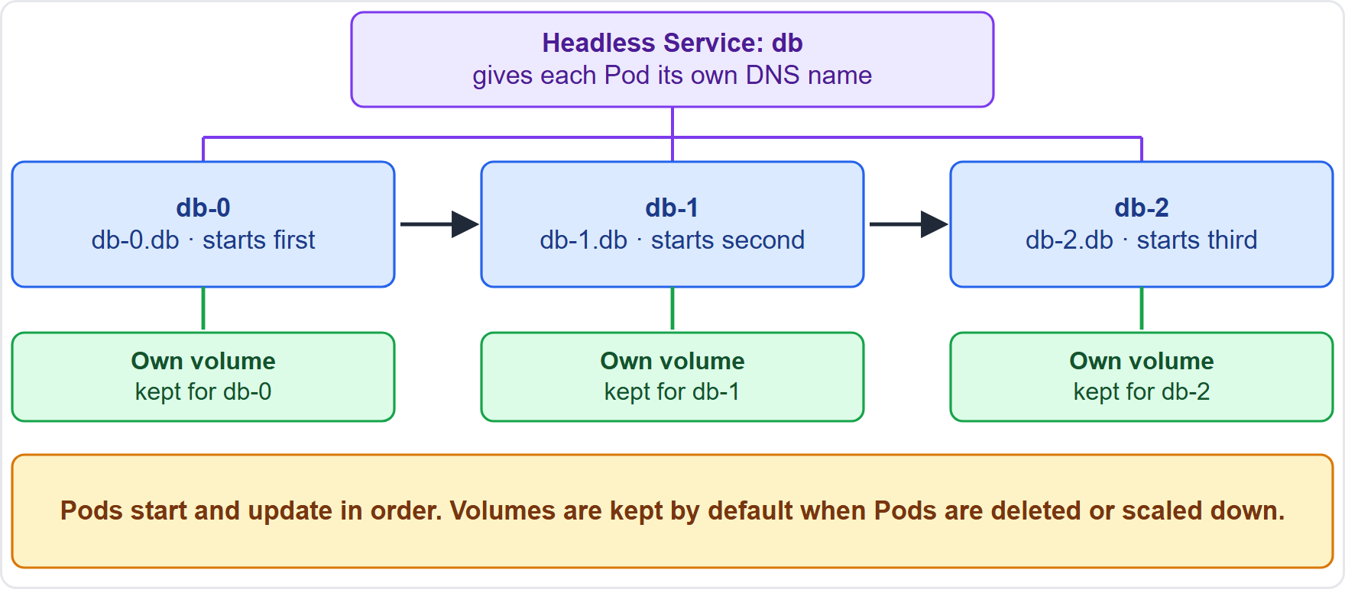
StatefulSet: Stable Identity and Storage
Part 1
Use a StatefulSet when each Pod needs a stable name, stable storage and an ordered start
Pods are named name-0, name-1, name-2 and keep their identity when replaced
A headless Service gives each Pod its own DNS name; volumeClaimTemplates give each Pod its own volume
Pods start and update in order (OrderedReady is the default), and the volumes are kept by default when Pods are deleted or scaled down
EXAM TIP Databases and clustered apps that must remember who they are belong in a StatefulSet.
KCNA Exam Prep Masterclass | Kubernetes and Cloud Native Associate
Module 3: Workloads and Controllers
10 / 26
Notes:
Use a Stateful Set when each Pod needs a stable name, stable storage and an ordered start. Pods are named with the set name and an ordinal, so db zero, db one and db two, and a Pod keeps its identity when it is replaced. A headless Service gives each Pod its own D N S name, and volume claim templates give each Pod its own volume. Pods start and update in order, Ordered Ready is the default, and the volumes are kept by default when Pods are deleted or scaled down. Exam tip: databases and clustered apps that must remember who they are belong in a Stateful Set.

Slide 11
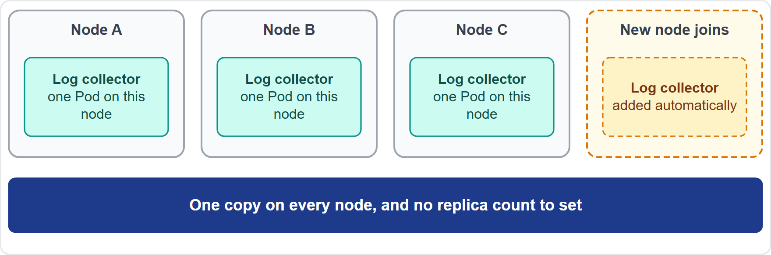
DaemonSet: One Pod per Node
Part 1
A DaemonSet keeps one copy of a Pod on every node, or on a chosen group of nodes
When a node joins, a Pod is added; when a node leaves, its Pod is garbage collected; deleting the DaemonSet removes its Pods
Typical uses: a logs collection daemon, a node monitoring daemon, a cluster storage daemon
Harbor Books: a log collector on every node
EXAM TIP "One on every node" means DaemonSet; it has no replica count.
KCNA Exam Prep Masterclass | Kubernetes and Cloud Native Associate
Module 3: Workloads and Controllers
11 / 26
Notes:
A Daemon Set keeps one copy of a Pod on every node, or on a chosen group of nodes. When a node joins the cluster, a Pod is added to it. When a node leaves, its Pod is garbage collected, and deleting the Daemon Set removes its Pods. Typical uses are a logs collection daemon, a node monitoring daemon and a cluster storage daemon. At Harbor Books it is the log collector on every node. Exam tip: one on every node means Daemon Set. It has no replica count.

Slide 12
Job and CronJob: Work That Ends
Part 1
A Job runs Pods until a set number finish successfully, and retries failures (backoffLimit defaults to 6)
A Job's Pods use restartPolicy OnFailure or Never; a Deployment allows only Always
A CronJob creates Jobs on a schedule written in cron syntax: minute, hour, day of the month, month, day of the week
concurrencyPolicy is Allow (the default), Forbid or Replace
YAML
kind: CronJob
spec:
schedule: "0 2 * * *"
jobTemplate:
spec:
template:
spec:
restartPolicy: OnFailure
containers:
- name: report
image: harborbooks/report:1.2
The nightly sales report as a CronJob
EXAM TIP Work that must finish is a Job; work that repeats on a schedule is a CronJob.
KCNA Exam Prep Masterclass | Kubernetes and Cloud Native Associate
Module 3: Workloads and Controllers
12 / 26
Notes:
A Job runs Pods until a set number of them finish successfully, and it retries failures. The backoff limit defaults to six. A Job's Pods use the restart policy On Failure or Never. A Deployment allows only Always. A Cron Job creates Jobs on a schedule written in cron syntax, with five fields: minute, hour, day of the month, month and day of the week. The snippet runs the nightly sales report at two in the morning. The concurrency policy is Allow by default, or Forbid, or Replace. Exam tip: work that must finish is a Job, and work that repeats on a schedule is a Cron Job.

Slide 13
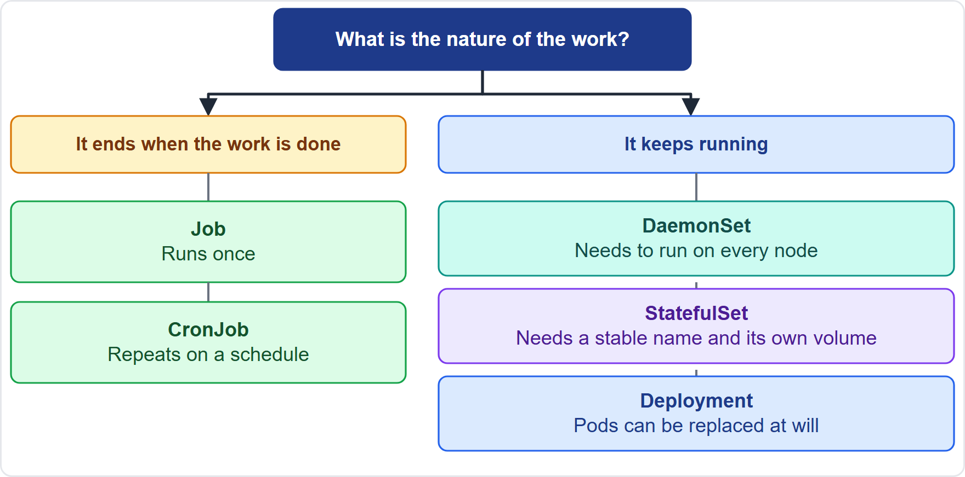
Choosing the Right Controller
Part 1
Does the work end? Once: Job. On a schedule: CronJob
Does it run on every node? DaemonSet
Does each Pod need a stable name and its own volume? StatefulSet
Otherwise, for replaceable Pods: Deployment
EXAM TIP Work out the nature of the workload first; the object follows.
KCNA Exam Prep Masterclass | Kubernetes and Cloud Native Associate
Module 3: Workloads and Controllers
13 / 26
Notes:
Choosing the right controller starts with the nature of the work. Does the work end? If it runs once, use a Job. If it repeats on a schedule, use a Cron Job. Does it run on every node? Use a Daemon Set. Does each Pod need a stable name and its own volume? Use a Stateful Set. Otherwise, for Pods that can be replaced at will, use a Deployment. Exam tip: work out the nature of the workload first. The object follows.

Slide 14
What the Exam Asks: Workloads
Part 1
Pod or container
Liveness or readiness
Deployment or StatefulSet
the Pod is what is scheduled and managed
liveness restarts; readiness stops traffic
replaceable Pods or named, sticky Pods
Scale or roll out
DaemonSet or replicas
Job or CronJob
replicas scales; the Pod template rolls out
a DaemonSet follows nodes, not a count
once or on a schedule
EXAM TIP Name the need first, then the object that fits.
KCNA Exam Prep Masterclass | Kubernetes and Cloud Native Associate
Module 3: Workloads and Controllers
14 / 26
Notes:
Six pairs to keep apart. Pod or container: the Pod is what is scheduled and managed. Liveness or readiness: liveness restarts, readiness stops traffic. Deployment or Stateful Set: replaceable Pods, or named, sticky Pods. Scale or roll out: replicas scales, and the Pod template rolls out. Daemon Set or replicas: a Daemon Set follows nodes, not a count. Job or Cron Job: once, or on a schedule. Exam tip: questions here usually describe a need. Name the need first, then the object.

Slide 15
Module Recap
Part 2
1
Pod
2
Containers and probes
3
Deployment
one or more containers with shared network and storage, scheduled together and replaced, not moved
manages ReplicaSets; a Pod template change rolls out; rollout undo goes back
init containers finish; sidecars keep running; liveness restarts, readiness stops traffic
4
StatefulSet and DaemonSet
5
Job and CronJob
work that ends, once or on a schedule
stable names and volumes, or one Pod per node
KCNA Exam Prep Masterclass | Kubernetes and Cloud Native Associate
Module 3: Workloads and Controllers
15 / 26
Notes:
To recap. A Pod is one or more containers with shared network and storage, scheduled together and replaced, never moved. Init containers finish, sidecars keep running, liveness restarts and readiness stops traffic. A Deployment manages Replica Sets, a change to the Pod template rolls out, and rollout undo goes back. A Stateful Set gives stable names and volumes, and a Daemon Set gives one Pod per node. A Job runs work that ends, and a Cron Job runs it on a schedule. Now ten practice questions.

Slide 16
Practice Question 1
Part 2
Q1
Which statement describes a Pod?
A
A group of worker nodes that report to the same control plane and API
B
A packaged container image kept in a registry so that nodes can pull it
C
One or more containers that run together and share network and storage
D
A virtual machine that the scheduler places on a single worker node
KCNA Exam Prep Masterclass | Kubernetes and Cloud Native Associate
Module 3: Workloads and Controllers
16 / 26
Notes:
Question one. Which statement describes a Pod? The four options are on the screen.
[PAUSE 12]
The answer is C. A Pod is the smallest unit Kubernetes deploys: one or more containers that share an I P address and storage and are scheduled together. A group of nodes is a cluster, an image is the template a container starts from, and a Pod is not a virtual machine.

Slide 17
Practice Question 2
Part 2
Q2
Harbor Books runs a Pod with an app container that serves the shop and a second container that ships its logs. How can the log shipper reach the app?
A
Over localhost, because the containers share the Pod's IP address
B
Through a Service, because the containers of a Pod are isolated from each other
C
Through the node's disk, which the two containers use as a shared channel
D
Through a private IP address that the cluster gives to each container separately
KCNA Exam Prep Masterclass | Kubernetes and Cloud Native Associate
Module 3: Workloads and Controllers
17 / 26
Notes:
Question two. Harbor Books runs a Pod with an app container that serves the shop and a second container that ships its logs. How can the log shipper reach the app? The four options are on the screen.
[PAUSE 12]
The answer is A. Containers in one Pod share an I P address and port space, so they can reach each other on local host. A Service is not needed inside a Pod, the Pod's volumes are not the only shared channel, and containers in a Pod do not get separate I P addresses.

Slide 18
Practice Question 3
Part 2
Q3
A container's readiness probe fails, but its liveness probe still passes. What does Kubernetes do?
A
It restarts the container, because any failed probe means the container is broken
B
It deletes the Pod and asks the controller to create a new one on another node
C
It marks the Pod as Failed, because a probe did not succeed within its timeout
D
It keeps the container running and stops sending Service traffic to that Pod
KCNA Exam Prep Masterclass | Kubernetes and Cloud Native Associate
Module 3: Workloads and Controllers
18 / 26
Notes:
Question three. A container's readiness probe fails, but its liveness probe still passes. What does Kubernetes do? The four options are on the screen.
[PAUSE 12]
The answer is D. A failed readiness probe removes the Pod from the Service's endpoints, so it gets no traffic, while the container keeps running. Only a failed liveness or startup probe leads to a restart, and a probe failure does not change the Pod phase to Failed.

Slide 19
Practice Question 4
Part 2
Q4
The orders service needs about two minutes to start, and its liveness probe keeps killing it before it is ready. Which change fits best?
A
Remove the readiness probe so that traffic reaches the Pod while it starts
B
Add a startup probe so that liveness checks wait until the app has started
C
Lower the liveness probe's period so that real failures are found sooner
D
Set the Pod's restart policy to Never so that the container is not restarted
KCNA Exam Prep Masterclass | Kubernetes and Cloud Native Associate
Module 3: Workloads and Controllers
19 / 26
Notes:
Question four. The orders service needs about two minutes to start, and its liveness probe keeps killing it before it is ready. Which change fits best? The four options are on the screen.
[PAUSE 12]
The answer is B. A startup probe holds back the liveness and readiness probes until the app has started, so a slow start is not mistaken for a failure. Removing readiness, checking more often or stopping restarts does not give the app time to start.

Slide 20
Practice Question 5
Part 2
Q5
The storefront Deployment runs four replicas. The team changes the container image tag in its Pod template and applies the file. What happens?
A
All four Pods are deleted at once and four new Pods start from the new image
B
A new ReplicaSet is created and Pods are replaced gradually by the new image
C
Nothing changes until someone runs a command to restart the existing Pods
D
The existing ReplicaSet is edited in place and its Pods restart one by one
KCNA Exam Prep Masterclass | Kubernetes and Cloud Native Associate
Module 3: Workloads and Controllers
20 / 26
Notes:
Question five. The storefront Deployment runs four replicas. The team changes the container image tag in its Pod template and applies the file. What happens? The four options are on the screen.
[PAUSE 12]
The answer is B. Changing the Pod template triggers a rollout: the Deployment creates a new Replica Set and, under the default Rolling Update strategy, scales it up while scaling the old one down. Deleting all Pods first is the Recreate strategy, which is not the default, and no manual restart is needed.

Slide 21
Practice Question 6
Part 2
Q6
A new release is faulty. Which command returns the Deployment named storefront to its previous revision?
A
kubectl scale deployment/storefront --replicas=0
B
kubectl rollout restart deployment/storefront
C
kubectl rollout pause deployment/storefront
D
kubectl rollout undo deployment/storefront
KCNA Exam Prep Masterclass | Kubernetes and Cloud Native Associate
Module 3: Workloads and Controllers
21 / 26
Notes:
Question six. A new release is faulty. Which command returns the Deployment named storefront to its previous revision? The four options are on the screen.
[PAUSE 12]
The answer is D. Rollout undo returns to the previous revision, or to a chosen one with to revision. Scaling to zero stops the app, a restart re-creates Pods from the same faulty template, and pause only halts further rollout steps.

Slide 22
Practice Question 7
Part 2
Q7
Harbor Books runs a database in which every replica needs its own persistent volume and a stable, predictable name. Which workload object fits?
A
A StatefulSet, with a headless Service and volume claim templates
B
A Deployment whose replicas share a single persistent volume
C
A DaemonSet, so that a database Pod runs on each node in the cluster
D
A Job, so that the database runs as a batch task until it is complete
KCNA Exam Prep Masterclass | Kubernetes and Cloud Native Associate
Module 3: Workloads and Controllers
22 / 26
Notes:
Question seven. Harbor Books runs a database in which every replica needs its own persistent volume and a stable, predictable name. Which workload object fits? The four options are on the screen.
[PAUSE 12]
The answer is A. A Stateful Set gives each Pod a stable name and its own volume through volume claim templates, with a headless Service for stable D N S names. A Deployment's replicas are interchangeable, a Daemon Set places one Pod per node, and a Job is for work that finishes.

Slide 23
Practice Question 8
Part 2
Q8
Which statement about a DaemonSet is correct?
A
It keeps a fixed number of identical Pods running, wherever the scheduler puts them
B
It gives each of its Pods a stable name and its own persistent volume by default
C
It runs a copy of its Pod on each matching node and adds one when a node joins
D
It runs a Pod to completion and then stops creating Pods once the work is done
KCNA Exam Prep Masterclass | Kubernetes and Cloud Native Associate
Module 3: Workloads and Controllers
23 / 26
Notes:
Question eight. Which statement about a Daemon Set is correct? The four options are on the screen.
[PAUSE 12]
The answer is C. A Daemon Set follows nodes, not a replica count: one copy per matching node, and a new copy when a node joins. A fixed number of Pods describes a Replica Set or Deployment, stable names and volumes describe a Stateful Set, and running to completion describes a Job.

Slide 24
Practice Question 9
Part 2
Q9
Harbor Books must build its sales report every night at two in the morning, and the work ends when the report is built. Which object fits?
A
A Deployment with one replica that sleeps until the scheduled time arrives
B
A Job, which repeats itself every night once it has been created
C
A DaemonSet that wakes up on each node at the scheduled hour of the night
D
A CronJob, which creates a new Job at the time its schedule says
KCNA Exam Prep Masterclass | Kubernetes and Cloud Native Associate
Module 3: Workloads and Controllers
24 / 26
Notes:
Question nine. Harbor Books must build its sales report every night at two in the morning, and the work ends when the report is built. Which object fits? The four options are on the screen.
[PAUSE 12]
The answer is D. A Cron Job creates Jobs on a schedule, and each Job runs to completion. A Job alone runs once, and a Deployment or a Daemon Set keeps its Pods running instead of letting them finish.

Slide 25
Practice Question 10
Part 2
Q10
Which pairing of workload and object is a poor match?
A
A stateless web front end that is replicated for availability: a Deployment
B
A log collector that runs on each node of the cluster: a DaemonSet
C
A database that needs stable names and its own volumes: a Deployment
D
A one-off data migration that runs to completion: a Job
KCNA Exam Prep Masterclass | Kubernetes and Cloud Native Associate
Module 3: Workloads and Controllers
25 / 26
Notes:
Question ten. Which pairing of workload and object is a poor match? The four options are on the screen.
[PAUSE 12]
The answer is C. A database that needs stable names and its own volumes belongs in a Stateful Set, because a Deployment's Pods are interchangeable. The other three pairings are correct.

Slide 26
Answers at a Glance
Part 2
Question | Answer | Why
Q1 | C | A Pod is one or more containers sharing network and storage
Q2 | A | Containers in a Pod reach each other on localhost
Q3 | D | Failed readiness stops traffic; it does not restart
Q4 | B | A startup probe holds back liveness during a slow start
Q5 | B | A Pod template change creates a new ReplicaSet
Q6 | D | rollout undo returns to the previous revision
Q7 | A | StatefulSet: stable names and own volumes
Q8 | C | DaemonSet: one copy per matching node
Q9 | D | CronJob: Jobs on a schedule
Q10 | C | A database needing stable identity is not a Deployment
KCNA Exam Prep Masterclass | Kubernetes and Cloud Native Associate
Module 3: Workloads and Controllers
26 / 26
Notes:
Here are the answers at a glance. Question one, C: a Pod is one or more containers sharing network and storage. Question two, A: containers in a Pod reach each other on local host. Question three, D: a failed readiness probe stops traffic, it does not restart. Question four, B: a startup probe holds back liveness during a slow start. Question five, B: a Pod template change creates a new Replica Set. Question six, D: rollout undo returns to the previous revision. Question seven, A: a Stateful Set gives stable names and its own volumes. Question eight, C: a Daemon Set runs one copy per matching node. Question nine, D: a Cron Job creates Jobs on a schedule. Question ten, C: a database needing stable identity is not a Deployment.

