Slide 1
Module 4: Configuration and Cluster Administration
Keeping settings out of images and keeping the cluster healthy
Kubernetes Fundamentals · Administration
YOU WILL BE ABLE TO
Use ConfigMaps and Secrets and say what protects a Secret
Set requests and limits, and apply LimitRange and ResourceQuota
Describe cluster setup, upgrades, version skew and etcd backup
Take a node out of service safely with cordon, drain and PodDisruptionBudgets
KCNA Exam Prep Masterclass
Module 4 · Part 1
Notes:
Welcome to Module 4: Configuration and Cluster Administration. This module is in the Kubernetes Fundamentals domain, and it covers the topic called Administration. By the end you will be able to do four things. Use Config Maps and Secrets, and say what protects a Secret. Set requests and limits, and apply Limit Range and Resource Quota. Describe cluster setup, upgrades, version skew and E T C D backup. And take a node out of service safely with cordon, drain and Pod Disruption Budgets.

Slide 2
Case Check-In: Harbor Books Runs the Shop for Real
Part 1
CASE CHECK-IN · Harbor Books
Settings such as the database host and the payment key must not live in the image
The shop must not starve other teams, and the platform engineer wants a quota for it
One worker node needs patching, and the cluster needs upgrades and backups
In this module you set up configuration, limits and routine maintenance
KCNA Exam Prep Masterclass | Kubernetes and Cloud Native Associate
Module 4: Configuration and Cluster Administration
2 / 25
Notes:
Harbor Books is moving from a trial to the real shop. Settings such as the database host and the payment key must not live in the image. The shop must not starve other teams, and the platform engineer wants a quota for it. One worker node needs patching, and the cluster needs upgrades and backups. In this module you set up configuration, limits and routine maintenance.

Slide 3
ConfigMaps
Part 1
A ConfigMap stores non-confidential settings as key-value pairs, separate from the code
The same image can run in development and in production with different ConfigMaps
data holds text values; binaryData holds binary values
A ConfigMap is limited to 1 MiB, and it gives no secrecy or encryption
YAML
apiVersion: v1
kind: ConfigMap
metadata:
name: shop-config
data:
DATABASE_HOST: postgres
LOG_LEVEL: info
Settings for the shop
EXAM TIP Anything you would be happy to see in a public repository belongs in a ConfigMap; anything confidential does not.
KCNA Exam Prep Masterclass | Kubernetes and Cloud Native Associate
Module 4: Configuration and Cluster Administration
3 / 25
Notes:
A Config Map stores non-confidential settings as key value pairs, separate from the code. The same image can run in development and in production with different Config Maps. The data field holds text values, and the binary data field holds binary values. A Config Map is limited to one mebibyte, and it gives no secrecy or encryption. The snippet shows a Config Map with a database host and a log level. Exam tip: anything you would be happy to see in a public repository belongs in a Config Map, and anything confidential does not.

Slide 4
Using a ConfigMap in a Pod
Part 1
As environment variables: envFrom loads every key, and configMapKeyRef picks one key
As files in a read-only volume mounted into the container
The ConfigMap and the Pod must share a namespace
YAML
containers:
- name: storefront
envFrom:
- configMapRef:
name: shop-config
volumeMounts:
- name: config
mountPath: /etc/shop
volumes:
- name: config
configMap:
name: shop-config
One ConfigMap used both ways
EXAM TIP A ConfigMap reaches a container as environment variables or as files.
KCNA Exam Prep Masterclass | Kubernetes and Cloud Native Associate
Module 4: Configuration and Cluster Administration
4 / 25
Notes:
A Pod can use a Config Map in two ways. As environment variables: env from loads every key, and config map key ref picks one key. Or as files, in a read-only volume mounted into the container. The snippet does both with the same Config Map. The Config Map and the Pod must share a namespace. Exam tip: a Config Map reaches a container as environment variables or as files.

Slide 5
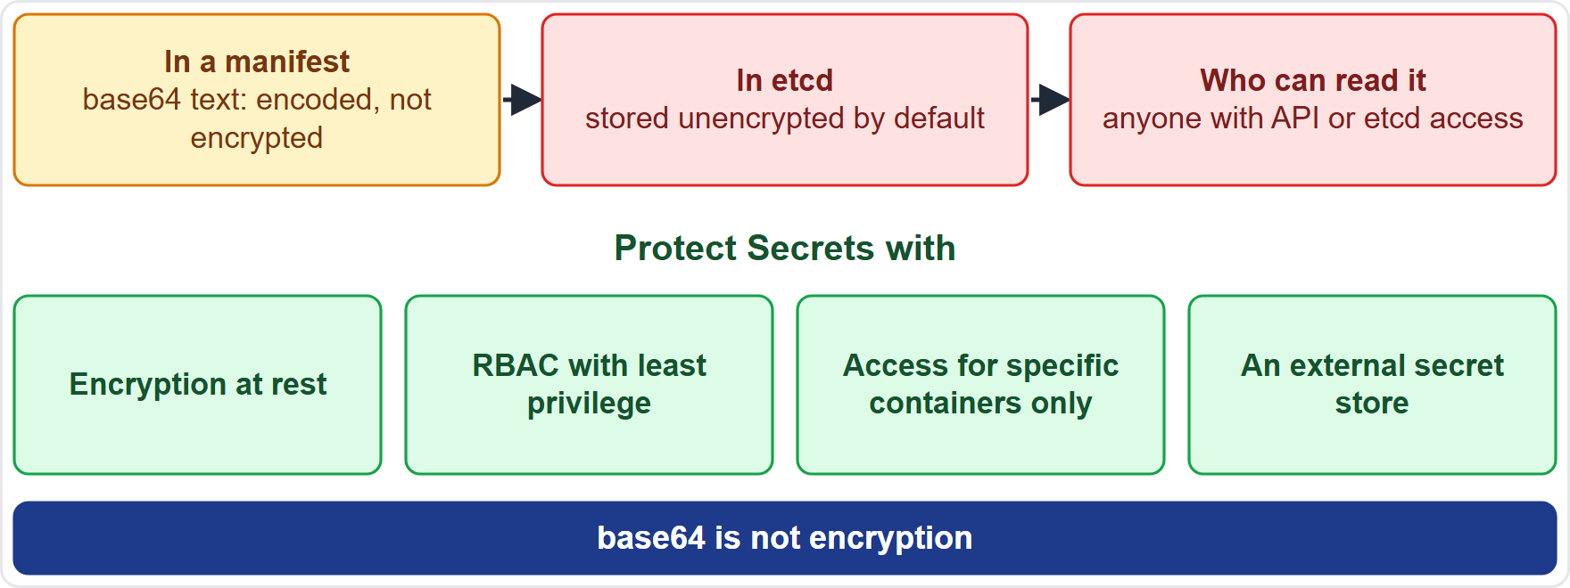
Secrets: Encoded, Not Encrypted
Part 1
A Secret holds confidential values such as passwords, tokens and keys, outside Pod specs and images
Values in a manifest are base64-encoded: that is encoding, not encryption
By default Secrets are stored unencrypted in etcd, and anyone with API or etcd access can read them
Protect them with encryption at rest, RBAC (role-based access control) with least privilege, access limited to specific containers, or an external secret store
EXAM TIP base64 is not encryption.
KCNA Exam Prep Masterclass | Kubernetes and Cloud Native Associate
Module 4: Configuration and Cluster Administration
5 / 25
Notes:
A Secret holds confidential values such as passwords, tokens and keys, outside Pod specs and images. Values in a manifest are base sixty-four encoded. That is encoding, not encryption. By default, Secrets are stored unencrypted in E T C D, and anyone with A P I access, or access to E T C D, can read them. So protect them. Enable encryption at rest. Use role-based access control, R B A C, with least privilege. Limit access to specific containers. Or use an external secret store. Exam tip: base sixty-four is not encryption.

Slide 6
Resource Requests and Limits
Part 1
A request is what the container needs: the scheduler uses it to place the Pod, and the kubelet reserves it
A limit is the most it may use: the kubelet enforces it
CPU is measured in CPU units: 1 is one physical core, and 500m is half a core
Memory is measured in bytes, with suffixes such as Mi
YAML
containers:
- name: storefront
image: harborbooks/storefront:1.4
resources:
requests:
cpu: 250m
memory: 64Mi
limits:
cpu: 500m
memory: 128Mi
Requests and limits on a container
EXAM TIP Requests are for scheduling; limits are for enforcement.
KCNA Exam Prep Masterclass | Kubernetes and Cloud Native Associate
Module 4: Configuration and Cluster Administration
6 / 25
Notes:
A request is what the container needs. The scheduler uses it to place the Pod, and the kube let reserves it. A limit is the most the container may use, and the kube let enforces it. C P U is measured in C P U units. One is a whole physical core, and five hundred millicpu is half a core. Memory is measured in bytes, with suffixes such as M I. The snippet sets a request and a limit for both. Exam tip: requests are for scheduling, and limits are for enforcement.

Slide 7
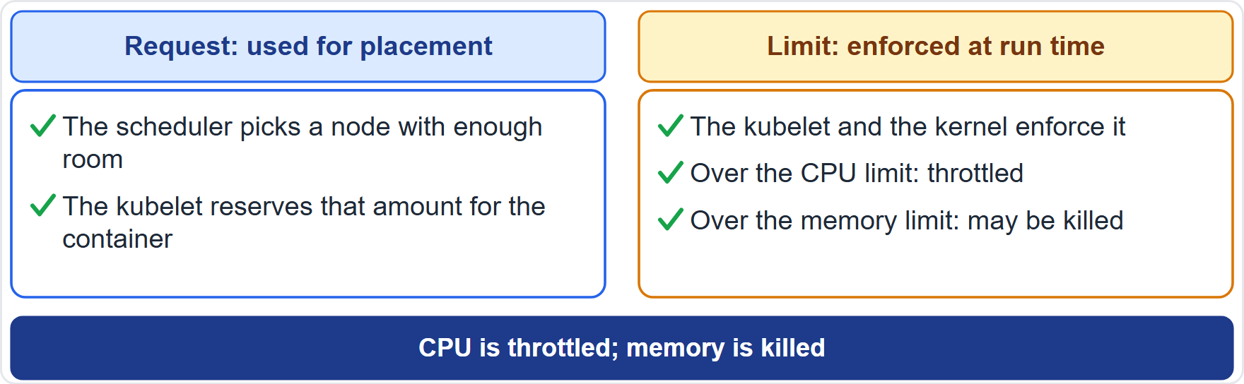
What Requests and Limits Do
Part 1
A container may use more than its request if the node has room to spare
Over its CPU limit, a container is throttled
Over its memory limit, the kernel may kill it, when memory is under pressure
So CPU limits slow a container down; memory limits can stop it
EXAM TIP CPU is throttled; memory is killed.
KCNA Exam Prep Masterclass | Kubernetes and Cloud Native Associate
Module 4: Configuration and Cluster Administration
7 / 25
Notes:
A container may use more than its request if the node has room to spare. Over its C P U limit, a container is throttled. Over its memory limit, the kernel may kill it, when memory is under pressure. So C P U limits slow a container down, while memory limits can stop it. The diagram shows the request on the left, deciding placement, and the limit on the right, enforced at run time. Exam tip: C P U is throttled, and memory is killed.

Slide 8
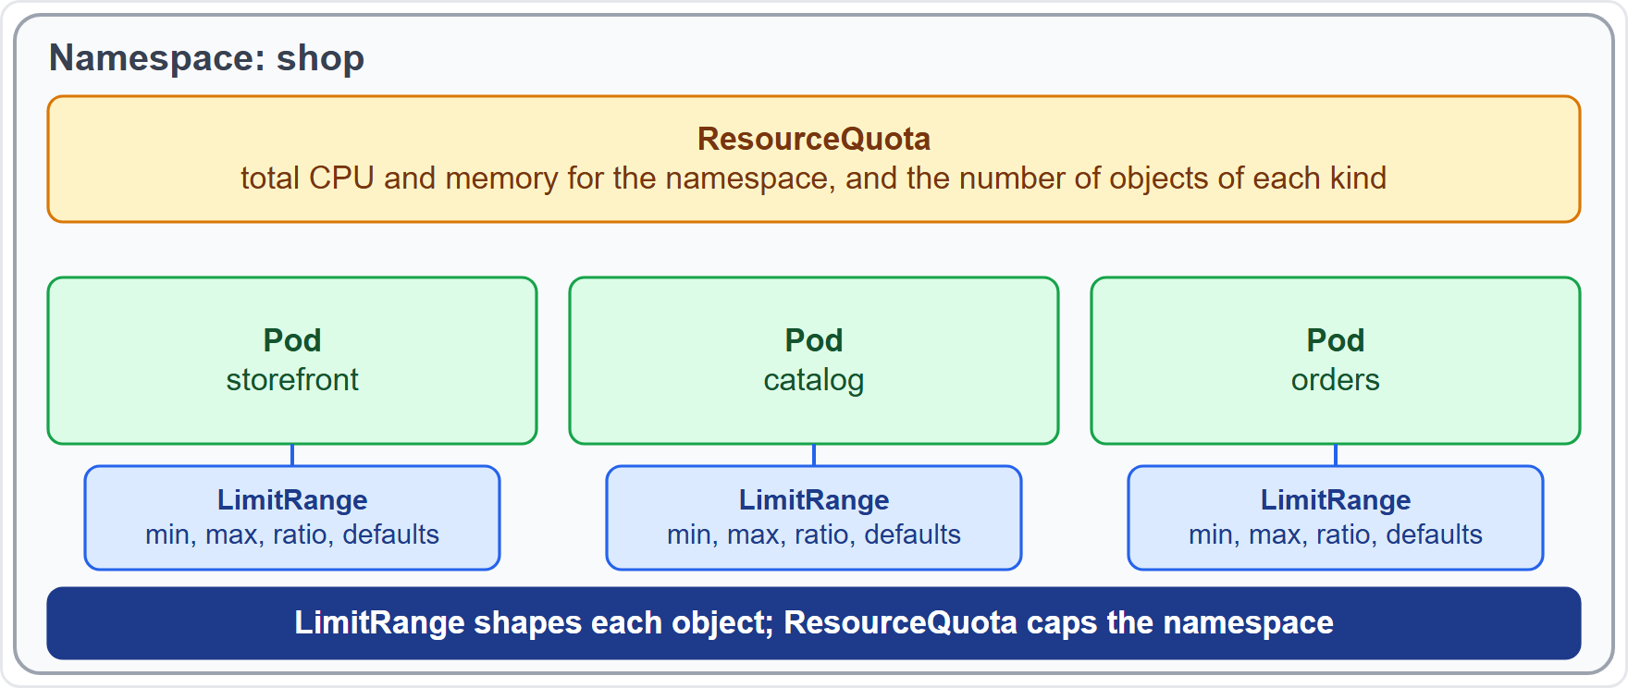
LimitRange and ResourceQuota
Part 1
A LimitRange constrains the requests and limits of each Pod or container: a minimum, a maximum, a ratio, and defaults
A ResourceQuota limits the total resources used in the namespace and the number of objects of a kind
The cluster administrator sets up at least one ResourceQuota per namespace
EXAM TIP LimitRange shapes each object; ResourceQuota caps the namespace.
KCNA Exam Prep Masterclass | Kubernetes and Cloud Native Associate
Module 4: Configuration and Cluster Administration
8 / 25
Notes:
Two objects control resources in a namespace. A Limit Range constrains the requests and limits of each Pod or container: a minimum, a maximum, a ratio, and defaults. A Resource Quota limits the total resources used in the whole namespace, and the number of objects of a kind. A cluster administrator creates at least one Resource Quota for each namespace. And a Limit Range can fill in default requests and limits for containers that set none. Exam tip: Limit Range shapes each object, and Resource Quota caps the namespace.

Slide 9
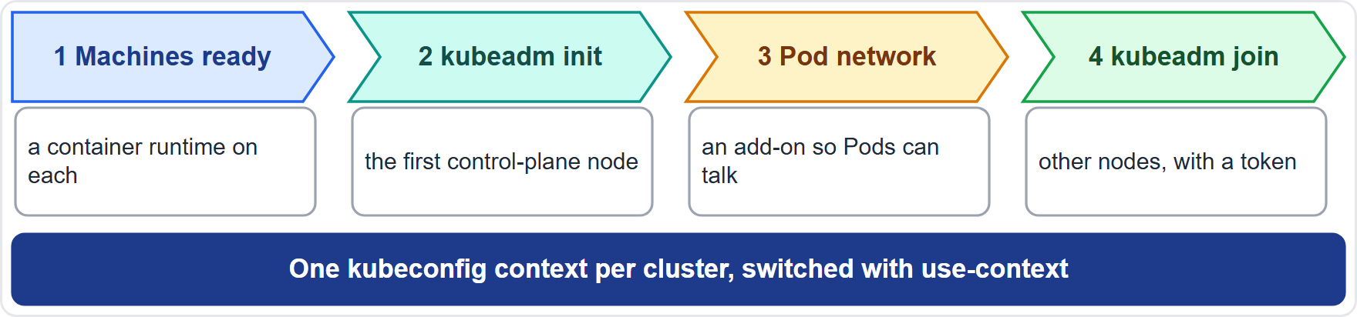
Cluster Setup with kubeadm
BEYOND THE CURRICULUM
Part 1
kubeadm init initializes the first control-plane node
Install a Pod network add-on so that Pods can communicate
kubeadm join, with a token, adds the other nodes
With several clusters, keep one kubeconfig context for each and switch with kubectl config use-context
EXAM TIP init for the control plane, join for the rest.
KCNA Exam Prep Masterclass | Kubernetes and Cloud Native Associate
Module 4: Configuration and Cluster Administration
9 / 25
Notes:
This slide is tagged beyond the curriculum. Kube A D M builds a cluster in a few steps. Kube A D M init initializes the first control plane node. Then you install a Pod network add-on, so that Pods can communicate. Kube A D M join, with a token, adds the other nodes. And when you work with several clusters, keep one kube config context for each, and switch with kube control config use context. Exam tip: init for the control plane, join for the rest.

Slide 10
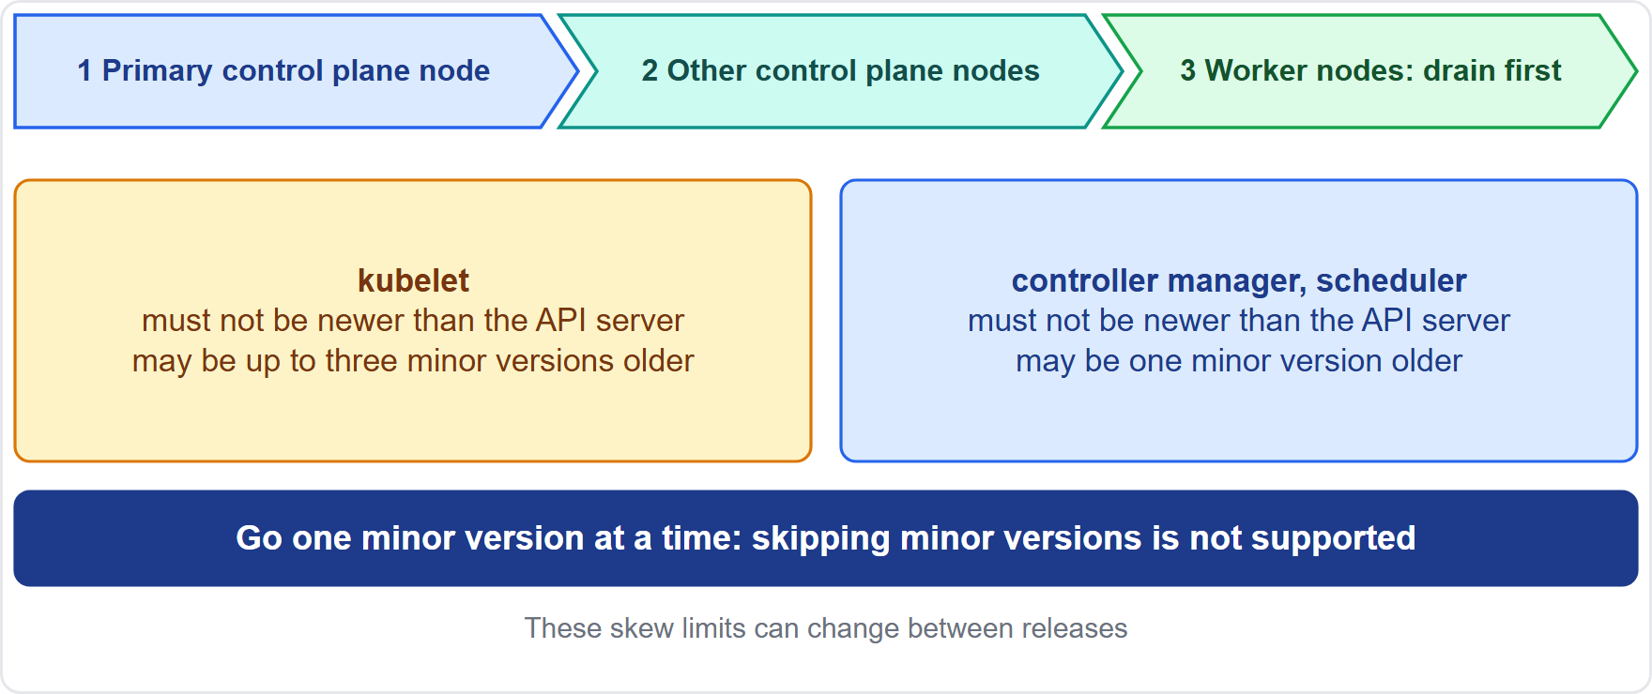
Upgrades and Version Skew
BEYOND THE CURRICULUM · MOVING
Part 1
Upgrade in order: the control plane first, then the worker nodes
Go one minor version at a time; skipping minor versions is not supported
Drain a node before a minor-version kubelet upgrade
As of 30 October 2026: the kubelet can lag the API server by up to three minor versions; the controller manager and scheduler by one
EXAM TIP Components may lag the API server but never lead it.
KCNA Exam Prep Masterclass | Kubernetes and Cloud Native Associate
Module 4: Configuration and Cluster Administration
10 / 25
Notes:
This slide is tagged beyond the curriculum. It is also tagged moving, because the skew numbers can change. You upgrade in order: the control plane first, then the worker nodes. You go one minor version at a time, because skipping minor versions is not supported. And you drain a node before a minor version kube let upgrade. As of the thirtieth of October, twenty twenty-six, the kube let can lag the A P I server by up to three minor versions. The controller manager and the scheduler can lag it by one. Exam tip: components may lag the A P I server, but never lead it.

Slide 11
etcd Backup and Restore
Part 1
etcd holds all cluster data, so back it up
A backup is a snapshot, taken with etcdctl snapshot save
A restore uses etcdutl snapshot restore
etcdctl is the client that talks to etcd over the network; etcdutl works directly on etcd data files
TERMINAL
ETCDCTL_API=3 etcdctl --endpoints $ENDPOINT snapshot save snapshot.db
etcdutl --write-out=table snapshot status snapshot.db
etcdutl --data-dir <data-dir-location> snapshot restore snapshot.db
Back up and restore etcd
EXAM TIP Save with etcdctl; restore with etcdutl.
KCNA Exam Prep Masterclass | Kubernetes and Cloud Native Associate
Module 4: Configuration and Cluster Administration
11 / 25
Notes:
E T C D holds all cluster data, so back it up. A backup is a snapshot, taken with E T C D C T L snapshot save. A restore uses E T C D U T L snapshot restore. E T C D C T L is the client that talks to E T C D over the network. E T C D U T L works directly on E T C D data files. The snippet saves a snapshot, checks its status, and restores it. Exam tip: save with E T C D C T L, and restore with E T C D U T L.

Slide 12
Node Maintenance: Cordon, Drain and PodDisruptionBudgets
Part 2
cordon marks a node unschedulable: no new Pods land on it
drain safely evicts the Pods, respecting PodDisruptionBudgets; --ignore-daemonsets skips DaemonSet Pods
uncordon makes the node schedulable again
A PodDisruptionBudget limits how many Pods of an app may be down at once during voluntary disruptions such as a drain
TERMINAL
kubectl cordon worker-2
kubectl drain worker-2 --ignore-daemonsets
kubectl uncordon worker-2
Patch a node without taking the app down
EXAM TIP Drain first, patch second, uncordon last.
KCNA Exam Prep Masterclass | Kubernetes and Cloud Native Associate
Module 4: Configuration and Cluster Administration
12 / 25
Notes:
Three commands take a node out of service. Cordon marks a node unschedulable, so no new Pods land on it. Drain safely evicts the Pods, respecting Pod Disruption Budgets, and the ignore daemon sets flag skips Daemon Set Pods. Uncordon makes the node schedulable again. A Pod Disruption Budget limits how many Pods of an app may be down at once during voluntary disruptions, such as a drain. Exam tip: drain first, patch second, uncordon last.

Slide 13
Releases, Deprecation and Support
MOVING
Part 2
Topic | The rule
Release cycle | about three Kubernetes releases a year
Patch support | about one year, plus two months of maintenance: 14 months
GA APIs (generally available) | may be deprecated but are not removed within a major version
Beta APIs | deprecated within 9 months or 3 releases, and no longer served 9 months or 3 releases after that, whichever is longer
Alpha APIs | may be removed in any release without a deprecation notice
As of 30 October 2026: v1.37 is the latest minor release
EXAM TIP Stable APIs are not removed within a major version; alpha ones can vanish at any time.
KCNA Exam Prep Masterclass | Kubernetes and Cloud Native Associate
Module 4: Configuration and Cluster Administration
13 / 25
Notes:
This slide is tagged moving. Kubernetes has about three releases a year. Each minor release gets about one year of patch support, plus two months of maintenance, fourteen months in all. For A P I versions, G A versions, the generally available ones, may be deprecated, but they are not removed within a major version. Beta versions are deprecated within nine months or three releases, and are no longer served nine months or three releases after that, whichever is longer. Alpha versions can disappear in any release, without notice. As of the thirtieth of October, twenty twenty-six, version one point thirty-seven is the latest minor release. Exam tip: stable A P I s are not removed within a major version, and alpha ones can vanish at any time.

Slide 14
What the Exam Asks: Configuration and Administration
Part 2
ConfigMap or Secret
base64 or encryption
Request or limit
settings anyone may see, or confidential data
base64 only encodes; encryption at rest protects Secrets in etcd
requests place the Pod; limits are enforced
LimitRange or ResourceQuota
Cordon or drain
Upgrade order
cordon stops new Pods; drain also evicts the running ones
control plane first, one minor version at a time
per object, or the whole namespace
EXAM TIP When a question names a limit, ask who enforces it: the scheduler, the kubelet or the kernel.
KCNA Exam Prep Masterclass | Kubernetes and Cloud Native Associate
Module 4: Configuration and Cluster Administration
14 / 25
Notes:
Six pairs to keep apart. Config Map or Secret: settings anyone may see, or confidential data. Base sixty-four or encryption: base sixty-four only encodes, and encryption at rest protects Secrets in E T C D. Request or limit: requests place the Pod, and limits are enforced. Limit Range or Resource Quota: per object, or the whole namespace. Cordon or drain: cordon stops new Pods, and drain also evicts the running ones. And upgrade order: the control plane first, one minor version at a time. Exam tip: when a question names a limit, ask who enforces it.

Slide 15
Module Recap
Part 2
1
Configuration
2
Resources
3
Cluster setup
ConfigMaps for non-confidential settings, as environment variables or files; Secrets for confidential data, protected beyond base64
requests place Pods, limits are enforced; LimitRange shapes objects, ResourceQuota caps a namespace
kubeadm init and join, then a Pod network add-on
4
Upgrades and backups
5
Maintenance
cordon, drain with PodDisruptionBudgets, uncordon
control plane first, one minor version at a time; snapshot etcd
KCNA Exam Prep Masterclass | Kubernetes and Cloud Native Associate
Module 4: Configuration and Cluster Administration
15 / 25
Notes:
To recap. Config Maps hold non-confidential settings, as environment variables or files, and Secrets hold confidential data that needs protection beyond base sixty-four. Requests place Pods and limits are enforced. A Limit Range shapes objects, and a Resource Quota caps a namespace. Kube A D M init and join build the cluster, and a Pod network add-on connects it. Upgrade the control plane first, one minor version at a time, and snapshot E T C D. And for maintenance, cordon, drain with Pod Disruption Budgets, then uncordon. Now nine practice questions.

Slide 16
Practice Question 1
Part 2
Q1
Which statement about ConfigMaps is correct?
A
They are stored encrypted in etcd, which makes them suitable for passwords and keys
B
They hold non-confidential settings as key-value pairs, apart from the code
C
They can hold large amounts of data, because a size limit does not apply to them
D
They can be read by Pods that run in a different namespace
KCNA Exam Prep Masterclass | Kubernetes and Cloud Native Associate
Module 4: Configuration and Cluster Administration
16 / 25
Notes:
Question one. Which statement about Config Maps is correct? The four options are on the screen.
[PAUSE 12]
The answer is B. A Config Map keeps non-confidential settings separate from the code. It gives no encryption, so it is not meant for passwords. It is limited to one mebibyte, and a Pod can use only Config Maps from its own namespace.

Slide 17
Practice Question 2
Part 2
Q2
Harbor Books runs the same storefront image in staging and in production, with a different database host in each. What is the best way to supply the host?
A
Keep it in a ConfigMap for each environment and pass it to the Pod
B
Build one image per environment with the host baked into its files
C
Store it in a Secret, since every setting has to be kept confidential
D
Edit the files inside the running container after each restart
KCNA Exam Prep Masterclass | Kubernetes and Cloud Native Associate
Module 4: Configuration and Cluster Administration
17 / 25
Notes:
Question two. Harbor Books runs the same storefront image in staging and in production, with a different database host in each. What is the best way to supply the host? The four options are on the screen.
[PAUSE 12]
The answer is A. A Config Map keeps settings apart from the image, so one image can serve both environments, and the Pod receives the value as an environment variable or a file. Building separate images defeats that, a database host is not confidential, and edits inside a container are lost on restart.

Slide 18
Practice Question 3
Part 2
Q3
A Secret's value in a manifest is base64-encoded. What does that mean?
A
The value is encrypted and cannot be read without the cluster's own secret key
B
The value is hashed, so nobody can recover the original text
C
The value is compressed, so it takes less space in etcd and in the API server
D
The value is only encoded, so anyone who can read the Secret can decode it
KCNA Exam Prep Masterclass | Kubernetes and Cloud Native Associate
Module 4: Configuration and Cluster Administration
18 / 25
Notes:
Question three. A Secret's value in a manifest is base sixty-four encoded. What does that mean? The four options are on the screen.
[PAUSE 12]
The answer is D. Base sixty-four is an encoding, not encryption, so anyone who can read the Secret can decode it. By default, Secrets are also stored unencrypted in E T C D, which is why encryption at rest and tight access rules are recommended.

Slide 19
Practice Question 4
Part 2
Q4
A Pod requests 500m of CPU and 256Mi of memory. What does the scheduler do with these requests?
A
It caps the container at those amounts for as long as the Pod keeps running
B
It ignores them unless a limit is also set on the container
C
It uses them to choose a node that has enough unreserved capacity
D
It terminates the Pod whenever it uses more than those amounts of either resource
KCNA Exam Prep Masterclass | Kubernetes and Cloud Native Associate
Module 4: Configuration and Cluster Administration
19 / 25
Notes:
Question four. A Pod requests five hundred millicpu of C P U and two hundred fifty-six M I of memory. What does the scheduler do with these requests? The four options are on the screen.
[PAUSE 12]
The answer is C. The scheduler uses requests to decide which node can fit the Pod, and the kube let reserves that amount for the container. Capping and terminating are enforcement of limits, not requests.

Slide 20
Practice Question 5
Part 2
Q5
One container goes over its CPU limit and another goes over its memory limit. What happens?
A
The CPU is throttled, while the memory over-use can get the container killed
B
Both containers are terminated at once, because every limit is enforced as a hard stop
C
Both containers are throttled until they fall below their limits again
D
Both limits are raised automatically to match what the containers use
KCNA Exam Prep Masterclass | Kubernetes and Cloud Native Associate
Module 4: Configuration and Cluster Administration
20 / 25
Notes:
Question five. One container goes over its C P U limit, and another goes over its memory limit. What happens? The four options are on the screen.
[PAUSE 12]
The answer is A. C P U limits are enforced by throttling, and memory limits by out of memory kills when the kernel sees memory pressure. Limits are not raised automatically, and C P U over-use does not terminate a container.

Slide 21
Practice Question 6
Part 2
Q6
The platform engineer wants to cap the total CPU and memory that all Pods in the shop namespace can use together. Which object does that?
A
A LimitRange, which caps the namespace's total usage of each resource
B
A ResourceQuota, which limits aggregate consumption per namespace
C
A PodDisruptionBudget, which limits how many Pods a namespace may run
D
A ConfigMap, which carries the quota settings into every Pod
KCNA Exam Prep Masterclass | Kubernetes and Cloud Native Associate
Module 4: Configuration and Cluster Administration
21 / 25
Notes:
Question six. The platform engineer wants to cap the total C P U and memory that all Pods in the shop namespace can use together. Which object does that? The four options are on the screen.
[PAUSE 12]
The answer is B. A Resource Quota limits the total resources used in a namespace. A Limit Range constrains the requests and limits of each object, a Pod Disruption Budget limits voluntary disruption, and a Config Map only holds settings.

Slide 22
Practice Question 7
Part 2
Q7
Which statement about upgrading a kubeadm cluster is correct?
A
Upgrade the worker nodes first, and afterwards upgrade the control plane nodes
B
Skip minor versions to reach the newest release in a single step
C
Upgrade the control plane first, one minor version at a time, then the workers
D
Upgrade the nodes together at the very same moment, so that the versions match each other
KCNA Exam Prep Masterclass | Kubernetes and Cloud Native Associate
Module 4: Configuration and Cluster Administration
22 / 25
Notes:
Question seven. Which statement about upgrading a kube A D M cluster is correct? The four options are on the screen.
[PAUSE 12]
The answer is C. The control plane is upgraded first, then the worker nodes, and minor versions cannot be skipped. Components such as the kube let may lag the A P I server, but must not be newer than it.

Slide 23
Practice Question 8
Part 2
Q8
How do you take a backup of the data in etcd?
A
By copying the kubelet's configuration directory to a safe place
B
By running kubeadm upgrade plan on the control plane node
C
By running kubectl get all and saving its output to a file
D
By taking a snapshot with etcdctl snapshot save against etcd
KCNA Exam Prep Masterclass | Kubernetes and Cloud Native Associate
Module 4: Configuration and Cluster Administration
23 / 25
Notes:
Question eight. How do you take a backup of the data in E T C D? The four options are on the screen.
[PAUSE 12]
The answer is D. E T C D is backed up with a snapshot, taken with E T C D C T L snapshot save, and restored with E T C D U T L snapshot restore. The kube let configuration and kube control output do not hold the cluster's data, and kube A D M upgrade plan only reports available upgrades.

Slide 24
Practice Question 9
Part 2
Q9
Harbor Books must patch a worker node without taking the storefront down. Which sequence is right?
A
Stop the kubelet, patch the node, and wait for the Pods to move on their own
B
Delete the node object and let the scheduler recreate its Pods elsewhere
C
Drain the node so the Pods are evicted gracefully, patch it, then uncordon it
D
Cordon the node and patch it at once, because cordon also moves the Pods away
KCNA Exam Prep Masterclass | Kubernetes and Cloud Native Associate
Module 4: Configuration and Cluster Administration
24 / 25
Notes:
Question nine. Harbor Books must patch a worker node without taking the storefront down. Which sequence is right? The four options are on the screen.
[PAUSE 12]
The answer is C. Drain cordons the node and evicts its Pods safely, respecting Pod Disruption Budgets, so the app keeps its minimum availability. Uncordon makes the node usable again afterwards. Cordon alone leaves the Pods running on the node.

Slide 25
Answers at a Glance
Part 2
Question | Answer | Why
Q1 | B | A ConfigMap holds non-confidential settings
Q2 | A | A ConfigMap per environment keeps the image the same
Q3 | D | base64 is encoding, not encryption
Q4 | C | The scheduler places Pods by their requests
Q5 | A | CPU is throttled; memory over-use can kill
Q6 | B | A ResourceQuota caps a namespace
Q7 | C | Control plane first, one minor version at a time
Q8 | D | etcdctl snapshot save
Q9 | C | Drain, patch, uncordon
KCNA Exam Prep Masterclass | Kubernetes and Cloud Native Associate
Module 4: Configuration and Cluster Administration
25 / 25
Notes:
Here are the answers at a glance. Question one, B: a Config Map holds non-confidential settings. Question two, A: a Config Map per environment keeps the image the same. Question three, D: base sixty-four is encoding, not encryption. Question four, C: the scheduler places Pods by their requests. Question five, A: C P U is throttled, and memory over-use can kill. Question six, B: a Resource Quota caps a namespace. Question seven, C: control plane first, one minor version at a time. Question eight, D: E T C D C T L snapshot save. Question nine, C: drain, patch, uncordon.

