Slide 1
Module 5: Scheduling and Scaling
Where Pods run and how capacity follows demand
Kubernetes Fundamentals · Scheduling
YOU WILL BE ABLE TO
Explain how the scheduler filters, scores and binds
Place Pods with node selectors, affinity, taints, tolerations and spread constraints
Use priority, QoS classes and eviction order in a scenario
Compare the HPA, VPA, Cluster Autoscaler and KEDA
KCNA Exam Prep Masterclass
Module 5 · Part 1
Notes:
Welcome to Module 5: Scheduling and Scaling. This module is in the Kubernetes Fundamentals domain, and it covers the topic called Scheduling. By the end you will be able to do four things. Explain how the scheduler filters, scores and binds. Place Pods with node selectors, affinity, taints, tolerations and spread constraints. Use priority, Q O S classes and eviction order in a scenario. And compare the H P A, the V P A, the Cluster Autoscaler and KEDA.

Slide 2
Case Check-In: Harbor Books Sells More at the Weekend
Part 1
CASE CHECK-IN · Harbor Books
On weekends the shop gets many more visitors, and the storefront must keep up
Payment Pods should run on dedicated nodes, and replicas should be spread so one failure does not take the shop down
Checkout matters more than the nightly report if the cluster is full
In this module you control where Pods go and how many there are
KCNA Exam Prep Masterclass | Kubernetes and Cloud Native Associate
Module 5: Scheduling and Scaling
2 / 24
Notes:
At Harbor Books, the weekend brings many more visitors, and the storefront must keep up. Payment Pods should run on dedicated nodes, and the replicas should be spread so that one failure does not take the shop down. Checkout matters more than the nightly report if the cluster is full. In this module you control where Pods go, and how many there are.

Slide 3
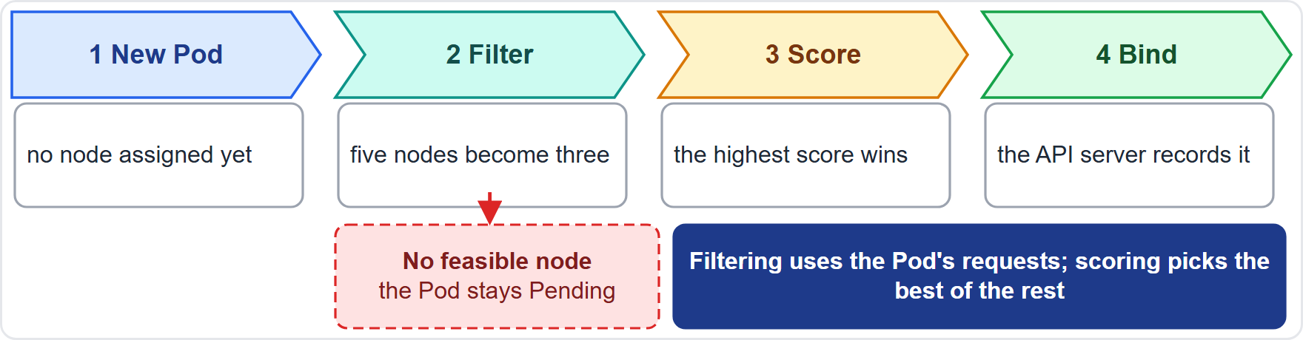
How the Scheduler Decides: Filter, Score, Bind
Part 1
kube-scheduler watches for new Pods with no node
Filtering removes nodes that cannot run the Pod, for example nodes without enough free resources for its requests
Scoring ranks the remaining nodes, and the highest score wins
Binding records the choice with the API server
If no node is feasible, the Pod stays unscheduled (Pending)
EXAM TIP Filter removes, score ranks, bind records.
KCNA Exam Prep Masterclass | Kubernetes and Cloud Native Associate
Module 5: Scheduling and Scaling
3 / 24
Notes:
The kube scheduler watches for new Pods with no node. Filtering removes nodes that cannot run the Pod, for example nodes without enough free resources for its requests. Scoring ranks the remaining nodes, and the highest score wins. Binding records the choice with the A P I server. If no node is feasible, the Pod stays unscheduled, shown as Pending. The diagram shows five nodes becoming three after filtering. Exam tip: filter removes, score ranks, bind records.

Slide 4
nodeSelector and Node Affinity
Part 1
nodeSelector is the simplest way to pick nodes: the Pod runs only on nodes whose labels match
Node affinity is more expressive, with operators such as In, NotIn, Exists and DoesNotExist
required during scheduling is a hard rule; preferred is a soft rule that the scheduler tries to meet
If you set both a nodeSelector and node affinity, both must be satisfied
YAML
nodeSelector:
disktype: ssd
affinity:
nodeAffinity:
requiredDuringSchedulingIgnoredDuringExecution:
nodeSelectorTerms:
- matchExpressions:
- key: topology.kubernetes.io/zone
operator: In
values: [zone-a, zone-b]
A node selector and a hard node affinity rule
EXAM TIP required means must, preferred means try.
KCNA Exam Prep Masterclass | Kubernetes and Cloud Native Associate
Module 5: Scheduling and Scaling
4 / 24
Notes:
A node selector is the simplest way to pick nodes. The Pod runs only on nodes whose labels match. Node affinity is more expressive, with operators such as In, Not In, Exists and Does Not Exist. A required rule is hard. A preferred rule is soft, and the scheduler only tries to meet it. If you set both a node selector and node affinity, both must be satisfied. The snippet asks for nodes with an S S D disk, in one of two zones. Exam tip: required means must, and preferred means try.

Slide 5
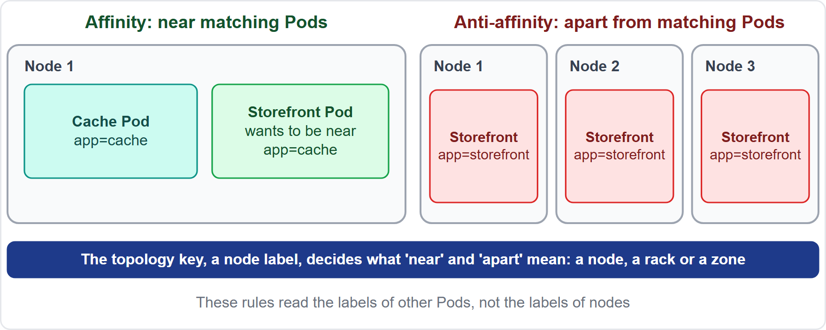
Pod Affinity and Anti-Affinity
Part 1
Pod affinity places a Pod in a domain that already runs Pods with matching labels
Pod anti-affinity keeps it out of such a domain, for example to spread replicas over nodes
The topology key, a node label, defines the domain: a node, a rack or a zone
These rules look at other Pods' labels, not at node labels, and cost scheduling time in large clusters
EXAM TIP Node affinity reads node labels; Pod affinity reads Pod labels.
KCNA Exam Prep Masterclass | Kubernetes and Cloud Native Associate
Module 5: Scheduling and Scaling
5 / 24
Notes:
Pod affinity places a Pod in a domain that already runs Pods with matching labels. Pod anti-affinity keeps it out of such a domain, for example to spread replicas over nodes. The topology key, a node label, defines the domain: a node, a rack or a zone. These rules look at other Pods' labels, not at node labels, and they cost scheduling time in large clusters. Exam tip: node affinity reads node labels, and Pod affinity reads Pod labels.

Slide 6
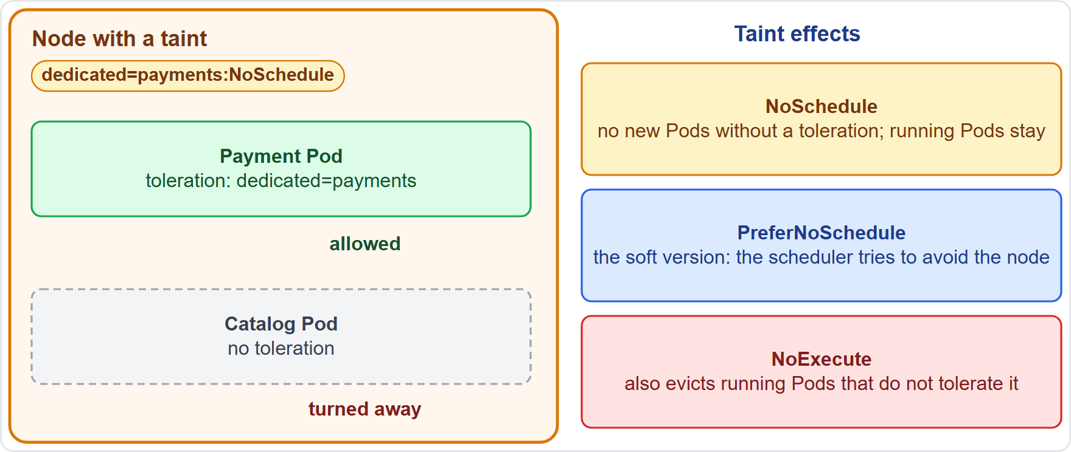
Taints and Tolerations
Part 1
A taint on a node repels Pods; a toleration on a Pod lets it be placed on a matching tainted node
A toleration allows placement but does not guarantee it
NoSchedule: no new Pods without a toleration; running Pods stay
PreferNoSchedule: the soft version
NoExecute: also evicts running Pods that do not tolerate the taint
EXAM TIP Taints repel; tolerations permit; NoExecute is the only effect that evicts.
KCNA Exam Prep Masterclass | Kubernetes and Cloud Native Associate
Module 5: Scheduling and Scaling
6 / 24
Notes:
A taint on a node repels Pods. A toleration on a Pod lets it be placed on a matching tainted node. A toleration allows placement, but it does not guarantee it. The effect decides how strict the taint is. No Schedule means no new Pods without a toleration, and running Pods stay. Prefer No Schedule is the soft version. And No Execute also evicts running Pods that do not tolerate the taint. Exam tip: taints repel, tolerations permit, and No Execute is the only effect that evicts.

Slide 7
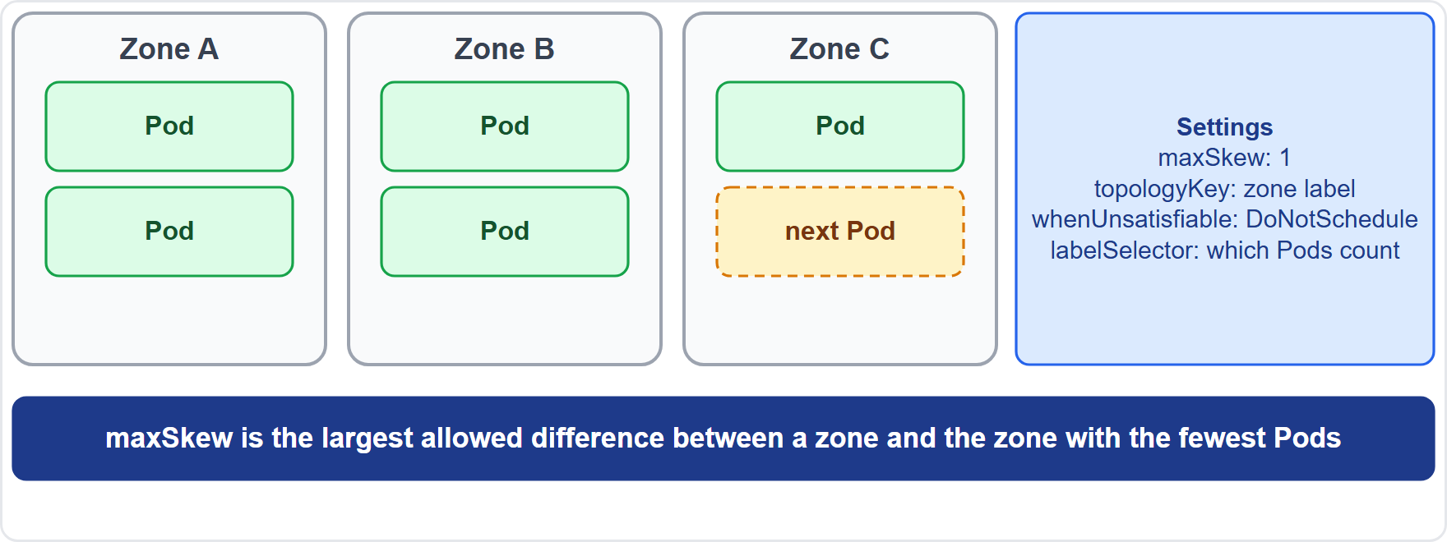
Topology Spread Constraints
Part 1
Topology spread constraints spread Pods across failure domains such as zones and nodes
maxSkew: the largest permitted difference in matching Pods between a domain and the domain with the fewest
topologyKey names the node label that defines the domains; labelSelector says which Pods count
whenUnsatisfiable: DoNotSchedule is hard; ScheduleAnyway is soft
EXAM TIP Use spread constraints for even distribution; use anti-affinity to keep apart.
KCNA Exam Prep Masterclass | Kubernetes and Cloud Native Associate
Module 5: Scheduling and Scaling
7 / 24
Notes:
Topology spread constraints spread Pods across failure domains, such as zones and nodes. Max skew is the largest permitted difference in matching Pods between a domain and the domain with the fewest. The topology key names the node label that defines the domains, and the label selector says which Pods count. When unsatisfiable chooses between Do Not Schedule, which is hard, and Schedule Anyway, which is soft. In the diagram, three zones hold two, two and one Pods, so the next Pod goes to the third zone. Exam tip: use spread constraints for even distribution, and anti-affinity to keep Pods apart.

Slide 8
Priority and Preemption
Part 1
A PriorityClass maps a name to an integer; the higher the value, the more important the Pod
A Pod picks one with priorityClassName
When a Pod finds no room, the scheduler may preempt: it evicts lower-priority Pods to make space
preemptionPolicy: Never stops a Pod from preempting others
Values for your own classes go up to one billion; larger ones are reserved for system-cluster-critical and system-node-critical
YAML
apiVersion: scheduling.k8s.io/v1
kind: PriorityClass
metadata:
name: checkout-critical
value: 100000
description: Checkout Pods come first
A class for checkout Pods
EXAM TIP Priority decides who is evicted to make room, not where a Pod goes.
KCNA Exam Prep Masterclass | Kubernetes and Cloud Native Associate
Module 5: Scheduling and Scaling
8 / 24
Notes:
A Priority Class maps a name to an integer. The higher the value, the more important the Pod. A Pod picks one with priority class name. When a Pod finds no room, the scheduler may preempt: it evicts lower priority Pods to make space. Preemption policy Never stops a Pod from preempting others. Values for your own classes go up to one billion. Larger ones are reserved for system cluster critical and system node critical. Exam tip: priority decides who is evicted to make room, not where a Pod goes.

Slide 9
QoS Classes and Eviction
Part 1
QoS class | When Kubernetes assigns it | Evicted
Guaranteed | every container has CPU and memory requests and limits, and each limit equals its request | last
Burstable | not Guaranteed, but at least one request or limit is set | in the middle
BestEffort | no container has any request or limit | first
Kubernetes assigns the QoS class from a Pod's requests and limits
When a node runs out of resources, the kubelet evicts BestEffort, then Burstable, and Guaranteed last
The kubelet itself ranks by usage above requests and by priority, so the QoS order is the likely result
EXAM TIP No requests and limits means first to go.
KCNA Exam Prep Masterclass | Kubernetes and Cloud Native Associate
Module 5: Scheduling and Scaling
9 / 24
Notes:
Kubernetes assigns every Pod a Q O S class, from its requests and limits. Guaranteed means every container has C P U and memory requests and limits, and each limit equals its request. Burstable means the Pod is not Guaranteed, but at least one request or limit is set. Best Effort means no container has any request or limit. When a node runs out of resources, the kube let evicts Best Effort Pods first, then Burstable, and Guaranteed last. The kube let itself ranks by usage above requests and by priority, so the Q O S order is the likely result. Exam tip: no requests and limits means first to go.

Slide 10
Static Pods and Manual Placement
BEYOND THE CURRICULUM
Part 1
Mechanism | What it is
Static Pod | a Pod the kubelet runs on one node from manifest files in a folder (staticPodPath); the API server does not manage it, but the kubelet shows a mirror Pod there
nodeName | a field that names the node for a Pod directly and skips the scheduler; unusual
The main use of static Pods is a self-hosted control plane: components such as the API server run as static Pods
The scheduler plays no part in either mechanism
EXAM TIP Static Pods belong to one kubelet, not to a controller.
KCNA Exam Prep Masterclass | Kubernetes and Cloud Native Associate
Module 5: Scheduling and Scaling
10 / 24
Notes:
This slide is tagged beyond the curriculum. A static Pod is a Pod that the kube let runs on one node, from manifest files in a folder. The A P I server does not manage it, but the kube let shows a mirror Pod there. The other mechanism is node name, a field that names the node for a Pod directly and skips the scheduler. It is unusual. The main use of static Pods is a self-hosted control plane. Exam tip: static Pods belong to one kube let, not to a controller.

Slide 11
Horizontal Pod Autoscaler
Part 1
The HPA changes the number of Pods of a Deployment or StatefulSet to match demand
It compares a metric, such as average CPU utilization, with a target
Utilization is measured against the Pods' requests; with no requests set, it takes no action
Metrics come from the Metrics Server; the HPA checks about every 15 seconds
minReplicas and maxReplicas bound the result
YAML
kind: HorizontalPodAutoscaler
spec:
scaleTargetRef: {apiVersion: apps/v1, kind: Deployment, name: storefront}
minReplicas: 3
maxReplicas: 10
metrics:
- type: Resource
resource:
name: cpu
target: {type: Utilization, averageUtilization: 60}
Scale the storefront on CPU
EXAM TIP The HPA scales out and in; it needs CPU requests to work.
KCNA Exam Prep Masterclass | Kubernetes and Cloud Native Associate
Module 5: Scheduling and Scaling
11 / 24
Notes:
The Horizontal Pod Autoscaler, the H P A, changes the number of Pods of a Deployment or Stateful Set to match demand. It compares a metric, such as average C P U utilization, with a target. Utilization is measured against the Pods' requests, so with no requests set, it takes no action. Metrics come from the Metrics Server, and the H P A checks about every fifteen seconds. Min replicas and max replicas bound the result. The snippet targets sixty percent C P U for the storefront. Exam tip: the H P A scales out and in, and it needs C P U requests to work.

Slide 12
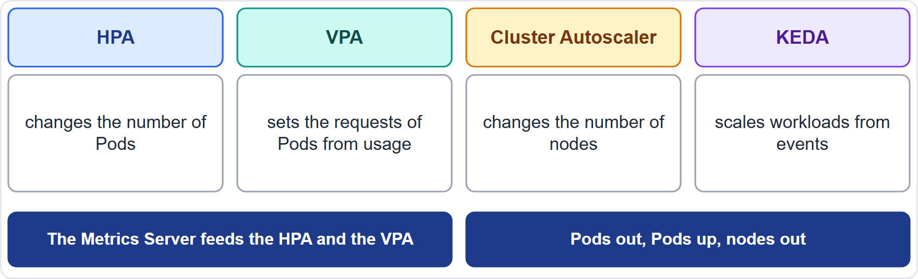
Other Autoscalers: VPA, Cluster Autoscaler and KEDA
ARCHIVED TOPIC
Part 2
HPA: more or fewer Pods; VPA: bigger or smaller Pods, by setting requests from usage
Cluster Autoscaler: adds nodes when Pods cannot be scheduled, and removes nodes that stay underutilized
KEDA (Kubernetes Event Driven Autoscaling) scales workloads from events
The Metrics Server feeds the HPA and the VPA
EXAM TIP Pods out, Pods up, nodes out: HPA, VPA, Cluster Autoscaler.
KCNA Exam Prep Masterclass | Kubernetes and Cloud Native Associate
Module 5: Scheduling and Scaling
12 / 24
Notes:
This slide is tagged archived topic. The H P A adds or removes Pods. The Vertical Pod Autoscaler, the V P A, makes Pods bigger or smaller, by setting requests from observed usage. The Cluster Autoscaler adds nodes when Pods cannot be scheduled, and removes nodes that stay underutilized. KEDA, Kubernetes Event Driven Autoscaling, scales workloads from events. And the Metrics Server feeds the H P A and the V P A. Exam tip: Pods out, Pods up, nodes out: H P A, V P A, Cluster Autoscaler.

Slide 13
What the Exam Asks: Scheduling
Part 2
Filter or score
Affinity or taint
NoSchedule or NoExecute
filtering removes nodes that cannot run the Pod; scoring ranks the rest
affinity attracts; taints repel; tolerations permit
NoSchedule blocks new Pods; NoExecute also evicts running ones
Requests or limits
QoS order
HPA, VPA or Cluster Autoscaler
requests drive placement; limits are enforced
BestEffort is evicted first, Guaranteed last
more Pods, bigger Pods, or more nodes
EXAM TIP For a placement question, ask whether the rule attracts, repels, spreads or ranks.
KCNA Exam Prep Masterclass | Kubernetes and Cloud Native Associate
Module 5: Scheduling and Scaling
13 / 24
Notes:
Six pairs to keep apart. Filter or score: filtering removes nodes that cannot run the Pod, and scoring ranks the rest. Affinity or taint: affinity attracts, taints repel, and tolerations permit. No Schedule or No Execute: No Schedule blocks new Pods, and No Execute also evicts running ones. Requests or limits: requests drive placement, and limits are enforced. Q O S order: Best Effort is evicted first, and Guaranteed last. And H P A, V P A or Cluster Autoscaler: more Pods, bigger Pods, or more nodes. Exam tip: ask whether the rule attracts, repels, spreads or ranks.

Slide 14
Module Recap
Part 2
1
The scheduler
2
Placement
3
Priority and QoS
filter, score, bind; no feasible node means the Pod stays Pending
node selector and affinity use node labels; Pod affinity uses Pod labels; taints repel and tolerations permit; spread constraints even out zones
higher priority can preempt lower; BestEffort is evicted first
4
Static Pods
5
Autoscaling
run by one kubelet from manifest files
HPA scales Pods out and in, VPA resizes Pods, the Cluster Autoscaler adds nodes, KEDA scales on events
KCNA Exam Prep Masterclass | Kubernetes and Cloud Native Associate
Module 5: Scheduling and Scaling
14 / 24
Notes:
To recap. The scheduler filters, scores and binds, and if no node is feasible the Pod stays Pending. Node selectors and node affinity use node labels, and Pod affinity uses Pod labels. Taints repel, tolerations permit, and spread constraints even out zones. Higher priority can preempt lower priority, and Best Effort Pods are evicted first. Static Pods run from manifest files under one kube let. And autoscaling: the H P A scales Pods out and in, the V P A resizes Pods, the Cluster Autoscaler adds nodes, and KEDA scales on events. Now nine practice questions.

Slide 15
Practice Question 1
Part 2
Q1
In which order does the kube-scheduler carry out its main steps for a new Pod?
A
It scores the nodes, binds the Pod, and then filters out unsuitable nodes
B
It binds the Pod to a node, then filters the nodes, and then scores them
C
It filters the nodes, binds the Pod to one, and then scores the result
D
It filters out unsuitable nodes, scores the rest, and then binds the Pod
KCNA Exam Prep Masterclass | Kubernetes and Cloud Native Associate
Module 5: Scheduling and Scaling
15 / 24
Notes:
Question one. In which order does the kube scheduler carry out its main steps for a new Pod? The four options are on the screen.
[PAUSE 12]
The answer is D. The scheduler filters out nodes that cannot run the Pod, scores the feasible ones, and then binds the Pod to the highest scoring node by telling the A P I server. Binding comes last.

Slide 16
Practice Question 2
Part 2
Q2
Harbor Books wants other teams' Pods kept off a group of nodes, while the payment Pods are allowed to run there. Which settings do that?
A
A toleration on the nodes and a taint on the payment Pods
B
A taint on the nodes and a matching toleration on the payment Pods
C
A node selector on the other teams' Pods that names the payment nodes
D
A PriorityClass for the payment Pods that is higher than the others
KCNA Exam Prep Masterclass | Kubernetes and Cloud Native Associate
Module 5: Scheduling and Scaling
16 / 24
Notes:
Question two. Harbor Books wants other teams' Pods kept off a group of nodes, while the payment Pods are allowed to run there. Which settings do that? The four options are on the screen.
[PAUSE 12]
The answer is B. A taint repels Pods from a node, and a toleration on the payment Pods lets them be placed there. Tolerations belong to Pods and taints to nodes, never the other way round, and a priority does not exclude other Pods from a node.

Slide 17
Practice Question 3
Part 2
Q3
What is the difference between the taint effects NoSchedule and NoExecute?
A
NoSchedule blocks only new Pods; NoExecute also evicts running Pods that lack a toleration
B
NoSchedule evicts the running Pods of a node, while NoExecute only blocks new Pods from being placed
C
The two effects are identical, and the two names differ only by the Kubernetes version that uses them
D
NoSchedule applies to Pods, while NoExecute applies only to the nodes of one particular cluster
KCNA Exam Prep Masterclass | Kubernetes and Cloud Native Associate
Module 5: Scheduling and Scaling
17 / 24
Notes:
Question three. What is the difference between the taint effects No Schedule and No Execute? The four options are on the screen.
[PAUSE 12]
The answer is A. No Schedule stops new Pods that do not tolerate the taint, but leaves running Pods alone. No Execute also evicts running Pods that do not tolerate it. Prefer No Schedule is the soft version.

Slide 18
Practice Question 4
Part 2
Q4
A Deployment's replicas must be spread across three zones, so that no zone holds more than one Pod more than the emptiest zone. Which setting does this?
A
A node selector that names one zone for the replicas of the Deployment
B
A taint on the nodes of each zone, with the effect NoExecute set on each of the taints
C
A topology spread constraint with a maxSkew of one and a zone topology key
D
A PriorityClass with the highest value that a user-defined class may have
KCNA Exam Prep Masterclass | Kubernetes and Cloud Native Associate
Module 5: Scheduling and Scaling
18 / 24
Notes:
Question four. A Deployment's replicas must be spread across three zones, so that no zone holds more than one Pod more than the emptiest zone. Which setting does this? The four options are on the screen.
[PAUSE 12]
The answer is C. A topology spread constraint spreads matching Pods across domains, and max skew sets the largest allowed difference, here one, with the zone label as the topology key. A node selector would pin all replicas to one zone, and taints and priorities do not distribute Pods.

Slide 19
Practice Question 5
Part 2
Q5
A node runs short of memory. Which Pods does the kubelet evict first?
A
Guaranteed Pods, because they hold the largest memory reservations
B
BestEffort Pods, because they have no requests or limits at all
C
Burstable Pods, because they are always the newest Pods on a node
D
Static Pods, because the API server does not manage them
KCNA Exam Prep Masterclass | Kubernetes and Cloud Native Associate
Module 5: Scheduling and Scaling
19 / 24
Notes:
Question five. A node runs short of memory. Which Pods does the kube let evict first? The four options are on the screen.
[PAUSE 12]
The answer is B. Under node pressure the usual order is Best Effort Pods first, then Burstable ones, and Guaranteed Pods last. The kube let ranks by usage above requests and then priority, which gives this order in the usual case. Age and static Pods do not decide it.

Slide 20
Practice Question 6
Part 2
Q6
Checkout Pods must keep running, even if less important batch Pods have to be evicted when the cluster is full. What gives them that ability?
A
A ResourceQuota for the shop namespace with a high CPU ceiling
B
A higher CPU limit on the checkout containers than on the batch ones
C
A nodeName that places the checkout Pods on the largest worker node
D
A PriorityClass with a higher value, which the checkout Pods select
KCNA Exam Prep Masterclass | Kubernetes and Cloud Native Associate
Module 5: Scheduling and Scaling
20 / 24
Notes:
Question six. Checkout Pods must keep running, even if less important batch Pods have to be evicted when the cluster is full. What gives them that ability? The four options are on the screen.
[PAUSE 12]
The answer is D. A higher priority lets the scheduler preempt lower priority Pods to place the checkout Pods. A quota caps a namespace, a C P U limit does not change eviction order for the scheduler, and node name bypasses scheduling without freeing any room.

Slide 21
Practice Question 7
Part 2
Q7
The storefront HPA targets 60% average CPU utilization, but it never scales the Deployment. Which cause is likely?
A
The containers set no CPU request, so the utilization is not defined
B
The Deployment uses the RollingUpdate strategy instead of Recreate
C
The nodes carry too few labels for the scheduler to read them correctly
D
The Pods have a QoS class of Guaranteed and so can never be scaled
KCNA Exam Prep Masterclass | Kubernetes and Cloud Native Associate
Module 5: Scheduling and Scaling
21 / 24
Notes:
Question seven. The storefront H P A targets sixty percent average C P U utilization, but it never scales the Deployment. Which cause is likely? The four options are on the screen.
[PAUSE 12]
The answer is A. C P U utilization is measured against the Pods' requests, so with no request the H P A has nothing to compute, and takes no action. The update strategy, node labels and the Q O S class do not stop an H P A.

Slide 22
Practice Question 8
Part 2
Q8
Pods stay Pending because no node has enough free CPU, and the cluster runs in a cloud. Which component adds nodes?
A
The Horizontal Pod Autoscaler, which adds Pods when CPU use is high
B
The Vertical Pod Autoscaler, which resizes the requests of the Pods
C
The Cluster Autoscaler, which adds nodes when Pods find no room
D
The kube-proxy on each node, which balances the load between nodes
KCNA Exam Prep Masterclass | Kubernetes and Cloud Native Associate
Module 5: Scheduling and Scaling
22 / 24
Notes:
Question eight. Pods stay Pending because no node has enough free C P U, and the cluster runs in a cloud. Which component adds nodes? The four options are on the screen.
[PAUSE 12]
The answer is C. The Cluster Autoscaler adjusts the number of nodes when Pods cannot be scheduled for lack of resources, and removes nodes that stay underutilized. The H P A changes Pod counts, and the V P A changes requests.

Slide 23
Practice Question 9
Part 2
Q9
Which autoscaler sets the CPU and memory requests of a Pod from its observed usage?
A
The Vertical Pod Autoscaler, which works from the usage it observes
B
The Horizontal Pod Autoscaler, which works from metrics such as CPU
C
The Cluster Autoscaler, which works from Pods that cannot be scheduled
D
KEDA, which works from events that it is configured to watch
KCNA Exam Prep Masterclass | Kubernetes and Cloud Native Associate
Module 5: Scheduling and Scaling
23 / 24
Notes:
Question nine. Which autoscaler sets the C P U and memory requests of a Pod from its observed usage? The four options are on the screen.
[PAUSE 12]
The answer is A. The V P A sets requests from observed usage. The H P A changes the number of Pods, the Cluster Autoscaler changes the number of nodes, and KEDA scales workloads from events.

Slide 24
Answers at a Glance
Part 2
Question | Answer | Why
Q1 | D | Filter, score, then bind
Q2 | B | A taint on the nodes and a toleration on the Pods
Q3 | A | NoExecute also evicts running Pods
Q4 | C | A topology spread constraint with maxSkew one
Q5 | B | BestEffort Pods go first
Q6 | D | A higher PriorityClass allows preemption
Q7 | A | The HPA needs CPU requests
Q8 | C | The Cluster Autoscaler adds nodes
Q9 | A | The VPA sets requests from usage
KCNA Exam Prep Masterclass | Kubernetes and Cloud Native Associate
Module 5: Scheduling and Scaling
24 / 24
Notes:
Here are the answers at a glance. Question one, D: filter, score, then bind. Question two, B: a taint on the nodes and a toleration on the Pods. Question three, A: No Execute also evicts running Pods. Question four, C: a topology spread constraint with max skew one. Question five, B: Best Effort Pods go first. Question six, D: a higher Priority Class allows preemption. Question seven, A: the H P A needs C P U requests. Question eight, C: the Cluster Autoscaler adds nodes. Question nine, A: the V P A sets requests from usage.

