Slide 1
Module 6: Networking and Service Mesh
How Pods, Services and traffic find each other
Container Orchestration · Networking
YOU WILL BE ABLE TO
Explain the network model and the role of CNI plugins
Choose a Service type and trace how DNS and kube-proxy deliver traffic
Route outside traffic with Ingress and Gateway API
Restrict traffic with a NetworkPolicy, and recognize a service mesh
KCNA Exam Prep Masterclass
Module 6 · Part 1
Notes:
Welcome to Module 6: Networking and Service Mesh. This module is in the Container Orchestration domain, and it covers the topic called Networking. By the end you will be able to do four things. Explain the network model and the role of C N I plugins. Choose a Service type and trace how D N S and kube proxy deliver traffic. Route outside traffic with Ingress and Gateway A P I. And restrict traffic with a Network Policy, and recognize a service mesh.

Slide 2
Case Check-In: Harbor Books Connects Its Parts
Part 1
CASE CHECK-IN · Harbor Books
The storefront, catalog, orders and postgres Pods must find each other, even as Pods are replaced
Each part needs a stable address, and visitors need a route from the internet to the storefront
Only orders may call postgres; every other Pod must be kept out
In this module you build the network around the shop
KCNA Exam Prep Masterclass | Kubernetes and Cloud Native Associate
Module 6: Networking and Service Mesh
2 / 26
Notes:
At Harbor Books, the storefront, catalog, orders and postgres Pods must find each other, even as Pods are replaced. Each part needs a stable address, and visitors need a route from the internet to the storefront. Only orders may call postgres, and every other Pod must be kept out. In this module you build the network around the shop.

Slide 3
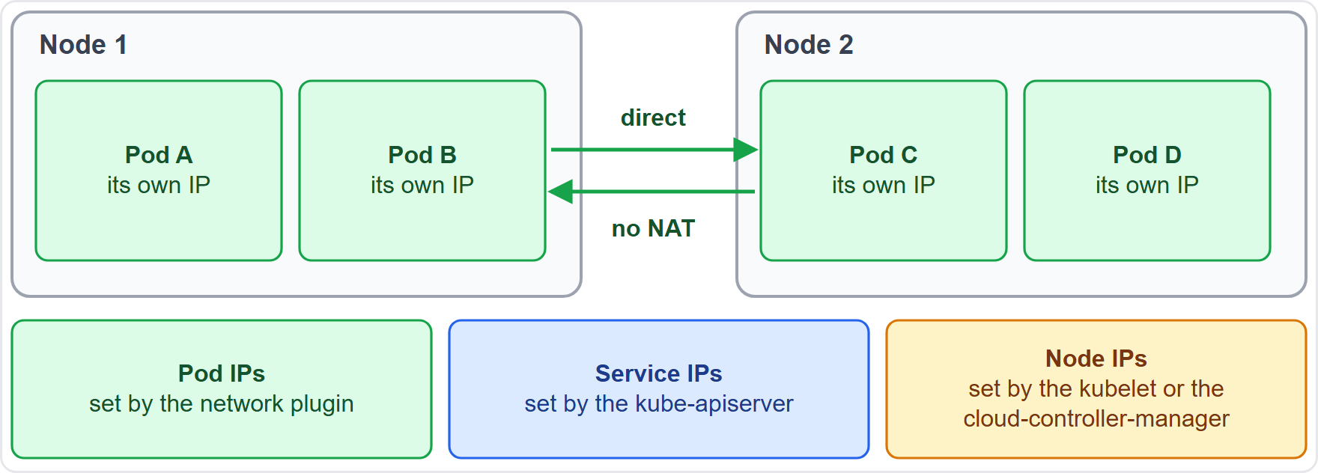
The Kubernetes Network Model
Part 1
Every Pod gets its own unique IP address, valid across the whole cluster
Containers in one Pod share a network namespace and reach each other on localhost
Any Pod can reach any other Pod directly, with no proxy and no NAT (network address translation)
Agents on a node, such as the kubelet, can reach all Pods on that node
EXAM TIP Pod IPs come from the network plugin, Service IPs from the API server.
KCNA Exam Prep Masterclass | Kubernetes and Cloud Native Associate
Module 6: Networking and Service Mesh
3 / 26
Notes:
The Kubernetes network model is simple. Every Pod gets its own unique I P address, valid across the whole cluster. Containers in one Pod share a network namespace, and reach each other on localhost. Any Pod can reach any other Pod directly, with no proxy and no N A T, network address translation, even on another node. And agents on a node, such as the kube let, can reach all Pods on that node. The diagram also shows who hands out addresses. The network plugin assigns Pod I Ps, the kube A P I server assigns Service I Ps, and the kube let or the cloud controller manager assigns Node I Ps. Exam tip: Pod I Ps come from the network plugin, and Service I Ps from the A P I server.

Slide 4
CNI and Network Plugins
BEYOND THE CURRICULUM
Part 1
Plugin | What it is known for
Cilium | an eBPF-based dataplane for networking, observability and security; enforces network policy up to the application layer
Calico | a CNI network plugin with Kubernetes network policy support
Flannel | a simple layer 3 network fabric; the flanneld agent gives each host a subnet
A CNI plugin (Container Network Interface) implements the network model: it gives Pods their addresses and connects them
A cluster needs a CNI plugin; the choice changes features such as NetworkPolicy support
EXAM TIP A CNI plugin builds the Pod network, and policy enforcement depends on the plugin.
KCNA Exam Prep Masterclass | Kubernetes and Cloud Native Associate
Module 6: Networking and Service Mesh
4 / 26
Notes:
This slide is tagged beyond the curriculum. A C N I plugin, for Container Network Interface, implements the network model. It gives Pods their addresses and connects them. A cluster needs a C N I plugin, and the choice changes features such as Network Policy support. Cilium has a dataplane based on e B P F, for networking, observability and security, and it enforces network policy up to the application layer. Calico is a C N I network plugin with network policy support. And Flannel is a simple layer three fabric, where the flanneld agent gives each host a subnet. Exam tip: a C N I plugin builds the Pod network, and policy enforcement depends on the plugin.

Slide 5
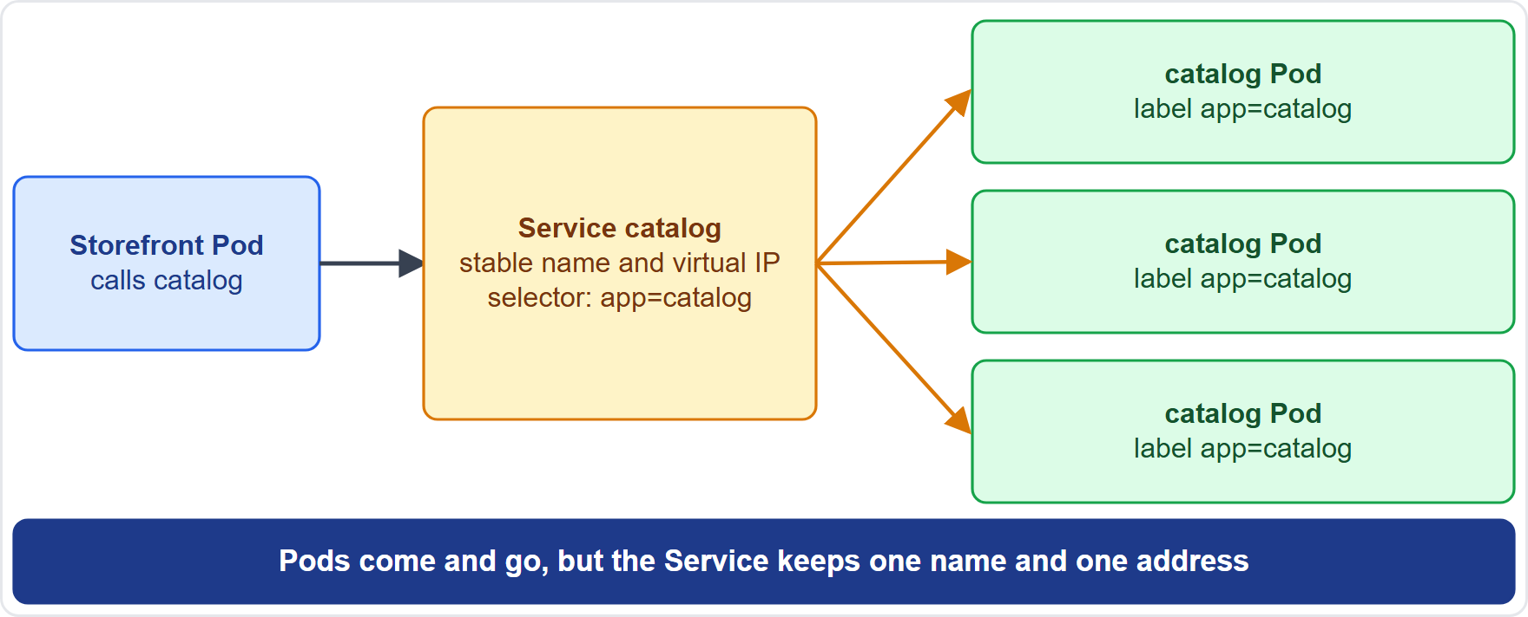
Services: A Stable Address for Pods
Part 1
Pods are replaced often, and each replacement has a new IP
A Service gives a set of Pods one stable name and virtual IP
A label selector chooses which Pods belong to the Service
Clients call the Service, and Kubernetes load balances the traffic over the matching Pods
EXAM TIP A Service finds its Pods by labels, not by names.
KCNA Exam Prep Masterclass | Kubernetes and Cloud Native Associate
Module 6: Networking and Service Mesh
5 / 26
Notes:
Pods are replaced often, and each replacement has a new I P. So other parts cannot rely on a Pod address. A Service gives a set of Pods one stable name and virtual I P. A label selector chooses which Pods belong to the Service. In the diagram, the storefront calls the catalog Service, and Kubernetes load balances the traffic over the three catalog Pods that match. When Pods come and go, the Service address stays. Exam tip: a Service finds its Pods by labels, not by names.

Slide 6
Service Types
Part 1
Type | What it does
ClusterIP (default) | a virtual IP inside the cluster, reachable only from within it
NodePort | opens the same port on every node, from 30000-32767 by default, on top of a ClusterIP
LoadBalancer | uses an external load balancer, which Kubernetes does not provide itself; a cloud provider usually does
ExternalName | answers with a CNAME (alias record) for an outside DNS name; no proxying
Headless | clusterIP: None: no virtual IP, and DNS returns the Pod IPs
EXAM TIP ClusterIP is the default; NodePort and LoadBalancer expose a Service outside.
KCNA Exam Prep Masterclass | Kubernetes and Cloud Native Associate
Module 6: Networking and Service Mesh
6 / 26
Notes:
There are five kinds to know. Cluster I P is the default. It is a virtual I P inside the cluster, reachable only from within it. Node Port opens the same port on every node, from a default range of thirty thousand to thirty-two thousand, seven hundred and sixty-seven, on top of a Cluster I P. Load Balancer uses an external load balancer, which Kubernetes does not provide itself. A cloud provider usually does. External Name answers with a C name, an alias record, for an outside D N S name, with no proxying. And a headless Service sets cluster I P to None. It has no virtual I P, and D N S returns the Pod I Ps. Exam tip: Cluster I P is the default, and Node Port and Load Balancer expose a Service outside.

Slide 7
A Service Manifest
Part 1
A Service picks its Pods with a selector on their labels
port is the port clients call; targetPort is the port in the container
If you leave out targetPort, it is the same as port
type defaults to ClusterIP
YAML
apiVersion: v1
kind: Service
metadata:
name: catalog
spec:
type: ClusterIP
selector:
app: catalog
ports:
- port: 80
targetPort: 8080
A Service for the catalog Pods
EXAM TIP port is what clients call; targetPort is where the container listens.
KCNA Exam Prep Masterclass | Kubernetes and Cloud Native Associate
Module 6: Networking and Service Mesh
7 / 26
Notes:
Here is a Service for the catalog Pods. The selector picks the Pods by their labels, here app equals catalog. Port is the port that clients call, and target port is the port in the container, here eighty and eighty-eighty. If you leave out target port, it is the same as port. And the type defaults to Cluster I P, which the snippet states for clarity. Exam tip: port is what clients call, and target port is where the container listens.

Slide 8
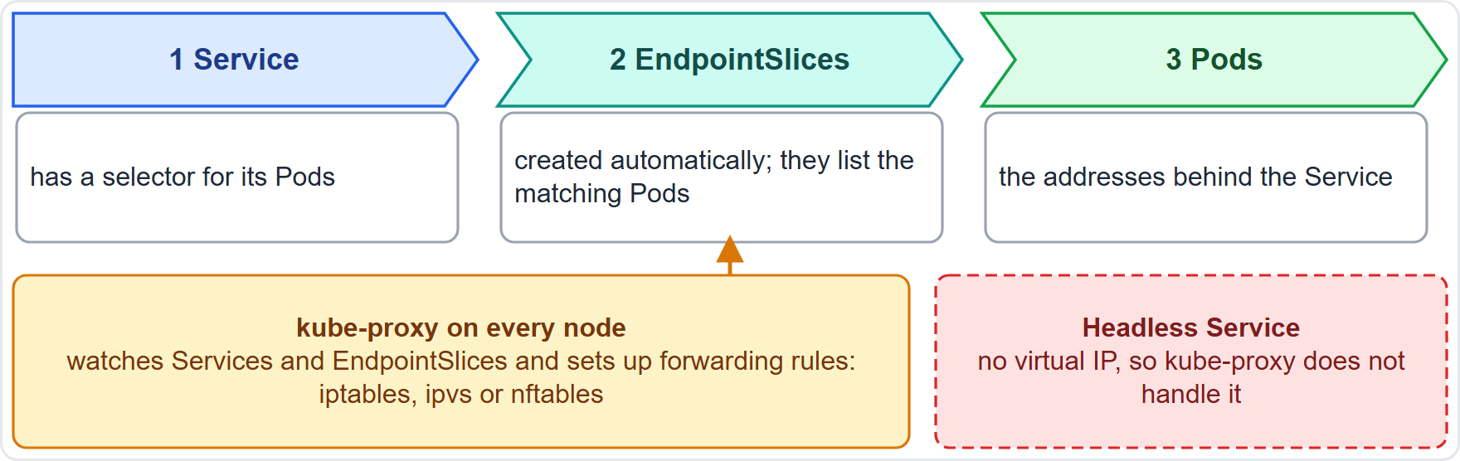
EndpointSlices and kube-proxy
Part 1
For a Service with a selector, Kubernetes creates EndpointSlices automatically; they list the matching Pods' addresses
A slice holds at most 100 endpoints by default, so a big Service has several slices
The older Endpoints API is deprecated
kube-proxy runs on each node and sets up the rules that send Service traffic to those addresses, in iptables, ipvs or nftables mode on Linux
EXAM TIP The Service is the name, the EndpointSlice is the list, kube-proxy is the plumbing.
KCNA Exam Prep Masterclass | Kubernetes and Cloud Native Associate
Module 6: Networking and Service Mesh
8 / 26
Notes:
How does a Service find its Pods? For a Service with a selector, Kubernetes creates Endpoint Slices automatically. They list the addresses of the matching Pods. A slice holds at most one hundred endpoints by default, so a big Service has several slices. The older Endpoints A P I is deprecated. Then kube proxy, which runs on each node, sets up the rules that send Service traffic to those addresses. On Linux it works in i p tables, i p v s or n f tables mode. A headless Service is not handled by kube proxy. Exam tip: the Service is the name, the Endpoint Slice is the list, and kube proxy is the plumbing.

Slide 9
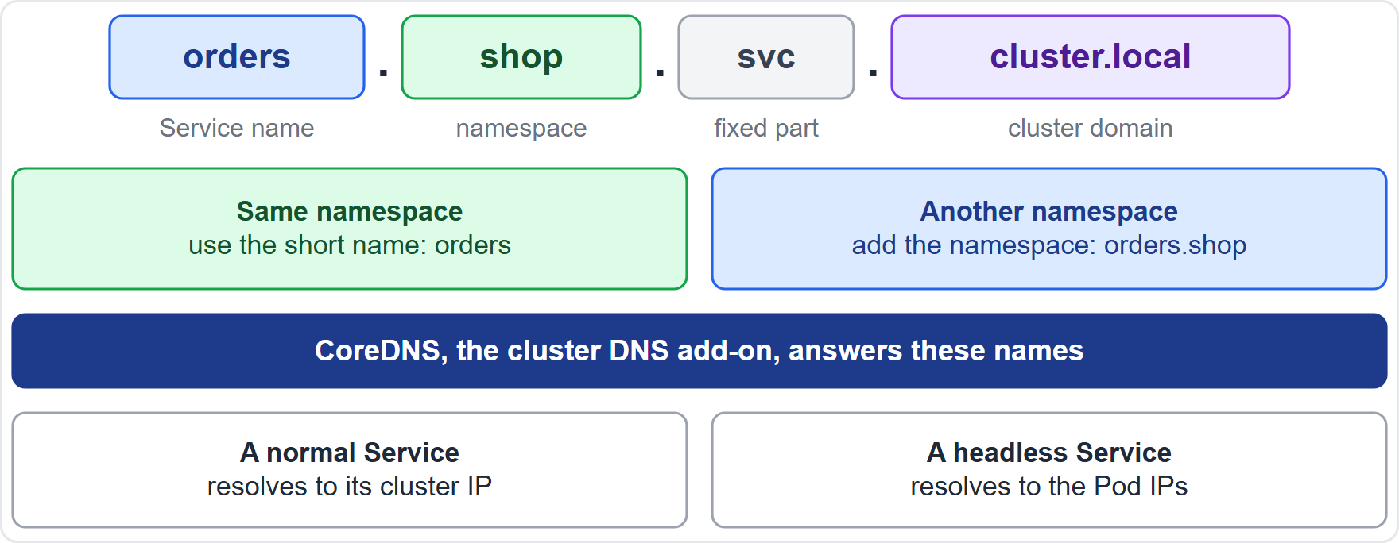
DNS, CoreDNS and Service Discovery
Part 1
Pods find a Service in two ways: DNS and environment variables
The kubelet adds {SVCNAME}_SERVICE_HOST and {SVCNAME}_SERVICE_PORT to new Pods, so the Service must exist before the Pod
DNS has no ordering problem; the full name joins the Service name, the namespace, svc and the cluster domain
CoreDNS, a CNCF graduated project, is the cluster DNS add-on
EXAM TIP Same namespace: short name. Other namespace: name.namespace.
KCNA Exam Prep Masterclass | Kubernetes and Cloud Native Associate
Module 6: Networking and Service Mesh
9 / 26
Notes:
Pods find a Service in two ways, D N S and environment variables. The kube let adds variables ending in service host and service port to new Pods, named after the Service. So the Service must exist before the Pod. D N S has no ordering problem. A Service named orders in the namespace shop is orders dot shop dot svc dot cluster dot local. A Pod can use the short name for a Service in its own namespace, and for another namespace it adds the namespace, as in orders dot shop. Core D N S, a C N C F graduated project, is the cluster D N S add-on, and it answers these names. Exam tip: same namespace, short name. Other namespace, name dot namespace.

Slide 10
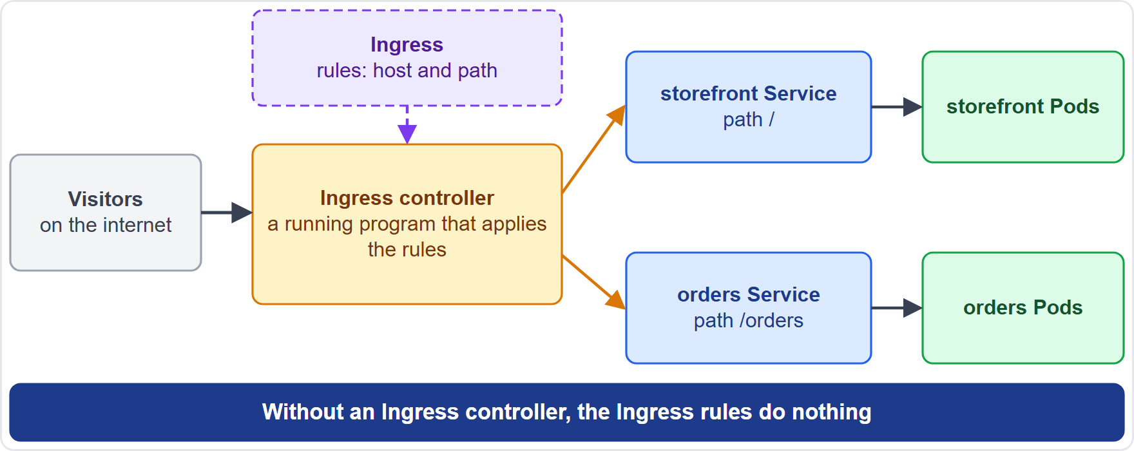
Ingress: HTTP Routes into the Cluster
Part 1
Ingress routes HTTP and HTTPS traffic from outside the cluster to Services, using rules on host and path
An Ingress is only rules: an Ingress controller must be running to act on them
ingressClassName says which controller handles an Ingress
The Ingress API is frozen: it stays and is stable, but gets no new features
EXAM TIP No Ingress controller, no routing.
KCNA Exam Prep Masterclass | Kubernetes and Cloud Native Associate
Module 6: Networking and Service Mesh
10 / 26
Notes:
An Ingress routes H T T P and H T T P S traffic from outside the cluster to Services, using rules on host and path. But an Ingress is only rules. An Ingress controller must be running to act on them. The ingress class name field says which controller handles an Ingress. In the diagram, visitors reach the controller, which sends the root path to the storefront Service and the orders path to the orders Service. The Ingress A P I is frozen. It stays and is stable, but it gets no new features. Exam tip: no Ingress controller, no routing.

Slide 11
Gateway API and the Ingress NGINX Retirement
MOVING
Part 1
Kind | Role
GatewayClass | a set of gateways with common configuration, run by one controller
Gateway | the entry point that actually takes in traffic, for example a cloud load balancer
HTTPRoute | HTTP rules that map traffic from a Gateway to backends, often Services
GRPCRoute | the same for gRPC traffic
Gateway API is the successor to Ingress: an add-on that is role-oriented, portable, expressive and extensible
As of 30 October 2026: the Ingress NGINX controller was retired in March 2026, with no more releases, bug fixes or security updates; existing installations keep working
The project advises moving to Gateway API or another Ingress controller
EXAM TIP Gateway API replaces Ingress for new designs; a retired controller still runs but gets no fixes.
KCNA Exam Prep Masterclass | Kubernetes and Cloud Native Associate
Module 6: Networking and Service Mesh
11 / 26
Notes:
This slide is tagged moving. Gateway A P I is the successor to Ingress. It is an add-on that is role-oriented, portable, expressive and extensible. Its stable kinds include Gateway Class, a set of gateways with common configuration. Gateway, the entry point that actually takes in traffic, for example a cloud load balancer. H T T P Route, which maps H T T P traffic from a Gateway to backends, often Services. And G R P C Route, the same for g R P C traffic. As of the thirtieth of October, twenty twenty-six, the Ingress Nginx controller was retired in March, twenty twenty-six. There are no more releases, bug fixes or security updates, but existing installations keep working. The advice is to move to Gateway A P I or another Ingress controller. Exam tip: Gateway A P I replaces Ingress for new designs.

Slide 12
LoadBalancer Without a Cloud: MetalLB
BEYOND THE CURRICULUM
Part 1
Where the cluster runs | Who creates the load balancer
A cloud provider | the provider's load balancer integration
Your own hardware (bare metal) | an add-on such as MetalLB
A Service of type LoadBalancer needs an external load balancer, and Kubernetes does not provide one itself
MetalLB fills that gap for bare-metal clusters, with an implementation built on standard routing protocols
EXAM TIP LoadBalancer needs something to make the load balancer: a cloud, or MetalLB on bare metal.
KCNA Exam Prep Masterclass | Kubernetes and Cloud Native Associate
Module 6: Networking and Service Mesh
12 / 26
Notes:
This slide is tagged beyond the curriculum. A Service of type Load Balancer needs an external load balancer, and Kubernetes does not provide one itself. On a cloud provider, the provider's integration creates it. On your own hardware, which is called bare metal, an add-on does the job. Metal L B fills that gap for bare-metal clusters, with an implementation built on standard routing protocols. Exam tip: Load Balancer needs something to make the load balancer, a cloud, or Metal L B on bare metal.

Slide 13
NetworkPolicy: Rules for Pod Traffic
Part 2
By default Pods are non-isolated: all inbound and outbound traffic is allowed
A policy that selects a Pod makes it isolated for that direction; only allowed traffic gets through
Policies are additive: they never conflict, and the allowed traffic is the union of their rules
Rules select peers with podSelector, namespaceSelector or ipBlock
The network plugin enforces policies; without support a policy has no effect
YAML
apiVersion: networking.k8s.io/v1
kind: NetworkPolicy
metadata:
name: postgres-from-orders
spec:
podSelector:
matchLabels: {app: postgres}
policyTypes: [Ingress]
ingress:
- from:
- podSelector:
matchLabels: {app: orders}
Only orders Pods may reach postgres
EXAM TIP Open by default; once a policy selects a Pod, only what policies allow gets in.
KCNA Exam Prep Masterclass | Kubernetes and Cloud Native Associate
Module 6: Networking and Service Mesh
13 / 26
Notes:
By default, Pods are non-isolated, and all inbound and outbound traffic is allowed. A Network Policy that selects a Pod makes it isolated for that direction, and then only allowed traffic gets through. Policies are additive. They never conflict, and the allowed traffic is the union of their rules. Rules select peers with pod Selector, namespace Selector or I P Block. The network plugin enforces policies, and without support a policy has no effect. The snippet lets only orders Pods reach postgres. Exam tip: open by default, and once a policy selects a Pod, only what policies allow gets in.

Slide 14
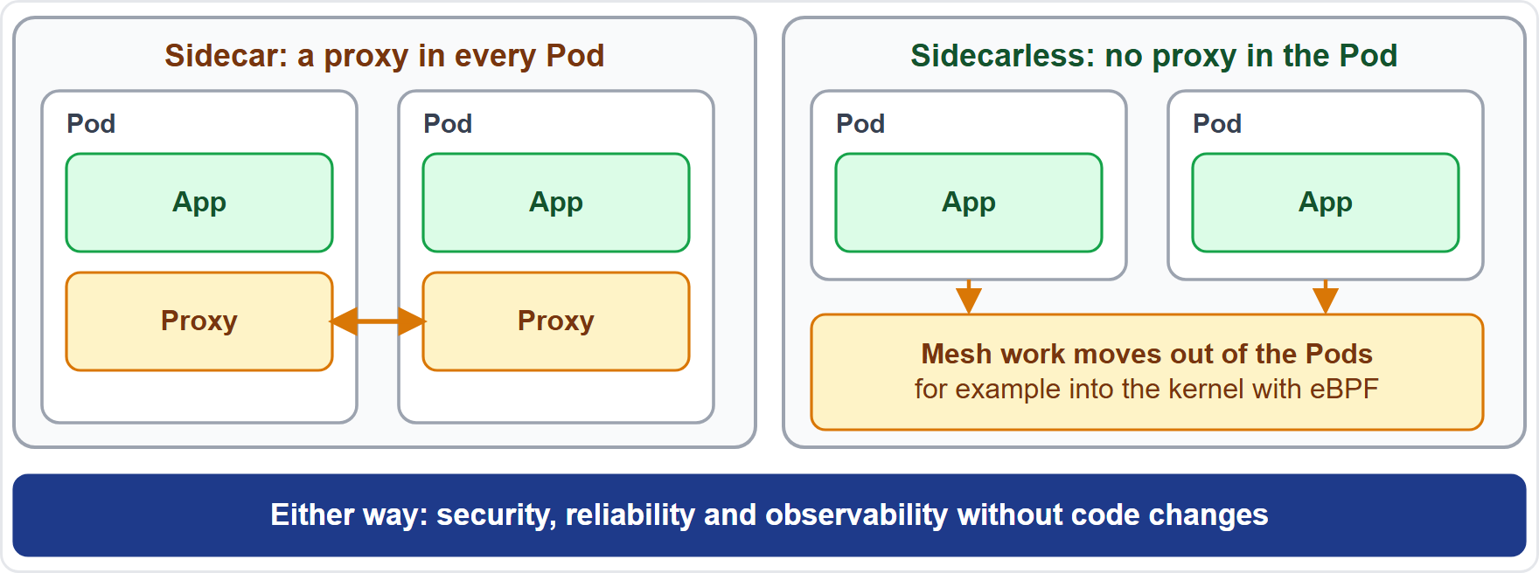
Service Mesh: Sidecar and Sidecarless
ARCHIVED TOPIC
Part 2
A service mesh manages traffic between services and adds reliability, observability and security the same way for all of them, without code changes
Sidecar design: a proxy beside each app intercepts its traffic and enforces policy, at the cost of more resources
Sidecarless design: the work moves out of the Pods, for example into the kernel with eBPF
Examples: Istio (Envoy sidecars, plus an ambient mode) and Linkerd; a common feature is mutual TLS (mTLS)
EXAM TIP A mesh handles traffic between services; Ingress and Gateway API handle traffic coming in.
KCNA Exam Prep Masterclass | Kubernetes and Cloud Native Associate
Module 6: Networking and Service Mesh
14 / 26
Notes:
This slide is tagged archived topic. A service mesh manages traffic between services, and adds reliability, observability and security the same way for all of them, without code changes. In the sidecar design, a proxy beside each app container intercepts its traffic and enforces policy, at the cost of more resources. In the sidecarless design, the work moves out of the Pods, for example into the kernel with e B P F. Examples are Istio, with Envoy sidecars and an ambient mode without them, and Linkerd. A common feature is mutual T L S. Exam tip: a mesh handles traffic between services, and Ingress and Gateway A P I handle traffic coming in.

Slide 15
What the Exam Asks: Networking
Part 2
Pod IP or Service IP
ClusterIP, NodePort or LoadBalancer
Service or Ingress
a Pod has its own IP from the network plugin; a Service gives a stable virtual IP
a Service exposes Pods; an Ingress routes HTTP by host and path to Services
inside only, a port on every node, or an external load balancer
Ingress or Gateway API
kube-proxy or CoreDNS
NetworkPolicy
kube-proxy sets up forwarding rules; CoreDNS answers names
open by default, additive, and needs a plugin that enforces it
Gateway API is the successor; both need a controller or implementation
EXAM TIP For a networking question, name the layer first: address, name, route or rule.
KCNA Exam Prep Masterclass | Kubernetes and Cloud Native Associate
Module 6: Networking and Service Mesh
15 / 26
Notes:
Six pairs to keep apart. Pod I P or Service I P: a Pod has its own I P from the network plugin, and a Service gives a stable virtual I P. Cluster I P, Node Port or Load Balancer: inside only, a port on every node, or an external load balancer. Service or Ingress: a Service exposes Pods, and an Ingress routes H T T P by host and path to Services. Ingress or Gateway A P I: Gateway A P I is the successor, and both need a controller or implementation. Kube proxy or Core D N S: kube proxy sets up forwarding rules, and Core D N S answers names. And Network Policy: open by default, additive, and it needs a plugin that enforces it. Exam tip: name the layer first.

Slide 16
Module Recap
Part 2
1
Network model
2
Services
3
Behind a Service
one IP per Pod, direct Pod-to-Pod traffic with no NAT; a CNI plugin builds it
a stable name and virtual IP over a label-selected set of Pods; ClusterIP, NodePort, LoadBalancer, ExternalName, headless
EndpointSlices list the Pods, kube-proxy programs the rules, CoreDNS answers the names
4
From outside
5
NetworkPolicy
6
Service mesh
Ingress needs a controller; Gateway API is the successor; MetalLB serves bare metal
open by default, additive, enforced by the plugin
sidecar or sidecarless proxies add security, reliability and observability
KCNA Exam Prep Masterclass | Kubernetes and Cloud Native Associate
Module 6: Networking and Service Mesh
16 / 26
Notes:
To recap. The network model gives one I P to every Pod, with direct traffic and no N A T, and a C N I plugin builds it. A Service is a stable name and virtual I P over a label-selected set of Pods, in the types Cluster I P, Node Port, Load Balancer, External Name and headless. Behind a Service, Endpoint Slices list the Pods, kube proxy programs the rules, and Core D N S answers the names. From outside, Ingress needs a controller, Gateway A P I is the successor, and Metal L B serves bare metal. A Network Policy is open by default, additive, and enforced by the plugin. And a service mesh adds security, reliability and observability. Now nine practice questions.

Slide 17
Practice Question 1
Part 2
Q1
Which statement describes the Kubernetes network model?
A
Pods on different nodes can reach one another through a NodePort Service
B
Each node hands its Pods private addresses, and traffic between nodes is translated by NAT
C
Each Pod has its own cluster-wide IP, and Pods talk to each other directly without NAT
D
The containers in the cluster share one network namespace and a single IP address
KCNA Exam Prep Masterclass | Kubernetes and Cloud Native Associate
Module 6: Networking and Service Mesh
17 / 26
Notes:
Question one. Which statement describes the Kubernetes network model? The four options are on the screen.
[PAUSE 12]
The answer is C. Every Pod gets its own unique I P, valid across the cluster, and Pods communicate directly without proxies or N A T. Only the containers of one Pod share a network namespace.

Slide 18
Practice Question 2
Part 2
Q2
The Harbor Books storefront must call the catalog Pods, which are replaced often and get new IPs each time. What gives the storefront a stable address to call?
A
A Service whose selector matches the labels of the catalog Pods
B
A ConfigMap that holds the current IP addresses of the catalog Pods, updated by hand
C
A NodePort opened on the node where the first catalog Pod happens to be running
D
A DaemonSet that restarts the storefront Pods every time a catalog Pod changes
KCNA Exam Prep Masterclass | Kubernetes and Cloud Native Associate
Module 6: Networking and Service Mesh
18 / 26
Notes:
Question two. The Harbor Books storefront must call the catalog Pods, which are replaced often and get new I Ps each time. What gives the storefront a stable address to call? The four options are on the screen.
[PAUSE 12]
The answer is A. A Service gives the Pods that match its selector one stable name and virtual I P, however often individual Pods change. A Config Map would need manual updates, a Node Port points at one node, and restarting the storefront does not give it an address.

Slide 19
Practice Question 3
Part 2
Q3
Which Service type uses an external load balancer, for example one from a cloud provider?
A
ClusterIP, which exposes the Service on a virtual IP that is reachable from inside the cluster
B
ExternalName, which answers with a CNAME record for a DNS name outside the cluster
C
Headless, which has no virtual IP and returns the addresses of the Pods from DNS
D
LoadBalancer, which uses an external load balancer for access from outside
KCNA Exam Prep Masterclass | Kubernetes and Cloud Native Associate
Module 6: Networking and Service Mesh
19 / 26
Notes:
Question three. Which Service type uses an external load balancer, for example one from a cloud provider? The four options are on the screen.
[PAUSE 12]
The answer is D. The Load Balancer type exposes a Service through an external load balancer, which Kubernetes does not provide itself. A cloud provider usually does. Cluster I P stays inside the cluster, External Name only maps a name, and a headless Service has no virtual I P.

Slide 20
Practice Question 4
Part 2
Q4
A storefront Pod in the namespace shop must call the Service orders in the namespace backend. Which name does it use?
A
orders, because a short name resolves in the other namespaces of the cluster
B
orders.backend, because the namespace follows the Service name
C
backend.orders, because the namespace comes before the Service name
D
orders.shop, because a Pod searches its own namespace first for each name
KCNA Exam Prep Masterclass | Kubernetes and Cloud Native Associate
Module 6: Networking and Service Mesh
20 / 26
Notes:
Question four. A storefront Pod in the namespace shop must call the Service orders in the namespace backend. Which name does it use? The four options are on the screen.
[PAUSE 12]
The answer is B. The short name only works for a Service in the Pod's own namespace. For another namespace the name is the Service name followed by the namespace, here orders dot backend, or the full form orders dot backend dot svc dot cluster dot local.

Slide 21
Practice Question 5
Part 2
Q5
Harbor Books created an Ingress with host and path rules for the storefront, but no traffic reaches the Pods. What is a likely cause?
A
The Ingress must be created in the kube-system namespace to have any effect on traffic
B
No Ingress controller is running, and an Ingress resource alone has no effect
C
The Ingress API was removed from Kubernetes, so the resource is simply ignored
D
Ingress rules can match the host of a request, but never the path of a request
KCNA Exam Prep Masterclass | Kubernetes and Cloud Native Associate
Module 6: Networking and Service Mesh
21 / 26
Notes:
Question five. Harbor Books created an Ingress with host and path rules for the storefront, but no traffic reaches the Pods. What is a likely cause? The four options are on the screen.
[PAUSE 12]
The answer is B. An Ingress is only a set of rules, and an Ingress controller must be running to act on them. The Ingress A P I is frozen but not removed, it can be created in any namespace, and rules can match both host and path.

Slide 22
Practice Question 6
Part 2
Q6
Which statement about Gateway API and Ingress is correct?
A
Gateway API replaces Services, so a cluster that uses it does not need Service objects
B
Ingress was removed from Kubernetes, so Gateway API is the way to route HTTP traffic
C
The two are the same API, and the names of their kinds differ between them
D
Gateway API is the successor to Ingress, with kinds such as GatewayClass, Gateway and HTTPRoute
KCNA Exam Prep Masterclass | Kubernetes and Cloud Native Associate
Module 6: Networking and Service Mesh
22 / 26
Notes:
Question six. Which statement about Gateway A P I and Ingress is correct? The four options are on the screen.
[PAUSE 12]
The answer is D. Gateway A P I is the successor to Ingress and is role-oriented, with kinds such as Gateway Class, Gateway and H T T P Route. Routes usually point at Services, and the Ingress A P I is frozen but still available.

Slide 23
Practice Question 7
Part 2
Q7
A namespace has no NetworkPolicy. Which traffic is allowed to and from its Pods?
A
All ingress and egress traffic, because Pods are non-isolated by default
B
No traffic at all, until the first policy is created to allow some of it
C
Only the traffic that stays inside the namespace, because policies are scoped to it
D
Only egress traffic, because ingress stays blocked until a rule opens it
KCNA Exam Prep Masterclass | Kubernetes and Cloud Native Associate
Module 6: Networking and Service Mesh
23 / 26
Notes:
Question seven. A namespace has no Network Policy. Which traffic is allowed to and from its Pods? The four options are on the screen.
[PAUSE 12]
The answer is A. Pods are non-isolated by default, so with no policy all inbound and outbound traffic is allowed. A Pod becomes isolated for a direction only when a policy selects it.

Slide 24
Practice Question 8
Part 2
Q8
Harbor Books applies a NetworkPolicy that lets only the orders Pods reach postgres, yet other Pods still connect. Which cause is most likely?
A
NetworkPolicy objects apply to Pods that belong to a StatefulSet
B
The same policy also needs to be created for the orders Pods before it takes effect
C
The network plugin of the cluster does not enforce NetworkPolicy
D
A second policy in the namespace overrides the first one and reopens the traffic
KCNA Exam Prep Masterclass | Kubernetes and Cloud Native Associate
Module 6: Networking and Service Mesh
24 / 26
Notes:
Question eight. Harbor Books applies a Network Policy that lets only the orders Pods reach postgres, yet other Pods still connect. Which cause is most likely? The four options are on the screen.
[PAUSE 12]
The answer is C. The network plugin does the enforcing, and a policy without a plugin that supports it has no effect. Policies apply to any selected Pods, need no matching policy on the callers, and are additive rather than overriding.

Slide 25
Practice Question 9
Part 2
Q9
What does a service mesh provide for the services of a cluster?
A
Reliability, observability and security features, applied the same way to all services without code changes
B
Persistent storage that several Pods on different nodes can share at the same time
C
A place to build container images and push them to a registry from inside the cluster
D
The scheduling of Pods onto nodes according to the requests of their containers
KCNA Exam Prep Masterclass | Kubernetes and Cloud Native Associate
Module 6: Networking and Service Mesh
25 / 26
Notes:
Question nine. What does a service mesh provide for the services of a cluster? The four options are on the screen.
[PAUSE 12]
The answer is A. A service mesh manages the traffic between services and adds reliability, observability and security uniformly, usually with proxies, without changes to application code. Storage, image builds and scheduling belong to other parts of the platform.

Slide 26
Answers at a Glance
Part 2
Question | Answer | Why
Q1 | C | One IP per Pod, direct traffic with no NAT
Q2 | A | A Service with a selector gives a stable address
Q3 | D | LoadBalancer uses an external load balancer
Q4 | B | A Service in another namespace: name.namespace
Q5 | B | An Ingress needs a running controller
Q6 | D | Gateway API is the successor to Ingress
Q7 | A | Pods are non-isolated by default
Q8 | C | The plugin must enforce NetworkPolicy
Q9 | A | A mesh adds security, reliability and observability
KCNA Exam Prep Masterclass | Kubernetes and Cloud Native Associate
Module 6: Networking and Service Mesh
26 / 26
Notes:
Here are the answers at a glance. Question one, C: one I P per Pod, and direct traffic with no N A T. Question two, A: a Service with a selector gives a stable address. Question three, D: Load Balancer uses an external load balancer. Question four, B: for a Service in another namespace, use name dot namespace. Question five, B: an Ingress needs a running controller. Question six, D: Gateway A P I is the successor to Ingress. Question seven, A: Pods are non-isolated by default. Question eight, C: the plugin must enforce Network Policy. Question nine, A: a mesh adds security, reliability and observability.

