Slide 1
Module 7: Storage
How Pods keep their data across restarts and moves
Container Orchestration · Storage
YOU WILL BE ABLE TO
Compare ephemeral and persistent storage and the common volume types
Explain PersistentVolumes, claims and binding
Use StorageClasses, access modes and reclaim policies in a scenario
Describe CSI, expansion, snapshots and StatefulSet storage
KCNA Exam Prep Masterclass
Module 7
Notes:
Welcome to Module 7: Storage. This module is in the Container Orchestration domain, and it covers the topic called Storage. By the end you will be able to do four things. Compare ephemeral and persistent storage, and the common volume types. Explain Persistent Volumes, claims and binding. Use Storage Classes, access modes and reclaim policies in a scenario. And describe C S I, expansion, snapshots and Stateful Set storage.

Slide 2
Case Check-In: Harbor Books Keeps Its Data
Module 7
CASE CHECK-IN · Harbor Books
The postgres database holds every order, so its data must survive when its Pod is replaced or moves to another node
The cache only needs scratch space that can disappear with its Pod
The platform team wants storage to be created on demand, not by hand for each request
In this module you give each part the right kind of storage
KCNA Exam Prep Masterclass | Kubernetes and Cloud Native Associate
Module 7: Storage
2 / 18
Notes:
At Harbor Books, the postgres database holds every order, so its data must survive when its Pod is replaced or moves to another node. The cache only needs scratch space that can disappear with its Pod. And the platform team wants storage to be created on demand, not by hand for each request. In this module you give each part the right kind of storage.

Slide 3
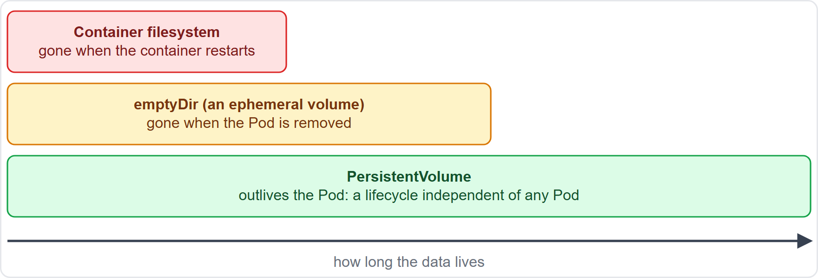
Volumes: Ephemeral and Persistent
Module 7
A container's own filesystem is ephemeral: after a crash the container comes back with a clean state
A volume is a directory that the containers of a Pod can use and share
Ephemeral volumes are created and deleted with the Pod
Persistent volumes have a lifecycle independent of any Pod, so the data stays when the Pod moves
EXAM TIP Ask how long the data must live: the container, the Pod, or longer.
KCNA Exam Prep Masterclass | Kubernetes and Cloud Native Associate
Module 7: Storage
3 / 18
Notes:
Start with how long data must live. A container's own filesystem is ephemeral. After a crash, the kube let restarts the container with a clean state. A volume is a directory that the containers of a Pod can use and share. Ephemeral volumes are created and deleted with the Pod. Persistent volumes have a lifecycle independent of any Pod, so the data stays when the Pod moves. The diagram shows three bars of growing length: the container filesystem, an empty Dir, and a Persistent Volume. Exam tip: ask how long the data must live. The container, the Pod, or longer.

Slide 4
Common Volume Types
Module 7
Volume | What it gives the Pod
emptyDir | scratch space that starts empty once the Pod has a node; shared by its containers; deleted with the Pod, but safe across container crashes
hostPath | a file or directory from the node's filesystem; many security risks, so avoid it
local | a disk, partition or directory on a node, used as a static PersistentVolume
configMap, secret | files filled from a ConfigMap or a Secret
projected | several sources mapped into one directory, all from the Pod's namespace
persistentVolumeClaim | the way a Pod uses a PersistentVolume
EXAM TIP An emptyDir lives and dies with its Pod; avoid hostPath.
KCNA Exam Prep Masterclass | Kubernetes and Cloud Native Associate
Module 7: Storage
4 / 18
Notes:
Six volume types to know. An empty Dir starts empty once the Pod has been given a node. Its containers share it. It is deleted with the Pod, but it is safe across container crashes. A host Path mounts a file or directory from the node's filesystem. It has many security risks, so avoid it. A local volume is a disk, partition or directory on a node, used as a static Persistent Volume. Config Map and secret volumes fill files from a Config Map or a Secret. A projected volume maps several sources into one directory, all from the Pod's namespace. And a persistent Volume Claim is the way a Pod uses a Persistent Volume. Exam tip: an empty Dir lives and dies with its Pod. Avoid host Path.

Slide 5
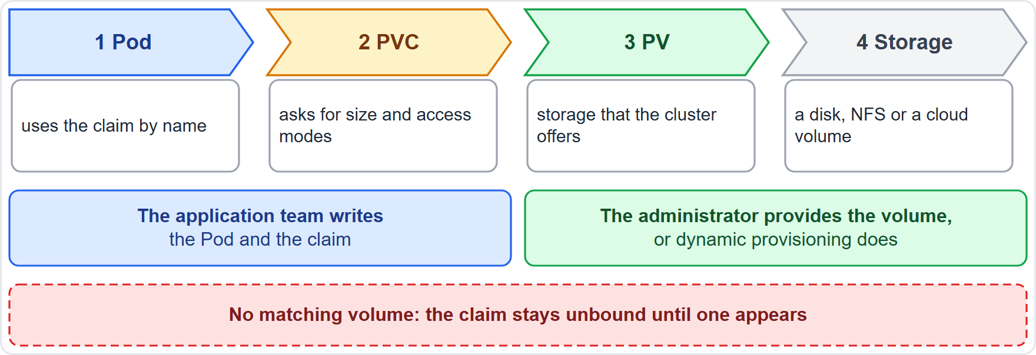
PersistentVolume and PersistentVolumeClaim
Module 7
A PersistentVolume (PV) is storage that the cluster offers, with a lifecycle independent of any Pod
A PersistentVolumeClaim (PVC) is a user's request for storage: a size and access modes
A control loop binds each claim to a matching PV, one to one
With no matching PV, the claim stays unbound until one appears
EXAM TIP Pods use claims; claims bind volumes.
KCNA Exam Prep Masterclass | Kubernetes and Cloud Native Associate
Module 7: Storage
5 / 18
Notes:
A Persistent Volume, or P V, is storage that the cluster offers, with a lifecycle independent of any Pod. A Persistent Volume Claim, or P V C, is a user's request for storage, with a size and access modes. A control loop binds each claim to a matching P V, one to one. And if no P V matches, the claim stays unbound until one appears. In the diagram, the Pod uses the claim by name. The claim is bound to a volume. And the volume is backed by real storage, such as a disk, N F S or a cloud volume. The application team writes the Pod and the claim. Exam tip: Pods use claims, and claims bind volumes.

Slide 6
Using a Claim
Module 7
The claim asks for a size, access modes and, optionally, a StorageClass
A Pod uses it with persistentVolumeClaim and a claimName in its volumes
The claim and the Pod must share a namespace
A claim that a Pod is using is protected from immediate removal
YAML
apiVersion: v1
kind: PersistentVolumeClaim
metadata:
name: postgres-data
spec:
accessModes: [ReadWriteOnce]
storageClassName: standard
resources:
requests:
storage: 5Gi
A claim for the postgres data
EXAM TIP The Pod names the claim, in its own namespace.
KCNA Exam Prep Masterclass | Kubernetes and Cloud Native Associate
Module 7: Storage
6 / 18
Notes:
Here is a claim for the postgres data. It asks for a size, here five gibibytes, access modes, here Read Write Once, and optionally a Storage Class. A Pod uses the claim with persistent Volume Claim and a claim name in its volumes. The claim and the Pod must share a namespace. And a claim that a Pod is using is protected from immediate removal. Exam tip: the Pod names the claim, in its own namespace.

Slide 7
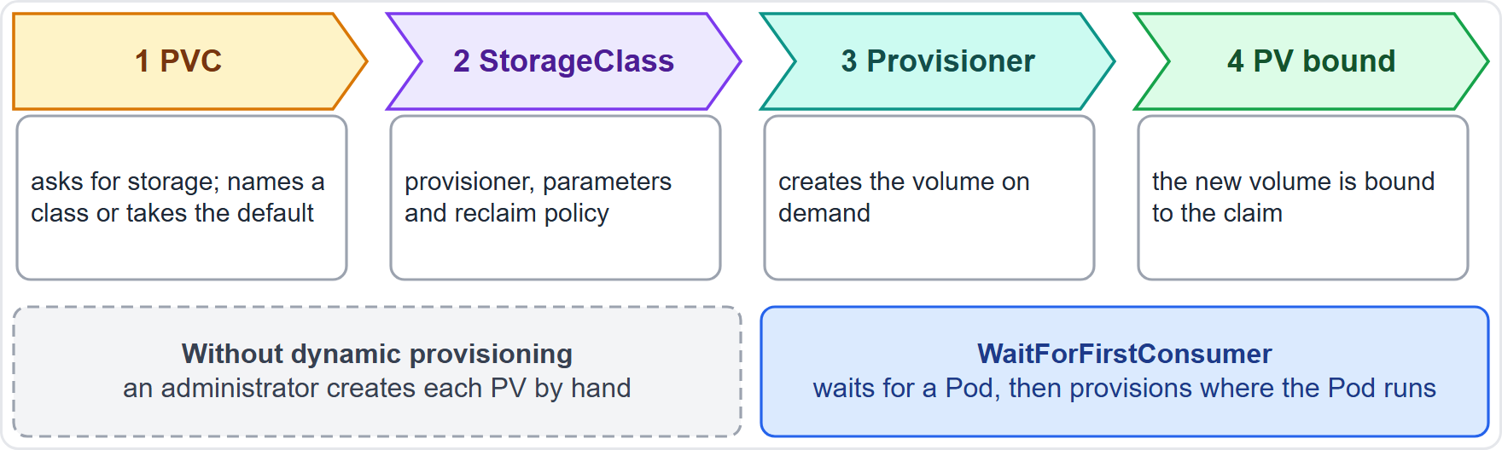
StorageClass and Dynamic Provisioning
Module 7
A StorageClass describes a class of storage: a provisioner, parameters and a reclaimPolicy
Dynamic provisioning creates a volume on demand when a claim asks for it, so nobody pre-creates PVs
A claim with no storageClassName gets the default StorageClass
WaitForFirstConsumer waits until a Pod uses the claim; the default mode is Immediate
EXAM TIP Claim in, StorageClass decides, PV out.
KCNA Exam Prep Masterclass | Kubernetes and Cloud Native Associate
Module 7: Storage
7 / 18
Notes:
A Storage Class describes a class of storage, with a provisioner, parameters and a reclaim policy. Dynamic provisioning creates a volume on demand when a claim asks for it, so nobody pre-creates Persistent Volumes by hand. A claim with no storage Class name gets the default Storage Class. In the diagram, the claim names a class, the provisioner creates the volume, and the new P V is bound to the claim. The binding mode matters too. Wait For First Consumer waits until a Pod uses the claim, so the volume matches where the Pod runs. The default mode is Immediate. Exam tip: claim in, Storage Class decides, P V out.

Slide 8
Access Modes and Reclaim Policy
Module 7
Access mode | Short | What it allows
ReadWriteOnce | RWO | read-write by a single node
ReadOnlyMany | ROX | read-only by many nodes
ReadWriteMany | RWX | read-write by many nodes
ReadWriteOncePod | RWOP | read-write by a single Pod in the whole cluster
Retain: when the claim is deleted, the PV is Released and keeps its data until an administrator reclaims it
Delete: the volume is deleted with the claim; a dynamically provisioned volume follows its StorageClass, which defaults to Delete
Recycle is deprecated
EXAM TIP RWO is per node, RWOP is per Pod; Retain keeps data, Delete removes it.
KCNA Exam Prep Masterclass | Kubernetes and Cloud Native Associate
Module 7: Storage
8 / 18
Notes:
There are four access modes. Read Write Once, R W O, is read-write by a single node. Read Only Many, R O X, is read-only by many nodes. Read Write Many, R W X, is read-write by many nodes. And Read Write Once Pod, R W O P, is read-write by a single Pod in the whole cluster. Then the reclaim policy. With Retain, when the claim is deleted, the P V is Released and keeps its data until an administrator reclaims it. With Delete, the volume is deleted with the claim, and a dynamically provisioned volume follows its Storage Class, which defaults to Delete. Recycle is deprecated. Exam tip: R W O is per node, R W O P is per Pod, Retain keeps data, and Delete removes it.

Slide 9
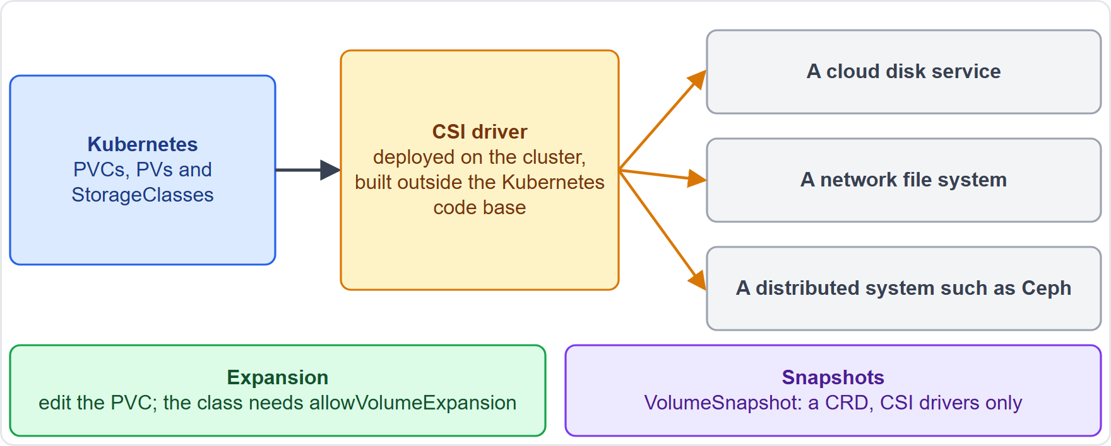
CSI, Expansion and Snapshots
Module 7
CSI (Container Storage Interface) is a standard interface for exposing storage systems to containers
A vendor ships a driver that is built outside the Kubernetes code base, unlike the older in-tree plugins
Expansion: edit the PVC to ask for more storage, if its StorageClass sets allowVolumeExpansion
Snapshots: a VolumeSnapshot requests a snapshot of a volume; it is a CRD and needs a CSI driver
EXAM TIP CSI is the standard plug-in interface for storage drivers.
KCNA Exam Prep Masterclass | Kubernetes and Cloud Native Associate
Module 7: Storage
9 / 18
Notes:
C S I, the Container Storage Interface, is a standard interface for exposing storage systems to containers. A vendor ships a driver that is built outside the Kubernetes code base, unlike the older in-tree plugins. In the diagram, Kubernetes talks to the C S I driver, and the driver talks to the storage system. Expansion works by editing the P V C to ask for more storage, if its Storage Class sets allow Volume Expansion. And snapshots work through a Volume Snapshot, which requests a snapshot of a volume. It is a C R D, and it needs a C S I driver. Exam tip: C S I is the standard plug-in interface for storage drivers.

Slide 10
StatefulSet Storage and Storage Types
BEYOND THE CURRICULUM
Module 7
Storage type | In Kubernetes
File | a filesystem mounted into a directory: the default Filesystem volume mode
Block | a raw device with no filesystem (volumeMode: Block); the application must handle it
A StatefulSet uses volumeClaimTemplates to give each replica its own claim
Those claims stay when the Pods or the StatefulSet go away: remove them by hand, unless a retention policy says otherwise
Rook, a CNCF graduated project, orchestrates Ceph, which offers file, block and object storage
EXAM TIP A StatefulSet's claims outlive its Pods.
KCNA Exam Prep Masterclass | Kubernetes and Cloud Native Associate
Module 7: Storage
10 / 18
Notes:
This slide is tagged beyond the curriculum. A Stateful Set uses volume Claim Templates to give each replica its own claim. Those claims stay when the Pods or the Stateful Set go away. You remove them by hand, unless a retention policy says otherwise. For storage types, file storage is a filesystem mounted into a directory, which is the default volume mode. Block storage is a raw device with no filesystem, and the application must handle it. Rook, a C N C F graduated project, orchestrates Ceph, which offers file, block and object storage. Exam tip: a Stateful Set's claims outlive its Pods.

Slide 11
Module Recap
Module 7
1
Lifetimes
2
Claims
3
StorageClass
container filesystem, emptyDir with the Pod, PersistentVolume beyond the Pod
a PVC requests storage, a control loop binds it to one PV, and the Pod names the claim in its own namespace
provisioner, parameters and reclaim policy; dynamic provisioning creates volumes on demand; the default class fills in for a claim with no class
4
Modes and reclaim
5
CSI
6
StatefulSet
RWO per node, RWOP per Pod; Retain keeps the data, Delete removes it
the standard driver interface, with expansion and snapshots
one claim per replica, kept when Pods go
KCNA Exam Prep Masterclass | Kubernetes and Cloud Native Associate
Module 7: Storage
11 / 18
Notes:
To recap. Data lives in the container filesystem, in an empty Dir as long as the Pod, or in a Persistent Volume beyond the Pod. A P V C requests storage, a control loop binds it to one P V, and the Pod names the claim in its own namespace. A Storage Class has a provisioner, parameters and a reclaim policy, dynamic provisioning creates volumes on demand, and the default class fills in for a claim with no class. R W O is per node and R W O P is per Pod, and Retain keeps data while Delete removes it. C S I is the standard driver interface, with expansion and snapshots. And a Stateful Set has one claim per replica, kept when Pods go. Now six practice questions.

Slide 12
Practice Question 1
Module 7
Q1
A container in a Pod with an emptyDir volume crashes and is restarted. Later the Pod is removed from its node. What happens to the files in the emptyDir?
A
They are lost at the crash, because an emptyDir belongs to the container and not to the Pod
B
They survive the crash, and they are deleted permanently when the Pod is removed from the node
C
They survive both the crash and the removal, because an emptyDir is a persistent kind of storage
D
They are copied to a PersistentVolume when the Pod is removed, so that the Pod can resume later
KCNA Exam Prep Masterclass | Kubernetes and Cloud Native Associate
Module 7: Storage
12 / 18
Notes:
Question one. A container in a Pod with an empty Dir volume crashes and is restarted. Later the Pod is removed from its node. What happens to the files in the empty Dir? The four options are on the screen.
[PAUSE 12]
The answer is B. An empty Dir is created once the Pod has a node. A crashing container does not remove the Pod, so the data survives the restart, but it is deleted permanently when the Pod is removed from the node.

Slide 13
Practice Question 2
Module 7
Q2
The Harbor Books postgres Pod must keep its data when it is replaced and started on another node. Which object does the team create to ask for that storage?
A
A PersistentVolume that names the postgres Pod as its owner, created by the Pod itself
B
An emptyDir volume in the Pod spec, sized large enough for the whole database
C
A hostPath volume that points at a folder on the node where the Pod started first
D
A PersistentVolumeClaim with a size and access mode, which the Pod uses by name
KCNA Exam Prep Masterclass | Kubernetes and Cloud Native Associate
Module 7: Storage
13 / 18
Notes:
Question two. The Harbor Books postgres Pod must keep its data when it is replaced and started on another node. Which object does the team create to ask for that storage? The four options are on the screen.
[PAUSE 12]
The answer is D. A claim requests persistent storage, and the Pod uses it by name, so the data stays when the Pod moves. An empty Dir is deleted with the Pod, a host Path ties the data to one node, and a Persistent Volume is not owned by a Pod.

Slide 14
Practice Question 3
Module 7
Q3
A PersistentVolumeClaim names no storageClassName, and the cluster has a default StorageClass. What happens?
A
The default class is used, and a volume is provisioned on demand for the claim
B
The claim is rejected, because every claim must name a StorageClass of its own
C
The claim waits until an administrator creates a matching PersistentVolume by hand
D
The claim is bound to the oldest PersistentVolume, whatever its size or access mode
KCNA Exam Prep Masterclass | Kubernetes and Cloud Native Associate
Module 7: Storage
14 / 18
Notes:
Question three. A Persistent Volume Claim names no storage Class name, and the cluster has a default Storage Class. What happens? The four options are on the screen.
[PAUSE 12]
The answer is A. A claim with no class gets the default Storage Class, and dynamic provisioning then creates a matching volume on demand. Nobody has to pre-create a P V, and binding always matches size and access modes.

Slide 15
Practice Question 4
Module 7
Q4
Which access mode lets only one Pod in the whole cluster mount a volume read-write?
A
ReadWriteOnce, because it allows one Pod to use the volume at a time
B
ReadOnlyMany, because many nodes may mount the volume, and they may read from it
C
ReadWriteOncePod, because it limits read-write use to a single Pod
D
ReadWriteMany, because many nodes may mount the volume for reading and writing
KCNA Exam Prep Masterclass | Kubernetes and Cloud Native Associate
Module 7: Storage
15 / 18
Notes:
Question four. Which access mode lets only one Pod in the whole cluster mount a volume read-write? The four options are on the screen.
[PAUSE 12]
The answer is C. Read Write Once Pod allows read-write use by a single Pod across the whole cluster. Read Write Once is per node, so several Pods on that node can still use the volume.

Slide 16
Practice Question 5
Module 7
Q5
Harbor Books deletes the claim of a test database, and the reclaim policy of the bound PersistentVolume is Retain. What happens to the volume and its data?
A
The volume is deleted at once, together with the data on the underlying storage
B
The volume stays in the Released phase, and its data is kept until an administrator reclaims it
C
The volume binds to the next claim that asks for storage, after its old data is erased first
D
The volume is scrubbed with a basic wipe and becomes Available again for a new claim
KCNA Exam Prep Masterclass | Kubernetes and Cloud Native Associate
Module 7: Storage
16 / 18
Notes:
Question five. Harbor Books deletes the claim of a test database, and the reclaim policy of the bound Persistent Volume is Retain. What happens to the volume and its data? The four options are on the screen.
[PAUSE 12]
The answer is B. Retain allows manual reclamation. The P V is Released and keeps its data. Delete would remove the volume, and Recycle, the basic scrub, is deprecated.

Slide 17
Practice Question 6
Module 7
Q6
What does the Container Storage Interface (CSI) make possible?
A
Storage vendors can add a driver for their system without changing the Kubernetes code base
B
Pods can share the network namespace of the node that runs them, for faster storage access
C
Container images can be built inside the cluster and pushed to a registry in one step
D
Administrators can pin Pods to nodes that hold the right disks, with no scheduler involved
KCNA Exam Prep Masterclass | Kubernetes and Cloud Native Associate
Module 7: Storage
17 / 18
Notes:
Question six. What does the Container Storage Interface, C S I, make possible? The four options are on the screen.
[PAUSE 12]
The answer is A. C S I is a standard interface between Kubernetes and storage systems, and drivers live outside the Kubernetes code base. It has nothing to do with node networking, image builds or scheduling.

Slide 18
Answers at a Glance
Module 7
Question | Answer | Why
Q1 | B | An emptyDir survives a crash and is deleted with the Pod
Q2 | D | A PersistentVolumeClaim, used by name
Q3 | A | The default StorageClass provisions a volume
Q4 | C | ReadWriteOncePod means a single Pod
Q5 | B | Retain keeps the volume and its data
Q6 | A | CSI lets vendors add drivers outside Kubernetes
KCNA Exam Prep Masterclass | Kubernetes and Cloud Native Associate
Module 7: Storage
18 / 18
Notes:
Here are the answers at a glance. Question one, B: an empty Dir survives a crash and is deleted with the Pod. Question two, D: a Persistent Volume Claim, used by name. Question three, A: the default Storage Class provisions a volume. Question four, C: Read Write Once Pod means a single Pod. Question five, B: Retain keeps the volume and its data. Question six, A: C S I lets vendors add drivers outside Kubernetes.

