Slide 1
Module 8: Security
Who may do what, and how workloads are locked down
Container Orchestration · Security
YOU WILL BE ABLE TO
Describe security through the lifecycle phases, and the older 4 Cs
Trace an API request through authentication, authorization and admission
Grant access with RBAC and ServiceAccounts, using least privilege
Apply Pod Security Standards, securityContext and supply chain controls
KCNA Exam Prep Masterclass
Module 8 · Part 1
Notes:
Welcome to Module 8: Security. This module is in the Container Orchestration domain, and it covers the topic called Security. By the end you will be able to do four things. Describe security through the lifecycle phases, and the older four Cs. Trace an A P I request through authentication, authorization and admission. Grant access with R B A C and Service Accounts, using least privilege. And apply Pod Security Standards, security Context and supply chain controls.

Slide 2
Case Check-In: Harbor Books Locks the Doors
Part 1
CASE CHECK-IN · Harbor Books
Developers may look at Pods in the shop namespace, but only the delivery pipeline may change them
The orders Pods must run with as few privileges as possible
Only trusted, checked images may run, and the payment key must stay secret
In this module you decide who may do what, and what a Pod may do
KCNA Exam Prep Masterclass | Kubernetes and Cloud Native Associate
Module 8: Security
2 / 26
Notes:
At Harbor Books, developers may look at Pods in the shop namespace, but only the delivery pipeline may change them. The orders Pods must run with as few privileges as possible. Only trusted, checked images may run, and the payment key must stay secret. In this module you decide who may do what, and what a Pod may do.

Slide 3
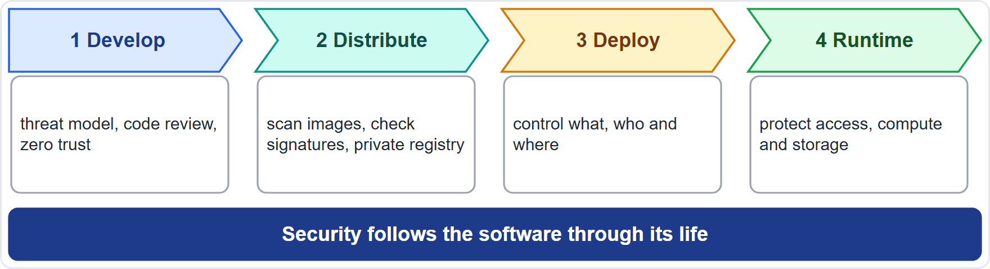
Security Through the Lifecycle
Part 1
The current docs follow the CNCF's lifecycle phases: Develop, Distribute, Deploy, Runtime
Develop: a threat model, code review, and zero trust: never trust, always verify
Distribute: secure the supply chain: scan images, use certificates or signatures, keep a private registry
Deploy: control what is deployed, who deploys it and where
Runtime: protect access, compute and storage
EXAM TIP Develop, Distribute, Deploy, Runtime: security follows the software through its life.
KCNA Exam Prep Masterclass | Kubernetes and Cloud Native Associate
Module 8: Security
3 / 26
Notes:
The current Kubernetes docs follow the C N C F lifecycle phases of cloud native security: Develop, Distribute, Deploy and Runtime. In Develop you build a threat model, review code, and adopt zero trust, which means never trust, always verify. In Distribute you secure the supply chain. You scan images, use certificates or signatures, and keep a private registry. In Deploy you control what is deployed, who deploys it and where. And in Runtime you protect access, compute and storage. Exam tip: Develop, Distribute, Deploy, Runtime. Security follows the software through its life.

Slide 4
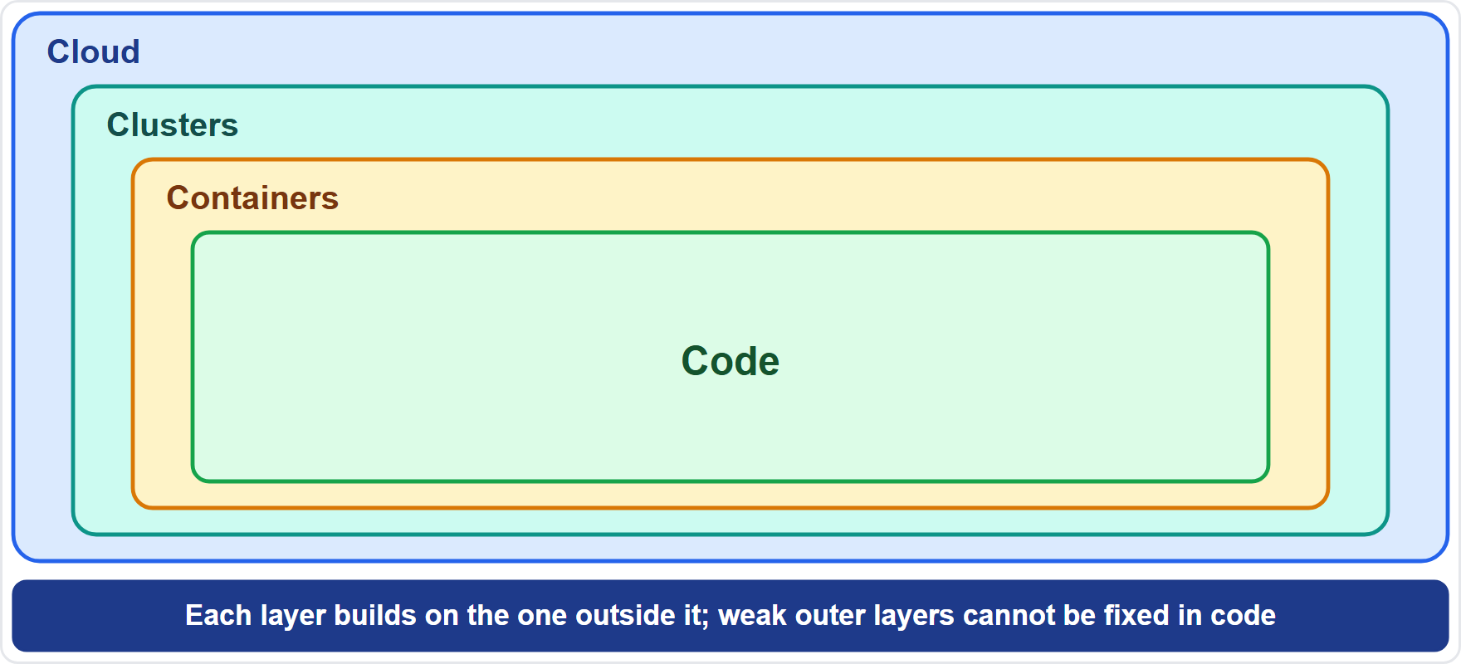
The 4 Cs of Cloud Native Security
OLD WORDING
Part 1
Older Kubernetes docs and study material describe the 4 Cs: Cloud, Clusters, Containers, Code
Security is layered: each layer builds on the layer outside it
Strong outer layers help the inner ones; weak outer layers cannot be repaired in code
The current docs use the lifecycle phases, so know both vocabularies
EXAM TIP 4 Cs: Cloud, Clusters, Containers, Code, from the outside in.
KCNA Exam Prep Masterclass | Kubernetes and Cloud Native Associate
Module 8: Security
4 / 26
Notes:
This slide is tagged old wording. Older Kubernetes docs and study material describe the four Cs of cloud native security: Cloud, Clusters, Containers and Code. Security is layered, and each layer builds on the layer outside it. Strong outer layers help the inner ones, and weak outer layers cannot be repaired in code. The current docs use the lifecycle phases instead, so know both vocabularies. Exam tip: Cloud, Clusters, Containers, Code, from the outside in.

Slide 5
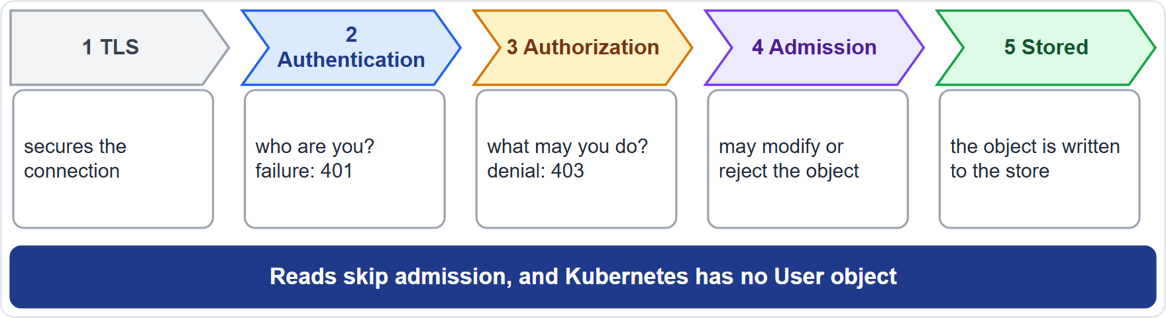
The API Request Path
Part 1
A request meets TLS, then three checks in order: authentication, authorization, admission
Authentication: who are you? Client certificates, tokens, bootstrap tokens and JWTs for service accounts; failure gives 401
Authorization: what may you do? RBAC is the usual mode; denial gives 403
Admission: may modify or reject objects being created, changed or deleted; it never acts on reads
Kubernetes has no User object: users come from outside
EXAM TIP Who are you, what may you do, is the object acceptable.
KCNA Exam Prep Masterclass | Kubernetes and Cloud Native Associate
Module 8: Security
5 / 26
Notes:
Every request to the A P I server meets T L S, and then three checks, in order. Authentication asks who you are. It uses client certificates, tokens, bootstrap tokens, and JSON Web Tokens for service accounts. Failure gives four hundred and one. Authorization asks what you may do. R B A C is the usual mode, and a denial gives four hundred and three. Admission may modify or reject objects being created, changed or deleted, but it never acts on reads. One more fact: Kubernetes has no User object, because users come from outside. Exam tip: who are you, what may you do, is the object acceptable.

Slide 6
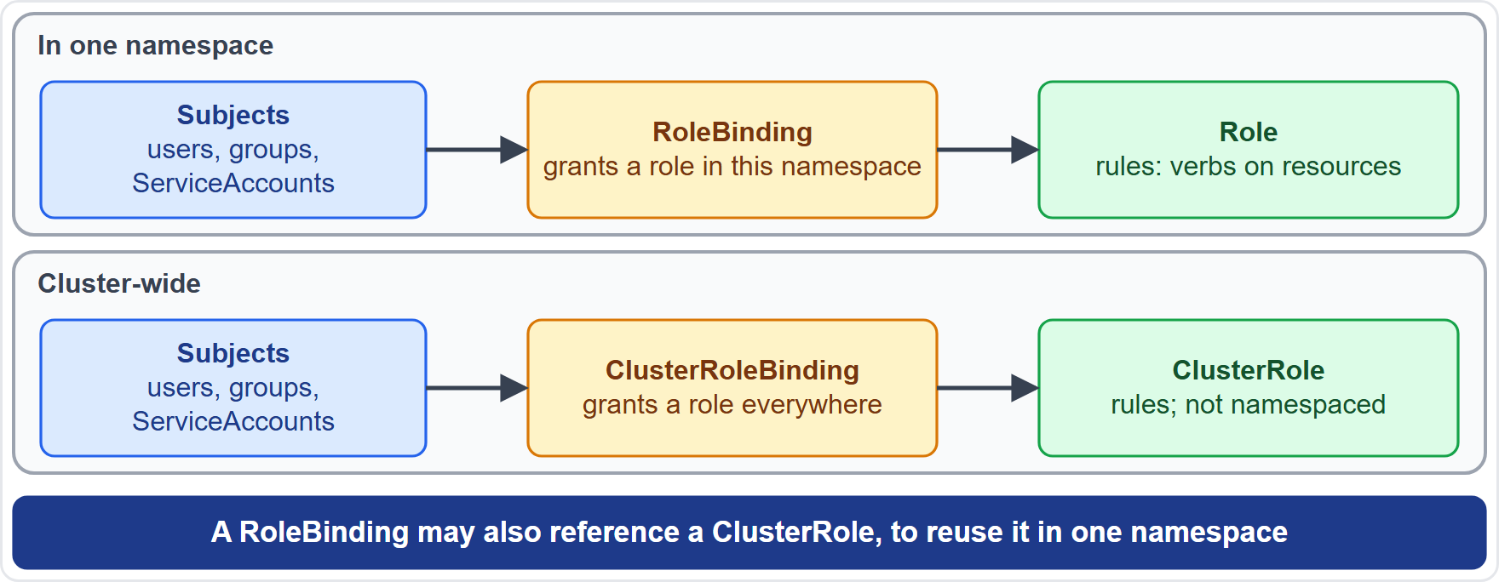
RBAC: Roles and Bindings
Part 1
Role: permissions in one namespace; ClusterRole: not namespaced, for cluster-wide or cluster-scoped resources
RoleBinding: gives a role to subjects (users, groups, ServiceAccounts) in a namespace; ClusterRoleBinding: cluster-wide
A RoleBinding can point at a ClusterRole to reuse it inside one namespace
Permissions are additive: there are no deny rules
Least privilege: avoid wildcards, and keep cluster-admin for when it is truly needed
EXAM TIP A role says what, a binding says to whom, and nothing denies.
KCNA Exam Prep Masterclass | Kubernetes and Cloud Native Associate
Module 8: Security
6 / 26
Notes:
R B A C has four kinds. A Role holds permissions in one namespace. A Cluster Role is not namespaced, and covers cluster-wide or cluster-scoped resources. A Role Binding gives a role to subjects, meaning users, groups or Service Accounts, in a namespace. A Cluster Role Binding gives it cluster-wide. A Role Binding can also point at a Cluster Role, to reuse it inside one namespace. Permissions are additive, and there are no deny rules. Follow least privilege: avoid wildcards, and keep cluster admin for when it is truly needed. Exam tip: a role says what, a binding says to whom, and nothing denies.

Slide 7
An RBAC Role
Part 1
A rule names apiGroups, resources and verbs; the empty string is the core group
Common verbs: get, list, watch, create, update, delete
resourceNames narrows a rule to named objects
A RoleBinding then gives this Role to a user, group or ServiceAccount
YAML
apiVersion: rbac.authorization.k8s.io/v1
kind: Role
metadata:
namespace: shop
name: pod-reader
rules:
- apiGroups: [""]
resources: ["pods", "pods/log"]
verbs: ["get", "list", "watch"]
Read-only access to Pods and their logs in the shop namespace
EXAM TIP A Role lists what is allowed; the binding says to whom.
KCNA Exam Prep Masterclass | Kubernetes and Cloud Native Associate
Module 8: Security
7 / 26
Notes:
Here is a Role in the shop namespace. A rule names A P I groups, resources and verbs. The empty string is the core group, so the rule covers Pods and Pod logs. The verbs are get, list and watch, so it is read-only. Other common verbs are create, update and delete. Resource names narrows a rule to named objects. And a Role Binding then gives this Role to a user, group or Service Account. Exam tip: a Role lists what is allowed, and the binding says to whom.

Slide 8
ServiceAccounts
Part 1
 | ServiceAccount | User
For | Pods and automation | people
Lives | as an API object in a namespace | outside Kubernetes; there is no User object
Credential | a short-lived, rotating token through the TokenRequest API | certificates, tokens and other methods
Every namespace gets a default ServiceAccount when it is created
A Pod runs as a ServiceAccount, and you give that account permissions with RBAC
automountServiceAccountToken: false stops a Pod from mounting a token, for Pods that never call the API
EXAM TIP ServiceAccounts are for Pods; users are for people.
KCNA Exam Prep Masterclass | Kubernetes and Cloud Native Associate
Module 8: Security
8 / 26
Notes:
A Service Account is the identity for Pods and automation. A user is for people. A Service Account lives as an A P I object in a namespace. Users live outside Kubernetes, and there is no User object. A Service Account gets a short-lived, rotating token through the Token Request A P I, while users use certificates, tokens and other methods. Every namespace gets a default Service Account when it is created. A Pod runs as a Service Account, and you give that account permissions with R B A C. And automount Service Account Token set to false stops a Pod from mounting a token, for Pods that never call the A P I. Exam tip: Service Accounts are for Pods, and users are for people.

Slide 9
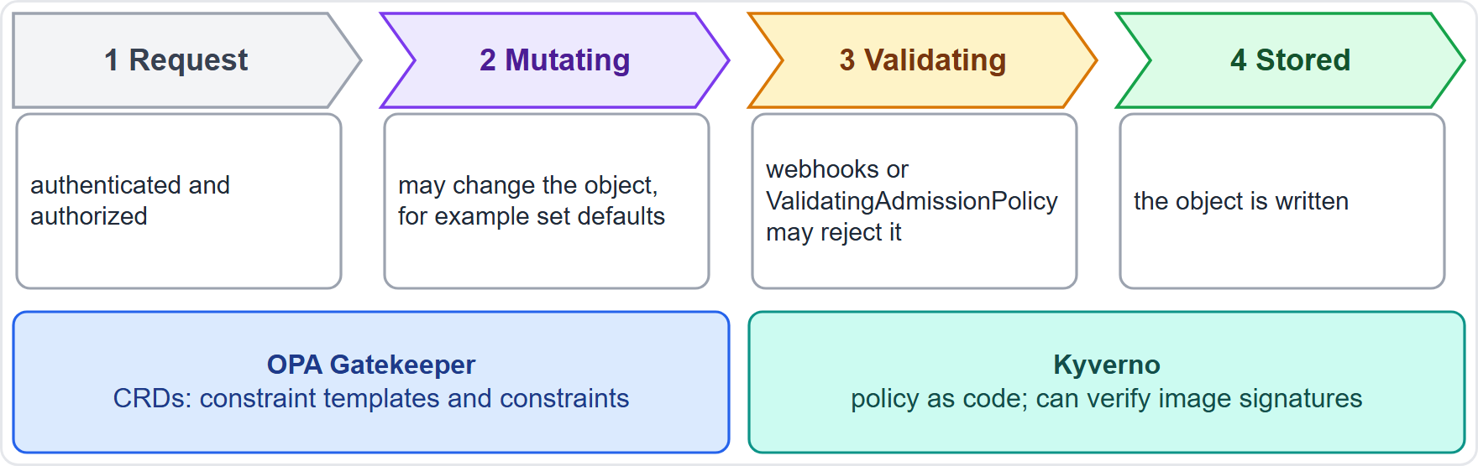
Admission Control and Policy Engines
BEYOND THE CURRICULUM
Part 1
Admission controllers run after authentication and authorization, and before the object is stored
They may mutate (set defaults) or validate (accept or reject); only mutating ones change the object
Webhooks: mutating first, then validating
ValidatingAdmissionPolicy is a built-in, declarative option for validation, with rules in the Common Expression Language (CEL)
Policy engines such as Open Policy Agent (OPA) Gatekeeper and Kyverno enforce rules through admission
EXAM TIP Admission sees changes to objects, never reads.
KCNA Exam Prep Masterclass | Kubernetes and Cloud Native Associate
Module 8: Security
9 / 26
Notes:
This slide is tagged beyond the curriculum. Admission controllers run after authentication and authorization, and before the object is stored. They may mutate, which sets defaults, or validate, which accepts or rejects. Only mutating ones change the object. With webhooks, mutating ones run first, then validating ones. Validating Admission Policy is a built-in, declarative option for validation, with rules written in the Common Expression Language, C E L. And policy engines such as Open Policy Agent Gatekeeper, O P A for short, and Kyverno enforce rules through admission. Gatekeeper uses C R Ds for constraint templates and constraints. Kyverno writes policy as code. Exam tip: admission sees changes to objects, never reads.

Slide 10
Pod Security Standards and Admission
Part 1
Level | What it allows
Privileged | unrestricted; allows known privilege escalations
Baseline | minimally restrictive; prevents known privilege escalations
Restricted | heavily restricted, following current hardening best practices
Pod Security admission is the built-in controller that applies a level to a namespace, with labels such as pod-security.kubernetes.io/enforce: baseline
The mode decides the effect: enforce rejects the Pod, audit adds an audit annotation, warn shows a warning
PodSecurityPolicy is gone; Pod Security admission replaces it
EXAM TIP The level says how strict; the mode says what happens.
KCNA Exam Prep Masterclass | Kubernetes and Cloud Native Associate
Module 8: Security
10 / 26
Notes:
Pod Security Standards define three levels. Privileged is unrestricted, and allows known privilege escalations. Baseline is minimally restrictive, and prevents known privilege escalations. Restricted is heavily restricted, and follows current hardening best practices. Pod Security admission is the built-in controller that applies a level to a namespace, using labels such as pod security enforce baseline. The mode decides the effect. Enforce rejects the Pod. Audit adds an audit annotation. Warn shows a warning. Pod Security Policy is gone, and Pod Security admission replaces it. Exam tip: the level says how strict, and the mode says what happens.

Slide 11
securityContext
Part 1
A securityContext sets privilege and access settings for a Pod, or for one container
A container's settings override the Pod's where they overlap
Common settings: run as non-root, no privilege escalation, a read-only root filesystem, dropped capabilities, a seccomp profile
allowPrivilegeEscalation is true when you leave it unset
YAML
securityContext:
runAsNonRoot: true
seccompProfile: {type: RuntimeDefault}
containers:
- name: orders
image: orders:stable
securityContext:
allowPrivilegeEscalation: false
readOnlyRootFilesystem: true
capabilities: {drop: [ALL]}
A locked-down orders container
EXAM TIP Drop everything the container does not need.
KCNA Exam Prep Masterclass | Kubernetes and Cloud Native Associate
Module 8: Security
11 / 26
Notes:
A security Context sets privilege and access settings for a Pod, or for one container. A container's settings override the Pod's where they overlap. Common settings are to run as non-root, to block privilege escalation, to use a read-only root filesystem, to drop capabilities, and to set a sec comp profile. The snippet locks down the orders container. It runs as non-root with the runtime default sec comp profile, and the container drops all capabilities. Allow privilege escalation is true when you leave it unset, so set it to false. Exam tip: drop everything the container does not need.

Slide 12
Protecting Secrets and Traffic
Part 2
Control | What it does
Secrets | enable encryption at rest, limit access with least-privilege RBAC, and consider an external secret store; base64 is not encryption
TLS | protects traffic to the Kubernetes API
NetworkPolicy | limits which Pods may talk to which (Module 6); needs a plugin that enforces it
Service mesh | can encrypt and authenticate traffic between services with mutual TLS (Module 6)
Granting list on Secrets lets the holder read their contents
EXAM TIP Defense in depth: no single control is enough.
KCNA Exam Prep Masterclass | Kubernetes and Cloud Native Associate
Module 8: Security
12 / 26
Notes:
Several controls protect data and traffic. For Secrets, enable encryption at rest, limit access with least-privilege R B A C, and consider an external secret store. Base sixty-four is not encryption. T L S protects traffic to the Kubernetes A P I. A Network Policy limits which Pods may talk to which, as in Module 6, and it needs a plugin that enforces it. A service mesh can encrypt and authenticate traffic between services with mutual T L S. And granting list on Secrets lets the holder read their contents. Exam tip: defense in depth. No single control is enough.

Slide 13
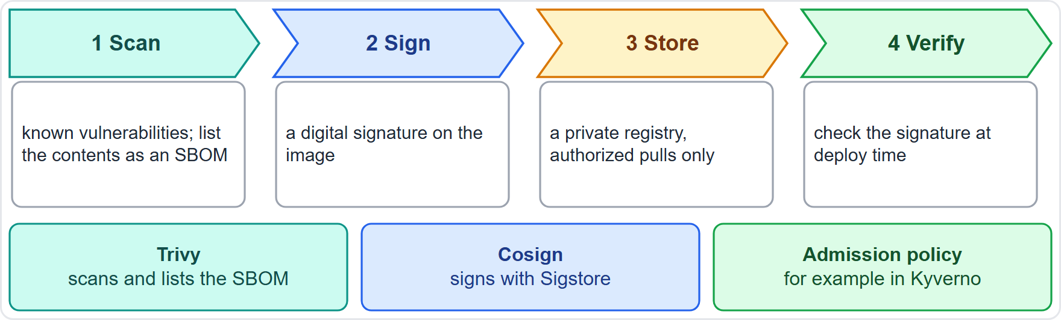
Image Supply Chain Security
BEYOND THE CURRICULUM
Part 2
Scan images for known vulnerabilities (CVEs); a scanner such as Trivy also lists the packages inside, an SBOM
Sign images and verify the signature before use: Cosign, from Sigstore, signs container images
Keep images in a private registry that lets only authorized clients pull
At deploy time an admission policy, for example in Kyverno, can verify signatures
EXAM TIP Scan, sign, store privately, verify at admission.
KCNA Exam Prep Masterclass | Kubernetes and Cloud Native Associate
Module 8: Security
13 / 26
Notes:
This slide is tagged beyond the curriculum. Trust the image from build to run. Scan images for known vulnerabilities, called C V Es. A scanner such as Trivy also lists the packages inside, which is an S B O M. Sign images and verify the signature before use. Cosign, from Sigstore, signs container images. Keep images in a private registry that lets only authorized clients pull. And at deploy time, an admission policy, for example in Kyverno, can verify signatures. Exam tip: scan, sign, store privately, verify at admission.

Slide 14
Runtime Security and Auditing
BEYOND THE CURRICULUM
Part 2
Tool | What it does
seccomp | filters the system calls a process may make
AppArmor | restricts programs with profiles
Falco | a CNCF graduated tool that watches kernel events such as system calls against rules, and alerts on abnormal behavior
Audit log | a chronological record of API actions, with levels None, Metadata, Request, RequestResponse
EXAM TIP Restrict with seccomp and AppArmor, detect with Falco, record with the audit log.
KCNA Exam Prep Masterclass | Kubernetes and Cloud Native Associate
Module 8: Security
14 / 26
Notes:
This slide is tagged beyond the curriculum. Four runtime tools. Sec comp filters the system calls a process may make. App Armor restricts programs with profiles. Falco, a C N C F graduated tool, watches kernel events such as system calls against rules, and alerts on abnormal behavior. And the audit log is a chronological record of A P I actions, with levels None, Metadata, Request and Request Response. Exam tip: restrict with sec comp and App Armor, detect with Falco, and record with the audit log.

Slide 15
What the Exam Asks: Security
Part 2
Authentication, authorization or admission
Role or ClusterRole
RBAC rules
one namespace, or cluster-wide; a RoleBinding can reuse a ClusterRole in one namespace
additive, with no deny
who you are, what you may do, whether the object is acceptable
ServiceAccount or user
Pod Security level or mode
Lifecycle phases or 4 Cs
Pods and a namespaced object, or people and external
Privileged, Baseline, Restricted; enforce, audit, warn
Develop, Distribute, Deploy, Runtime now; Cloud, Clusters, Containers, Code in older material
EXAM TIP For a security question, find the layer first: identity, permission, admission, Pod or supply chain.
KCNA Exam Prep Masterclass | Kubernetes and Cloud Native Associate
Module 8: Security
15 / 26
Notes:
Six pairs to keep apart. Authentication, authorization or admission: who you are, what you may do, whether the object is acceptable. Role or Cluster Role: one namespace, or cluster-wide, and a Role Binding can reuse a Cluster Role in one namespace. R B A C rules are additive, with no deny. Service Account or user: Pods and a namespaced object, or people and external. Pod Security level or mode: Privileged, Baseline, Restricted, then enforce, audit, warn. And lifecycle phases or four Cs: Develop, Distribute, Deploy, Runtime now, and Cloud, Clusters, Containers, Code in older material. Exam tip: find the layer first.

Slide 16
Module Recap
Part 2
1
Layers
2
Request path
3
RBAC
the lifecycle phases (Develop, Distribute, Deploy, Runtime) and the older 4 Cs
authentication, authorization, then admission; no User object
Role and ClusterRole with bindings; additive; least privilege
4
ServiceAccounts
5
Admission and Pod security
6
Supply chain and runtime
identities for Pods, with short-lived tokens
mutating then validating; Privileged, Baseline, Restricted; enforce, audit, warn; securityContext
scan, sign, private registry; seccomp, AppArmor, Falco, audit log
KCNA Exam Prep Masterclass | Kubernetes and Cloud Native Associate
Module 8: Security
16 / 26
Notes:
To recap. Layers: the lifecycle phases Develop, Distribute, Deploy and Runtime, and the older four Cs. The request path is authentication, authorization, then admission, and there is no User object. R B A C uses Role and Cluster Role with bindings, it is additive, and it follows least privilege. Service Accounts are identities for Pods, with short-lived tokens. Admission is mutating then validating. Pod Security has the levels Privileged, Baseline and Restricted, the modes enforce, audit and warn, and the security Context. And for supply chain and runtime: scan, sign and use a private registry, then sec comp, App Armor, Falco and the audit log. Now nine practice questions.

Slide 17
Practice Question 1
Part 2
Q1
Which four lifecycle phases of cloud native security do the current Kubernetes docs use?
A
Cloud, Clusters, Containers and Code, each one built on the layer outside it
B
Plan, Build, Test and Release, each one run by the delivery pipeline of the team
C
Identify, Protect, Detect and Respond, each one owned by a separate security team
D
Develop, Distribute, Deploy and Runtime, which follow the software through its life
KCNA Exam Prep Masterclass | Kubernetes and Cloud Native Associate
Module 8: Security
17 / 26
Notes:
Question one. Which four lifecycle phases of cloud native security do the current Kubernetes docs use? The four options are on the screen.
[PAUSE 12]
The answer is D. The current docs follow the C N C F lifecycle phases: Develop, Distribute, Deploy and Runtime. Cloud, Clusters, Containers and Code are the four Cs of older material.

Slide 18
Practice Question 2
Part 2
Q2
In which order does the API server check an incoming request?
A
Admission, then authorization, then authentication of the user who sent the request
B
Authentication, then authorization, then admission, before the object is stored
C
Authorization, then authentication, then admission, because roles come first
D
Authentication, then admission, then authorization, so that policies see the user
KCNA Exam Prep Masterclass | Kubernetes and Cloud Native Associate
Module 8: Security
18 / 26
Notes:
Question two. In which order does the A P I server check an incoming request? The four options are on the screen.
[PAUSE 12]
The answer is B. The request is authenticated first, so the cluster knows who is asking. Then it is authorized, so the cluster knows what that user may do. Finally it passes through admission control, which can modify or reject the object.

Slide 19
Practice Question 3
Part 2
Q3
Harbor Books wants developers to read Pods only in the shop namespace. Which objects achieve this?
A
A Role that allows get, list and watch on Pods in shop, and a RoleBinding to the developers
B
A ClusterRole that allows every verb on every resource, and a ClusterRoleBinding to the developers
C
A ServiceAccount for each developer, with the default token mounted into the Pods of the namespace
D
A NetworkPolicy that selects the Pods of shop and allows traffic from the developers' laptops
KCNA Exam Prep Masterclass | Kubernetes and Cloud Native Associate
Module 8: Security
19 / 26
Notes:
Question three. Harbor Books wants developers to read Pods only in the shop namespace. Which objects achieve this? The four options are on the screen.
[PAUSE 12]
The answer is A. A Role limits permissions to one namespace, and a Role Binding gives it to the developers. A cluster-wide role breaks least privilege, Service Accounts are for workloads, and a Network Policy does not control A P I permissions.

Slide 20
Practice Question 4
Part 2
Q4
Which statement about RBAC permissions is correct?
A
A deny rule in a ClusterRole overrides every allow rule that applies to the same user
B
A RoleBinding can never refer to a ClusterRole, because a binding is tied to Roles
C
Permissions are purely additive, and RBAC has no deny rules
D
A Role is a cluster-scoped object that can be bound only through a ClusterRoleBinding
KCNA Exam Prep Masterclass | Kubernetes and Cloud Native Associate
Module 8: Security
20 / 26
Notes:
Question four. Which statement about R B A C permissions is correct? The four options are on the screen.
[PAUSE 12]
The answer is C. R B A C permissions only add up. The rules of all applicable roles are combined, and there are no deny rules. A Role Binding can reference a Cluster Role to reuse it in one namespace, and a Role is namespaced.

Slide 21
Practice Question 5
Part 2
Q5
A Harbor Books Pod never calls the Kubernetes API. How can the team reduce the risk from its API credential?
A
Set automountServiceAccountToken to false in the Pod spec, so that no token is mounted
B
Bind the Pod's ServiceAccount to cluster-admin, so that the API can never deny it anything
C
Create a User object for the Pod in the API, and let the Pod log in with a password
D
Delete the namespace and create it again, so that a new default token is created
KCNA Exam Prep Masterclass | Kubernetes and Cloud Native Associate
Module 8: Security
21 / 26
Notes:
Question five. A Harbor Books Pod never calls the Kubernetes A P I. How can the team reduce the risk from its A P I credential? The four options are on the screen.
[PAUSE 12]
The answer is A. Turning off the automatic mount means the Pod holds no A P I token that an attacker could steal. Granting cluster admin does the opposite, Kubernetes has no User object, and recreating the namespace does not change how tokens are mounted.

Slide 22
Practice Question 6
Part 2
Q6
What can a mutating admission webhook do that a validating admission webhook cannot?
A
Check who sent the request before any other part of the API server does
B
Block get and list requests, because reads pass through admission control too
C
Replace the RBAC rules of the cluster while the request is being processed
D
Modify the object in the request, for example by setting defaults
KCNA Exam Prep Masterclass | Kubernetes and Cloud Native Associate
Module 8: Security
22 / 26
Notes:
Question six. What can a mutating admission webhook do that a validating admission webhook cannot? The four options are on the screen.
[PAUSE 12]
The answer is D. Mutating admission may change the object, and validating admission may only accept or reject it. Authentication comes earlier, and admission does not act on reads.

Slide 23
Practice Question 7
Part 2
Q7
Which Pod Security admission mode rejects a Pod that violates the chosen level?
A
audit, which adds an annotation to the audit log and still allows the Pod
B
enforce, which rejects the Pod
C
warn, which shows a warning to the user and still allows the Pod
D
baseline, which blocks every Pod that asks for more than the default settings
KCNA Exam Prep Masterclass | Kubernetes and Cloud Native Associate
Module 8: Security
23 / 26
Notes:
Question seven. Which Pod Security admission mode rejects a Pod that violates the chosen level? The four options are on the screen.
[PAUSE 12]
The answer is B. The enforce mode rejects violating Pods. Audit and warn allow them, and baseline is a level, not a mode.

Slide 24
Practice Question 8
Part 2
Q8
The Harbor Books orders Pods must not gain extra privileges, and must not write to their root filesystem. Which securityContext settings do this?
A
privileged set to true, and runAsUser set to zero, so the container owns its files
B
hostNetwork set to true, and hostPID set to true, so the container can see the node
C
allowPrivilegeEscalation set to false, and readOnlyRootFilesystem set to true
D
priorityClassName set to a high value, and a memory limit set on every container
KCNA Exam Prep Masterclass | Kubernetes and Cloud Native Associate
Module 8: Security
24 / 26
Notes:
Question eight. The Harbor Books orders Pods must not gain extra privileges, and must not write to their root filesystem. Which security Context settings do this? The four options are on the screen.
[PAUSE 12]
The answer is C. Setting allow Privilege Escalation to false stops a process from gaining more privileges, and setting read Only Root Filesystem to true makes the root filesystem read-only. The other options widen access, or have nothing to do with a container's privileges.

Slide 25
Practice Question 9
Part 2
Q9
Which tool watches kernel events such as system calls and alerts on abnormal behavior at runtime?
A
Cosign, which signs container images and checks the signatures later
B
Falco, a runtime security tool that applies rules to kernel events
C
Trivy, which scans images for known vulnerabilities and lists their packages
D
Kyverno, a policy engine that validates and mutates objects at admission
KCNA Exam Prep Masterclass | Kubernetes and Cloud Native Associate
Module 8: Security
25 / 26
Notes:
Question nine. Which tool watches kernel events such as system calls and alerts on abnormal behavior at runtime? The four options are on the screen.
[PAUSE 12]
The answer is B. Falco watches kernel events against rules and raises alerts at runtime. Cosign signs images, Trivy scans them, and Kyverno enforces policies at admission.

Slide 26
Answers at a Glance
Part 2
Question | Answer | Why
Q1 | D | Develop, Distribute, Deploy, Runtime
Q2 | B | Authentication, authorization, admission
Q3 | A | A Role and a RoleBinding limit access to one namespace
Q4 | C | RBAC permissions are additive, with no deny
Q5 | A | Turn off the token mount
Q6 | D | Mutating admission can change the object
Q7 | B | The enforce mode rejects the Pod
Q8 | C | No privilege escalation, read-only root filesystem
Q9 | B | Falco watches kernel events
KCNA Exam Prep Masterclass | Kubernetes and Cloud Native Associate
Module 8: Security
26 / 26
Notes:
Here are the answers at a glance. Question one, D: Develop, Distribute, Deploy, Runtime. Question two, B: authentication, authorization, admission. Question three, A: a Role and a Role Binding limit access to one namespace. Question four, C: R B A C permissions are additive, with no deny. Question five, A: turn off the token mount. Question six, D: mutating admission can change the object. Question seven, B: the enforce mode rejects the Pod. Question eight, C: no privilege escalation, and a read-only root filesystem. Question nine, B: Falco watches kernel events.

